Slide 1
Lecture 20: Translation

Slide 2
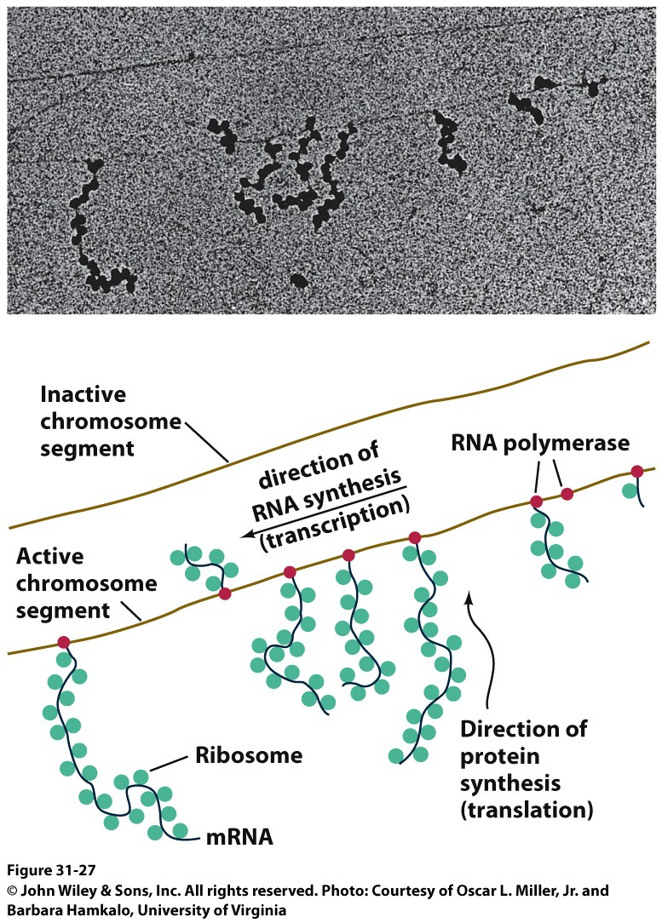
The Third Pillar of the Central Dogma
Translation / Protein Synthesis
We’ve replicated our DNA, transcribed a gene (or an operon) and now we have to make protein
In 1961, Francis Crick and Sydney Brenner devised the Adaptor Hypothesis

Slide 3
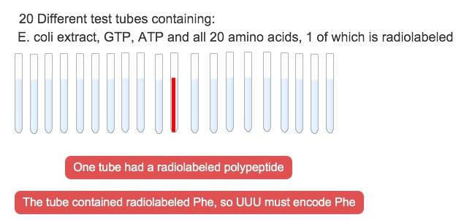
We need to review the message and Codons
mRNA is read in the 5’ → 3’ direction
The code was “cracked” by many scientists using synthetic mRNAs of a single repeating base
Nuremberg and Matthaei had the seminal experiment
5’-(UUU)_{X}-3’

Slide 4
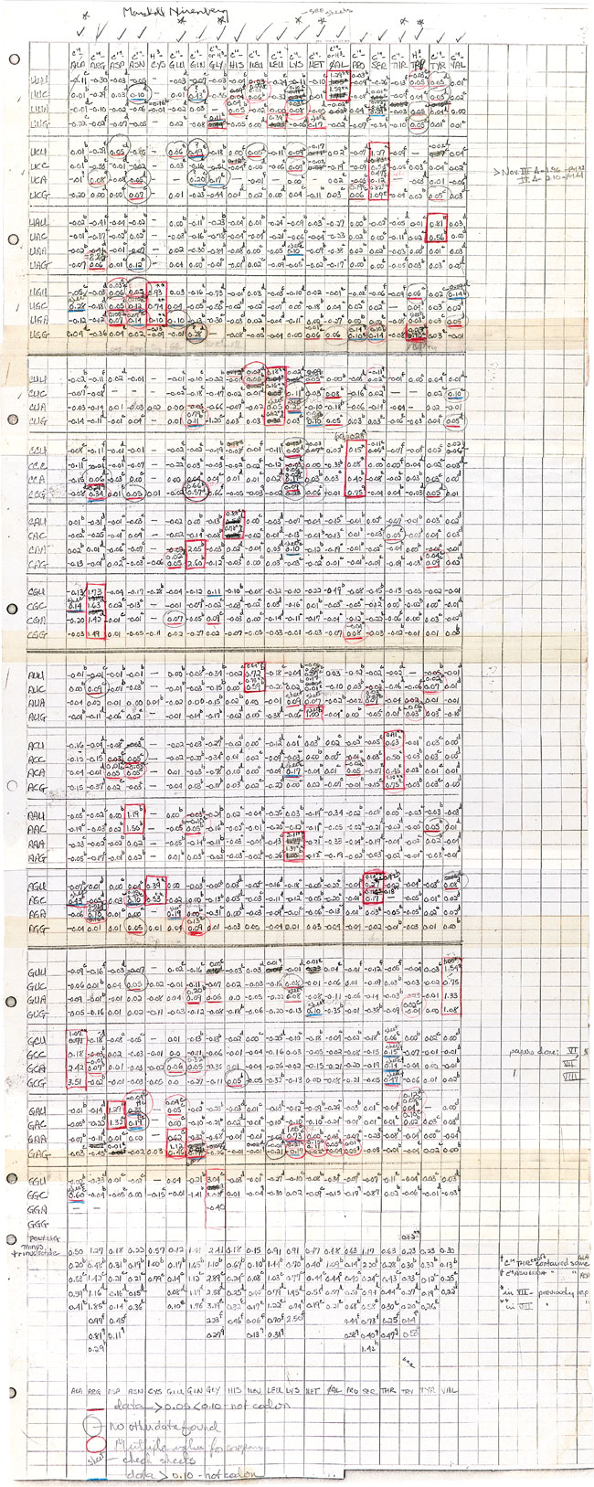
We need to review the message and Codons
They did the same thing for Poly CCC, Poly AAA and Poly GGG
They found radiolabeled polyPro, polyLys and polyGly, respectively
They also found that UAG, UAA and UGA are stop codons
They also found that AUG is the start codon (initiation codon)
This was pure luck
The ribosome will indiscriminately start translation at the high Mg²⁺ levels used in their experiment

Slide 5
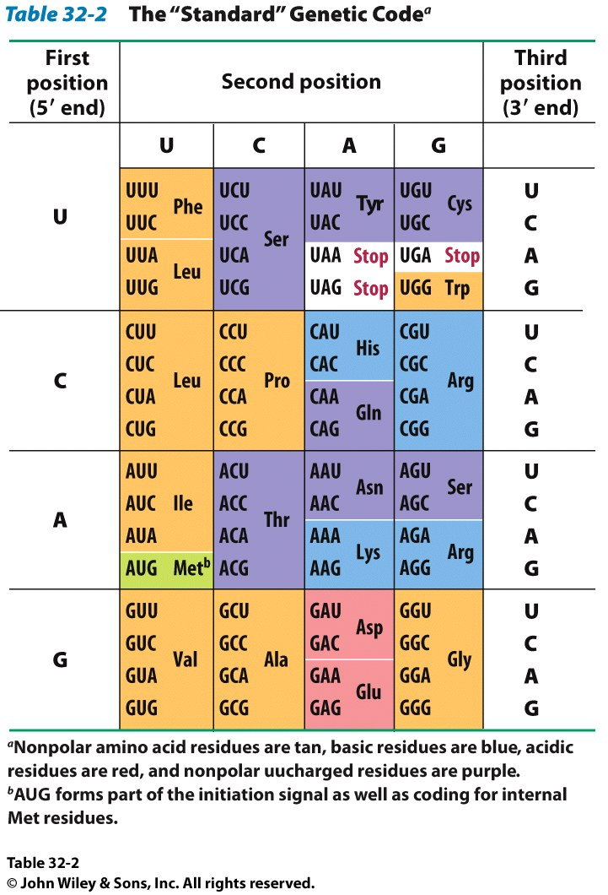
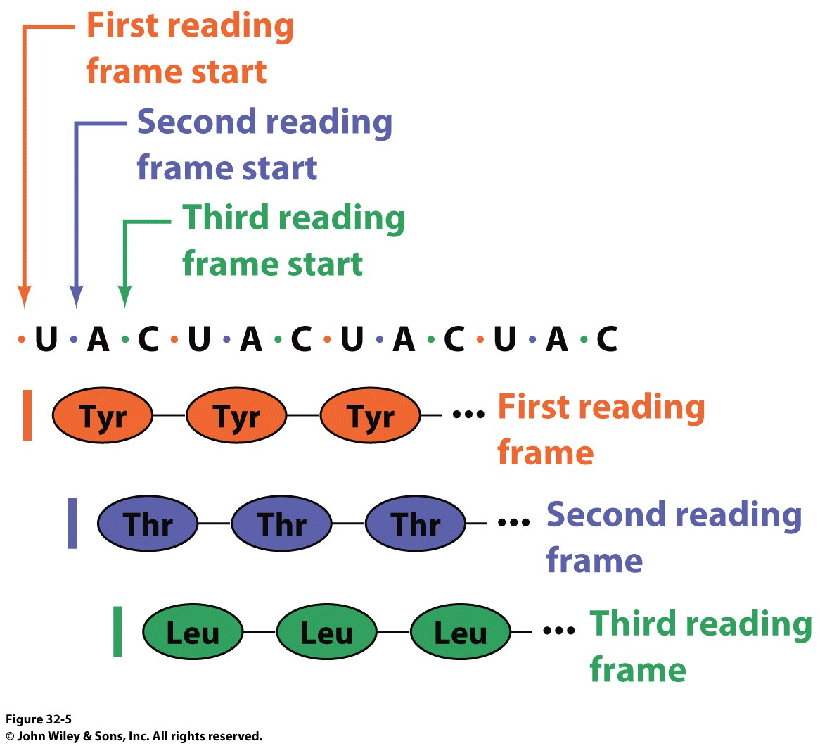
The result of many different experiments was…
The genetic code is written in 3 base codons
The genetic code is highly degenerate
Three amino acids are encoded by six codons each (R, L and S)
Codons specifying the same amino acid are called Synonyms

Slide 6
The result of many different experiments was…
The arrangement of the codon table is non-random
Most synonyms occupy the same box
The third position doesn’t seem to matter as much (“wobble”)
The degeneracy gives an organism the potential to accept point mutations without a phenotypic change

Slide 7
The result of many different experiments was…
The “wobble” actually refers to the wobbling of the anticodon loop of tRNA when pairing with mRNA
The 1st two bases of the codon form tight H-bond interactions with the second two bases of the anticodon loop

Slide 8
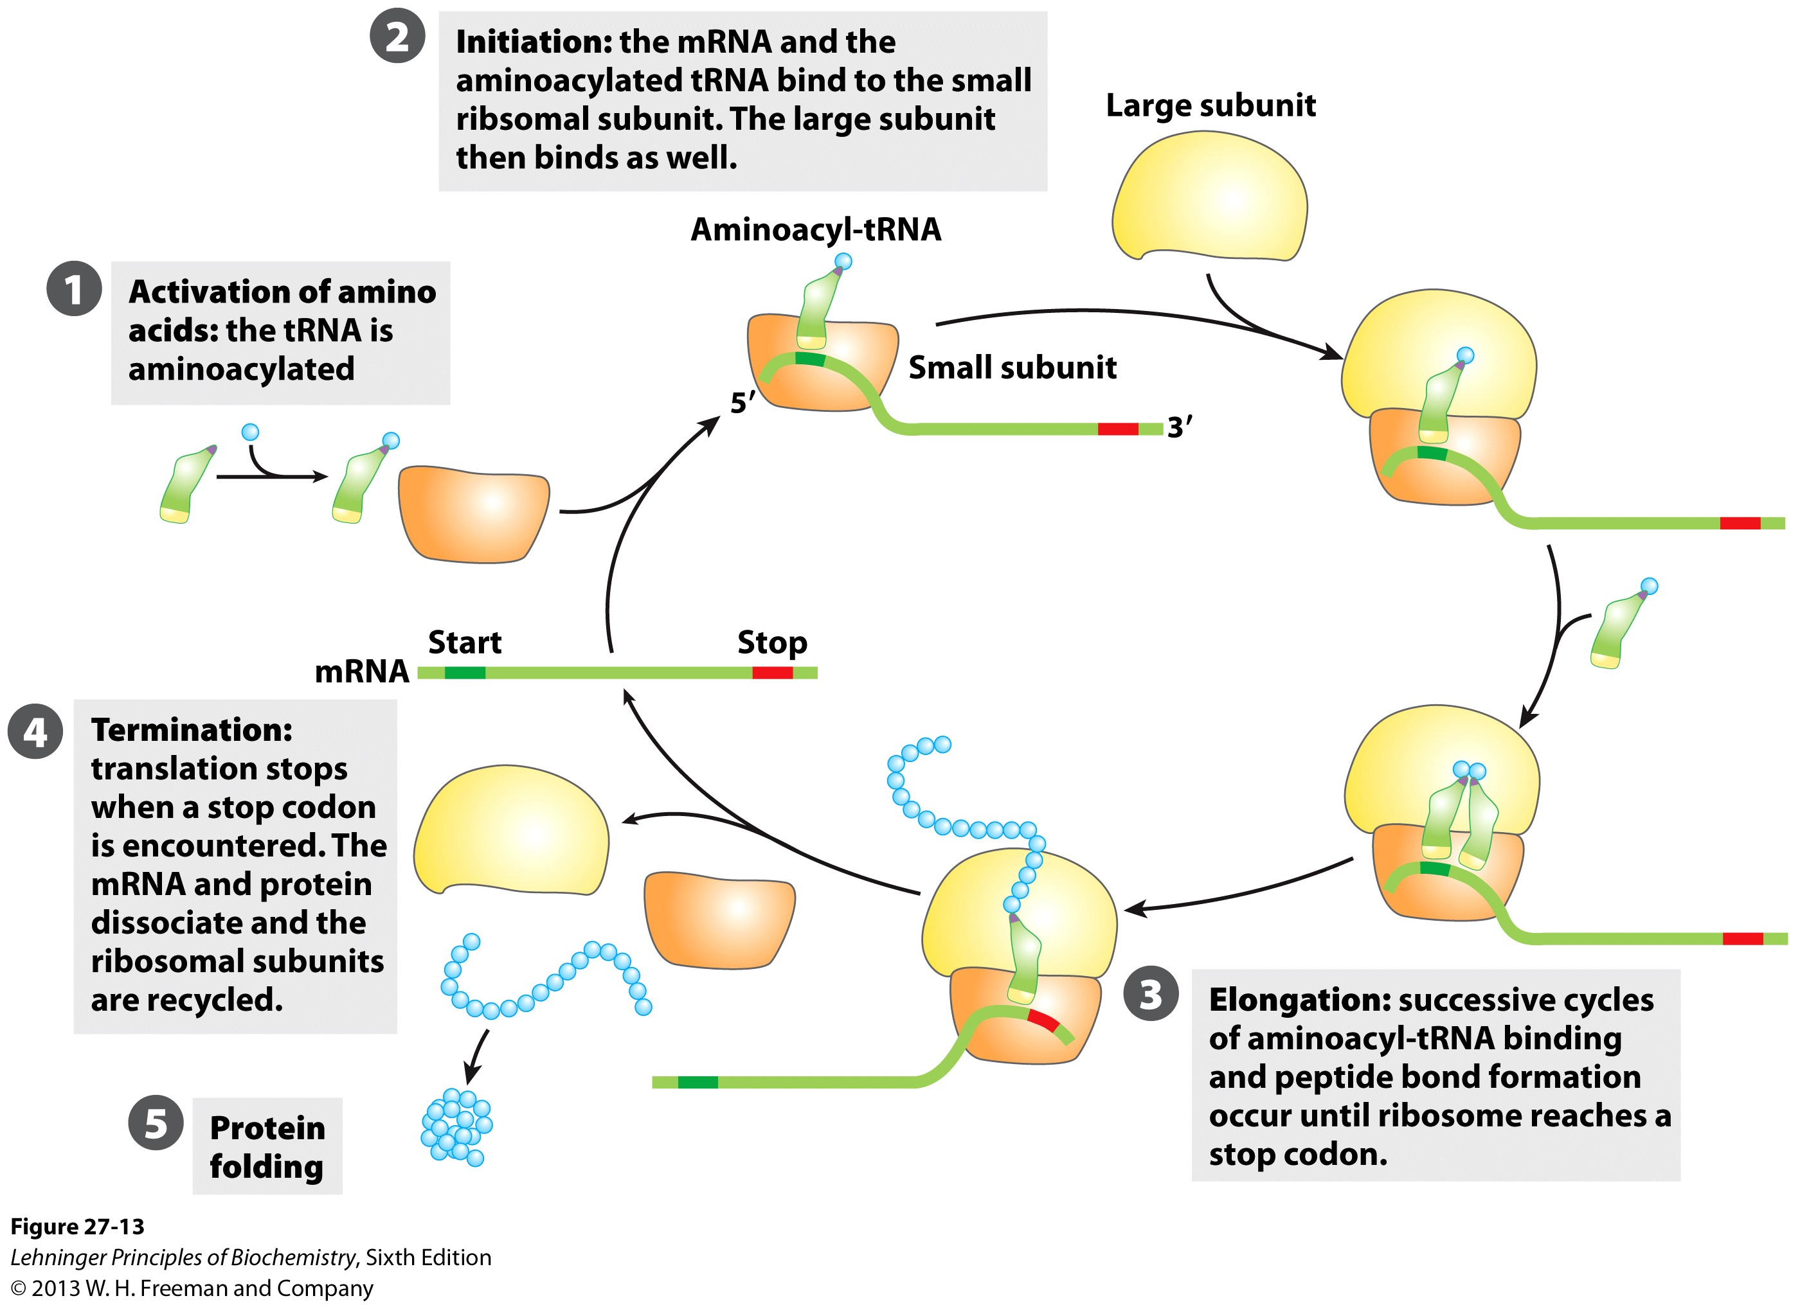
Overview of the 5 Stages of Protein Synthesis
Stage 1: Activation of amino acids (Formation of aminoacyl tRNA)
Costs ATP for every single amino acid conjugated to tRNA
Catalyzed by tRNA synthetases

Slide 9
Overview of the 5 Stages of Protein Synthesis
Stage 2: Initiation
mRNA to be translated binds to the small subunit of the ribosome
The large subunit, initiating aminoacyl tRNA, GTP and initiation factors bind and the process start

Slide 10
Overview of the 5 Stages of Protein Synthesis
Stage 3: Elongation
Amino acids are added to the nascent polypeptide
The ribosome moves along the mRNA (or is it the other way around?) via GTP hydrolysis

Slide 11
Overview of the 5 Stages of Protein Synthesis
Stage 4: Termination
When the stop codon is reached, the ribosome releases the polypeptide and dissociates

Slide 12
Overview of the 5 Stages of Protein Synthesis
Stage 5: Protein Folding and Posttranslational Modifications
We’ve already covered this! You must review it for the exam!

Slide 13
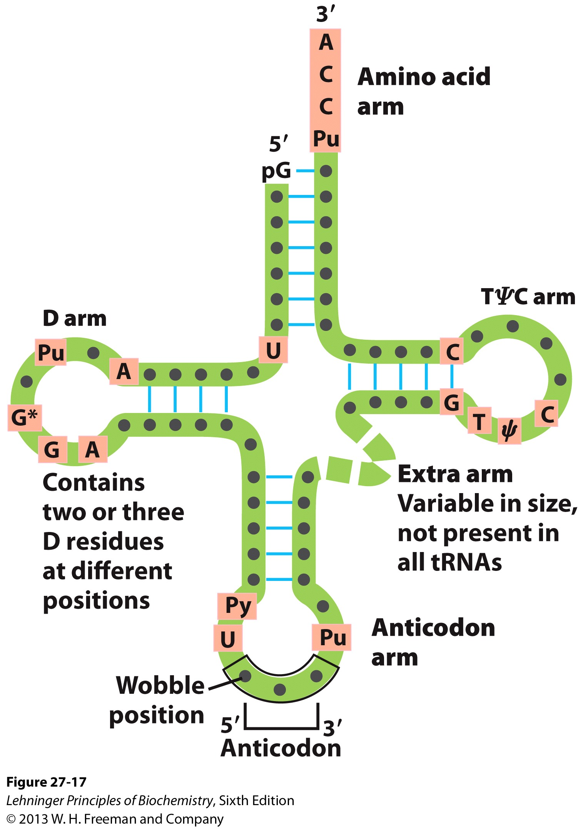
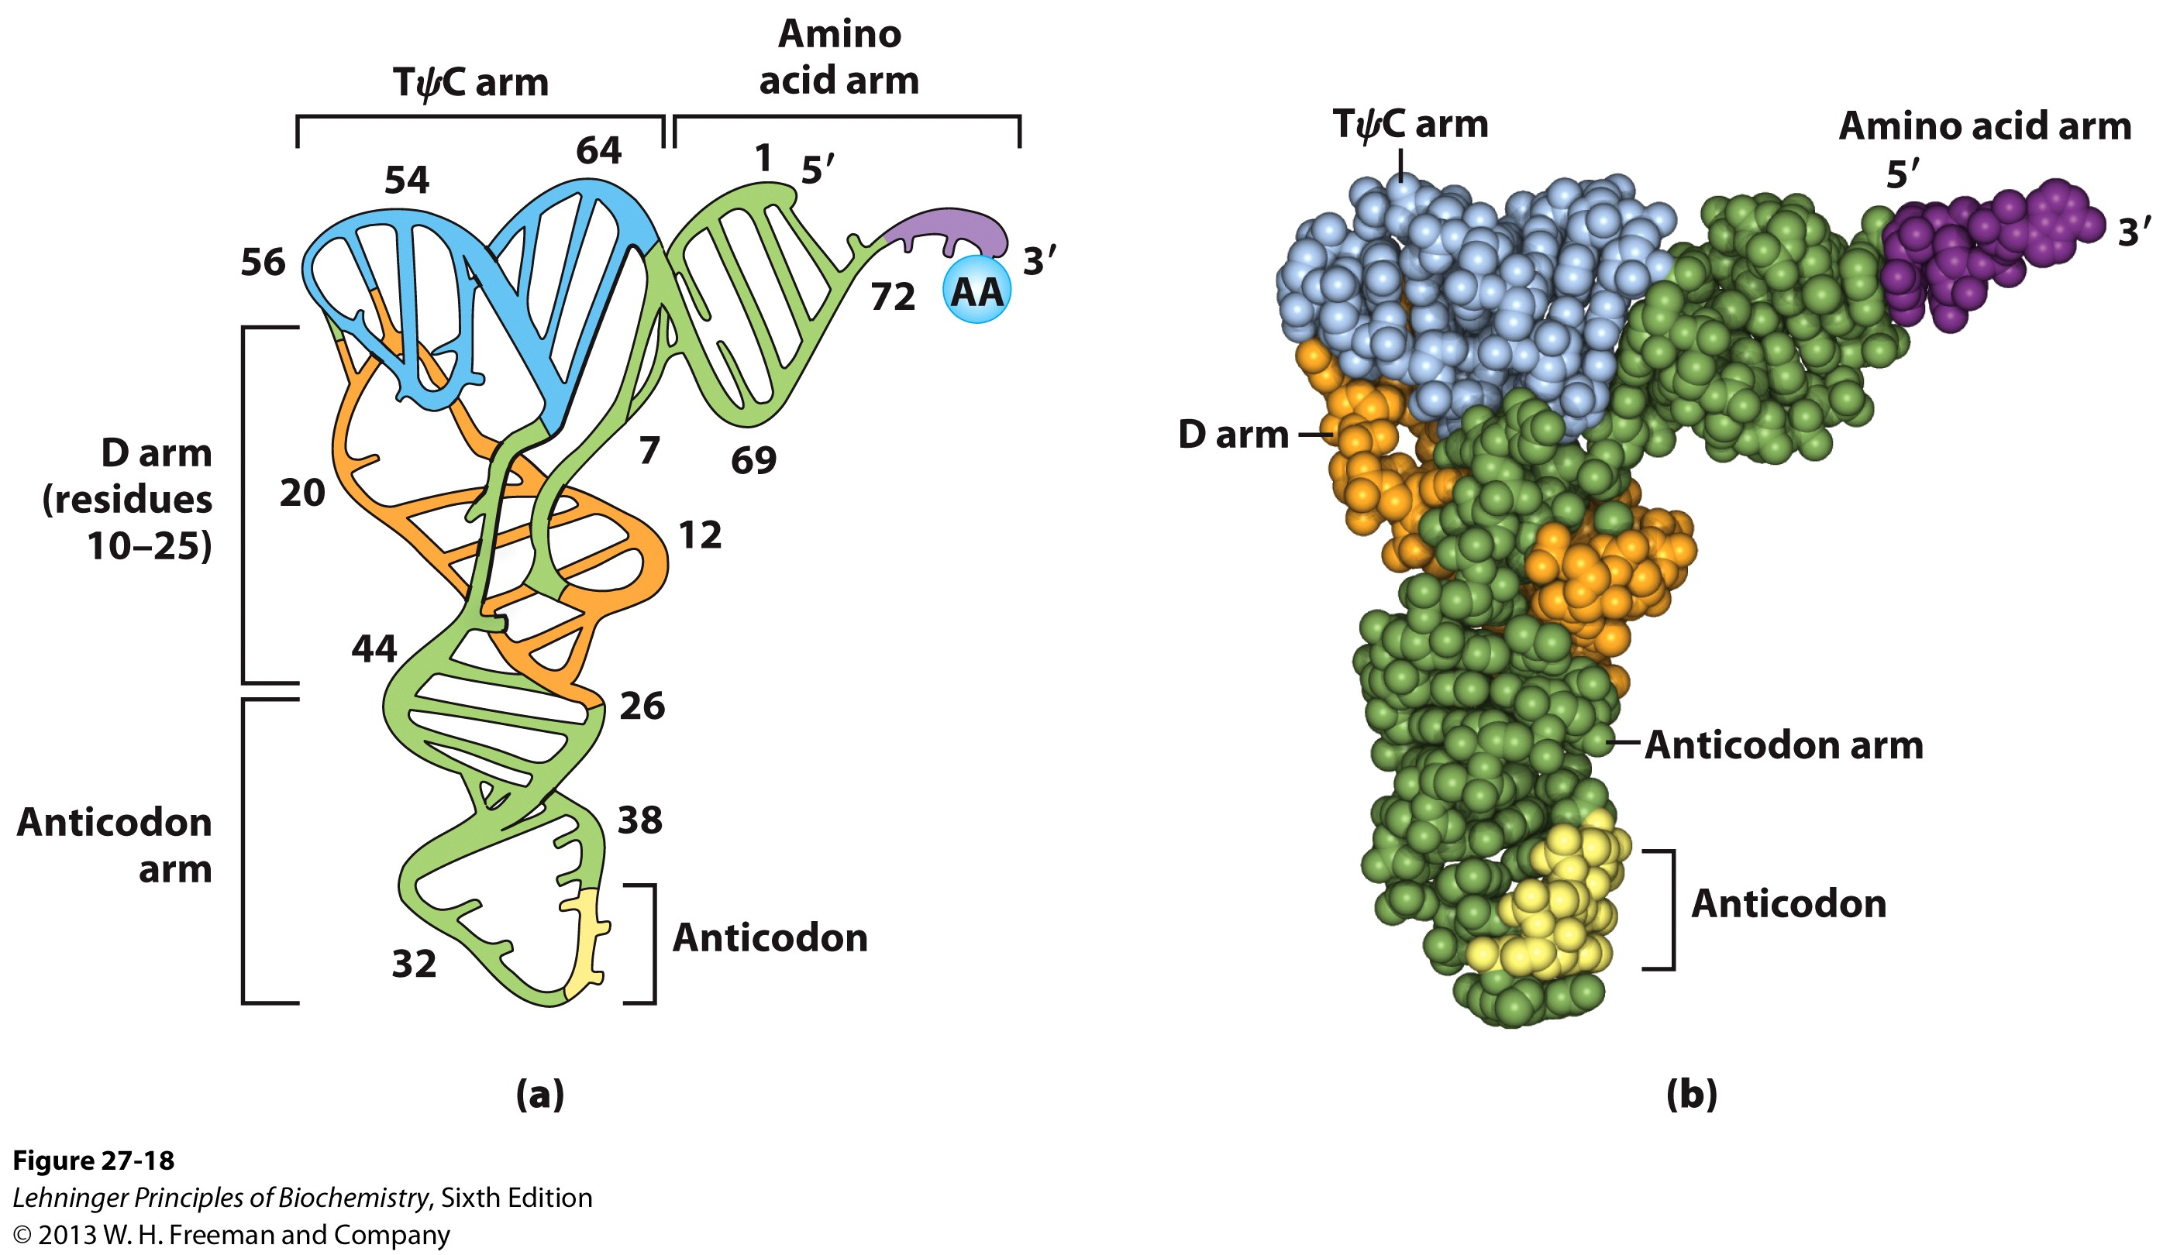
Stage 1: tRNA and aminoacyl tRNA formation
All tRNAs share the following:
5’ phosphate group
7 bp stem that includes the 5’ phosphate group. This is called the Acceptor Stem on the Amino Acid Arm
The D Arm which contains dihydrouridine
5 bp stem that contains the anticodon loop called the Anticodon Arm
5 bp stem containing the sequence TΨC where Ψ is pseudouridine

Slide 14
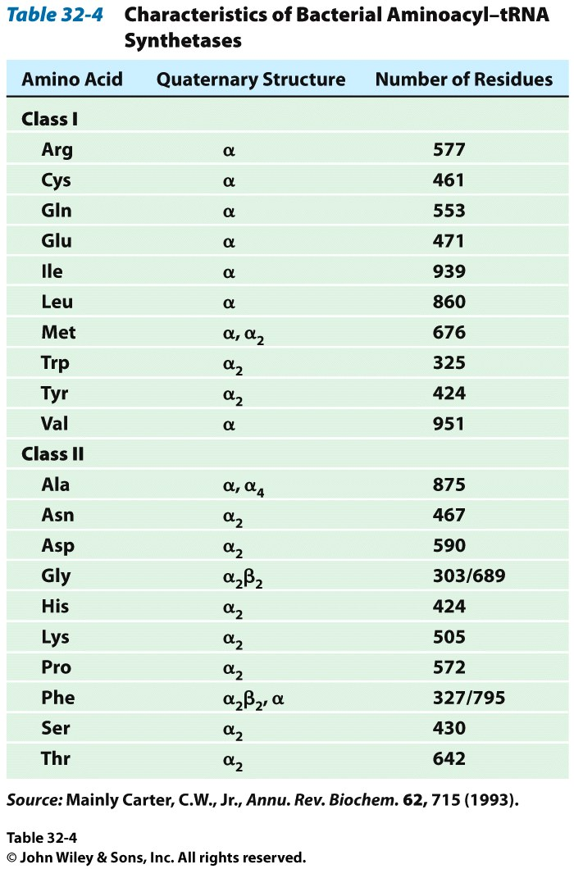
How do tRNAs get loaded?
All cells have one aminoacyl tRNA synthetase for each amino acid
They all catalyze the same base reaction, but are divided into 2 classes based upon primary and tertiary structure
There is no evidence that the classes share a common ancestor through evolution
Amino acid + tRNA + ATP → aminoacyltRNA + AMP + PPi

Slide 15
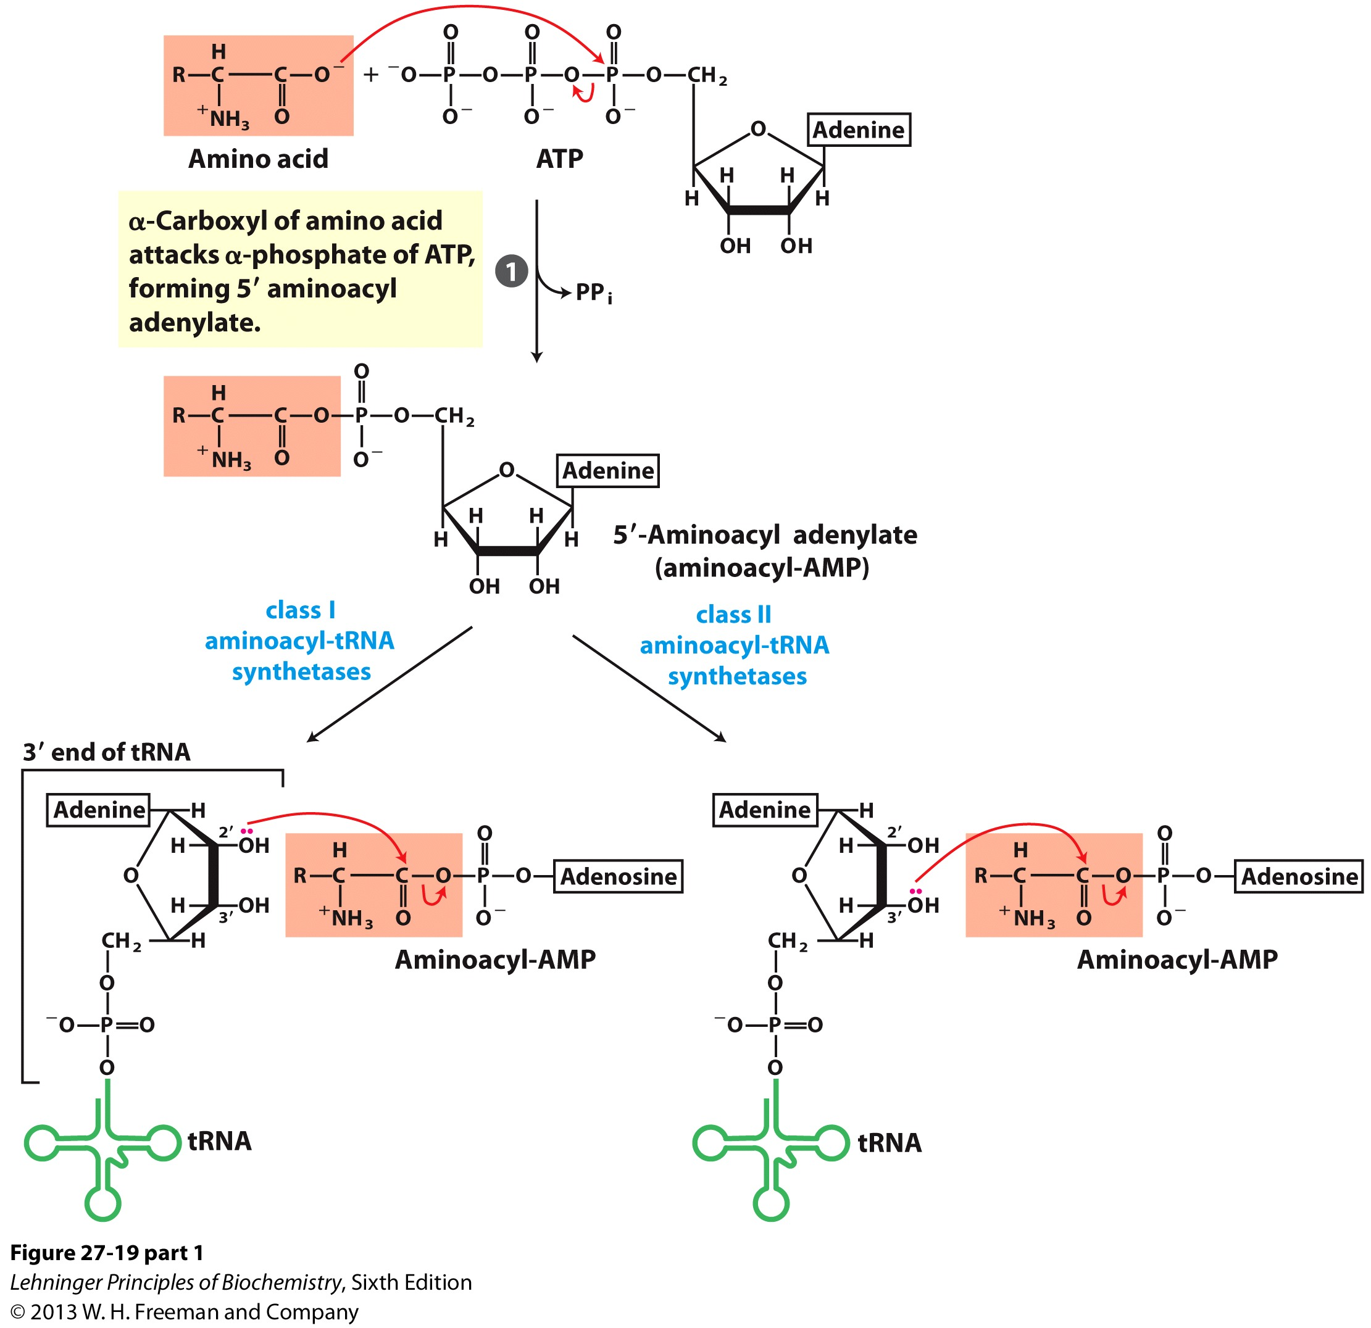
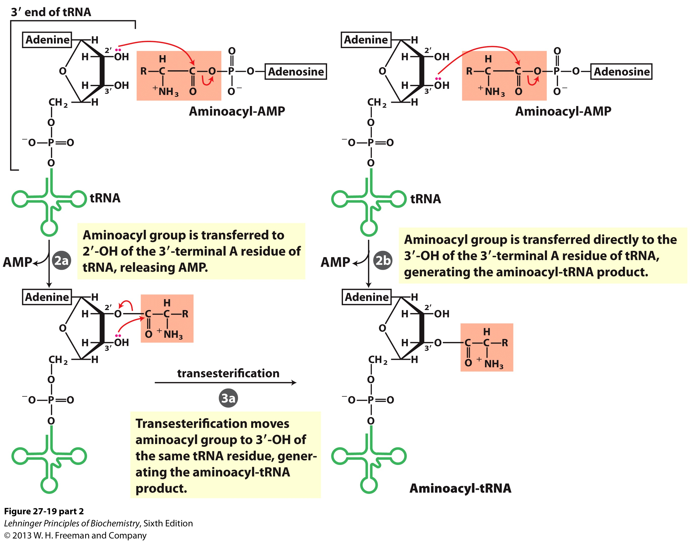
How do tRNAs get loaded?
Class I synthetases have the 2’ hydroxyl attack the carbonyl and then transfer the amino acid to the 3’ hydroxyl
Class II synthetases have the 3’ hydroxyl attack the amino acid carbonyl carbon directly
Note how the amino acid is “primed” for conjugation by covalently attaching an AMP

Slide 16
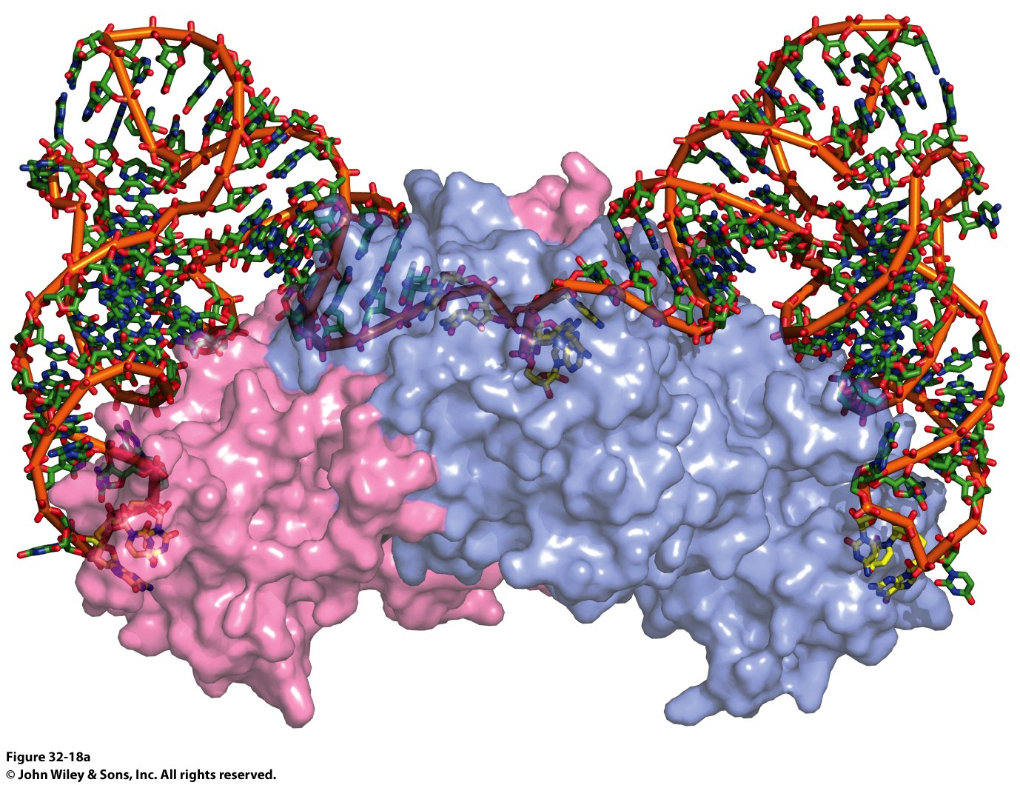
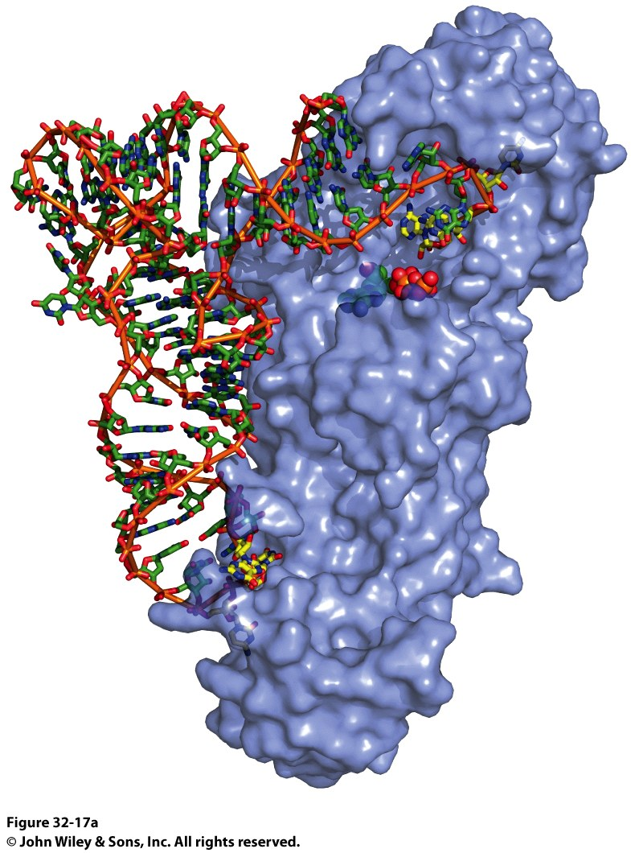
Why the Difference?
Class I Synthetase
Class II Synthetase

Slide 17
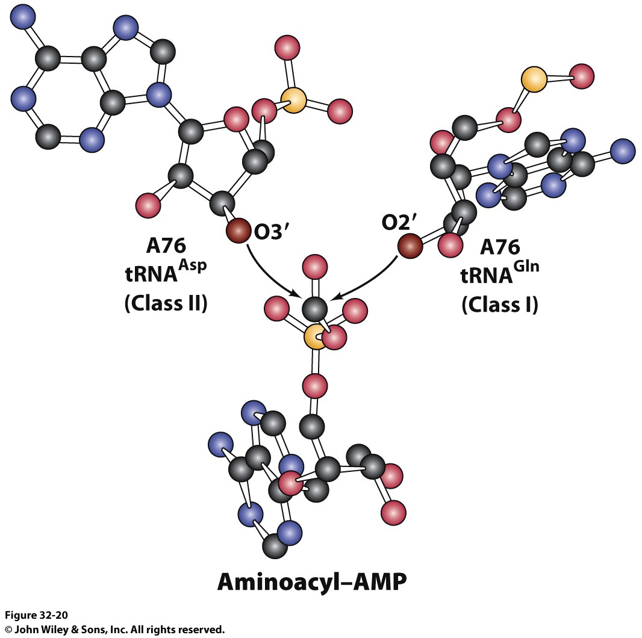
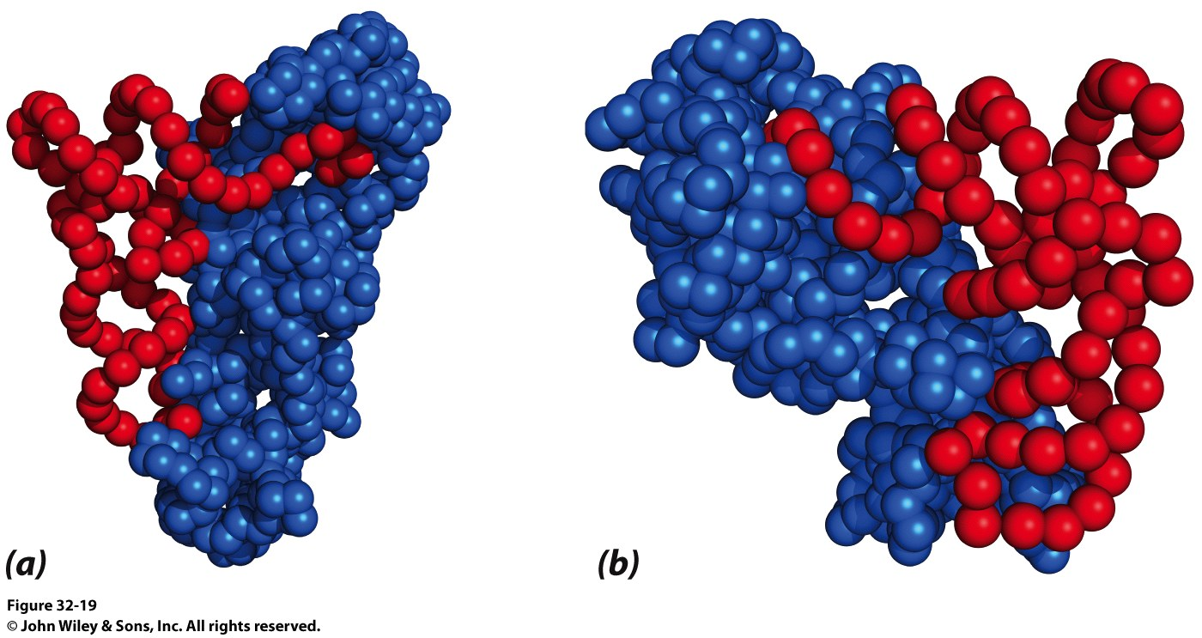
Why the Difference?
The tRNA approaches the active site from different sides!

Slide 18
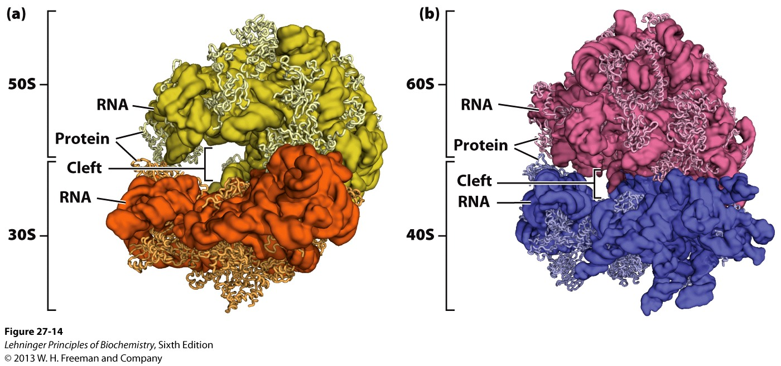
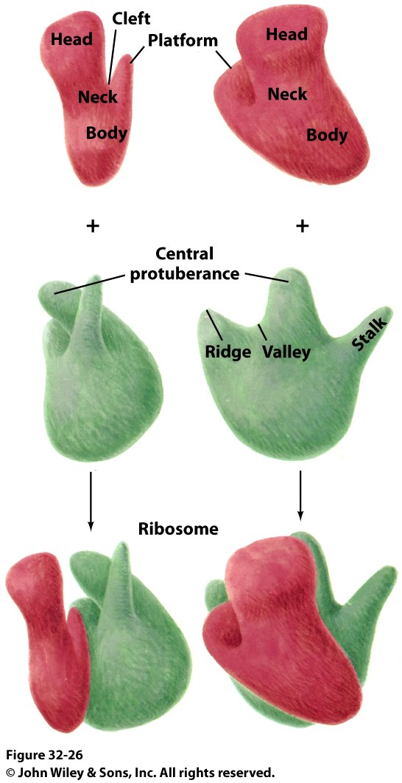
Stage 2: Initiation of Protein Synthesis
Bacterial Ribosome
Yeast Ribosome
Enter the Ribosome: The largest protein/nucleic acid complex known
Essentially a ribozyme (2/3 RNA and 1/3 Protein)
The most important macromolecule in the cell

Slide 19
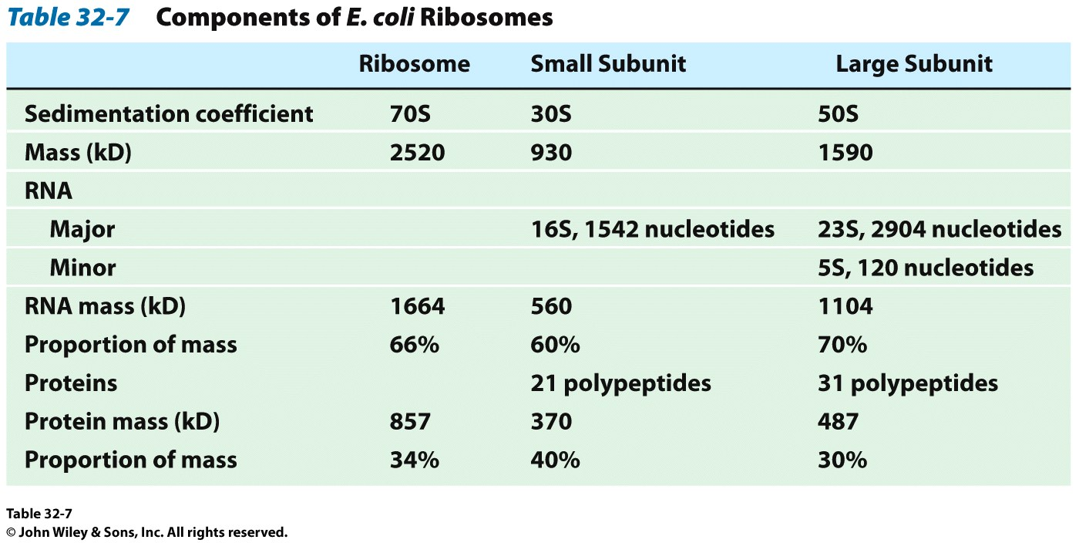
Stage 2: Initiation of Protein Synthesis

Slide 20
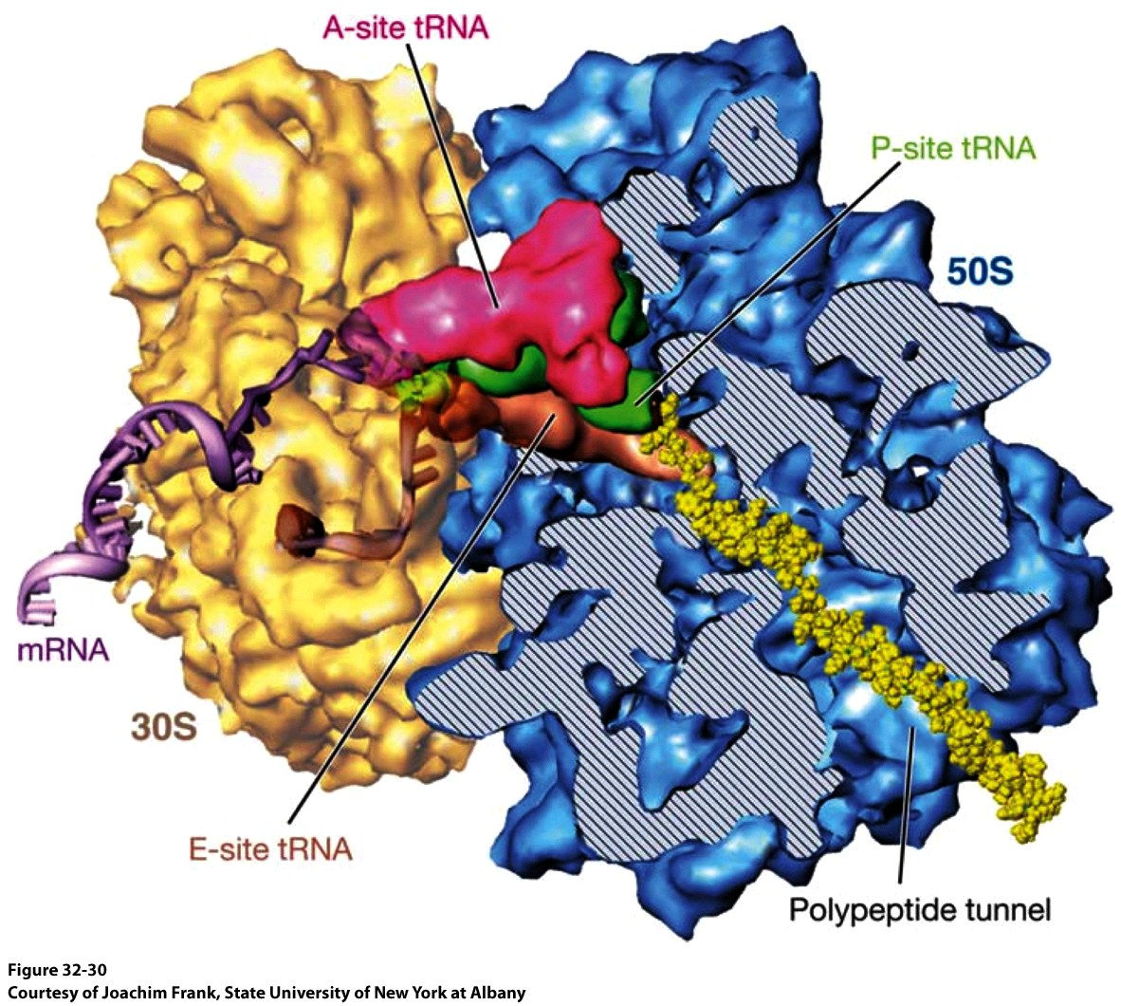
Stage 2: Initiation of Protein Synthesis

Slide 21
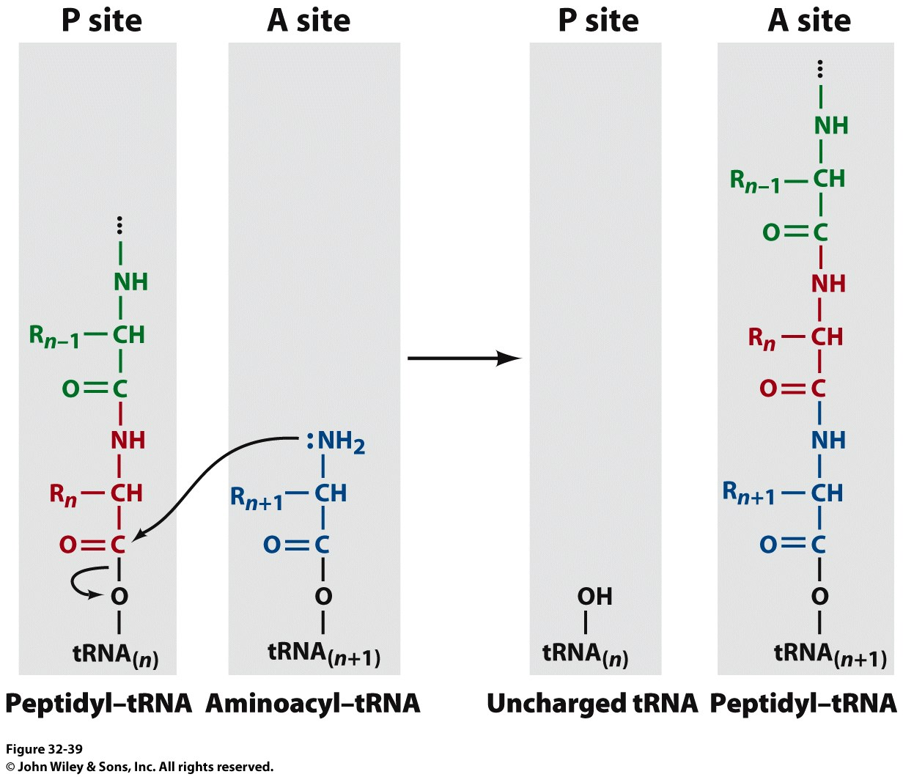
Stage 2: Initiation of Protein Synthesis
The ribosome adds amino acids directionally
3 Sites:
1) A-site: Aminoacyl site: tRNAs come here
2) P-site: Peptidyl site: The polypeptide chain is here before it moves over to the A-site in the transpeptidation rxn
3) E-site: Exit site: The spent tRNA leaves here

Slide 22
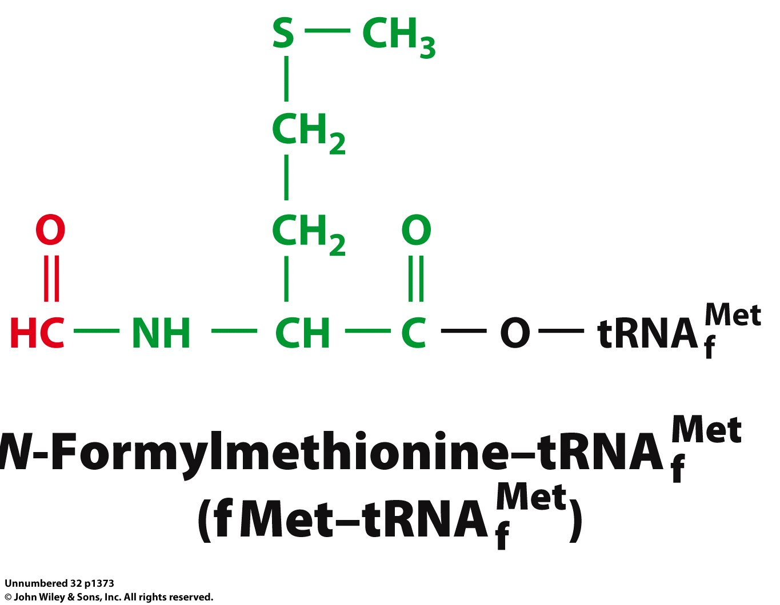
Chain Initiation
Half of mature E. coli proteins begin with methionine.
This codon is otherwise very rare
N-formyl-methionine is the very first amino acid added to every protein made in prokaryotes and eukaryotes
It is often cleaved off later
Why is N-formyl-methionine the first amino acid?
Dr. H drew Met, N-Foryml-Met and a dipeptide on the board.
It worked and I learned something. Yay learning! I feel so alive and powerful with KNOWLEDGE!!!! I might go read my textbook later. Hahahahahahahahahahahahaha! Yeah, right.

Slide 23
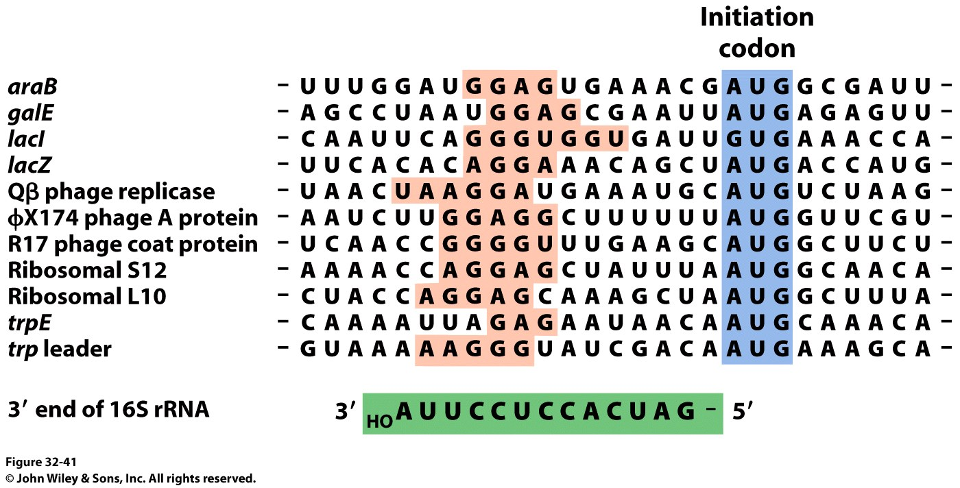
The Shine-Delgarno Sequence
How does the mRNA get placed correctly so that the first codon (AUG) lines up in the P-site?
The Shine-Delgarno sequence, that’s how!

Slide 24
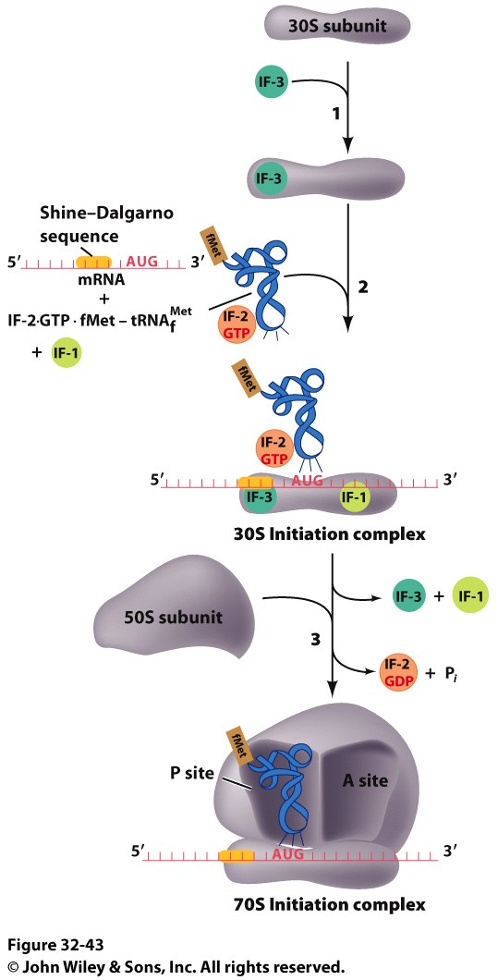
The Initiation Complex
IF3 Binds to the 30S subunit
Prevents the large subunit from binding
mRNA, fMet-tRNA/IF2/GTP and IF1 bind
mRNA Shine-Delgarno sequence binds to complementary sequence on 16S rRNA
IF1 binds to the A-site
The fMet-tRNA/IF2/GTP ternary complex binds to the initiation codon in the P-site
The 50S subunit associates with the 30S subunit and IF2 hydrolyzes its bound GTP
This causes a conformational shift in the 30S subunit and all 3 initiation factors dissociate as does GDP and PPi

Slide 25
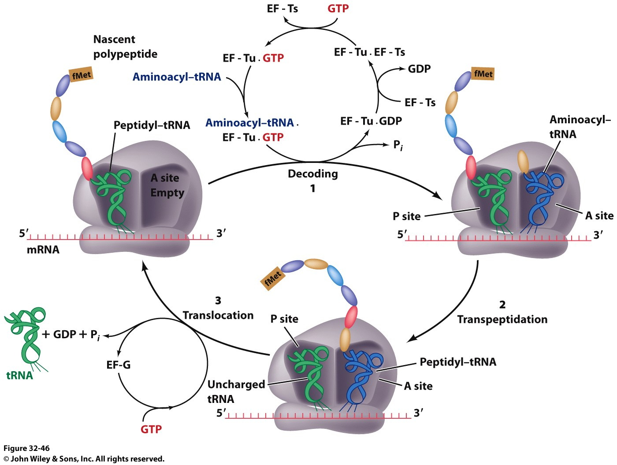
Stage 3: Elongation
3 Step Reaction Cycle
Decoding: Binding of aminoacyl-tRNA complementary to mRNA codon
Transpeptidation: Peptidyl group in P-site is transferred to the A-site
Translocation: A-site and P-site contents are transferred to the P-site and E-site, respectively
mRNA is translocated through the ribosome

Slide 26
Stage 3, Step 1: Decoding
EF-Tu/GTp complex binds to aminoacyl-tRNA
Ternary complex binds to the A-site of ribosome
GTP is hydrolyzed and the aminoacyl-tRNA complexes with codon via anticodon
EF-Tu is the most abundant protein in E. coli (~100,000 copies/cell)
Without EF-Tu, the rate of aminoacyl-tRNA binding to the A-site is too low to support cell growth

Slide 27
Stage 3, Step 1: Decoding
EF-Ts displaces the GDP from EF-Tu
When EF-Tu binds another aminoacyl-tRNA, it dissociates from EF-Ts and also binds GTP
It is then ready to load that aminoacyl-tRNA into the A-site if it pairs with the codon

Slide 28
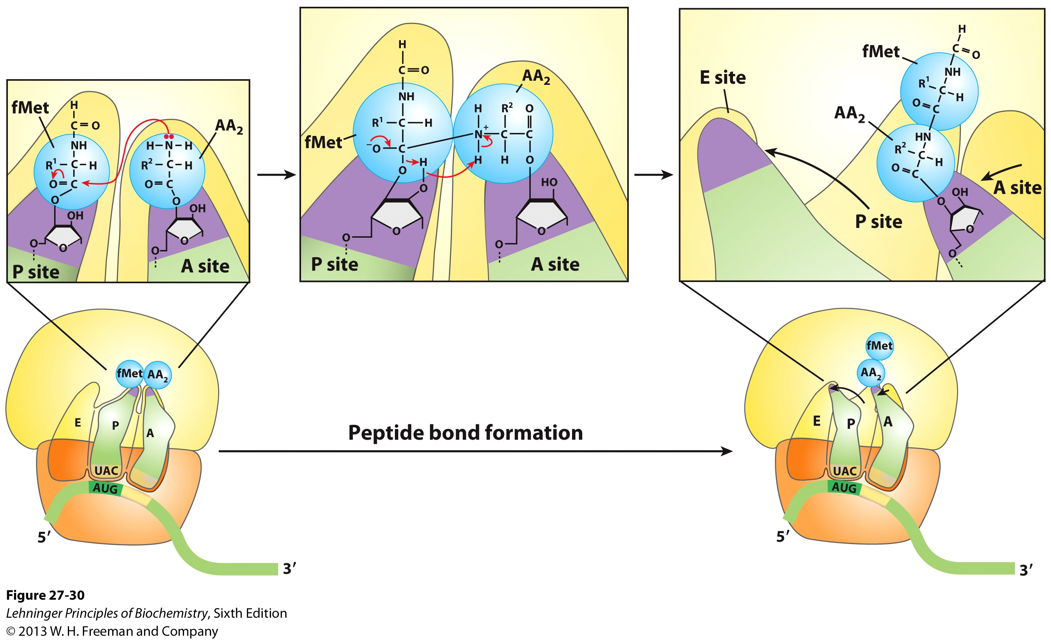
Stage 3, Step 2: Transpeptidation
The ribosome enhances the rate of peptide bond formation by properly positioning and orienting the substrates and/or excluding water from the active site rather than by chemical catalysis
The ribosome is a workbench
Net effect: An amino acid is added to the polypeptide chain and the chain is transferred to the aminoacyl-tRNA in the A-site from the aminoacyl-tRNA in the P-site

Slide 29
Stage 3, Step 2: Transpeptidation
Note the conformational change of the tRNA in P-site
After peptide transfer, part of the molecule has moved over to the E-site

Slide 30
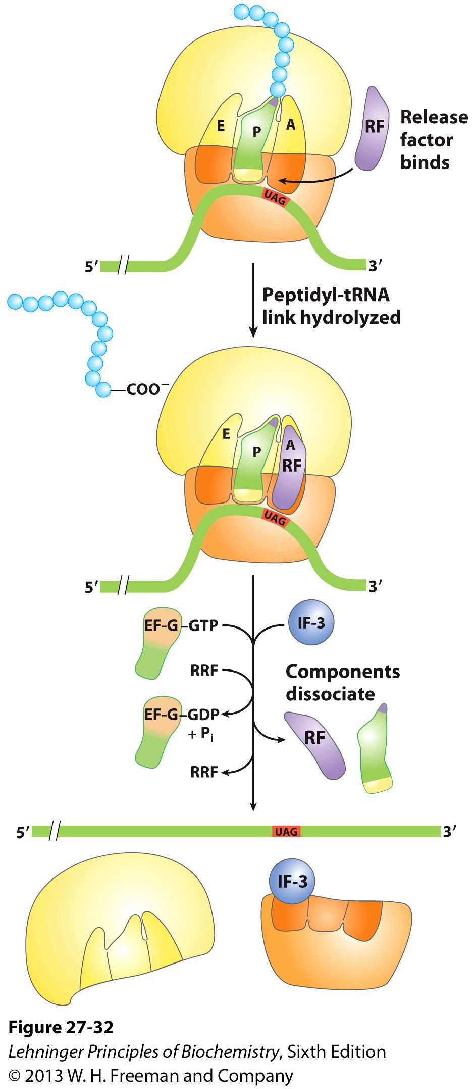
Stage 3, Step 3: Translocation
EF-G/GTP binds to A-site tRNA
As it does, it hydrolyzes GTP which causes a conformational change in the ribosome
The mRNA slides over one codon; The peptidyl-tRNA in the A-site moves to the P-site and the tRNA in the P-site moves to the E-site
Notice how structurally similar the EF-Tu/Aminoacyl tRNA complex and EF-G are

Slide 31
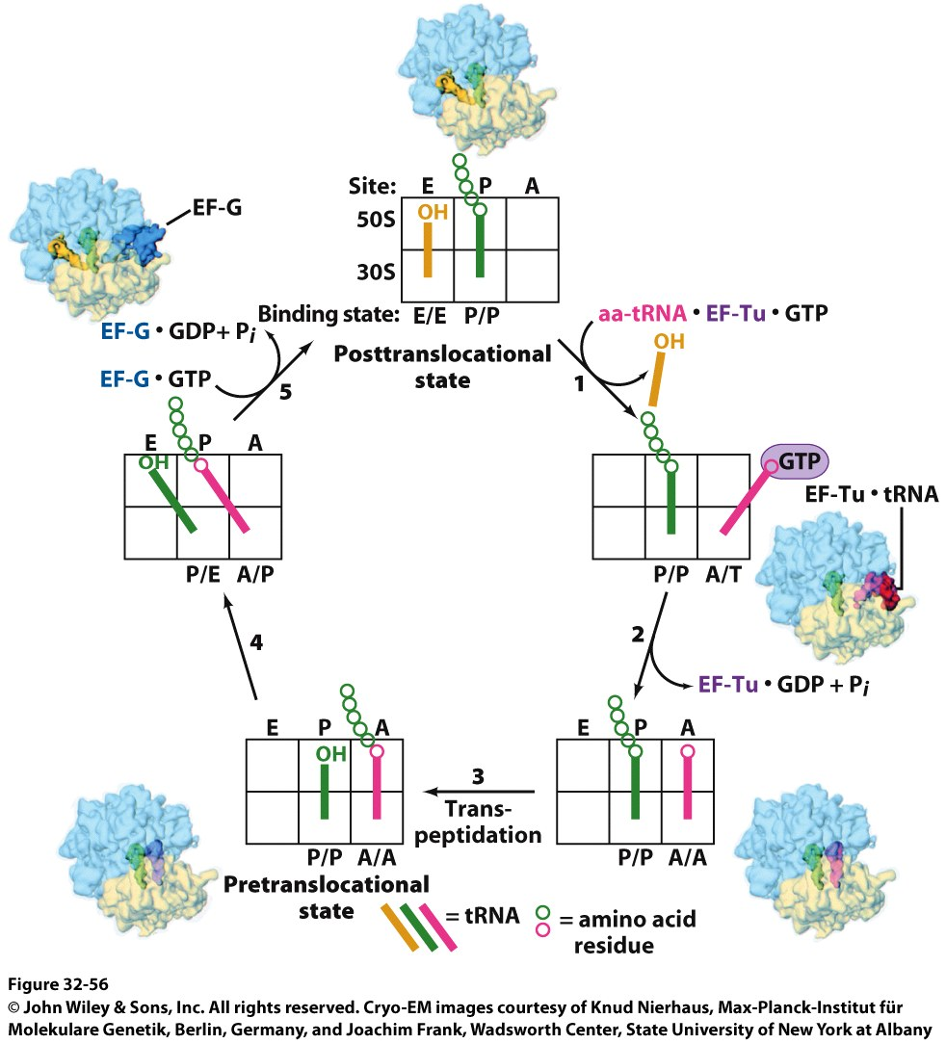
Stage 3, Step 3: Translocation
Note the sliding of moieties!

Slide 32
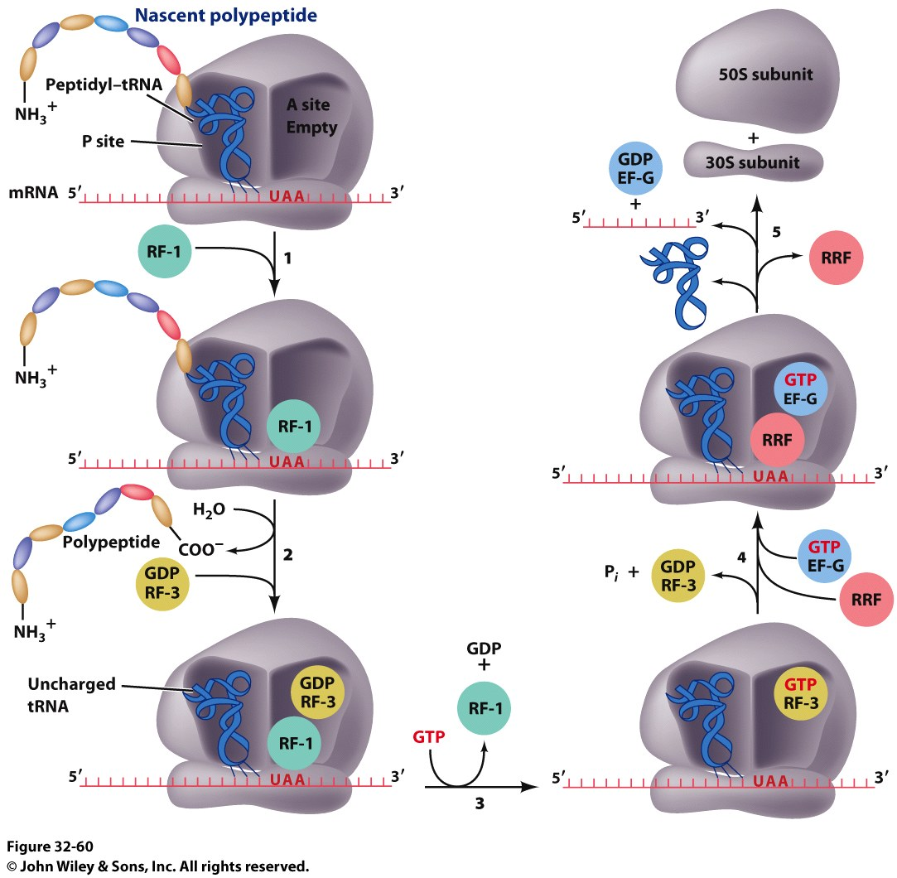
Stage 4: Termination
RF-1 (UAA or UAG) or RF-2 (UAA or UGA) bind to the A-site
Binding of RF-1 or RF-2 to the A-site causes hydrolysis of polypeptide from the tRNA in the P-site
RF-3 binds to RF-Tu/EF-G site, binds GTP and hydrolyzes it
The hydrolysis of GTP by RF-3 causes a conformational change in the ribosome that allows EF-G/GTP and Ribosome Recycling Factor (RRF) to bind

Slide 33
Stage 4: Termination
EF-G hydrolyzes GTP which translocates RRF to the P-site
The ribosome dissociates and all other molecules dissociate from the subunits as well

Slide 34
Termination of Protein Synthesis in Bacteria
Notes:
FIGURE 27–32 Termination of protein synthesis in bacteria. Termination occurs in response to a termination codon in the A site. First, a release factor, RF (RF-1 or RF-2, depending on which termination codon is present), binds to the A site. This leads to hydrolysis of the ester linkage between the nascent polypeptide and the tRNA in the P site and release of the completed polypeptide. Finally, the mRNA, deacylated tRNA, and release factor leave the ribosome, which dissociates into its 30S and 50S subunits, aided by ribosome recycling factor (RRF), IF-3, and energy provided by EF-G–mediated GTP hydrolysis. The 30S subunit complex with IF-3 is ready to begin another cycle of translation (see Fig. 27–25).

Slide 35
Features of Protein Synthesis
Large energy cost
Can be rapid when accomplished on clusters of ribosomes called a polysome
In bacteria, tightly coupled to transcription
Translation can begin before transcription is finished

Slide 36
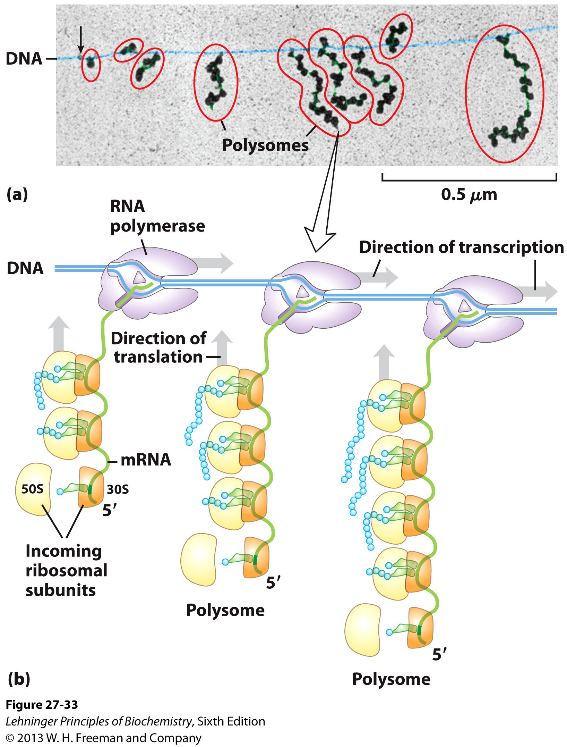
Coupling of Transcription and Translation in Bacteria
Notes:
FIGURE 27–33 Coupling of transcription and translation in bacteria. (a) Electron micrograph of polysomes forming during the transcription of a segment of DNA from E. coli. Each mRNA is being translated by many ribosomes simultaneously. The nascent polypeptide chains forming on the ribosomes are difficult to see under the spreading conditions used to prepare the samples shown in these electron micrographs. The arrow marks the approximate beginning of the gene that is being transcribed. (b) Each mRNA is translated by ribosomes while it is still being transcribed from DNA by RNA polymerase. This is possible because the mRNA in bacteria does not have to be transported from a nucleus to the cytoplasm before encountering ribosomes. In this schematic diagram the ribosomes are depicted as smaller than the RNA polymerase. In reality the ribosomes (M_{r} 2.7 x 10⁶) are an order of magnitude larger than the RNA polymerase (M_{r} 3.9 x 10⁵).

Slide 37
Post-translational modifications are required by some proteins
Some proteins require modification before the fully active conformation is achieved
Post-translational modifications include:
Enzymatic removal of formyl group from first residue, or removal of Met and sometimes additional residues
Acetylation of N-terminal residue
Removal of signal sequences or other regions
Attaching carbohydrates

Slide 38
Post-translational modifications are required by some proteins (ctd.)
Modifying amino acids with additional carboxylic acid groups, etc.
Addition of isoprenyl groups (such as farnesyl pyrophosphate from intermediates of cholesterol synthesis pathway
Isoprene or derived group helps anchor proteins in membranes
Adding prosthetic groups
Forming disulfide links

