Slide 1
Lecture 19: Transcription and Transcriptional Control
Chapter 26.1 – DNA-dependent RNA Transcription
Chapter 28 – Regulation of Transcription
Regulation of Transcription

Slide 2
INDUCTION of Enzyme Production using OPERONS
One way to regulate of an enzyme
If it isn’t needed, it isn’t made
Operons have: Control sites and Structural Genes in a linear array on the chromosome
The regulatory protein is encoded outside the boundaries of the operon

Slide 3
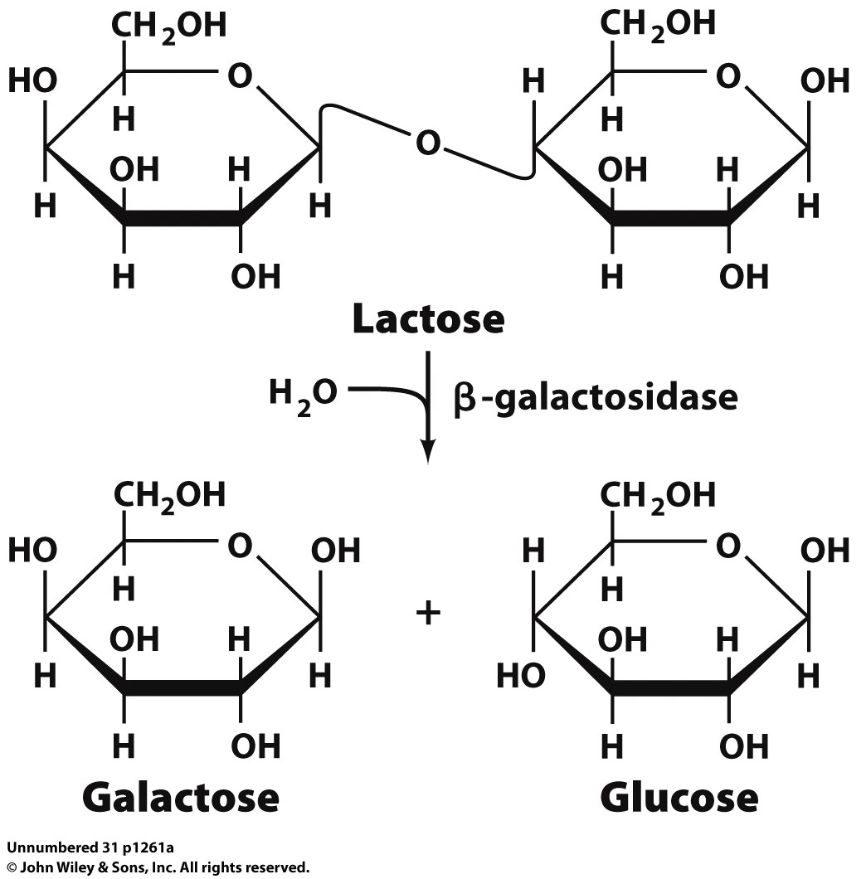
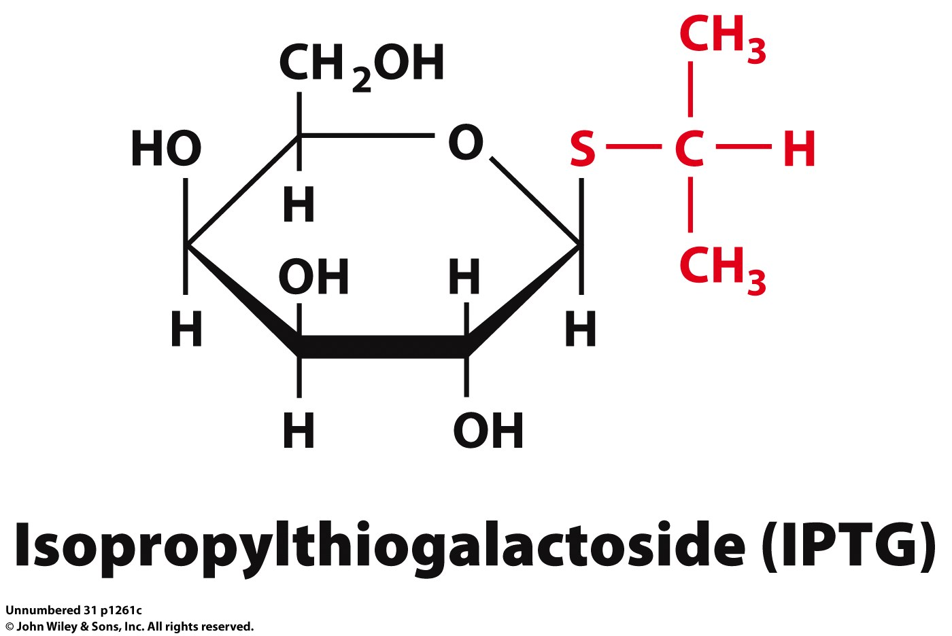
Example 1: The lac operon
The lac operon has the structural genes for three proteins:
1) lacZ: beta-galactosidase
2) lacY: galactoside permease
lacA: Thiogalactoside transacetylase
Unknown role in pathway
Transfers acetyl group to C-6 hydroxyl group on IPTG and other thiogalactosides

Slide 4
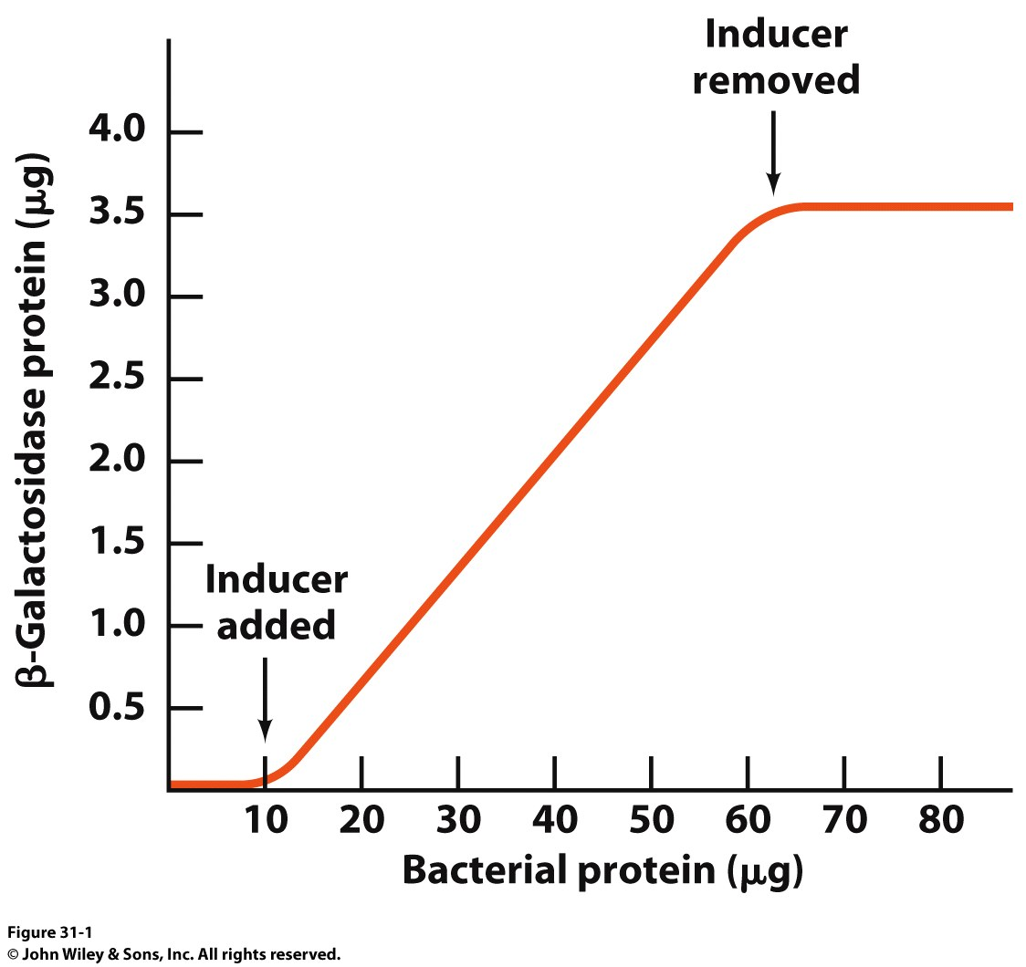
Example 1: The lac operon
Allows proteins to be made when needed and then halt production when they aren’t
Inducer

Slide 5
The lac operon led to…
Monod and Jacob postulating in 1961:
1) The structural genes on DNA are TRANSCRIBED into complementary strands of messenger RNA (mRNA)
2) mRNA must associate with ribosomes which catalyze the synthesis of polypeptides

Slide 6
RNA Polymerase: Components
Two α subunits function in assembly and binding to UP (upstream promoter) elements
The β subunit is the main catalytic subunit
The β’ subunit is responsible for DNA binding
The σ subunit directs enzyme to the promoter
The ω appears to protect the polymerase from denaturation

Slide 7
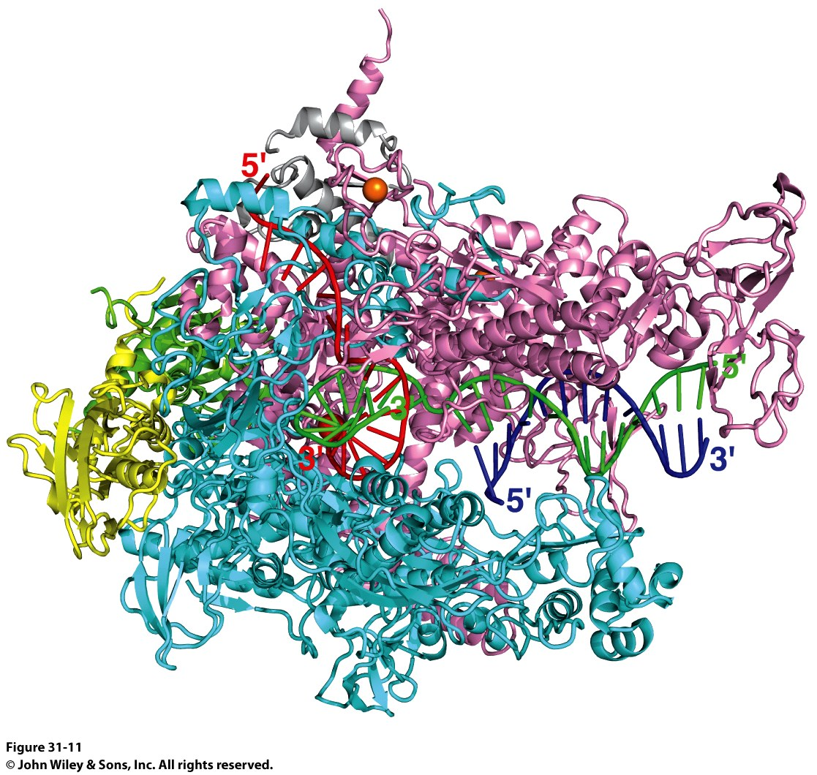
RNA Polymerase
RNA Polymerase (RNAP)
PDB ID Codes:
2O5I: Crystal structure of the Thermus thermophilus RNA polymerase elongation complex
1L9Z: Thermus aquaticus RNA Polymerase Holoenzyme/Fork-Junction Promoter DNA Complex at 6.5 A Resolution
2A69: Crystal structure of the Thermus Thermophilus RNA polymerase holoenzyme in complex with antibiotic rifapentin
2O5I

Slide 8
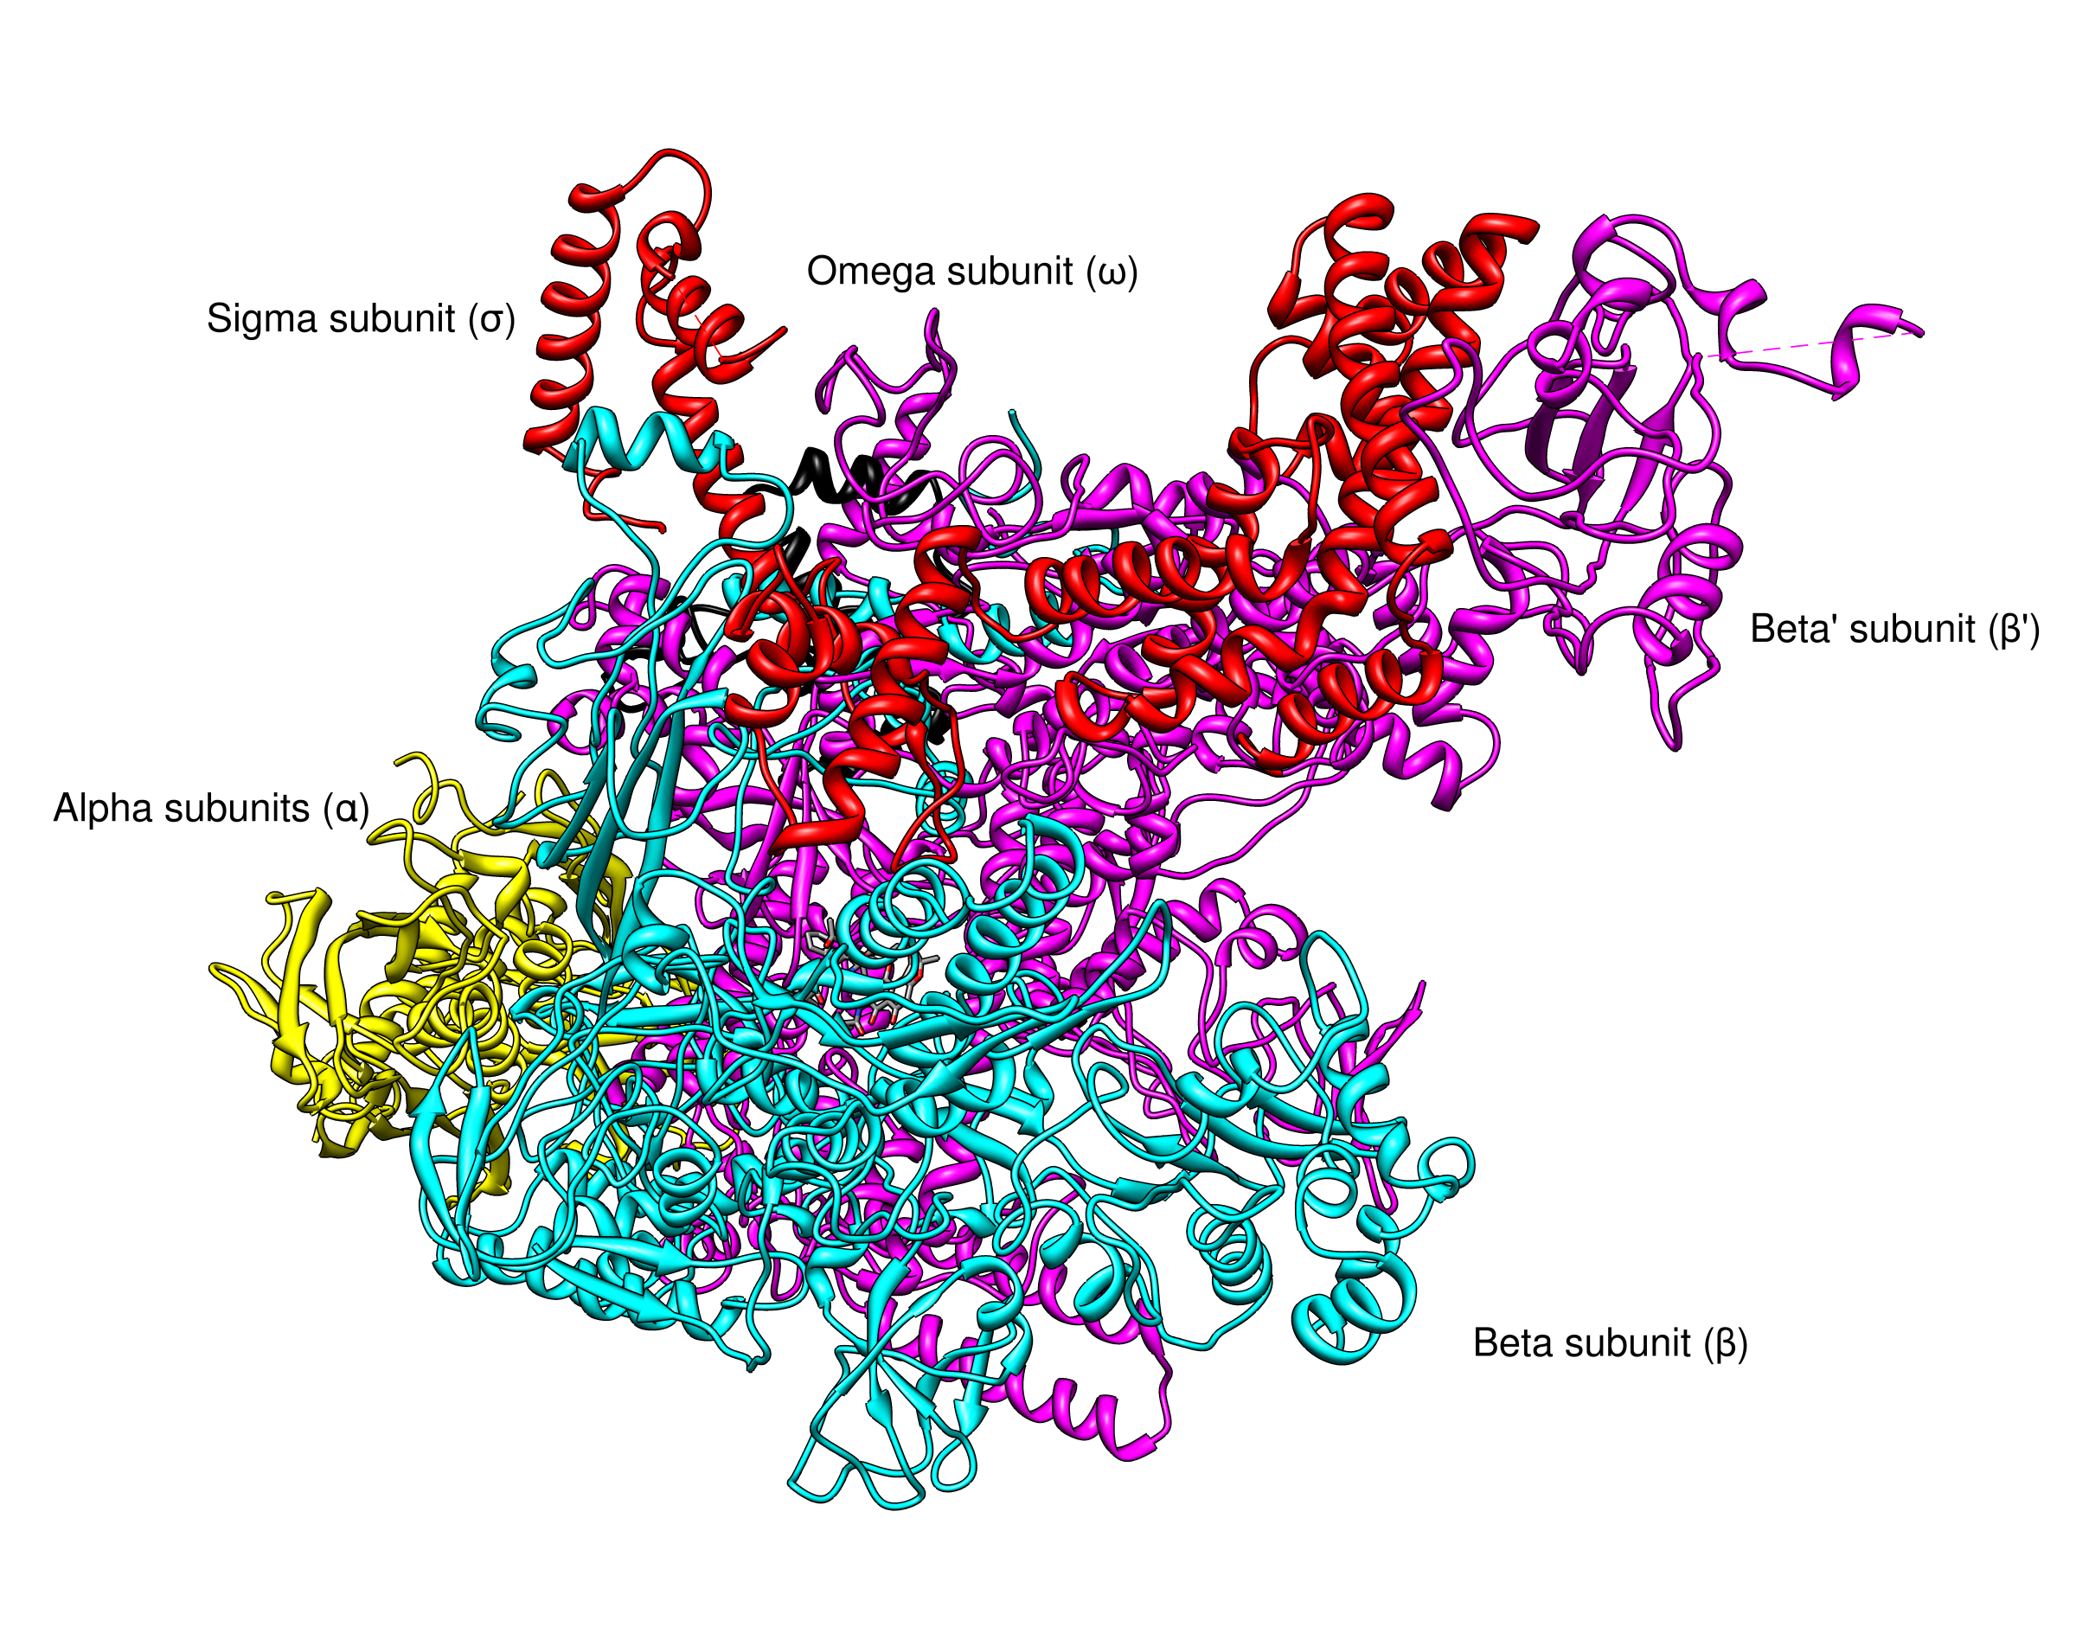
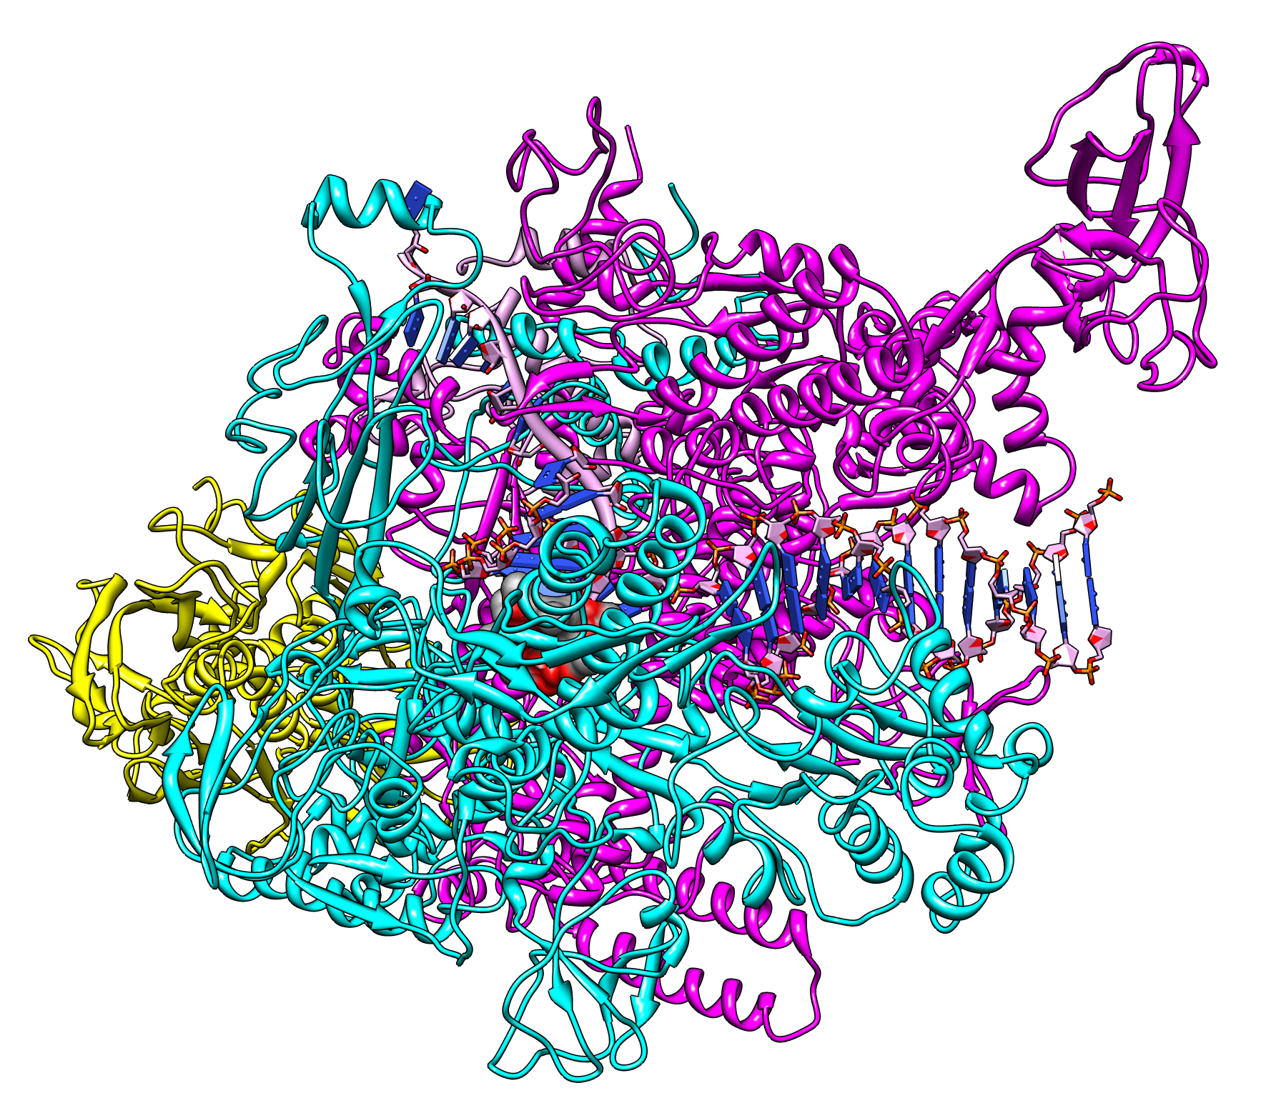
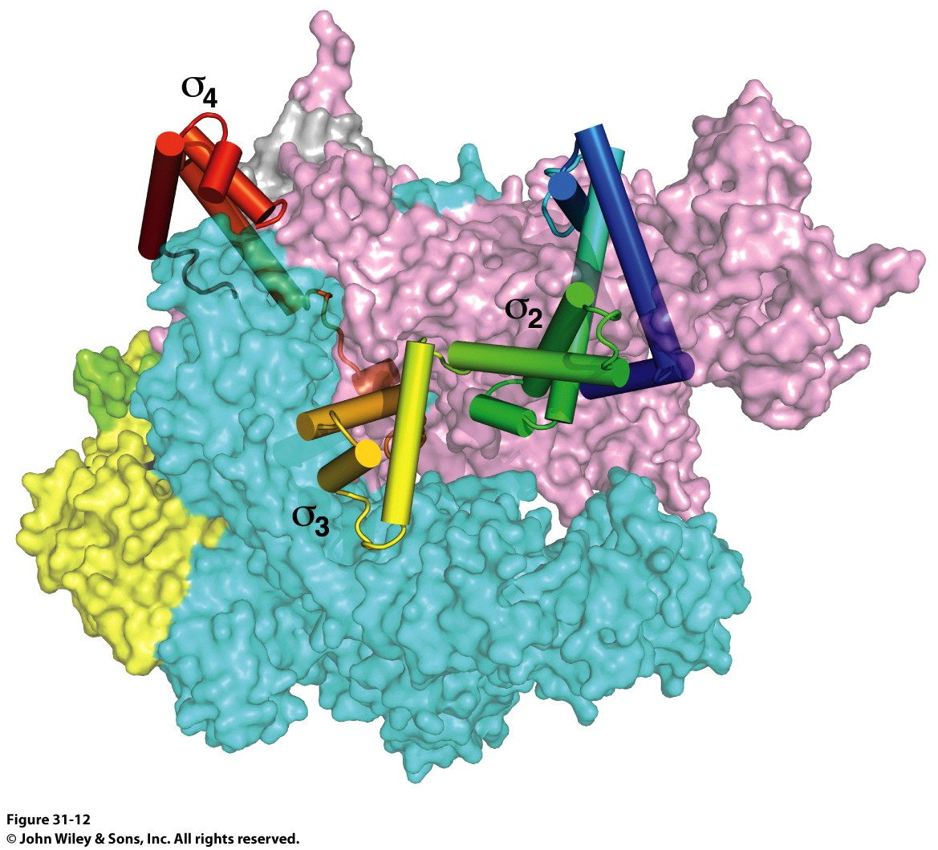
RNA Polymerase
2O5I
1IW7
2A69
The Holoenzyme (1IW7)
(The initial assembly on the promoter)
459 kDa
α₂ββ’ωσ subunits
The Core Enzyme (2A69)
(The functional assembly)
389 kDa
α₂ββ’ω subunits

Slide 9
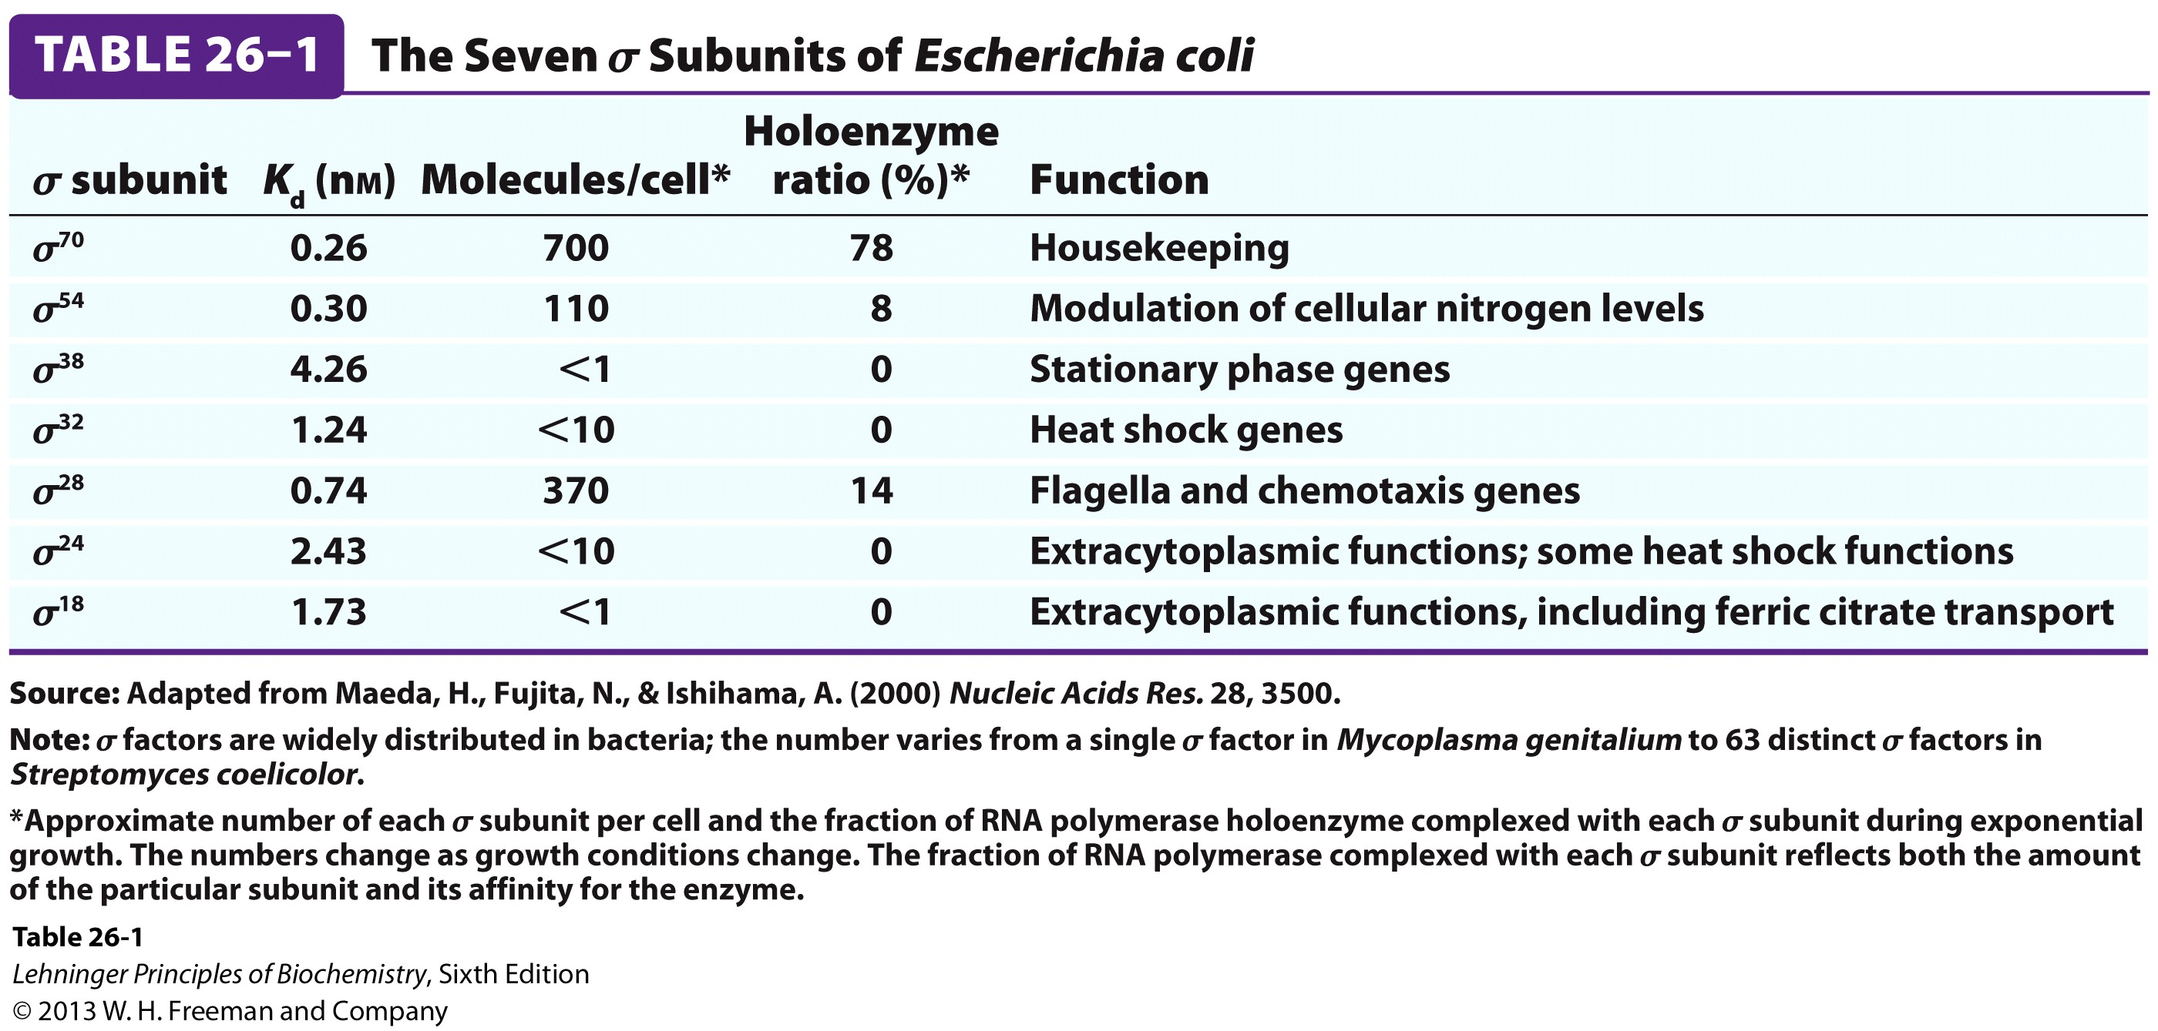
Sigma Subunits are Promoter Specific
The most prevalent is σ⁷⁰

Slide 10
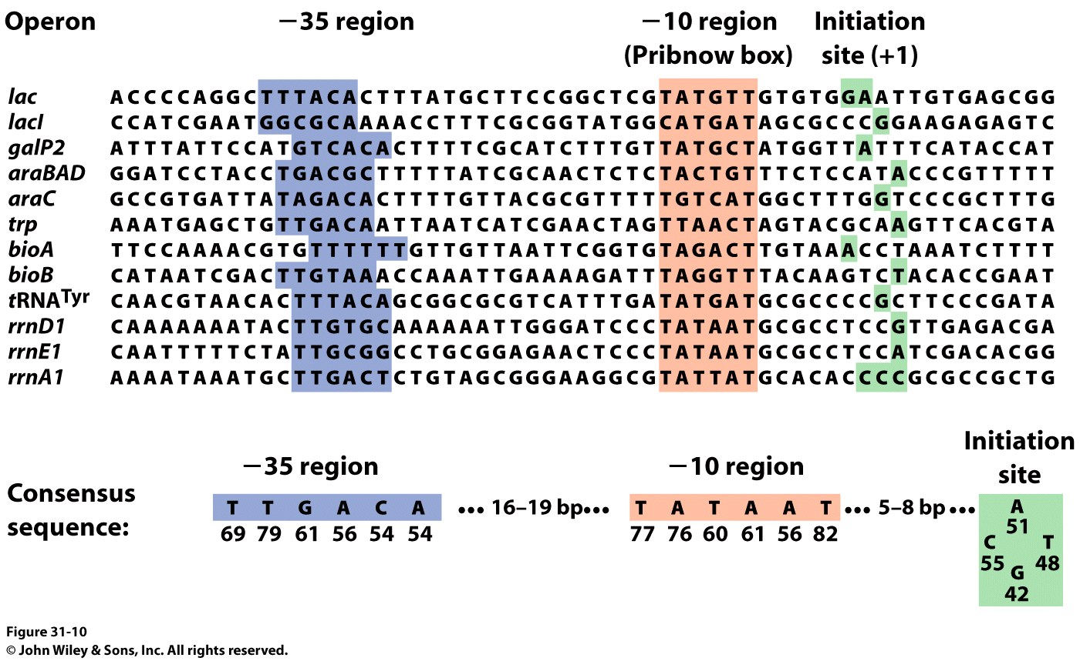
Promoters:
RNAP Binds to Specific Sites on the DNA
DNA is a duplex:
Antisense Strand: Strand that is transcribed
Sense Strand: The coding strand, has the same sequence as the transcribed mRNA

Slide 11
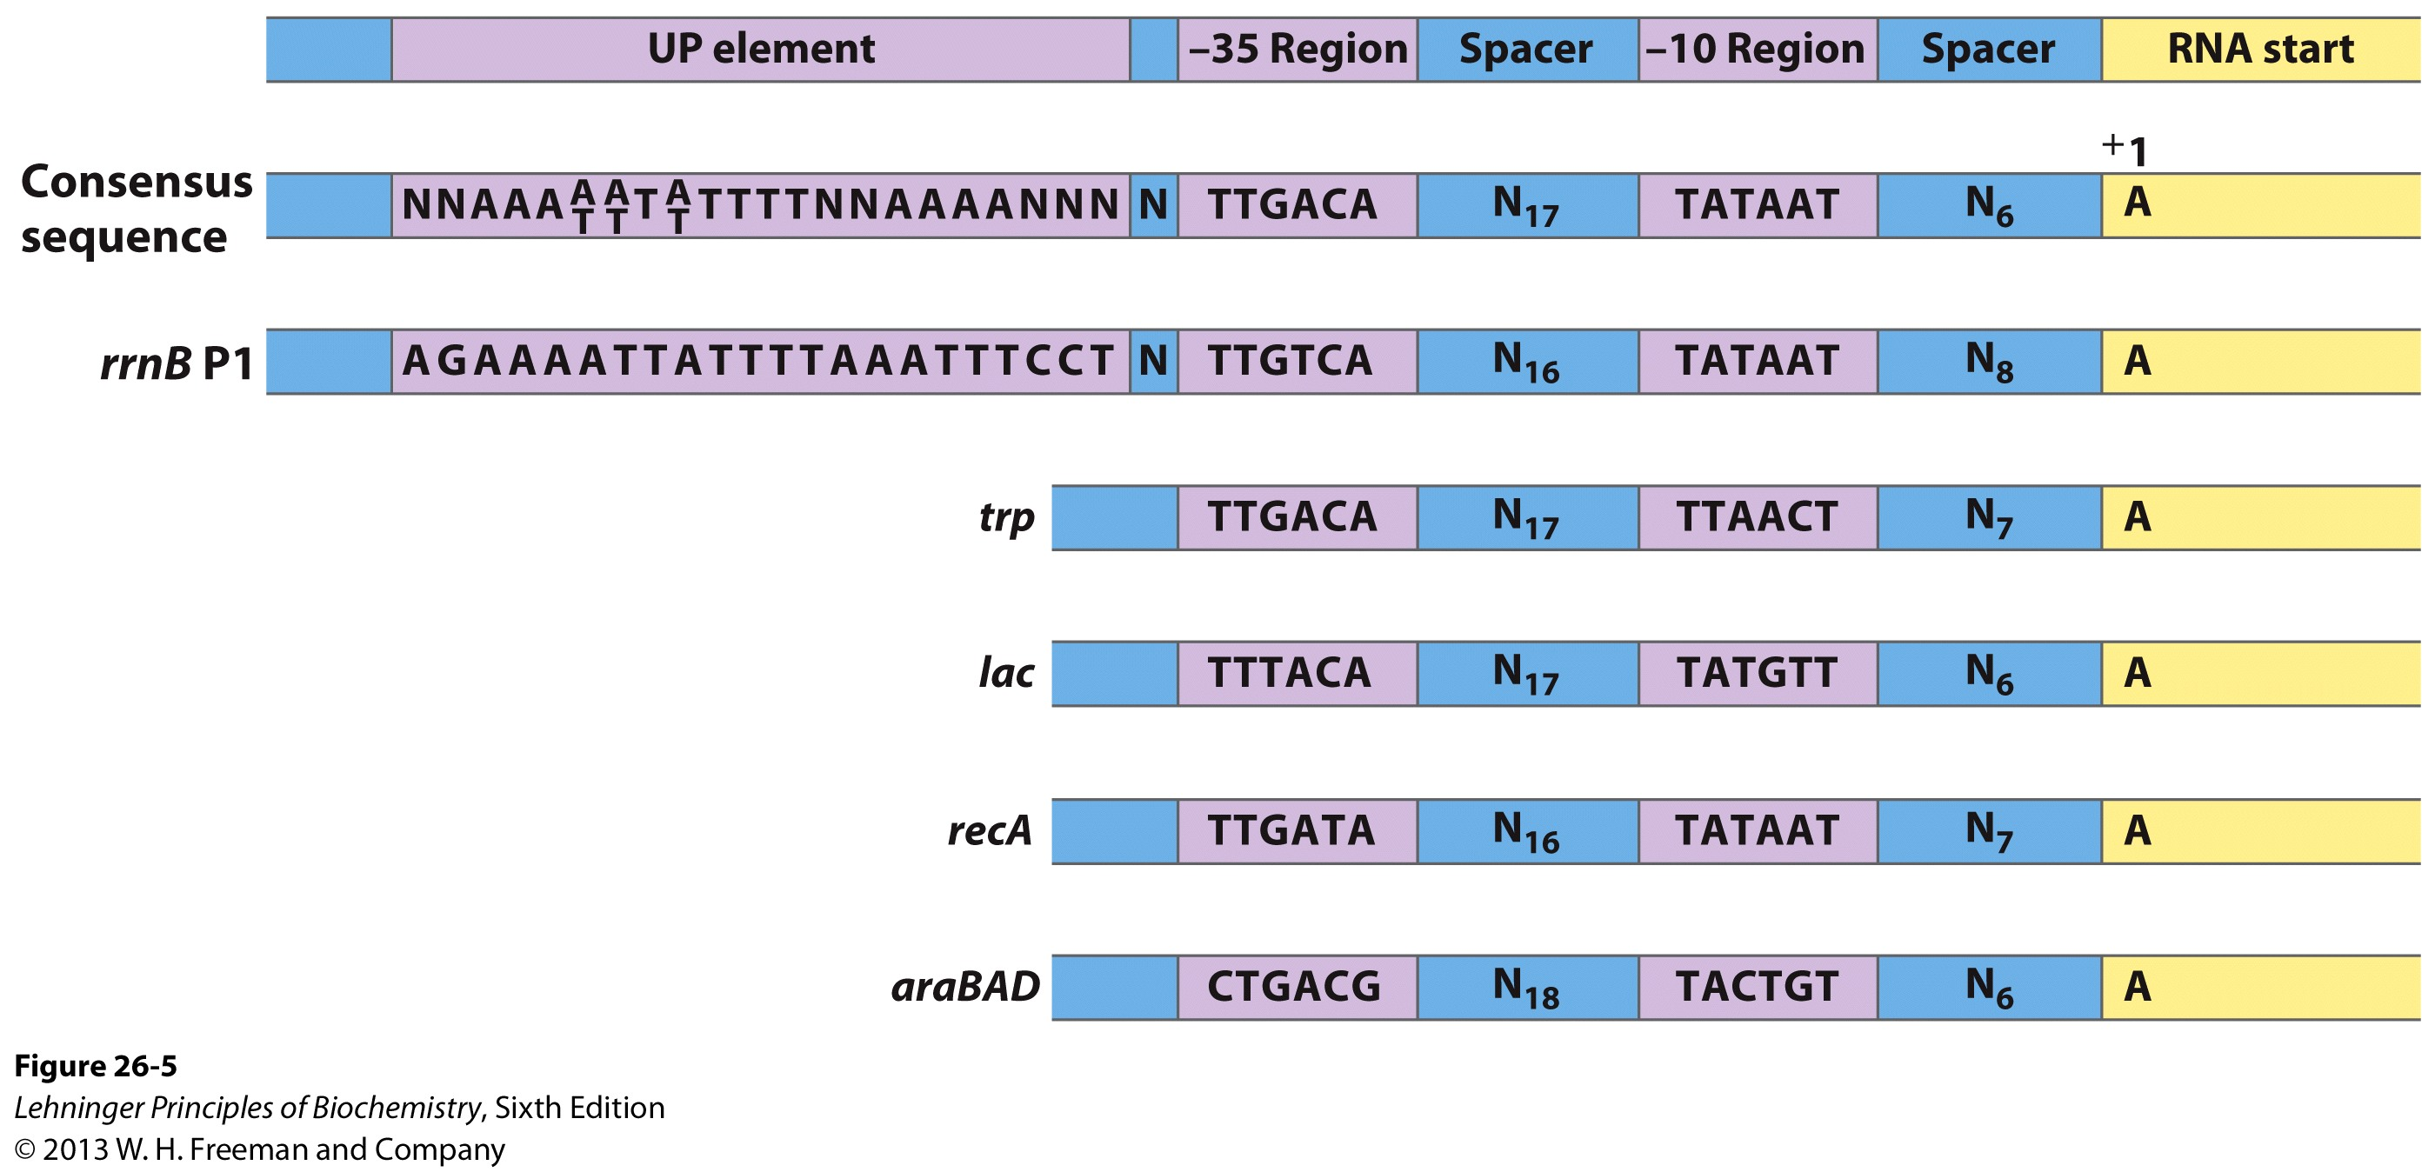
Promoters:
RNAP Binds to Specific Sites on the DNA
Promoters are 40bp sequences BEFORE the transcriptional start site (+1 site)
There is some variation in the -35 region, and almost none in the Pribnow box
The distance between the -35 and -10 regions is ABSOLUTELY CRITICAL
Mutation changes the affinity of RNAP for the DNA
Normally 1x10⁻¹⁴ M
Binding of RNAP to the promoter “melts” the DNA through the Pribnow box

Slide 12
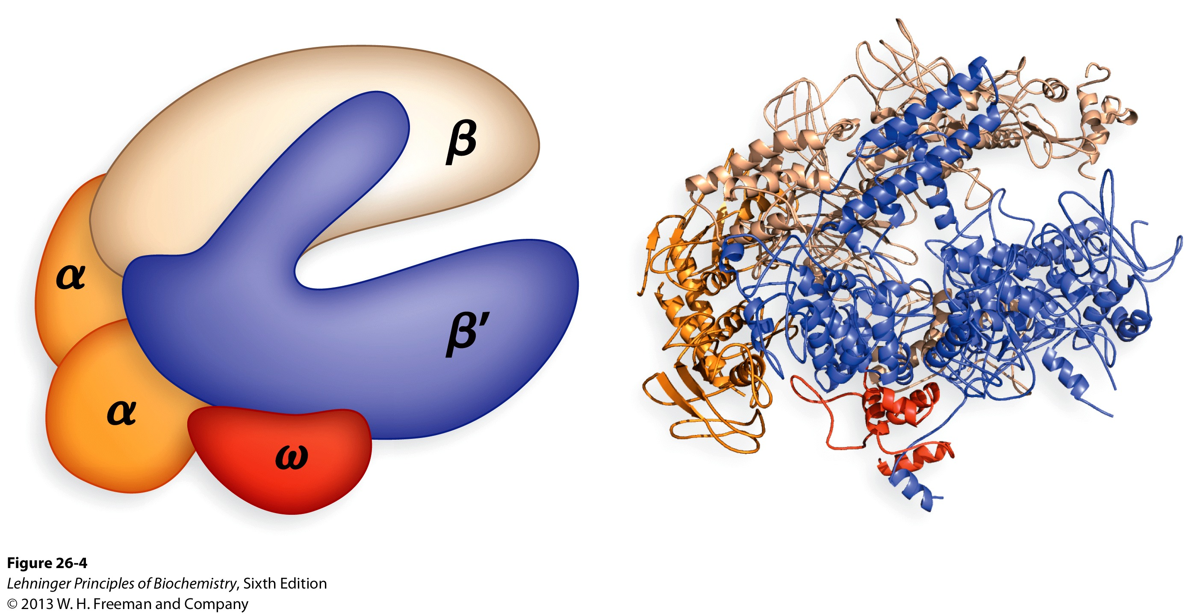
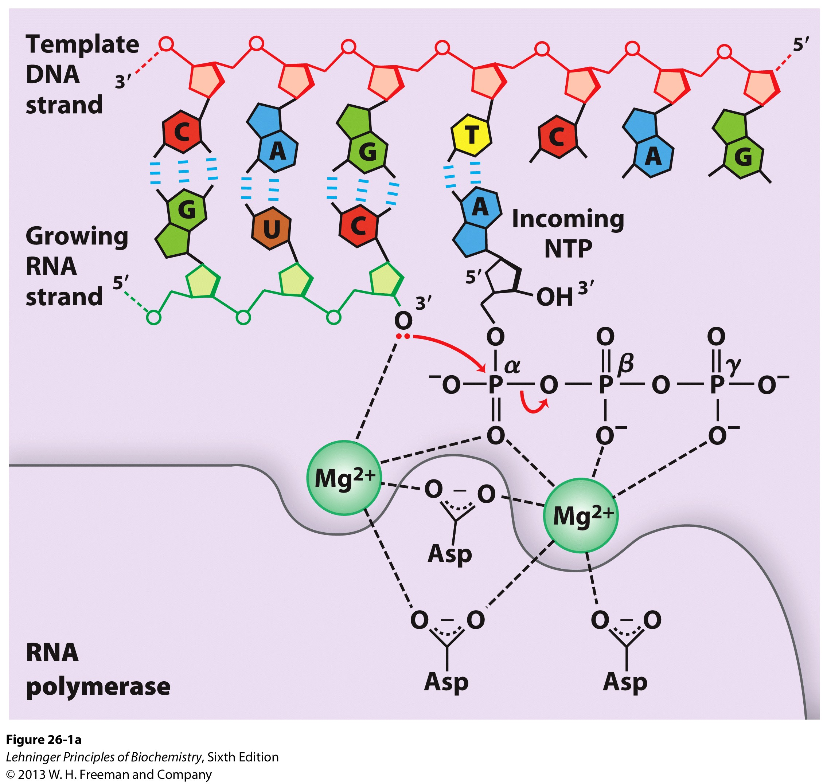
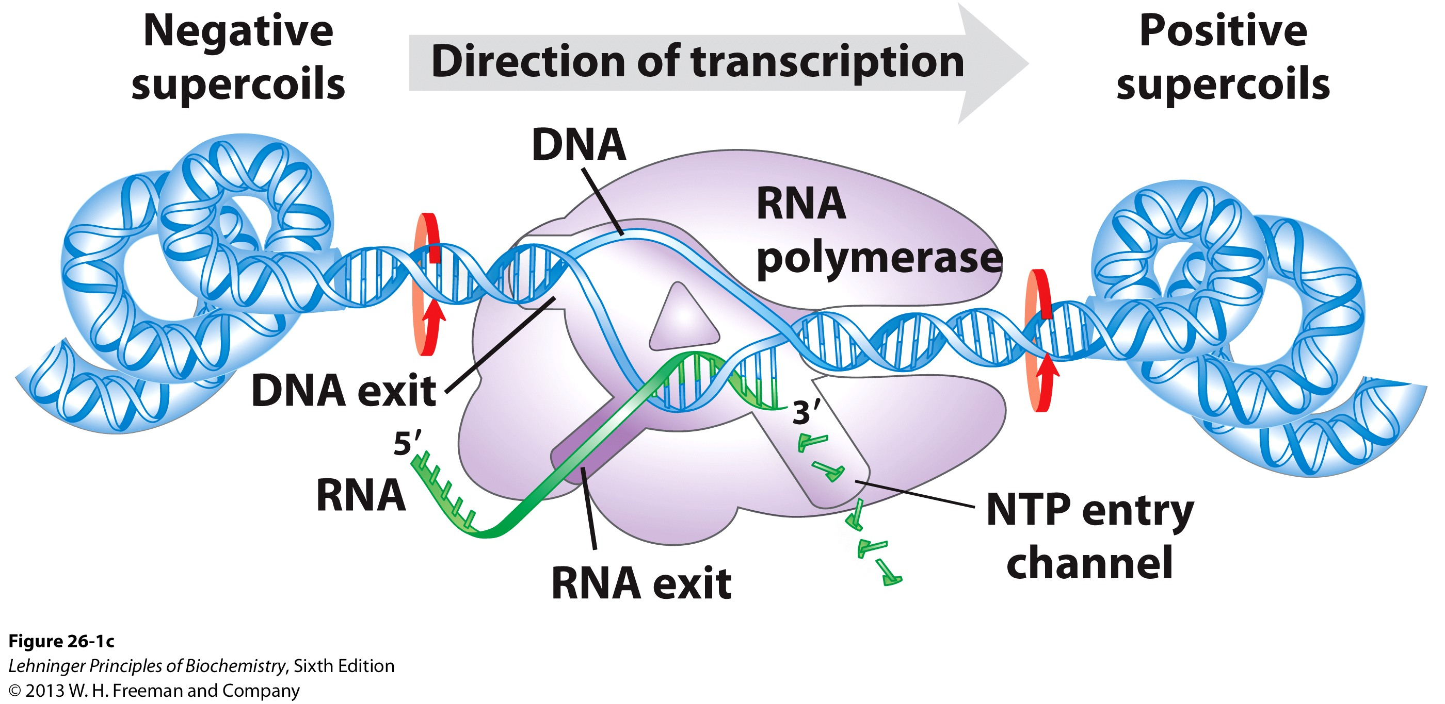
Structure of E. coli RNAP and Mechanism
What other mechanism does this look like?
RNA polymerase holoenzyme has five core subunits of α₂ββ’ω plus a sixth called σ
RNA Pol lacks 3’ → 5’-exonuclease, so has high error rate of 1/10⁴–1/10⁵
RNA binds to promoter regions to initiate transcription

Slide 13
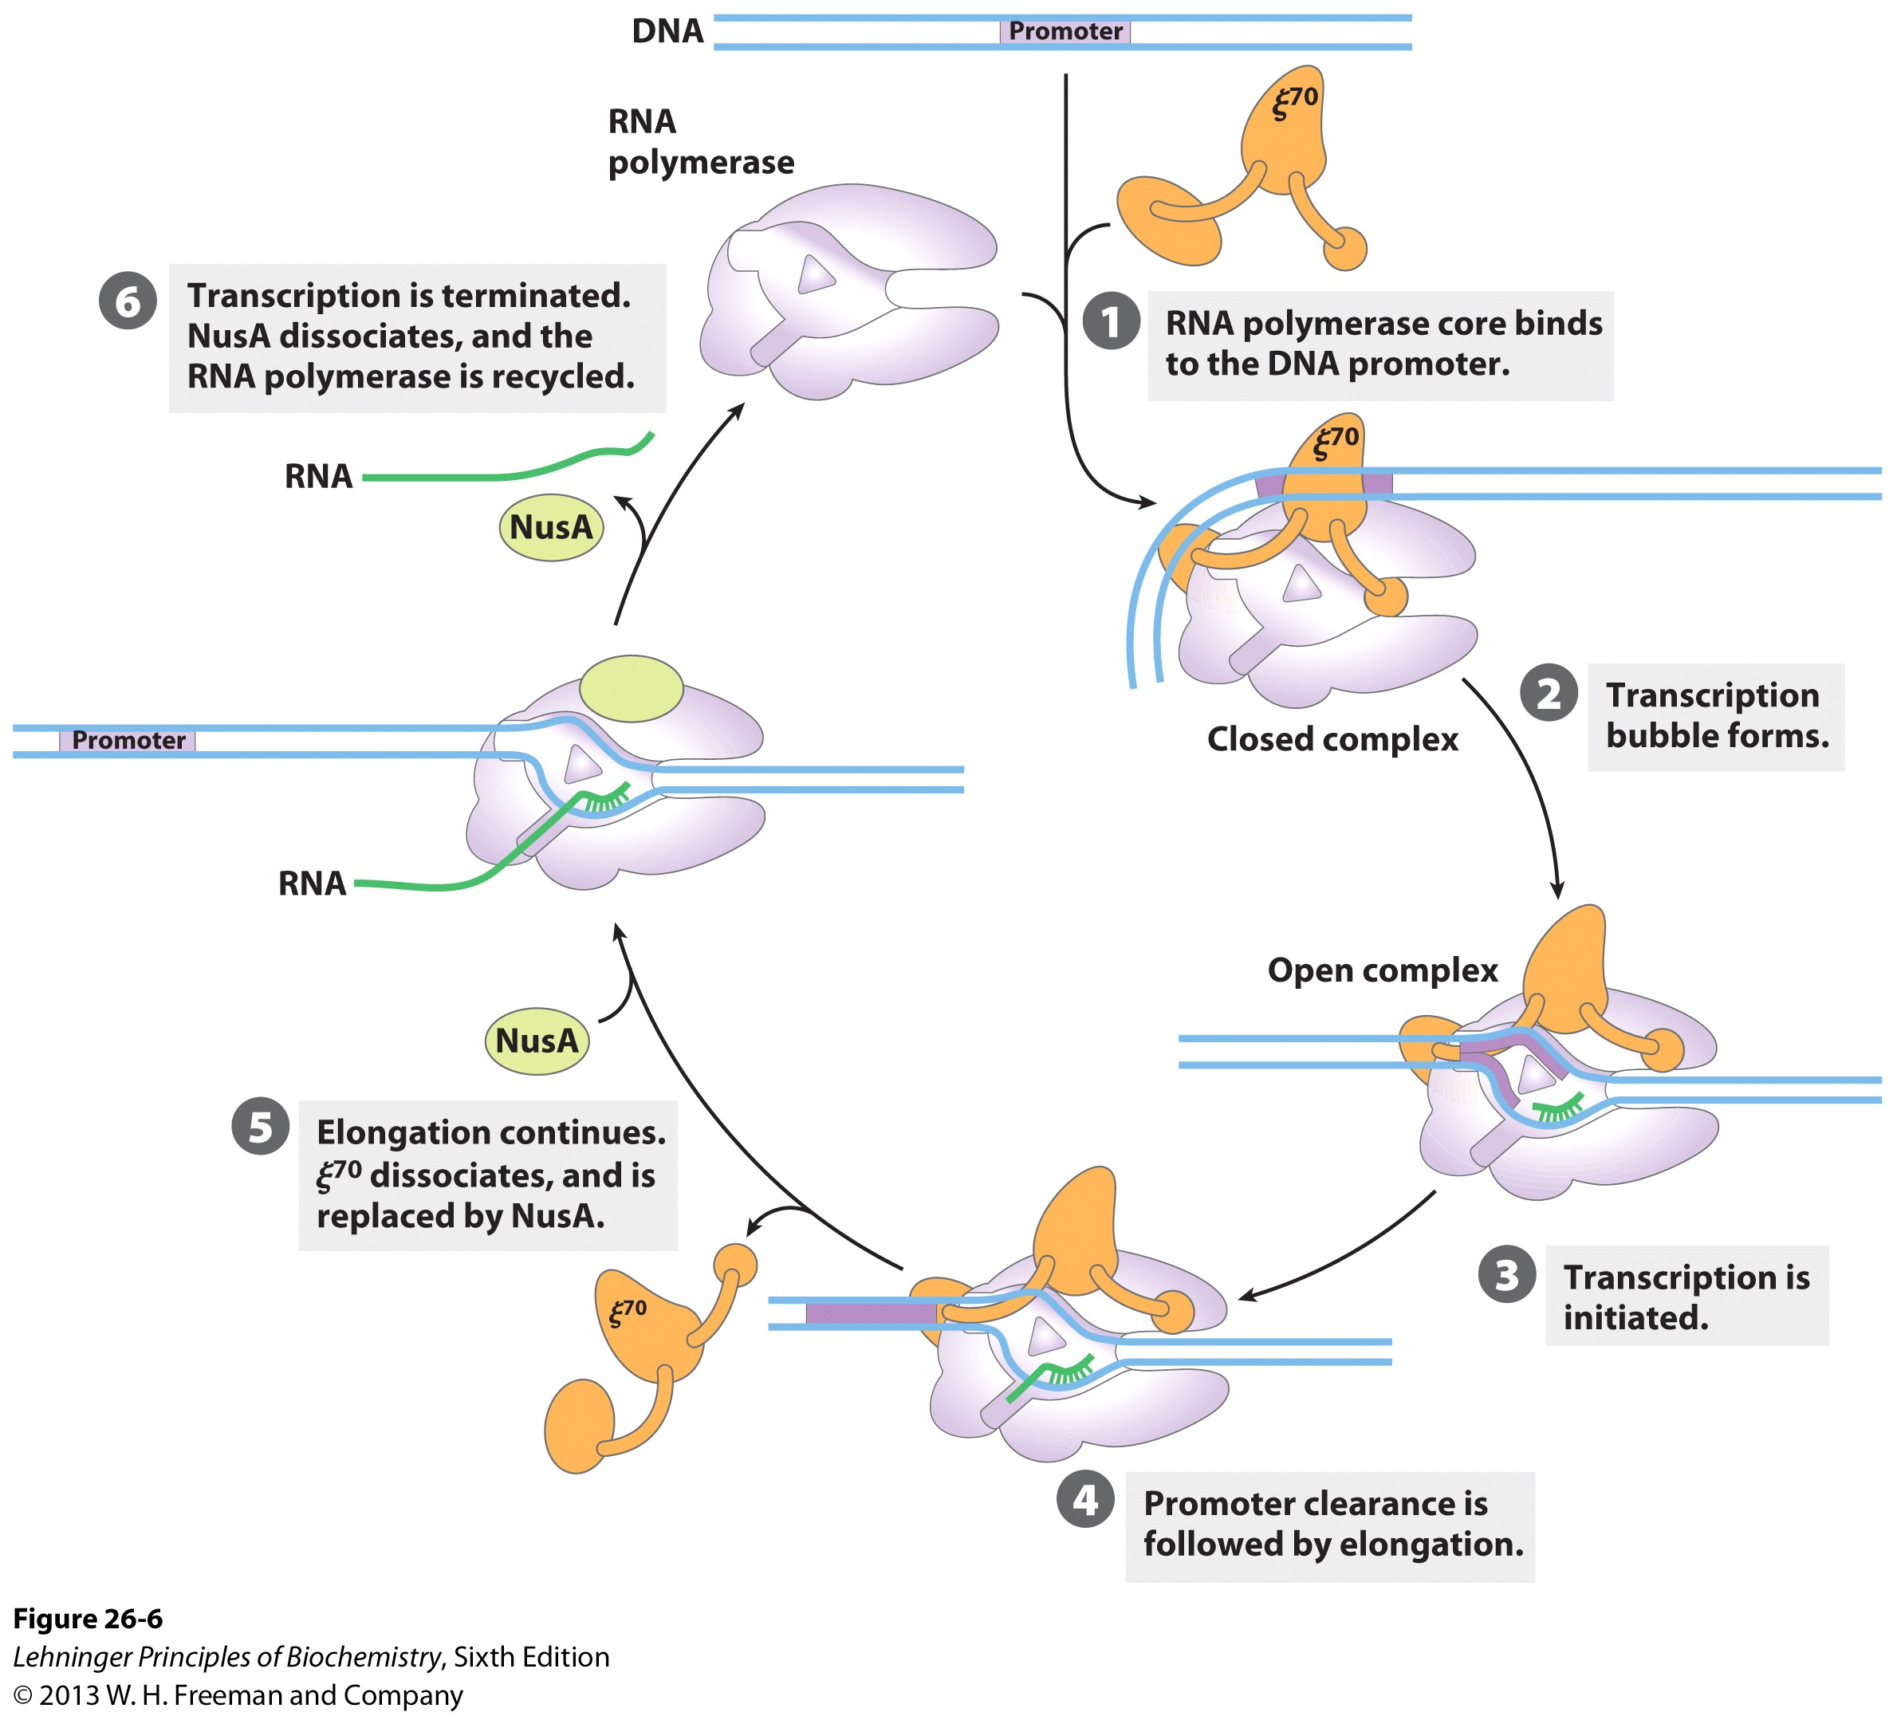
Structure of E. coli RNAP and Mode of Action
See the sense strand going over the surface of the protein?

Slide 14
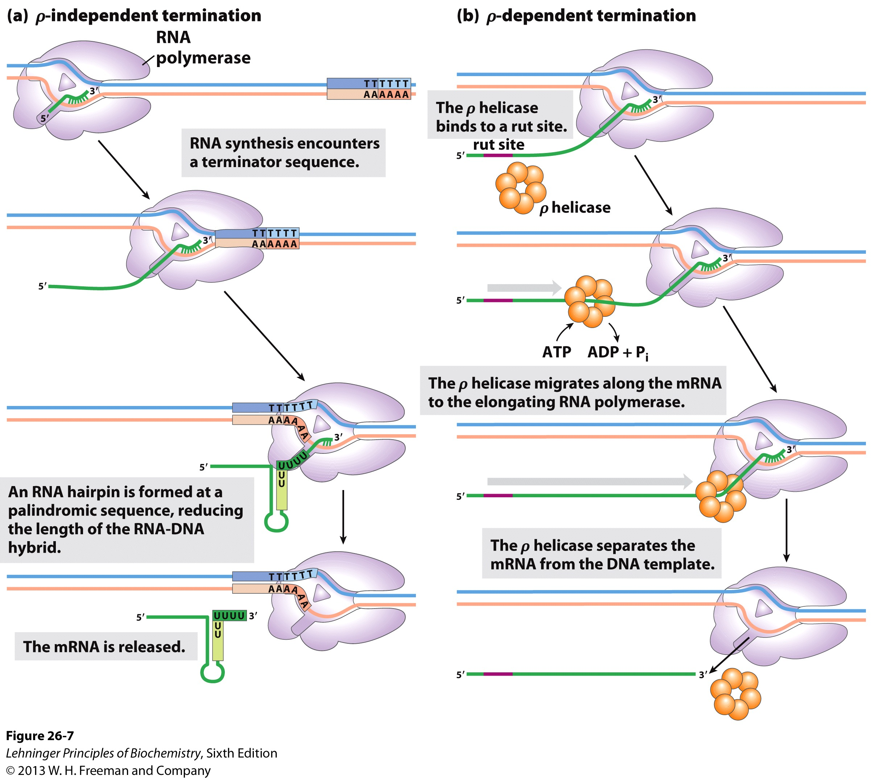
Termination of Transcription
Two methods: Rho independent and Rho-dependent

Slide 15
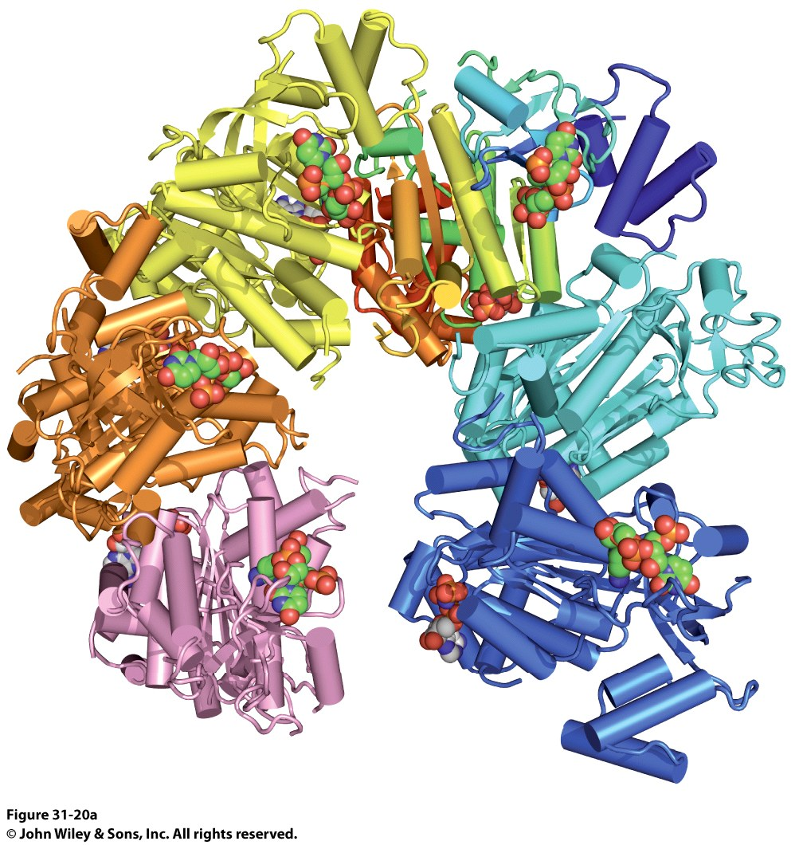
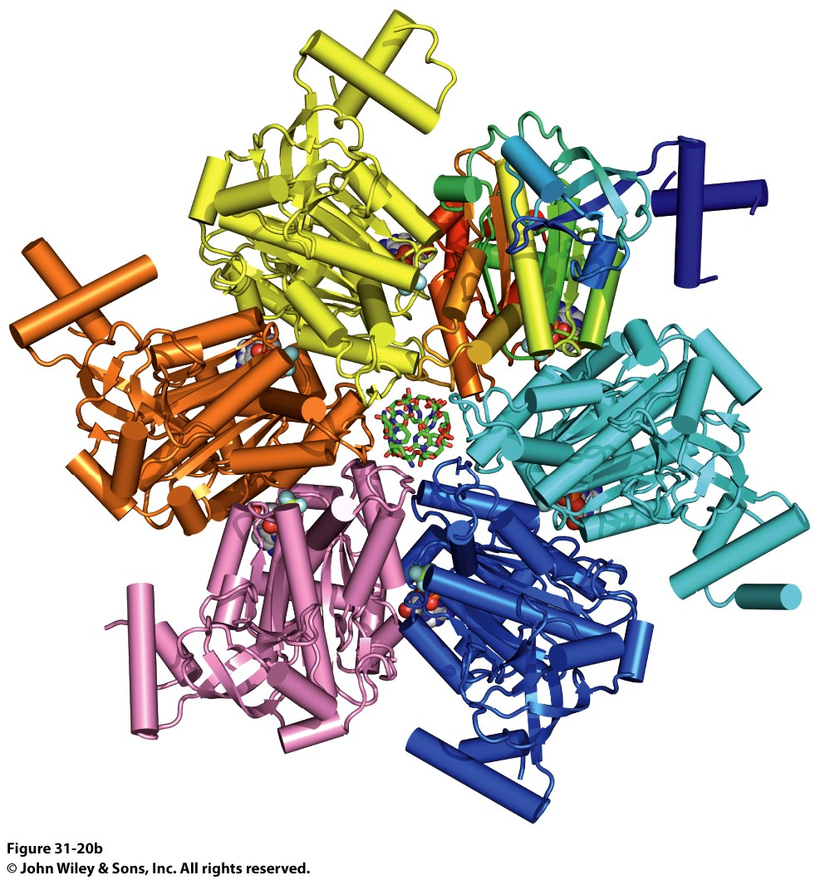
Rho-Dependent Termination of Transcription
The Rho protein is a helicase that loads onto DNA at specific sites (Rho Utilization Sites, RUT)

Slide 16
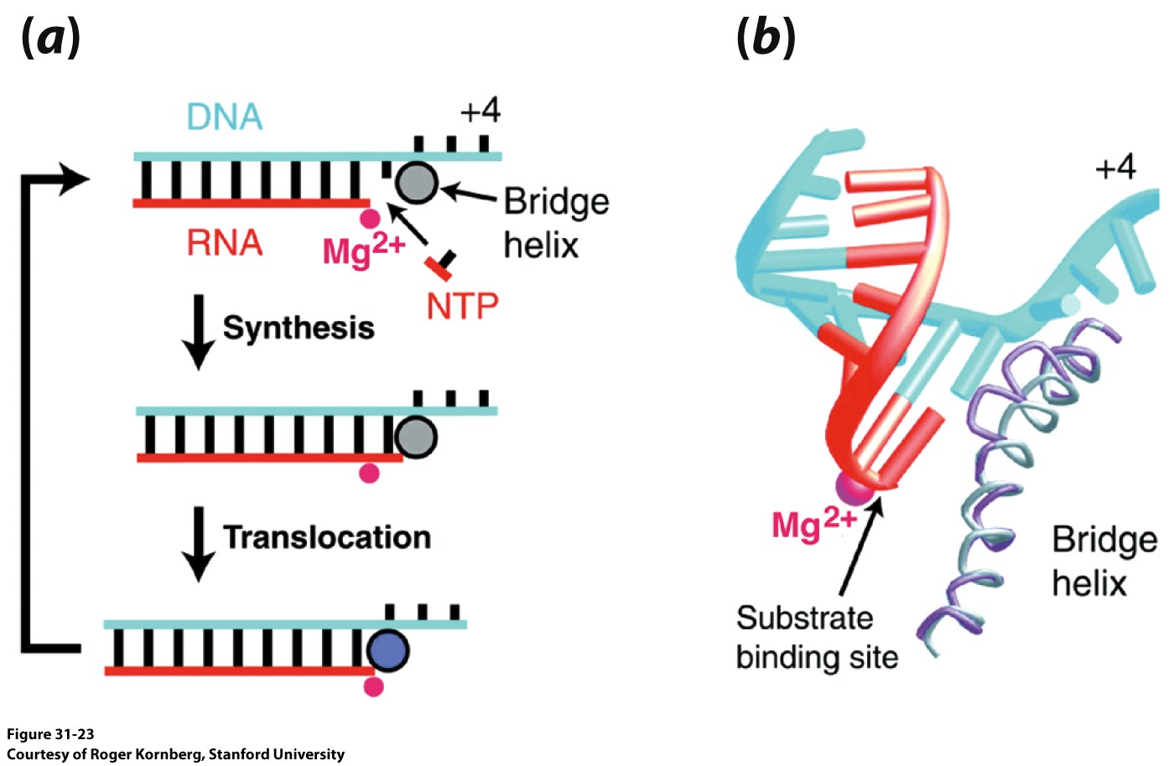
Molecular Details of RNA Polymerase II Function
DNA Unwinds and enters the active site
The antisense strand is clamped down upon and the sense strand wraps over the enzyme
The antisense strand or template strand hits a “wall” and bends 90° to exit the enzyme
This causes the +1 template base to point towards the nucleotide funnel

Slide 17
Molecular Details of RNA Polymerase II Function
4) As the transcript is made, a DNA/RNA hybrid starts to exit the enzyme.
It makes it one full turn before it hits the RUDDER loop
This loop separates the DNA strand from the RNA strand
Each strand exits through a different port
5) The DNA template strand reencounters the sense strand and forms a DNA duplex

Slide 18
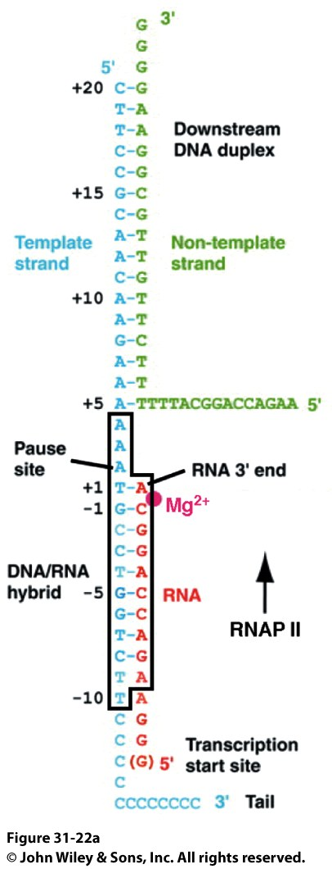
Molecular Details of RNA Polymerase II Function
The bridge helix contacts the DNA at the i+1 site
The bridge helix varies between 2 conformations: Bent and Straight
The conformations vary by 4Å
This bending and straightening would be large enough to move the DNA/RNA hybrid one position (What is the distance between nucleotides in DNA?)

Slide 19
Structure of E. coli RNAP and Mode of Action

Slide 20
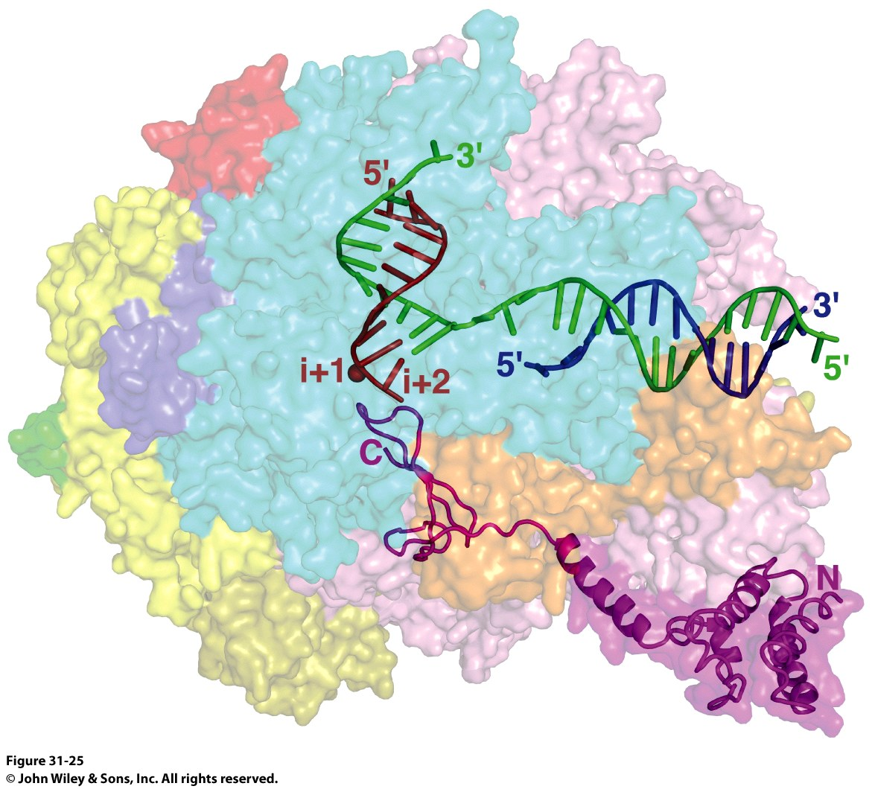
Error Correction in RNAP
Companion proteins to RNAP bind to the polymerase and assist in error correction
In E. coli: GreA/GreB
In Eukaryotes: TFIIS
These proteins bind to the Polymerase when mispairing causes stalling of the polymerase
The Proteins “reach” into the A-site, scavenge a catalytic Mg²⁺, and hydrolyze the mispaired base

Slide 21
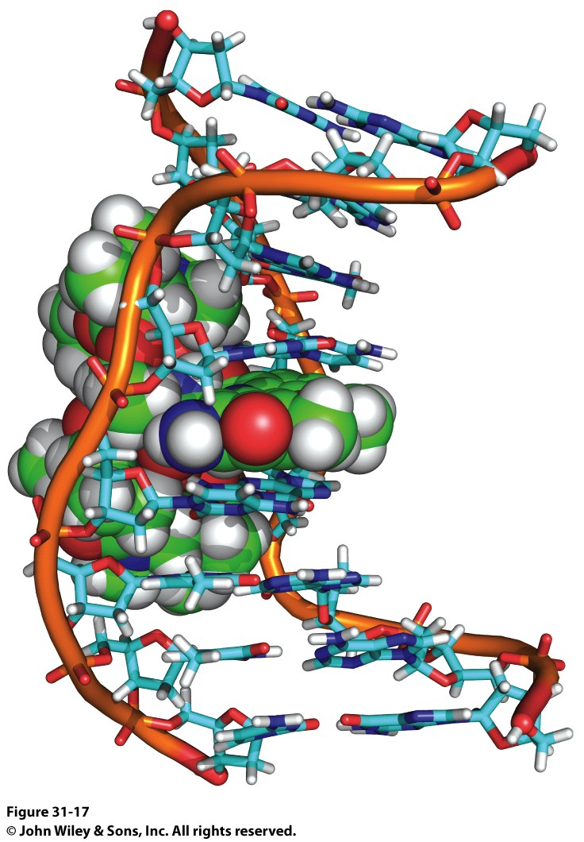
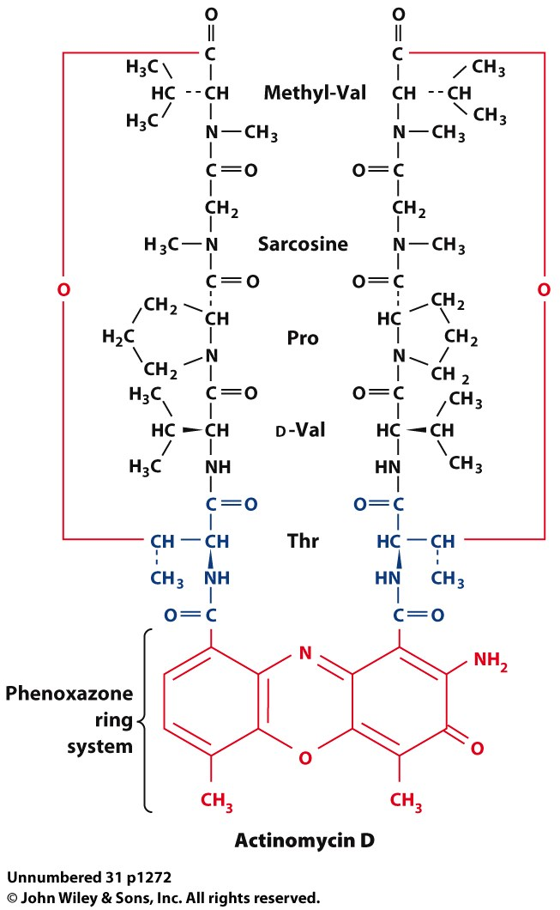
Compounds that Affect Transcription
Actinomycin D
An Intercalating Agent
Prevents both DNA and RNA polymerase function
Phenoxazone ring system intercalates b/w successive G-C base pairs of DNA
Depsipeptide “Arms” bind above and below intercalation site in minor groove
The whole complex is stabilized by IMFs

Slide 22
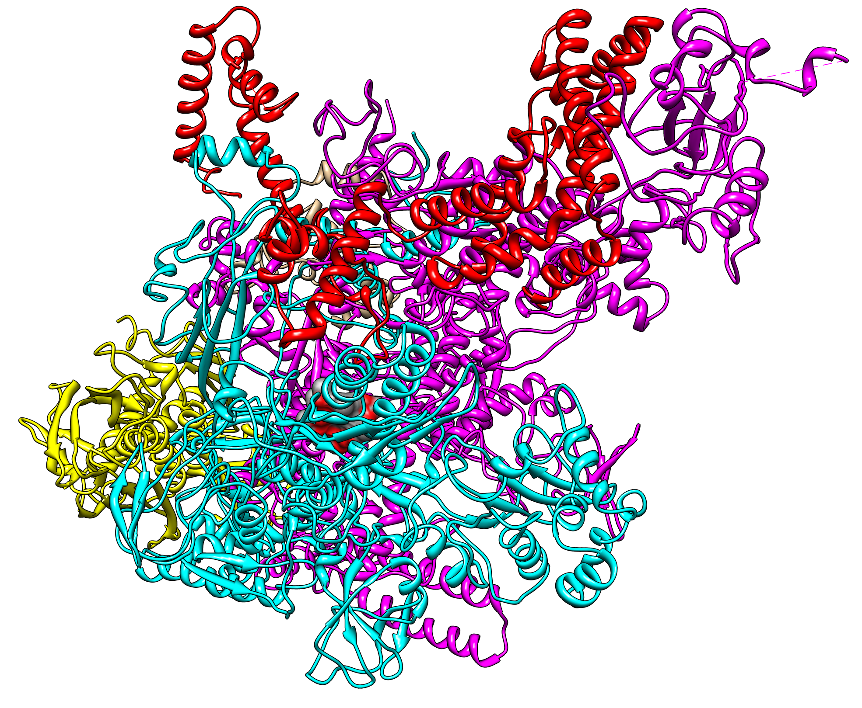
Compounds that Affect Transcription
σ subunit
2) Rifamycin
An antibiotic compound produced by Streptomyces
Stops mRNA synthesis in prokaryotes, but not eukaryotes. How?
See the ligand?

Slide 23
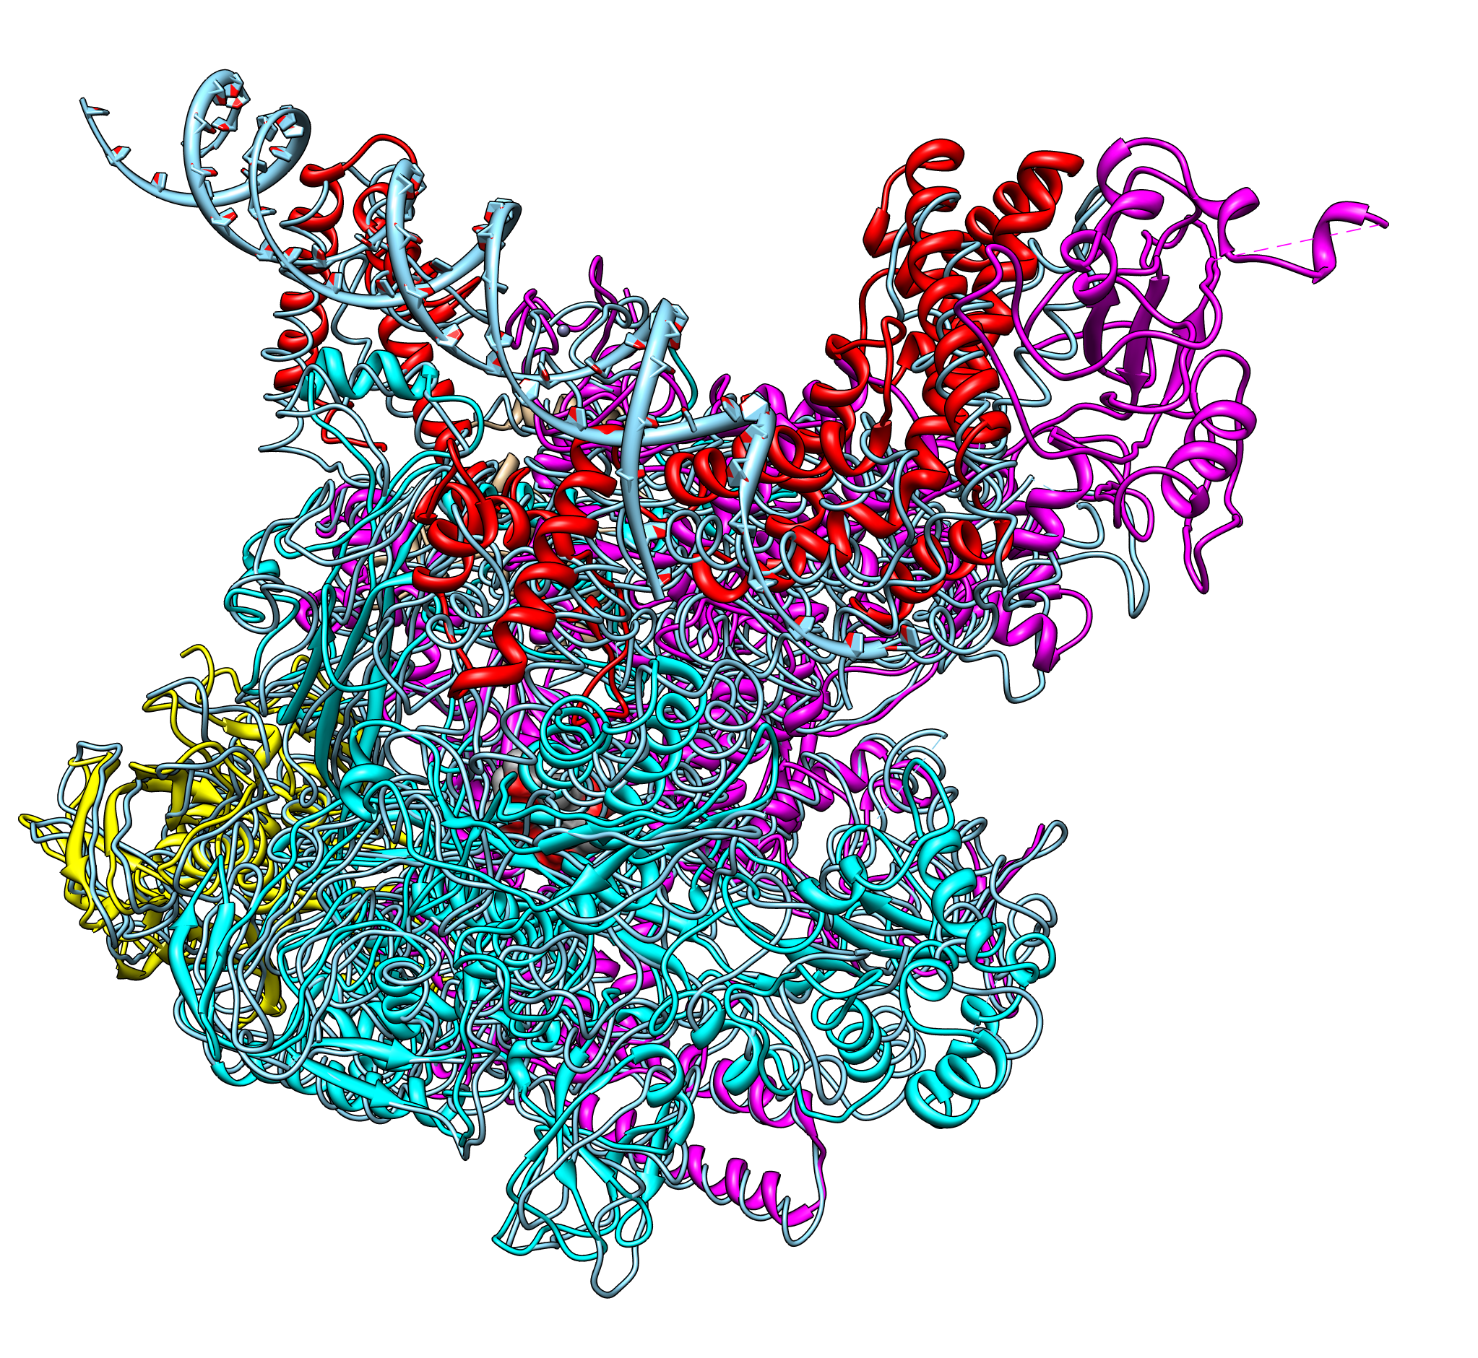
Compounds that Affect Transcription
2) Rifamycin
An antibiotic compound produced by Streptomyces
Stops mRNA synthesis in prokaryotes, but not eukaryotes. How?

Slide 24
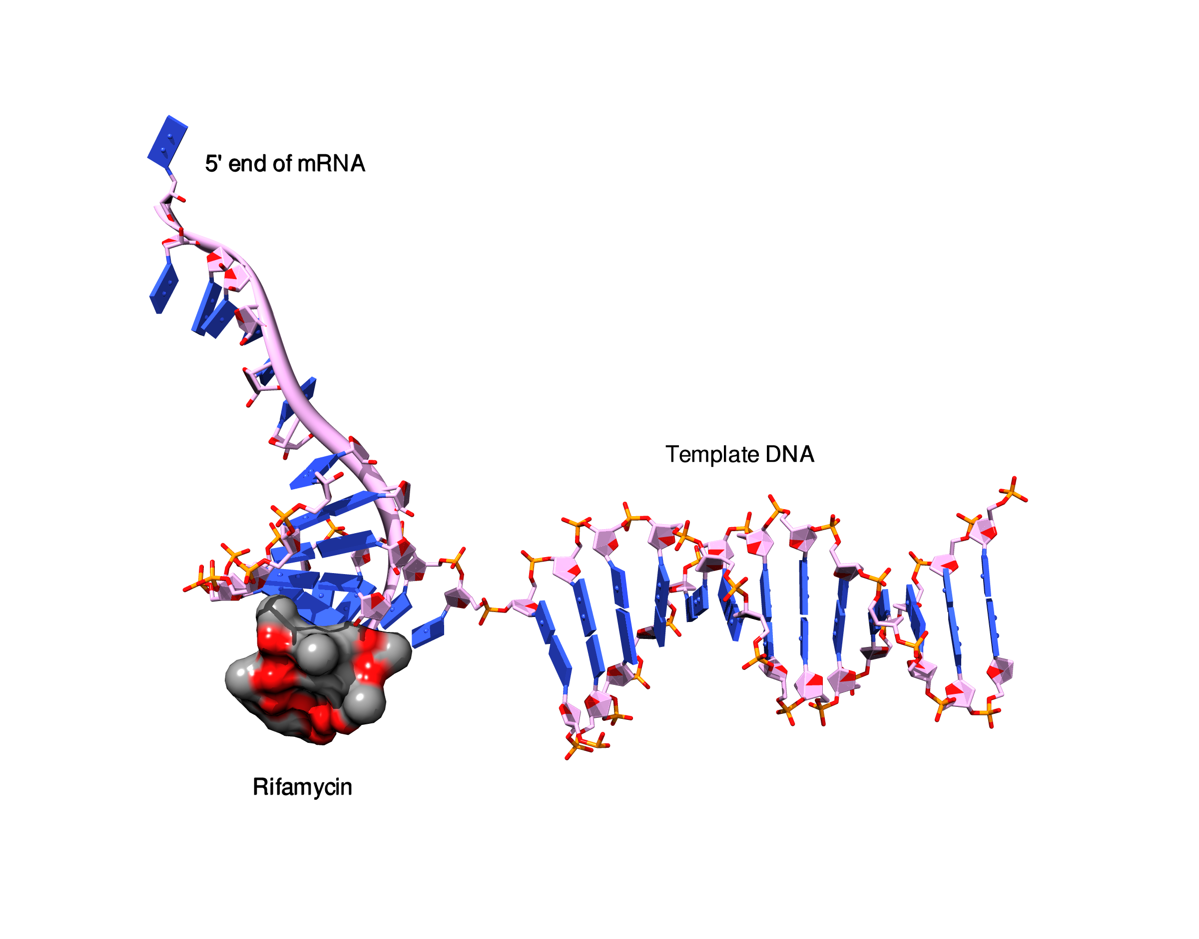
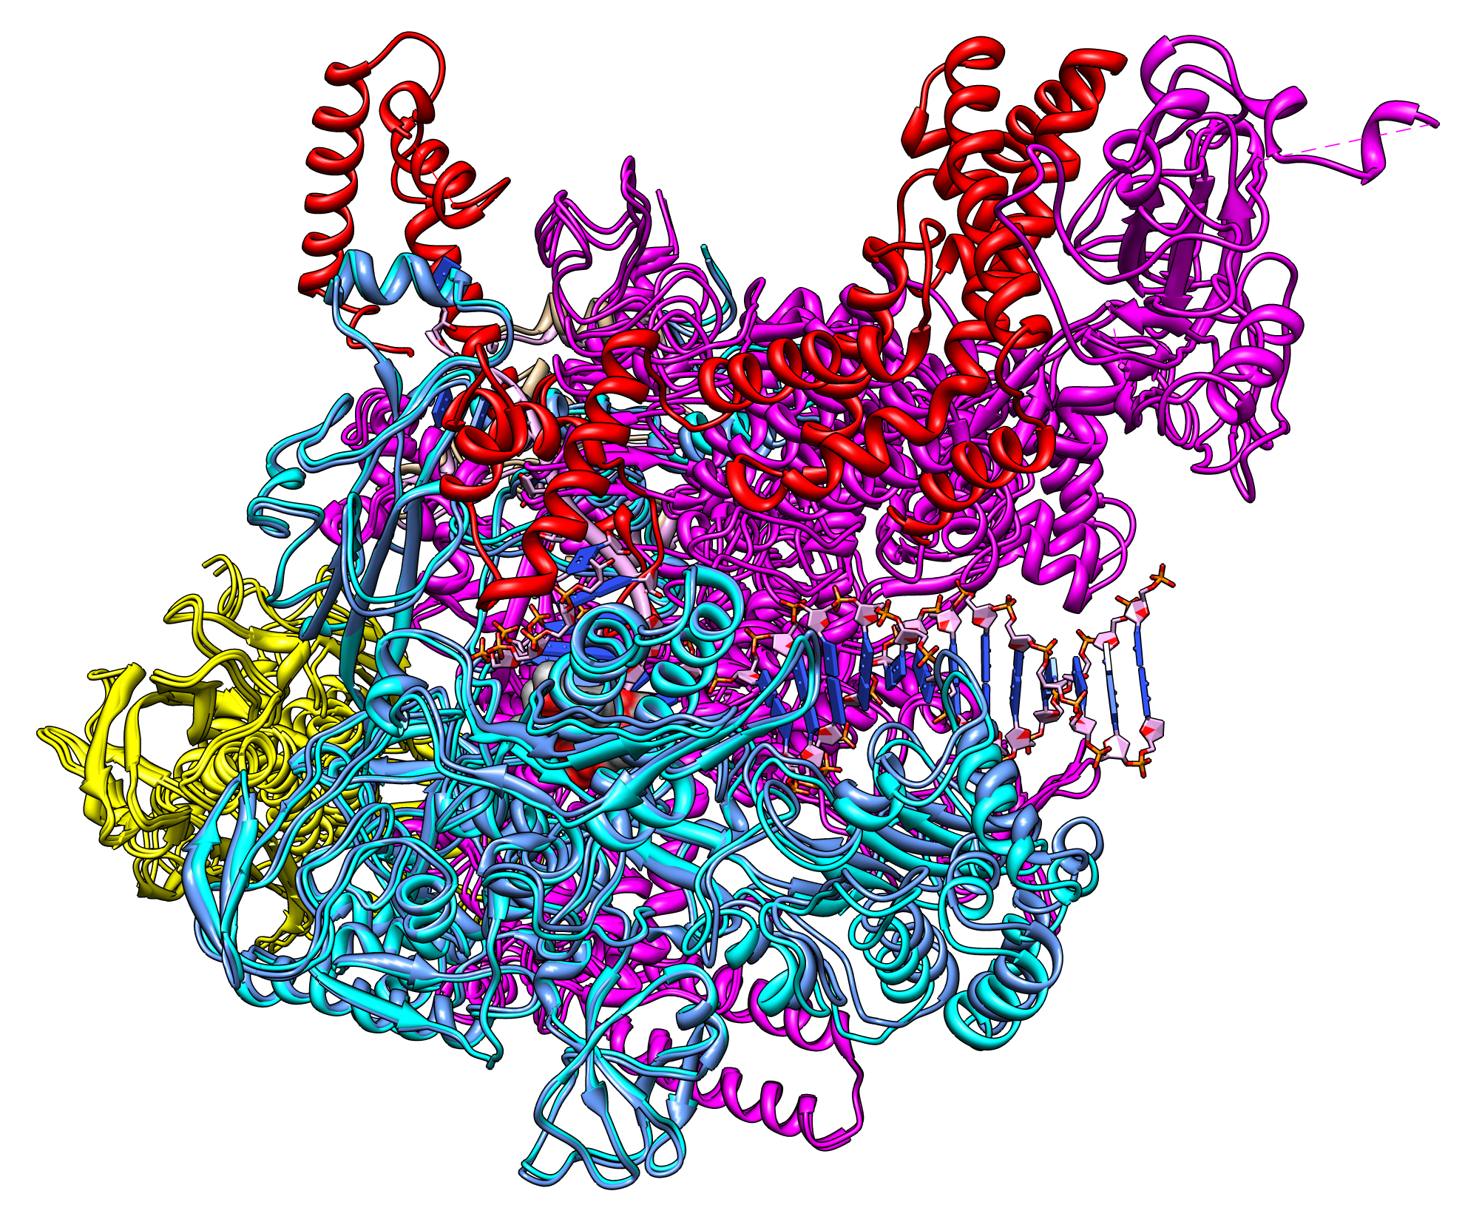
Compounds that Affect Transcription
2) Rifamycin
Actually prevents chain extension of the nascent mRNA chain

Slide 25
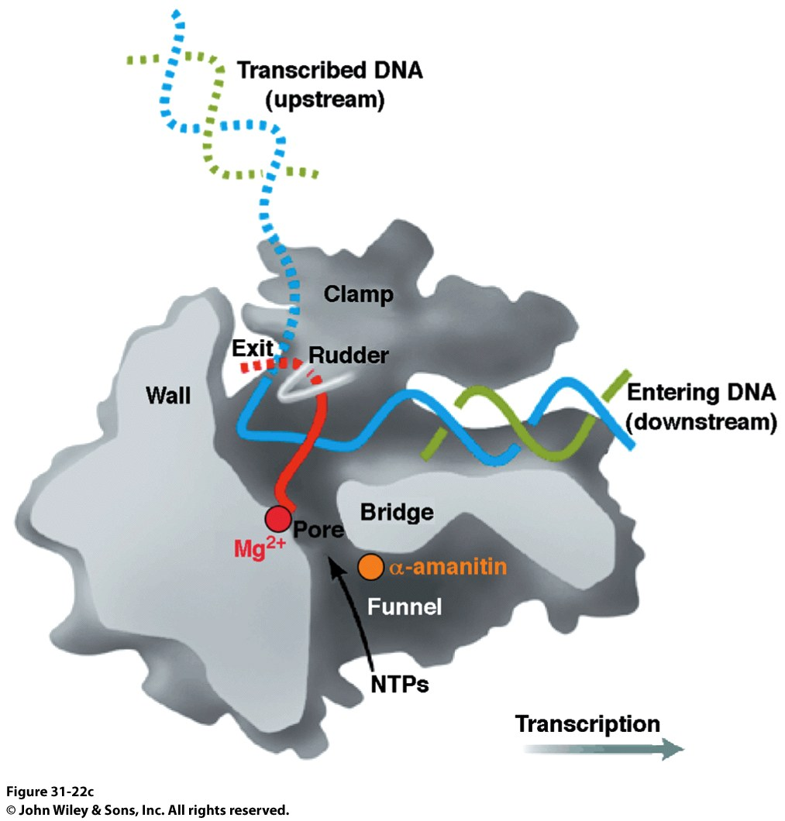
Compounds that Affect Transcription
α-amanitin
A circular peptide that is produced in some mushroom species
Belongs to a family of compounds called amatoxins: HIGHLY TOXIC!!!
Does not alter the affinity of RNAP for NTPs
Does not prevent RNA synthesis
Interferes with Bridge Helix and Trigger loop: Prevents Translocation

Slide 26
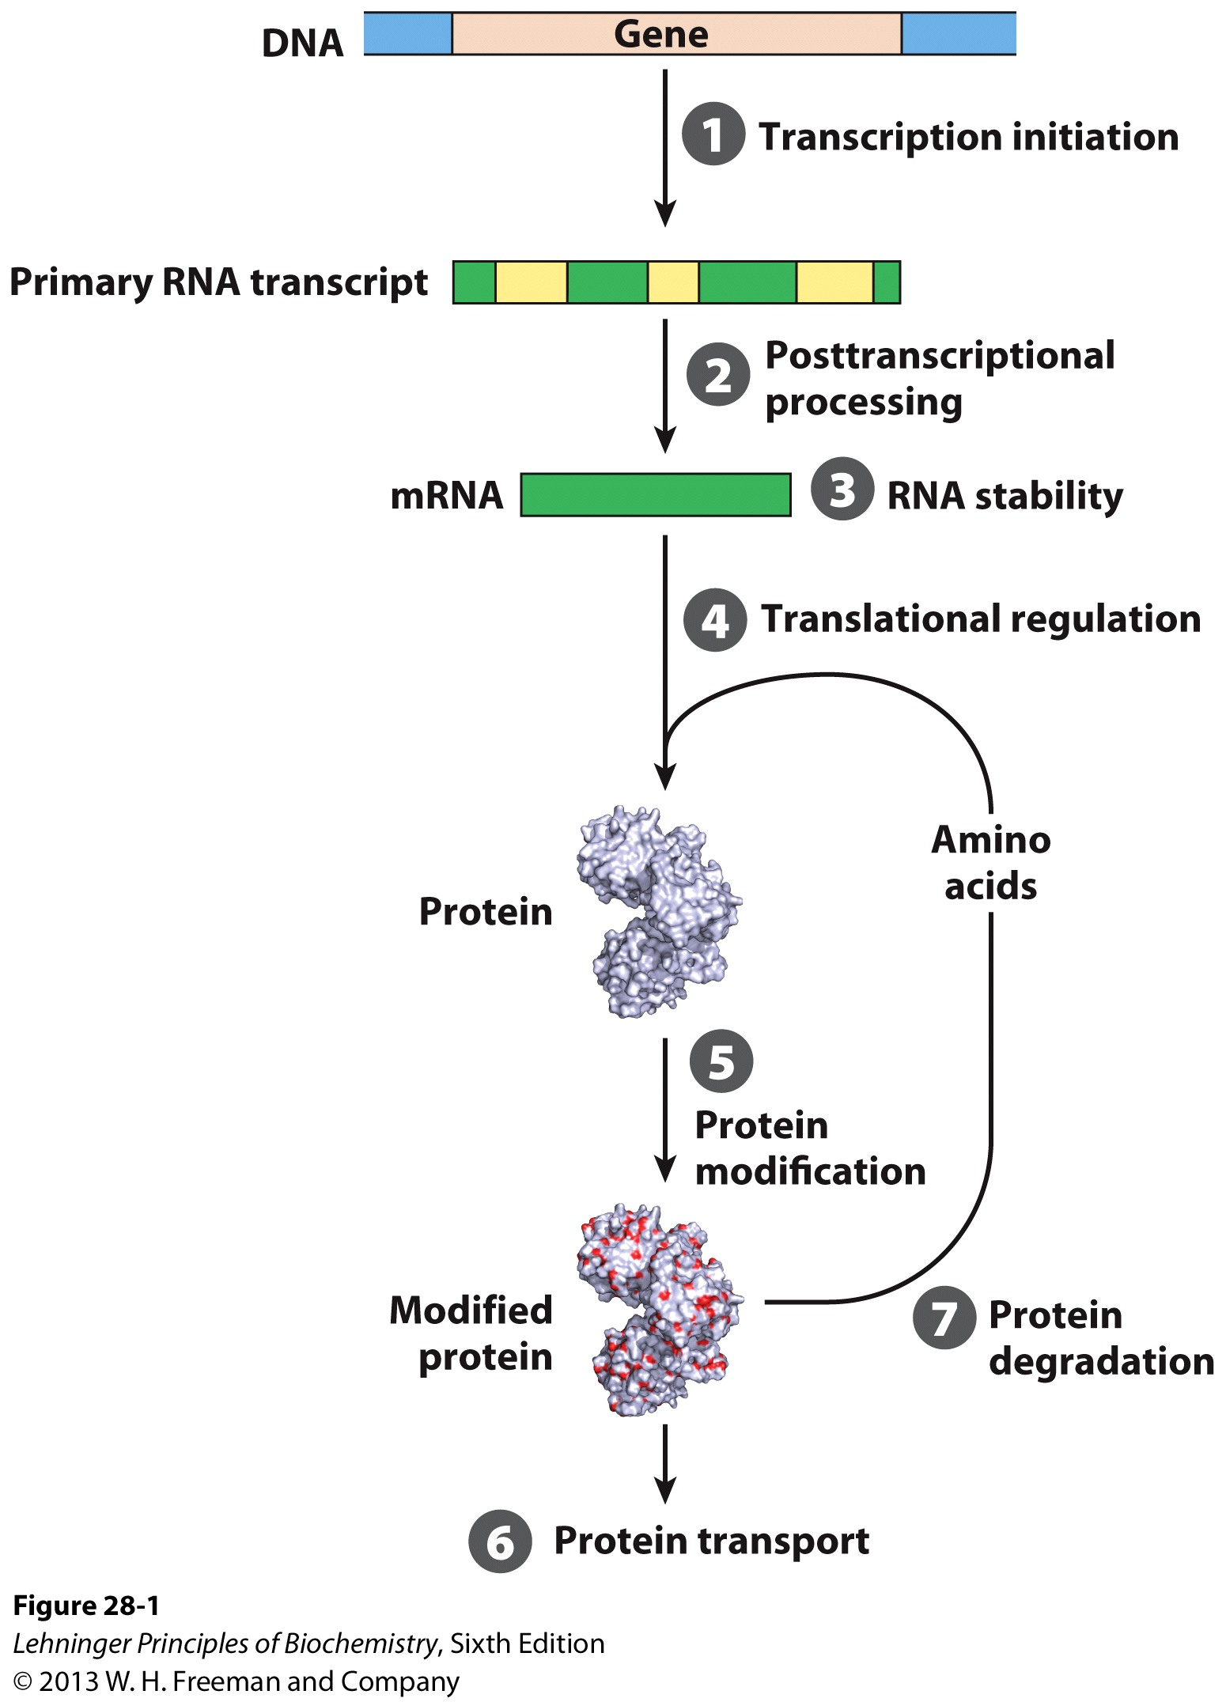
Transcriptional Regulation
We have seen how DNA is synthesized and how the cell creates mRNA to convert the information stored in genes into something that can do work
How do we regulate the process of transcription?
Let’s break the problem down into key checkpoints:
We could use different sigma factors (stop RNAP from binding)
We could block access to the promoter
We could have secondary structures in the mRNA that hang up translation
We could degrade the mRNA (short lifetime = little translation)

Slide 27
Promoters and Transcription
-60 region: UP (upstream promoter) elements strongly stimulate binding of RNAP to the promoter
More than the normal affinity of 1x10⁻¹⁴ M for DNA by RNAP
Get more action from the same promoter (Nitrous Boost!)
σ32: Heat shock sigma factor. Normally present in low abundance in the cell (<10 copies per cell)
Only transcribe when you need to!

Slide 28
Promoters and Transcription
In other words:
If we decrease how often a promoter is bound by RNAP, then we also decrease how many times the genes controlled by the promoter are transcribed
Mutations in promoter sequence will affect RNAP binding
RNAP has a finite activity
Anything that will change that rate will affect the amount of transcript produced and, therefore, the amount of protein made

Slide 29
Proteins and Promoters
We can regulate the initiation of transcription with 3 different types of proteins:
Specificity factors: Alter the specificity of RNAP for a promoter (eg: sigma factors)
Repressors: Prevent RNAP from binding the promoter at all
If a repressor protein is involved, it is NEGATIVE regulation. Period.
Activators: Promote RNAP binding to the promoter
If an activator protein is involved, it is POSITIVE REGULATION. Period.

Slide 30
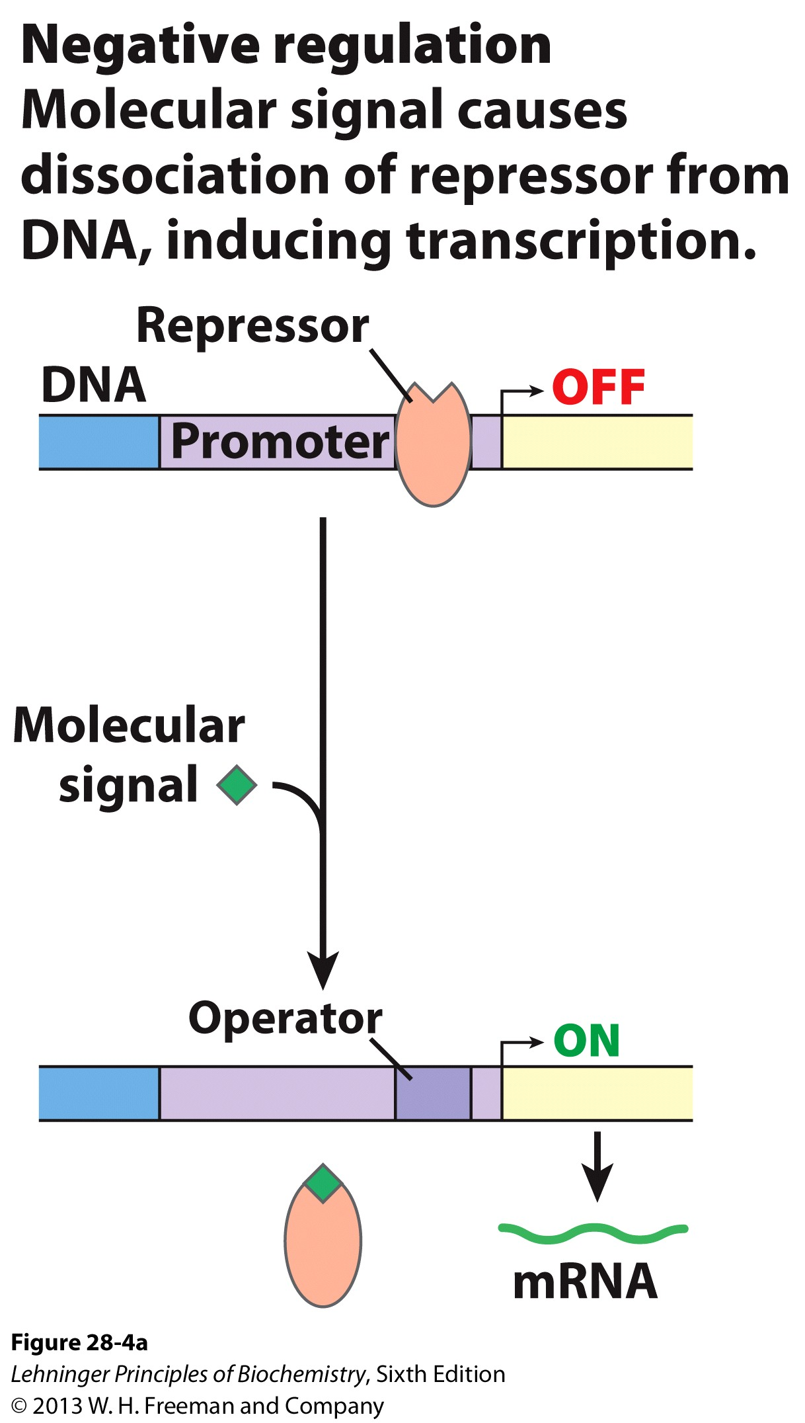
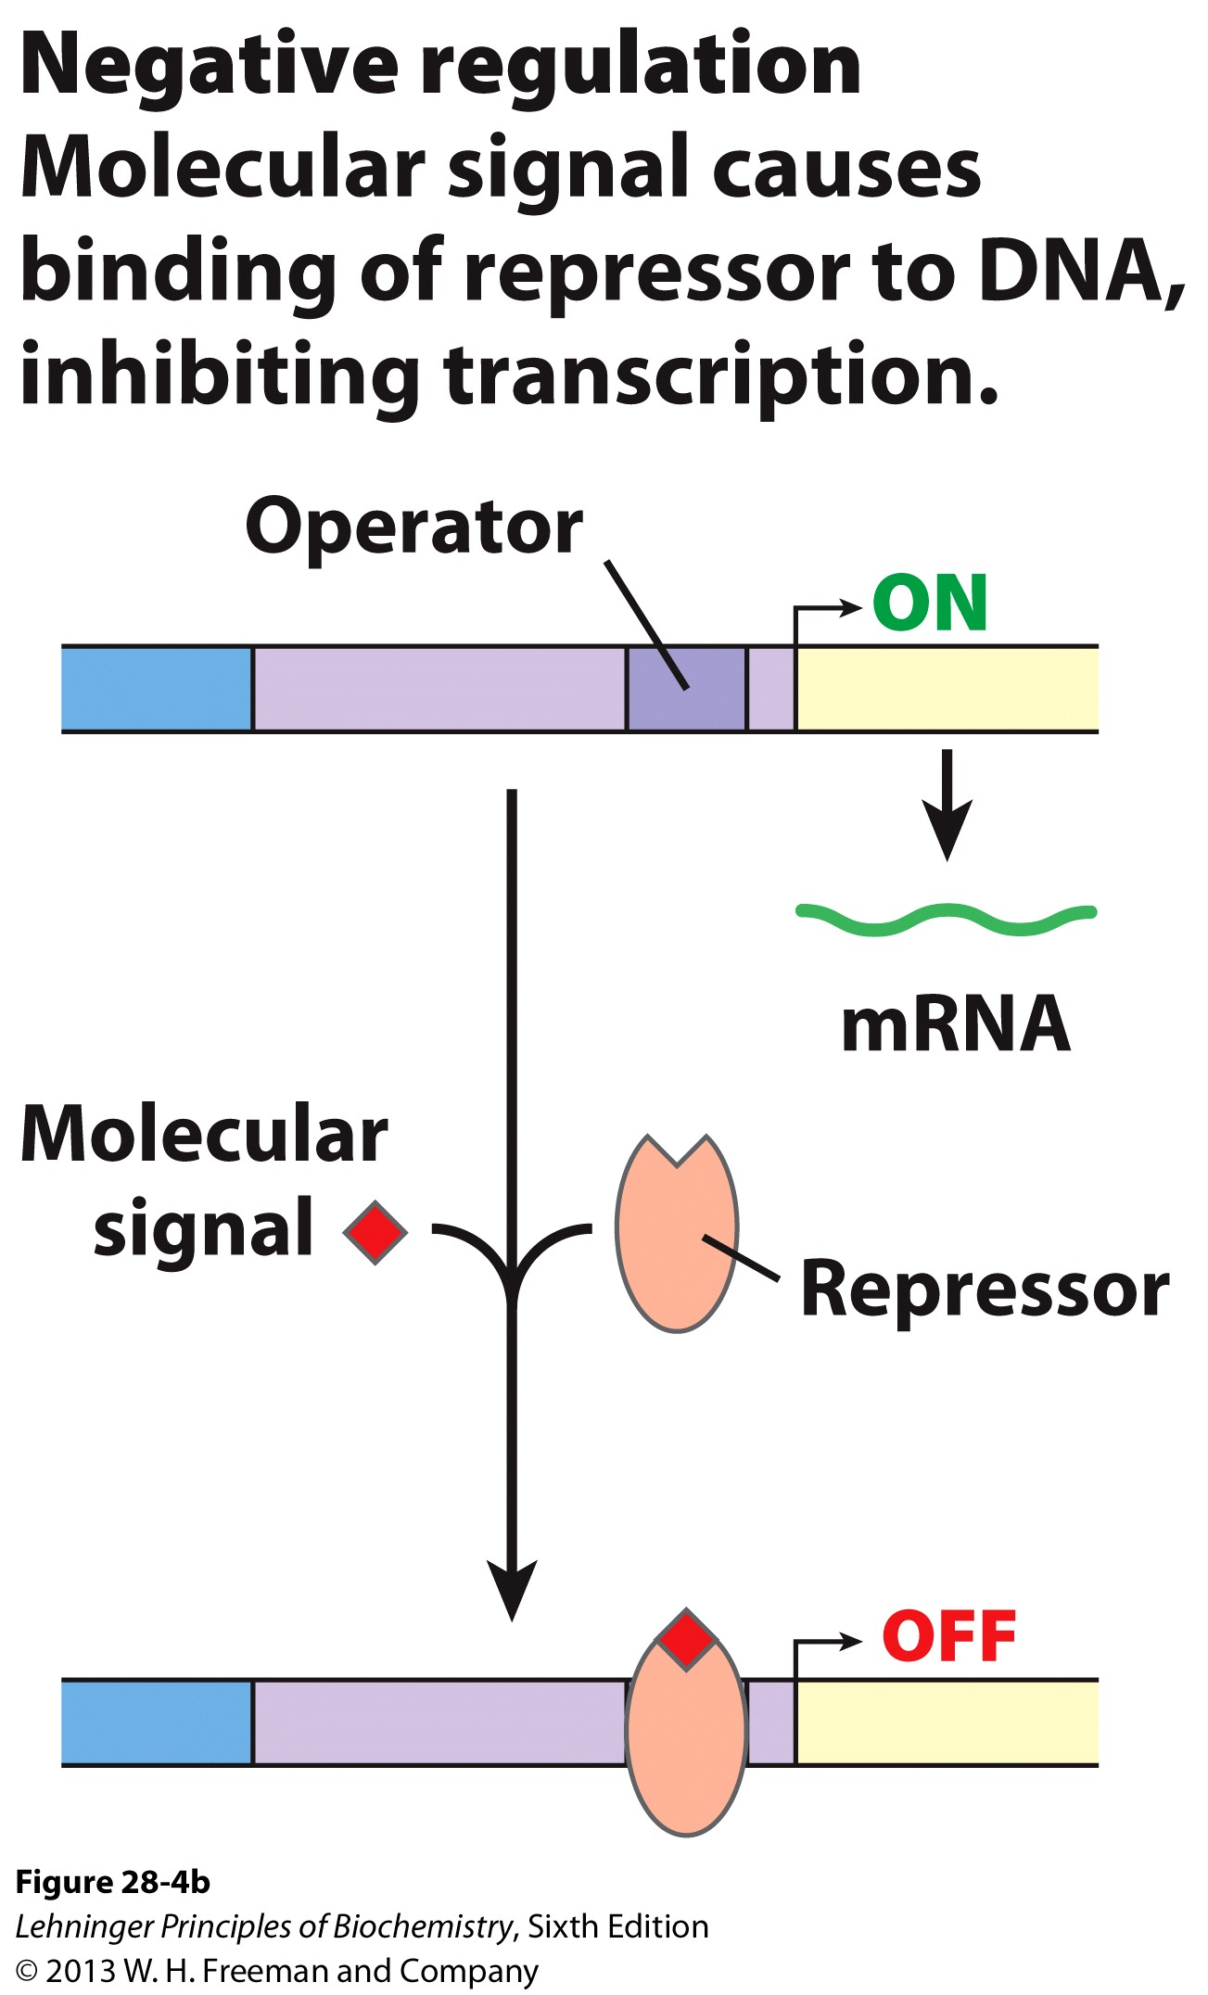
Repressors and Negative Regulation
Repressors bind at the OPERATOR site near the promoter
The repressor can bind to the operator in the presence of a ligand or the absence of a ligand
If the repressor binds, there is a negative effect on the expression of the operon

Slide 31
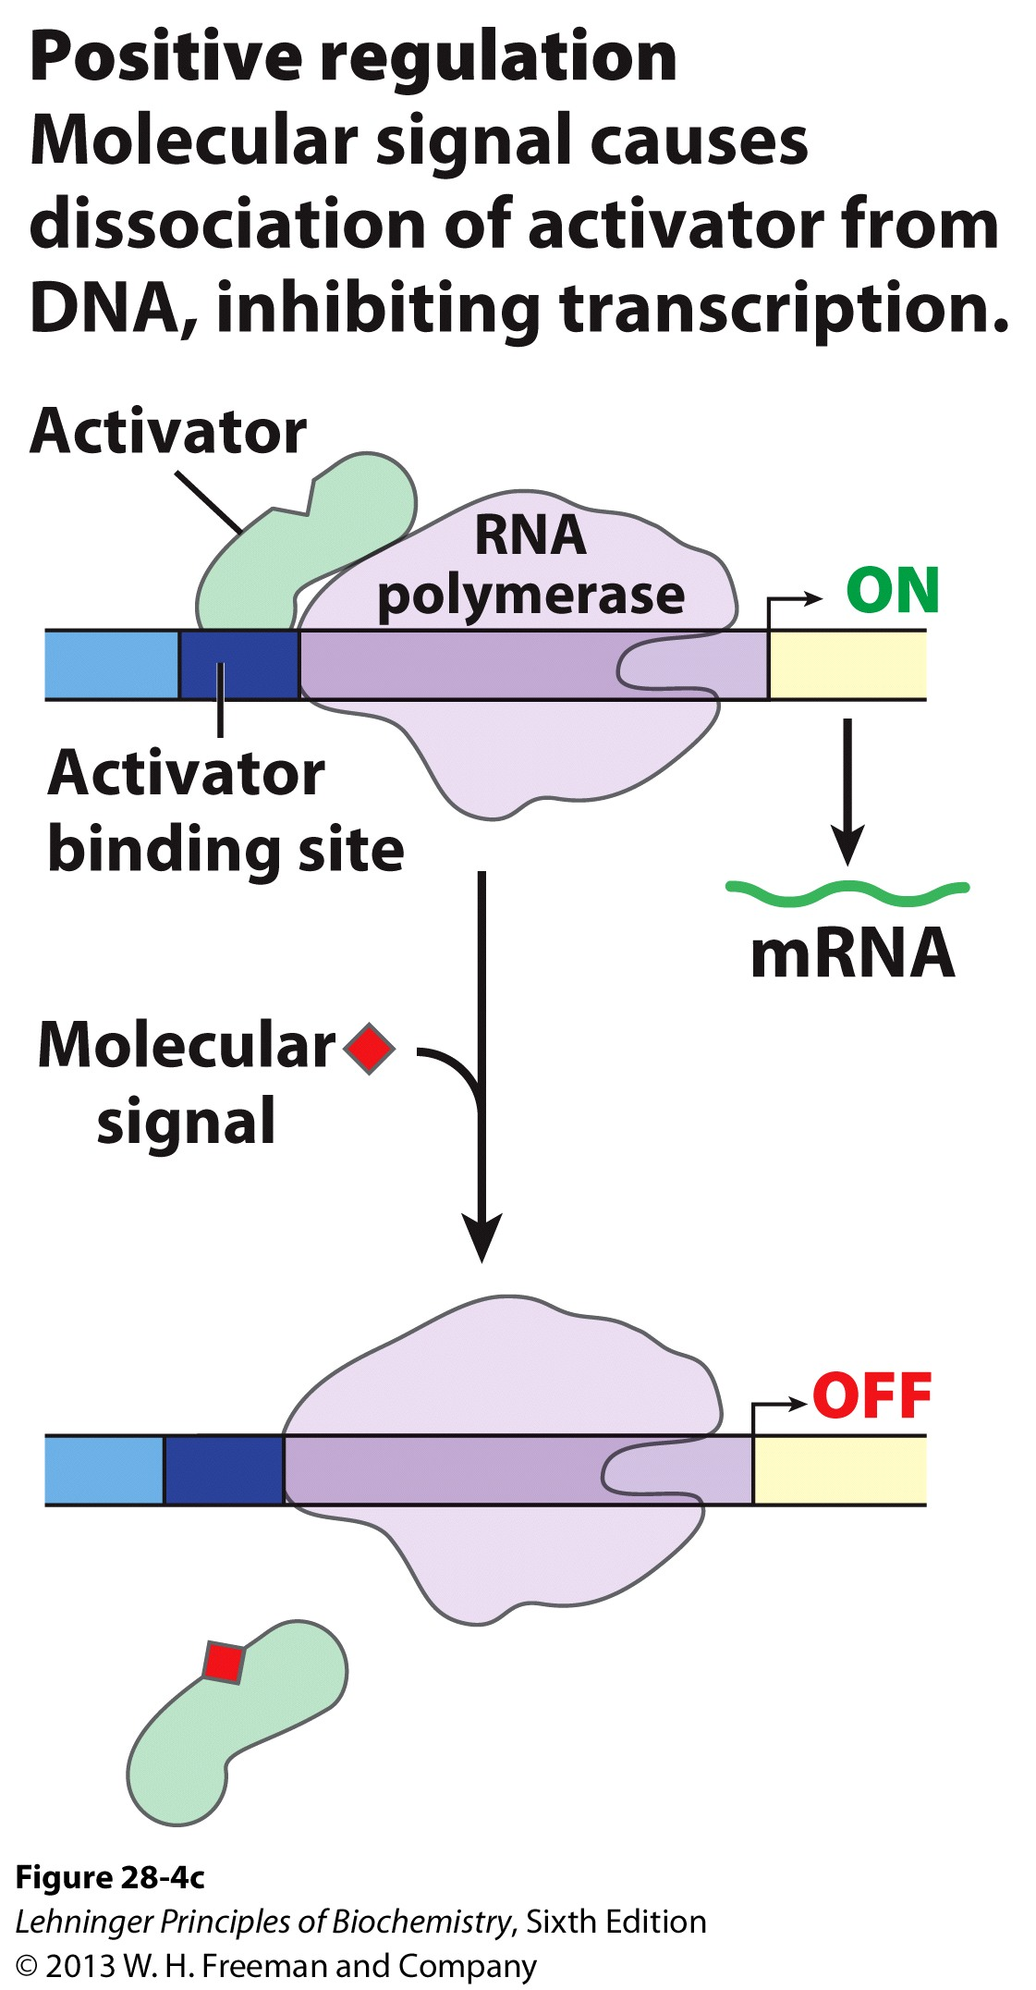
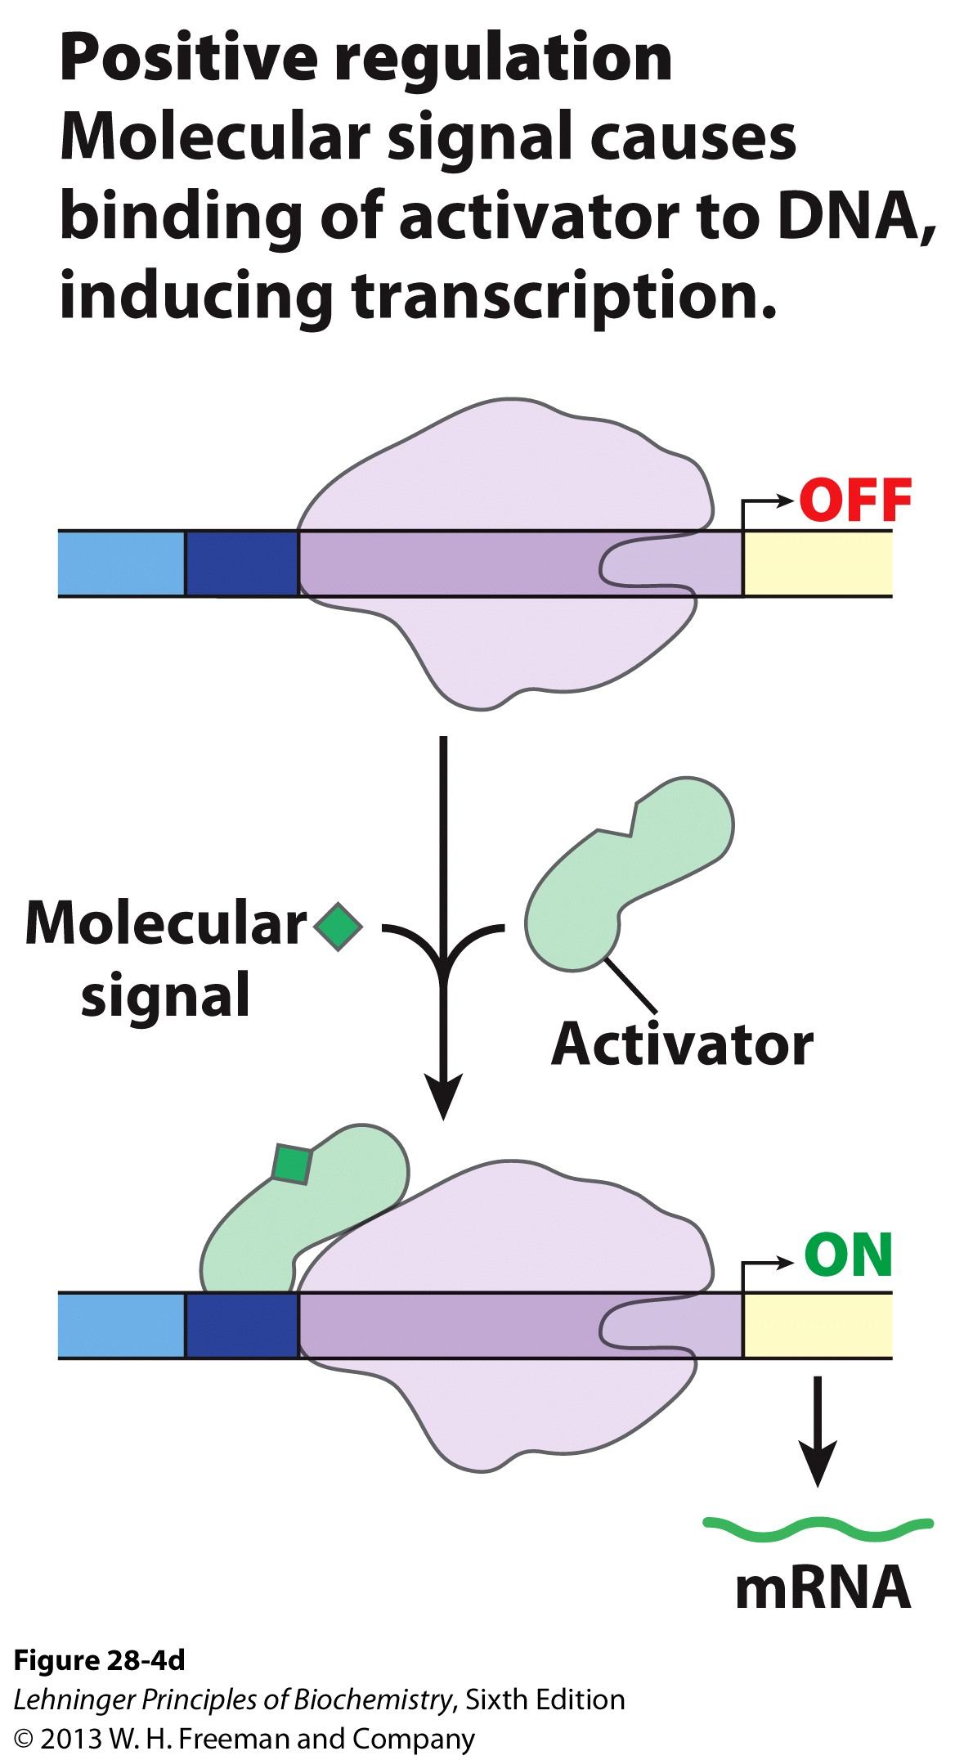
Activators and Positive Regulation
Activators bind at the promoter and ENHANCE the binding of RNAP
The activator can bind to the operator in the presence of a ligand or the absence of a ligand
If the activator binds, there is a positive effect on the expression of the operon

Slide 32
Operons
Polycistronic mRNA: Bacterial mRNAs often encode multiple genes on a single transcript
By having the transcripts of the structural genes in a single array, the cell can get a much more immediate response

Slide 33
How do Regulatory Proteins Work?
Transcriptional Regulatory Proteins must interact with DNA and with other protein molecules
These proteins have an affinity for their cognate DNA binding sequence that is 10⁴ – 10⁶ fold greater than non-specific DNA sequences
These proteins have very specific traits that allow them to do their job:
1) Specificity of DNA interaction
Specific Protein domains
Helix-Turn Helix
Zinc-finger
Homeodomain
Leucine Zipper
Helix-Loop-Helix

Slide 34
DNA – Protein Interactions
On the major and minor grooves of DNA, chemical moieties on the nitrogenous bases are available to interact with amino acid side chains of proteins
Most frequent amino acid side chains found to interact with DNA are:
Asn, Gln, Glu, Lys and Arg
There is much greater variation in the Major groove (one more position), so proteins have more chances at selectivity

Slide 35
Protein Domains that Interact with DNA
DNA binding domains tend to be small (~60-90 residues)
Tend to form dimers (and sometimes tetramers)
Each monomer recognizes a specific repeated palindromic sequence
Hence the dimerization
The monomers bind cooperatively

Slide 36
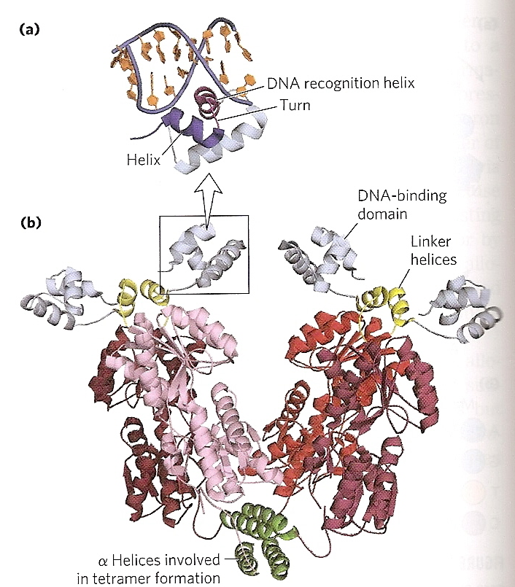
Helix-Turn-Helix Domain
20 amino acids arrayed in:
2 α-helices (7-9 amino acids long)
β-turn separates the helices
One α-helix is called the RECOGNITION HELIX
This helix interacts with a specific DNA sequence in the DNA
Fits in the major groove
(lac repressor, PDB ID: 2PE5)

Slide 37
Zinc-finger Domain
30 amino acids
Single Zn²⁺ coordinated by 4 amino acids
4 Cys or 2 Cys/ 2His
The Zn²⁺ doesn’t interact with the DNA but serves to stabilize the domain
Single interactions b/w the fingers and DNA are weak, so multiple fingers are common in proteins with these domains
Zif268 PDB ID: 1ZAA

Slide 38
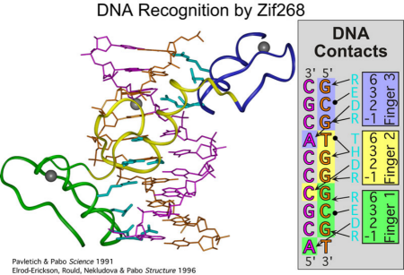
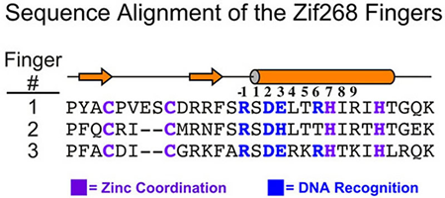
Zinc-finger Domain

Slide 39
Homeodomains
60 amino acids long
3 α-helices connected by short loops
ONLY FOUND IN EUKARYOTES
Serves to regulate genes responsible for limp patterns in development

Slide 40
Protein-Protein Interaction Domains of DNABPs
We said that DNA binding proteins tend to form dimers or tetramers
This means that not only must they interact with DNA, but with each other as well
Two primary Protein-Protein Interaction domains are found in Transcriptional Regulatory Proteins:
Leucine zippers
Basic Helix-Loop-Helix

Slide 41
Leucine Zipper
Clothespin type of helical arrangement
Clamps onto DNA
Amphipathic α-helix
One side is rich in hydrophobic residues
Every 7th residue is a Leu
When a Leucine-zipper dimerizes, these Leu residues align
Basic residues in the helix interact with DNA backbone
Very small DNA-binding surface, but you get it twice so it helps specify a target sequence

Slide 42
Basic Helix-Loop-Helix
Eukaryotic regulatory protein domain
50 amino acids
2 short, amphipathic α-helices linked by a loop of variable length
Distinct from HTH domains b/c these are Protein/Protein Interaction domains
Almost resemble a Leucine Zipper motif interrupted by a short loop
A single Leu residue (red) lies on one end of each helix

Slide 43
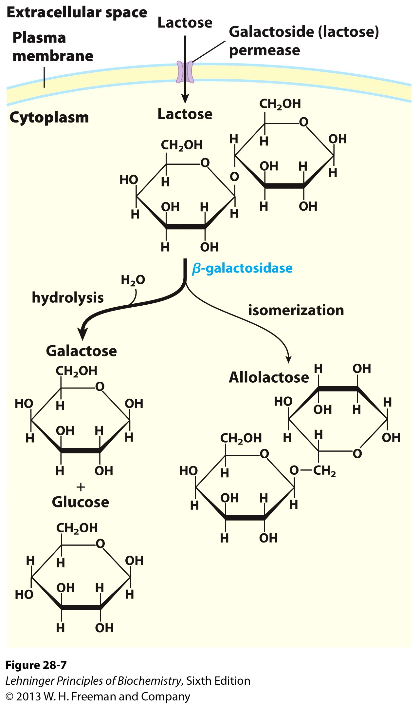
Transcriptional Regulation
Example 1: Remember the lac operon?
The lac operon has the structural genes for three proteins:
1) lacZ: beta-galactosidase
2) lacY: galactoside permease
lacA: Thiogalactoside transacetylase
Unknown role in pathway
Transfers acetyl group to C-6 hydroxyl group on IPTG and other thiogalactosides

Slide 44
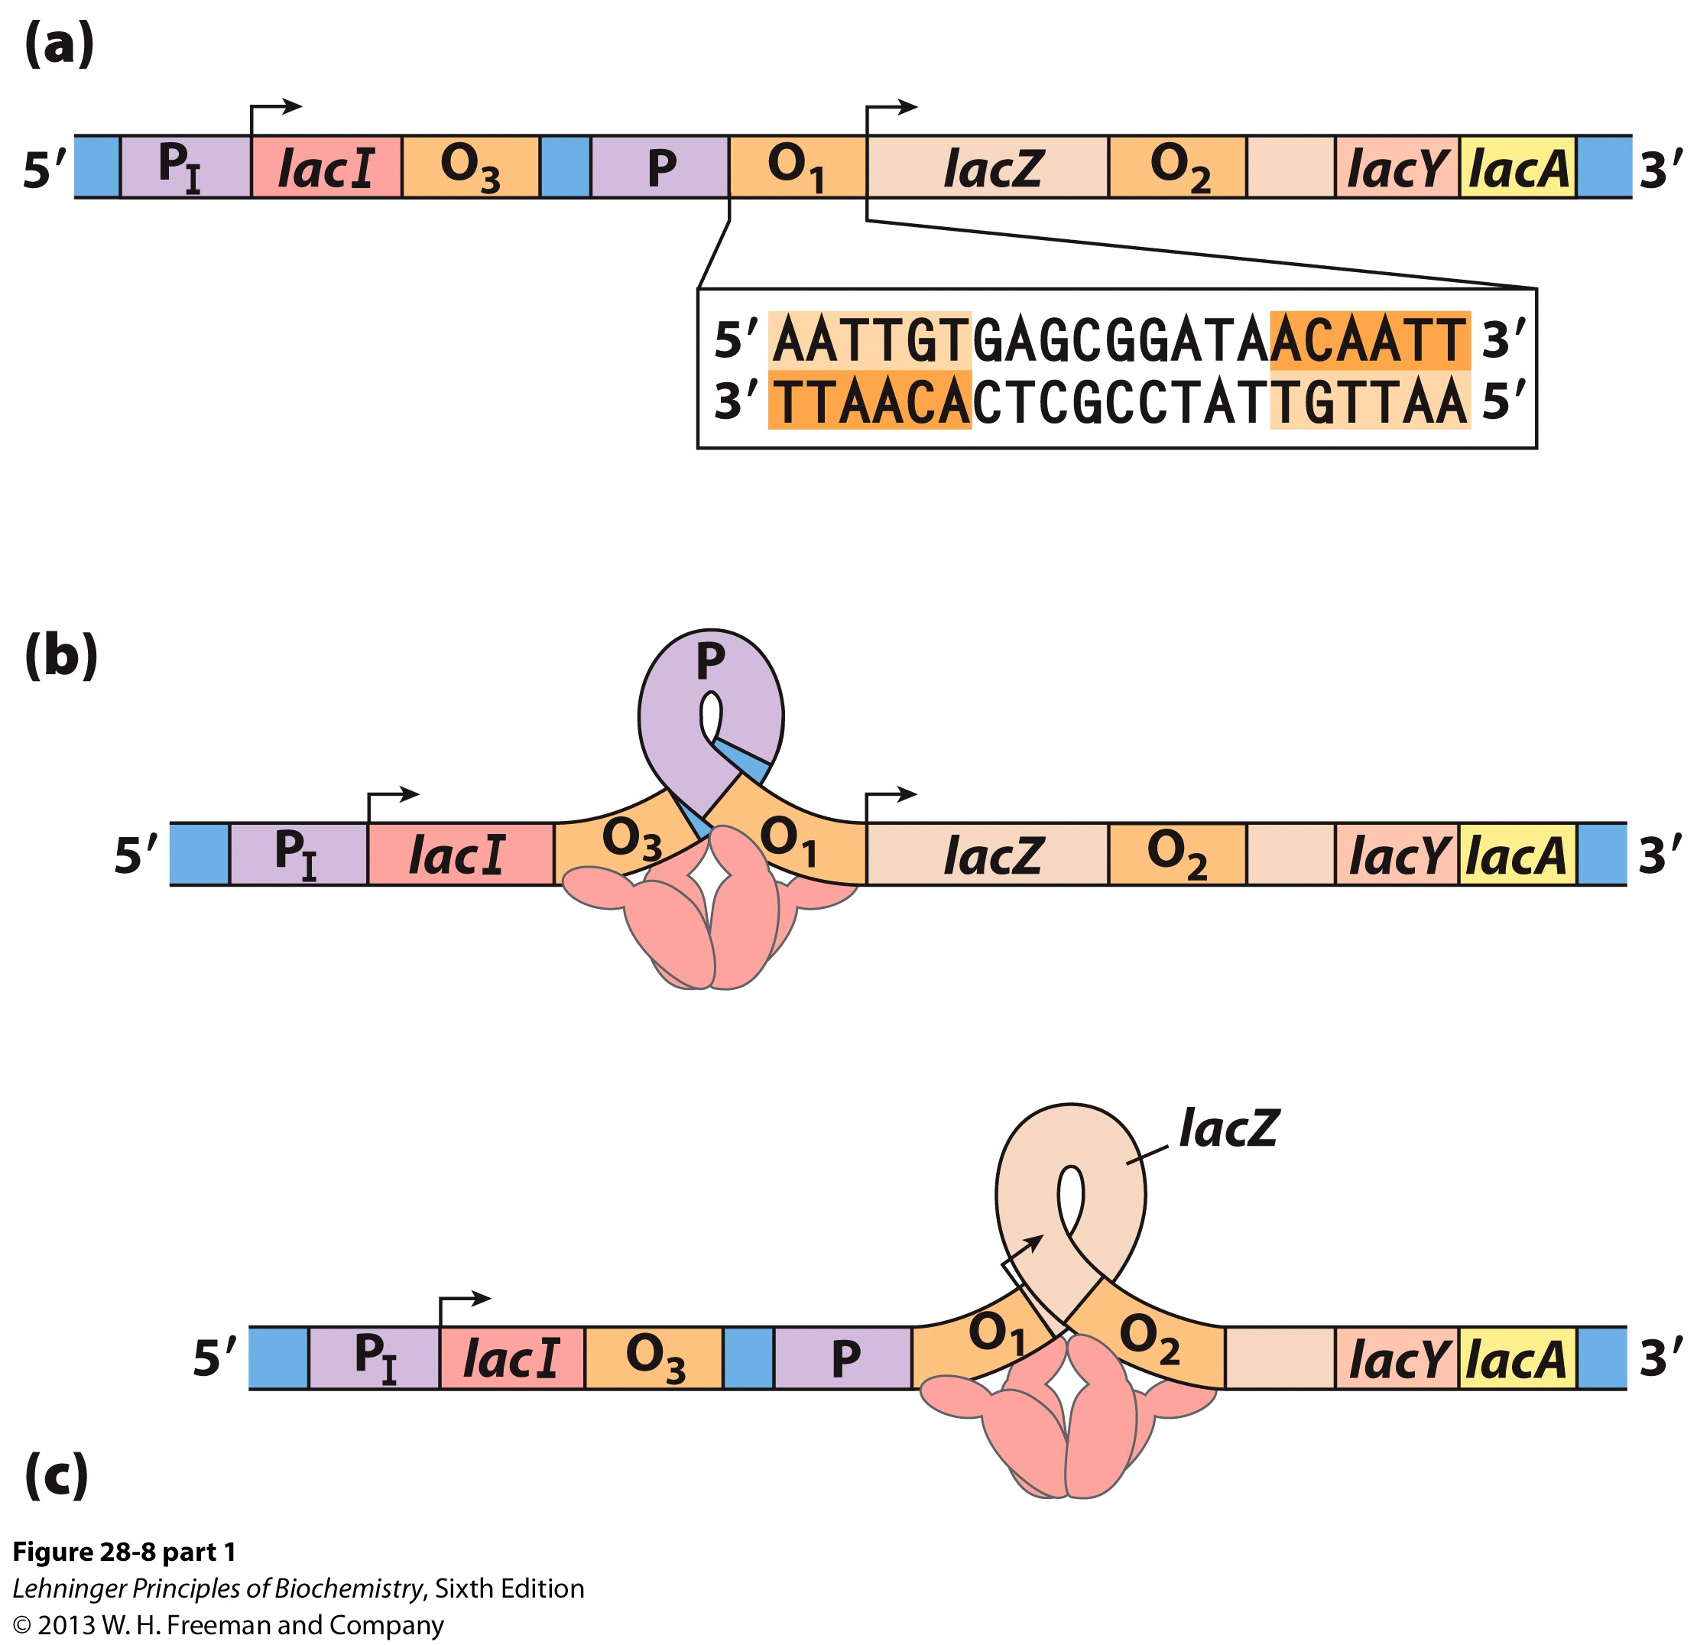
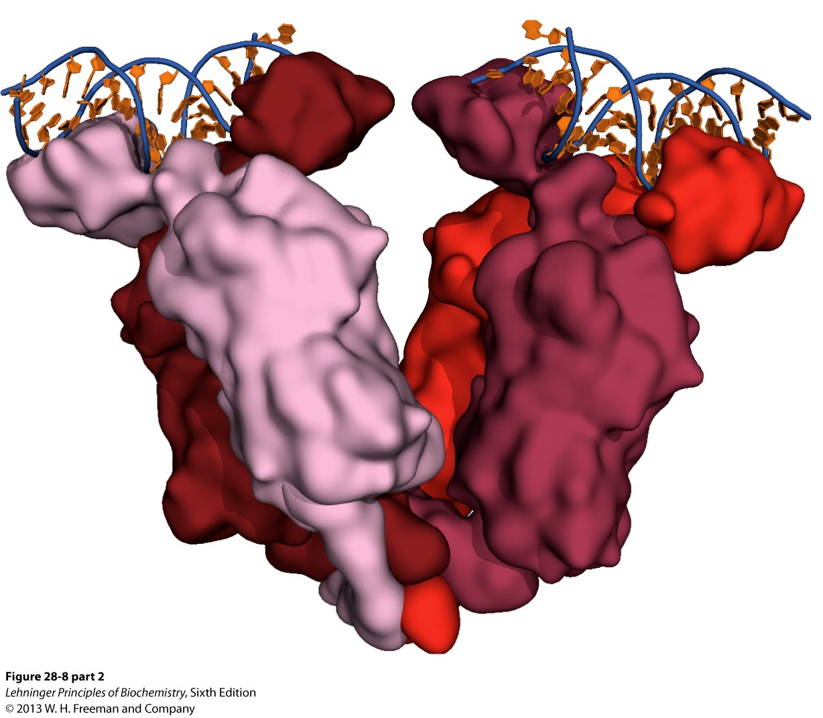
The lac Operon
The lac operon is an example of NEGATIVE REGULATION
The repressor protein binds to the O1 sequence (Operator 1) and induces a conformational change in the DNA
The dimers of the tetramer interact via leucine zippers
DNA binding is via HTH domains
The tetramer can bind another operator region on either side of O1:
O2 (+410) or O3 (-90) to shut down transcription of the operon
When inducer molecule is added, it binds to the repressor protein and causes a conformational change that makes the repressor dissociate from the DNA
The Operon is Transcribed!!!

Slide 45
The lac Operon: Nothing is that Easy!
The lac operon is an example of POSITIVE REGULATION!! (Told you it wasn’t simple) (Remember: This means that an Activator is present)
If glucose is present then the cell wants to use it before any other carbon source. Period.
What happens if both glucose AND lactose are present?
eg: Milk chocolate easter candy
CATABOLITE REPRESSION
RESTRICTS THE PRODUCTION OF THE ENZYMATIC MACHINERY NECESSARY TO UTILIZE OTHER SUGARS

Slide 46
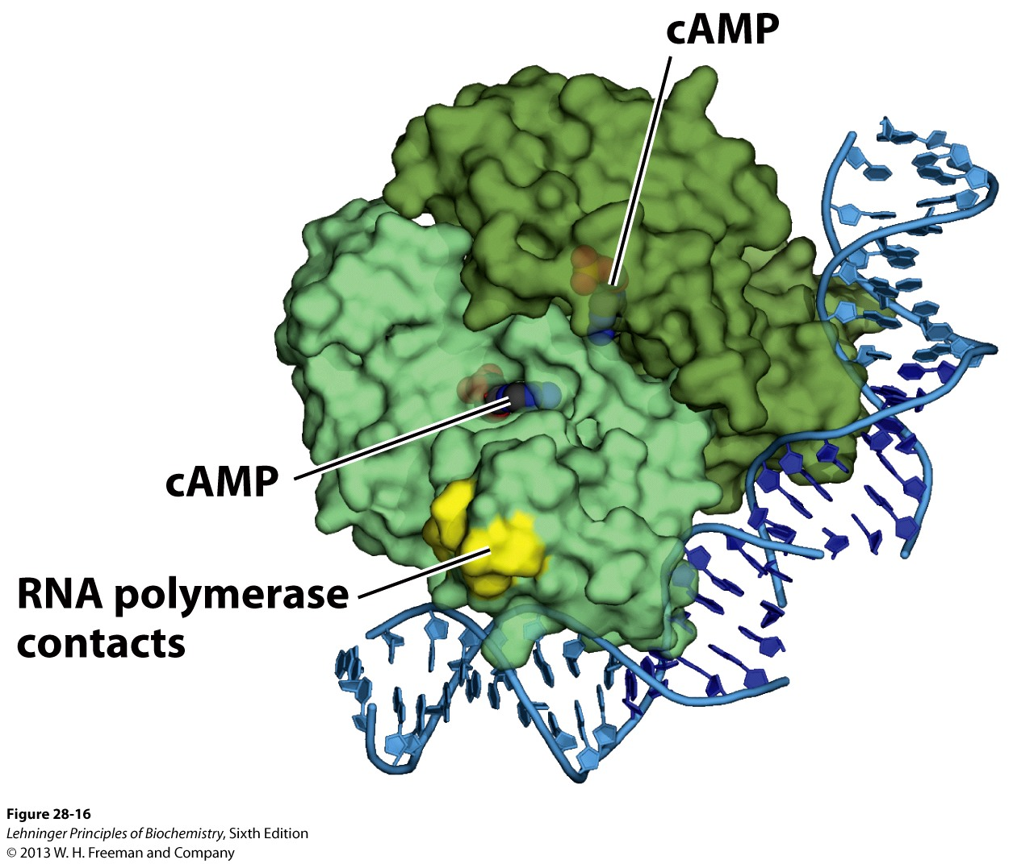
Catabolite Repression
Effect is mediated by cAMP receptor protein or CRP
22 kDa homodimer
Binds to DNA and cAMP
cAMP is a signaling molecule that cells use to regulate metabolism
When glucose is present, cAMP levels are low inside the cell
CRP doesn’t bind cAMP and is in the T-state
When glucose is absent, cAMP levels rise, CRP binds cAMP then DNA and recruits RNAP to promoter

Slide 47
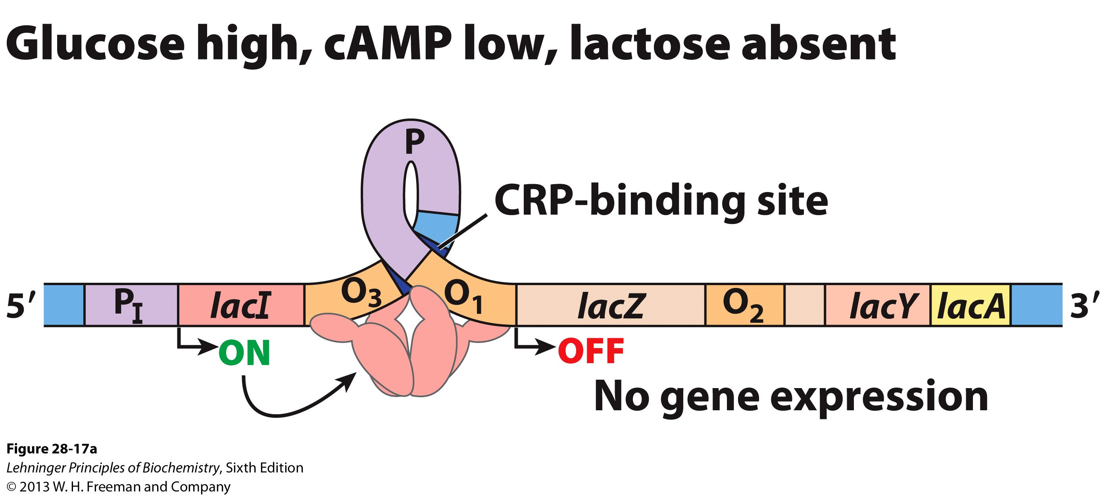
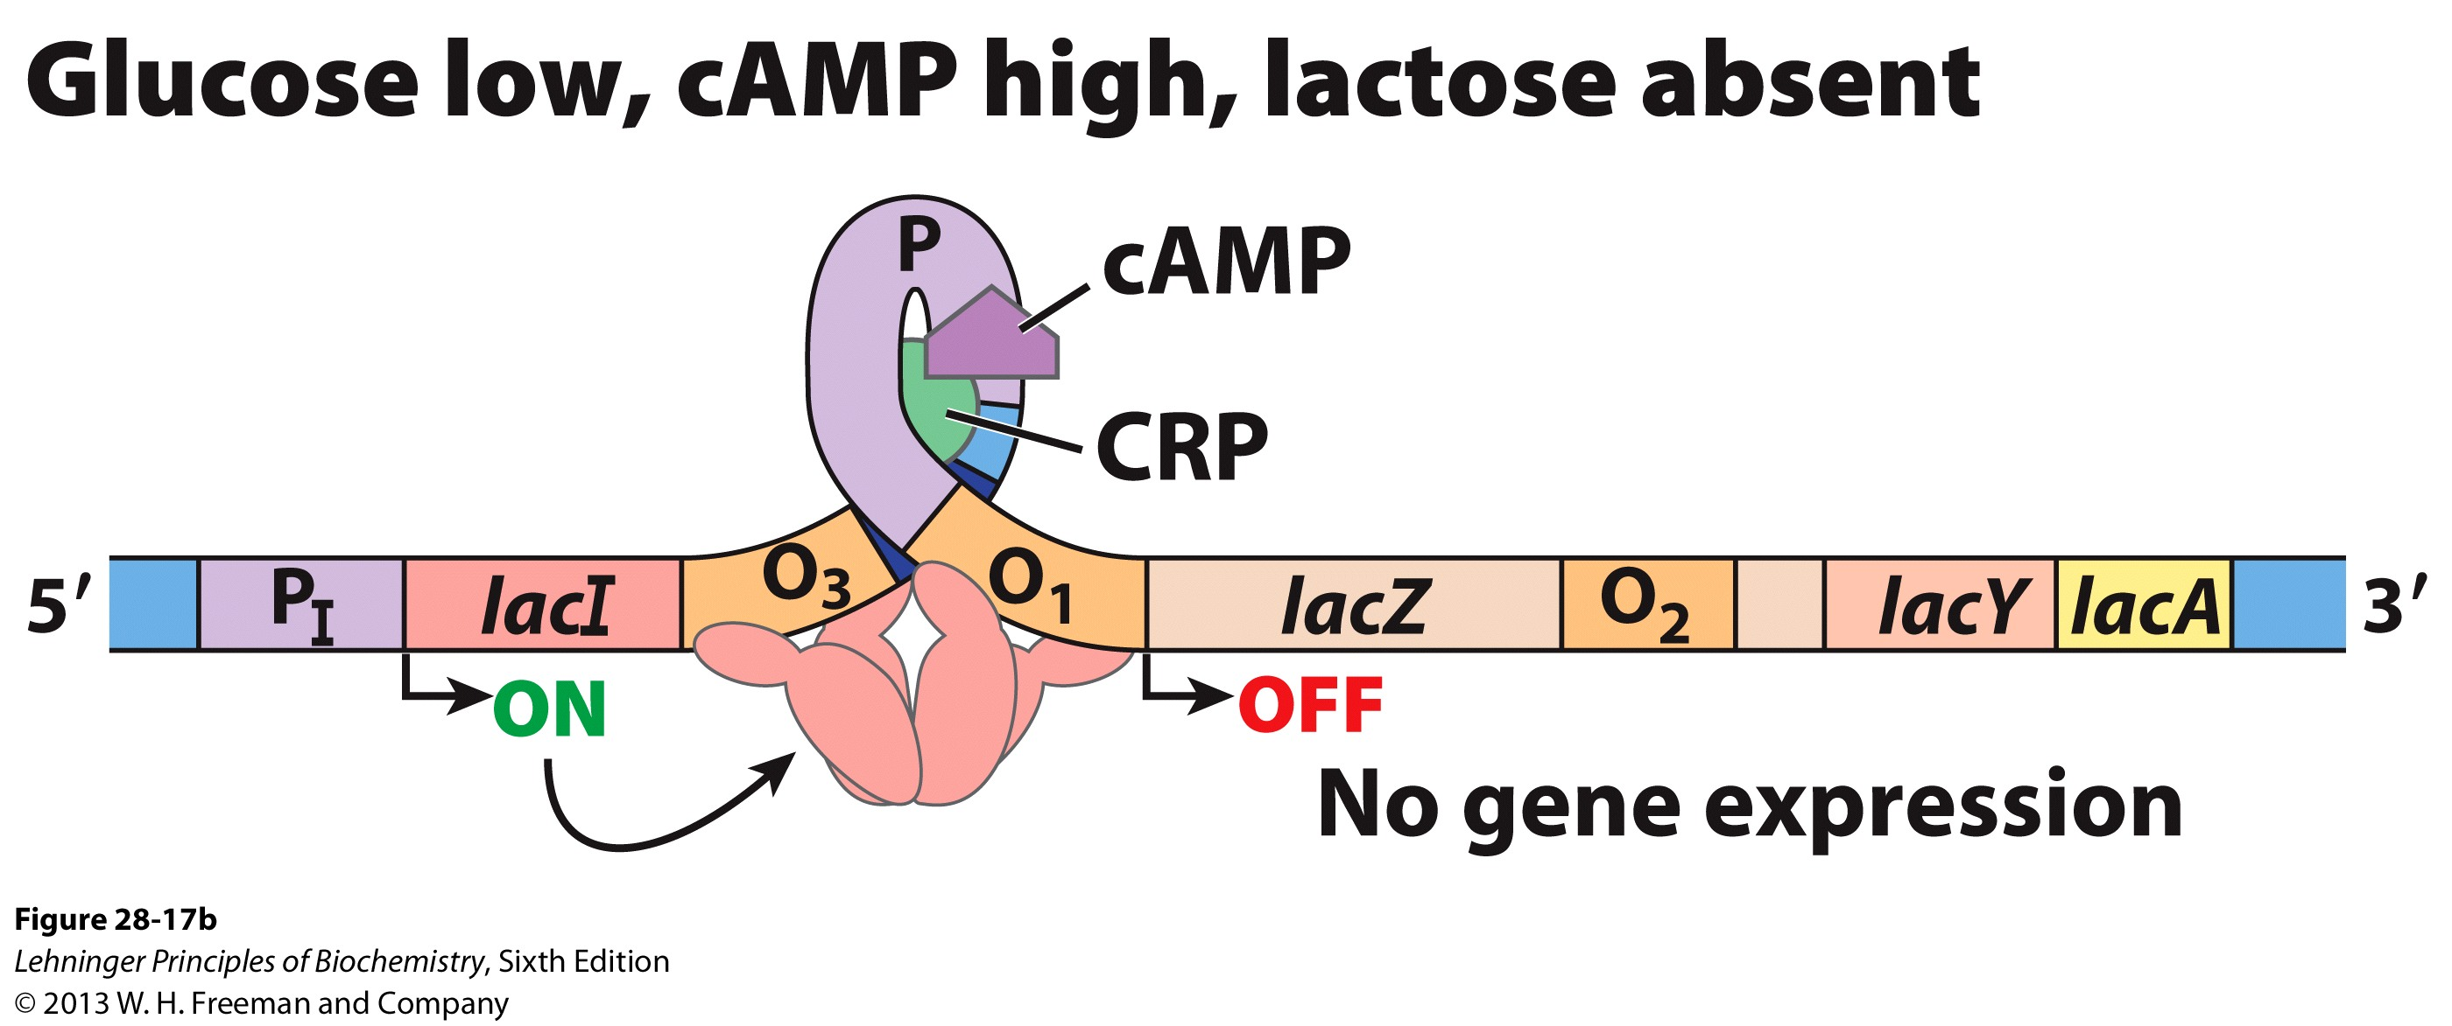
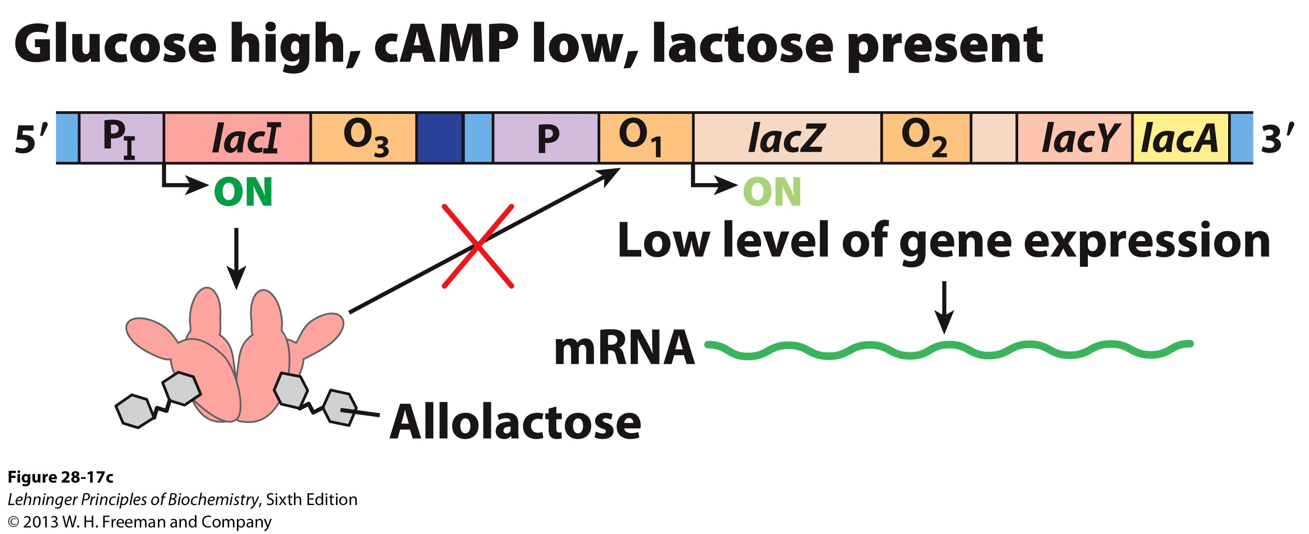
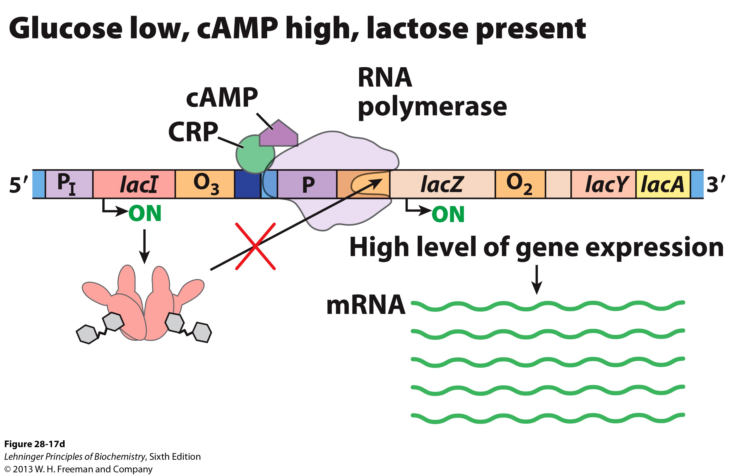
Catabolite Repression and the lac Operon
CRP is allosterically regulated by cAMP
Strong induction of the lac operon requires both the presence of lactose and a low [glucose]

Slide 48
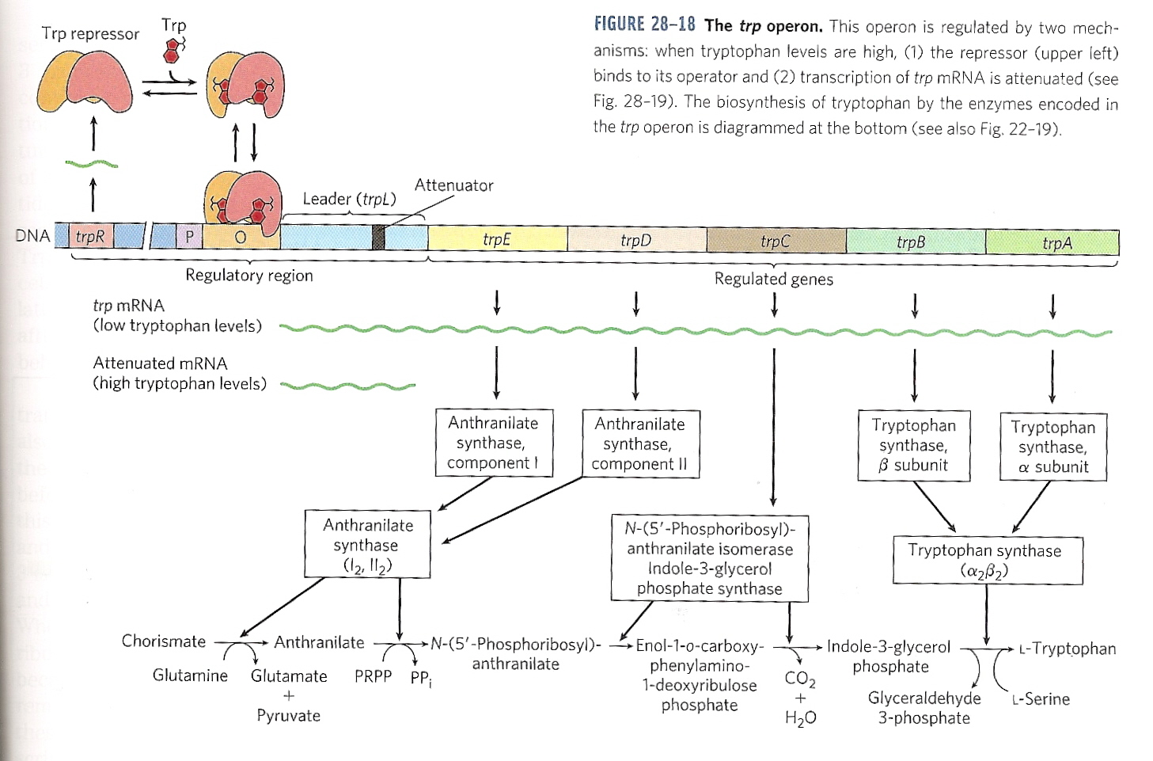
The trp Operon
E. coli cells can biosynthesize all 20 amino acids
If an amino acid is abundant in the growth medium, then the cell doesn’t need to synthesize it
5 proteins are required to synthesize tryptophan
(two enzymes catalyze more than one step in the pathway)

Slide 49
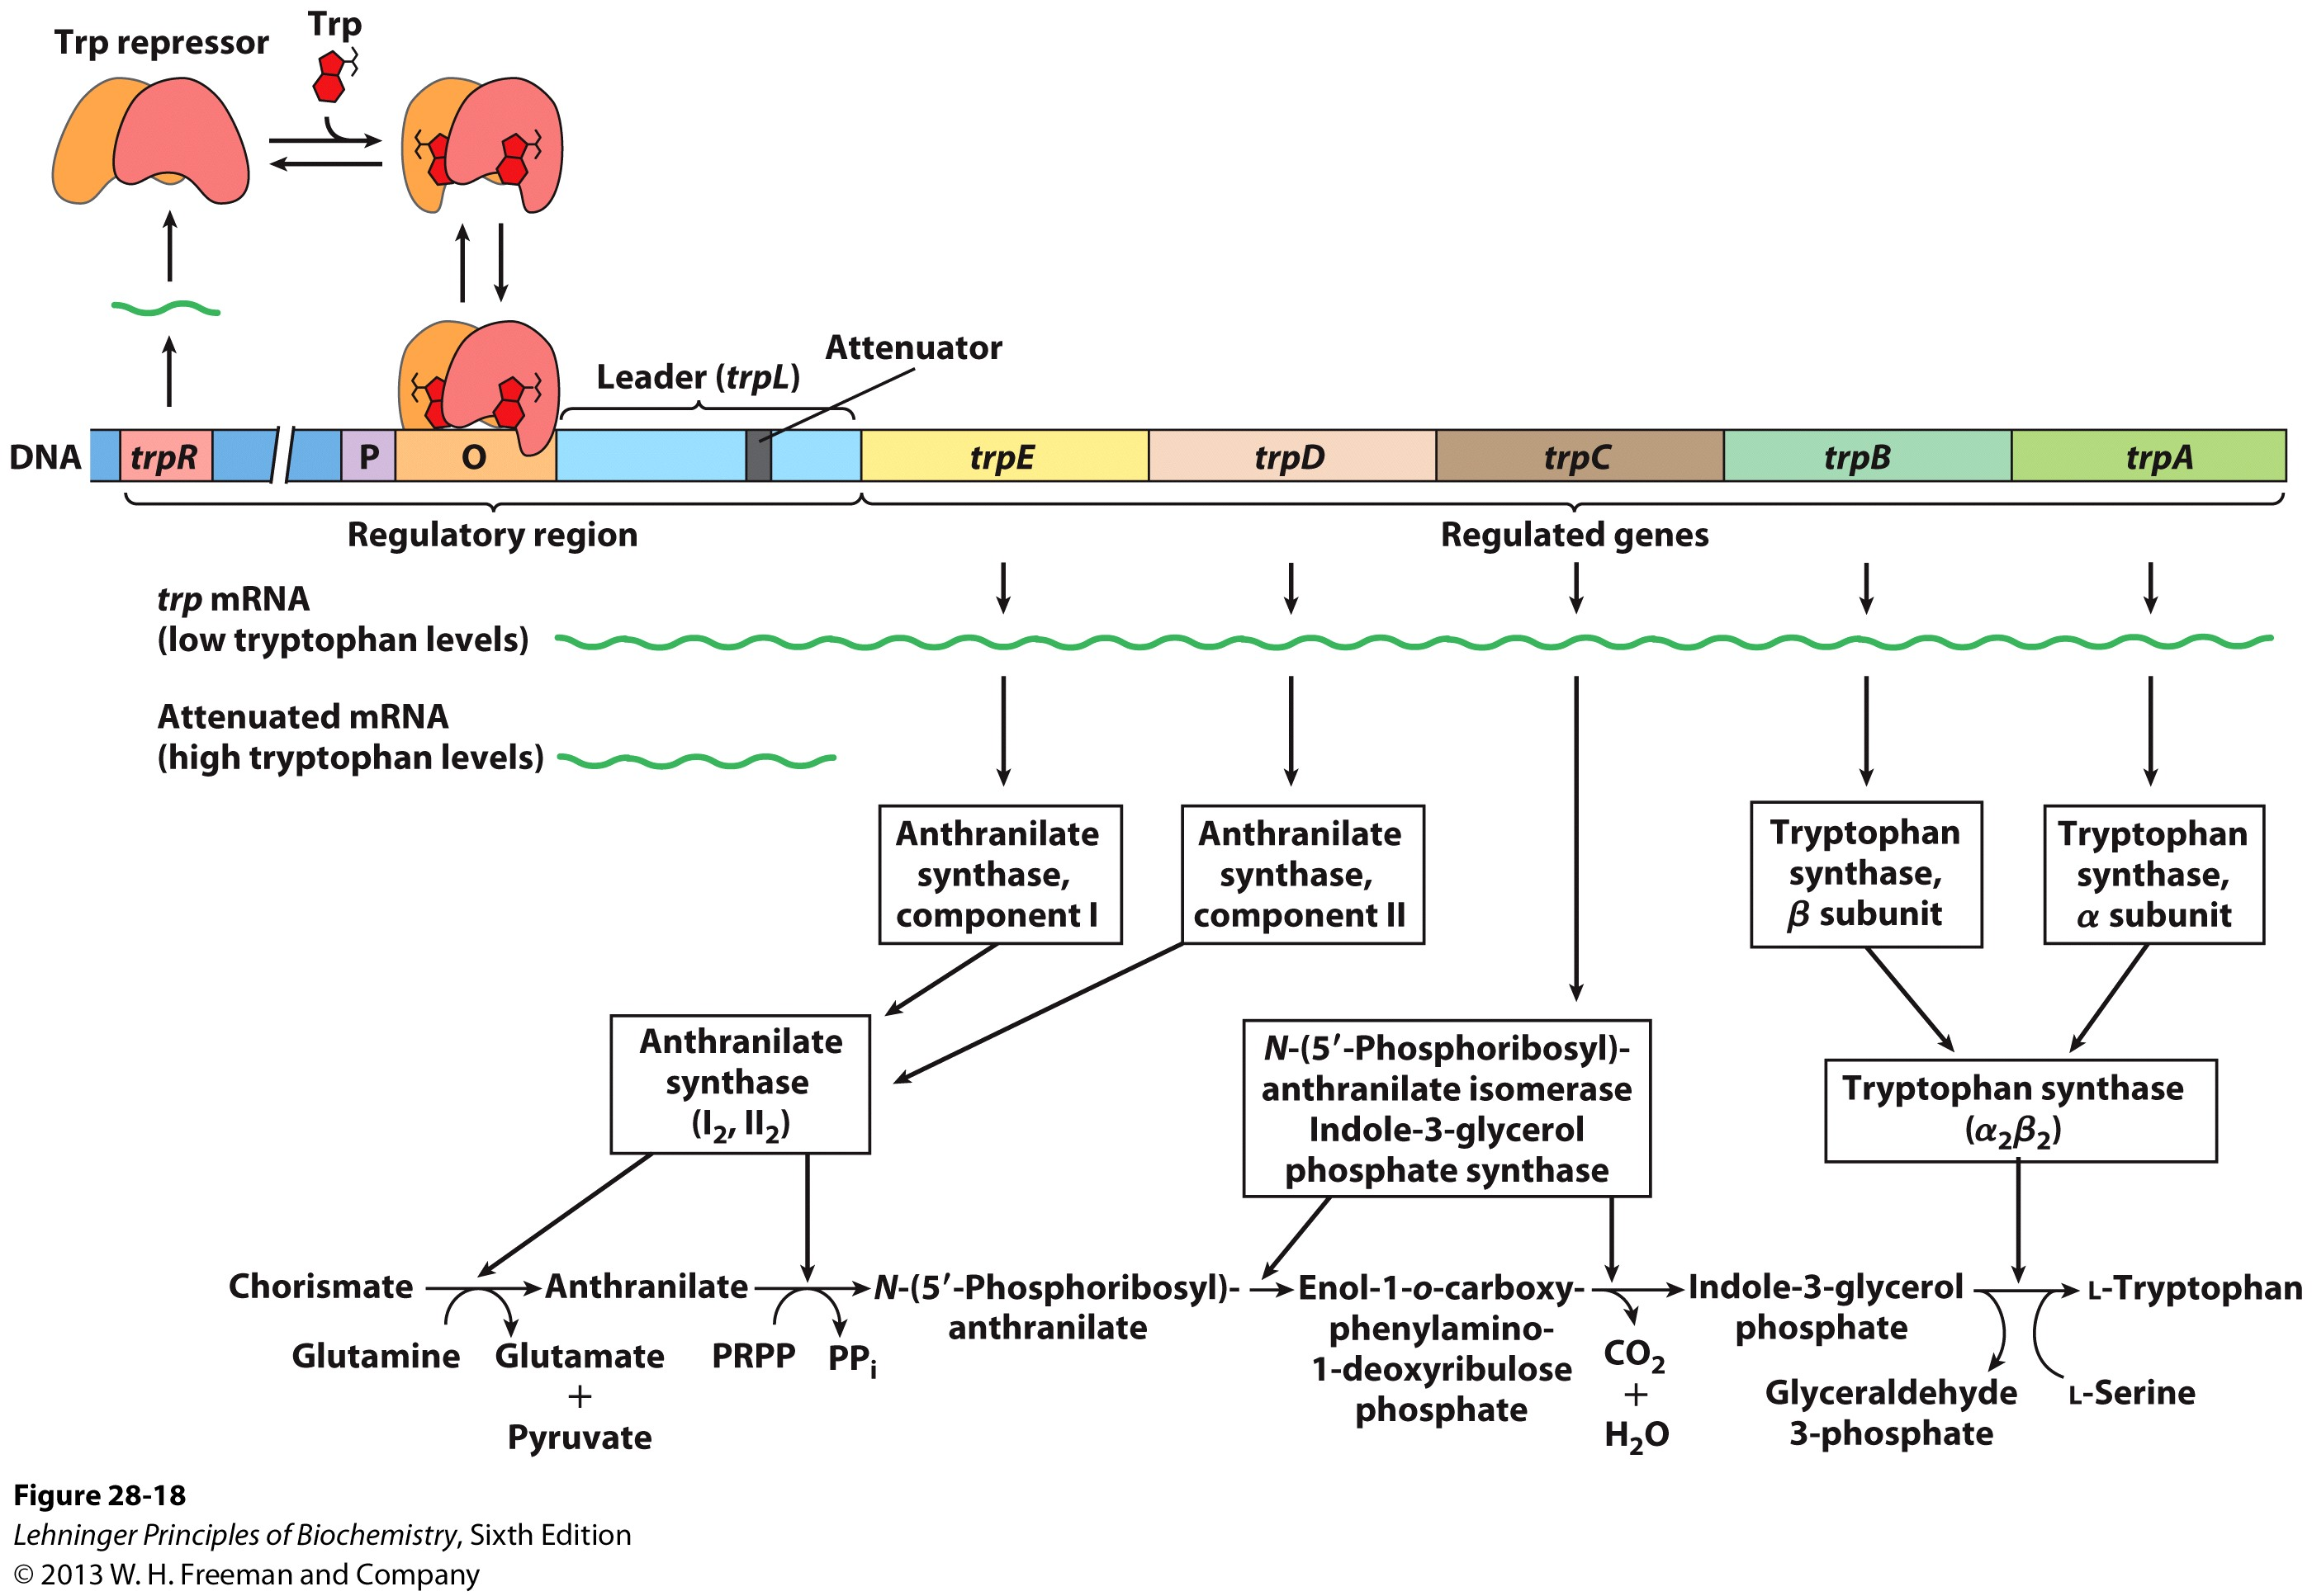
The trp Operon
The mRNA of the trp operon has a half-life of 3 min
Allowing the cell to rapidly respond to changing media conditions
The Trp repressor is a homodimer that binds tryptophan and undergoes a conformational change

Slide 50
The trp Operon
The conformational change caused by tryptophan binding converts the Trp repressor to the R-state from the T-state and it binds the operator of the trp operon
The operator overlaps the promoter, so no transcription
Straightforward, right?

Slide 51
Yeah, right. ATTENUATION!
At decreased tryptophan levels, the repressor loses its bound tryptophan ligands and dissociates from DNA
This should cause a massive increase in the production of the enzymes in the tryptophan biosynthetic pathway, yes?
Maybe…
It all depends on HOW MUCH tryptophan is around.
The cell can attenuate the signal from the transcript at the translational level.
Huh?

Slide 52
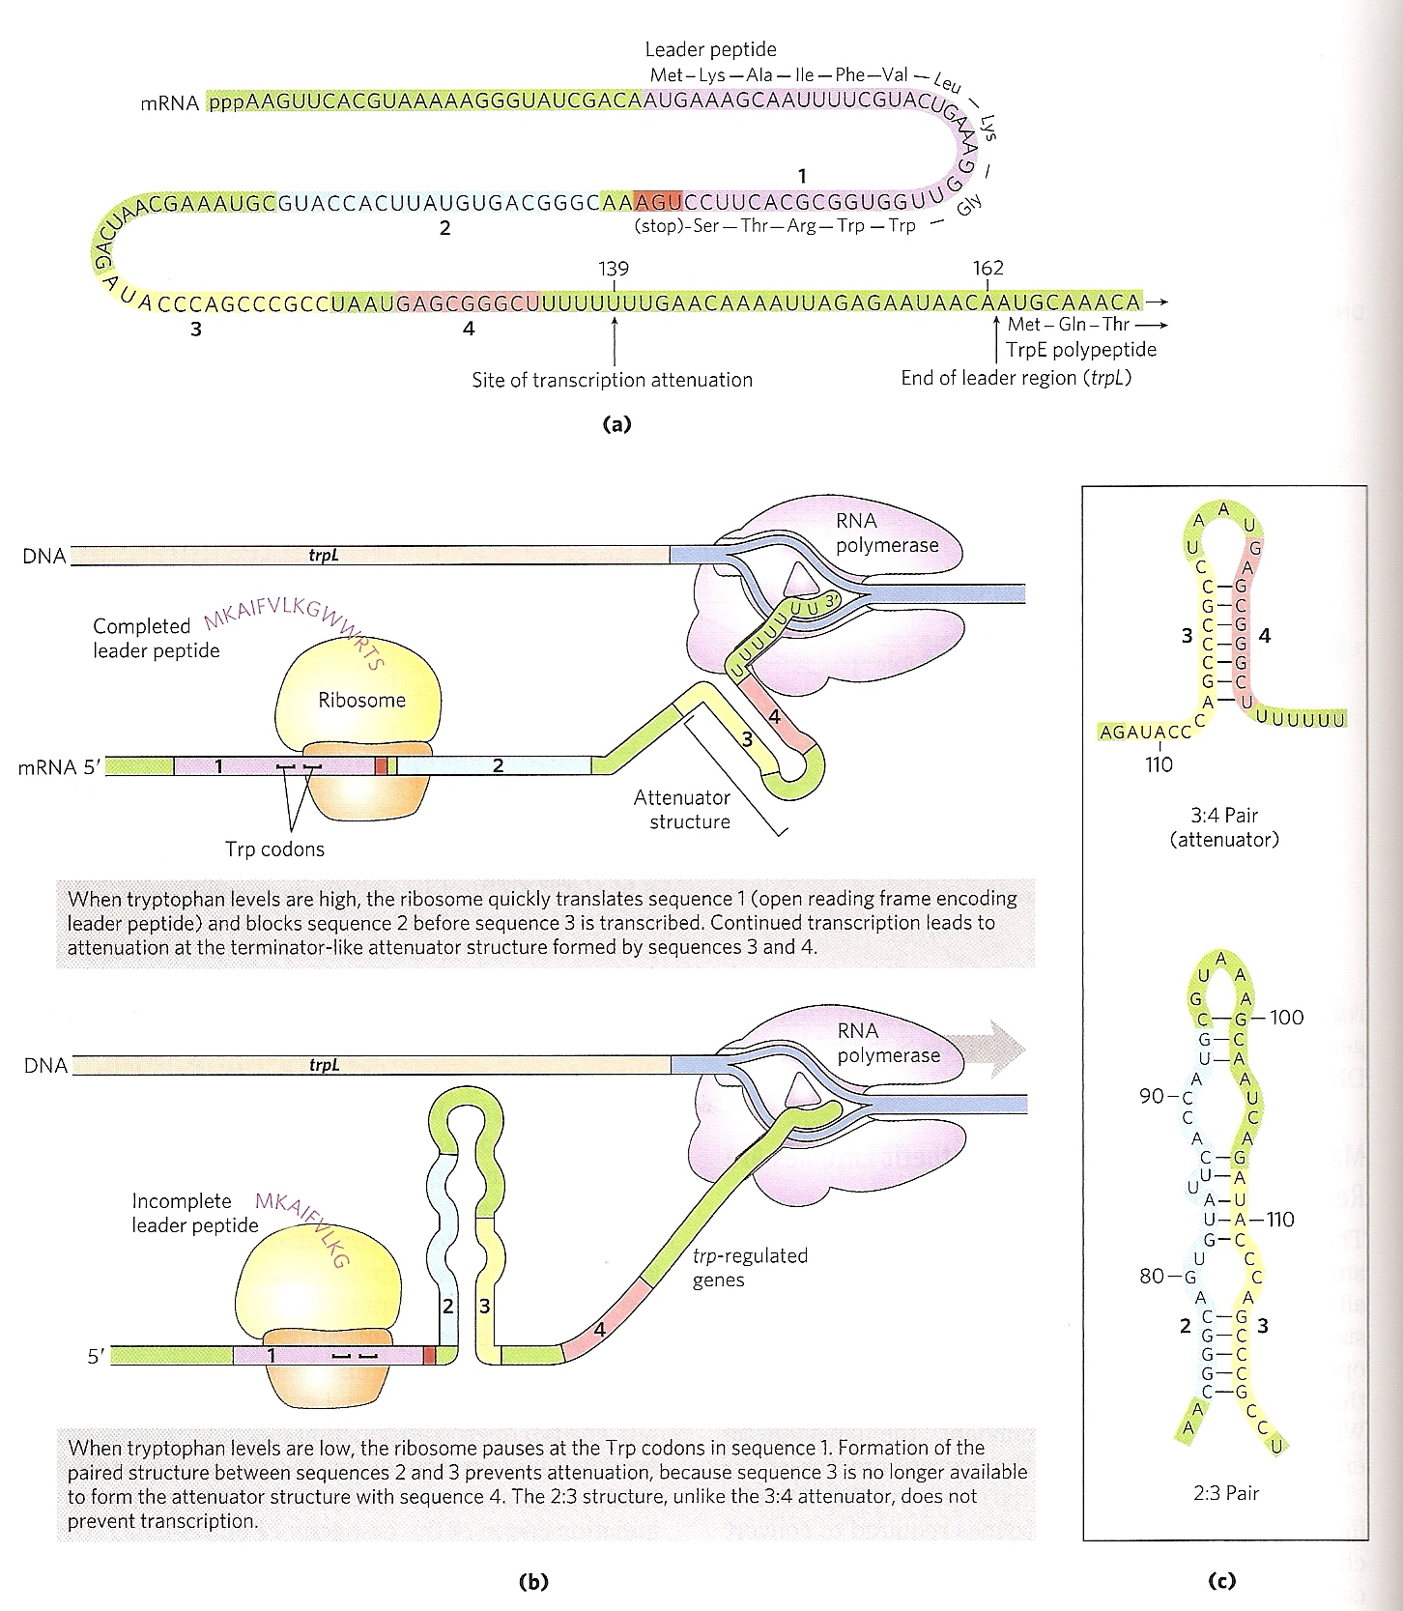
ATTENUATION
The mRNA has a 162 bp Leader Sequence that contains 4 sequences
Sequence 1 and 2: Regulatory sequences
Sequence 3 and 4: Attenuator sequence

Slide 53
ATTENUATION
Sequence 1 contains two codons for tryptophan.
If there is plenty of tryptophan in the cell, then there are plenty of tryptophan tRNA molecules so to ribosome goes right through both sequences

Slide 54
ATTENUATION
This allows Sequences 3 and 4 to form a base paired duplex called The Attenuator
This attenuator is very strong due to its size and loop structure
Transcription stops because the attentuator structure “jams up the gears” of RNAP

Slide 55
ATTENUATION
At tryptophan concentrations below the threshold, the ribosome stalls at Sequence 1
This allows a weaker pairing of Sequences 2 and 3
The ribosome can blast through the weaker 2:3 pair and make the proteins of the trp operon

