Slide 1
CHAPTER 5: Function of Globular Proteins
Key topics in protein function:
Reversible binding of ligands is essential
Specificity of ligands and binding sites
Ligand binding is often coupled to conformational changes, sometimes quite dramatic (Induced Fit)
In multisubunit proteins, conformational changes in one subunit can affect the others (Cooperativity)
Interactions can be regulated
Illustrated by:
Hemoglobin

Slide 2
Before we can start talking about Hemoglobin or Myoglobin…
We need to have a discussion about how globular proteins function, specifically how they bind ligands.
Warning: There will be math on this, but according to your peers, the Hill Plot and hemoglobin was on the MCAT, so I’m including it for your benefit.
Don’t freak out, it’s just math and I’ll walk you through it in a way that (hopefully makes sense)

Slide 3
Interaction with Other Molecules
Reversible, transient process of chemical equilibrium:
A + B → AB
A molecule that binds to a protein is called a ligand
Typically a small molecule
A region in the protein where the ligand binds is called the binding site
Ligand binds via same noncovalent forces that dictate protein structure (see Chapter 4)
Allows the interactions to be transient
←

Slide 4
Binding: Quantitative Description
Consider a process in which a ligand (L) binds reversibly to a site in a protein (P)
The kinetics of such a process is described by:
the association rate constant k_{a} or the dissociation rate constant k_{d}
After some time, the process will reach the equilibrium
where the association and dissociation rates are equal
The equilibrium composition is characterized
by the equilibrium constant K_{a}
k_{a}
+
L
P
k_{d}
PL

Slide 5
Binding: Analysis in Terms of the Bound Fraction
In practice, we can often determine the fraction of occupied binding sites (θ)
Substituting [PL] with K_{a}[L][P], we’ll eliminate [PL]
Eliminating [P] and rearranging gives the result in terms of equilibrium association constant
In terms of the more commonly used equilibrium dissociation constant

Slide 6
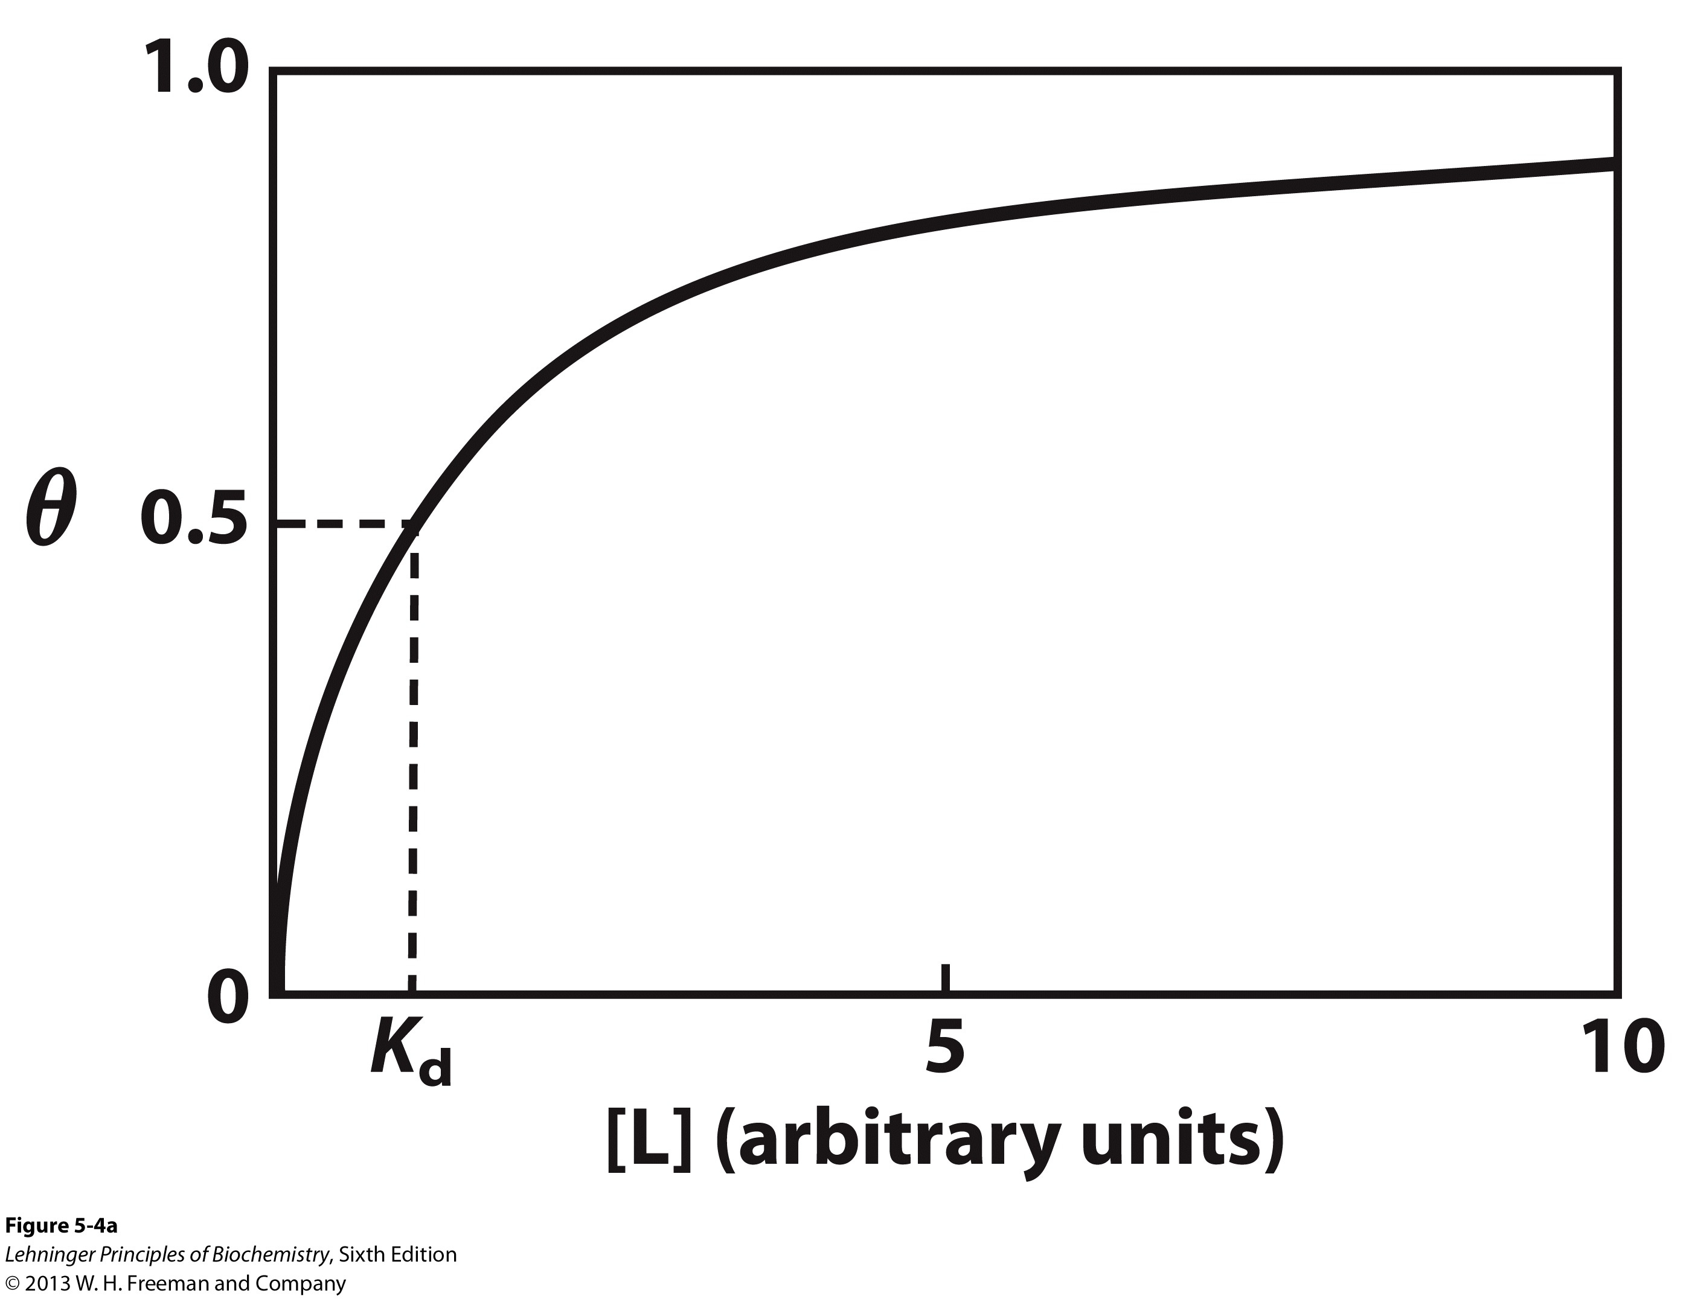
Binding: Graphical Analysis
The fraction of bound sites depends on
the free ligand concentration and K_{d}
Experimentally
Ligand concentration is known
K_{d} can be determined graphically or via least-squares regression
[L] ≈ [L]_{total}
Notes:
FIGURE 5-4a Graphical representations of ligand binding. The fraction of ligand-binding sites occupied, θ, is plotted against the concentration of free ligand. Both curves are rectangular hyperbolas. (a) A hypothetical binding curve for a ligand L. The [L] at which half of the available ligand-binding sites are occupied is equivalent to 1/K_{a}, or K_{d}. The curve has a horizontal asymptote at θ = 1 and a vertical asymptote (not shown) at [L] = –1/K_{a}.

Slide 7
Binding: Thermodynamic Connections
Interaction strength can be expressed as
association (binding) constant K_{a}, units M⁻¹
dissociation constant K_{d}, units M, K_{d} = 1/K_{a}
interaction (binding) free energy ΔGº, units: kJ/mol
Definitions
ΔGº = ΔHº -TΔSº : enthalpy and entropy
K_{a} = [PL]/[P][L] K_{d} = [P][L]/[PL]
Relationships
ΔGº = -RT ln K_{a} = RT ln K_{d} (RT at 25ºC is 2.48 kJ/mol)
Magnitudes
Strong binding: K_{d} < 10 nM
Weak binding: K_{d} > 10 μM
Note: Lower K_{d}, higher affinity of protein for ligand

Slide 8
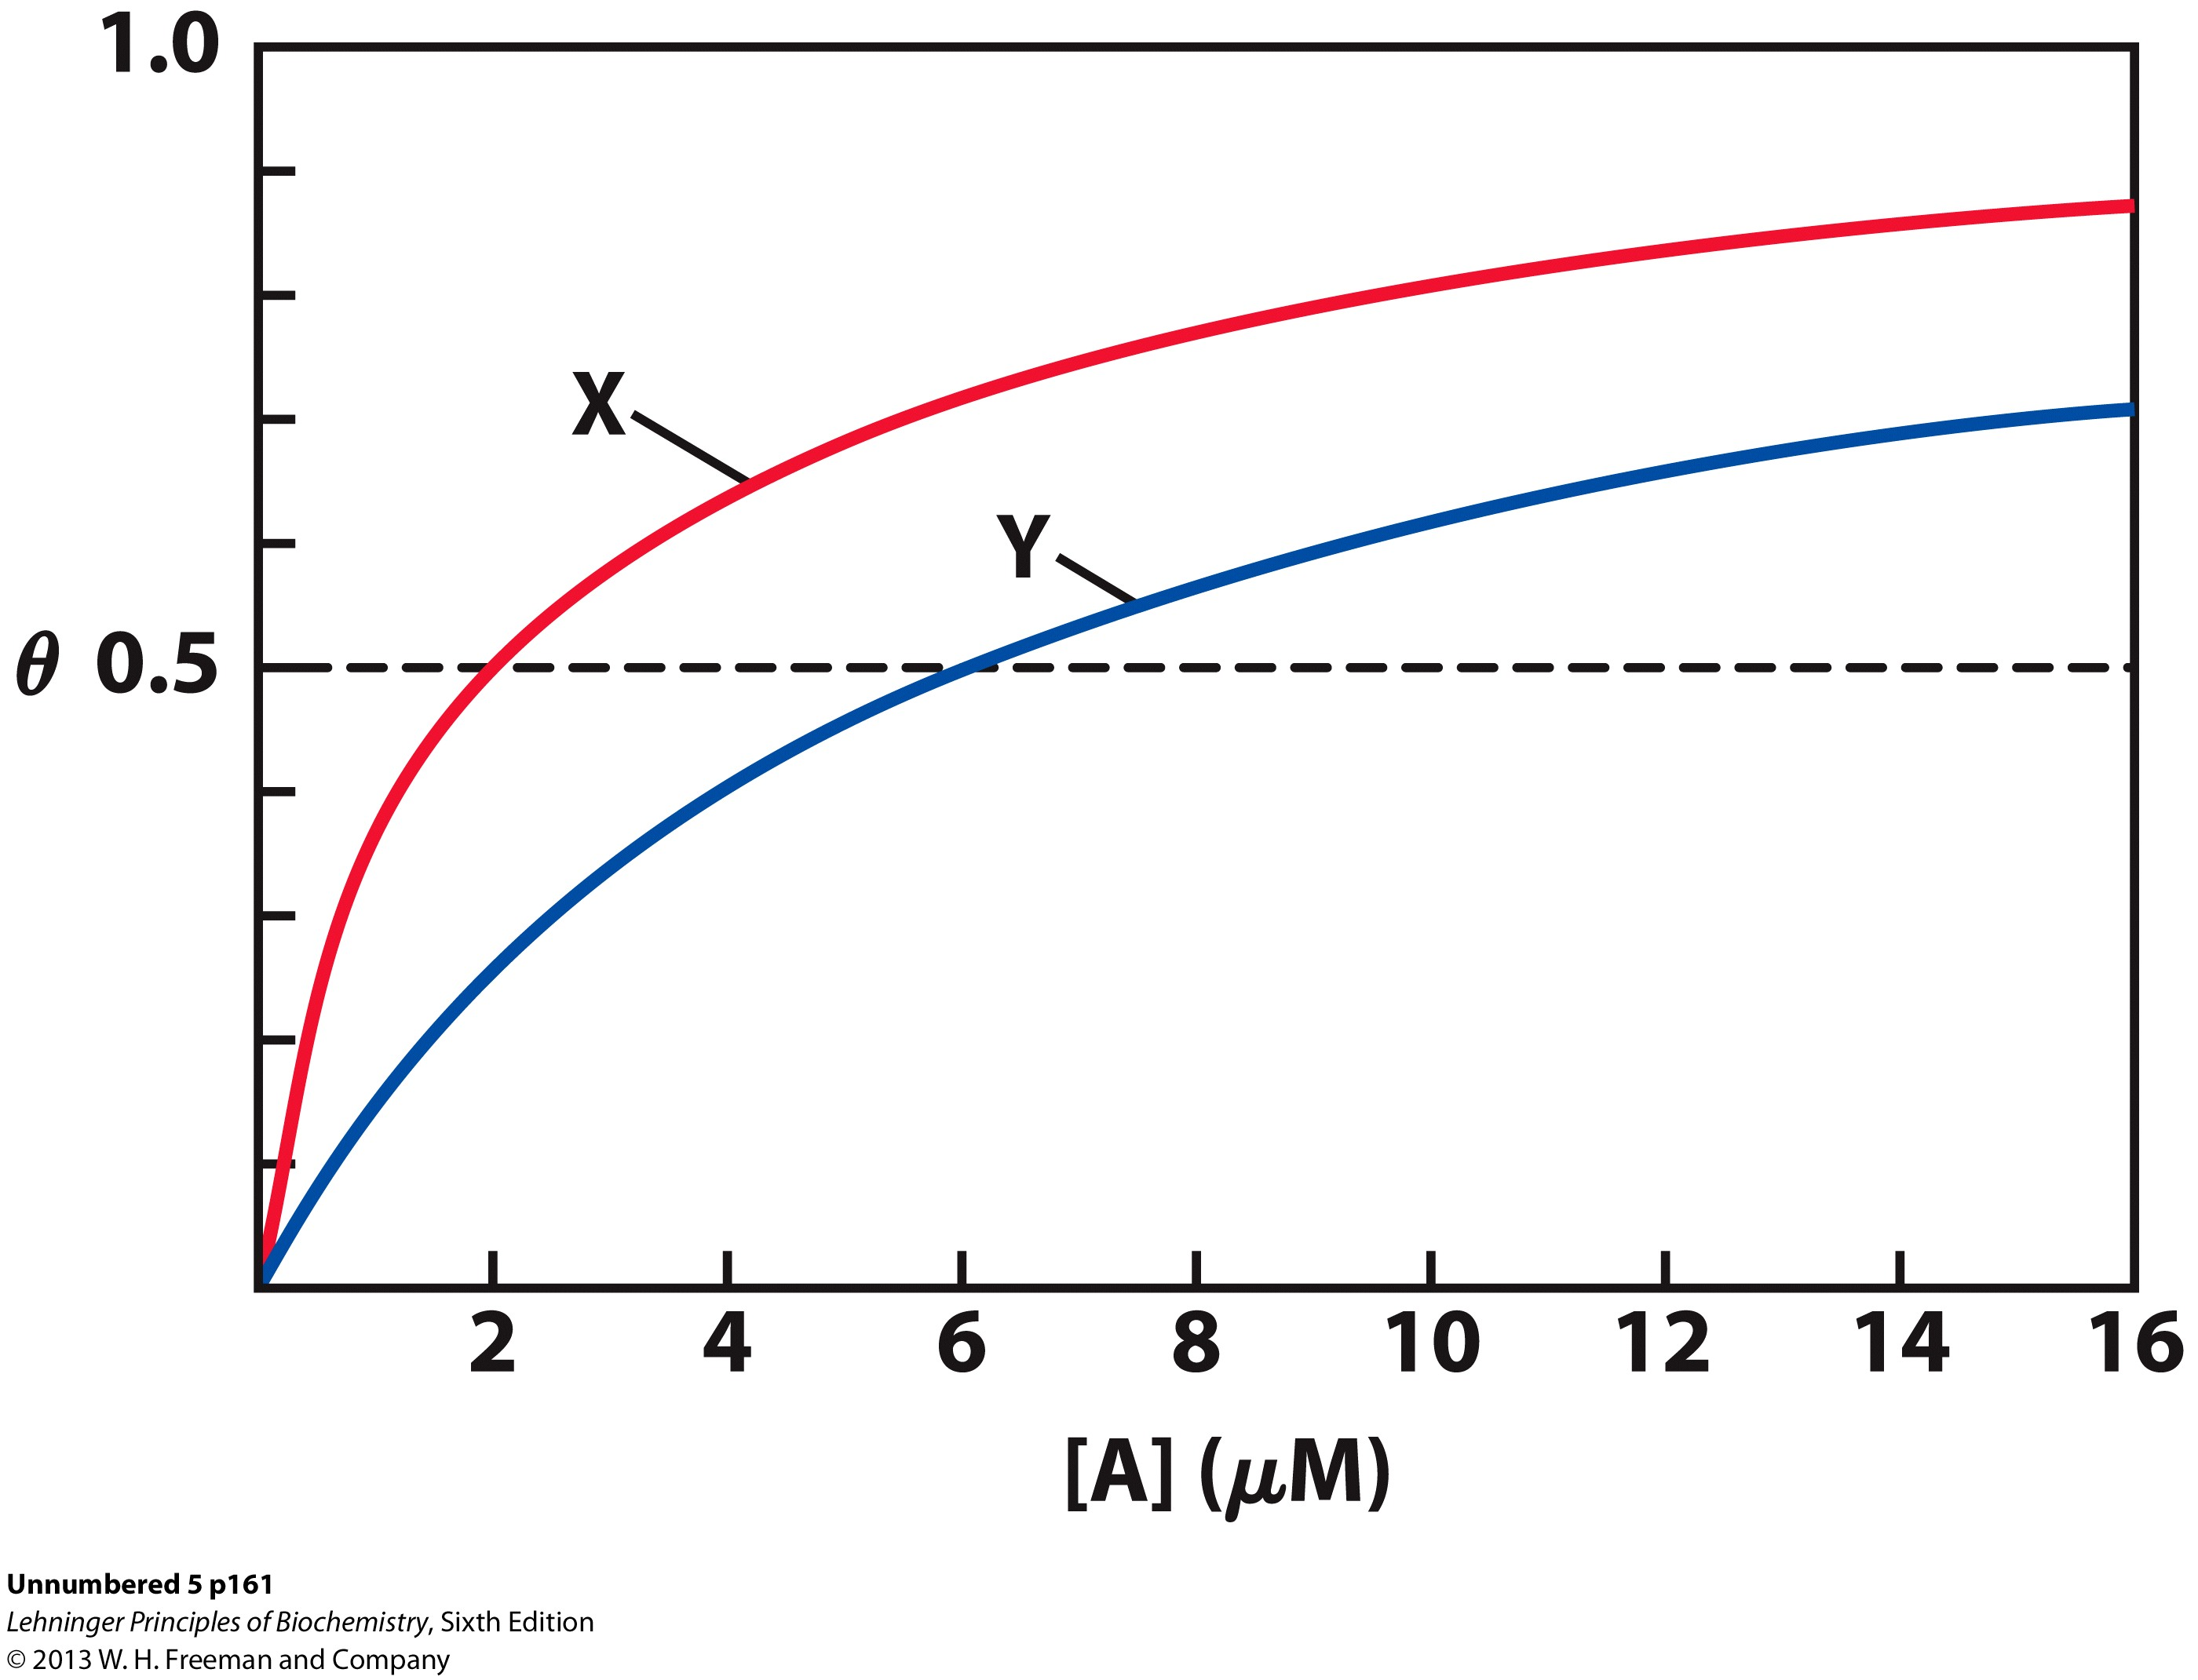
Example Problem: K_{d} and θ
Two proteins, X and Y, bind to the same ligand, A, with the binding curves shown. What is the dissociation constant, K_{d}, for each protein? Which protein has the greater affinity for ligand A?
When θ equals 0.5, the concentration of ligand equals the Kd.
X has a K_{d} of 2μM
Y has a K_{d} of 6μM
X has a greater affinity for ligand
Notes:
FIGURE 5–3 Myoglobin. (PDB ID 1MBO) The eight α-helical segments (shown here as cylinders) are labeled A through H. Nonhelical residues
in the bends that connect them are labeled AB, CD, EF, and so forth, indicating the segments they interconnect. A few bends, including BC
and DE, are abrupt and do not contain any residues; these are not normally labeled. (The short segment visible between D and E is an artifact
of the computer representation.) The heme is bound in a pocket made up largely of the E and F helices, although amino acid residues from
other segments of the protein also participate.
FIGURE 5–4b Graphical representations of ligand binding. The fraction of ligand-binding sites occupied, θ, is plotted against the concentration of free ligand. Both curves are rectangular hyperbolas. (b) A curve describing the binding of oxygen to myoglobin. The partial pressure of O₂ in the air above the solution is expressed in kilopascals (kPa). Oxygen binds tightly to myoglobin, with a P₅₀ of only 0.26 kPa.

Slide 9
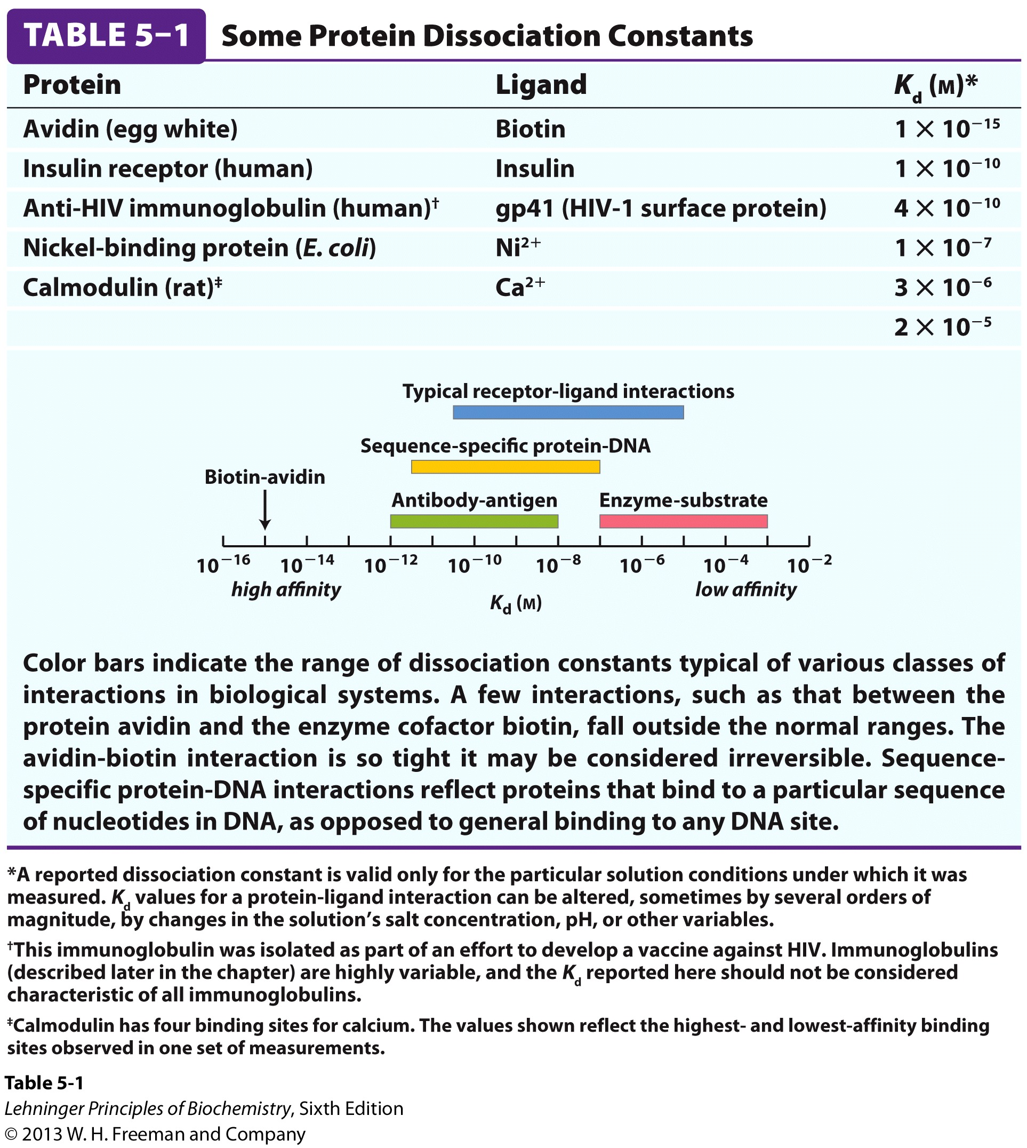
Examples of Binding Strength

Slide 10
Specificity: Lock-and-Key Model
Proteins typically have high specificity: only certain ligands bind
High specificity can be explained by the complementary of the binding site and the ligand.
Complementary in
size,
shape,
charge,
or hydrophobic/hydrophilic character
“Lock and Key” model by Emil Fisher (1894) assumes that complementary surfaces are preformed.
+

Slide 11
Specificity: Induced Fit
Conformational changes may occur upon ligand binding (Daniel Koshland in 1958)
This adaptation is called the induced fit
Induced fit allows for tighter binding of the ligand
Induced fit allows for high affinity for different ligands
Both the ligand and the protein can change their conformations
+

Slide 12
Globins are oxygen-binding proteins
Protein side chains lack affinity for O₂
Some transition metals bind O₂ well but would generate free radicals if free in solution
Organometallic compounds such as heme are more suitable, but Fe²⁺ in free heme could be oxidized to Fe³⁺
Solution
Capture the oxygen molecule with heme that is protein bound
Myoglobin is the main oxygen storage protein
Hemoglobin is a circulating oxygen-binding protein

Slide 13
Myoglobin
18 kDa monomeric protein, 153 amino acids
The rate of O₂ diffusion from capillaries to tissue is slow because of the solubility of oxygen.
Myoglobin increases the solubility of oxygen by binding it and moving it form capillaries to muscle tissue.
Oxygen storage is also a function because Myoglobin concentrations are 10-30 fold greater in whales and seals than in land mammals
Also functions to oxidize the signaling molecule Nitric oxide (NO)
Converts NO to NO₃⁻ in aerobic conditions
Converts NO to NO₂⁻ in oxygen limited conditions

Slide 14
Hemoglobin
65 kDa heterotetramer α₂,β₂ dimer
Each subunit is structurally similar to myoglobin
Transports oxygen from lungs to tissues.
O₂ diffusion alone is too poor for transport in larger animals.
Solubility of O₂ is low in plasma i.e. 10⁻⁴ M.
But bound to hemoglobin, [O₂] = 0.01 M or nearly that of air

Slide 15
Average of <30% Sequence Identity b/w myoglobin and other proteins
If the proteins are only 27% identical, how similar do you think their tertiary structures will be?

Slide 16
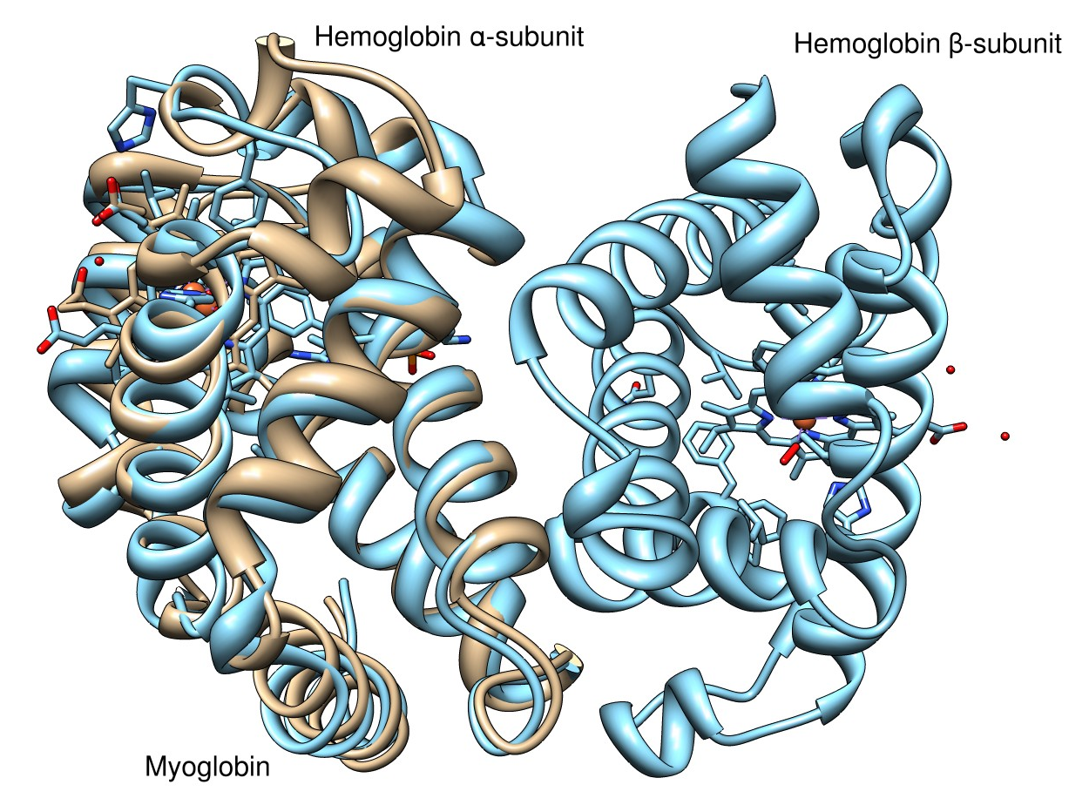
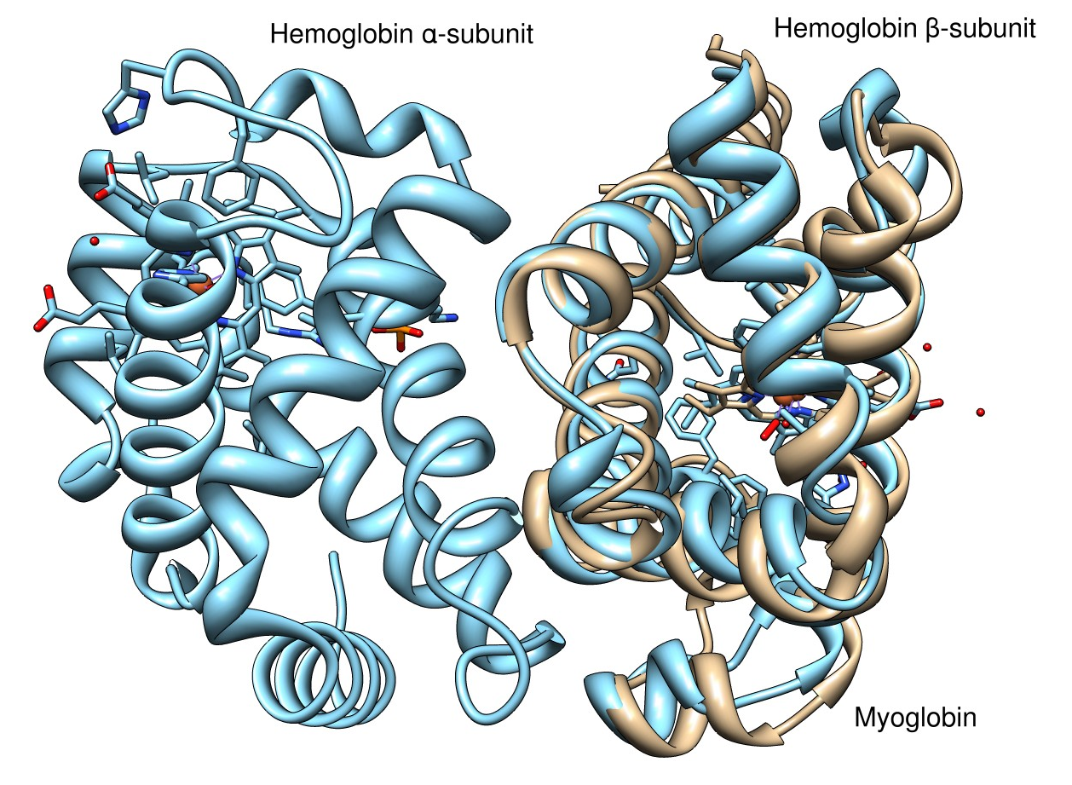
A lot more similar than you thought, right?
The key residues were retained during evolution and the overall tertiary structure had to be maintained or the proteins would not function.

Slide 17
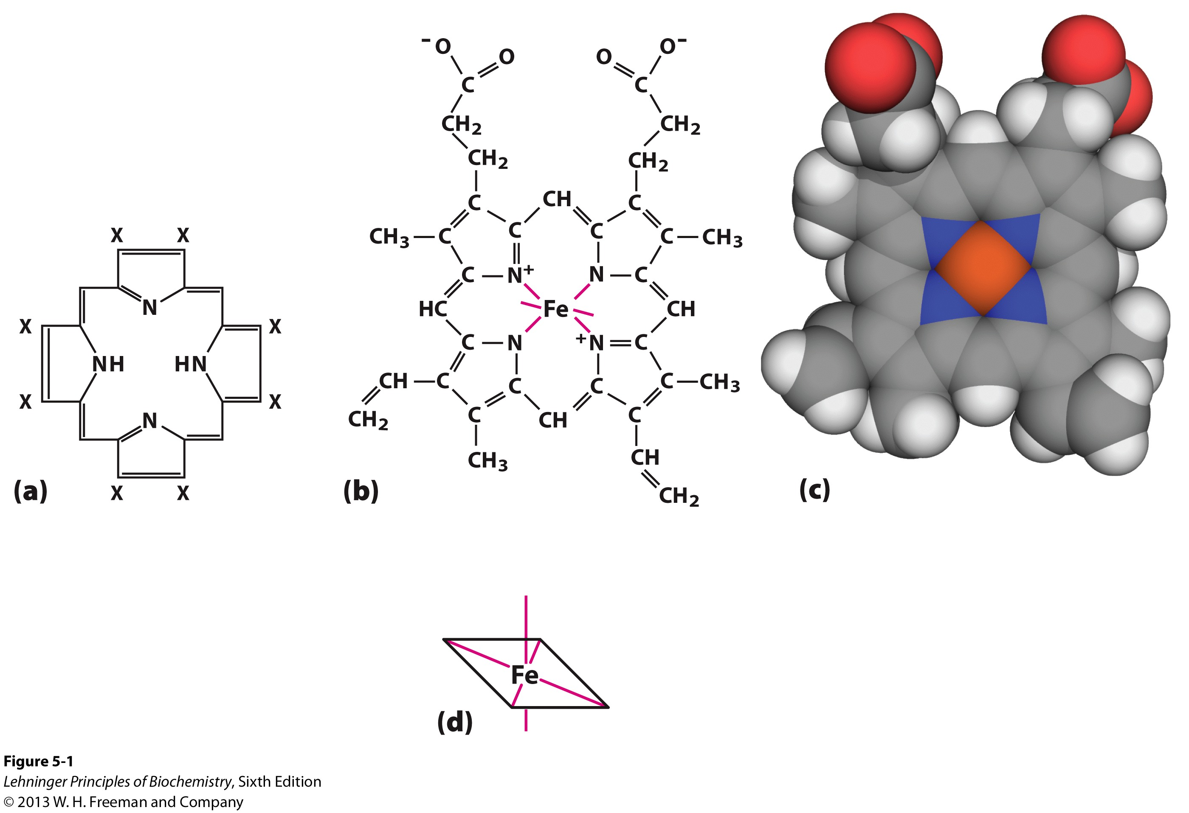
Structures of Porphyrin and Heme
Notes:
FIGURE 5–1 Heme. The heme group is present in myoglobin, hemoglobin, and many other proteins, designated heme proteins. Heme consists
of a complex organic ring structure, protoporphyrin IX, with a bound iron atom in its ferrous (Fe²⁺) state. (a) Porphyrins, of which protoporphyrin
IX is only one example, consist of four pyrrole rings linked by methene bridges, with substitutions at one or more of the positions denoted X. (b, c) Two representations of heme (derived from PDB ID 1CCR). The iron atom of heme has six coordination bonds: four in the plane of, and bonded to, the flat porphyrin ring system, and (d) two perpendicular to it.

Slide 18
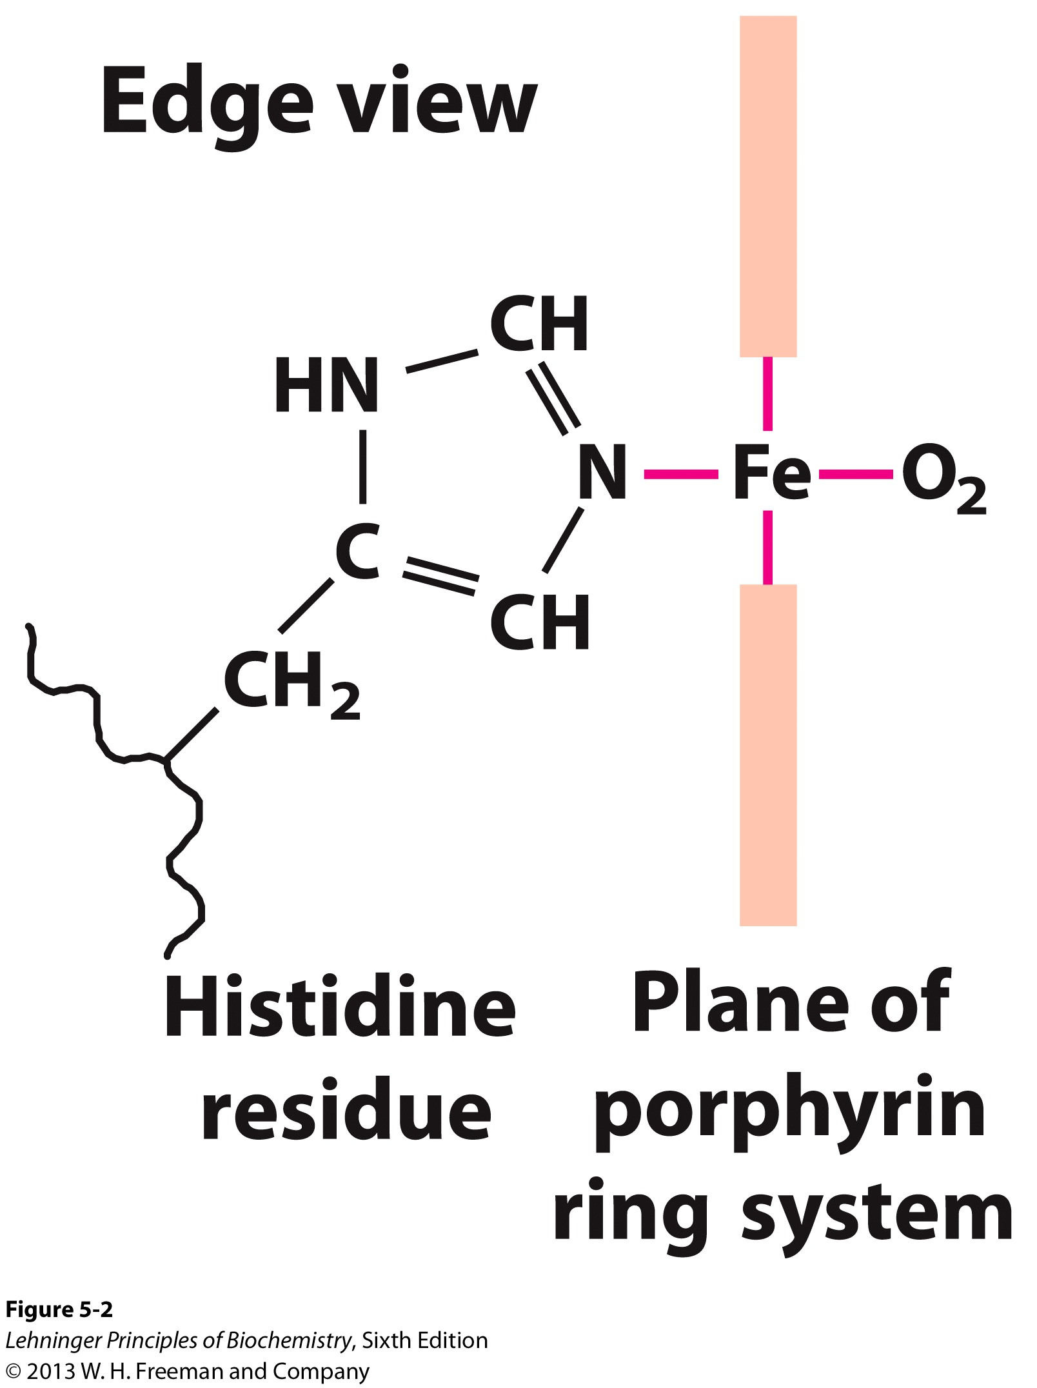
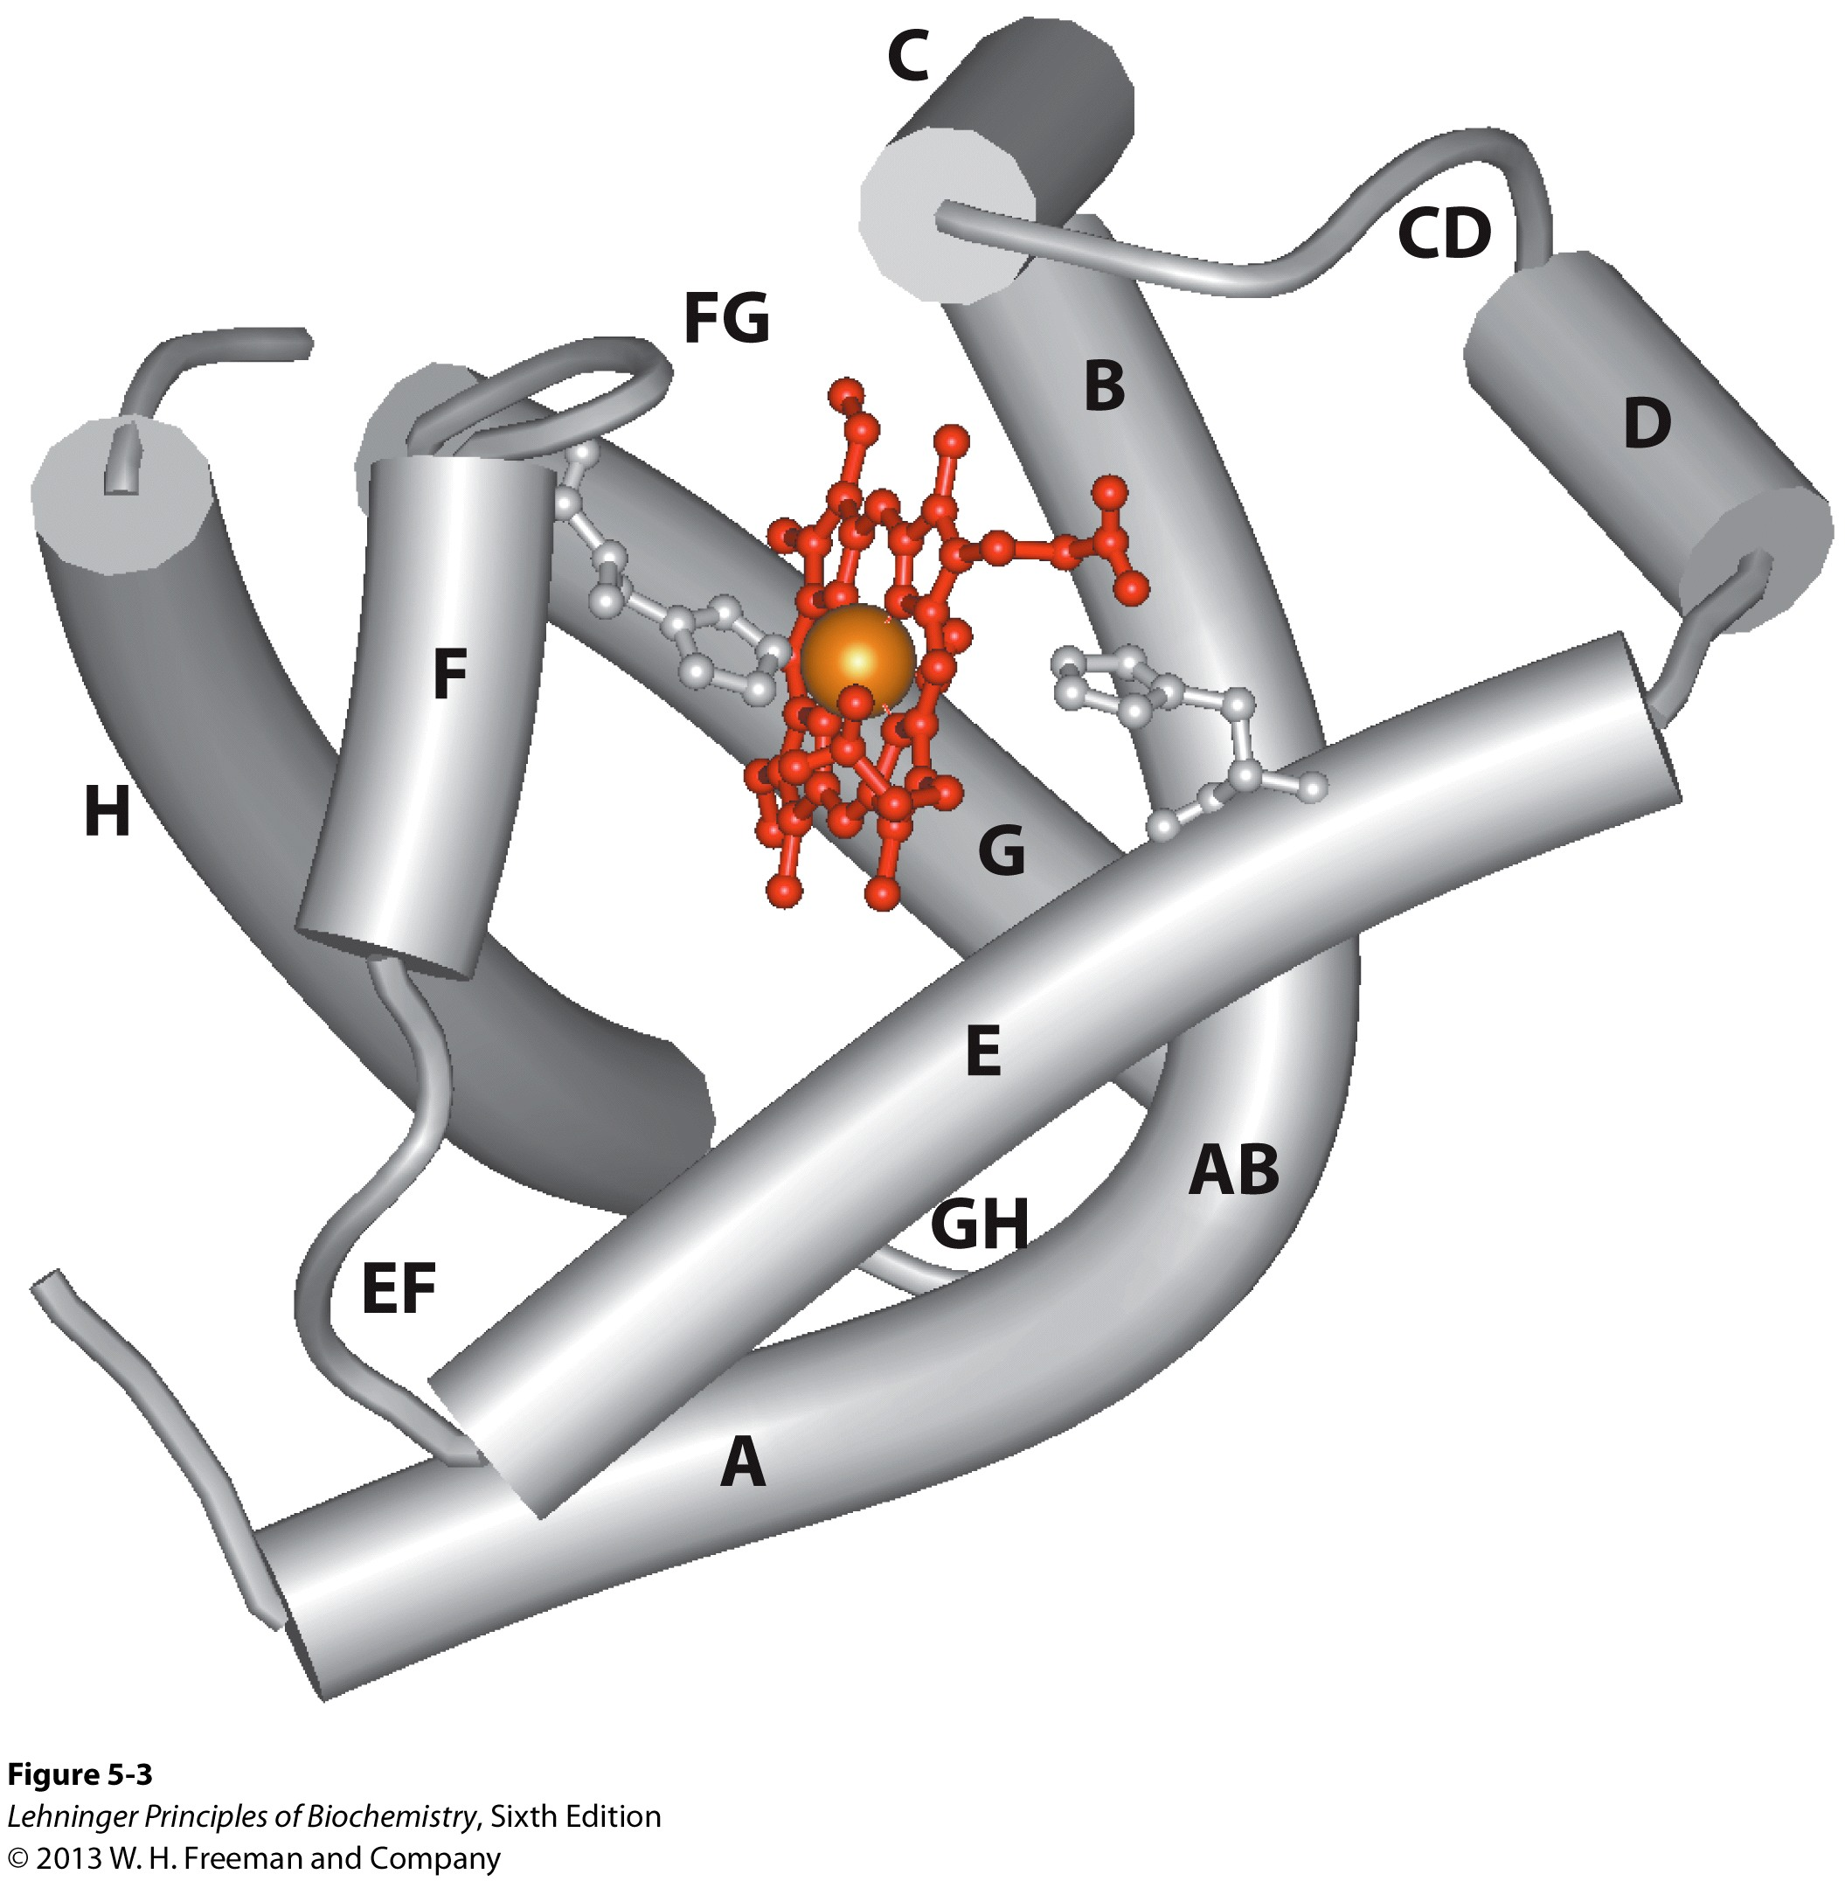
Structure of Myoglobin (1MBO)
Proximal His (F8)
Notes:
FIGURE 5–2 The heme group viewed from the side. This view shows the two coordination bonds to Fe²⁺ that are perpendicular to the porphyrin ring system. One is occupied by a His residue, sometimes called the proximal His; the other is the binding site for oxygen. The remaining four coordination bonds are in the plane of, and bonded to, the flat porphyrin ring system.
FIGURE 5–3 Myoglobin. (PDB ID 1MBO) The eight α-helical segments (shown here as cylinders) are labeled A through H. Nonhelical residues
in the bends that connect them are labeled AB, CD, EF, and so forth, indicating the segments they interconnect. A few bends, including BC
and DE, are abrupt and do not contain any residues; these are not normally labeled. (The short segment visible between D and E is an artifact
of the computer representation.) The heme is bound in a pocket made up largely of the E and F helices, although amino acid residues from
other segments of the protein also participate.

Slide 19
Binding of Carbon Monoxide
CO has similar size and shape to O₂; it can fit to the same binding site
CO binds over 20,000 times better than O₂ because the carbon in CO has a filled lone electron pair that can be donated to vacant d-orbitals on the Fe²⁺
Protein pocket decreases affinity for CO, but it still binds about 250 times better than oxygen
CO is highly toxic as it competes with oxygen. It blocks the function of myoglobin, hemoglobin, and mitochondrial cytochromes that are involved in oxidative phosphorylation

Slide 20
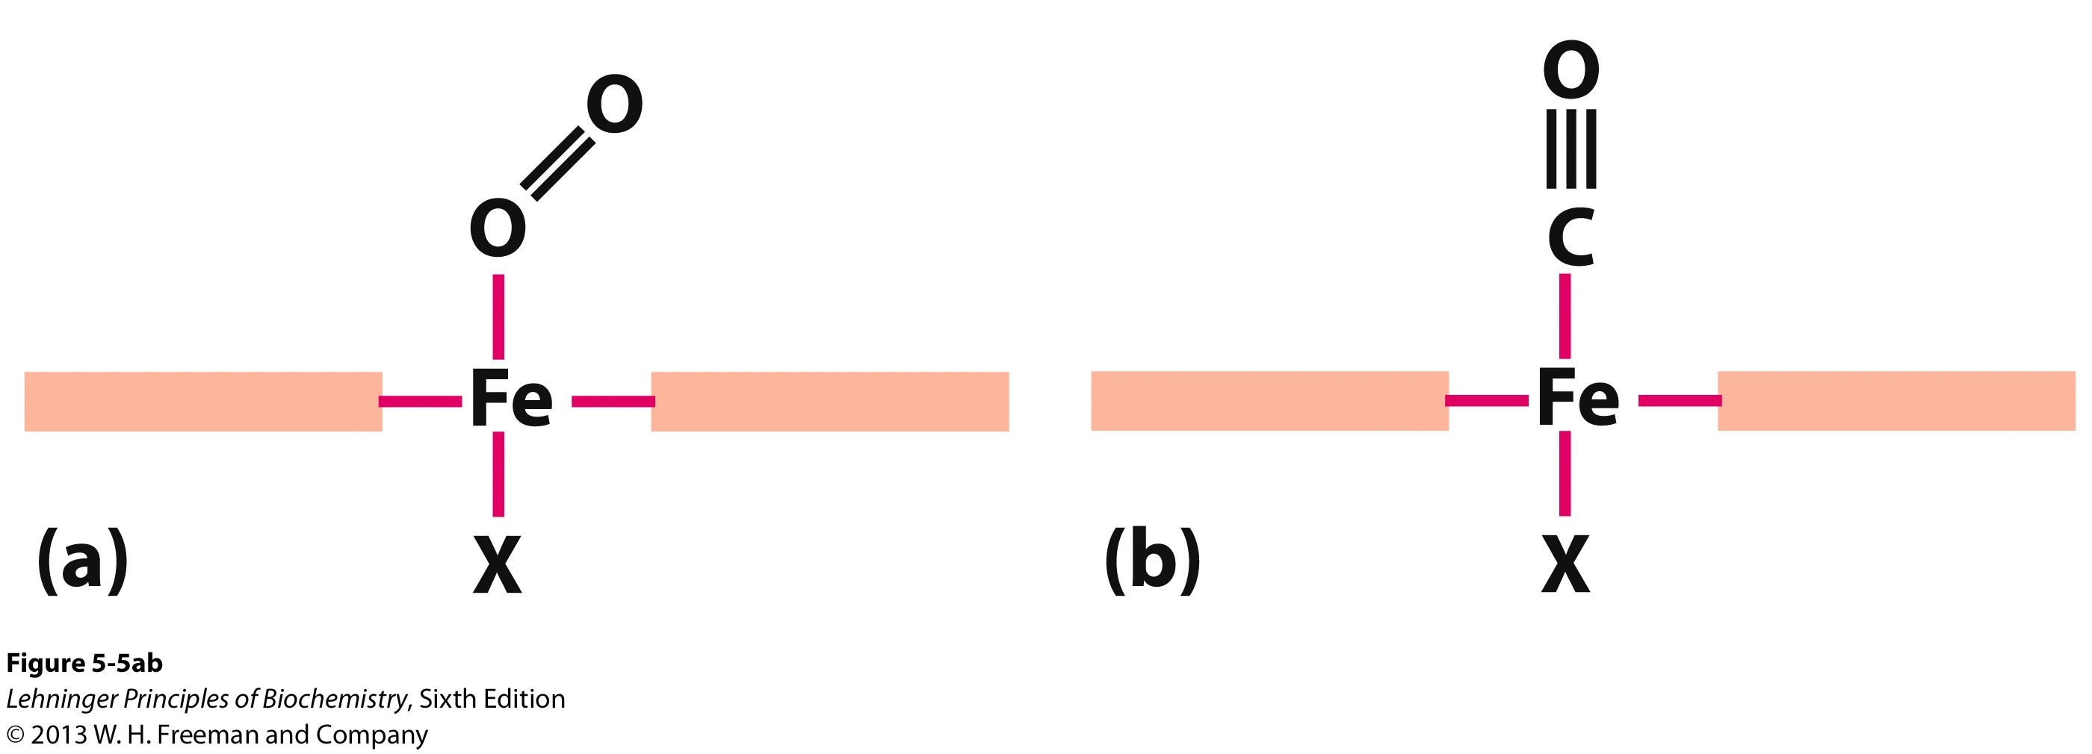
CO vs. O₂ Binding to Free Heme
When the heme group is bound to myoglobin, the CO must bind at an angle, which is weaker than the straight on binding seen in the free heme
Notes:
FIGURE 5–5a, b Steric effects caused by ligand binding to the heme of myoglobin. (a) Oxygen binds to heme with the O₂ axis at an angle, a binding conformation readily accommodated by myoglobin. (b) Carbon monoxide binds to free heme with the CO axis perpendicular to the plane of the porphyrin ring. When binding to the heme in myoglobin, CO is forced to adopt a slight angle because the perpendicular arrangement is sterically blocked by His E7, the distal His. This effect weakens the binding of CO to myoglobin.

Slide 21
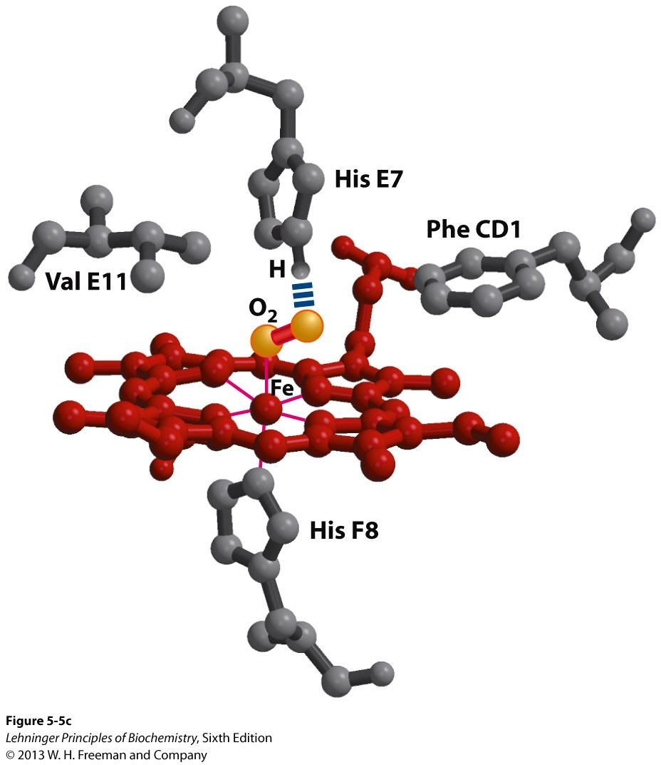
Heme binding to protein affects
CO vs. O₂ binding
Mb has a much higher affinity for oxygen than hemoglobin does, right?
Here’s why: Look at the distal His!
This caps the oxygen and keeps it bound until the pO2 is very low
Notes:
FIGURE 5-5c Steric effects caused by ligand binding to the heme of myoglobin. (c) Another view of the heme of myoglobin (derived from PDB ID 1MBO), showing the arrangement of key amino acid residues around the heme. The bound O₂ is hydrogen-bonded to the distal His, His E7 (His⁶⁴), further facilitating the binding of O₂.

Slide 22
O₂ binding to Myoglobin
Now, we’ll define p50 as the value of p_{O2} when θ =0.5 or when the pressure of oxygen in the blood when 50% of the Mb molecules are bound with oxygen (Try setting θ equal to 0.5 and solving for K_{D})

Slide 23
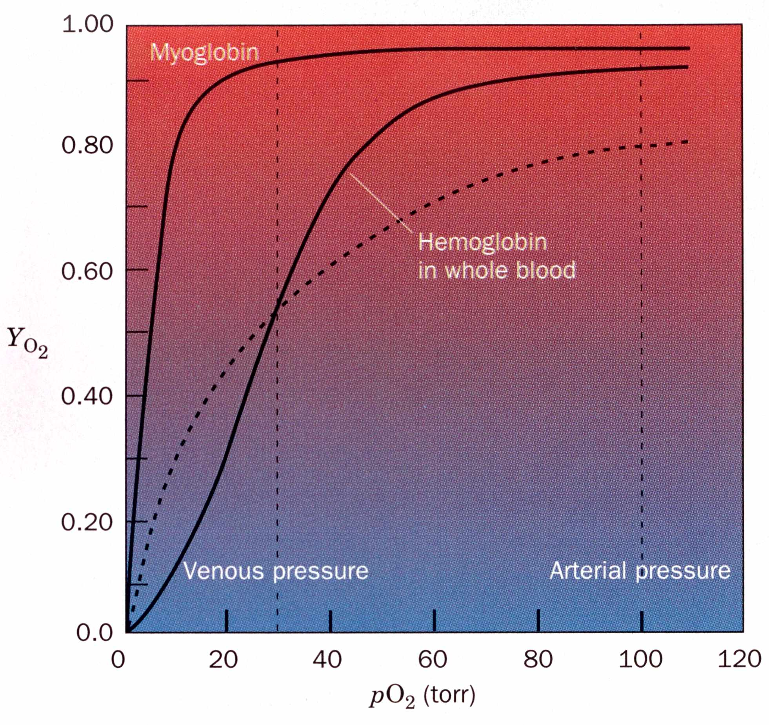
O₂ binding to Myoglobin
Normal Artery pO₂=100 Torr
Normal Vein pO₂ = 30 Torr
We see that the curve for Mb is very straightforward
Mb p50 is 2.8 Torr, so it takes very little O₂ to fill all Mb molecules
Mb doesn’t release the bound O₂ very readily over physiological pH
This means that Mb can scavenge O₂
θ

Slide 24
O₂ binding to Myoglobin
For Myoglobin,
When pO₂ falls to very low levels, O₂ is released
θ

Slide 25
O₂ binding to Hemoglobin
Huh?!
A simple θ equation cannot describe this sigmoidal curve
Hb’s oxygen binding behaviour changes significantly over physiological pO₂
θ
Dashed line is the theoretical curve if Hb had a single p50 value of 26 Torr

Slide 26
O₂ binding to Hemoglobin
θ for Hb:
0.95 @ pO₂ = 100 Torr
0.55 @ pO₂ = 30 Torr
It would seem that Hb never gives up its oxygen!
We’ll need to modulate its behaviour (Bohr Effect)
Hb releases O₂ at the same pressure that Mb becomes saturated
The sigmoidal curve is indicative of Cooperativity
The ligand binding sites of Hb are somehow “talking” to one another and the binding of a ligand in one site affects the binding in the other sites.
θ
Dashed line is the theoretical curve if Hb had a single p50 of 26 Torr

Slide 27
How can affinity to oxygen change?
Must be a protein with multiple binding sites
Binding sites must be able to interact with each other
This phenomenon is called cooperativity
positive cooperativity
first binding event increases affinity at remaining sites
recognized by sigmoidal binding curves
negative cooperativity
first binding event reduces affinity at remaining sites

Slide 28
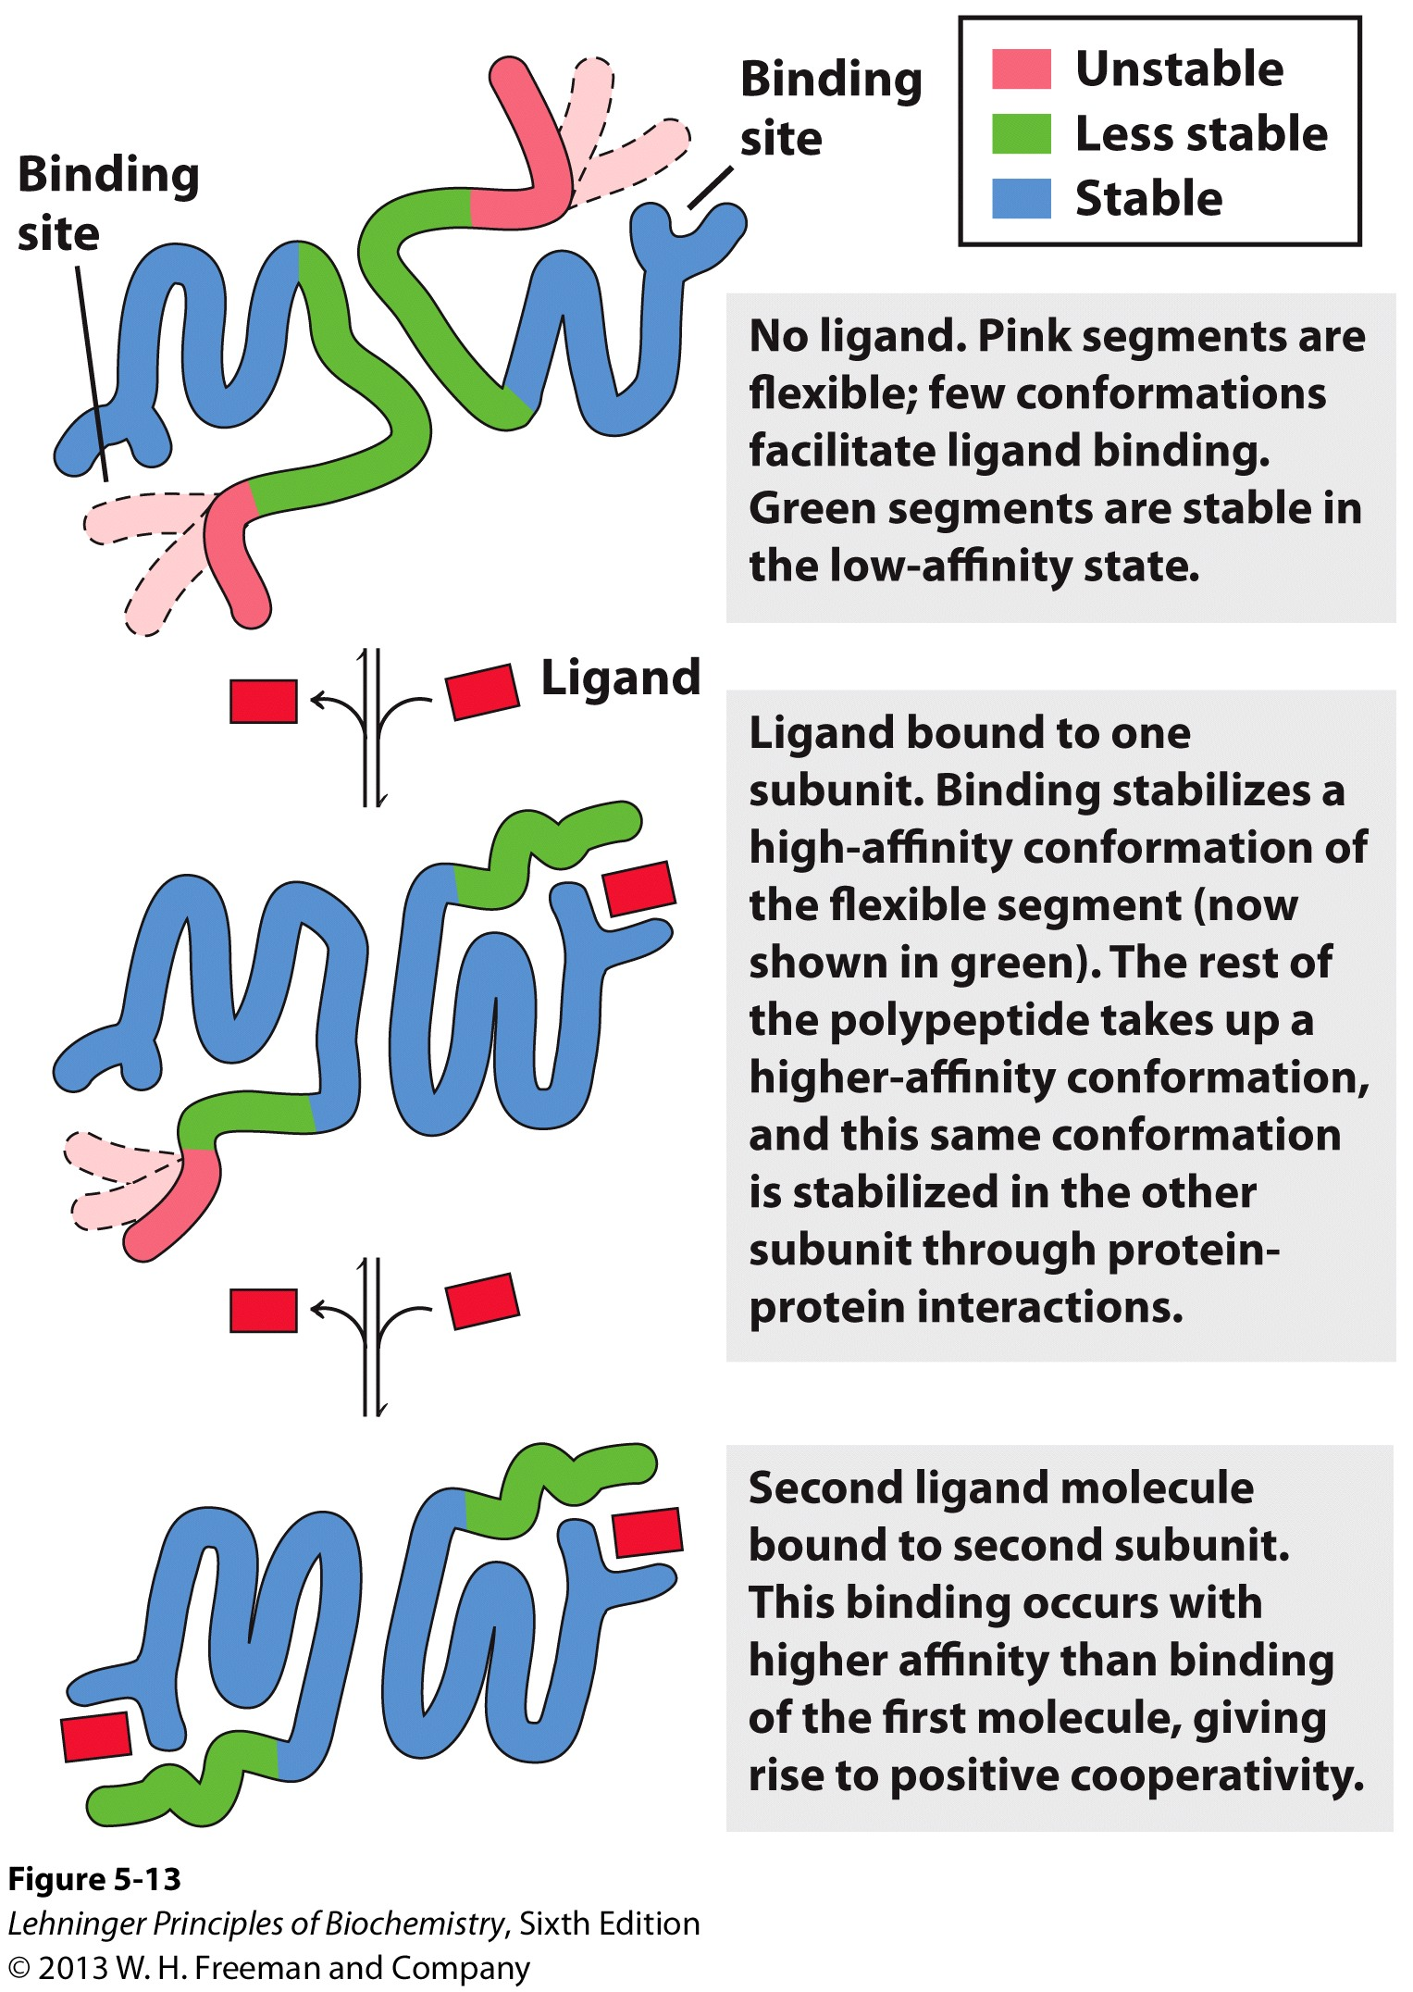
Cooperativity
Notes:
FIGURE 5–13 Structural changes in a multisubunit protein undergoing cooperative binding to ligand. Structural stability is not uniform throughout a protein molecule. Shown here is a hypothetical dimeric protein, with regions of high (blue), medium (green), and low (red) stability. The ligand-binding sites are composed of both high- and low-stability segments, so affinity for ligand is relatively low. The conformational
changes that occur as ligand binds convert the protein from a low- to a high-affinity state, a form of induced fit.

Slide 29
The Hill Equation
Take a protein (P) that has n subunits, each of which can bind a ligand
2.
1.
Remember: Fractional Saturation, θ = bound/total

Slide 30
As we did before, combine those two equations to get the Hill Equation
or
Looks similar to Mb + O₂ except for the n
The Hill equation describes the degree of saturation of a multisubunit protein as a function of ligand concentration

Slide 31
The Hill Equation
The quantity “n” is the Hill Constant
The Hill Constant increases with the degree of cooperativity of a reaction
Mb has n=1 and is therefore, Non-cooperative
If n>1, then the binding of a ligand increases the affinity of the other binding sites for the ligand: Positive Cooperativity
If n<1, then the binding of a ligand decreases the affinity of the other binding sites for the ligand: Negative Cooperativity

Slide 32
Hill Plot
We can rearrange the Hill Equation to show the saturation curve graphically:
y = mx + b

Slide 33
Hill Plot
For Hemoglobin:
y = mx + b

Slide 34
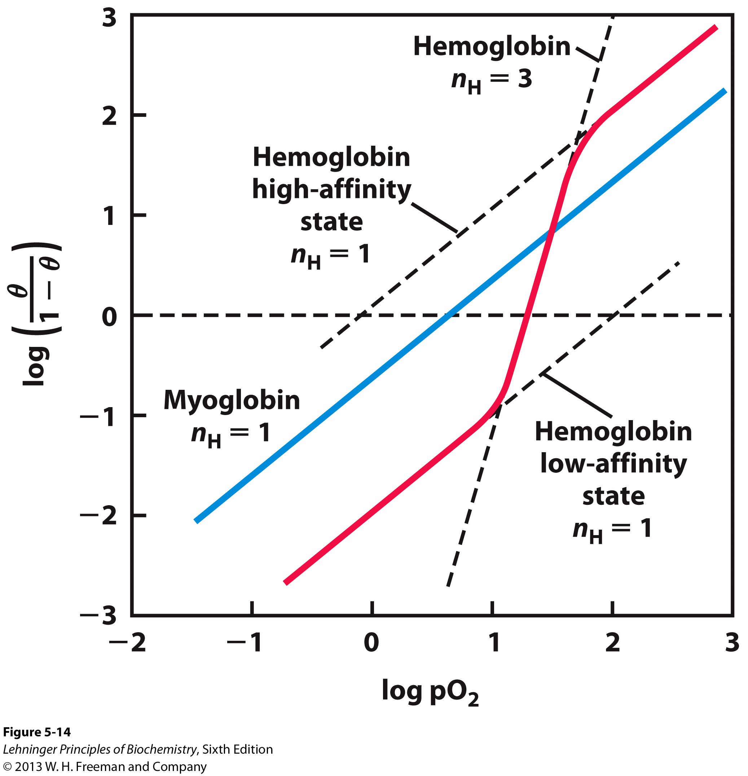
@p50, θ = 0.5
When θ = 0.5, (θ/1−θ) = 1
And log(1) = 0
Maximum slope occurs @ p50 (n=3)
If we extrapolate to the p50 line from either asymptote, we can see that the enzyme has an affinity for the first O₂ molecule of 30 Torr and the affinity for the last molecule is 0.3 Torr.
That’s a 100 fold change in affinity from the first molecule to the last!
At low pO₂ values, Hb gives up its bound oxygen easier than at higher pressures

Slide 35
Models of Allostery
Allostery and Allosteric Interactions come from the Greek words for “Other” and “Space”
Cooperativity and Allostery are innately tied together
The binding of an Allosteric Effector influences the binding of a ligand at another site
If the ligand and the effector are identical, then the interaction is called a Homotropic Effect
Hb binding O₂ in one site influences the binding of O₂ in another subunit. This is an example of the homotropic effect

Slide 36
Models of Allostery
The Monod/Wyman/Changeaux (MWC) or Symmetry Model
Essentially, all the similar subunits of a multimeric complex must be in the same state.
“All or None”
Tenets of the Model:
An allosteric protein is an oligomer of symmetry related protomers.
Each protomer can exist in 2 different conformations, designated as “Tense” or “Relaxed”
These protomers are always in equilibrium with each other
The ligand can bind to a protomer in either conformation
The specific conformation of the protomer dictates its affinity
The molecular symmetry of the protein is always conserved during the conformational change

Slide 37
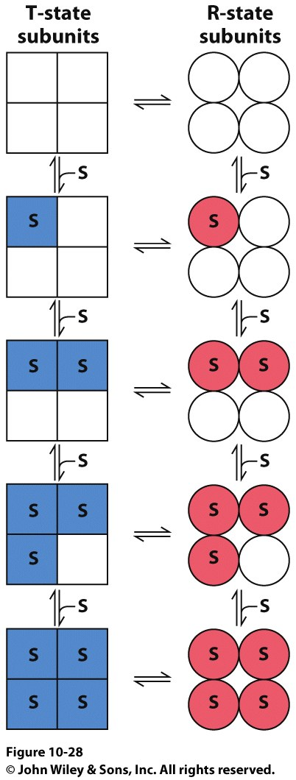
The MWC Model
In other words…
All subunits are either T or R and the 2 conformations are always in equilibrium
Remember what equilibrium means: It DOESN’T mean that they population of each state are equal
The ligand can bind to either conformation, but it does so with differing affinities for each
Still allows for selectivity and different Hill coefficients of different states
As more and more ligand molecules bind the equilibrium shifts towards the high affinity conformation, why?
We’ve already paid an energy cost to convert everything to the R-State when the first ligand bound and stayed that way
Binding more ligands into more R-State subunits gives us more energy release without paying the T->R conversion cost

Slide 38
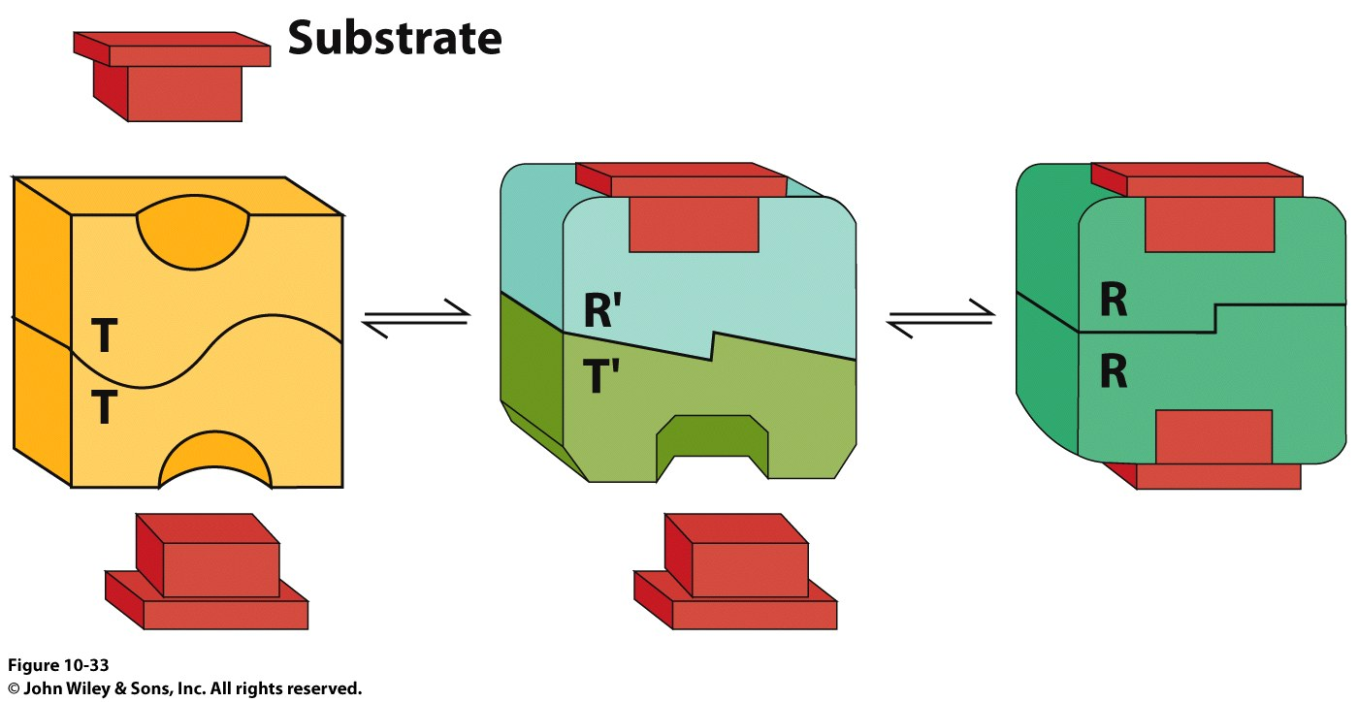
Models of Allostery
The Koshland, Nemethy, Filmer (KNF) or Sequential Model
Daniel Koshland felt that the MWC model was too limiting and unlikely.
Hybrid conformations/mixtures (eg: TRRR and RTTT) had to exist.
The KNF Model is based upon the concept of Induced Fit w.r.t. enzyme activity.
The binding of ligand to the T state induces a conformational change that predisposes an Adjacent subunit to bind ligand.

Slide 39
Models of Allostery
The Koshland, Nemethy, Filmer (KNF) or Sequential Model
The affinity of a a subunit for ligand varies with the number of bound ligands.
This is different from the MWC model which says that only conformation determines the affinity.
See the difference?

Slide 40
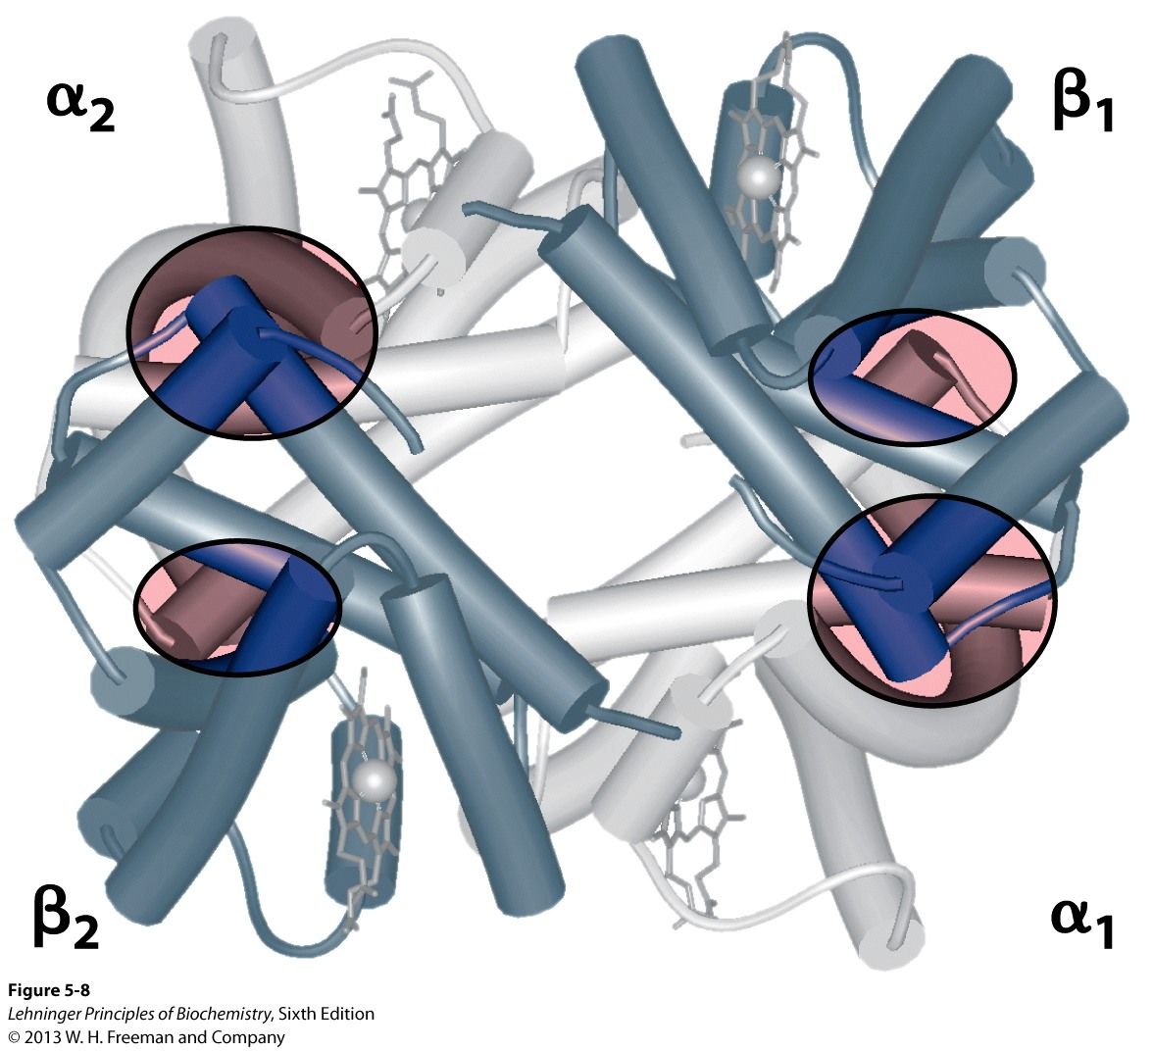
Subunit Interactions in Hemoglobin
Notes:
FIGURE 5–8 Dominant interactions between hemoglobin subunits. (PDB ID 1HGA) In this representation, α subunits are light and β subunits are dark. The strongest subunit interactions (highlighted) occur between unlike subunits. When oxygen binds, the α₁β₁ contact changes
little, but there is a large change at the α₁β₂ contact, with several ion pairs broken.

Slide 41
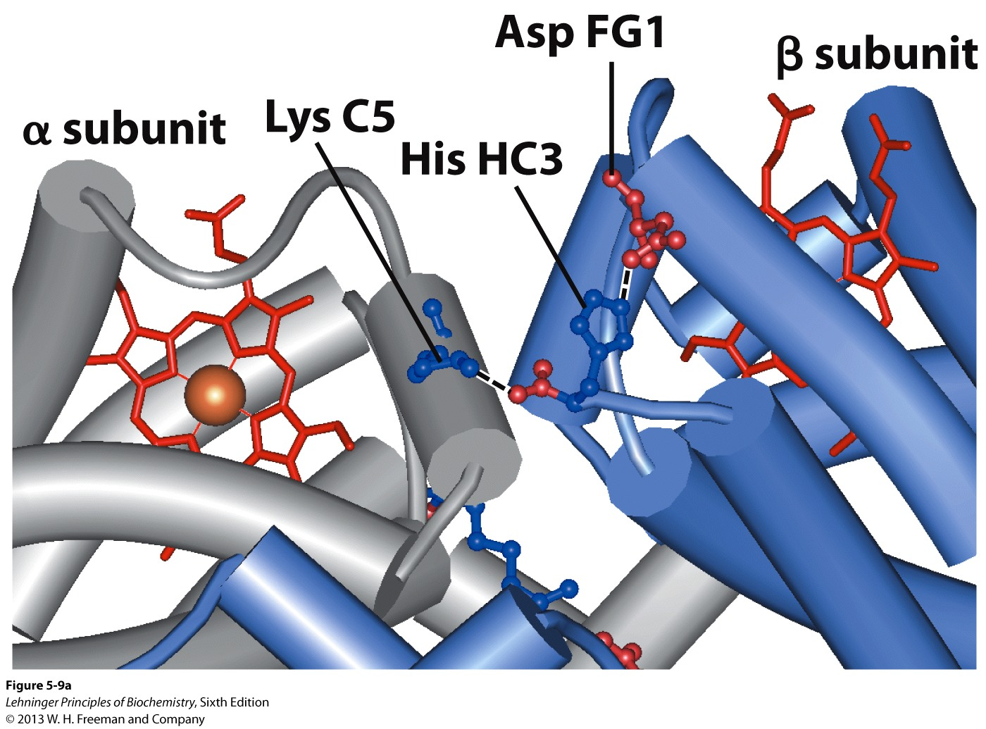
Subunit Interactions: Details
Notes:
FIGURE 5–9a Some ion pairs that stabilize the T state of deoxyhemoglobin. (a) Close-up view of a portion of a deoxyhemoglobin molecule in the T state (PDB ID 1HGA). Interactions between the ion pairs His HC3 and Asp FG1 of the β subunit (blue) and between Lys C5 of the α subunit (gray) and His HC3 (its α-carboxyl group) of the β subunit are shown with dashed lines. (Recall that HC3 is the carboxyl-terminal residue of the β subunit.)

Slide 42
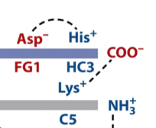
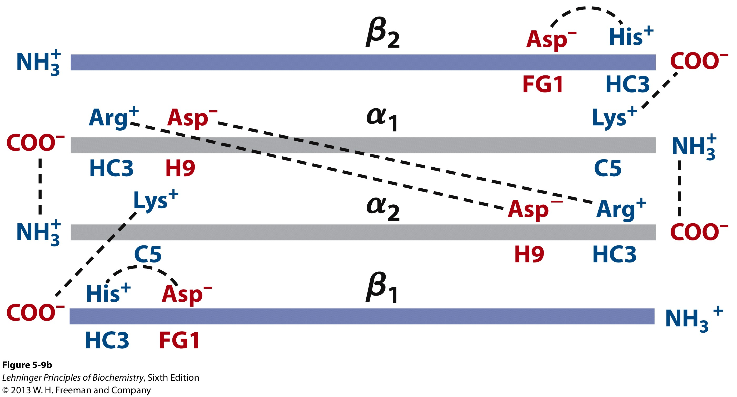
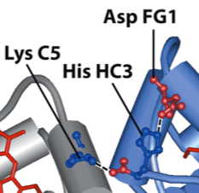
Subunit Interactions: Details
Notes:
FIGURE 5-9b Some ion pairs that stabilize the T state of deoxyhemoglobin. (b) Interactions between these ion pairs, and between others not shown in (a), are schematized in this representation of the extended polypeptide chains of hemoglobin.

Slide 43
R and T States of Hemoglobin
T = Tense state,
More interactions, more stable
Lower affinity for O₂
R = Relaxed state,
Fewer Interactions, more flexible
Higher affinity for O₂
O₂ binding triggers a T → R conformational change
Conformational change from the T state to the R state involves breaking ion pairs between the α1-β2 interface

Slide 44
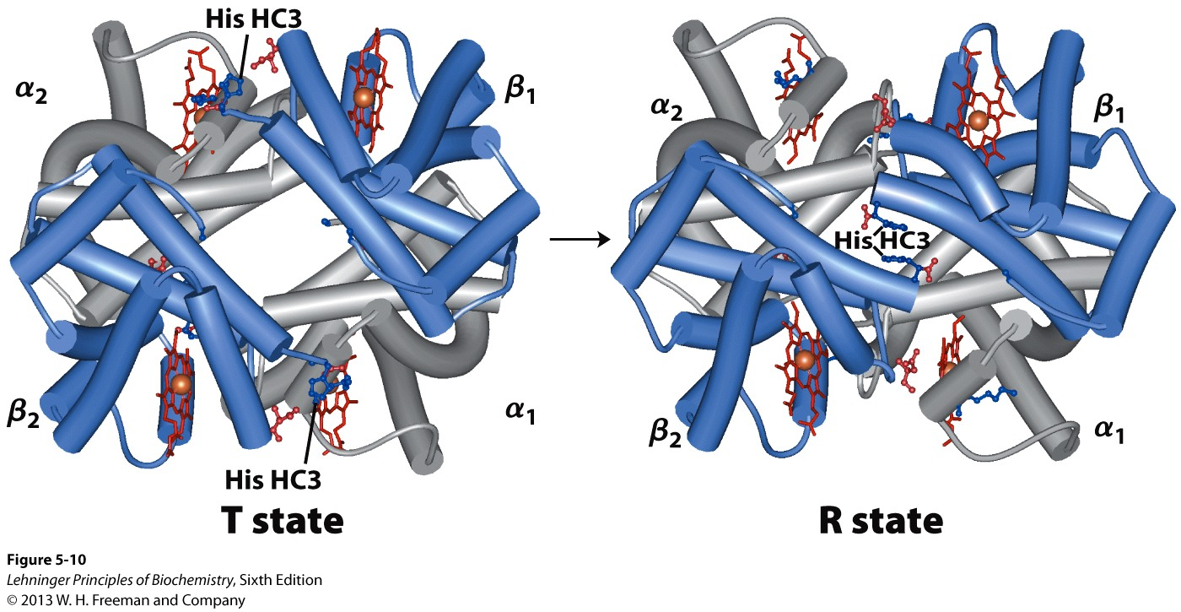
R and T States of Hemoglobin
Notes:
FIGURE 5–10 The TR transition. (PDB ID 1HGA and 1BBB) In these depictions of deoxyhemoglobin, as in Figure 5–9, the β subunits are
blue and the α subunits are gray. Positively charged side chains and chain termini involved in ion pairs are shown in blue, their negatively charged partners in red. The Lys C5 of each α subunit and Asp FG1 of each β subunit are visible but not labeled (compare Fig. 5–9a). Note that the molecule is oriented slightly differently than in Figure 5–9. The transition from the T state to the R state shifts the subunit pairs substantially, affecting certain ion pairs. Most noticeably, the His HC3 residues at the carboxyl termini of the β subunits, which are involved in ion pairs in the T state, rotate in the R state toward the center of the molecule, where they are no longer in ion pairs. Another dramatic result of the TR transition is a narrowing of the pocket between the β subunits.

Slide 45
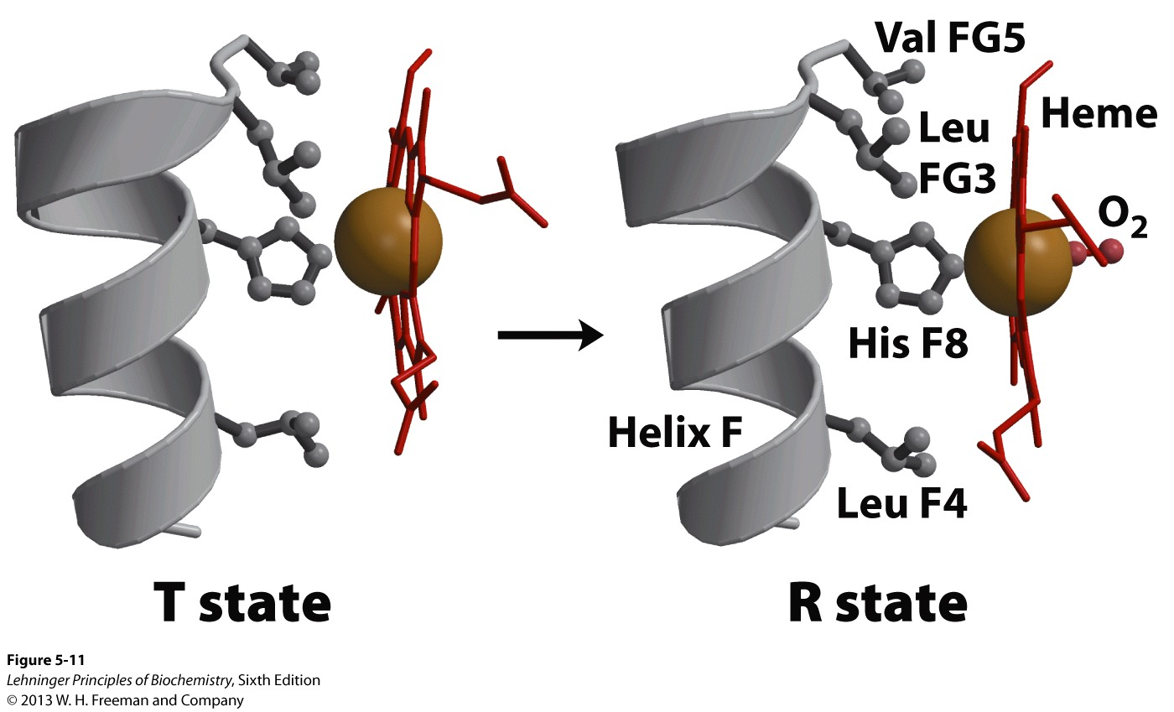
Conformational change is triggered by oxygen binding
Notes:
FIGURE 5-11 Changes in conformation near heme on O₂ binding to deoxyhemoglobin. (Derived from PDB ID 1HGA and 1BBB) The shift in the position of helix F when heme binds O₂ is thought to be one of the adjustments that triggers the T → R transition.

Slide 46
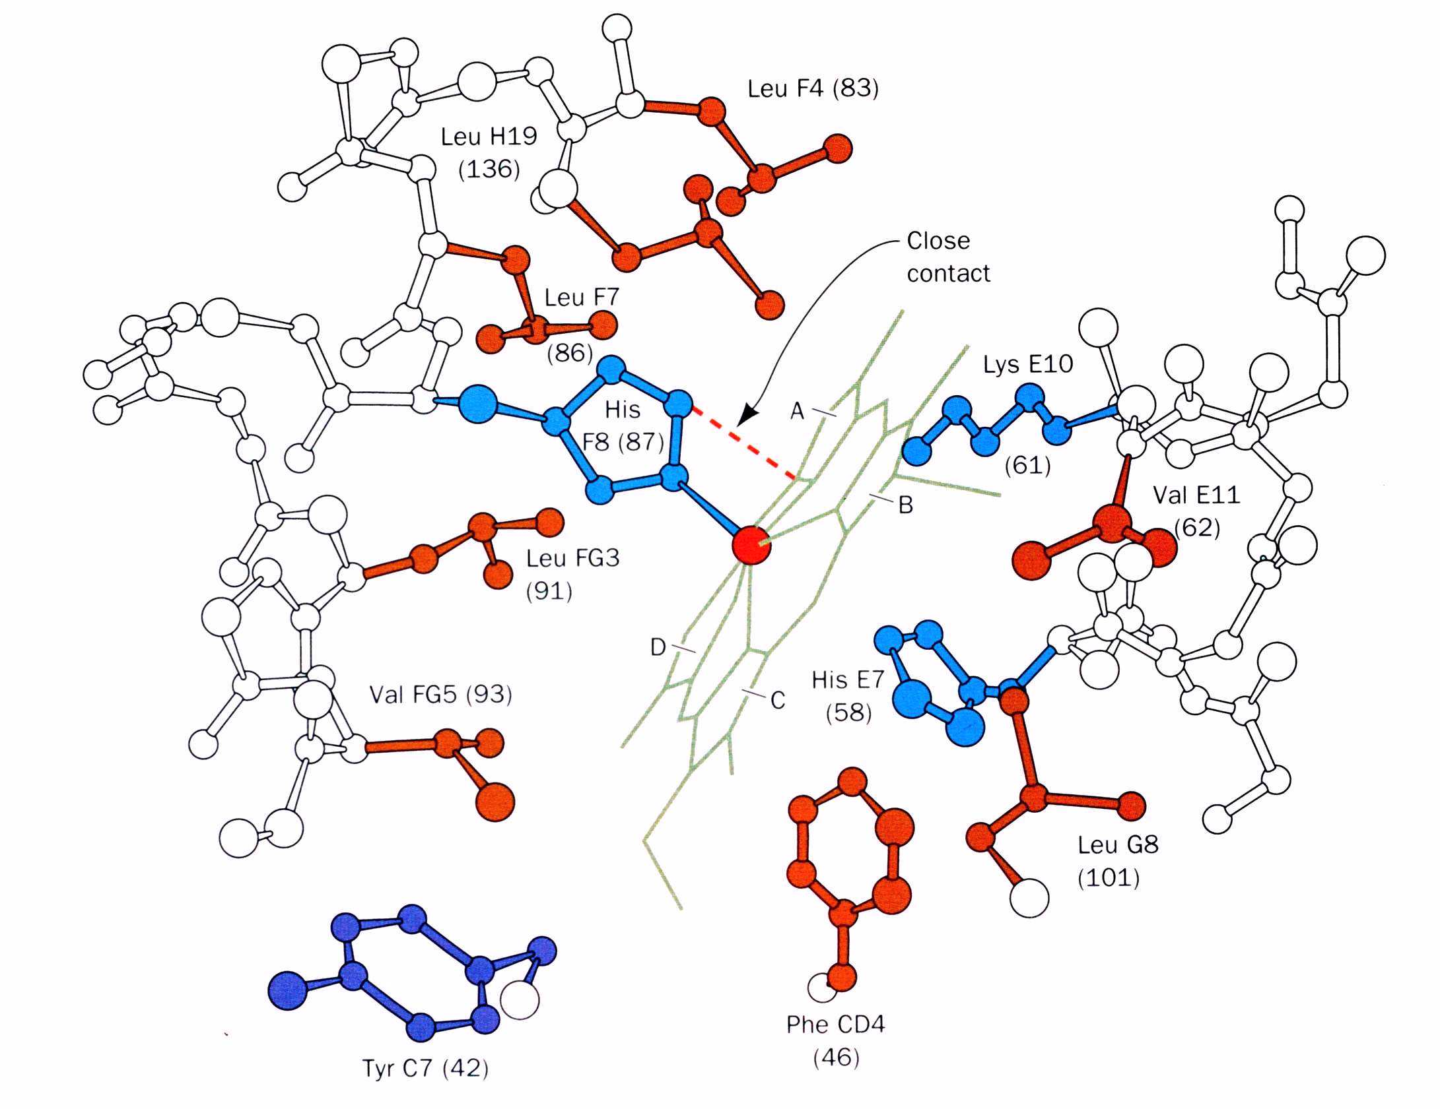
Mechanism of Cooperativity in Hb
The proximal His in Hb (His87) is tightly packed in a pocket
This restricts its motion until it is pulled and even then, it has to move with its neighbors

Slide 47
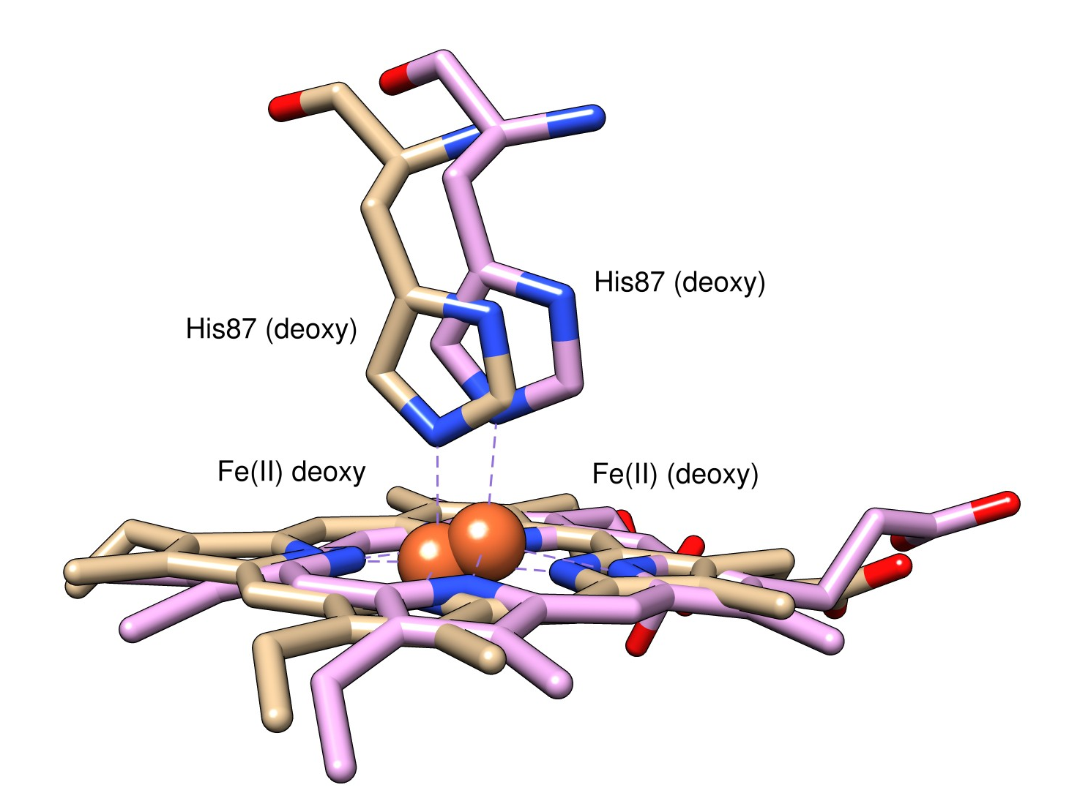
Mechanism of Cooperativity in Hb
The movement of the Fe(II) into the plane of the heme ring upon oxygen binding triggers the T-state to R-state transition
His87 (F8) is pulled by the by the Fe(II) a distance of 0.6Å (compared to only 0.3Å in Mb)
This tilts the F-Helix and translates it 1Å across the plane of the helix
(Oxy)
(Oxy)

Slide 48
Conformation of deoxy- and oxyhemoglobin
Motion of the α1 subunit going from the T-state to the R-state

Slide 49
Conformation of deoxy- and oxyhemoglobin
Motion of the β1 subunit going from the T-state to the R-state

Slide 50
Conformational Change upon Oxygenation
Notes:
Note the twist of the a1b1 and a2b2 dimers. That pair doesn’t change as much as the a1b2 and a2b1 pairs do.

Slide 51
pH Effect on O₂ Binding to Hemoglobin
Actively metabolizing tissues generate H⁺, lowering the pH of the blood near the tissues relative to the lungs
Hb Affinity for oxygen depends on the pH
H⁺ binds to Hb and stabilizes the T state
Protonates His146 which then forms a salt bridge with Asp94
Leads to the release of O₂ (in the tissues)
The pH difference between lungs and metabolic tissues increases efficiency of the O₂ transport
This is known as the Bohr effect

Slide 52
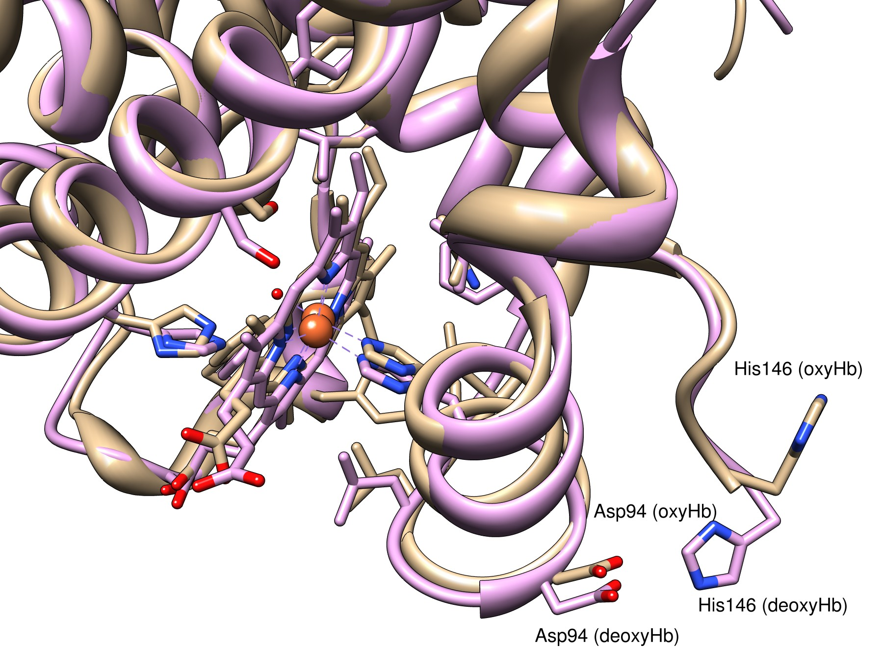
The Bohr Effect
When Hb binds to O₂, it undergoes a conformational change that exposes some amino acid side chains to solvent, specifically His146.
The His146 residue is normally involved in a salt-bridge with Asp94
His146 swings out and deprotonates
deoxyHb = 2DHB oxyHb = 2MHB
As blood pH decreases, the increased [H+] causes protonation of His146, stabilizing the T-State which makes Hb deposit its oxygen in tissues with high [CO₂]
His146 (oxyHb) pKa=6.27 His146 (deoxyHb) pKa=7.40

Slide 53
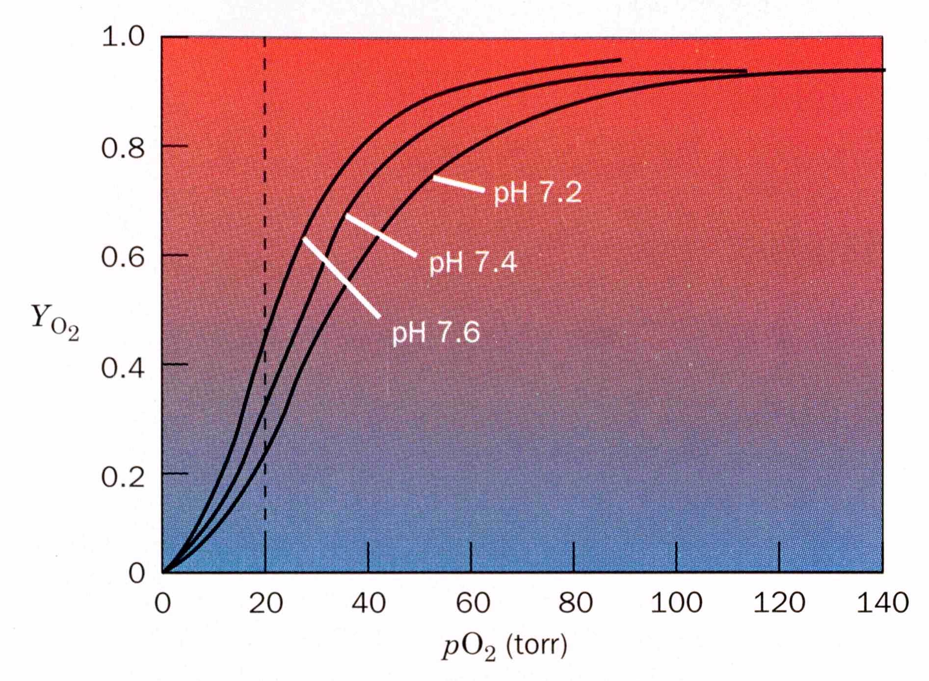
At increasing pH values, Hb has been driven to bind more oxygen at lower pO₂ values (Its affinity has increased)

Slide 54
Look at the relationship between pH and the p50 values for oxygen binding.
As the pH increases, the p50 value decreases, indicating that the protein binds more oxygen. The opposite effect occurs when the pH decreases.
At 20 torr 10 more oxygen is released when the pH drops from 7.4 to 7.2!!
As oxygen is consumed, CO₂ is released.
Carbonic Anhydrase catalyzes this reaction in red blood cells.

Slide 55
CO₂ in the blood is transported as HCO₃⁻
In Capillaries:
pO₂ is low
H⁺ generated in bicarbonate formation is taken up by Hb
Causes Hb to unload O₂
More HCO₃⁻ is made b/c the removal of H⁺ from the bulk by Hb shifts the equilibrium towards consumption of CO₂ and H⁺ production

Slide 56
CO₂ in the blood is transported as HCO₃⁻
In the Lungs:
pO₂ is high
Causes Hb to bind O₂ and release H⁺ from His146
The added H⁺ shifts the equilibrium towards CO₂ production which is exhaled

Slide 57
CO₂ in the blood is transported as HCO₃⁻
In Active Muscles:
Lactic acid production decreases the pH which drives Hb to release O₂ and pick up protons on His146
This drives CO₂ solubilization into HCO₃⁻ and it is carried into the lungs

Slide 58
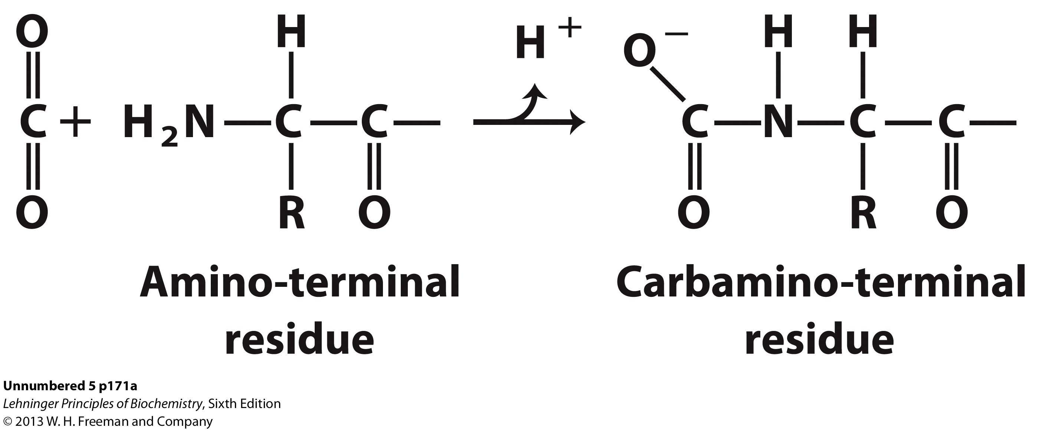
Hemoglobin and CO₂ Export
CO₂ is produced by metabolism in tissues and must be exported
15–20% of CO₂ is exported in the form of a carbamate on the amino terminal residues of each of the polypeptide subunits.
Notice:
the formation of a carbamate yields a proton which can contribute to the Bohr Effect
the carbamate forms additional salt bridges stabilizing the T state
The rest of the CO₂ is exported as dissolved bicarbonate
Formed by carbonic anhydrase, and also producing a proton

