Slide 1
Lecture 15: Biological Redox Reactions
Almost everyone has a dehydrogenase or a racemase as one of their assigned enzymes
Biological Redox Reactions rely upon COFACTORS to do the “heavy lifting” of the electrons
NAD/NADH
FAD/FADH₂
Pyridoxal Phosphate: The Electron Sink

Slide 2
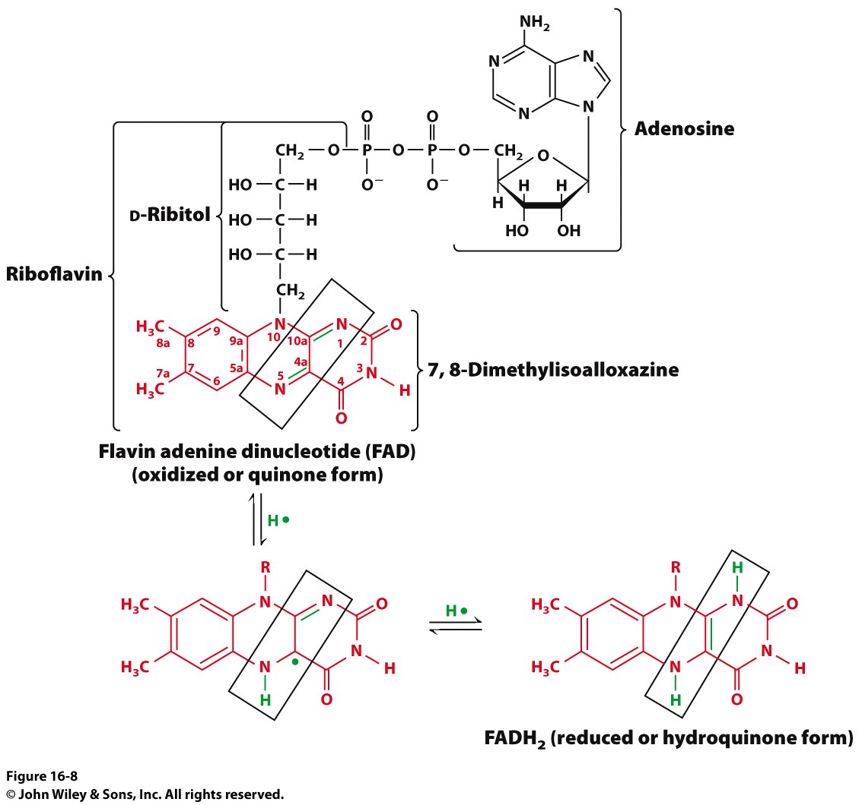
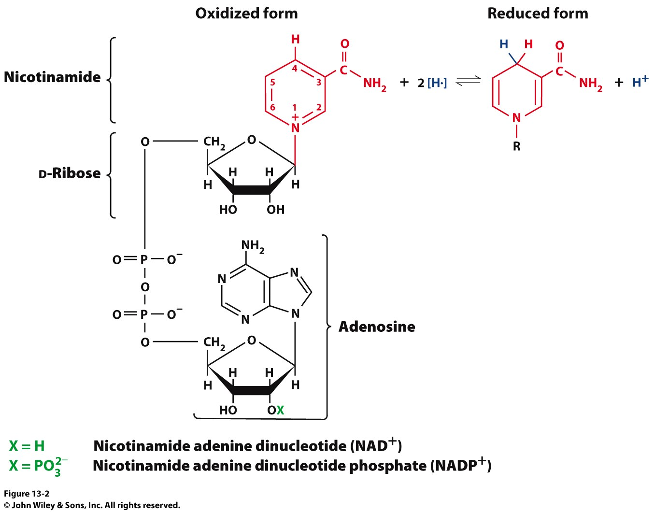
NAD⁺/NADH and FAD/FADH₂
The currency of biological redox reactions is the Hydride Ion.
NAD⁺ -> NADH + H⁺
FAD -> FADH -> FADH₂
These cofactors are really Electron Carriers

Slide 3
Oxidoreductases
Enzymes provide proximity and proper orientation for substrates to interact.
Oxidoreductases constitute a large group of enzymes. They catalyze the transfer of electrons from one molecule to another.
Within this class of enzymes, hydrogen atoms and hydride ions are the most common groups transferred.
Alcohol dehydrogenase (ADH) oxidizes alcohol into aldehyde or ketone through the reduction of NAD⁺ to NADH.

Slide 4
Oxidoreductases
We are going to look at 2 specific enzymes that use NAD+ as a cofactor and 3 general reactions catalyzed by the cofactor PLP
NAD+ Utilizing Enzymes
Alcohol dehydrogenase
Glycerol dehydrogenase
PLP-Catalyzed Reactions
Racemization
Decarboxylation
Retro-aldol reaction

Slide 5
ADH
Catalyzes the NAD-dependent oxidation of ethanol to acetaldehyde

Slide 6
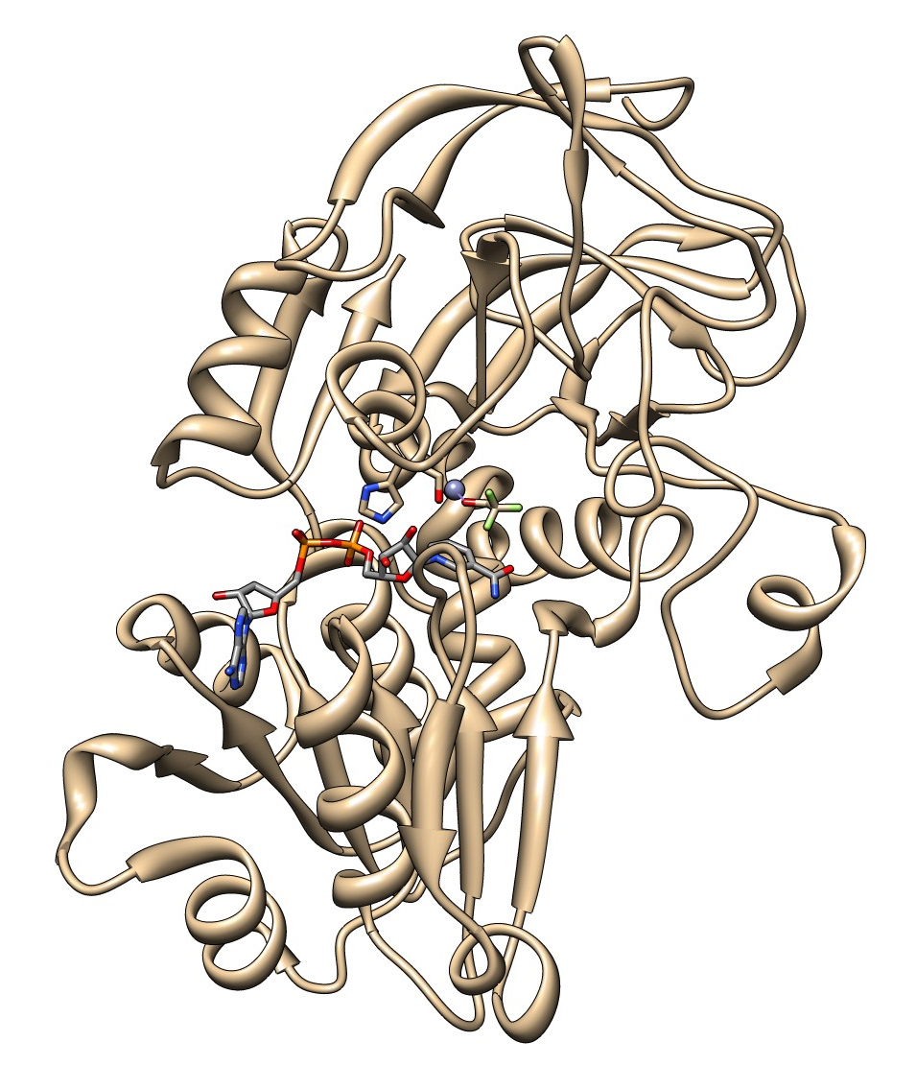
Alcohol Dehydrogenase (4DXH)

Slide 7
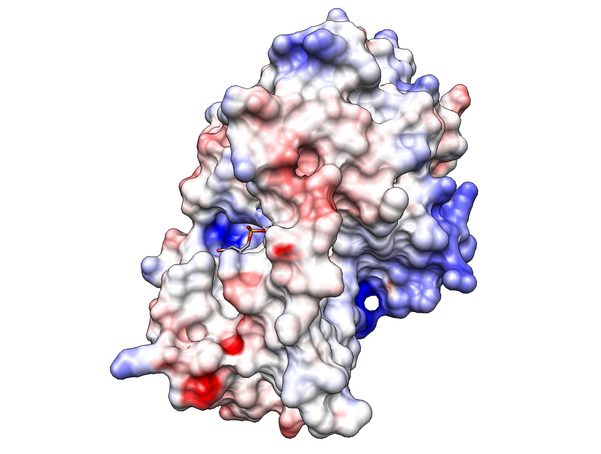
Alcohol Dehydrogenase (ADH)
Alcohol
NAD⁺

Slide 8
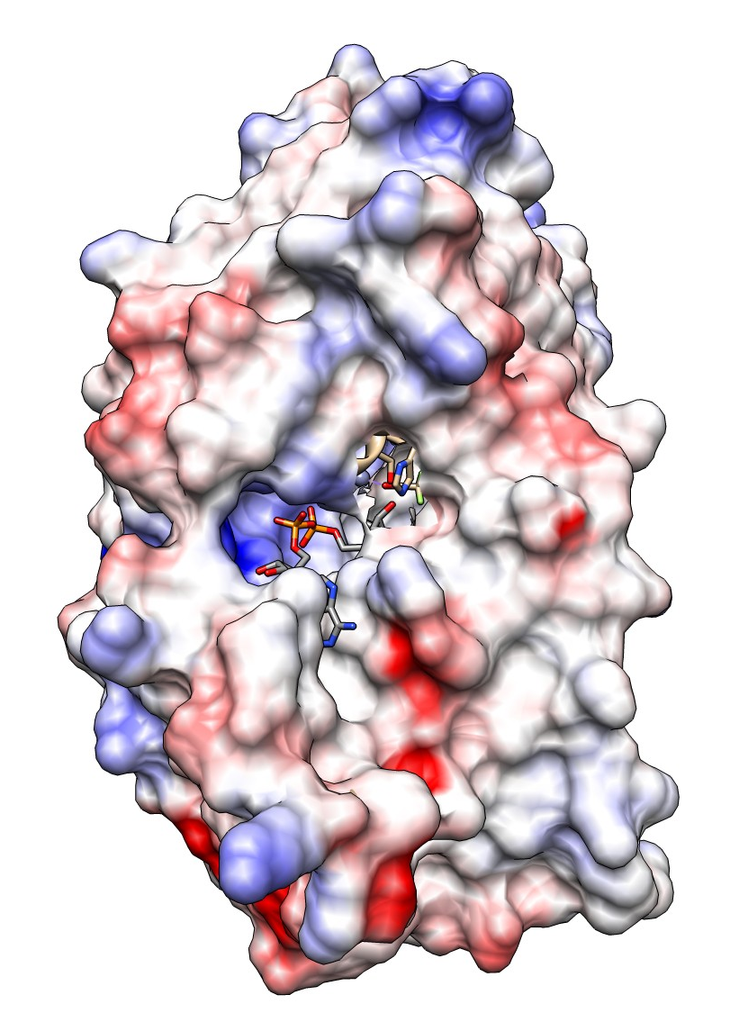
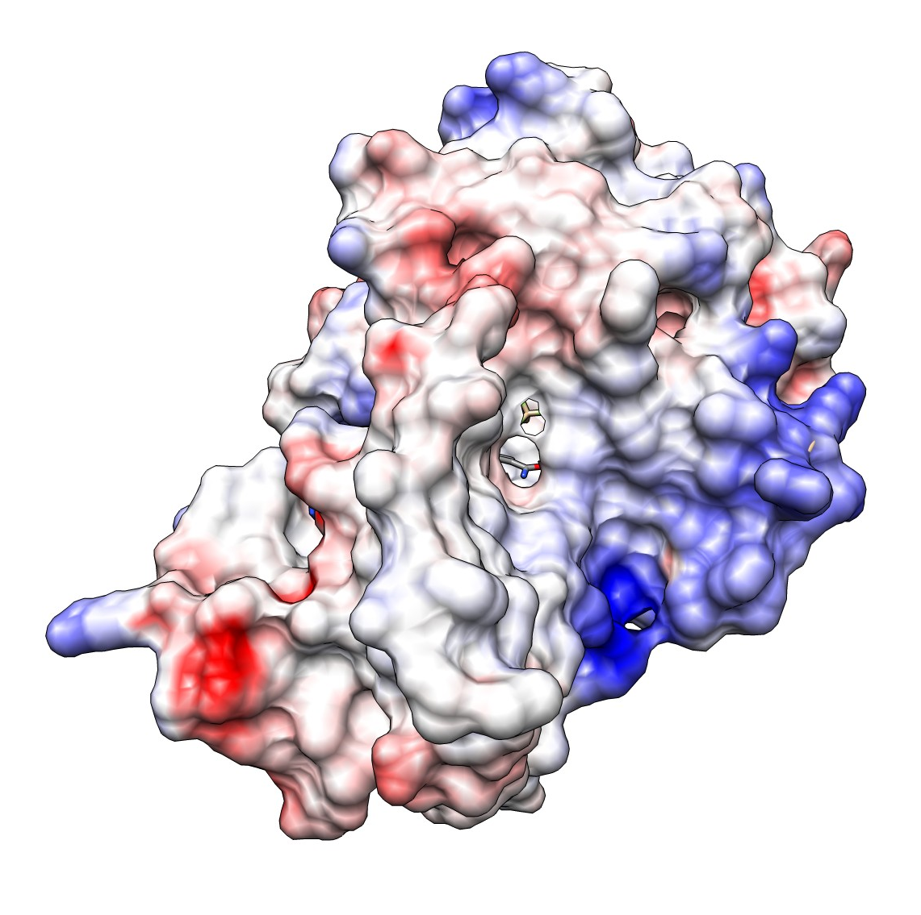
Alcohol Dehydrogenase (ADH)

Slide 9
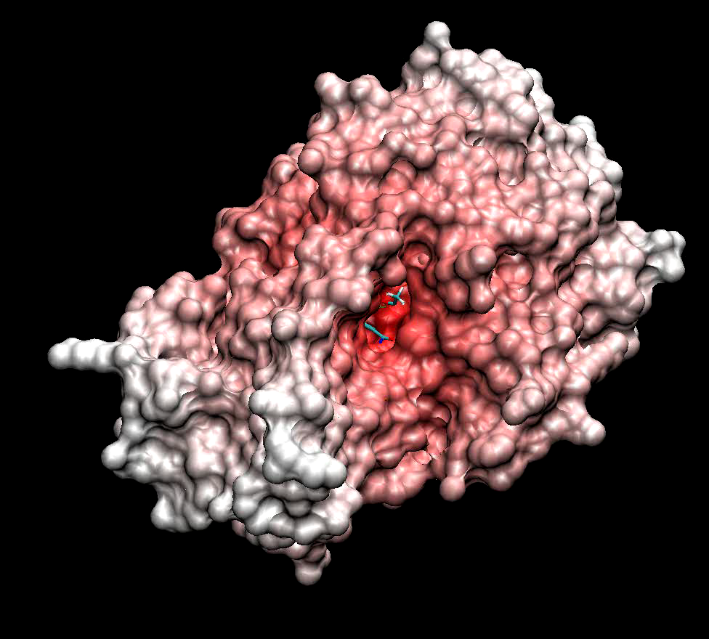
Alcohol Dehydrogenase (ADH)

Slide 10
How are the Ligands Bound?
Ethanol
The ethanol is bound by an ion-dipole interaction with the Zn²⁺ and a dipole-dipole interaction with Ser48

Slide 11
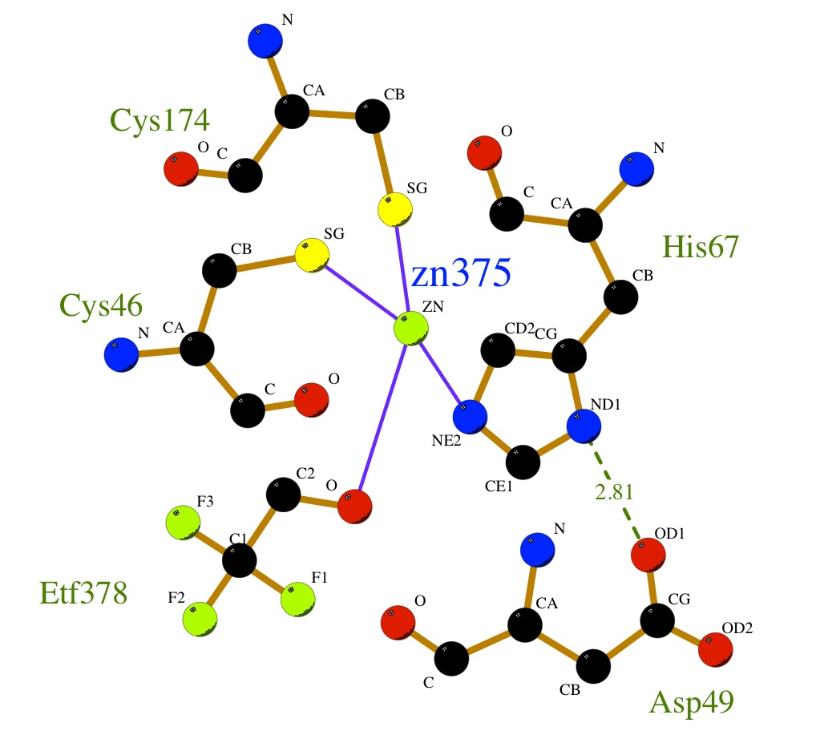
How are the Ligands Bound?
Zn²⁺
The catalytic zinc ion is coordinated by:
2 Cys suflhydryl S
A His imidazole nitrogen
the ethanol oxygen (Substrate activation)

Slide 12
How are the Ligands Bound?
NAD⁺
The shortest interactions are the catalytically relevant ones:
His51
Ser48

Slide 13
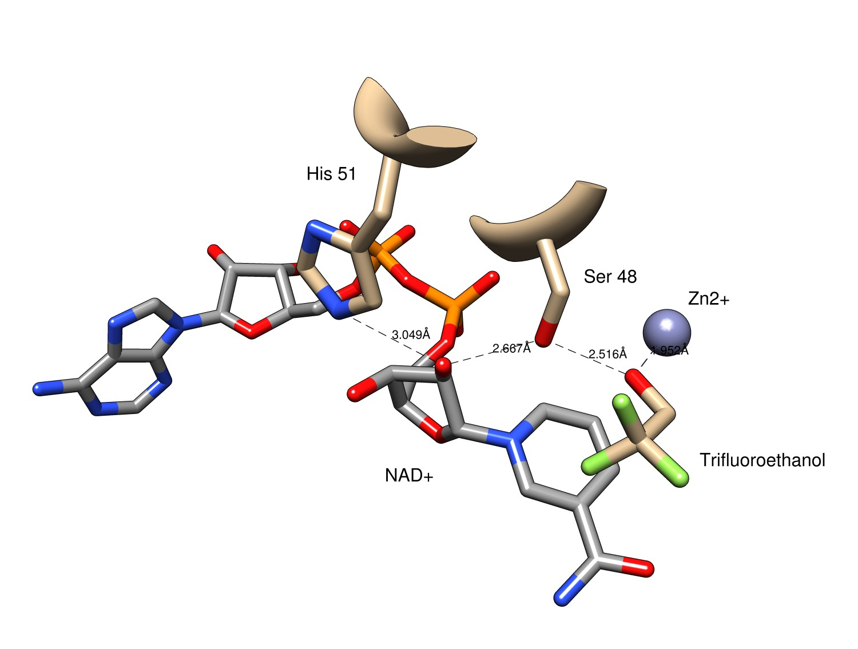
How are the Ligands Arranged?
Distance between Residues

Slide 14
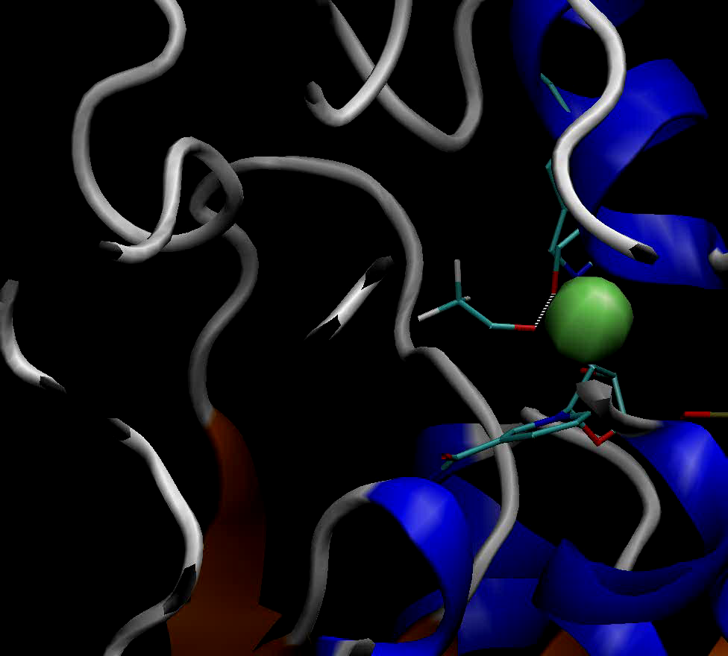
How are the Ligands Arranged?
Active Site and Surroundings

Slide 15
Alcohol Dehydrogenase Mechanism
Steps
Binding of the coenzyme NAD+
Binding of the alcohol substrate by coordination to zinc
Deprotonation of nicotinamide ribose by His-51
Deprotonation of Ser-48 by nicotinamide ribose
Deprotonation of the alcohol by Ser-48
Hydride transfer from the alkoxide ion to NAD+, leading to NADH and a zinc bound aldehyde or ketone
Release of the product aldehyde

Slide 16
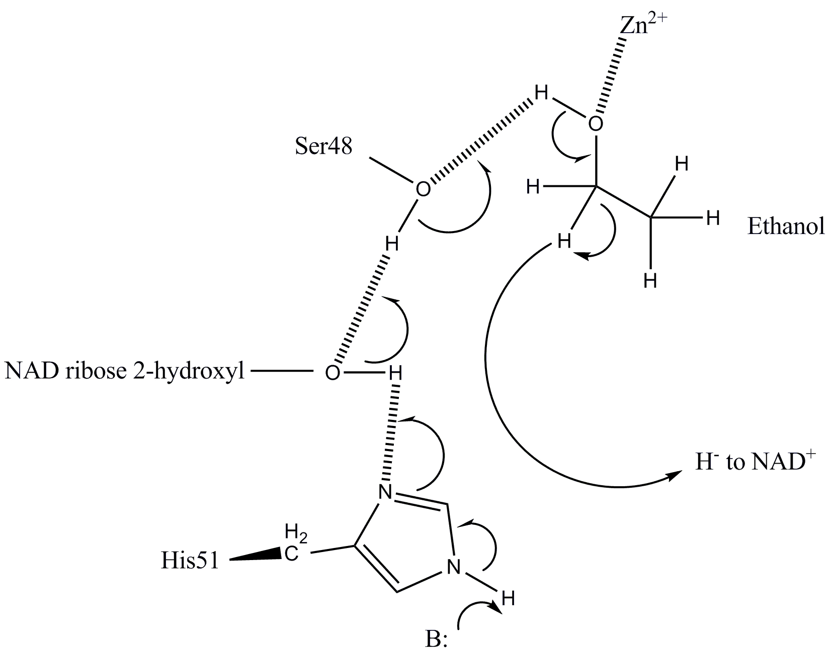
Alcohol Dehydrogenase Mechanism
Start at bottom and work your way clockwise, Follow the electrons!

Slide 17
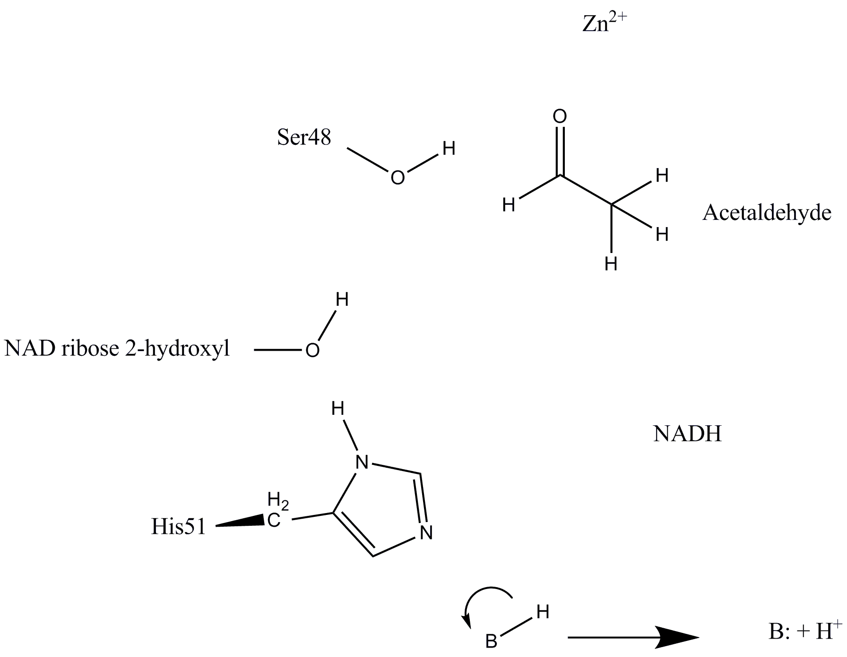
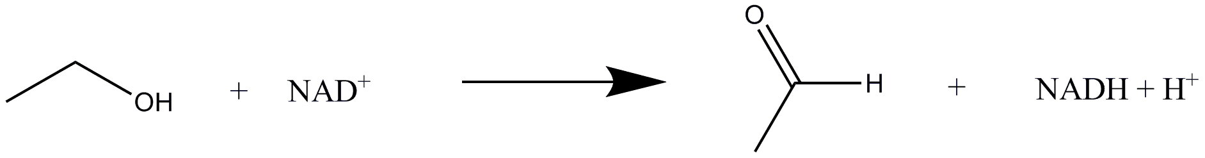
Alcohol Dehydrogenase Mechanism
Overall Rxn:

Slide 18
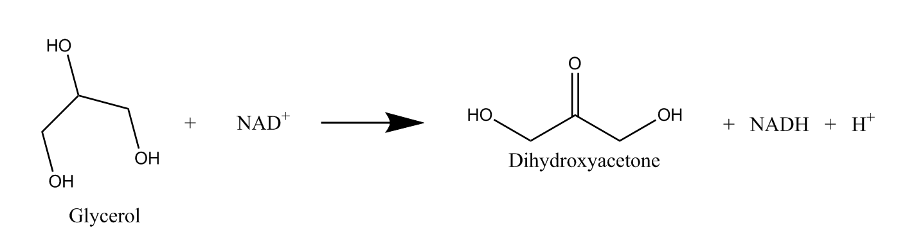
Glycerol Dehydrogenase (1JQA/1JQ5)
Catalyzes the oxidation of glycerol to dihydroxyacetone
Uses Zn²⁺ and NAD⁺ as cofactors
Zn²⁺ Activates a Water molecule
NAD⁺ is the electron sink
Overall Rxn:

Slide 19
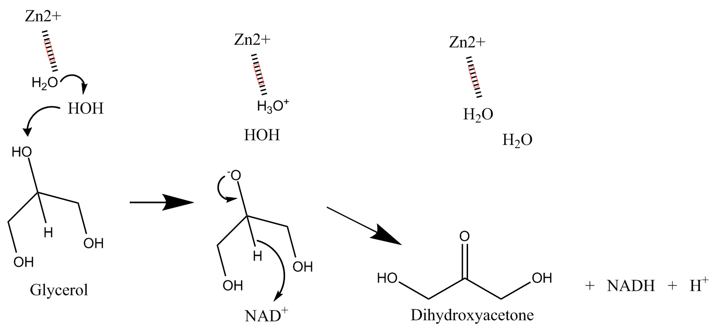
Glycerol Dehydrogenase (1JQA/1JQ5)
Overall Rxn:

Slide 20
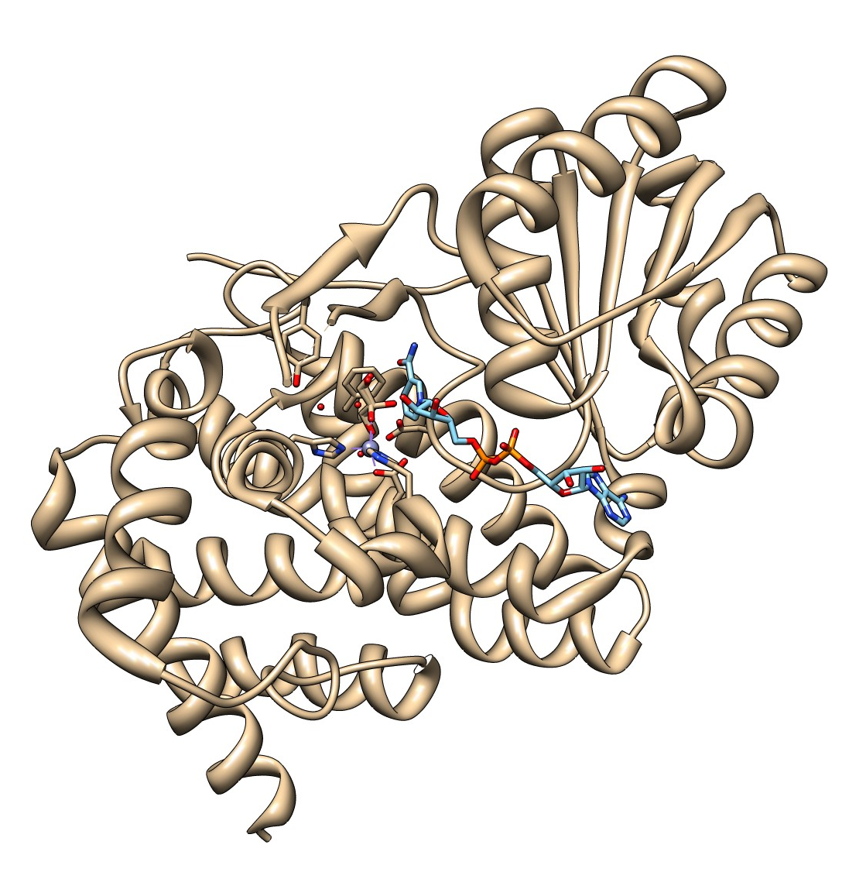
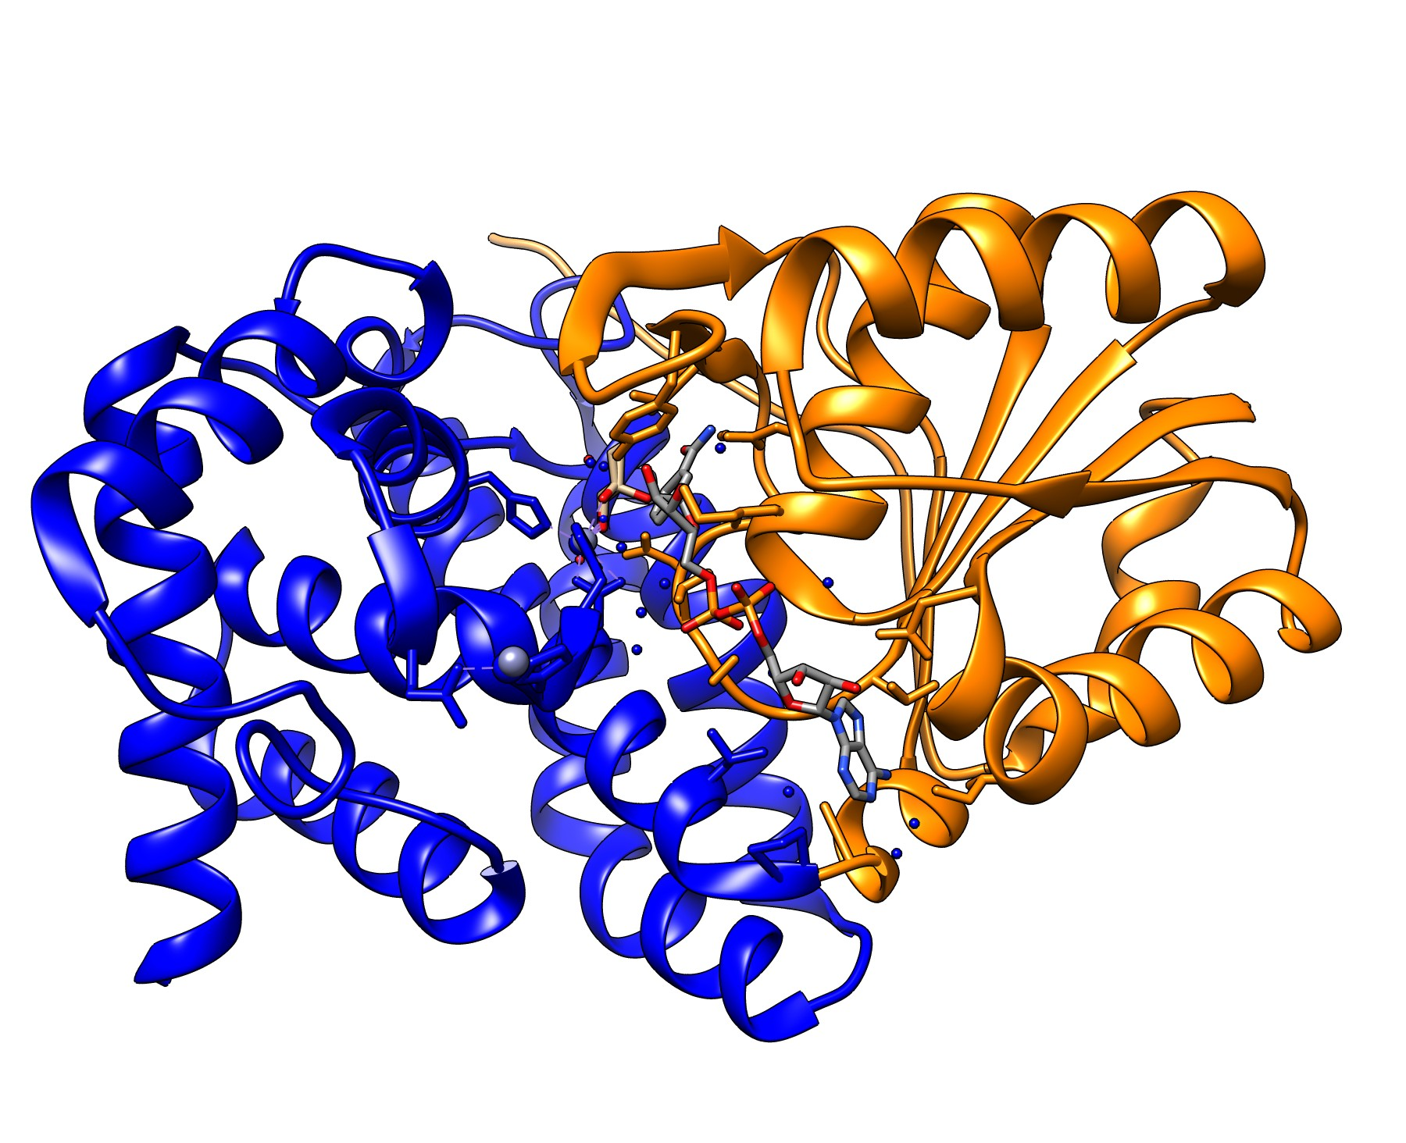
Glycerol Dehydrogenase (1JQA/1JQ5)
Note 2 domain structure
Active site is at interface of the domains

Slide 21
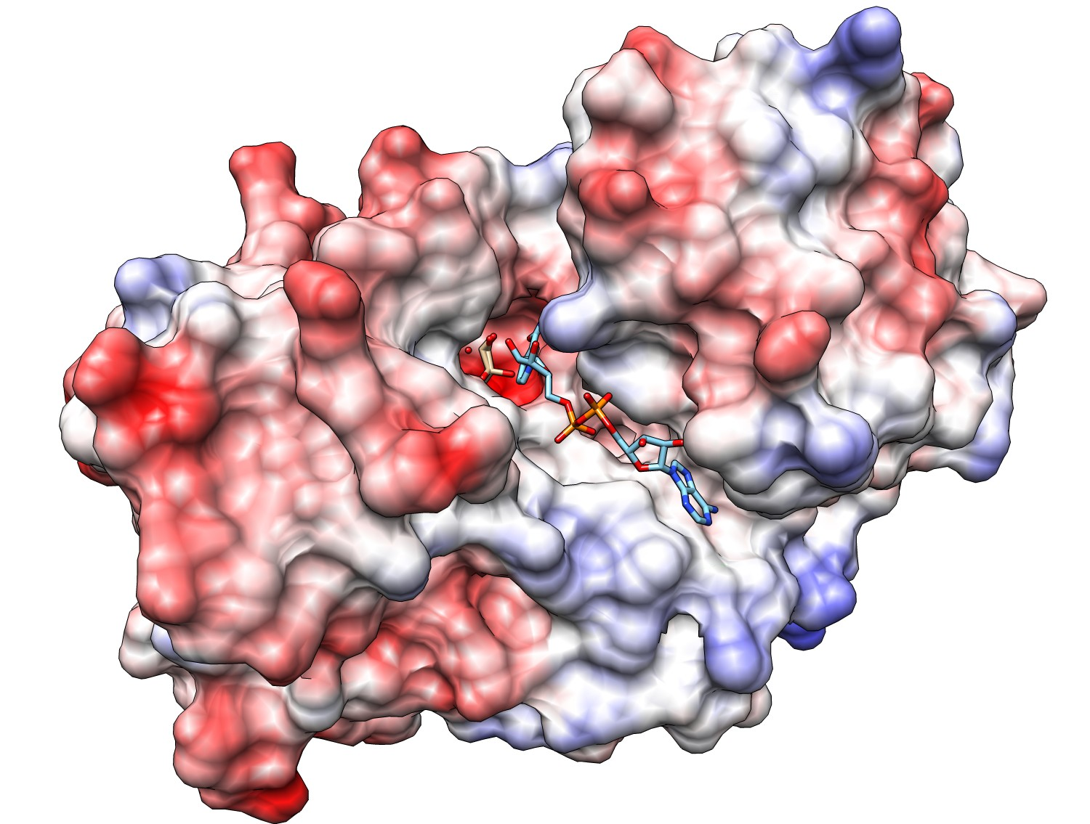
Glycerol Dehydrogenase (1JQA/1JQ5)

Slide 22
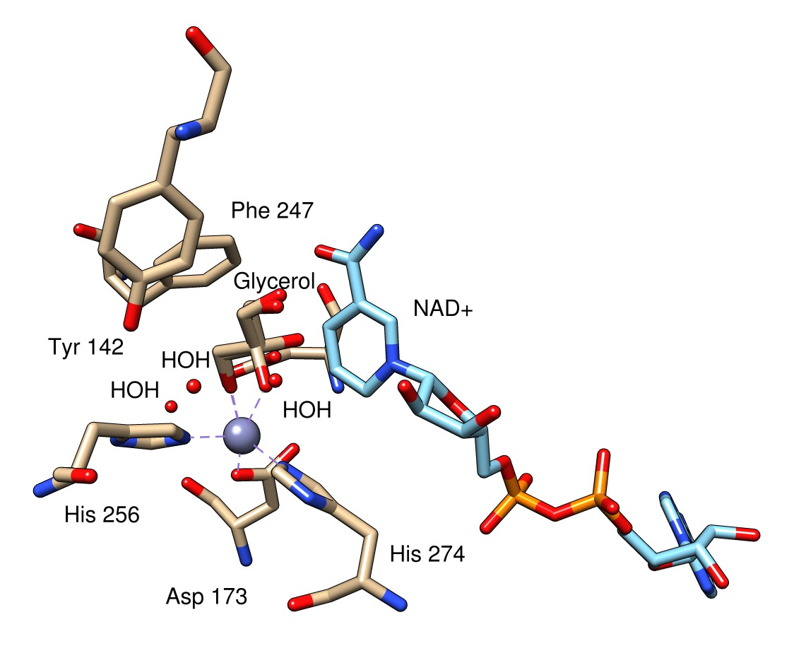
Glycerol Dehydrogenase (1JQA/1JQ5)

Slide 23
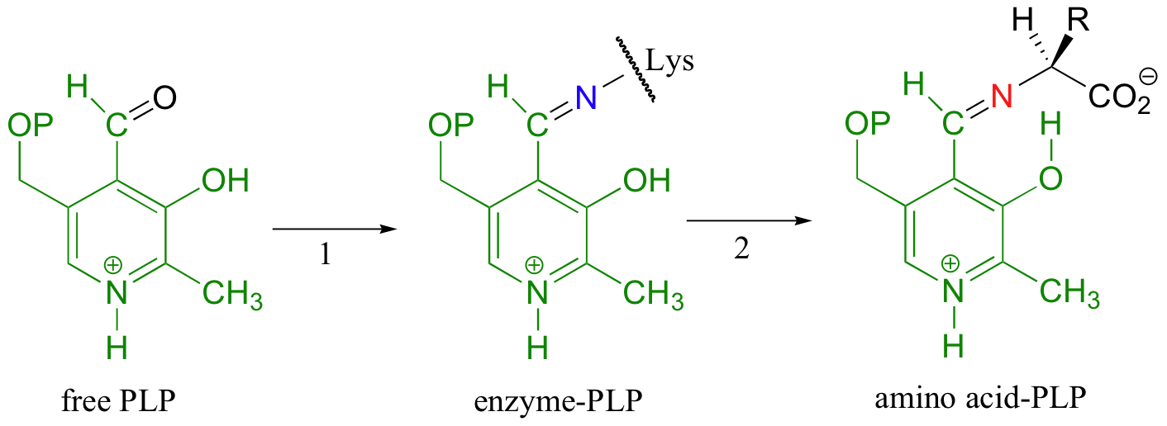
Pyridoxal 5’ Phosphate
Imine (Schiff Base)
Many enzymes involved in the metabolism of amino acids make use of PLP as a coenzyme.
The basic function of PLP is to act as an 'electron sink',

Slide 24
Pyridoxal 5’ Phosphate
Generally, the next step (step 2 in the figure above) is an imine exchange, as the amine nitrogen on the amino acid substrate replaces the enzyme lysine nitrogen in the imine linkage.
This substrate-coenzyme adduct is stabilized by a favorable hydrogen bond between the phenol of PLP and the imine nitrogen.

Slide 25
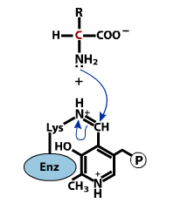
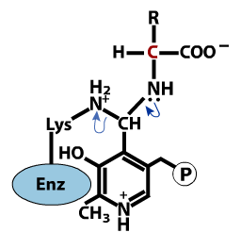
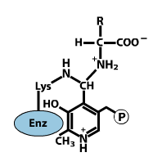
Imine Exchange

Slide 26
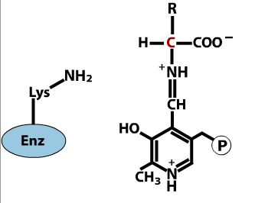
Imine Exchange
This is the fundamental mechanism by which the enzyme “loads” the substrate onto the PLP, regardless of the reaction being catalyzed

Slide 27
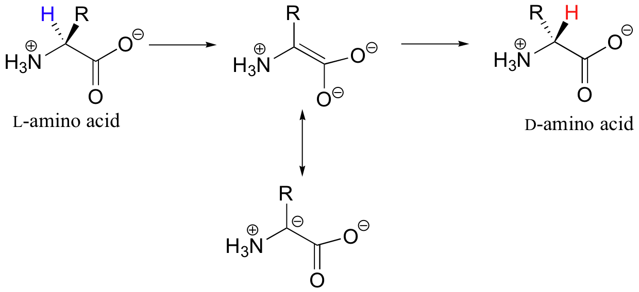
1. PLP-Dependent Racemization

Slide 28
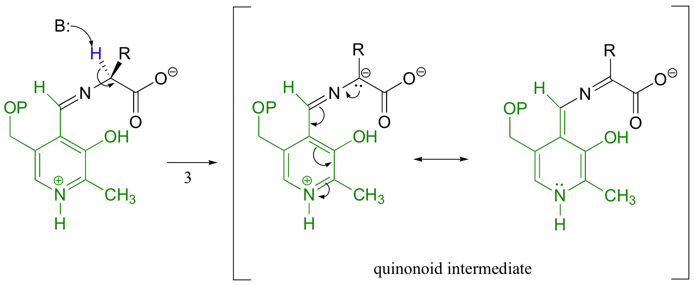
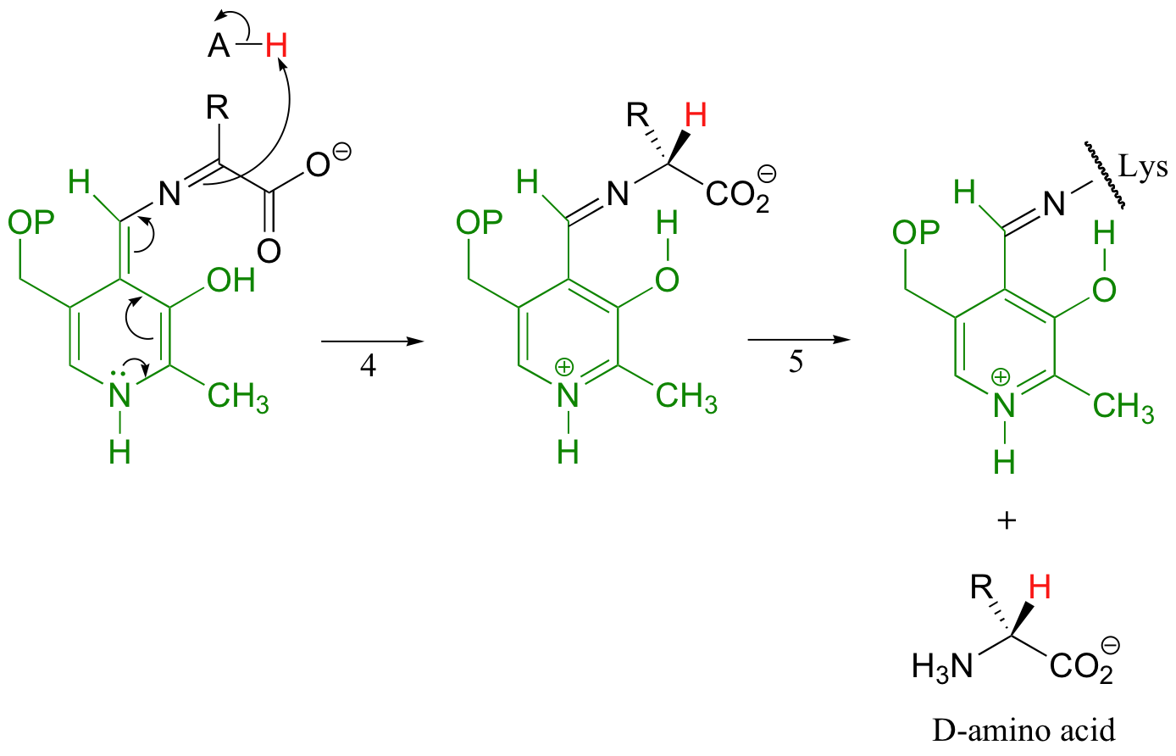
1. PLP-Dependent Racemization
Electron Sink!
Reactions 1 and 2 are the loading reactions previously shown

Slide 29
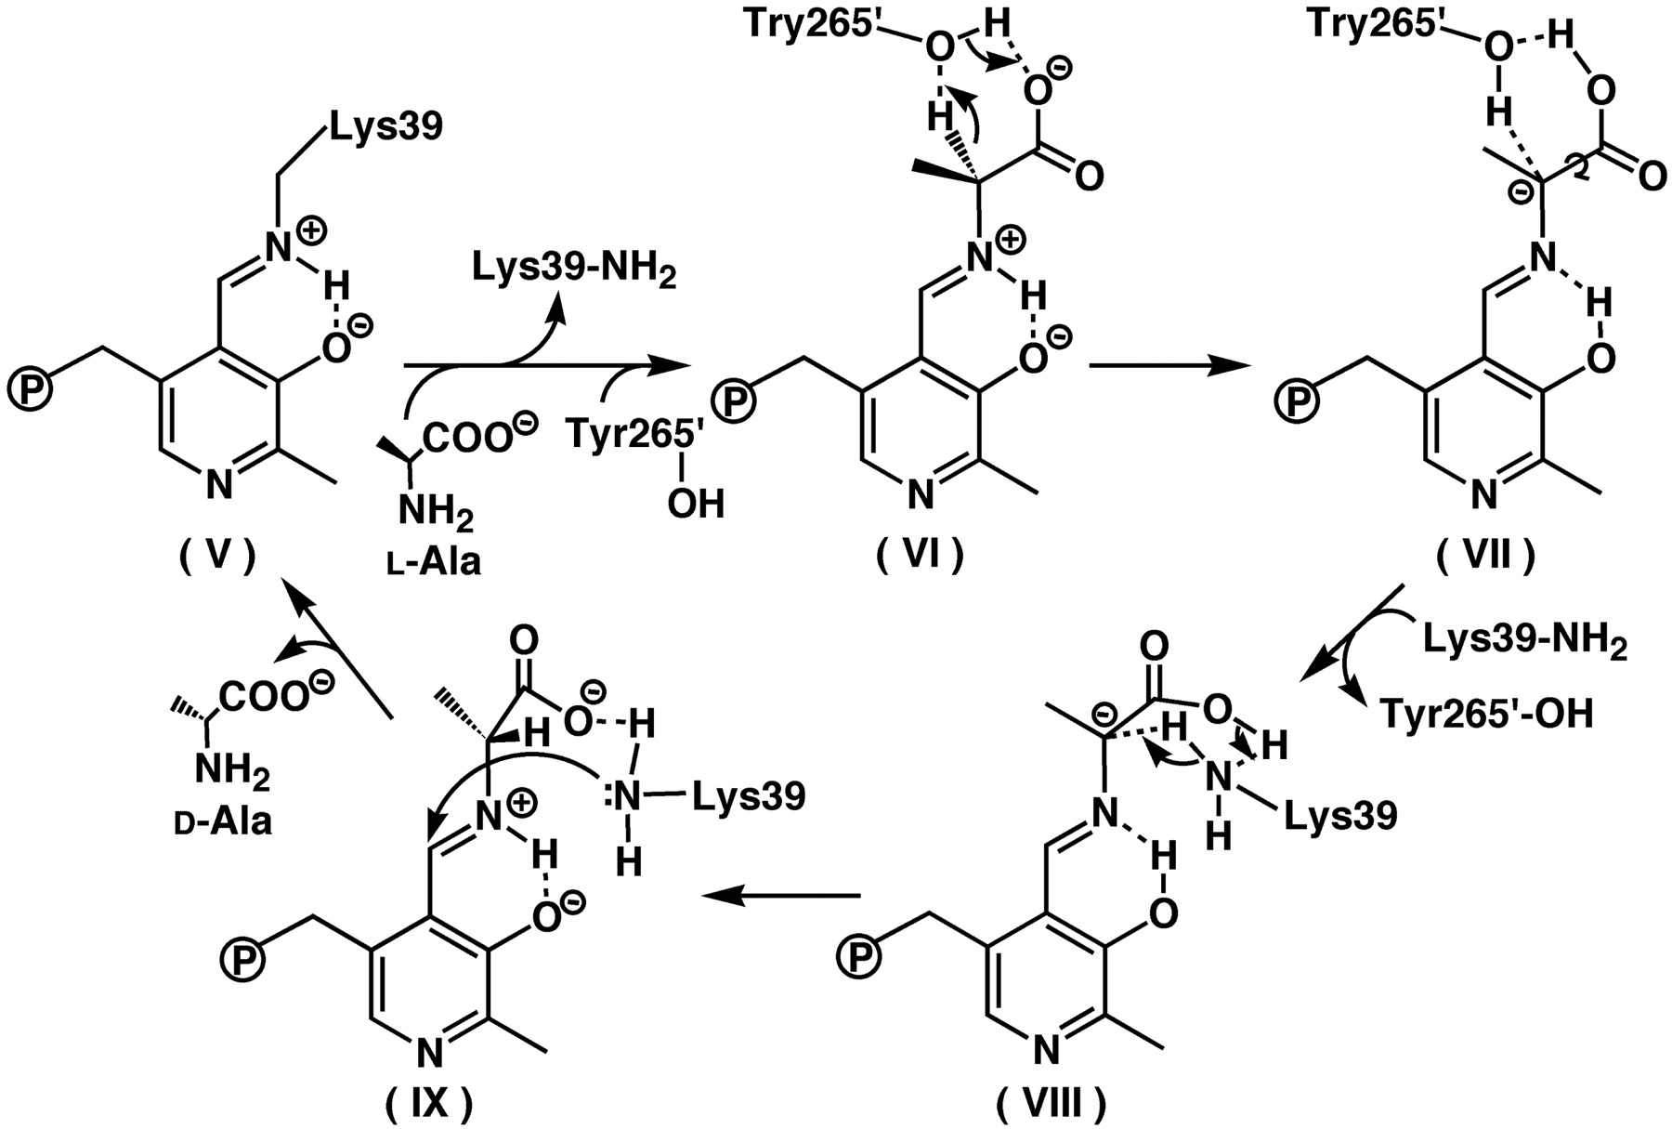
1. PLP-Dependent Racemization
Example:
Alanine Racemase
Mammalian Cells don’t have this enzyme, so it is a viable target for drug-design
Watanabe A et al. (2002) J. Biol. Chem. 277:19166-19172
©2002 by American Society for Biochemistry and Molecular Biology

Slide 30
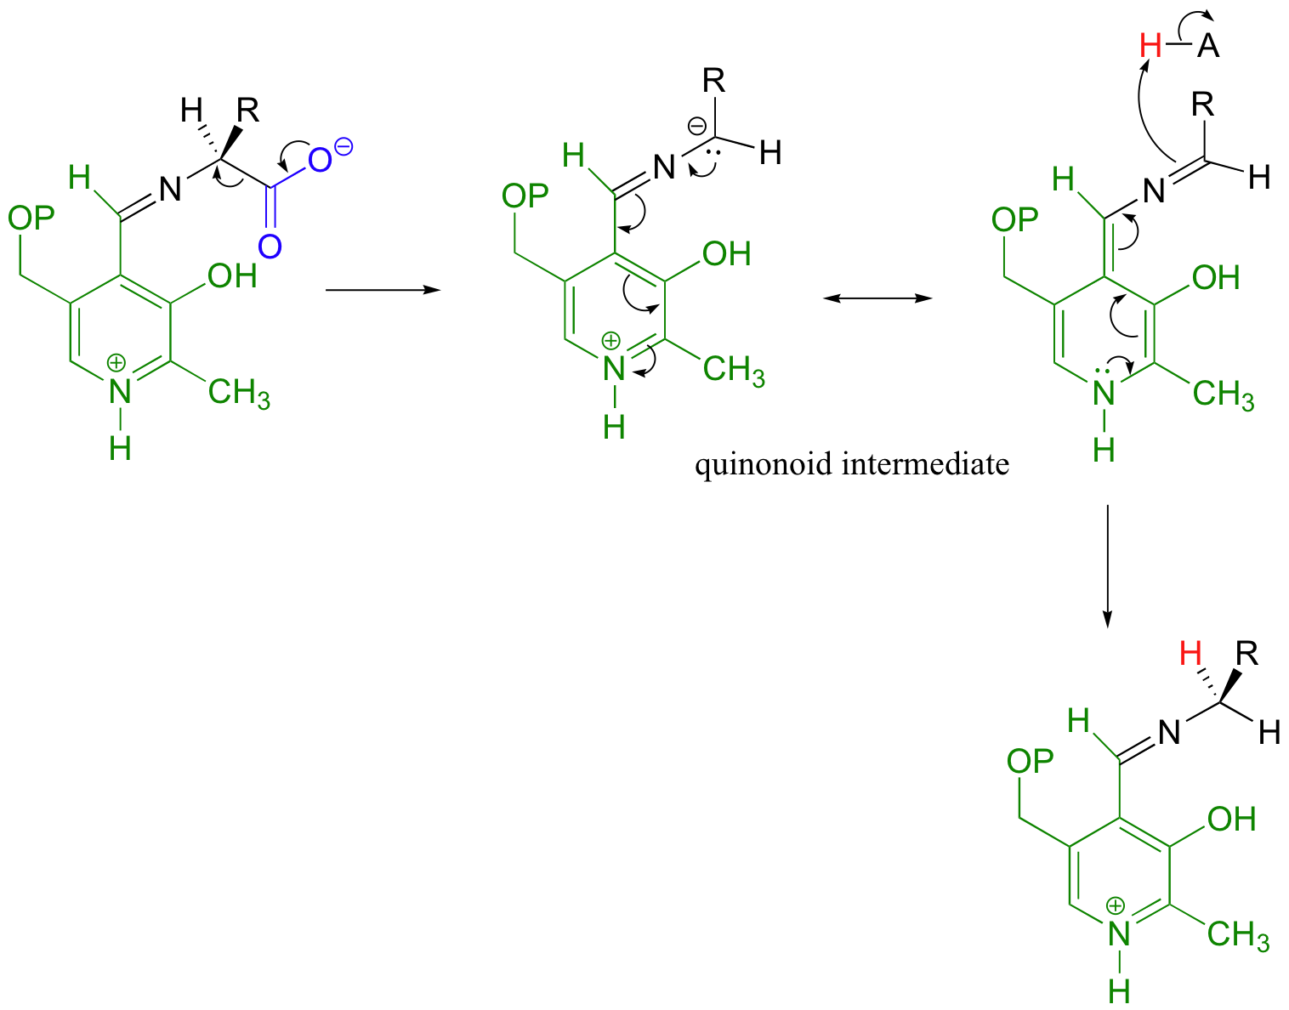
2. PLP-Dependent Decarboxylation
Once the substrate molecule is conjugated to PLP, the active site of the enzyme provides an electronic environment suitable for the elimination and an acid proton for the decarboxylated leaving group

Slide 31
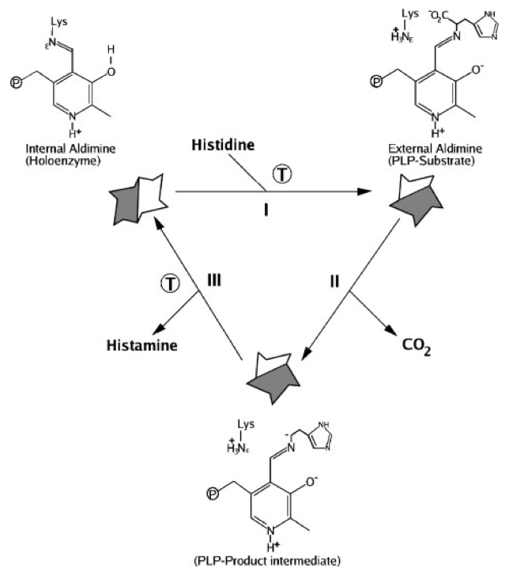
2. PLP-Dependent Decarboxylation
Example:
Histidine decarboxylase
A source of histamine in your body
Moya-Garcia et al. (2004) Mammalian histidine decarboxylase: from structure to function. BioEssays 27: 57-63.

Slide 32
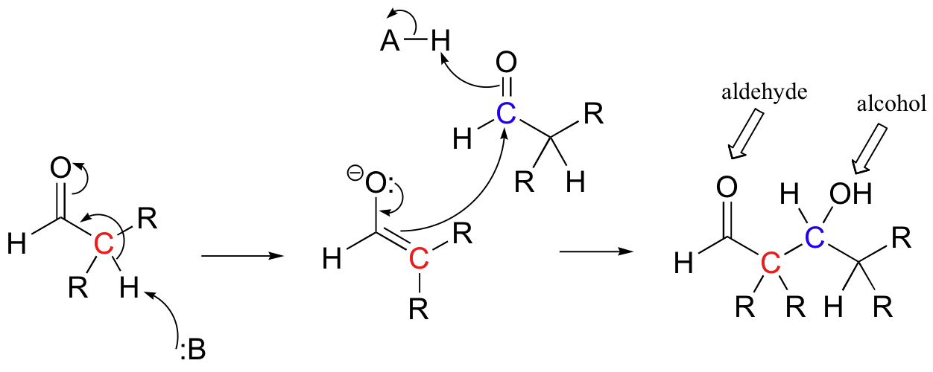
Aldol reactions
Remember: In an Aldol condensation, we are making a product that has an Aldehyde and an AlcohOL
Retro-aldol reactions are the reverse of that
Typical Aldol-Condensation

Slide 33
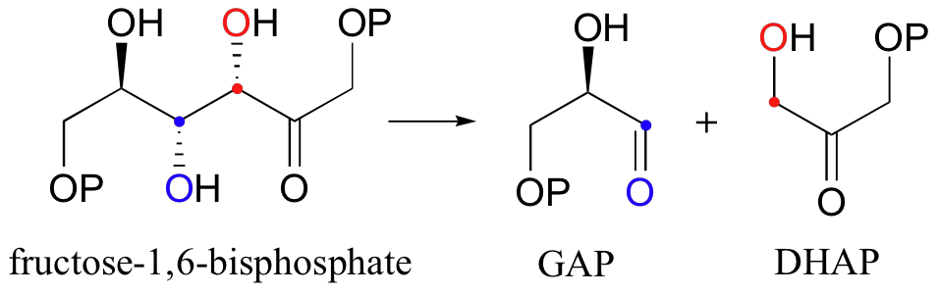
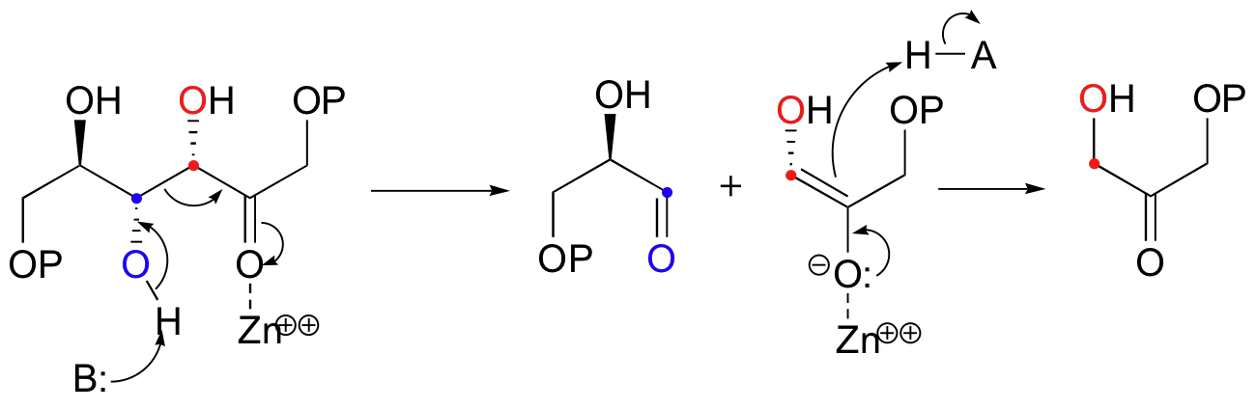
Retro-Aldol reaction (Aldolase)
Typical Retro-aldol reaction (Catalyzed by Aldolase, a Zn²⁺-dependent enzyme)

Slide 34
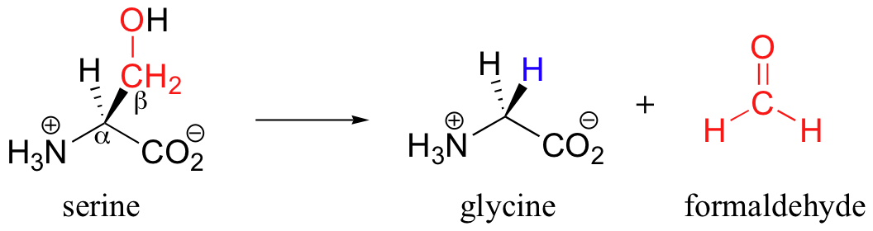
3. PLP-Dependent Retro-Aldol reaction

Slide 35
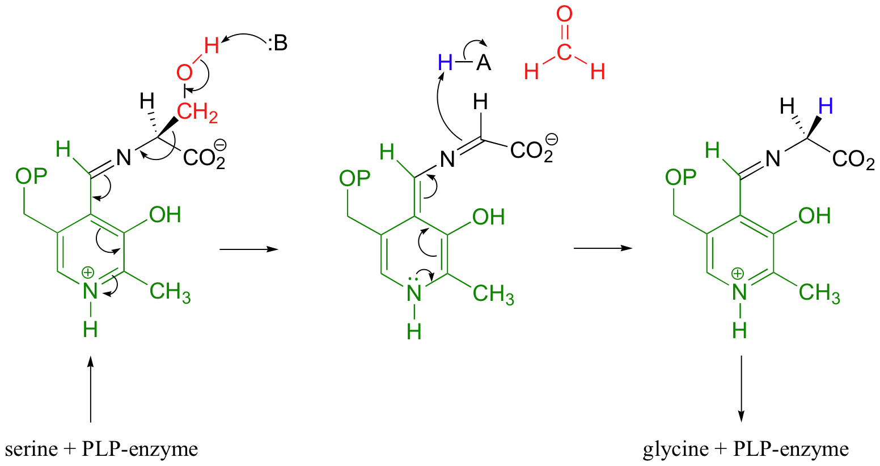
3. PLP-Dependent Retro-Aldol reaction

