Slide 1
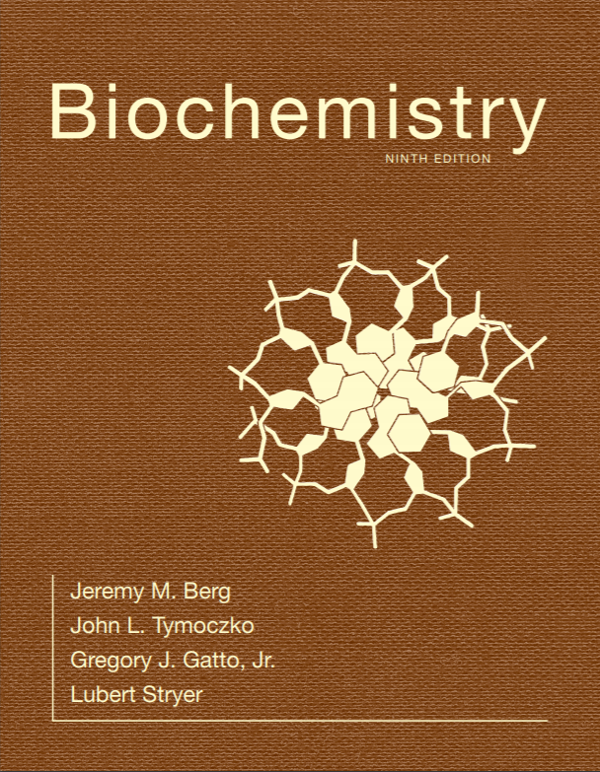
Chapter 16
Glycolysis and Gluconeogenesis
© 2019 W. H. Freeman and Company
Notes:
Corresponding Chapters: 1, 2, 8, 9, 10

Slide 2
Glucose is an Important Fuel for Most Organisms
Almost all organisms use glucose as a fuel. In mammals, glucose is the only fuel the brain uses under nonstarvation conditions and the only fuel red blood cells are able to use at all.
Why is glucose such a prominent fuel in all life-forms?
  Glucose may have been available for primitive biochemical systems because it can form under prebiotic conditions.
  Glucose is the most stable hexose.
  Glucose has a low tendency to nonenzymatically glycosylate proteins.

Slide 3
Section 16.1 Glycolysis Is an Energy-Conversion Pathway in Many Organisms
The glycolytic pathway is common to virtually all cells, both prokaryotic and eukaryotic.
In eukaryotic cells, glycolytic enzymes are organized in cytoplasmic supramolecular complexes. This strategy is efficient due to substrate channeling between active sites and prevents the release of any toxic intermediates.

Slide 4
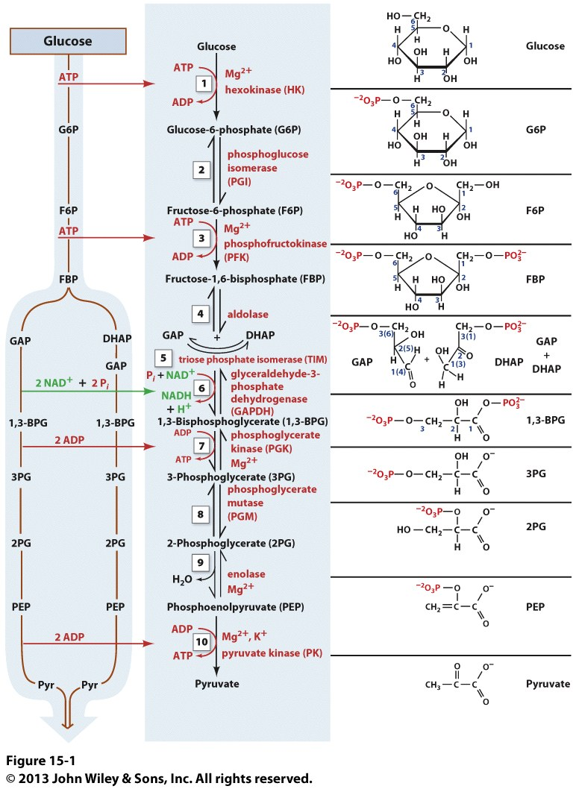

Slide 5
Glycolysis can be Divided into Two Parts
Glycolysis converts one molecule of glucose into two molecules of pyruvate with the generation of two molecules of ATP.
Glycolysis can be thought of as occurring in two stages:
  Stage 1 traps glucose in the cell and modifies it so that it can be cleaved into a pair of phosphorylated 3-carbon compounds.
  Stage 2 oxidizes the 3-carbon compounds to pyruvate while generating two molecules of ATP.

Slide 6
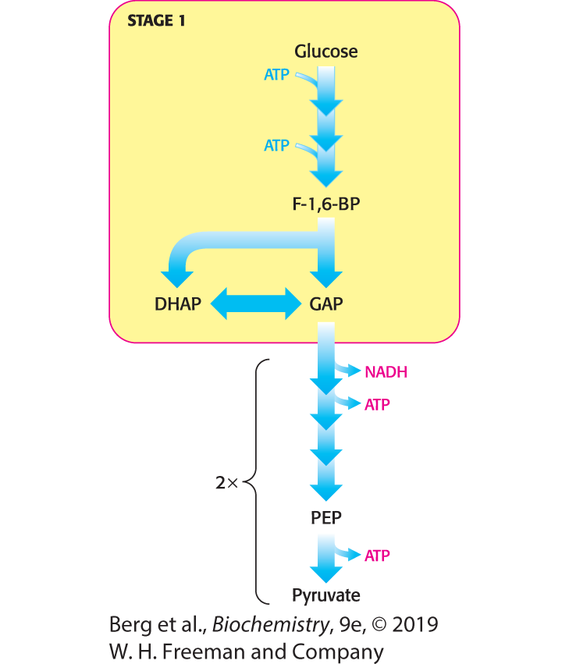
First Stage of Glycolysis
Notes:
First stage of glycolysis. The first stage of glycolysis begins with the phosphorylation of glucose by hexokinase and ends with the isomerization of dihydroxyacetone phosphate to glyceraldehyde 3-phosphate.

Slide 7
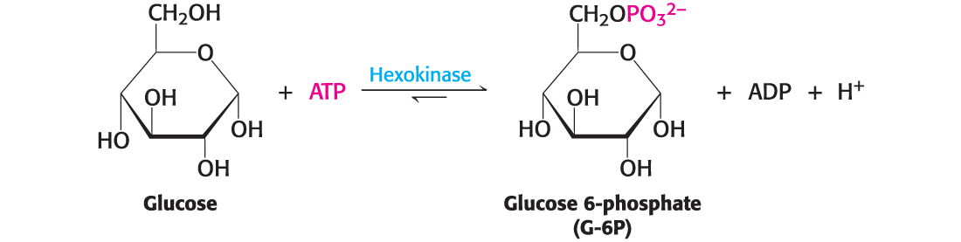
Hexokinase Traps Glucose in the Cell and Begins Glycolysis
Upon entering the cell through a specific transport protein, glucose is phosphorylated at the expense of ATP to form glucose 6-phosphate.
Hexokinase, which requires Mg²⁺ or Mn²⁺ as a cofactor, catalyzes the reaction.
Hexokinase, like most kinases, employs substrate-binding induced fit to help exclude water and minimize undesired hydrolysis of ATP.

Slide 8
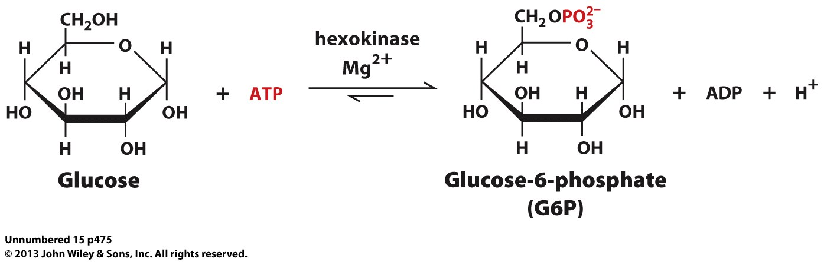
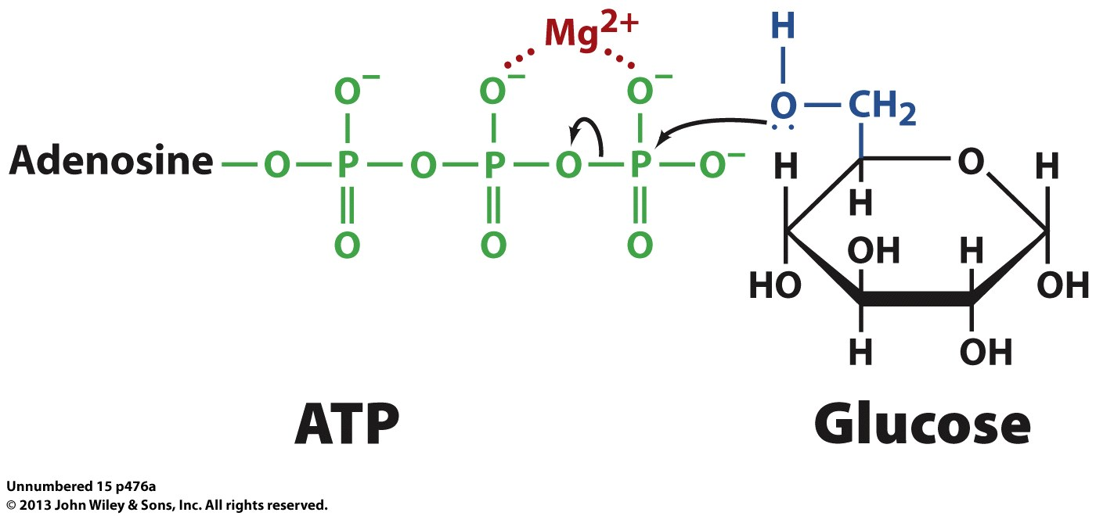

Slide 9
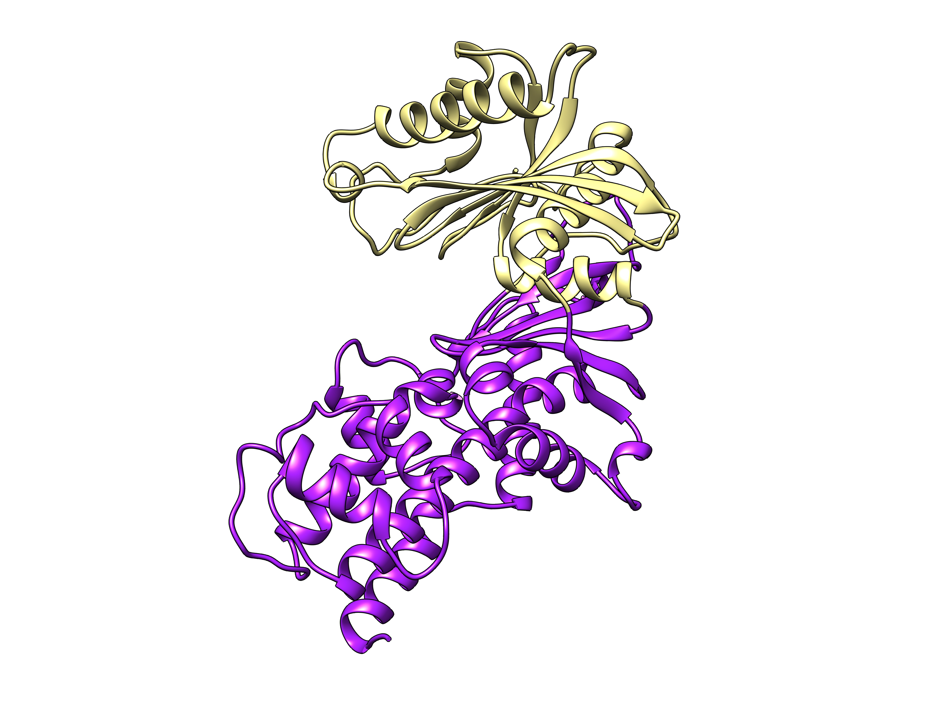

Slide 10
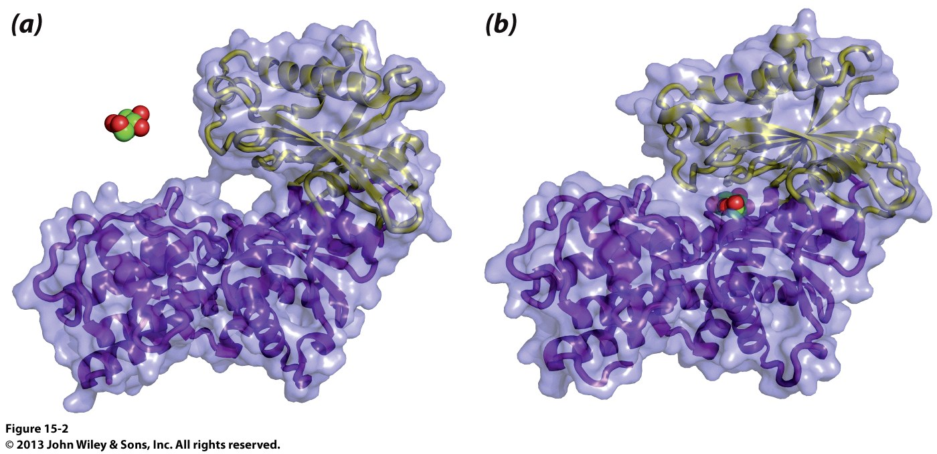

Slide 11
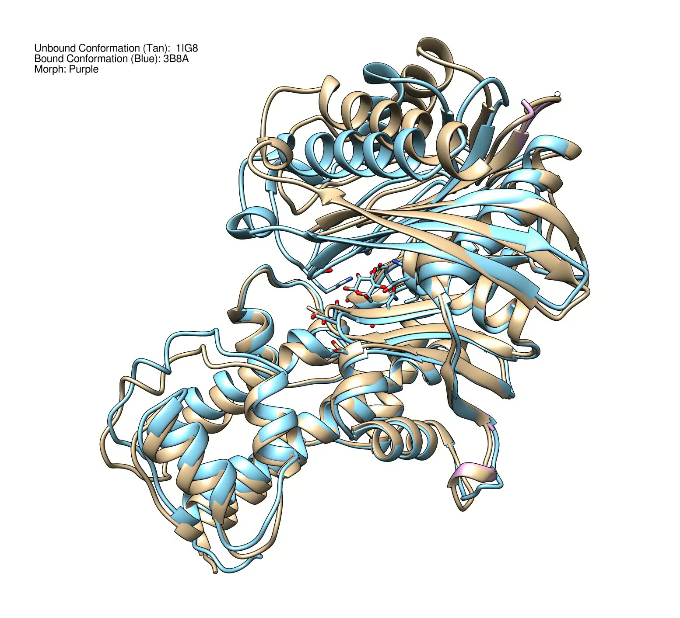

Slide 12
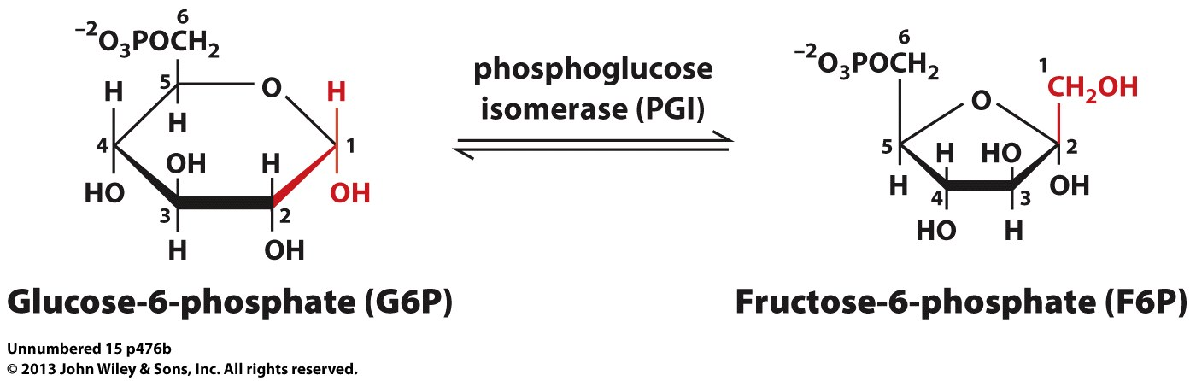
Phosphoglucose Isomerase (PGI) Reaction

Slide 13
3NBU: E. coli
1GZD: Sus scrufa
2HJB: Vibrio cholera
1N8T: Oryctolagus cuninculus
1JLH: Homo sapiens

Slide 14
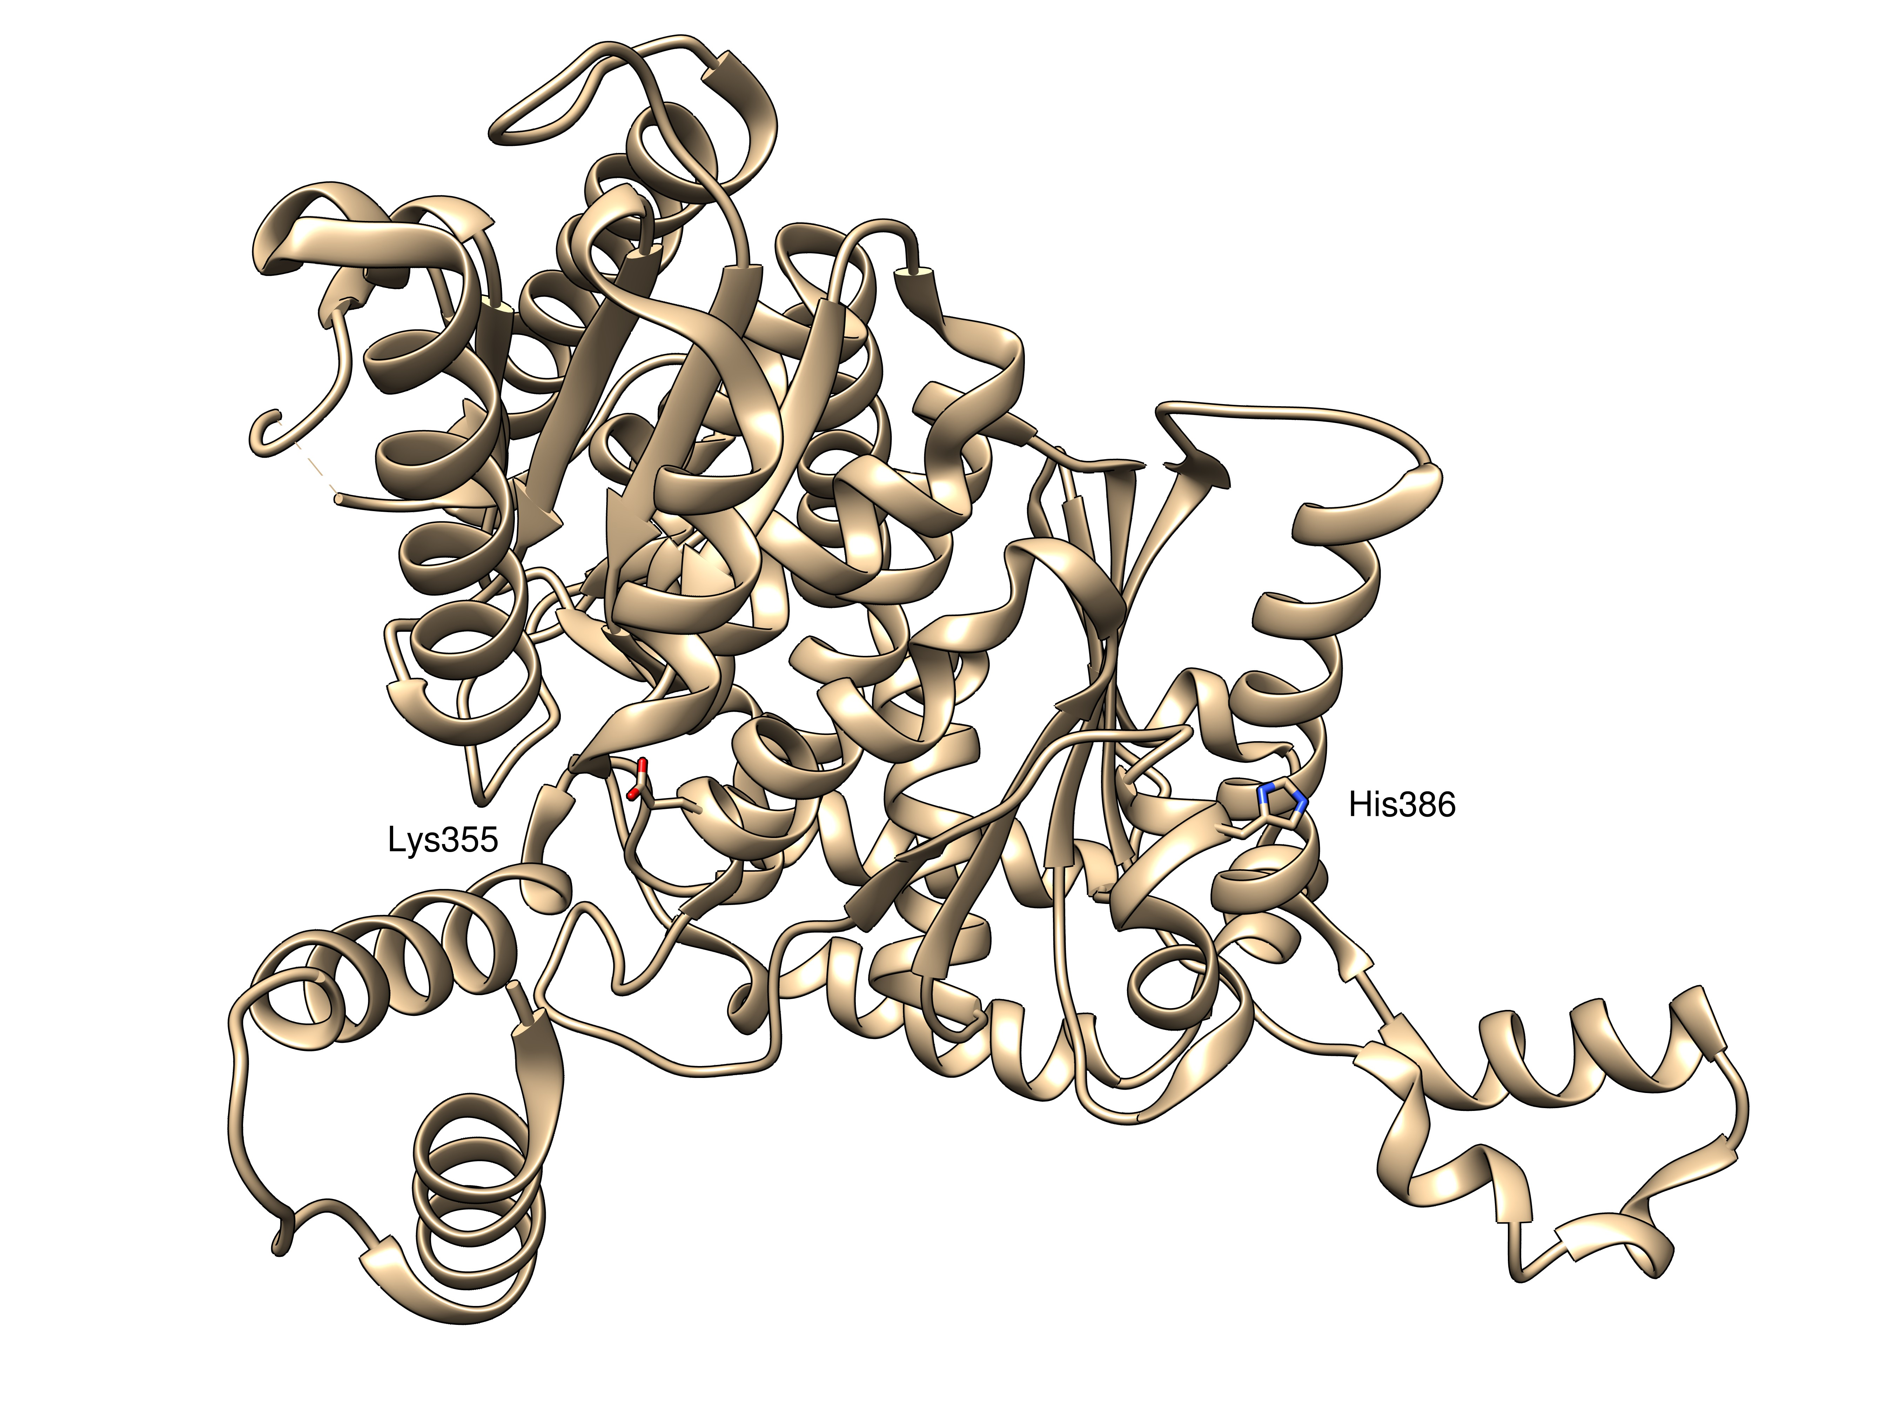

Slide 15
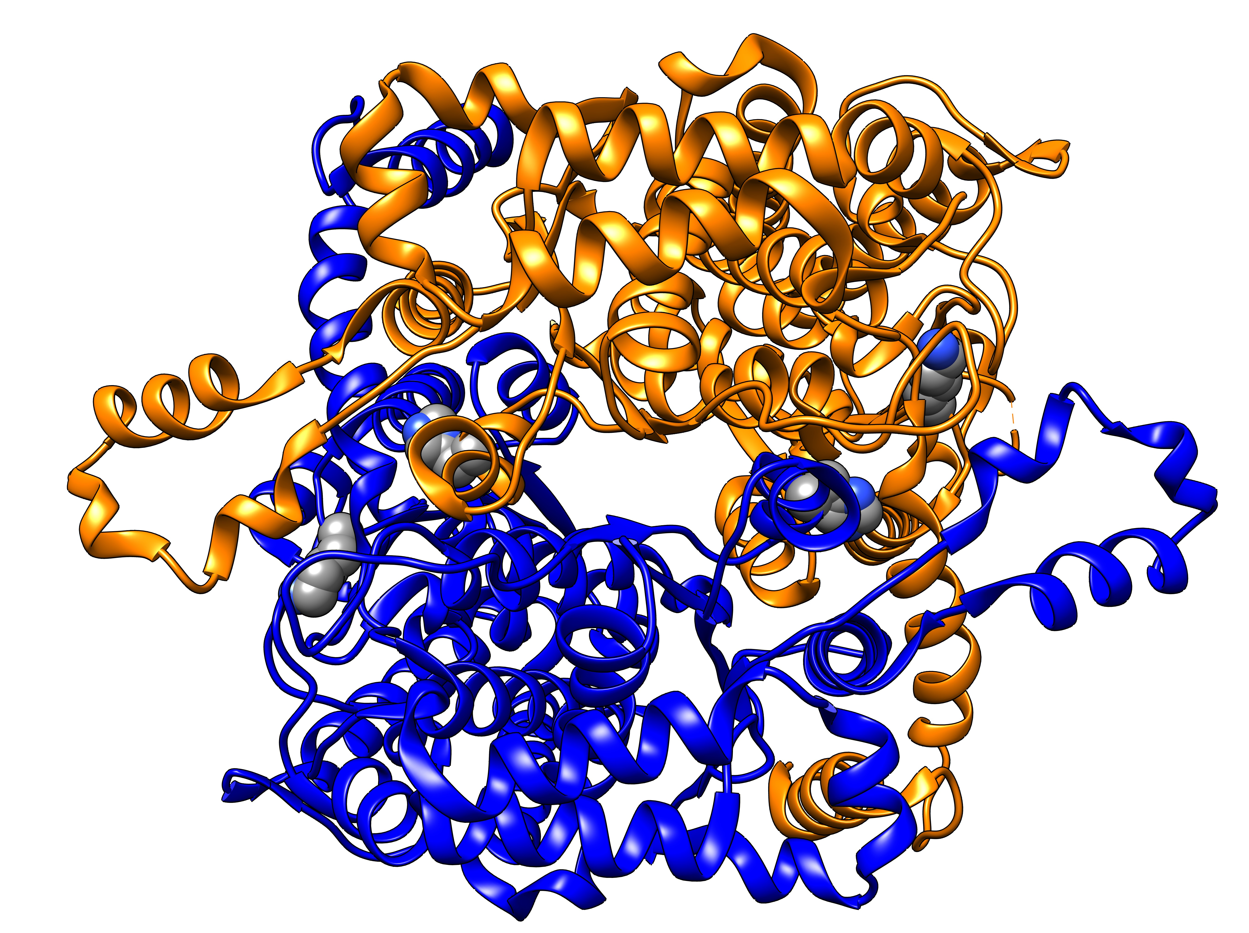

Slide 16
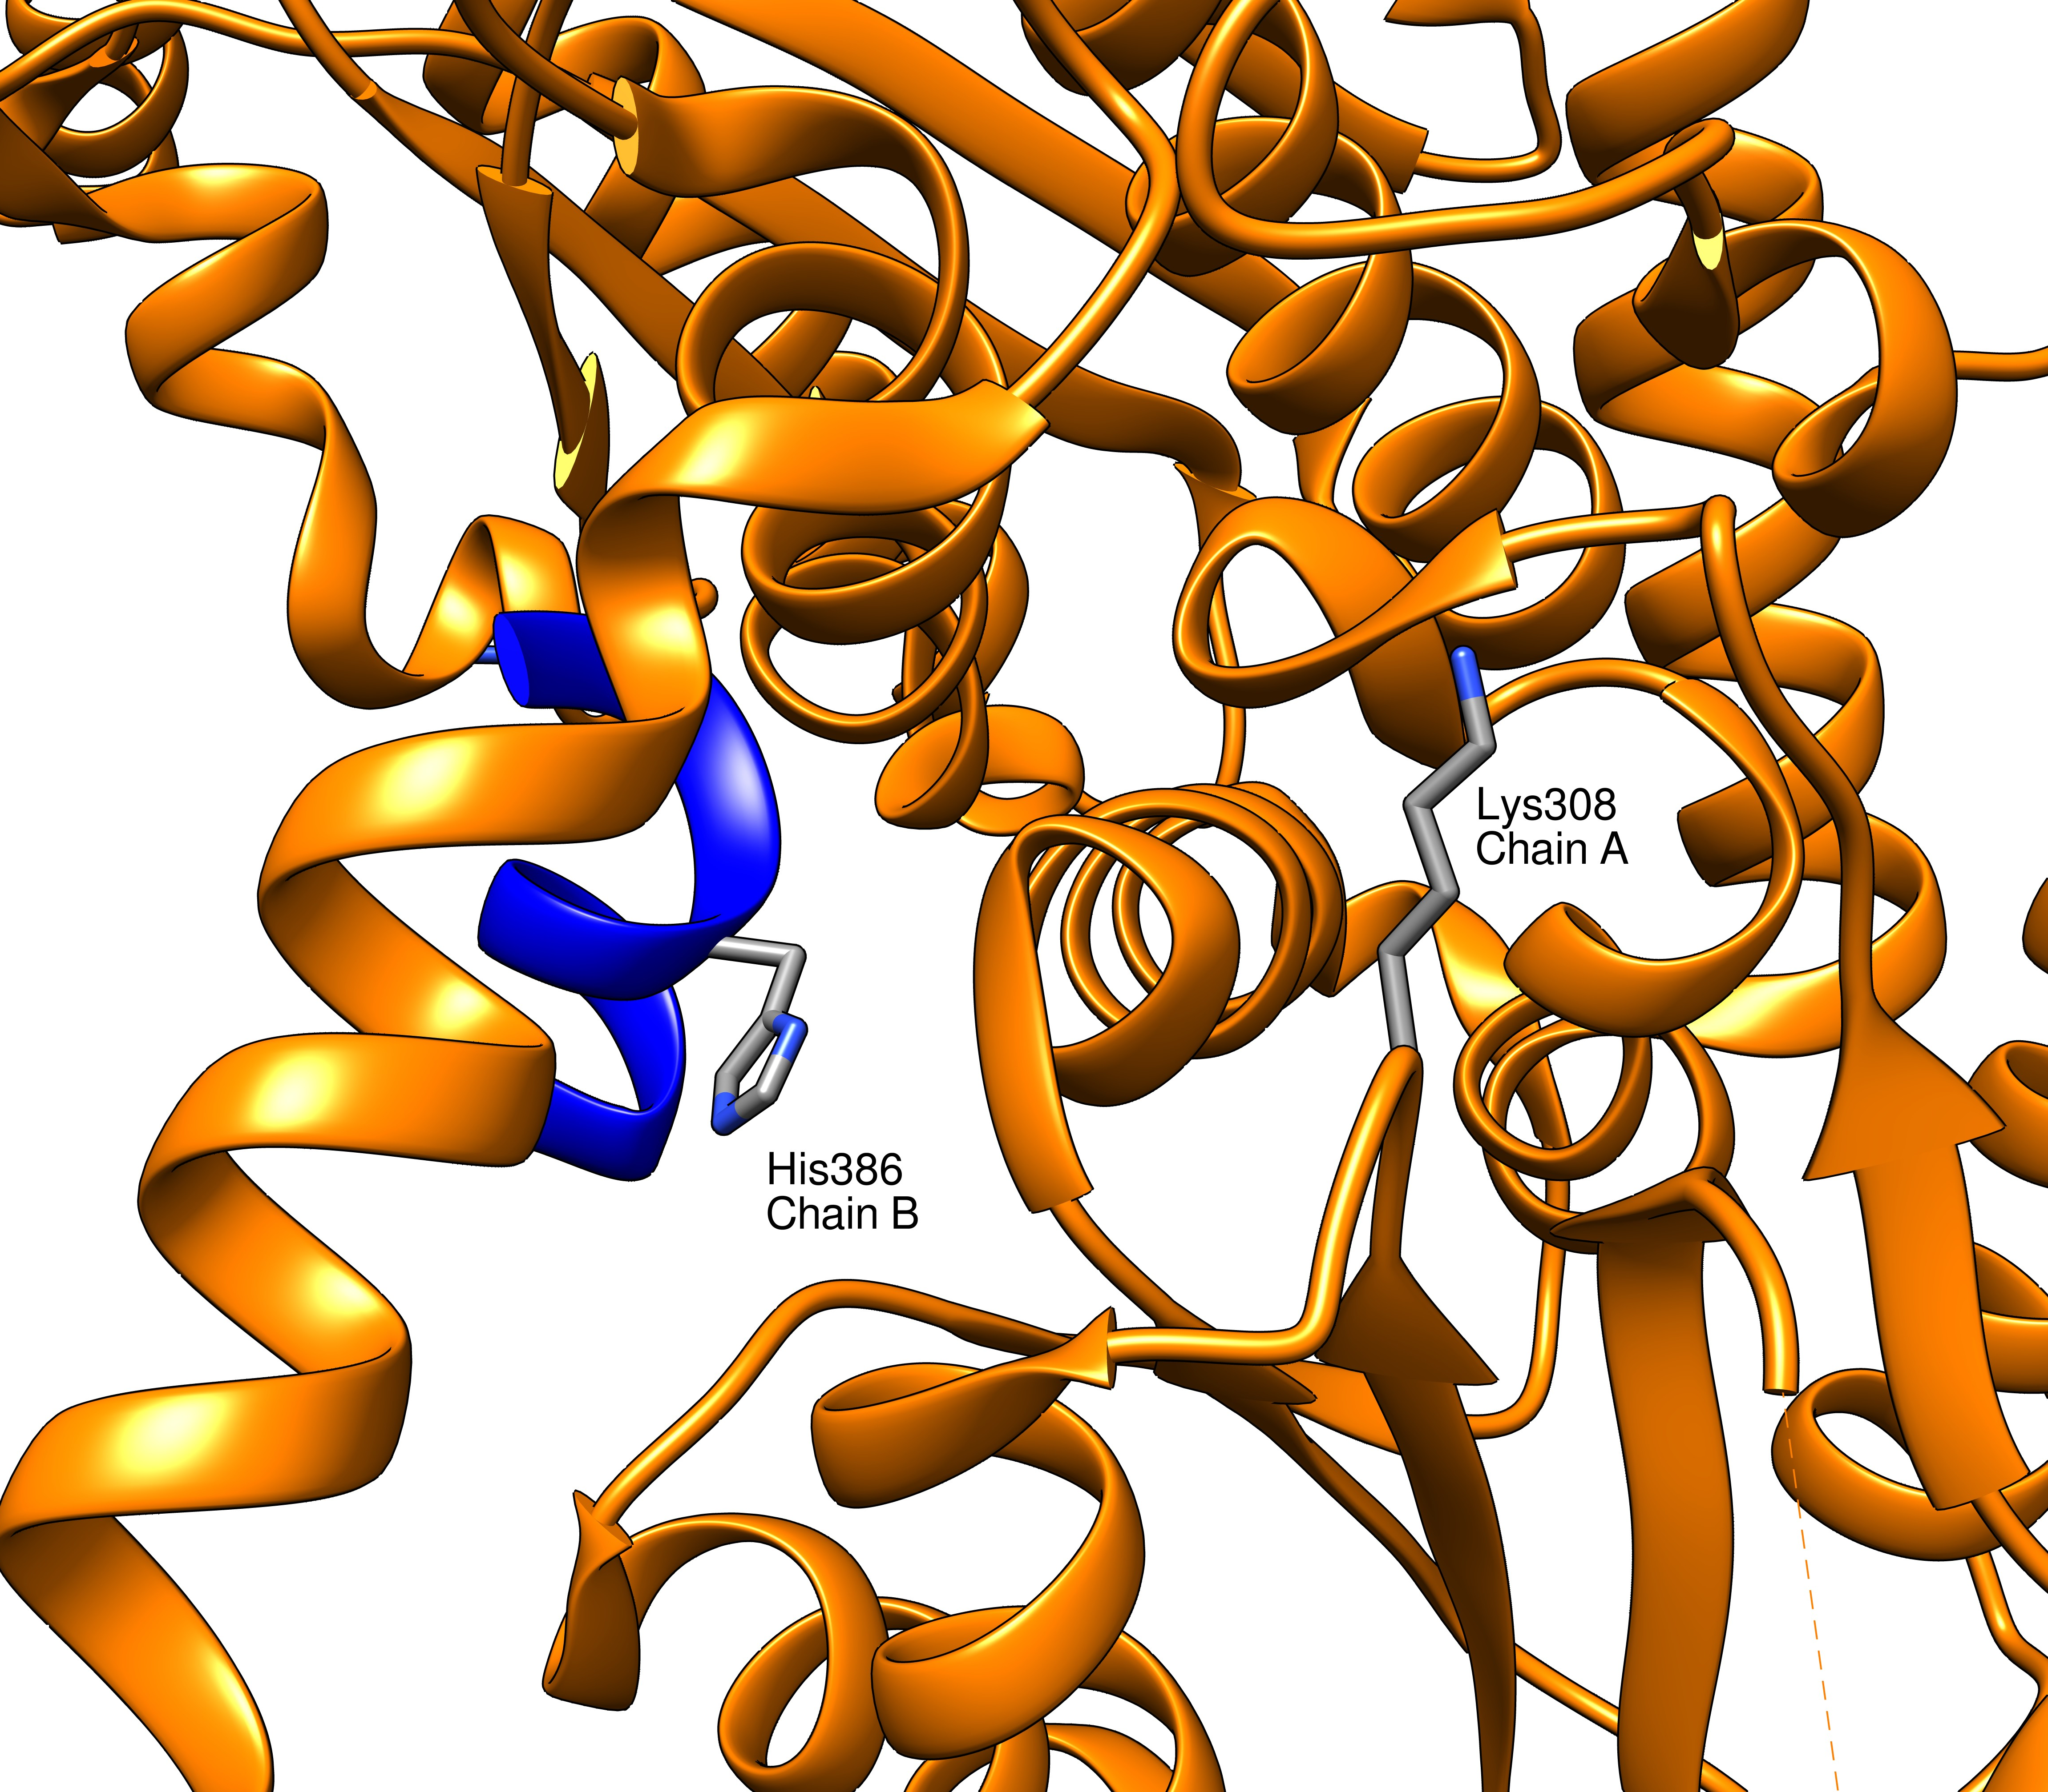

Slide 17
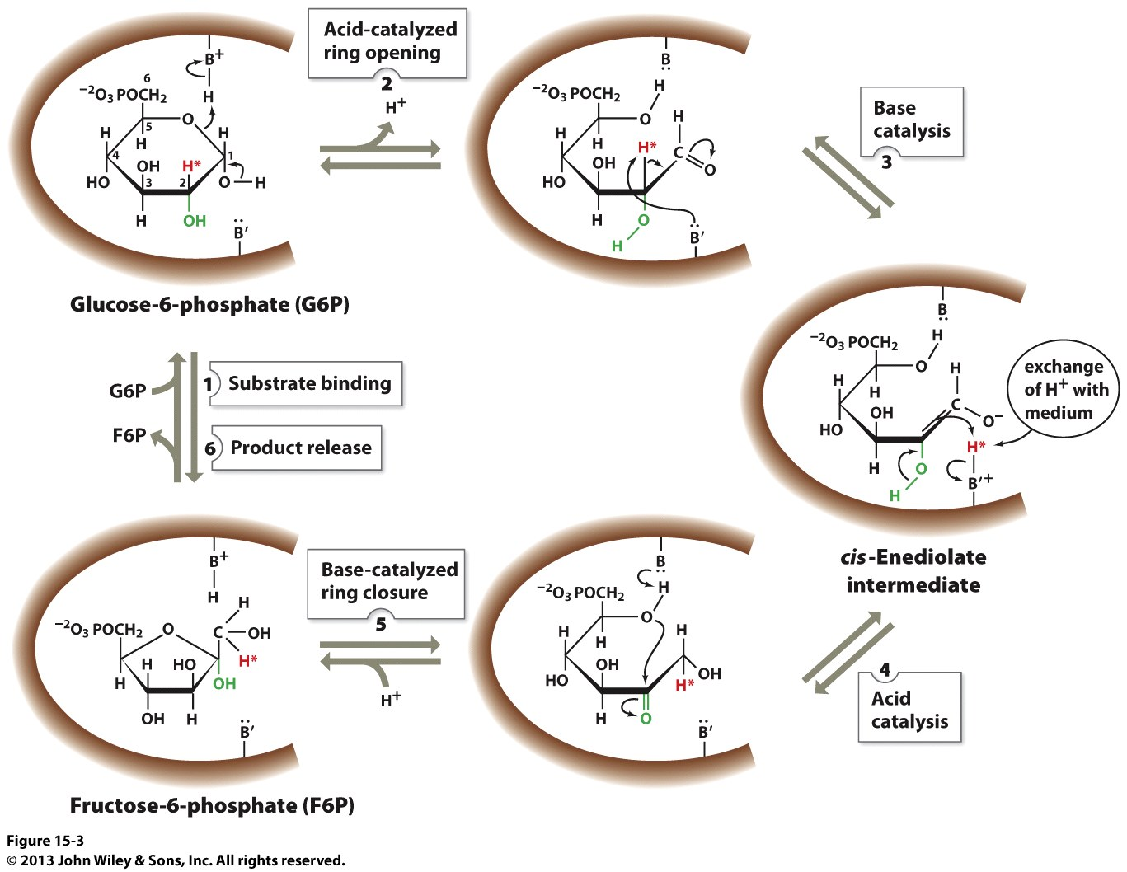

Slide 18
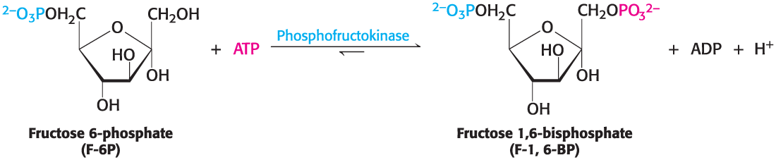
Phosphofructokinase Catalyzes the Second Irreversible Step in Glycolysis
The carbohydrate is trapped in the fructose form by the addition of a second phosphate to form fructose 1,6 bisphosphate.
This irreversible reaction is catalyzed by the allosteric enzyme phosphofructokinase (PFK).

Slide 19
The Six-carbon Sugar is Cleaved into Two Three-carbon Fragments
The first phase of glycolysis ends with the cleavage of fructose 1,6-bisphosphate into dihydroxyacetone phosphate (DHAP) and glyceraldehyde 3-phosphate (GAP).
This readily reversible reaction is catalyzed by the enzyme aldolase.
GAP can be processed to pyruvate to yield ATP, whereas DHAP cannot.
The enzyme triose phosphate isomerase interconverts GAP and DHAP, allowing the DHAP to be further metabolized.

Slide 20
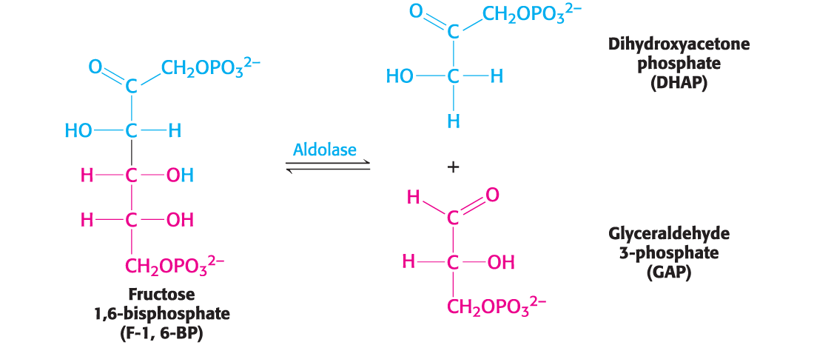
The Reaction Catalyzed by Aldolase

Slide 21
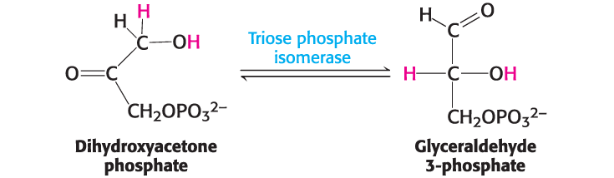
The Reaction Catalyzed by Triose Phosphate Isomerase
Triose phosphate isomerase is the only glycolytic enzyme for which genetic deficiency in expression can be lethal.

Slide 22
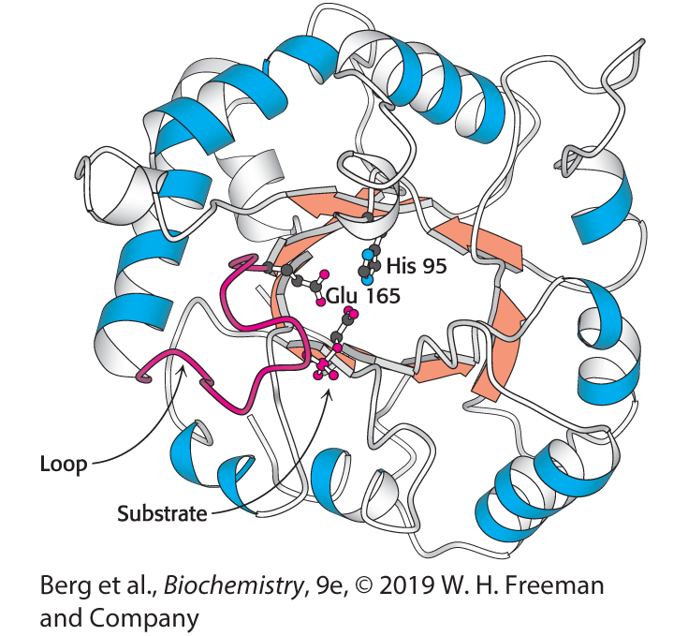
Structure of Triose Phosphate Isomerase
Notes:
FIGURE 16.4 Structure of triose phosphate isomerase. This enzyme consists of a central core of eight parallel β strands (orange) surrounded by eight α helices (blue). This structural motif, called an αβ barrel, is also found in the glycolytic enzymes aldolase, enolase, and pyruvate kinase. Notice that histidine 95 and glutamate 165, essential components of the active site of triose phosphate isomerase, are located in the barrel. A loop (red) closes off the active site on substrate binding. [Drawn from 2YPI.pdb.]

Slide 23
Mechanism: Triose Phosphate Isomerase Salvages a Three-carbon Fragment
Triose phosphate isomerase converts DHAP into GAP. This conversion of a ketose into an aldose proceeds through an enediol intermediate.
  Glutamate 165 acts as a general base catalyst and removes a proton from C-1 of the substrate to form the enediol intermediate.
  Glutamate 165, now acting as a general acid catalyst, donates a proton to C-2, while histidine 95 removes a proton from C-1.
  The product is formed, and glutamate 165 and histidine 95 return to their initial states.

Slide 24
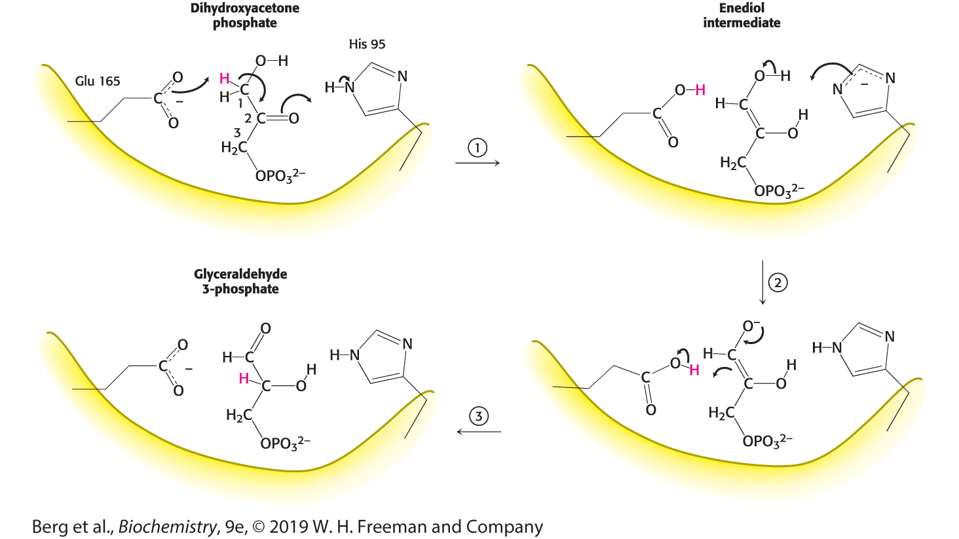
Catalytic Mechanism of Triose Phosphate Isomerase
Notes:
FIGURE 16.5 Catalytic mechanism of triose phosphate isomerase. (1) Glutamate 165 acts as a general base by abstracting a proton (H⁺) from carbon 1. Histidine 95, acting as a general acid, donates a proton to the oxygen atom bonded to carbon 2, forming the enediol intermediate. (2) Glutamic acid, now acting as a general acid, donates a proton to C-2 while histidine removes a proton from the OH group of C-1. (3) The product is formed, and glutamate and histidine are returned to their ionized and neutral forms, respectively.

Slide 25

Design of Triose Phosphate Isomerase Enhances its Efficiency
Triose phosphate isomerase is considered to be a kinetically perfect enzyme because its rate of catalysis is near the diffusion limit.
The enediol intermediate may potentially decompose into the very reactive methyl glyoxal. However, structural features in the enzyme prevent production of this undesired product.

Slide 26
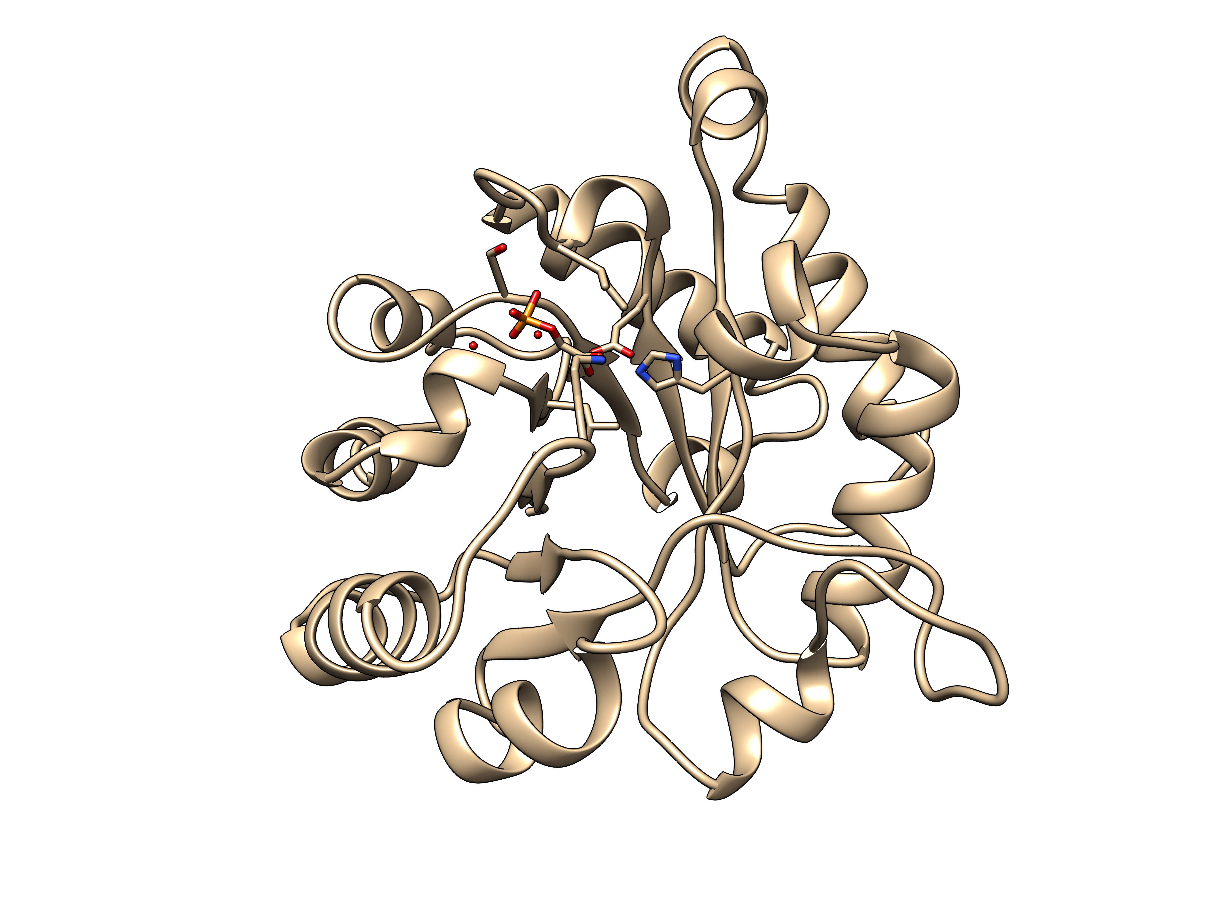
The tertiary structure of TIM is one of the oldest in evolutionary time
2YPI: S. cerevisiae TIM

Slide 27
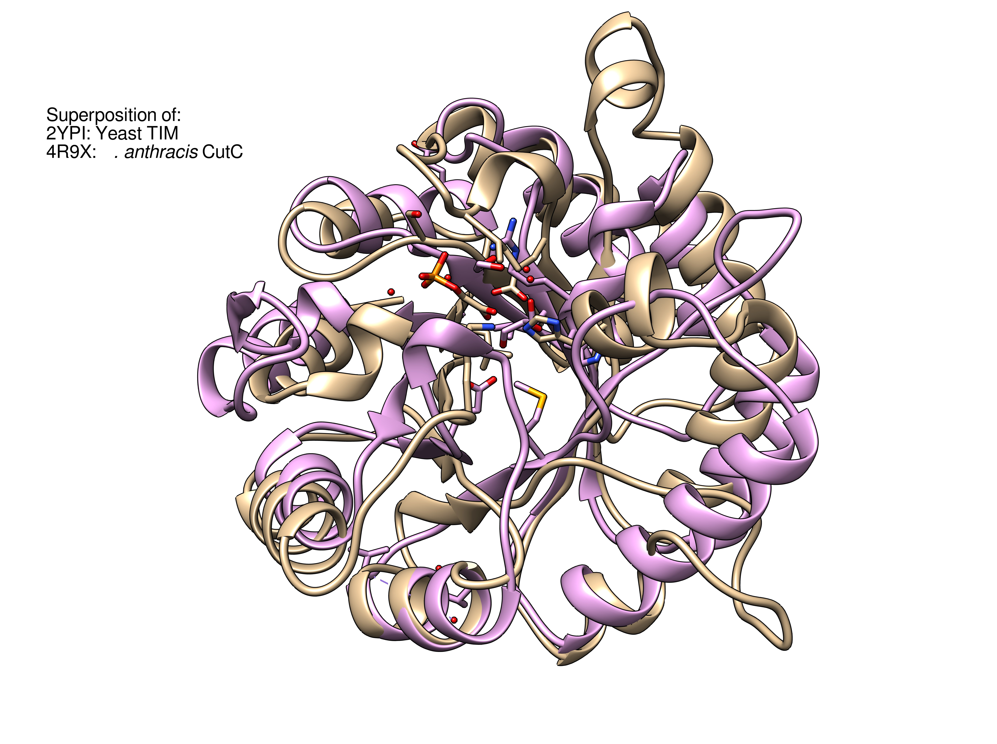
Superposition of:
2YPI: S. cerevisiae TIM
4R9X: B. anthracis CutC

Slide 28
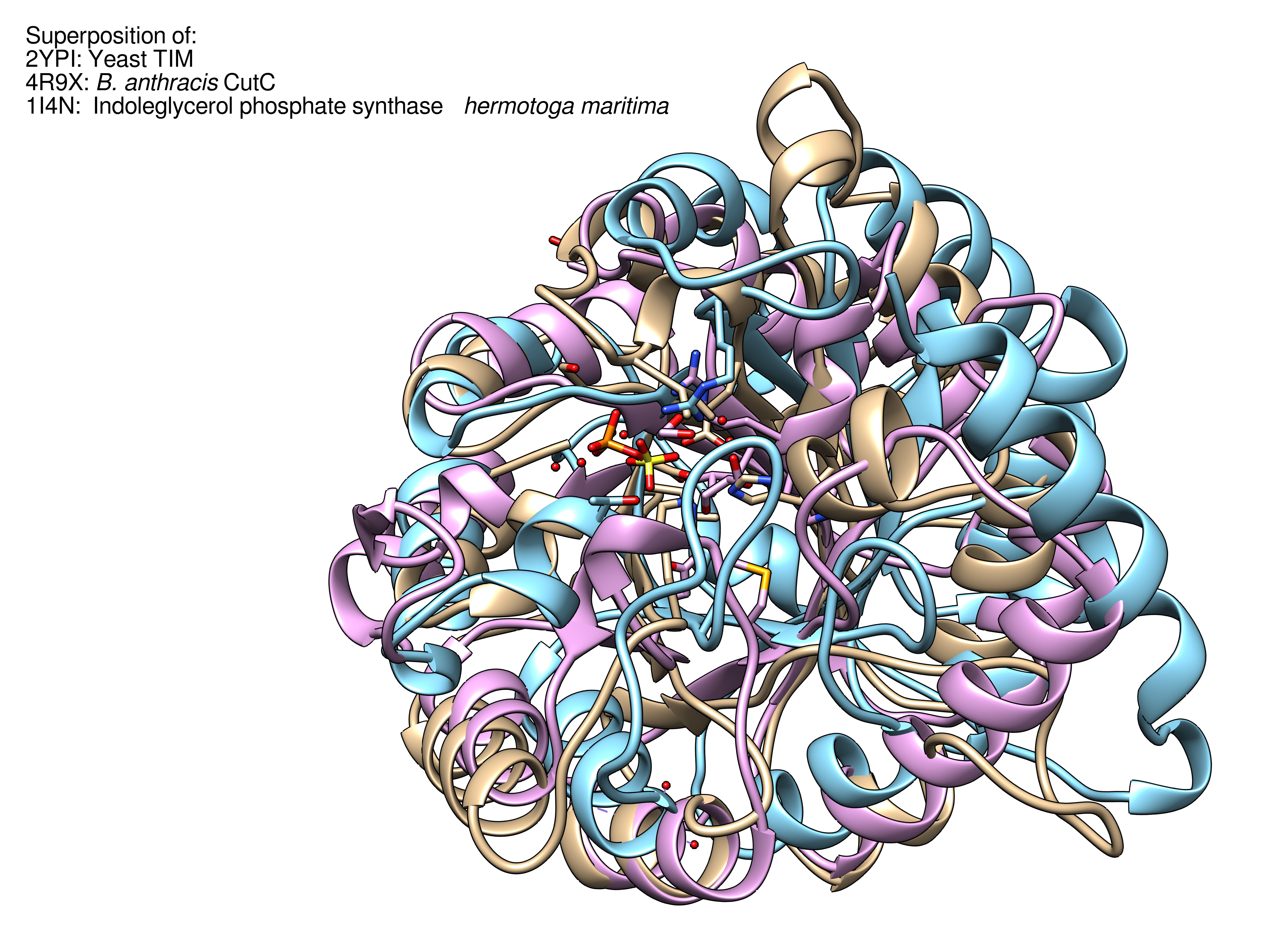
Superposition of:
2YPI: S. cerevisiae TIM
4R9X: B. anthracis CutC
1I4N: T. maritima Indoleglycerol phosphate synthase

Slide 29
Completely different amino acid sequences, but identical folds!

Slide 30
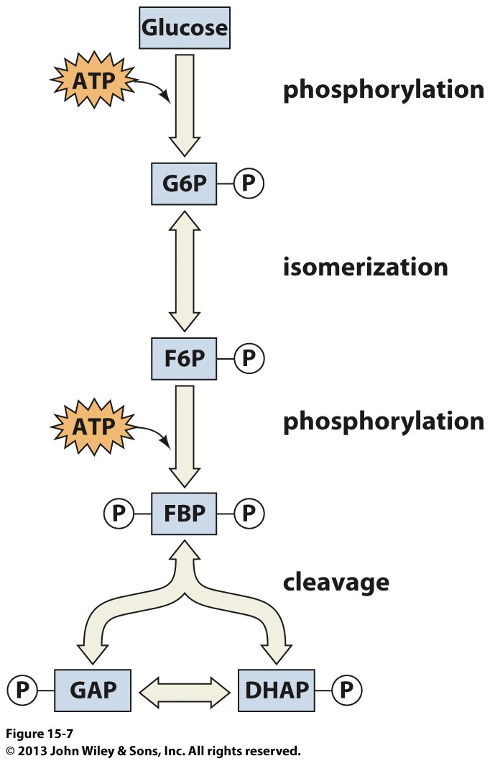
Where are we now and where have we been?

Slide 31
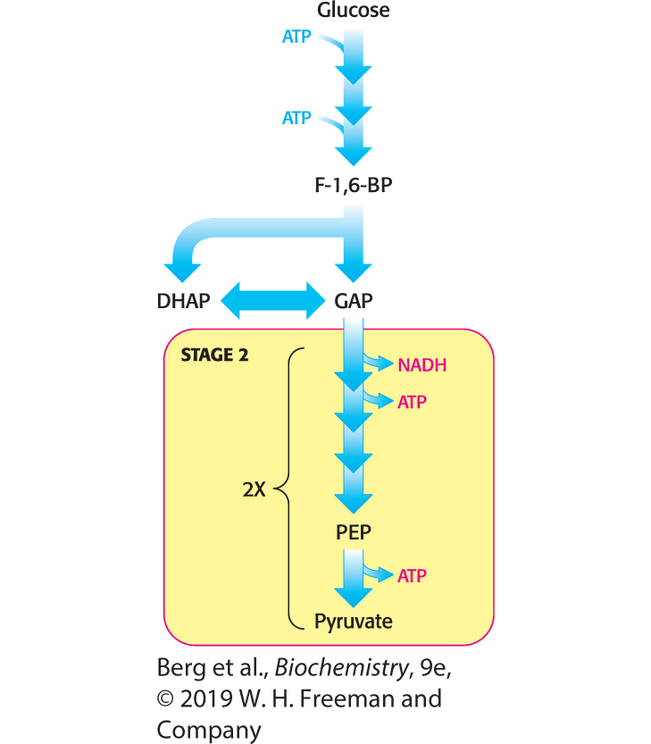
Second Stage of Glycolysis
Notes:
Second stage of glycolysis. The oxidation of three-carbon fragments yields ATP.

Slide 32
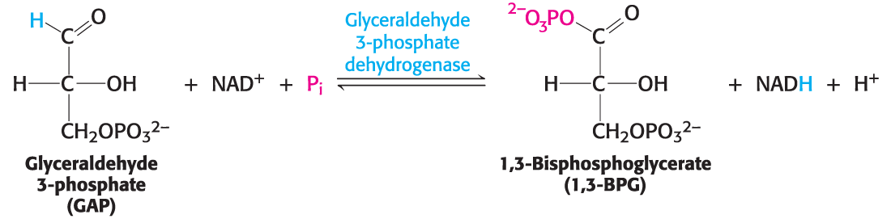
The Reaction Catalyzed by Glyceraldehyde 3-phosphate Dehydrogenase (1/3)

Slide 33
The Reaction Catalyzed by Glyceraldehyde 3-phosphate Dehydrogenase (2/3)
The formation of glyceraldehyde 1,3-bisphosphate can be thought of as occurring in two steps:
  The highly exergonic oxidation of carbon 1 in GAP to an acid
  The highly endergonic formation of glyceraldehyde 1, 3-bisphosphate from the acid
These two reaction are linked by the formation of an energy-rich thioester in the active site of glyceraldehyde 3-phosphate dehydrogenase.

Slide 34
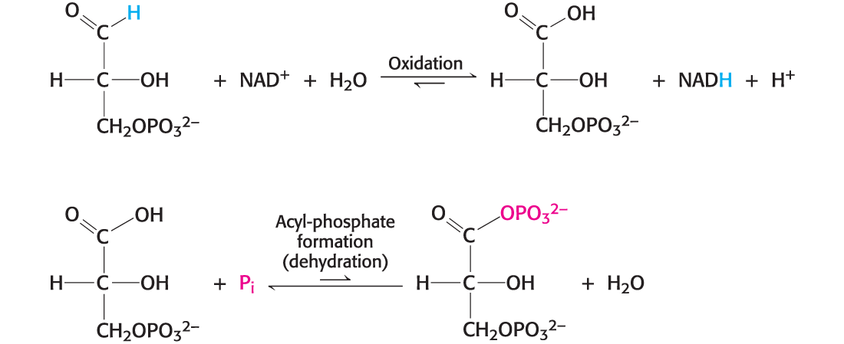
The Reaction Catalyzed by Glyceraldehyde 3-phosphate Dehydrogenase (3/3)

Slide 35
Mechanism: Phosphorylation is Coupled to the Oxidation of Glyceraldehyde 3-phosphate by a Thioester Intermediate
The reaction mechanism of glyceraldehyde 3-phosphate dehydrogenase consists of four steps:
  GAP reacts with a cysteine residue to form a hemithioacetal.
  A thioester is formed by the transfer of a hydride to NAD⁺.
  NADH is exchanged for NAD⁺. The charge on NAD⁺ facilitates the attack by the phosphate on the thioester.
  Phosphate attacks the thioester, forming the product 1,3-BPG.

Slide 36
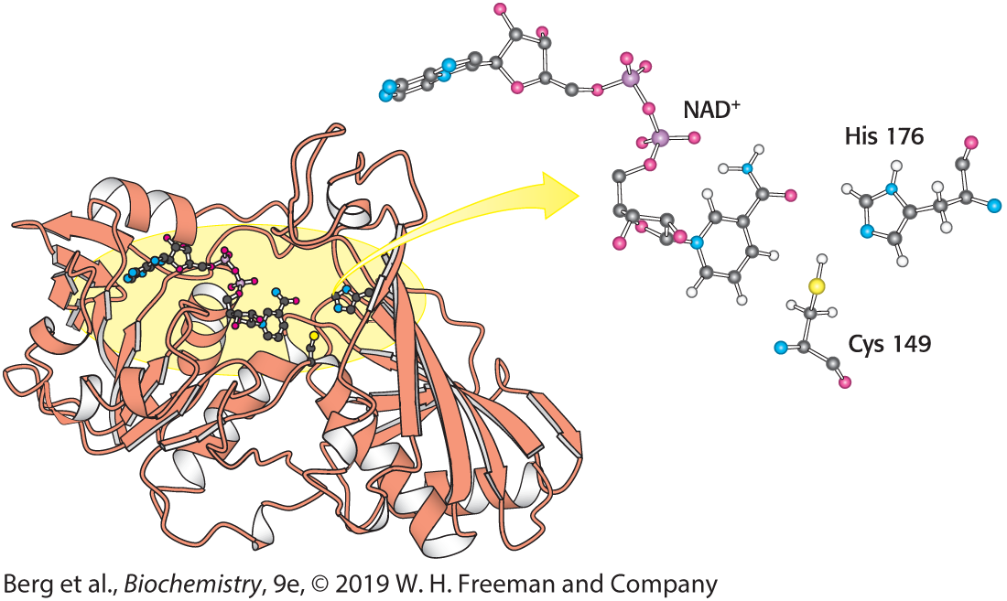
Structure of Glyceraldehyde
3-Phosphate Dehydrogenase
Notes:
FIGURE 16.7 Structure of glyceraldehyde 3-phosphate dehydrogenase. Notice that the active site includes a cysteine residue and a histidine residue adjacent to a bound NAD⁺ molecule. The sulfur atom of cysteine will link with the substrate to form a transitory thioester intermediate. [Drawn from 1GAD.pdb.]

Slide 37
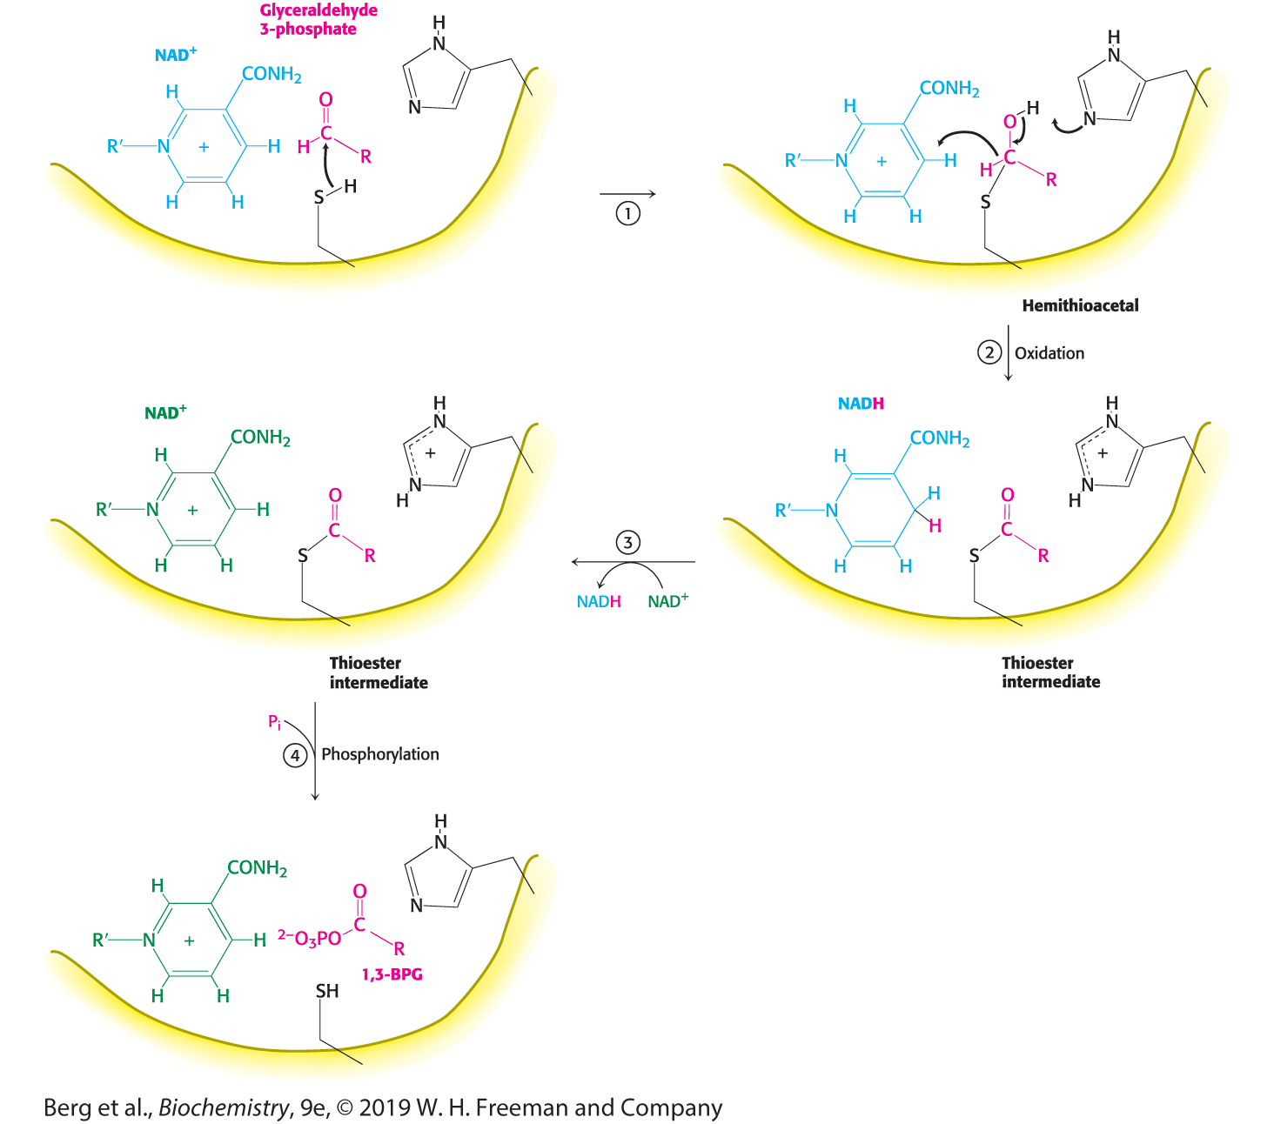
Catalytic Mechanism of Glyceraldehyde 3-phosphate Dehydrogenase
Notes:
FIGURE 16.8 Catalytic mechanism of glyceraldehyde 3-phosphate dehydrogenase. The reaction proceeds through a thioester intermediate, which allows the oxidation of glyceraldehyde to be coupled to the phosphorylation of 3-phosphoglycerate. (1) Cysteine reacts with the aldehyde group of the substrate, forming a hemithioacetal. (2) An oxidation takes place with the transfer of a hydride ion to NAD⁺, forming a thioester. This reaction is facilitated by the transfer of a proton to histidine. (3) The reduced NADH is exchanged for an NAD⁺ molecule. (4) Orthophosphate attacks the thioester, forming the product 1,3-BPG.

Slide 38
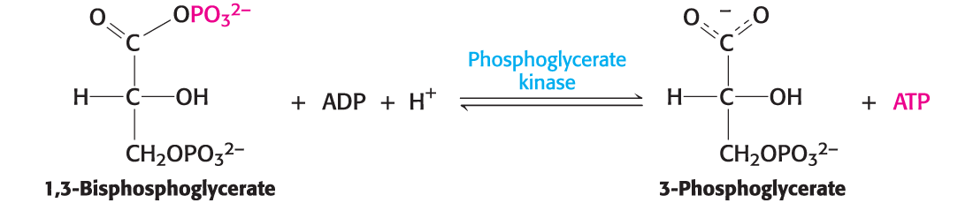
ATP is Formed by Phosphoryl Transfer from 1,3-Bisphosphoglycerate
1, 3-Bisphosphoglycerate has a greater phosphoryl-transfer potential than ATP and thus can be used to power the synthesis of ATP from ADP and P_{i} .
This reaction is catalyzed by phosphoglycerate kinase.
This is an example of generating ATP by substrate-level phosphorylation.

Slide 39
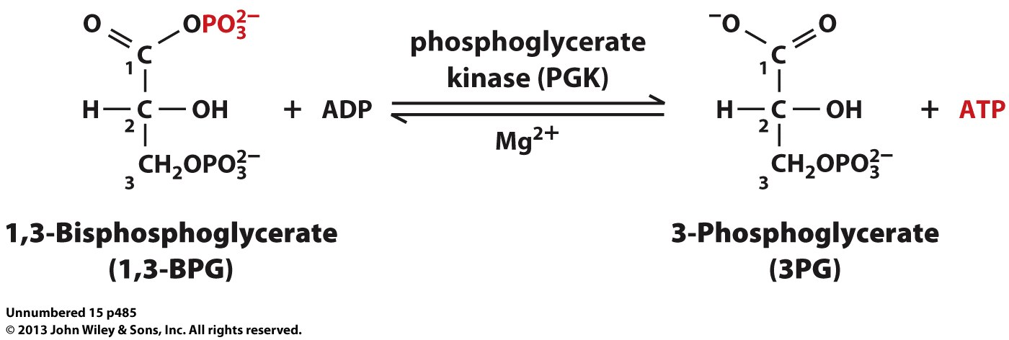

Slide 40
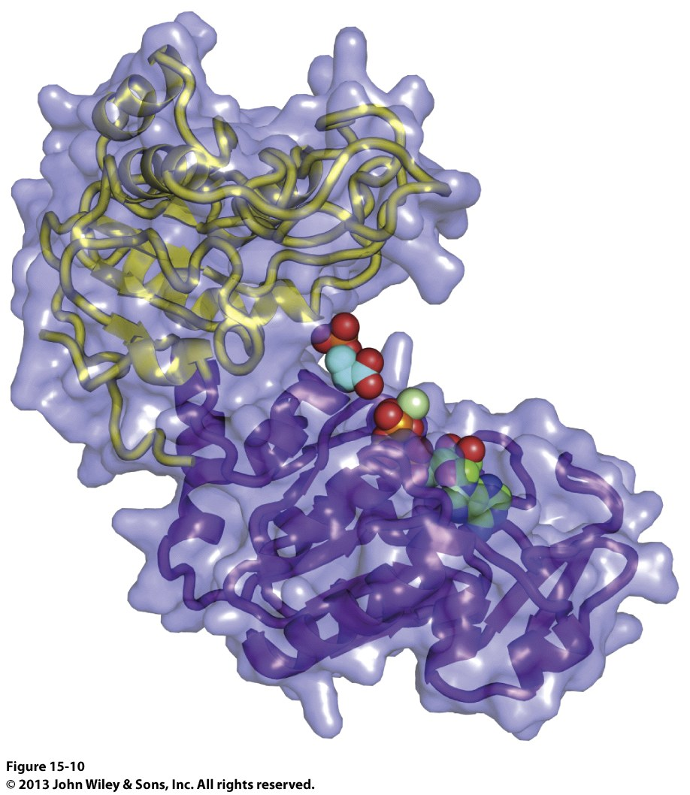
Does this resemble another enzyme earlier in the pathway? Hexokinase perhaps?

Slide 41
Additional ATP is Generated with the Formation of Pyruvate
3-Phosphoglycerate is converted into 2-phosphoglycerate by phosphoglycerate mutase. A dehydration reaction, catalyzed by enolase, results in the production of phosphoenolpyruvate (PEP).
Phosphoenolpyruvate is a high phosphoryl-transfer compound because the presence of the phosphate traps the compound in the unstable enol tautomer.
ADP is phosphorylated at the expense of PEP, generating ATP and pyruvate, in a reaction catalyzed by pyruvate kinase.

Slide 42
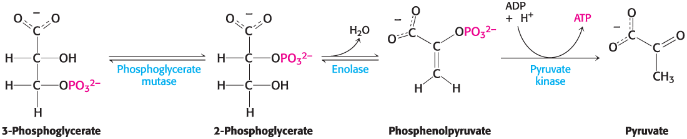
The Final Three Reactions in Glycolysis

Slide 43

Phosphoglycerate Mutase Causes a Shift in the Position of the Phosphate on the Glycerate
The reaction catalyzed by the mutase involves a phosphorylated enzyme intermediate and the substrate passing through the 2,3-bisphosphorylated form.
The net reaction is

Slide 44
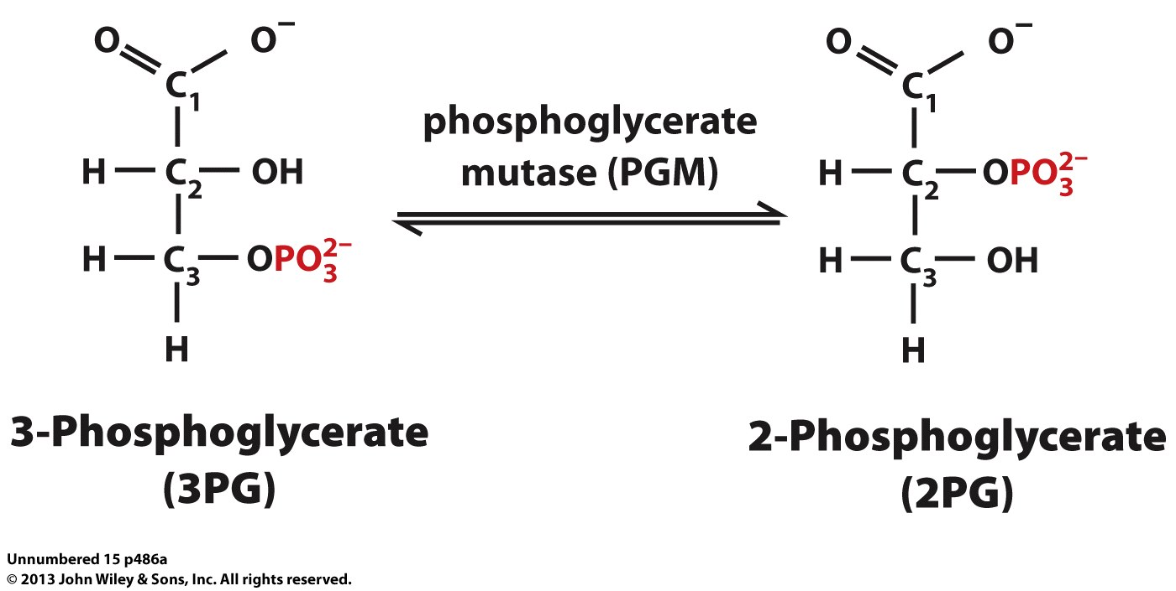
Phosphoglycerate Mutase (PGM) Reaction

Slide 45
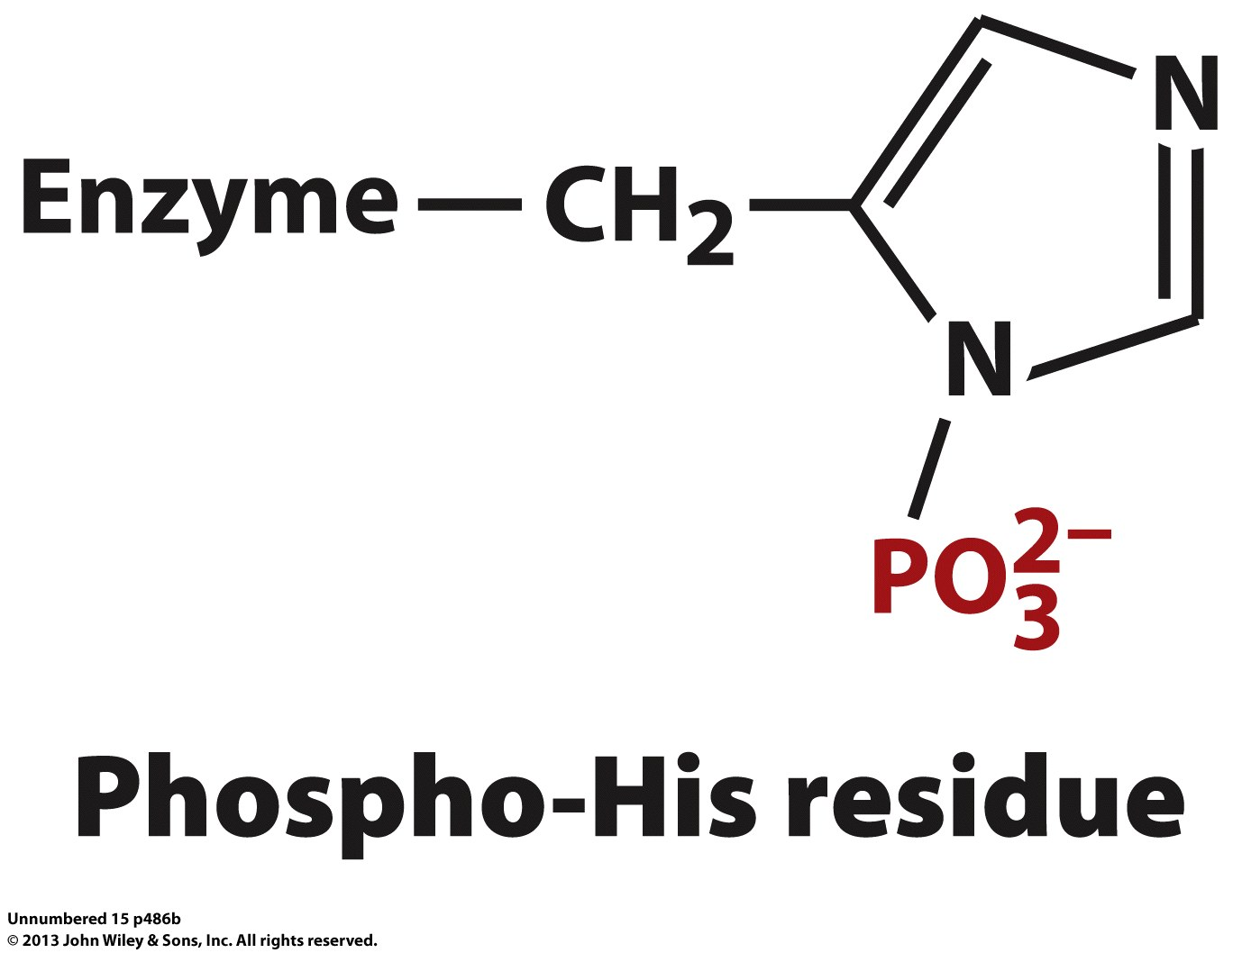

Slide 46
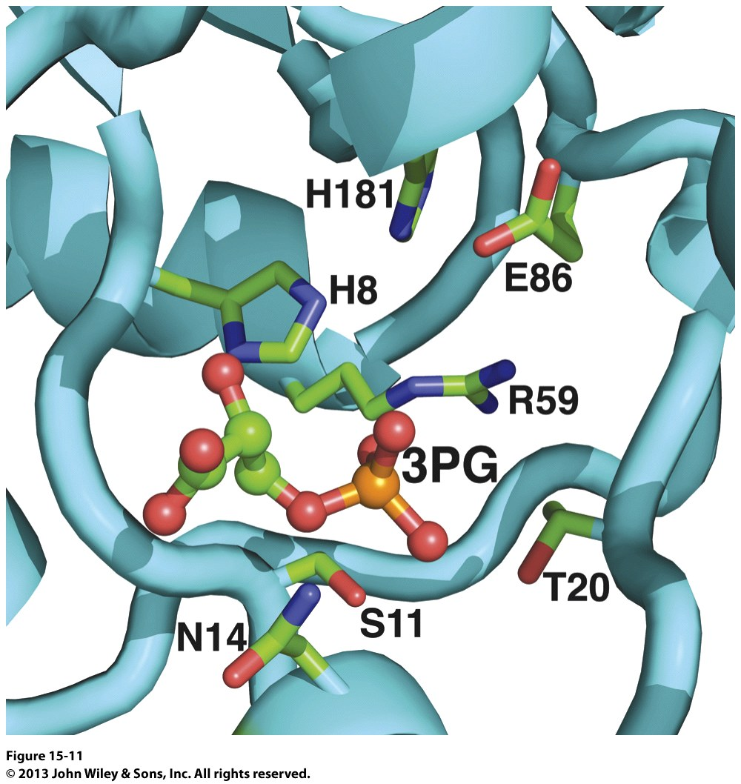

Slide 47
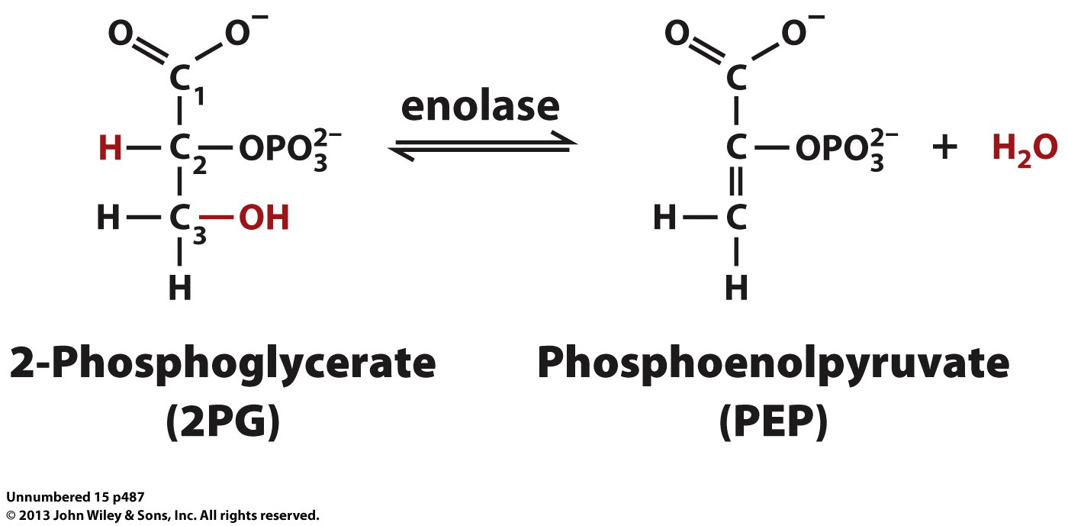
Enolase Reaction

Slide 48
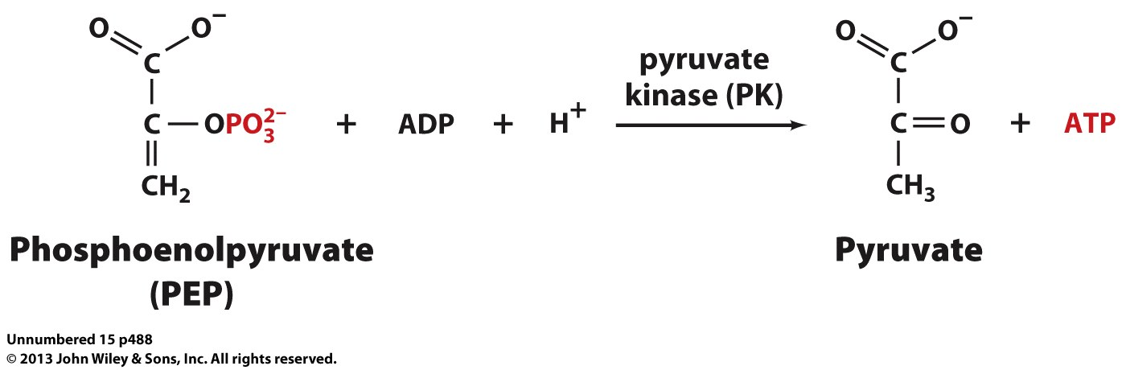
Pyruvate Kinase Reaction

Slide 49
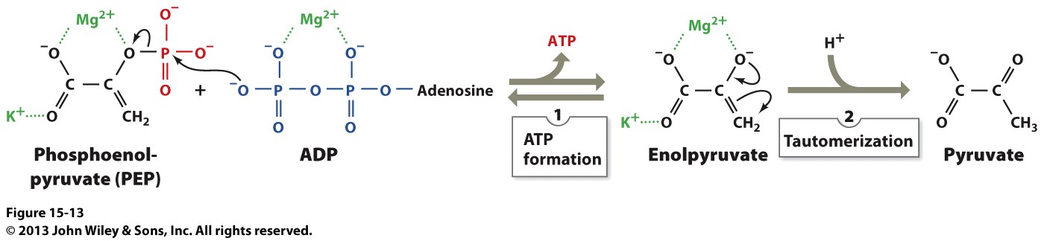

Slide 50
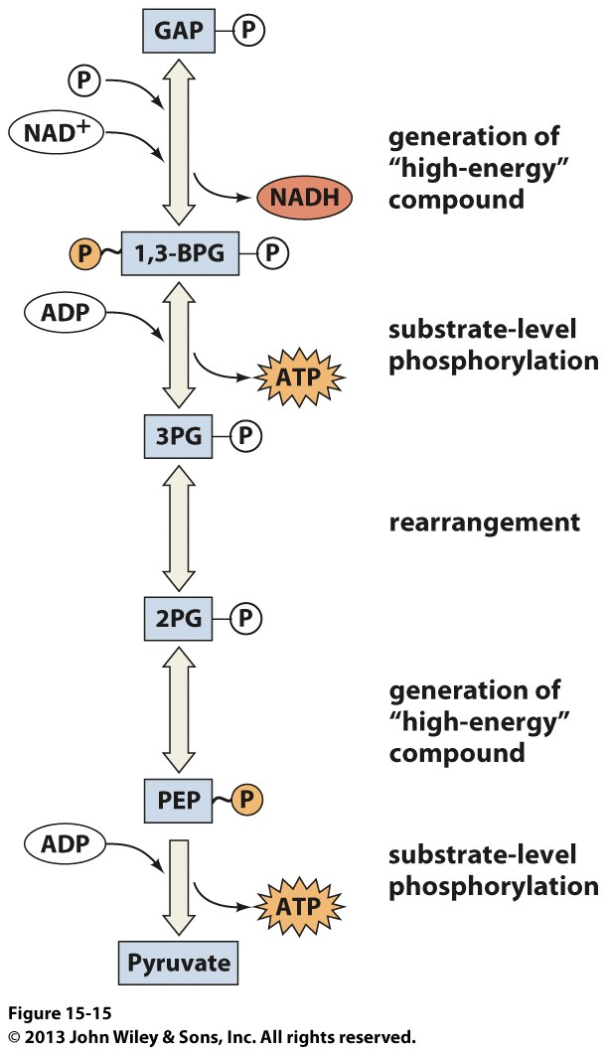
What have we done in the 2nd Half?

Slide 51
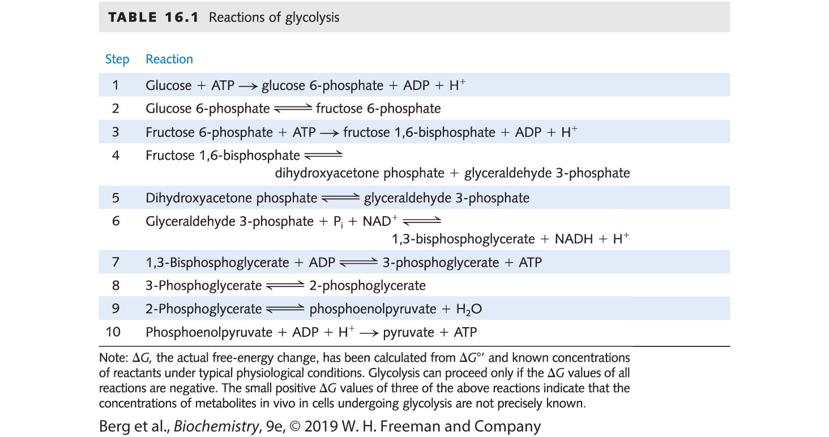
Reactions of Glycolysis

Slide 52
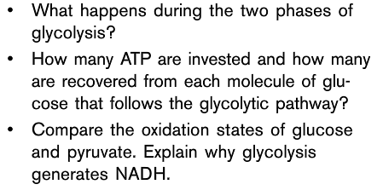
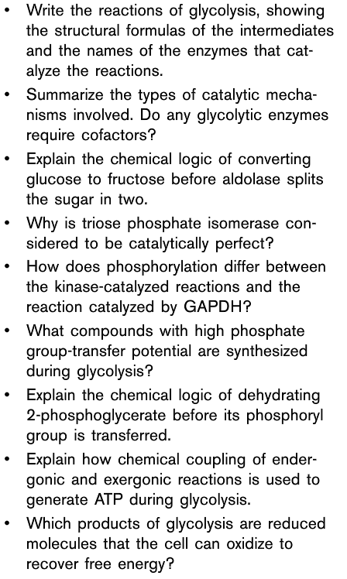
You should be able to answer these questions after READING the textbook, taking notes in class today and THINKING about the material.

Slide 53
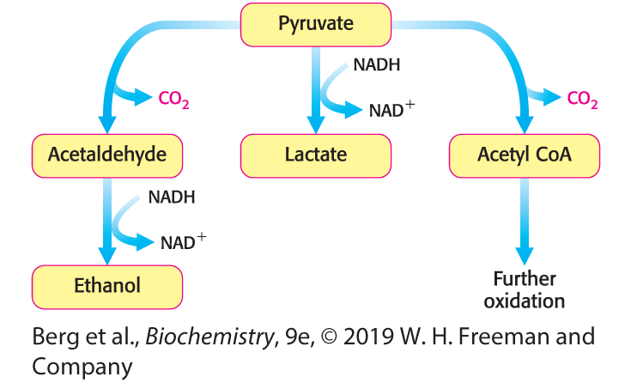
NAD+ is Regenerated from the Metabolism of Pyruvate
The conversion of glucose into pyruvate generates ATP, but for ATP synthesis to continue, NADH must be reoxidized to NAD⁺. Cells have limited amounts of NAD⁺, which is derived from niacin (vitamin B₃).
NAD⁺ can be regenerated by further oxidation of pyruvate to CO₂ or by the formation of ethanol or lactate from pyruvate.
Notes:
FIGURE 16.9 Diverse fates of pyruvate. Ethanol and lactate can be formed by reactions that include NADH. Alternatively, a two-carbon unit from pyruvate can be coupled to coenzyme A (Chapter 17) to form acetyl CoA.

Slide 54
While Glycolysis is Similar in Most Organisms, the Fate of Pyruvate is Variable
There are three possible fates of pyruvate: fermentation (two types) or metabolism in the citric acid cycle and electron transport chain.
Fermentations are ATP-generating pathways in which electrons are removed from one organic compound and passed to another organic compound.
The formation of ethanol from pyruvate regenerates NAD⁺. Pyruvate decarboxylase requires the vitamin thiamine (B₁).

Slide 55
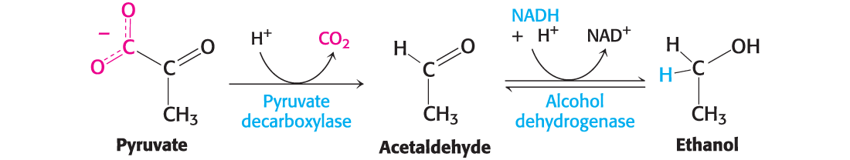
Alcoholic Fermentation
The first type of fermentation is regeneration of NAD⁺ by processing pyruvate to ethanol. This is called alcoholic fermentation.

Slide 56
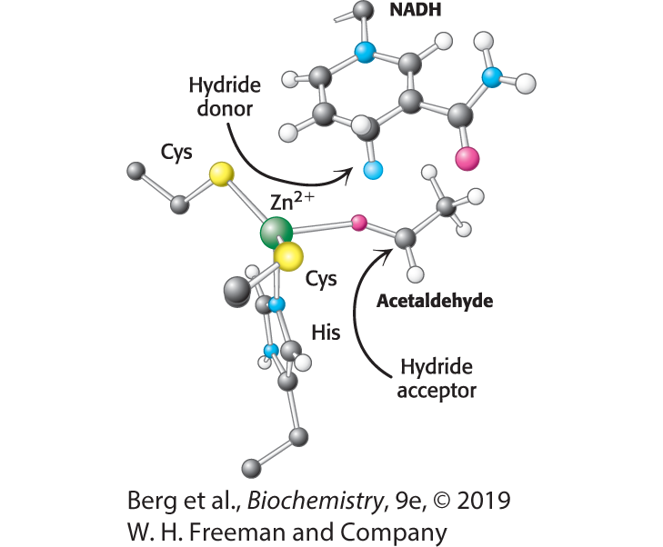
Active Site of Alcohol Dehydrogenase
Notes:
FIGURE 16.10 Active site of alcohol dehydrogenase. The active site contains a zinc ion bound to two cysteine residues and one histidine residue. Notice that the zinc ion binds the acetaldehyde substrate through its oxygen atom, polarizing the substrate so that it more easily accepts a hydride from NADH. Only the nicotinamide ring of NADH is shown.

Slide 57
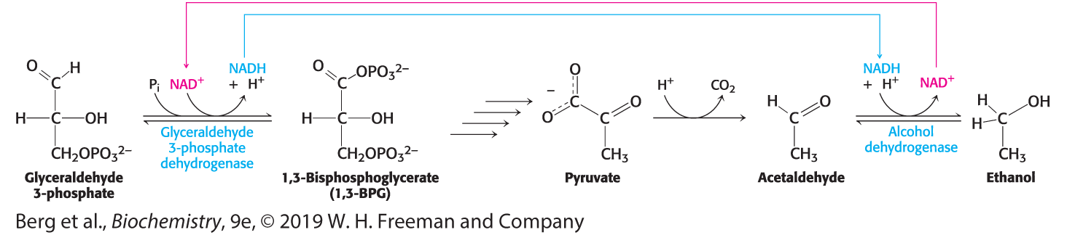
Maintaining Redox Balance
The real reason for any fermentation!
Notes:
FIGURE 16.11 Maintaining redox balance. The NADH produced by the glyceraldehyde 3-phosphate dehydrogenase reaction must be reoxidized to NAD⁺ for the glycolytic pathway to continue. In alcoholic fermentation, alcohol dehydrogenase oxidizes NADH and generates ethanol. In lactic acid fermentation (not shown), lactate dehydrogenase oxidizes NADH while generating lactic acid.

Slide 58

Lactic Acid Fermentation
The second type of fermentation is lactic acid fermentation, in which pyruvate is reduced to lactate to regenerate NAD⁺.
The net reaction starting from glucose:

Slide 59
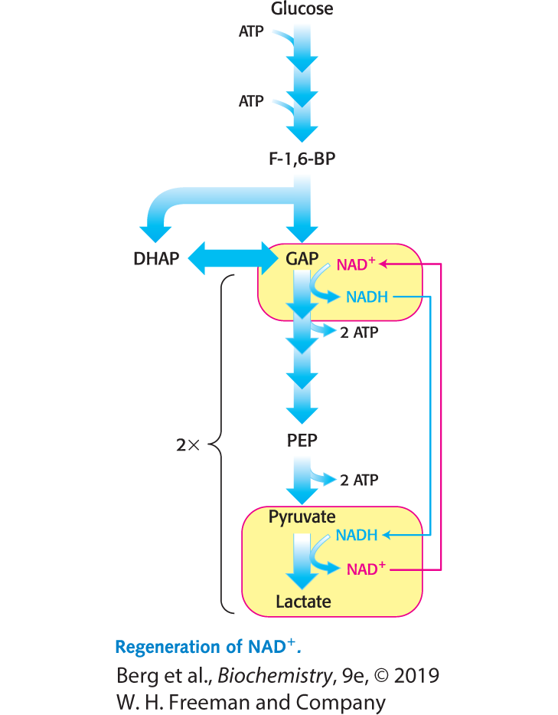
Regeneration of NAD+ in Lactic Acid Fermentation

Slide 60
Aerobic Metabolism Through the Citric Acid Cycle and Electron Transport Chain
The third possible fate of pyruvate, rather than a type of fermentation, is to completely oxidize the pyruvate through pyruvate processing (to generate acetyl CoA) and the citric acid cycle (to oxidize the acetyl group).
The electrons are transferred to the final acceptor in the electron transport chain (i.e., O2) via aerobic metabolism. As the electrons are delivered from NADH to the electron transport chain, NAD+ is restored.

Slide 61
Section 16.2 The Glycolytic Pathway Is Tightly Controlled
Enzymes catalyzing irreversible reactions in metabolic pathways are potential control sites.
In glycolysis, these enzymes are
  hexokinase,
  phosphofructokinase, and
  pyruvate kinase.

Slide 62
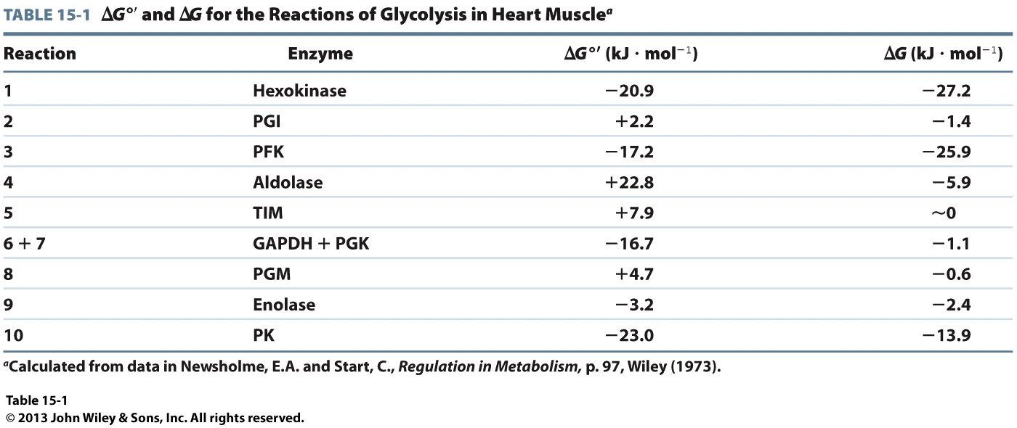
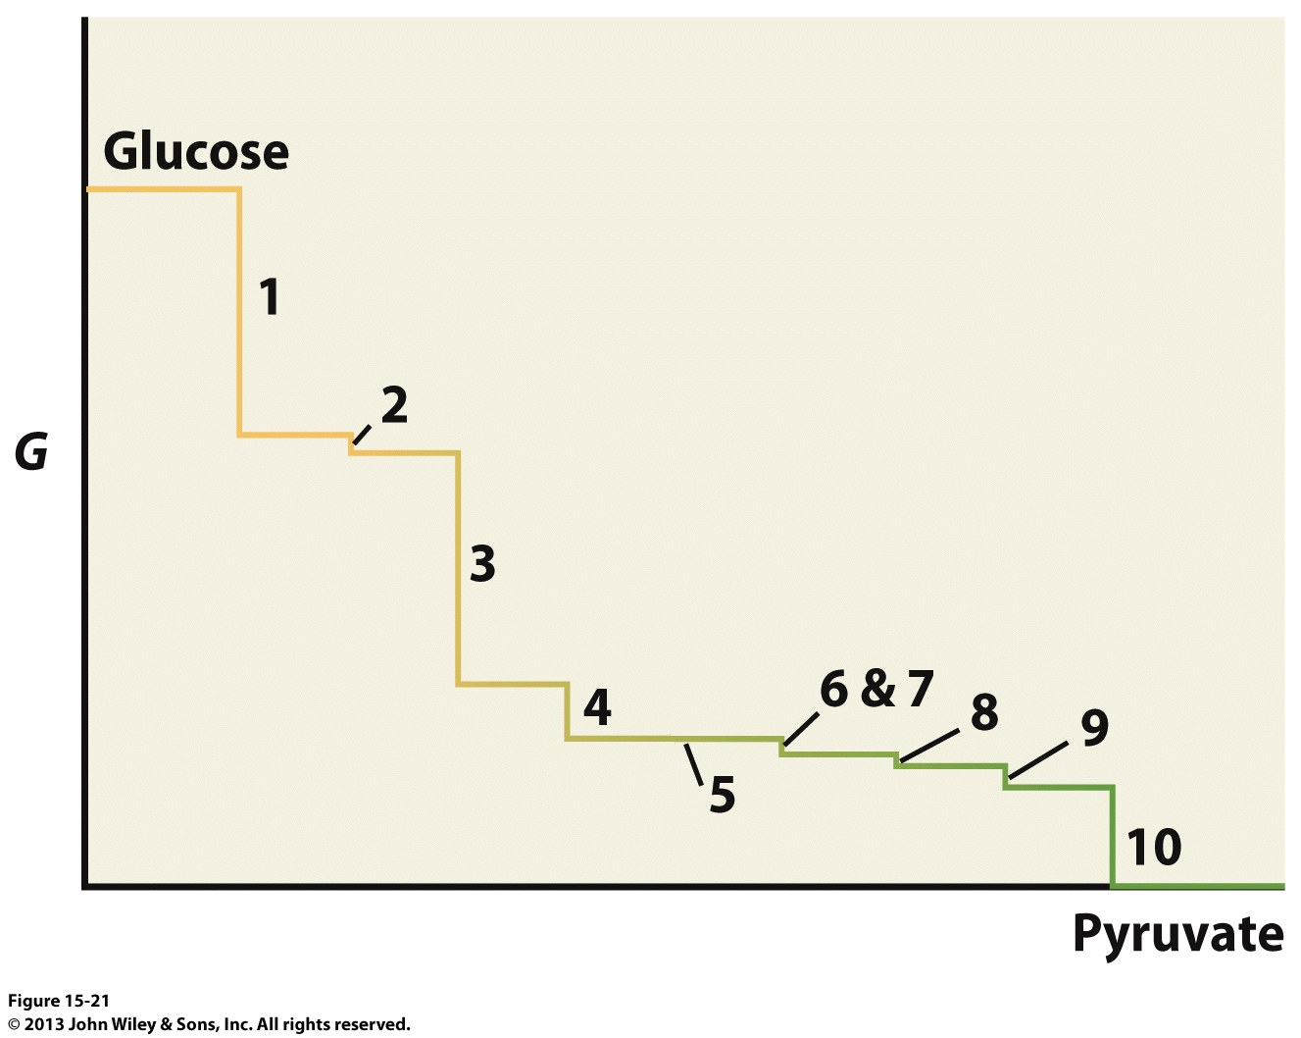
Regulation of Glycolysis

Slide 63
Glycolysis in Muscle is Regulated to Meet the Need for ATP
Phosphofructokinase is the most important regulator of glycolysis in mammals. The enzyme is allosterically inhibited by ATP and allosterically stimulated by AMP.
  ATP binding lowers the enzyme’s affinity for fructose 6-phosphate, while AMP reverses the inhibitory action of ATP.
  This means that the activity of the enzyme increases when the ATP/AMP ratio is lowered (i.e., glycolysis is stimulated as the energy charge falls).
Low pH also inhibits phosphofructokinase activity by enhancing the inhibitory activity of ATP. pH can fall when muscle is functioning anaerobically, producing excessive amounts of lactic acid, and this inhibition protects the muscle from damage that would result from accumulation of too much acid.

Slide 64
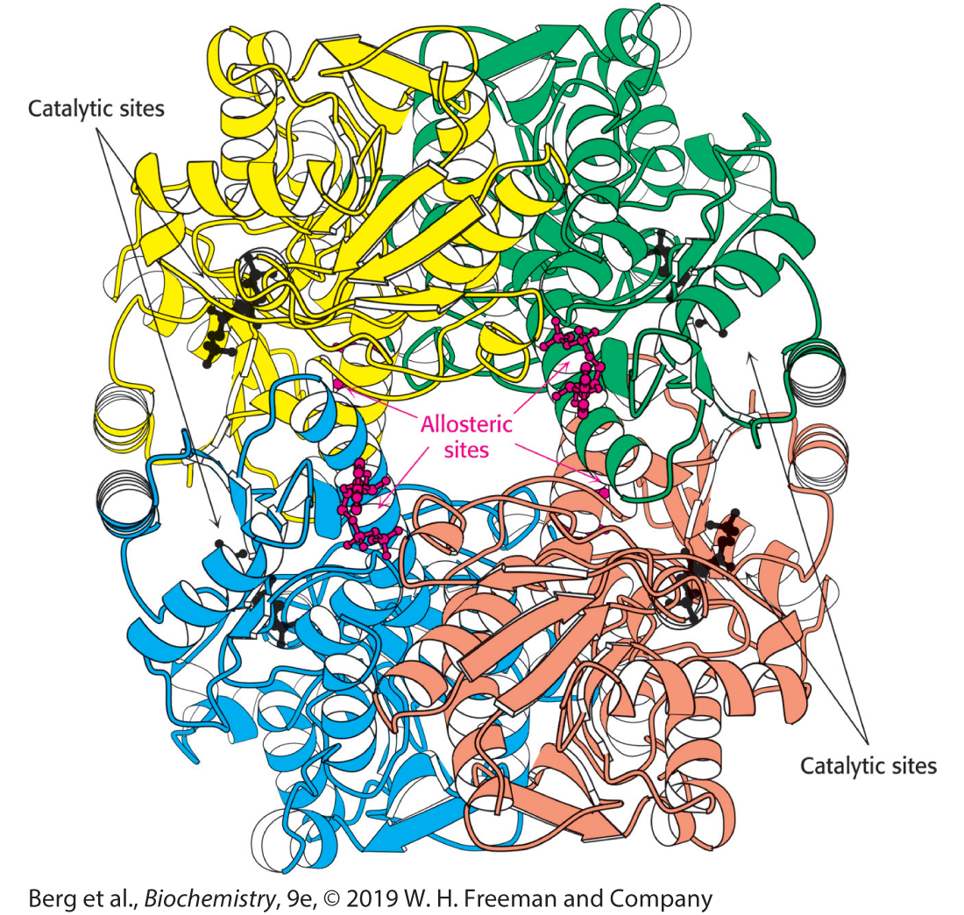
Structure of Phosphofructokinase
Notes:
FIGURE 16.15 Structure of phosphofructokinase. The structure of phosphofructokinase from E. coli comprises a tetramer of four identical subunits. Notice the separation of the catalytic and allosteric sites. Each subunit of the human liver enzyme consists of two domains that are similar to the E. coli enzyme. [Drawn from 1PFK.pdb.]

Slide 65

Allosteric Regulation of Phosphofructokinase
Notes:
FIGURE 16.16 Allosteric regulation of phosphofructokinase. A high level of ATP inhibits the enzyme by decreasing its affinity for fructose 6-phosphate.

Slide 66

AMP as a Positive Regulator of Phosphofructokinase
Why is AMP, not ADP, the positive regulator of phosphofructokinase?
When ATP needs are great, adenylate kinase can generate ATP from 2 ADP.
AMP then becomes the signal for the low-energy state.
Also, use of AMP as an allosteric regulator provides sensitive control, because in the cell [ATP] > [ADP] > [AMP]; so small fluctuations in ATP concentration are magnified into large changes in [AMP] concentration.

Slide 67
Two Additional Enzymes in Glycolysis are Allosterically Regulated
Hexokinase is allosterically inhibited by its product glucose 6-phosphate.
  If the product isn’t being used by the next enzyme in the pathway, then there is no need to make it.
    Think of metabolic pathways like the interstate during morning traffic. If there’s a lot of cars on the road, you aren’t going anywhere
Pyruvate kinase is allosterically inhibited by ATP and is stimulated by the phosphofructokinase product fructose 1,6-bisphosphate in an example of feedforward stimulation.

Slide 68

Regulation of Glycolysis in Muscle
Notes:
FIGURE 16.17 Regulation of glycolysis in muscle. At rest (left), glycolysis is not very active (thin arrows). The high concentration of ATP inhibits phosphofructokinase (PFK), pyruvate kinase, and hexokinase. Glucose 6-phosphate is converted into glycogen (Chapter 21). During exercise (right), the decrease in the ATP/AMP ratio resulting from muscle contraction activates phosphofructokinase and hence glycolysis. The flux down the pathway is increased, as represented by the thick arrows.

