Slide 1
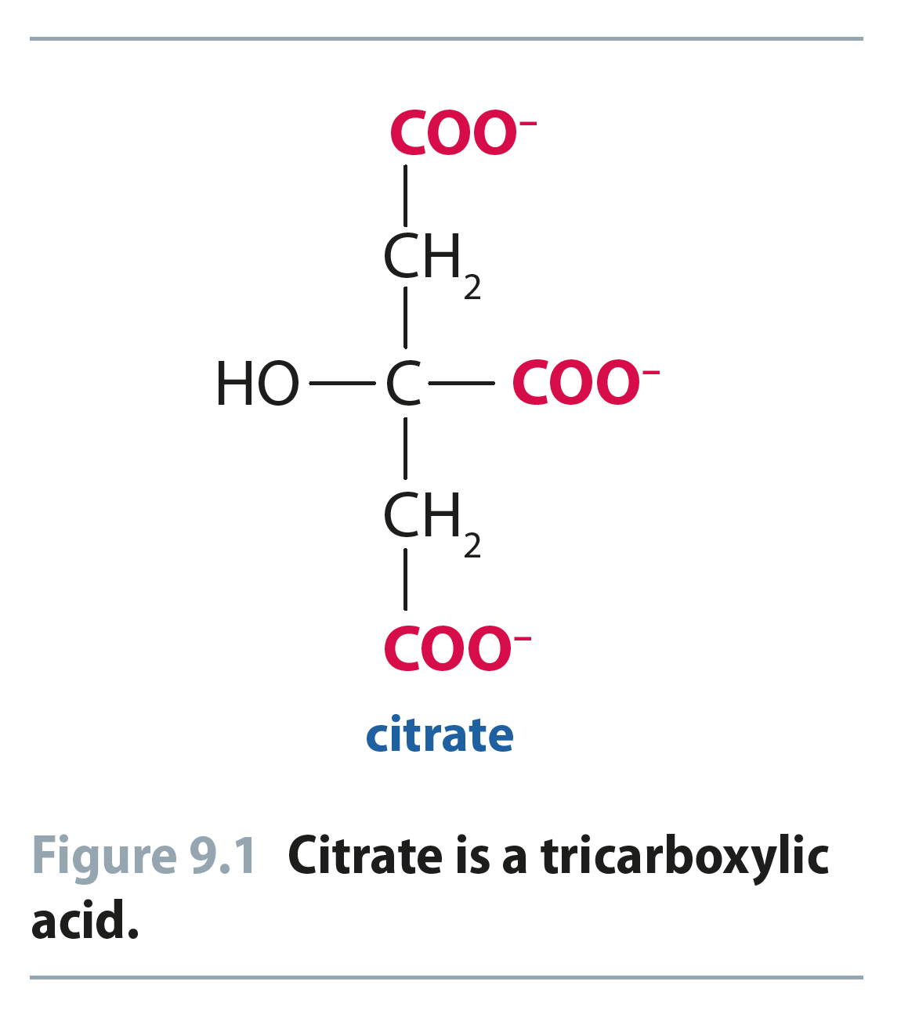
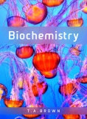
Fig 9.1
Reproduced from: Biochemistry by T.A. Brown, ISBN: 9781907904288 © Scion Publishing Ltd, 2017

Slide 2
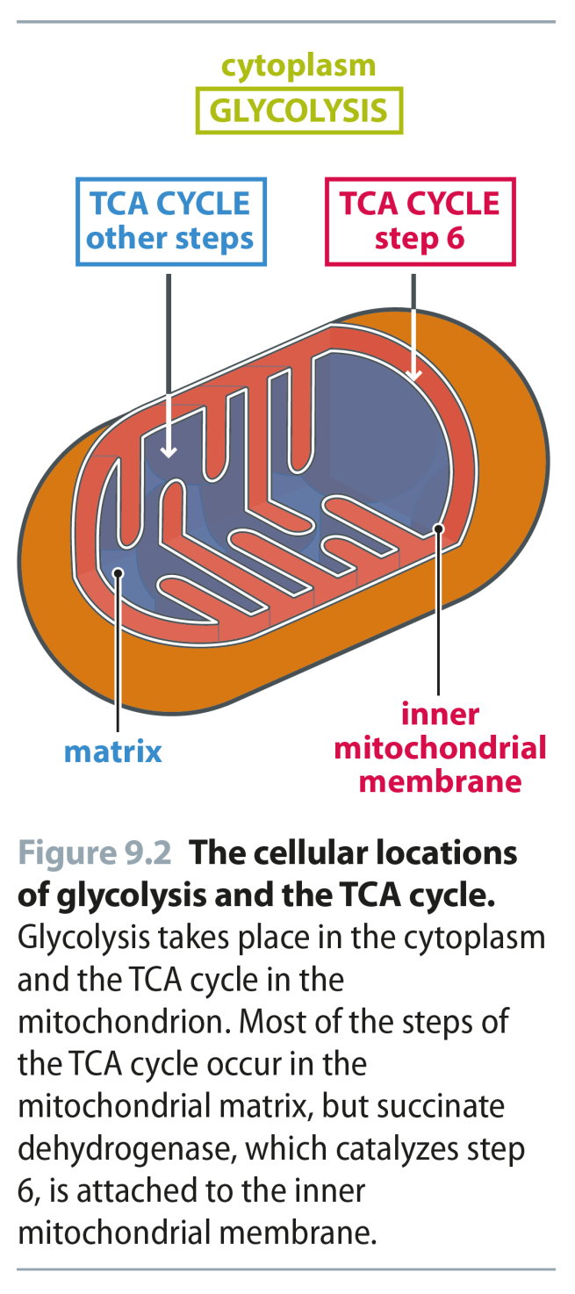
Fig 9.2
Reproduced from: Biochemistry by T.A. Brown, ISBN: 9781907904288 © Scion Publishing Ltd, 2017

Slide 3
Fig 9.3
Reproduced from: Biochemistry by T.A. Brown, ISBN: 9781907904288 © Scion Publishing Ltd, 2017

Slide 4
Fig 9.4
Reproduced from: Biochemistry by T.A. Brown, ISBN: 9781907904288 © Scion Publishing Ltd, 2017

Slide 5
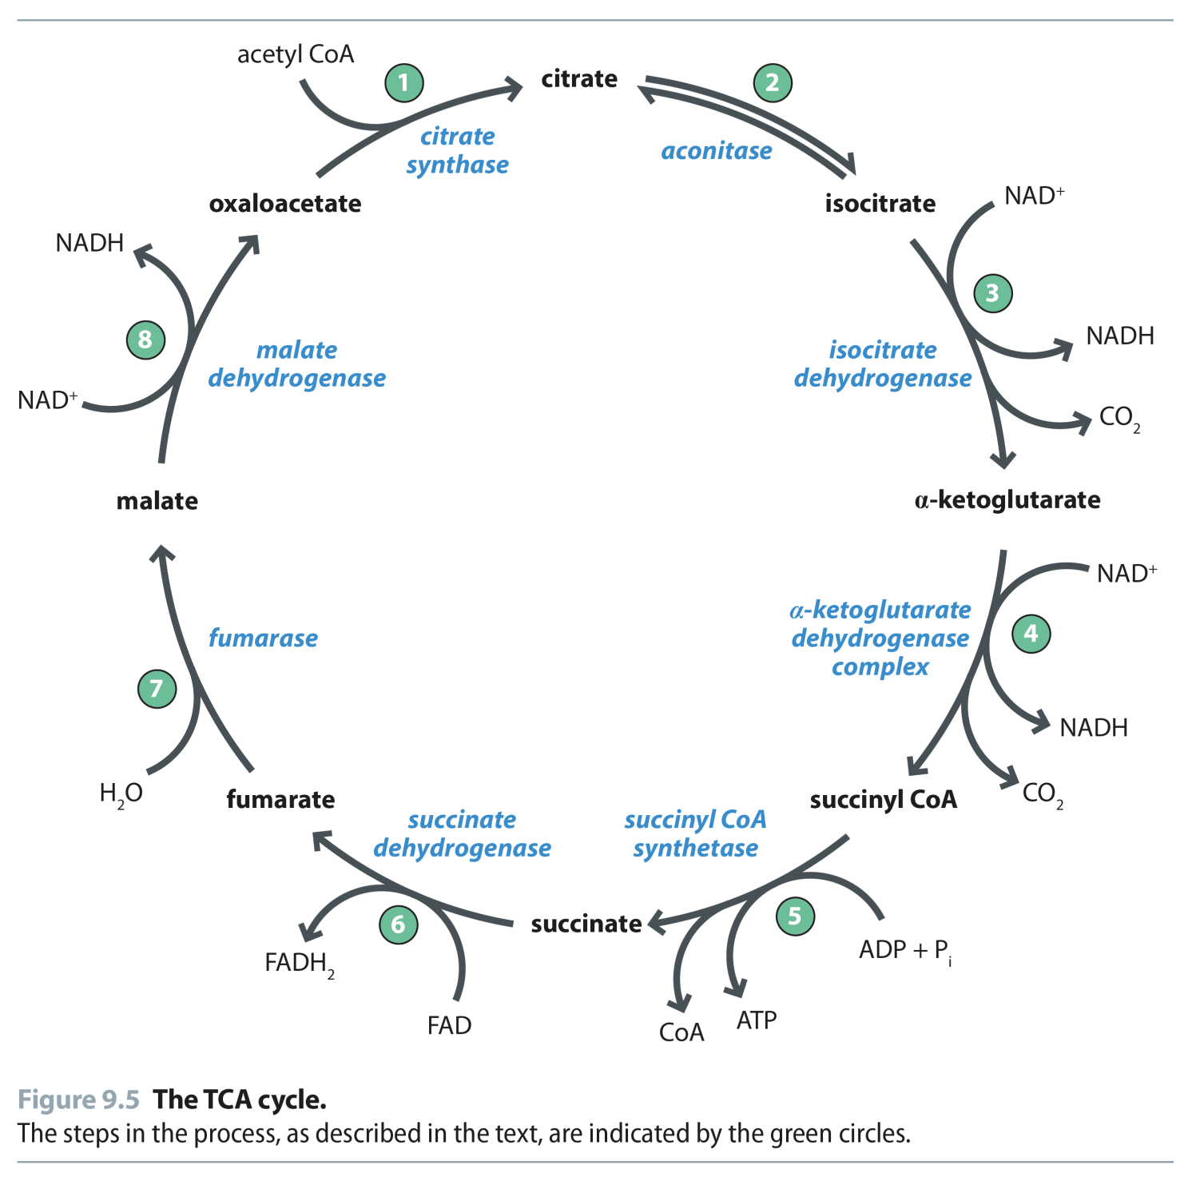
Fig 9.5
Reproduced from: Biochemistry by T.A. Brown, ISBN: 9781907904288 © Scion Publishing Ltd, 2017

Slide 6
Fig 9.6
Reproduced from: Biochemistry by T.A. Brown, ISBN: 9781907904288 © Scion Publishing Ltd, 2017

Slide 7
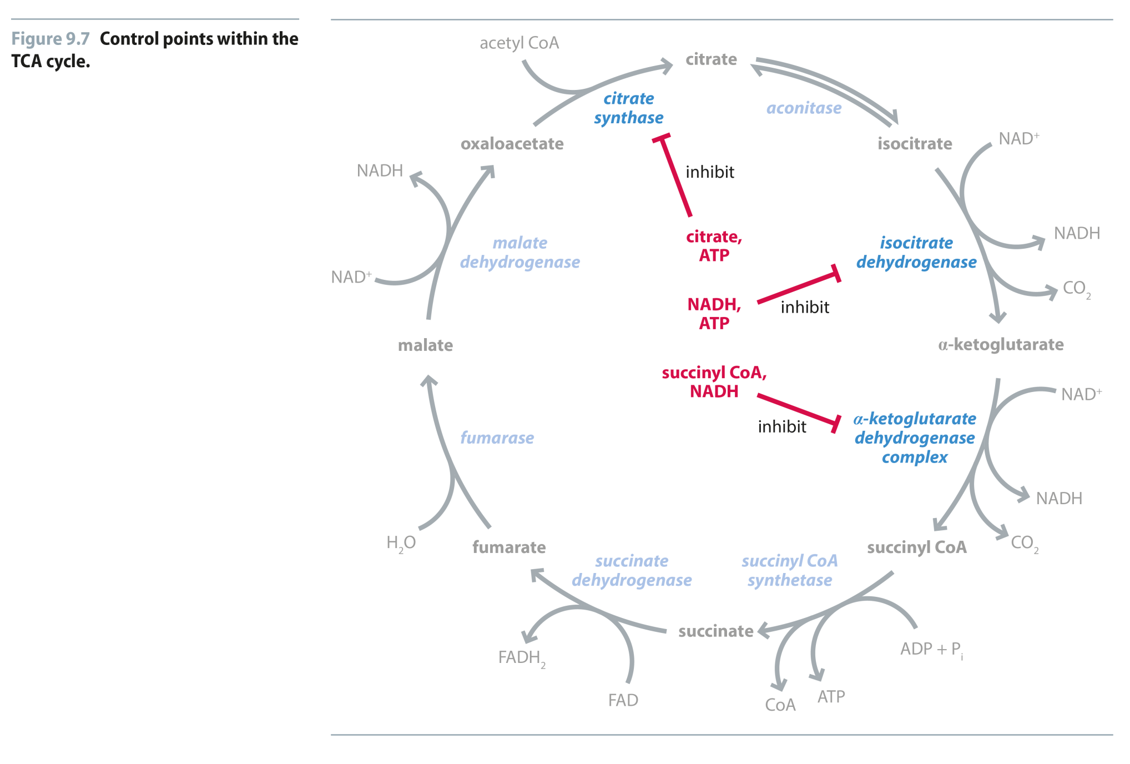
Fig 9.7
Reproduced from: Biochemistry by T.A. Brown, ISBN: 9781907904288 © Scion Publishing Ltd, 2017

Slide 8
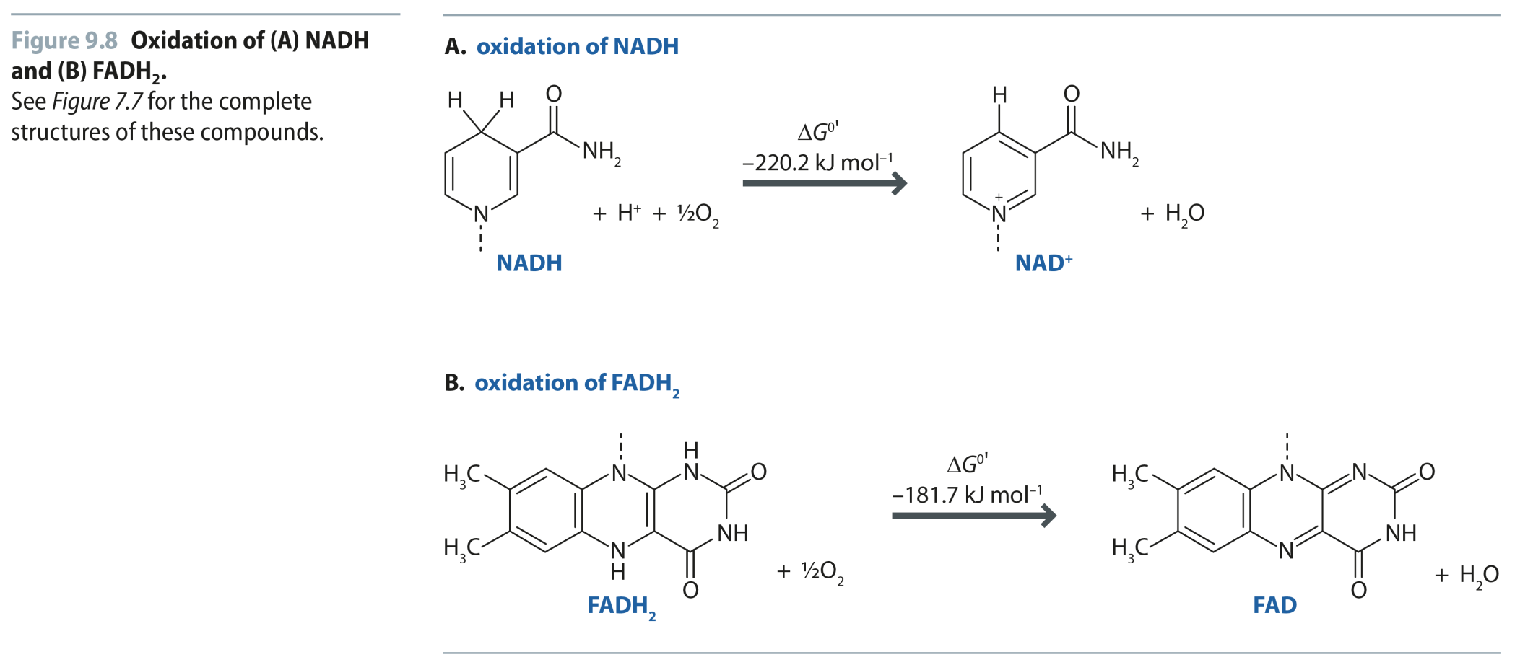
Fig 9.8
Reproduced from: Biochemistry by T.A. Brown, ISBN: 9781907904288 © Scion Publishing Ltd, 2017

Slide 9
Fig 9.9
Reproduced from: Biochemistry by T.A. Brown, ISBN: 9781907904288 © Scion Publishing Ltd, 2017

Slide 10
Fig 9.10
Reproduced from: Biochemistry by T.A. Brown, ISBN: 9781907904288 © Scion Publishing Ltd, 2017

Slide 11
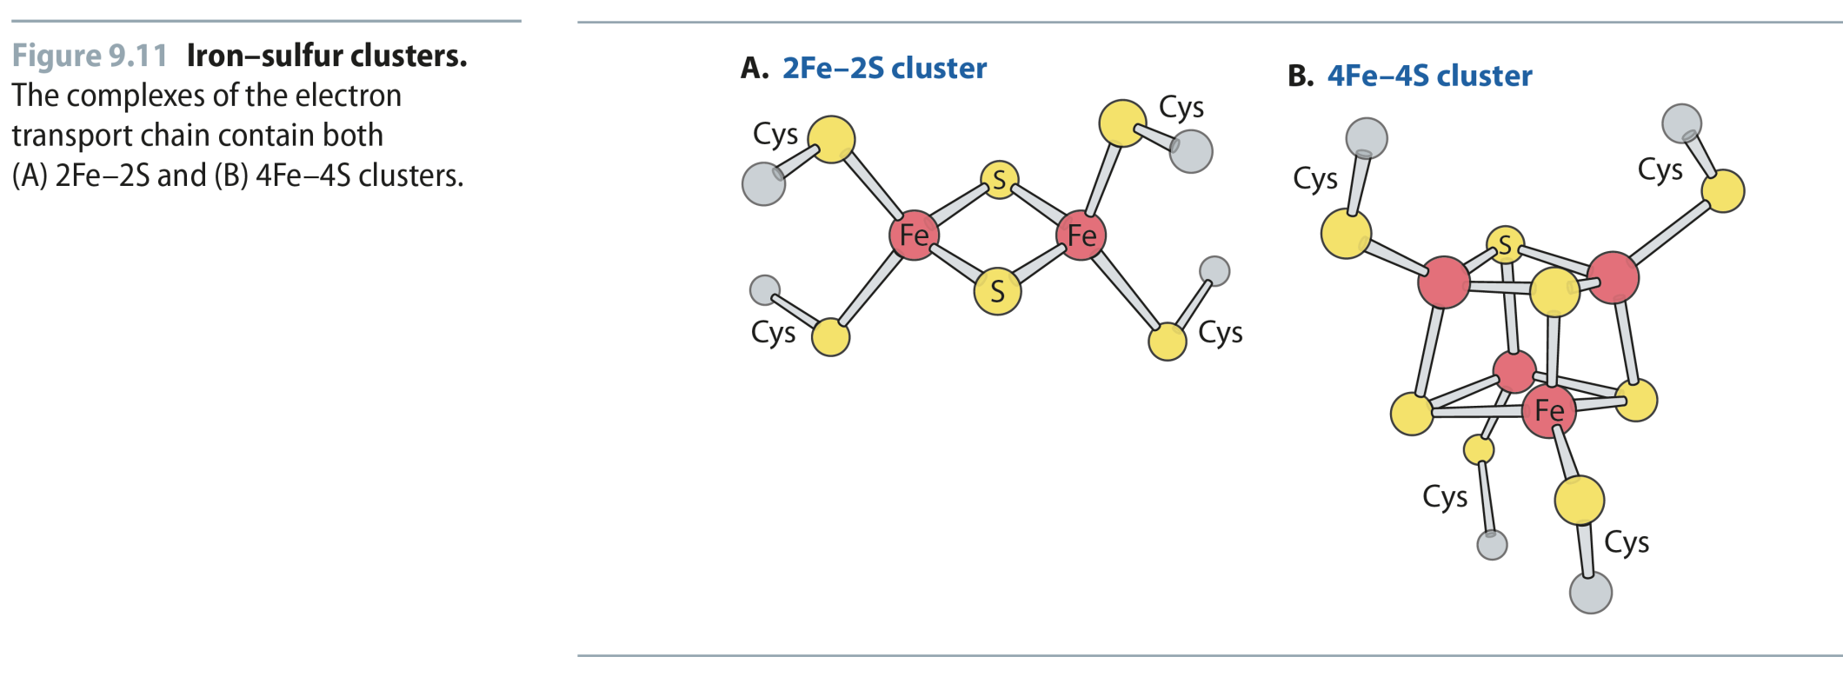
Fig 9.11
Reproduced from: Biochemistry by T.A. Brown, ISBN: 9781907904288 © Scion Publishing Ltd, 2017

Slide 12
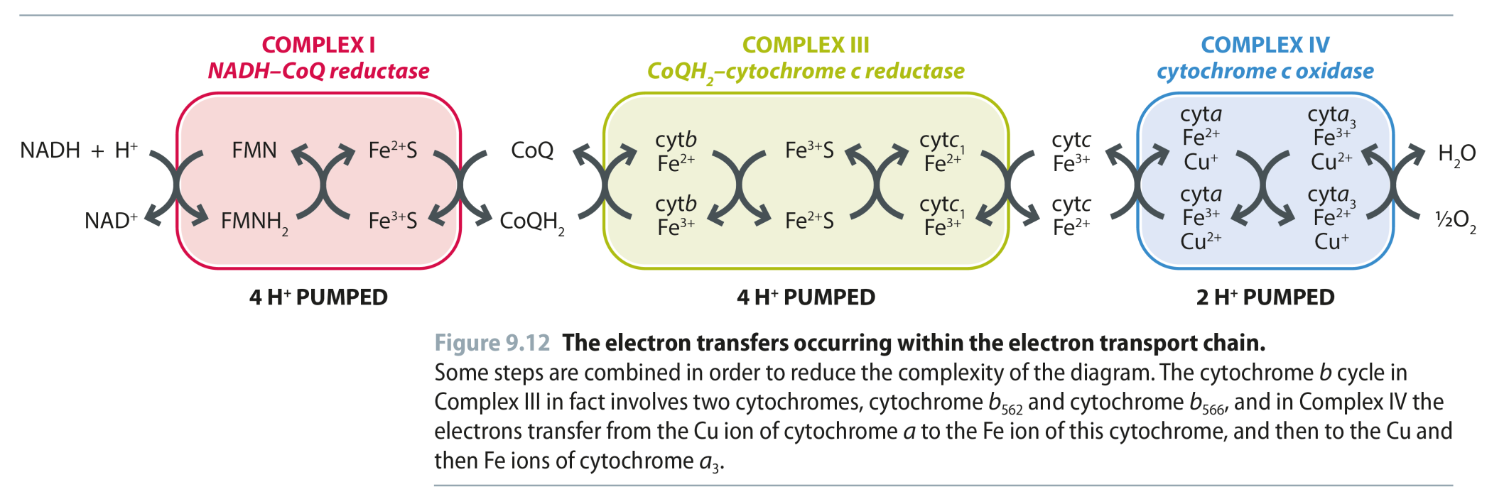
Fig 9.12
Reproduced from: Biochemistry by T.A. Brown, ISBN: 9781907904288 © Scion Publishing Ltd, 2017

Slide 13
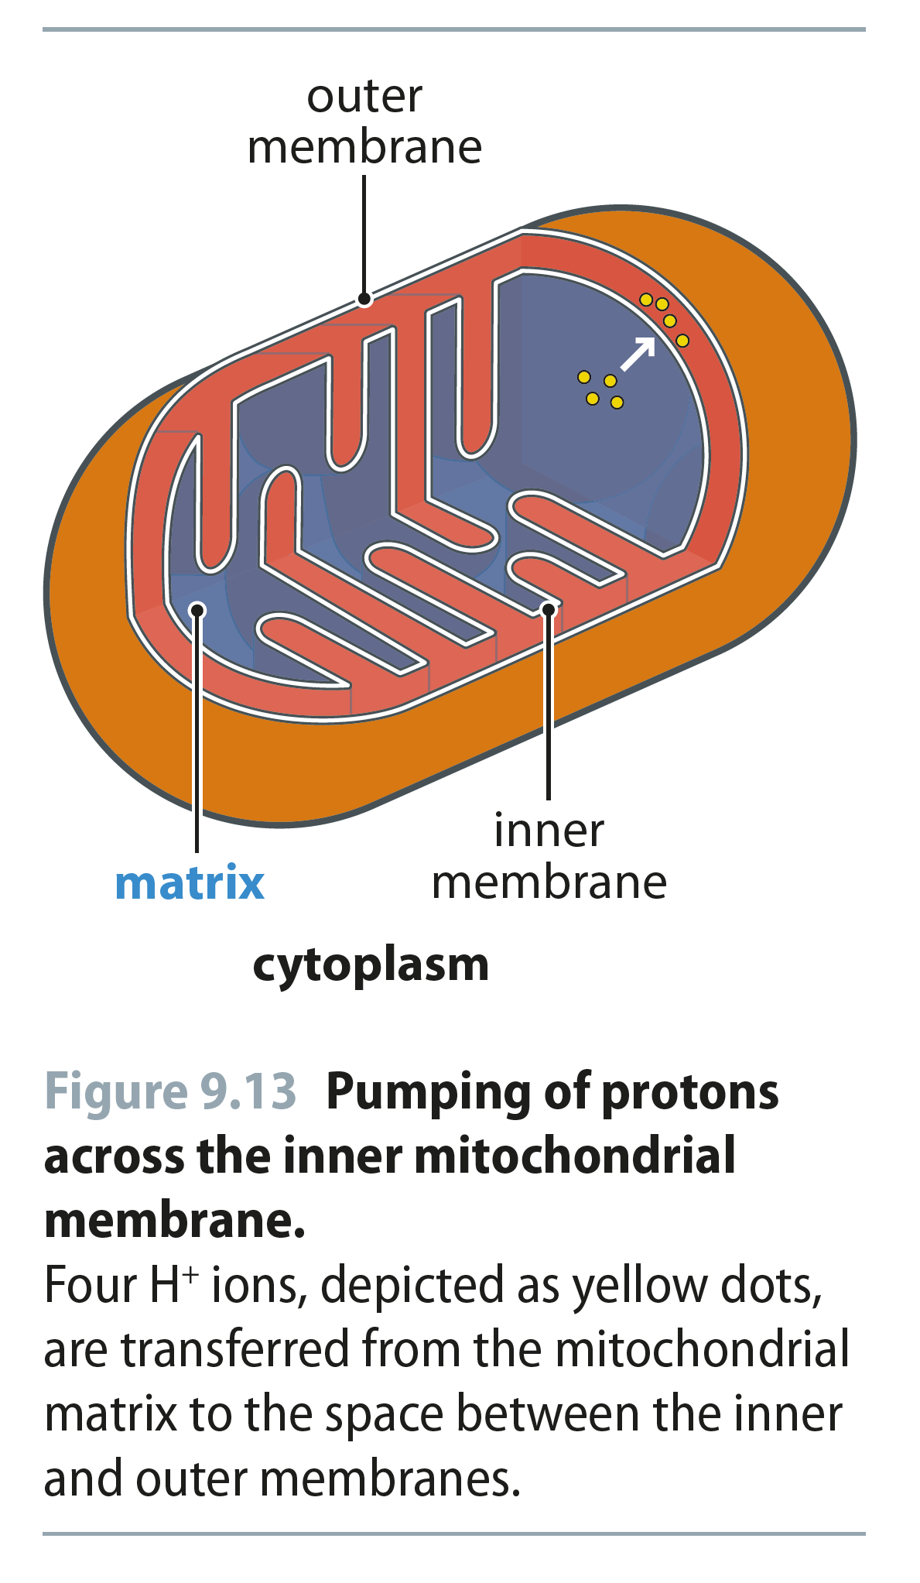
Fig 9.13
Reproduced from: Biochemistry by T.A. Brown, ISBN: 9781907904288 © Scion Publishing Ltd, 2017

Slide 14
Fig 9.14
Reproduced from: Biochemistry by T.A. Brown, ISBN: 9781907904288 © Scion Publishing Ltd, 2017

Slide 15
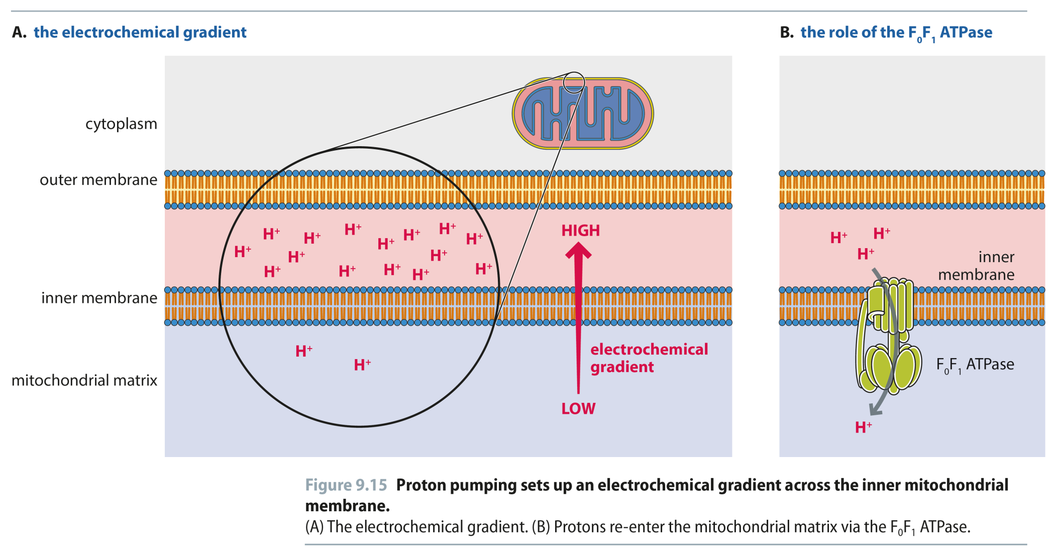
Fig 9.15
Reproduced from: Biochemistry by T.A. Brown, ISBN: 9781907904288 © Scion Publishing Ltd, 2017

Slide 16
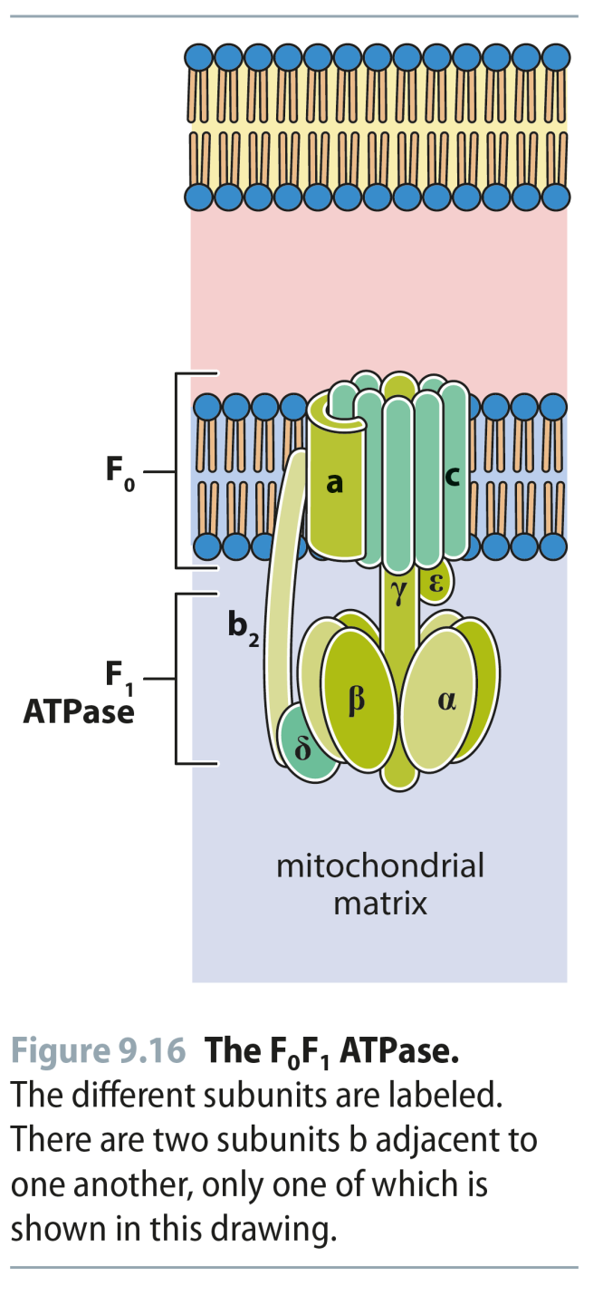
Fig 9.16
Reproduced from: Biochemistry by T.A. Brown, ISBN: 9781907904288 © Scion Publishing Ltd, 2017

Slide 17
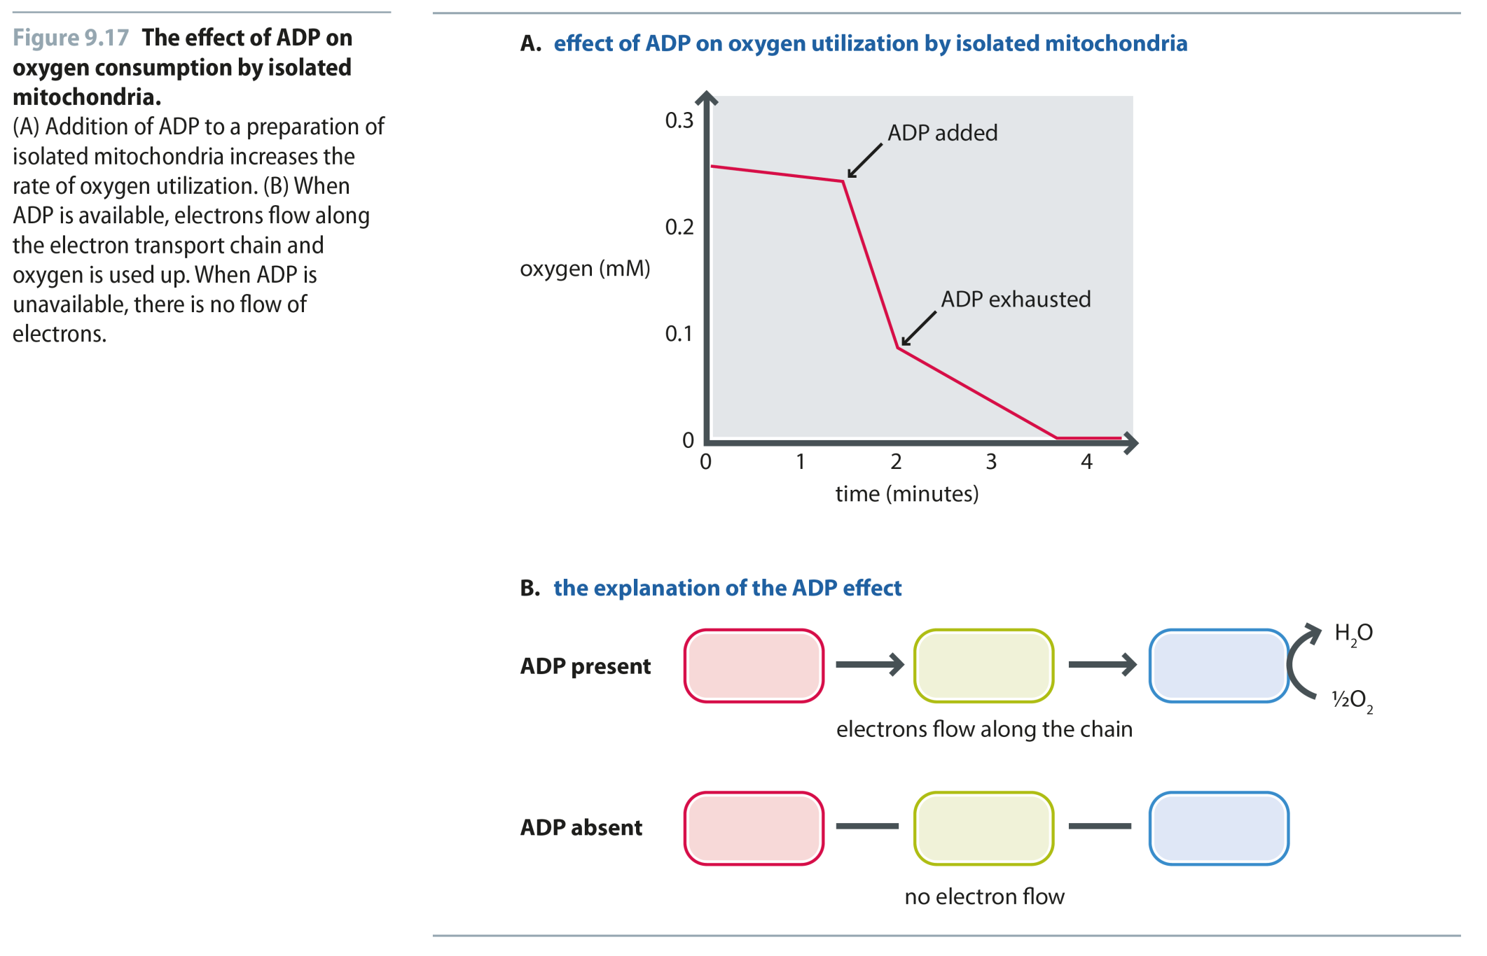
Fig 9.17
Reproduced from: Biochemistry by T.A. Brown, ISBN: 9781907904288 © Scion Publishing Ltd, 2017

Slide 18
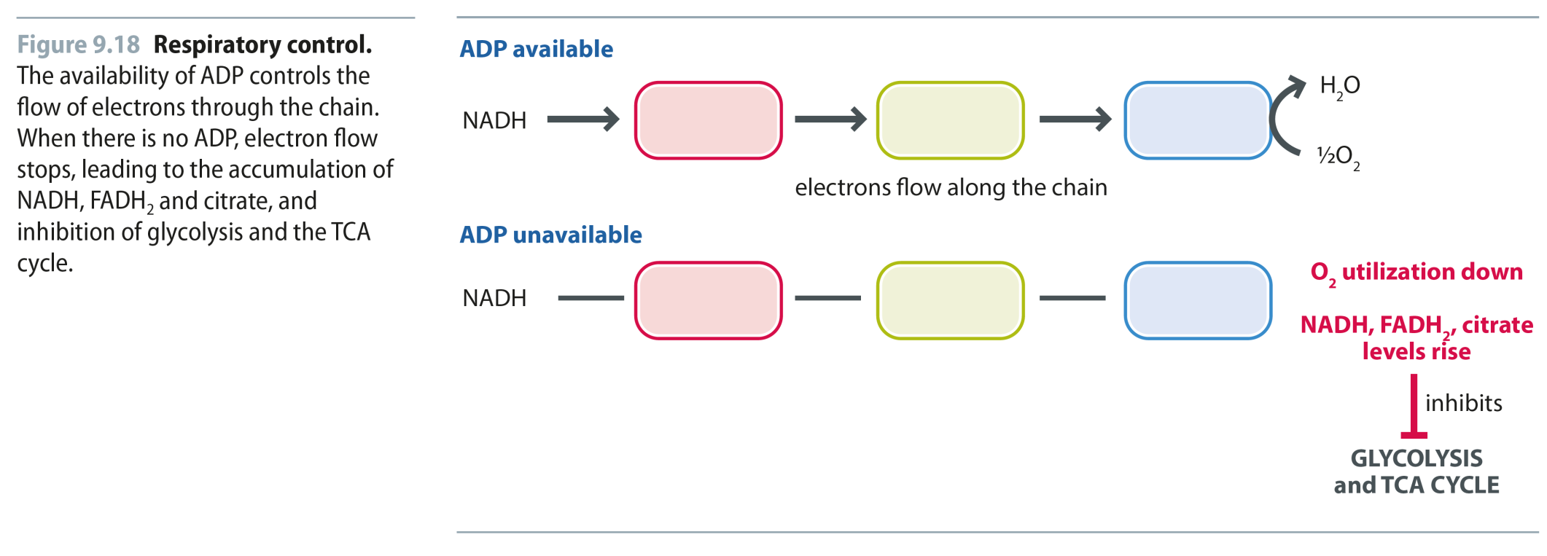
Fig 9.18
Reproduced from: Biochemistry by T.A. Brown, ISBN: 9781907904288 © Scion Publishing Ltd, 2017

Slide 19
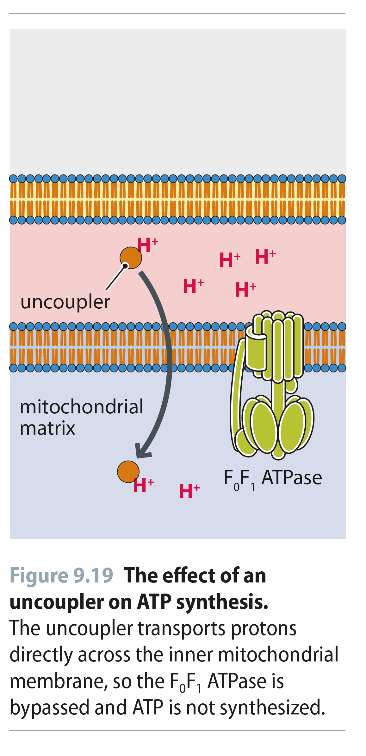
Fig 9.19
Reproduced from: Biochemistry by T.A. Brown, ISBN: 9781907904288 © Scion Publishing Ltd, 2017

Slide 20
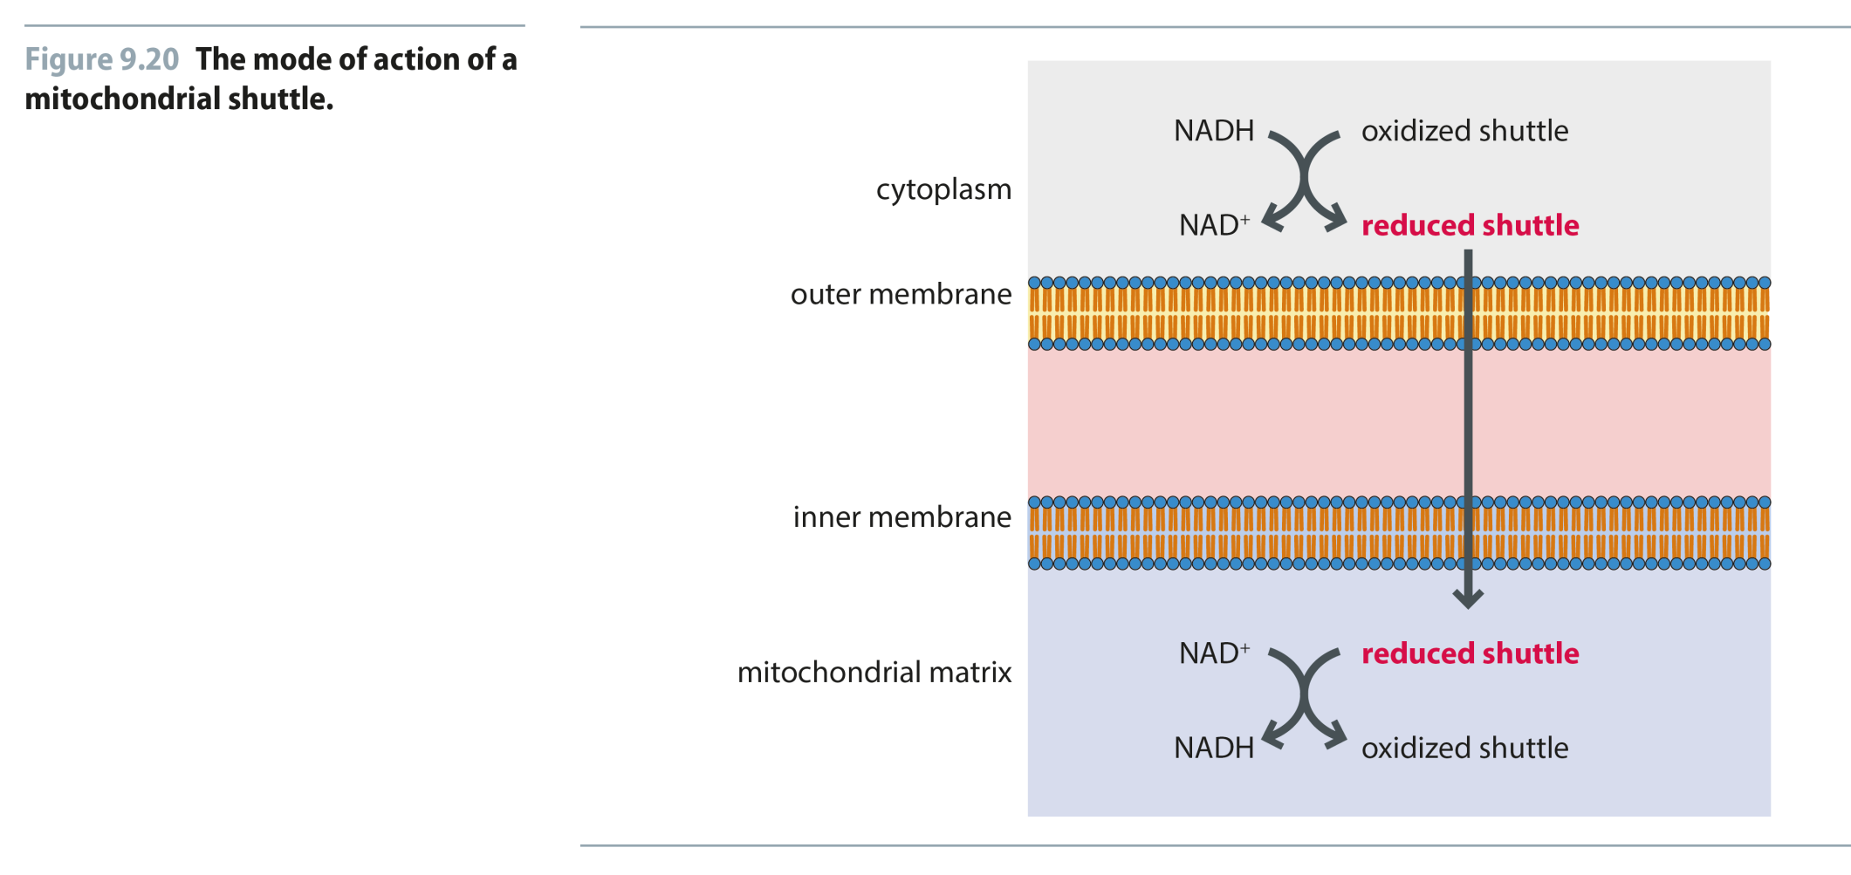
Fig 9.20
Reproduced from: Biochemistry by T.A. Brown, ISBN: 9781907904288 © Scion Publishing Ltd, 2017

Slide 21
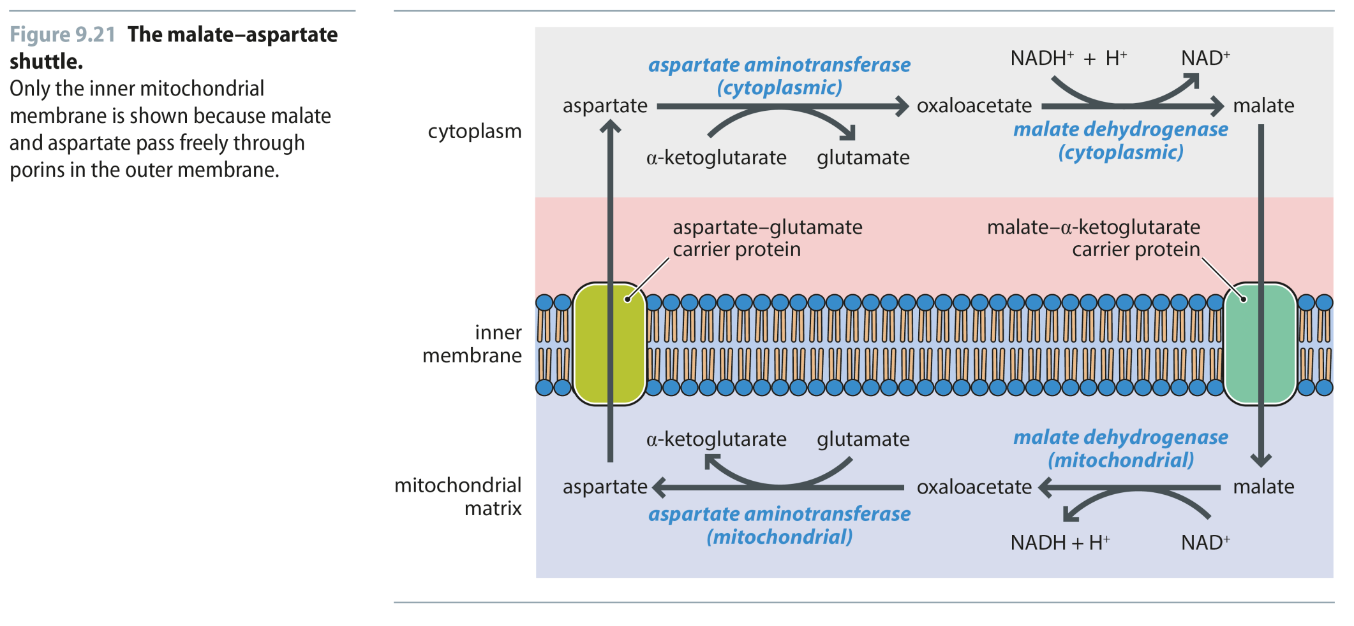
Fig 9.21
Reproduced from: Biochemistry by T.A. Brown, ISBN: 9781907904288 © Scion Publishing Ltd, 2017

Slide 22
Fig 9.22
Reproduced from: Biochemistry by T.A. Brown, ISBN: 9781907904288 © Scion Publishing Ltd, 2017

Slide 23
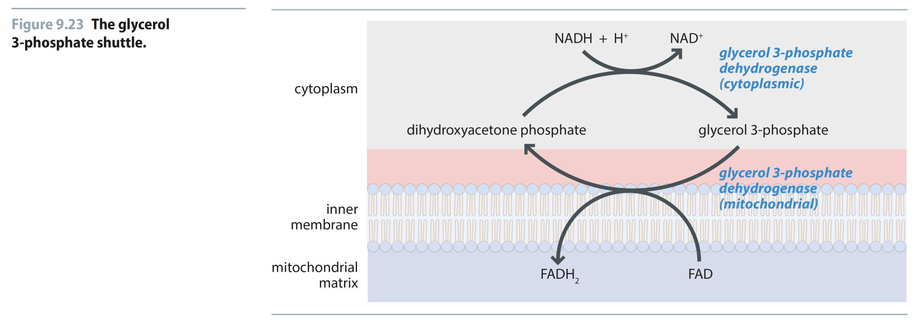
Fig 9.23
Reproduced from: Biochemistry by T.A. Brown, ISBN: 9781907904288 © Scion Publishing Ltd, 2017

