Slide 1
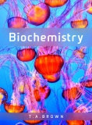
Fig 8.1
Reproduced from: Biochemistry by T.A. Brown, ISBN: 9781907904288 © Scion Publishing Ltd, 2017

Slide 2
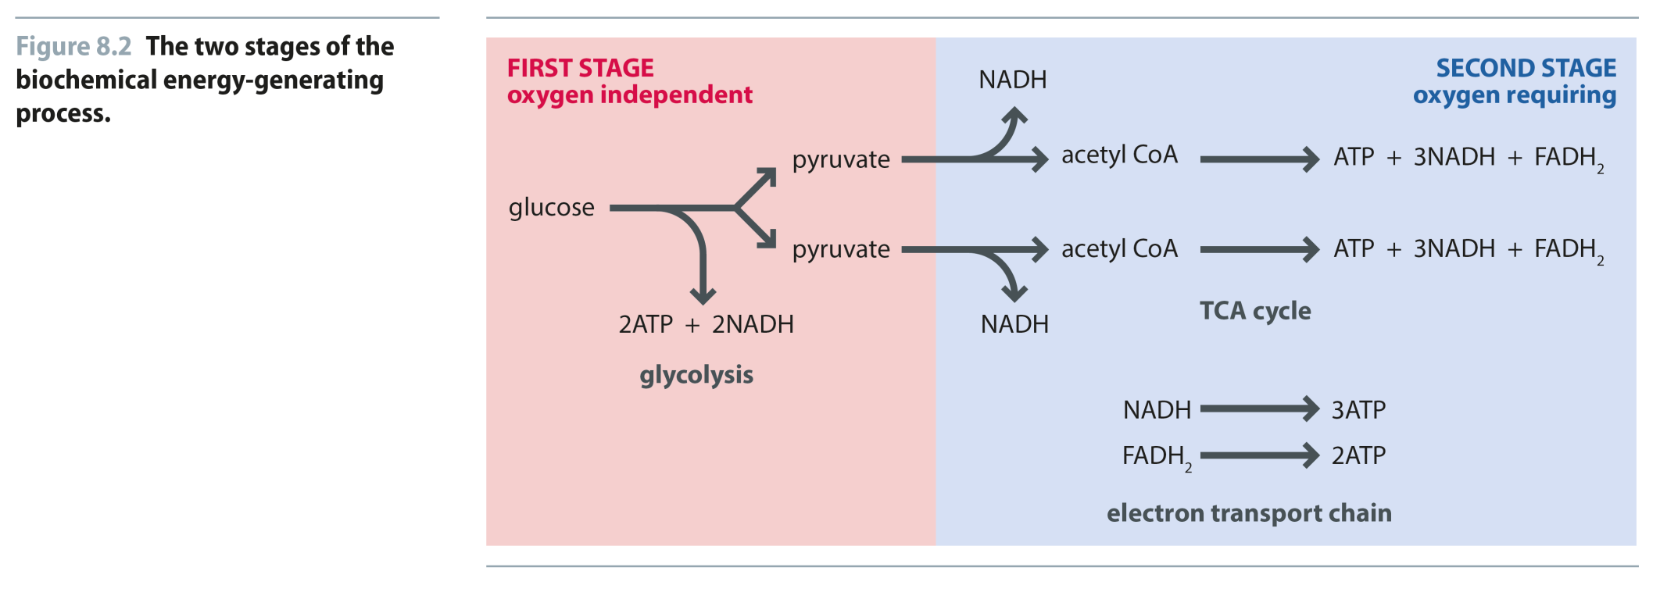
Fig 8.2
Reproduced from: Biochemistry by T.A. Brown, ISBN: 9781907904288 © Scion Publishing Ltd, 2017

Slide 3
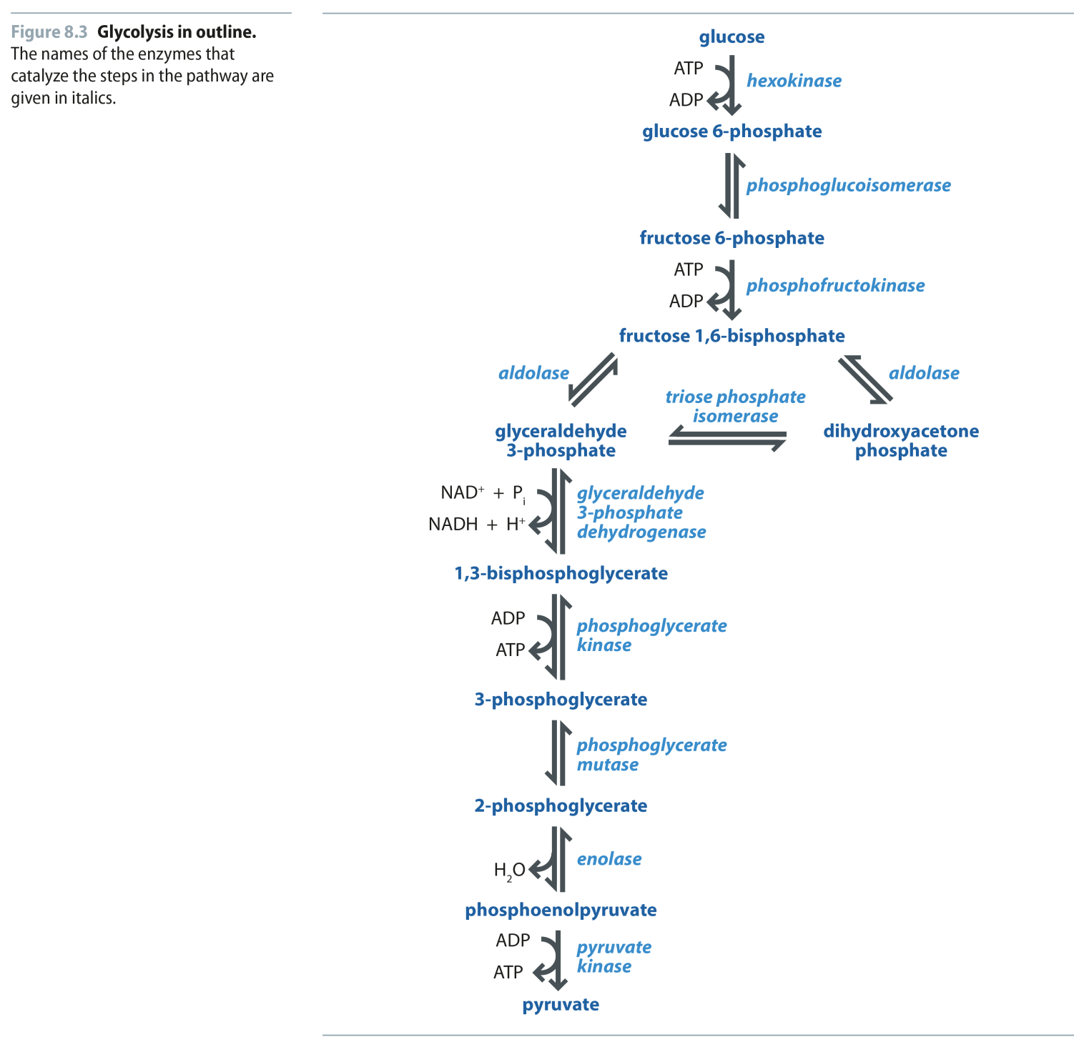
Fig 8.3
Reproduced from: Biochemistry by T.A. Brown, ISBN: 9781907904288 © Scion Publishing Ltd, 2017

Slide 4
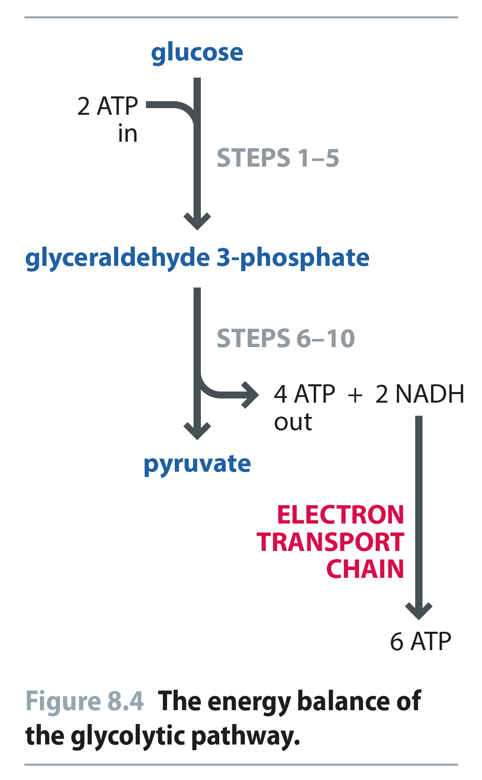
Fig 8.4
Reproduced from: Biochemistry by T.A. Brown, ISBN: 9781907904288 © Scion Publishing Ltd, 2017

Slide 5
Fig 8.5
Reproduced from: Biochemistry by T.A. Brown, ISBN: 9781907904288 © Scion Publishing Ltd, 2017

Slide 6
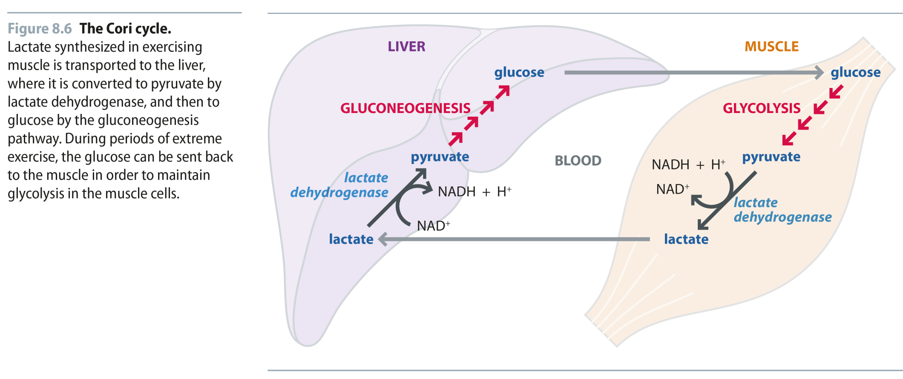
Fig 8.6
Reproduced from: Biochemistry by T.A. Brown, ISBN: 9781907904288 © Scion Publishing Ltd, 2017

Slide 7
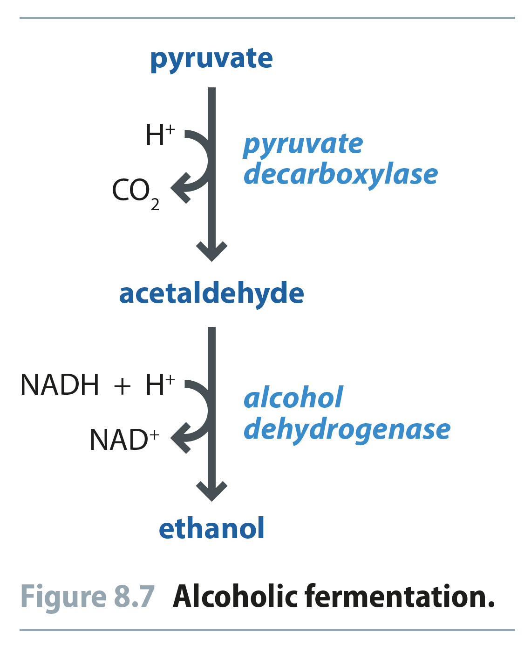
Fig 8.7
Reproduced from: Biochemistry by T.A. Brown, ISBN: 9781907904288 © Scion Publishing Ltd, 2017

Slide 8
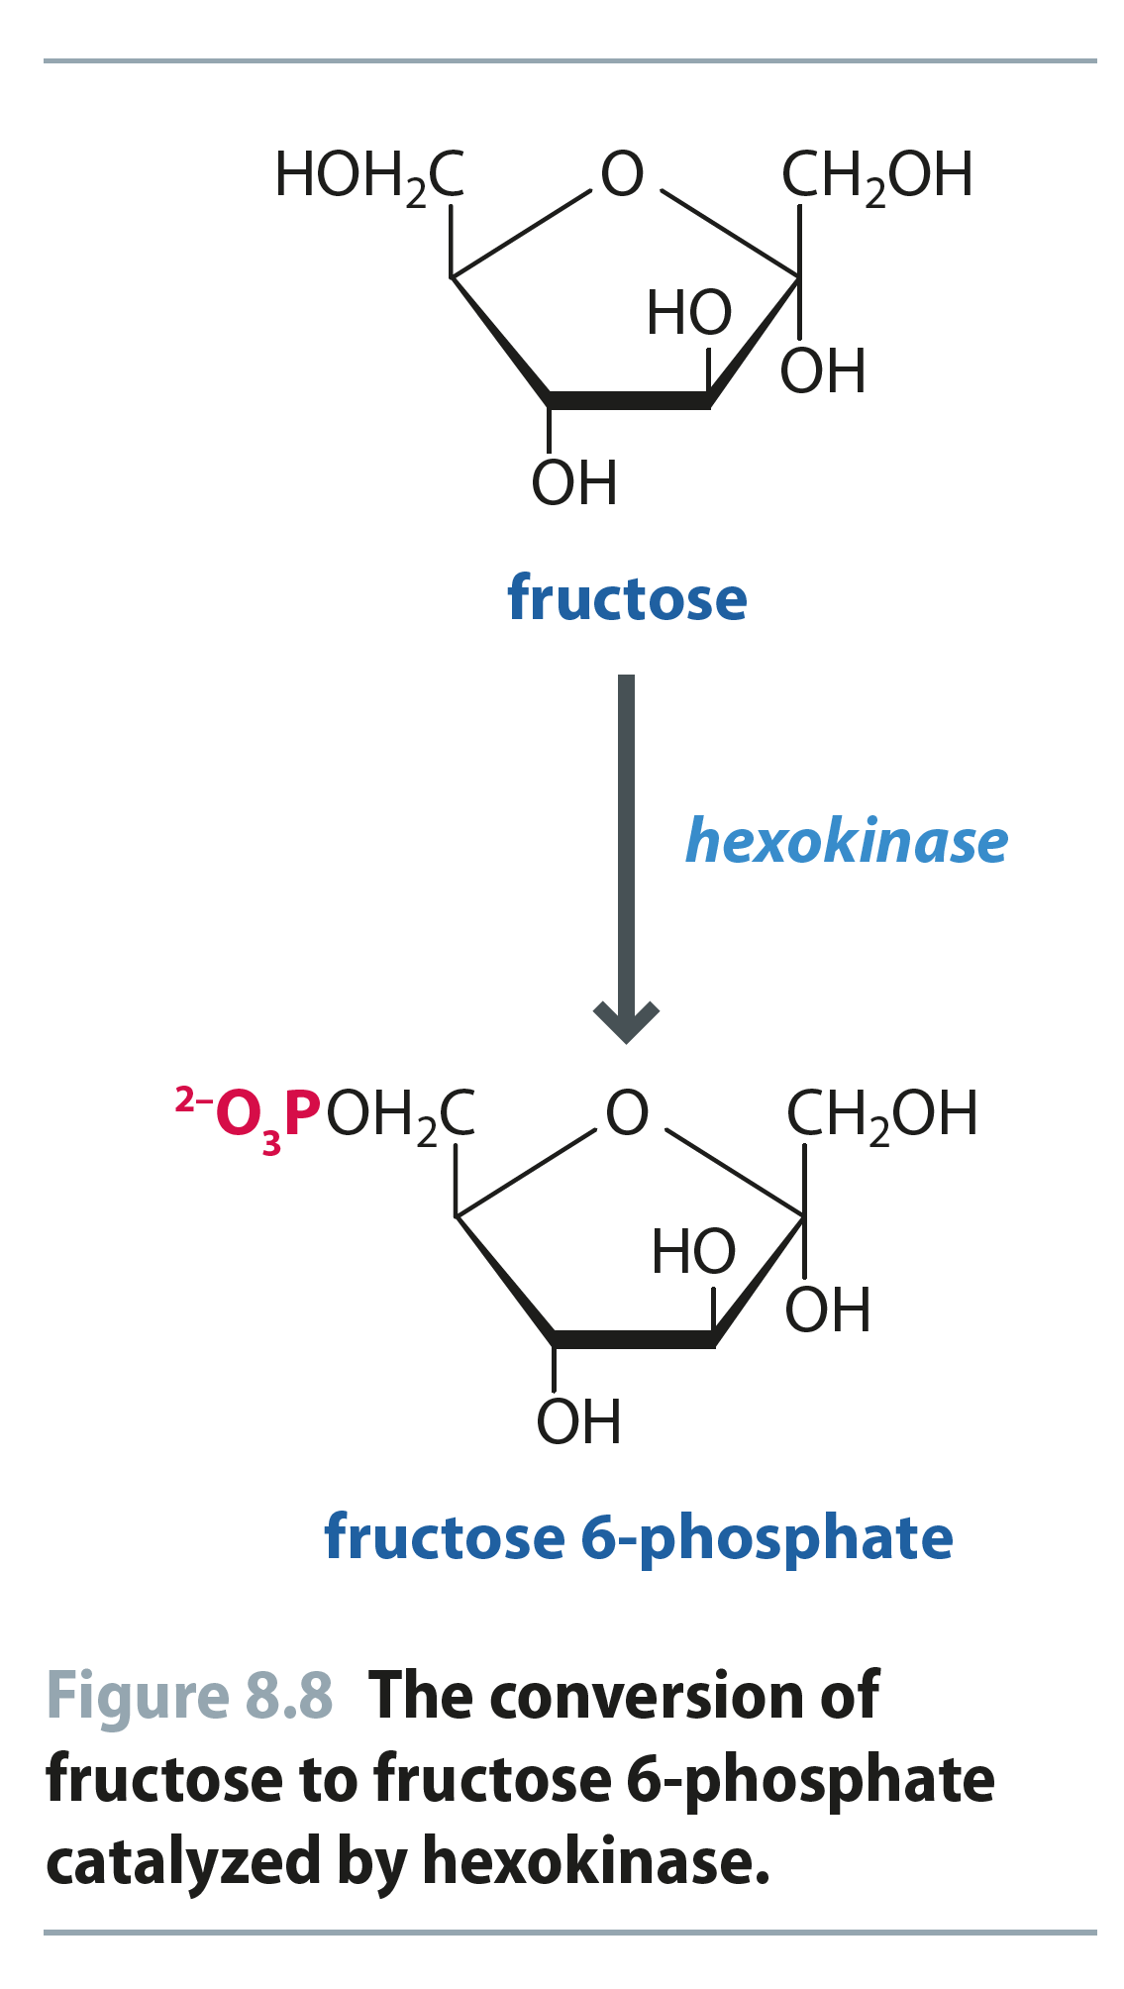
Fig 8.8
Reproduced from: Biochemistry by T.A. Brown, ISBN: 9781907904288 © Scion Publishing Ltd, 2017

Slide 9
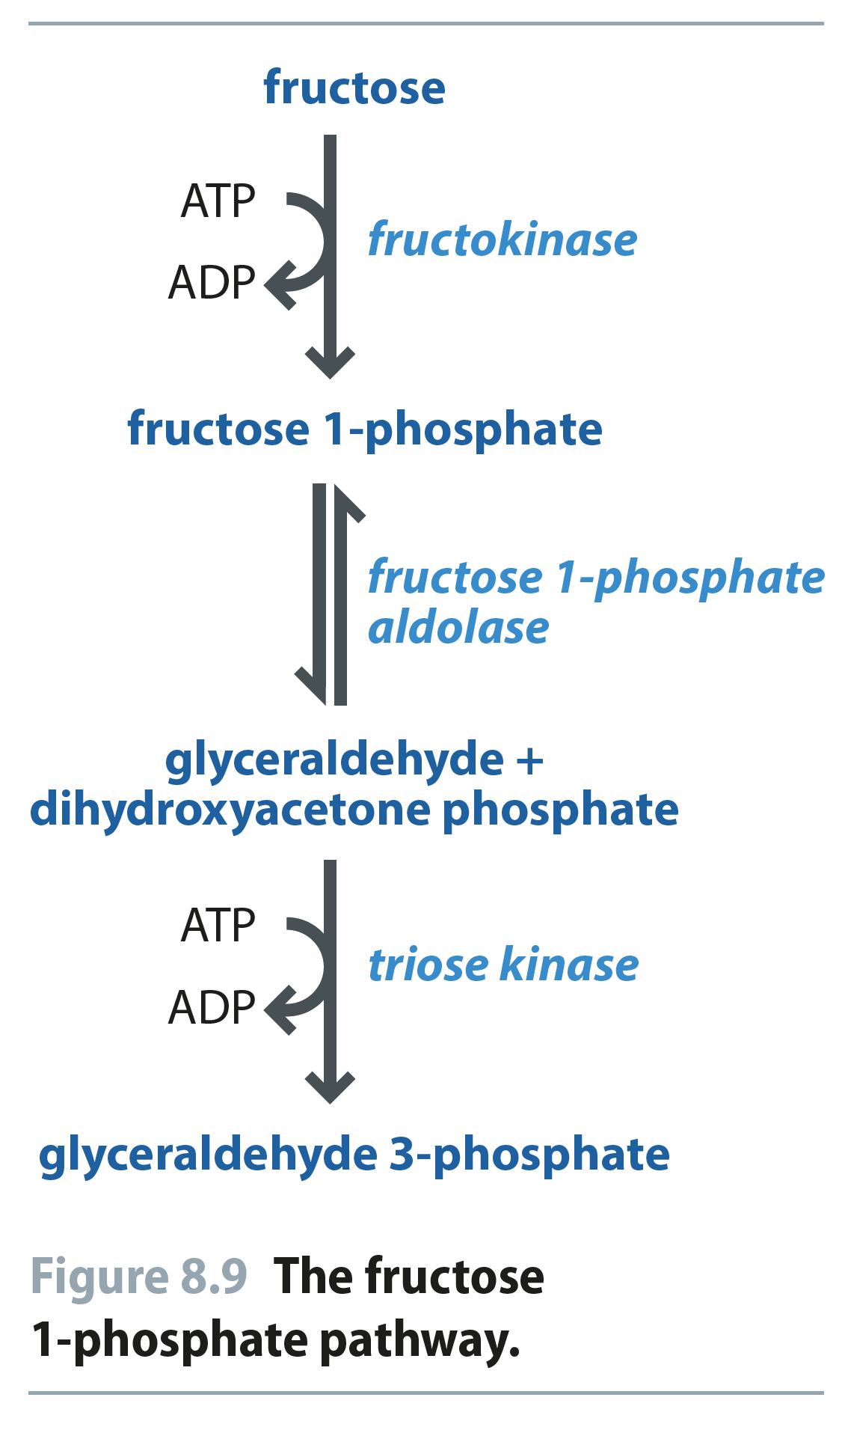
Fig 8.9
Reproduced from: Biochemistry by T.A. Brown, ISBN: 9781907904288 © Scion Publishing Ltd, 2017

Slide 10
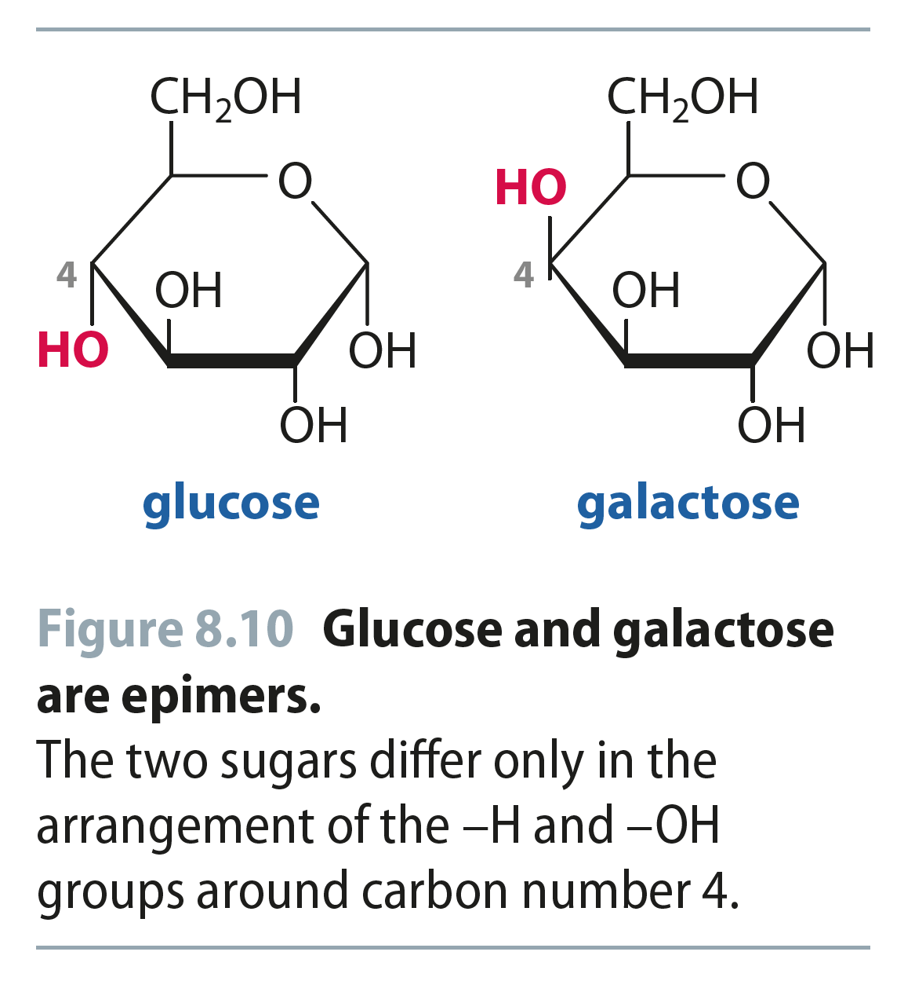
Fig 8.10
Reproduced from: Biochemistry by T.A. Brown, ISBN: 9781907904288 © Scion Publishing Ltd, 2017

Slide 11
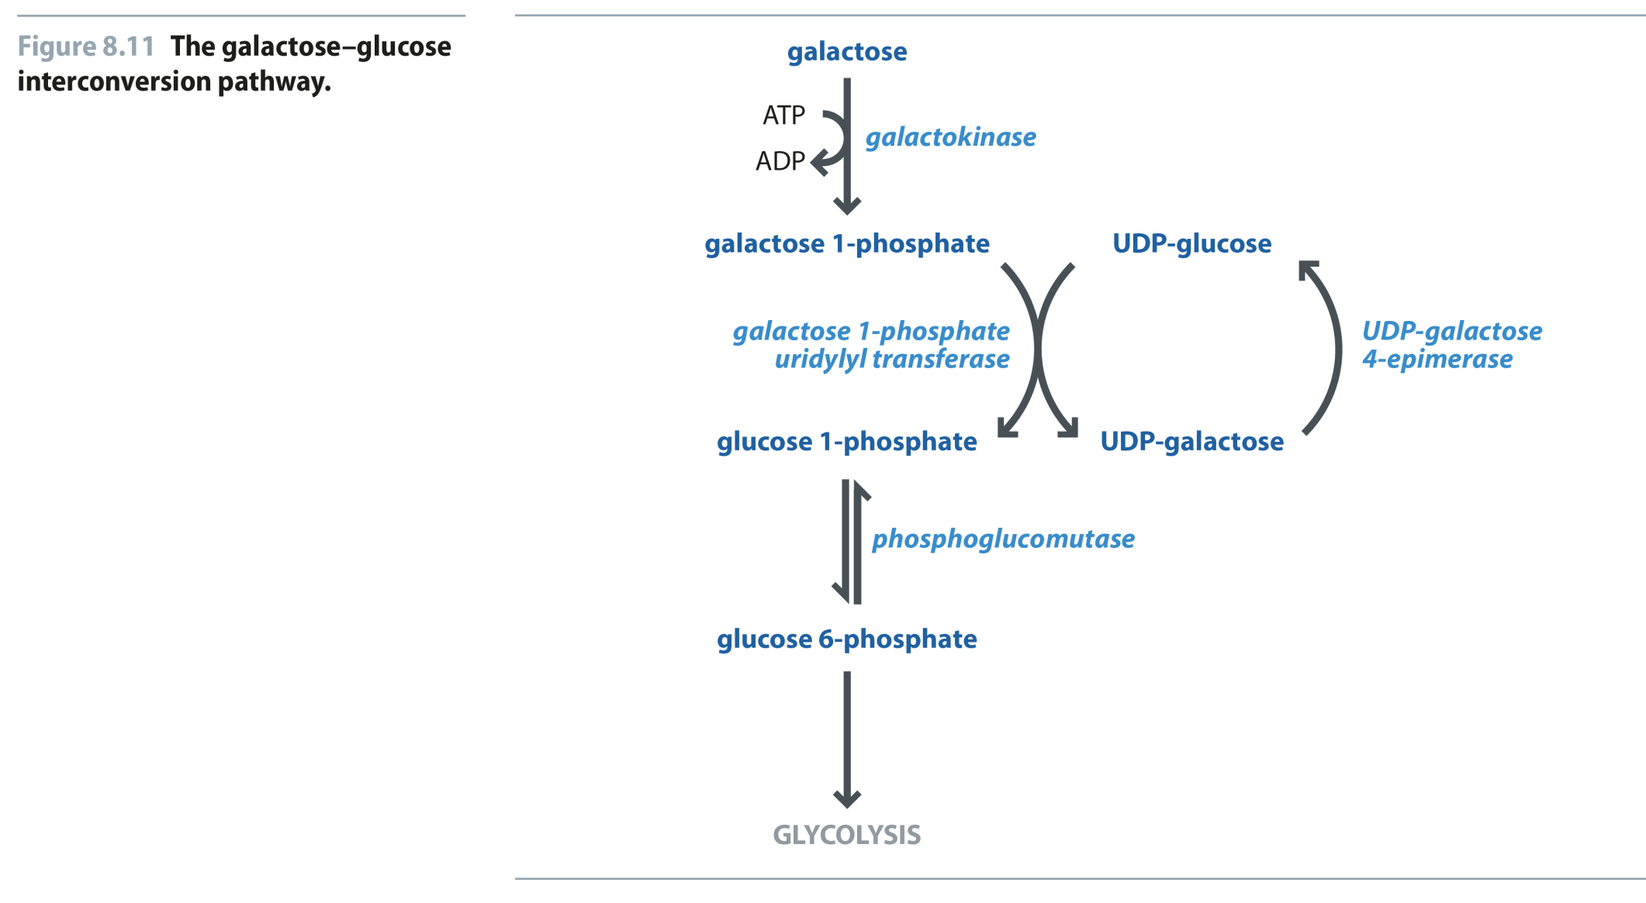
Fig 8.11
Reproduced from: Biochemistry by T.A. Brown, ISBN: 9781907904288 © Scion Publishing Ltd, 2017

Slide 12
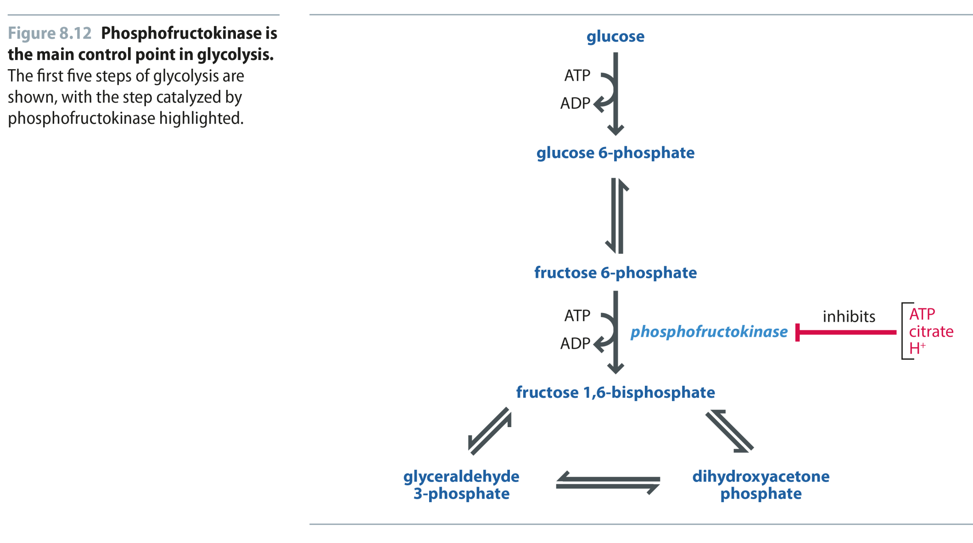
Fig 8.12
Reproduced from: Biochemistry by T.A. Brown, ISBN: 9781907904288 © Scion Publishing Ltd, 2017

Slide 13
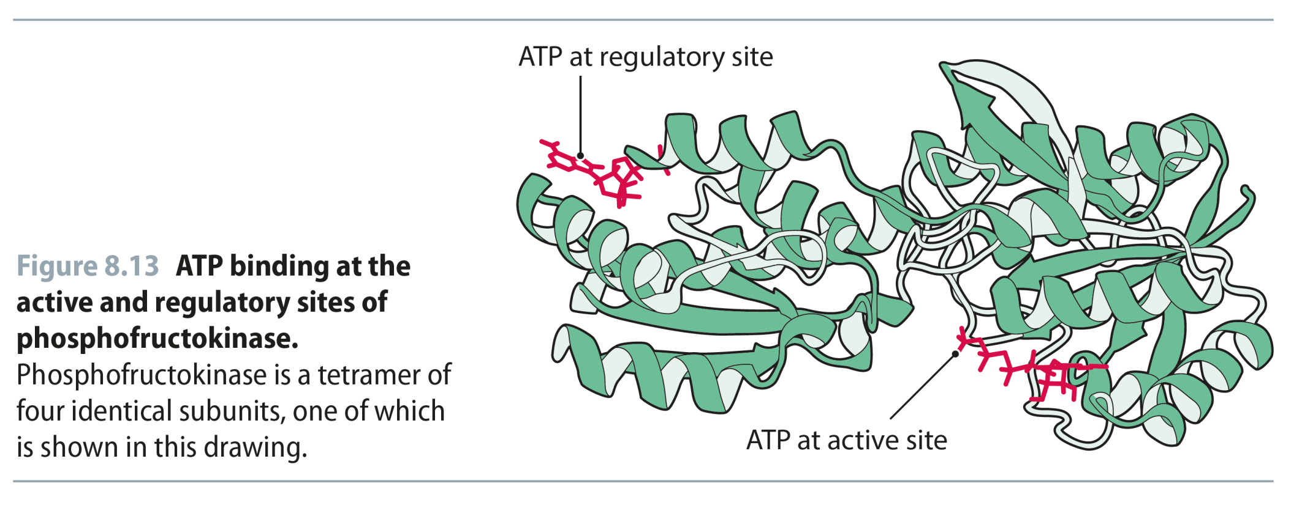
Fig 8.13
Reproduced from: Biochemistry by T.A. Brown, ISBN: 9781907904288 © Scion Publishing Ltd, 2017

Slide 14
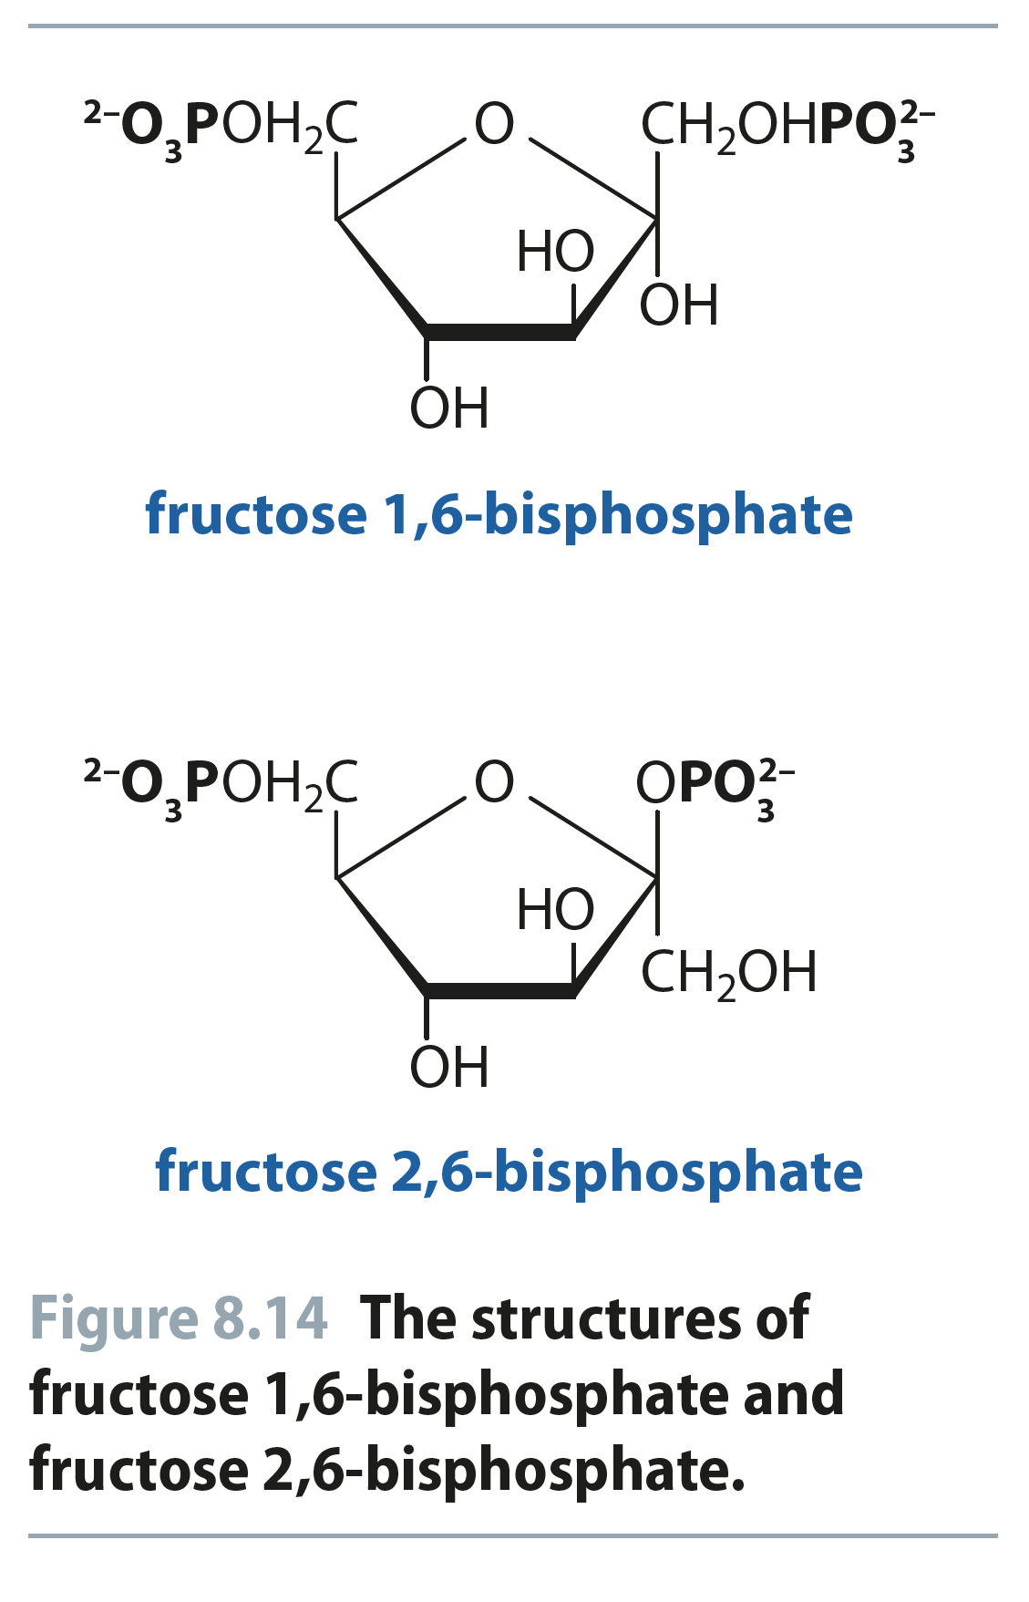
Fig 8.14
Reproduced from: Biochemistry by T.A. Brown, ISBN: 9781907904288 © Scion Publishing Ltd, 2017

Slide 15
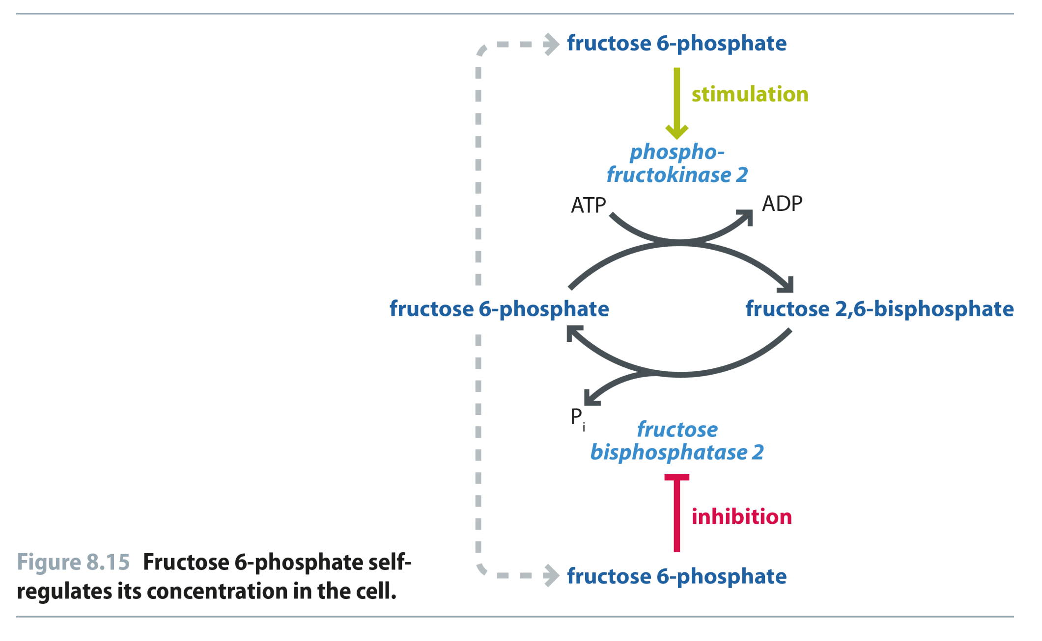
Fig 8.15
Reproduced from: Biochemistry by T.A. Brown, ISBN: 9781907904288 © Scion Publishing Ltd, 2017

Slide 16
Fig 8.16
Reproduced from: Biochemistry by T.A. Brown, ISBN: 9781907904288 © Scion Publishing Ltd, 2017

Slide 17
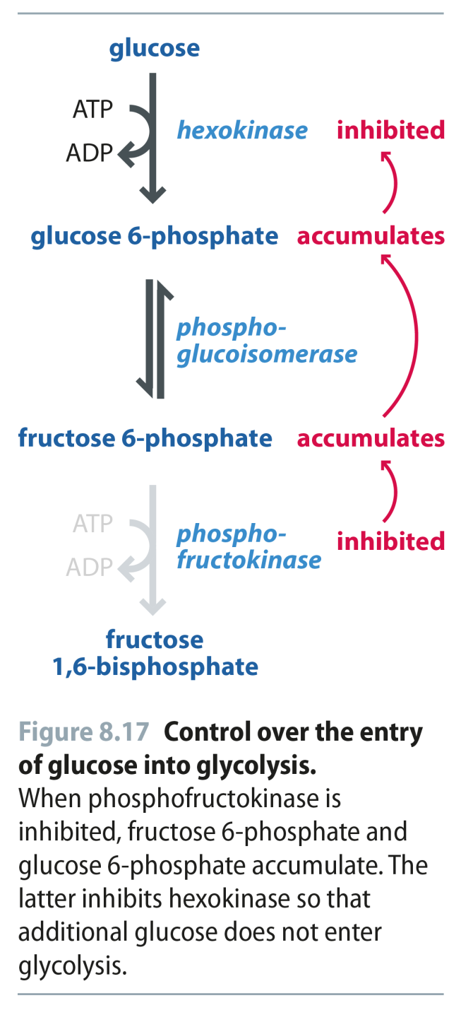
Fig 8.17
Reproduced from: Biochemistry by T.A. Brown, ISBN: 9781907904288 © Scion Publishing Ltd, 2017

Slide 18
Fig 8.18
Reproduced from: Biochemistry by T.A. Brown, ISBN: 9781907904288 © Scion Publishing Ltd, 2017

