Slide 1
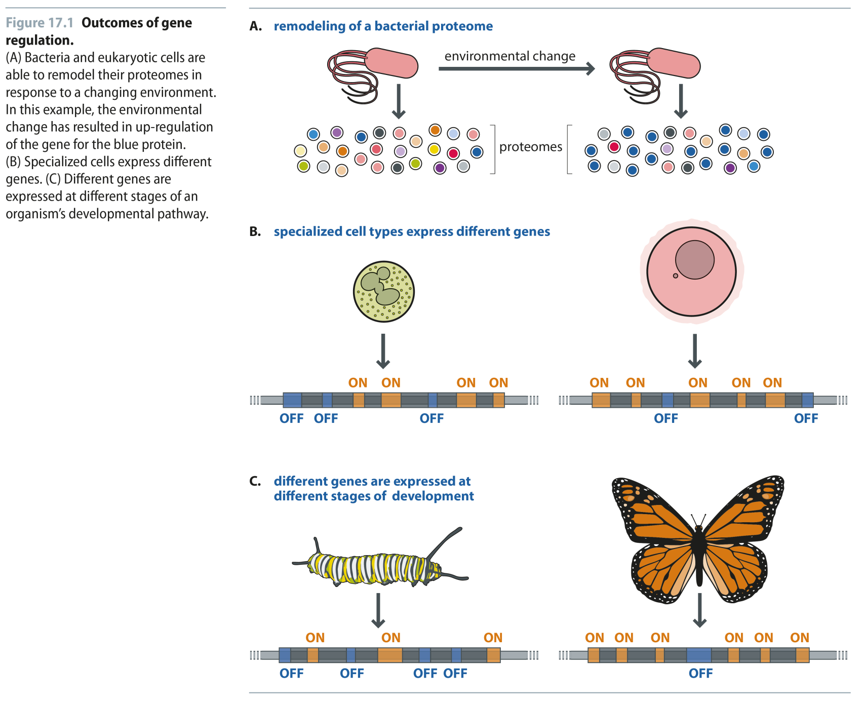
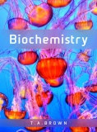
Fig 17.1
Reproduced from: Biochemistry by T.A. Brown, ISBN: 9781907904288 © Scion Publishing Ltd, 2017

Slide 2
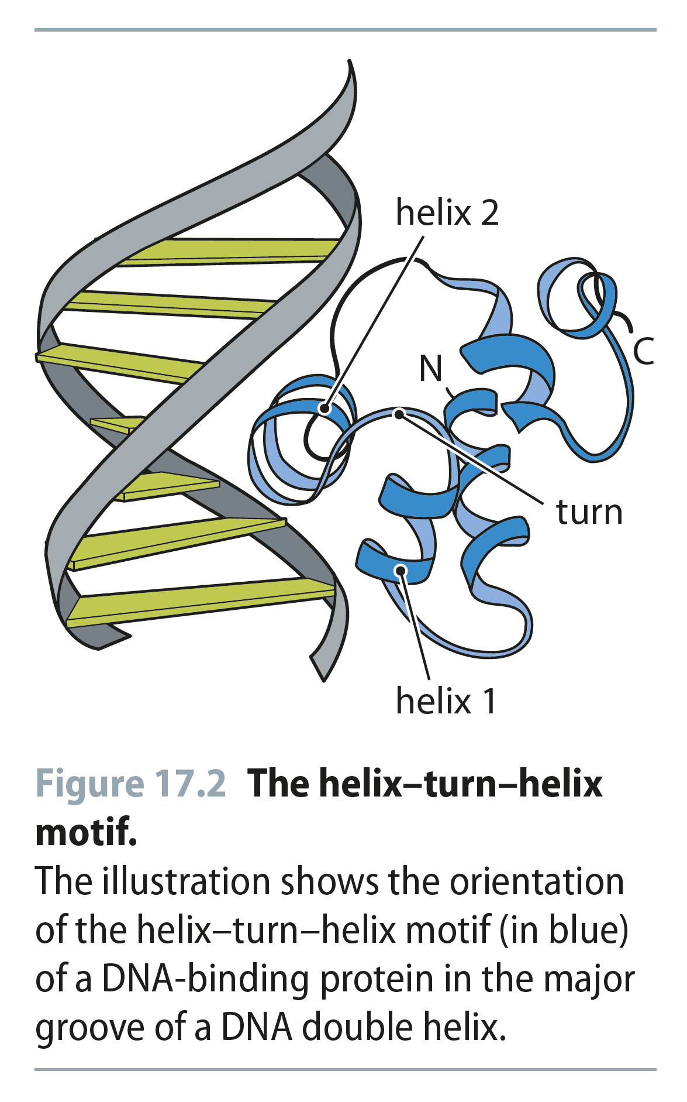
Fig 17.2
Reproduced from: Biochemistry by T.A. Brown, ISBN: 9781907904288 © Scion Publishing Ltd, 2017

Slide 3
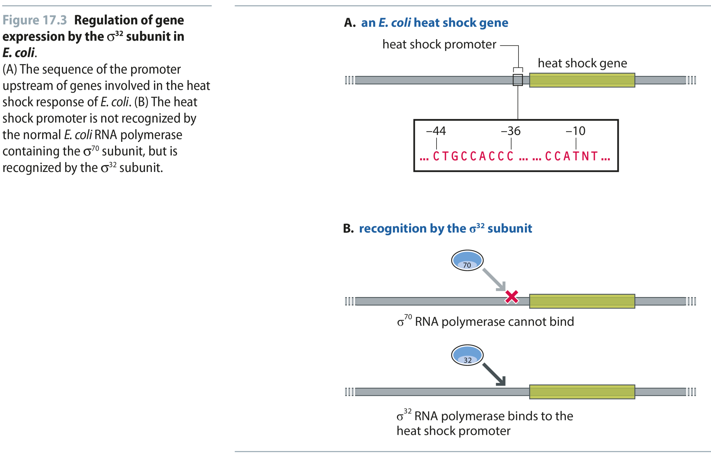
Fig 17.3
Reproduced from: Biochemistry by T.A. Brown, ISBN: 9781907904288 © Scion Publishing Ltd, 2017

Slide 4
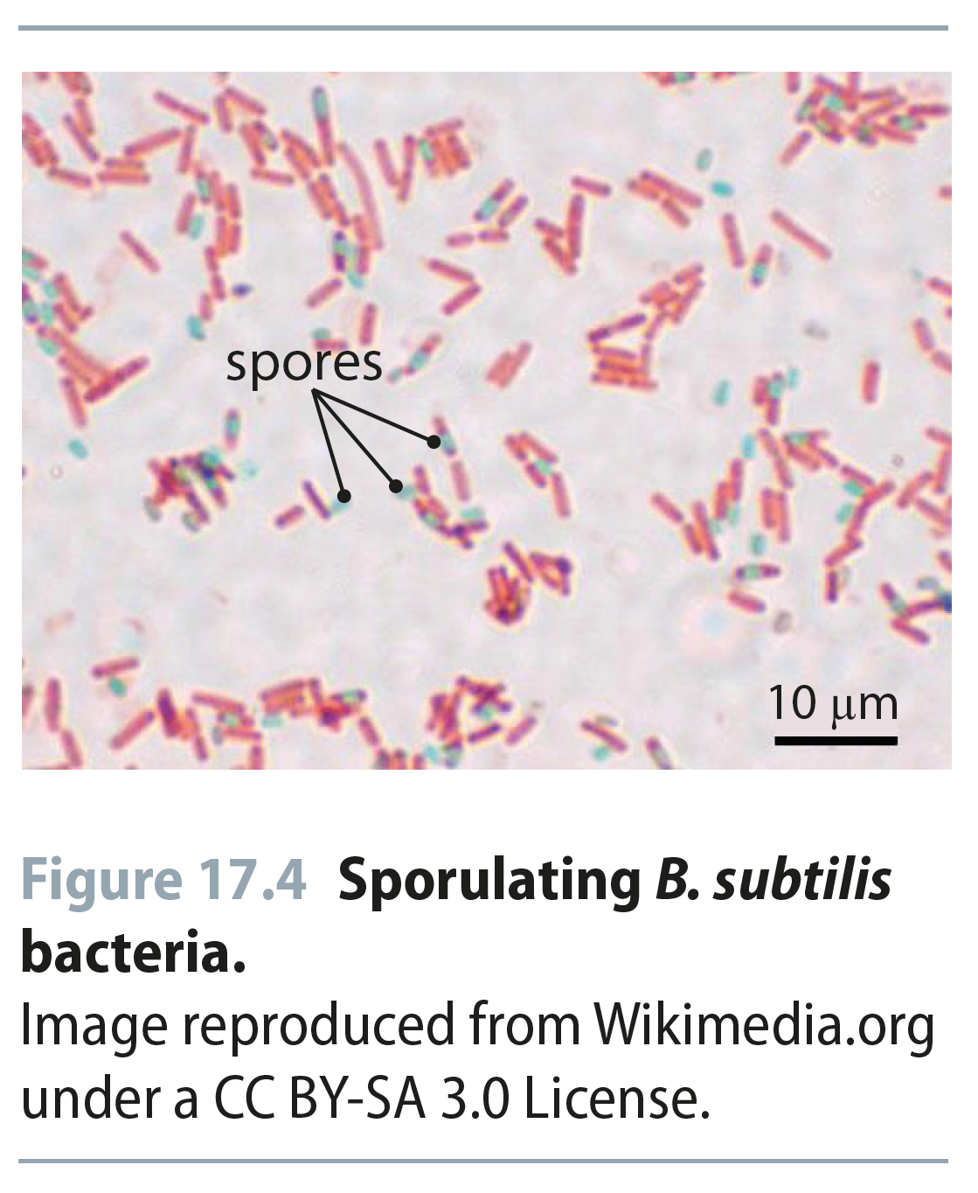
Fig 17.4
Reproduced from: Biochemistry by T.A. Brown, ISBN: 9781907904288 © Scion Publishing Ltd, 2017

Slide 5
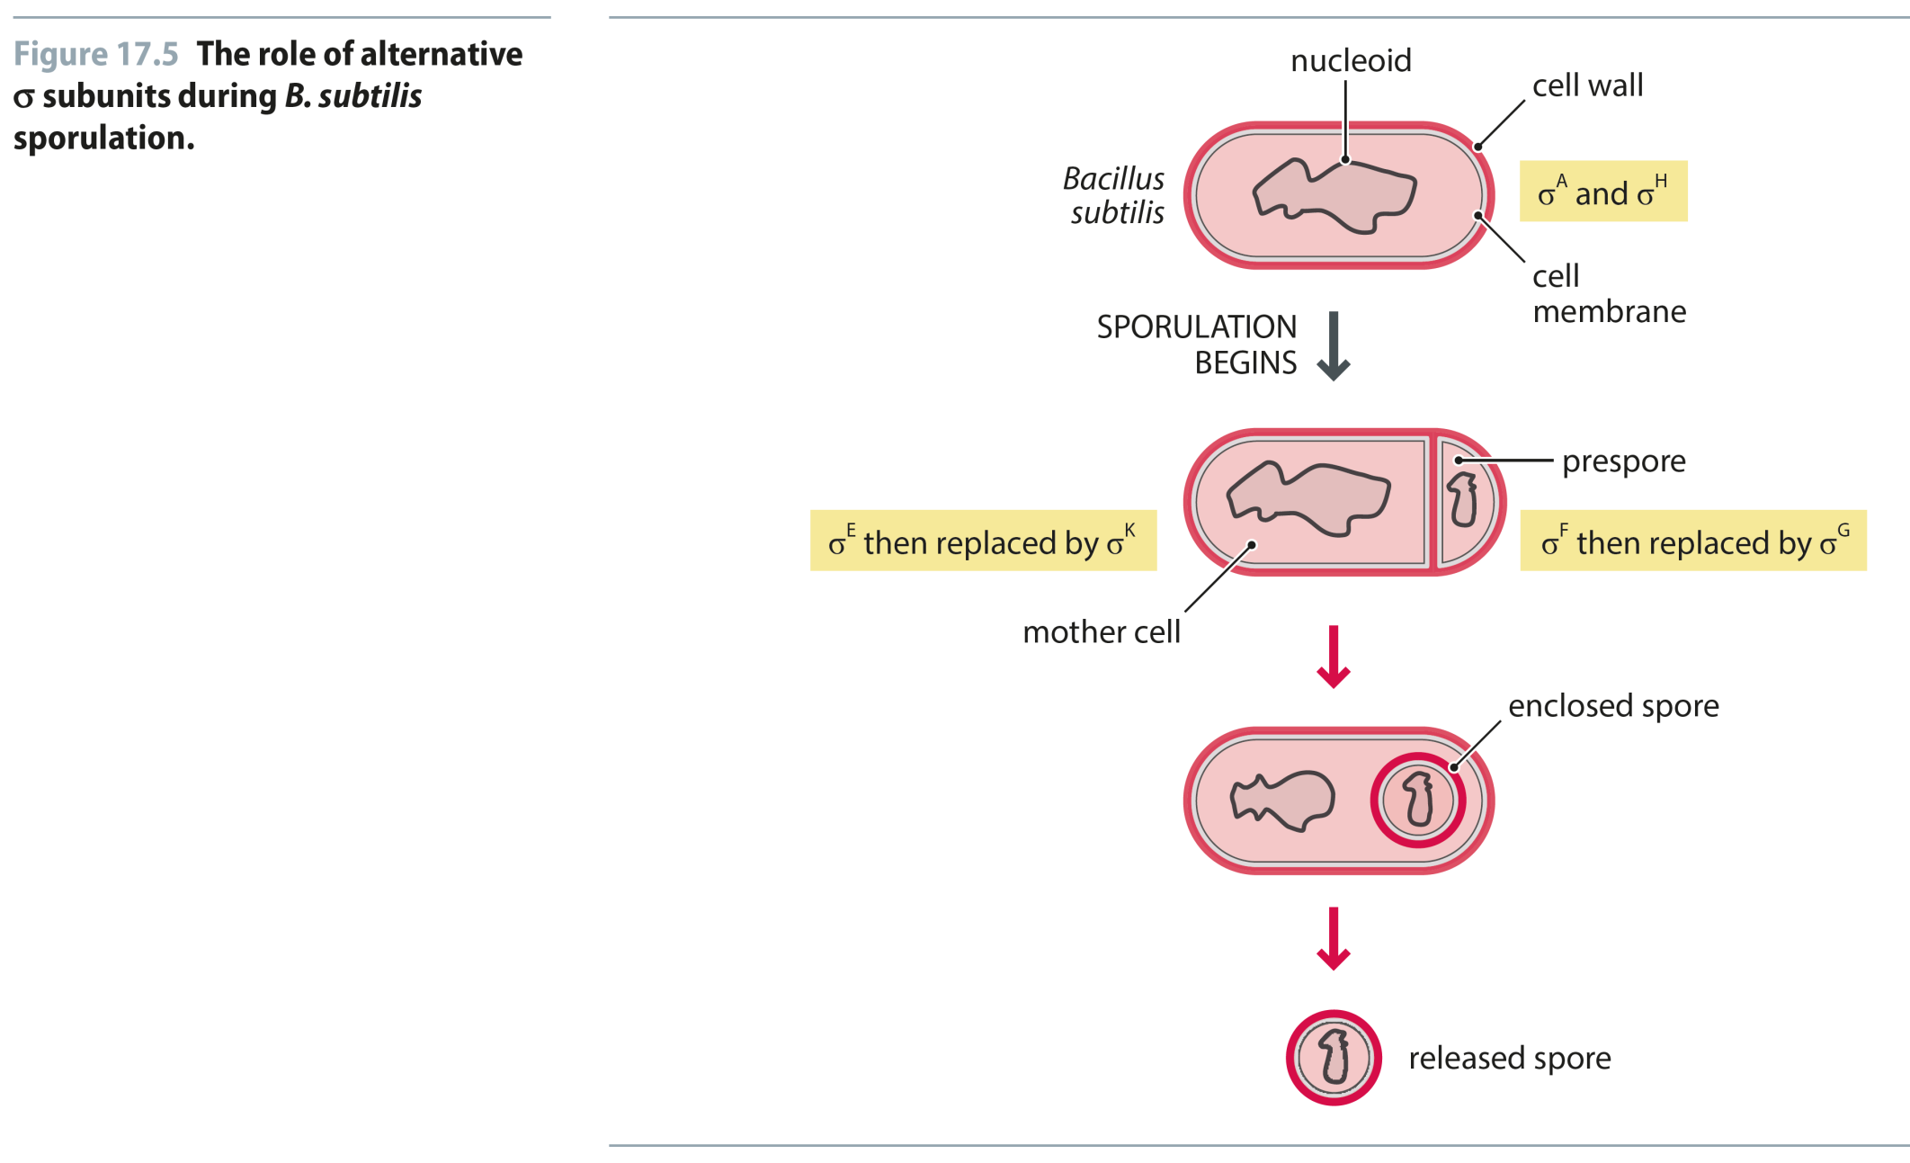
Fig 17.5
Reproduced from: Biochemistry by T.A. Brown, ISBN: 9781907904288 © Scion Publishing Ltd, 2017

Slide 6
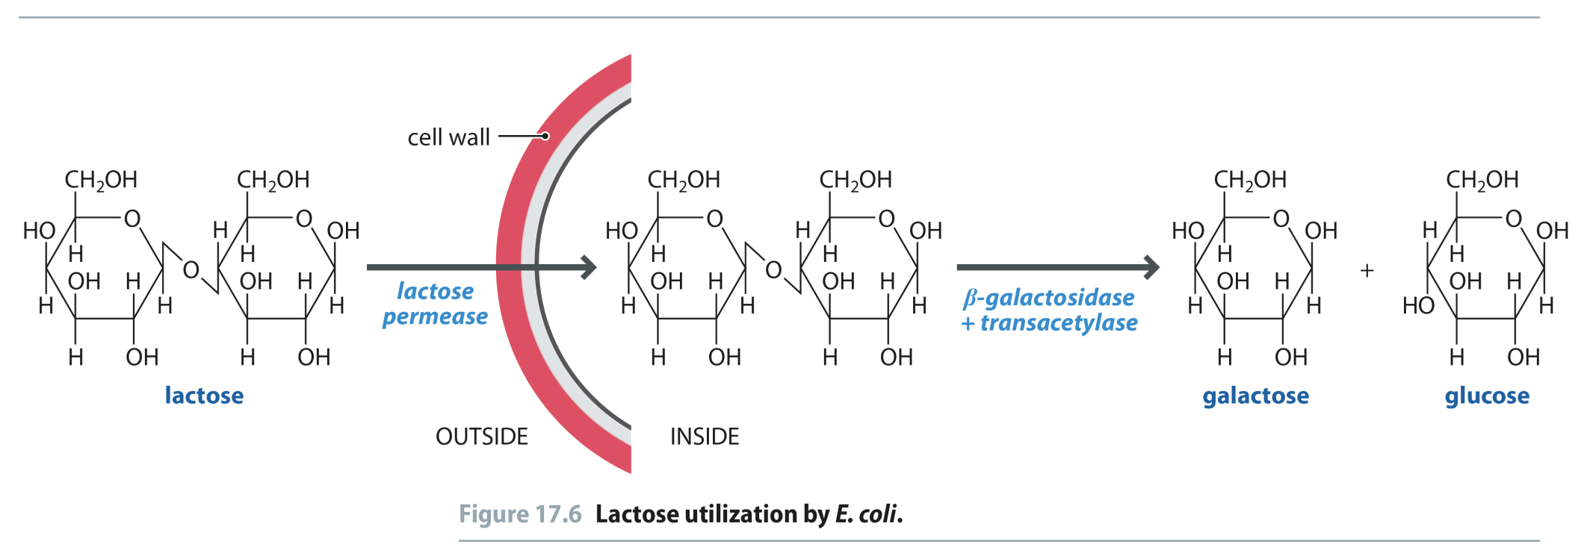
Fig 17.6
Reproduced from: Biochemistry by T.A. Brown, ISBN: 9781907904288 © Scion Publishing Ltd, 2017

Slide 7
Fig 17.7
Reproduced from: Biochemistry by T.A. Brown, ISBN: 9781907904288 © Scion Publishing Ltd, 2017

Slide 8
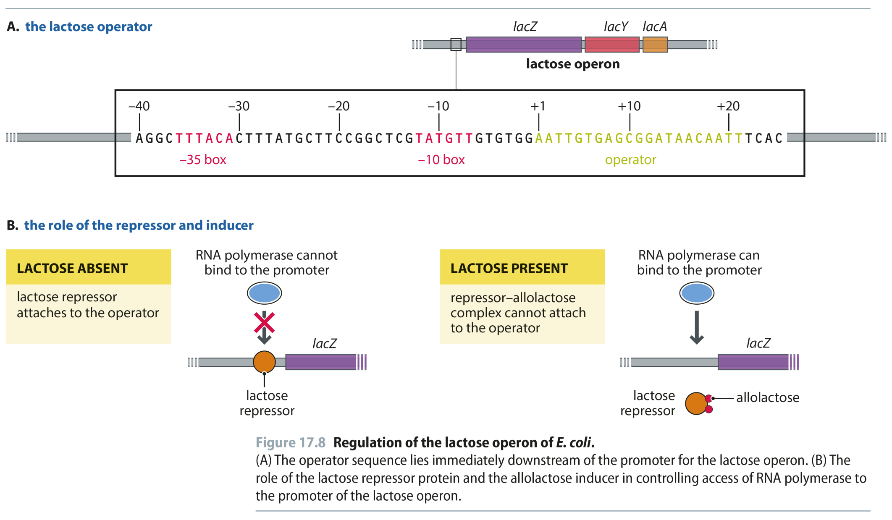
Fig 17.8
Reproduced from: Biochemistry by T.A. Brown, ISBN: 9781907904288 © Scion Publishing Ltd, 2017

Slide 9
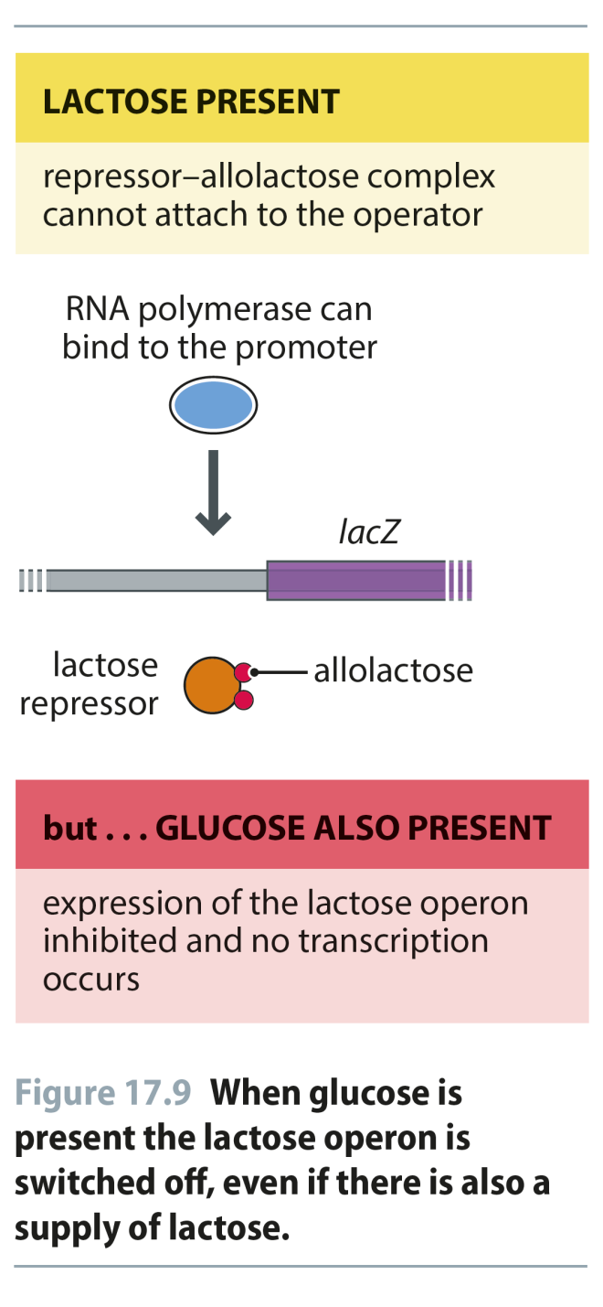
Fig 17.9
Reproduced from: Biochemistry by T.A. Brown, ISBN: 9781907904288 © Scion Publishing Ltd, 2017

Slide 10
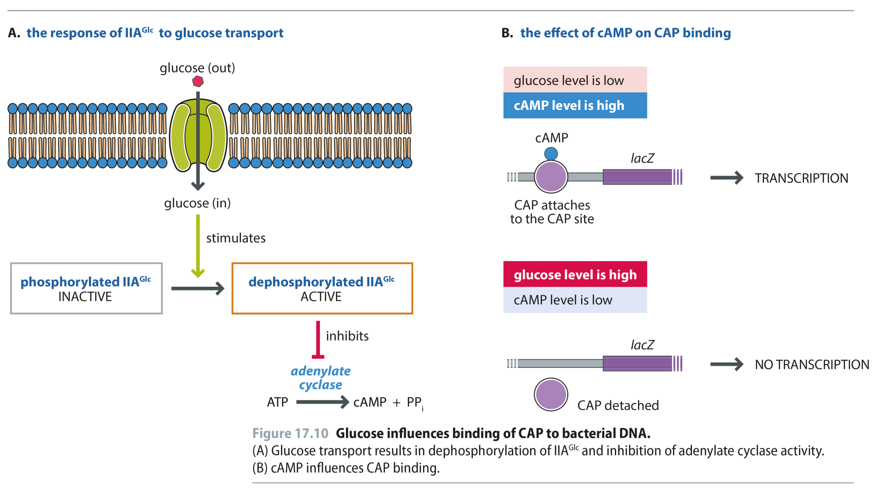
Fig 17.10
Reproduced from: Biochemistry by T.A. Brown, ISBN: 9781907904288 © Scion Publishing Ltd, 2017

Slide 11
Fig 17.11
Reproduced from: Biochemistry by T.A. Brown, ISBN: 9781907904288 © Scion Publishing Ltd, 2017

Slide 12
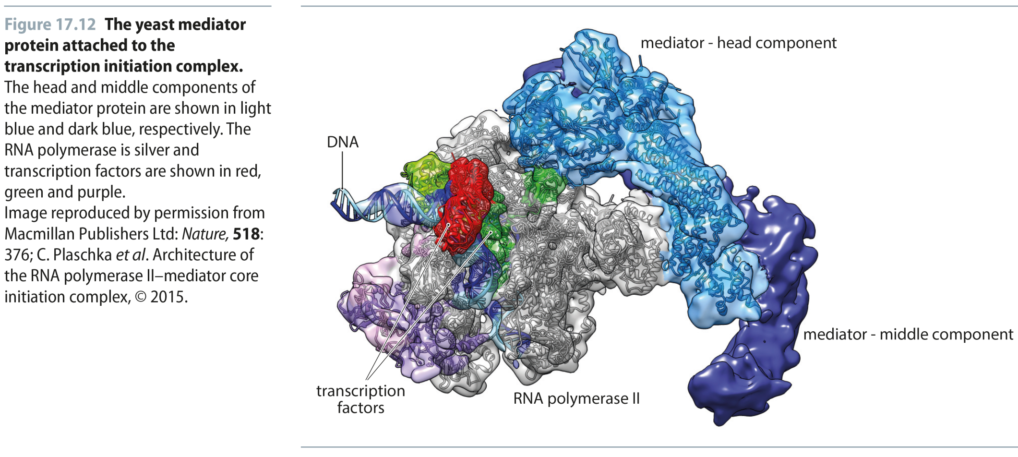
Fig 17.12
Reproduced from: Biochemistry by T.A. Brown, ISBN: 9781907904288 © Scion Publishing Ltd, 2017

Slide 13
Fig 17.13
Reproduced from: Biochemistry by T.A. Brown, ISBN: 9781907904288 © Scion Publishing Ltd, 2017

Slide 14
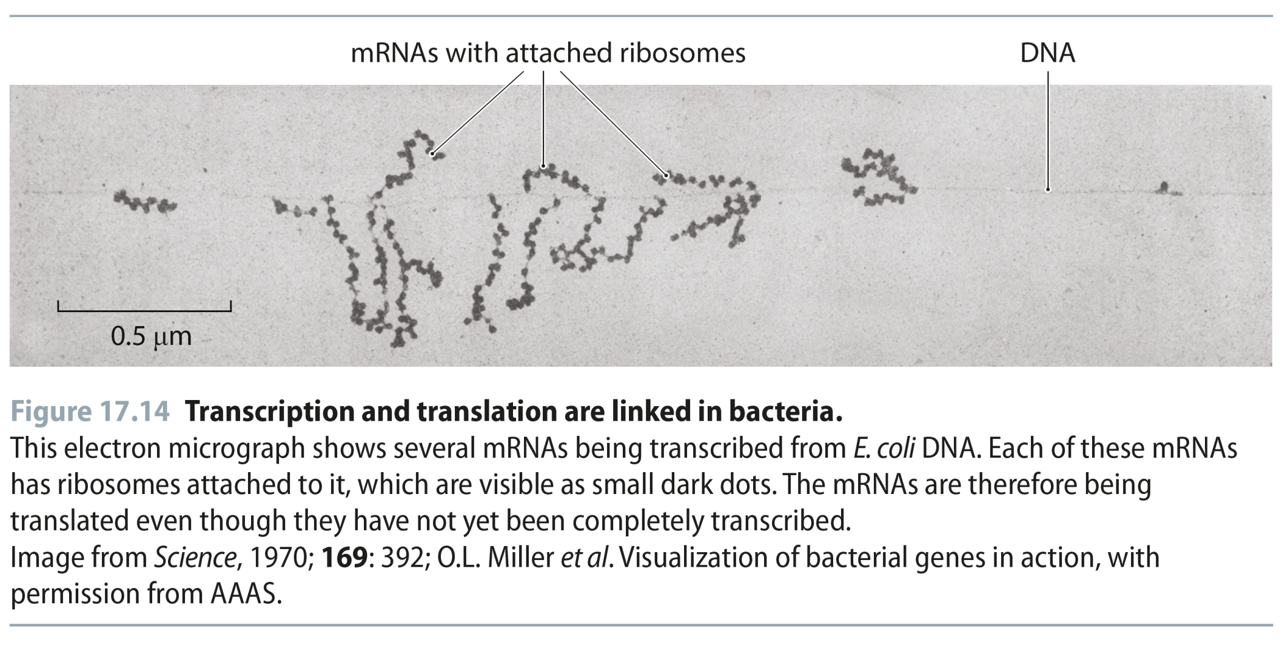
Fig 17.14
Reproduced from: Biochemistry by T.A. Brown, ISBN: 9781907904288 © Scion Publishing Ltd, 2017

Slide 15
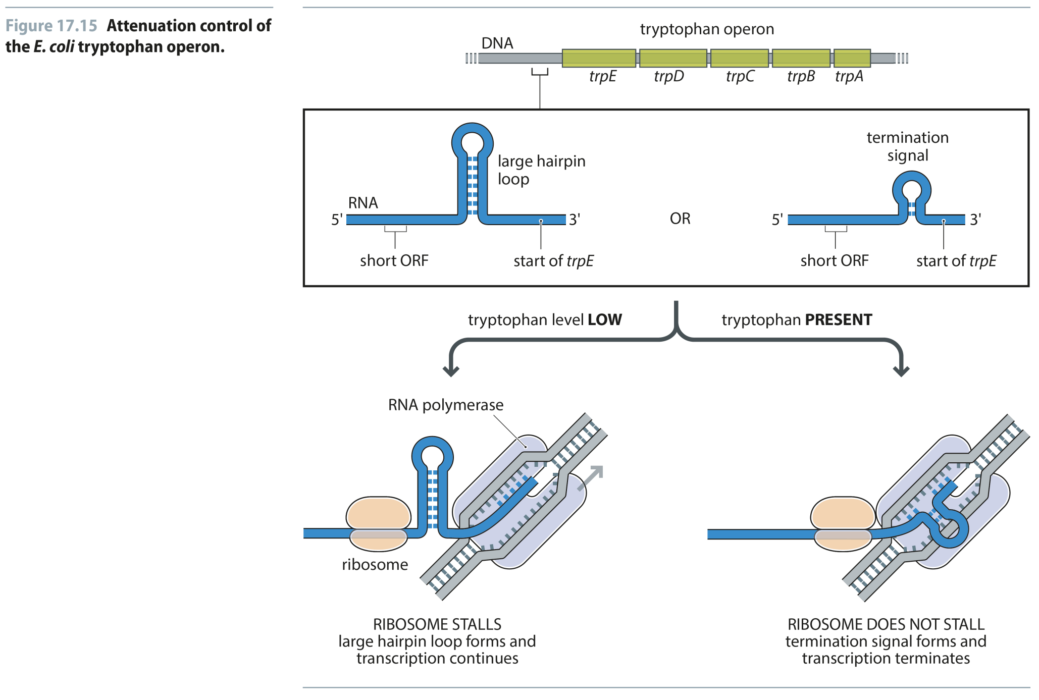
Fig 17.15
Reproduced from: Biochemistry by T.A. Brown, ISBN: 9781907904288 © Scion Publishing Ltd, 2017

Slide 16
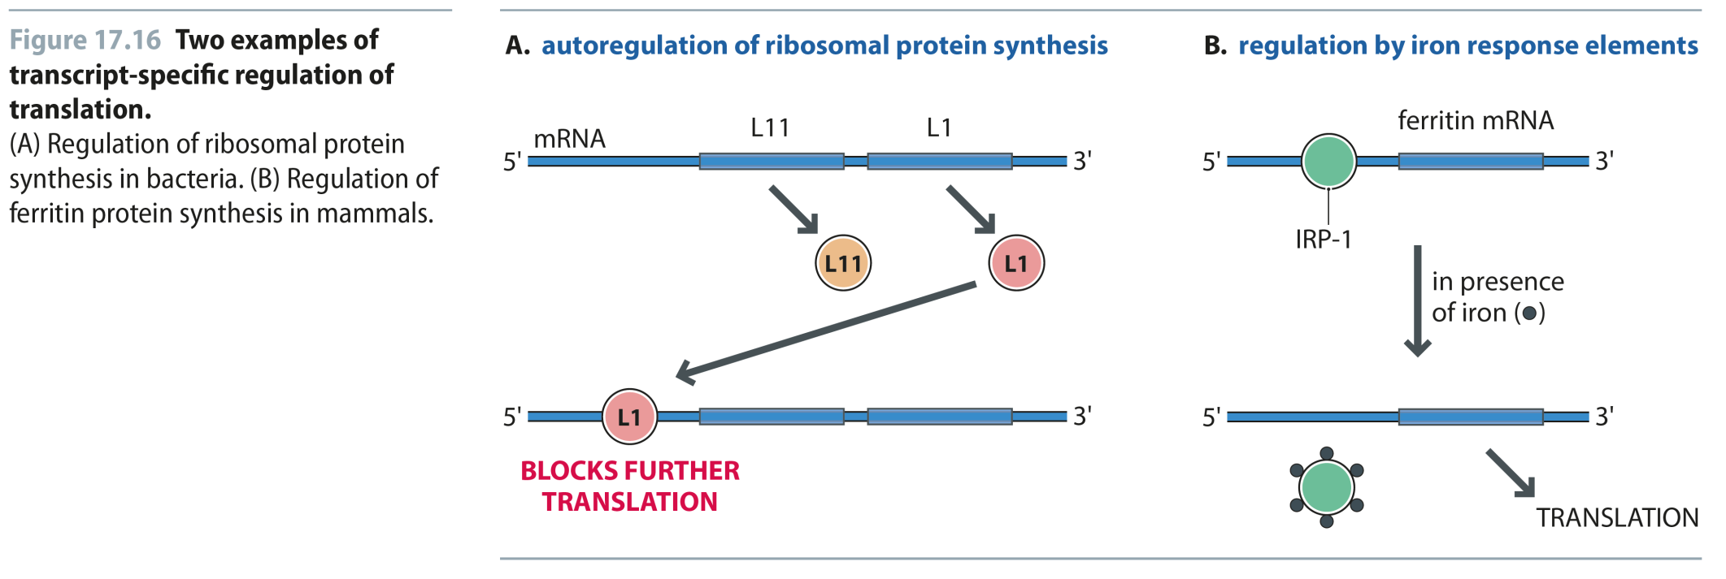
Fig 17.16
Reproduced from: Biochemistry by T.A. Brown, ISBN: 9781907904288 © Scion Publishing Ltd, 2017

Slide 17
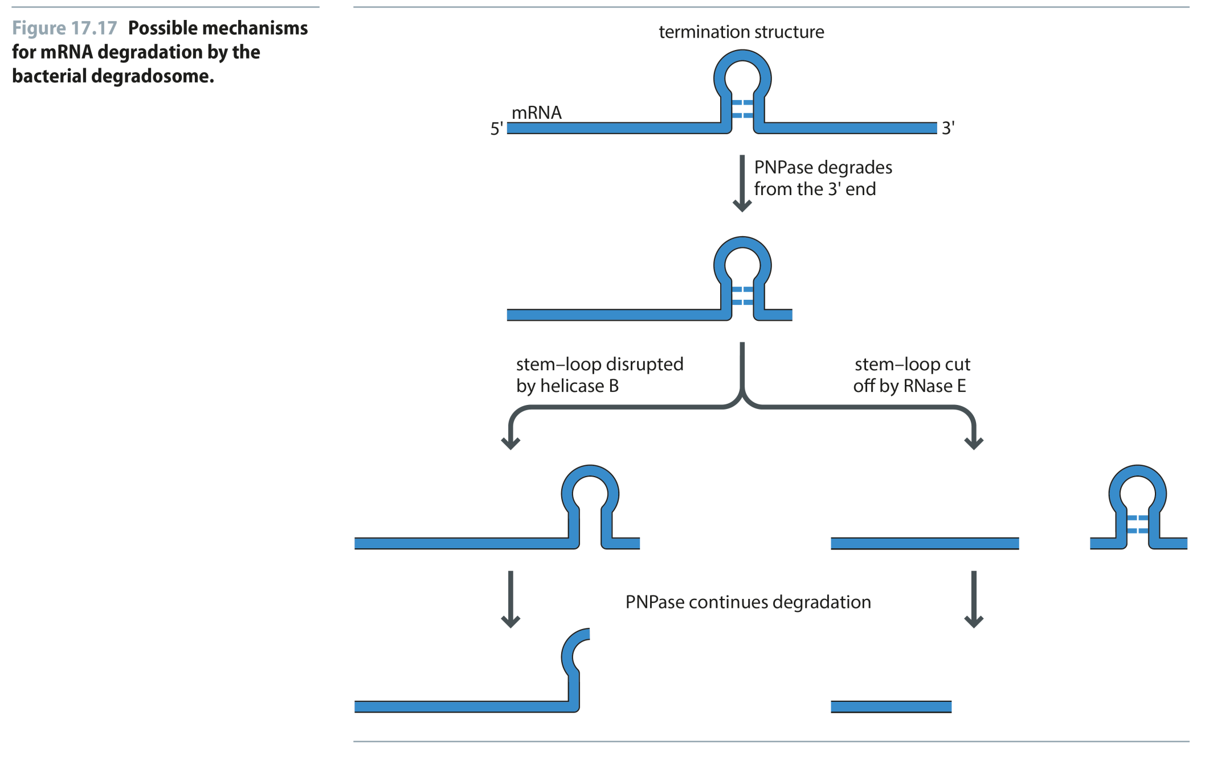
Fig 17.17
Reproduced from: Biochemistry by T.A. Brown, ISBN: 9781907904288 © Scion Publishing Ltd, 2017

Slide 18
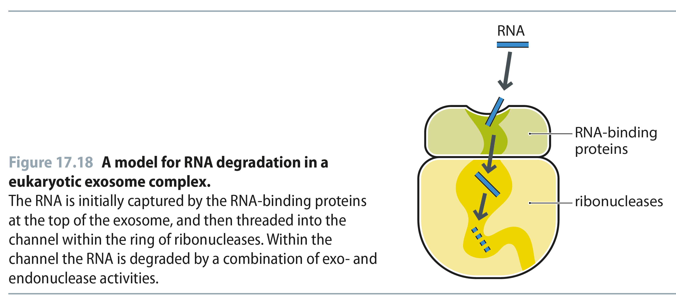
Fig 17.18
Reproduced from: Biochemistry by T.A. Brown, ISBN: 9781907904288 © Scion Publishing Ltd, 2017

Slide 19
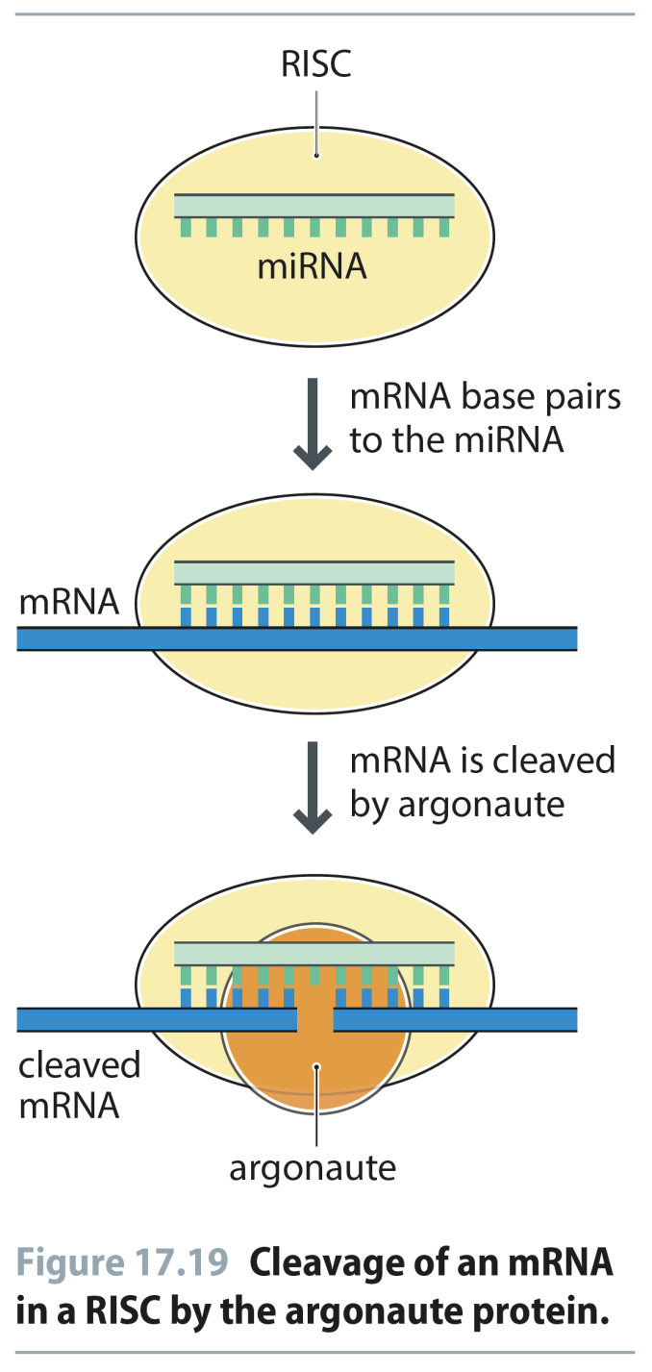
Fig 17.19
Reproduced from: Biochemistry by T.A. Brown, ISBN: 9781907904288 © Scion Publishing Ltd, 2017

Slide 20
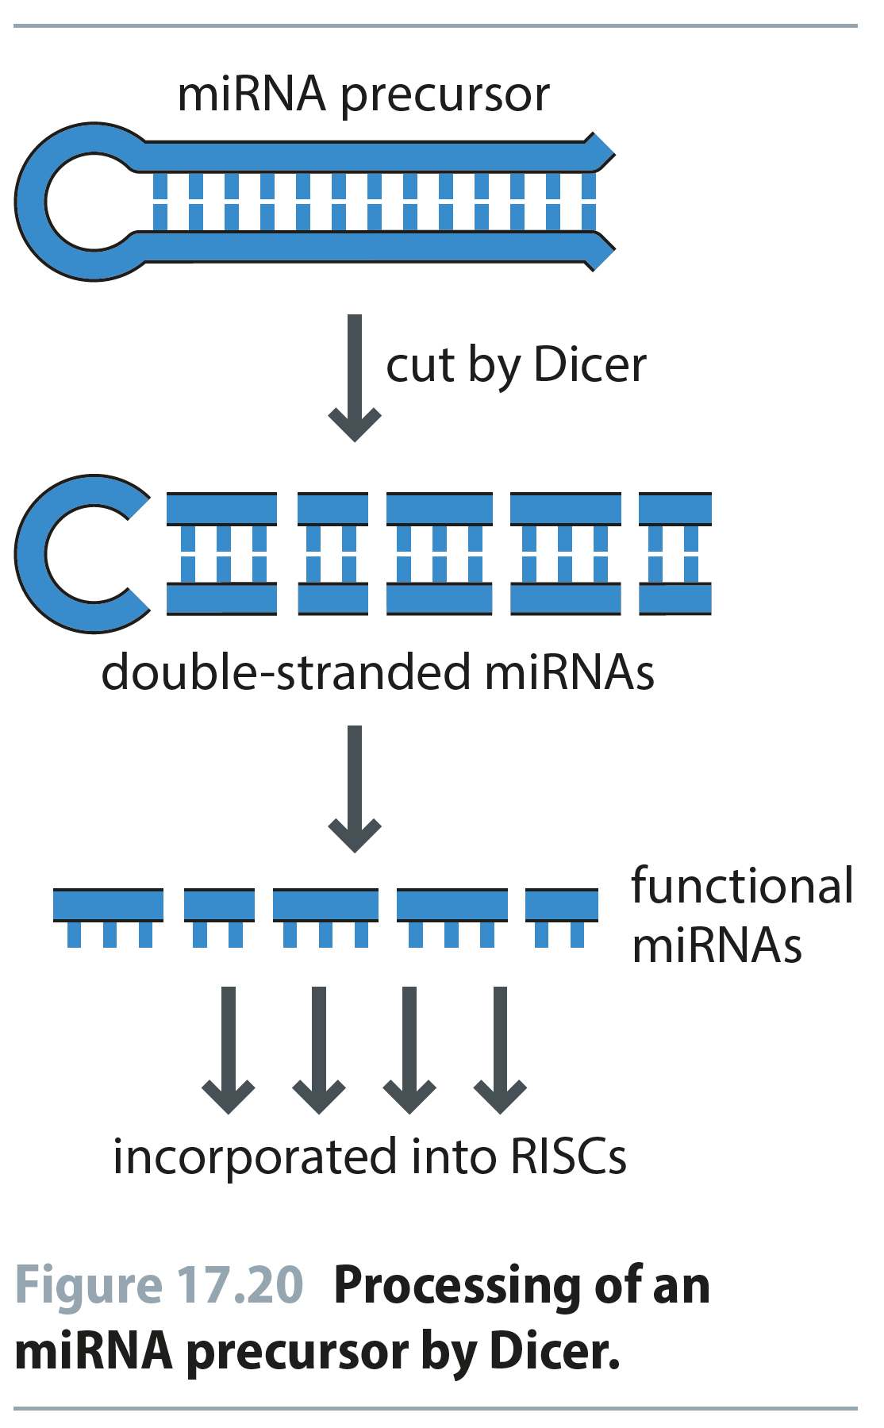
Fig 17.20
Reproduced from: Biochemistry by T.A. Brown, ISBN: 9781907904288 © Scion Publishing Ltd, 2017

Slide 21
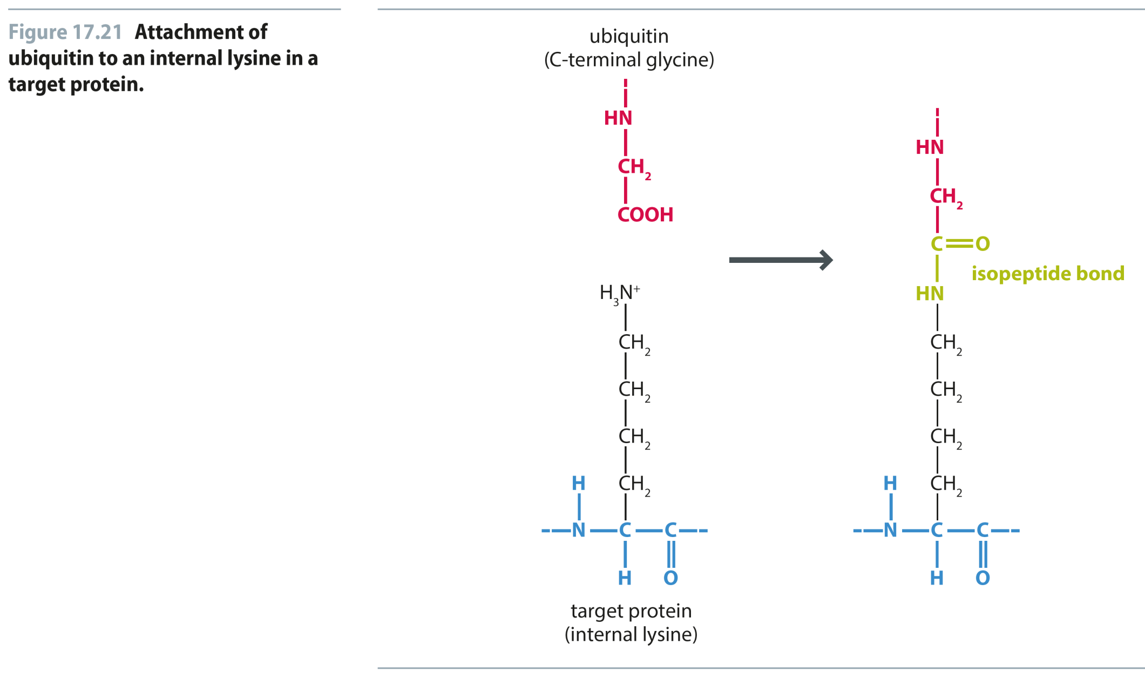
Fig 17.21
Reproduced from: Biochemistry by T.A. Brown, ISBN: 9781907904288 © Scion Publishing Ltd, 2017

Slide 22
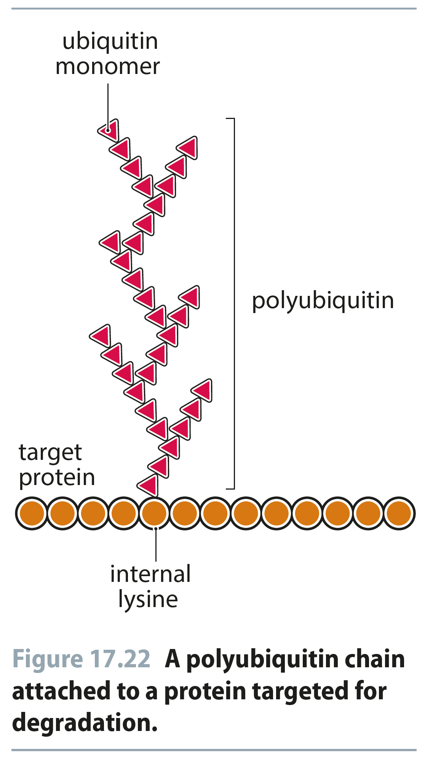
Fig 17.22
Reproduced from: Biochemistry by T.A. Brown, ISBN: 9781907904288 © Scion Publishing Ltd, 2017

Slide 23
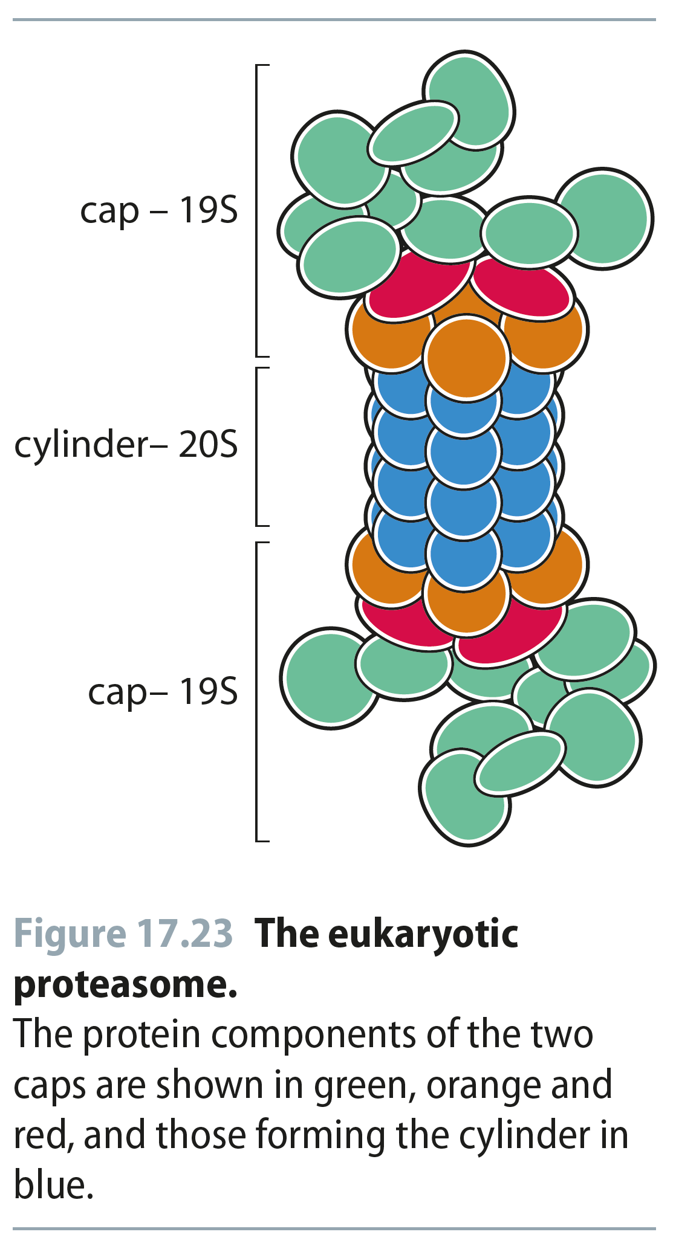
Fig 17.23
Reproduced from: Biochemistry by T.A. Brown, ISBN: 9781907904288 © Scion Publishing Ltd, 2017

