Slide 1
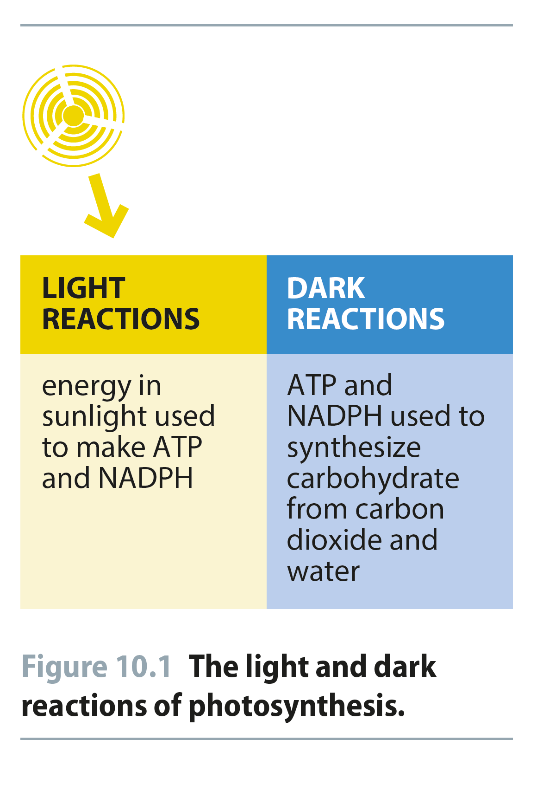
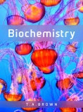
Fig 10.1
Reproduced from: Biochemistry by T.A. Brown, ISBN: 9781907904288 © Scion Publishing Ltd, 2017

Slide 2
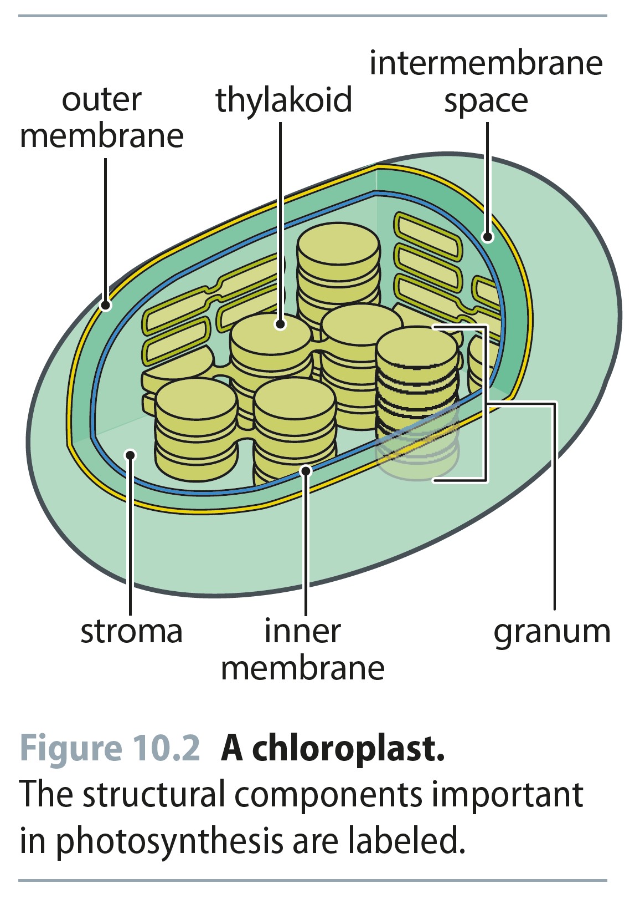
Fig 10.2
Reproduced from: Biochemistry by T.A. Brown, ISBN: 9781907904288 © Scion Publishing Ltd, 2017

Slide 3
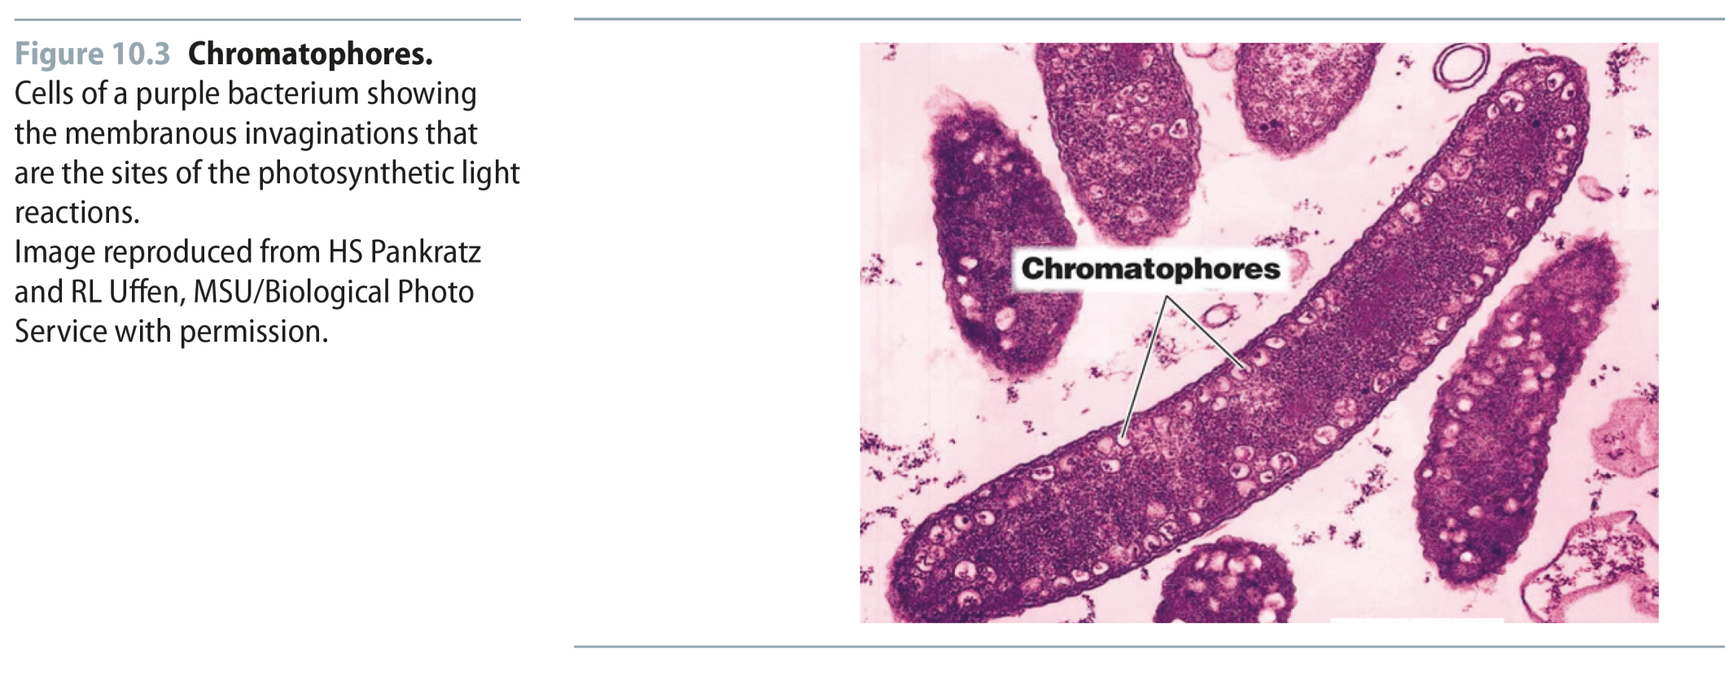
Fig 10.3
Reproduced from: Biochemistry by T.A. Brown, ISBN: 9781907904288 © Scion Publishing Ltd, 2017

Slide 4
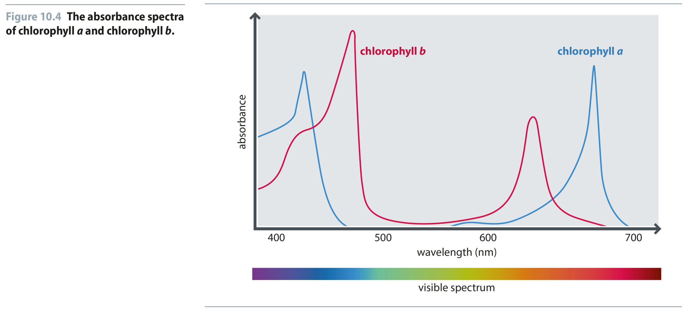
Fig 10.4
Reproduced from: Biochemistry by T.A. Brown, ISBN: 9781907904288 © Scion Publishing Ltd, 2017

Slide 5
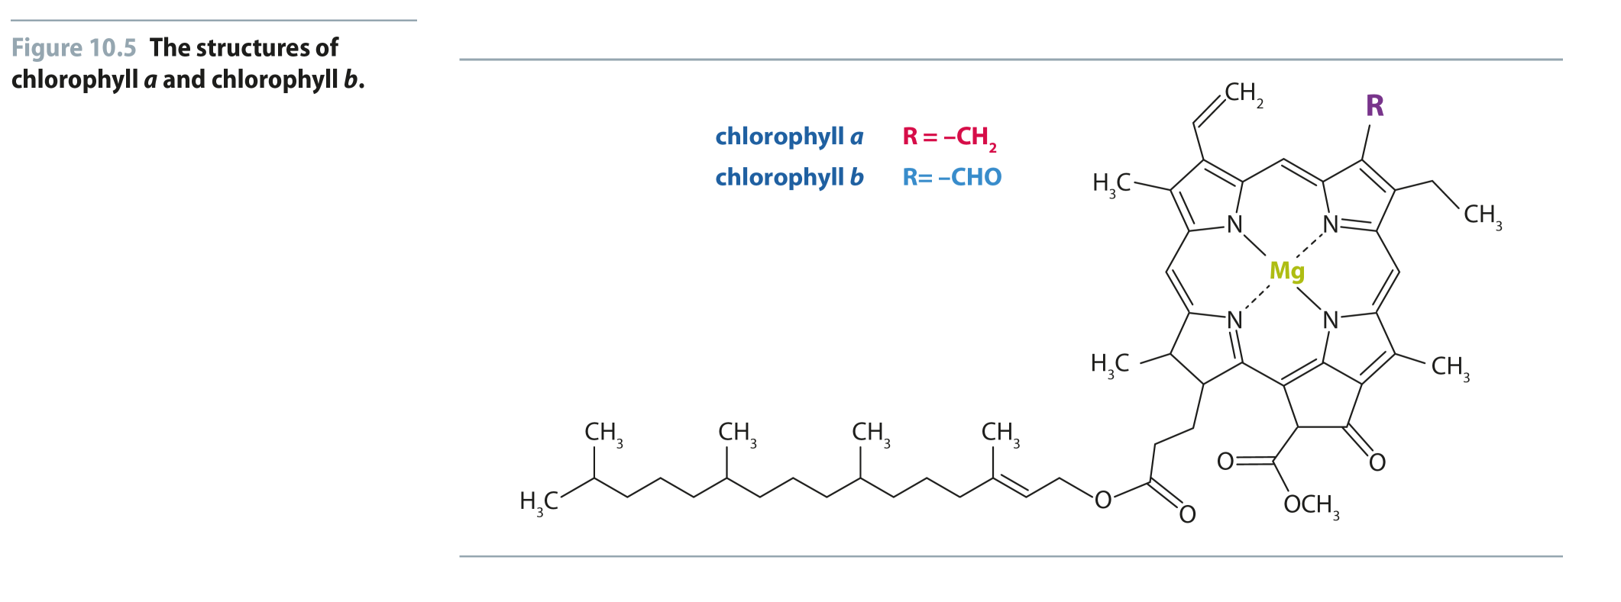
Fig 10.5
Reproduced from: Biochemistry by T.A. Brown, ISBN: 9781907904288 © Scion Publishing Ltd, 2017

Slide 6
Table 10.1
Reproduced from: Biochemistry by T.A. Brown, ISBN: 9781907904288 © Scion Publishing Ltd, 2017

Slide 7
Fig 10.6
Reproduced from: Biochemistry by T.A. Brown, ISBN: 9781907904288 © Scion Publishing Ltd, 2017

Slide 8
Fig 10.7
Reproduced from: Biochemistry by T.A. Brown, ISBN: 9781907904288 © Scion Publishing Ltd, 2017

Slide 9
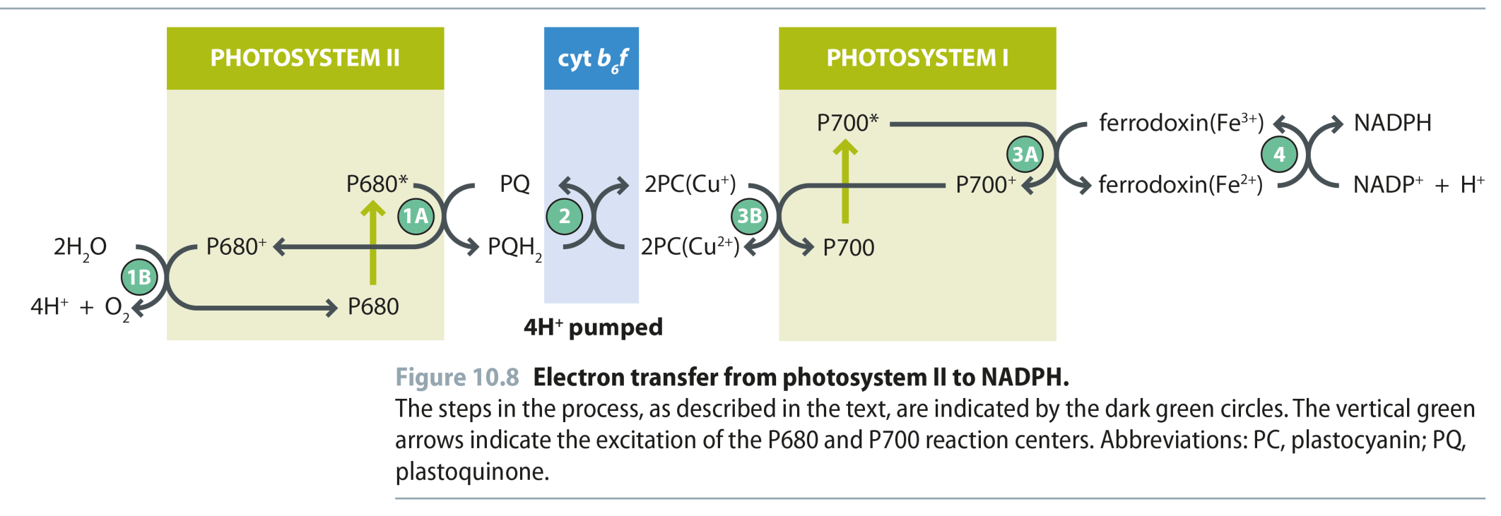
Fig 10.8
Reproduced from: Biochemistry by T.A. Brown, ISBN: 9781907904288 © Scion Publishing Ltd, 2017

Slide 10
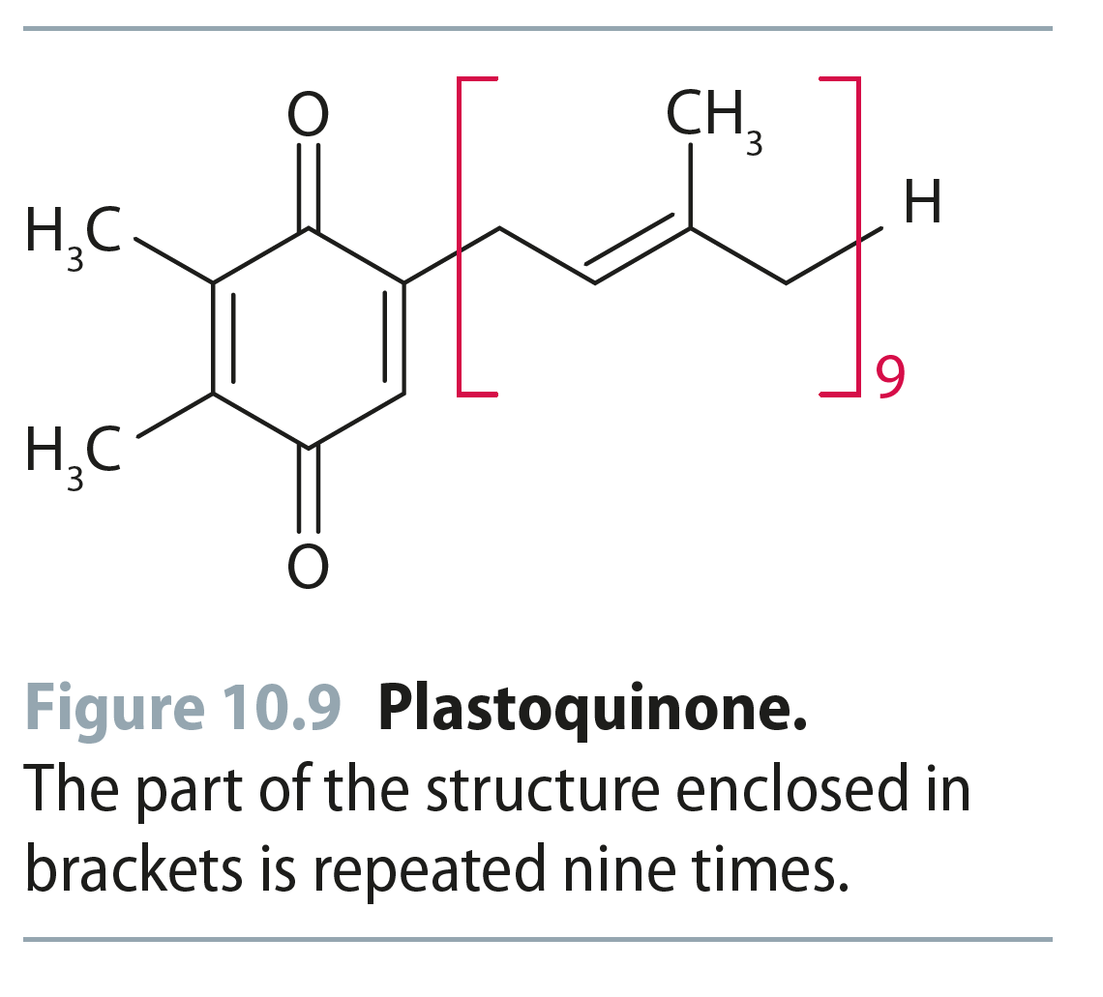
Fig 10.9
Reproduced from: Biochemistry by T.A. Brown, ISBN: 9781907904288 © Scion Publishing Ltd, 2017

Slide 11
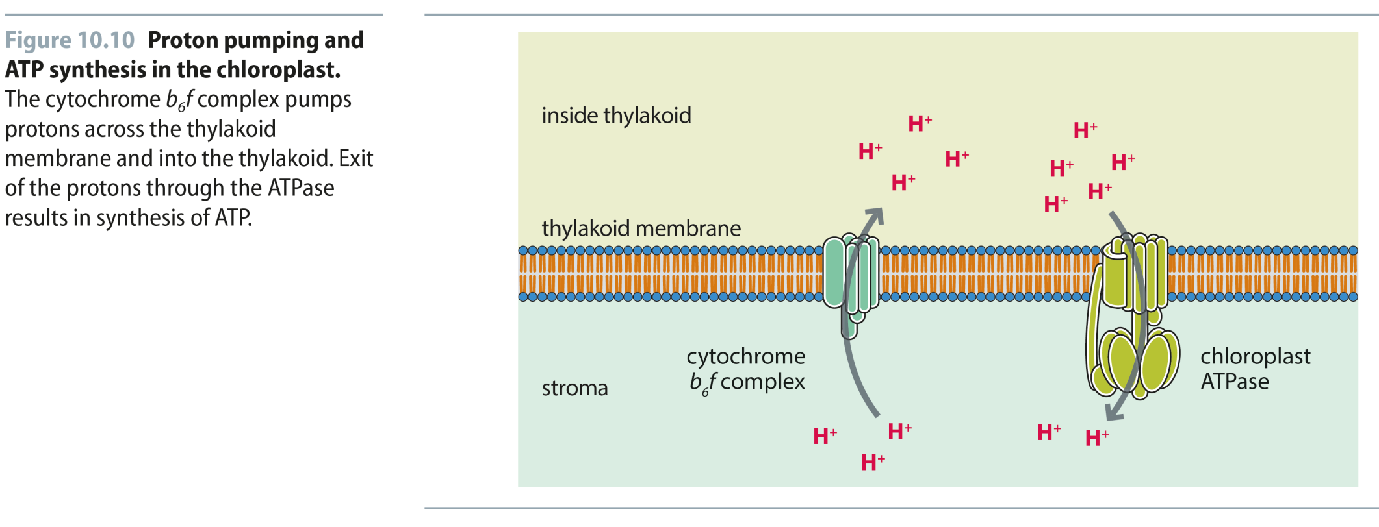
Fig 10.10
Reproduced from: Biochemistry by T.A. Brown, ISBN: 9781907904288 © Scion Publishing Ltd, 2017

Slide 12
Fig 10.11
Reproduced from: Biochemistry by T.A. Brown, ISBN: 9781907904288 © Scion Publishing Ltd, 2017

Slide 13
Fig 10.12
Reproduced from: Biochemistry by T.A. Brown, ISBN: 9781907904288 © Scion Publishing Ltd, 2017

Slide 14
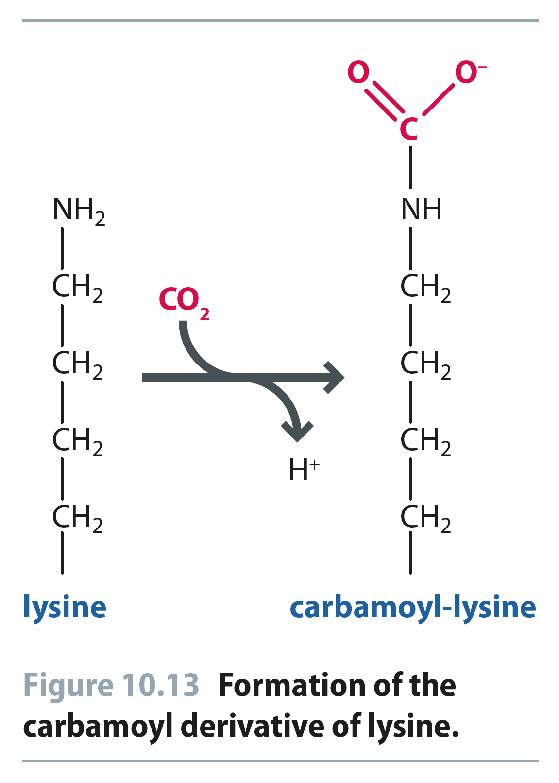
Fig 10.13
Reproduced from: Biochemistry by T.A. Brown, ISBN: 9781907904288 © Scion Publishing Ltd, 2017

Slide 15
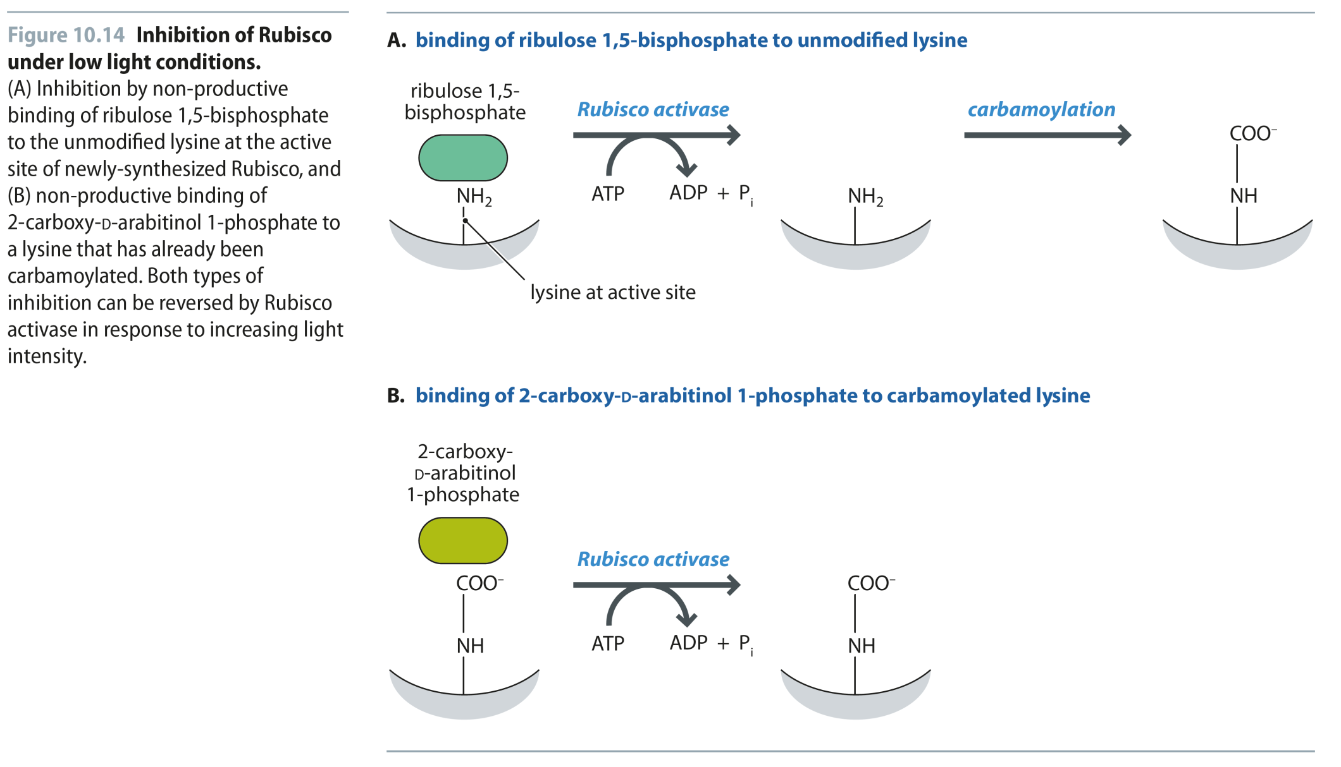
Fig 10.14
Reproduced from: Biochemistry by T.A. Brown, ISBN: 9781907904288 © Scion Publishing Ltd, 2017

Slide 16
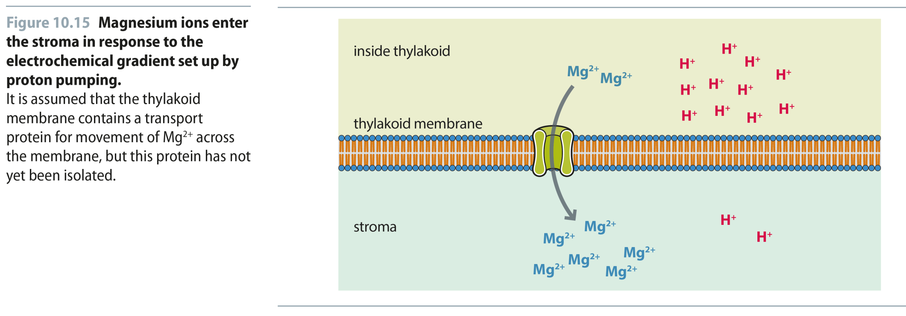
Fig 10.15
Reproduced from: Biochemistry by T.A. Brown, ISBN: 9781907904288 © Scion Publishing Ltd, 2017

Slide 17
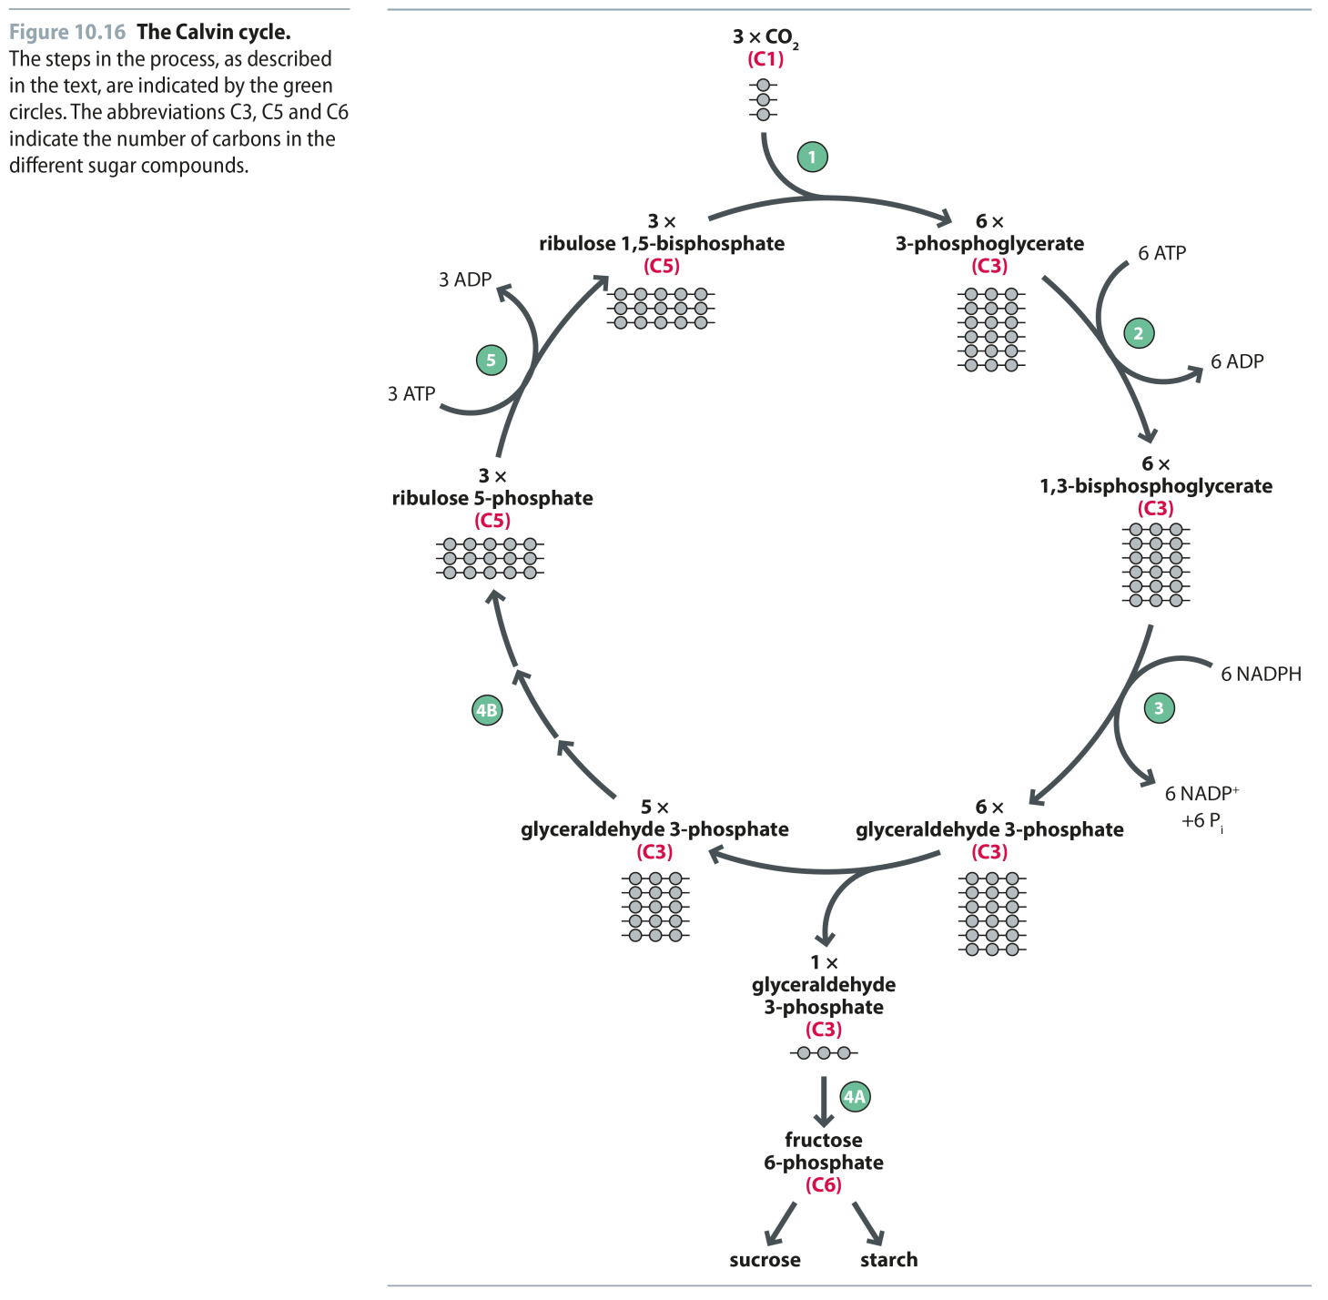
Fig 10.16
Reproduced from: Biochemistry by T.A. Brown, ISBN: 9781907904288 © Scion Publishing Ltd, 2017

Slide 18
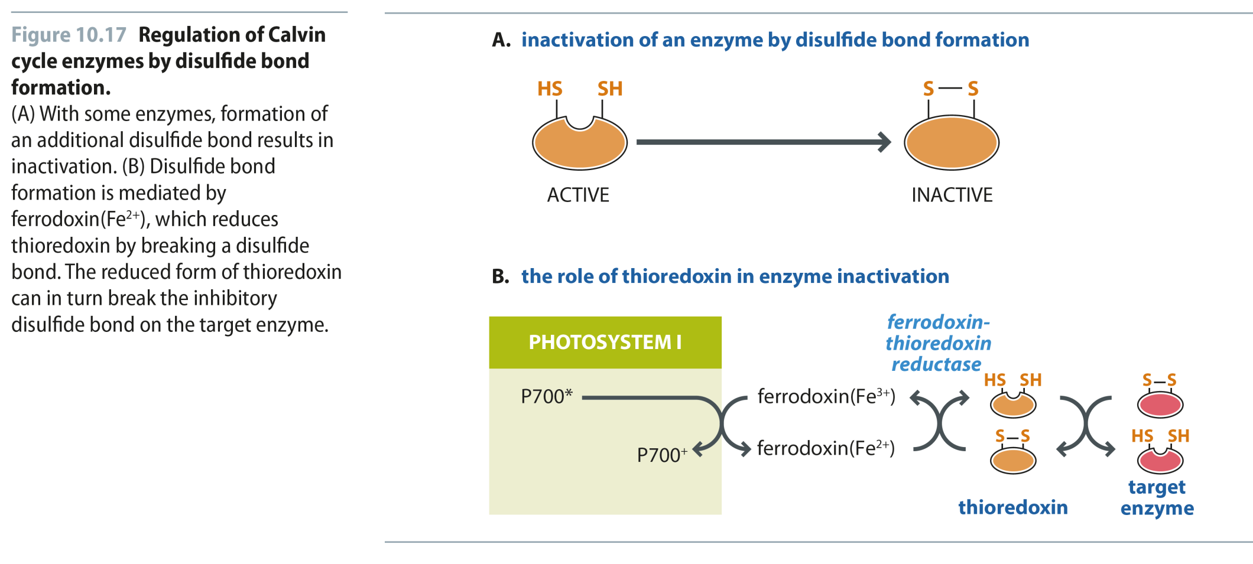
Fig 10.17
Reproduced from: Biochemistry by T.A. Brown, ISBN: 9781907904288 © Scion Publishing Ltd, 2017

Slide 19
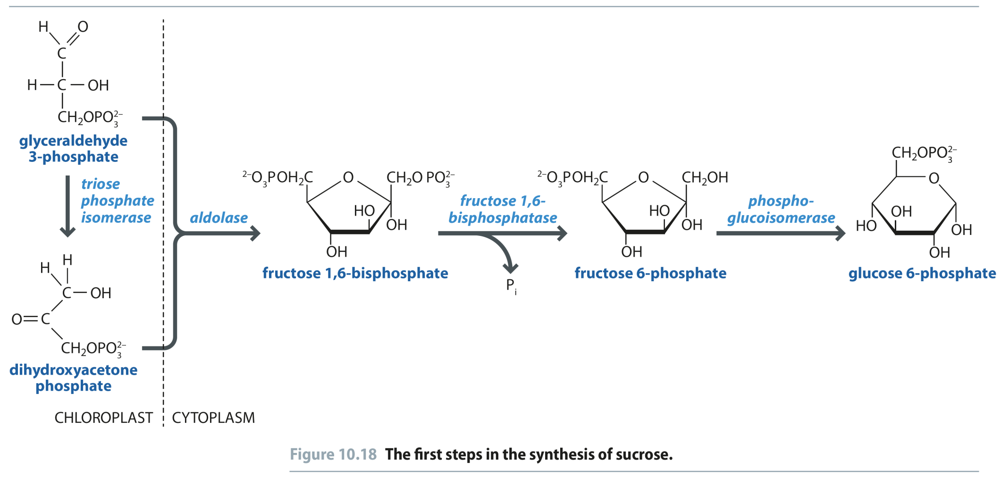
Fig 10.18
Reproduced from: Biochemistry by T.A. Brown, ISBN: 9781907904288 © Scion Publishing Ltd, 2017

Slide 20
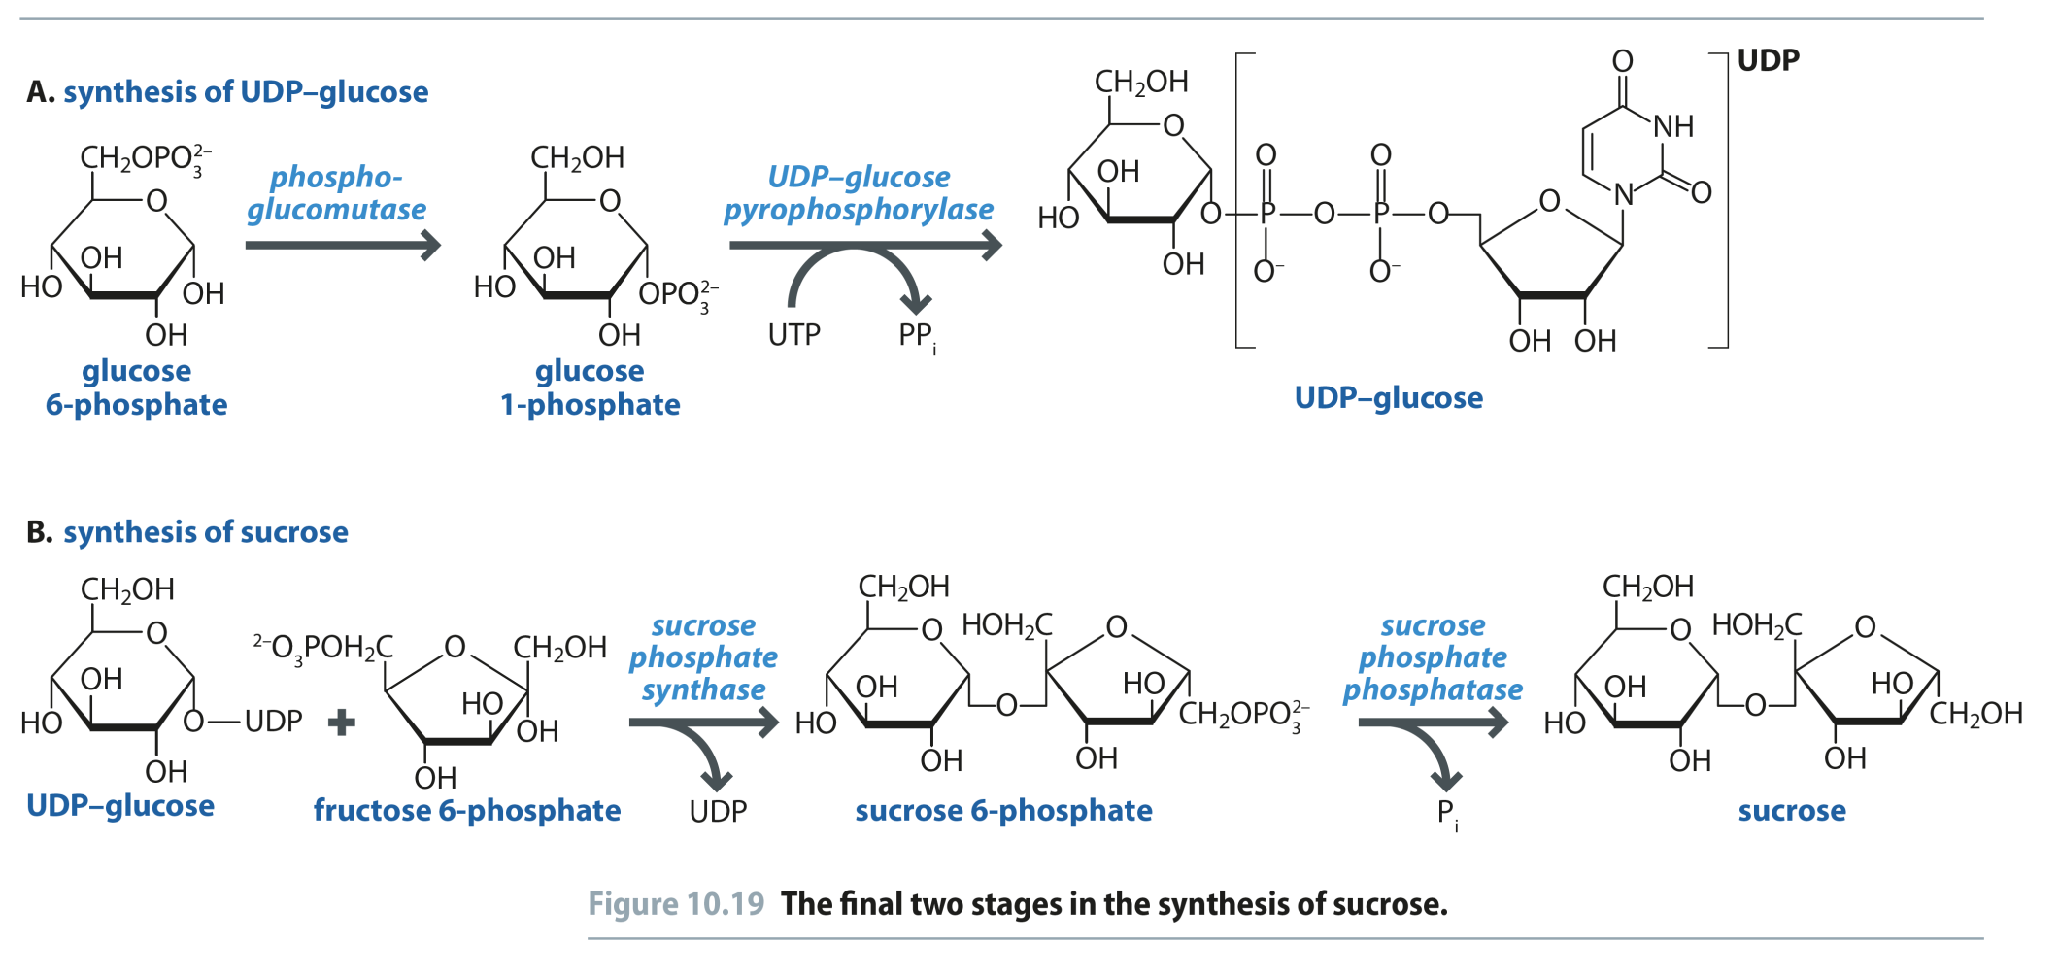
Fig 10.19
Reproduced from: Biochemistry by T.A. Brown, ISBN: 9781907904288 © Scion Publishing Ltd, 2017

Slide 21
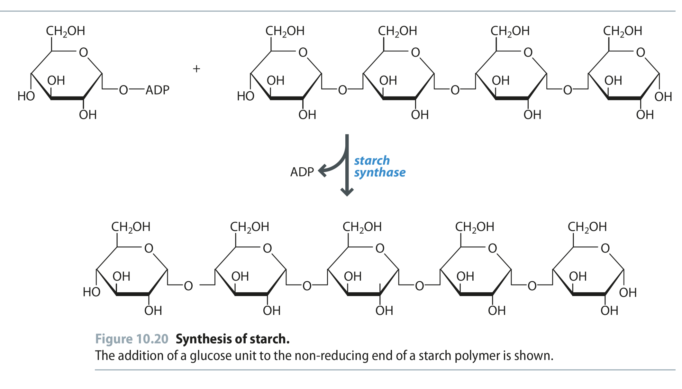
Fig 10.20
Reproduced from: Biochemistry by T.A. Brown, ISBN: 9781907904288 © Scion Publishing Ltd, 2017

Slide 22
Fig 10.21
Reproduced from: Biochemistry by T.A. Brown, ISBN: 9781907904288 © Scion Publishing Ltd, 2017

Slide 23
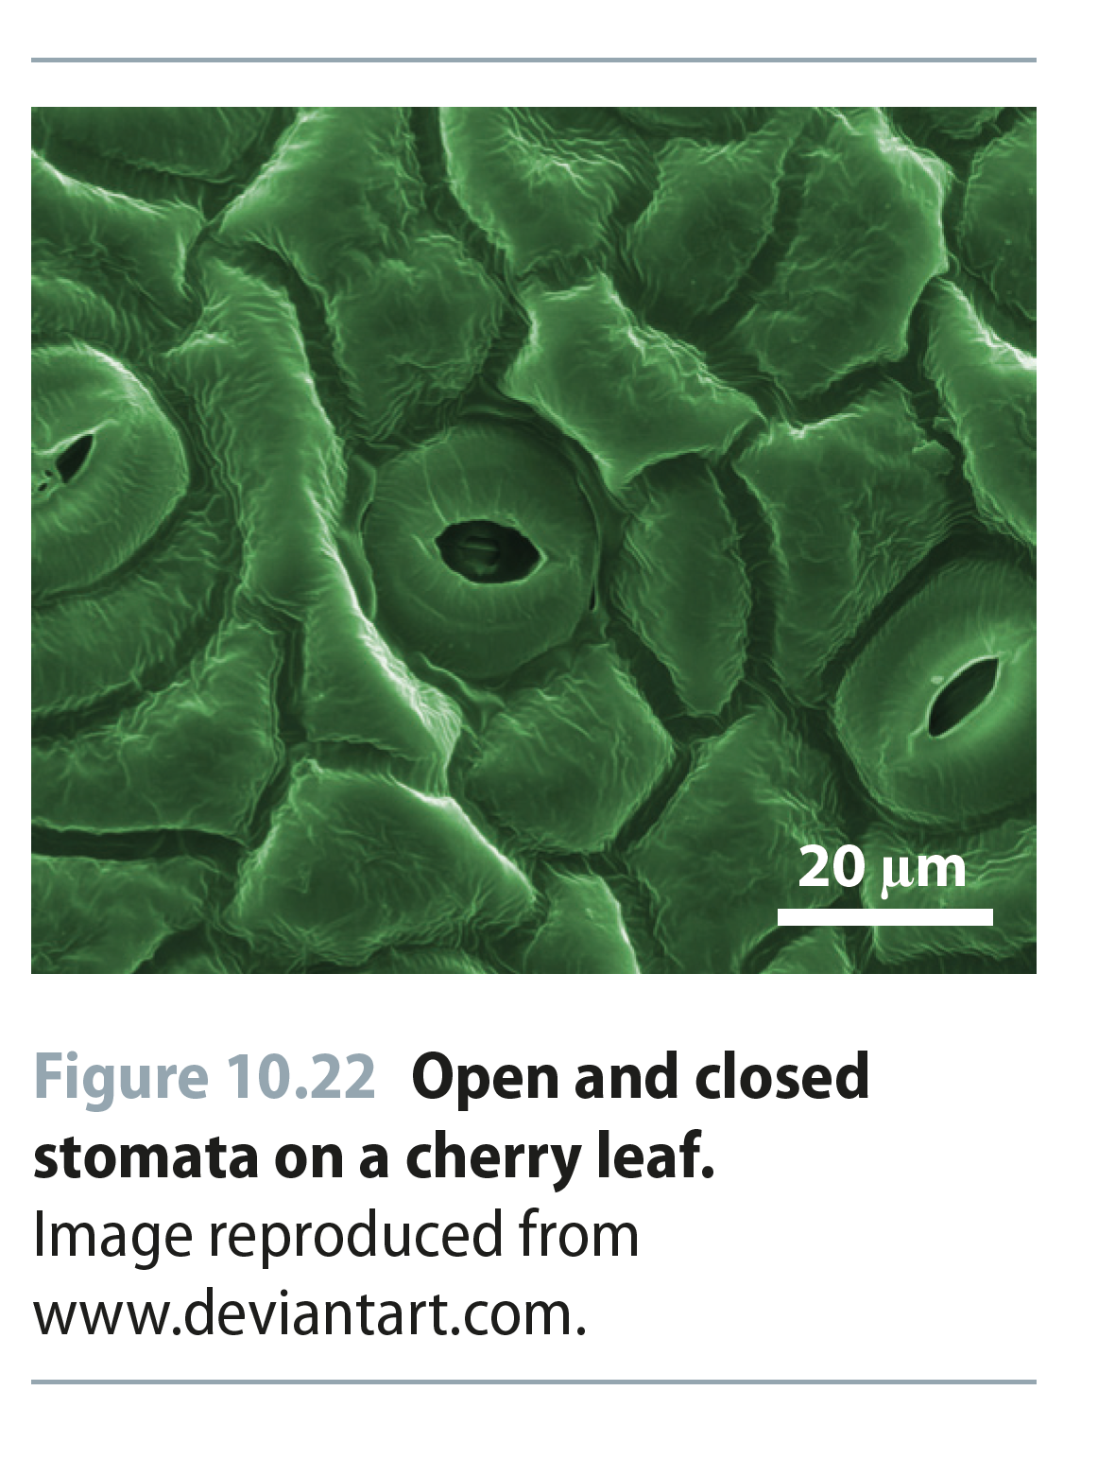
Fig 10.22
Reproduced from: Biochemistry by T.A. Brown, ISBN: 9781907904288 © Scion Publishing Ltd, 2017

Slide 24
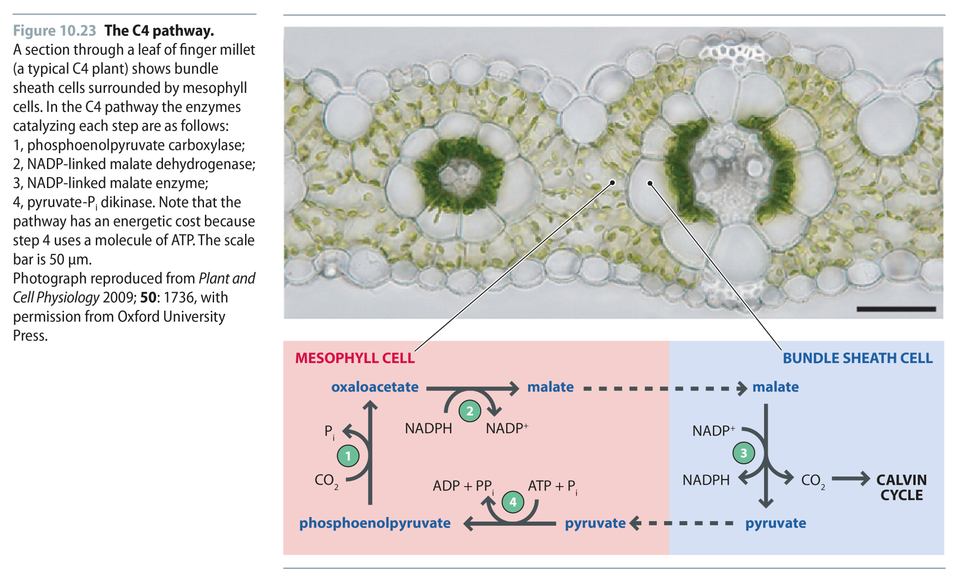
Fig 10.23
Reproduced from: Biochemistry by T.A. Brown, ISBN: 9781907904288 © Scion Publishing Ltd, 2017

