Slide 1
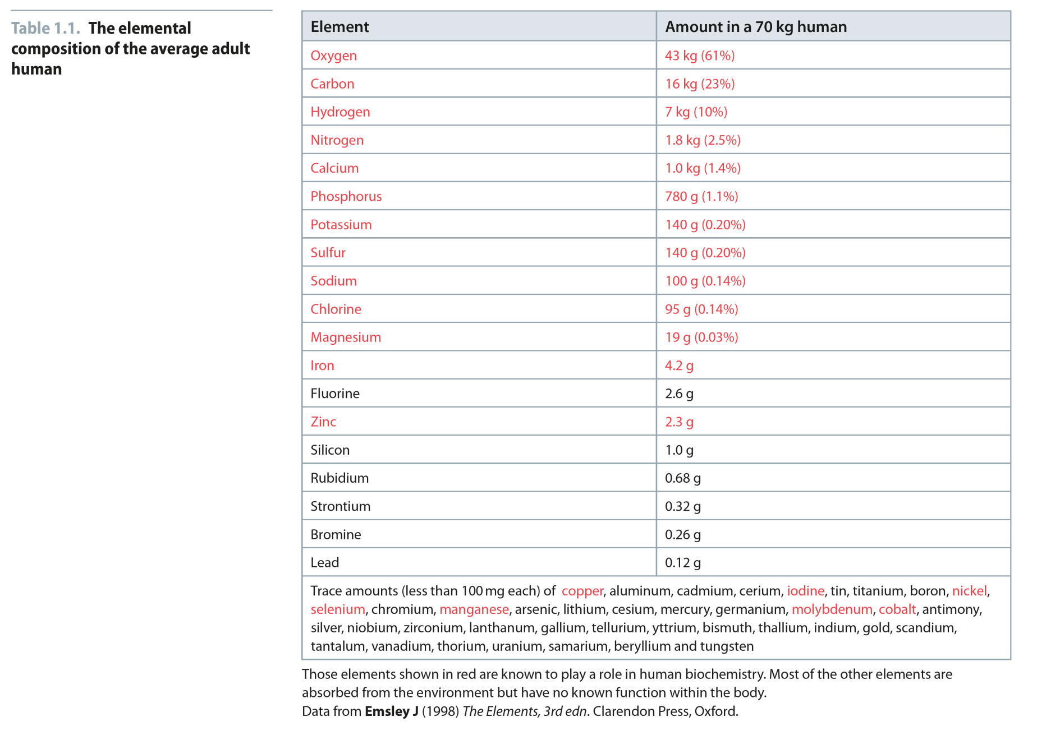
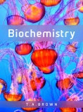
Table 1.1
Reproduced from: Biochemistry by T.A. Brown, ISBN: 9781907904288 © Scion Publishing Ltd, 2017

Slide 2
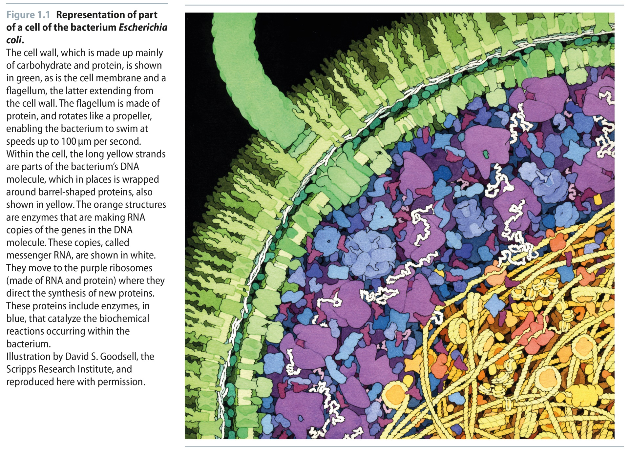
Fig 1.1
Reproduced from: Biochemistry by T.A. Brown, ISBN: 9781907904288 © Scion Publishing Ltd, 2017

Slide 3
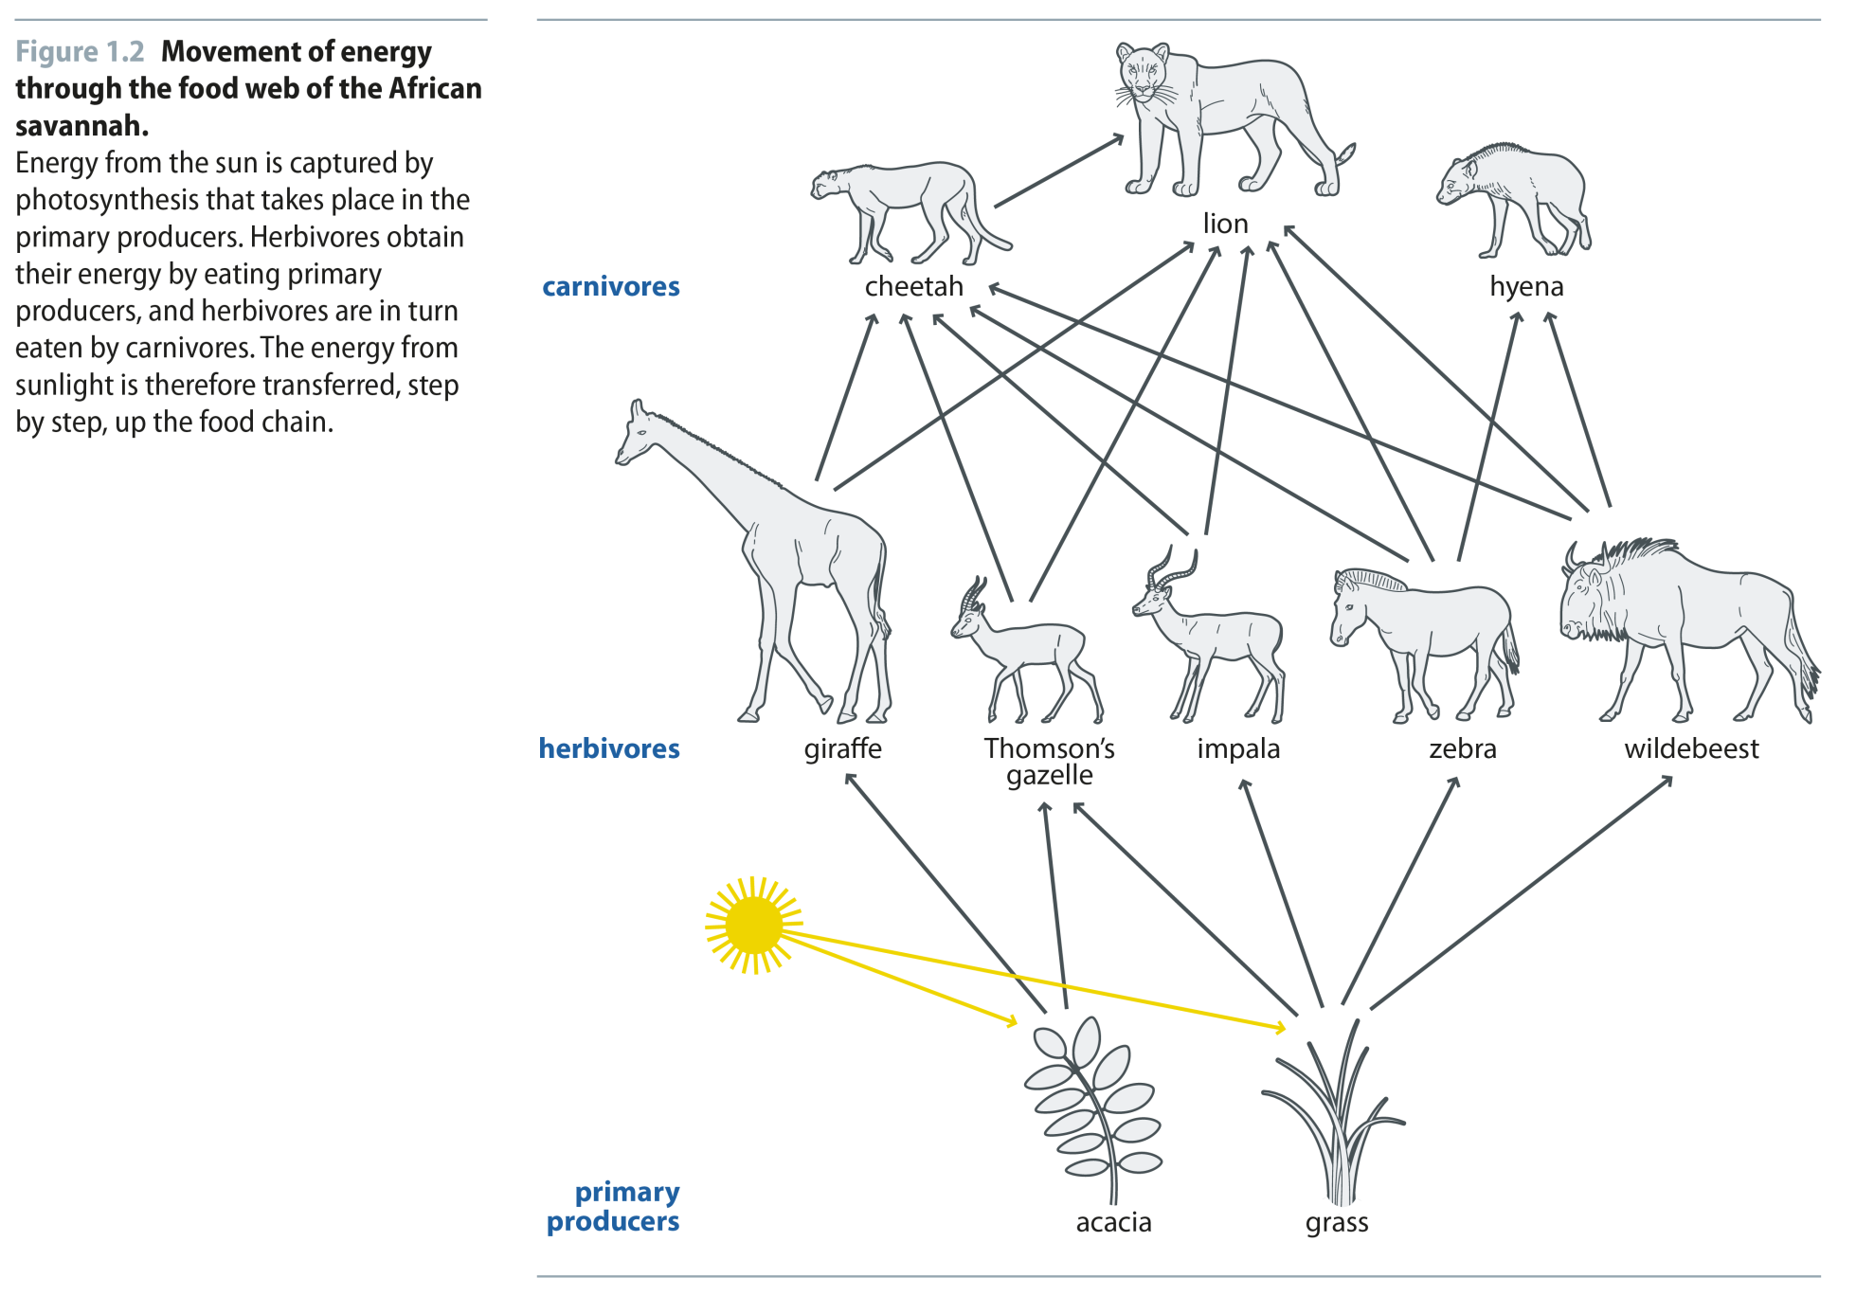
Fig 1.2
Reproduced from: Biochemistry by T.A. Brown, ISBN: 9781907904288 © Scion Publishing Ltd, 2017

Slide 4
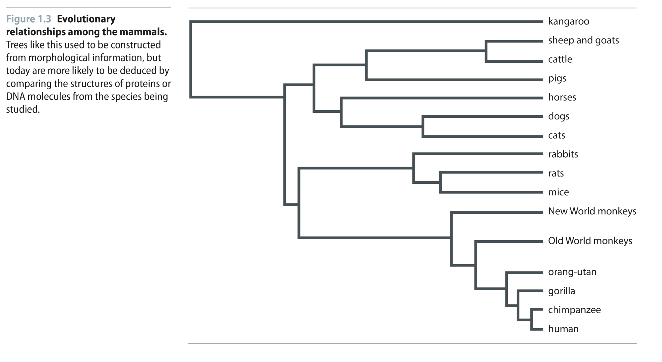
Fig 1.3
Reproduced from: Biochemistry by T.A. Brown, ISBN: 9781907904288 © Scion Publishing Ltd, 2017

Slide 5
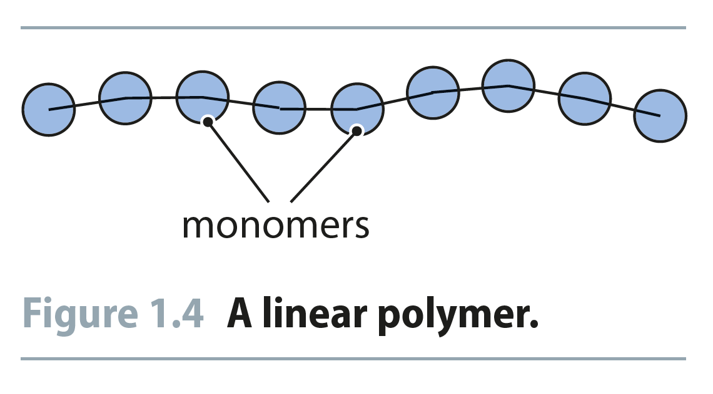
Fig 1.4
Reproduced from: Biochemistry by T.A. Brown, ISBN: 9781907904288 © Scion Publishing Ltd, 2017

Slide 6
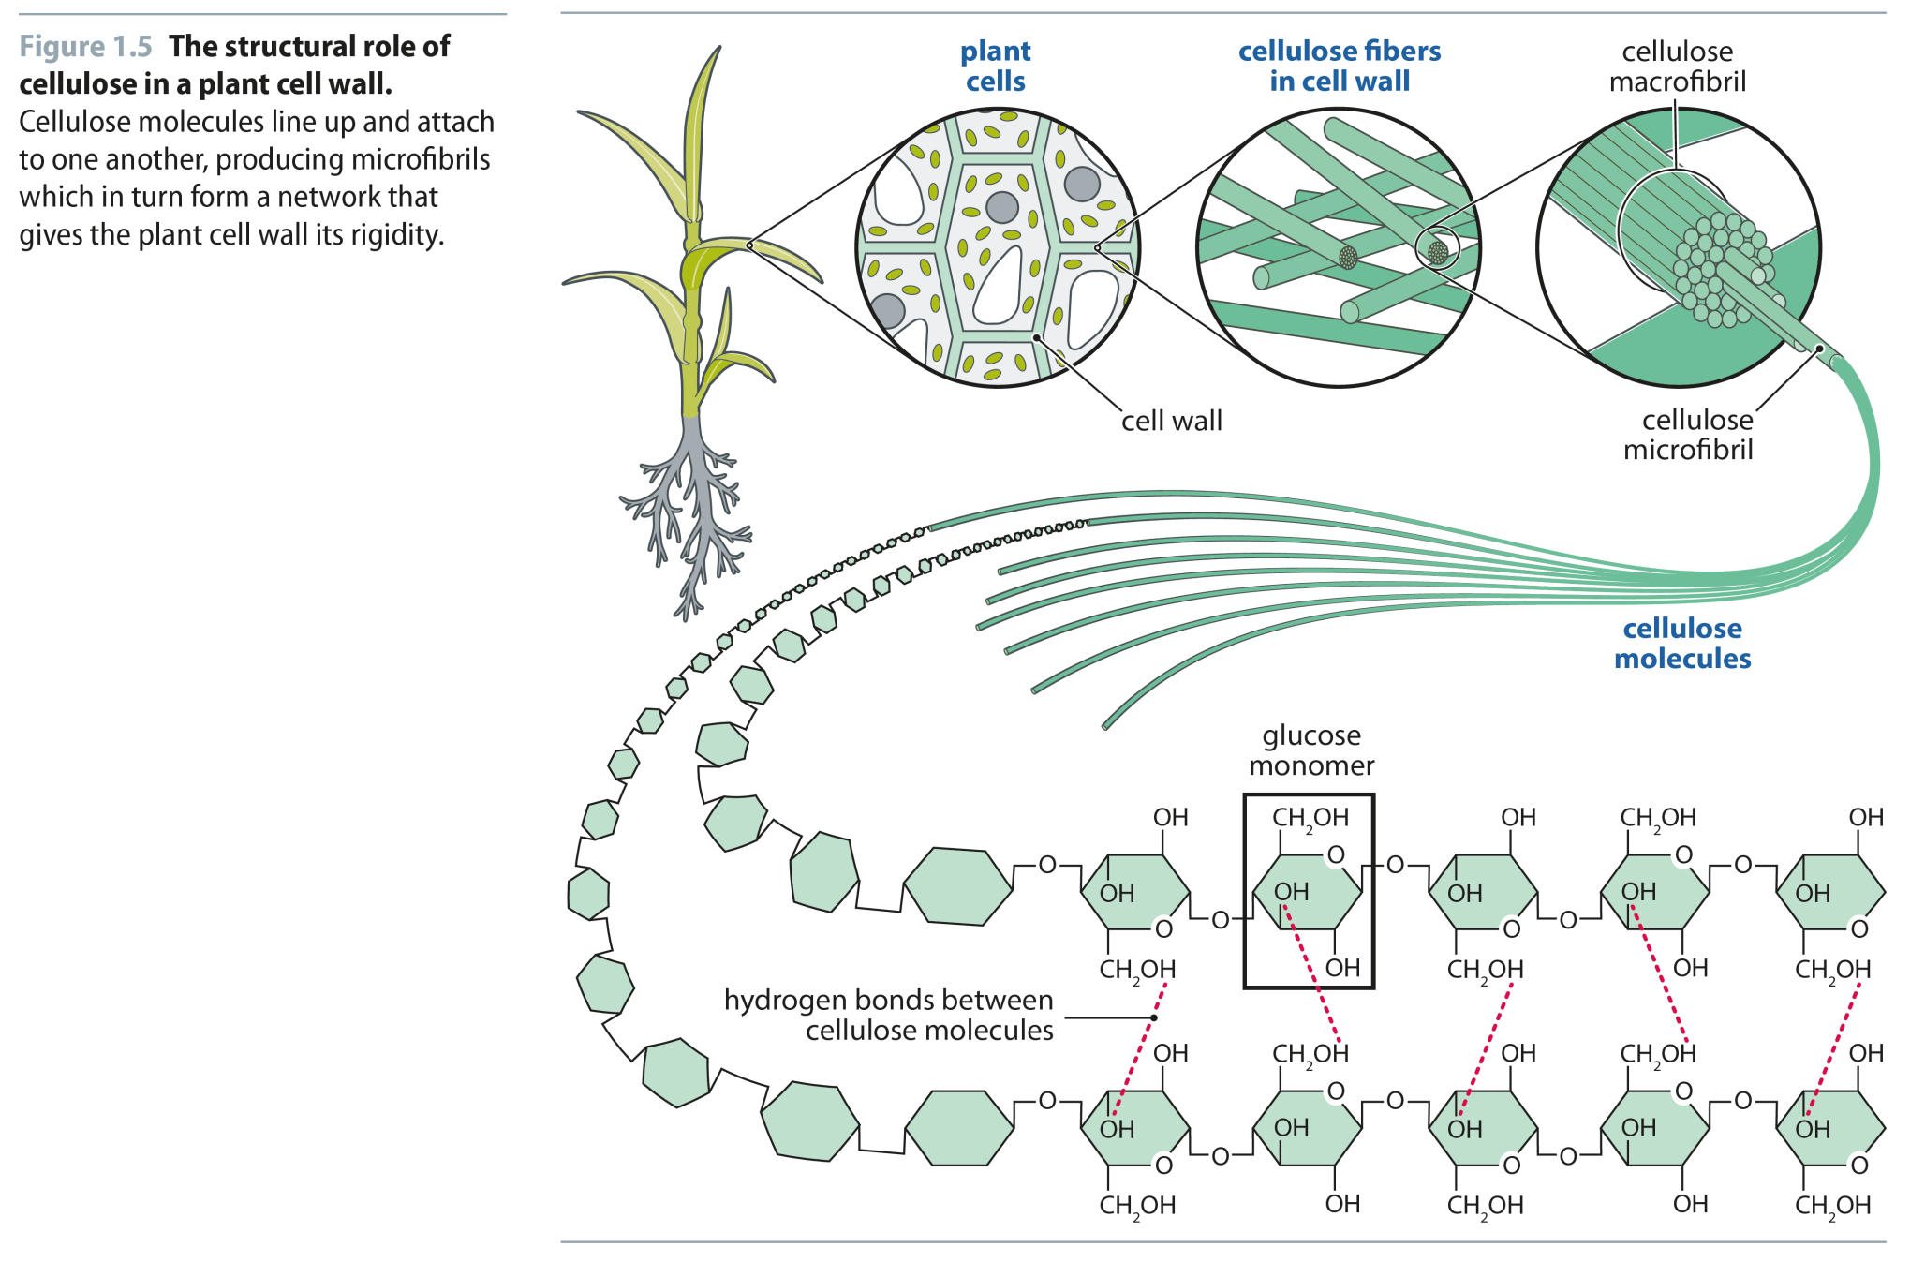
Fig 1.5
Reproduced from: Biochemistry by T.A. Brown, ISBN: 9781907904288 © Scion Publishing Ltd, 2017

Slide 7
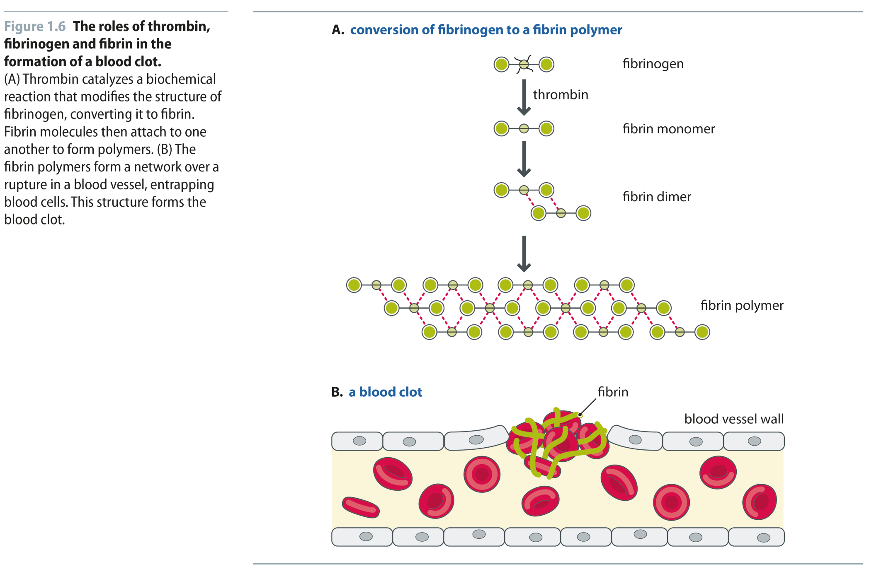
Fig 1.6
Reproduced from: Biochemistry by T.A. Brown, ISBN: 9781907904288 © Scion Publishing Ltd, 2017

Slide 8
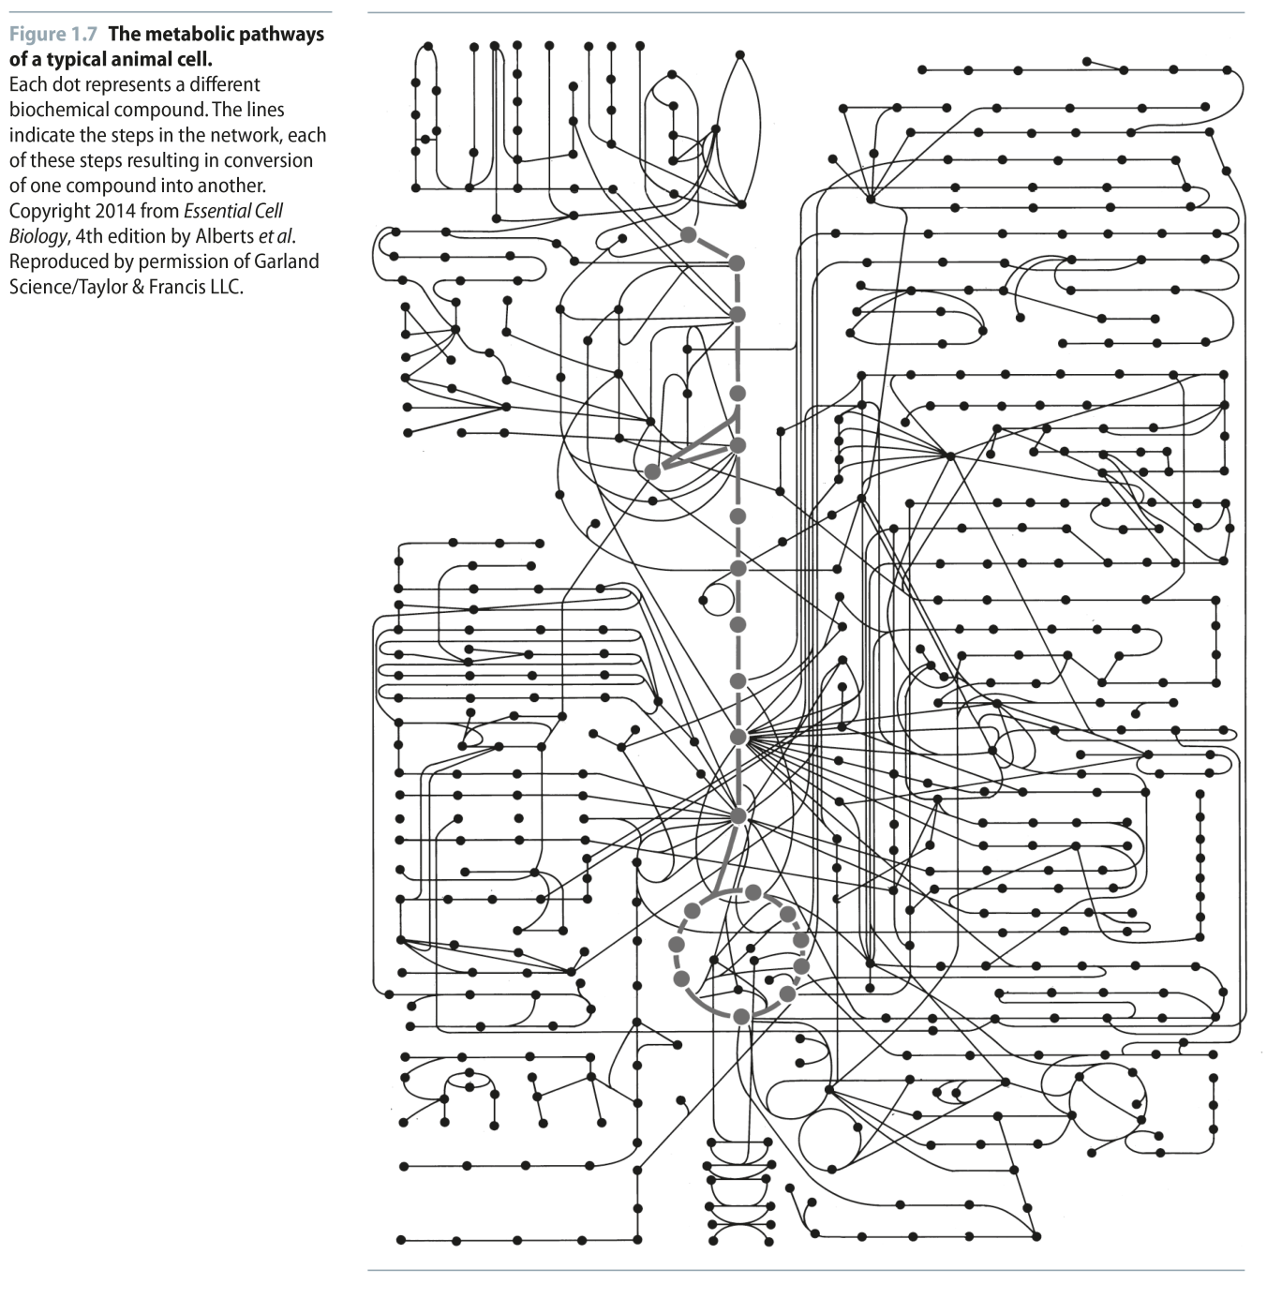
Fig 1.7
Reproduced from: Biochemistry by T.A. Brown, ISBN: 9781907904288 © Scion Publishing Ltd, 2017

Slide 9
Fig 1.8
Reproduced from: Biochemistry by T.A. Brown, ISBN: 9781907904288 © Scion Publishing Ltd, 2017

Slide 10
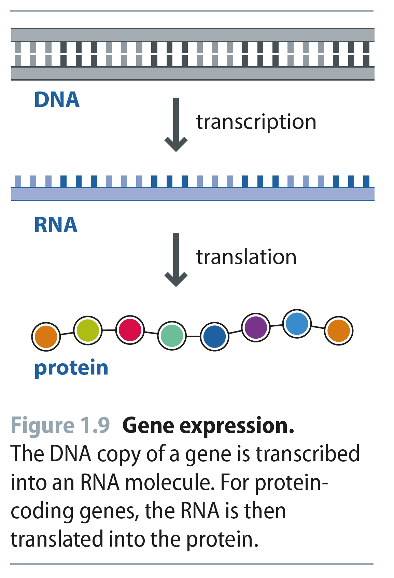
Fig 1.9
Reproduced from: Biochemistry by T.A. Brown, ISBN: 9781907904288 © Scion Publishing Ltd, 2017

