Slide 1
Acids, bases and pH
We talked about strong acids and bases last lecture in our discussion of Electrolytes
A strong acid completely dissociates in solution
HA --> H⁺ + A⁻
pH = -log [H⁺] or pH = -log [H₃O⁺]
For a strong acid, the pH will equal the -log[H⁺]
Remember: Some acids are polyprotic (H₂SO₄, H₃PO₄)

Slide 2
Acids, Bases and pH
For strong bases, we need to remember that ph and pOH are related:
pH + pOH = 14
Take the negative log of the [OH⁻] and subtract it from 14 to determine the pH

Slide 3
Acids, Bases and pH
Weak acids (and bases) pose a new problem: The fact that they do not completely dissociate in solution
They exist in an equilibrium between the acid and conjugate base
HA (aq) + H₂O (l) --> H₃O⁺ (aq) + A⁻ (aq)

Slide 4
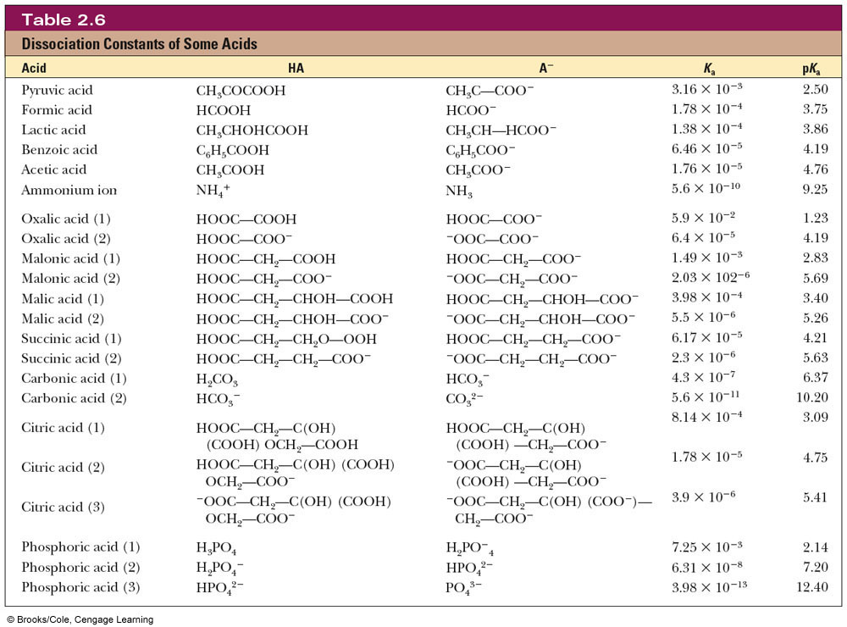
Common Biochemical Acids

Slide 5
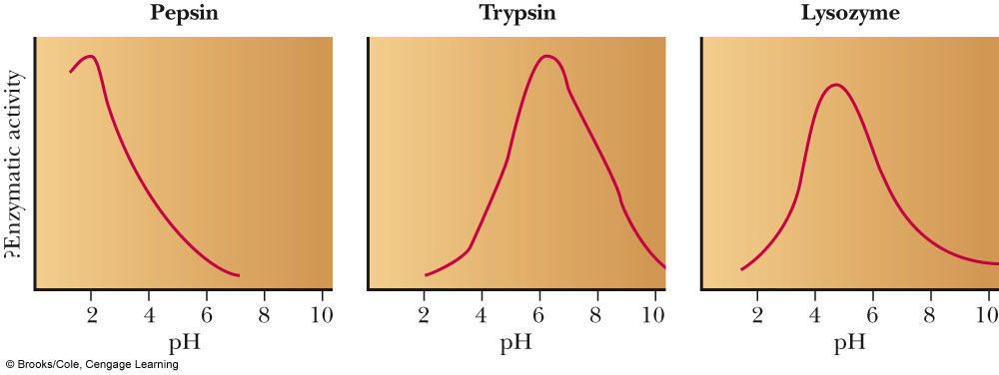
Henderson-Hasselbach Equation
Enzymes have very specific pH ranges in which they will function

Slide 6
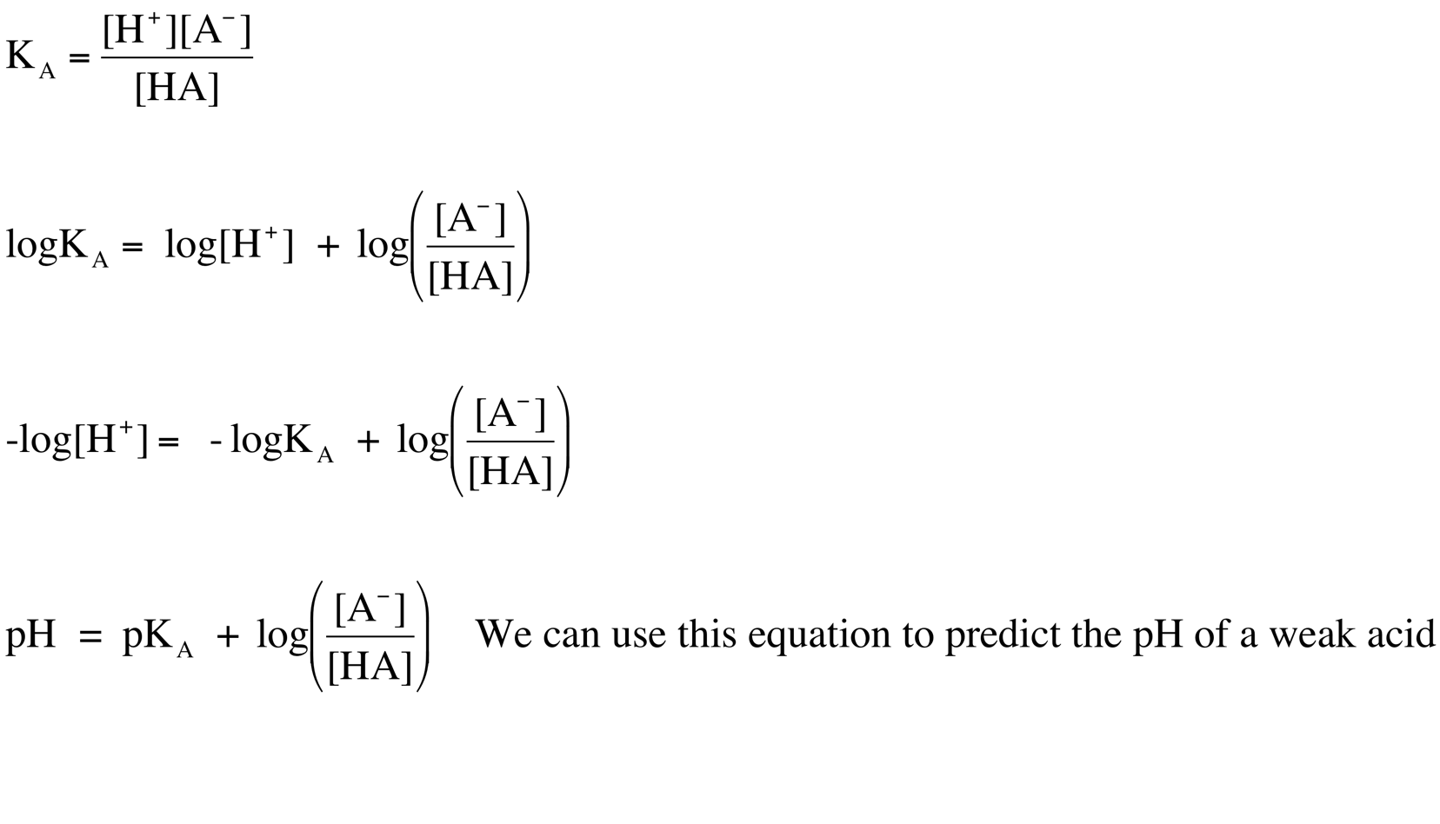
Henderson-Hasselbach Equation

Slide 7
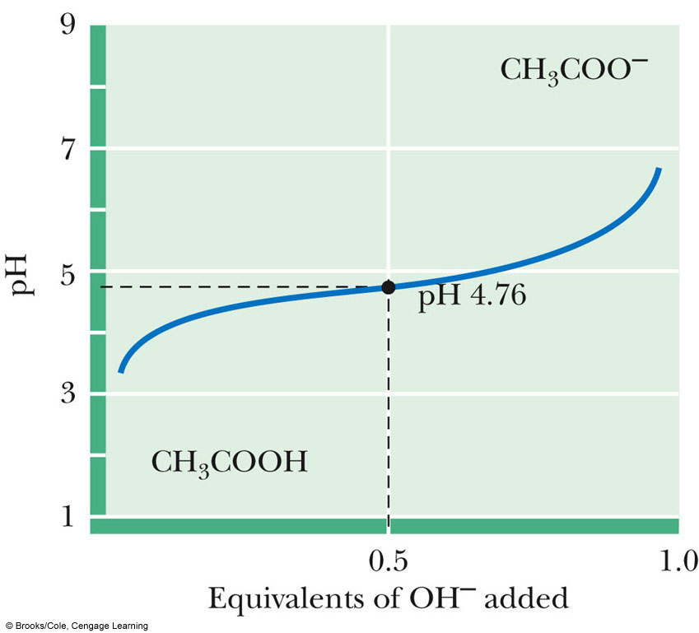
Titration Curves
When we mix an acid and a base together in small increments and then measure the pH, we can make a Titration Curve
HA (aq) + OH⁻ (aq)  H₂O (l) + A⁻ (aq)
The equivalence or endpoint (EP) is the point in the titration at which all of the acid molecules have reacted with base
Halfway to the EP: [HA]=[A⁻]
The pH at this point is the pKa. Why?
At the EP: [A⁻] = Initial [HA]


