Slide 1
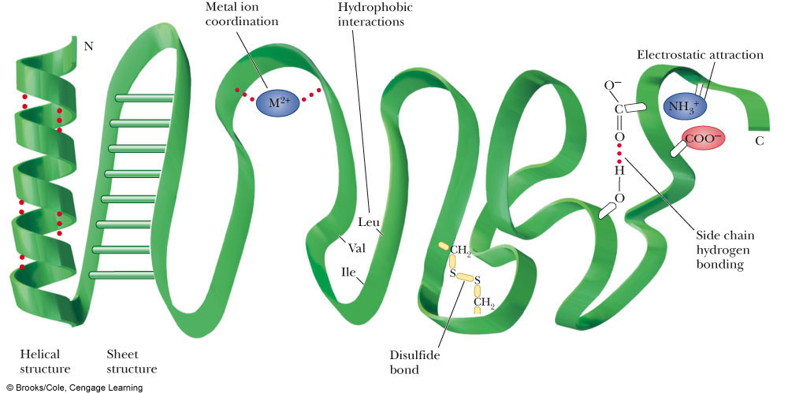

Slide 2
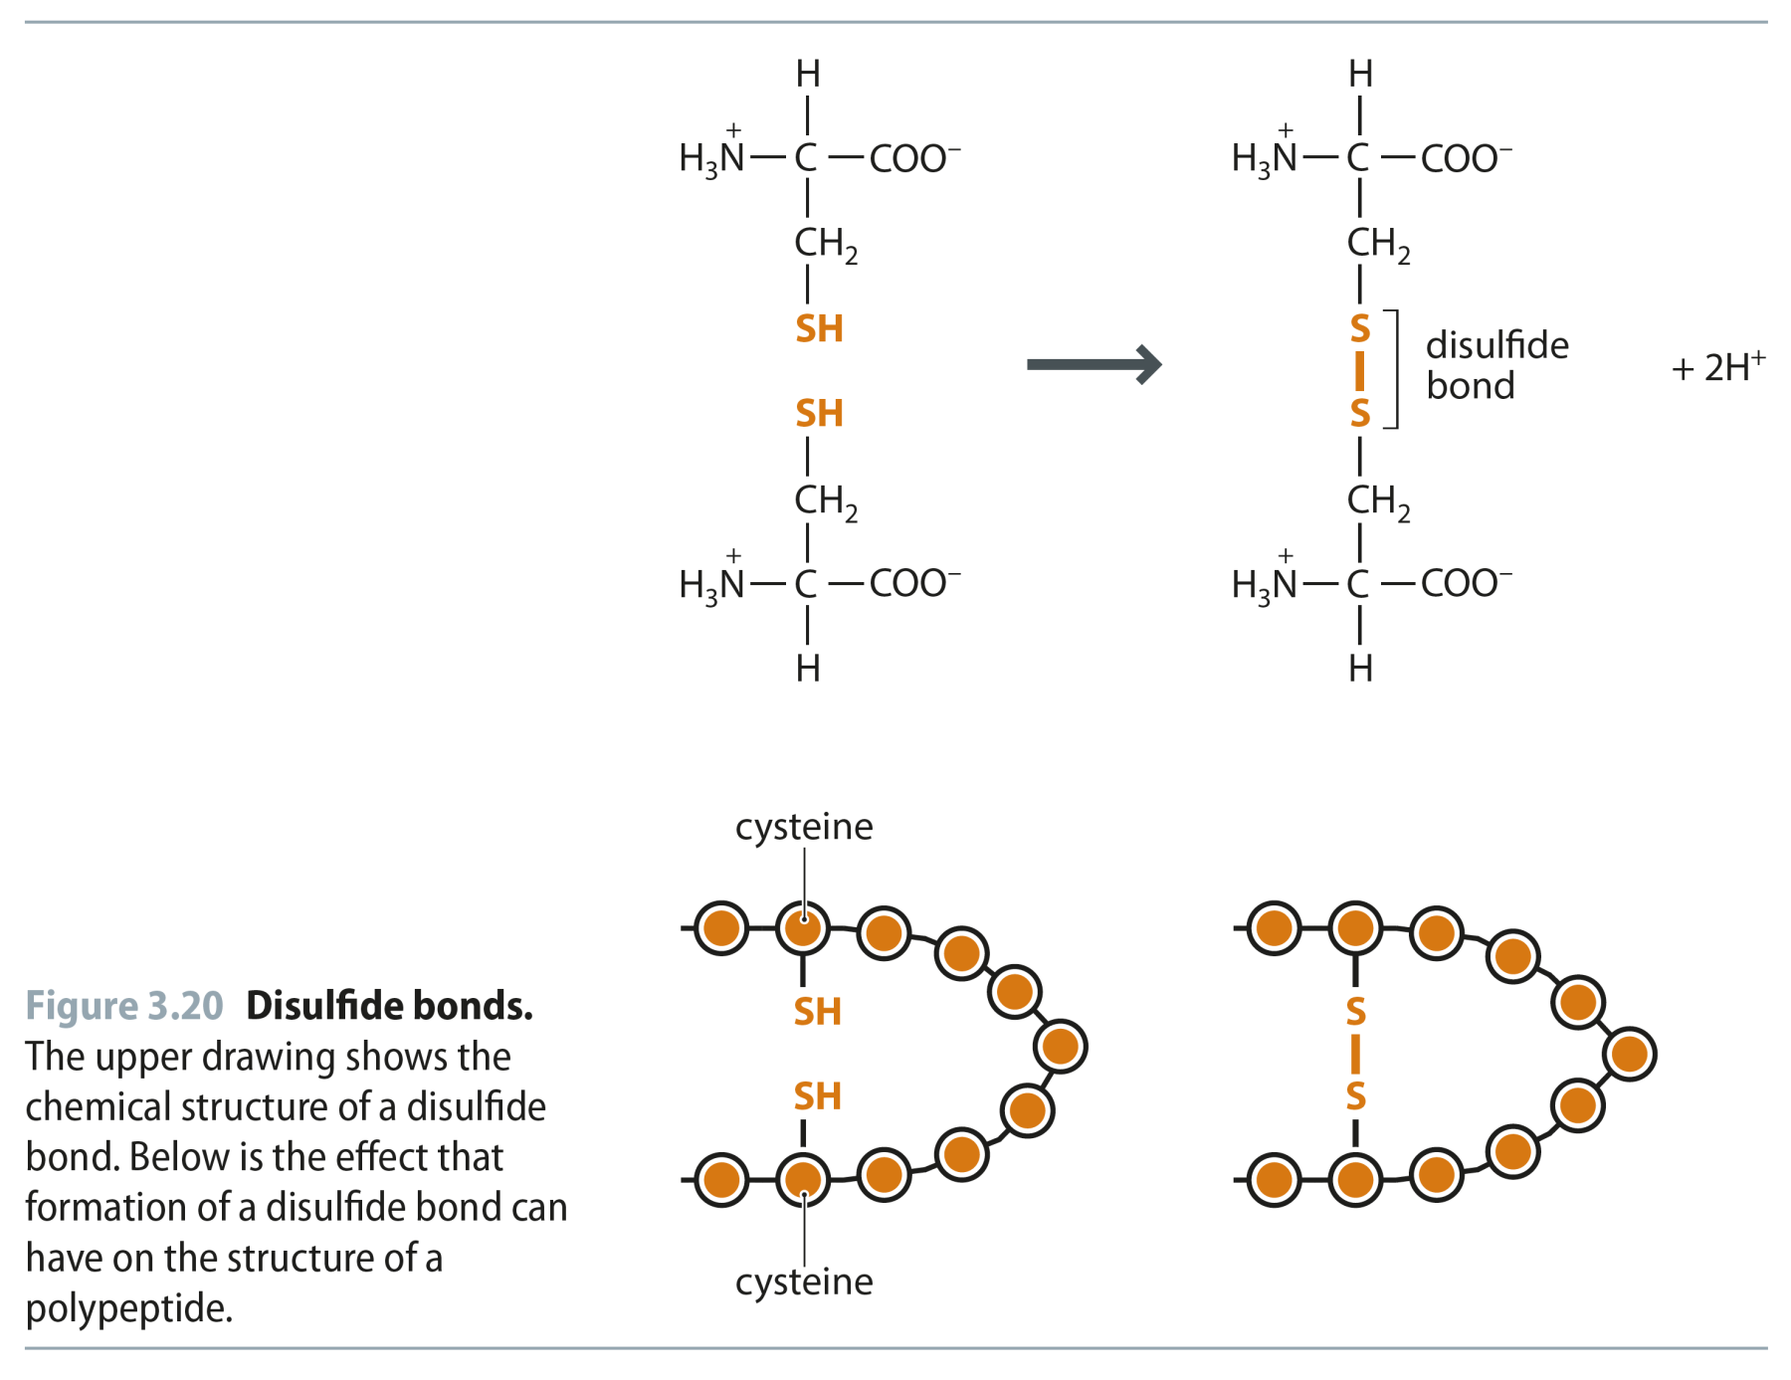
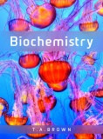
Fig 3.20
Reproduced from: Biochemistry by T.A. Brown, ISBN: 9781907904288 © Scion Publishing Ltd, 2017

Slide 3
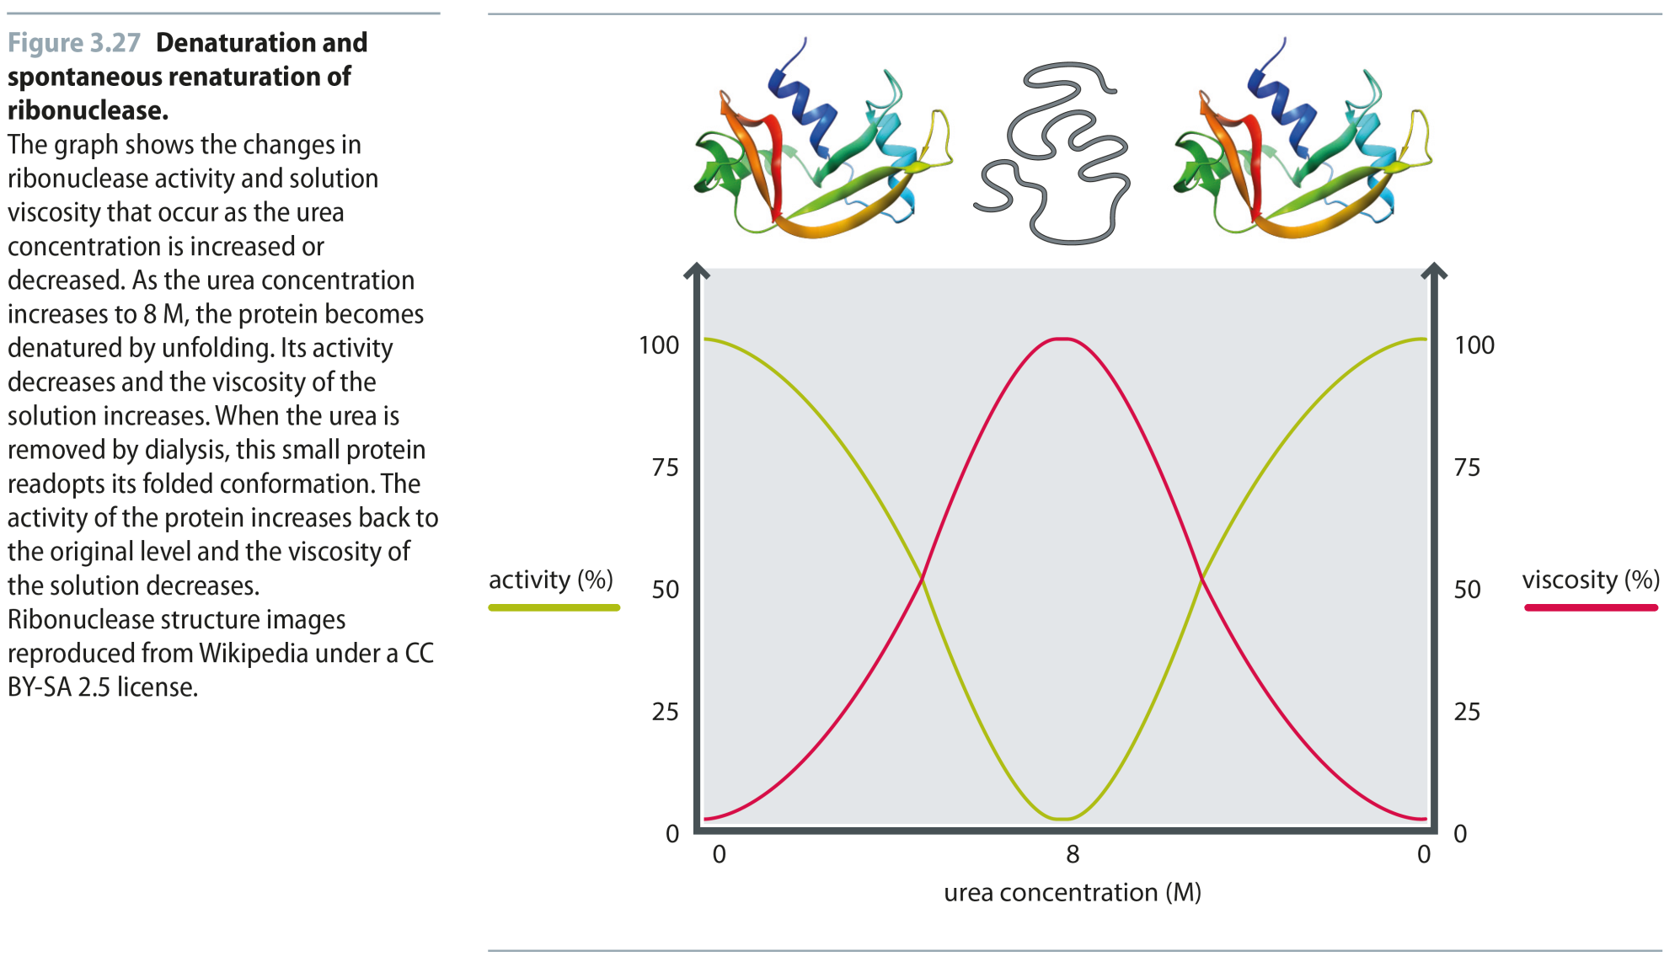
Fig 3.27
Reproduced from: Biochemistry by T.A. Brown, ISBN: 9781907904288 © Scion Publishing Ltd, 2017

Slide 4
Fig 3.28
Reproduced from: Biochemistry by T.A. Brown, ISBN: 9781907904288 © Scion Publishing Ltd, 2017

Slide 5
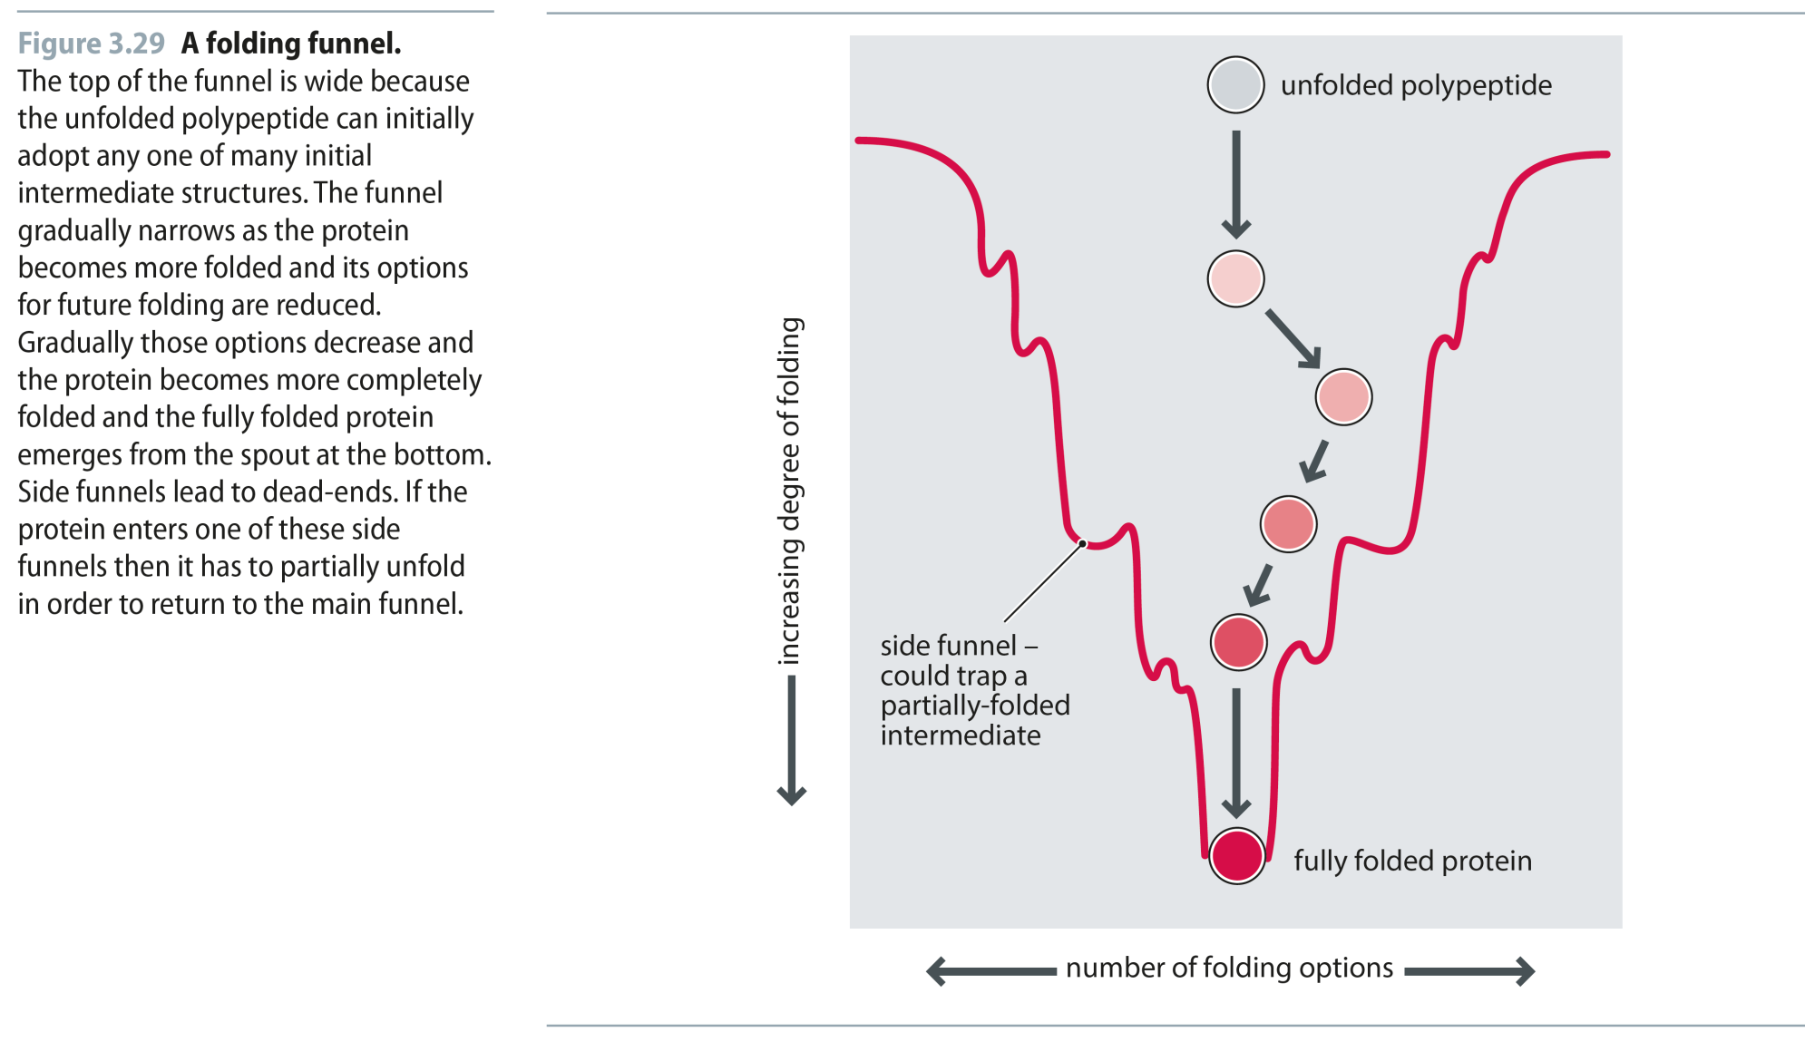
Fig 3.29
Reproduced from: Biochemistry by T.A. Brown, ISBN: 9781907904288 © Scion Publishing Ltd, 2017

Slide 6
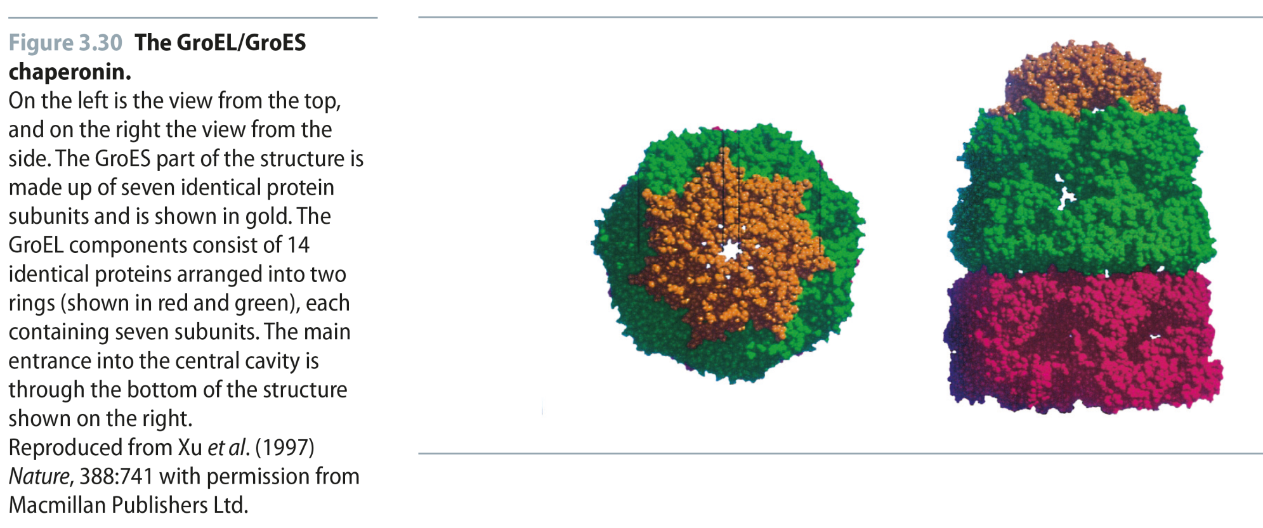
Fig 3.30
Reproduced from: Biochemistry by T.A. Brown, ISBN: 9781907904288 © Scion Publishing Ltd, 2017

Slide 7
Quick Thoughts on Protein Folding
There are literally millions of possible ways a simple protein can fold, but only one conformation that works
Hydrophobic interactions help drive protein folding
Not so much the hydrophobic groups attracting each other (That only involves London Forces, right?)
The dipole-dipole interactions between water molecules in solution are much stronger and push the hydrophobic side chains aside
The entropy of the universe must increase in a spontaneous process, and protein folding is a spontaneous process
When water molecules surround a nonpolar compound, they are restricted in the number of hydrogen bonds then can form which represents a lower entropy
By having the hydrophobic residues sequestered in the core of the folded protein, the water molecules are free to form up to 4 hydrogen bonds each.
This freedom represents greater entropy, thus helping drive folding of the protein

Slide 8
Protein Folding: Myoglobin
Note Placement of hydrophobic residues (green)
Where are the side chains pointing?
Note Placement of polar residues (blue)
Where are the side chains pointing?

Slide 9
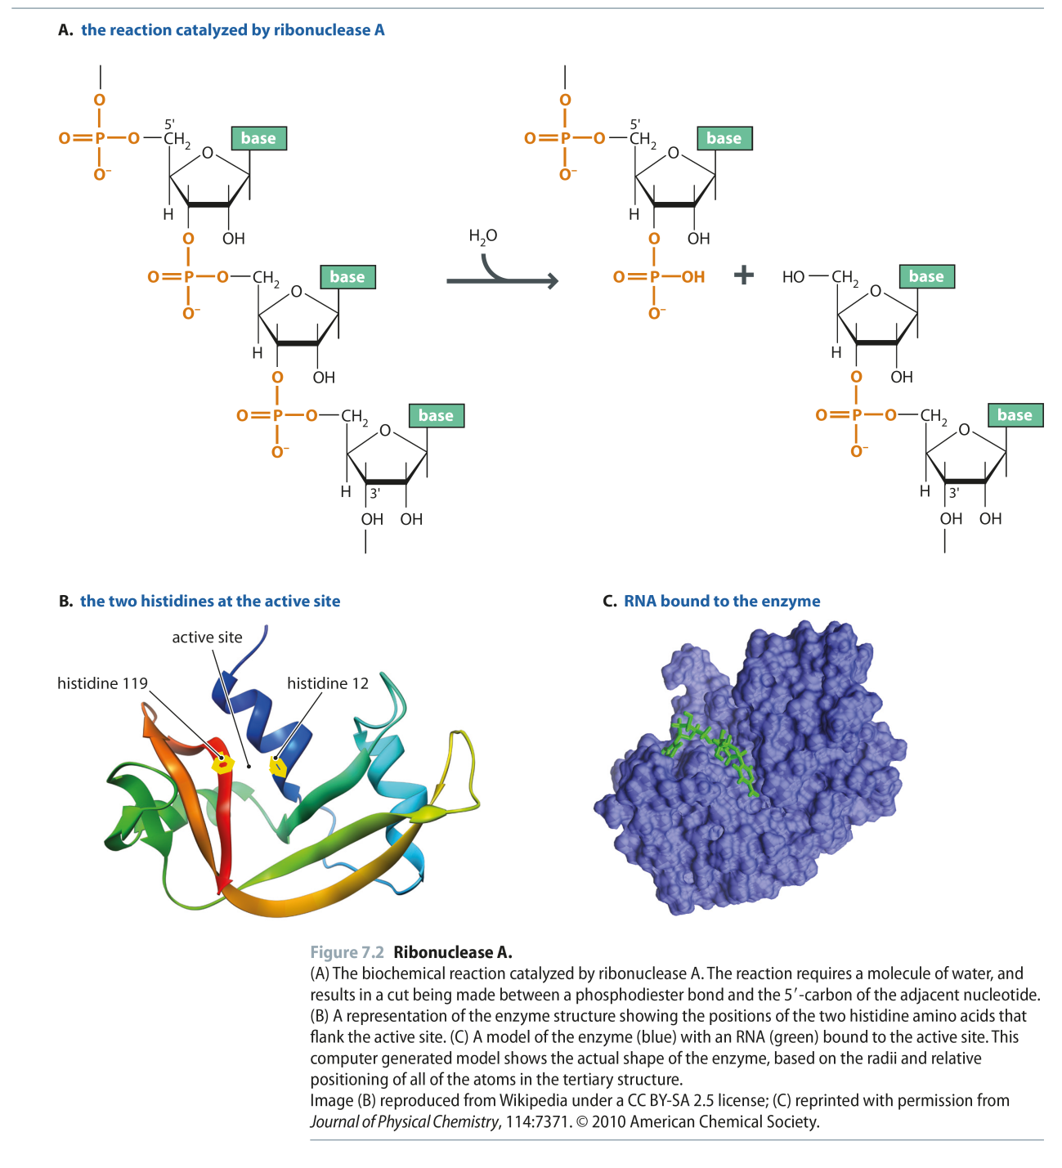
Fig 7.2
Reproduced from: Biochemistry by T.A. Brown, ISBN: 9781907904288 © Scion Publishing Ltd, 2017

Slide 10
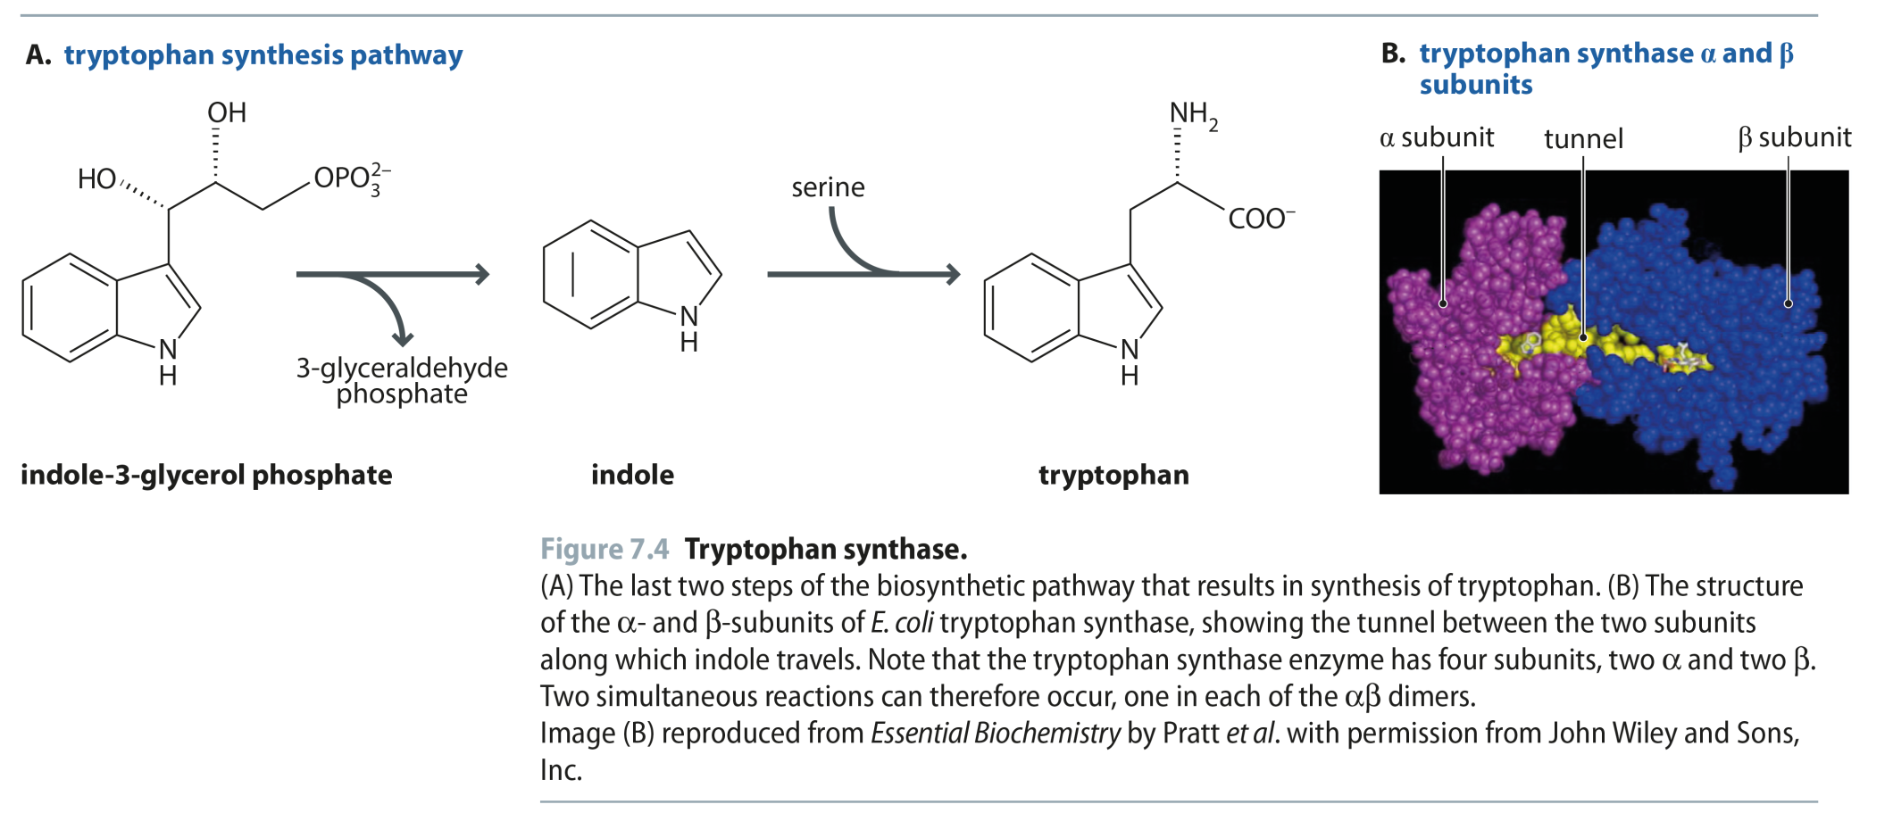
Fig 7.4
Reproduced from: Biochemistry by T.A. Brown, ISBN: 9781907904288 © Scion Publishing Ltd, 2017

Slide 11
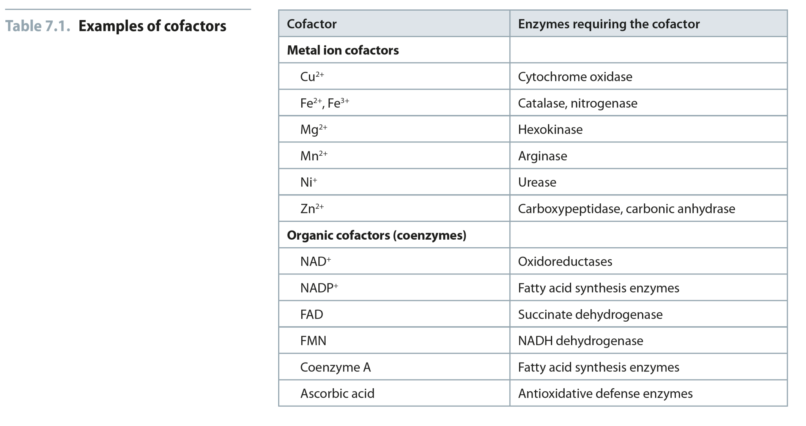
Table 7.1
Reproduced from: Biochemistry by T.A. Brown, ISBN: 9781907904288 © Scion Publishing Ltd, 2017

Slide 12
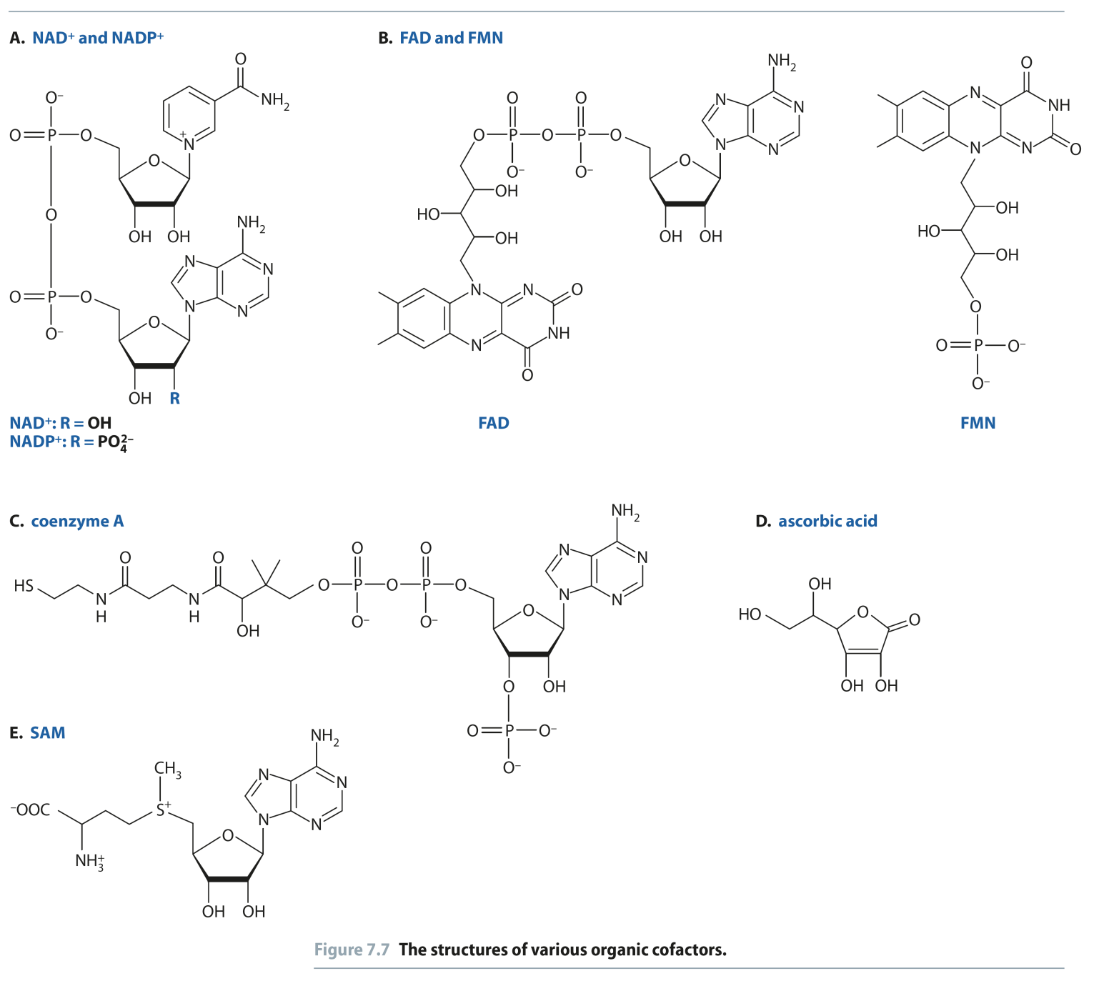
Fig 7.7
Reproduced from: Biochemistry by T.A. Brown, ISBN: 9781907904288 © Scion Publishing Ltd, 2017

Slide 13
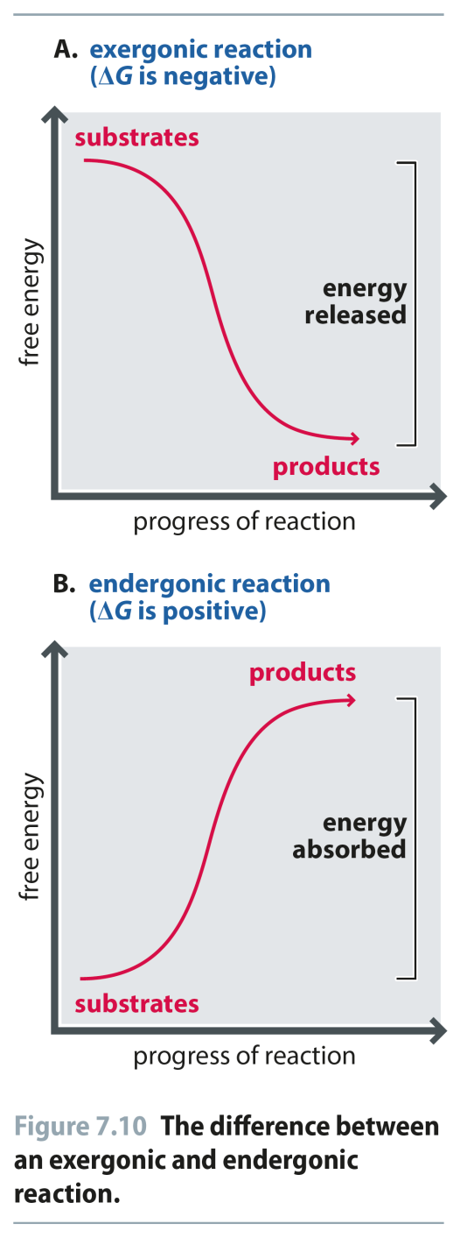
Fig 7.10
Reproduced from: Biochemistry by T.A. Brown, ISBN: 9781907904288 © Scion Publishing Ltd, 2017

Slide 14
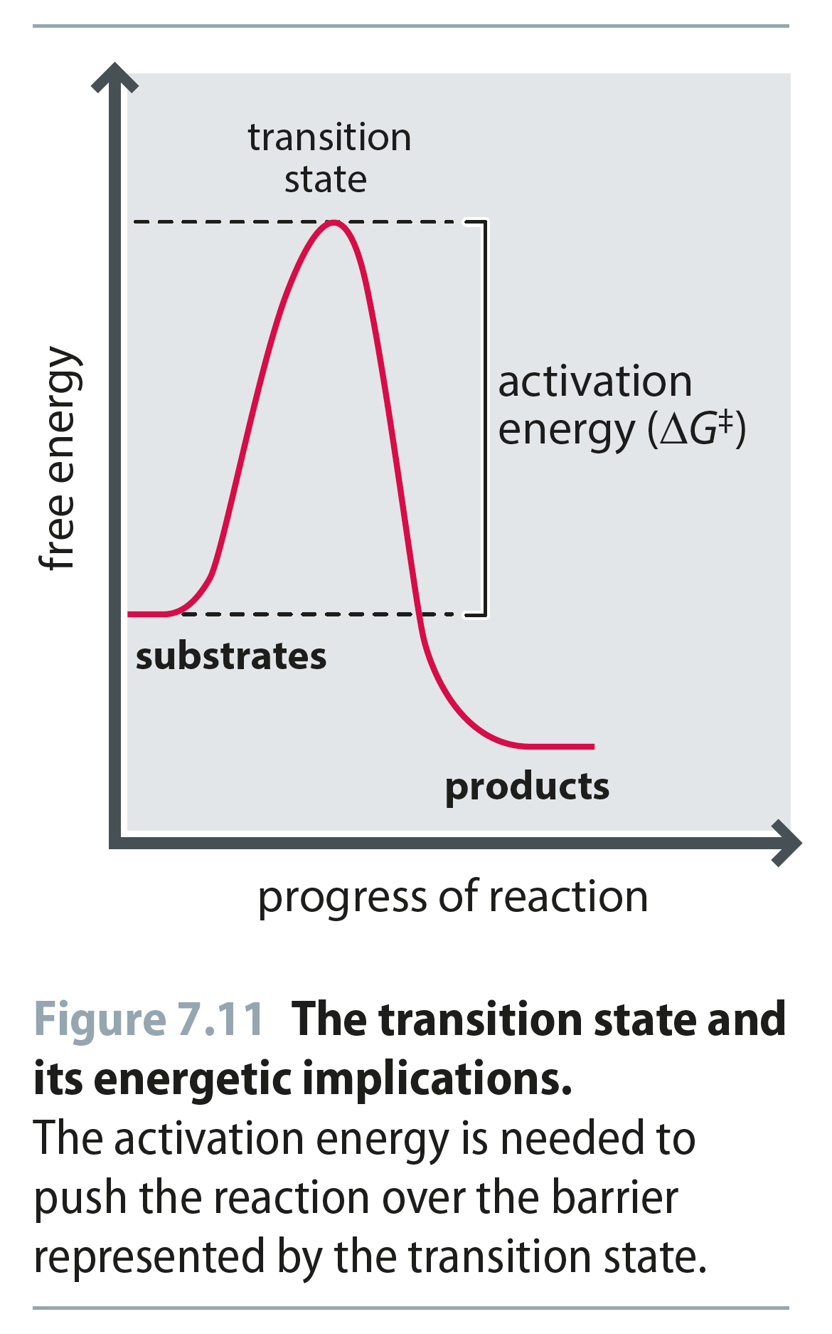
Fig 7.11
Reproduced from: Biochemistry by T.A. Brown, ISBN: 9781907904288 © Scion Publishing Ltd, 2017

Slide 15
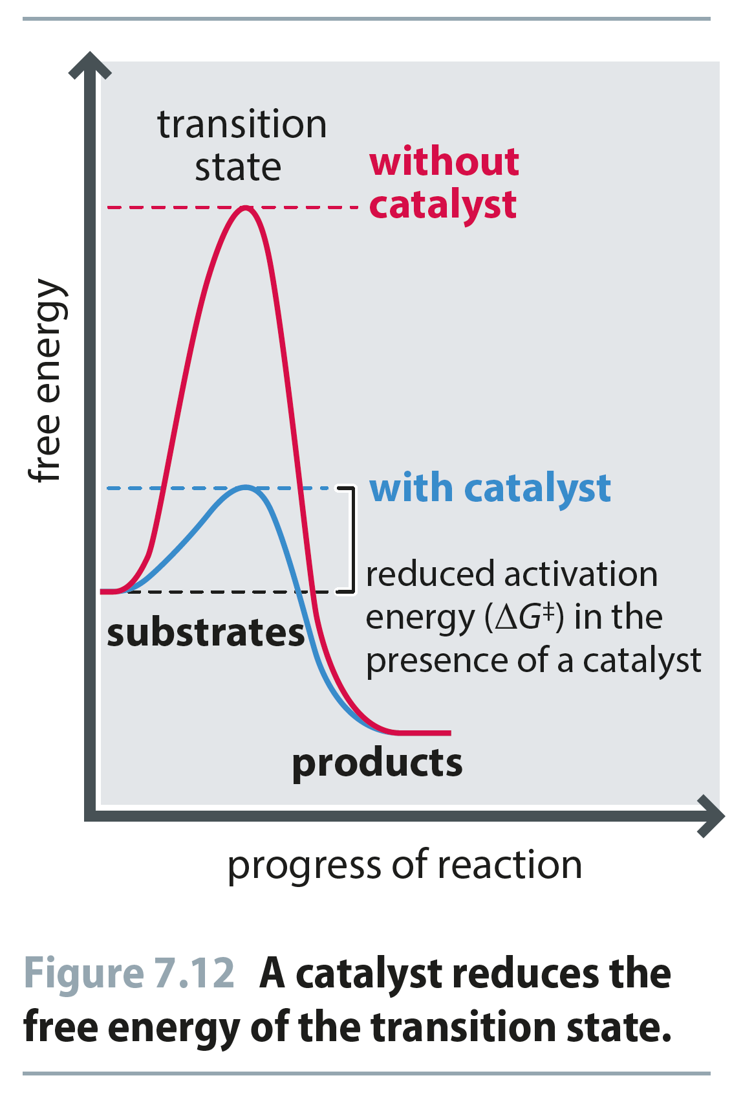
Fig 7.12
Reproduced from: Biochemistry by T.A. Brown, ISBN: 9781907904288 © Scion Publishing Ltd, 2017

Slide 16
How Do Enzymes Work So Well?
How do they bring about huge rate enhancements?
What is the source of the energy necessary to decrease the activation energy?
Many enzyme catalyzed reactions involve the rearrangement of covalent bonds
The enzyme has prosthetic groups and amino acid side chain functional groups that can break and make bonds, thereby lowering ΔG*

Slide 17
How Do Enzymes Work So Well?
How do they bring about huge rate enhancements?
What is the source of the energy necessary to decrease the activation energy?
Noncovalent or Intermolecular forces (Duh!)
By making A LOT of low energy interactions with the substrate, the enzyme can lower the activation energy
These interactions ALL contribute to the BINDING ENERGY, ΔG_{b},
This binding energy is the primary source of free energy used to lower the activation energy of reactions

Slide 18
How to Lower ΔG≠ - The Proximity Model
Enzymes organize reactive groups into close proximity and proper orientation
Uncatalyzed bimolecular reactions
two free reactants → single restricted transition state
conversion is entropically unfavorable
Uncatalyzed unimolecular reactions
flexible reactant → rigid transition state conversion is
entropically unfavorable for flexible reactants
Catalyzed reactions
Enzyme uses the binding energy of substrates to organize
the reactants to a fairly rigid ES complex
Entropy cost is paid during binding
Rigid reactant complex → transition state conversion is entropically OK

Slide 19
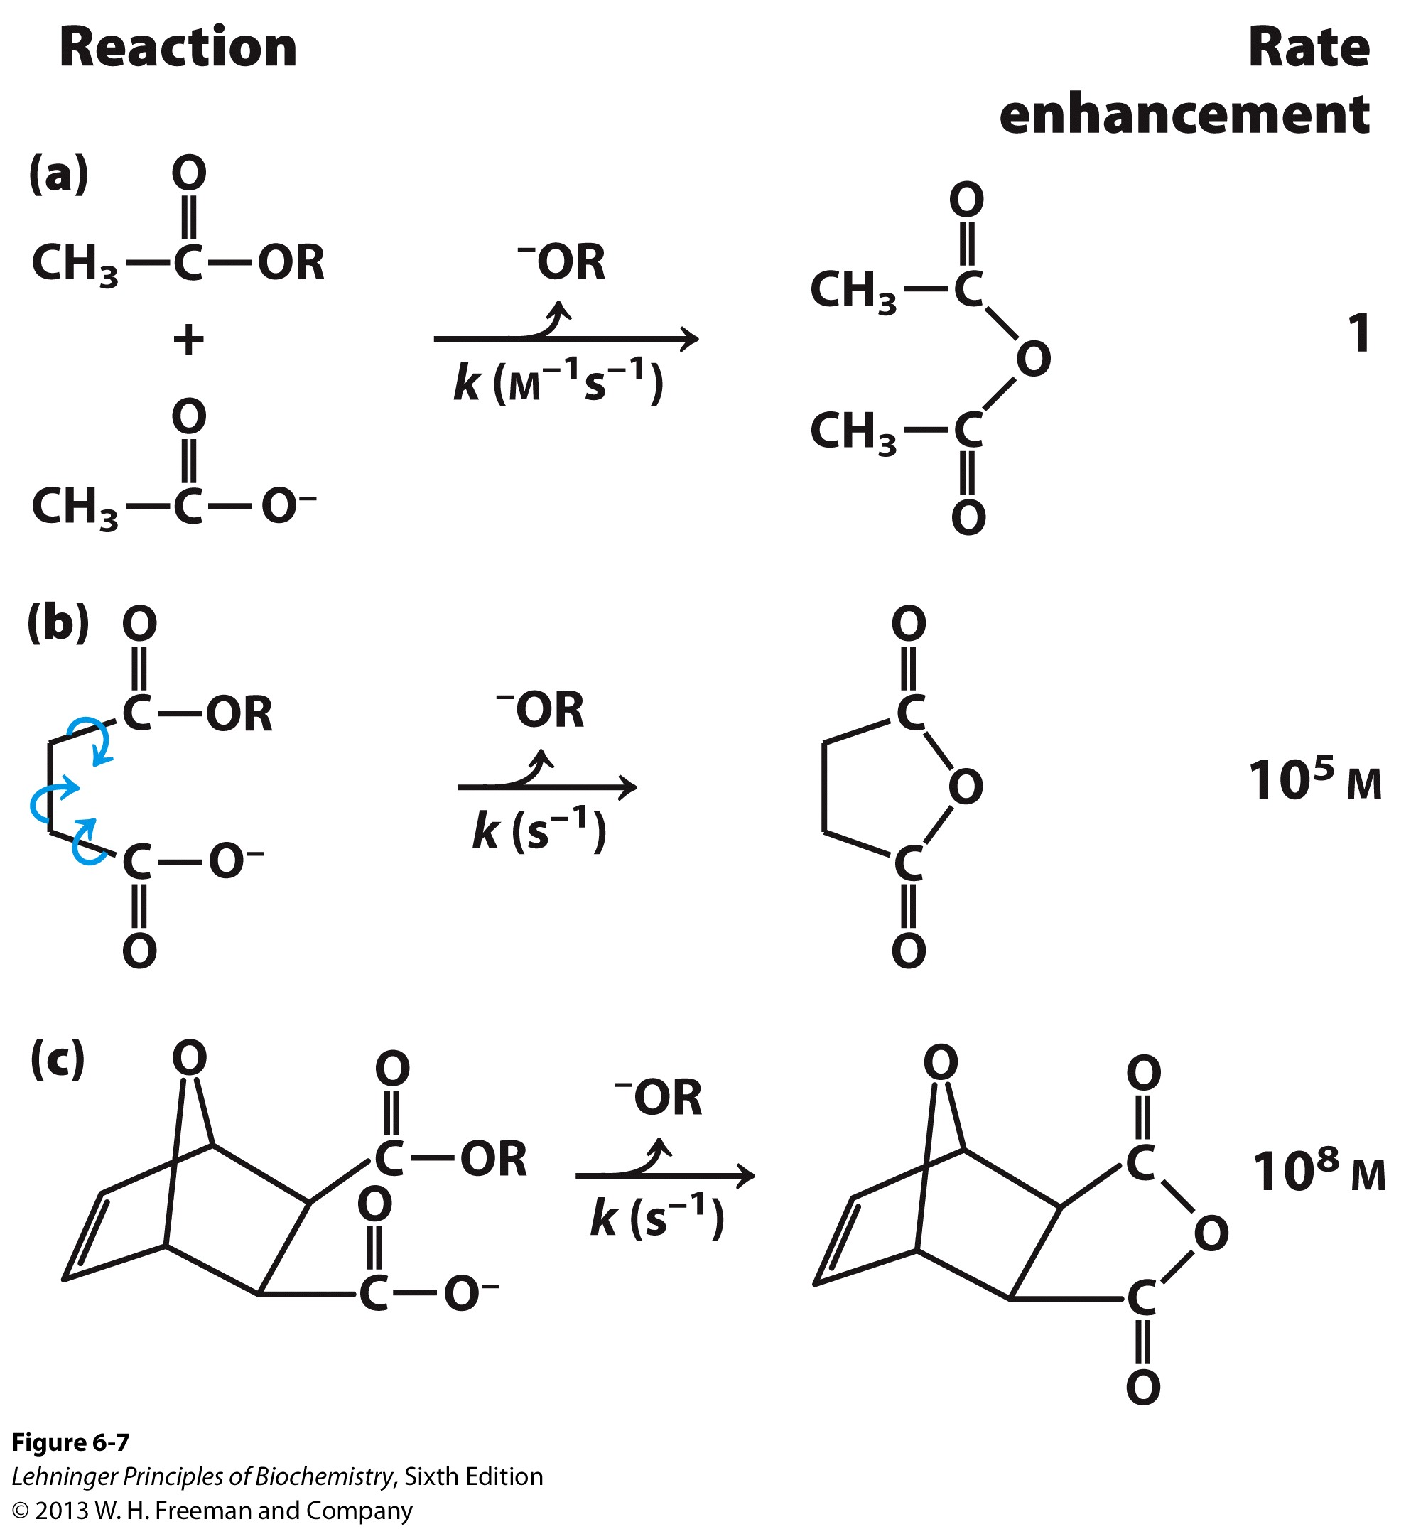
Support for the Proximity Model
The rate of anhydride formation from esters and carboxylates shows a strong dependence on proximity of two reactive groups (work by Thomas C. Bruice’s group).
The smaller the reactants for a given reaction, the fewer degrees of freedom and therefore the faster the reaction.
Enzymes “hold” groups into place, minimizing the possibility of rotation and maximizing the possibility of encountering each other
Notes:
FIGURE 6–7 Rate enhancement by entropy reduction. Shown here are reactions of an ester with a carboxylate group to form an anhydride. The R group is the same in each case. (a) For this bimolecular reaction, the rate constant k is second-order, with units of M⁻¹s⁻¹. (b) When the two reacting groups are in a single molecule, and thus have less freedom of motion, the reaction is much faster. For this unimolecular reaction, k has units of s⁻¹. Dividing the rate constant for (b) by the rate constant for (a) gives a rate enhancement of about 10⁵ M. (The enhancement has units of molarity because we are comparing a unimolecular and a bimolecular reaction.) Put another way, if the reactant in (b) were present at a concentration of 1 M, the reacting groups would behave as though they were present at a concentration of 10⁵ M. Note that the reactant in (b) has freedom of rotation about three bonds (shown with curved arrows), but this still represents a substantial reduction of entropy over (a). If the bonds that rotate in (b) are constrained as in (c), the entropy is reduced further and the reaction exhibits a rate enhancement of 10⁸ M relative to (a).

Slide 20
How to Lower ΔG≠
Enzymes bind transition states best
The idea was proposed by Linus Pauling in 1946
Enzyme active sites are complimentary to the transition state of the reaction
Enzymes bind transition states better than substrates
Stronger/additional interactions with the transition state as compared to the ground state lower the activation barrier

Slide 21
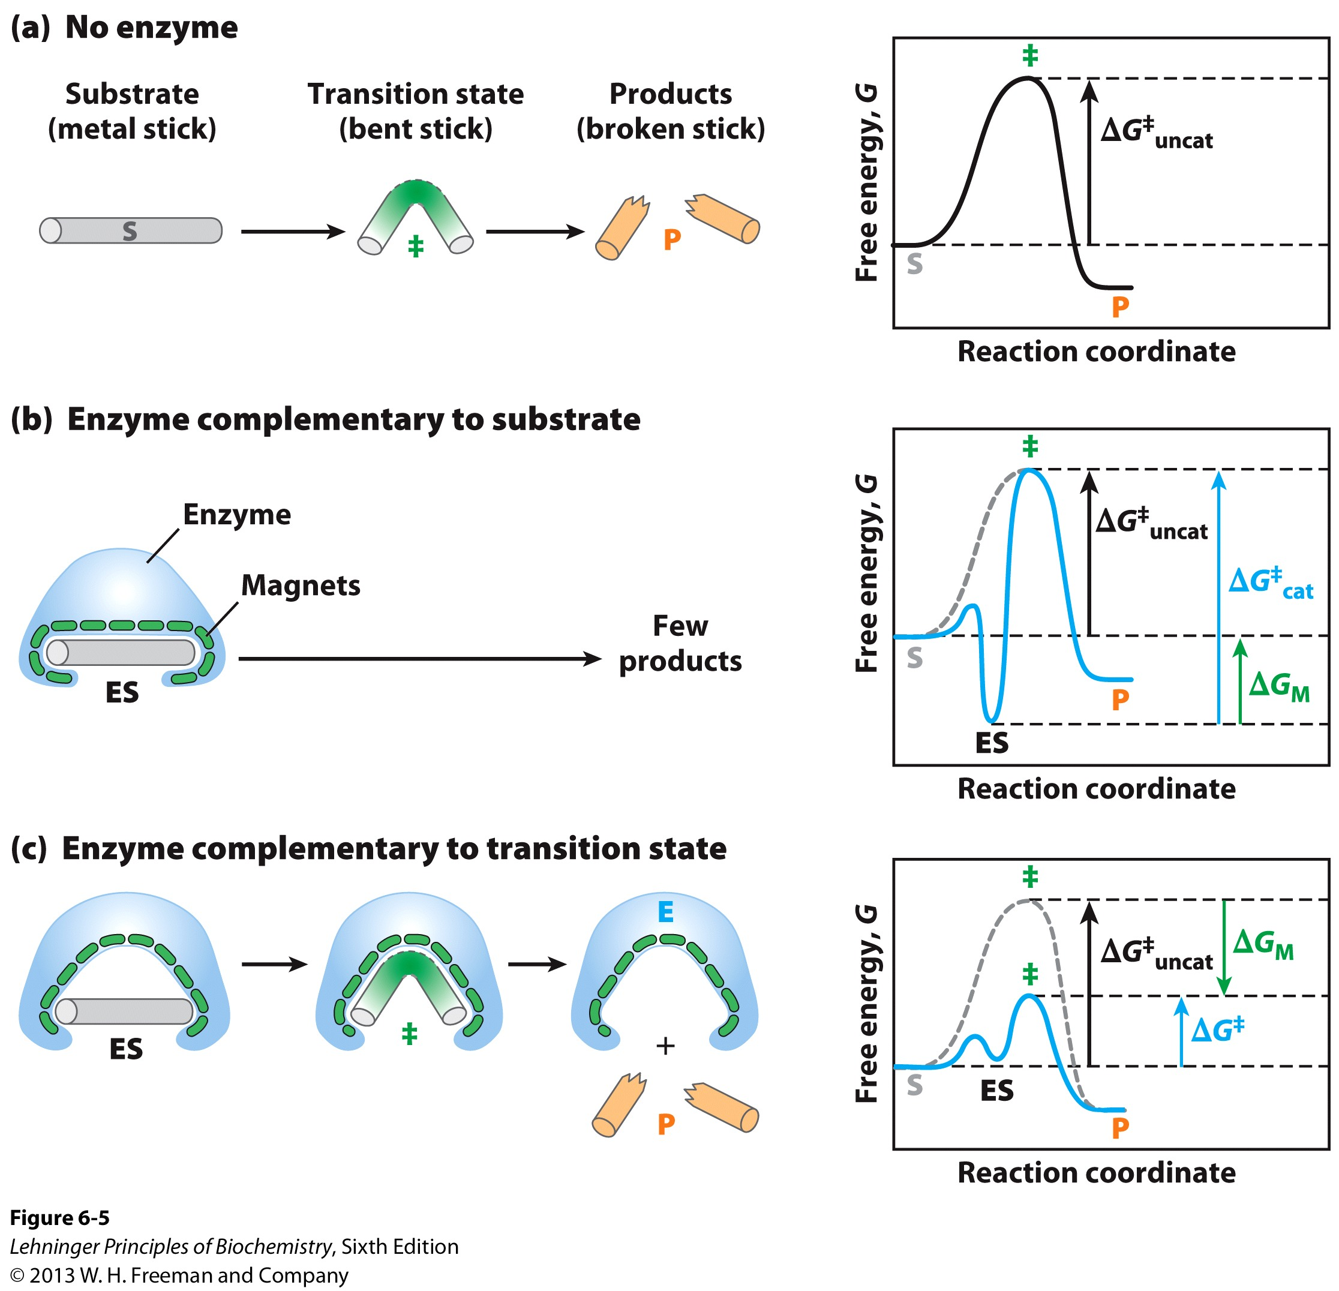
Transition State Stabilization: Imaginary Stickase
Notes:
FIGURE 6–5 An imaginary enzyme (stickase) designed to catalyze breakage of a metal stick. (a) Before the stick is broken, it must first be bent (the transition state). In both stickase examples, magnetic interactions take the place of weak bonding interactions between enzyme and substrate. (b) A stickase with a magnet-lined pocket complementary in structure to the stick (the substrate) stabilizes the substrate. Bending is impeded by the magnetic attraction between stick and stickase. (c) An enzyme with a pocket complementary to the reaction transition state helps to destabilize the stick, contributing to catalysis of the reaction. The binding energy of the magnetic interactions compensates for the increase in free energy required to bend the stick. Reaction coordinate diagrams (right) show the energy consequences of complementarity to substrate versus complementarity to transition state (EP complexes are omitted). ∆G_{M}, the difference between the transition-state energies of the uncatalyzed and catalyzed reactions, is contributed by the magnetic interactions between the stick and stickase. When the enzyme is complementary to the substrate (b), the ES complex is more stable and has less free energy in the ground state than substrate alone. The result is an increase in the activation energy.

Slide 22
Key Principles of Enzyme Function
1) Binding energy, ΔG_{b} is the key player in catalysis
ΔG_{b} determines Specificity and Catalytic Rate
If you don’t form as many low energy IMF interactions b/w enzyme and substrate, the ΔG* is not decreased as much and the rate is decreased relative to another substrate with a higher ΔG_{b} value
The weak interactions that comprise the ΔG_{b} are optimized for the transition state NOT the substrate conformation
This helps “pull” the substrate over the hump and into product

Slide 23
Key Principles of Enzyme Function
By combining these two ideas with everything we’ve learned to date, we can come up with a good thought model that describes how and enzyme functions:
Binding substrates restricts their degrees of rotational and translational freedom
This places them in a mode that primes them for reaction
It decreases their entropy (Uh oh)
Binding disrupts IMFs between solvent and substrate and even the active site residues
Desolvation of substrate Increases Solvent Entropy
Remember the hydrophobic effect and clathrate cages?

Slide 24
Key Principles of Enzyme Function
By combining these two ideas with everything we’ve learned to date, we can come up with a good thought model that describes how and enzyme functions
The binding energy, ΔG_{b}, is at its maximum during the transition state, so this helps pay the activation cost
The enzyme itself changes conformation when binding substrate
Remember the Induced Fit model?
Energetic Shock Absorber

Slide 25
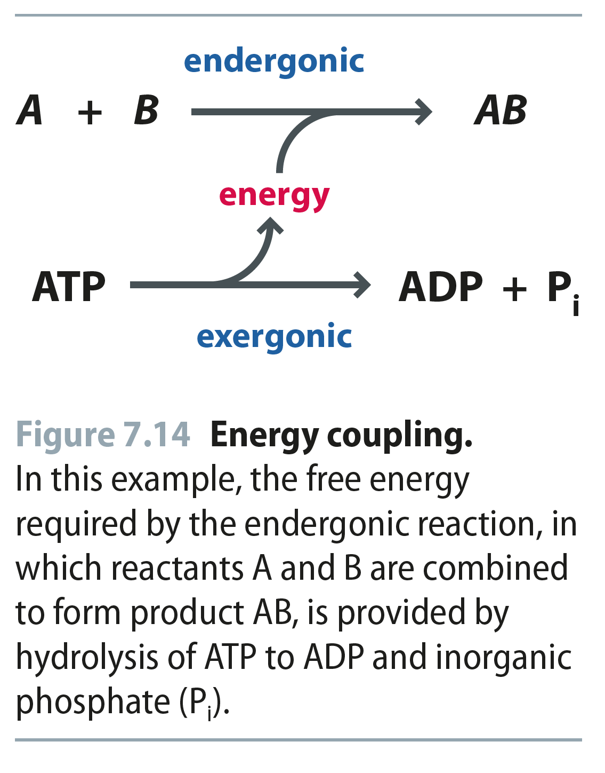
Fig 7.14
Reproduced from: Biochemistry by T.A. Brown, ISBN: 9781907904288 © Scion Publishing Ltd, 2017

Slide 26
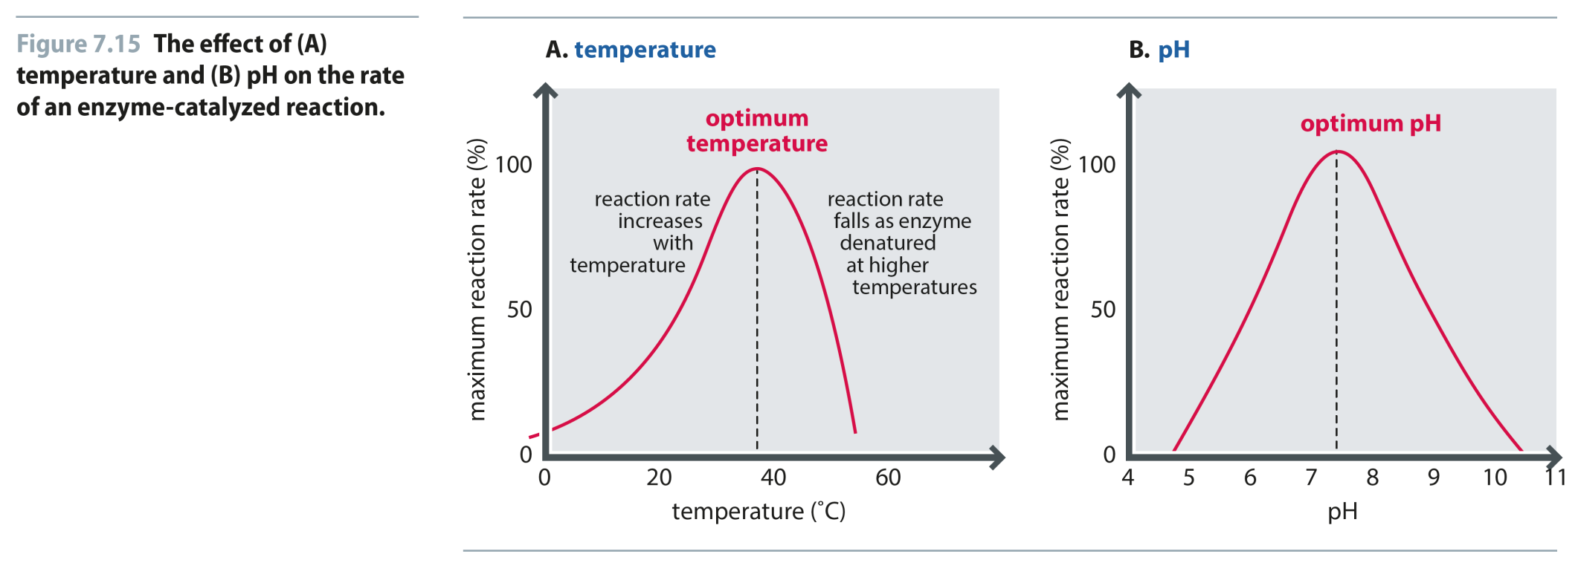
Fig 7.15
Reproduced from: Biochemistry by T.A. Brown, ISBN: 9781907904288 © Scion Publishing Ltd, 2017

