Slide 1
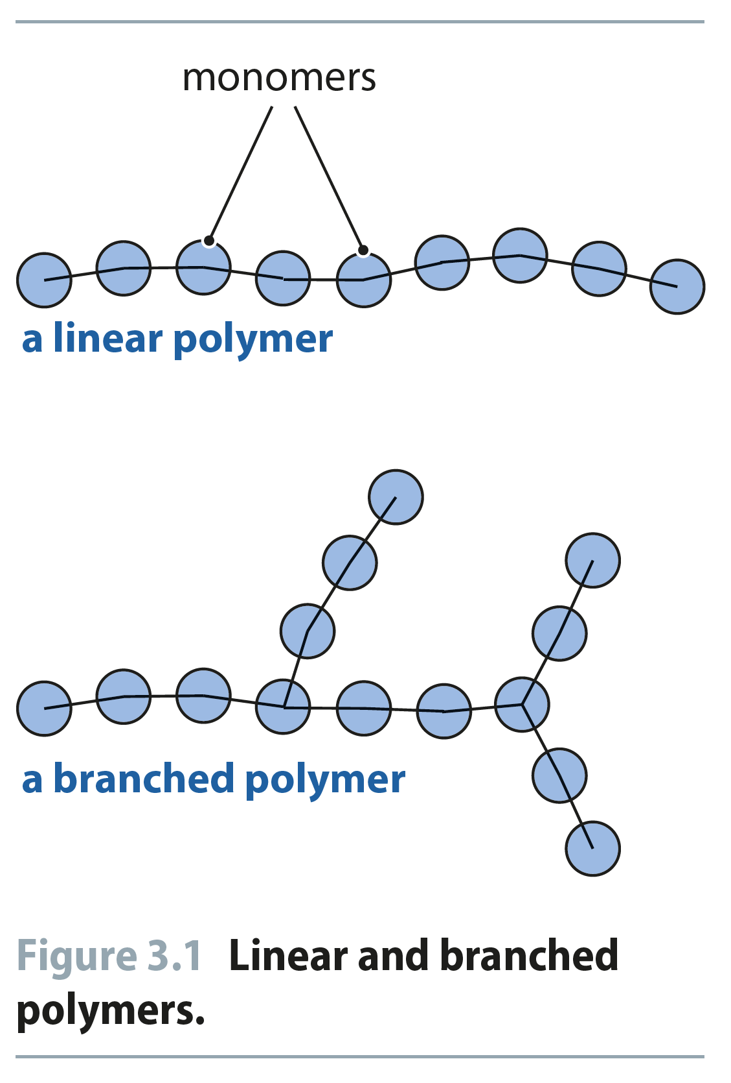
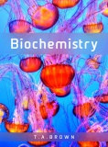
Fig 3.1
Reproduced from: Biochemistry by T.A. Brown, ISBN: 9781907904288 © Scion Publishing Ltd, 2017

Slide 2
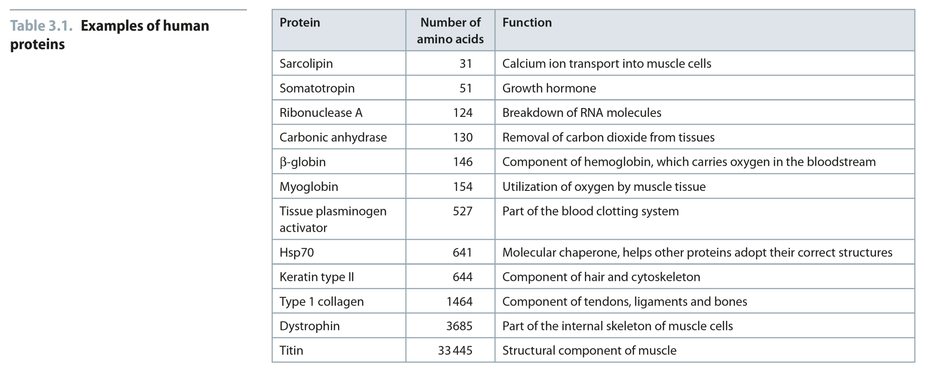
Table 3.1
Reproduced from: Biochemistry by T.A. Brown, ISBN: 9781907904288 © Scion Publishing Ltd, 2017

Slide 3
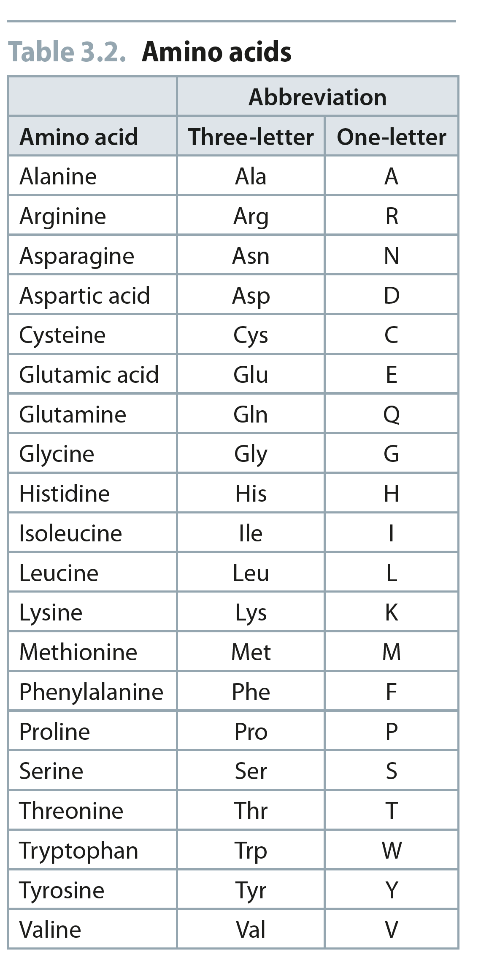
Table 3.2
Reproduced from: Biochemistry by T.A. Brown, ISBN: 9781907904288 © Scion Publishing Ltd, 2017

Slide 4
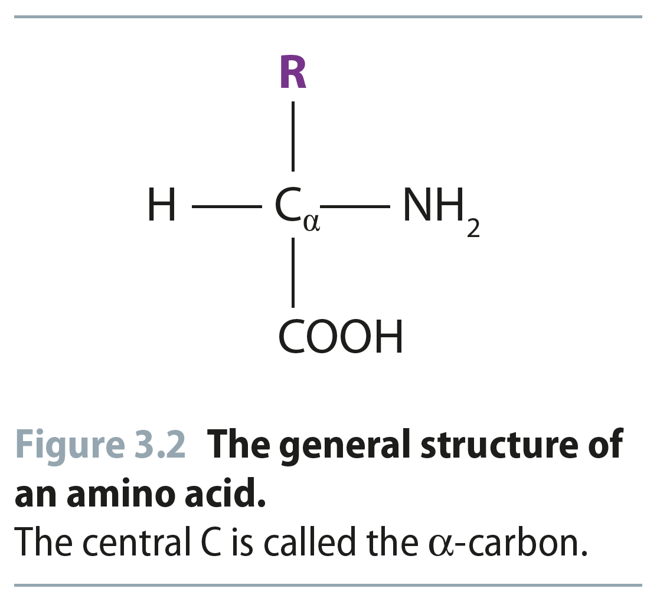
Fig 3.2
Reproduced from: Biochemistry by T.A. Brown, ISBN: 9781907904288 © Scion Publishing Ltd, 2017

Slide 5
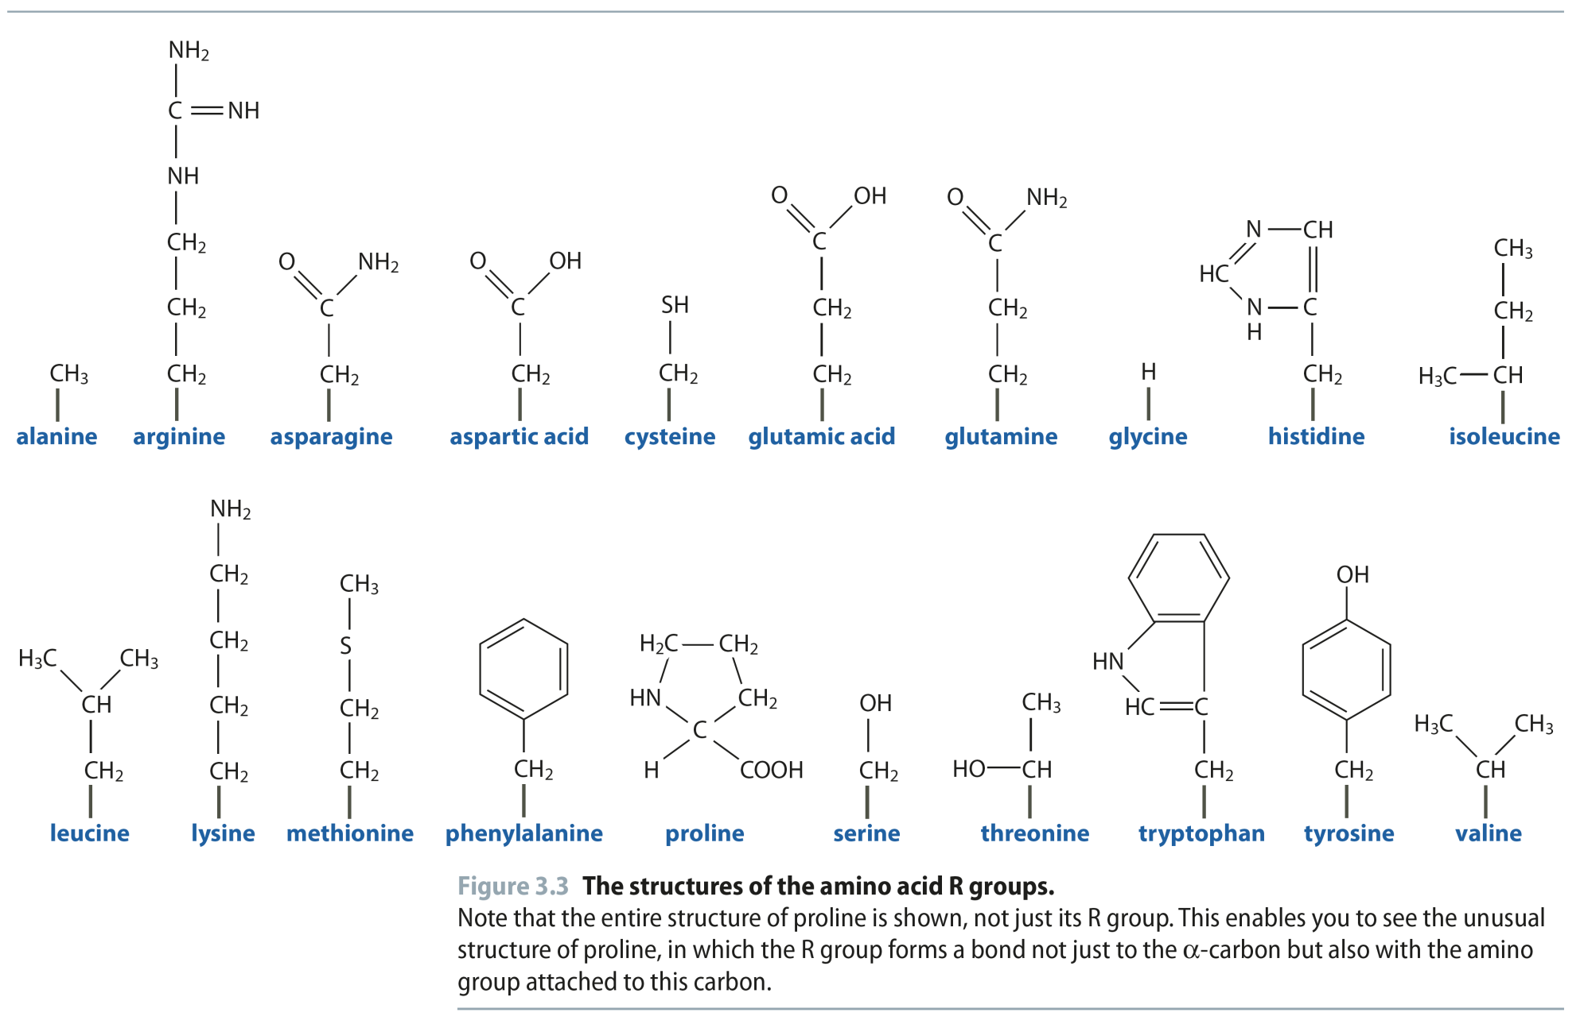
Fig 3.3
Reproduced from: Biochemistry by T.A. Brown, ISBN: 9781907904288 © Scion Publishing Ltd, 2017

Slide 6
Amino Acid Side Chains: Where the Action is!
The amino acids are classified according to the chemical character of the R-group attached to the α-carbon
Important Criteria:
Polar or Nonpolar side chains
Acidic or Basic
Charged or uncharged Polar residues

Slide 7
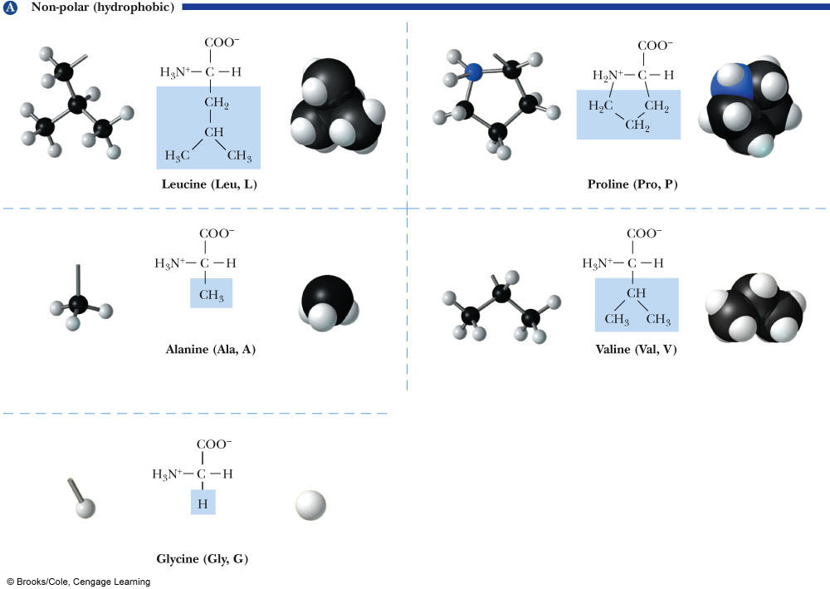

Slide 8
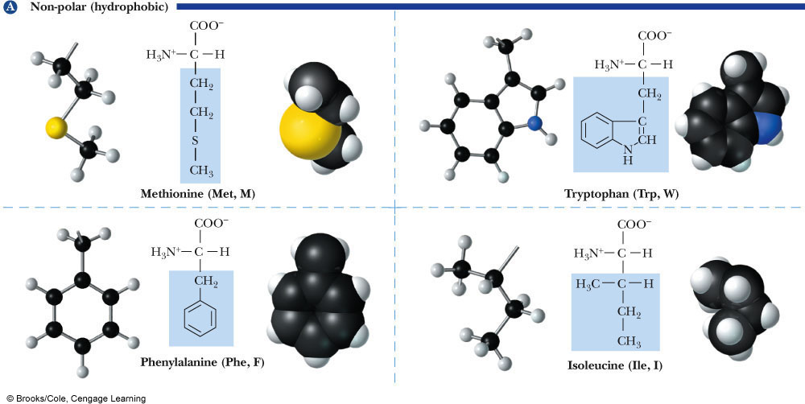

Slide 9
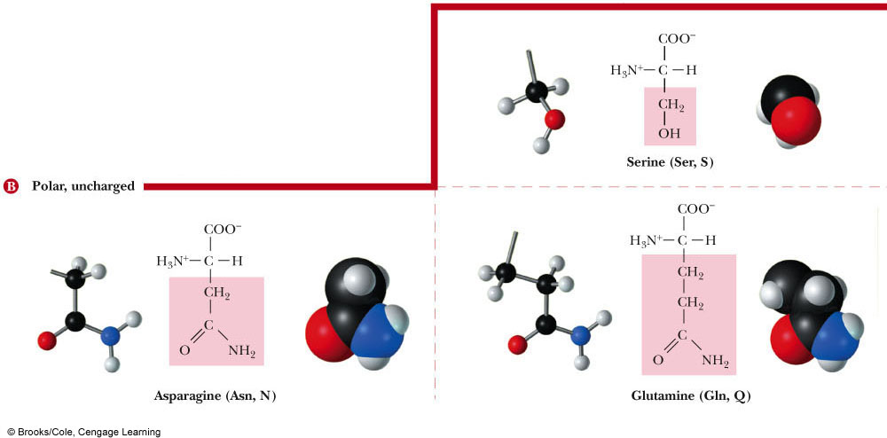

Slide 10
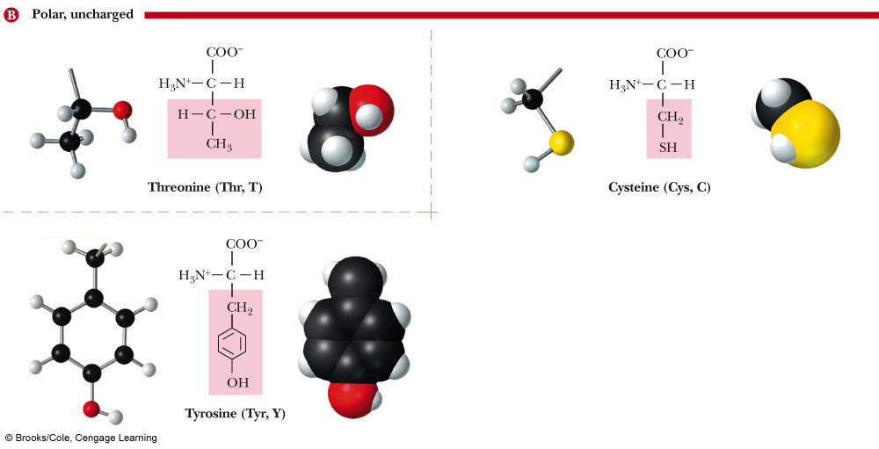

Slide 11
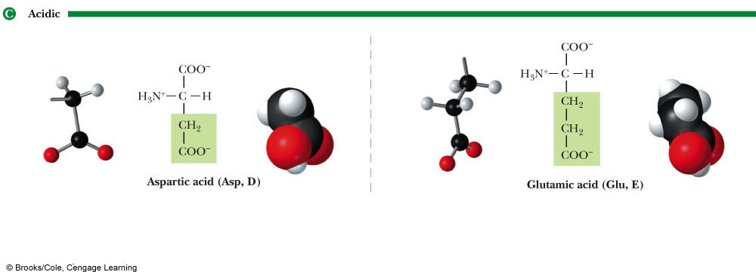

Slide 12
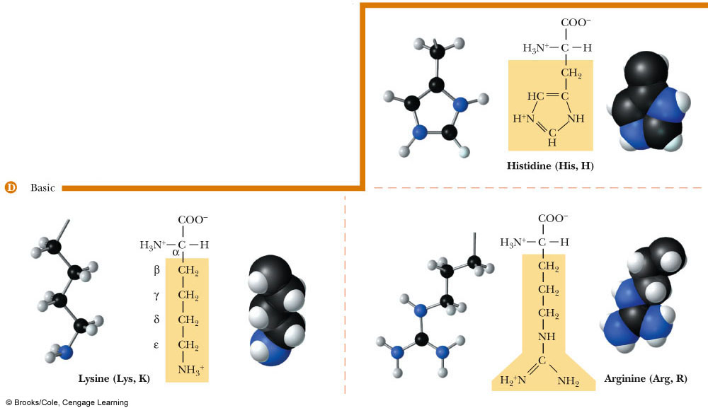

Slide 13
Side Chain Classification
Nonpolar (hydrophobic) Amino Acids
G, A, V, L, I, P, F, W, M
These amino acids have aliphatic side chains
Phenylalanine and Tryptophan are aromatic
Proline is cyclic
Induces turns in proteins

Slide 14
Side Chain Classification
Polar, Uncharged Amino Acids
S, T, Y, C, N, Q
S, T, Y have hydroxyl groups (-OH)
C has a sulfhydryl (-SH)
N and Q have amide side chains
Uncharged at neutral pH

Slide 15
Side Chain Classification
Acidic Amino Acids
D and E have carboxylic acids on their side chains
The side chains are negatively charged at neutral pH
This means the pKa’s of the side chains are less than 7

Slide 16
Side Chain Classification
Basic Amino Acids
H, K and R have side chains that are positively charged at neutral pH
Because these side chains have basic groups, they accept protons at pH values lower than the pKa of the side chain

Slide 17
But Dr. Hurlbert, there are so many, they’re like Pokemon and I hate Pokemon. Sorry, you still gotta catch ‘em all. At the very least you MUST know S, C, D, E, H, K, R Why? Because they do things, the rest don’t.

Slide 18
Fig 3.4
Reproduced from: Biochemistry by T.A. Brown, ISBN: 9781907904288 © Scion Publishing Ltd, 2017

Slide 19
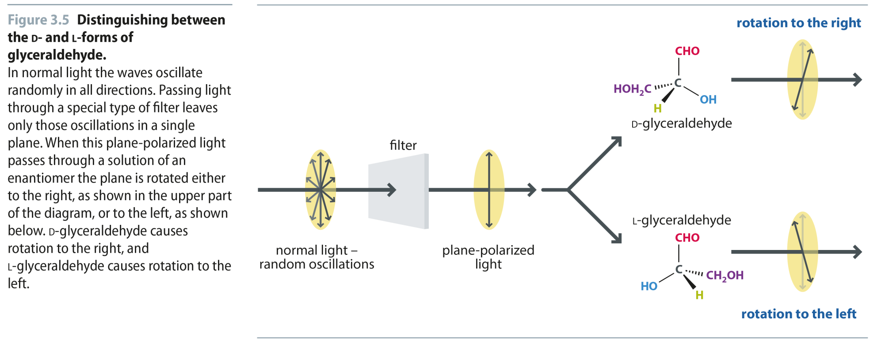
Fig 3.5
Reproduced from: Biochemistry by T.A. Brown, ISBN: 9781907904288 © Scion Publishing Ltd, 2017

Slide 20
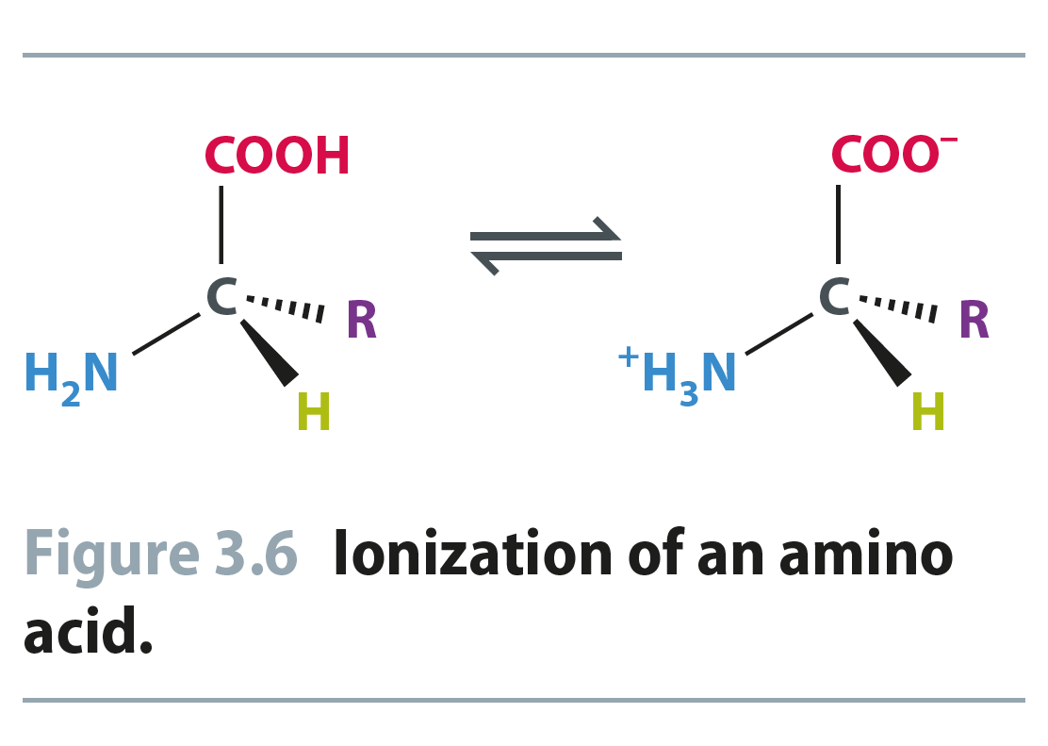
Fig 3.6
Reproduced from: Biochemistry by T.A. Brown, ISBN: 9781907904288 © Scion Publishing Ltd, 2017

Slide 21
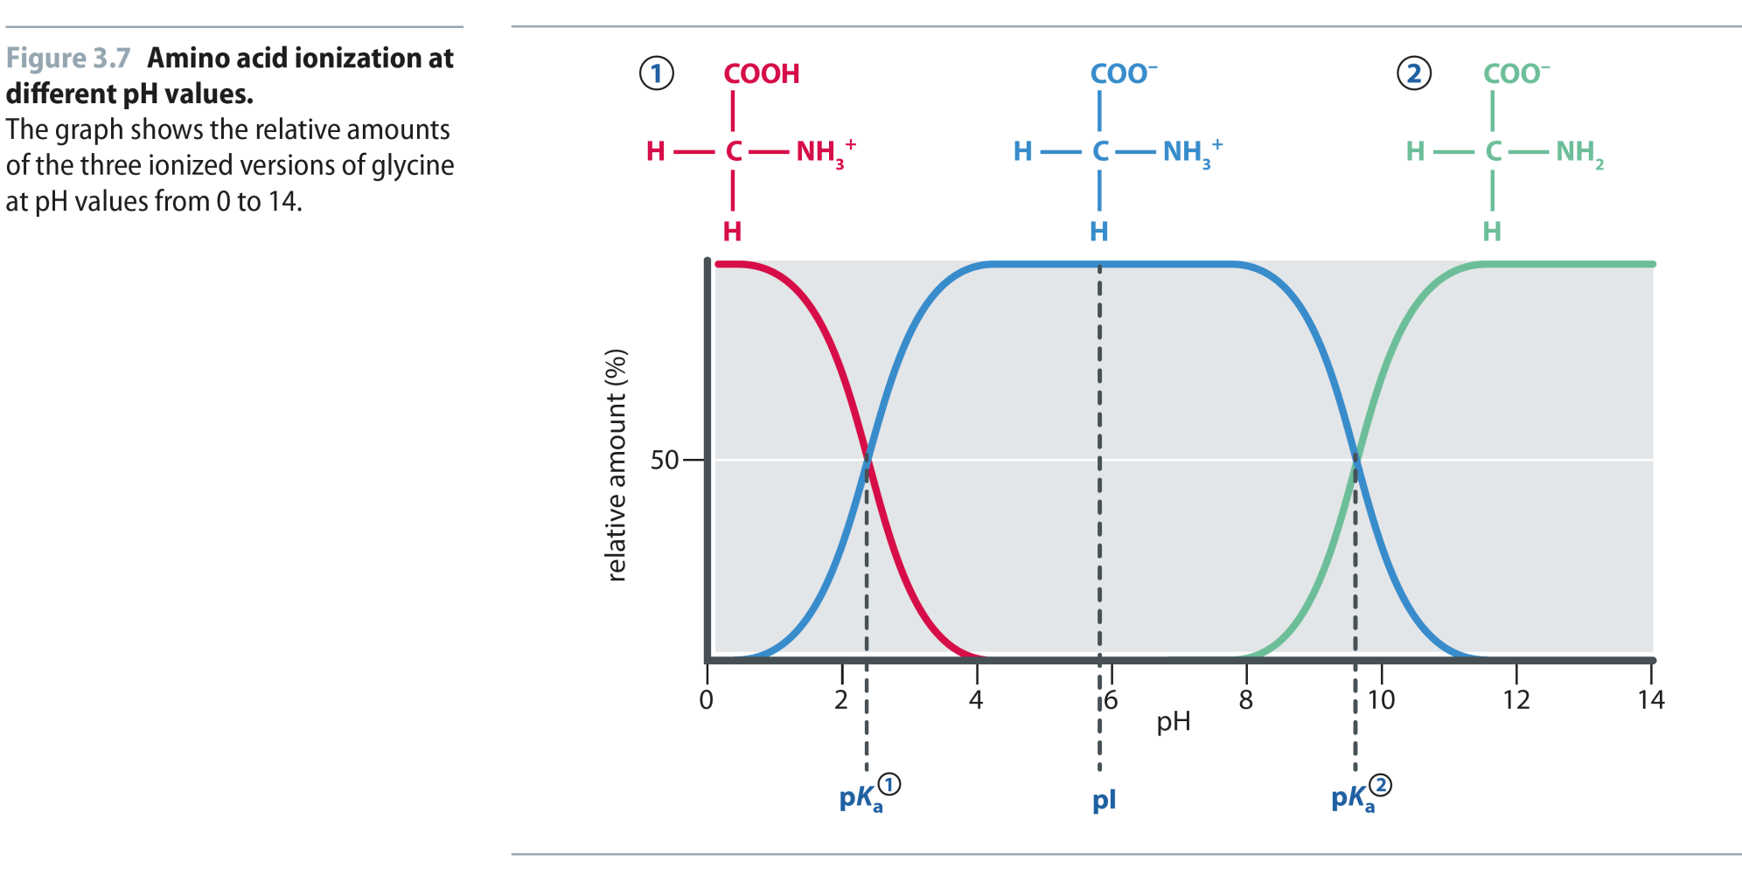
Fig 3.7
Reproduced from: Biochemistry by T.A. Brown, ISBN: 9781907904288 © Scion Publishing Ltd, 2017

Slide 22
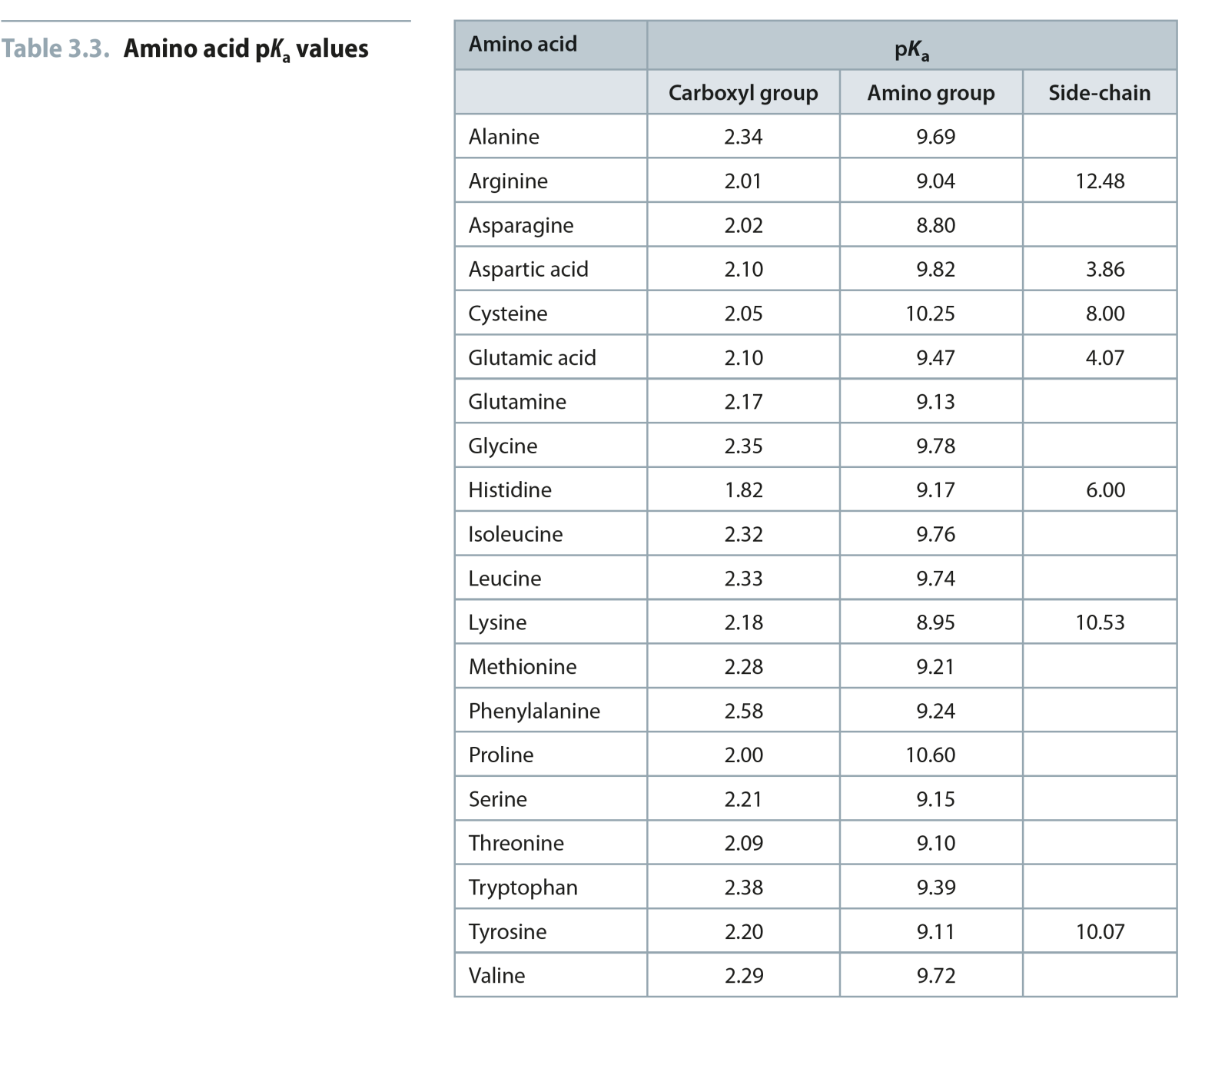
Table 3.3
Reproduced from: Biochemistry by T.A. Brown, ISBN: 9781907904288 © Scion Publishing Ltd, 2017

Slide 23
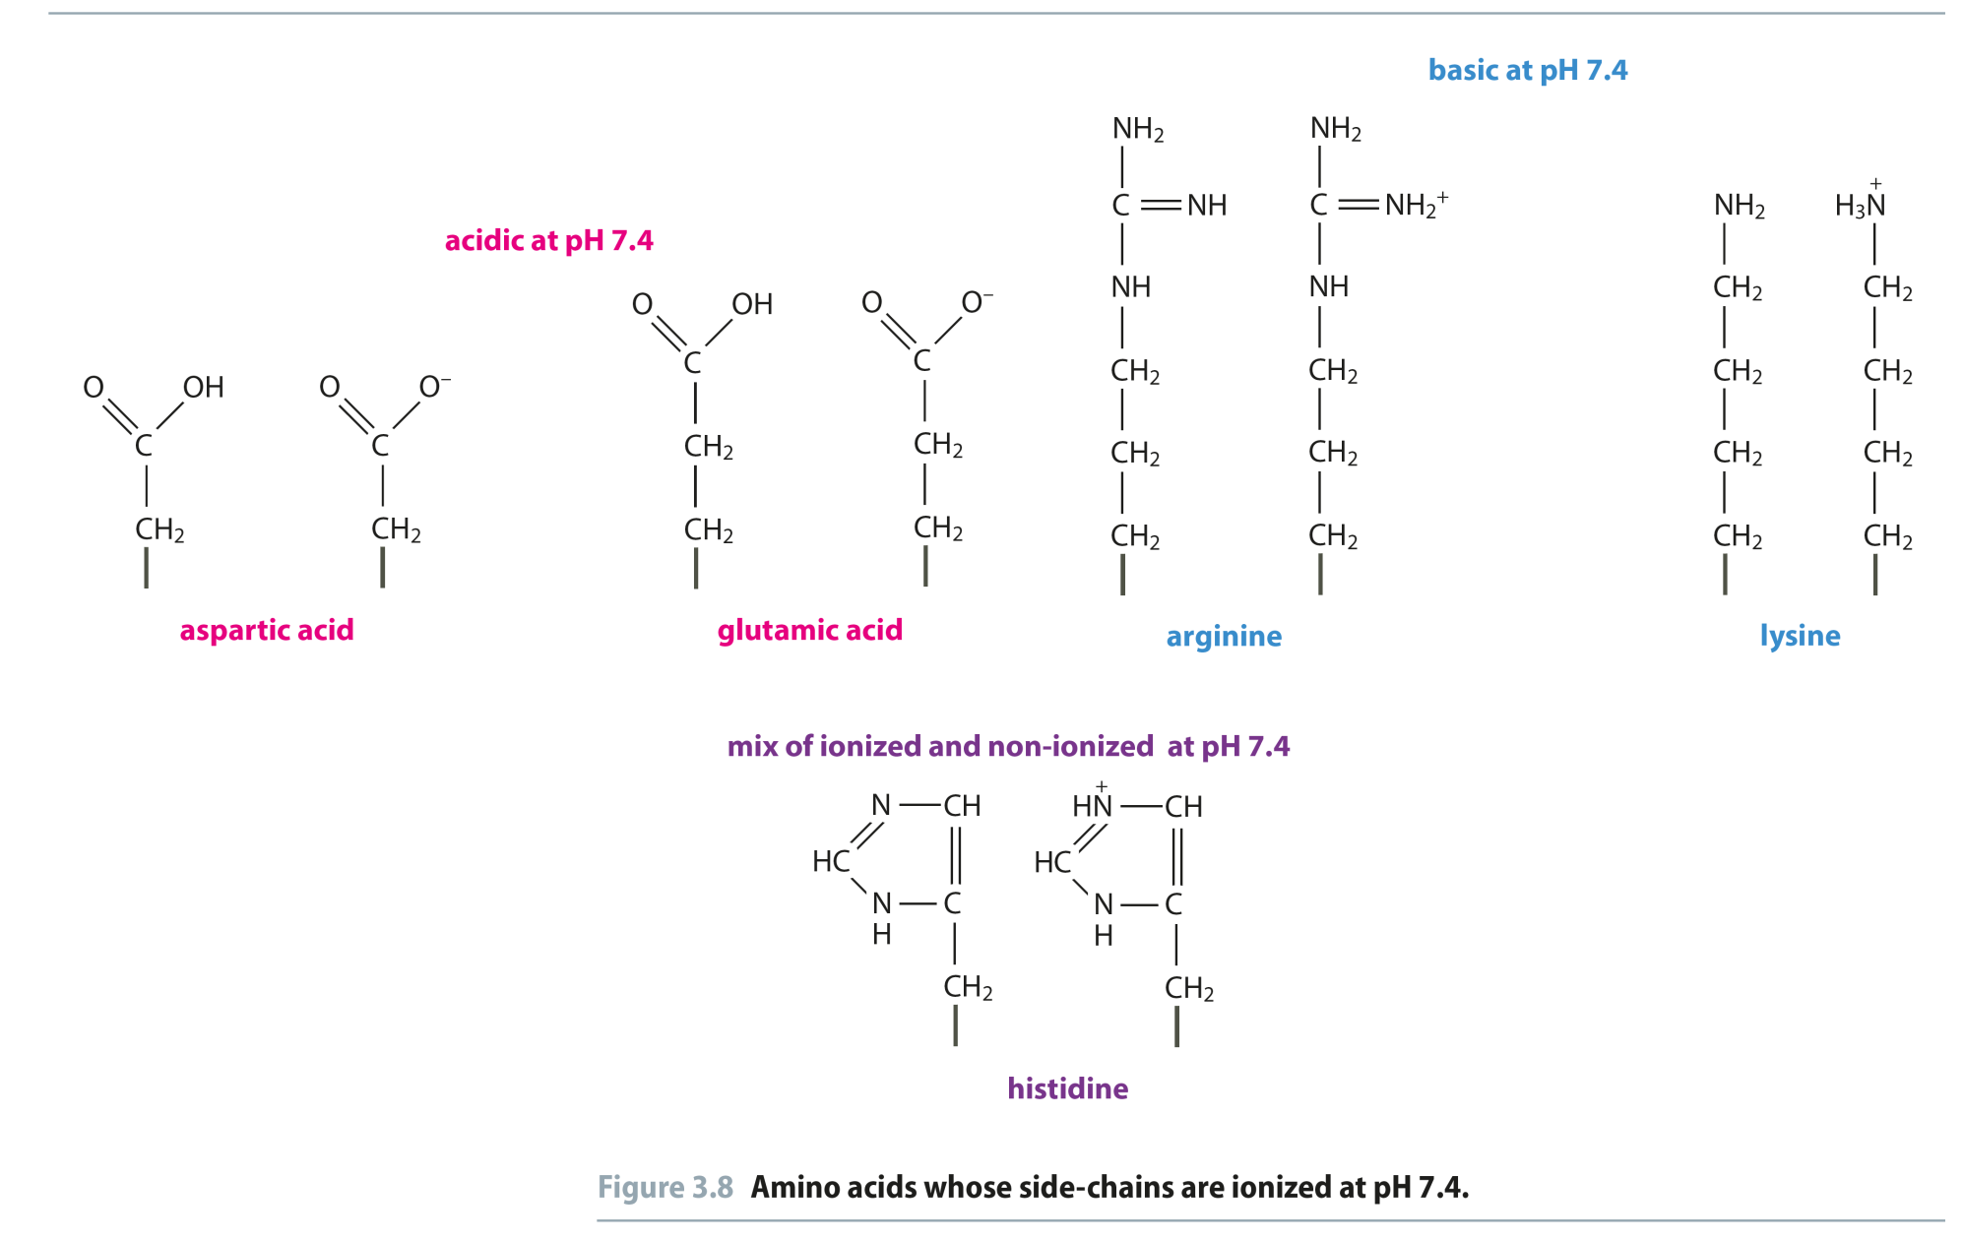
Fig 3.8
Reproduced from: Biochemistry by T.A. Brown, ISBN: 9781907904288 © Scion Publishing Ltd, 2017

Slide 24
Fig 3.13
Reproduced from: Biochemistry by T.A. Brown, ISBN: 9781907904288 © Scion Publishing Ltd, 2017

