Slide 2
Carbohydrates
Carbohydrate: a polyhydroxyaldehyde or polyhydroxyketone, or a substance that gives these compounds on hydrolysis
Monosaccharide: a carbohydrate that cannot be hydrolyzed to a simpler carbohydrate
Building blocks of all carbohydrates
They have the general formula C_{n}H_{2n}O_{n}, where n varies from 3 to 8
Aldose: a monosaccharide containing an aldehyde group
Ketose: a monosaccharide containing a ketone group

Slide 3
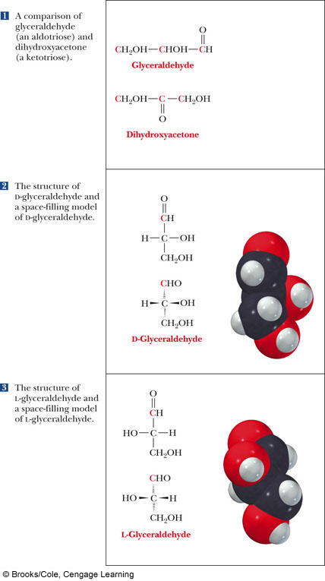
Monosaccharides
Monosaccharides are classified by their number of carbon atoms
Trioses are simplest carbohydrate monosaccharides
Glyceraldehyde contains a stereocenter and exists as a pair of enantiomers
Mirror-images stereoisomers are called enantiomers

Slide 4
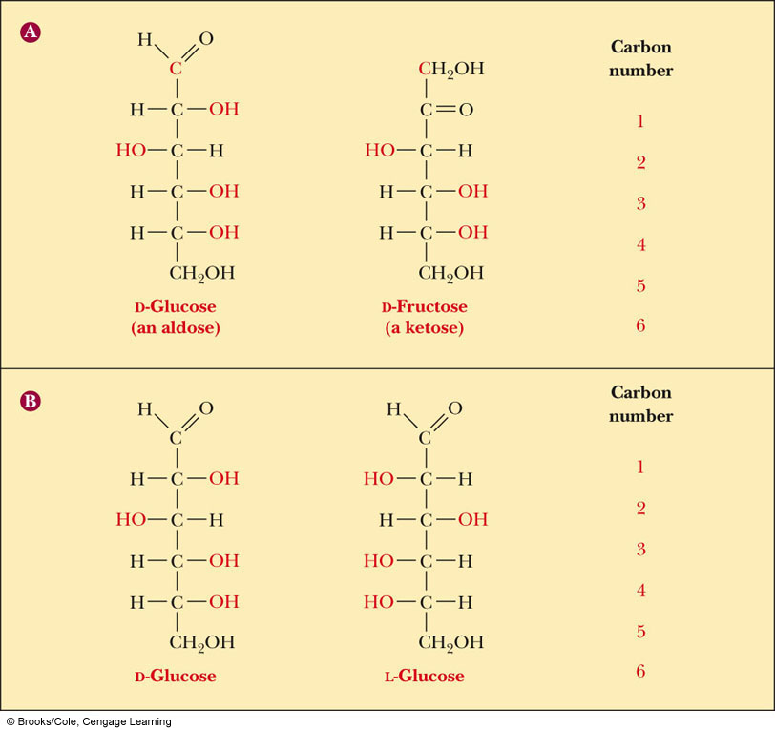
Fischer Projections
Fischer projection: bonds are written in a two dimensional representation showing the configuration of tetrahedral stereocenters
horizontal lines represent bonds projecting forward
vertical lines represent bonds projecting to the rear
the carbon atom at the intersection of the horizontal and vertical lines is not shown

Slide 5
D,L Monosaccharides
According to the conventions proposed by Fischer
D-monosaccharide: a monosaccharide that, when written as a Fischer projection, has the -OH on its penultimate carbon on the right
L-monosaccharide: a monosaccharide that, when written as a Fischer projection, has the -OH on its penultimate carbon on the left

Slide 6
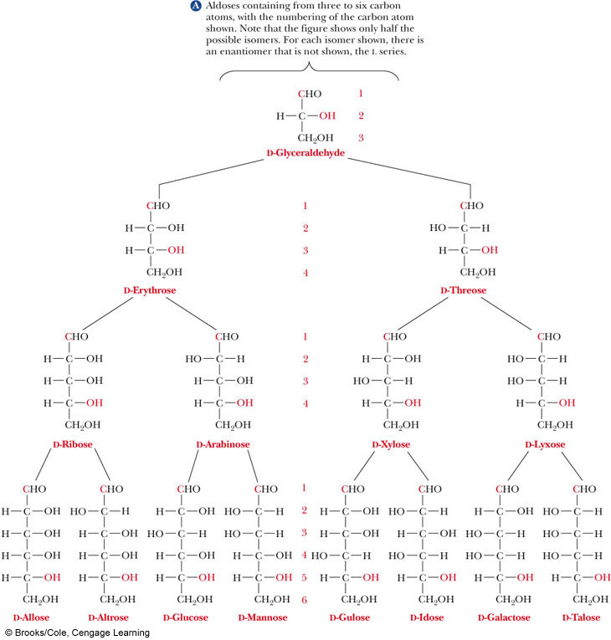
Different hydroxyl position, different sugar
You MUST know α- and β-D-glucose, ribose, galactose and mannose
Here’s the trick:
α-D-glucose: DDUDU
Mannose is the 2 epimer
Galactose is the 4 epimer

Slide 7
What Happens if a Sugar Forms a Cyclic Molecule?
Cyclization of sugars takes place due to interaction between functional groups on distant carbons, C1 to C5, to make a cyclic hemiacetal
Cyclization using C2 to C5 results in hemiketal formation.
In both cases, the carbonyl carbon is new chiral center and becomes an anomeric carbon

Slide 8
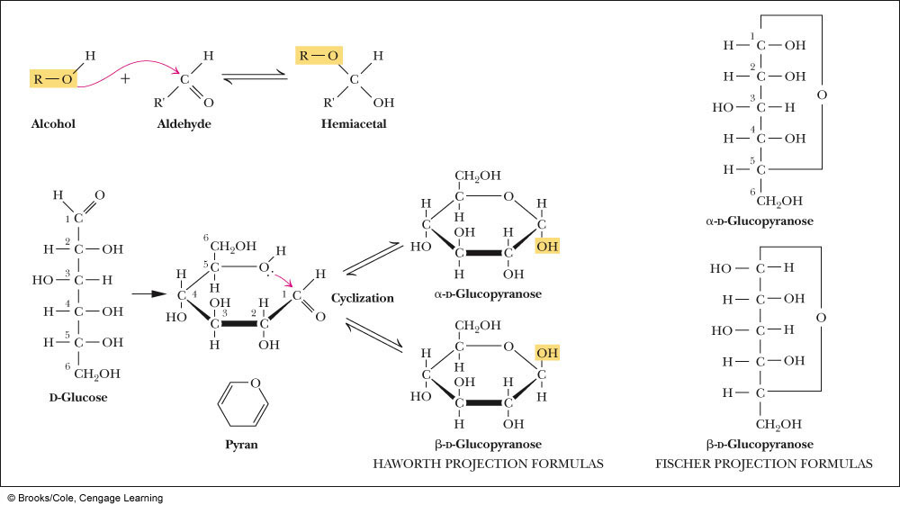
Formation of a Cyclic Hemiacetal

Slide 9
Cyclic Structure
Monosaccharides have -OH and C=O groups in the same molecule and exist almost entirely as five- and six-membered cyclic hemiacetals
anomeric carbon: the new stereocenter resulting from cyclic hemiacetal formation
anomers: carbohydrates that differ in configuration only at their anomeric carbons
For example: alpha- and beta-D-glucose are anomers

Slide 10
Haworth Projections
Haworth projections
five- and six-membered hemiacetals are represented as planar pentagons or hexagons, as the case may be, viewed through the edge
most commonly written with the anomeric carbon on the right and the hemiacetal oxygen to the back right
Remember the designation of the anomeric carbon:
α-: means that it is trans
β-: means that -OH on the anomeric carbon is cis to the terminal -CH₂OH

Slide 11
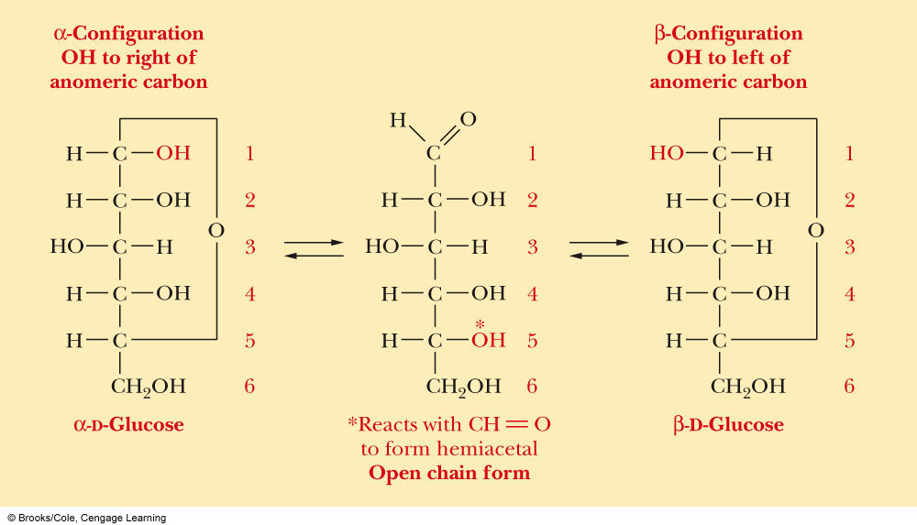
Formation of a Cyclic Hemiacetal

Slide 12
Haworth Projections (Cont’d)
A six-membered hemiacetal ring is shown by the infix -pyran- (pyranose)
A five-membered hemiacetal ring is shown by the infix -furan- (furanose)
Five-membered rings are so close to being planar that Haworth projections are adequate to represent furanoses
For pyranoses, the six-membered ring is more accurately represented as a strain-free chair conformation

Slide 13
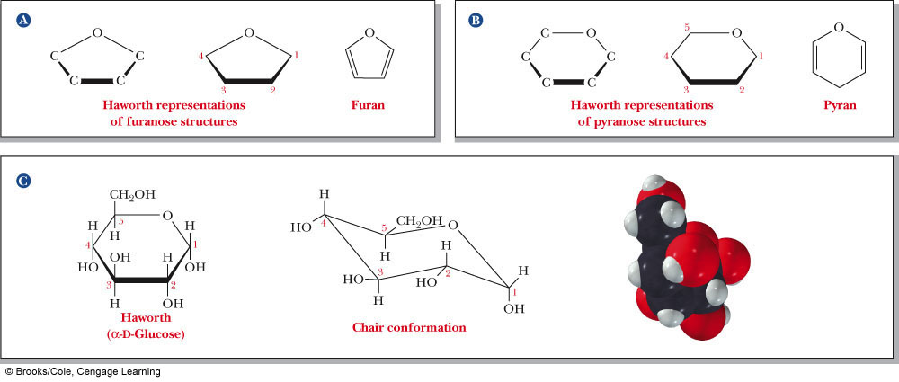
Haworth Projections (Cont’d)

Slide 14
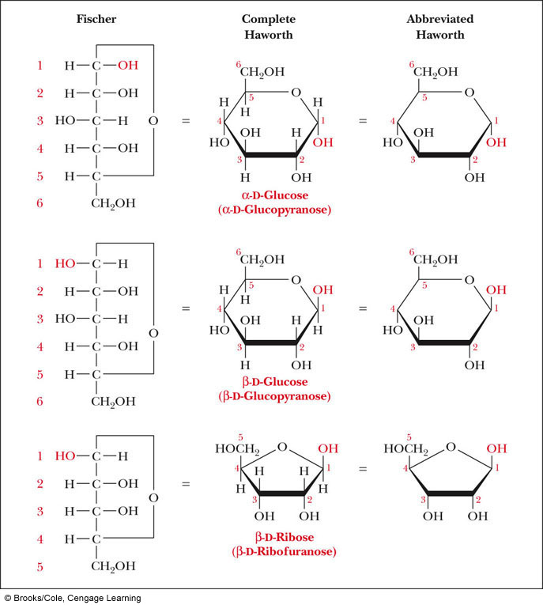
Comparison of the Fischer and Haworth Representations
Groups on the Right Side of the Fischer Representation are drawn as DOWN in the Haworth Projection

Slide 15
Hexoses

Slide 16
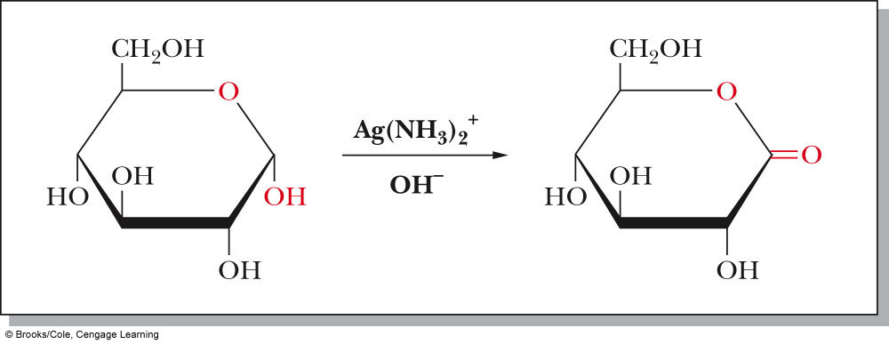
Reaction of Monosaccharides
Reducing sugar: one that reduces an oxidizing agent
Oxidation of a cyclic hemiacetal form gives a lactone
When the oxidizing agent is Tollens solution, silver precipitates as a silver mirror
If anomeric carbons are involved in glycosidic linkage, there will be a negative Tollens reagent test
If another anomeric carbon is not bonded and is free, there will be a positive Tollens reagent test

Slide 17
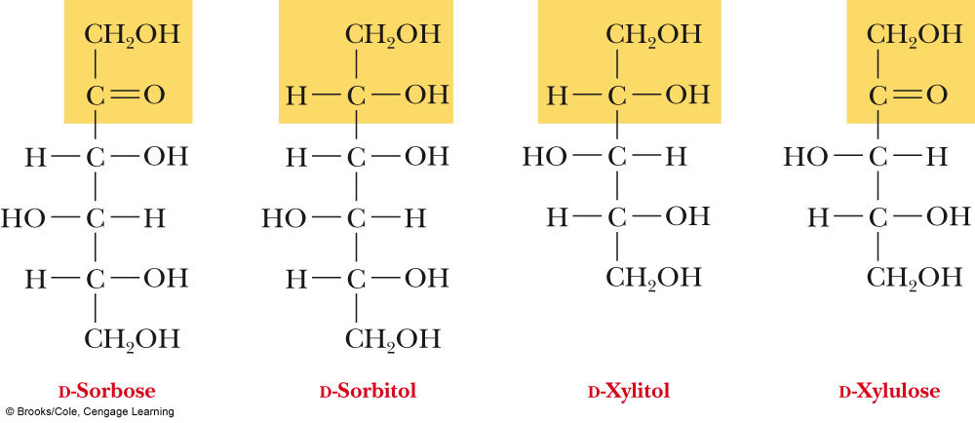
Reaction of Monosaccharides (Cont’d)
The carbonyl group of a monosaccharide can be reduced to an hydroxyl group by a variety of reducing agents, such as NaBH₄
reduction of the C=O group of a monosaccharide gives a polyhydroxy compound called an alditol

Slide 18
Phosphoric Esters
Phosphoric esters are particularly important in the metabolism of sugars to provide energy
phosphoric esters are frequently formed by transfer of a phosphate group from ATP

Slide 19
Glycosidic Bond Formation
Glycoside: a carbohydrate in which the -OH of the anomeric carbon is replaced by -OR
those derived from furanoses are furanosides; those derived from pyranoses are pyranosides
glycosidic bond: the bond from the anomeric carbon to the -OR group
This is the basis for the formation polysaccharides/oligosaccharides

Slide 20
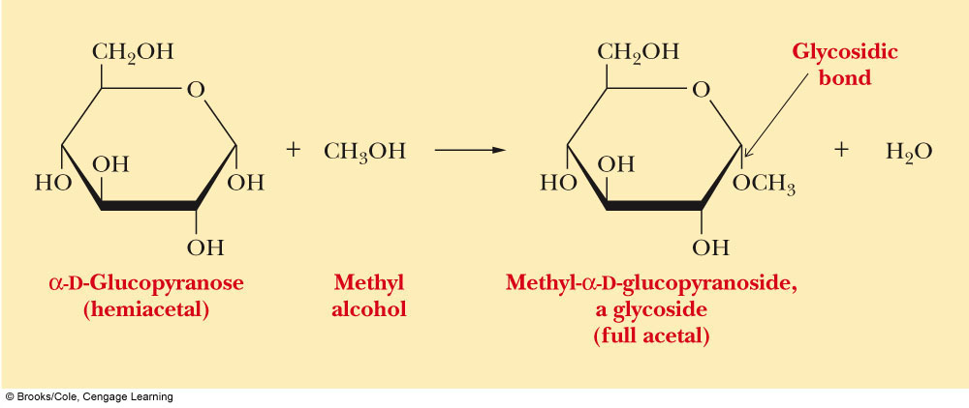
Glycosidic Bond Formation (Cont’d)

Slide 21
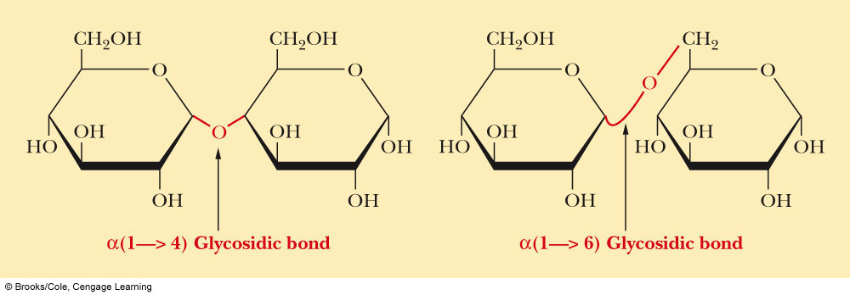
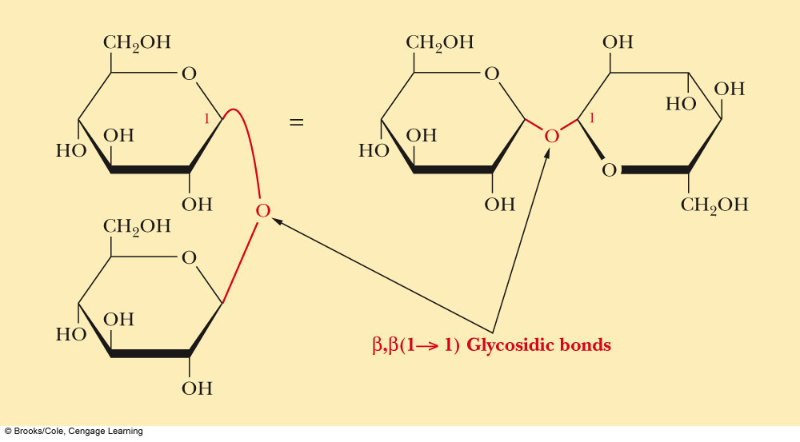
Two Different Disaccharides of α-D-Glucose
Glycosidic linkages can take various forms; the anomeric carbon of one sugar to any of the -OH groups of another sugar to form an α- or β-glycosidic linkage
Different linkages, different properties

Slide 22
Summary
Sugars can and undergo oxidation reactions, as well as, forming esters
Glycosidic linkages are responsible for the bonding of monosaccharides to form oligosaccharides and polysaccharides

Slide 23
Disaccharides
Sucrose
Table sugar; obtained from the juice of sugar cane and sugar beet
One unit of D-glucose and one unit of D-fructose joined by an α-1,2-glycosidic bond
Lactose
Made up of D-galactose and one unit of D-glucose joined by a β-1,4-glycosidic bond
Galactose is a C-4 epimer of glucose
Maltose
Two units of D-glucose joined by an α-1,4-glycosidic bond
Formed from the hydrolysis of starch
Differs from cellobiose by the conformation of the glycosidic linkage

Slide 24
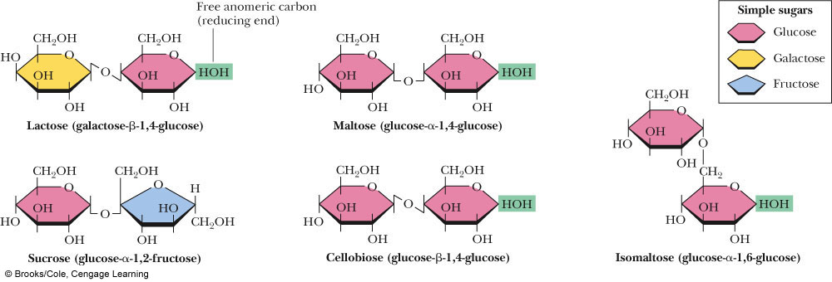
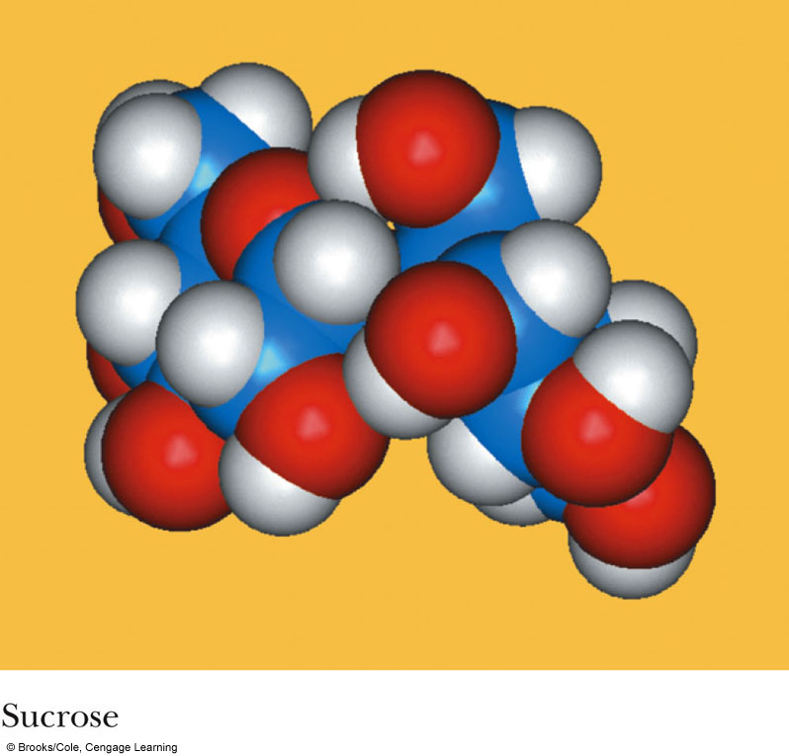
Some Important Disaccharides

Slide 25
Summary
The disaccharide sucrose is a common table sugar. It consists of glucose and fructose linked by a glycosidic bond
Lactose, found in milk, and maltose, obtained from starch, are two other common disaccharides

Slide 26
Structures and Function of Polysaccharides
Polysaccharide- When many monosaccharides are linked together
Cellulose: the major structural component of plants, especially wood and plant fibers
a linear polymer of approximately 2800 D-glucose units per molecule joined by β-1,4-glycosidic bonds
fully extended conformation with alternating 180° flips of glucose units
extensive intra- and intermolecular hydrogen bonding between chains

Slide 27
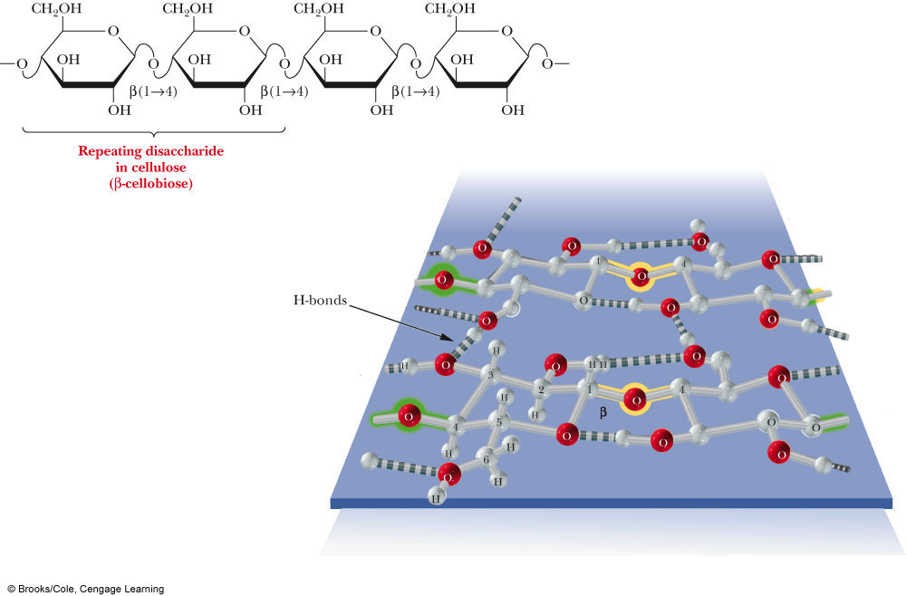
Polymeric Structure of Cellulose

Slide 28
Polysaccharides (Cont’d)
Starch is used for energy storage in plants
a polymers of α-D-glucose units
amylose: continuous, unbranched chains of up to 4000 α-D-glucose units joined by α-1,4-glycosidic bonds
amylopectin: a highly branched polymer consisting of 24-30 units of D-glucose joined by α-1,4-glycosidic bonds and branches created by α-1,6-glycosidic bonds
amylases catalyze hydrolysis of α-1,4-glycosidic bonds
β-amylase is an exoglycosidase and cleaves from the nonreducing end of the polymer
α-amylase is an endoglycosidase and hydrolyzes glycosidic linkages anywhere along the chain to produce glucose and maltose
debranching enzymes catalyze the hydrolysis of α-1,6-glycosidic bonds

Slide 29
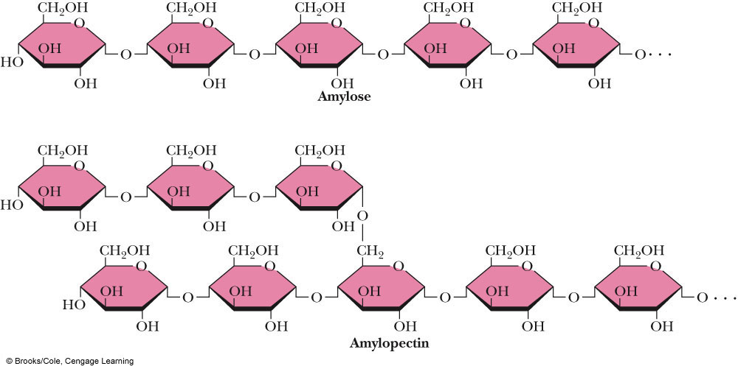
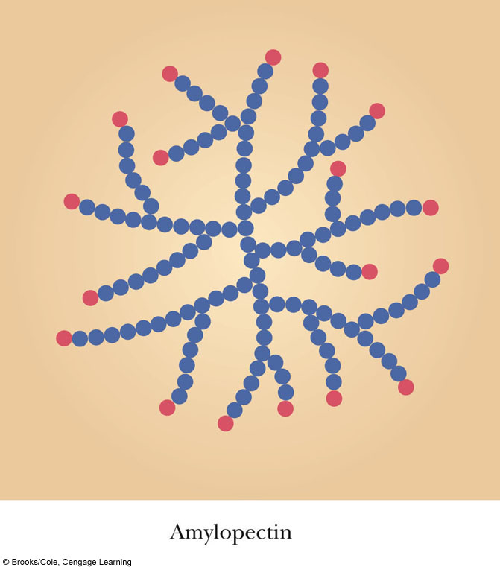
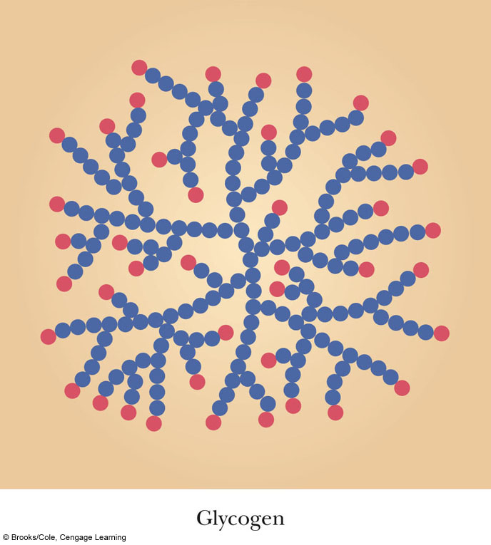
Amylose and Amylopectin
α-1,4 linkages
α-1,6 linkage
What advantage does the branched structure of the storage polysaccharide give the cell?

Slide 30
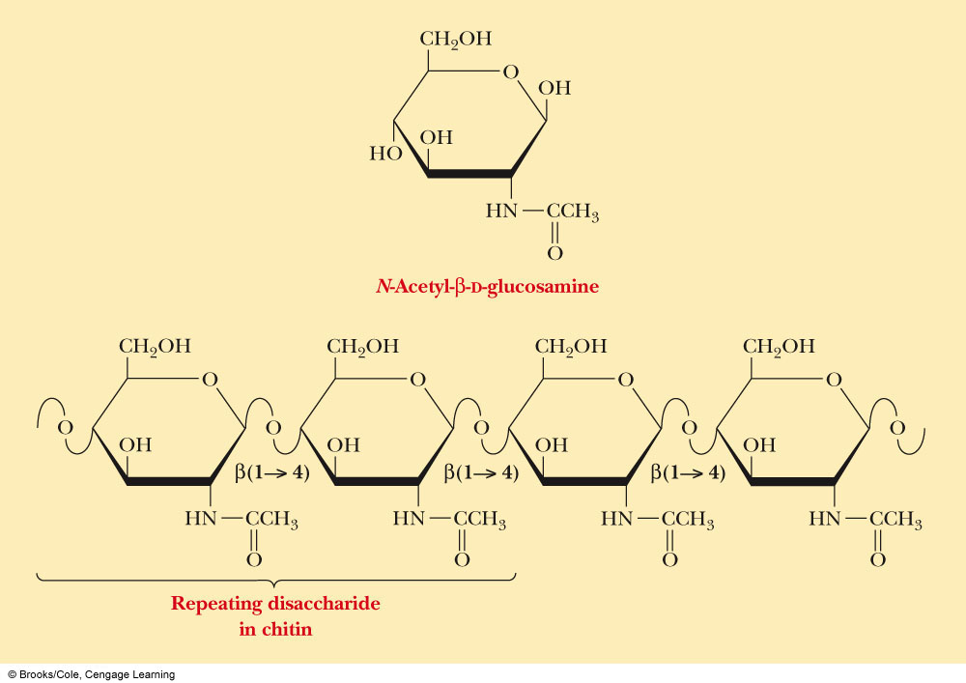
Chitin
Chitin: the major structural component of the exoskeletons of invertebrates, such as insects and crustaceans; also occurs in cell walls of algae, fungi, and yeasts
composed of units of N-acetyl-β-D-glucosamine joined by β-1,4-glycosidic bonds

Slide 31
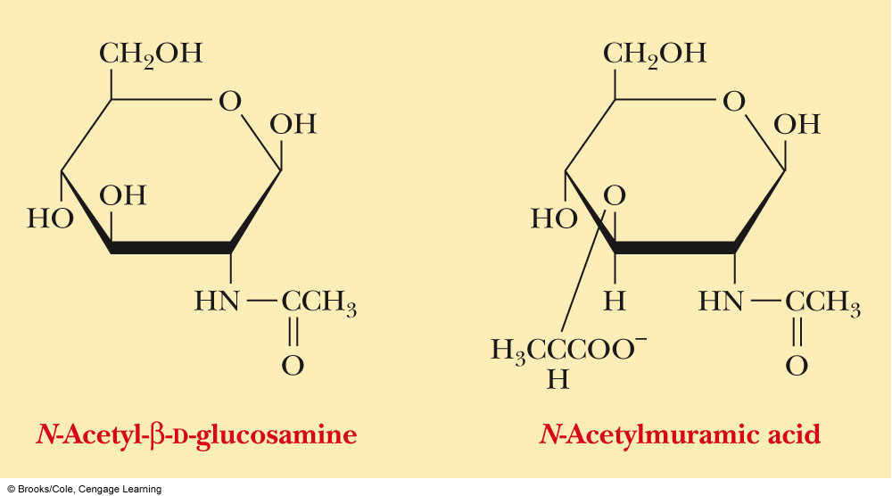
Amino Sugars

Slide 32
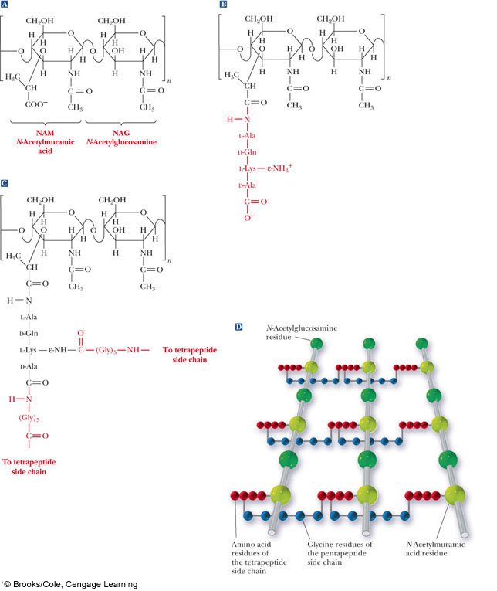
Polysaccharides (Cont’d)
Bacterial cell walls: prokaryotic cell walls are constructed on the framework of the repeating unit NAM-NAG joined by β-1,4-glycosidic bonds

Slide 33
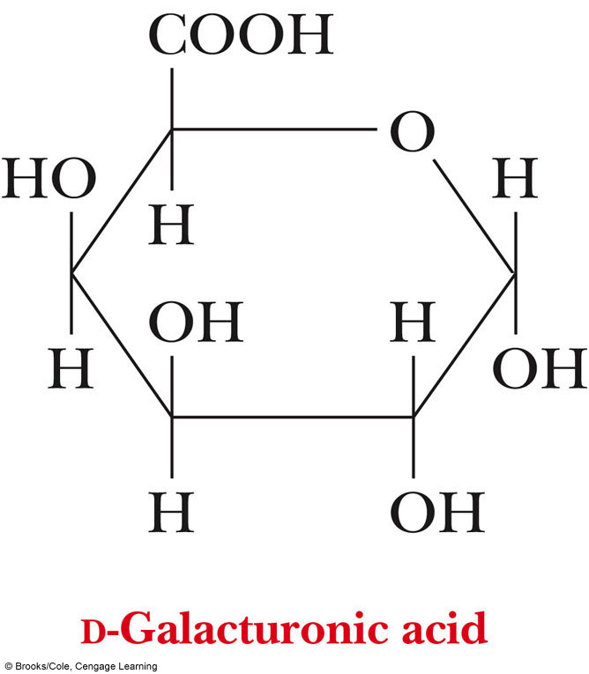
Plant Cell Walls
consist largely of cellulose
also contain pectin which functions as an intercellular cementing material
pectin is a polymer of D-galacturonic acid joined by α-1,4-glycosidic bonds

Slide 34
Glycosaminoglycans
Glycosaminoglycans: polysaccharides based on a repeating disaccharide where one of the monomers is an amino sugar and the other has a negative charge due to a sulfate or carboxylate group
Heparin: natural anticoagulant
Hyaluronic acid: a component of the vitreous humor of the eye and the lubricating fluid of joints
Chondroitin sulfate and keratan sulfate: components of connective tissue

Slide 35
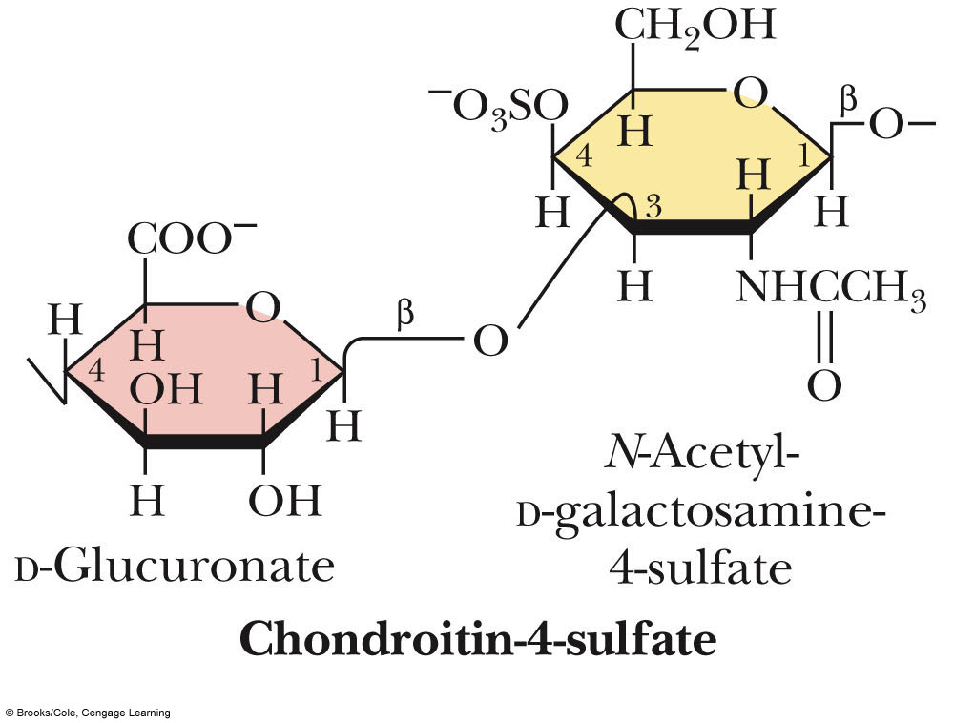
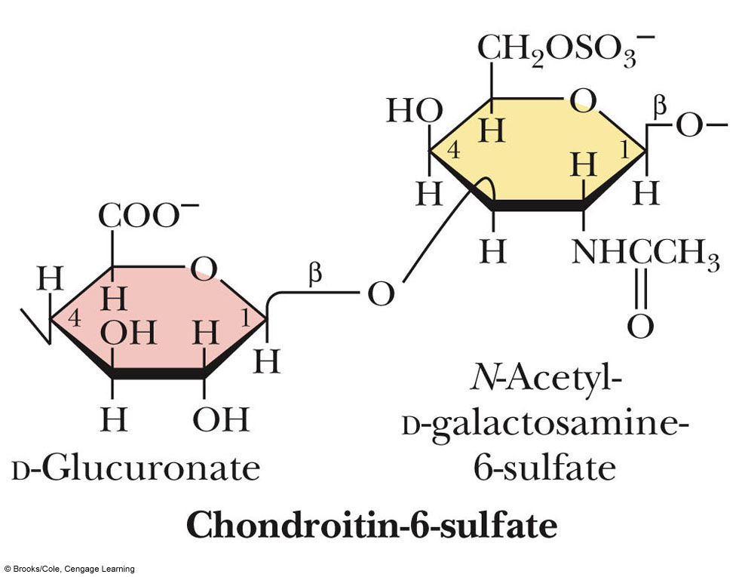
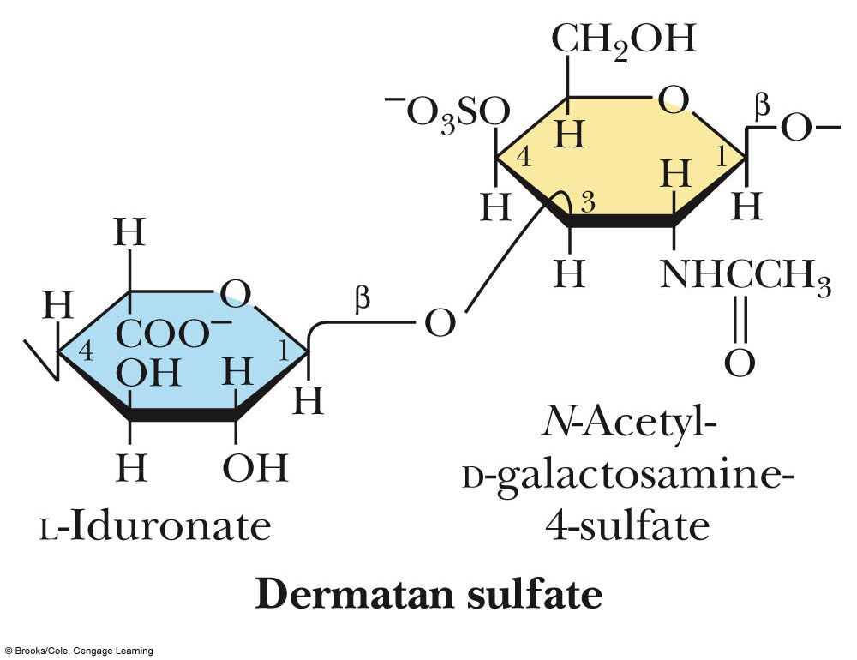
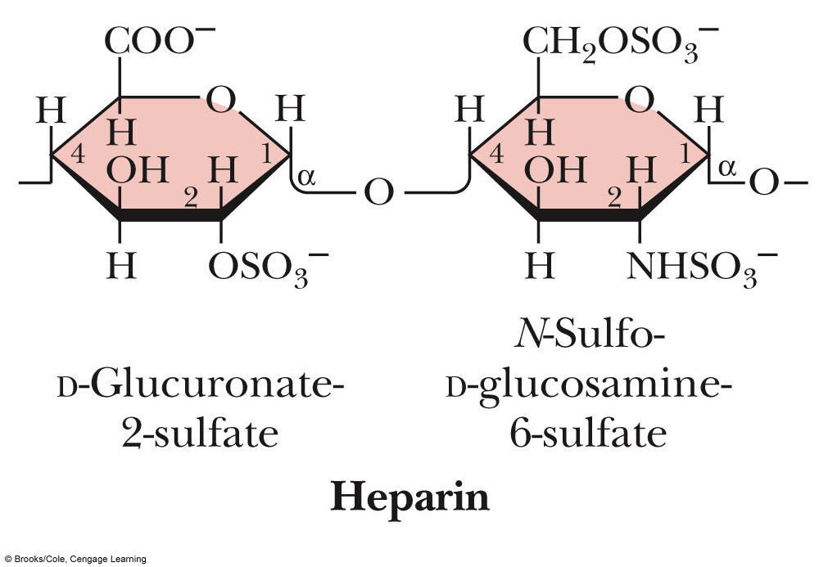
Glycosaminoglycans
Why are the Sulfate or Carboxylate groups so important to the function of glycosaminoglycans?

Slide 36
Summary
Polysaccharides are formed by linking monomeric sugars through glycosidic linkages
Starch and glycogen are energy-storage polymers or sugars
Cellulose and chitin are structural polymers
Polysaccharides are important components of cell walls in bacteria and plants

Slide 37
Chicken Egg White Lysozyme
Enzyme responsible for degrading bacterial cell walls
Hydrolyzes the glycosidic linkage between NAM and NAG

Slide 38
Chicken Egg White Lysozyme
Binding Site
Substrate fits in groove in enzyme

