Slide 1
The Nature of the Active Site
Questions we want to ask:
Looking at the reactants and products, what type of reaction has occurred
Hydrolysis, Condensation, Acid-Base Catalysis
What amino acid residues are present in the active site that would allow us to perform this reaction?
How are these amino acids arranged in the active site?
Once we know these pieces of information, we can propose a mechanism for the reaction and really begin to understand how the structure determines the function of the protein

Slide 2
Remember THE 3 RULES
CHNOPS
CHP
NOS
Draw the substrate and the product. Look at what is different in the substrate when converted to product.
Attack the electrophile in the substrate with the nucleophile of the enzyme and start pushing arrows.
This “arrow pushing” is a fundamental concept of documenting chemical reactivity and is a major part of Organic Chemistry
Arrows represent where electrons go!

Slide 3
Identifying the Reaction
Look closely at the reactants and products.
What is chemically different about the product?
If new groups are present, (phosphate groups for example), you’ll need to account for them
Since the cell is mostly water, a lot of chemical reactions involve the breaking of O-H bonds in water and using the atoms in a reaction

Slide 4
Identifying Important Amino Acids in the Active Site
Since the α-amino group and the carboxylic acid group at the start and finish of every amino acid are involved in forming peptide bonds, we usually only need to worry about the side chains.
USUALLY (The carbonyl oxygen and nitrogen involved in the peptide bond may be positioned JUST right…)
Hydrophobic Amino Acids are non-reactive, so we can drop them from our consideration
That leaves us with…

Slide 5
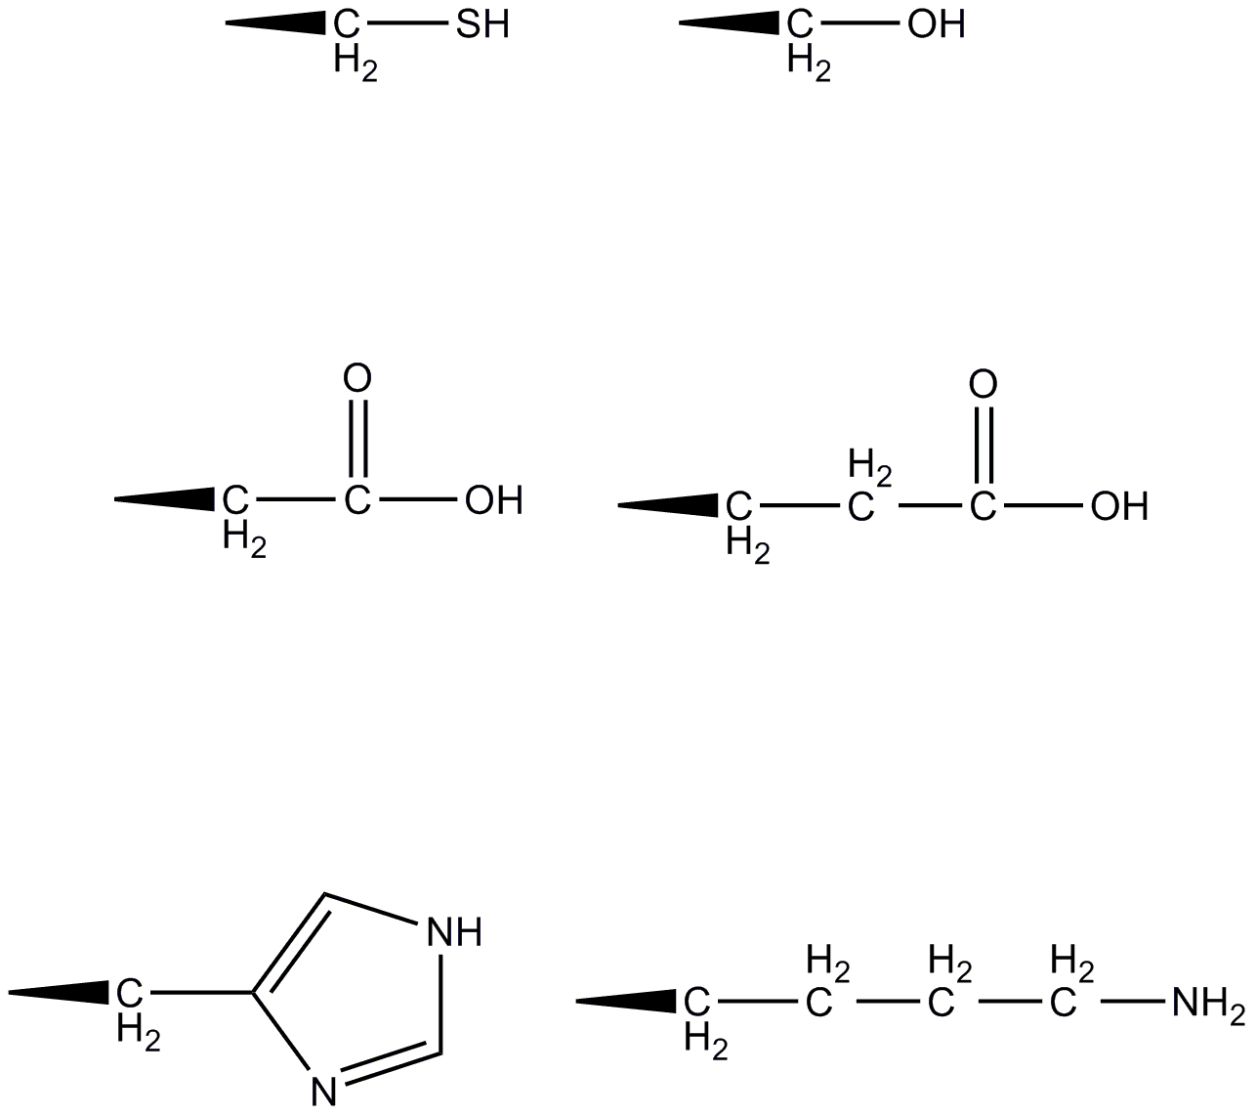
Reactive Amino Acid Side Chain Functional Groups

Slide 6
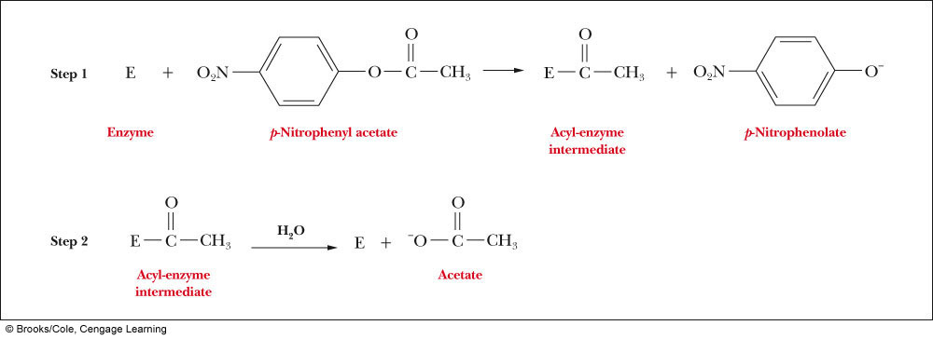
Let’s Look at a Specific Reaction: Chymotrypsin
Chymotrypsin normally catalyzes the hydrolysis of the primary structure of proteins, however it can also catalyze the hydrolysis of various esters:

Slide 7
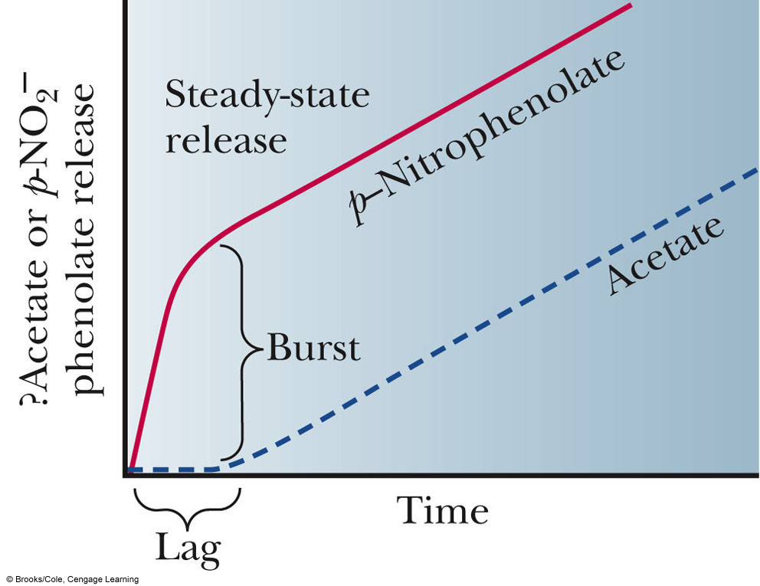
Chymotrypsin
We can see a 2-stage reaction:
Production of p-Nitrophenolate
Release of acetate
This indicates that there is a clear difference in the rate constants for each step

Slide 8
Chymotrypsin Hydrolysis of p-Nitrophenylacetate
What amino acids might be involved in the first step?
Serine, Glutamate, Aspartate. Why?
Nucleophilic attack of the carbonyl carbon by one of the side chain oxygens.

Slide 9
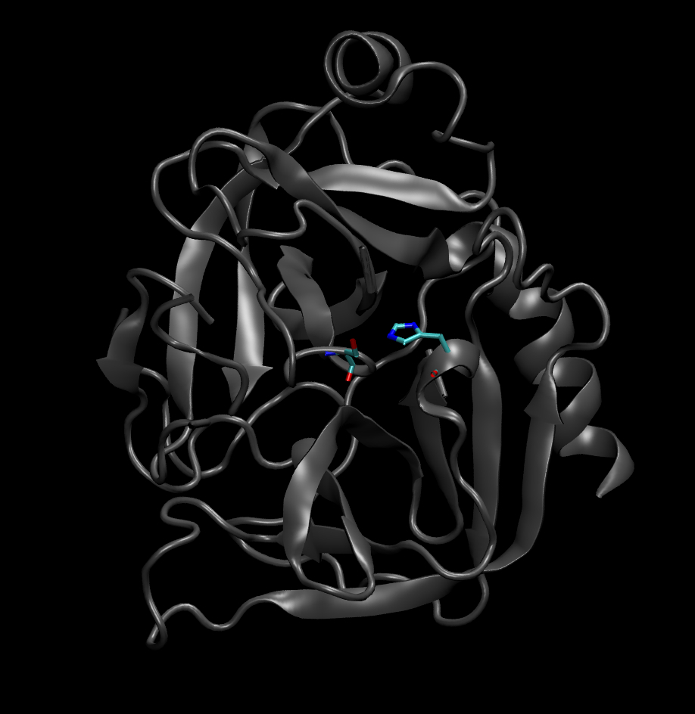
Idenitfying the Critical Amino Acids
Biochemical data from many laboratories indicated that Ser195 and His57 were important in the reaction
X-ray crystallographic analysis of the protein supported these data
Ser195 and His57 are involved in the reaction mechanism

Slide 10
Chymotrypsin Structure
Remember: Chymotrypsin is produced as a zymogen
Look at the positioning of the active site residues at the bottom of a cleft in the center of the protein

Slide 11
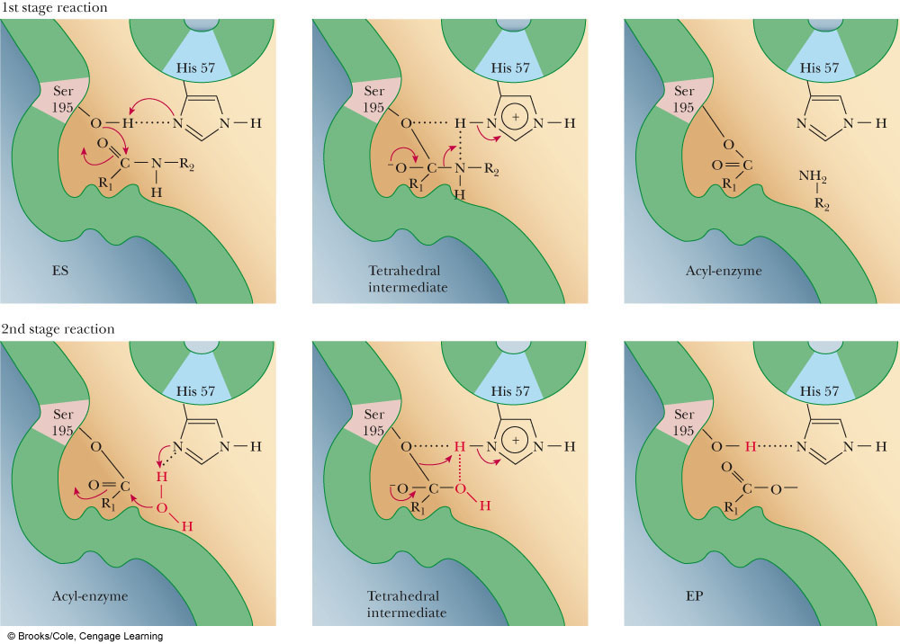
Chymotrypsin Mechanism

Slide 12
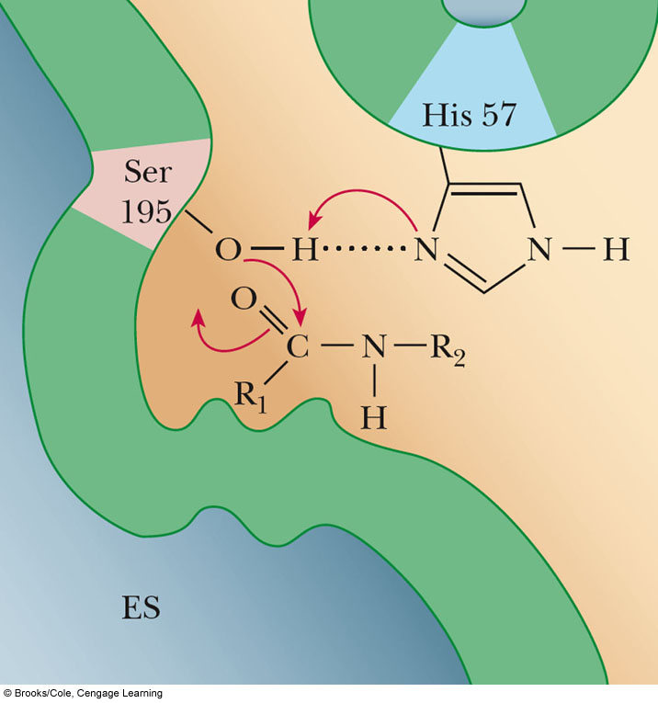
Let’s break the reaction down into steps
1st Stage: Formation of the Acyl-Enzyme intermediate
Imidazole nitrogen from histidine side chain acts as a General Base Catalyst and abstracts the hydroxyl proton from the Serine side chain
The electrons from that bond move to the hydroxyl oxygen, which then acts as a nucleophile, attacking the carbonyl carbon
The carbonyl carbon-oxygen double bond breaks and a pair of electrons moves to the oxygen, stabilizing the intermediate.

Slide 13
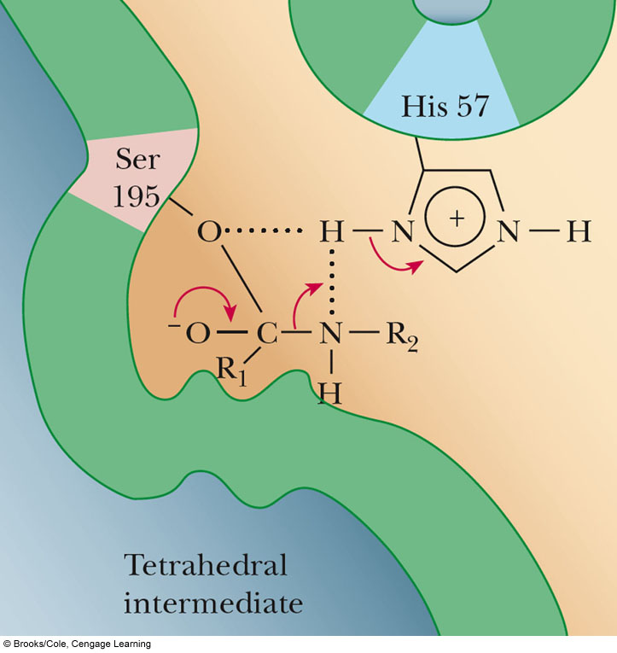
Let’s break the reaction down into steps
1st Stage: Formation of the Acyl-Enzyme intermediate
The tetrahedral intermediate rearranges, breaking the amide carbon-nitrogen bond
The nitrogen is stabilized by taking the proton from the imidazole nitrogen which acts like a General Acid Catalyst since it donated the proton.

Slide 14
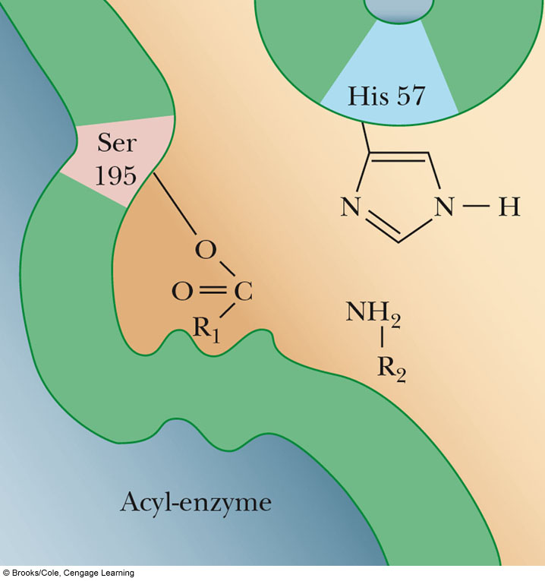
Let’s break the reaction down into steps
1st Stage: Formation of the Acyl-Enzyme intermediate
The recently generated product leaves the active site by diffusion
The remainder of the substrate is covalently bonded to the enzyme, forming the Acyl-enzyme intermediate

Slide 15
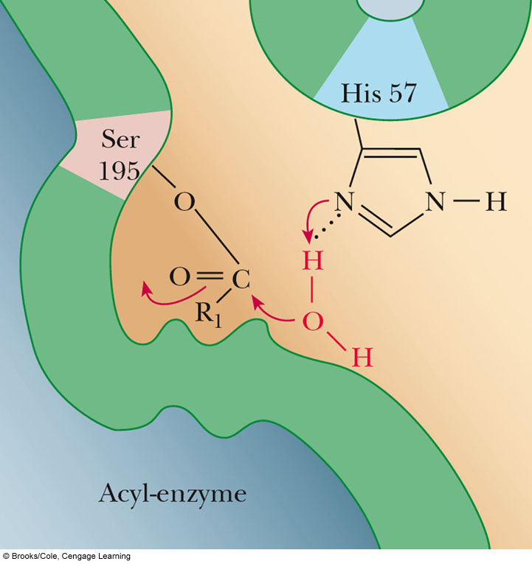
Let’s break the reaction down into steps
2nd Stage: Deacylation and Regeneration
The imidazole nitrogen once again acts as a General Base and abstracts a proton from a water molecule
The electrons from the O-H bond move to the oxygen and it begins a nucleophilic attack on the carbonyl carbon in the acyl-enzyme intermediate

Slide 16
Let’s break the reaction down into steps
2nd Stage: Deacylation and Regeneration
The tetrahedral intermediate reorganizes with the serine oxygen taking the proton from the imidazole, thereby breakign the bond between the enzyme and the product

Slide 17
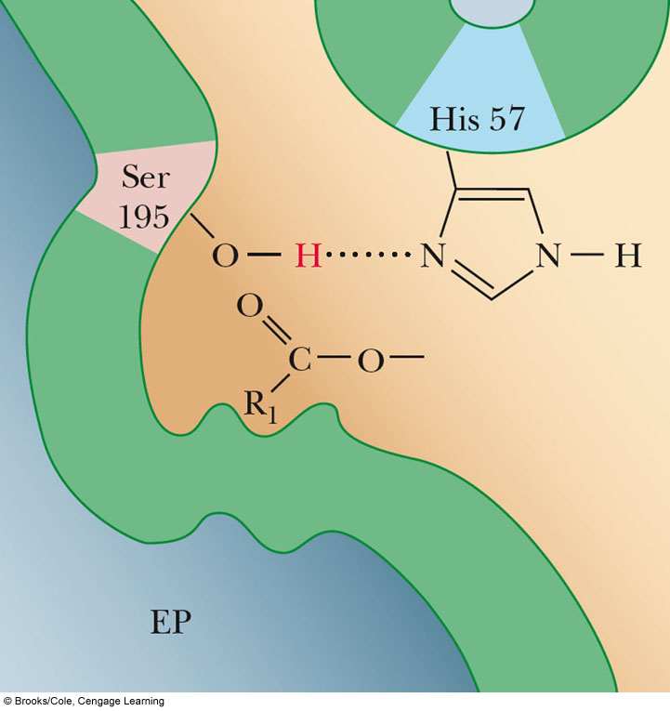
Let’s break the reaction down into steps
2nd Stage: Deacylation and Regeneration
The product diffuses out and the enzyme is ready for the whole process to start over again…

Slide 18
What can we learn from the proposed mechanism?
The active site amino acids have specific tasks
Ser195 - Hydroxyl oxygen: Nucleophile
His57 - Imidazole nitrogen: General Acid-Base Catalyst
The amino acids must be in proximity or no reaction would occur
His57 Imidazole nitrogen starts the reaction by increasing the nucleophilicity of the serine hydroxyl oxygen
This happens simply because the imidazole ring is close enough to the serine hydroxyl group that it can form a hydrogen bond

Slide 19
Different Active Site, Slightly Different Mechanisms
Chymotrypsin is a protease, specifically a Serine Protease
There are other types of proteases:
Cysteine Proteases
Cys residue replaces Ser in mechanism similar to Serine proteases
Aspartic Proteases
2 Asp residues act as General Acid-base catalysts
Zinc Proteases
Zn²⁺ is coordinated by 2 His
Zn²⁺ promotes attack of carbonyl carbon by water

Slide 20
Guessing the Catalytic Mechanism of Papain
Papain is a cysteine protease from Papaya commonly found in meat tenderizer
Why?
In the active site of papain, you will find a cysteine and a histidine in close proximity
What mechanism would you propose for papain knowing that the substrate is a peptide, and the reaction results in the hydrolysis of a peptide bond?
Turn your answer in class Wednesday, October 30.

