Slide 1
Organic Chemistry 2: Important Reactions
In the biological world, organisms are capable of synthesizing or degrading nearly any molecule
For the remainder of this class, we are going to look at the chemistry of basic biological molecules and the reaction mechanisms these molecules are involved in

Slide 2
Reaction Types
We are going to focus on 3 basic reaction types:
Nucleophilic Substitution Reactions: An electron rich atom (nucleophile) attacks a electron deficient atom
Acid-Base Catalysis: Certain amino acid side chains of enzymes can accept or donate protons, making them act like acids (donate protons) or bases (accept protons)
Condensation Reactions: The involve the combining of two molecules to form a larger molecule and a smaller one
The reverse reaction is called a Hydrolytic Reaction. We’ll look at those as well.

Slide 3
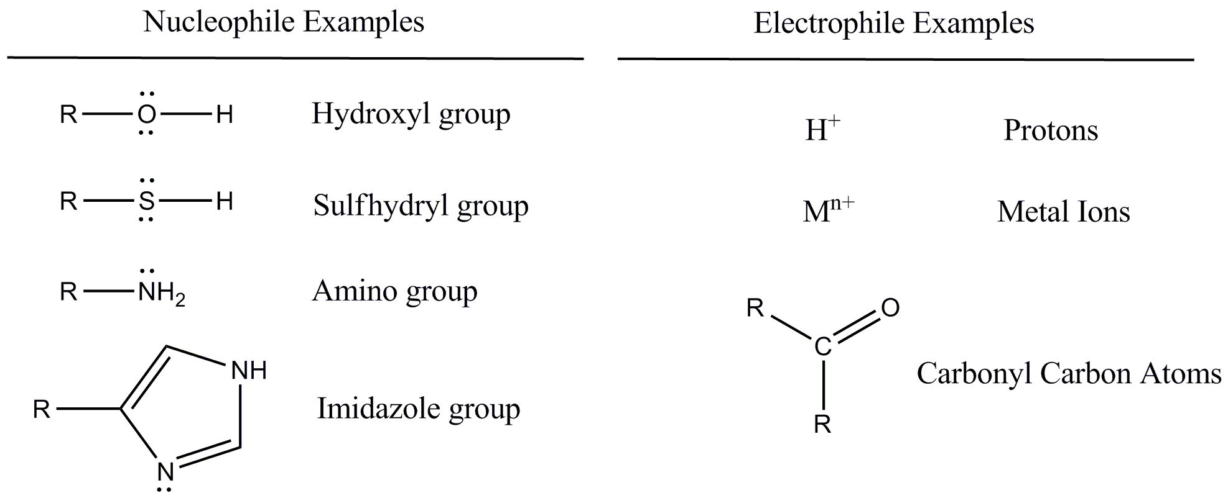
Nucleophilic Substitution Reactions
Terminology:
Nucleophile: An electron rich atom. May be negatively charged or have an available lone pair
Electrophile: An electron poor atom. May or may not have a positive charge

Slide 4
Nucleophilic Substitution Reactions
Two types of Sn Reactions Exist
They are classified and named based upon the slowest (rate limiting) step: Sn1 and Sn2
The General form of these reactions is:
R:X + :Z --> R:Z + X
:Z is the nucleophile
X is the leaving group
In a condensation reaction for the formation of a lipid from a glycerol and a fatty acid, a glycerol hydroxyl is the nucleophile attacking the carbonyl carbon of the carboxylic acid
Remember: The nucleophile attacks atoms of partial positive charge

Slide 5
Types of Nucleophilic Substitution Reactions
Sn1: The rate is dependent on the leaving group leaving
Stands for: Substitution Nucleophilic Unimolecular
Note: The first step is the dissociation of the chlorine

Slide 6
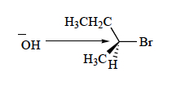
Types of Nucleophilic Substitution Reactions
Sn2: The rate is dependent on the nucleophile and the substrate forming a bond at the SAME TIME the leaving group dissociates
Stands for: Substitution Nucleophilic Bimolecular
Steric hindrances may prevent Sn2 reactions
The concentration of both reactants affects the rate

Slide 7
Nucleophilic Substitution Reactions
Actually, many reactions are mixtures of Sn1 and Sn2 mechanisms
Many factors affect whether a reaction proceeds via the Sn1 or Sn2 route, including:
Nucleophilicity
Bond polarizability
Leaving group stability
Solvent composition
Think about these factors, you will see them again in Organic Chemistry

Slide 8
General Acid-Base Catalysis
In these reactions, groups accept or donate protons, thereby acting as acids or bases
In proteins, acid-base catalysis is mediated by side chains containing:
Imidazole, hydroxyl, carboxyl, sulfhydryl, amino and phenol groups
For an enzyme catalyzed reaction in which the enzyme abstracts a proton from a substrate, the protein is acting like a base
R-H⁺ + R-O⁻ --> R + R-OH

Slide 9
General Acid-Base Catalysis
For an enzyme catalyzed reaction in which the enzyme donates a proton to a substrate, the protein is acting like an acid
R-H⁺ + R-O⁻ --> R + R-OH
We would call this General Acid Catalysis
For an enzyme catalyzed reaction in which the enzyme abstracts a proton from a substrate, the protein is acting like a base
R-H⁺ + R-OH --> R + R-O⁻
We would call this General Base Catalysis

Slide 10
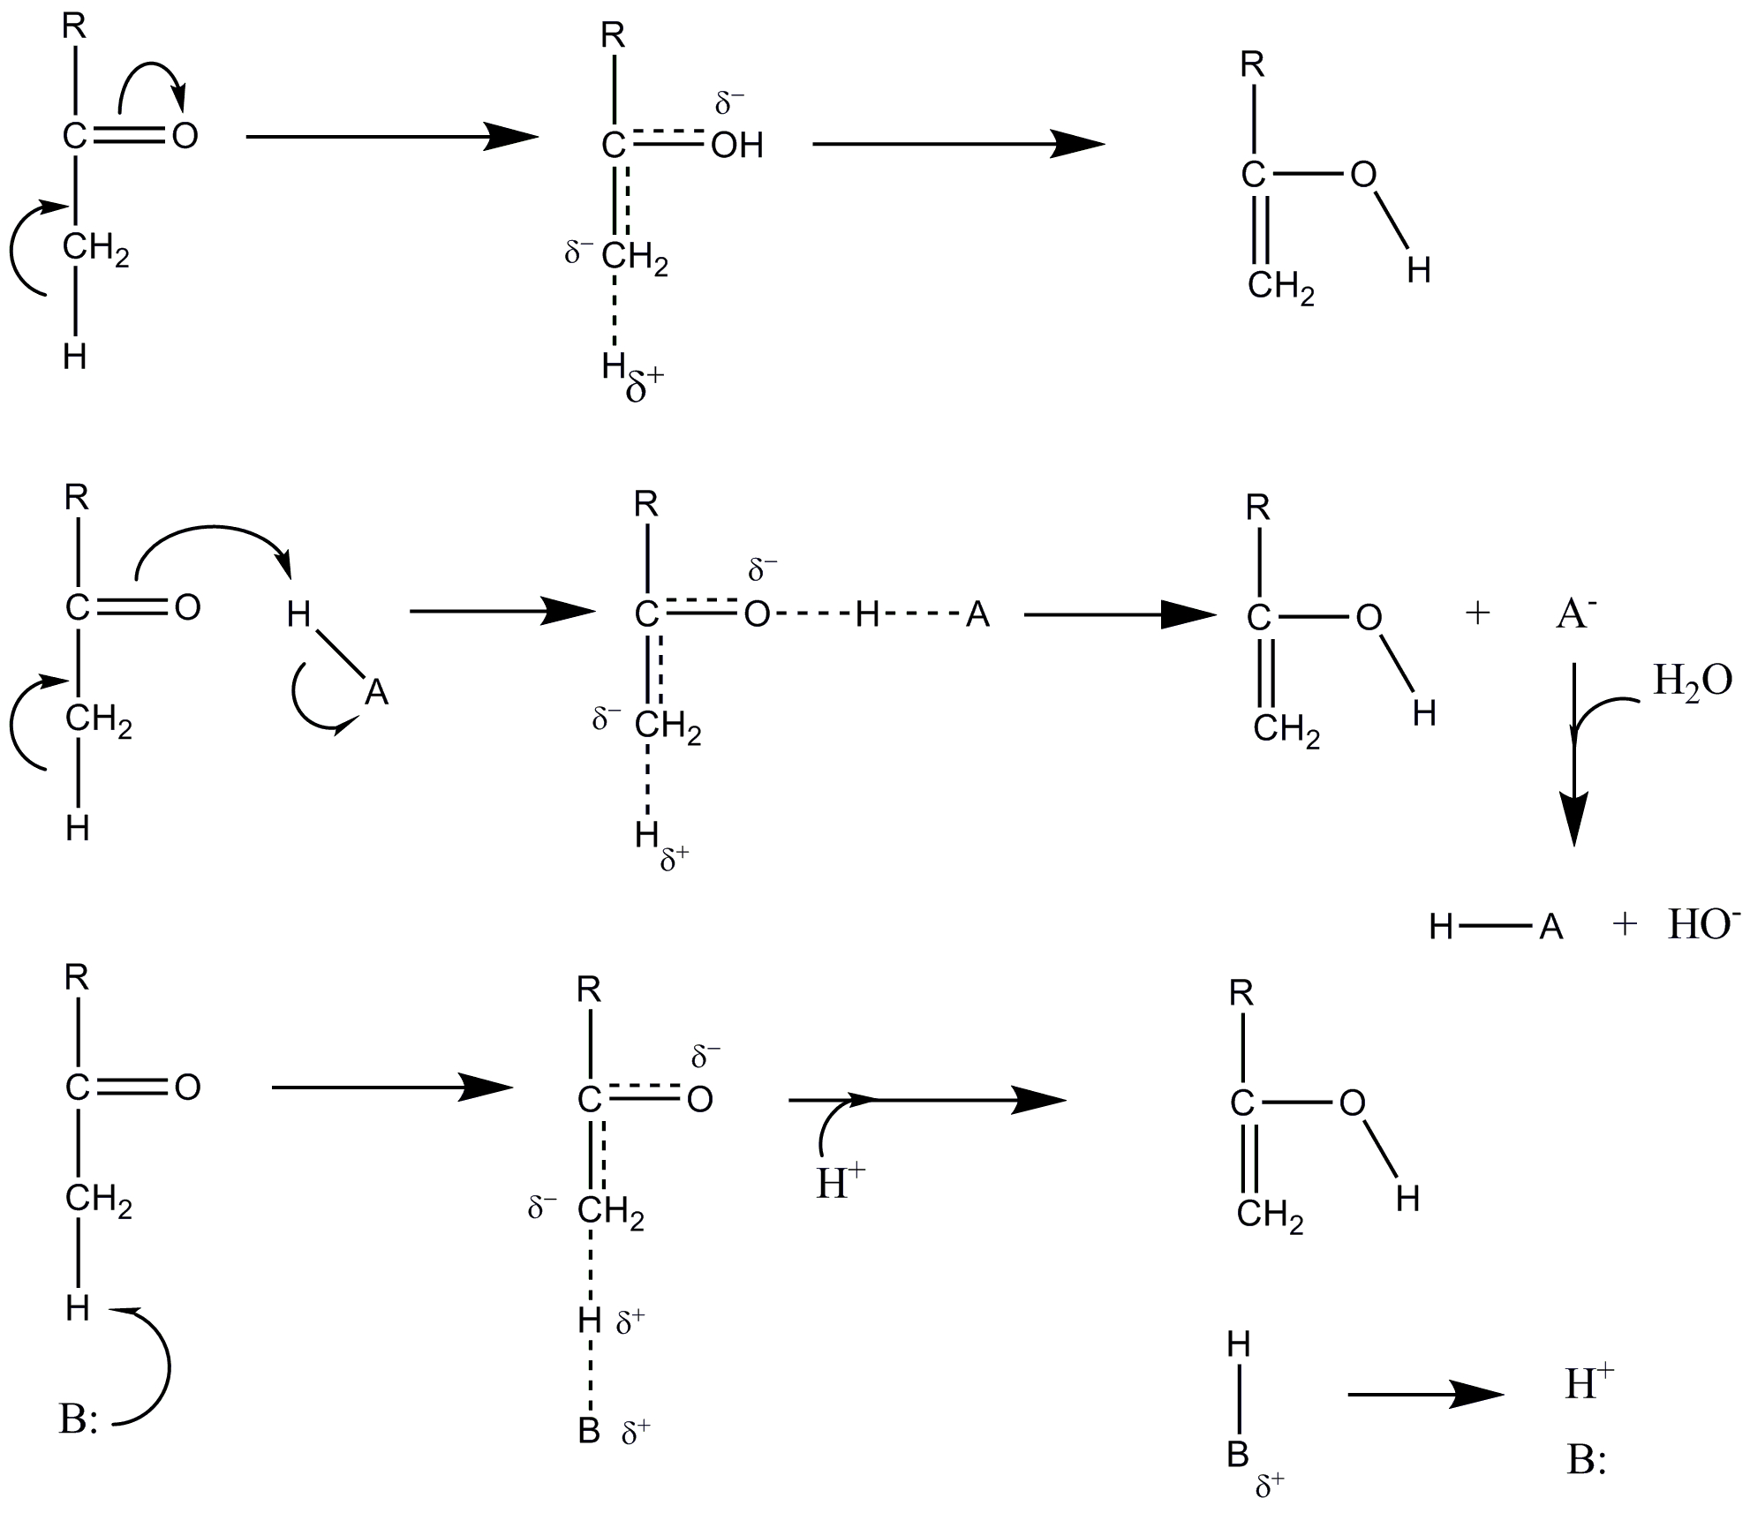
General Acid-Base Catalysis: An Example
Keto-Enol Tautomerization
Uncatalyzed
General acid catalysis: Partial proton transfer from an acid lowers the free energy of the high-free energy carbanionlike transition state of the keto-enol tautomerization
General base catalysis: The rate can be increased by partial proton abstraction by a base.
Concerted acid-base catalyzed reactions involve both processes occurring simultaneously.
Adapted from Voet, Voet and Pratt. Fundamentals of Biochemistry, 3rd Ed. 2008.

Slide 11
General Acid-Base Catalysis: An Example
Enzymatic Degradation of 4-Nitrophenylacetate proceeds via a General Acid-Base mechanism
Imidazole nitrogen extracts proton from water initiating the reaction

Slide 12
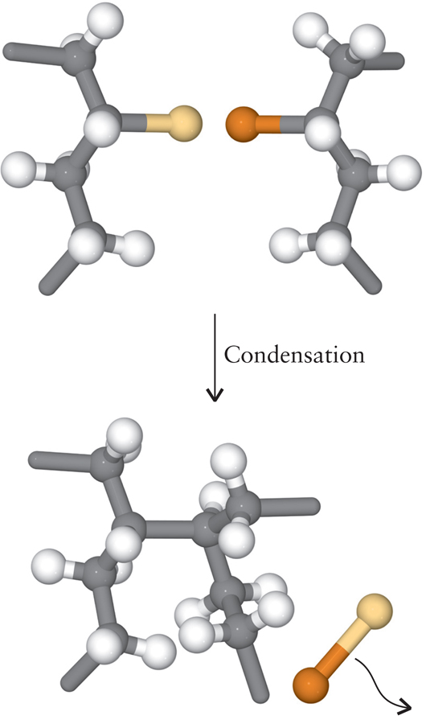
Condensation Reactions
Two molecules combine with the generation of a smaller molecule

Slide 13
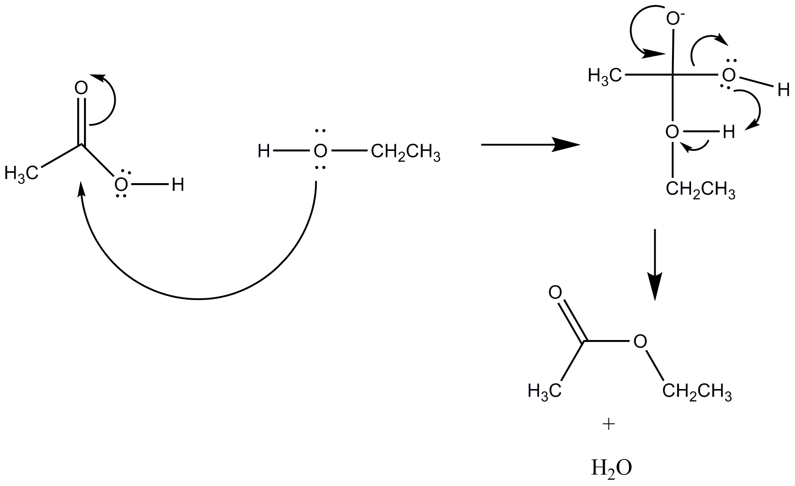
Condensation Reactions
Reaction of Acetic Acid and Ethanol

Slide 14
Looking at the Reaction Mechanism
The carbonyl carbon is:
Electron deficient
In a trigonal planar geometry
120º between substituents
The carbonyl oxygen is pulling electrons towards it
Resonance stabilization
The Lone Pair of the alcohol oxygen can react with the carbonyl carbon to set the whole thing in motion
Remember your VSEPR Geometry

Slide 15
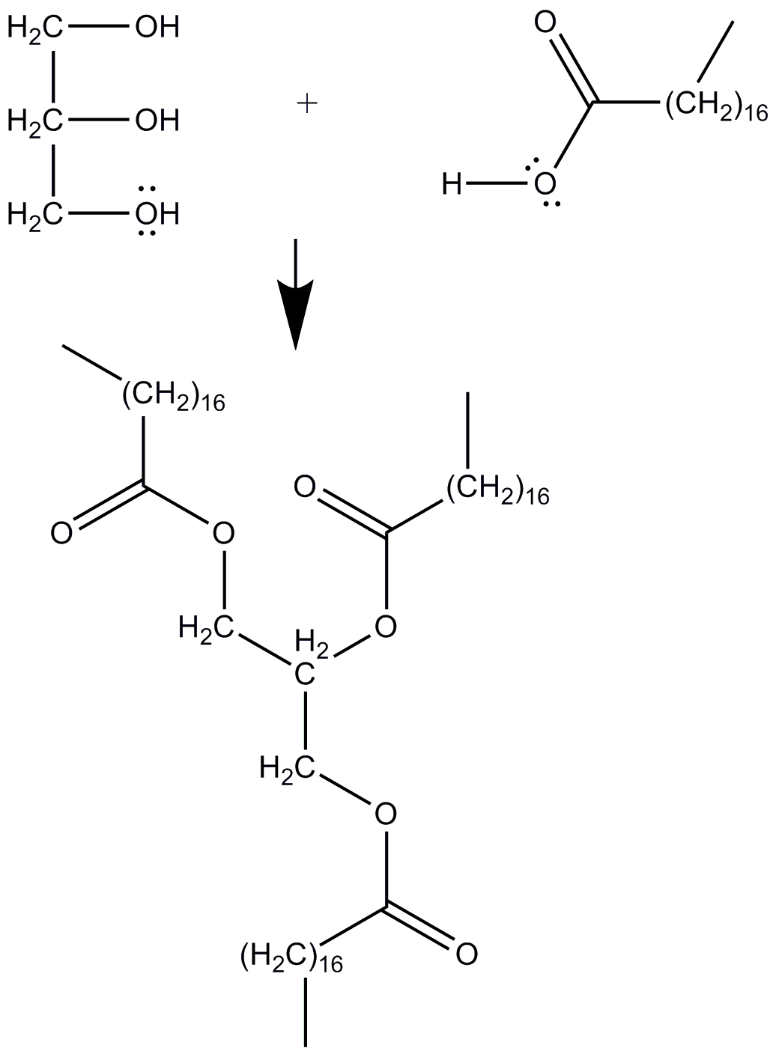
Condensation Reactions: Making Lipids from Sugars and Fatty Acids
Your cells can synthesize lipids from glycerol and fatty acids in a condensation reaction


Slide 16
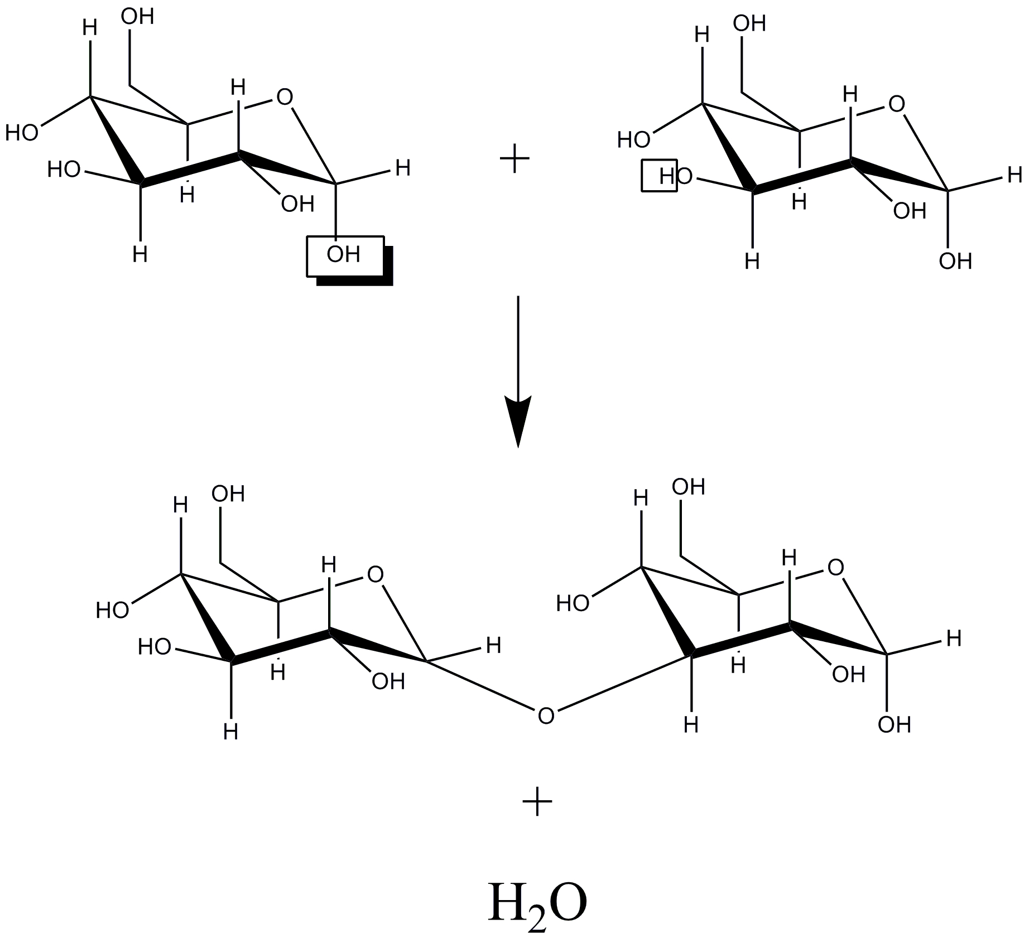
Condensation Reactions: Polymerizing Carbohydrate Monomers

Slide 17
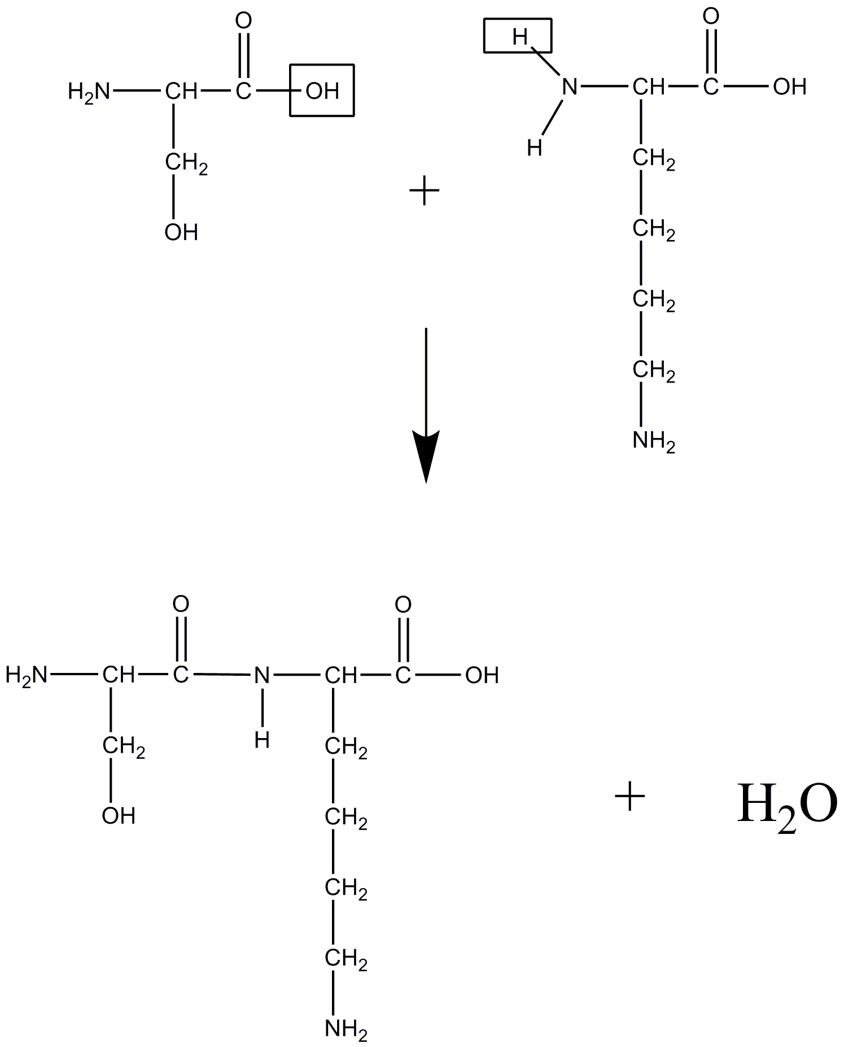
Condensation Reactions: Forming a Peptide Bond
What are the amino acids in the figure?
What function group is formed?
Its not really this simple, but it illustrates a point!

Slide 18
Hydrolysis: The Opposite of Condensation
In a hydrolytic reaction, we add the elements of water (H⁺ and OH⁻) across a bond
Many enzymes use this kind of reaction to degrade polymers
Lipases: Hydrolyze lipid esters
Glycosidases: Hydrolyze carbohydrate polymers
Peptidases: Hydrolyze peptide bonds
Compound Name + ase : Usually indicates a hydrolase (but not always!)
If it isn’t a compound name and ase, then it usually does something else:
Lyase
Reductase
Kinase
Transferase

Slide 19
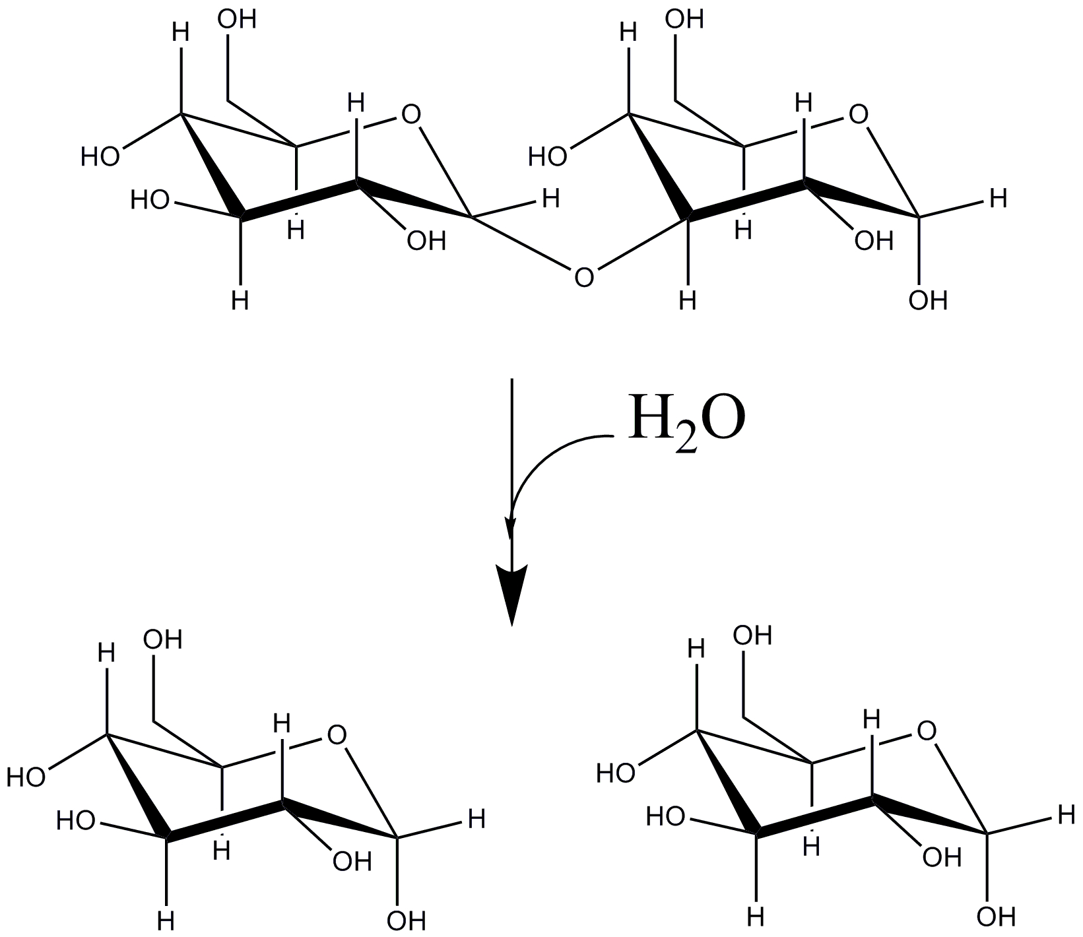
Hydrolysis of Sugar Polymers
We add water across the Glycosidic Bond of Maltose to break it and generate 2 monomers
Catalyzed by a glycosidase (Maltase perhaps?)

Slide 20
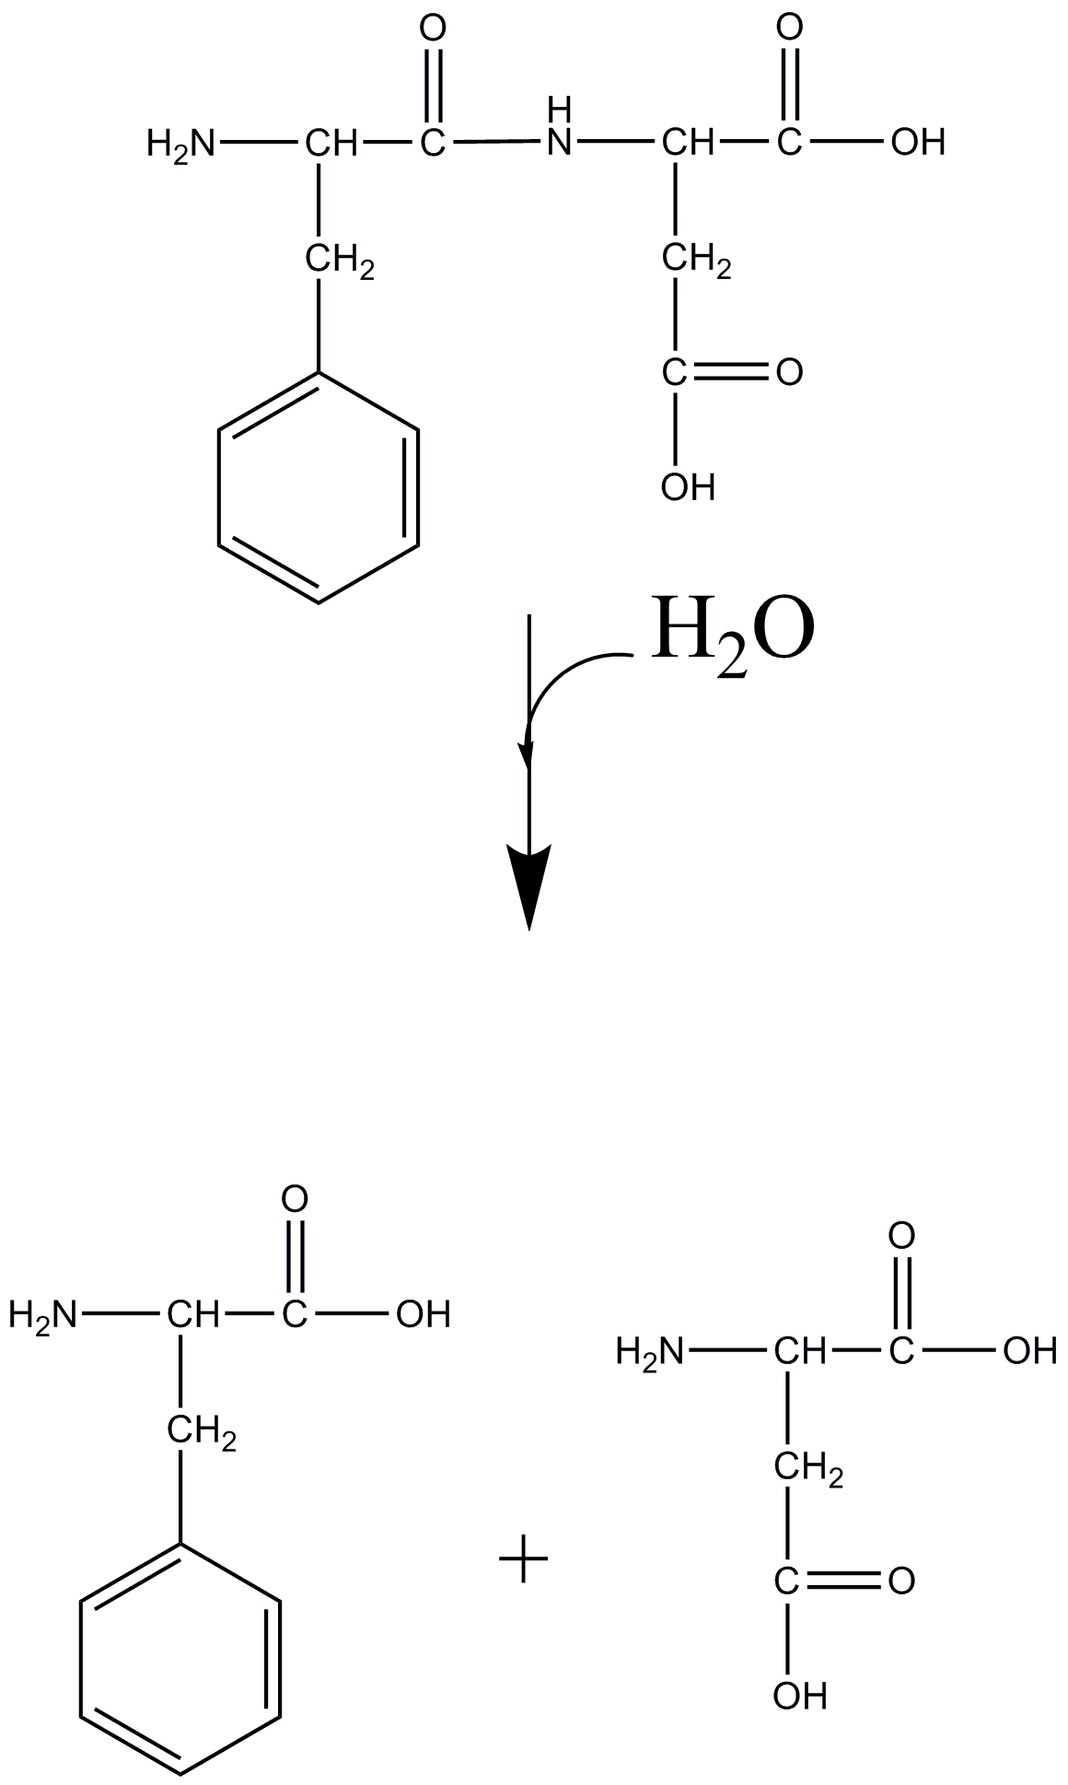
Hydrolysis of Peptides
Dipeptide (What are the amino acids) is hydrolyzed to ???
Catalyzed by a peptidase or a protease

