Slide 1
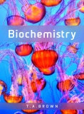
Fig 3.13
Reproduced from: Biochemistry by T.A. Brown, ISBN: 9781907904288 © Scion Publishing Ltd, 2017

Slide 2
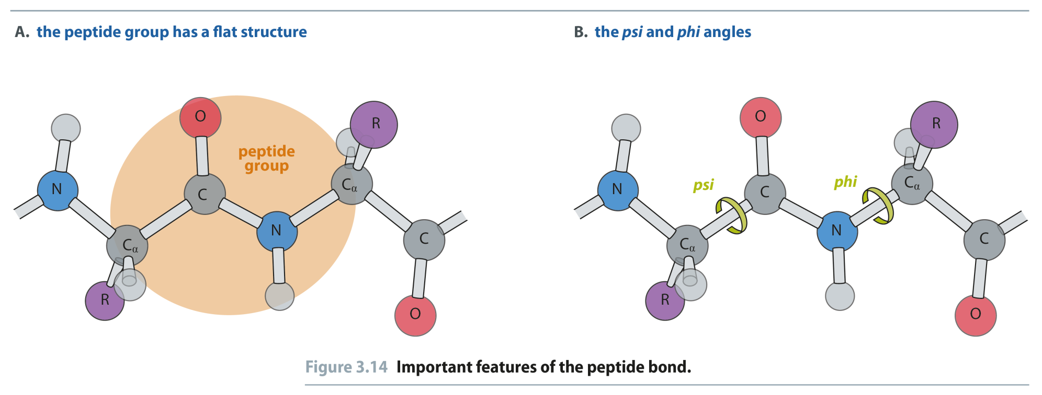
Fig 3.14
Reproduced from: Biochemistry by T.A. Brown, ISBN: 9781907904288 © Scion Publishing Ltd, 2017

Slide 3
Proteins
A protein is a biological macromolecule composed of hundreds of amino acids
A peptide is less than 50 amino acids
A protein can fold into tens of thousands of different three dimensional shapes or Conformations
Usually only one conformation is biologically active
Many diseases such as Alzheimer’s, Mad Cow Disease and various cancers result from the misfolding of a protein
We can break the structure of a protein down to three levels…

Slide 4
Protein Structure: Primary (1°) Structure
The primary structure of a protein is the order in which the amino acids are covalently linked together
Remember: A chain of amino acids has directionality from NH₂ to COOH
Do not be confused:
R-G-H-K-L-A-S-M
And
G-H-K-A-M-S-L-R
May have the same amino acid composition but they have completely different primary structures and are therefore, completely different peptides

Slide 5
Proteins: Secondary (2°) Structure
The secondary structure of a protein arises from the interactions and folding of the primary structure onto itself
Hydrogen bonding, hydrphobic interactions and electrostatic interactions
Every amino acid has 2 bonds that areof primary importance to the formation of secondary structure
Φ angle: Phi angle. The amino group-α−carbon bond angle
Ψ angle: Psi angle. The α-carbon-carbonyl carbon bond angle

Slide 6
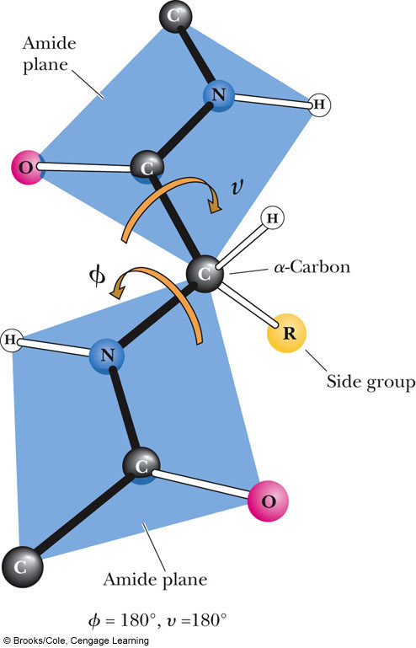
angle
(note typo in textbook)
The amide peptide bond has planar character due to resonance
Look at the Φ/Ψ angles as the rotation of 2 playing cards connected at their corners
Φ angle

Slide 7
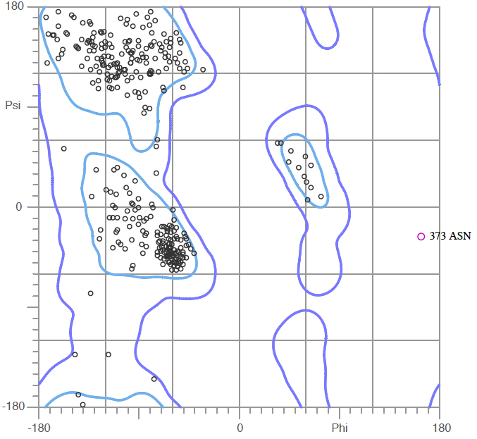
Ramachandran Plot
In 1963, G.N. Ramachandran studied the rotations of the phi/psi angles and determined that each amino acid had a preferred set of them
AND
That particular combinations of phi/psi angles led to stable secondary structures
β-sheet
α-helix

Slide 8
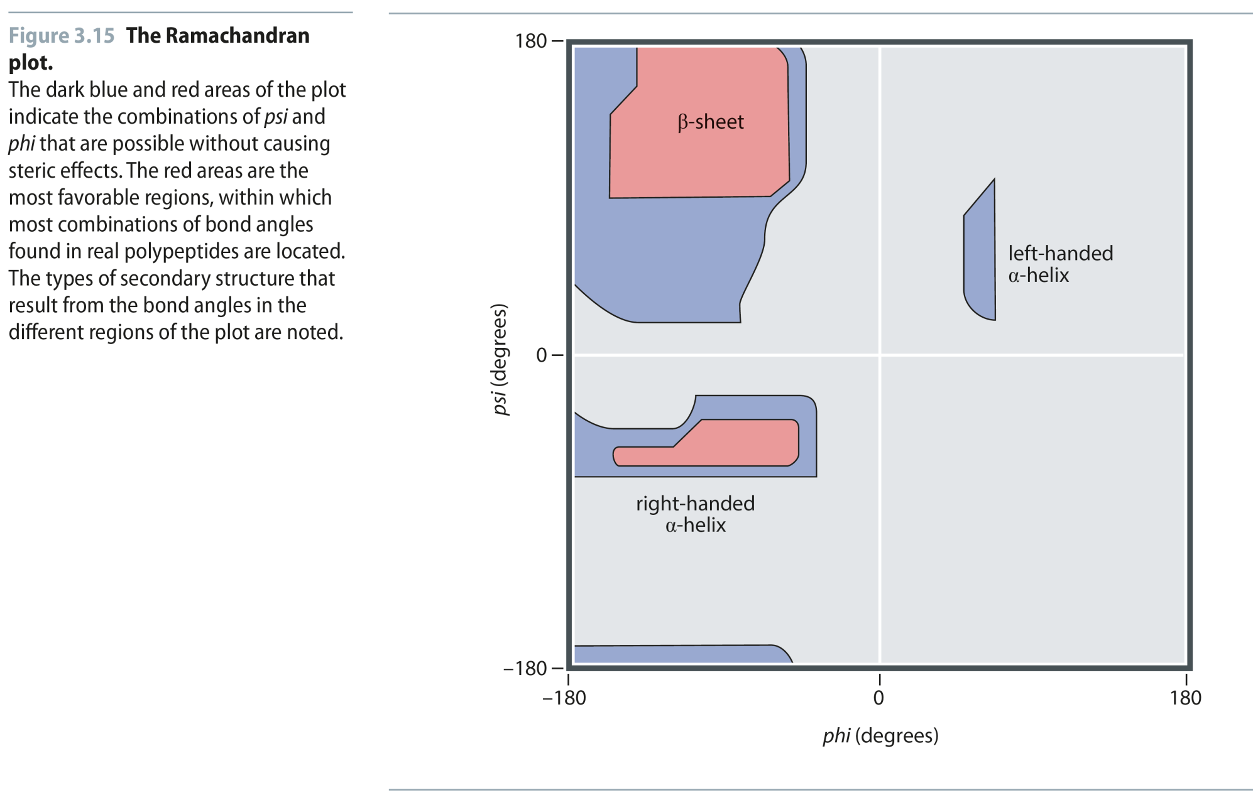
Fig 3.15
Reproduced from: Biochemistry by T.A. Brown, ISBN: 9781907904288 © Scion Publishing Ltd, 2017

Slide 9
Secondary Structures: α-helices and β-sheets
The 2 secondary structures that proteins are primarily composed of ar:
α-helix: a rod-like coil held together by hydrogen bonds
β-helix: A ribbon-like structure held together by hydrogen bonds
Both types of structure are Periodic
Their features repeat at regular intervals

Slide 10
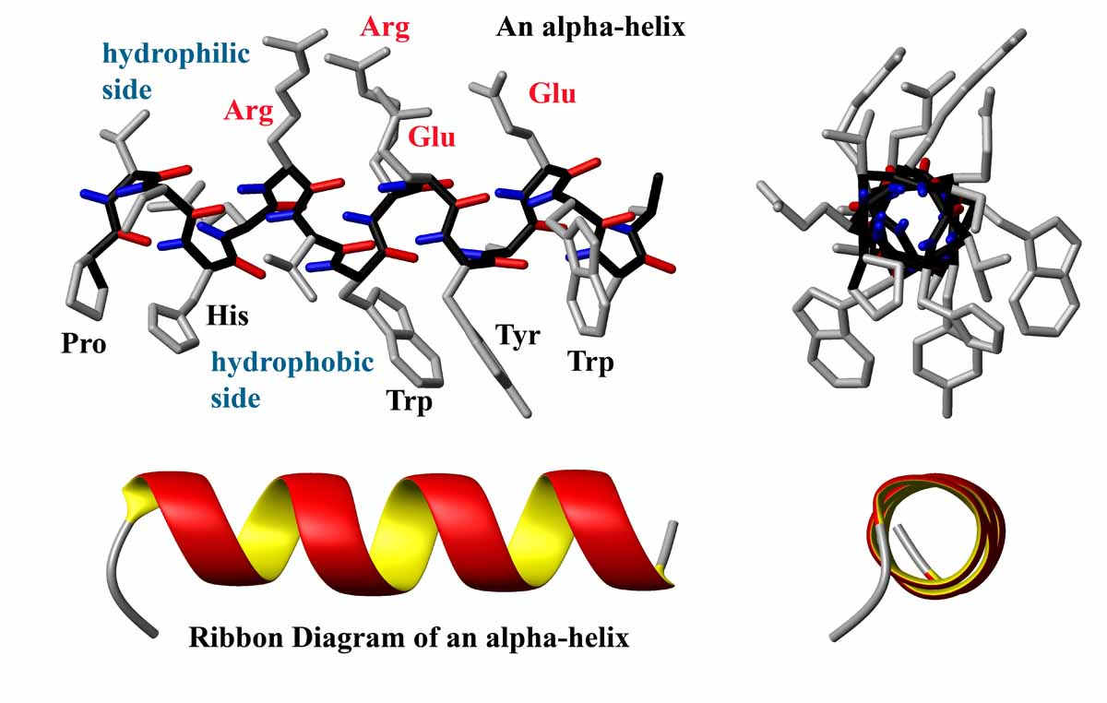
α-helices
Held together by hydrogen bonds running parallel to the helical axis
The carboxyl group of one amino acid is H-bonded to an amino-group hydrogen 4 residues down the chain
For every turn of the helix, there are 3.6 amino acid residues
The pitch (gap between residues above and below the gap between turns) is 5.4 Å (1 Å = 1x10⁻¹⁰ m)

Slide 11
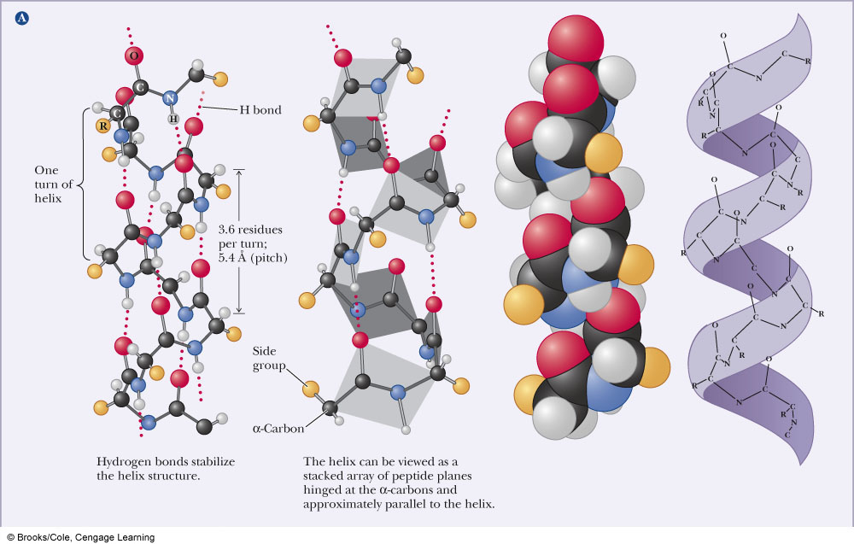

Slide 12
α-helices
Some proteins consist entirely of them
Myoglobin for example
Proline breaks a helix (Why?)
The helical conformation gives a linear arrangement of the atoms involved in hydrogen bonds which maximizes their strength
H-bond distance ~3.0Å
Stretches of charged amino acids will disrupt a helix as will a stretch of amino acids with bulky side chains
Charge repulsion and steric repulsion

Slide 13
β-sheets
A beta sheet is composed of individual beta strands: stretches of polypeptide in an extended conformation
Linear arrangement of amino acids
Hydrogen bonds can form between amino acids of the same strand (intrachain) or adjacent strands (interchain)
β-sheets can be parallel (the strands run in the same direction) or antiparallel (the strands run in opposite directions).

Slide 14
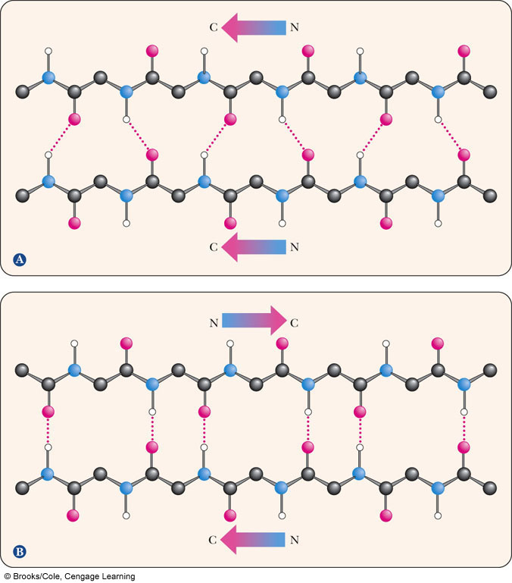

Slide 15
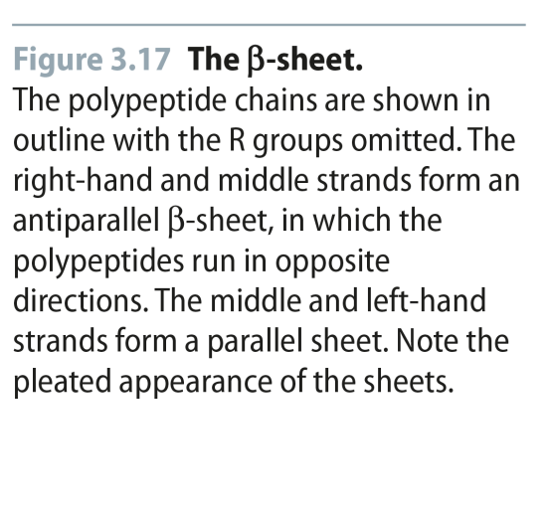
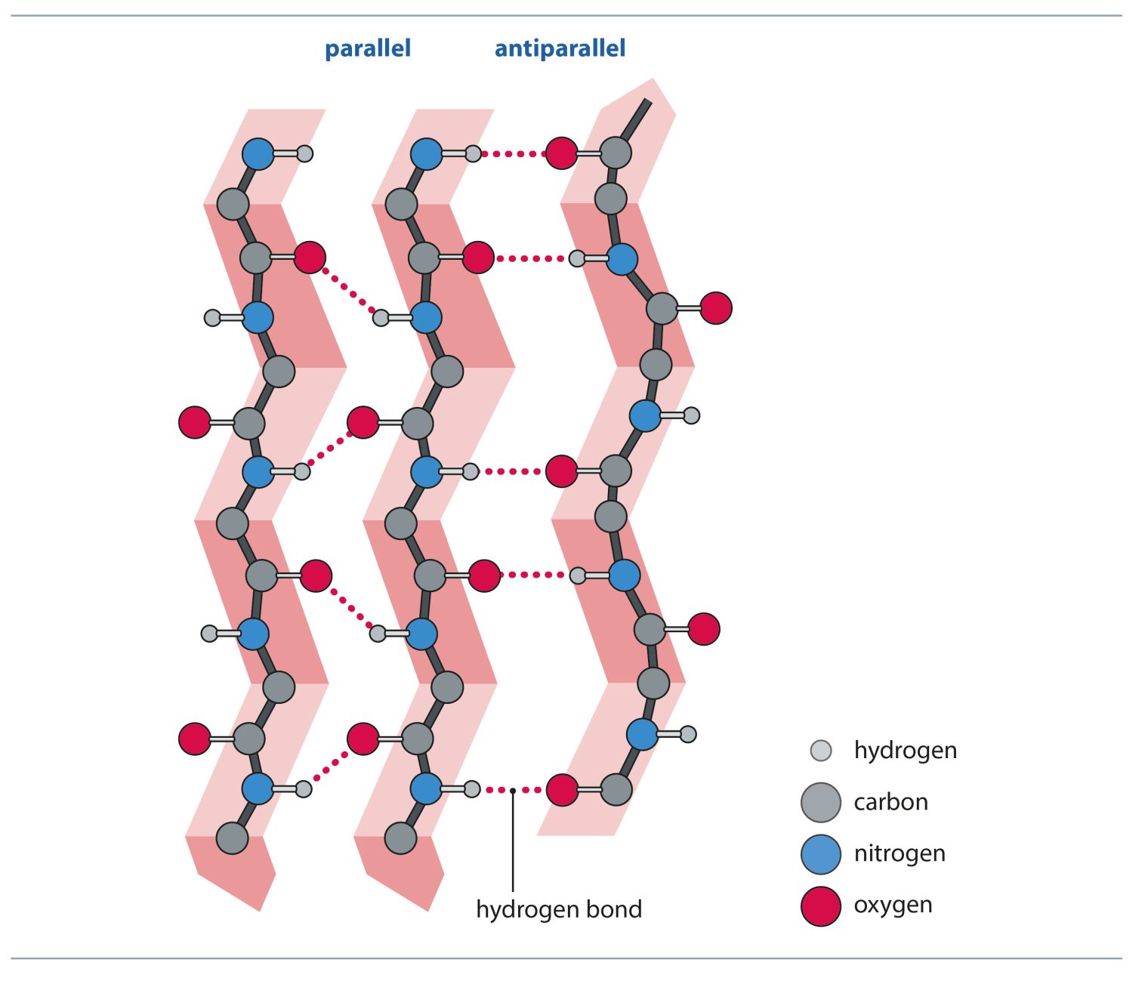
Fig 3.17
Reproduced from: Biochemistry by T.A. Brown, ISBN: 9781907904288 © Scion Publishing Ltd, 2017

Slide 16
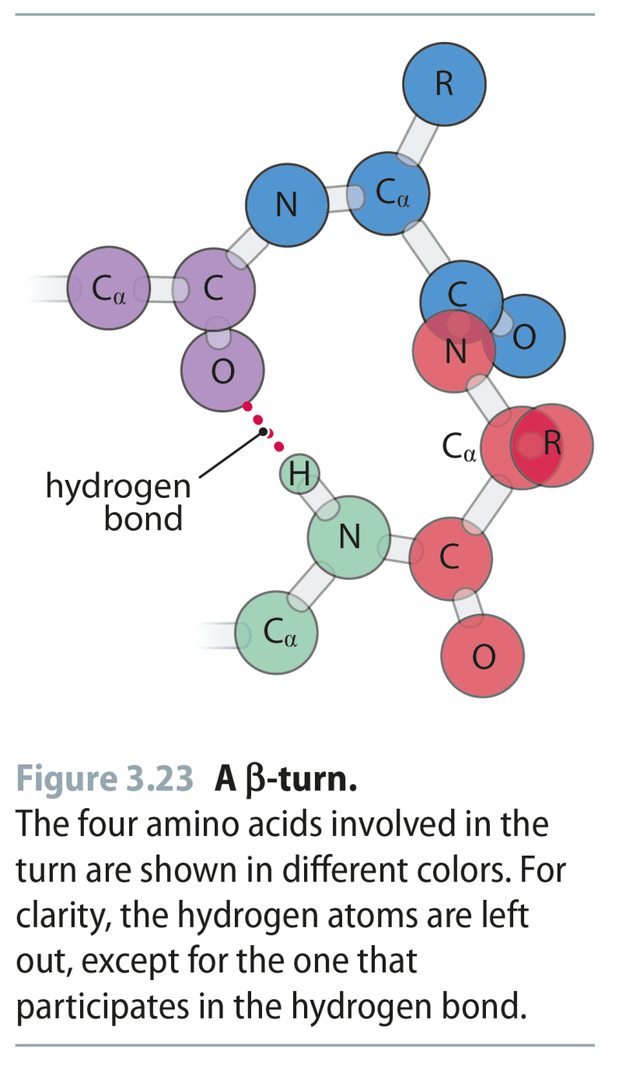
Fig 3.23
Reproduced from: Biochemistry by T.A. Brown, ISBN: 9781907904288 © Scion Publishing Ltd, 2017

Slide 17
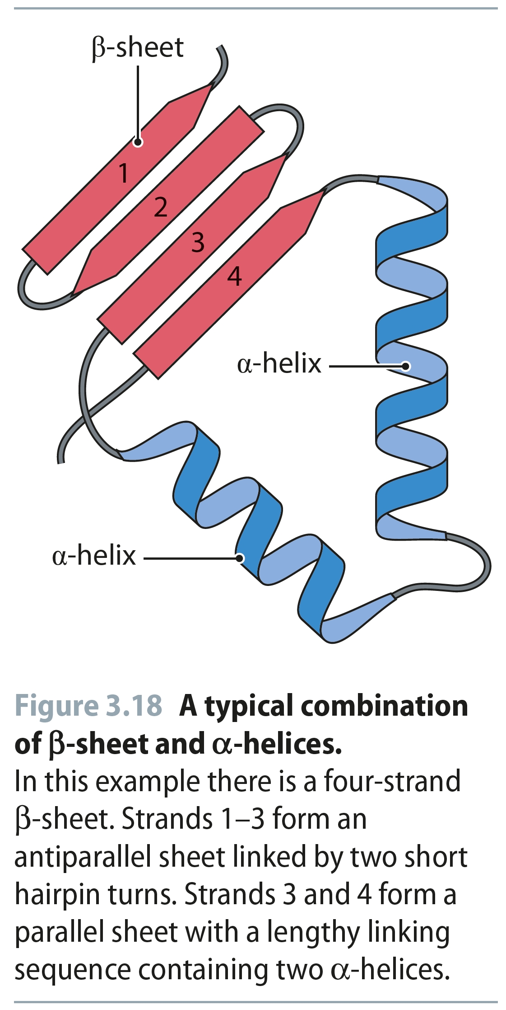
Fig 3.18
Reproduced from: Biochemistry by T.A. Brown, ISBN: 9781907904288 © Scion Publishing Ltd, 2017

Slide 18
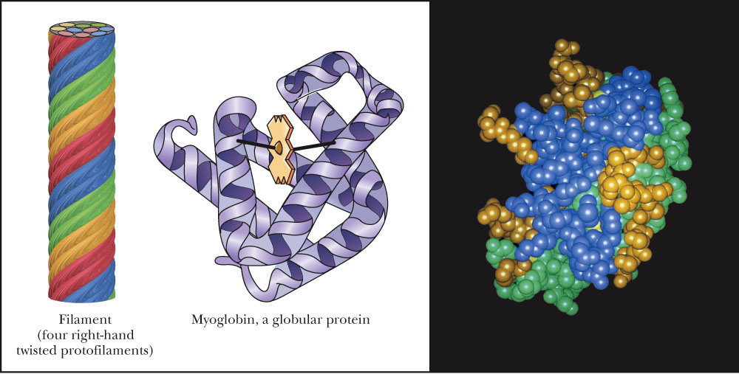
Tertiary Structure
The three dimensional arrangement of all atoms in the molecule
This includes any non-amino acid atoms such as porphyrin rings and metal ions
The overall shape of most proteins is either fibrous or globular

Slide 19
Forces Important in Maintaining Tertiary Structure
Peptide bonds = Covalent bonds
2° and 3° structures = Noncovalent interactions
Let’s look at these non-covalent interactions:
Hydrogen bonding:
H-bonds between backbone atoms (C=O and H-N)
H-bonds between sidechains (COO- and -O-H)
Hydrophobic interactions:
Nonpolar amino acids tend to be found in the core of the protein due to phydrophobic interactions
Electrostatic Interactions:
Metal/Side Chain interactions
Side chain/Ion interactions
Disulfide bonds:
Two cysteine side chains can form S-S bonds, thereby linking two different sections of the polypeptide chain together
Not every protein has disulfide bonds!

Slide 20
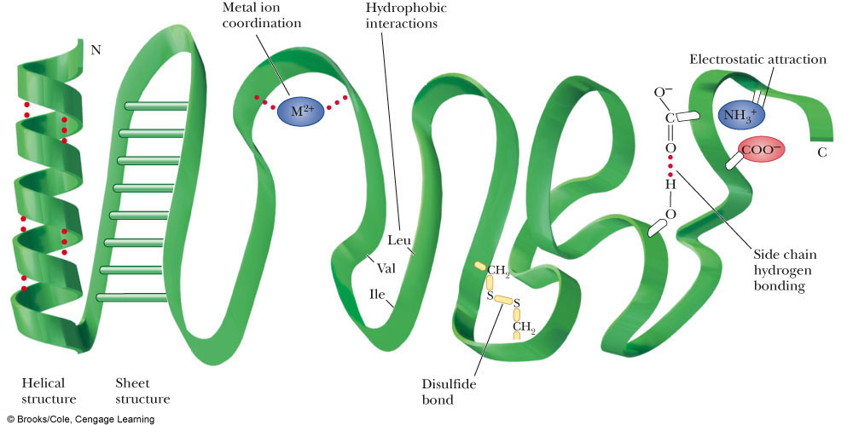

Slide 21
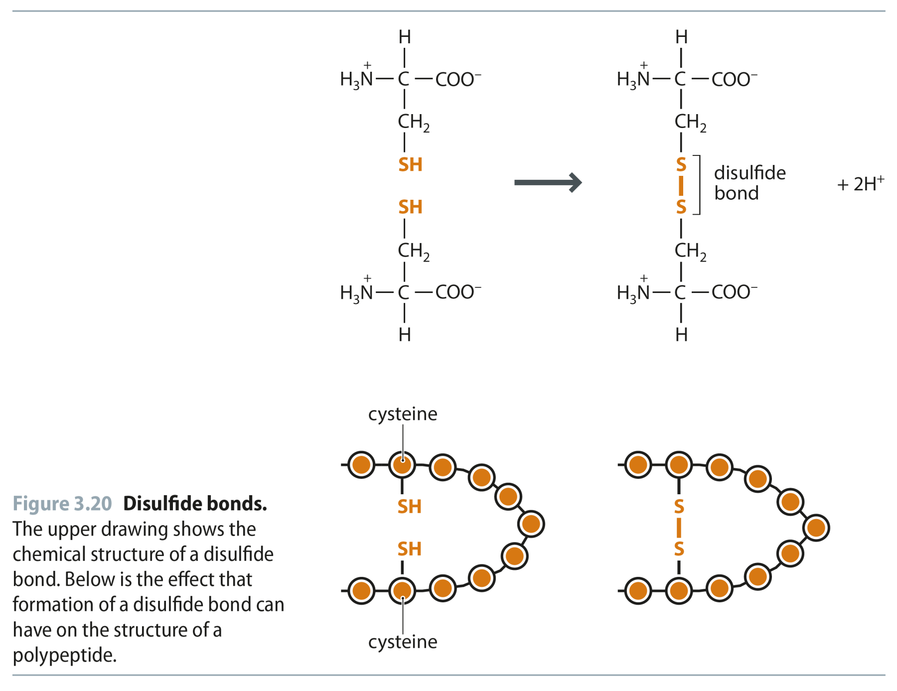
Fig 3.20
Reproduced from: Biochemistry by T.A. Brown, ISBN: 9781907904288 © Scion Publishing Ltd, 2017

Slide 22
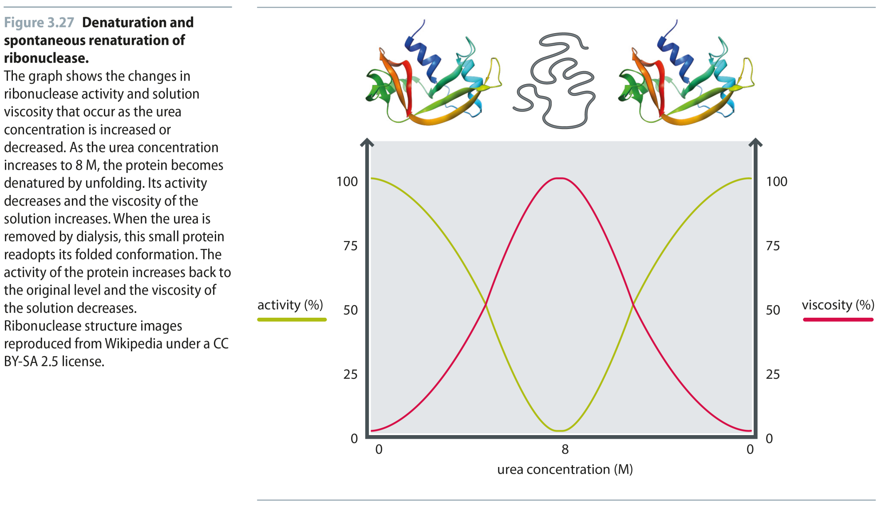
Fig 3.27
Reproduced from: Biochemistry by T.A. Brown, ISBN: 9781907904288 © Scion Publishing Ltd, 2017

Slide 23
Fig 3.28
Reproduced from: Biochemistry by T.A. Brown, ISBN: 9781907904288 © Scion Publishing Ltd, 2017

Slide 24
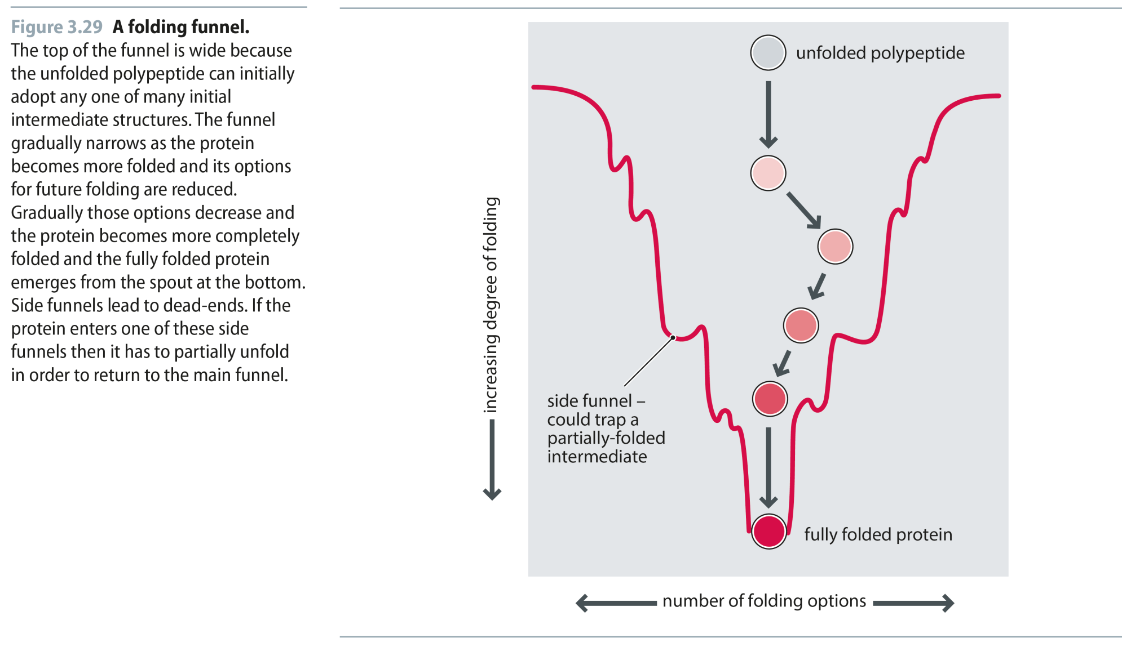
Fig 3.29
Reproduced from: Biochemistry by T.A. Brown, ISBN: 9781907904288 © Scion Publishing Ltd, 2017

Slide 25
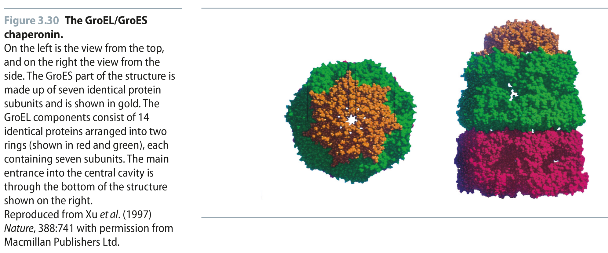
Fig 3.30
Reproduced from: Biochemistry by T.A. Brown, ISBN: 9781907904288 © Scion Publishing Ltd, 2017

