Slide 2
Matter
Chemical substances are composed of matter
Matter is the physical material of the universe; anything with mass that occupies space is matter
Matter can take many forms.
Most matter is formed by unique arrangements of elementary substances called elements

Slide 3
Elements, Molecules and Compounds
Any pure substance that can not be broken down into simpler substances is an element.
Millions of different materials in the world, all comprised of some combination of only 118 elements
Similar to how the alphabet combines 26 letters to yield hundreds of thousands of words, elements bond in unique arrangements to give different molecules
Molecules agglomerate to yield compounds

Slide 4
Elements, Molecules and Compounds
Elements: H, O, Na, Cl (etc.)
Molecules:
H₂O (water),
HOOH (hydrogen peroxide)
NaCl (sodium chloride)
HCl (hydrochloric acid)
NaClO₄ (sodium perchlorate)
We refer to a compound as a bulk accumulation of molecules (i.e. A single water molecule vs. a glass full of water composed of billions and billions of molecules)
Elements can be classified as metals, nonmetals, and semiconductors

Slide 5
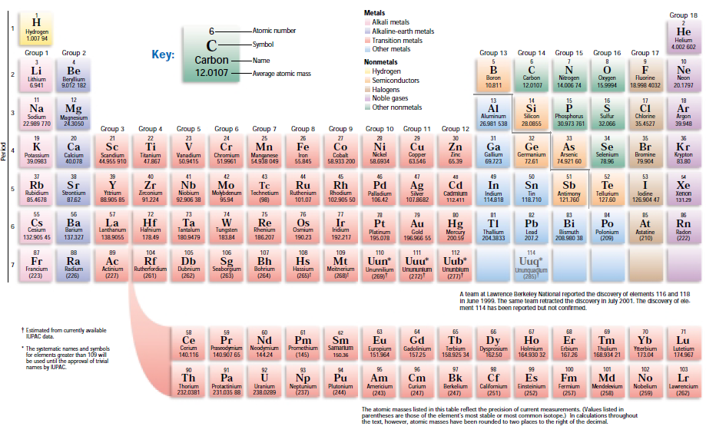
Metals are all elements LEFT of the black line, except Hydrogen. Orange elements along black line are semiconductors.

Slide 6
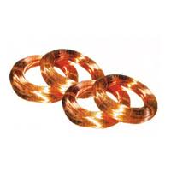
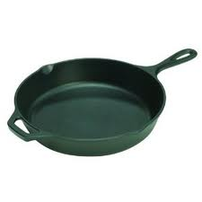
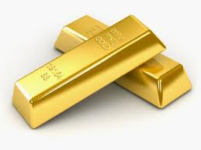
Metals
Metals are highly reactive elements that exhibit the characteristics outlined below:
Metal characteristics
Malleable
Ductile
Conductive of electricity
Conductive of heat
Have luster and shine

Slide 7
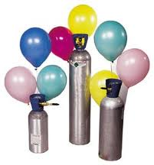
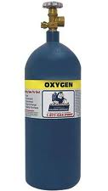
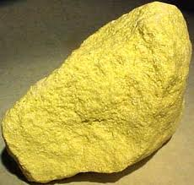
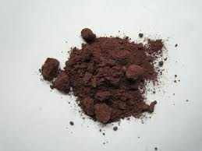
Nonmetals
He (g)
Nonmetal characteristics
Most nonmetals are gases
Non conductive
Those that are solid are not conductive, malleable, or ductile
O₂ (g)
P(s)
S(s)

Slide 8
Diatomic Species
Certain elements are unstable, and hence, do not exist naturally in atomic form, but as diatomic molecules
These specific elements (all gases) include H, O, N, and all of the halogens (group 17)
H → H₂ (Hydrogen gas)
O → O₂ (Oxygen gas)
N → N₂ (Nitrogen gas)
F, Cl, Br, I → F₂, Cl₂, Br₂, I₂ (Fluorine gas, chlorine gas, bromine gas and iodine gas)

Slide 9
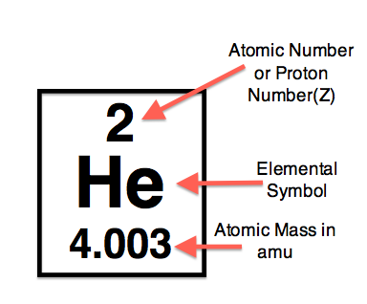
Atomic Mass
Dmitri Mendeleev created the periodic table in in 1869 by arranging the elements in order of increasing atomic mass.
Atoms have extremely small masses. To express such small masses, we use the atomic mass unit (amu), which is equal to 1.66 x 10⁻²⁴ g.

Slide 10
Atomic Structure
The mass of an atom is derived from the subatomic particles that compose it. These electrically charged particles are known as:
electrons (negatively charged)
protons (positively charged)
neutrons (neutral)
Neutral atoms have equal numbers of protons and electrons, so they have no net electrical charge. Electrons and protons have equal but opposite charge.
The structure of the atom is a “spherical” system containing a central nucleus surrounded by orbiting electrons

Slide 11
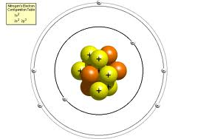
Atomic Structure
Particle | Relative Charge | Mass (amu)
Proton (yellow) | +1 | 1.007
Neutron (orange) | 0 | 1.008
Electron (white) | -1 | .000548
Nearly all the mass of an atom is contained in the nucleus. The electrons are so light that they do not contribute to the total atomic mass.
Therefore, atomic mass increases proportionally with atomic number

Slide 12
Atomic Number
The number of protons in an atom is called the atomic number. This number defines an element.
As shown to the right, only Helium has 2 protons.
The atoms of a given element (same number of protons) are exactly the same in every way.
Since nearly all of the mass of an element is in the nucleus, the atomic mass is merely the sum of the number of protons and neutrons

Slide 13
Isotopes
As you may have noticed, atomic masses are not whole numbers.
The atomic masses listed on the periodic table are average values.
The reason for these averages is that elements exist in nature as numerous isotopes.

Slide 14
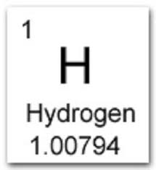
Isotopes
Isotopes are variations of elements with the same number of protons but different numbers of neutrons.
For example, the most common isotope of hydrogen contains one proton, one electron, and no neutrons (99.985% of all hydrogen atoms).
An isotope of hydrogen is deuterium, which has one neutron (.0115 %)
A third isotope, tritium, has two neutrons (~ 0%).
mass number
$${}_{1}^{1}H$$
hydrogen
atomic number
$${}_{1}^{2}H$$
deuterium
$${}_{1}^{3}H$$
tritium

Slide 15
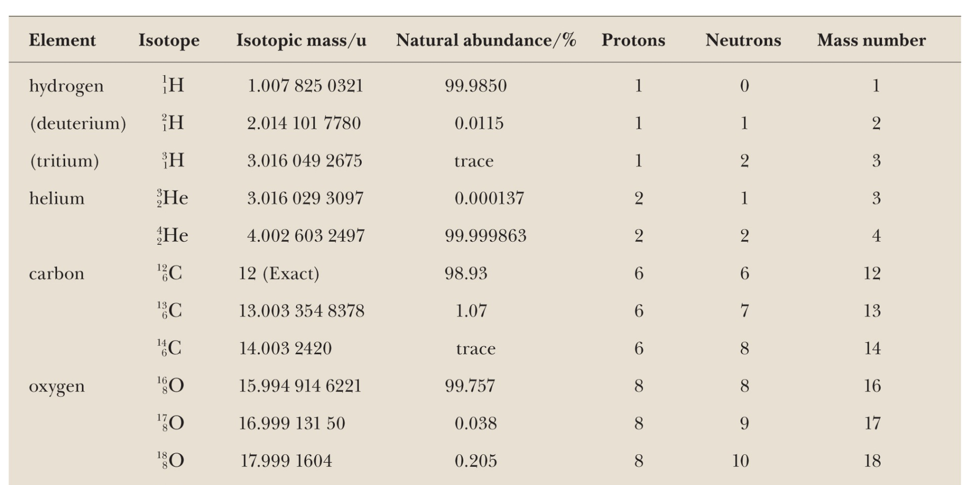
$$Average atomic mass= \sum{\left(abundance\right) x} (isotopic mass)$$

Slide 16
Example
Determine the number of protons,neutrons, and electrons for a neutral carbon atom
Isotope | Protons | Neutrons | Electrons
$${}_{6}^{12}C$$
$${}_{6}^{13}C$$
$${}_{6}^{14}C$$

Slide 17
Ions
Thus far, we’ve learned than an element is essentially defined by it’s atomic number
Each element has an exact number of protons.
For example, Hydrogen has only one proton. If you force a second proton onto the atom, you no longer have hydrogen… you now have Helium.
We have also learned that atoms of a particular element can have variations in the number of neutrons. Atoms of the same element with varying numbers of neutrons are called isotopes.
Next, we will discuss ions.

Slide 18
Ions
Ions are electrically charged atoms, resulting from the gain or loss of electrons.
Positively charged ions are called cations. You form cations when electrons are lost
Negatively charged ions are called anions. You form anions when electrons are gained
A cation is named by adding the word “ion” to the end of the element name
Anions are named by adding the suffix –ide to the end of an element

Slide 19
Ions
$${Li}^{+}$$
Lithium ion
Sodium ion
Magnesium ion
Aluminum ion
$${Na}^{+}$$
$${Mg}^{2+}$$
$${Al}^{3+}$$
$${Cl}^{−}$$
Chloride
Sulfide
Oxide
Phosphide
$$S^{2−}$$
$$O^{2−}$$
$$P^{3−}$$

Slide 20
Ions
Fill in the tables below
$${}_{16}^{32}S$$
ionized
$${}_{16}^{32}{S^{2−}}$$
Sulfur-32
Sulfide-32
ISOTOPE | Protons | Neutrons | Electrons
$${}_{16}^{32}S$$
${}_{ 16}^{32}S$ ²⁻
$${}_{13}^{27}{Al}$$
ionized
$${}_{13}^{27}{{Al}^{3+}}$$
Aluminum-27
Aluminum ion-27
ISOTOPE | Protons | Neutrons | Electrons
$${}_{13}^{27}{Al}$$
${}_{ 13}^{27}{Al}$ ³⁺

Slide 21
Nomenclature
There are special rules to naming molecules. You will see two types of molecules: IONIC and COVALENT
Ionic bonds are formed between metals and nonmetals
To name an ionic compound, you do the following
write the name of the metal
Follow it with the name of the nonmetal, but change the last syllable of the name of the nonmetal to –ide
Example: KF
K (potassium) is a metal. F (fluorine) is a non metal.
We write the name as: Potassium Fluoride
Na₂S = Sodium Sulfide; MgO = Magnesium Oxide

Slide 22
Nomenclature
Covalent bonds are formed between nonmetals and nonmetals
To name a covalent compound, you do the following
Include a prefix corresponding to the first nonmetal. Do not use mono on the first nonmental.
Use a prefix to name the second nonmetal. We only use –mono for oxygen. Drop the ending of the second nonmetal and replace it with –ide
SF₄ = sulfur tetrafluoride
N₂O = dinitrogen monoxide
P₂O₃ = diphosphorus trioxide
SiC = silicon carbide

Slide 23
Groups and Periodicity
As Mendeleev continued to add elements to the periodic table in order of atomic mass, he observed similarities in chemical/physical properties as well as repetitive patterns in chemical behavior.
Thus, the periodic table was arranged vertically in groups, and horizontally across periods. This periodicity is described in the next few slides.

Slide 24
Chemical Groups
Consider the three metals Li, Na, and K
All 3 metals are soft
All 3 metals are less dense than water
All 3 metals have similar appearance and low melting points
The most interesting feature is that all 3 metals react with the same elements in a similar manner
As you see in the periodic table, these elements are all listed vertically in the same group.
Elements in a group behave similarly. Recognizing patterns allows us to predict reactions without memorizing every characteristic of every element

Slide 25
Periodicity
2
He
Totally unreactive gas
Decreasing metallic character
3
Li
4
Be
6
C
9
F
10
Ne
Highly reactive, highly conductive metal
Less reactive, less conductive metal
Nonconductive, nonmetallic solid
Highly reactive, diatomic, nonmetallic gas
Totally unreactive gas
Decreasing metallic character
11
Na
12
Mg
14
Si
17
Cl
18
Ar
Highly reactive, highly conductive metal
Less reactive, less conductive metal
Slightly conductive semi-metal
Highly reactive, diatomic, nonmetallic gas
Totally unreactive gas
Decreasing metallic character
19
K
20
Be
22
C
25
F
26
Kr
Highly reactive, highly conductive metal
Less reactive, less conductive metal
Nonconductive, nonmetallic solid
Highly reactive, diatomic, nonmetallic liq.
Totally unreactive gas

Slide 26
How to Interpret the Findings of Mendeleev
The existence of periodicity proves a very important point:
*Atomic number, and therefore, atomic mass, has no effect on elemental properties. Otherwise, chemical behaviors would never repeat.
Therefore, the chemical behavior of an element must be due to the configuration of electrons around the nucleus.

Slide 27
Periodicity is Due To Repeating Valence Electrons
The outermost electrons of an element (valence electrons) are responsible for chemical reactivity. The number of valence electrons is the same down a group.
Li
Be
B
C
N
O
F
Ne
Na
Mg
Al
Si
P
S
Cl
Ar
Na

Slide 28
EMR: Light and Energy
What is Light?
The light that we see with our eyes is a type of electromagnetic radiation (EMR)
When we use the term radiation, we are referring to energy that is propagated (moves and spreads outward) through space as waves
Light, such as that which emits from a lamp is comprised of visible waves
Radio waves from a radio are another
Invisible UV and Infrared rays from the sun are also EMR

Slide 29
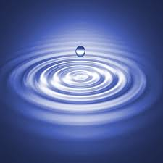
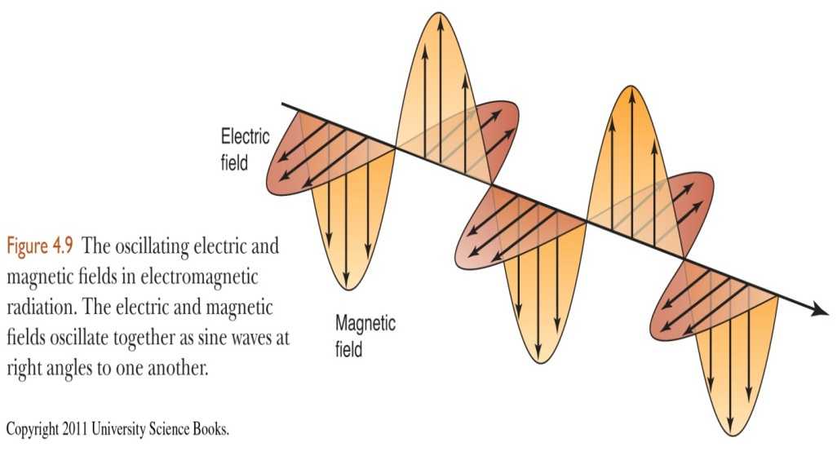
Propagation of Waves
The waves created in water when an external force is applied are an example of propagation.
The energy transferred to the spot of impact when the droplet strikes the surface is spread and transmitted throughout the water.
EMR propagates through the universe as oscillating, perpendicular electric and magnetic fields

Slide 30
Wavelength and Frequency
The distance between local maxima, or crests, is the wavelength λ (units of meters)
If we picture these waves moving across the page, the number of crests that pass a given point per second is the frequency, ν (units of s⁻¹)
The speed of a wave is given by the product of ν and λ:
λν = c
c is the speed of light, 3.0 x 10⁸ m/s. All EMR moves at this speed through vacuum

Slide 31
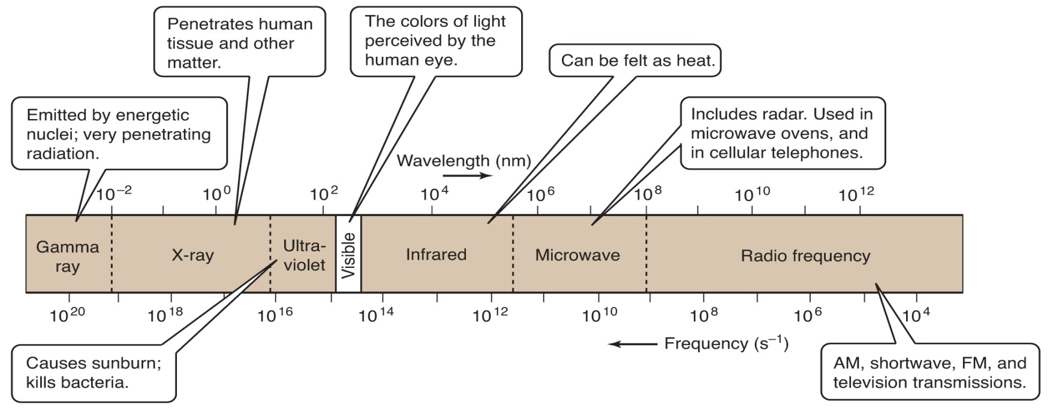
Different Types of EMR Have Different Wavelengths
The electromagnetic spectrum below shows EMR listed by increasing wavelength
Wavelengths vary from the size of an atomic nucleus to the length of a football field

Slide 32
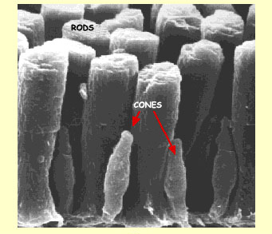
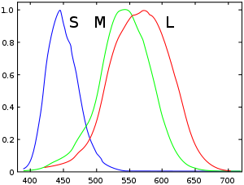
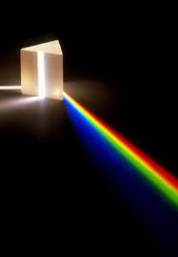
The Visible Spectrum
ROY G. BIV (increasing Energy)

Slide 33
Examples
What is the frequency of orange (~650 nm) light?
A certain type of radiation has a frequency of 10¹⁵ s⁻¹. What is the wavelength, in nm, of this radiation? What kind of radiation is it?

Slide 34
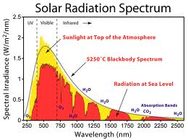
Continuous Spectra
White light is comprised of all wavelengths of the visible spectrum. Because the spectrum of white light has no gaps, it is a continuous spectrum.
Sunlight, for example, is continuous over a long range of wavelengths. The spectrum of sunlight is shown.
Just something to know: Sunlight is actually white, but absorption and scattering of light by the atmosphere causes the sky to appear blue and the sun to appear yellow.

Slide 35
The Birth Of Quantum Physics
The failure of Classical Physics to explain blackbody radiation lead to the creation of Quantum Physics by Planck, Einstein, and others.
Planck explained blackbody radiation by asserting that radiation can only be emitted in small, exact amounts called quanta
He then derived the amount of energy absorbed or released in a single event is equal to:
E = nhν
where E is the total energy in J, n is the number of quanta, and h is Planck’s constant, 6.626 x 10⁻³⁴ Js

Slide 36
Examples
Calculate the energy contained in a single quanta of blue light (~400 nm)
Calculate the energy of contained in 10 quanta of green light (~520 nm)
A laser beam of yellowish light (~550 nm) emits 10¹⁸ quanta per minute. How much energy is emitted per hour?

