Slide 1
Lecture 1: Introduction to Units
1/9/13

Slide 2
Quantitative Measurements
Quantitative measurements are represented by a:
NUMBER and a UNIT
A unit is a standard against which a physical quantity is compared physical quantity
Temperature is measured in Cº, Kº,or Fº
Currency is measured in $USD
Distance is measured in meters, miles, ft, etc.
Time is reported in seconds, minutes, hr, etc.
Internationally accepted system of measurements is called the SI unit system

Slide 3
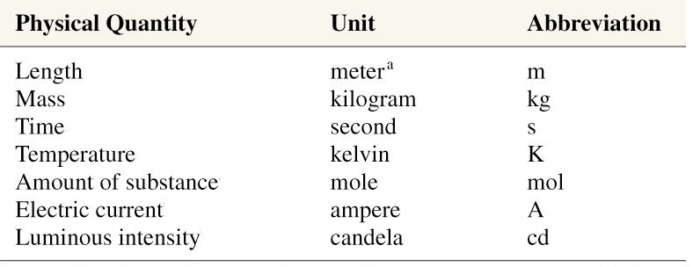
SI Units
Seven Fundamental Quantities

Slide 4
Scientific Notation & Exponent Review
Scientific notation indicates a factor (F) multiplied by a power (n) of 10
F x 10^{n} (1 < F < 10)
Important: All integers end with a decimal point, even though it is not commonly written (1 → 1. )
If no factor is shown, assume there is a 1. in front of powers of 10:
10² = 1. x 10² 10⁻⁷ = 1. x 10⁻⁷
For every positive power of 10, shift the decimal 1 place to the right, add a zero for each place
10² = 1. x 10² = 100. 10⁵ = 1. x 10⁵ = 100000.
scientific
standard

Slide 5
Scientific Notation & Exponent Review
For all non integers, simply shift the decimal. All values greater than 10 have positive exponents.
2.5 x 10⁵ = 250000.
1.8773 x 10⁸ = 187730000.
For negative exponents, shift the decimal left. All values less than 1 have negative exponents.
7.141 x 10⁻² = .07141
3.867 x 10⁻⁷ = .0000003867
Convert to standard notation
3.4912 x 10⁴
8.971 x 10⁻³
6.50 x 10⁰
Convert to scientific notation
15
125.3
0.003003

Slide 6
Multiplying and Dividing Exponents
When multiplying powers of 10, the product is the sum of the powers
10² x 10⁵ = 10 ²⁺⁵ = 10⁷
10⁻⁴ x 10⁻³ = 10⁻⁷
(2.5 x 10³) x (2 x 10⁻⁶) = (2.5 x 2) x (10³⁺⁽⁻⁶⁾) = 5 x 10⁻³
When dividing powers of 10, subtract the powers
10² / 10⁵ = 10 ⁽²⁻⁵⁾ = 10⁻³
(6.6 x 10¹⁰)/ (2.2 x 10⁻⁶) = 3 x (10 ¹⁰⁻⁽⁻⁶⁾) = 3 x 10¹⁶

Slide 7
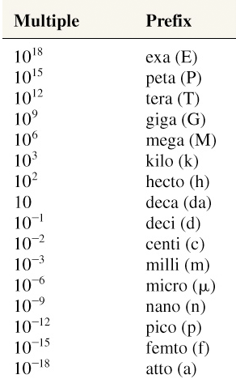
Unit Prefixes
SI Prefixes – KNOW THESE!
Express the following quantities in meters.
Give values in both scientific and standard notation.
5.0 km
3.2 cm
7.5 x 10⁸ nm

Slide 8
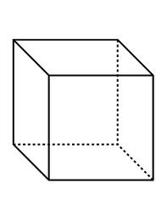
Derived Units (Volume)
Many measured properties have units that are combinations of the fundamental SI units
Volume: defines the quantity of space an object contains or occupies; or the amount of fluid a container can hold
expressed in units of Liters (L) or length³
1 L is equal to the volume of fluid that a cube which is 10 cm on each side can hold
V = LWH = 10 cm x 10 cm x 10 cm = 1000 cm³
1L = 1000cm³
10 cm
10 cm
10 cm

Slide 9
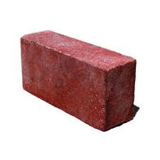
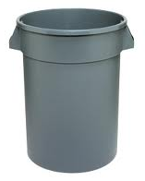
Derived SI Units (Density)
Density: mass per unit volume (mass/volume). Different materials have different densities.
Does a 20-gallon trash filled with bricks weigh the same as one filled with feathers?
Of course not!!

Slide 10
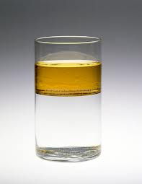
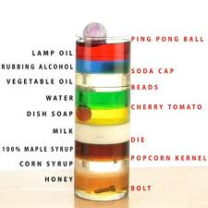
Density
More dense substances will sink.
Oil
0.91 g/cm³
Water
1.0 g/cm³

Slide 11
Unit Conversion: Dimensional Analysis
There are two types of numbers: exact and inexact.
Exact numbers represent defined values
There are 60 seconds in a minute
There are 12 months in a year
There are 1000 grams in a kilogram
Inexact numbers come from measurement. All inexact numbers contain error.
In many instances, its is necessary to express a measurement in units that differ from those given. Dimensional analysis is an algebraic method used to convert between different units by employing conversion factors
Conversion factors are simply exact numbers that are expressed as ratios of values in different units that are equal to unity (1)

Slide 12
Dimensional Analysis
Using our previous example, we can convert between seconds and minutes. The conversion factor would be written as:
In other words, there are 60 seconds per minute, or a minute every 60 seconds. The values of the fractions written above are simply one.

Slide 13
Dimensional Analysis
conversion factor (s)
Example. How many seconds are there in 30 minutes?
Our given unit of time is minutes
Our desired unit of time is seconds
We will use our conversion factor that equates seconds and minutes to obtain units of seconds. The conversion factor must be arranged such that the desired units are ‘on top’
$$30 min x \frac{60 sec}{1 min}=1800 sec$$

Slide 14
Group Examples
Non-SI to SI conversions
Use dimensional analysis to convert units for the following. Report your answer in both standard and scientific notation.
35 minutes to hours
Convert 40 weeks to seconds
**4 gallons to liters
*** 35 $\frac{miles}{hr}$to $\frac{ft}{sec}$
The density of water is 1 $\frac{g}{mL}$. How many grams of water are in 2.4 L?
1 in = 2.54 cm
1 ft = 12 in.
1 mile = 5280 ft
1 quart = 946.3 mL
1 gallon = 4 quarts
1 min = 60 sec
60 min = 1 hr
24 hr = 1 day
1 lb = 453.59 g

Slide 15
Solutions
$$1. 35\min{x \frac{1 hour}{60 min}= .58 hr}or 5.8 x 10^{−1} hr$$
$$2. 40 weeks x \frac{7 days}{week} x \frac{24 hours}{day} x \frac{60 min}{hour} x \frac{60 seconds}{min}$$
$$=2419200 sec or 2.42 x 10^{7} sec$$
$$3. 4 gal x \frac{4 qt}{gal} x \frac{946.3 mL}{qt}x \frac{10^{−3}L}{mL}=15.14 L or 1.514 x 10^{1} L$$
$$4. \frac{35 mi}{hr} x \frac{5280 ft}{mi}x \frac{hr}{60 min}x\frac{min}{60 sec}=51.3 \frac{ft}{sec} or 5.13 x 10^{1}\frac{ft}{sec}$$
$$5. 2.4 L x \frac{1000 mL}{L}x \frac{1 g}{mL}=2400 g or 2.4 x 10^{3} g$$

