Slide 1
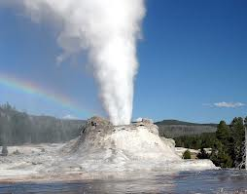
Geothermal Power
Dr. Harris
Phys 105
4/3/13

Slide 2
What is Geothermal Energy?
Geothermal energy is defined as heat from the Earth. It is a clean, renewable resource that provides energy around the world.
It is considered a renewable resource because the heat emanating from the interior of the Earth is essentially limitless.
Geothermal is a natural form of nuclear power, as it originates from radioactive decay.

Slide 3
Origin of Geothermal Power
Geothermal energy originates from the Earth’s core, which is estimated to have a temperature of about 5,000° C. This nearly constant temperature is possible because of continuous radioactive decay, compression, and because the core is very well insulated.
Crust
Upper Mantle
600ºC
Mantle
1200ºC
Outer Core
4000ºC
Inner Core
5000ºC

Slide 4
Harnessing Geothermal
Geothermal power emits from earth at a rate of 44 x 10¹² W. This is more than double the total power consumption of the world.
The Earth’s crust acts as a massive insulating “blanket” that traps this heat deep under the surface. Thus, the crust must be pierced to release this heat
Unfortunately, this power is too spread out to effectively use it all.
The distribution of geothermal energy, however, is not uniform. Certain regions have an enormous geothermal resource
Where the crust is thin or fractured, as at the edges of tectonic plates, volcanoes, geysers and hot springs deliver this energy to the surface.

Slide 5
Geothermal Sources
Hot Water Reservoirs
Heated underground water pools, very large in magnitude in the U.S.; not appropriate for electricity but can be useful for space heating
Natural Steam Reservoirs*
e.g. The Geysers power plant (Ca). Highly desirable type of resource for direct generation of electric, though very rare
Geopressured Reservoirs*
Hot, superheated brine solution saturated with natural gas. Useful for both its heat content and natural gas
Hot Dry Rock
Hot rock can be used to heat a working fluid is forced through a series of man-made channels and cycled. No technology yet exists to do this
Hot Molten Rock (Lava)
No technology yet exists to extract heat energy from lava

Slide 6
Estimated U.S. Geothermal Resources
Resource Type | Total Resource (QBtu) | Potentially Usable Resource (QBtu)
Hot Water | 12,000 | 6,000
Natural Steam | 180 | 45
Geopressurized | 73,000 | 2,400
Hot Rock | 1,410,000 | 14,100
Lava | 3,500 | 35
* The U.S. consumes 98 QBtu of energy per year

Slide 7
Geothermal Power Plants
There are three types of geothermal power plants
Direct Dry Steam Plants
Flash Cycle Plants
Binary Closed Cycle Plants

Slide 8
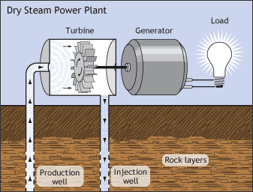
Direct Dry Steam Power Plant

Slide 9
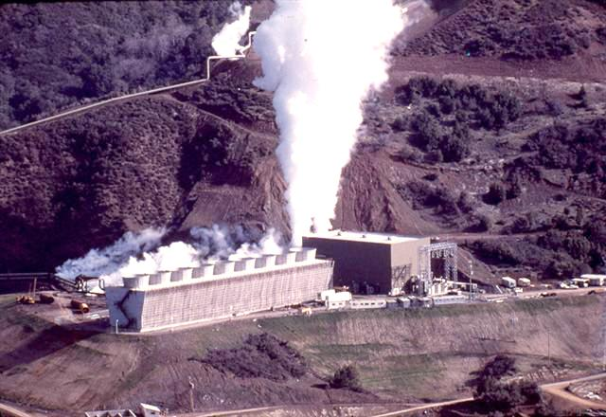
The Geysers (California)

Slide 10
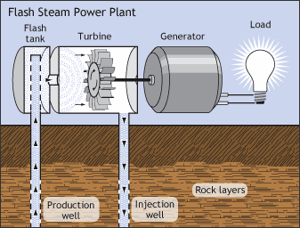
Flash Cycle Plants
Uses superheated brine. When the brine enters a low pressure chamber called a flash tank, it instantly vaporizes (flashes).

Slide 11
Binary Closed Cycle Plants
Binary closed cycle plants use a working fluid (i.e. Freon) to spin a turbine. The working fluid cycles through a heat exchanger where it is evaporated by hot water from a geothermal reservoir.
working fluid
flow direction
condenser
Cold water
evaporator
hot water
pump

Slide 12
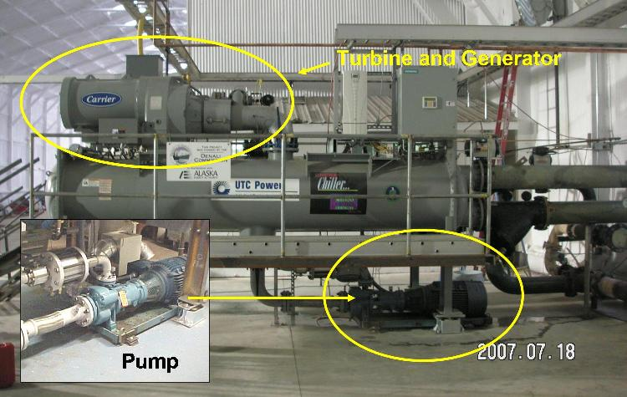
Binary Closed Cycle Turbine At Chena Power Plant in Alaska

Slide 13
Binary Closed Cycle Plants
Binary cycle plants are the most useful because it is not necessary for the water to reach the extreme temperatures that are experienced with dry steam and flash plants.
The water in a binary cycle plants needs only to be above the boiling temperature of the working fluid
Considering that most geothermal water is of moderate temperature (> 400ºF), these are the most useful and most viable types of geothermal plants.

Slide 14
Advantages of Geothermal
Geothermal energy is a renewable energy source.
Geothermal energy is relatively clean
Produces 12% of GHG emission of fossil fuel plants)
Geothermal energy can be used for cooling and heating homes.
Not subject to the same fluctuations as solar or wind
Smallest land footprint of any major power source
Virtually limitless supply
Inherently simple and reliable
Can provide base load or peak power
Already cost competitive in some areas (~$0.07 per kWh)
Could be built underground
Massive potential for the utilization of untapped sources
New technologies show promise to utilize lower water temperatures

Slide 15
Disadvantages of Geothermal
High upfront costs associated with exploration and drilling
Finite lifetime of useful energy production
Continuous drop in thermal output overtime
Once the thermal energy of a well is tapped, it requires a “recharging” period that can take several years.
Very location specific (e.g. Iceland)
There are significant volumes of greenhouse gases and toxic compounds such as hydrogen sulfide that are released when geothermal reservoirs are tapped
Foul smelling gases
Pumps used to circulate working fluid consume fossil fuel
Earthquakes induced by fracking.

