Slide 1
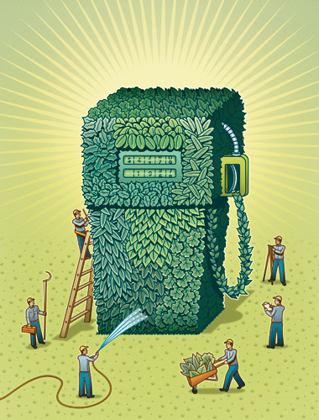
BIOFUELS (Part 1)

Slide 2
Restating the Issue At Hand
The world is facing a serious energy crisis
Fossil fuels like oil and coal produce 80% of the energy consumed each year
With climate change and depletion of resources looming, a reliable, renewable alternative must be derived.

Slide 3
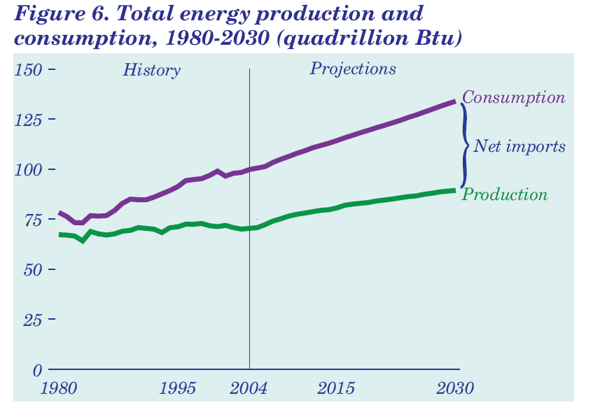
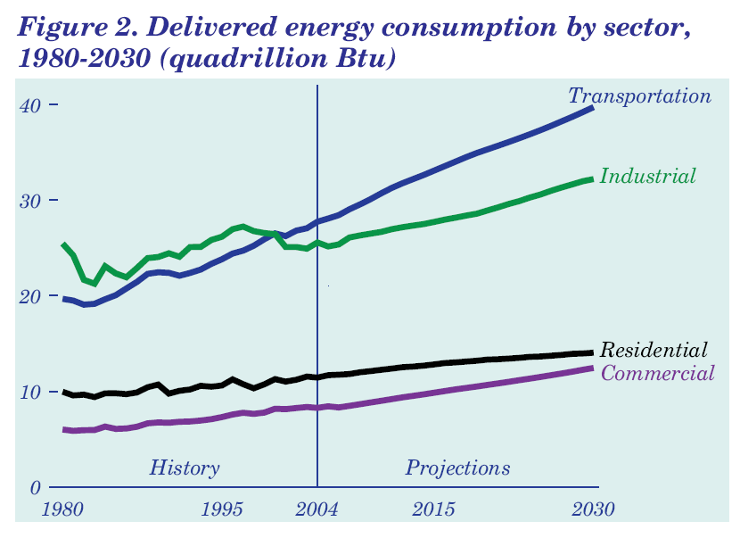
Electricity Isn’t The Only Concern
US energy production and consumption (QBtu)
Energy Usage By Sector

Slide 4
Biomass?
Biomass, or plant life, is considered a highly viable energy source.
Solar energy is absorbed by plants. During photosynthesis, CO₂ and water absorbed from the surroundings are converted into various carbohydrates (C_{n}(H₂O)_{n}) and oxygen gas, O₂
The simplest carbohydrates formed are sugars such as glucose
The reaction leading to the formation of glucose is:
The green pigment in plants, chlorophyll, plays a huge role in this process by absorbing visible light from the sun.
$$6 CO_{2}\left(g\right)+6 H_{2}O \left(L\right)+light → C_{6}H_{12}O_{6} \left(s\right)+6 O_{2} (g)$$

Slide 5
Conversion of Biomass To Fuel?
The plants sustains itself on the glucose it produces. These stored sugars provide the plant with its caloric content, which is what allows the animals that eat the plants to obtain nourishment.
This carbon-rich biomass can also be used to provide energy
Until 1880, the main source of energy for heating and transportation in the US was wood. Energy could be obtained directly by burning the wood.
Today, biomass can be converted into liquid fuels like alcohols (ethanol, propanol, butanol) and serve as substitutes to gasoline
For example, most gasoline is actually 10% ethanol, 90% oil (gashol)

Slide 6
Biofuel Production
There are two types of biofuels: ethanol and biodiesel
The primary form of biofuel used in the US is ethanol.
The primary type of biomass used to obtain ethanol is corn.
After harvest, the corn, including the stalk, husk and cob, are ground up and mixed with water
The slurry is then boiled, releasing starch from the kernels (chains of connected glucose molecules)
The starches are easily fermented to alcohol
Distillation removes alcohol from the slurry
The inedible portions of the corn, known as stover, are not easily fermented due to high celluose and lignin content. This material is typically discarded as waste.

Slide 7
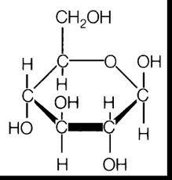
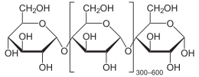
amylase
starch
glucose molecules
glycolysis
yeast
fermentation
O
O
O
O
+ CO₂
C
C
C
C
H₃C
O
H₃C
O
ethanol
2 pyruvate molecules

Slide 8
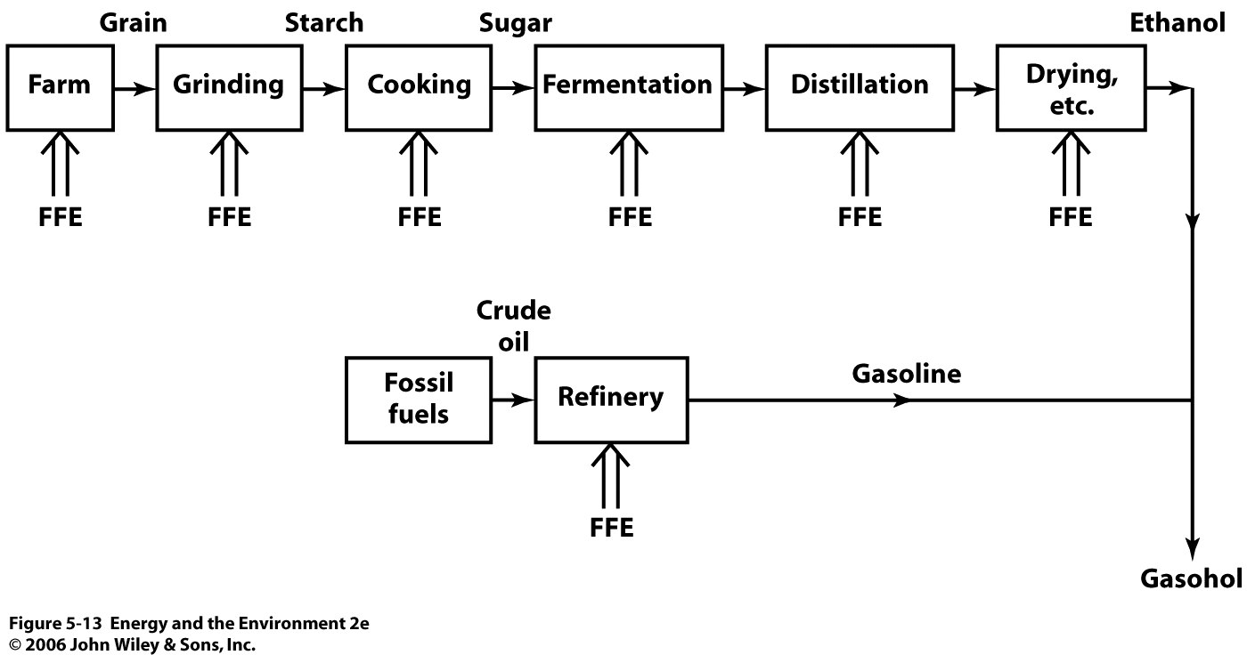
Conversion of Biomass to Liquid and Gas Fuels
FFE = fossil fuel energy

Slide 9
Brazil is the Gold Standard For Biofuel Implementation
Brazil, which has very little oil, made a serious effort to shift to alcohol as transportation fuel
Brazil grows massive amounts of sugarcane, which is converted to ethanol as previously described
Last year, Brazil produced 27 billion liters of ethanol for transportation, and produced 2GW of electricity by burning the waste
During the 80’s, nearly 90% of the vehicles were designed to run on ethanol

Slide 10
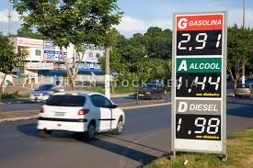
Virtually none of the cars in Brazil run on pure gasoline. Consumers use various blends such as E20, E85, or pure ethanol.
The country has replaced the vast majority of its oil with ethanol, and saves nearly $50B per year by not importing.

Slide 11
Fuel vs. Food?
Biomass is the cheapest form of renewable energy, and 78% of all renewable energy used in the world is derived from biofuels
However, in the face of expanding food demands, the use of food crops and/or food-producing farm lands for the production of biofuels is unsustainable and inefficient
In order for biofuels to reach their full potential, scientist must utilize stover.
It is estimated that the energy content of corn would double if the stover is fermented (currently, 95% of ethanol is derived from corn starch)
There are many other cellulose-rich biomass sources available

Slide 12
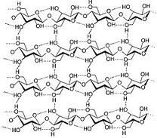
Cellulose

Slide 13
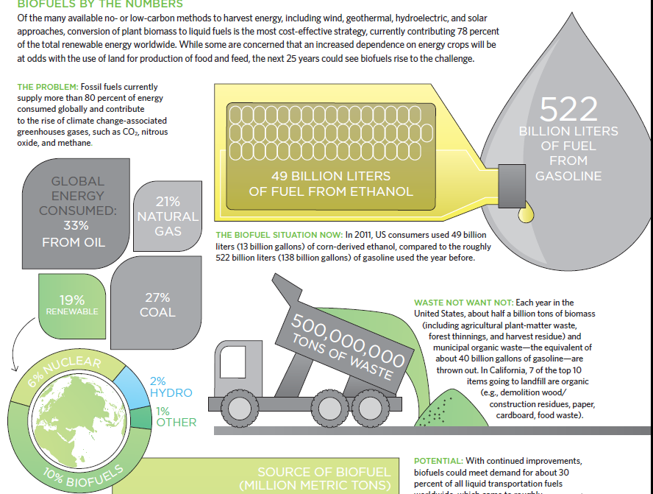

Slide 14
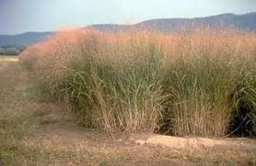
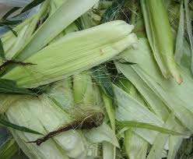
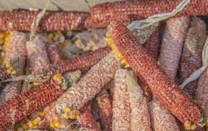
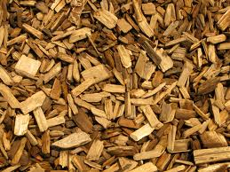

Slide 15
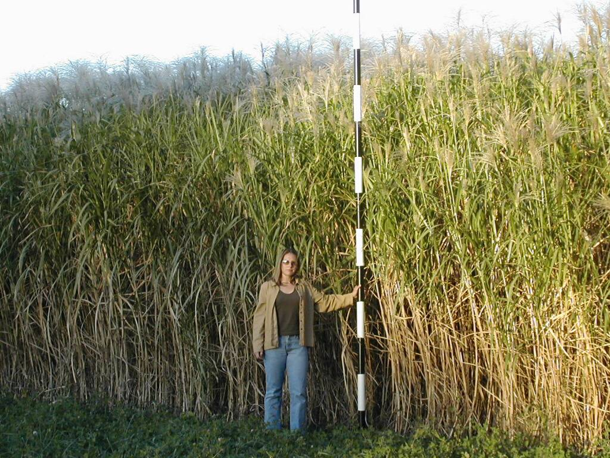
20 tons/acre? (www.bical.net)
10-30 tons/acre (www.aces.uiuc.edu/DSI/MASGC.pdf)

Slide 16
Cellulosic Ethanol
All plant matter contains celluose, and another material called hemicellulose.
These polysaccharides are tangled within another material called lignin. This is the armor of a plant, and is what gives some plants a “woody” texture.
Cellulose is difficult reach, and even harder to break down.
Currently, ethanol fermented from cellulose cost more than four times as much as gasoline.

Slide 17
Cellulosic Ethanol
When starting with cellulose, the fermentation is very slow
Material must first be boiled in concentrated acid, which unweaves hemicellulose, cellulose and lignin
Lignin is discarded as waste since it is not fermentable.
The acid breaks down hemicellulose into four component sugars.
Then cellulose is freed, but enzymes must break it into glucose.
Now, refineries are stuck with five sugars to convert to ethanol. Glucose is easy, but the others aren't.
Microbes that naturally ferment all five sugars poorly tolerate bioreactors, so refineries need to bioengineer special microbes.
Toxin buildup, incomplete conversions and slow enzymes all complicate the process and lower the ethanol yield

Slide 18
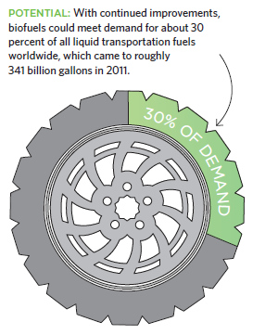
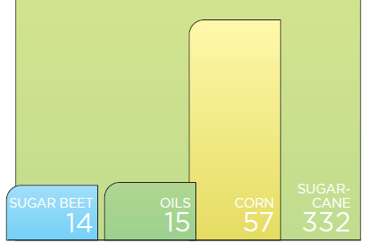

Slide 19
U.S Investment
$1.3B invested in cellulosic ethanol research
A subsidy is provided for gashol.
$0.052 reduction from the federal tax of $0.184 per gallon
Ethanol currently costs twice as much as gasoline, with only 66% of the energy content because it is currently derived from feedstock
Additional research is underway to genetically engineer plants that:
undergo photosynthesis more effectively, and grow more rapidly with less water and fertilizer
one study showed that a particular species of switchgrass produced 60% more biomass without fertilizer than well fertilized corn
contain “soft” lignin that is easily separated from the sugars

