Slide 1
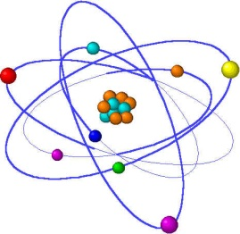
Lecture 7
Analysis of Proteins

Slide 2

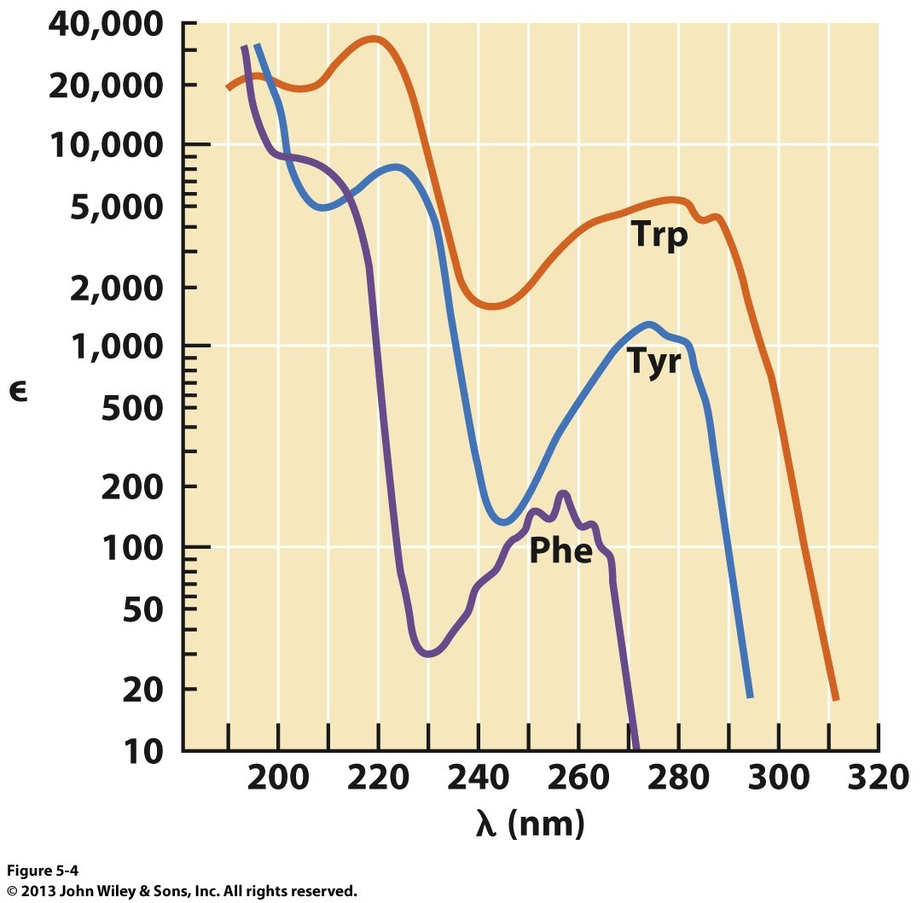
Protein - Characterization
Absorbance Spectroscopy: The aromatic amino acids all have characteristic absorbance profiles
5500 M⁻¹cm⁻¹
1490 M⁻¹cm⁻¹
Also Cysteine
125 M⁻¹cm⁻¹
ExPASy Tool: ProtParam http://web.expasy.org/protparam/

Slide 3
Protein Characterization
Electrophoresis: separation of polar compounds based on their
mobility through a solid support. The separation is based on
charge (pI – Isoelectric Focusing) or molecular mass (SDS-PAGE).

Slide 4
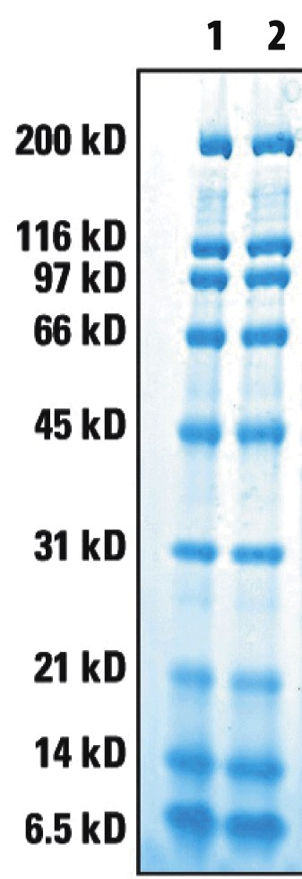
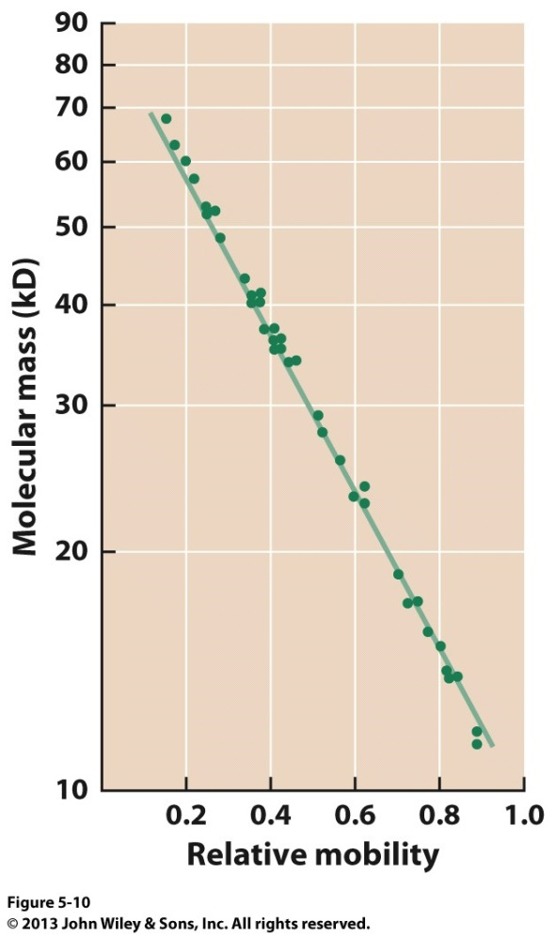
Protein Characterization
Electrophoresis: separation of polar compounds based on their
mobility through a solid support. The separation is based on
charge (pI – Isoelectric Focusing) or molecular mass (SDS-PAGE).

Slide 5
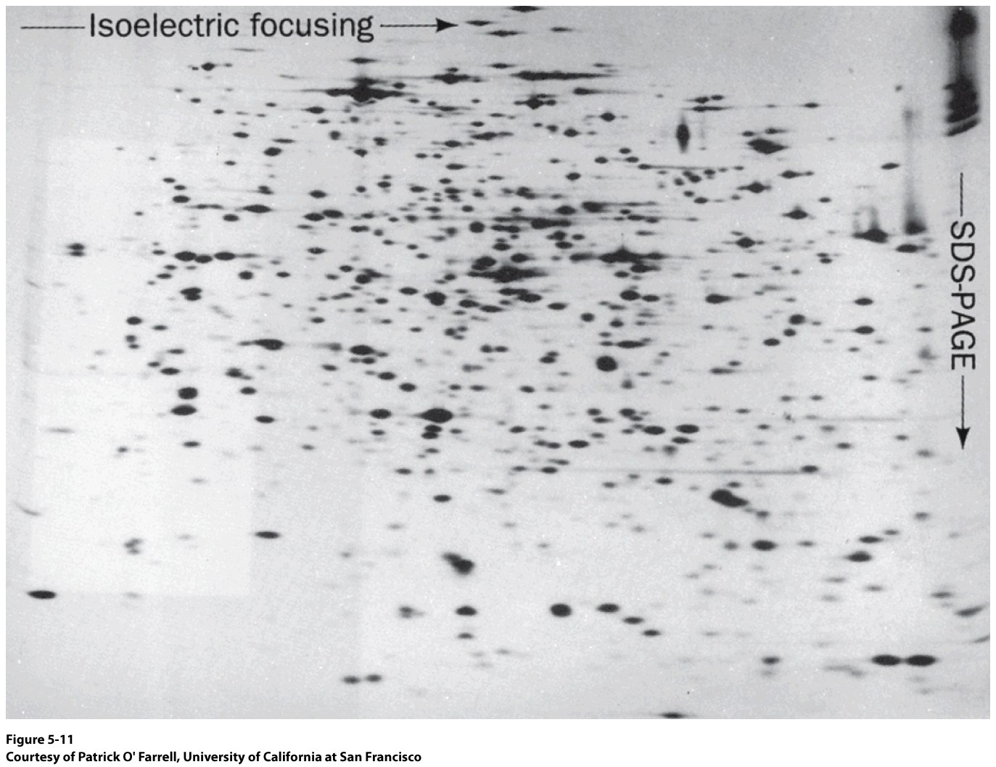
Protein Characterization
2D Electrophoresis:
Isoelectric Focusing
SDS-PAGE
How could this be useful?

Slide 6
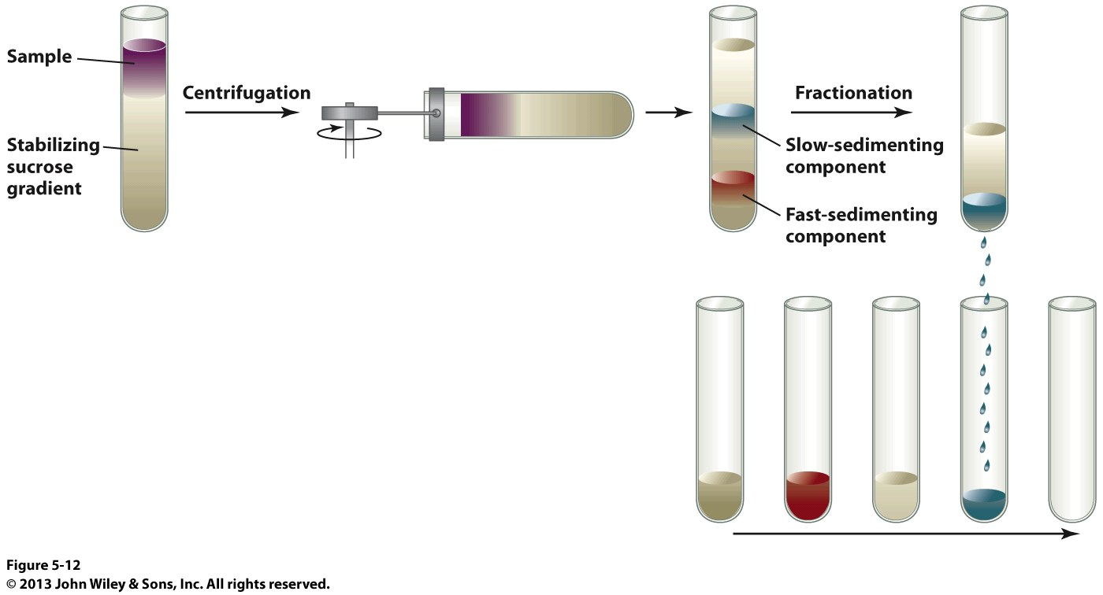
Protein Characterization
Ultracentrifugation: Technique that was developed to separate proteins by mass.
Relies on ultra high centrifugation speeds (80,000 RPM)
Big molecules sediment more slowly than small molecules
Native Protein Structure
Data measured in Svedberg Units (S)
Size vs. S is NOT linear!

Slide 7
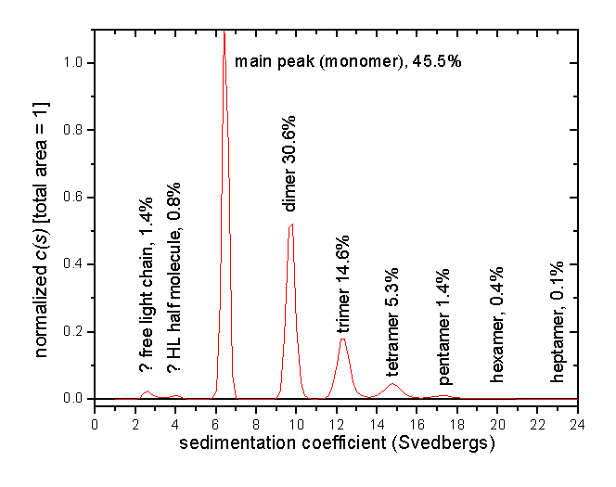
Protein Characterization
Ultracentrifugation: Technique that was developed to separate proteins by mass.

Slide 8
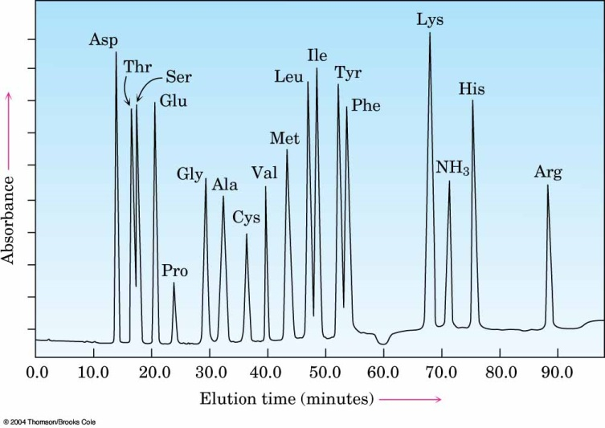
Protein Characterization
Amino Acid Analysis: Determine the total amino acid content within a protein
peptide
-or-
protein
[H]
reduce any
disulfide
bonds
H₃O⁺, Δ
individual
amino acids
liquid
chromatography
derivatize w/
ninhydrin
Detected w/
UV-vis
Different amino
acids have different
chromatographic
mobilities (retention
times)
1972 Nobel Prize in Chemistry
William Stein
Stanford Moore

Slide 9
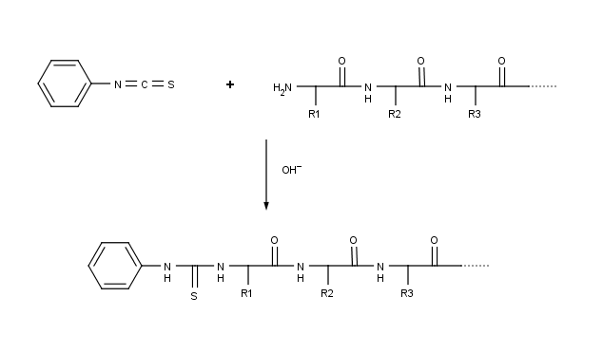
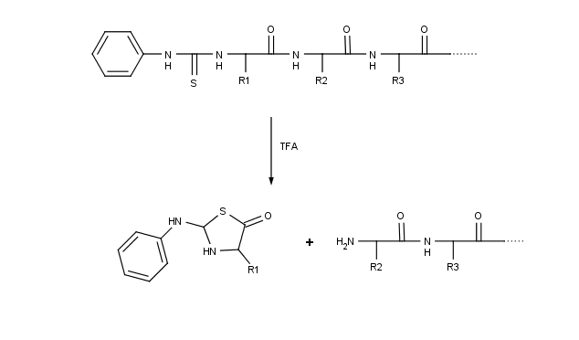
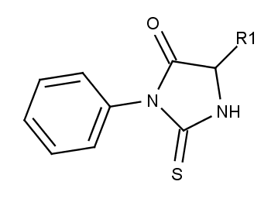
Sequencing from the N-terminus
Edman Degradation
PVDF membrane
What analytical techniques would be useful to identify the PTH amino acid?
H⁺
Phenyl Thiazoline

Slide 10
Sequencing Complications
Edman degradation is limited to ~40-60 amino acids
Incomplete reactions
Side reactions
Peptide loss
Method 1 Specificity
Method 2 Specificity

Slide 11
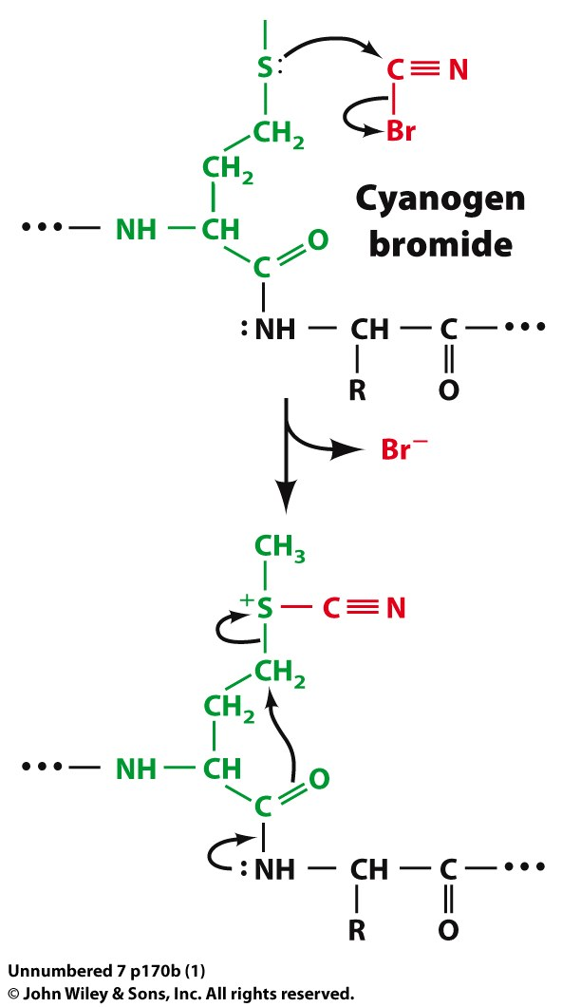
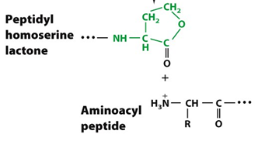
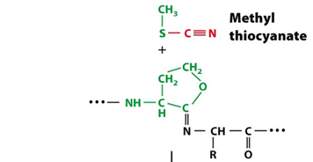
Peptide Cleavage Reactions – Cyanogen Bromide
γ carbon becomes electrophilic
H₂O
Cyanogen bromide cleaves C-term to ALL methionines

Slide 12
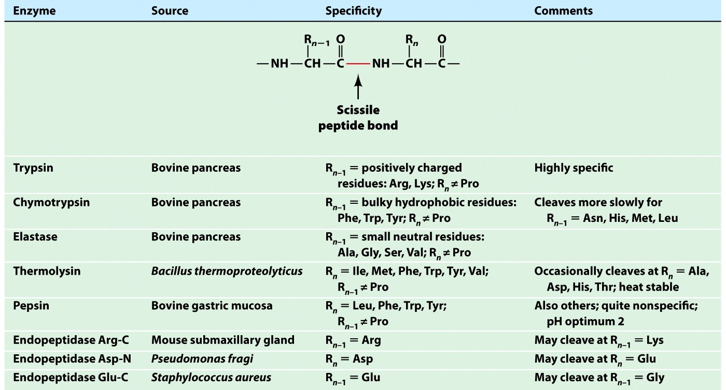
Sequencing Complications
ExPASy Tool: Peptide Cutter http://web.expasy.org/peptide_cutter/

Slide 13
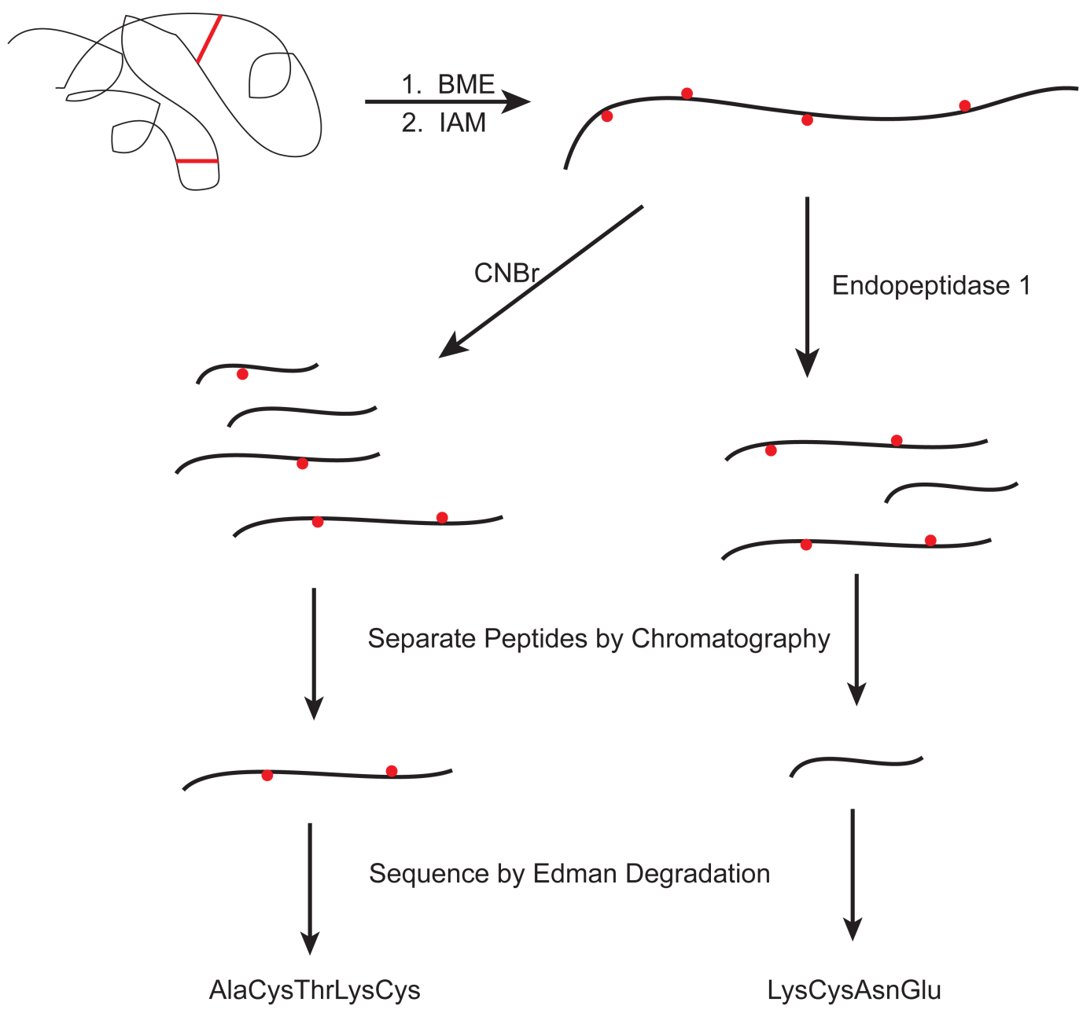
Sequencing Summary
What are these and why are they used?

Slide 14
Sequencing Summary
CNBr treatment
Endopeptidase Treatment
Peptide 1
Peptide 1
MEGVNDNEEMGFFSAR
GAKALAPP
Peptide 2
Peptide 2
FWMGAK
GFFSARVHLTPEEKFWM
Peptide 3
Peptide 3
ALAPP
EGVNDNEEM
Peptide 4
VHLTPEEK
VHLTPEEK
ALAPP
GFFSARVHLTPEEKFWM
MEGVNDNEEMGFFSAR
FWMGAK
EGVNDNEEM
GAKALAPP

Slide 15
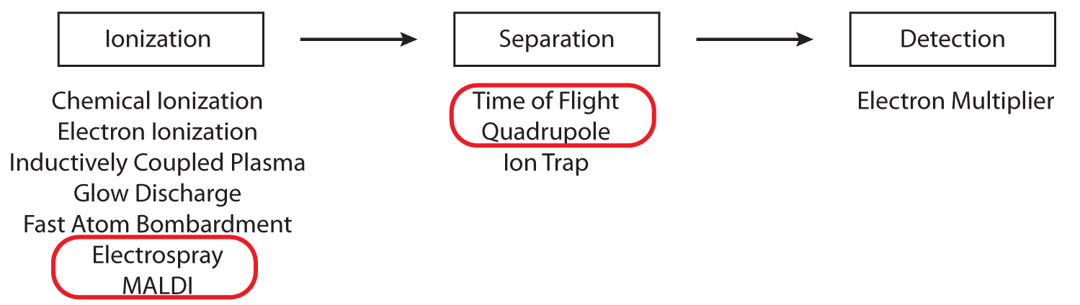
Mass Spectrometry

Slide 16
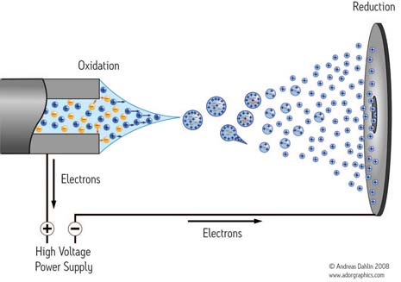
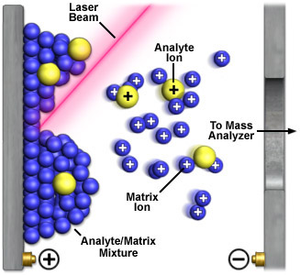
Soft Ionization Techniques
Matrix Assisted Laser Desorption Ionization (MALDI)
Electrospray Ionization (ESI)
Aqueous sample introduced to metal capillary
High voltage (2000-4000 V) applied
Released to vacuum
Desolvation of aerosol leaving highly charged ions
Aqueous sample is cocrystallized on a metal surface with a Matrix
Intense Laser beam is directed toward sample/matrix mixture - desorption
Matrix absorbs the energy and is ionized
Some of the charge is transferred to the analyte

Slide 17
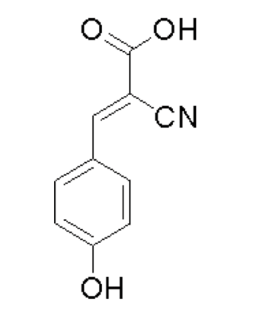
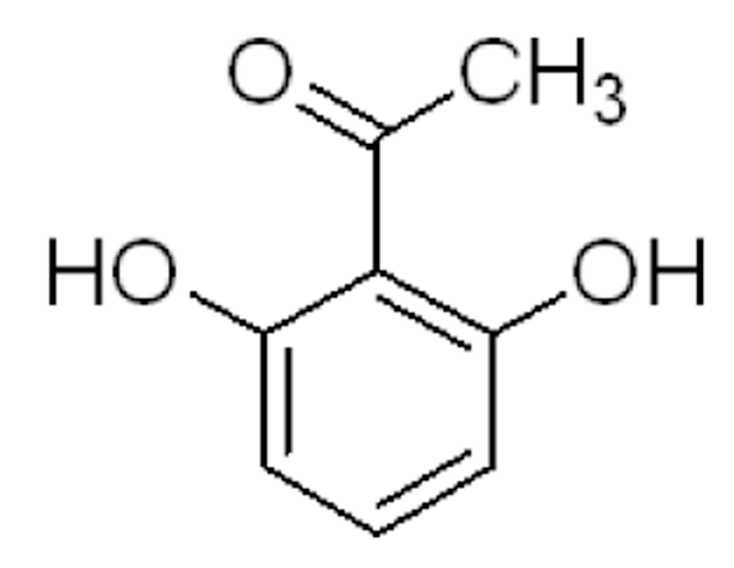
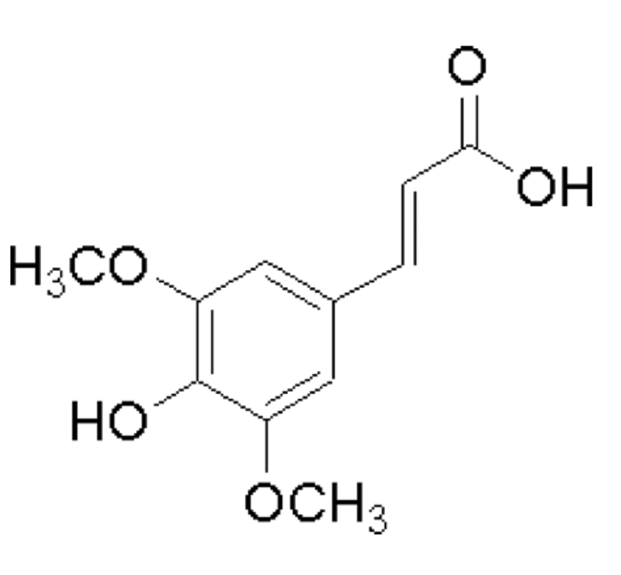
MALDI Matrix
α-cyano-4-hydroxycinnamic acid (CCA)
2,6-dihydroxyacetophenone (DHAP)
Sinapinic Acid (SA)

Slide 18
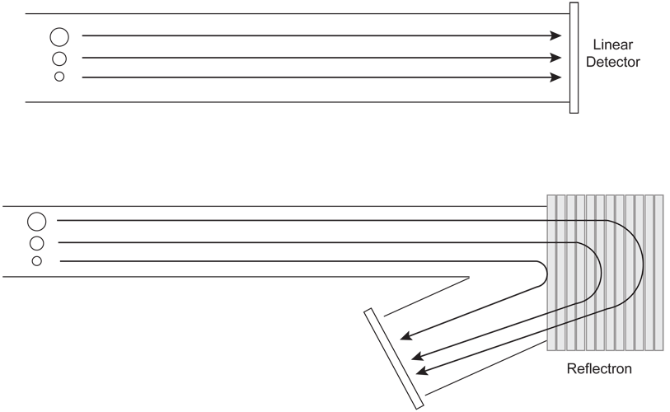
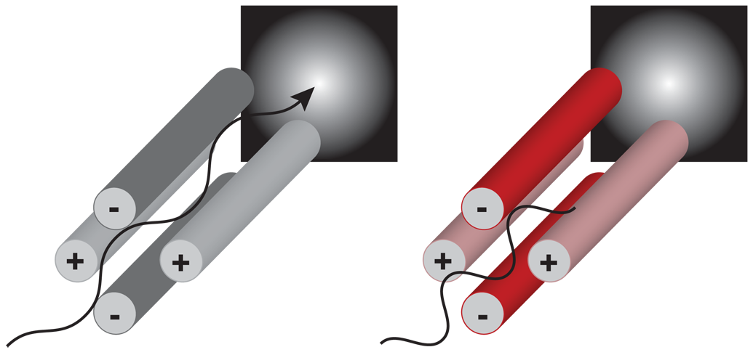
Separation Techniques
Quadrupole
Flight Tube
Four rods are arranged opposite each other and connected electronically
Voltage applied to each rod is carefully regulated
The trajectory of a charged particle is influenced by the electric field
Molecules separate by the time it takes for them to travel from the ion source to the detector
Resolution is dependent on tube length (limits resolving power)
Reflectron enhances the resolution

Slide 19
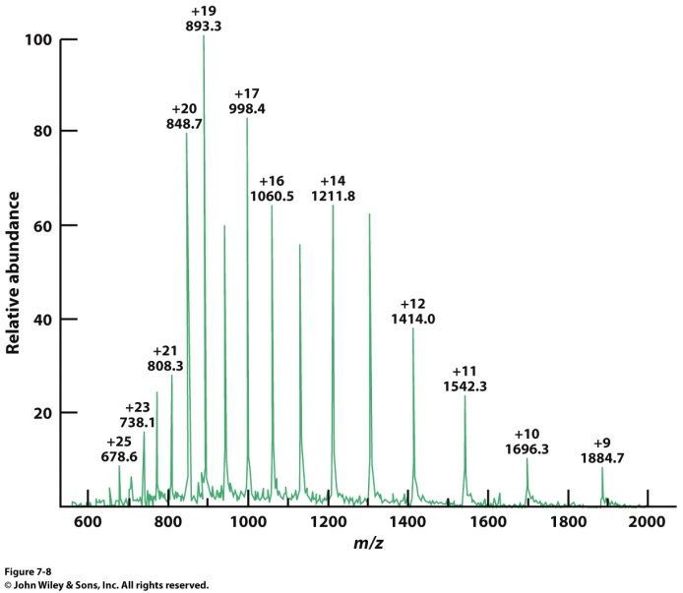
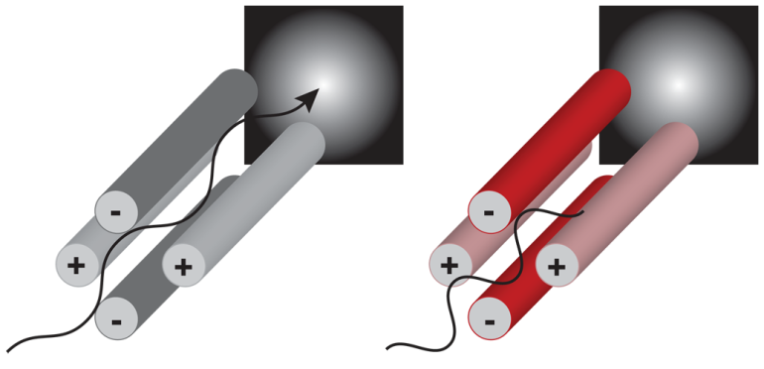
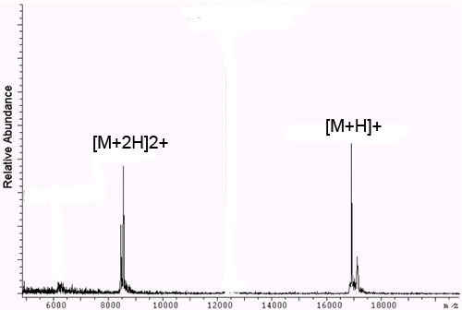
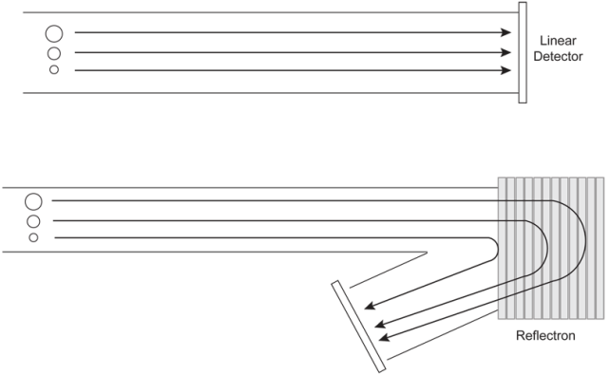
Ideal Pairs
ESI-QMS
MALDI-TOF MS

Slide 20

ESI-QMS Spectrum
What is the parent mass?

Slide 21
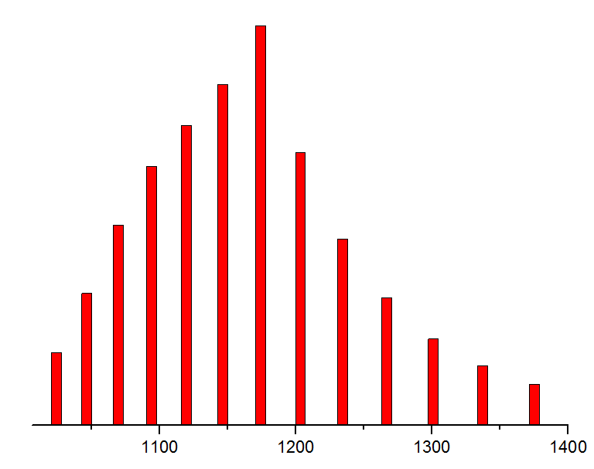
ESI-QMS Spectrum
1415.68
1375.232
1337.032
1300.896
1266.661
1234.183
1203.328
1173.979
1146.027
1119.375
1093.935
1069.625
1046.373
1024.109
What is the parent mass?

Slide 22
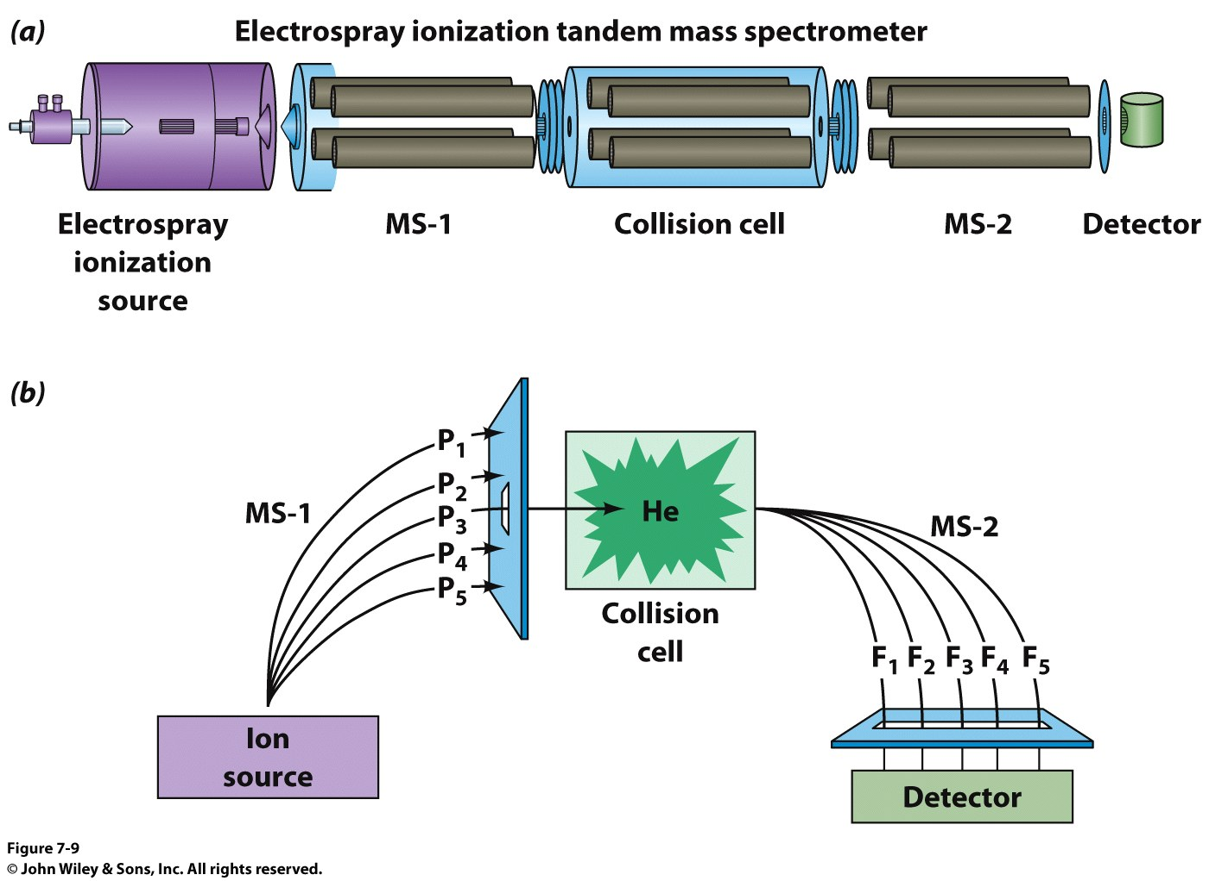
Mass Spec and Sequencing

Slide 23
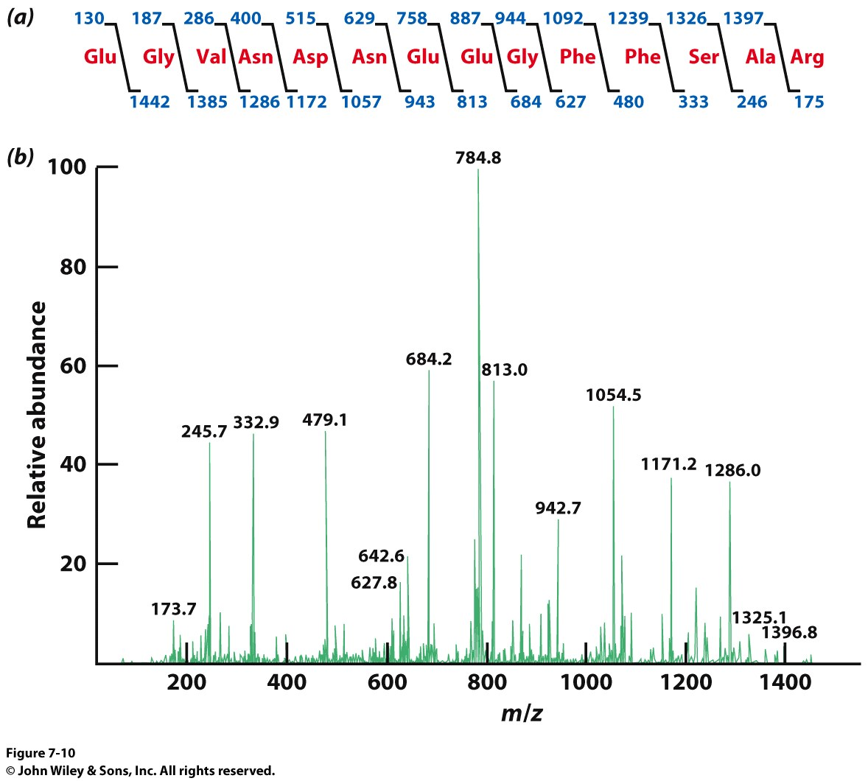
Mass Spec and Sequencing

Slide 24
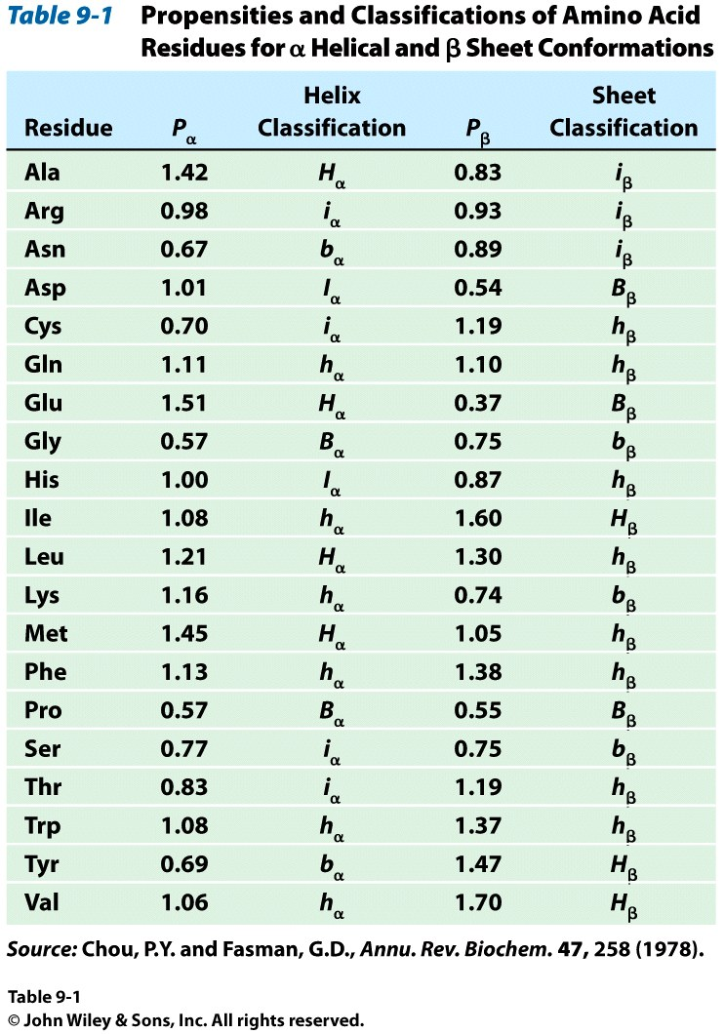
Structural Predictions – Chou Fasman
Guidelines
A cluster of 4 helix forming residues (H_{α} or h_{α)} out of 5 sequential residues will nucleate a helix.
  Once the average value of 4 sequential residues falls below 1, the helix is broken.
A cluster of 3 sheet forming residues (H_{β} or h_{β)} out of 5 sequential residues will nucleate a sheet.
  Once the average value of 4 sequential residues falls below 1, the helix is broken.
If both helix and sheet are predicted, the highest average value will be preferred.
http://www.biogem.org/tool/chou-fasman/

Slide 25
Structural Predictions – Chou Fasman
AA | Helix |  | Sheet
Gln | 1.11 | h | 1.10 | h
Leu | 1.21 | H | 1.30 | h
Met | 1.45 | H | 1.05 | h
Thr | 0.83 | i | 1.19 | h
Trp | 1.08 | h | 1.37 | h
Ala | 1.42 | H | 0.83 | i
Ser | 0.77 | i | 0.75 | b
Thr | 0.83 | i | 1.19 | h
Pro | 0.57 | B | 0.55 | B
Cys | 0.70 | i | 1.19 | h
Gln Leu Met Thr Trp Ala Ser Thr Pro Cys

Slide 26
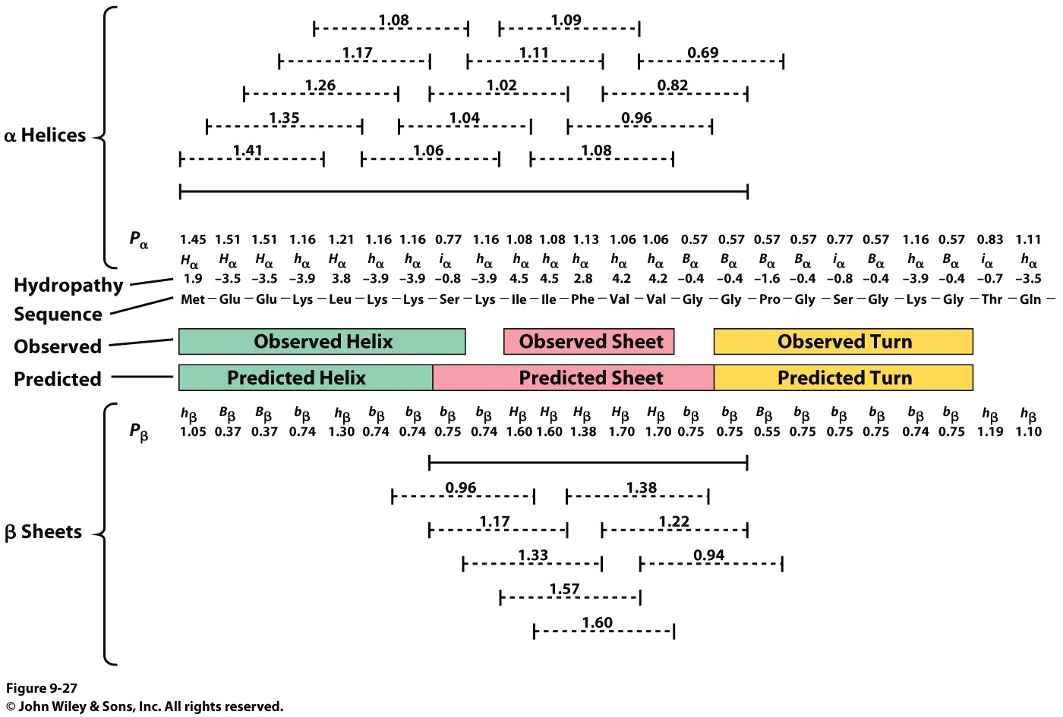
Structural Predictions – Chou Fasman

Slide 27
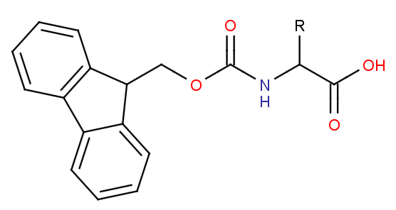
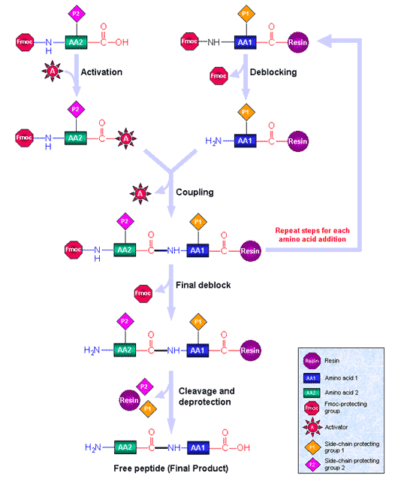
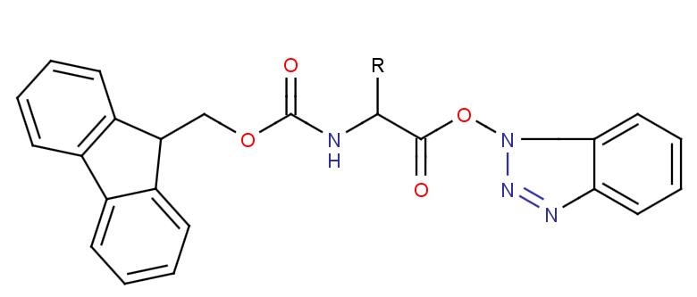
Peptide Synthesis
Fmoc
Activated Ester

Slide 28
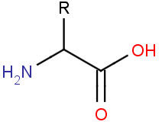
Peptide Synthesis

Slide 29
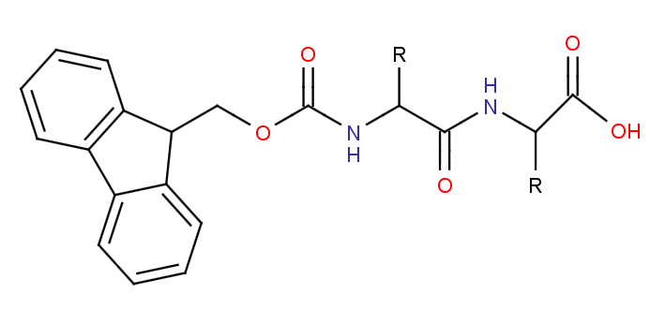
Peptide Synthesis

