Slide 1
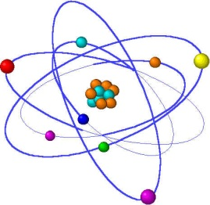
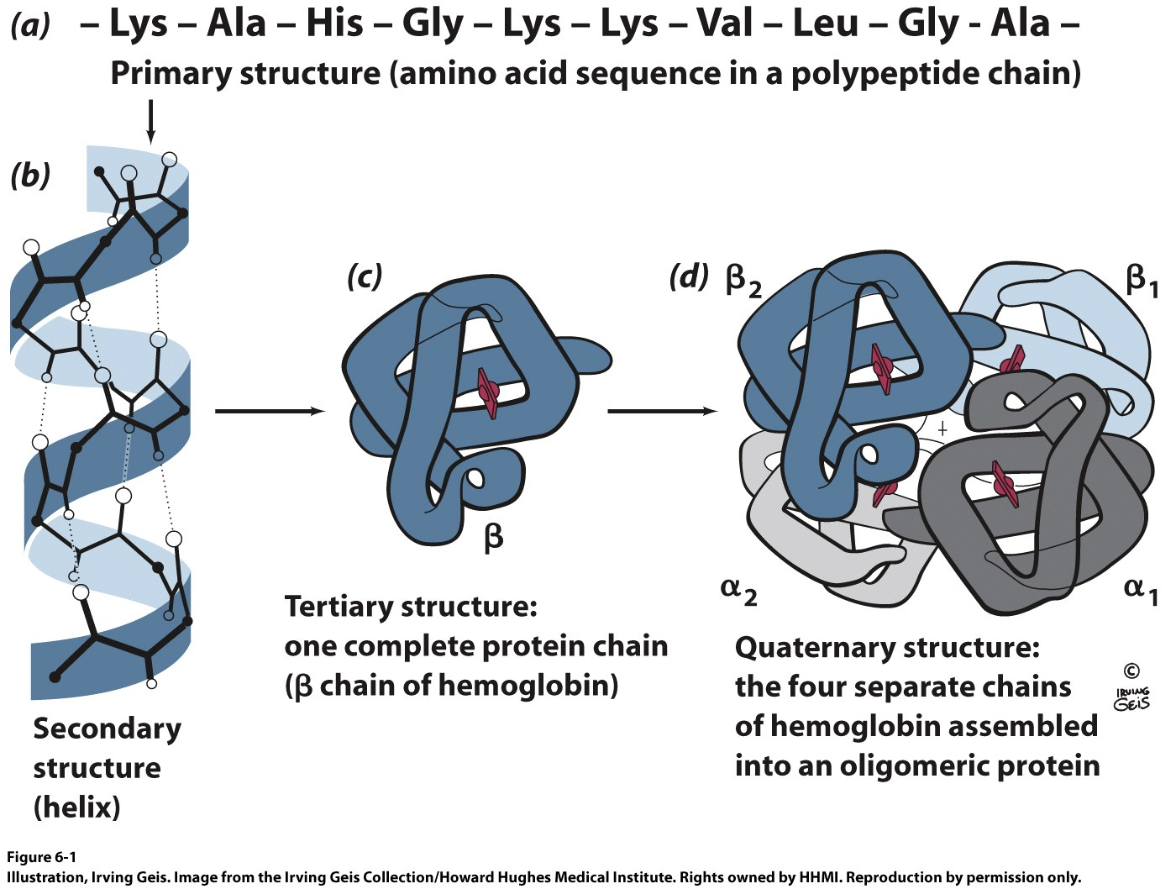
Lecture 5
Protein Structure

Slide 2
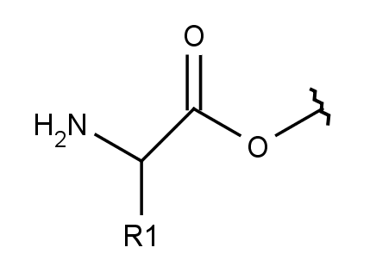
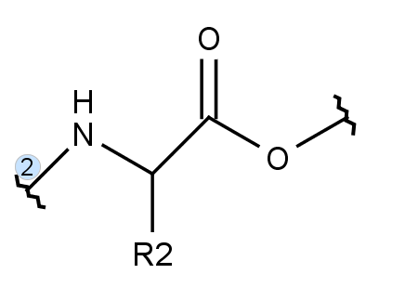
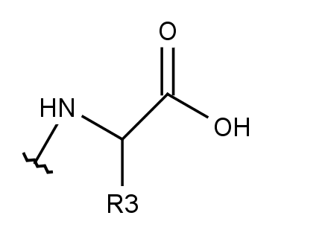
Protein Chains are Polymers of Amino Acids

Slide 3
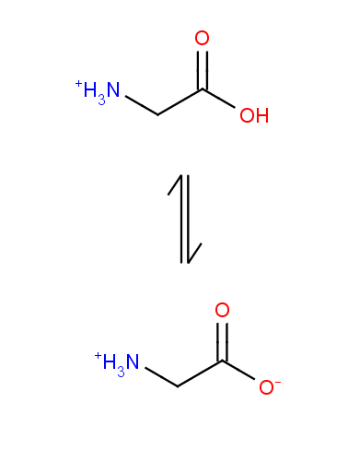
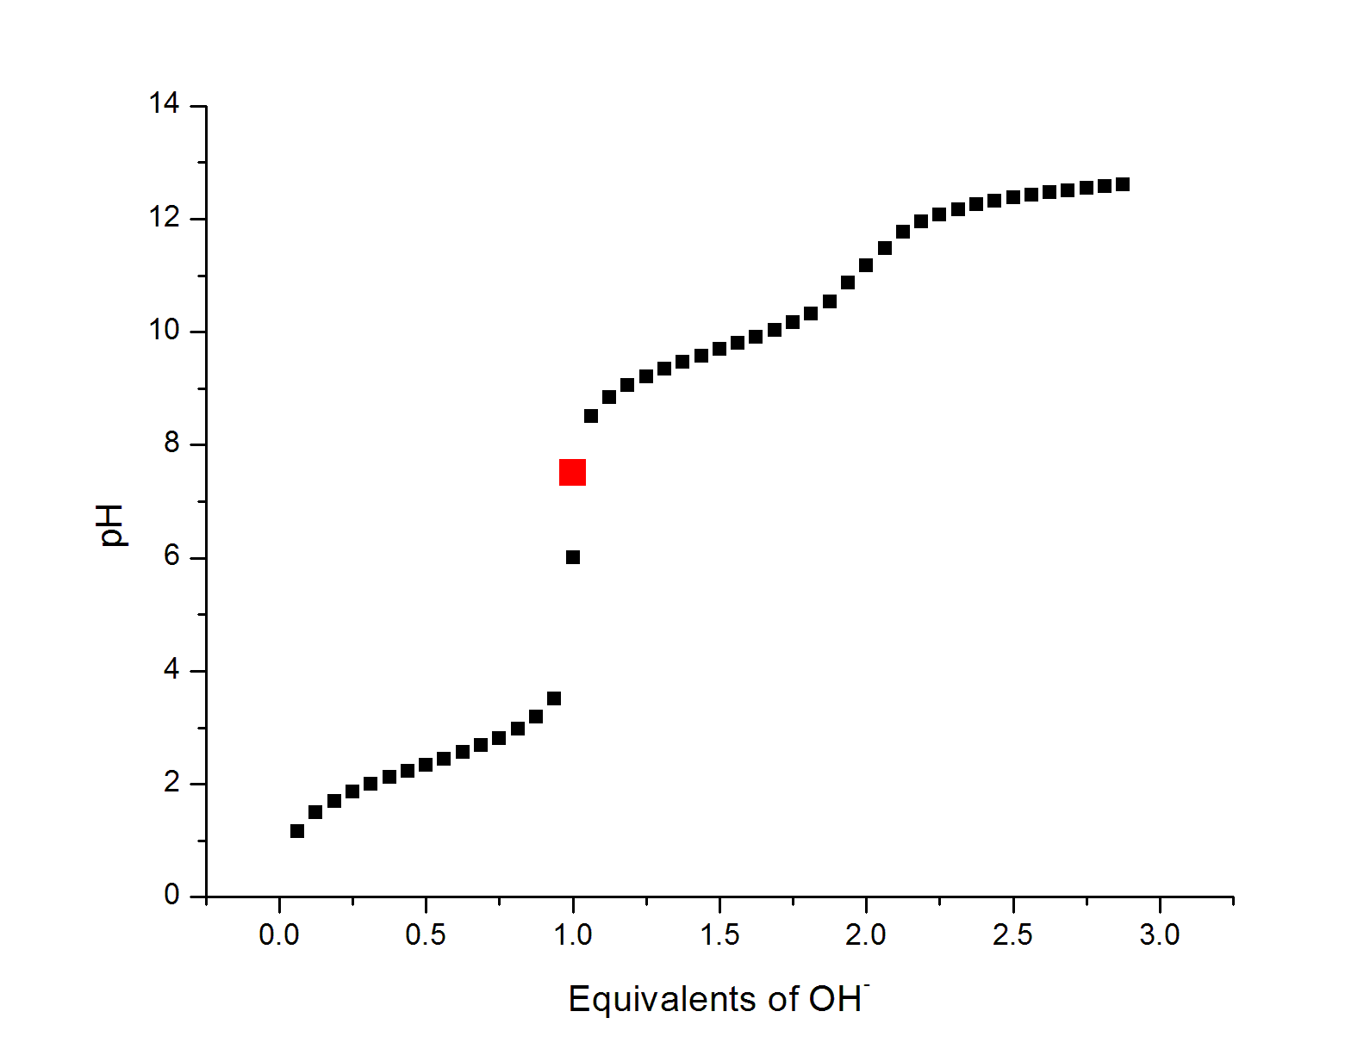
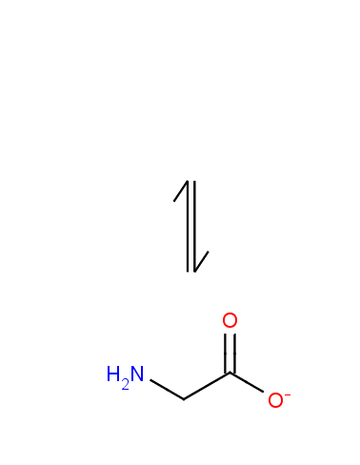
Isoelectric Point
The pH at which a zwitterion carries no net charge
(NH₃CH₂CO₂H)⁺ + H₂O ⇌ (NH₃CH₂CO₂) + H₃O⁺ pKa = 2.34
(NH₃CH₂CO₂) + H₂O ⇌ (NH₂CH₂CO₂)⁻ + H₃O⁺ pKa = 9.69
pK_{a,1}
C
Expected pH @ equivalence for HA with pKa = 2.34
pK_{a,1}
Actual pH @ equivalence for glycine
pK_{a,2}

Slide 4
Isoelectric Point
The pH at which a zwitterion carries no net charge
(NH₃CH₂CO₂H)⁺ + H₂O ⇌ (NH₃CH₂CO₂) + H₃O⁺ pKa = 2.34
(NH₃CH₂CO₂) + H₂O ⇌ (NH₂CH₂CO₂)⁻ + H₃O⁺ pKa = 9.69

Slide 5
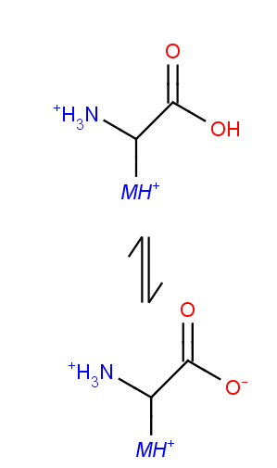
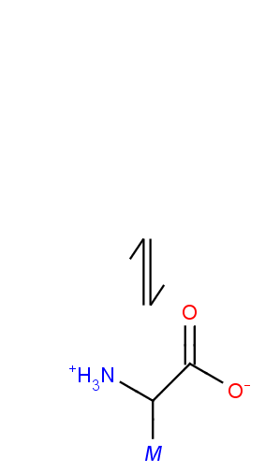
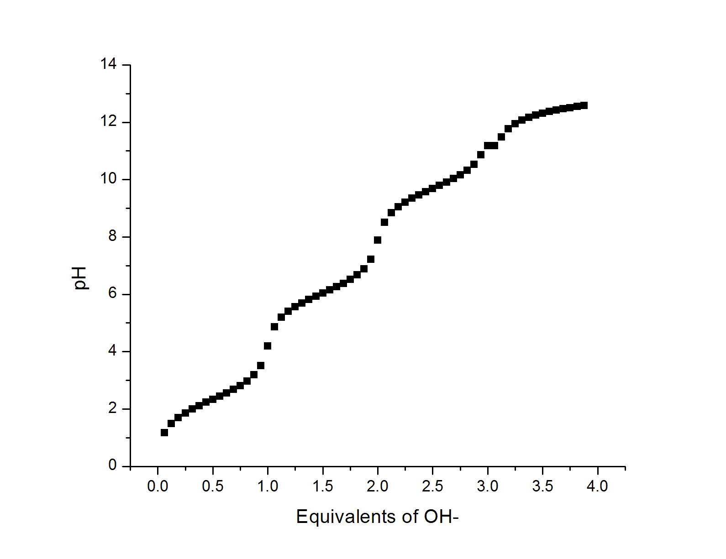
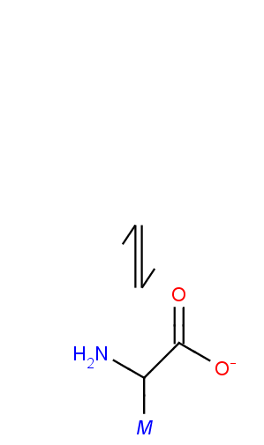
Isoelectric Point
The pH at which a zwitterion carries no net charge
AH₃²⁺ + H₂O ⇌ AH₂⁺ + H₃O⁺ pKa = 2.34
AH₂⁺ + H₂O ⇌ AH + H₃O⁺ pKa = 6.04
AH + H₂O ⇌ A⁻ + H₃O⁺ pKa = 9.69

Slide 6
Common Side Chain Chemistry
Disulfide Formation
Phosphorylation of Side Chain

Slide 7
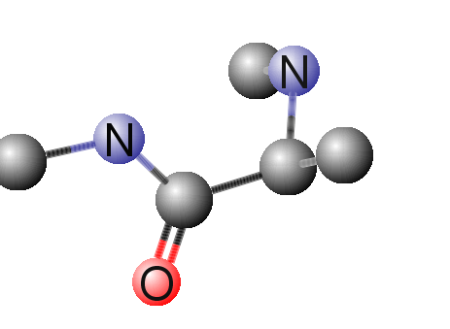
The Peptide Bond
D
B
What can explain the deviation from expected values?
A
C
Bond | Expected Bond Length (Å) | Actual Bond Length (Å)
A | 1.46 | 1.33
B | 1.51 | 1.51
C | 1.22 | 1.24
D | 1.46 | 1.46
**
**

Slide 8
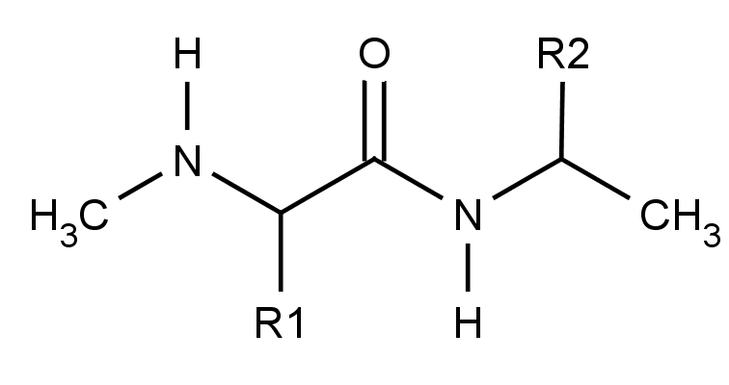
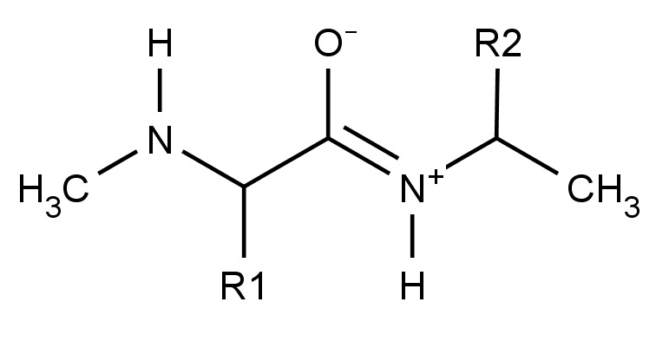
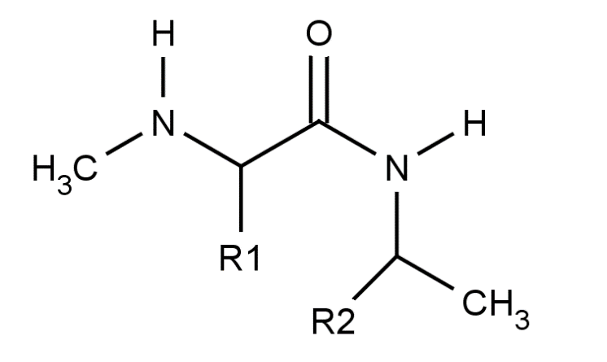
The Peptide Bond
~60%
~40%
So the peptide bond is planar
cis and trans conformations can be envisioned

Slide 9
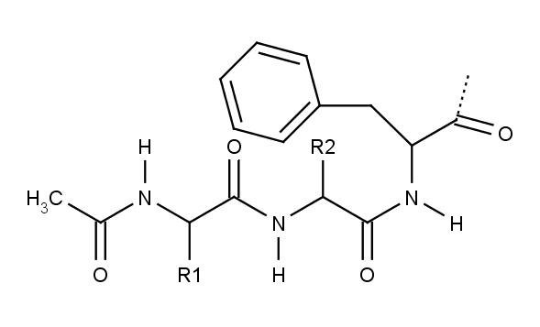
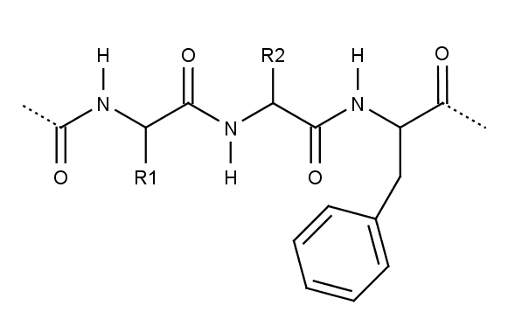
The Peptide Bond

Slide 10
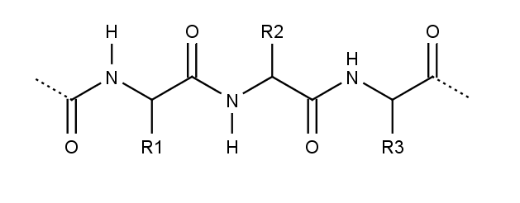
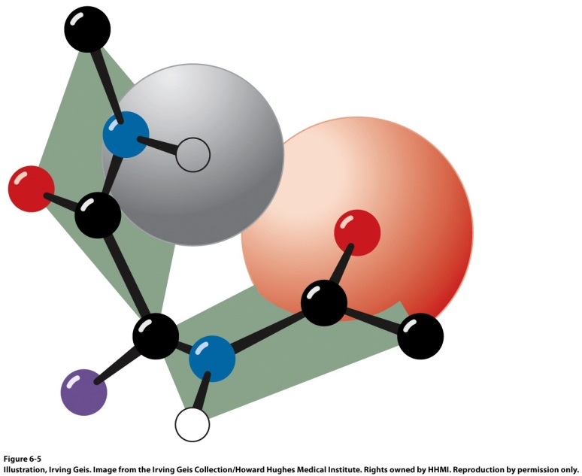
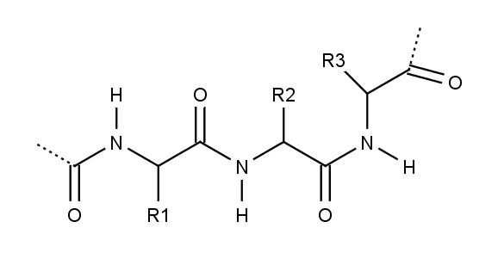
The Peptide Bond
Polypeptide chains are sequences of peptide bond planes joining at every C_{α}
Modest rotation of one plane relative to another will dramatically influence the stability of a polypeptide
Steric restrictions will disallow this conformation

Slide 11
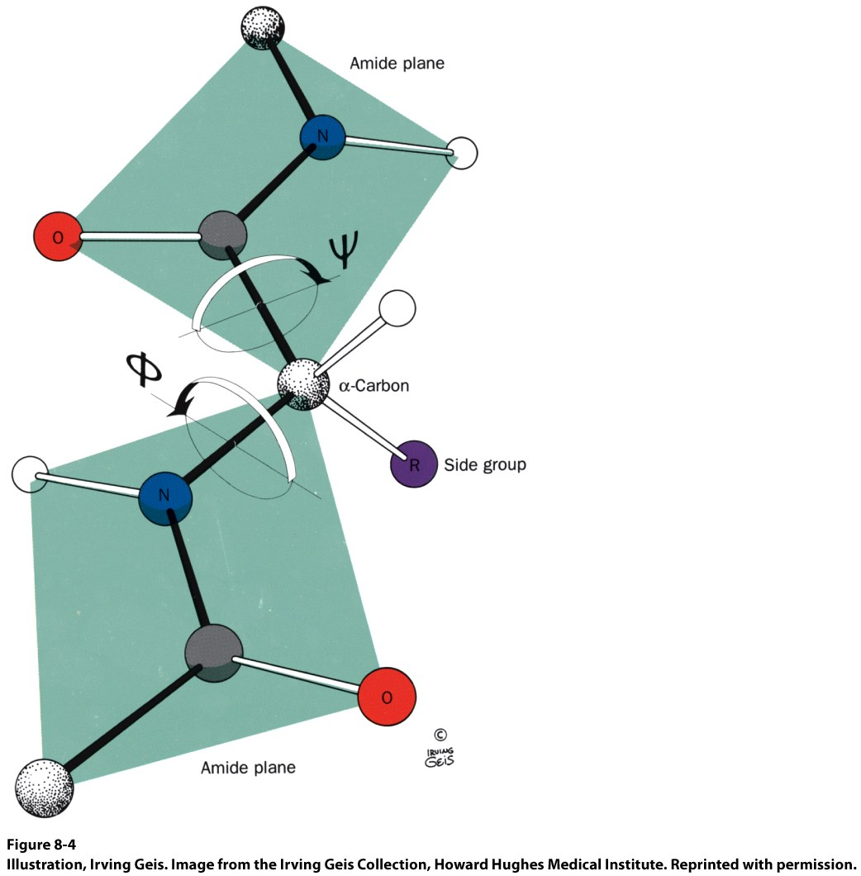
Torsion Angles

Slide 12
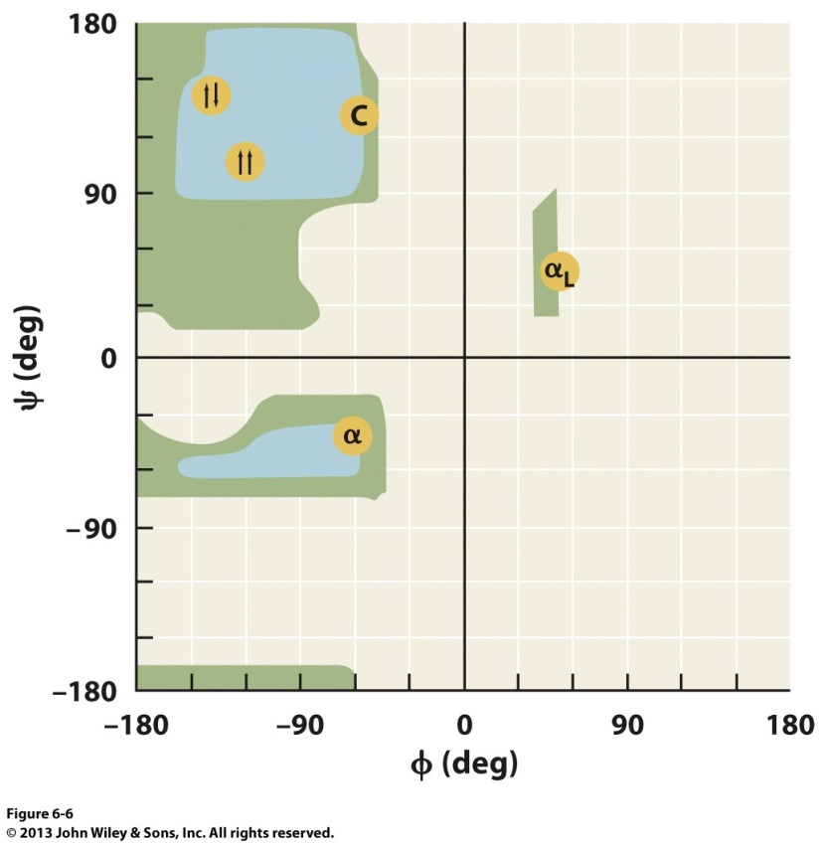
Ramachandran Plot
There are only a few “allowable” combinations of φ and ψ.
Notable exceptions:
The side chain of Proline restricts φ ≈ -60°
Glycine does not have a β carbon and can assume φ,ψ combinations that are forbidden in other amino acids
All other regions of the ramachandran plot are sterically forbidden

Slide 13
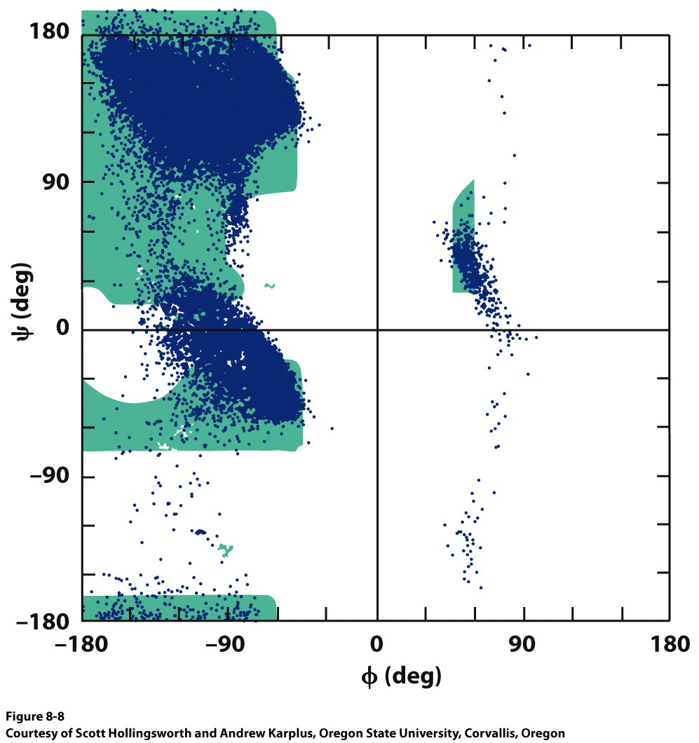
Ramachandran Plot
For full length proteins, several areas appear
β sheets
Centered around Φ = -139, Ψ = 135
Helical structures
Centered around Φ = -57, Ψ = 47

Slide 14
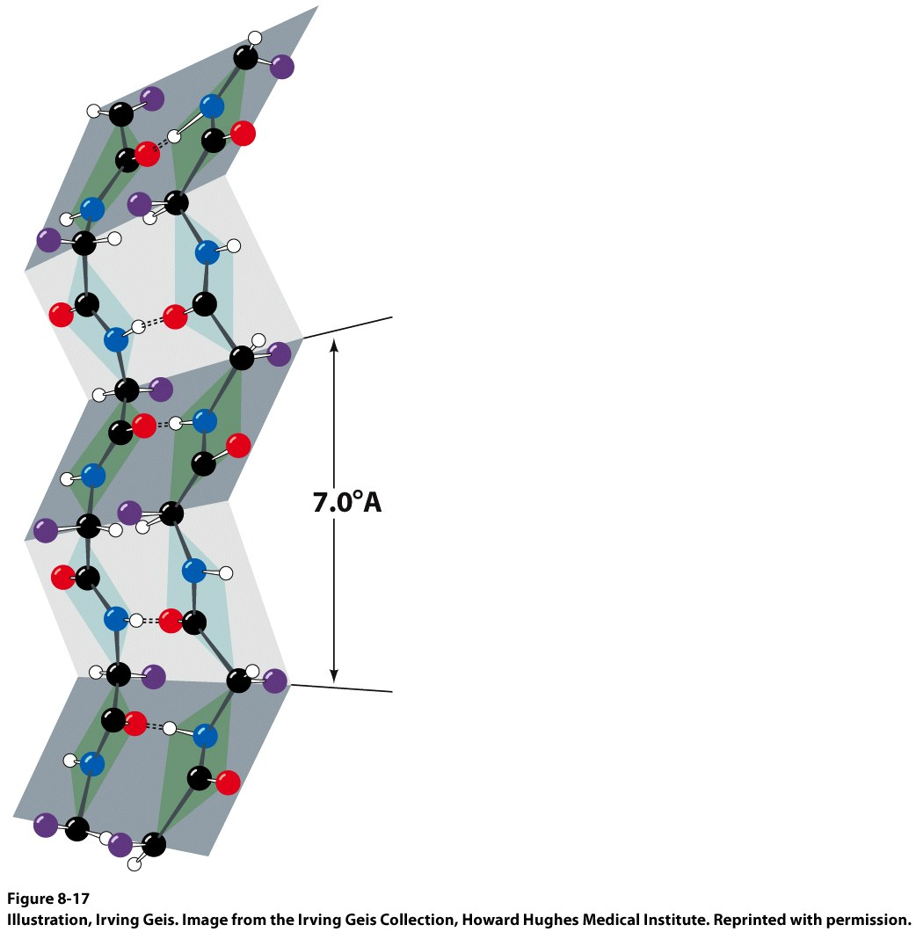
β Sheets
Note the alternating orientation of the side chains
β sheets occur when two nearly fully extended (Φ = -139, Ψ = 135) polypeptide chains interact
Significant hydrogen-bonding between O and N of opposite chains
Because the chains are extended, the sheets take on a pleated appearance
N-term
C-term
Parallel
Antiparallel

Slide 15
Parallel β Sheets
N Term
C Term
C Term
N Term

Slide 16
Antiparallel β Sheets
N Term
C Term
N Term
C Term

Slide 17
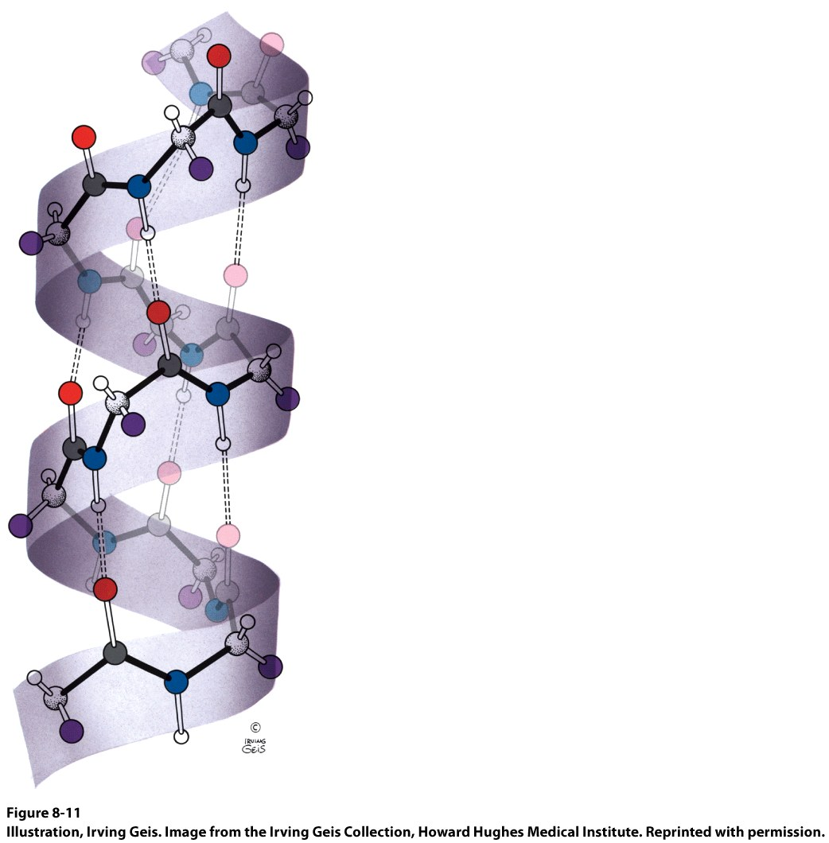
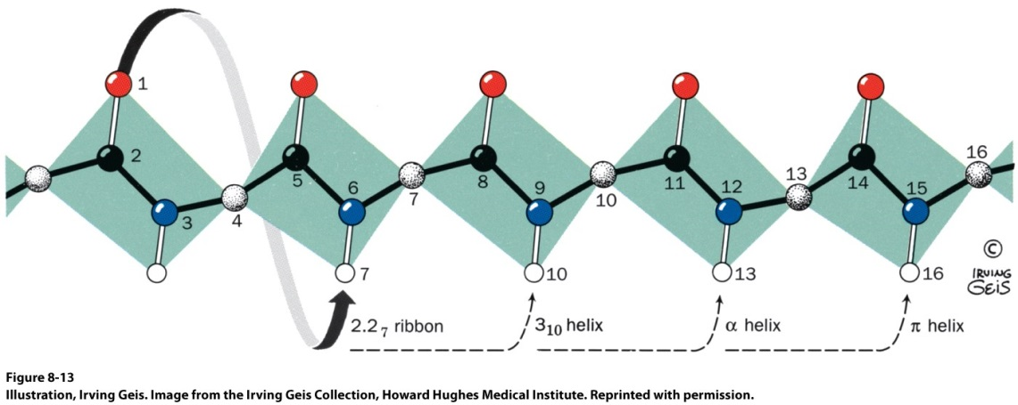
Helices
Note the side chains decorate the exterior of the helix
Helices occur when one peptide chain coils up (Φ = -57, Ψ = 47)
Significant hydrogen-bonding between backbone carbonyl Oxygen and amide Nitrogen
δ⁺
Helices are polar
δ⁺

Slide 18
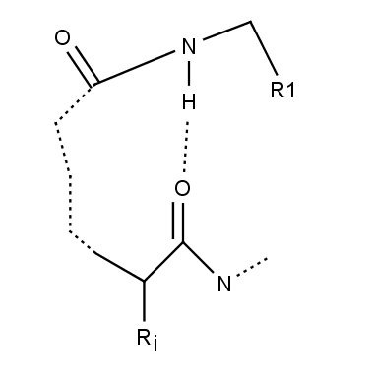
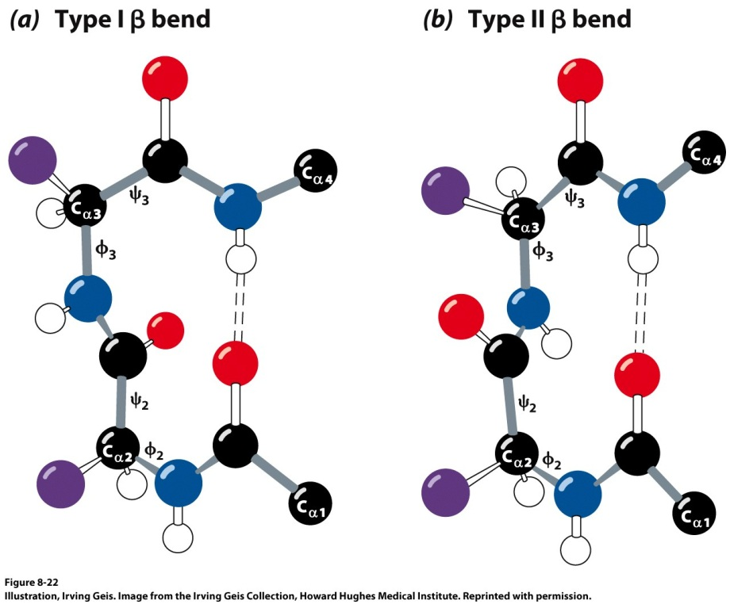
Other 2˚ Structural Motifs
Random Coil
When the peptide backbone adopts no repeating structural features. It is not correct to say the protein is disordered in random coil.
Turns
Abrupt changes in direction in polypeptide structures.
Φ₂ = -60, Ψ₂ = -30
Φ₃ = -90, Ψ₃ = 0
Φ₂ = -60, Ψ₂ = 120
Φ₃ = -90, Ψ₃ = 0
Type | Separating Residues
δ | 1
γ | 2
β | 3
α | 4
Π | 5

Slide 19
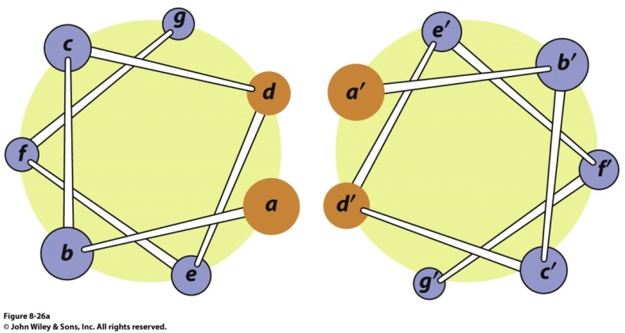
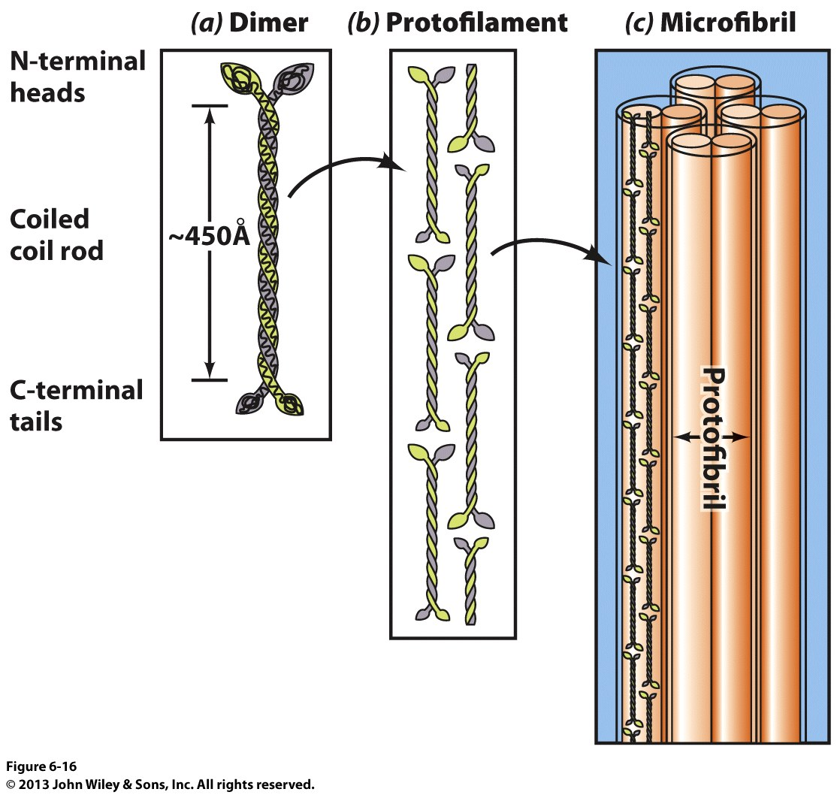
Fibrous Proteins vs. Globular Proteins
Repeating Primary Structures
Not Repeating
Keratin – Form Coiled Coils
Heptad Repeat → a b c d e f g
Tropomyosin PDBid 1IC2

Slide 20
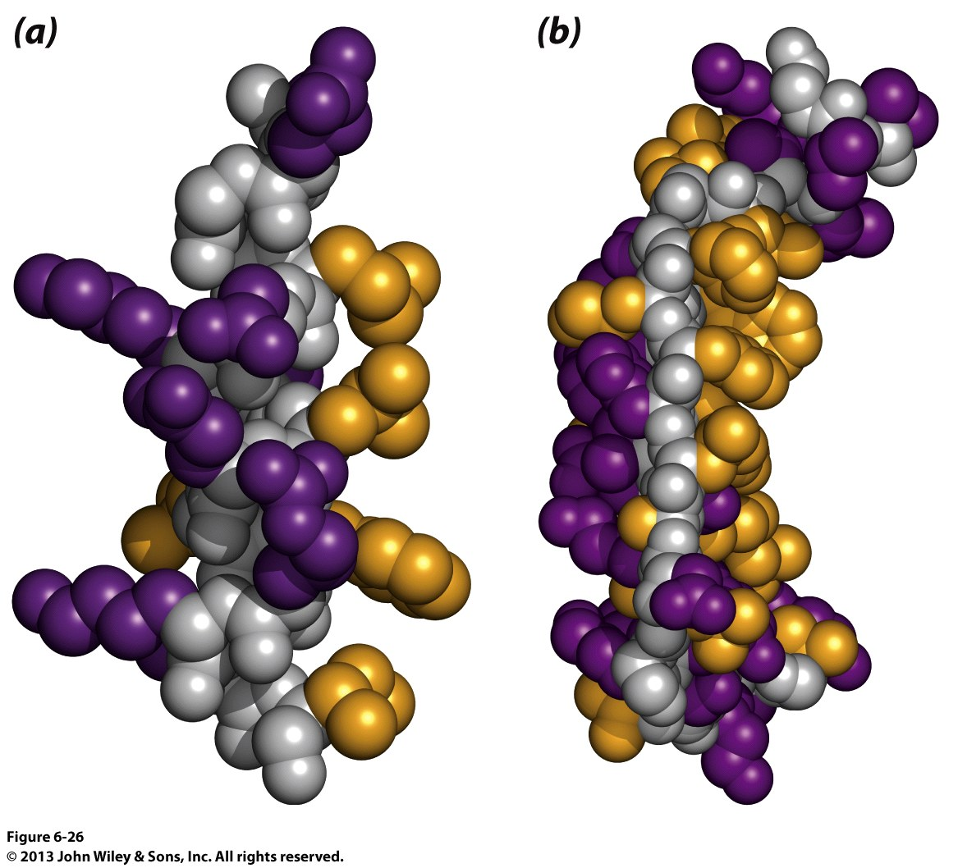
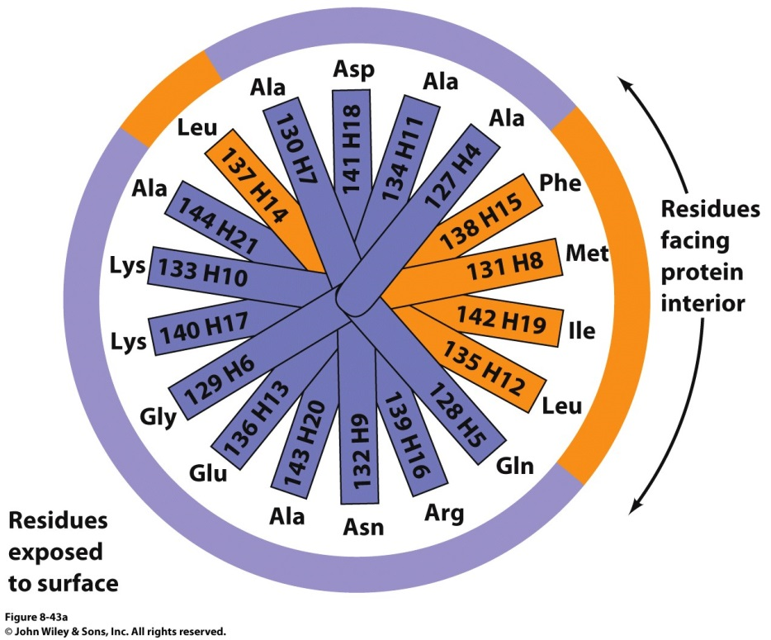
Tertiary Structure
Secondary Structural elements send to form so that Polar side chains and non-Polar side chains form opposite ‘faces’
Hydrophobic Regions pack together to form the core of globular proteins
Non-Polar
Polar
Backbone

Slide 21
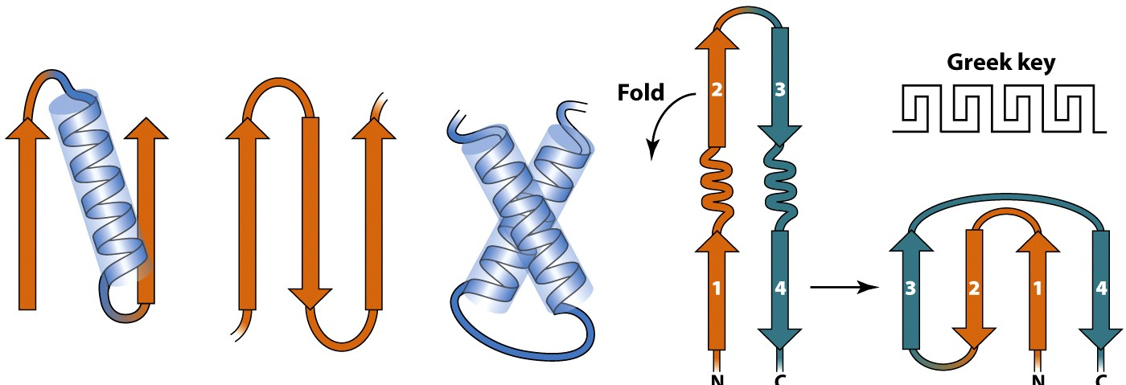
Tertiary Structure
Structural Motifs (or Super Secondary Structure)
Certain Combinations of secondary structural elements tend to be found very commonly in protein structures

Slide 22
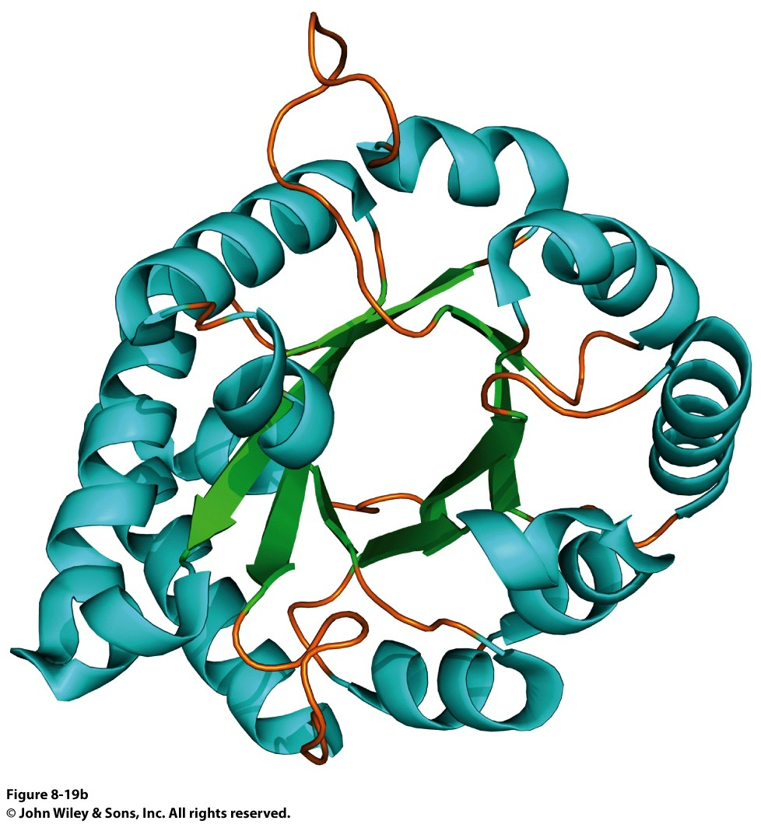
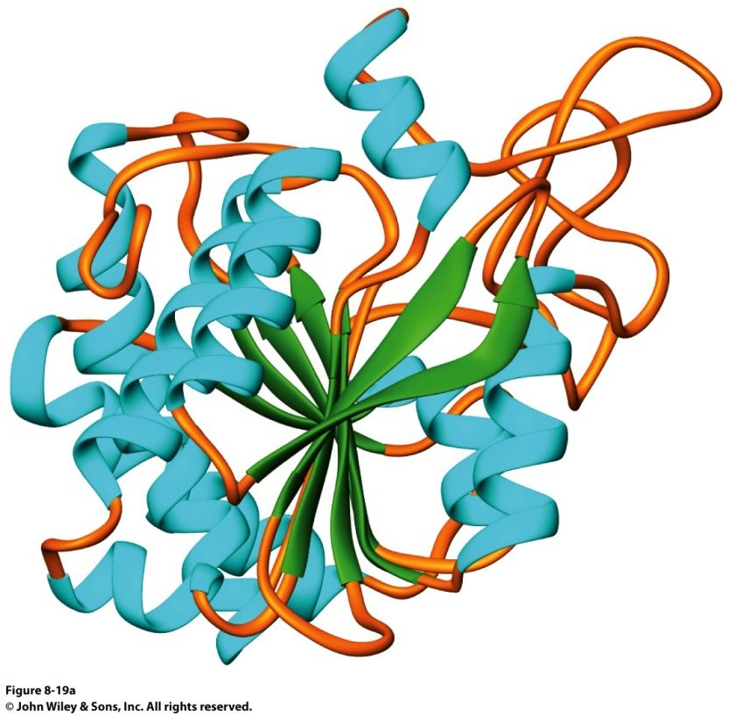
Tertiary Structure
Proteins are represented by showing how 2nd structures interact with each other.
Arrow are β sheets
Coils are α helices

