Slide 1
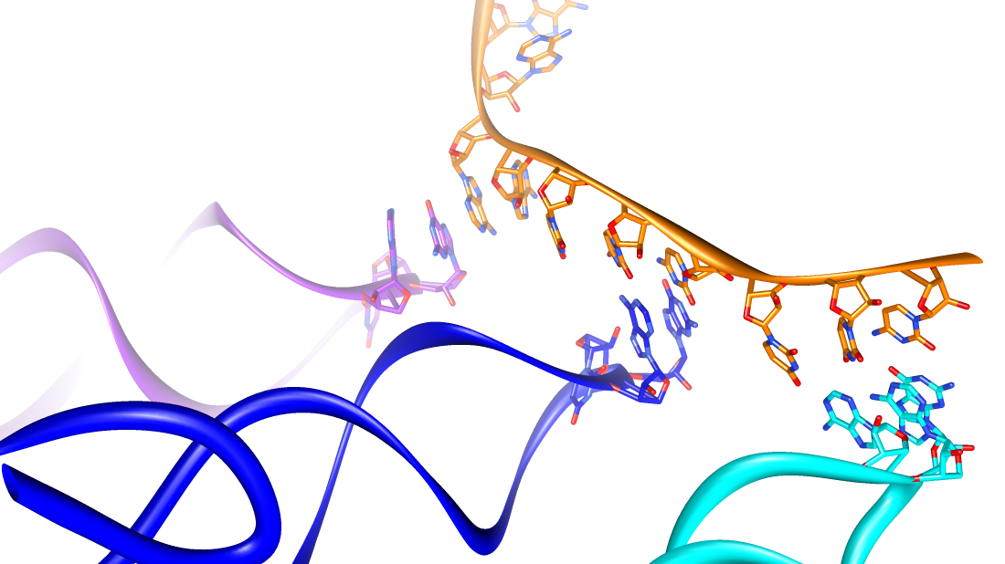
Translation and Regulation of Gene Expression

Slide 2
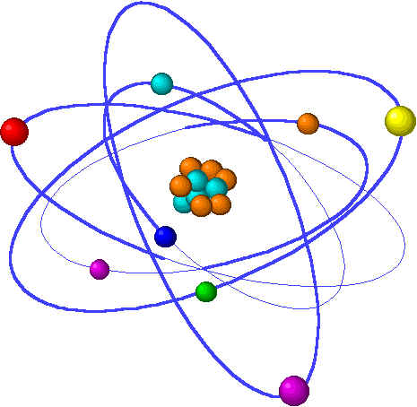
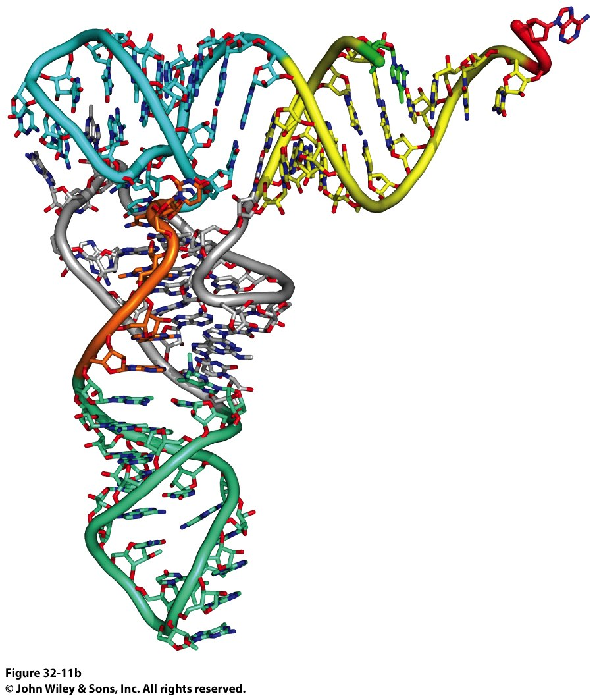
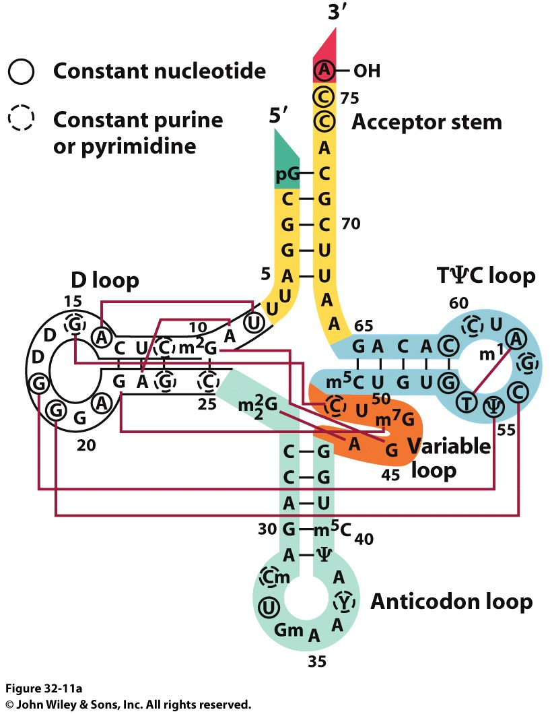
tRNA Tertiary Structure
Forms of DNA Helices
Continuous A-Form helix formed by Acceptor and TΨC-stems
L-shaped structures with ~60 Å legs
Helical junction is stabilized by several absolutely conserved base pairs
Anticodons are ‘looped out’

Slide 3
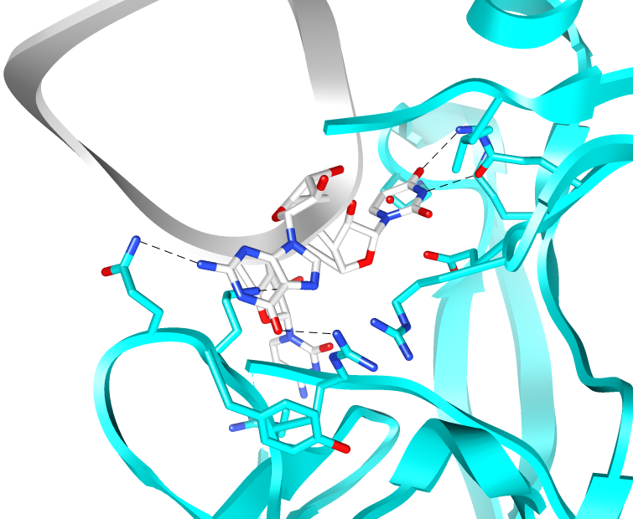
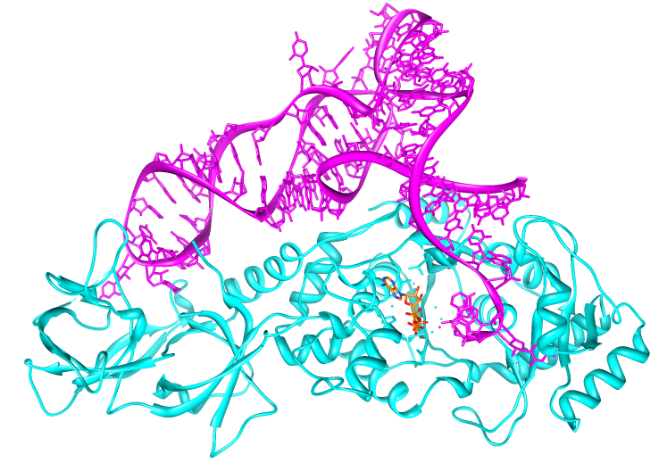
Aminoacyl-tRNA Synthase
Forms of DNA Helices
Every amino acid has at least one aaRS
Anticodon Loop
Amino Acid
Binding Site
Matching the amino acid to a
specific anticodon is the role of the aaRS.
Must be sensitive to the flexibility of wobble position

Slide 4
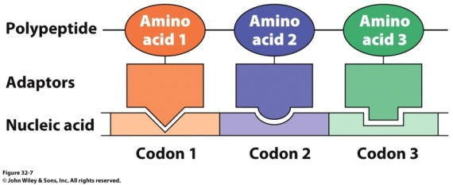
Incoming Amino Acid Activation
Forms of DNA Helices
Amino acid is originally activated by ATP to form an aminoacyl-AMP intermediate
Incoming tRNA displaces AMP to form an aminoacyl-tRNA
tRNA

Slide 5
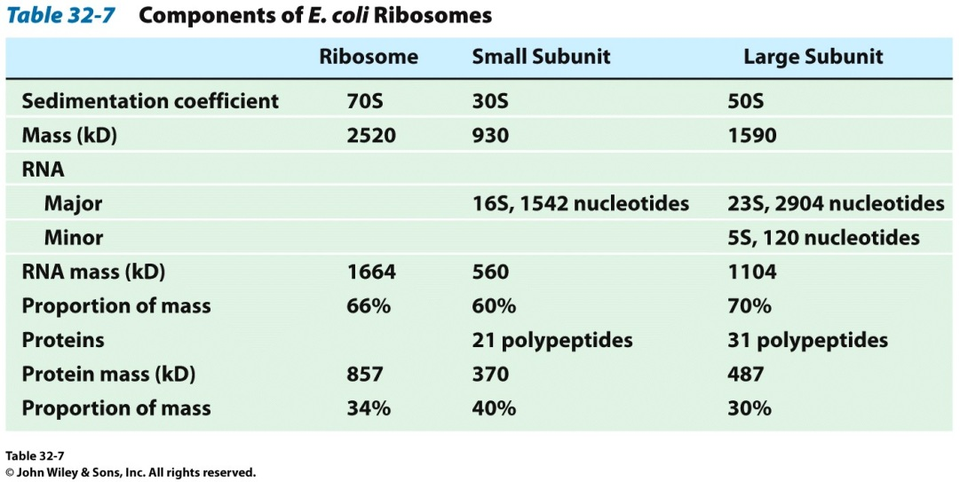
The Ribosome
Forms of DNA Helices
2.5 MDa complex (in E. coli)
Consists of 3 RNA chains
16S → small subunit
23S + 5S → large subunit
and 52 proteins
21 associated with small subunit
31 associated with large subunit
Sedimentation coefficient (Svedberg Units)
Reports on the size and hydrodynamic properties of a particle

Slide 6
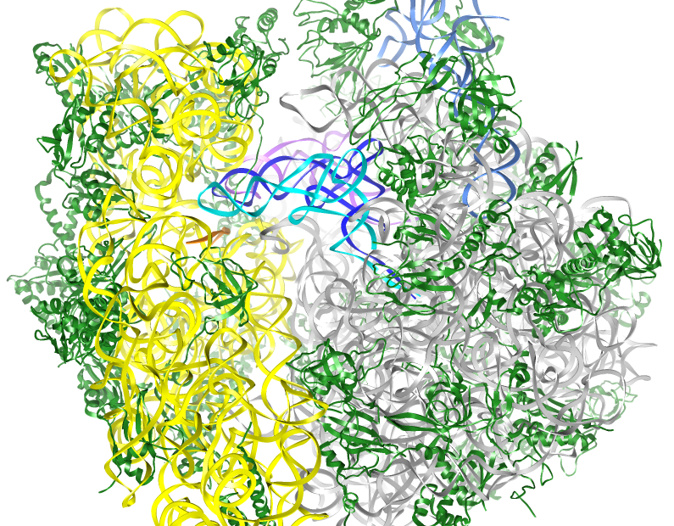
Aminoacyl-tRNA Binding to the Ribosome
Forms of DNA Helices
30S subunit binds mRNA while 50S anchors tRNAs and catalyzes the peptide chain elongation
3 distinct tRNAs binding sites
A site → Aminoacyl site
binds incoming aa-tRNA
P site → Peptidyl-transfer Site
tRNA with growing peptide chain
E site → Exit Site
tRNA bound that lacks peptide and weakly base paired with mRNA

Slide 7
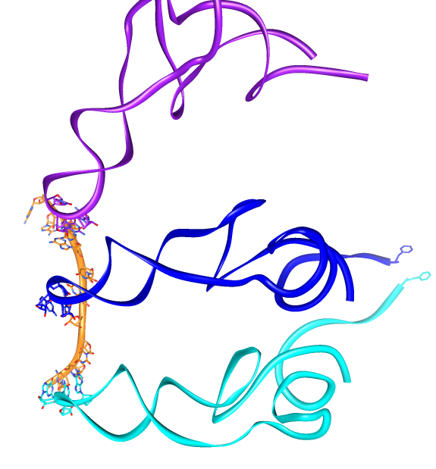
Aminoacyl-tRNA Binding to the Ribosome
Forms of DNA Helices
A site → Aminoacyl site
binds incoming aa-tRNA
P site → Peptidyl Site
tRNA with growing peptide chain
E site → Exit Site
tRNA bound that lacks peptide and weakly base paired with mRNA

Slide 8
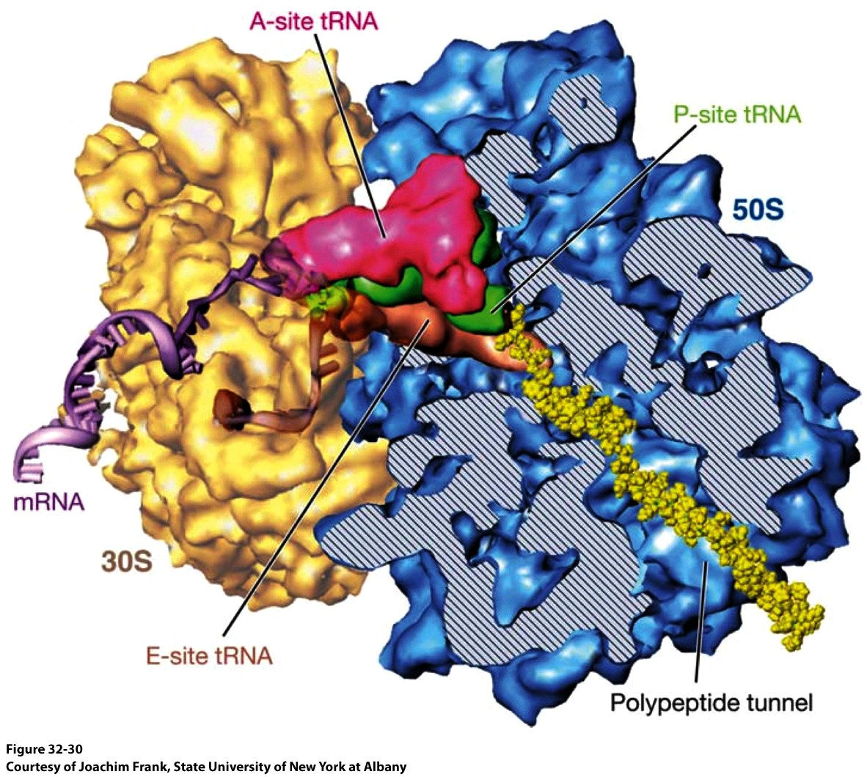
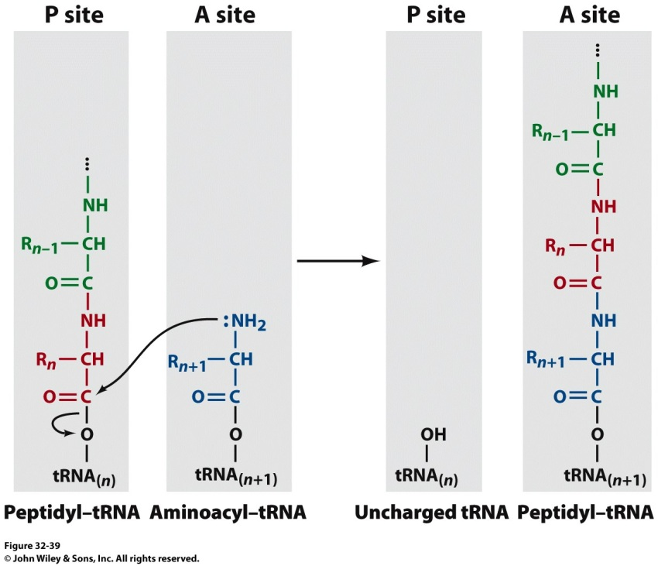
Peptide Elongation at the Ribosome
Forms of DNA Helices

Slide 9
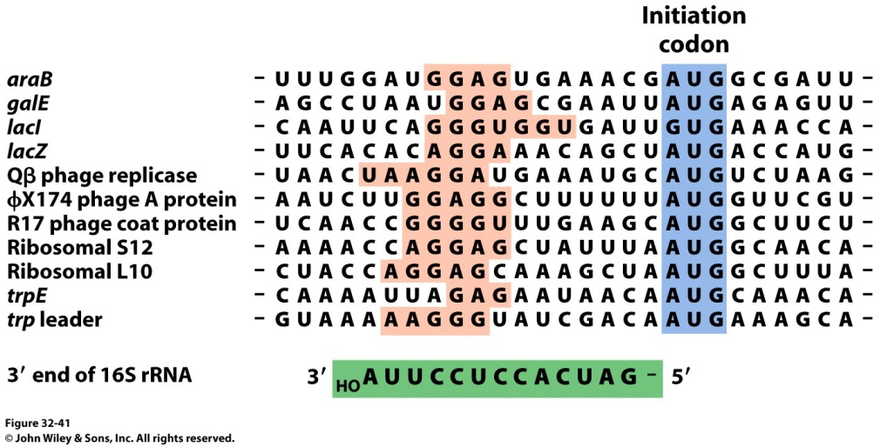
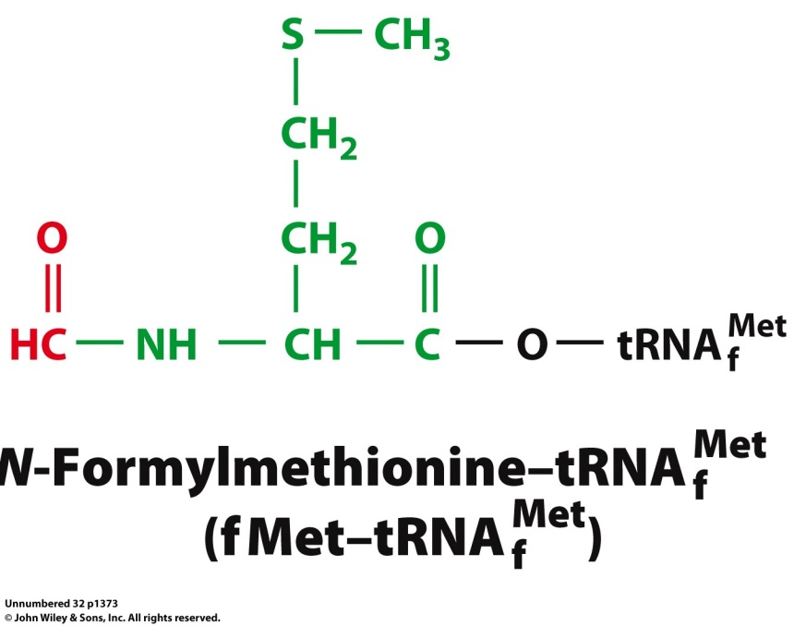
Translation Initiation
Forms of DNA Helices
Orientation of mRNA on the ribosome
The 16S rRNA contains a purine rich sequence that recognizes a pyrimidine rich sequence ~10 nucleotides downstream from the start codon – Shine Dalgarno Sequence
Specialized tRNA for initiation
The initial tRNA to insert into the P-site is a formaldehyde modified tRNA

Slide 10
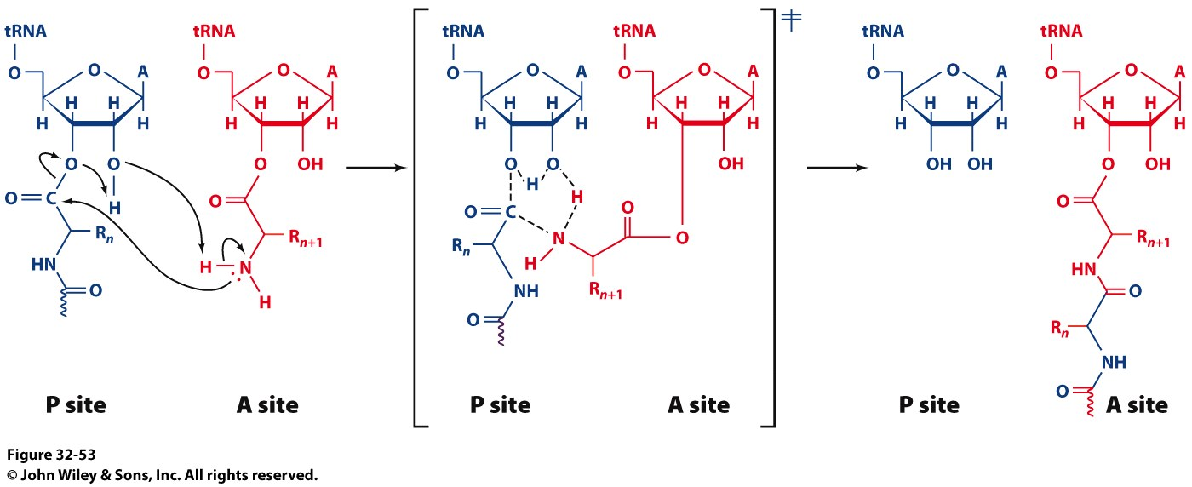
Peptide Elongation at the Ribosome
Forms of DNA Helices
Chain Elongation happens in 3 steps
Decoding – ribosomes selects and binds the proper tRNA
Transpeptidation – peptide group on the P-site tRNA is transferred to the A-site tRNA
Translocation – A-site tRNA transferred to the P-site and P-site tRNA transferred to the E-site

Slide 11
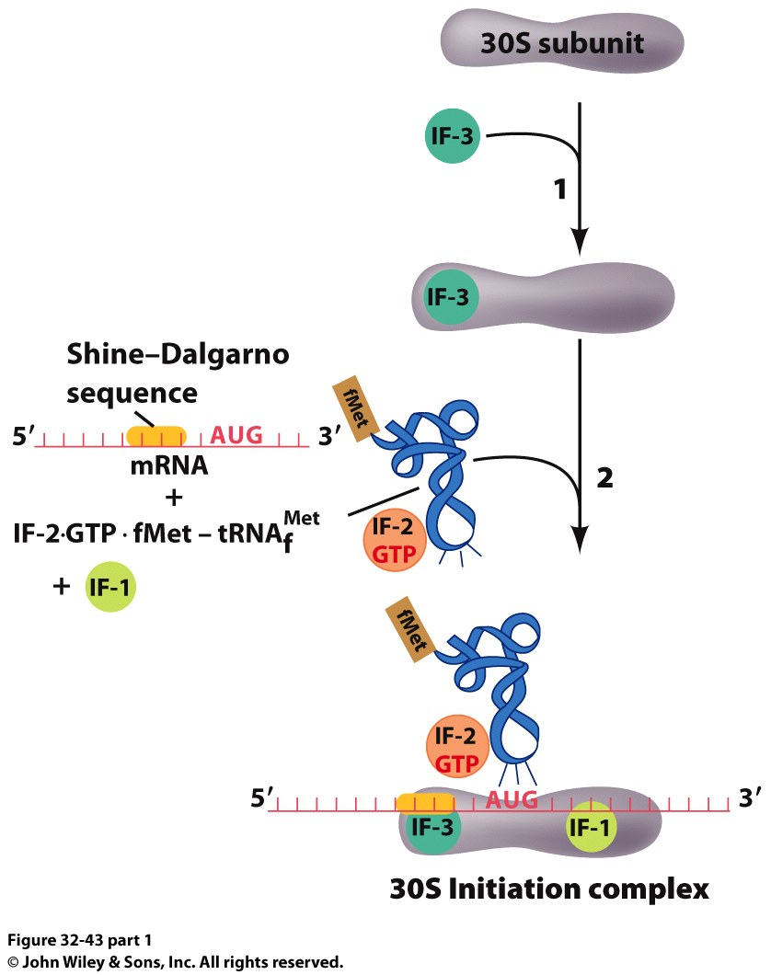
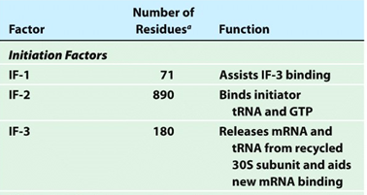
Translation Initiation
Forms of DNA Helices
Translation Initiation is a complex process:
30S and 50S subunits are initially separated
IF-3 keeps them from reassembling
mRNA binds to the 30S subunit (guided insertion)
fMet modified tRNA in a complex with IF-2 binds to 30S
This is assisted by IF-1

Slide 12
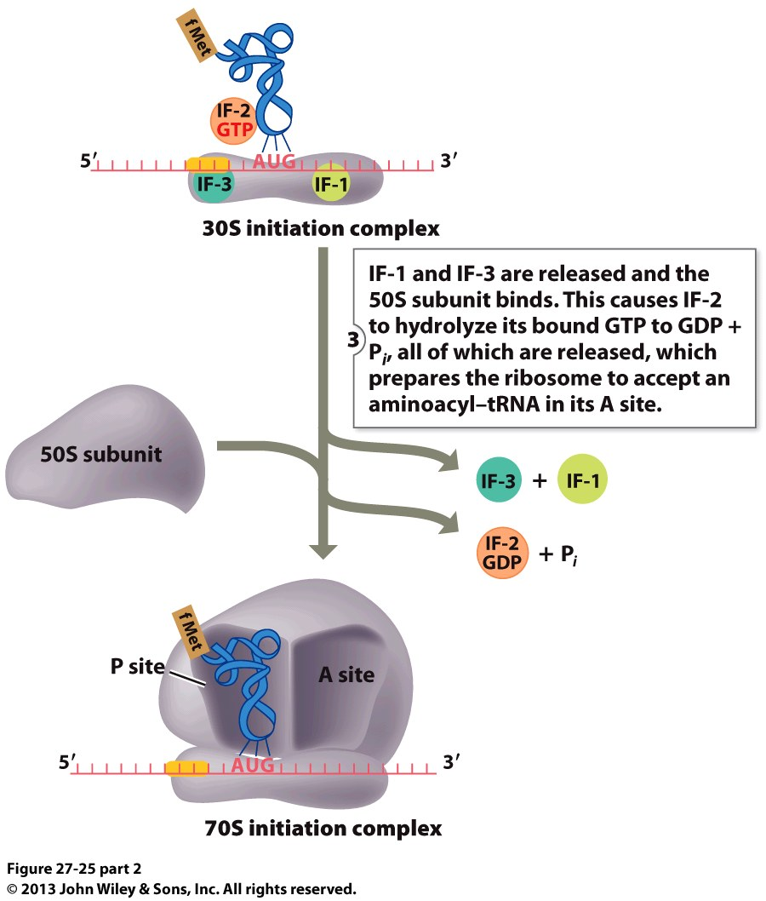
Translation Initiation
Forms of DNA Helices

Slide 13
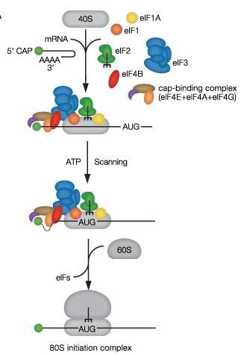
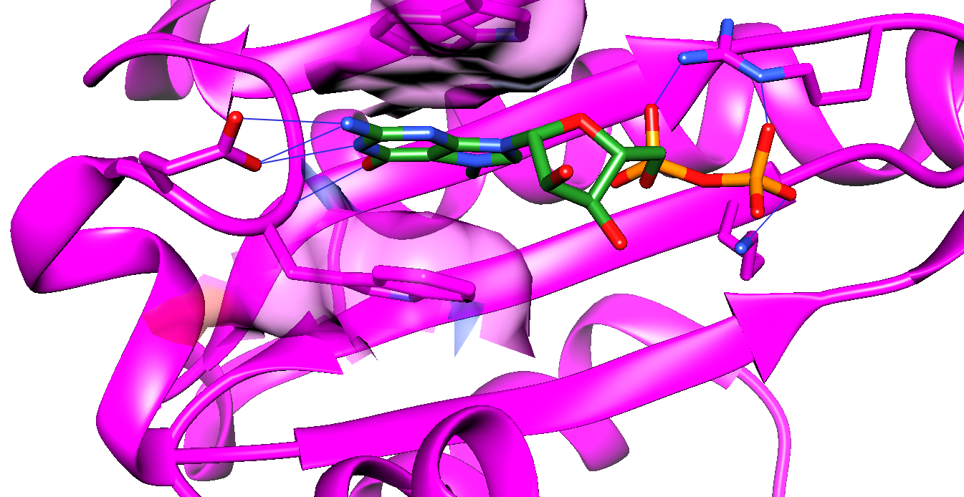
Translation Initiation in Eukaryotes
Forms of DNA Helices
eIF = eukaryotic initiation factors
eIF4E interaction with 5’cap
2 Trp present planar groove for m⁷G to intercalate
H-bonds localized to W-C face and 5’ PP

Slide 14
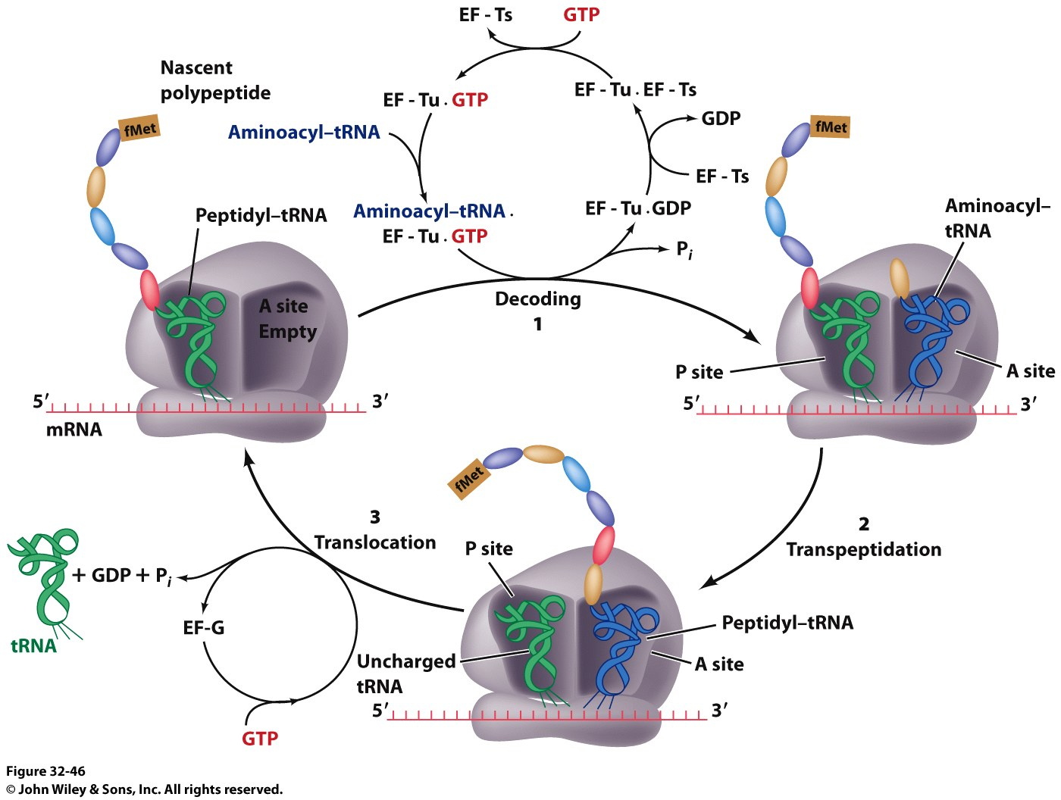
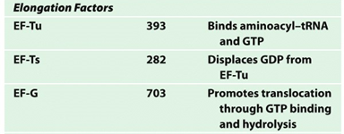
Peptide Elongation at the Ribosome
Forms of DNA Helices
Decoding Process
EF-Tu forms a complex with GTP (displacing EF-Ts) and the incoming aa-tRNA
This complex binds to the empty mRNA at the A Site (energy dependent step)
EF-Ts displaces the spent GDP
Translocation Process
The A-site tRNA displaces the P-site (uncharged) tRNA in an energy dependent process
EF-G is the GTPase that hydrolyzes the GTP to promote translocation

Slide 15
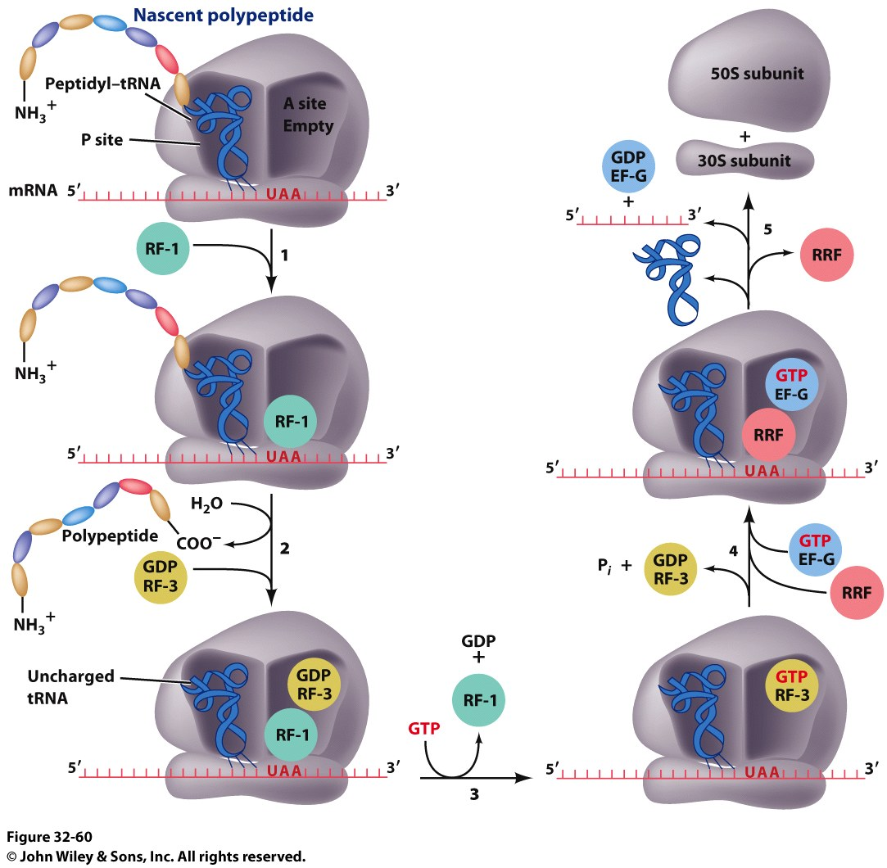
Peptide Termination
Forms of DNA Helices

Slide 16
Transcription Regulation

Slide 17
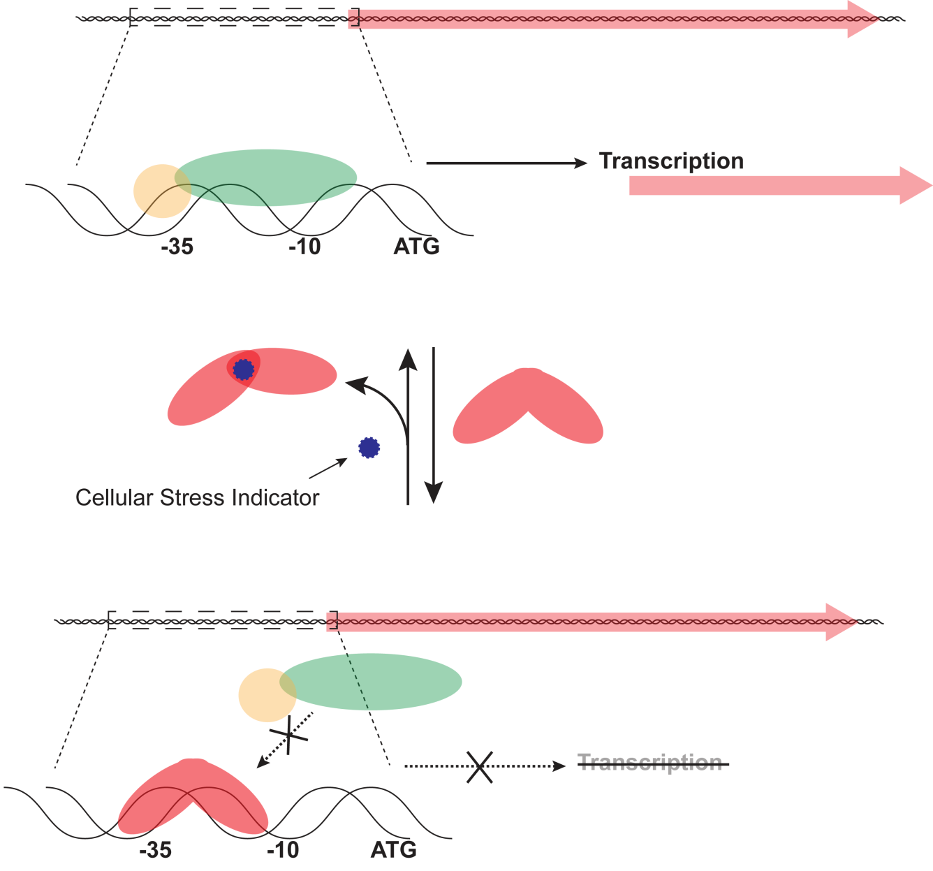
Transcriptional Repression
Forms of DNA Helices
Promoter/Operator
Not all genes need to be ‘turned on’ at all times. Doing so would be very wasteful
Organisms have evolved mechanisms to control the cellular levels of proteins in the cell
Inducer

Slide 18
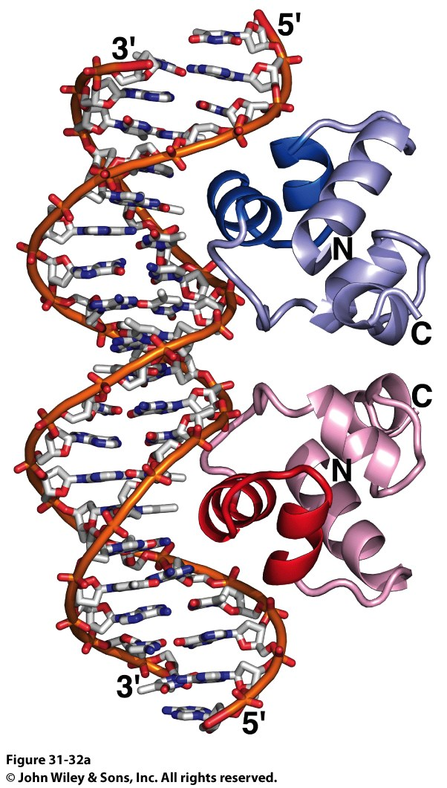
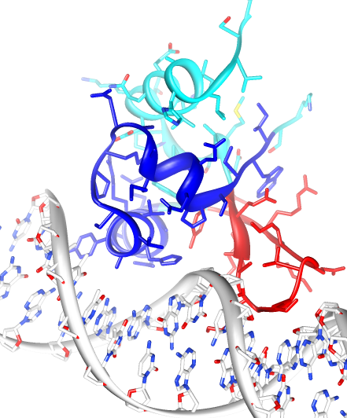
Common Features of Regulatory Proteins
Forms of DNA Helices
The recognition sequences tend to be palindromic
Regulatory proteins tend to interact as symmetric dimers (or dimers of dimers)
Base specific contacts are not always obvious
Intricate water networks
In bacteria, the helix-turn-helix motif (HTH) is very common
Variations: Winged Helix-Turn-Helix

Slide 19
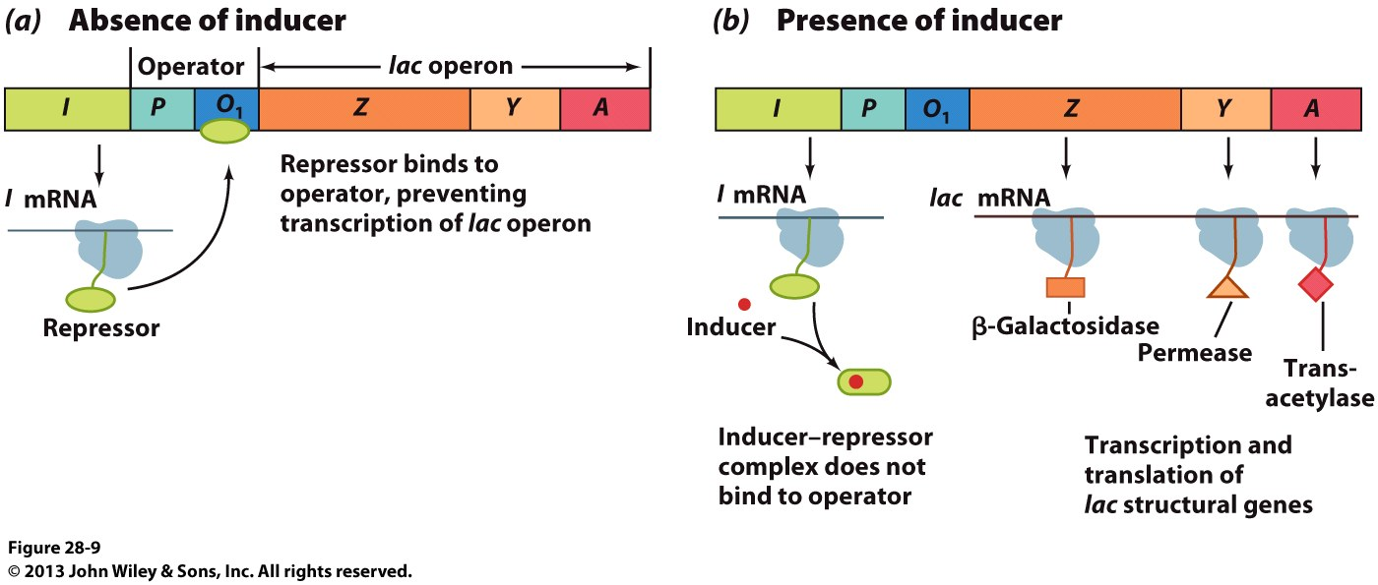
Transcriptional Repression
Forms of DNA Helices

Slide 20
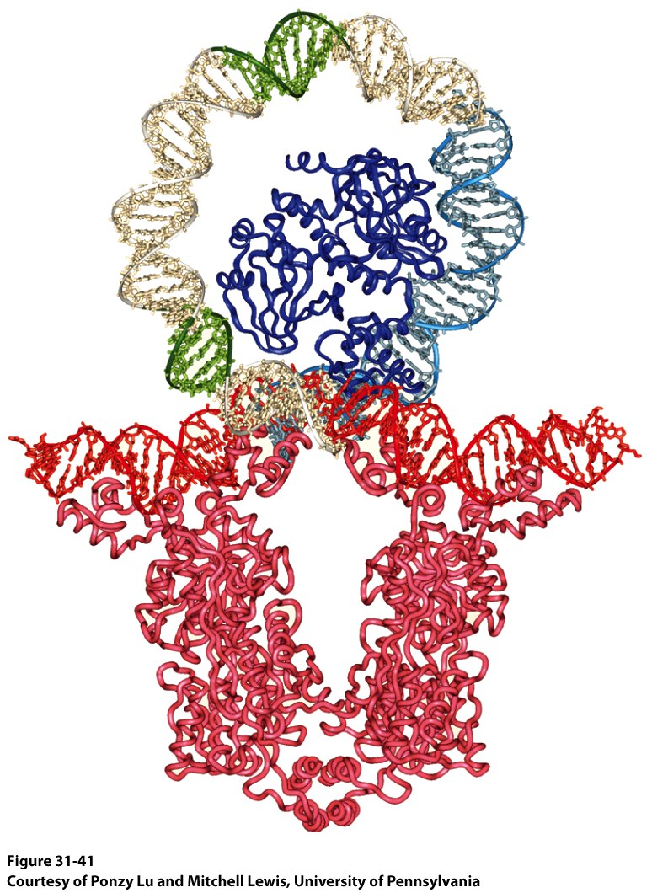
Lac Repressor
Forms of DNA Helices

Slide 21
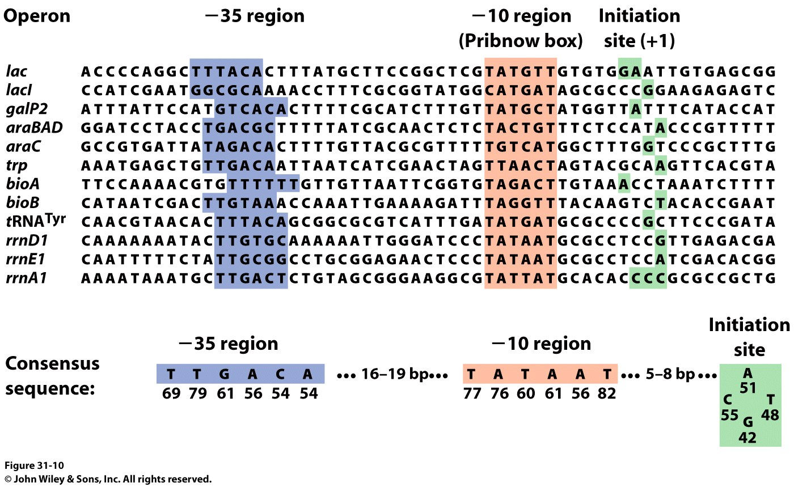
Transcriptional Regulation – Deviant Promoters
Forms of DNA Helices

Slide 22
Transcriptional Regulation – Deviant Promoters
Forms of DNA Helices
Suboptimal spacing or sequence of the Sigma Factor recognition elements decreases transcription efficiency
CATATCGCTTGACTCCGTACATGAGTACGGAAGTAAGGTTACGCTAT
-35
-10

Slide 23
Transcription Activators – MerR Family
Forms of DNA Helices
Sigma factor recognition elements are on opposite faces of the DNA helix
CATATCGCTTGACTCCGTACATGAGTACGGAAGTAAGGTTACGCTAT
To increase transcription efficiency:
the spacing of the -10 and -35 elements must be changed
OR
We need another sigma factor
OR
We need to add another recognition element that increases affinity of RNAP for promoter
Why won’t this work?

Slide 24
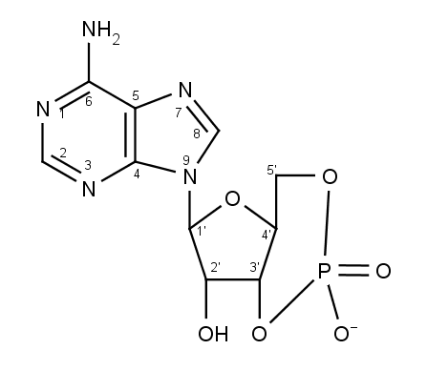
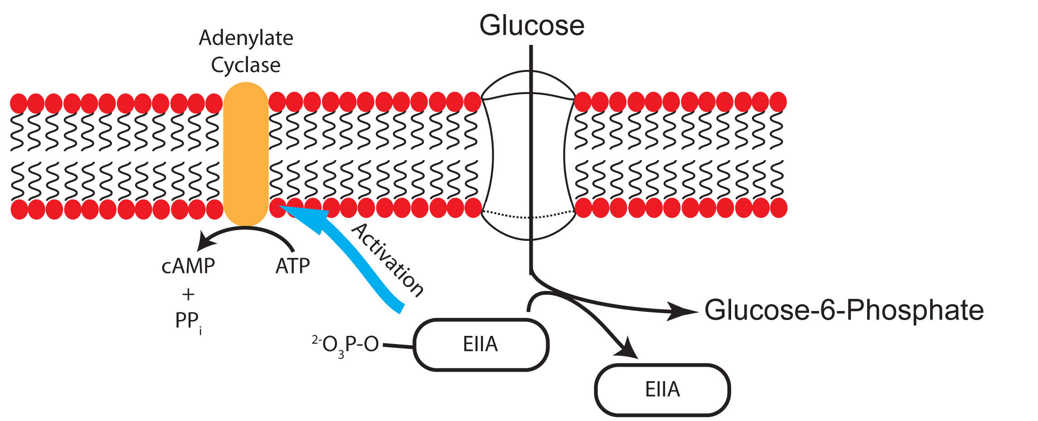
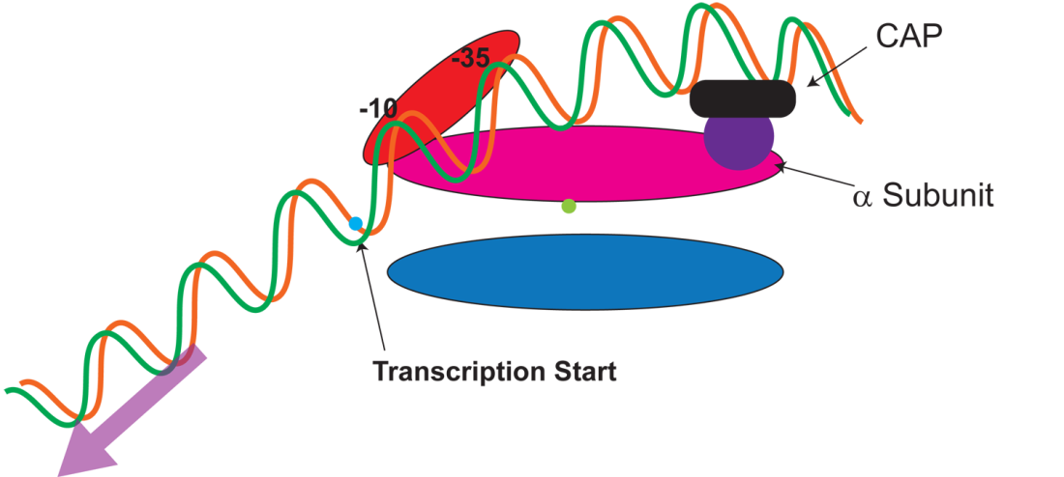
Catabolite Activator Protein (CAP)
Forms of DNA Helices
cAMP levels are inversely proportional to glucose levels
cAMP
When glucose, an organisms primary energy source, is low, a large array of catabolic enzymes are produced
CAP controls the expression of over 100 genes that play a role in sugar metabolism
CAP functions primarily to aid poor promoters
HOW?

Slide 25
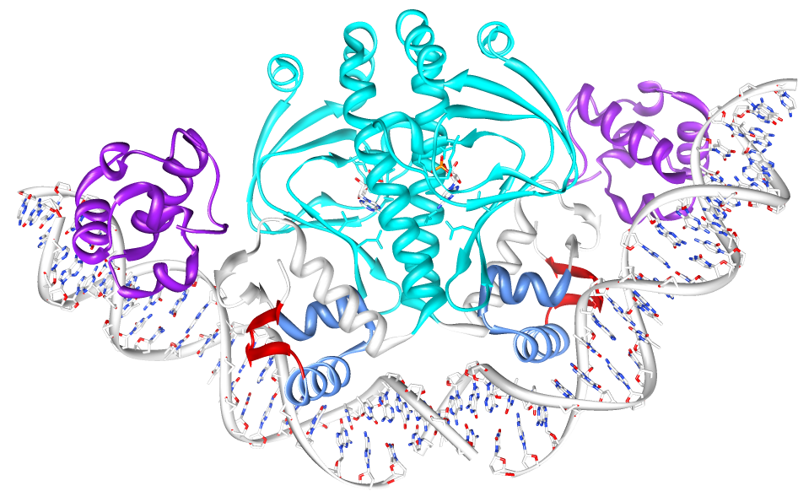
Catabolite Activator Protein (CAP)
Forms of DNA Helices
cAMP bound in activator domain
α subunit makes contact with DNA and CAP
cAMP-CAP promotes binding to the α subunit of RNAP
CAP is a symmetric dimer that senses cAMP concentrations in in the Activation/Dimerization domain and binds to palindromic DNA by a winged HTH motif in the DNA Binding Domain

Slide 26
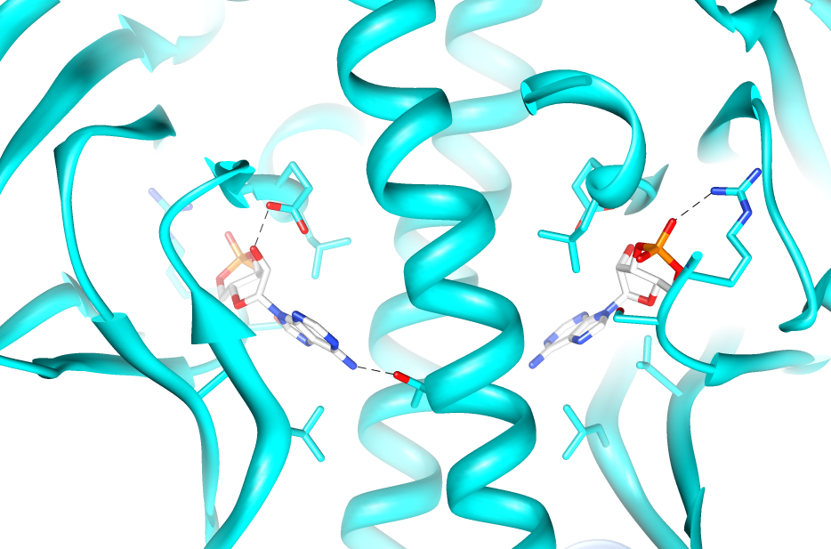
Catabolite Activator Protein (CAP)
Forms of DNA Helices

Slide 27
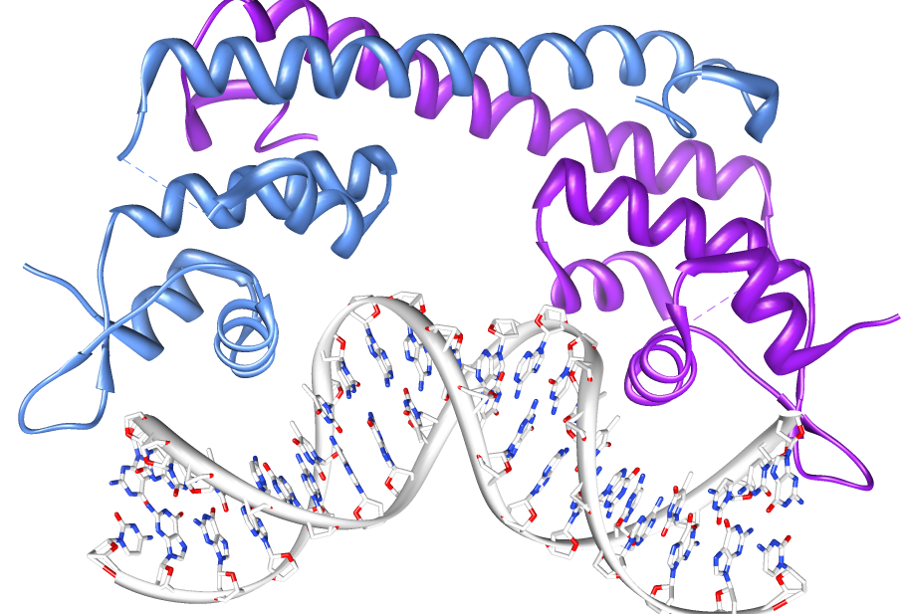
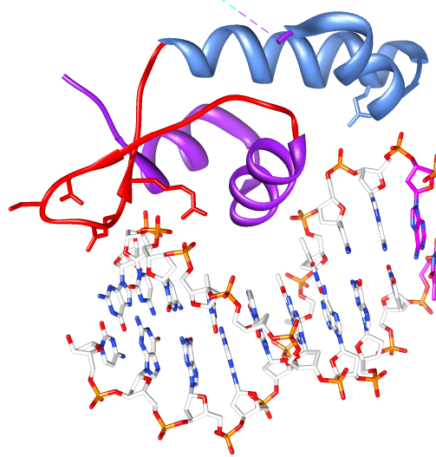
Transcription Activators - MerR
Forms of DNA Helices
MerR family proteins are symmetric dimers of HTH motifs connected by a single dimerization helix
DNA binding occurs through a double winged HTH motif
Primary interaction occurs through the HTH in the major groove
Secondary interactions (primarily backbone) occur through the β-haripin that forms a wing as well as a second wing formed by 2 sequential helices

Slide 28
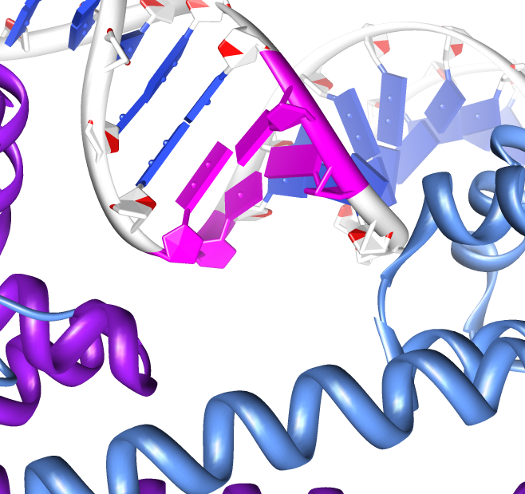
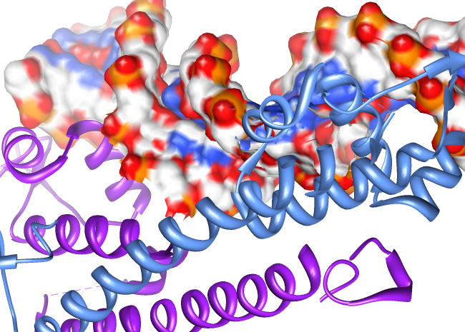
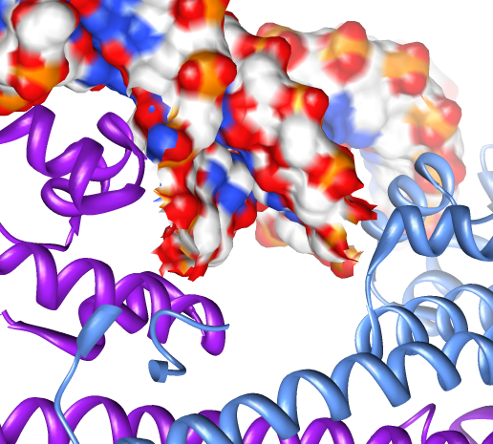
Transcription Activators - MerR
Forms of DNA Helices
Helix bending by DNA binding proteins is not particularly uncommon
This family is unique among these proteins due to the twisting of the helix in addition to bending.
Twisting is accomplished by ripping apart two base pairs make the minor groove significantly wider, and more solvent exposed

Slide 29
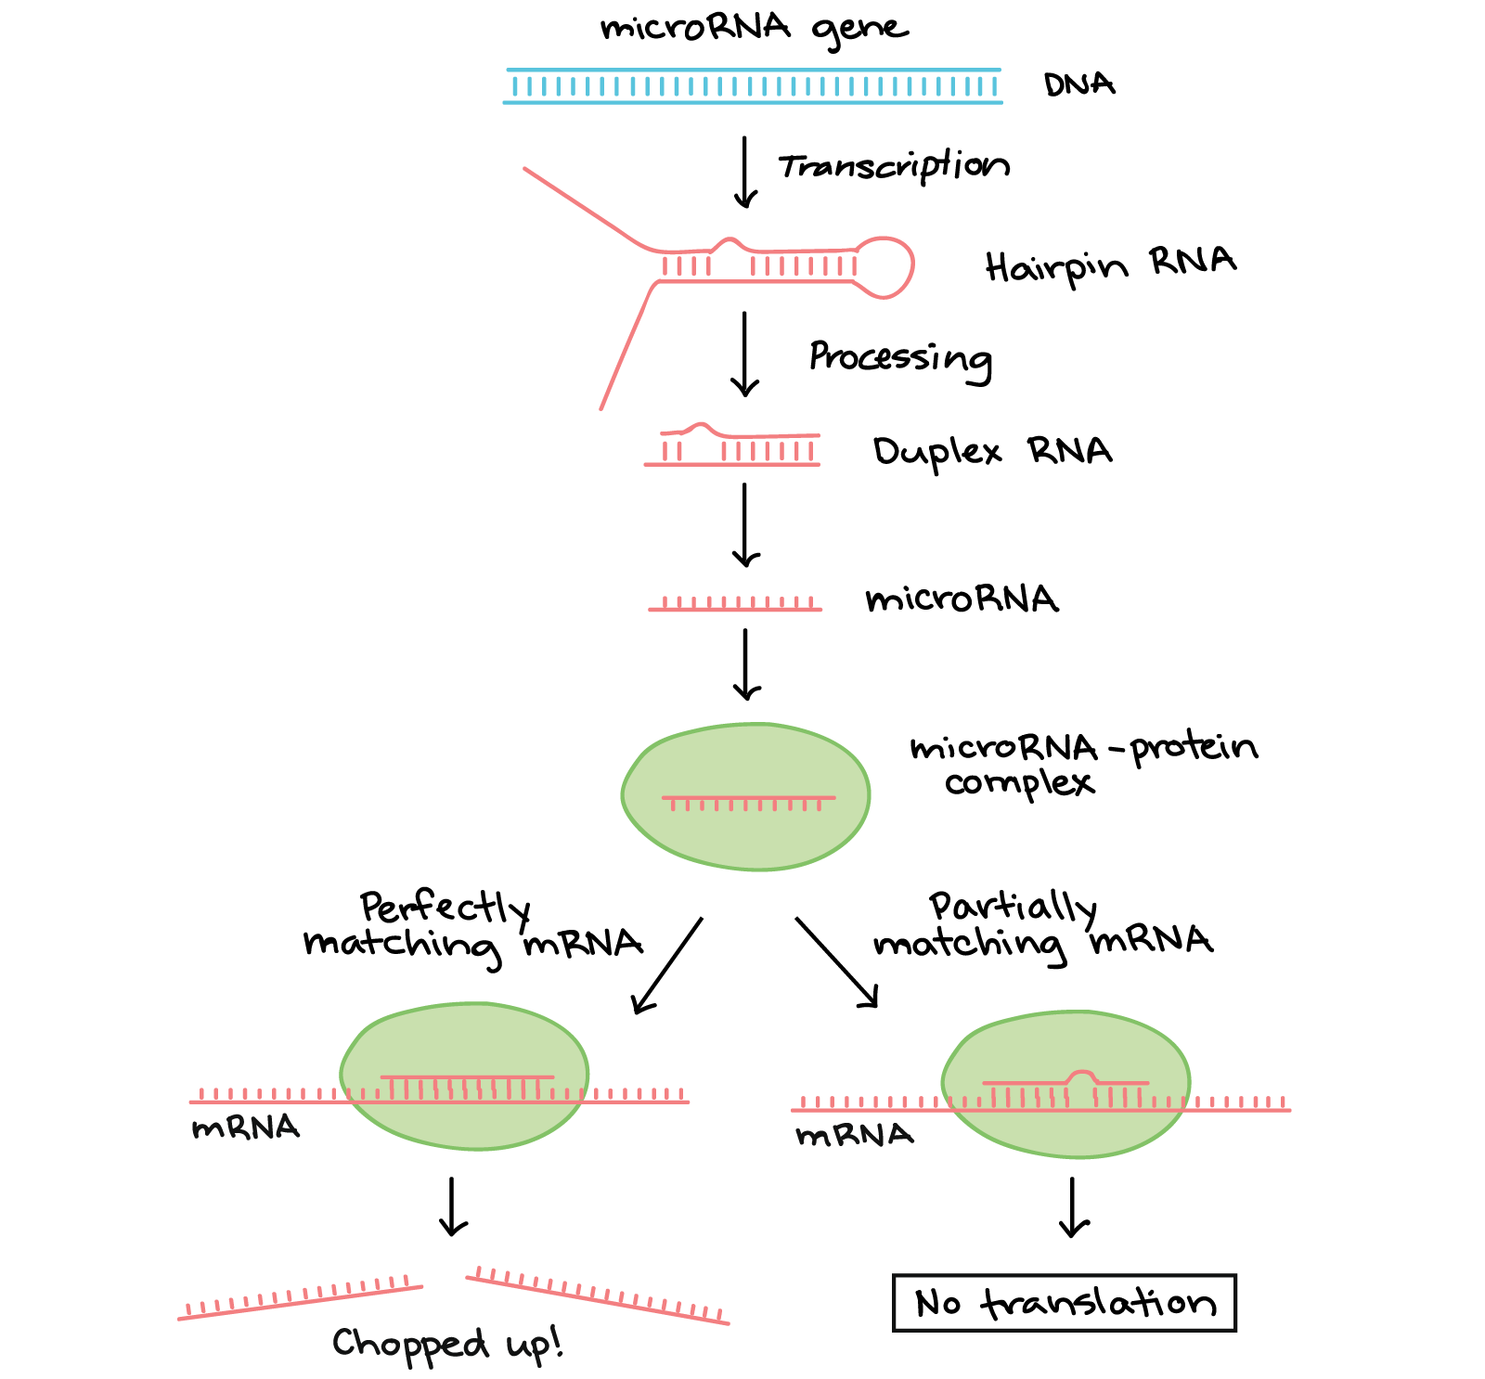
Post-transcriptional Regulation: microRNA
Forms of DNA Helices

Slide 30
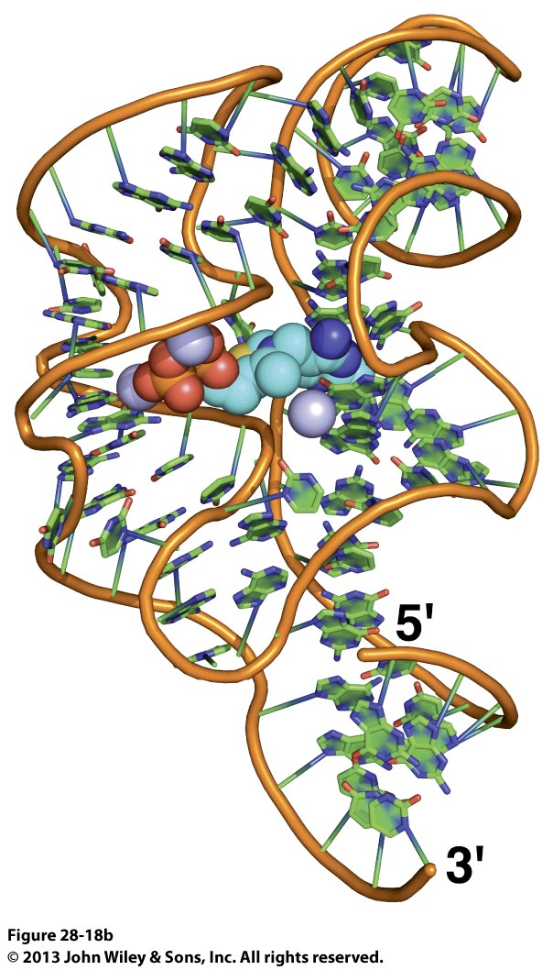
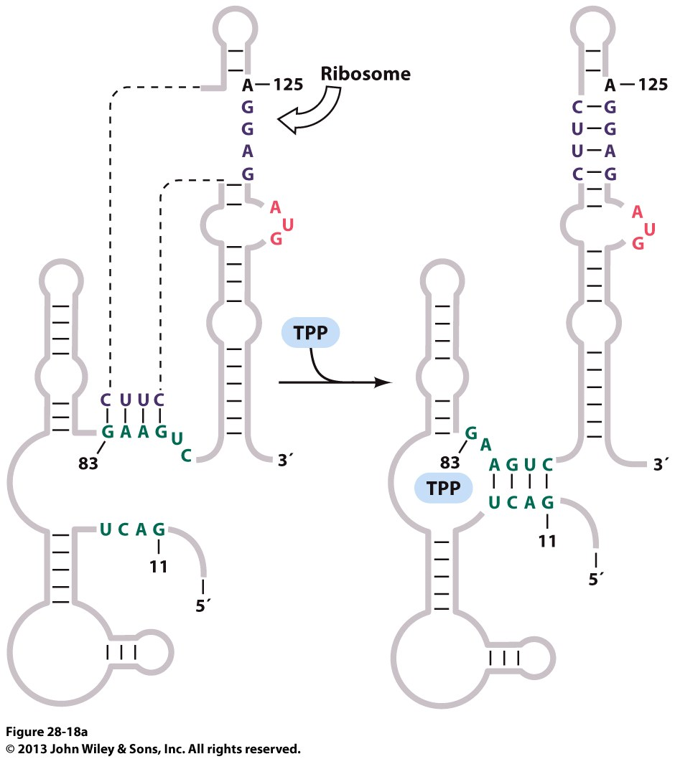
Post-transcriptional Regulation: Riboswitches
Forms of DNA Helices

Slide 31
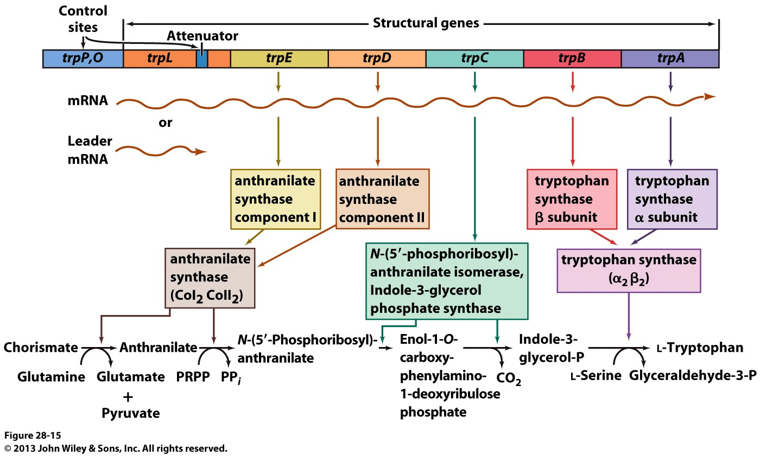
Regulation of the trp Operon
Forms of DNA Helices

Slide 32
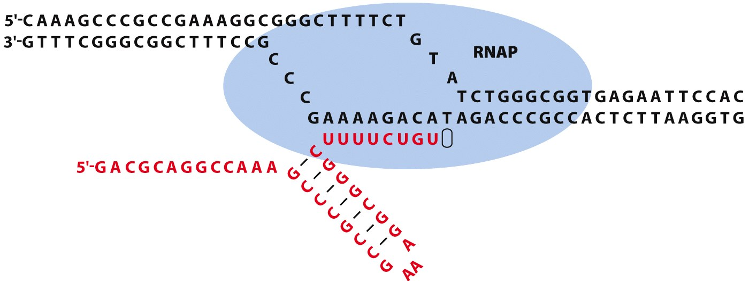
Regulation of the trp Operon – Attenuator Structure
Forms of DNA Helices
Leader Sequence = 5’ end of mRNA that is transcribed
Two possible conformations of the attenuator sequence
Spontaneous termination of transcription
A terminator stem loop forms that causes the RNA polymerase to stall and “fall off” the mRNA

Slide 33
Regulation of the trp Operon – Attenuator Structure
Forms of DNA Helices
Leader Sequence = 5’ end of mRNA that is transcribed
Two possible conformations of the attenuator sequence
TrpTrp dimer (unstructured)
More stable conformation (lots of GC stacking)
Alternate structure (“antiterminator”) requires some way to prevent the formation of the more stable stem loops
Trp makes up < 1% of amino acids in proteins – the presence of this ditryptophan is very unlikely
A terminator stem loop forms that causes the RNA polymerase to stall and “fall off” the mRNA

Slide 34
Regulation of the trp Operon
Forms of DNA Helices
Ribosome plays an important role!
Video Summary: https://www.youtube.com/watch?v=YAr18UR2dos
High [Trp]
Plenty of tRNA-Trp
Ribosome sequesters regions 1 and 2
Termination Stem loop stable
Low [Trp]
Limited tRNA-Trp
Ribosome stalls at region 1
Region 2 available for 2-3 stem loop formation (“antiterminator”)
No Terminator
Not enough tRNA-Trp

Slide 35
Overview
Forms of DNA Helices
https://www.youtube.com/watch?v=u9dhO0iCLww

