Slide 1
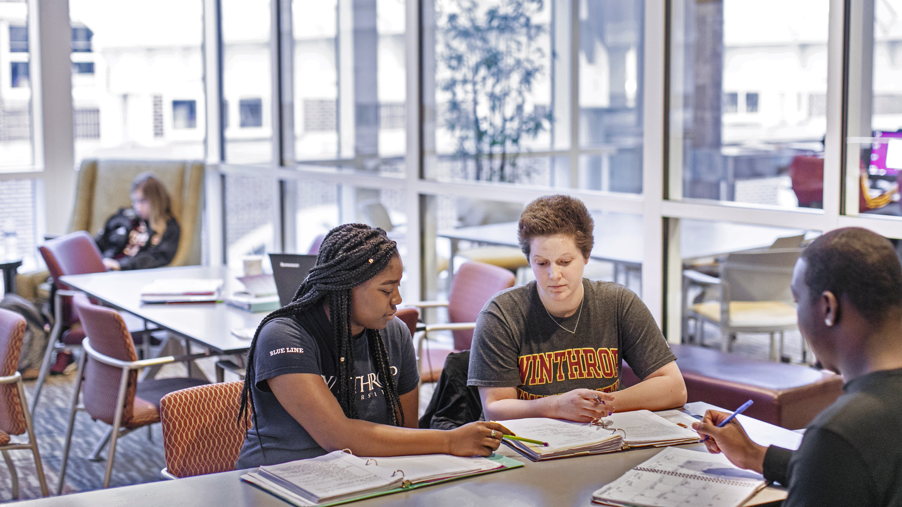
WEEK FIVE: CRITICAL READING

Slide 2
STUDY ABROAD FAIR RECAP
pg. 40

Slide 3
REFLECTION
STUDENT ORGANIZATIONS
pg. 36

Slide 5
Why should I vote
in the November election?

Slide 6
1) Be heard
2) Voting is important
3) Who is elected matters

Slide 7
In 2016, 48.5% of Winthrop freshmen voted compared to 58.1% for all students. That’s a significantly lower percentage.

Slide 8
How well are you
transitioning to college?

Slide 9
BEST/WORST CLASS ACTIVITY
WHAT MAKES A GOOD CLASS?

Slide 10
CLASSROOM
GRAFFITI
YOUR LEARNING EXPERIENCE

Slide 12
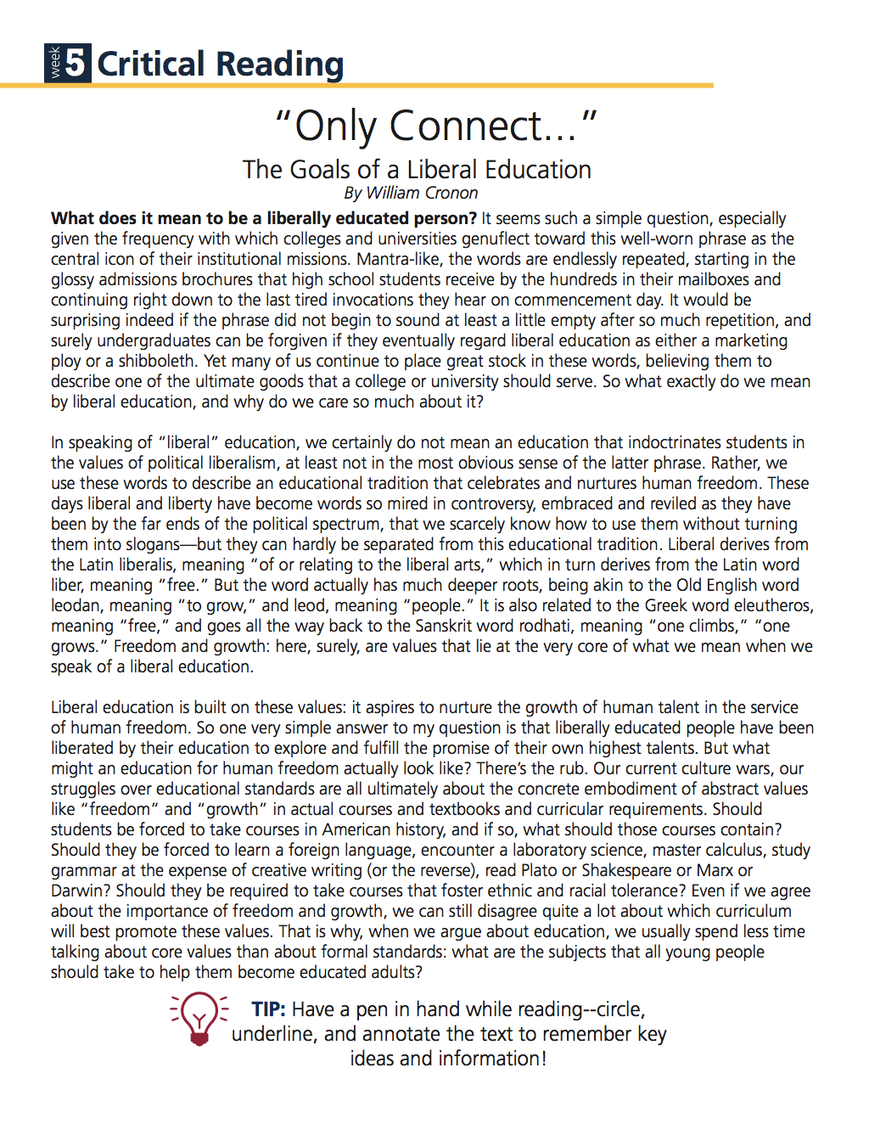
DISCUSSION
“Only Connect” Reading
pgs. 44-48

Slide 13
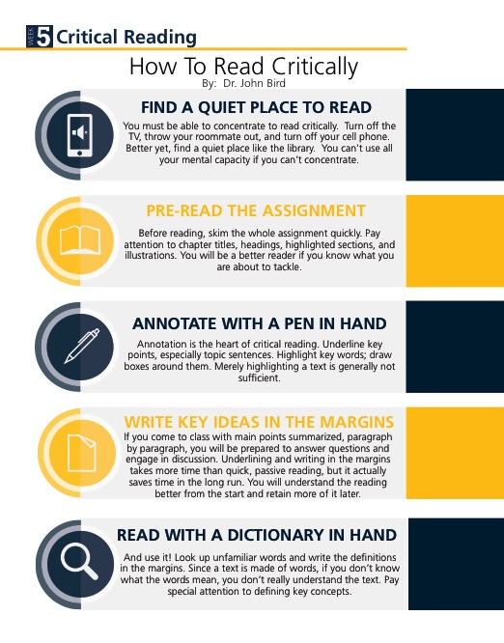
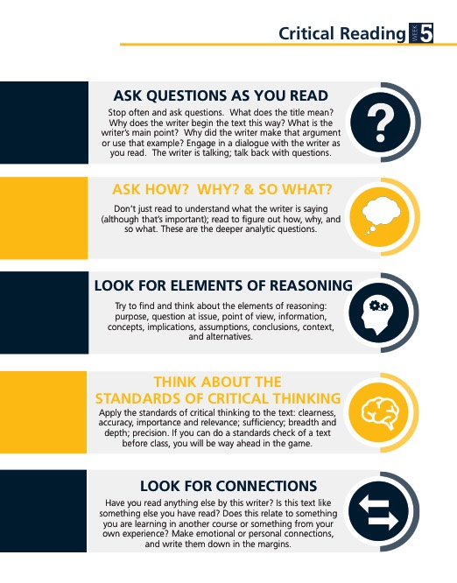

Slide 14
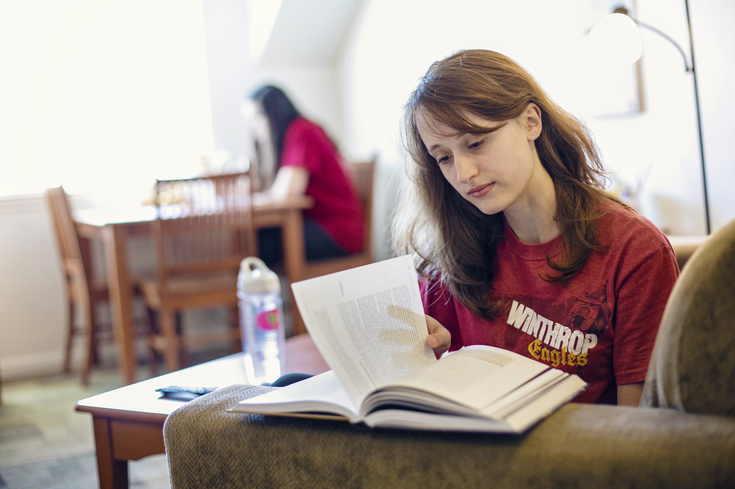
ASSIGNMENTS
DUE NEXT WEEK

Slide 15
• Weekly Time Log (pgs.52-53)
• Where Does My Time Go? (pg. 54)

Slide 16
CRITICAL READING
MODEL
EFFECTIVE READING STRATEGIES

Slide 17
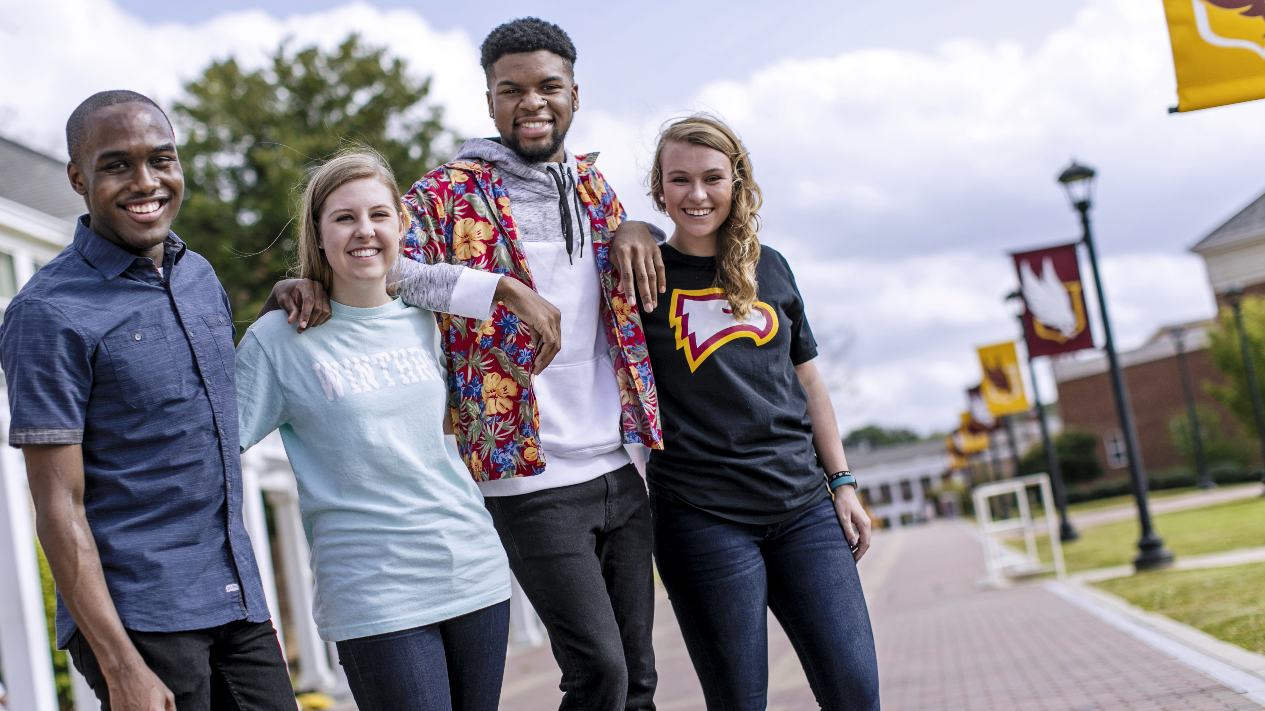
ANNOUNCEMENTS
& UPCOMING EVENTS

