Slide 1
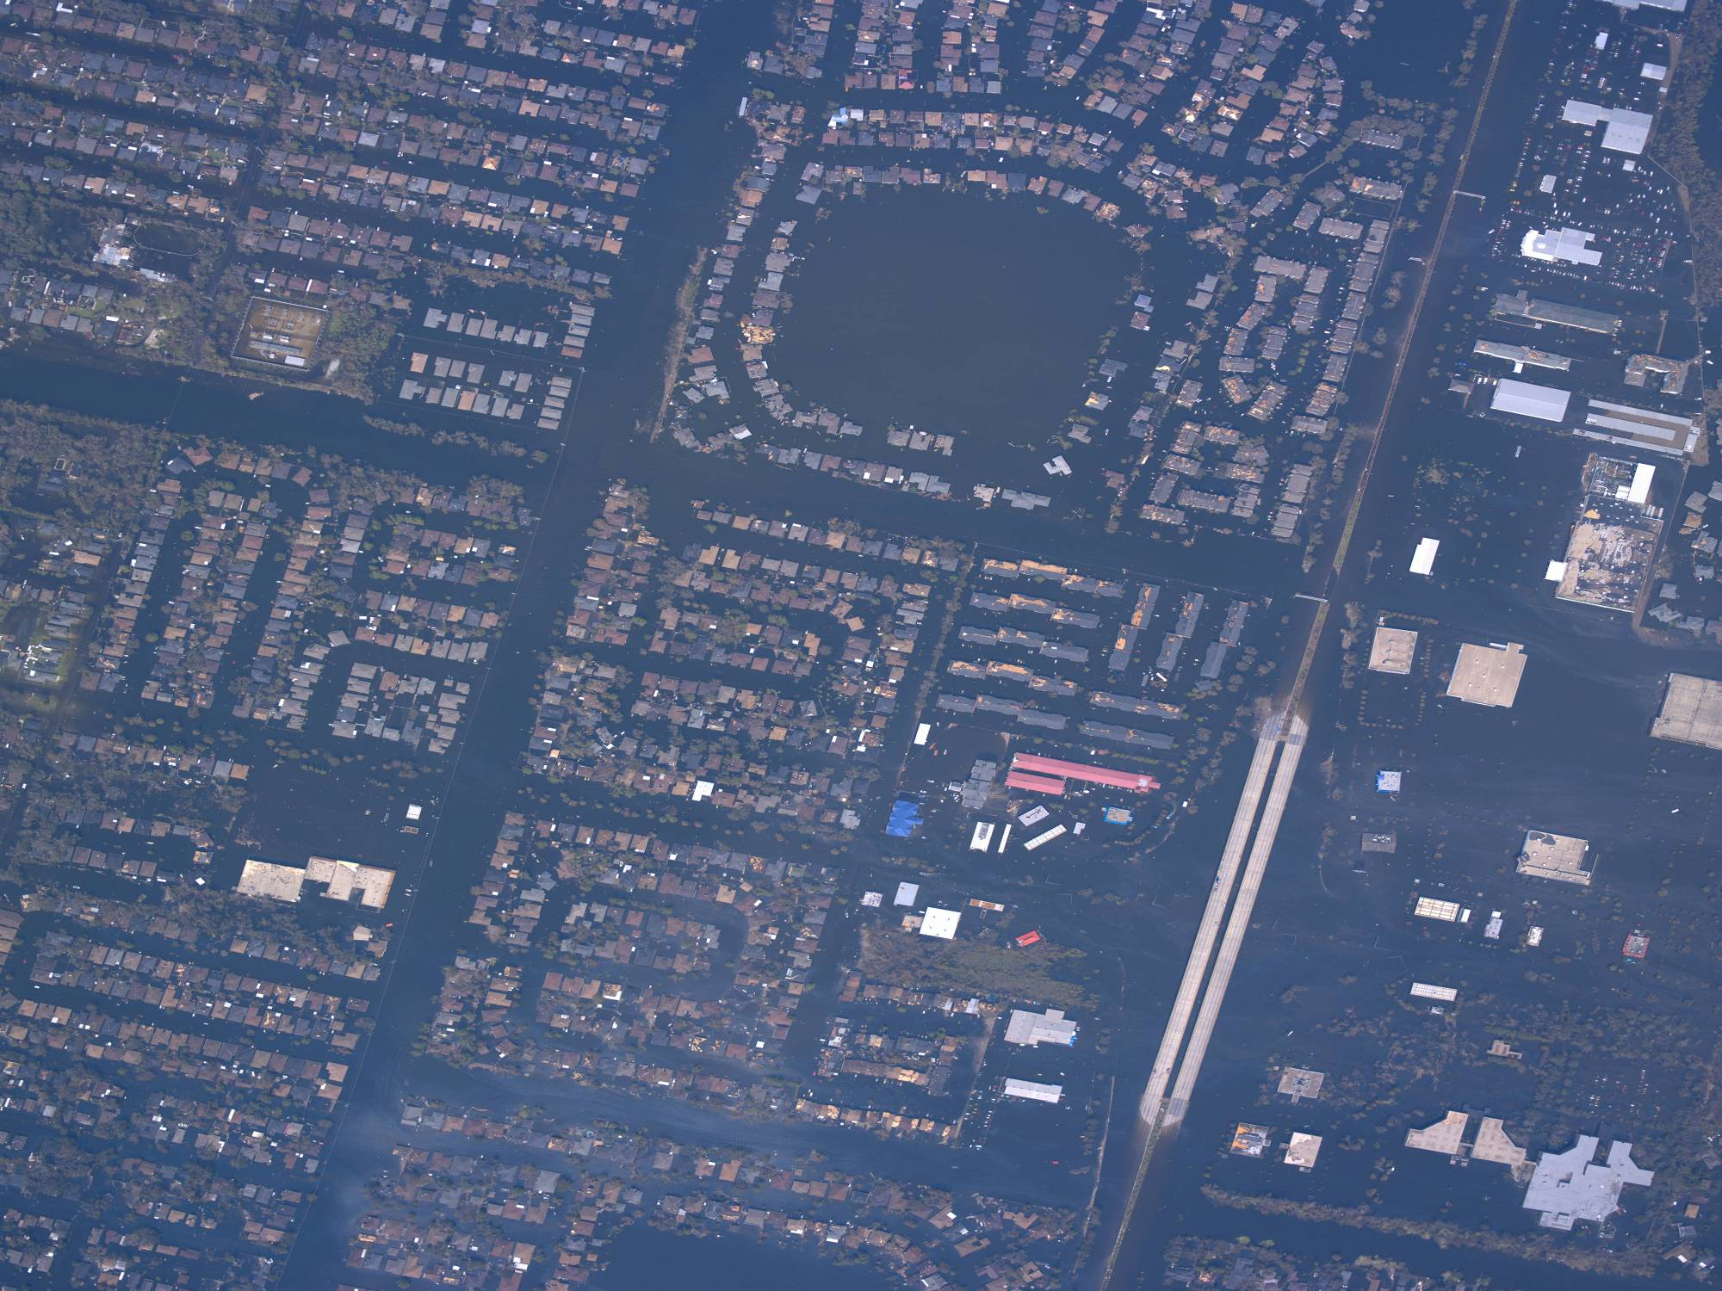
The Hydrologic Cycle
Streams
Flooding
http://ngs.woc.noaa.gov/storms/katrina/

Slide 2
Solar
radiation
Condensation
Precipitation
Evaporation
Evaporation
Percolation
Sea
Ground water
Salt water

Slide 3
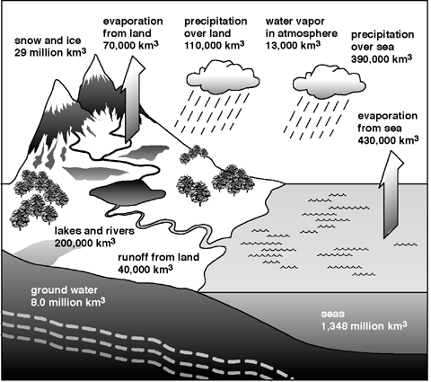
Total Evaporation = Total Precipitation = 500,000 km³/yr
22%
78%
http://www.jhuccp.org/pr/m14/m14figs.stm

Slide 4
Water Reserves
Salt Water
Fresh Water
http://www.jhuccp.org/pr/m14/m14figs.stm

Slide 5
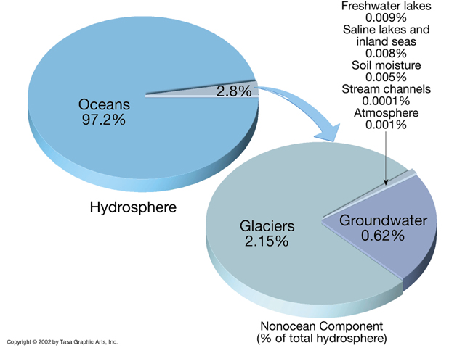

Most of the Earth’s water is saline (salt water)
Of the remaining, most is locked up in glacial ice

Slide 6
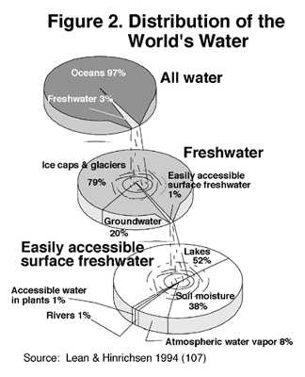
Less than 1% of the Earth’s freshwater is on the surface at any time.
20% of the freshwater flows through the ground – groundwater.
http://www.jhuccp.org/pr/m14/m14figs.stm

Slide 7

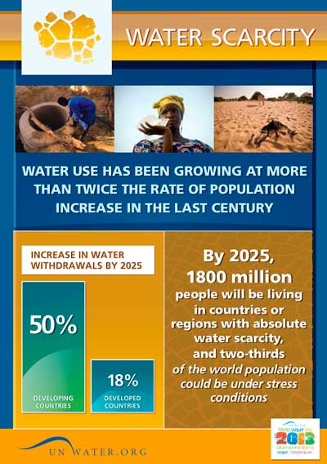
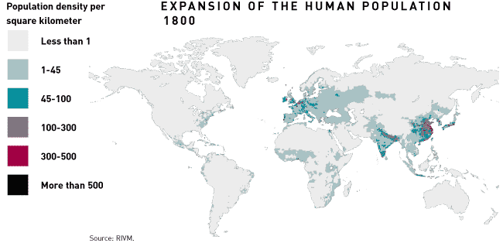
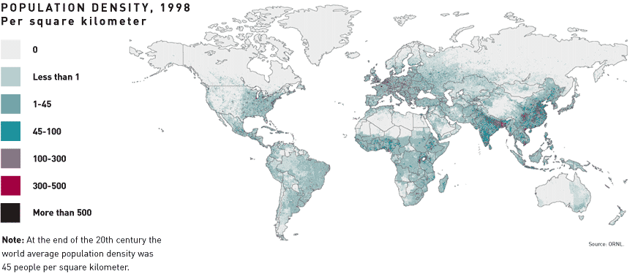
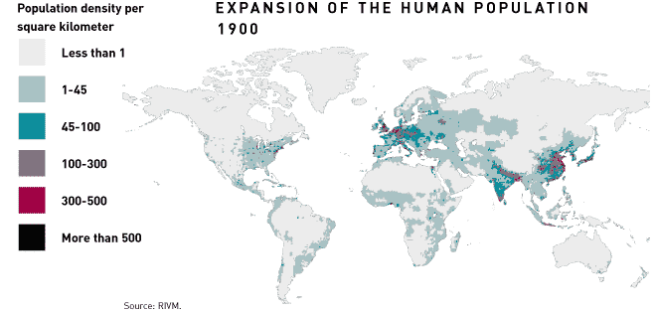
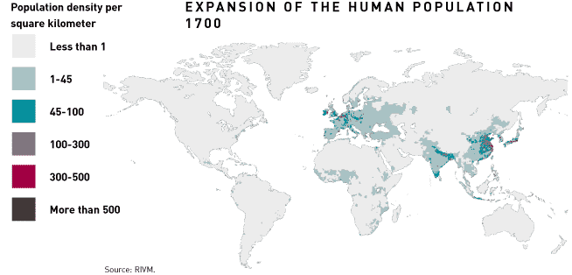
http://atlas.aaas.org/
http://blogs.salon.com/0002007/2007/11/08.html

Slide 8
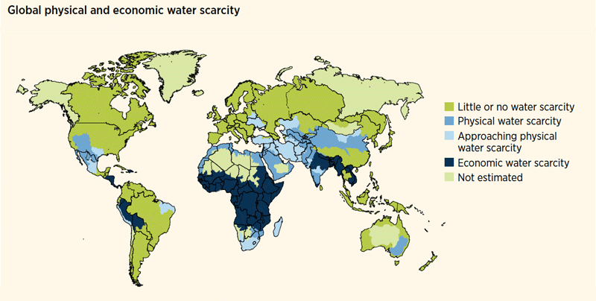
Source: World Water Development Report 4. World Water Assessment Programme (WWAP), March 2012.

Slide 9
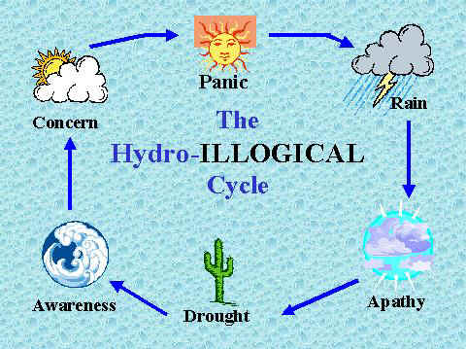
http://www.waterwisetexas.org/understanding_our_water_supply.htm

Slide 10
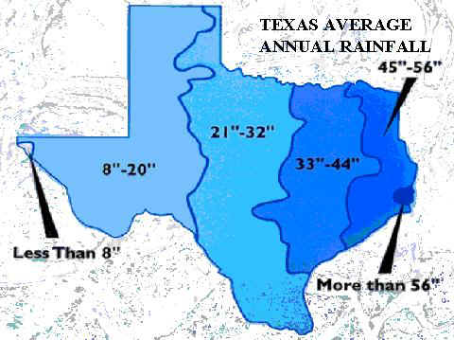
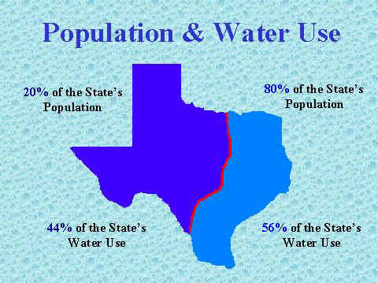
East Texas: Gulf of Mexico influence, soggy
West Texas: mountains, desert
West Texas: Agriculture, mining
East Texas: Houston, Dallas
Texas Water Use
http://www.waterwisetexas.org/understanding_our_water_supply.htm

Slide 11
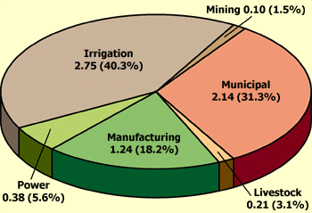
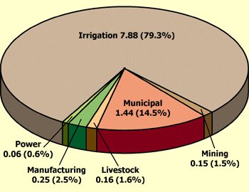
Surface Water
Texas Water Use
Groundwater
Most water for agriculture is drawn from the ground.
If the rate of withdrawal exceeds aquifer recharge, the resource becomes depleted
http://www.texasep.orgl

Slide 12
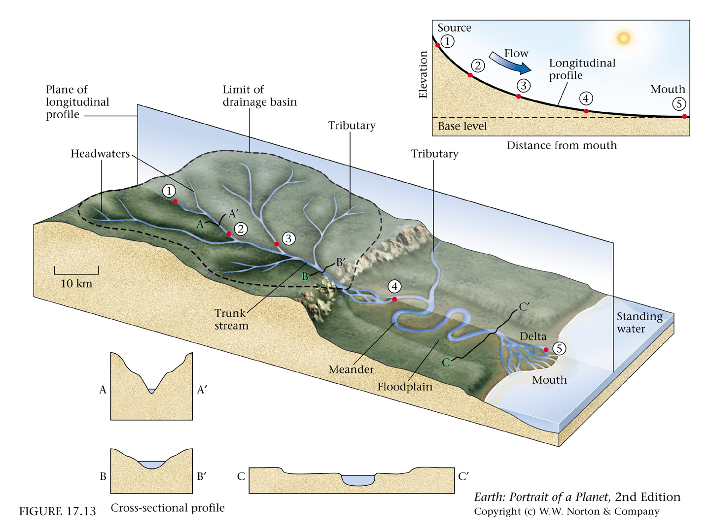
Stream: body of running water that is confined to a channel and moves downhill due to gravity

Slide 13
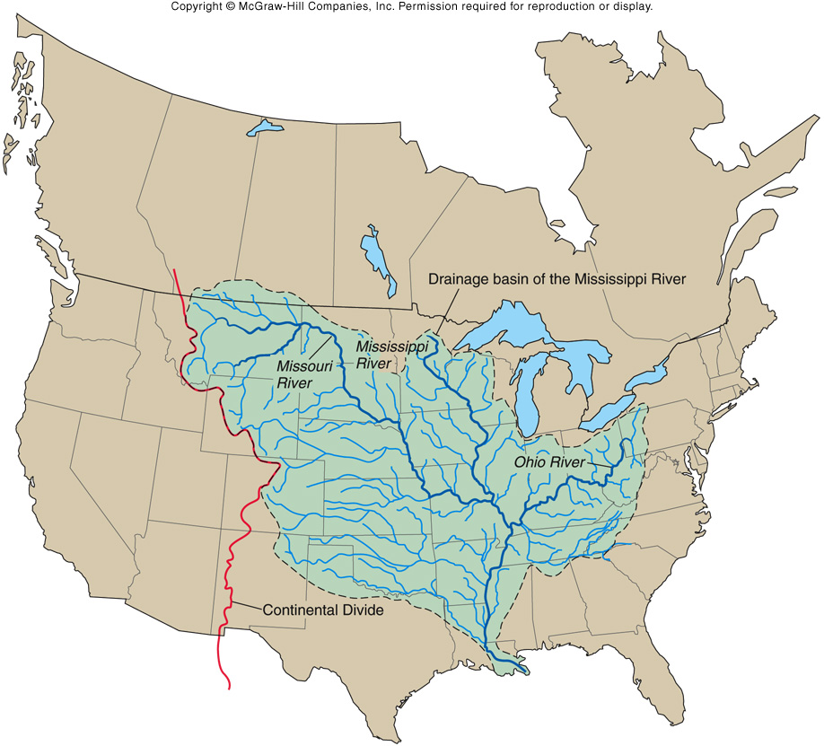
Drainage Basin: total area drained by a stream. Larger streams have larger drainage basins.
The size and composition of the sediment carried by the stream depends on the nature of the drainage basin.

Slide 14
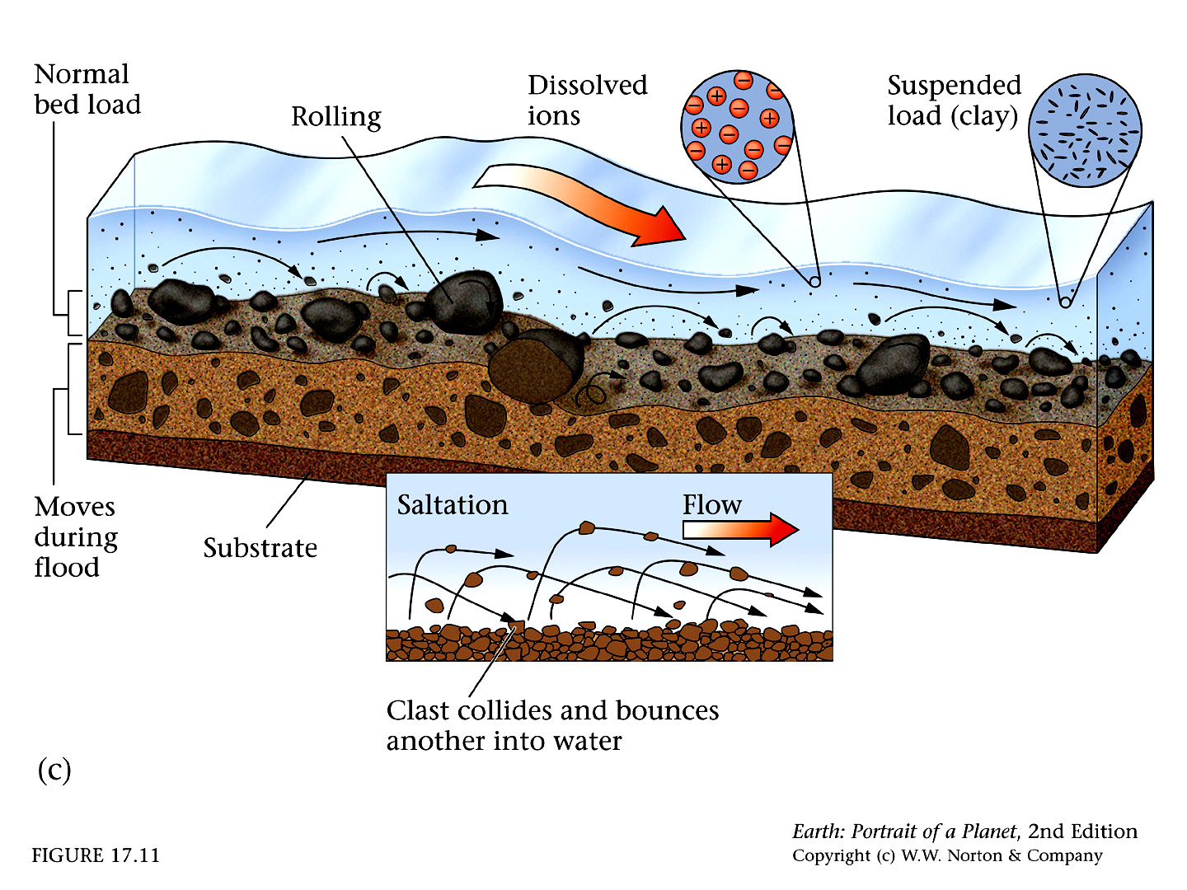
Dissolved Load
Suspended Load
Bed Load

Slide 15
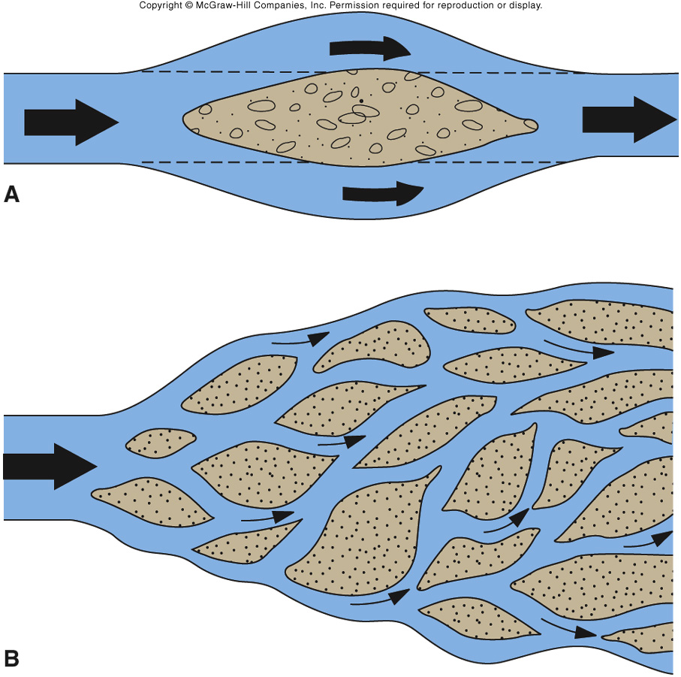
Braided Streams
Streams with high sediment loads deposit lots of channel bars. The stream moves around the bars, wending through the barriers.
Usually found near sediment source areas and/or areas with easily eroded substrate.
Fig. 10.18

Slide 16
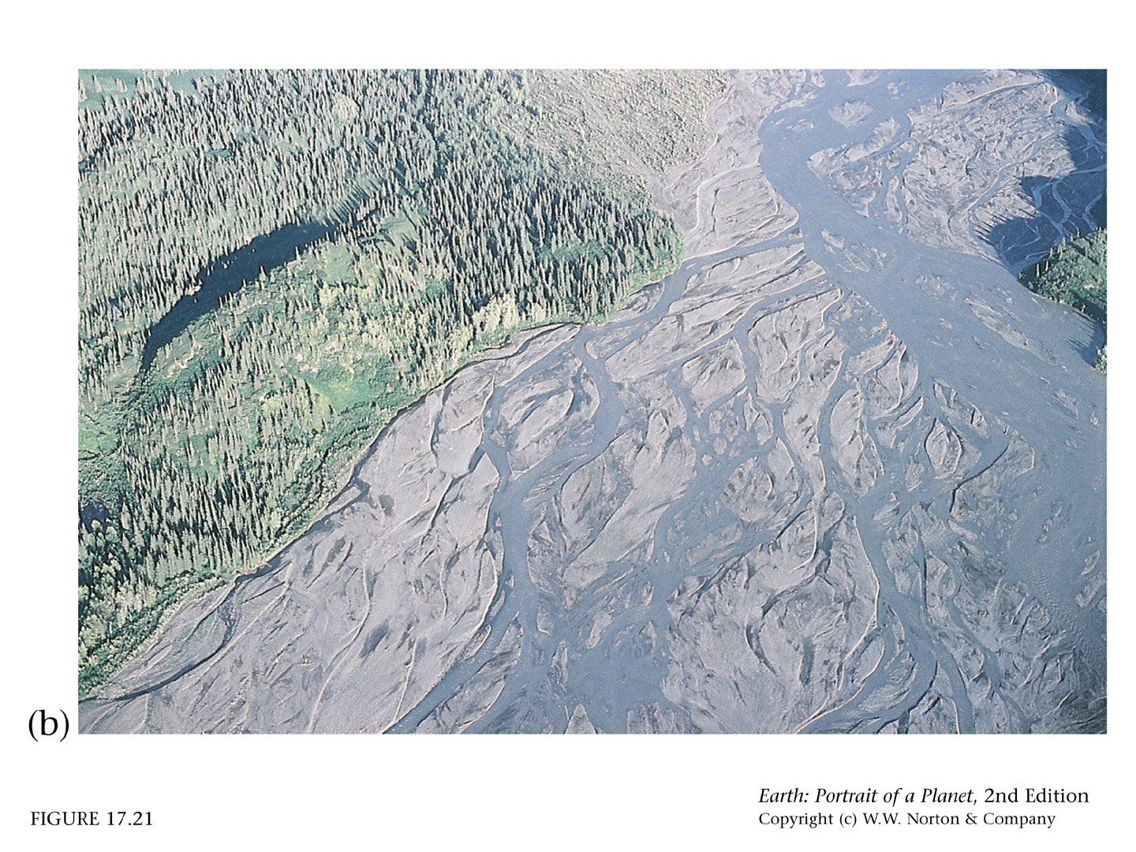
Braided stream fed by a glacier in Alaska. The sediment load is very high, and the substrate is loose sediment.

Slide 17

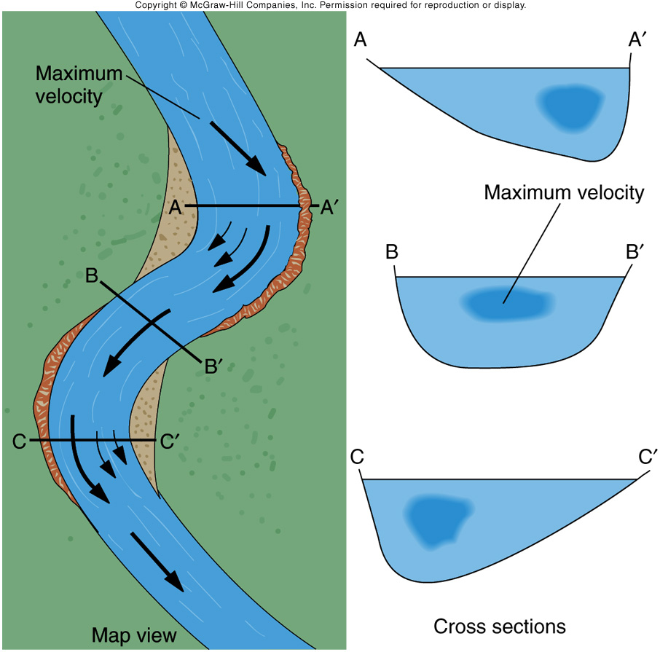
Meandering Stream
Deposition occurs on point bars, where stream velocity is low
Erosion occurs on cutbanks, where stream velocity is high
Fig. 10.06

Slide 18
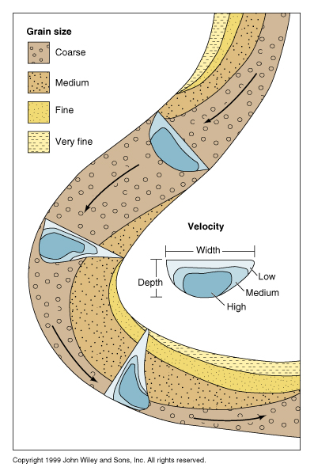
Meandering Stream
Fine-grain sediment is usually deposited in:
point bars - sediment deposited on the banks of a stream
channel bars - sediment deposited within the stream channel
Coarse-grain sediment is usually found in the stream channel. The largest clasts move only during floods
http://www.usd.edu/esci/figures/

Slide 19
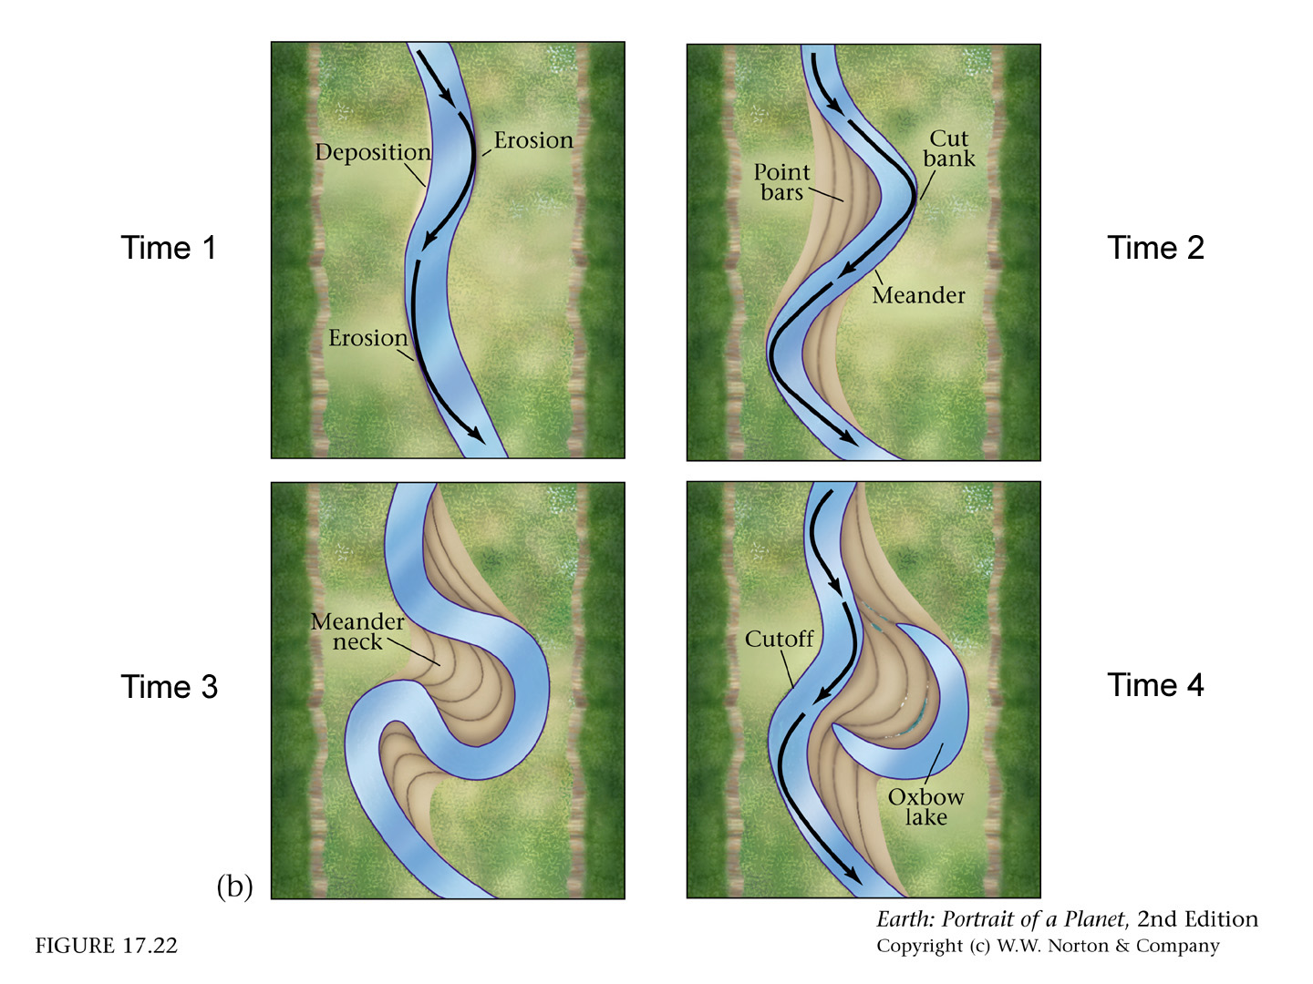
Meandering Streams
Once started, a meander tends to become more pronounced through lateral erosion.
The cutbank at the start of the meander frequently cuts through the meander neck, diverting the flow of water.
New sediment deposition isolates the old meander from the stream, forming an oxbow lake.

Slide 20
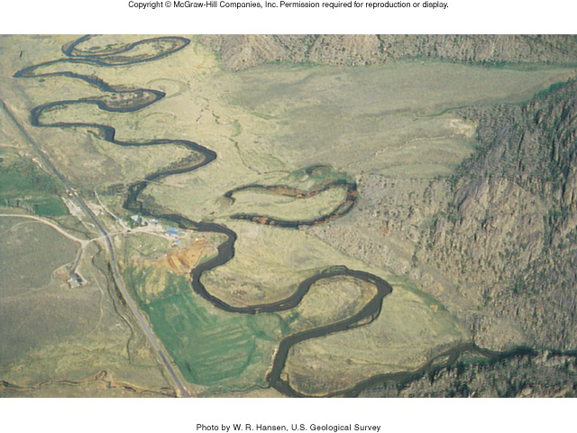
Meandering Stream
oxbow lake
Fig. 10.24

Slide 21
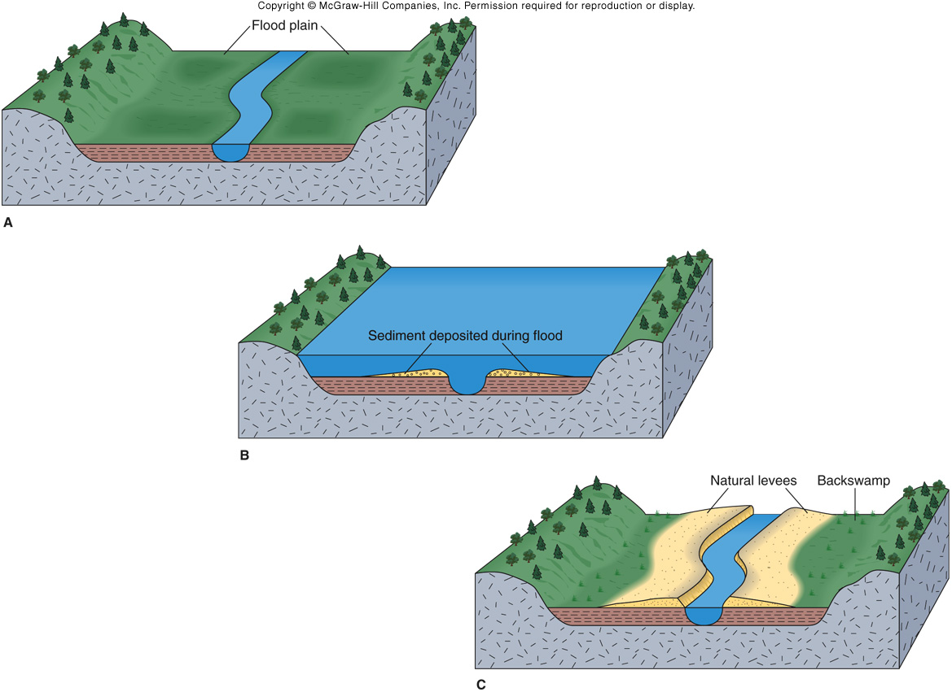
Flood Plain: area habitually flooded by a stream at high water. Contains fine-grain sediment deposited during flooding
Natural levee: low ridges formed along sides of main stream channel during flooding.
Fig. 10.27

Slide 22


Stream Budget
Water In (Inflow)
Water Out (Outflow)
Discharge from upstream
Rate (slope-dependent)
Surface runoff
Capacity (shape-dependent)
Groundwater influx
Direct precipitation
150 m
93 m
I <=> O normally
I > O channel fills
If channel fills completely, river can overflow banks and flood

Slide 23
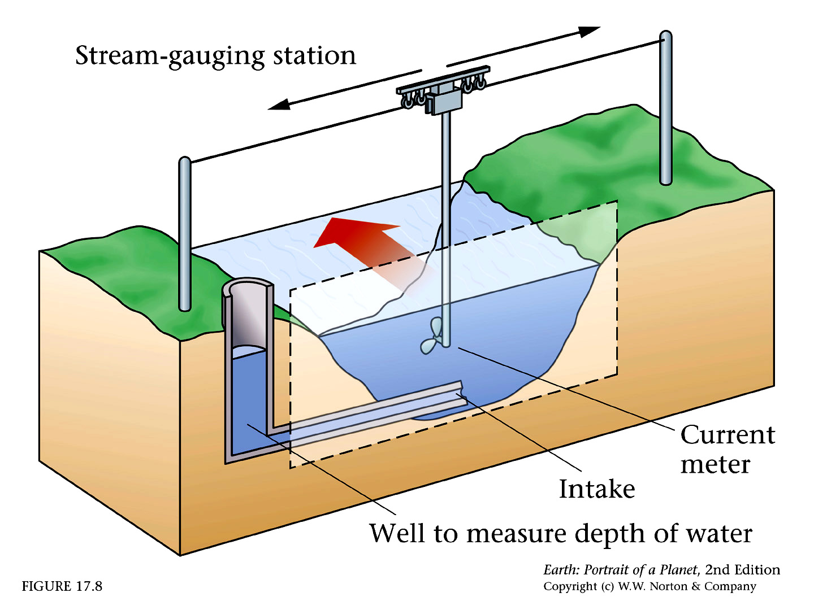

Slide 24
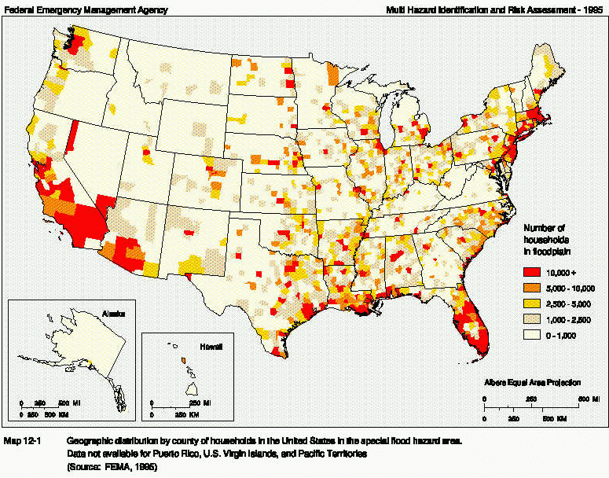
Flooding

Slide 25
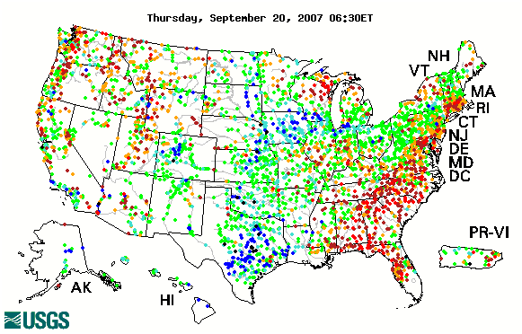
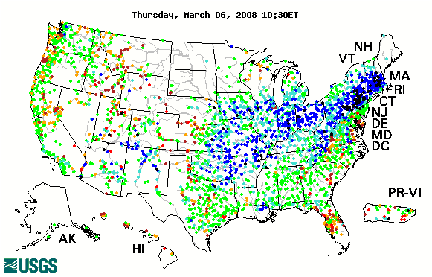
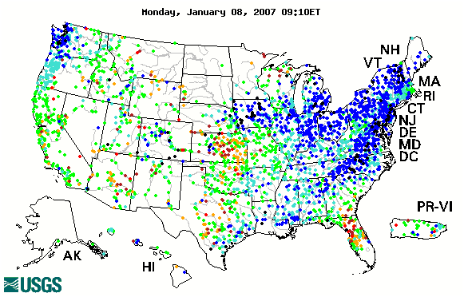
WaterWatch
http://water.usgs.gov/waterwatch/
Current water resources conditions. Map of real-time streamflow compared to historical streamflow for the day of the year (United States).
Blue and black dots indicate high relative percentages, green is normal, orange and red are low values

Slide 26
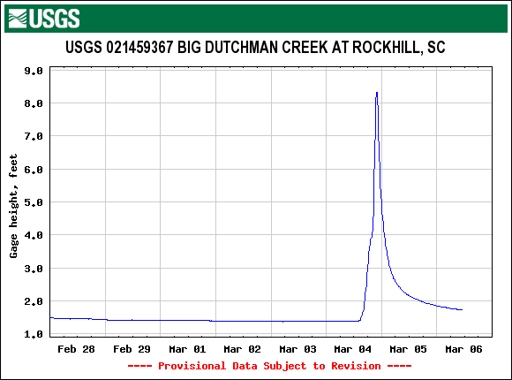
WaterWatch
Big storm
The WaterWatch system allows you to download data from individual monitoring stations. This is the data from earlier this year for the gauge hanging over the Mount Gallant Rd. bridge over Big Dutchman Creek.
http://waterdata.usgs.gov/

Slide 27
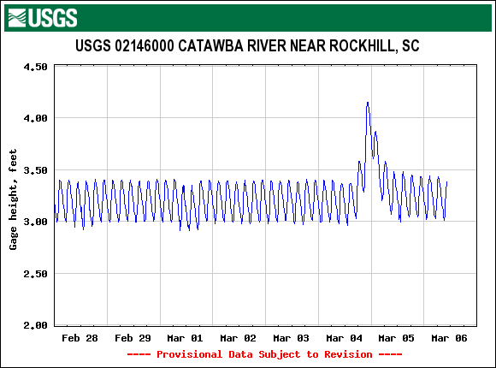
WaterWatch
Big storm
This is from a gauge from below one of the dams on the Catawba river. The weird pattern is caused by controlling outflow from a hydroelectric dam.
http://waterdata.usgs.gov/

Slide 28
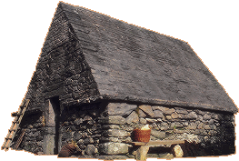


Normal Stage

Slide 29
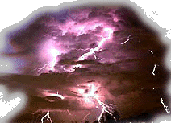

Bankfull Stage

Slide 30
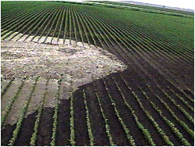
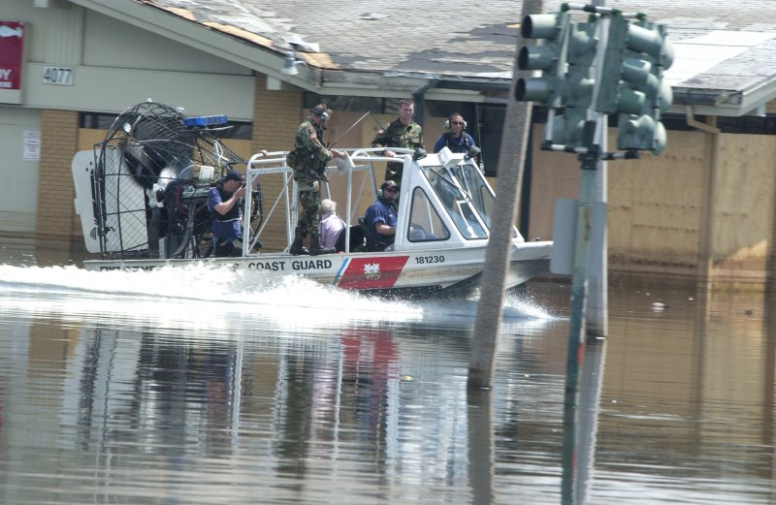

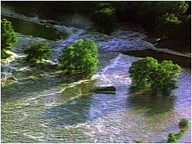
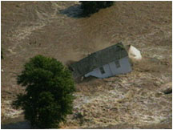
Flood Stage
http://www.globalsecurity.org/military/facility/html/new-orleans_050908_1234579.htm

Slide 31
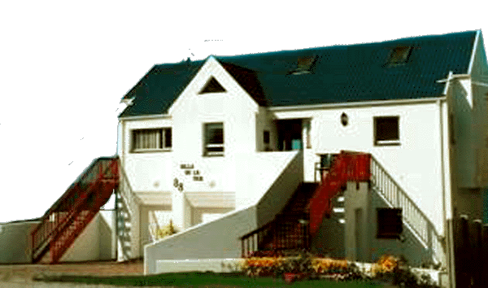

Dream Home?
20 Year Flood Record
NO SALE
2
10
20
1
10
40 year flood
100
Recurrence Interval

Slide 32
Dream Home?
What is the probability of this house drowning while you own it?
elapsed
interval
Probability = 1 - (1 - (1 / return interval))
Probability = 1 - (1 - (1 / 40 ))
20 years
= 40%
Elapsed Interval (yrs)
Flood Probability
5
10
15
20
40
60
100
120
12%
22%
32%
40%
64%
78%
92%
95%

Slide 33



Discharge
Volume of water per unit time that passes a specific point on the river.
average width (m)
Q =
V
W
D
m³/s
water velocity (m/sec)
average depth (m)

Slide 34
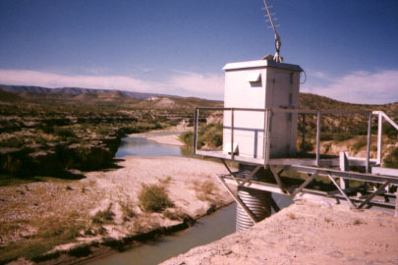
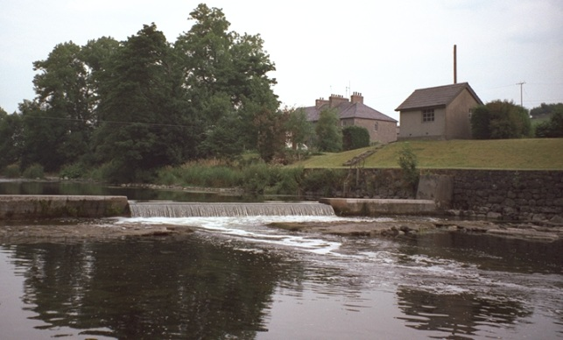
gauge house
records continuous record of river level
Tracking Discharge
flow weir
records continuous record of river discharge

Slide 35
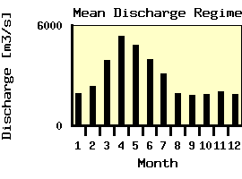
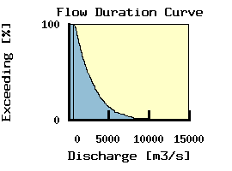
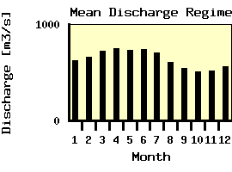
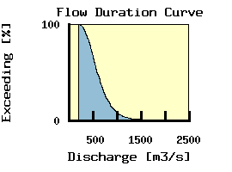
Mississippi River (Alton, Illinois)
Danube River

Slide 36

Determining Return Interval (RI) based on maximum yearly discharge (Q_{max})
Weibull Equation
(n+1)
(# of years recorded + 1)
RI =
=
m
rank of recorded value
Fake River
year
Q_{max}
rank
RI
1963
1964
1970
1971
1980
1982
1986
2550
2490
1280
1380
1600
1240
1230
1
2
5
4
3
6
7
8.0
4.0
1.6
2.0
2.7
1.3
1.1

Slide 37



Fake River
3000
2900
2000
Discharge (ft³/s)
Return Interval (years)

