Slide 1
Absolute Age Dating
Absolute Ages
Radiometric Dating
Radioactive isotopes
Radioactive decay
Half-life

Slide 2
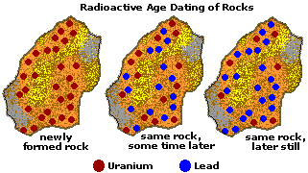
Radiometric Dating
Absolute dating using radioactive decay data
http://www.cotf.edu/ete/modules/msese/earthsysflr/geotime.html

Slide 3
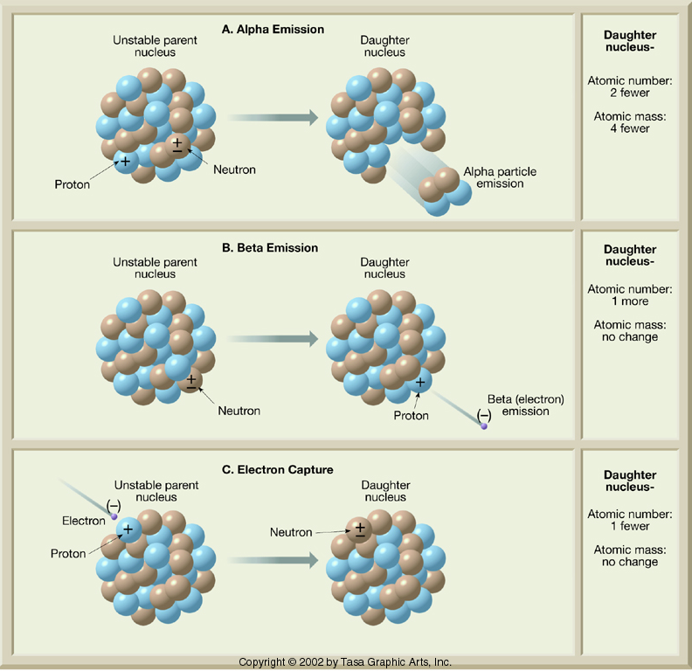
Alpha Emission
Beta Emission
Electron Capture

Slide 4
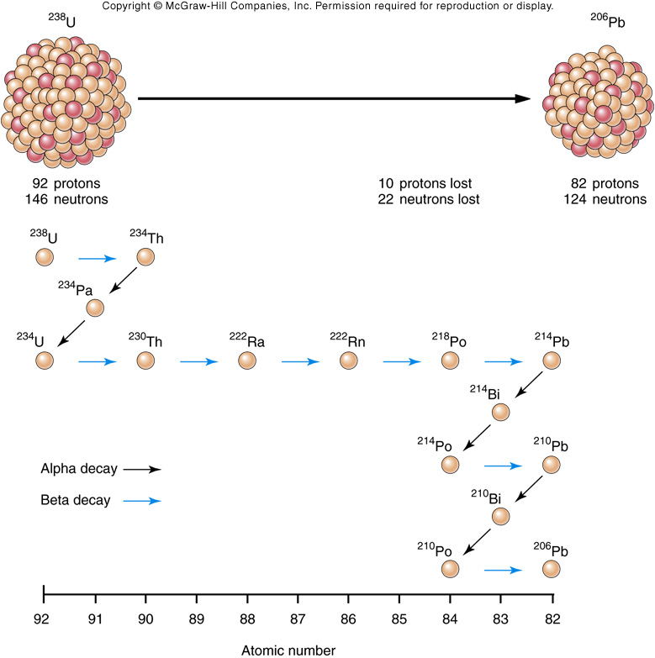
Decay of ²³⁸U
Alpha emission
General Decay Rules
Atomic mass number
No change
Decrease
Atomic number
Decrease
Increase
Beta emission
Fig. 08.23

Slide 5
Decay sequence for Uranium-238
http://www.asa3.org/ASA/resources/Wiens.html
Half life – the time it takes for half of the original element to decay to the new element.

Slide 6
Hypothetical Element Parentium
Half Life = 10,000 yrs
Decays to Daughterium
Starting with 1,000,0000 nuclei of Parentium

Slide 7
+20,000
250,000
750,000
+10,000
500,000
500,000
0
1,000,000
0
Time
Parentium
Daughterium

Slide 8
+50,000
31,250
968,750
+40,000
62,500
937,500
+30,000
125,000
825,000
Time
Parentium
Daughterium

Slide 9
1,000,000
Parentium
750,000
Nuclei
500,000
250,000
Daughterium
0
0
10
20
30
40
50
Time (thousands of years)

Slide 10
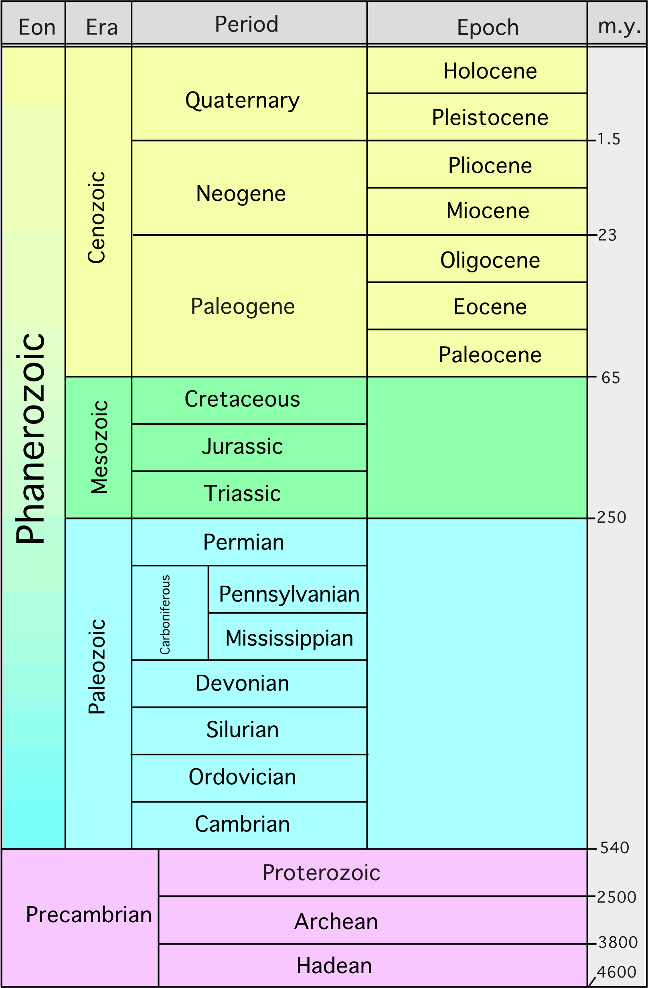
Geologically Useful Radioactive Isotopes
Parent
Daughter
Half-life (yrs)
Useful Range (yrs)
⁴⁰K
²³⁸U
²³⁵U
⁸⁷Rb
⁴⁰Ar
²⁰⁶Pb
²⁰⁷Pb
⁸⁷Sr
1,250,000,000
4,500,000,000
713,000,000
49,000,000,000
100,000 - formation of Earth
10,000,000 - formation of Earth
10,000,000 - formation of Earth
10,000,000 - formation of Earth
Geologist collects samples of rock
Geologist interprets the geologic history of area during the time that the rock was being formed
Geochemist finds radiometric age

Slide 11
Geologically Useful Radioactive Isotopes
Parent
Daughter
Half-life (yrs)
Useful Range (yrs)
⁴⁰K
²³⁸U
²³⁵U
⁸⁷Rb
⁴⁰Ar
²⁰⁶Pb
²⁰⁷Pb
⁸⁷Sr
1,250,000,000
4,500,000,000
713,000,000
49,000,000,000
100,000 - formation of Earth
10,000,000 - formation of Earth
10,000,000 - formation of Earth
10,000,000 - formation of Earth
An analysis of a feldspar crystal in a rock reveals that it contains 75% ⁴⁰Ar and 25% ⁴⁰K.
How many half-lives have passed since the formation of the feldspar?
Assuming the feldspar and rock formed at the same time, how old is the rock?

Slide 12
Parent
Daughter
Half-life (yrs)
Useful Range (yrs)
²³⁸U
²³⁵U
²⁰⁶Pb
²⁰⁷Pb
4,500,000,000
713,000,000
10,000,000 - formation of Earth
10,000,000 - formation of Earth
An analysis of a zircon crystal in a rock reveals that it contains:
50.0% ²³⁸U and 50.0% ²⁰⁶Pb
1.6% ²³⁵U and 98.4% ²⁰⁷Pb
How many half-lives of ²³⁸U have passed since the formation of the zircon?
How many half-lives of ²³⁵U have passed since the formation of the zircon?
What is the age of the zircon?

