Slide 1
Climate
Weather vs. Climate
Global Circulation
Climate parameters
Climate change

Slide 2
Weather - the physiochemical state of the atmosphere during any short period of time.
Climate - the average physiochemical state of the atmosphere over the course of the year.

Slide 3
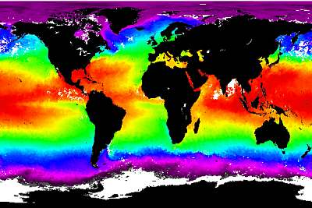
Surface Ocean Temperatures
Cold near poles
Hot near equator
Cold near poles
http://www.seafriends.org.nz/oceano/currents.htm

Slide 4
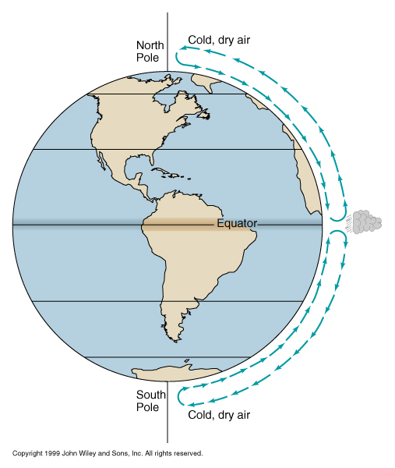
Atmospheric Circulation if the Earth Didn’t Rotate
Hot air rises in the equatorial region and travels toward the poles.
Cold air sinks near the poles and moves toward the equator.
http://www.usd.edu/esci/figures/BluePlanet.html

Slide 5
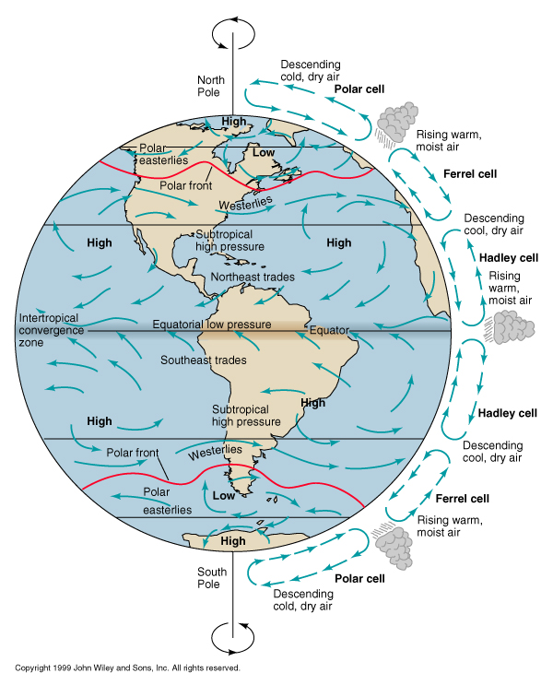
Circulation on a Rotating Earth
As the Earth rotates, the rising and sinking air is deflected (this deflection is called the Coriolis effect).
The atmosphere is also broken into smaller circulating cells, rather than circulating in an unbroken loop from equator to pole.
http://www.usd.edu/esci/figures/BluePlanet.html

Slide 6
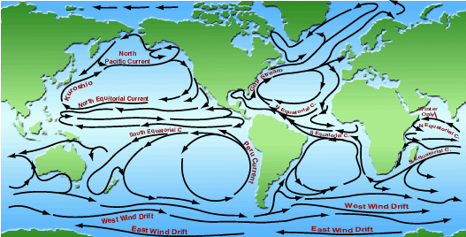
Global Oceanic Circulation
Wind drives water, resulting in global oceanic circulation. Water currents are more strongly affected by land mass than wind currents.
http://www.onr.navy.mil/focus/ocean/

Slide 7
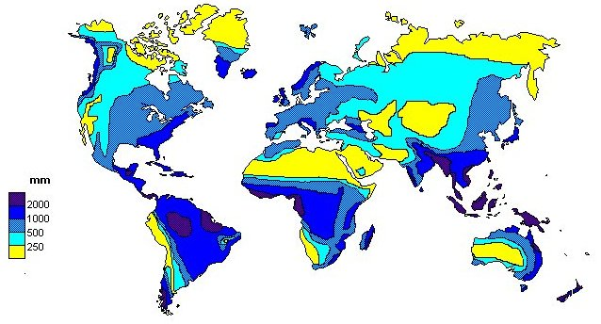
Global Rainfall
Temperature and precipitation patterns are strongly controlled by global circulation.
http://www.doc.mmu.ac.uk/aric/eae/english.html

Slide 8
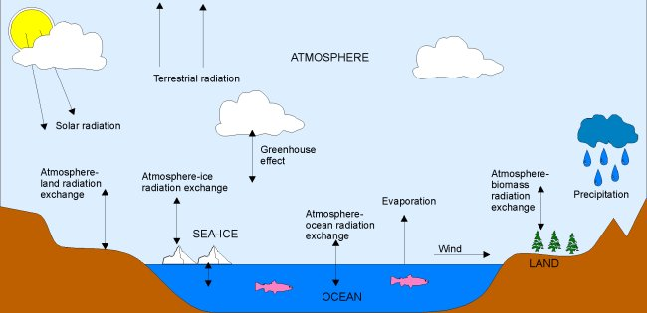
Other Factors Affecting Climate
In addition to latitude and global circulation, climate at any specific place on Earth is strongly affected by altitude and topography, which affect both temperature and precipitation.
http://www.doc.mmu.ac.uk/aric/eae/english.html

Slide 9
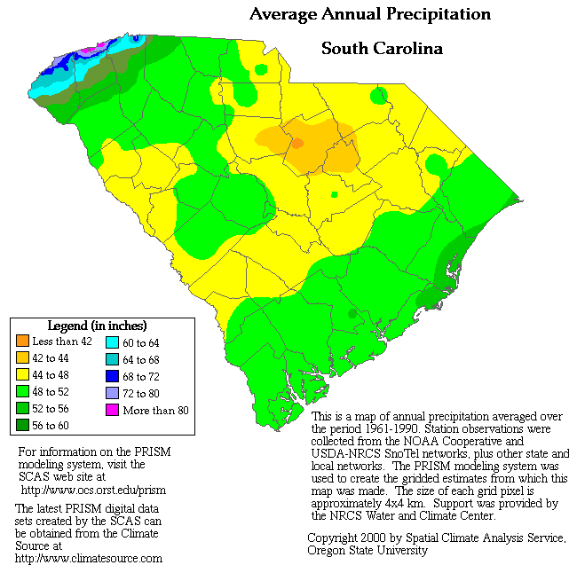
Topography can have a strong control on local climate.
Proximity to the ocean also affects climate.
http://www.ocs.orst.edu/pub/maps/Precipitation/Total/States/SC/sc.gif

Slide 10
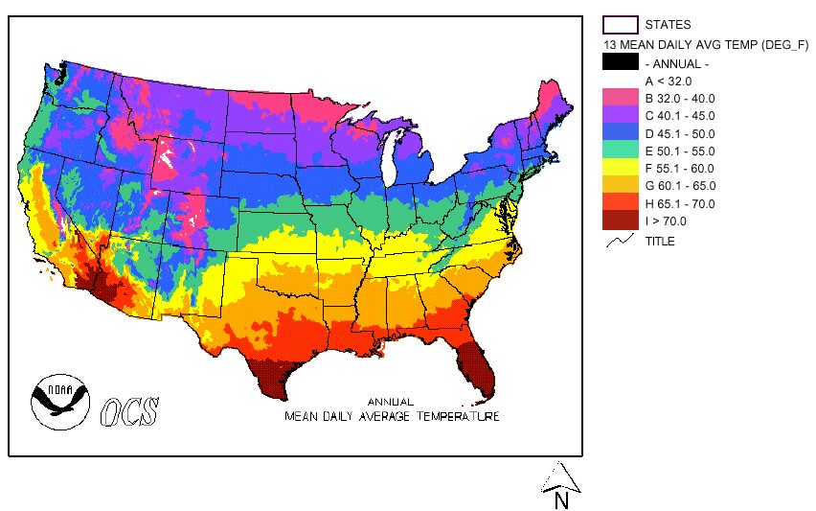
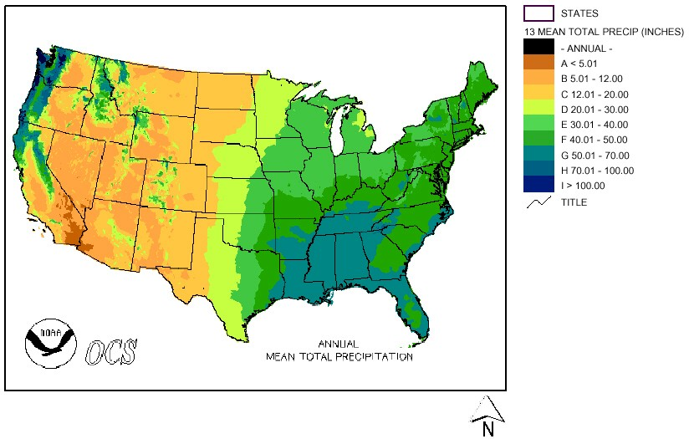
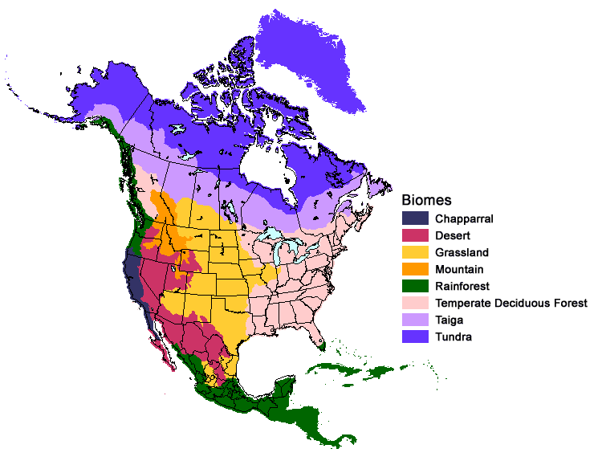
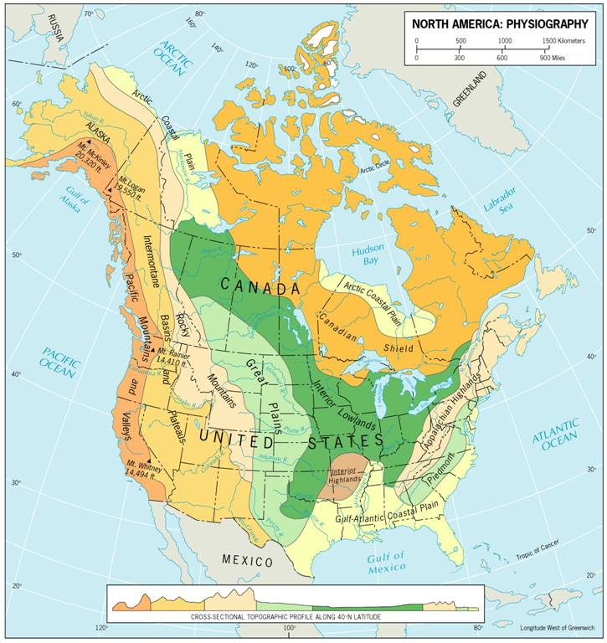
Temperature
Precipitation
+
Topography and other land surface features
Climate
+
=
Physiography
http://www.mobot.org/education

Slide 11
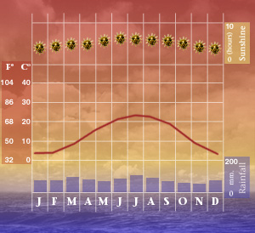
Climograph – a graphic showing average monthly precipitation, temperature and sometimes other climatic parameters
This is a climograph for Charlotte, North Carolina. The graphic came from a website touting Charlotte’s climate as a plus for businesses.
http://www.worldexecutive.com/cityguides/charlotte/weather.shtml

Slide 12
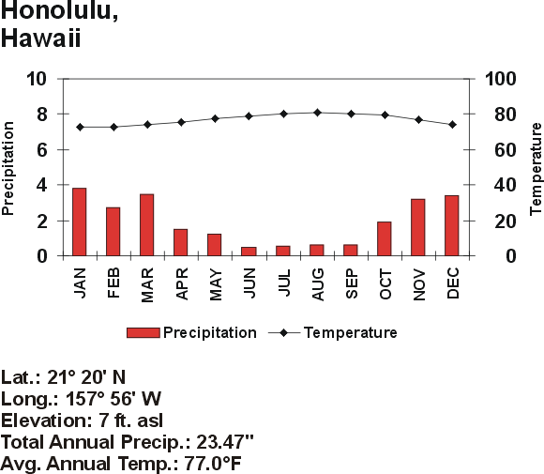
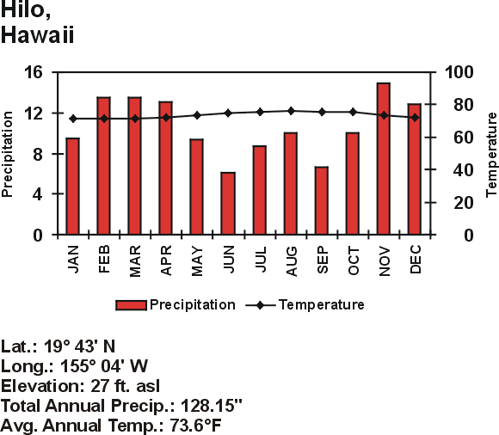
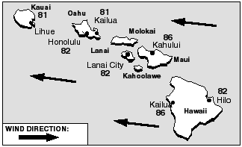
The precipitation differences between these Hawaiian cities is due to orographic lifting and dependant on the prevailing wind direction
http://starbulletin.com/
http://www.drought.unl.edu/whatis/climographs.htm

Slide 13
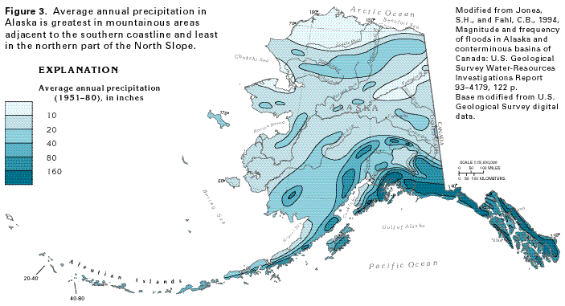
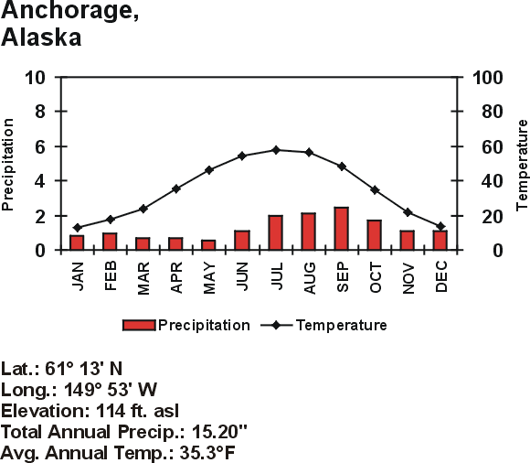
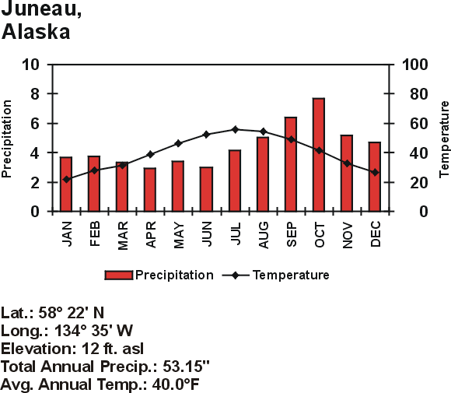
Anchorage is in the rain shadow of the Alaska Range; Juneau is a coastal city.
http://capp.water.usgs.gov/gwa/ch_n/gif/N010.gif
http://www.drought.unl.edu/whatis/climographs.htm

Slide 14
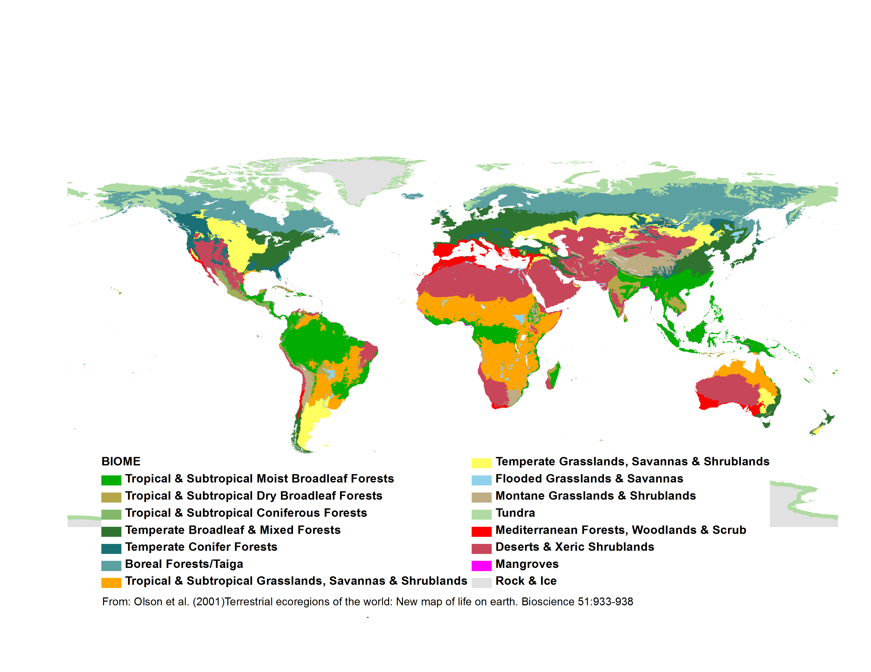
Biomes - largest level ecologic communities, defined by type of vegetation and environmental conditions (especially temperature and precipitation for terrestrial biomes).

Slide 15
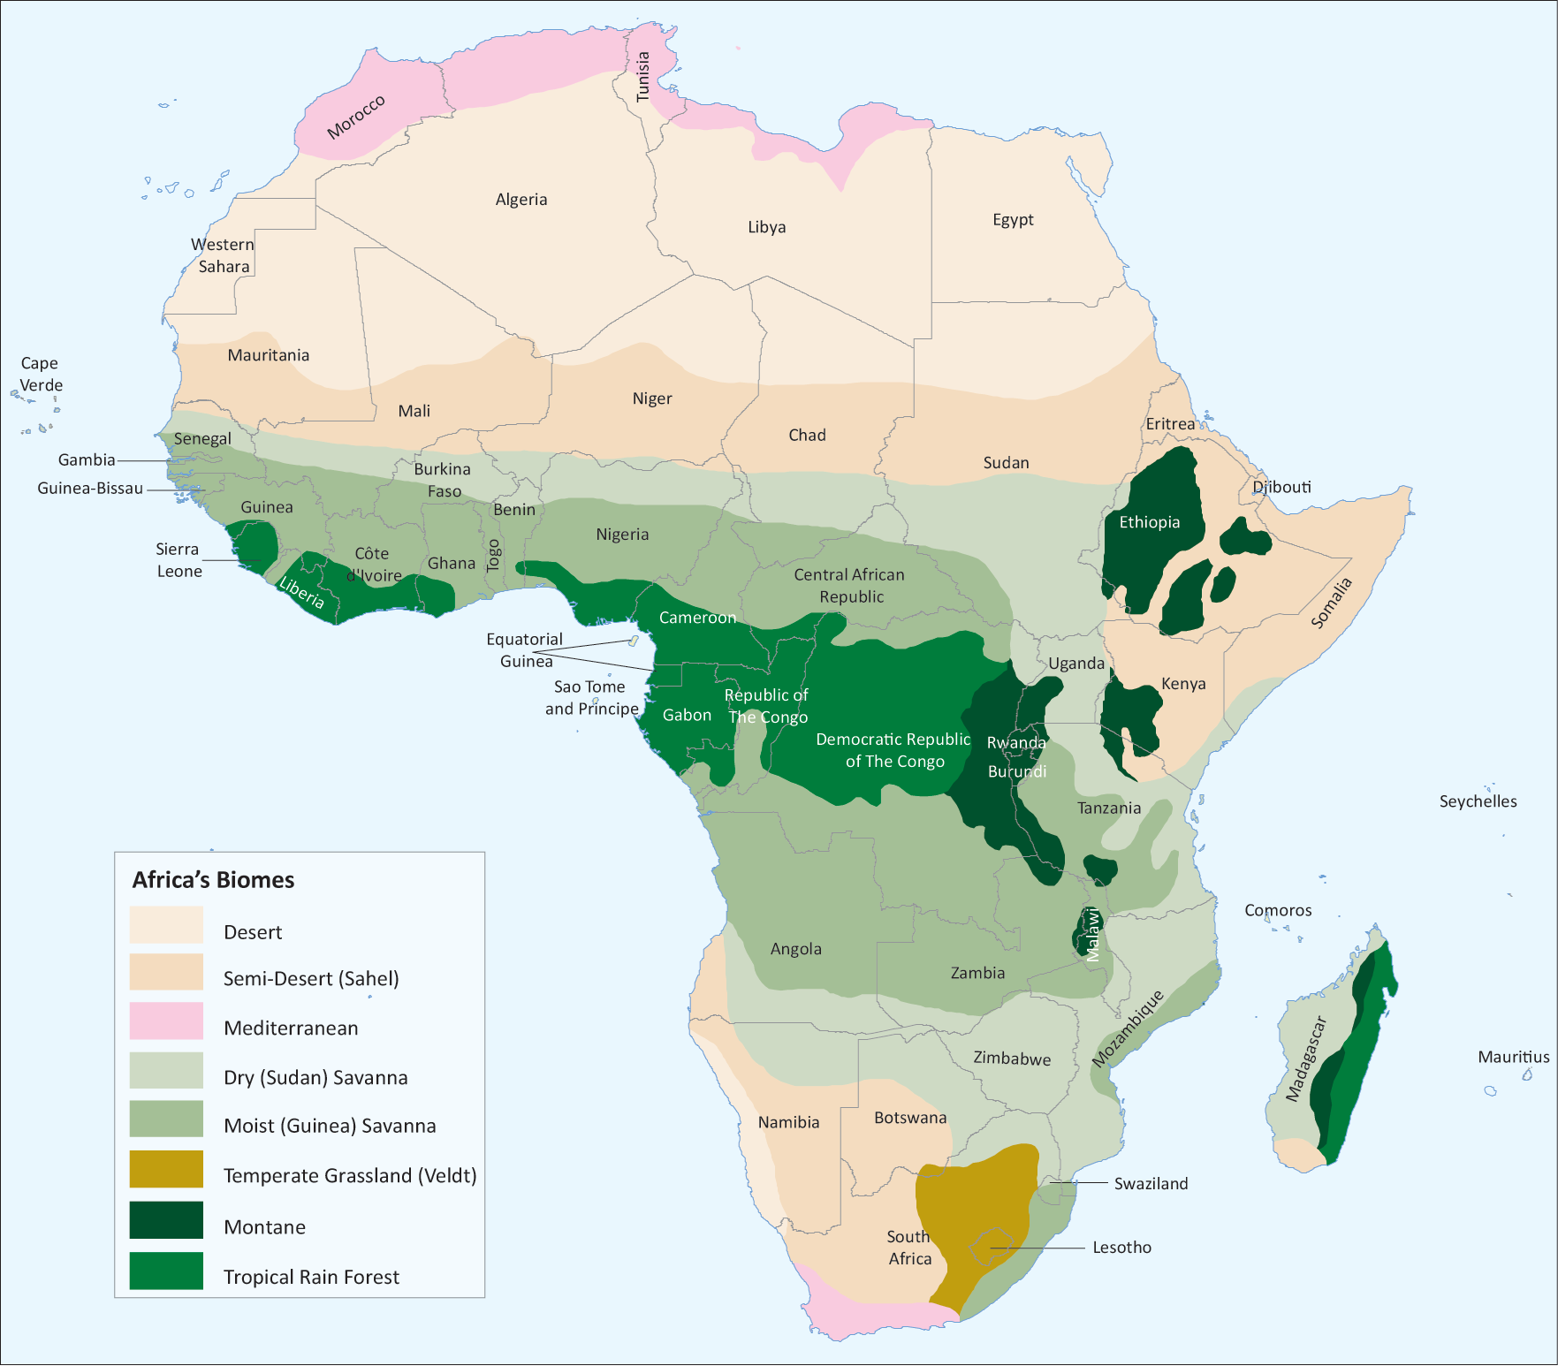
Biomes - because of variations in topography and other factors, most continents are a complex mosaic of biomes.
http://na.unep.net/atlas/africaWater/book.php

Slide 16
Global Climate Change
The geologic record indicates that there have been extreme climate changes in the past. These changes have several major causes, including:
Mega-cycles in global warming and cooling
Movement of continents over time
Changes in elevation due to mountain building
These changes have affected the distribution of organisms in both time and space throughout Earth’s history.
http://www.floridawildlifemagazine.com/globalwarming.htm

Slide 17
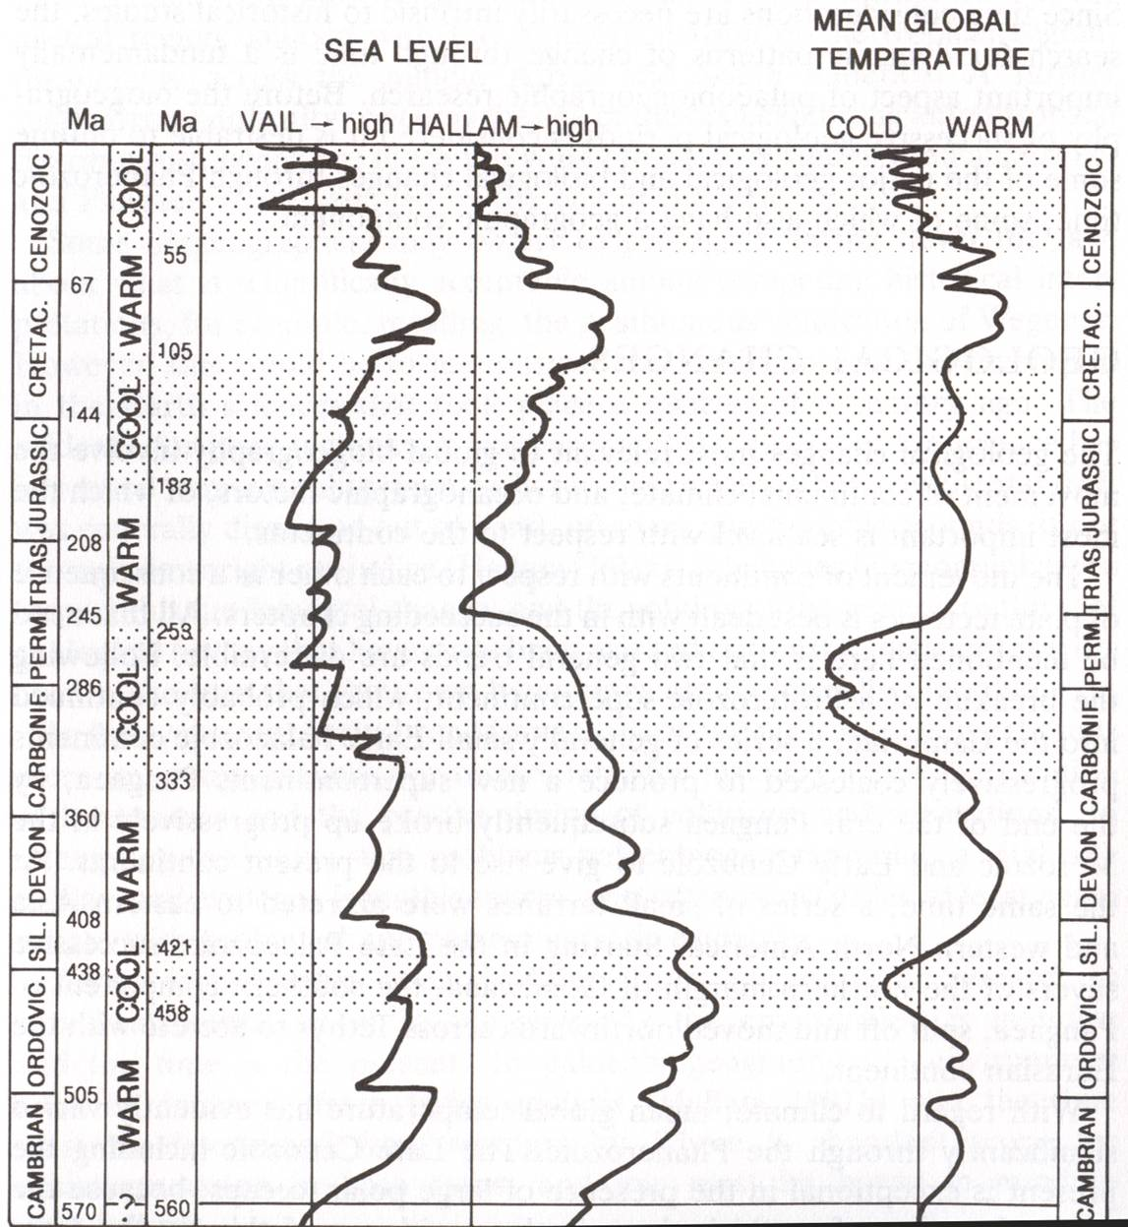
Today
The Age of Coal
540 Million Years Ago
Hallam, A. 1994. An outline of Phanerozoic biogeography. Oxford Univ. Press.

Slide 18
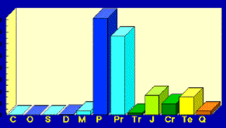
Carboniferous - The Age of Coal
Most of Earth’s economic reserves of coal were deposited in the Carboniferous and Permian Periods.
By dumb luck, most of these deposits are located in modern North America and Europe - a historical accident with obvious socio-economic consequences.
http://earthsci.org/energy/coal2/peat.gif

Slide 19
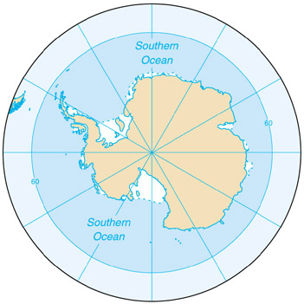
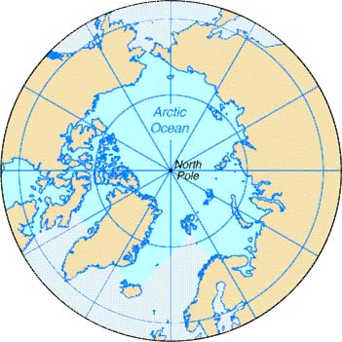
Global climate change is also driven by paleogeography (the geography of the Earth of the past). The Earth’s continents move in relationship to each other over time, causing new seas and oceans to open and close.
The modern Earth is unusually cold compared to times in the past primarily because both poles are segregated from the temperate zones.

Slide 20
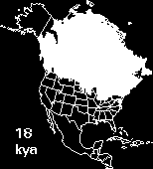
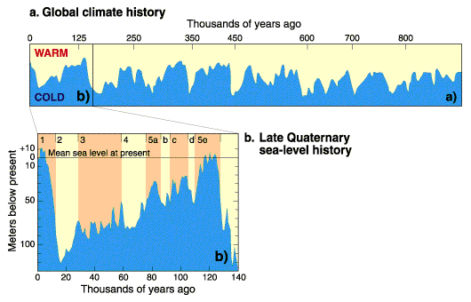
Pleistocene to Recent
Recurrent ice ages. Small variations in orbital parameters caused cyclic glacial advance and retreat.
http://www.ngdc.noaa.gov/paleo/ctl/clisci100k.html

Slide 21
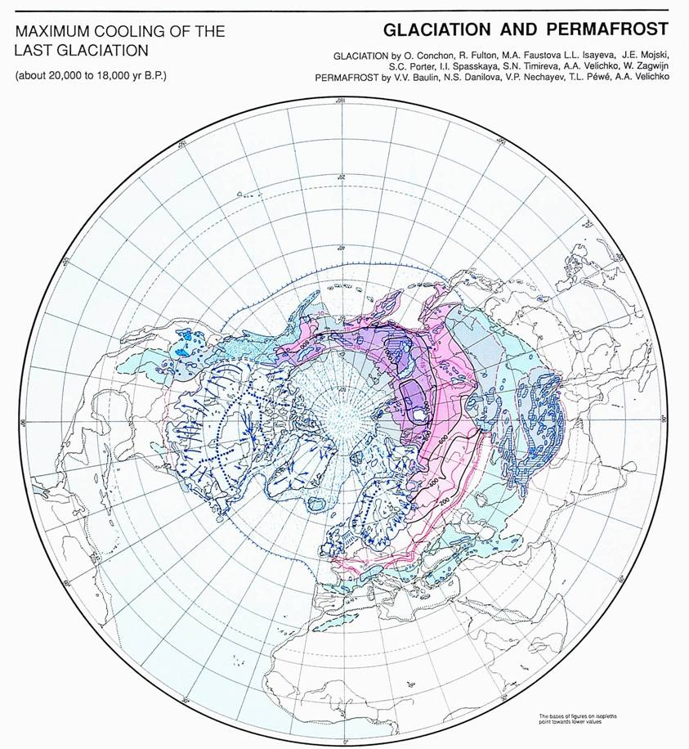
From about 20,000-18,000 years ago, much of the northern hemisphere was covered in large sheets of ice.
http://www.pangaea.de/Projects/PKDB/PaleoAtlas.html

Slide 22
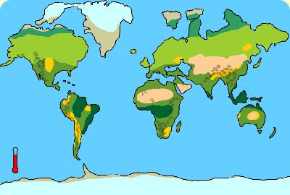
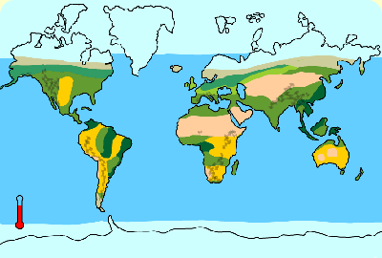
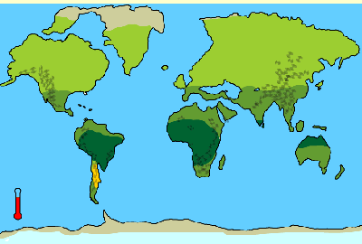
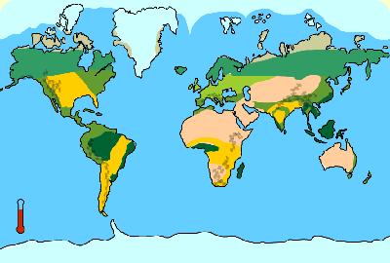
Miocene
Pliocene
Holocene
Pleistocene
Global drying is another trend of the last few million years
http://www.bbc.co.uk/beasts/

Slide 23
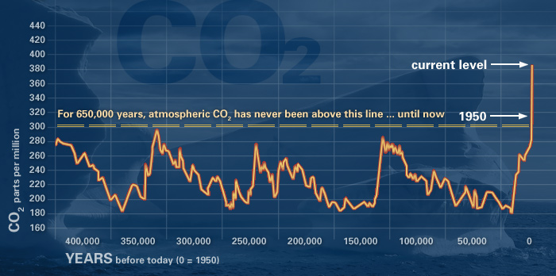
The rate of carbon dioxide accumulation in the atmosphere has risen at a rather alarming rate when viewed against the historical trend of the past half million years.
http://climate.nasa.gov/evidence

Slide 24
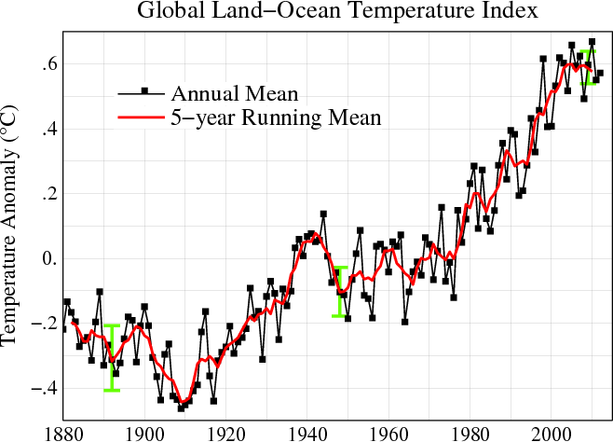
This rise in atmospheric carbon dioxide correlates with global temperature anomalies and global climate anomalies.
http://data.giss.nasa.gov/

Slide 25
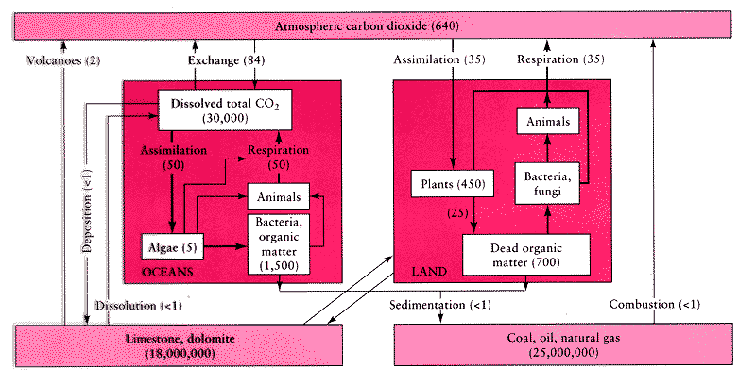
Tracking the interactions between all of the various groups of sources and sinks or CO₂ is quite complex. A linear change in one set of processes may cause an exponential change elsewhere!
http://essp.csumb.edu/esse/climate/climatefigures/Ccycle.html

Slide 26
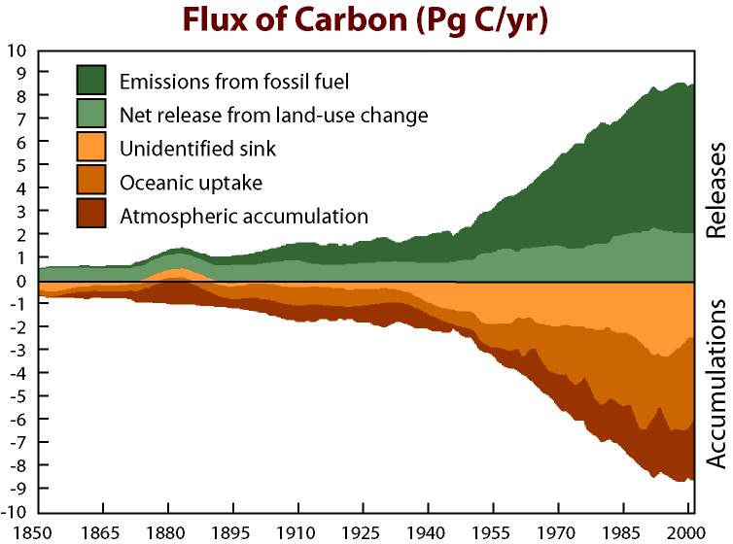
Thought to be due to a combination of factors including unexpectedly high uptake in intact tropical rainforests.
http://www.blog.thesietch.org/2007/06/24/exactly-where-does-all-that-co2-go-scientists-close-in-on-missing-carbon-sink/

Slide 27
Non-atmospheric CO₂ does not lead to warming!
Adds to atmospheric CO₂:
Respiration + Fossil Fuel Emission + Land Use Change
Takes away atmospheric CO₂:
Photosynthesis + Ocean Uptake + Land Uptake + Missing Uptake
http://www.whrc.org/science/carbon/carbon.htm

