Slide 1
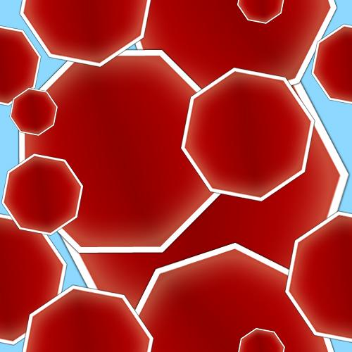
Proterozoic Earth History I

