Slide 1
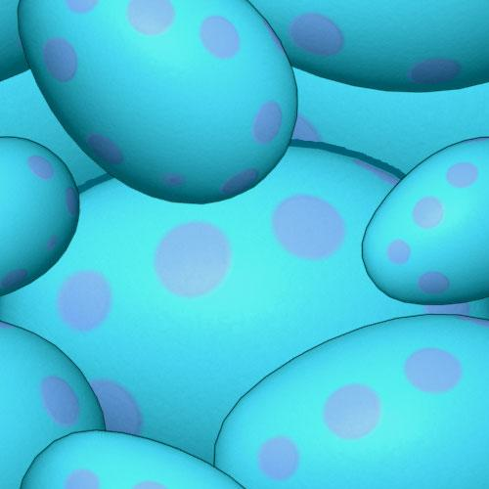
Mesozoic Earth History I

