Slide 1
Coastal Ocean
Laws of ocean ownership
Estuaries
Humans interactions

Slide 2
Laws of ownership
Freedom of the Seas
UN Law of the Sea
Territorial Sea
Exclusive Economic Zone

Slide 3
Estuaries
Where rivers meet the sea
Embayment
Mixing of salt and fresh water
Protected from waves and storms
Good harbors
Chesapeake Bay

Slide 4
Estuaries: formation
Coastal plain: Chesapeake Bay as example
Fjord: Puget Sound as example
Bar-built: Pamlico Sound as example
Tectonic: San Francisco Bay as example

Slide 5
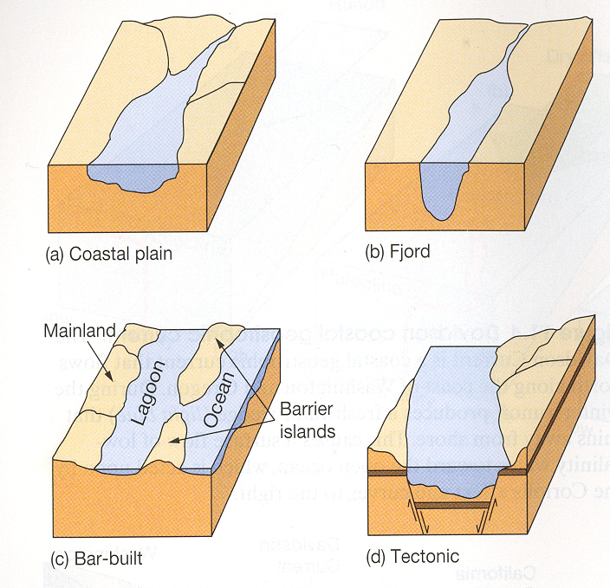
COASTAL PLAIN
FJORD
BAR BUILT
TECTONIC

Slide 6
Estuaries: circulation
Vertically mixed
Highly stratified
Salt wedge (classic)
Think about salinity variation with depth
Consider what causes these patterns

Slide 7
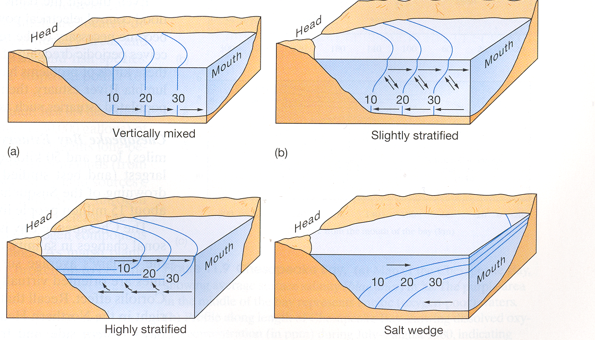
VERTICALLY MIXED
SLIGHTLY STRATIFIED
HIGHLY STRATIFIED
SALT WEDGE

Slide 8
Human impacts
Estuaries in general
Estuaries – specific examples
Chesapeake Bay
Columbia River estuary
Marine pollution – some examples

Slide 9
Coastal pollution
Petroleum
Sewage
Specific chemicals
DDT and PCBs
Mercury
Plastics
Non-native species

Slide 10
Petroleum pollution examples
Exxon Valdez in AK, 1989
Deepwater Horizon in Gulf of Mexico, 2010
Spills due to Persian Gulf War, 1991
But most oil in ocean comes from small sources

Slide 11
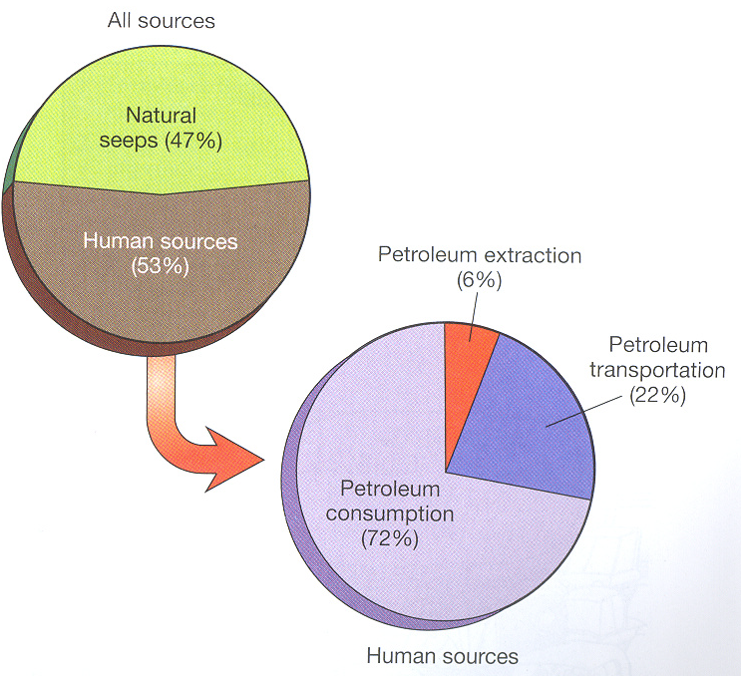
Sources of oil to oceans

Slide 12
Sewage
New York City – closed shallow water sewage sludge disposal sites; using deep water site, but fisheries are degrading
Boston harbor – new sewage treatment plant and tunnel to offshore site; unintended consequences?

Slide 13
Sewage
New York City – closed shallow water sewage sludge disposal sites; using deep water site, but fisheries are degrading
Boston harbor – new sewage treatment plant and tunnel to offshore site; unintended consequences?

Slide 14
Specific chemicals
DDT (pesticide) – problems with bird populations; persistent in environment
PCB ( used in insulation) – reproductive problems in sea lions; persistent in environment
Mercury – bioaccumulation; affects human nervous system

Slide 15
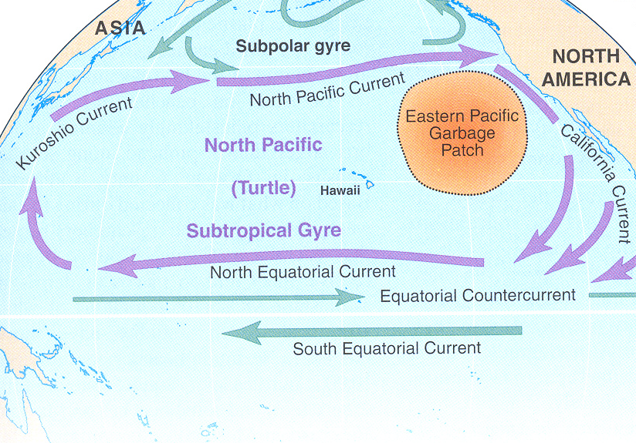
Plastics

