Slide 1
Chapter 9: The Greenhouse Effect and Climate Change
Chapter 10: Environmental Impacts of Energy Production
PHYS305

Slide 2
Introduction
One of a scientist’s goals is to explore a particular component of nature—a property of matter or the interaction of one thing with another.
With the combustion of fossil fuels to power, the Industrial Revolution and continued economic growth, our atmosphere has become one large experimental laboratory.
Evidence shows that the addition of gases, such as CO₂ and methane, into our atmosphere, has caused the earth’s temperature to increase by nearly 2°F.
Coastal areas are seeing rising sea levels, causing cities and countries to adapt and even contemplate the mass migration of people.

Slide 3
Climate Change: Data
Variations in solar radiation, the earth’s orbital motion, atmospheric water vapor, or ground cover can cause fluctuations in the global temperature, just to name a few.
Likewise, variations in greenhouse gas concentrations have impacted global temperature over time.
The cessation of one ice age about 130,000 years ago and another about 10,000 years ago are reflected in strong changes in both temperature and CO₂ concentrations.

Slide 4
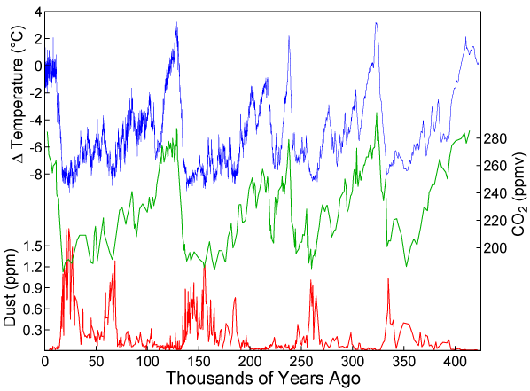
Climate Change: Data
Data were obtained from measurements of the Vostok, Antarctica ice cores. (Source: https://en.wikipedia.org/wiki/image:Vostok-ice-core-petit.png )
Data taken from analysis of air bubbles trapped within ice core samples collected in Antarctica and Greenland
Dust concentration
The correlation between carbon dioxide concentrations and the earth’s temperature over the past 400,000 years.

Slide 5
Climate Change: Data
The twentieth century was the warmest in the past 1000 years, by far. Furthermore, the years 2016–2020 were the hottest years on record, and 2010–2020 was the hottest decade on record.
Going back about 125 years, the past 10 years had nine of the 10 warmest average global temperatures on record.
Between 2000 and 2016, the number of people exposed to heat waves increased by about 125 million.
In 2003, more than 70,000 people died due to heat-related causes during a single heat wave in Europe.

Slide 6
Climate Change: Data
Other gases that are accumulating in the atmosphere also play an important role in warming the earth.
Methane can be traced in part to growing populations of cattle, the decay of organic matter in rice paddies and landfills, and the production of fossil fuels.
Methane concentrations held steady since the end of the last ice age about 10,000 years ago, but they began to climb about 100 years ago at a rate of 1% per year, rising almost 2600% since the start of the industrial age.
The United States emits about 15 metric tons/person/year.

Slide 7
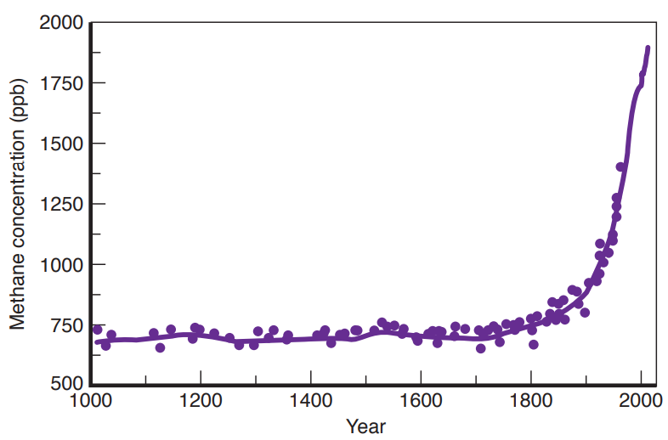
Climate Change: Data
The data were obtained from air bubbles trapped in ice in Greenland. (Source: EPA)
Global concentration of methane gas over the past 1000 years indicates a dramatic increase beginning about 100 years ago.

Slide 8
Climate Change: Data
Additional evidence for global warming is found in the rapid recession of glaciers outside the polar areas and a decrease in snow cover in some areas, such as Europe.
Scientists have found that glaciers are currently losing more mass than either Greenland or Antarctic ice sheets.
Studies indicate that the ice cover is being lost through sublimation caused by winds flowing up from the lower-elevation plains.

Slide 9
Air Pollutants and their Sources
Air Pollutants are the substances added to the air by human activities.
They are in a form gases, small particles of solids ( particulates), or small droplets of liquids ( aerosols).
The worse pollutants emitted by human are:
  Carbon monoxide
  Sulfur Oxides
  Particulate matter
  Hydrocarbons
  Nitrogen oxides

Slide 10
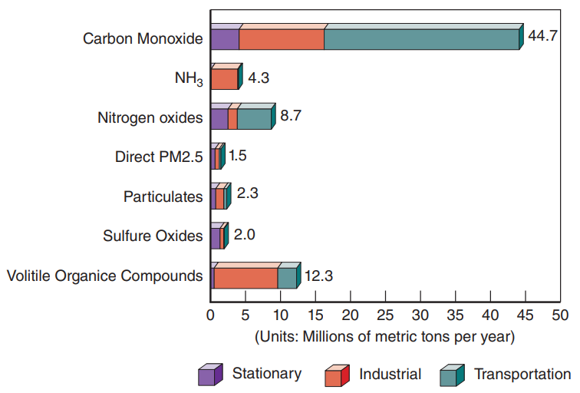
Air Pollutants and Their Sources
Emissions of major air pollutants in the United States by source: 2020 Particulates refer to those of size less than 10 microns (PM-10).
Notes:
Figure 10.9 Emissions of major air pollutants in the United States by source: 2020 Particulates refer to those of size less than 10 microns (PM-10).
(Source: U.S. EPA)

Slide 11
Pollution from fossil-fuel combustion
Automobile | Coal-fired plant
Unburned hydrocarbons | Particulates
Carbon monoxide (CO) | Sulfur oxides: produce acid rain
Nitrogen oxides (NOx) | Mercury
Ozone (O₃)
Pollution can come from moving sources or stationary sources (column 2)

Slide 12
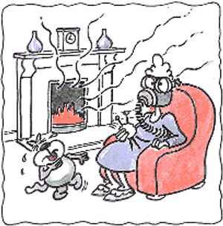
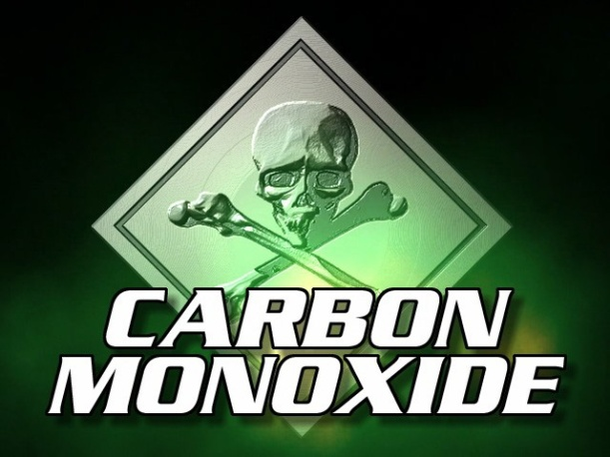
Carbon monoxide, CO
Caused by burning coal / hydrocarbons without sufficient oxygen to produce CO₂.
Sources: cars, improperly vented furnace.
Colorless, odorless, tasteless, POISONOUS.
667ppm * enough to cause seizure, coma, death.
Hemoglobin (blood) absorbs it 240x more readily than the O₂ it replaces. 4-6hr “half-life” in bloodstream, 40min if replace air with O₂.
CO is produced in the oxidation process.
The symptoms of CO poisoning are those associated with oxygen deprivation, such as dizziness, headache, and visual aberrations.
The air-quality standard set for CO levels is a maximum of 9 ppm for an eight-hour interval.
* Concentration: Parts per million
Image: http://www.heatusa.com/wp-content/uploads/2011/01/carbon_monoxide_300.jpg , http://kiddecarbonmonoxidedetectorbeeping.com/wp-content/uploads/2011/09/is-carbon-monoxide-heavier-than-air.jpg

Slide 13
Reducing risk of CO poisoning
Burn your fuel in an oxygen-rich environment.
  More oxygen means CO₂, not CO, as result.
  Oxygen-poor environment necessary for making charcoal, e.g.
Properly vent the furnace/car/burner, etc.

Slide 14
Worked problem: combustion
How much oxygen do you need to burn octane, C₈H₁₈, a principal ingredient of gasoline?
Hint: you can either produce carbon dioxide [CO₂], or poisonous carbon monoxide [CO].

Slide 15
Worked problem: combustion
Generalize the last problem to all alkanes, C_{n}H_{2n+2}.
Again, you can either produce carbon dioxide [CO₂], or poisonous carbon monoxide [CO].
I’ll leave it to you to verify that these expressions hold for the cases of the last two slides (n=1 and n=8).

Slide 16
Air Pollutants and Their Sources
Sulfur Oxides:
  The oxides of sulfur, have long been recognized as important contributors to air pollution.
  Sulfur dioxide is a colorless gas with a suffocating odor.
  Sulfur is added to the environment from natural sources as well as from human activities.
  Sulfur dioxide in the atmosphere has many harmful effects on human health, vegetation, and materials.
  Increased breathing difficulty can be fatal to a person with a respiratory ailment.

Slide 17
Air Pollutants and Their Sources
Particulates:
  Particles with diameters greater than 1 micron are usually associated with natural sources, such as dust, while those less than 1 micron in size usually originate from combustion processes.
  Particulates can affect breathing, aggravate the existing cardiovascular disease, and possibly damage the body’s immune system.
  Small particles with diameters less than 10 microns, denoted as PM-10, or the smaller PM-2.5, are of special concern because they can reach the lower regions of the respiratory tract.

Slide 18
Air Pollutants and Their Sources
Hydrocarbons or Volatile Organic Compounds (VOC):
  Hydrocarbons are compounds consisting of carbon and hydrogen atoms.
  Gasoline contains almost one hundred different hydrocarbons, including isooctane, heptane, and ethane.
  Many gasoline stations use vapor-recovery systems to minimize VOC emissions while pumping gas.
  Natural sources account for about 85% of the hydrocarbons in the air.
  Plant damage from smog can be severe.

Slide 19
Air Pollutants and Their Sources
Nitrogen Oxides, Smog, and Ozone:
  The element oxidized in this case (Nitrogen) comes not from the fuel but from the air that the fuel-combustion processes use.
  Photochemical smog has been a serious problem for several decades.
  Ozone occurs in two separate regions of the atmosphere and creates a different concern in each place.
  The largest contributor to photochemical smog is the automobile.
  Ozone production is stimulated by sunlight and high temperatures.

Slide 20
Air Pollutants and Their Sources
Acid Rain:
  The rainy season brings not just hope and vitality but also a subtle threat to the environment.
  Acid rain can have many harmful effects including the acidification of lakes.
  The acidity of any solution is measured on a scale known as the pH scale.
  Acid rain also affects crops by suppressing the bacterial decomposition of organic matter.
  Some possible solutions to the acid rain problem involve burning lower sulfur fuel.

Slide 21
Nitrogen oxides and ozone
NO=nitric oxide, NO₂=nitrous oxide (“laughing gas”), N₂O₅.
  Irritates breathing, Produces ozone and acid rain
Ozone, O₃:
Ozone is a gas composed of three atoms of oxygen. Ozone occurs both in the Earth's upper atmosphere and at ground level. Ozone can be good or bad, depending on where it is found.

Slide 22
Ozone
Good Ozone
Good ozone occurs naturally in the upper atmosphere, 6 to 30 miles above the Earth's surface, where it forms a protective layer that shields us from the sun's harmful ultraviolet rays. This beneficial ozone is gradually being destroyed by manmade chemicals. When the protective ozone "layer" has been significantly depleted; for example, over the North or South Pole; it is sometimes called a "hole in the ozone."
Bad Ozone
Tropospheric, or ground level ozone, is not emitted directly into the air, but is created by chemical reactions between oxides of nitrogen (NOx) and volatile organic compounds (VOC). Ozone is likely to reach unhealthy levels on hot sunny days in urban environments. Ozone can also be transported long distances by wind. For this reason, even rural areas can experience high ozone levels.

Slide 23

Clean Air Act
Clean Air Act The Clean Air Act is a United States federal law designed to control air pollution on a national level. It requires the Environmental Protection Agency (EPA) to develop and enforce regulations to protect the public from airborne contaminants known to be hazardous to human health.
The 1963 version of the legislation established a research program, expanded in 1967.
Major amendments to the law, requiring regulatory controls for air pollution, passed in 1970, 1977, and 1990.
Image: http://airexpertsofmichigan.com/blog/wp-content/uploads/2010/05/clean-air-act.jpg.

Slide 24
Clean Air Act
The 1990 amendments: addressed acid rain, ozone depletion and toxic air pollution, established a national permits program for stationary sources, and increased enforcement authority. The amendments also established new auto gasoline reformulation requirements, set Reid vapor pressure (RVP) standards to control evaporative emissions from gasoline, and mandated new gasoline formulations sold from May to September in many states. Air Resources Board (CARB), est. 1967. 1990 defined...
In California
LEV (low-emission vehicle)
ULEV, SULEV, etc. more stringent guidelines
Carmakers must pass certain guidelines for the LEV, ULEV, etc. cars in their fleet.

Slide 25

Progress in reducing auto emissions
Image: http://marinasleeps.files.wordpress.com/2010/11/smart-monster-car.jpg.
Pollutant | 1975 | 1990 | 2004
Hydrocarbons | 3.4 g/mile | 0.41 | 0.15
NO_{x} | 3.1 | 1.0 | 0.43
CO | 34 | 2.4 | 3.4

Slide 26
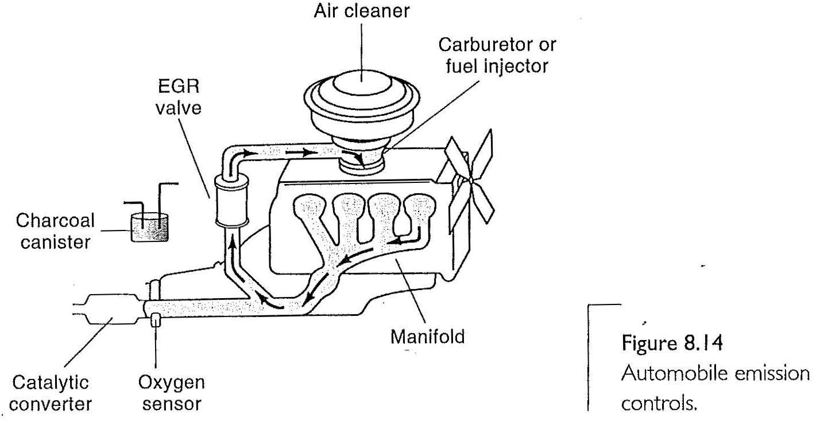
Auto emissions controls
Used to capture vapors
And feed them to the carburetor when the engine is running
Before 1960 the blow by
Gases were vented to the
Atmosphere
20% of the hydrocarbon emission were from fuel evaporation.
In the combustion chamber, combustion is so rapid that a thin layer of gasoline does not burn, it goes to the engine and accumulate in the crankcase
Incomplete combustion of gas, creates hydrocarbons

Slide 27
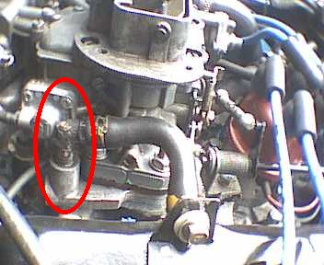
Auto emissions control:
Blow by gases and PCV
Blow by gases, caused, e.g. by scratches in cylinder, passes piston rings, leaking hydrocarbons into crankcase.
Installation of positive crankcase ventilation (PCV )on vehicles brought the first major reduction in automotive hydrocarbon emissions (crankcase is usually <P_{atm}).
Instead of the gases going to the atmosphere , there are back into an intake manifold, and renter the combustion chamber (the PVC valve used to make a closed system).
Image: http://www.lextreme.com/pcv/pcv_2.JPG

Slide 28
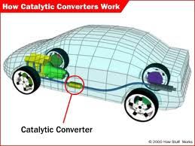
Auto emissions control:
Catalytic converters
Catalytic Converters (Pt or Pd+ Rh):
Introduced 1975. A catalytic converter is a vehicle emissions control device that converts toxic pollutants in exhaust gas to less toxic pollutants, by catalyzing a redox reaction (oxidation or reduction).
Catalytic converters are used in internal combustion engines fueled by either petrol (gasoline) or diesel—including lean burn engines.
Requires unleaded gasoline (or else catalyst is ‘poisoned’)
Eliminates: unburned hydrocarbons, CO, NO_{x}
Images: http://t0.gstatic.com/images?q=tbn:ANd9GcSCH0DuoZHUt1LWLh3vq1gkuCuhjMP-kB4GCbCSN7vyMNxjp9L4cWsaO5B3 ,

Slide 29
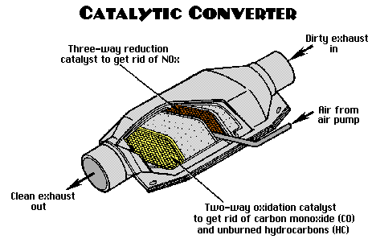
Auto emissions control:
Catalytic Converters
The “two-way” converters combined carbon monoxide (CO) with unburned hydrocarbons (HC) to produce carbon dioxide (CO₂) and water (H₂O).
In 1981, two-way catalytic converters were obsoleted by “three-way” converters that also reduce oxides of nitrogen (NOx).
http://www.aa1car.com/library/converter.gif

Slide 30
Auto emissions control:
Nitrogen oxides and EGR
NOx forms primarily when a mixture of nitrogen and oxygen is subjected to high temperature from the air combusting at the engine’s
Exhaust Gas Recirculation (EGR) is a nitrogen oxide (NOx) emissions reduction technique by reducing temperature.
EGR works by recirculating a portion of an engine's exhaust gas back to the engine cylinders.

Slide 31
Emission-Control Devices
there are devices that are installed to meet the standards of the Clean Air Act.
Pollution sources are often broken into two categories: stationary sources and mobile sources.
Automobiles now rely on the Evaporative Emissions Control System (EVAP) to prevent gasoline vapors from escaping into the atmosphere from the vehicle’s fuel system.
The electrostatic precipitator has been very successful in reducing particulate emissions from power plants.

Slide 32

Study questions
The production of nitrogen oxides in an automobile is a result of
incomplete combustion of the gasoline.
releasing nitrogen oxides that are a component of gasoline.
catalytic converters.
oxidation of nitrogen taken into the engine.
hydrogenation of gasoline.
http://www.shamblottfamilydentistry.com/images/laughing-gas.jpg. Accessed 10/12/12.

Slide 33
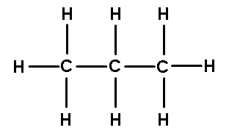
Study questions
The presence of hydrocarbons in an automobile’s exhaust is a result of
incomplete combustion of the gasoline.
releasing nitrogen oxides that are a component of gasoline.
catalytic converters.
oxidation of nitrogen taken into the engine.
hydrogenation of gasoline.
http://antranik.org/wp-content/uploads/2012/02/hydrocarbon.gif. accessed 10/12/12.

Slide 34
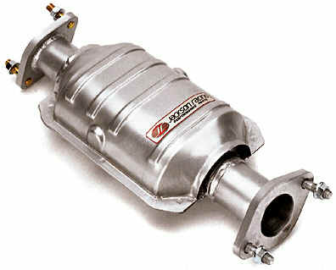
Study questions
Catalytic converters are not helpful for eliminating which of the following pollutants:
carbon monoxide
sulfur oxides
nitrogen oxides
hydrocarbons
http://www.camarillocarcare.com/wp-content/uploads/catalytic-converter.jpg. Accessed 10/12/12.

Slide 35
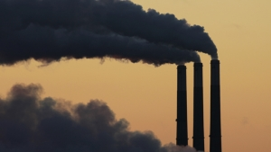
Stationary Sources
Stationary Sources present a different challenge than cars.
Their primary pollutants are sulfur dioxide and Particulates
To meet air quality and emission standards:
Use low-sulfur, low-ash fuel
Remove sulfur before burning
Remove sulfur oxides, particulates after burning
Shift fuel or power output as air quality demands
Use tall chimneys for natural diffusion/dispersion

Slide 36
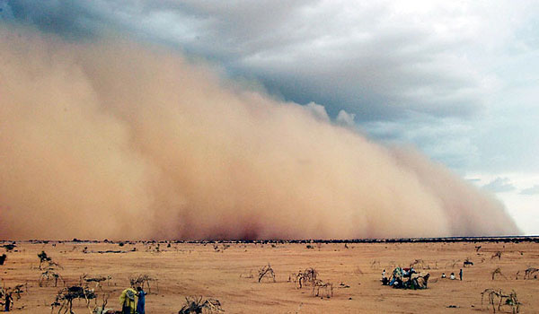
Particulate pollution
Caused by “burning” noncombustible materials, i.e. “ash”.
Causes respiratory illness, immunological illnesses, cardio aggravation.
Particles can travel long distances, depending on their size. Saharan dust often settles in Europe, as far as UK, Germany.
In 2016, and 2017 they were detected as far as Puerto Rico
Image: sandstorm.
Image: http://www.questionanswers.info/wp-content/uploads/2009/07/4sandstorms.jpg

Slide 37
Sulfur oxides
The largest sources of SO₂ emissions are from fossil fuel combustion at power plants (73%) and other industrial facilities (20%): SO₂, SO₃.
Neutral acidity: pH=7.0.
Unpolluted rain: pH=5.6 (thanks to H₂CO₃)
Adirondack lakes: pH = 4.0-4.5. Coke: 2.5.

Slide 38
Effect of Acid Rain: US, Canada
Between 50% and 70% of Canada's acid rain comes from the United States, while only 2-10% of America's pollution in this area comes from Canada.
Many of the province's 31,000 small lakes have a pH value of about 5, making them dangerously acidic for fish and plants.
http://www.nature.com/news/2005/050810/full/news050808-10.html

Slide 39
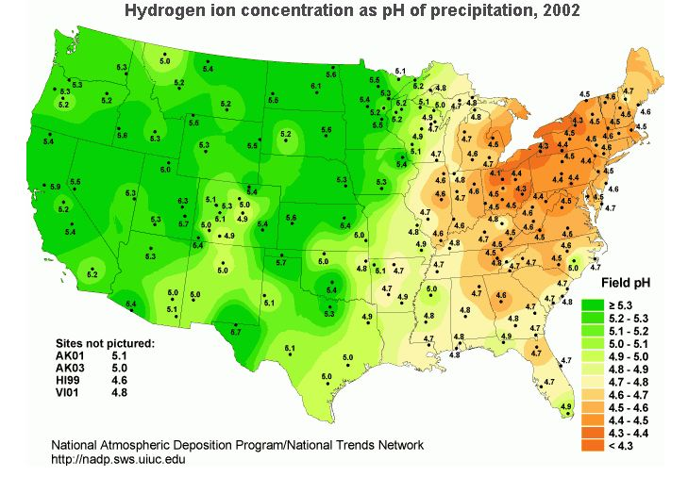
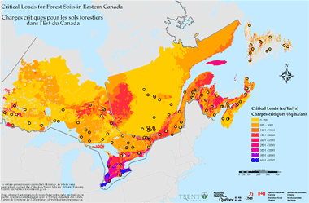
Effects of Acid Rain: US, Ontario
Images: http://www.gov.ns.ca/nse/air/images/criticalloads.gif, http://www.breakthroughlearningcollege.com/wp-content/uploads/2011/04/Acid-Rain-USGS.jpg

Slide 40
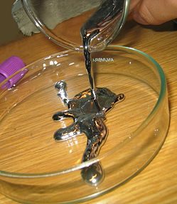
Mercury poisoning
2/3 of human-caused environmental mercury due to burning coal.
Burning untreated coal can release the coal’s trace mercury impurities. (But then it’s a trace part of a huge amount of coal.
“On August 14, 1996, Karen Wetterhahn, a chemistry professor working at Dartmouth College, spilled a small amount of dimethyl mercury on her latex glove. She began experiencing the symptoms of mercury poisoning five months later and, despite aggressive chelation therapy, died a few months later from brain malfunction due to mercury intoxication.”
Image: http://upload.wikimedia.org/wikipedia/commons/thumb/9/99/Pouring_liquid_mercury_bionerd.jpg/249px-Pouring_liquid_mercury_bionerd.jpghttp://en.wikipedia.org/wiki/Mercury_poisoning

Slide 41
Stationary emissions control
http://www.epa.gov/airmarkt/progsregs/epa-ipm/docs/v410/Chapter5.pdf

Slide 42

Discussion question
How did replacing incandescent bulbs with compact fluorescent lamps CFLs (which have trace amounts of Hg) reduce mercury pollution?
CFLs contains very small amount of mercury within the glass tube, EPA estimates that the US is responsible for the release of 103 metric tons of mercury emission/ year

Slide 43
Light bulbs
https://www.energystar.gov/ia/partners/promotions/change_light/downloads/Fact_Sheet_Mercury.pdf

Slide 44
Thermal Pollution
Thermal pollution is defined as the addition of unwanted heat to the environment, in particular, to natural waters.
The water demands of electrical generating plants account for about 50% of current water usage.
The current usage of electrical plants is about 400 billion gallons per day!
Fossil- and nuclear-fueled power plants have different impacts on the environment, but one common feature is their emission of waste heat.

Slide 45
Ecological Effects of Thermal Pollution
Major impacts on aquatic ecosystems attributable to thermal pollution.
Aquatic Life:
  Increased water temperatures lead to various adverse effects.
  Temperature is one of the most important factors governing the occurrence and behavior of life.
  Growth and reproduction of fish as a function of water temperature varies among species.
  For fish, reproduction rates are not necessarily changed in mildly warmer waters.

Slide 46
Ecological Effects of Thermal Pollution
Lake Processes: Eutrophication
  Eutrophication is the name given to the process in which a body of water is enriched by the addition of extra nutrients, stimulating the growth of algae.
  Other permanent changes in aquatic communities on a large scale can be brought about by waste-heat discharges.
  Heat transfer occurs through the process of convection.
  Mixing brings up nutrients from the bottom to enhance biological growth in the upper layers and supplies oxygen to the bottom layers.

Slide 47
Cooling Towers and Ponds
Cooling towers are one of the most common means used to dispose of waste heat without putting it directly into a water system.
One of the disadvantages of a wet tower is the possible alteration of local weather.
Another cooling device is a closed body of water like a reservoir, called a cooling pond.
These artificial lakes are shallow to allow a maximum surface area to volume ratio for good heat loss via evaporation.

Slide 48
Climate Change: Impacts

Slide 49
Evidence for global warming
The evidence for global warming is found in the rapid recession of glaciers outside the polar areas and a decrease in snow cover in some areas, such as Europe. For more than a century, the World Glacier Monitoring Service and its predecessor organizations have studied fluctuations in glacier mass. Scientists have found that glaciers are currently losing more mass than either Greenland or Antarctic ice sheets. The glaciers shrinking fastest are in central Europe, the Caucasus region, western Canada, the U.S. lower 48 states, New Zealand, and near the tropics, losing more than 1% of their mass each year.

Slide 50
Climate Change: Impacts
Global climate change is already observable effects on the global environment:
  Glaciers have shrunk
  Precipitation patterns have changed
  Plant and animal ranges have shifted
Things that we depend upon, like water, agriculture, and ecosystems, are experiencing the effects of a changing climate.

Slide 51
Climate Change: Impacts
The climatic effects of global warming depend upon the magnitude of the temperature change.
A key element in predicting that rise is an understanding of the carbon cycle.
Carbon continuously cycles among living creatures, the oceans, the atmosphere, and plants.
Carbon is fixed into terrestrial and oceanic plants via photosynthesis.
Without human influence, the flow of carbon among the air, plants, and oceans would be roughly balanced.
Fossil fuel combustion adds about 9.8 billion tons of carbon per year to the atmosphere.

Slide 52
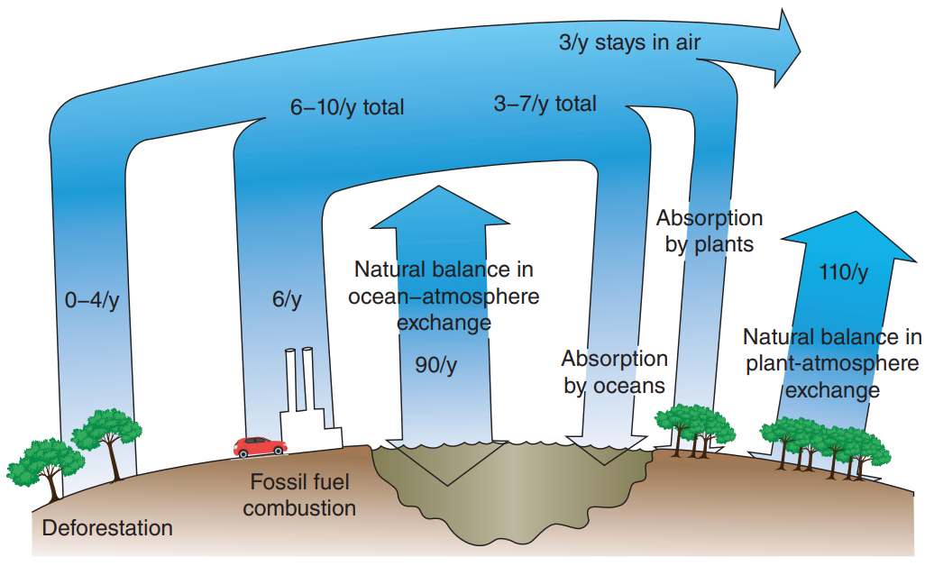
Climate Change: Impacts
The carbon cycle of the earth, showing flows of carbon among the air, plants, oceans, fossil-fuel combustion, and deforestation. (Emissions in billions of tons per year.) Without human influence, the flows of carbon among the air, plants, and oceans would be roughly balanced.
(Source: Electric Power Research Institute Journal)

Slide 53
Climate Change: Impacts
About half of this carbon is absorbed by the oceans and by plants, while the other half remains in the atmosphere.
The carbon added to our atmosphere by the results of deforestation—burning and decay—is estimated to be about 1 to 2 billion tons per year.
Much of the uncertainty associated with predictions of warming trends depends on an understanding of the sizes of various feedbacks.
The effects of global warming will not be felt equally around the world.
Differences from region to region could be both in the magnitude and in the rate of climate change.

Slide 54
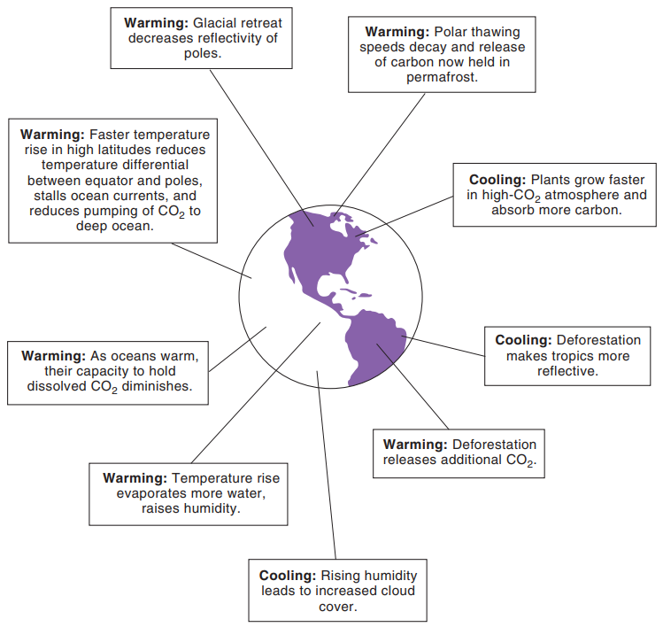
Climate Change: Impacts
Potential feedbacks to global warming. Positive feedbacks are expected to increase the warming, while negative feedbacks will probably have a cooling effect.
Source: Electric Power Research Institute Journal

Slide 55
Climate Change: Impacts
A study of the Arctic has found glaciers there to be retreating and permafrost to be thawing.
This thawing can release methane gas—and even more potent greenhouse gas—that is trapped there.
Due to positive feedback mechanisms, the Arctic is expected to warm more rapidly than other regions, as much as four times as fast.
Over the past 30 years, the Arctic has warmed at roughly twice the rate the entire planet has warmed.

Slide 56
Implications of the warming trend
List some potential implications of the warming trend.
Increased global temperatures have caused significant melting of the ice sheets and glaciers.
Changes in precipitation and altered storm patterns could have serious effects on agriculture.
A few degrees warmer might seem nicer in the middle of winter, but summer days could become unbearable.

Slide 57
Climate Change: Mitigation and Adaptation
the processes of adjusting to the current and future effects of climate change.
Energy policy is certainly one area in which changes can be made to reduce CO₂ and methane emissions.
Greater emphasis on energy conservation, economic incentives, renewable-energy technologies, and nuclear power are a few of the options.
Natural gas-fired electricity produces about 60% less CO₂ per kWh generated than coal.
Increased energy efficiency will also cut down on emissions while allowing us to maintain the same level of activity.

Slide 58
Climate Change: Mitigation and Adaptation
Use | Basis | CO₂ Emissions (lb)
Car | Per gallon | 20
Electricity | Per kWh (using coal) | 2
Natural gas | Per kWh | 0.90
Electricity in U.S. | Per kWh (all sources) | 0.85
Individual Carbon Dioxide Production

Slide 59
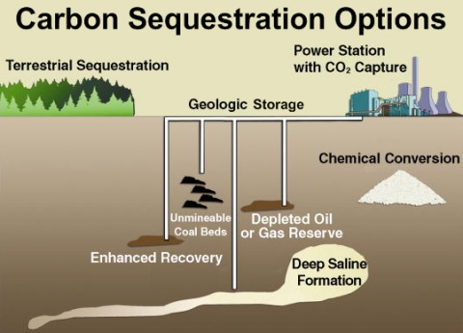
Sequestration
In addition to reducing CO₂ emissions, we can “bury” the gas or carbon: “sequestration”.
Ocean
Peat, wetlands
Oil and gas reservoirs. (Note: CO₂ is heavier than air.)
Image: http://blogs.edf.org/climate411/files/2008/03/ carbon_sequestration_options_480px.jpg.

Slide 60
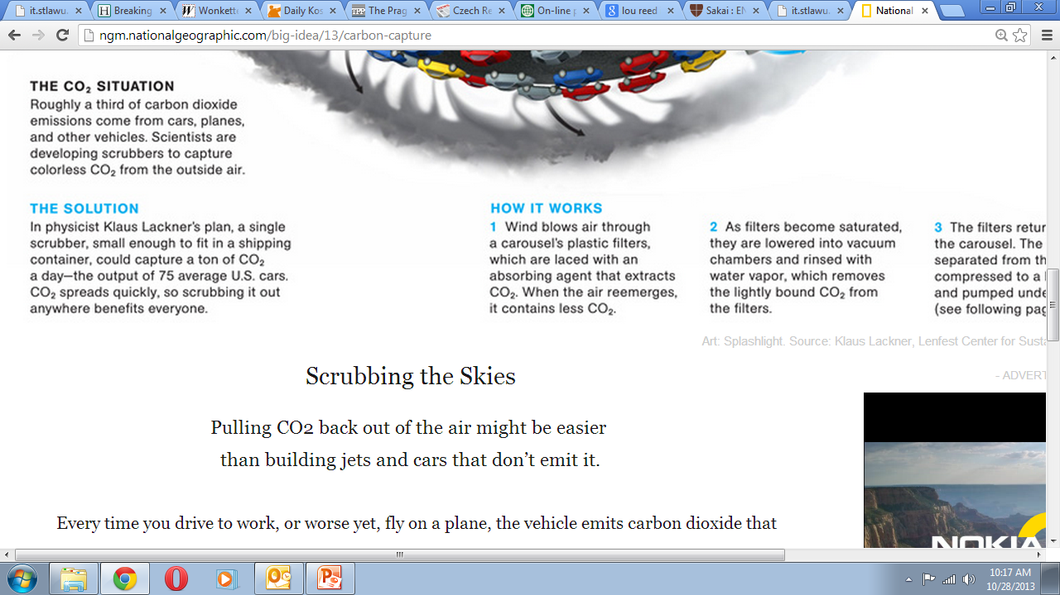
Carbon sequestration: other interesting solutions
Artificial trees. (see box)
http://ngm.nationalgeographic.com/big-idea/13/carbon-capture
Charcoal. Absorbs more CO₂, enriches the soil.
CO₂-absorbing minerals. Olivine, serpentine. Huge resources, carbon held more tightly than in CO₂ itself. Very long-term storage.
Why not change how combustion works, have sequestration occur on site?

Slide 61
Climate Change: Mitigation and Adaptation
Two forms of legislative action that can tackle the issue of global warming are a “cap-and-trade” policy and a carbon tax.
In cap and trade, a limit on emissions is instituted, but one that allows utilities and other industries to adopt the most cost-effective strategy for meeting those limits.
A carbon tax is a tax on the amount of CO₂ produced—as so many dollars per ton of carbon emitted.
This tax encourages reduced consumption and increased efficiency.

Slide 62
Climate Change: Mitigation and Adaptation
One approach being actively pursued to reduce the amount of CO₂ being added to our atmosphere is carbon sequestration.
The goal here is to capture carbon at its source and direct it to non-atmospheric sinks.
Steps to slow the rate of global warming will be costly and controversial.
Regulations on fossil fuel use certainly will be burdensome on some groups, and developing nations will be hard-pressed to agree to controls on fossil fuel combustion and increased energy conservation.

Slide 63
Climate Change: Mitigation and Adaptation
In June 1992, at the United Nations Earth Summit in Rio de Janeiro, 167 nations ratified the U.N. Framework Convention on Climate Change to Prevent “dangerous human interference with the climate system”.
The political consequences of a global temperature rise of several degrees and the accompanying changes in regional climates and agricultural productivity can be unsettling.
Governments are held accountable on matters involving national security, economies, and the basic freedoms of their citizens.
Climate change, however, is not a problem to be solved in the future—it is happening now.

Slide 64
Climate Change: Mitigation and Adaptation
Adaptation actions may be incremental, such as building and fortifying seawalls, building rainwater collection systems, and strengthening emergency preparedness.
Adaptation can be transformative, such as moving an entire town to higher ground, rebuilding communities on stilts, or converting urban or industrial land back to its natural form.
You can find incremental adaptation in nearly any city plan.
Transformational adaptations are becoming more and more common.

