Slide 1
Chapter 8: Energy from Fossil Fuels
Exam 2 –October 21, study guide posted
Chapter 8: Energy from Fossil Fuels

Slide 2
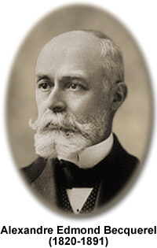
The photovoltaic effect
Photovoltaic effect is the conversion of sunlight into electricity
Discovered in 1839 by A. Edmond Becquerel:
Son of physicist Antoine-César
Father of physicist [Antoine-]Henri Becquerel, co-discoverer of radioactivity [Nobel Prize, 1903].
He was interested in phosphorence and luminescence and discovers that chemical reactions can produce electric current
Sunlight + semiconductor → electricity
Image: http://micro.magnet.fsu.edu/optics/timeline/people/antiqueimages/becquerel.jpg

Slide 3
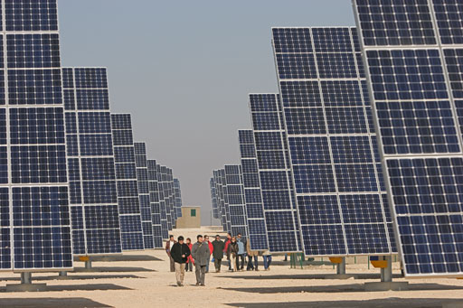


Materials science in a nutshell
Metals: 1 mobile electron / atom.
Insulators: 0 mobile electrons / atom.
Semiconductors: 0-1 mobile electrons / atom. Silicon, carbon, germanium, gallium arsenide (GaAs), e.g.
Images: http://www.palive365.com/wp-content/uploads/2011/08/copper-wire.jpg, http://img1.topfreebiz.com/o2010-5/cache/LAN-Cable-UTP-CAT5-2001053480.jpg, http://www.rechargenews.com/multimedia/archive/00028/acciona_solar_28806a.jpg

Slide 4
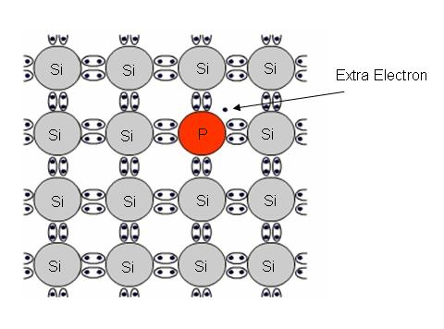
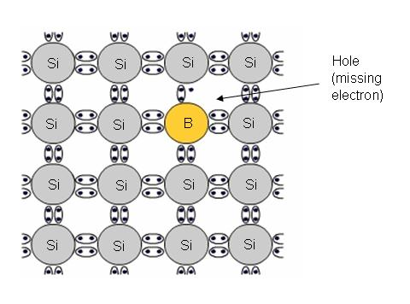
Semiconductors
Pure silicon is a semiconductor. The electrons are bound tightly to the lattice.
Doping with phosphorus [P], arsenic [As], etc. puts extra electrons in the lattice, creating an “n-type” semiconductor.
Doping with boron [B], aluminum [Al], gallium [Ga], etc. produces absences of electrons, much like bubbles, creating a “p-type” semiconductor.
Thickness of semiconductors is very critical for the conductivity, so are the growth temperature, and pressure conditions
Images: http://solarhorizon.com.au/SolarCells.html

Slide 5
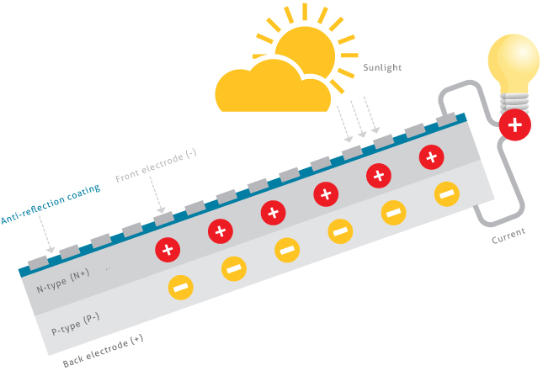
Photovoltaic effect
The photovoltaic effect is the generation of voltage and electric current in a material upon exposure to light.
Light is absorbed, causing excitation of an electron or other charge carrier to a higher-energy state.
Sunlight can deposit energy in a semiconductor, liberating electron-hole pairs, which travel through a circuit, producing electricity.
Image: http://www.stion.com/technology/photovoltaic-effect/

Slide 6
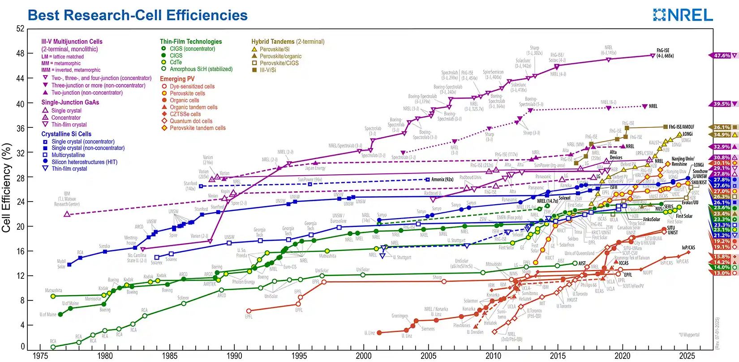
Energy conversion efficiencies, photovoltaics
Image: http://www.solarnavigator.net/images/pv_solar_module_efficiency_chart.jpg
*
GaAs solar cells, roughly 30%
Silicon solar cells, less than roughly 30%
Thin-film technologies cheaper, but lower yield.
Emergent technologies not yet competitive.
These are mostly lab results. Commercial units are lower in energy conversion efficiency.

Slide 7
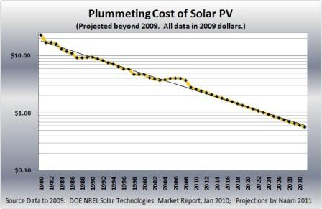
Photovoltaics and Moore’s Law
Moore’s Law:
Production increases 10x every 10yr or so.
Price drops 10x every 20-30 yr
Image: http://blogs.scientificamerican.com/media/inline/blog/Image/naam-solar-moore_s-law-5.jpg

Slide 8
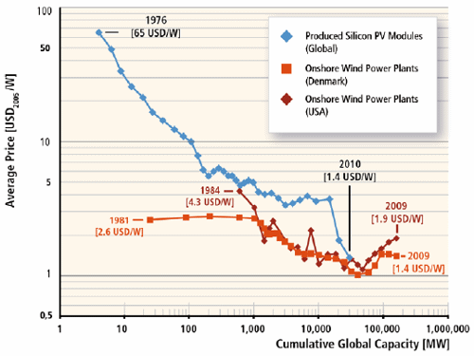
Photovoltaics, cost
Image: http://1.bp.blogspot.com/-kAwqHkCzTCE/TeK8SrymA3I/AAAAAAAABbU/tQ0nY3he0BE/s1600/PV-curve-IPCC.gif

Slide 9
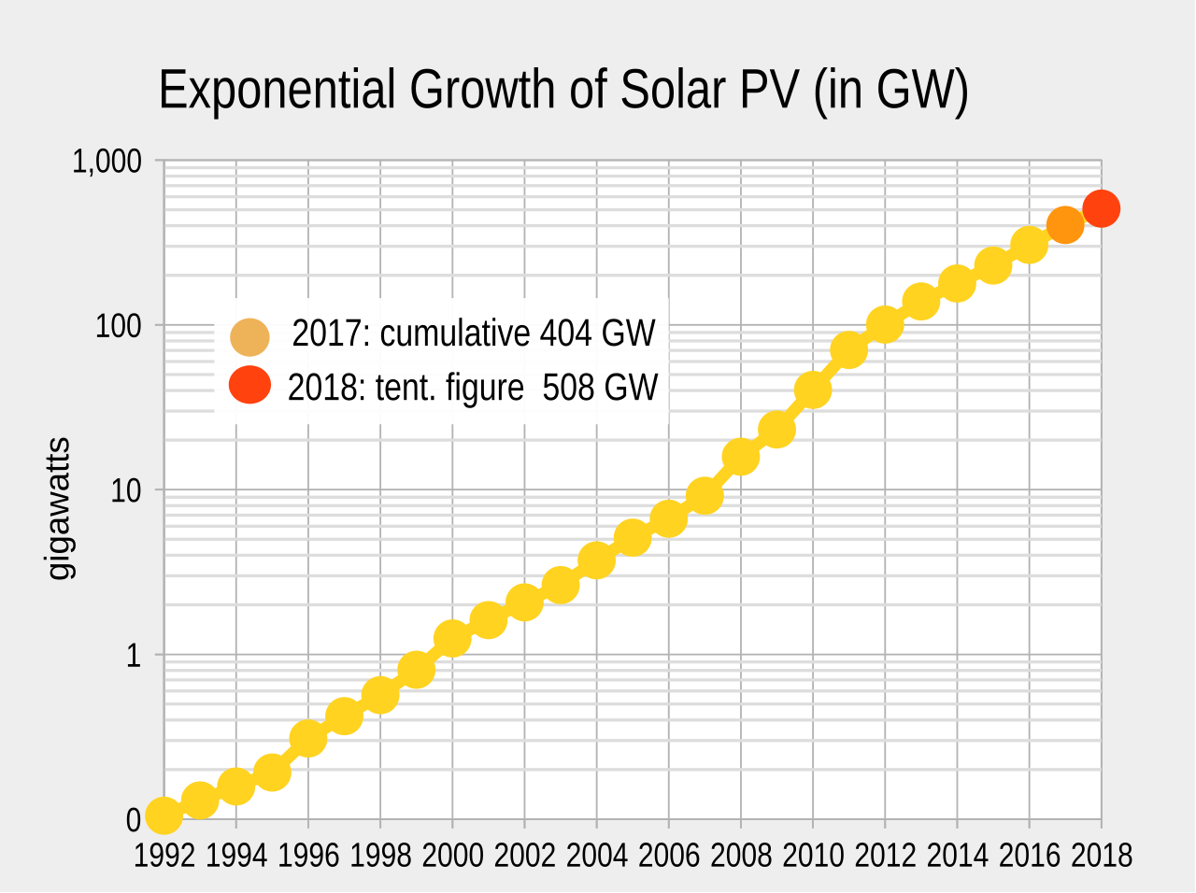
PV cell production in the world
The application of solar photovoltaics is growing rapidly and the worldwide installed capacity reached one terawatt in April 2022.
The total power output of the world's PV capacity in a calendar year is now beyond 500 TWh of electricity. This represents 2% of worldwide electricity demand. More than 100 countries, such as Brazil and India, use solar PV.
China is followed by the United States and Japan, while installations in Germany, once the world's largest producer, have been slowing down.
Honduras generated the highest percentage of its energy from solar in 2019, 14.8%

Slide 10

World Solar Challenge
This is the Hong-kong team who won the Bridgestone world solar challenge in 2025.
It happens every year in Australia (Darwin to Adelaide).
Teams, usually comprising of tertiary and secondary students, traverse 3,000 kilometres from Darwin to Adelaide in a energy efficient electric vehicle designed, engineered, and built with their own hands.
Image: http://www.worldsolarchallenge.org/

Slide 11
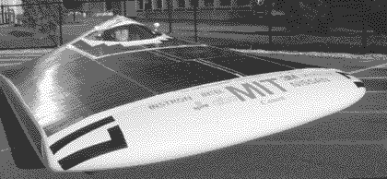
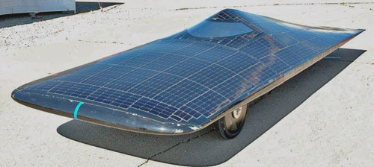
Solar races
MIT Manta (1995)
panels 14′×6.5′ [138hp, theor.] drives 8hp motor.
weight: 620 lb.
MIT Tesseract
6hp motor.
375 lb + driver.
Images: MIT Manta: http://tech.mit.edu/V117/N40/sunrayce.40.gif
Tesseract: http://ccn1.net/POTD4/solar-cars/MIT-solar-electric.jpg
http://en.wikipedia.org/wiki/Solar_car_racing for more information.

Slide 12

Worked Problem
The Nuna2 (Tech. Univ. Delft) won the 2002 and 2003 World Solar Challenge. Its gallium arsenide triple junction solar cells covered a 9 sq. meter surface and were over 24.5% efficient. What is its top power in W and hp?
The car was capable of over 100mph. It is reported to have required only 1650W to reach 62mph (100km/hr). 2007 rules limited the solar panels to more than 6m², so the cars are now slower and safer.
http://www.spacedaily.com/images/solarcar-nuna2-australia-bg.jpg

Slide 13
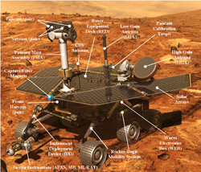
Photovoltaic application: The Mars Rover
Image: http://marsrover.nasa.gov/mission/spacecraft_surface_rover.html

Slide 14
Question
The “efficiency” of a light bulb is the ratio of the:
a. heat plus electricity produced to the electrical input
b. voltage output of the bulb to the power input
c. energy into the bulb to the energy out of the bulb
d. light output to the electrical energy input
Notes:
d

Slide 15
Question
Heat energy will spontaneously always flow in the direction of ________.
a. a higher temperature
b. a lower temperature
c. up, since heat rises
d. a smaller heat capacity
Notes:
B

Slide 16
Question
A heat engine ________.
a. converts work into heat energy
b. needs a temperature difference to be able to work
c. can be 100% efficient in the absence of friction
d. needs electricity to be able to run
Notes:
b

Slide 17
Chapter 8: Energy from Fossil Fuels
Approximately 80% of the commercial energy resources used in the world come from fossil fuels—coal, petroleum, and natural gas.
Petroleum is the most used fuel source worldwide.
The United States has depended on the middle east for its oil supply, but more recently, North American sources have produced the bulk of the petroleum products needed.
In the United States, petroleum accounts for the largest share of domestic energy consumption (35% in 2020), followed closely by natural gas (34%) and coal (10%).

Slide 18
Resource Terminology
There is an important differences between “reserves,” “known reserves,” and “undiscovered resources.”
The terminology used to describe the status of fossil fuel resources seems ambiguous at best.
The amount of a particular resource that remains unused or undiscovered in the ground is hard to predict.
Because our predictions always reflect incomplete exploration, there will always be some left to discover.
Even though a certain amount of a resource is believed to exist, economic and technical factors often affect how much of it can be extracted.

Slide 19
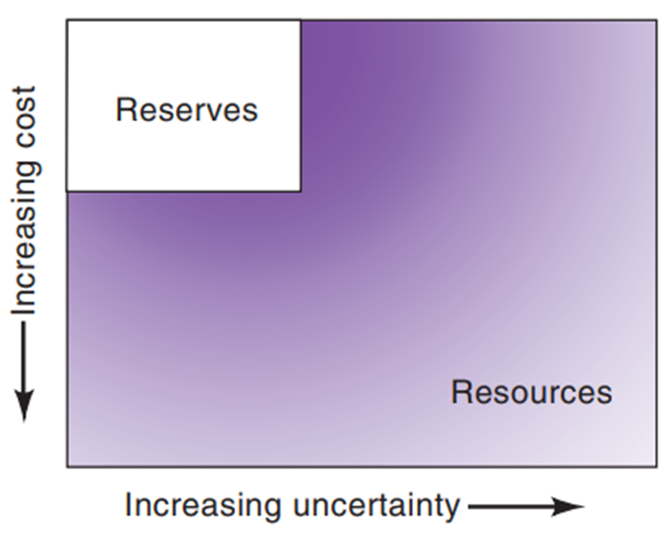
Resource Terminology
Reserves occupy the upper-left part of this rectangle.
Undiscovered resources occupy the right side of the diagram.
Proven reserves are reasonably certain of being produced from known reservoirs under existing economic and technological conditions.
Indicated reserves are those amounts believed recoverable from known fields using improved recovery techniques.
Inferred reserves are those deposits expected in identified fields but not yet measured.
The McKelvey diagram for categorizing reserves and resources relates the variables of geological certainty and economic feasibility

Slide 20
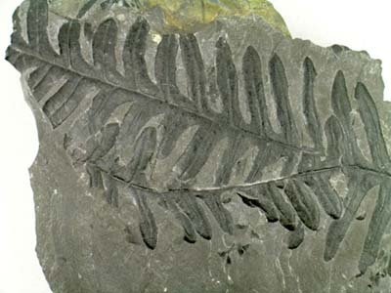
Fossil Fuels
Coal is created from
plant life from as many
as hundreds of millions
of years ago.
There are three major forms of fossil fuels: coal, oil and natural gas.
All three were formed many hundreds of millions of years ago before the time of the dinosaurs – hence the name fossil fuels.
Today 85% of the world energy come from fossil fuels.
Coal is one of the largest source of energy for generation of electricity, and largest source of carbon dioxide
Fossiliferous coal http://www.kgg.org.uk/alethopteris4.jpg

Slide 21
Coal: An Abundant Resource
Coal is America’s and the world’s most abundant fuel.
The United States has been called the “Saudi Arabia of coal.”
Total world recoverable reserves are estimated at 1080 billion tons, enough to last for 470 years at 2020 rates of consumption.
Despite the U.S. abundance of coal, more than twice as much of our energy consumption comes from oil as from coal.
Liquids made from coal have been available for many years, primarily in countries without petroleum resources.

Slide 22
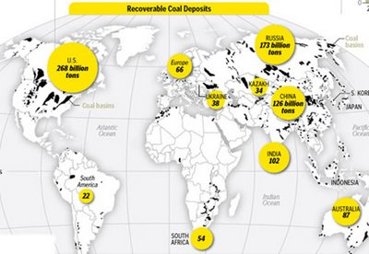
Recoverable coal: where is it?
Image: http://4.bp.blogspot.com/__APCzEFEiDk/SVugnf1R_UI/AAAAAAAAADY/uQ-dxnz1uxY/s400/coal_deposits.jpg.
The US has about ¼ of the total coal reserves.
About 1080 billion tons is recoverable reserves of coal

Slide 23
Types of Coal
Rank | Carbon (%) | Energy Content (Btu/lb)
Lignite | 30 | 5000-7000
Subbituminous | 40 | 8000-10,000
Bituminous | 50-70 | 11,000-15,000
Anthracite | 90 | 14,000
Ranks of Coal
Notes:
Table 8.3 Ranks of Coal
Source: P. Averitt, U.S. Geological Survey Bulletin, 1412 (1975).

Slide 24
Types of Coal
There are three main types of coal : anthracite, bituminous and lignite:
Anthracite coal is the hardest and has more carbon, which gives
it a higher energy content
Lignite is the softest and is low in carbon but high in hydrogen and
oxygen content.
Bituminous is in between.

Slide 25
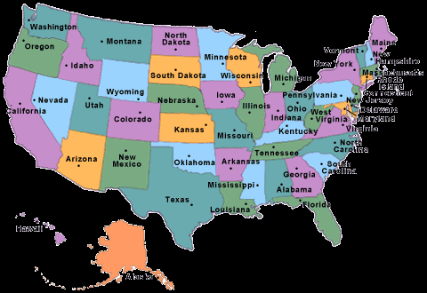
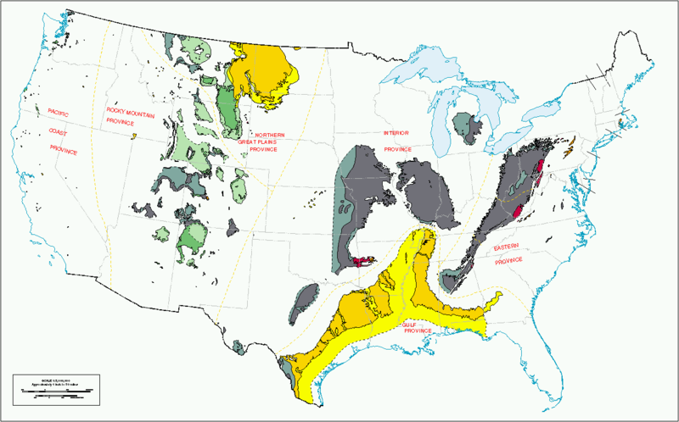
US Coal deposits
Red: anthracite Gray: bituminous coal
Green: sub-bituminous coal Yellow/orange: lignite
Image: http://upload.wikimedia.org/wikipedia/en/thumb/8/85/Us_coal_regions_1996.png/800px-Us_coal_regions_1996.png

Slide 26
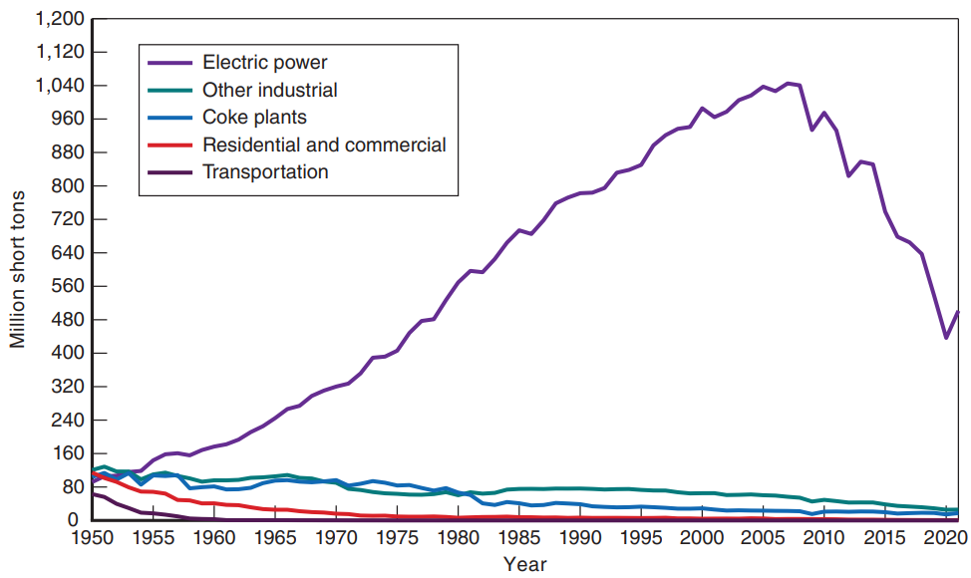
Coal Production and Consumption Patterns
Coal’s contribution to domestic energy consumption rose steeply from the middle 1970s until 2008 and has been dropping sharply.
U.S. coal production peaked at 1170 million tons in 2008, and in 2020, was at the lowest levels since 1965.
The only sector whose use of coal increased was the utilities, going from 50 million tons in 1940 to 1095 million tons in 2003.
U.S. coal consumption by sector: 1950–2021.
Notes:
Figure 8.18 U.S. coal consumption by sector: 1950–2021.
(Source: U.S. EIA)

Slide 27
Strip Mining
Coal occurs in seams or beds, varying in thickness from inches to more than 100 ft.
About 48% of the coal produced today is by strip mining, from seams lying fairly close to the earth’s surface.
In strip mining, the earth and rock above the seam—called the overburden—are removed and placed aside.
The exposed coal is broken up, loaded into trucks, and hauled away.
The strip mining of coal poses some important environmental problems, which are critical to expanded coal production.

Slide 28
Constraints to Coal Supply and Demand
Deterrents to increased use of coal can come from the supply side, the demand side, or both.
Constraints on coal supply come from several areas.
The speed of the development of western coal depends on the success of rehabilitating these lands.
Coal mining is the most dangerous major occupation today, so it might be difficult to attract the new workers needed for the projected increase in the workforce.
Major constraints to coal use are posed by climatic effects resulting from CO₂ emissions.

Slide 29
Coal
Fossil fuel formed millions of years ago by the anaerobic decay of living plants.
Complex mixture of many compounds.
The chemical formula of coal has been approximated as C₁₃₅H₉₆O₉NS
This translates to a material with 85% C (which is the energy producing component)

Slide 30
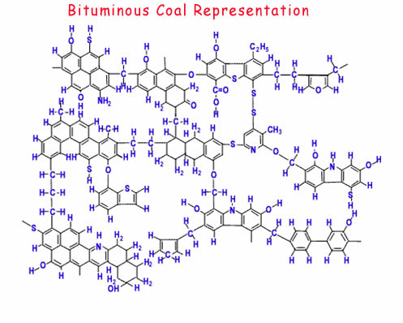
Coal, chemically
Molecular model of bituminous coal.
Chiefly carbon, with bits
of sulfur, hydrogen, oxygen, nitrogen.
https://www.wou.edu/las/physci/GS361/Fossil%20fuels/Coal.htm

Slide 31
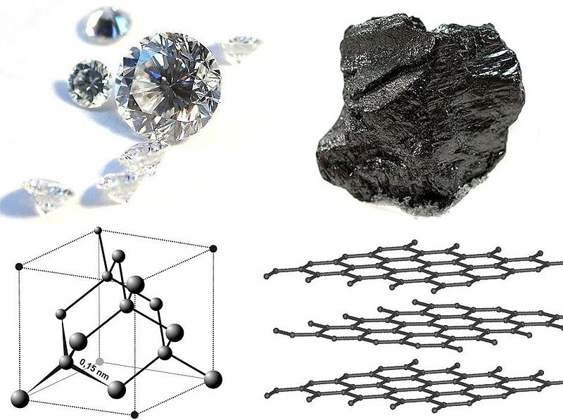
Carbon structure
Graphene 1 atom thick layer of graphite
FCC structure
Image: http://upload.wikimedia.org/wikipedia/commons/thumb/d/d9/Diamond_and_graphite2.jpg/800px-Diamond_and_graphite2.jpg

Slide 32
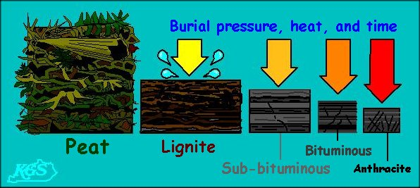
From biomass to coal
Heat, pressure and time turn biomass into peat, sub-coals, coals, and eventually [maybe] diamond.
Each step removes other elements, concentrating the carbon content.
Image: http://www.uky.edu/KGS/coal/images/peat_to_anthracite.jpg
Material | % carbon
Peat | 30
Lignite | 25-35
Sub-bituminous
Bituminous | 60-80
Anthracite | 90
Diamond | 100

Slide 33
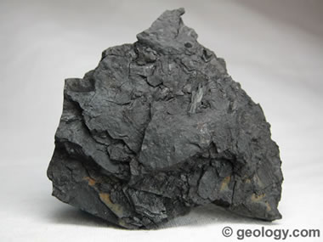
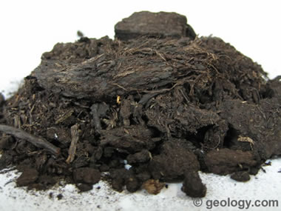
Peat & Lignite
“Lignite: The lowest rank of coal is "lignite". It is peat that has been compressed, dewatered and lithified into a rock. It often contains recognizable plant structures, it is knows as brown coal, it is the lowest rank of coal .
Image: http://geology.com/rocks/pictures/coal-lignite.jpg
“Peat: A mass of recently accumulated to partially carbonized plant debris. This material is on its way to becoming coal but its plant debris source is still easily recognizable.”
Image: http://geology.com/rocks/coal.shtml

Slide 34
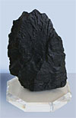
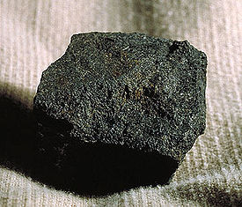
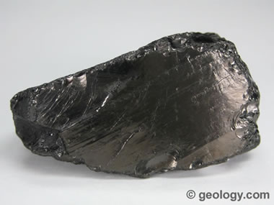
Sub-bituminous, Bituminous, Anthracite
“Anthracite Coal: Anthracite is the highest rank of coal. It has a bright luster and breaks with a semi-conchoidal fracture.”
Image: http://geology.com/rocks/pictures/coal-anthracite-380.jpg
Sub-bituminous: Reduces SO₂ emission in power plants
http://www.teachcoal.org/images/aboutcoal/subbituminous.jpg
Bituminous: Black Coal, contains Bitumen. http://upload.wikimedia.org/wikipedia/commons/thumb/2/20/Coal_bituminous.jpg/275px-Coal_bituminous.jpg

Slide 35
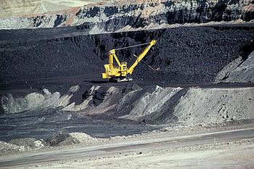
Coal
The Good
The Bad
Huge deposits >> petroleum
Cheap
Can be converted to synthetic fuel
Strip mining (mountain top removal-surface mining-removing earth rock to discover minerals)
http://upload.wikimedia.org/wikipedia/commons/thumb/0/05/Coal_mine_Wyoming.jpg/350px-Coal_mine_Wyoming.jpg
Huge carbon footprint
Acid rain (sulfur) (due to emission SO₂)
Non-renewable
Pollution (particulates, sulfur oxides, mercury)
Being a solid limits its applications (no coal-powered cars)

Slide 36
Synthetic Oil and Gas from Coal
Coal cannot be used directly as a source of energy because it is not fluid and is not as clean burning as oil or gas.
Coal can be converted into forms of oil and natural gas called synthetic fuels or “synfuels”.
The gasification of coal is a straightforward process that entails adding hydrogen to the coal.
This process was first used in the early 1800s in various “gas works”.
The conversion of coal into oil, or syncrude, is called liquefaction.

Slide 37
Oil Shale and Tar Sands
Medicine salespeople in the eastern states marketed certain rocks as providing both good lamp oil and ideal medicine.
Both groups were using rock containing a substantive amount of oil: oil shale.
Deposits of shale in the United States constitute a huge resource of oil.
The process for extracting oil from shale is called retorting.
Another important source of crude oil is tar sands.
Tar sands (also called oil sands) contain a highly viscous asphalt-like oil, called bitumen.

Slide 38
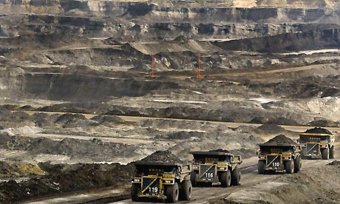
Oil sands, shales
Oil sands, tar sands or bituminous sands, are a type of unconventional petroleum deposit.
Is an unconventional petroleum deposit
Dense and extremely viscous form of petroleum
Oil shales, also known as kerogen shales, are organic-rich fine-grained sedimentary rock containing kerogen
Kerogen: material that either hasn’t become pure hydrocarbons (like natl. gas, petroleum) or that has degraded.
1 ton of material typically yields 25-35 gallons of petroleum. Heated to 800F-1000F first.
Processing is highly water-intensive.
Image: Alberta Oil Sands http://static.guim.co.uk/sys-images/Business/Pix/pictures/2007/12/06/OilJeffMcIntoshAP476.jpg

Slide 39
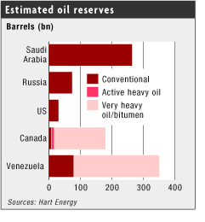
Oil sands
The Good
The Bad
Canada, US, Venezuela
Huge deposits >> petroleum
Image: http://www.eurotrib.com/files/3/051103_oil_reserves_SA_RU_US_CA_unconventional.gif.
Strip mining
Wastes are 30% larger in volume than deposits
Water- energy- intensive industry
Huge carbon footprint
Hydrogen sulfides
Only profitable as petroleum prices rise: hence profitability highly volatile

Slide 40
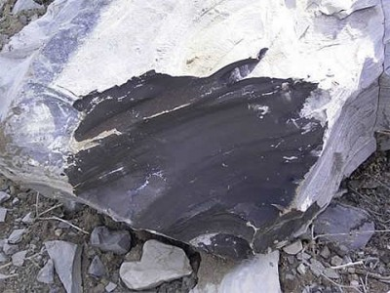
Oil shale
Chipped oil shale sample, Uinta Basin, Utah.
Chemical composition of oil shales:
E.g. Great River deposits in Colorado:
Carbon 215: Hydrogen 330: Oxygen 12: Nitrogen 5: Sulfur 1
Image: http://newenergyandfuel.com/wp-content/uploads/2010/07/Shale-Oil-Rock-Specimen-400x300.jpg

Slide 41
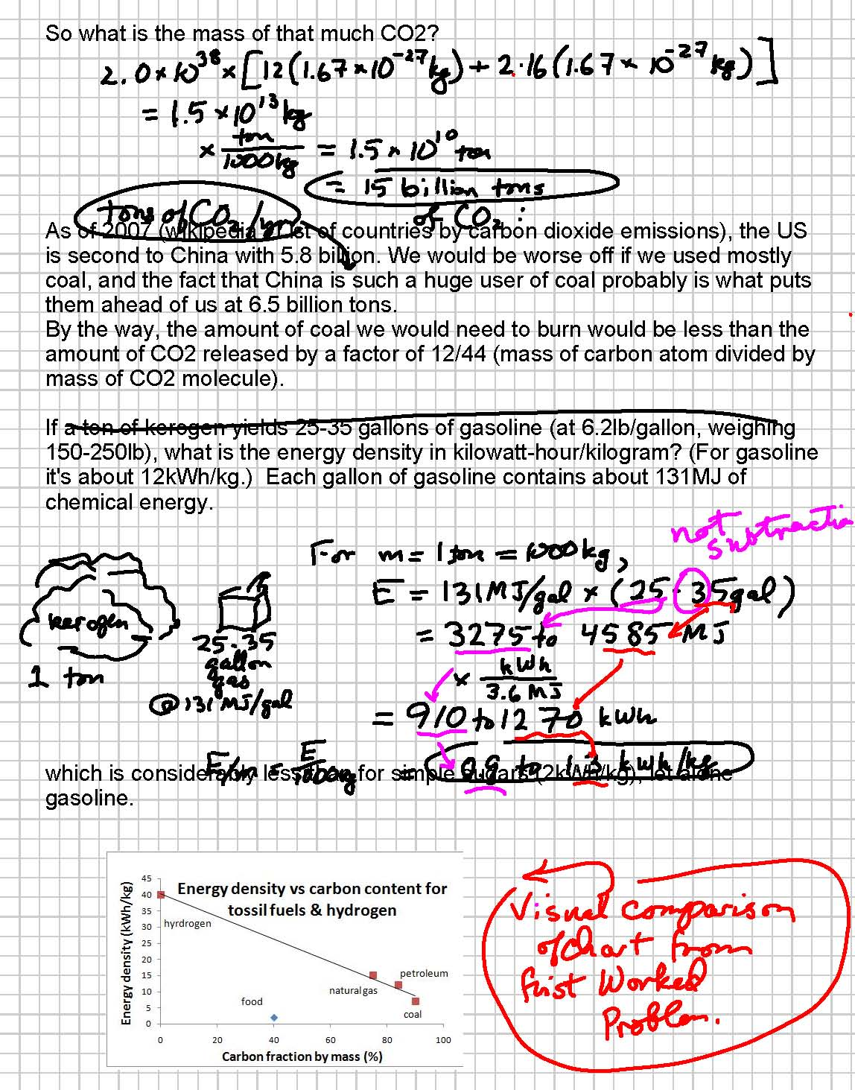
Worked problems
Calculate the percentage carbon per mass of the following materials. (Coal is up to 90% carbon.)
Sugar (C₆H₁₂O₆) 40% carbon (2kWh/kg)
Coal 90% carbon (7kWh/kg)
Octane (C₈H₁₈) 84% carbon (12kWh/kg)
Natural gas (CH₄) 75% carbon (15kWh/kg)
Hydrogen (H₂) 0% carbon (40kWh/kg)

Slide 42
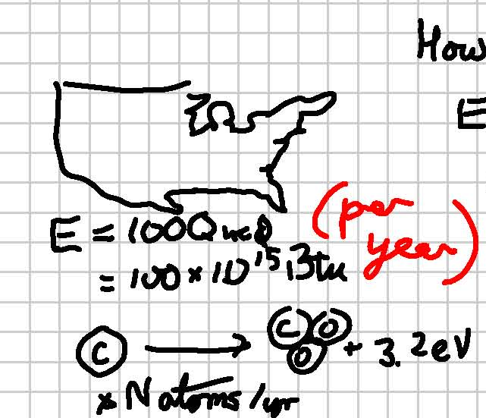
Worked problems
Let’s make a crude estimate of how much carbon dioxide is produced in the US per year as a result of our energy usage. Simple model: assume that all we use is coal. A carbon atom has a mass of 12×(1.67×10⁻²⁷kg); oxygen =16×(1.67×10⁻²⁷kg), and burning the carbon liberates 3.2eV of energy. [1eV=1.6×10⁻¹⁹J]
In the course of one year, we use 100Quad by burning “N” atoms of carbon:

Slide 43
Worked problems
So what is the mass of all that CO₂?
As of 2023, (http://en.wikipedia.org/wiki/List_of_countries_by_carbon_dioxide_emissions), the US is second to China with of CO₂ with 4.68 billion tons (and decreasing by 21%). China is ahead of us with 13.26 billion tons (and increasing by 262%) . The fact that China is such a large user of coal is probably why they are in the lead.
By the way, the amount of coal burned is smaller than the amount of CO₂ produced, by a factor of 12/44 (the ratio of their atomic masses).

Slide 44
Worked problems
If a ton of kerogen yields 25-35 gallons of gasoline (at 6.2lb/gallon, weighing 150-250lb), what is its energy density in kWh/kg? (Gasoline, e.g. has a density of 12kWh/kg.) Each gallon of gasoline contains about 131MJ of chemical energy.
which is considerably less than for simple sugars (2kWh/kg), let alone gasoline.

Slide 45
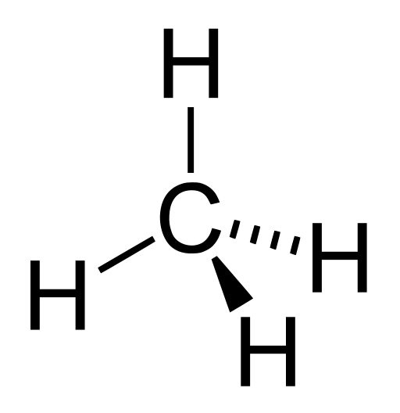
Hydrocarbons
Petroleum and Natural gas consist of hydrocarbons:
Saturated hydrocarbons (alkanes) are the simplest of the hydrocarbon species.
Alkanes consist only of hydrogen and carbon atoms.
The alkanes from pentane (C₅H₁₂) to octane (C₈H₁₈) are refined into petrol, the ones from nonane (C₉H₂₀) to hexadecane (C₁₆H₃₄) into diesel fuel, kerosene and jet fuel. Alkanes with more than 16 carbon atoms can be refined into fuel oil and lubricating oil
This is Methane the simplest alkane

Slide 46
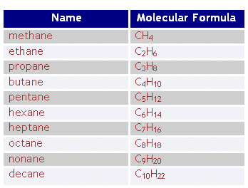
The alkanes: a class of hydrocarbons
Alkanes: C_{n}H_{2n+2}
Images: http://www.4college.co.uk/as/df/organic1.gif; http://www.btinternet.com/~chemistry.diagrams/alkanes.gif

Slide 47
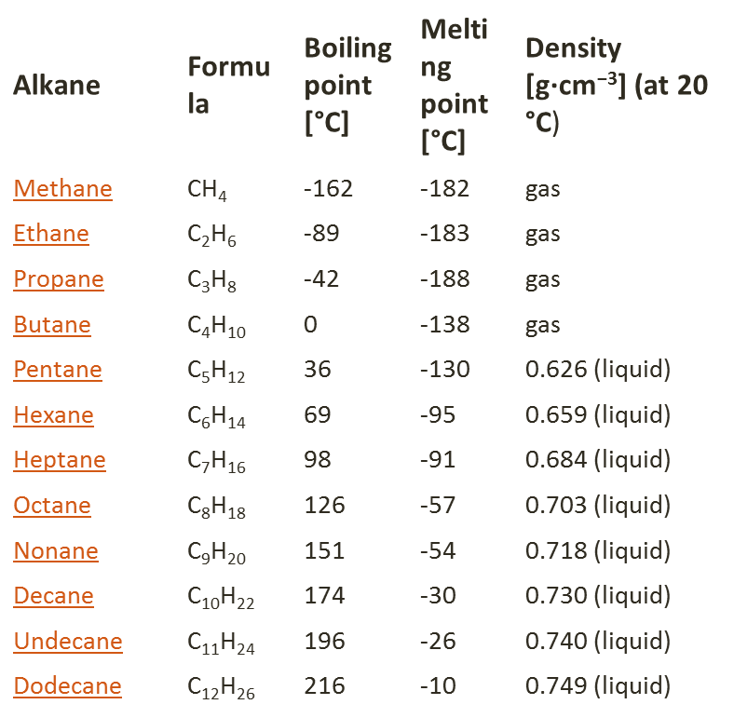
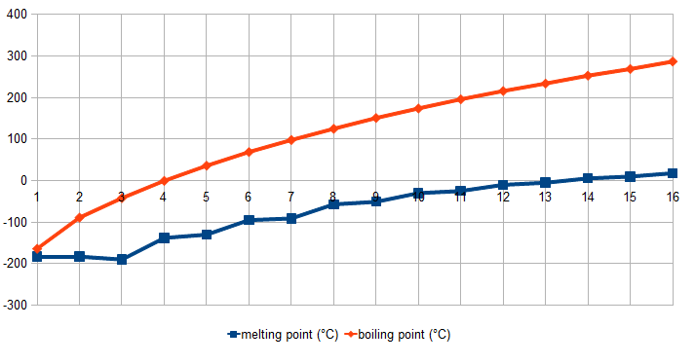
Melting points of the Alkanes
Higher-n alkanes include paraffin (wax) for 20 ≤n ≤ 40, solid at room temperature
Lowest-n alkanes include methane, ethane, propane, butane (n=1-4), gaseous at room temperature.
In between: gasoline.
http://en.wikipedia.org/wiki/Alkane#Melting_point

Slide 48
Petroleum
The world’s appetite for petroleum or oil continues to grow.
In 2020, the world’s total daily consumption was 93 million barrels per day (MBPD), of which 18 MBPD were consumed in the United States (20% of the world's total).
In 2020, the United States became a net petroleum exporter due to reduced oil consumption resulting from the Covid-19 pandemic.
The oil fields in the Middle East contain about 55% of the world’s oil in 0.5% of its land area.

Slide 49
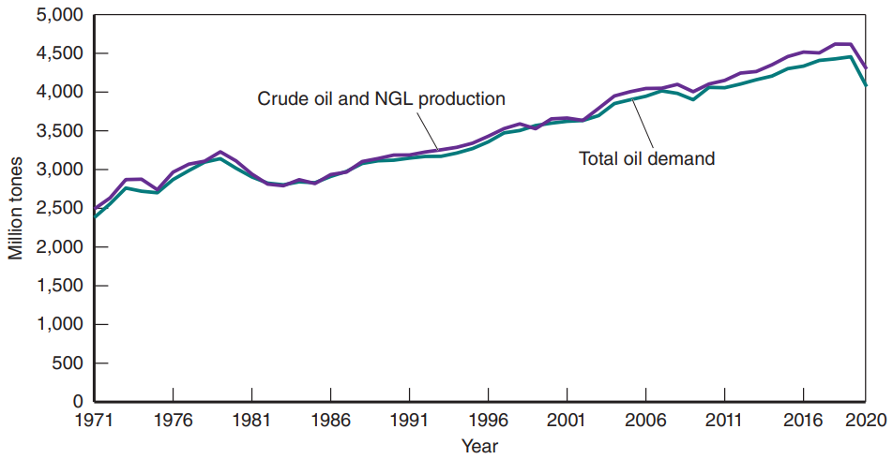
Petroleum
World petroleum consumption, 1971–2020. The Organization for Economic Cooperation and Development (OECD) countries include the United States, Japan, Western Europe, and Canada. (Source: U.S. EIA)

Slide 50
Petroleum
Petroleum is a mixture of crude oil, natural gas in solution, and heavy, thick, asphaltic semi-solids.
All petroleum deposits contain natural gas, but not all natural gas deposits contain oil.
Crude petroleum must pass through a series of stages in the refining process to convert it into a valuable product.
The refinery output can be adjusted according to the season to produce more or less gasoline and heating oil.

Slide 51
Petroleum
Enhanced recovery methods are estimated to significantly increase oil production from a given reservoir.
The United States has more drilled wells per square mile than any other country.
As the technology needed to extract the oil advances, the energy expended per drilled foot increases.
Most increases to U.S. reserves are expected to come from offshore drilling.
Offshore drilling is expensive, and it is a monument to twentieth-century engineering.

Slide 52
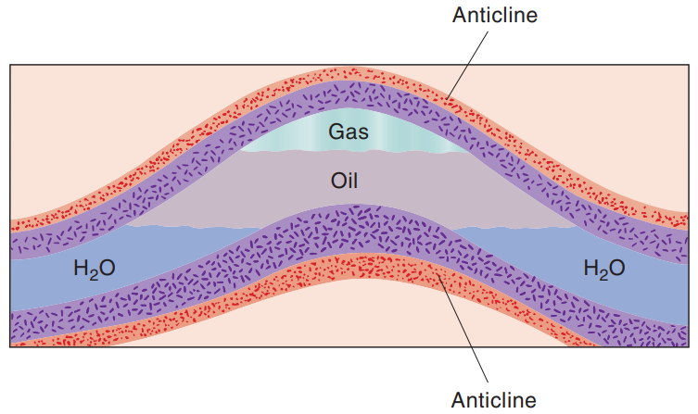
typical petroleum trap
In the typical petroleum trap as shown in the diagram:
For the oil to accumulate and not escape, the reservoir rock must be covered with impermeable or nonporous rock that acts as a trap to prevent the upward migration of the oil and gas. The most common type of structural trap or barrier is the “anticline,” caused by the upfolding of the earth’s strata. As the oil moves up in the anticline, it is trapped by an arched-over caprock, such as impervious shale.
Typical petroleum trap. The upper boundary of the trap is an impermeable layer of rock called a roof or caprock.
Notes:
Figure 8.9 Typical petroleum trap. The upper boundary of the trap is an impermeable layer of rock called a roof or caprock.

Slide 53
Worked problems
The lightest of the alkanes are gases and liquids that can be used as fuels. In order, they are methane (n=1), ethane (n=2), propane (n=3), pentane (n=5), hexane (n=6), etc. Octane (n=8) is a major component of gasoline. Figure out the chemical formulas for each of the above.

Slide 54
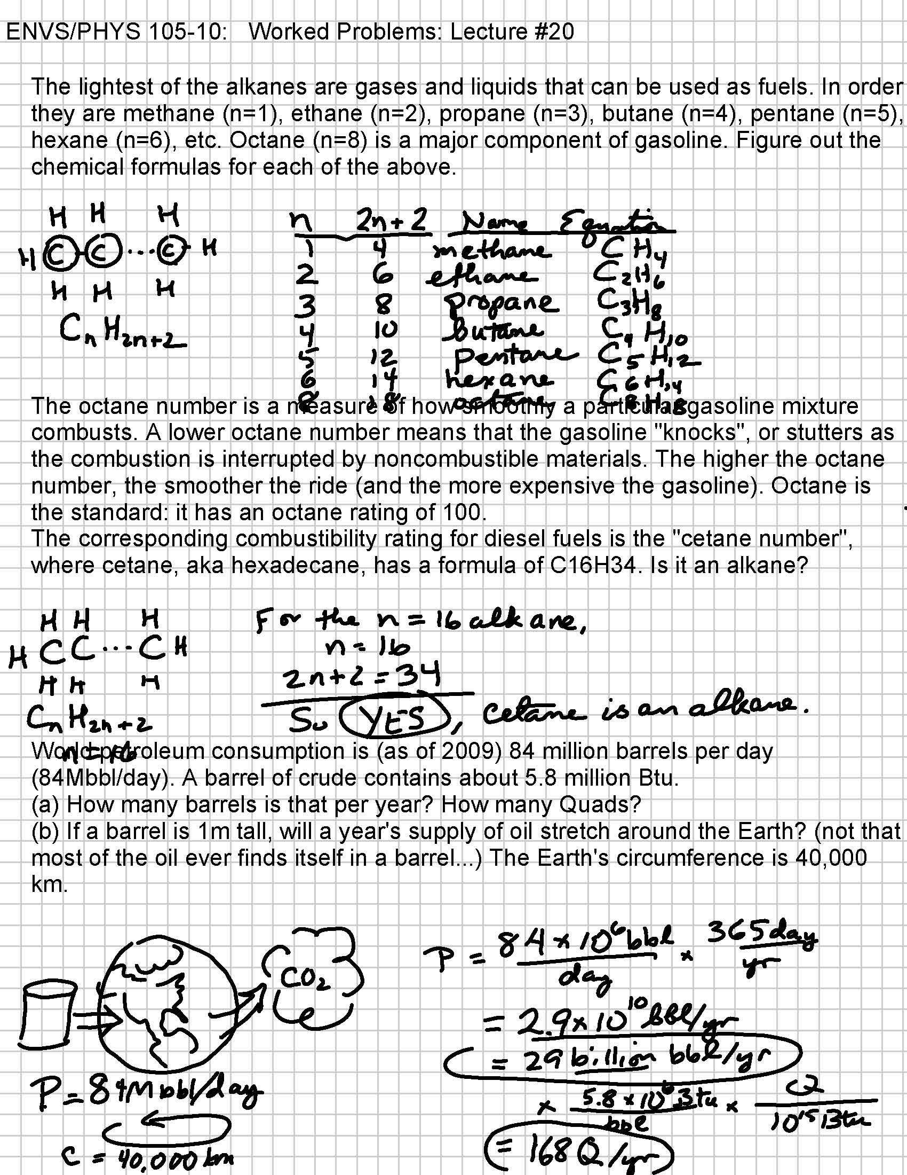

Slide 55
Worked problems
The octane number is a measure of how smoothly a particular gasoline mixture combusts. A lower octane number means that the gasoline “knocks”, or stutters as the combustion is interrupted by noncombustible materials. The higher the octane number, the smoother the ride (and the more expensive the gasoline). Octane is the standard: it has an octane rating of 100.
The corresponding combustibility rating for diesel fuels is called the “cetane number”, where cetane, aka hexadecane, has a formula of C₁₆H₃₄. Is it an alkane?

Slide 56
Octane
C₈H₁₈, octane, is a standard for smooth, no-knock, engine function. Gasoline is rated relative to octane, it’s “octane number”.
TEL = tetra-ethyl lead, [ (CH₃CH₂)₄Pb ] in trace amounts, was used to fight knocking. Discontinued in US 1976-86, in China in 2001. Lead (Pb) still in soils adjacent to highways.

Slide 57
Natural Gas
Natural gas is a mixture of light hydrocarbons, primarily methane (CH₄).
Natural gas found alone in reservoirs is called non-associated gas.
Natural gas found in the same reservoir as crude oil is called associated gas.
Natural gas is cleaner burning than other fossil fuels and is readily available in the United States.
World reserves of natural gas are estimated at more than 7000 tcf, enough for about 52 years at the current consumption rate of 132 tcf per year (in 2020).

Slide 58
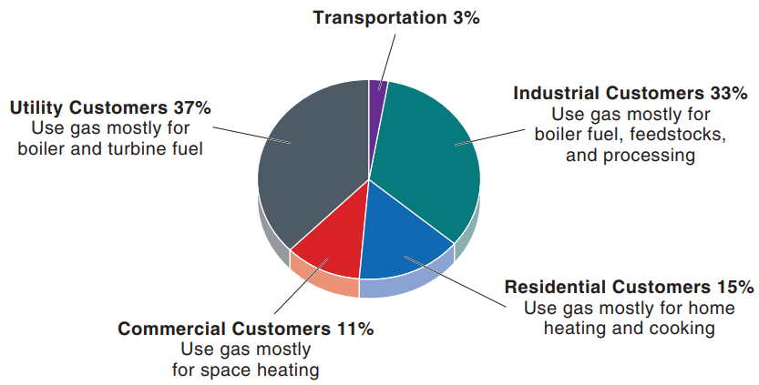
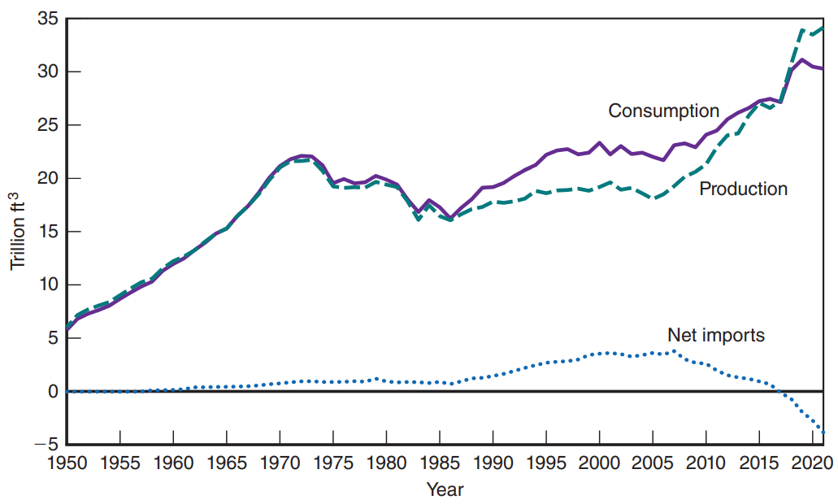
Natural Gas
U.S. natural gas consumption by end-use sector: 2021.
U.S. natural gas consumption by year: 1950–2020.
Notes:
Figure 8.14 (a) U.S. natural gas consumption by end-use sector: 2021. (Source: U.S. EIA)
Figure 8.14 (b) U.S. natural gas consumption by year: 1950–2020. (Source: U.S. DOE)

Slide 59
Natural Gas
In recent years, the difficulty is remedied by constructing facilities for the liquefaction of natural gas.
This liquefied natural gas (LNG) can then be shipped in large, refrigerated ships to locations anywhere on the earth.
LNG occupies 1/600th of the volume of methane at room temperatures and pressures.
Gas hydrates are also significant unexploited sources of natural gas.
These consist of methane trapped within the crystal structure of frozen water.

Slide 60
Natural Gas
This resource has been estimated to be many times the conventional reserves of natural gas in the United States.
Another use for natural gas is in the transportation sector—for cars and trucks.
The same basic energy-conversion principles apply to gasoline-powered vehicles.
Electricity generation by natural gas has been expanding in the United States, as of 2020, 38% of all natural gas is used to produce electricity.
Many of the new gas-fired units are not owned by utilities but instead are part of “co-generation” efforts by independent power producers.

Slide 61
The new popularity of natural gas
Burns clean compared to oil (less polluting)
40% less carbon dioxide compared to other fossil fuels
has high heating value of 24,000 Btu per pound
Inexpensive compared to coal
This explain the natural gas raise production ( and the shale gas fracking)

Slide 62
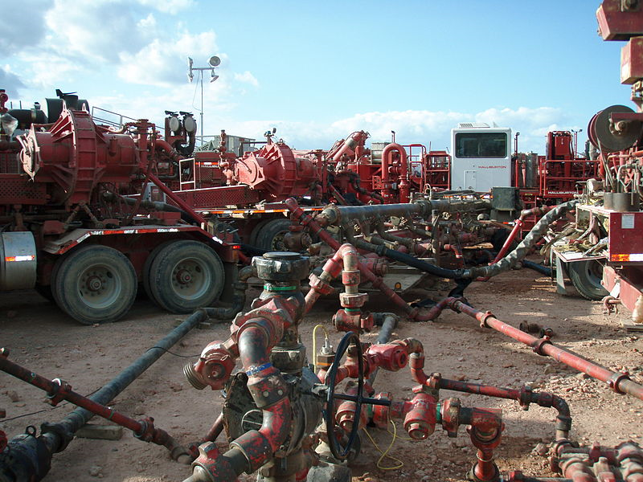
Hydraulic fracturing = “Fracking”
Hydraulic fracturing, or “fracking”, is the process of drilling and injecting fluid into the ground at a high pressure in order to fracture shale rocks to release natural gas or oil inside.
It takes 1-8 million gallons of water to complete each fracturing job.
Halliburton Frack Job
http://en.wikipedia.org/wiki/File:Halliburton_Frack_Job_in_the_Bakken.JPG

Slide 63
Hydraulic fracturing = “Fracking”
The water brought in is mixed with sand and chemicals to create fracking fluid. Approximately 40,000 gallons of chemicals are used per fracturing.
During this process, methane gas and toxic chemicals leach out from the system and contaminate nearby groundwater.
Methane concentrations are 17x higher in drinking-water wells near fracturing sites than in normal wells.

Slide 64

Hydraulic fracturing = “Fracking”
Energy Policy Act (2005) exempts “propping agents” used in fracking from Federal EPA jurisdiction, leaving it up to the States.
Pictured: Hot and cold burning water in Granville Twp, Mifflin Co., PA.
Image: http://cache.gawkerassets.com/assets/images/8/2011/09/methanesinktop.jpg

Slide 65
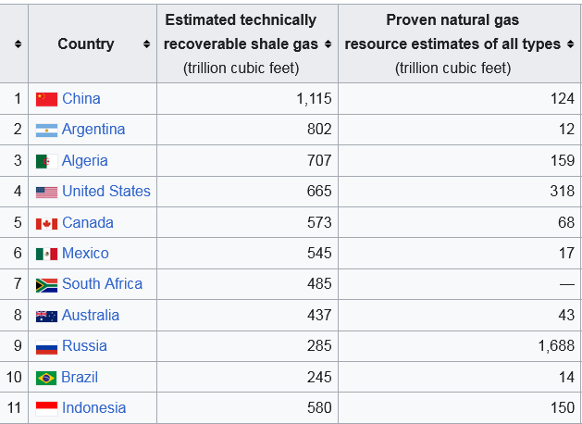
Fracking (shale gas)
Shale gas is natural gas embedded in shale.
Shale is naturally not very permeable, so it needs fractures to allow the contained gas to be harvested.
As of 2013;
http://en.wikipedia.org/wiki/Shale_gas

Slide 66
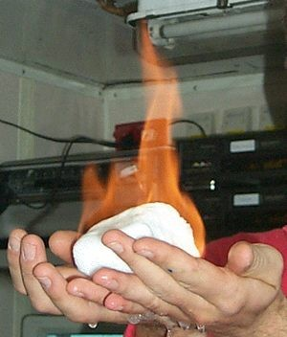
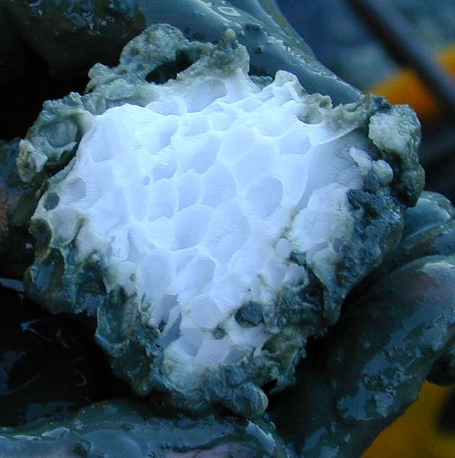
Other, unconventional oil sources:
Methane clathrate (CH4.5.75H2O), also called methane hydrate, hydromethane, methane ice, fire ice, natural gas hydrate, or gas hydrate, is a solid clathrate compound (more specifically, a clathrate hydrate) in which a large amount of methane is trapped within a crystal structure of water, forming a solid similar to ice.
The sedimentary methane hydrate reservoir probably contains 2–10 times the currently known reserves of conventional natural gas, as of 2013.
http://en.wikipedia.org/wiki/Methane_clathrateImage: http://www.chm.bris.ac.uk/motm/methane/methaneh.htm
(methane clathrate) block embedded in the sediment of hydrate ridge, off Oregon, USA

Slide 67
What are gas hydrates? In which part of the ocean do methane hydrates occur?
Answer: Gas hydrates are also significant unexploited sources of natural gas. These hydrates consist of methane trapped within the crystal structure of frozen water. The gas is released when the ice melts; the volume released is about 150 times larger than the volume of the original hydrate. Methane hydrates occur in sediments in parts of the ocean where temperatures are near 0°C; they have also been discovered in the permafrost of the Arctic.

Slide 68
What is the difference between the liquefaction and gasification processes?
Answer:
The conversion of coal into oil, or syncrude, is called liquefaction. As in gasification, the basic process involves heating of coal in the presence of hydrogen and separating the gases and liquids produced in the reaction.

Slide 69
Worked problems: combustion
How much oxygen do you need to burn octane, C₈H₁₈, a principal ingredient of gasoline?
Again, you can either produce carbon dioxide [CO₂], or poisonous carbon monoxide [CO].
So, to produce carbon monoxide, only 8.5 molecules of oxygen are needed for each molecule of octane, while if there are 12.5 molecules or more, carbon dioxide [CO₂] will be produced.

