Slide 1
Chapter 7:Solar Energy: Characteristics and Heating

Slide 2
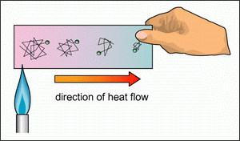
How does thermal conduction work?
Neighboring molecules exchange heat in random collisions. Statistically, the warmer molecules have more energy to give, and so heat moves from the higher to lower temperature.
Image: http://www.phy.cuhk.edu.hk/contextual/heat/hea/condu/conduction_e.gif

Slide 3
Thermal conduction and resistance
Increased insulation of houses is one of the easiest and most effective means to reduce energy consumption, it can save as much as 50% on heating or cooling
Thermal conduction, the rate of heat flow:
P=heat transferred via conduction/ time elapsed
(P is power, Q is heat)
Useful if you know the thermal conductivity of the material (k), and the thickness (δ) of the insulator
Thermal Resistance R ( resistance of the material to heat)

Slide 4
Thermal resistance, R
Conductive heat flow:
So
R is called the R-Value and is a function of the type of material (k) and the thickness δ

Slide 5
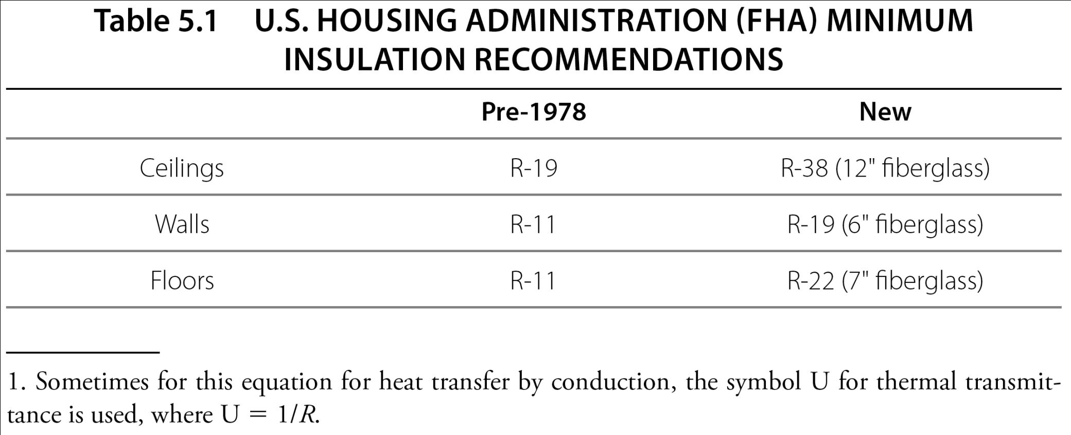
House Insulation and Heating Calculations
Table 5-1 p127

Slide 6
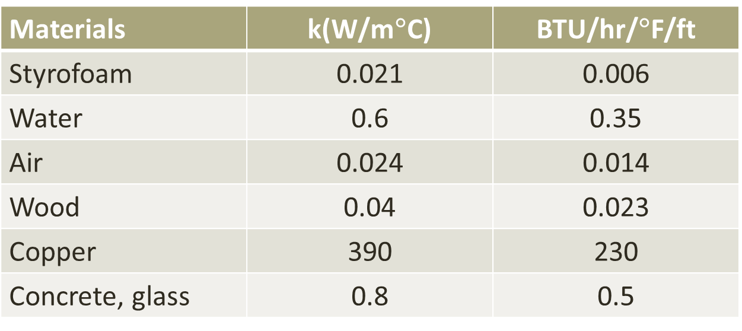
Thermal conductivities

Slide 7
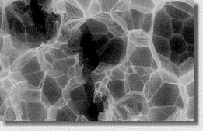
Thermal conduction
Microscope image of Styrofoam material used in packing peanuts. It is mostly air.
Stagnant air is a good insulator, as long as it can’t move.
http://www.worsleyschool.net/science/files/silly/polymeregpeanut.JPG

Slide 8
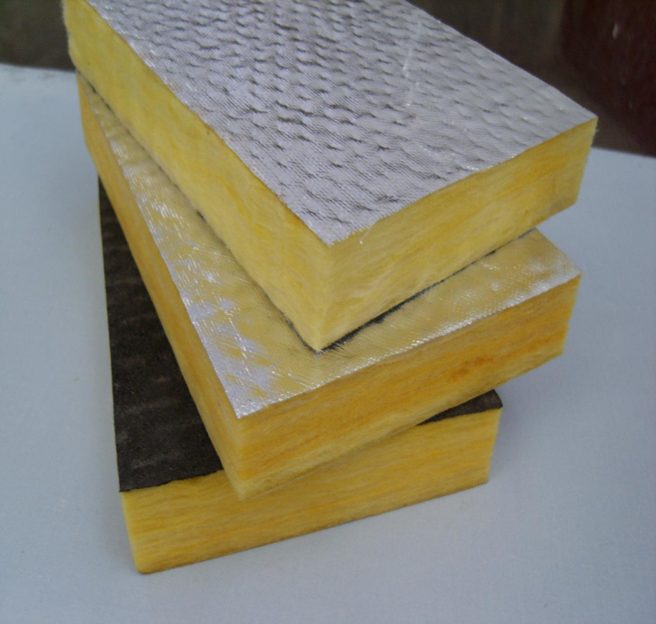
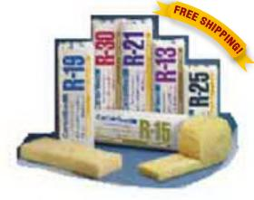
Typical R values, fiberglass
Mostly air.
Stagnant air.
Image: http://www.capitolsupply.com/ImageServer.ashx?w=280&h=280&ni=1&imageid=17422&oiur=FreeShipping200

Slide 9
High R value
Aerogel is an extremely efficient man-made insulator and has a very high R-value.
Aerogels have exceptional thermal insulation and acts as a barrier to heat, radiation, and convection, giving more time for evacuation or containing fires

Slide 10
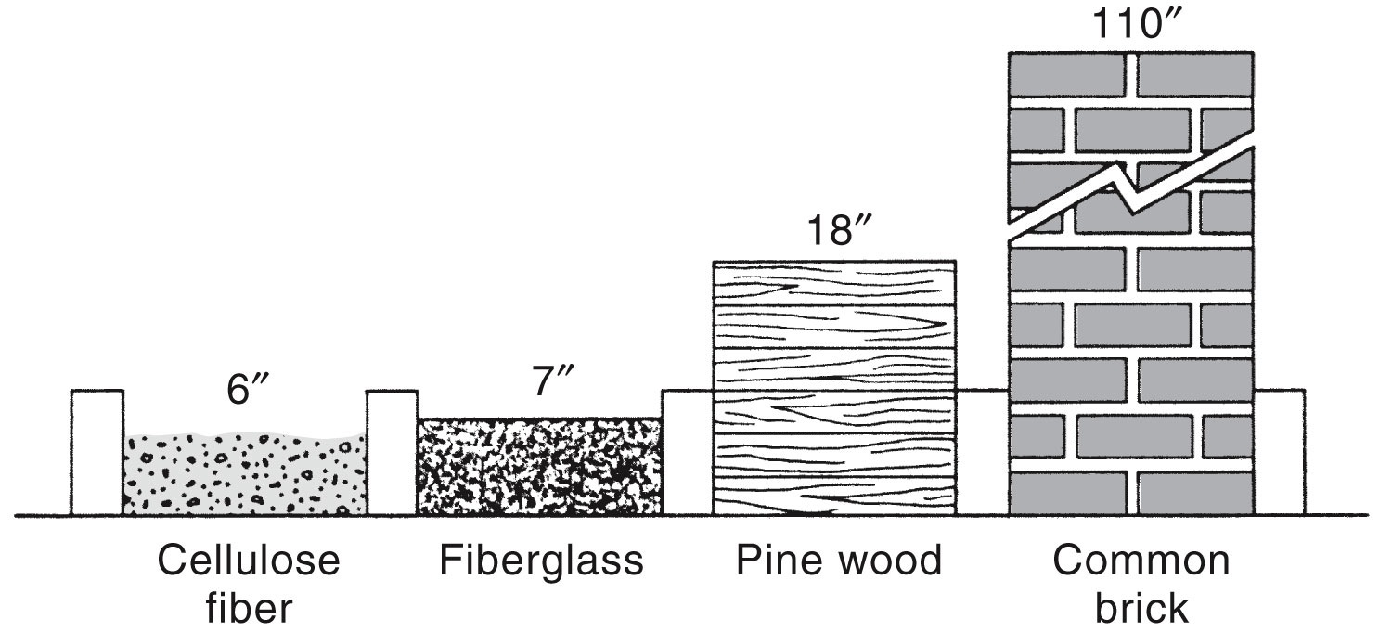
To obtain R-value of 22 ft²-h-°F/Btu, you have to use the
indicated thicknesses of various materials
Figure 5-5 p129
Notes:
Figure 5.5
To obtain an
R-value of 22
ft2-h-8F/Btu,
you have to use
the indicated
thicknesses of
various materials.

Slide 11
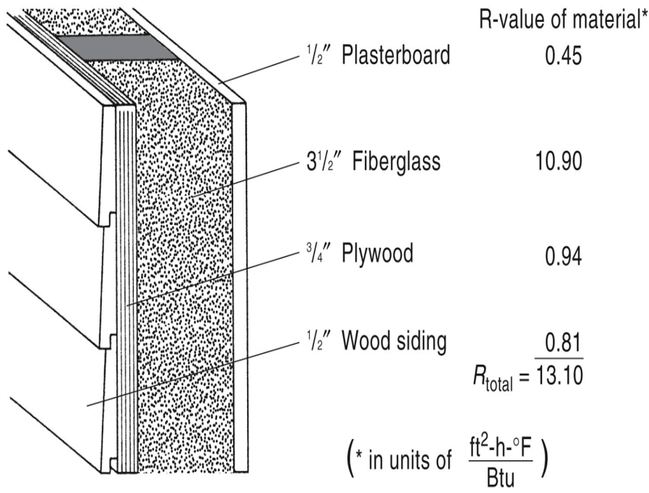
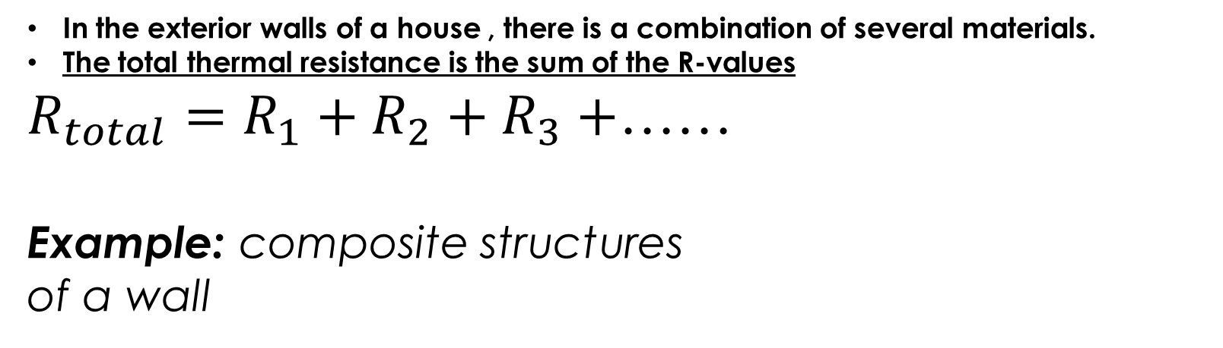
FHA recommendations
Ceilings: R38
Walls: R19
Floor: R22
In the exterior walls of a house , there is a combination of several materials.
The total thermal resistance is the sum of the R-values
$R_{total}=R_{1}+R_{2}+R_{3}+$……
Example: composite structures
of a wall

Slide 12
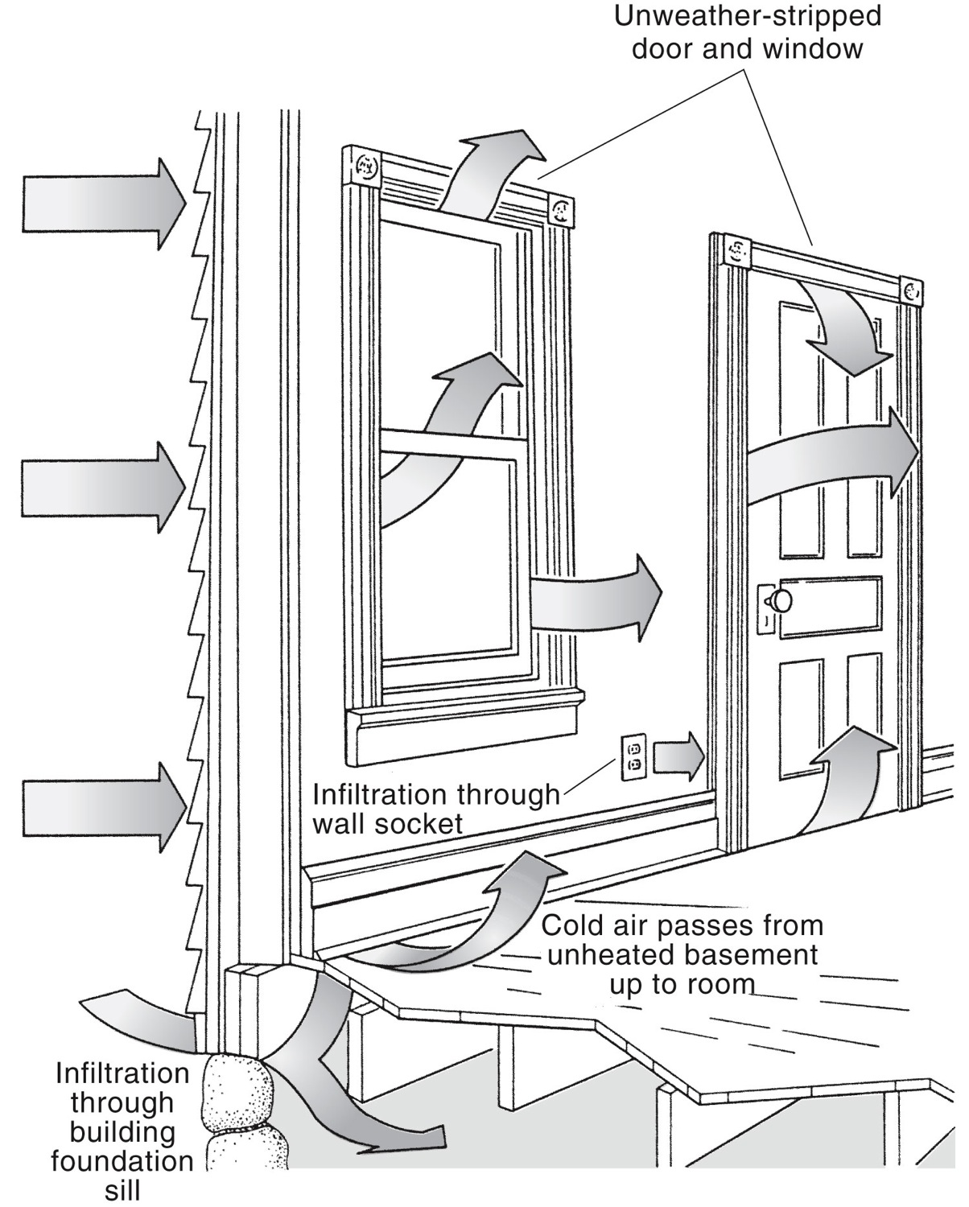
Heat Losses in a house
Cold air infiltration can
account for 50% of
the energy needs of a house . Wherever there is a way for the air to get in, it will. Winds can significantly increase infiltration rates.

Slide 13
Degree Days, Annual Degree Days
Degree Day: A measure of how much heat is needed to maintain a reasonable room temperature (65°F)
Annual Degree Days [ADD]: Add up the number of degree days for every day of the year colder than 65°F.
*can be defined for any other “room temperature”, but base temperature must be specified.

Slide 14
Heating needs
Total heating needs for conductive losses for one year:
The sum includes all the exterior
Surfaces.

Slide 15
Thermal resistance = “R value”
1. The R value of an insulator depends on its thickness
True
False
2. The R value of an insulator depends on the material of which it’s made
True
False
3. The R value of an insulator depends on its area perpendicular to the heat flow
True
False

Slide 16
Study questions
R can be represented in units of
Btu/hr/ºF/ft²
hr ºF ft²/Btu
Btu.hr/ºF/ft²
Btu.hr/ºF/ft

Slide 17
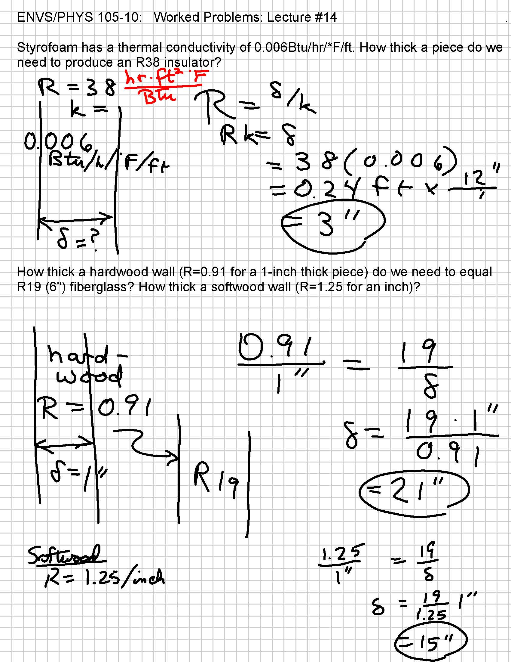
Worked problem
Styrofoam has a thermal conductivity of 0.006 Btu/hr/°F/ft². How thick a piece do we need to produce an R38 insulator?

Slide 18
Worked problems
How thick a hardwood wall (R=0.91 for a 1-inch thick piece) do we need to equal R19 fiberglass? How thick a softwood wall (R=1.25 for an inch) would do the trick?

Slide 19
Study questions
Two insulating layers are laid side by side so that the heat must travel through one or the other. Which of the following quantities add?
R/A of the two.
A/R of the two
RA of the two.
none of the above.

Slide 20
Study questions
The people building your new home go to the hardware store for some R38 fiberglass batting for laying down in the attic. The store is all out of R38. What should they do?
Buy twice as many linear feet of R19 rolls as they had planned to buy of R38 and simply lay the two layers on top of each other.
Buy twice as many linear feet of R76 rolls, and simply lay the two layers on top of each other.
Wait until the R38 comes in and charge for overtime: neither of the above solutions will do the same job.

Slide 21
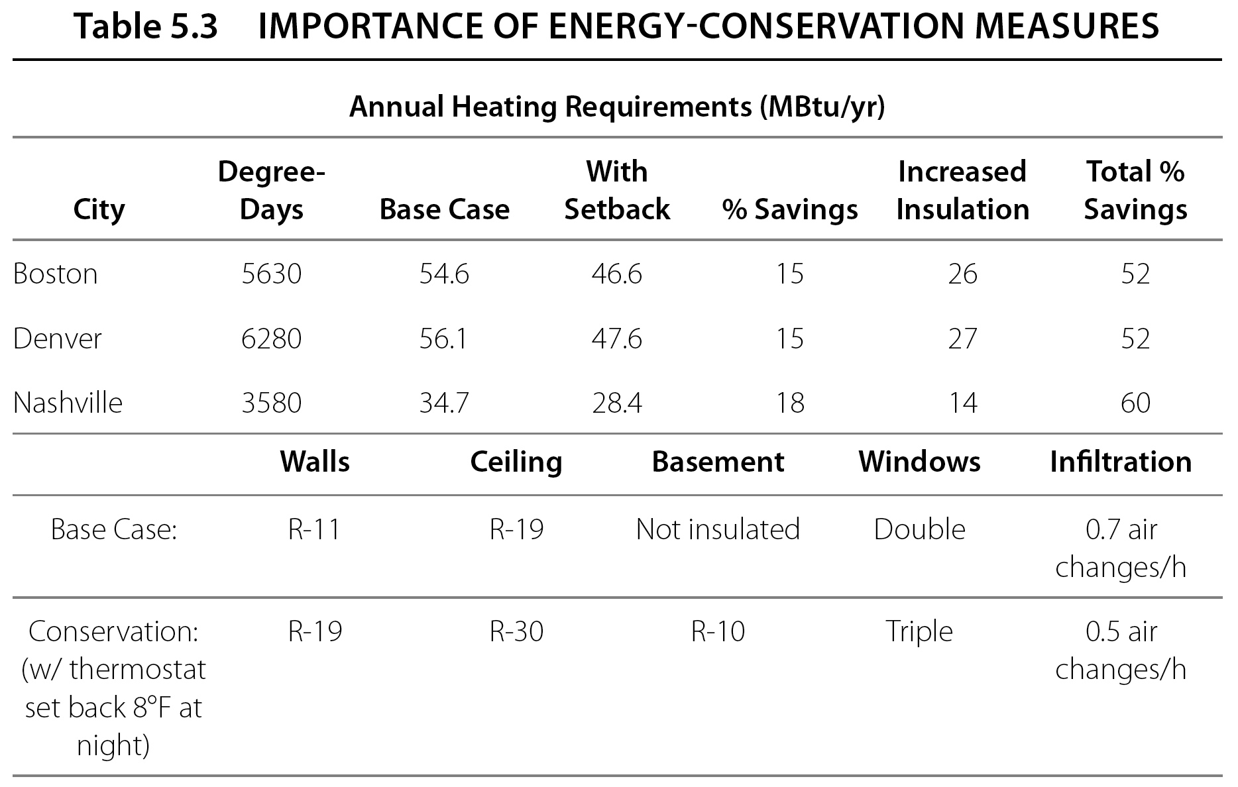

Slide 22
Heat flow II: convection
Thermal Convection = heat transfer via movement of fluids
Familiar examples:
the upward flow of air due to a fire
hot object and the circulation of water in a pot that is heated from below.
convection oven

Slide 23
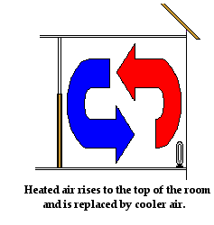
Convection
Electric heater placed on the floor of a cold room warms up the air in the room.
Air present near the coils of the heater warm up. As the air warms up, it expands, becomes less dense and begins to rise.
As the hot air rises, it pushes some of the cold air near the top of the room out of the way.
The cold air moves towards the bottom of the room to replace the hot air that has risen

Slide 24
Heat flow III: thermal radiation
Heat transferred as light, infrared, microwaves, etc. (emitted in the form of electromagnetic waves traveling at the speed of light).
Power radiated proportional to fourth power of T (in Kelvin).
Amount of radiation changes with temperature.
All objects with temperatures above the absolute zero emit electromagnetic radiation.

Slide 25
Chapter 7:Solar Energy: Characteristics and Heating

Slide 26

Introduction (1 of 3)
Contributions of renewable energy sources in the world energy
Renewable energy today provides about 12% of the world’s energy and more than 12% of the U.S.'s needs.
Renewable-energy resources can be categorized into forms of radiant solar, wind, hydropower, biomass, and geothermal.
Renewable-energy resources offer many advantages to an energy-hungry world.
Renewable-energy resources particularly offer hope to developing countries whose economic growth rates are seriously hampered by high energy costs.

Slide 27
Introduction (2 of 3)
Radiant | Space heating and cooling (active and passive) Domestic hot water, swimming pools Electricity (photovoltaics) Solar furnaces, thermal electric
Wind | Electricity (wind turbines) Mechanical (water pumping, grinding) (Texas, North and South Dakota, enough wind energy for all the US)
Hydroelectric | Electricity, mechanical (waterwheels) 52% from all the renewable energies in the US
Biomass | Heat (direct combustion: wood and agricultural waste), electricity Fuels (gas, liquids)
Geothermal | Electricity, district heating

Slide 28
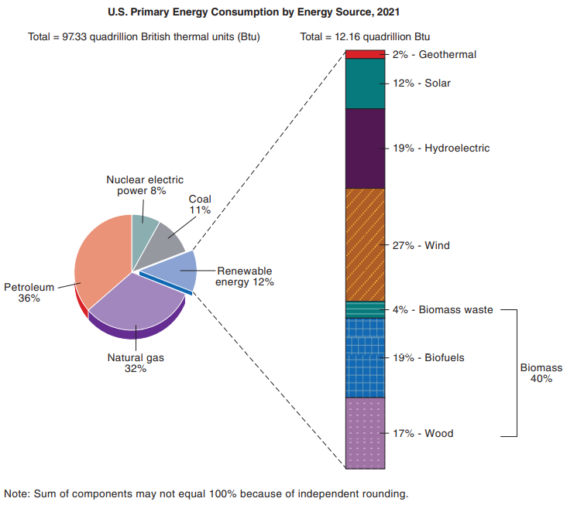
Introduction (3 of 3)
U.S. renewable energy consumption (by source), 2021. The generation of electricity accounts for about one-half of the renewable resources used (Source: USEIA).

Slide 29
Solar energy: motivation
The energy of most fuel sources comes from the sun.
8% of the world energy comes from renewable energies.
Solar energy (photovoltaics and passive solar heating)
Fossil fuels: fossilized remains of vegetation, animals
Wind

Slide 30
Solar energy: motivation
One year’s solar energy incident on Earth’s atmosphere ≈ 5 million Quads (half of which reaches the ground).
The amount of energy reaching the earth is called Insolation (Incident Solar Radiation).
Historical deposits of fossil fuels:
Coal: 300,000 Q (20,000Q recoverable)
Petroleum: 14,000Q (70% left)
Natural gas: 15,000Q

Slide 31
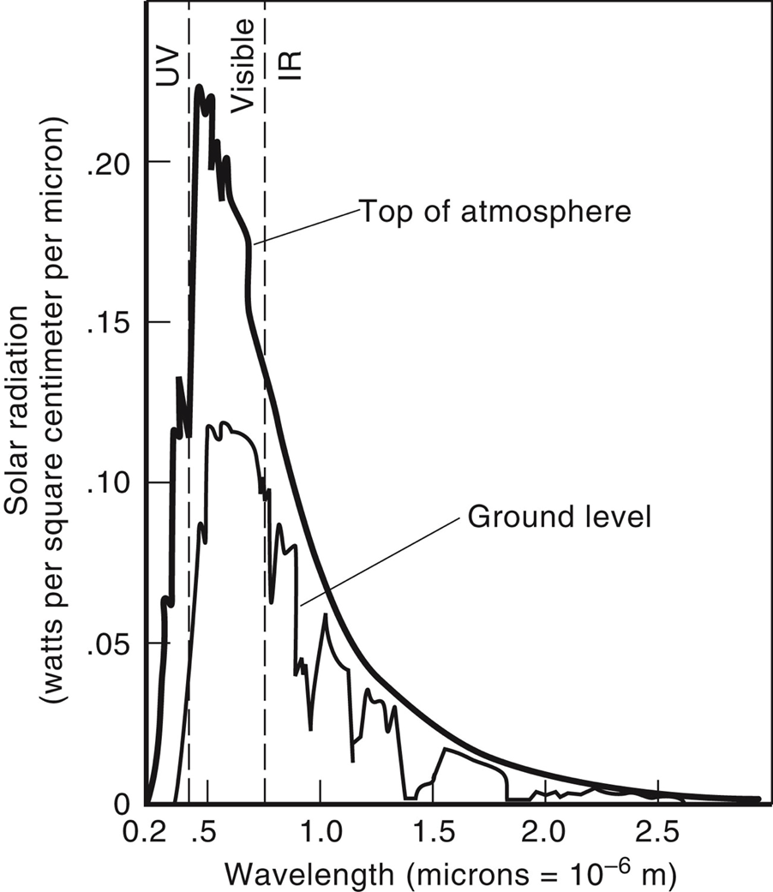
Incident Solar Energy
The predominant Nuclear reaction in the sun responsible for the solar energy is the fusion of Hydrogen nuclei into helium nuclei.
4 billions kilograms of matter per second is released as matter converted into energy.
Only about half of the solar constant makes it to Earth’s surface.
Chief absorbers:
H₂O, CO₂, O₃ (Ozone)
Minima due to absorption by water vapor,
About 20% of the radiation is in the visible, 9% in the UV and 50% is infrared
Spectrum of solar radiation reaching earth.

Slide 32
Characteristics of Incident Solar Radiation (1 of 4)
Different phenomena associated with incident solar radiation and energy balance of the earth’s system.
The amount of solar radiation reaching the earth is called insolation.
The fraction of light reflected from the earth and its atmosphere is called the albedo.
The re-radiation back to the earth causes what is known as the greenhouse effect.
The amount of insolation reaching the top of the earth’s atmosphere is about 1366 W/m² or 432 Btu/ft²/h. This number is known as the solar constant.

Slide 33
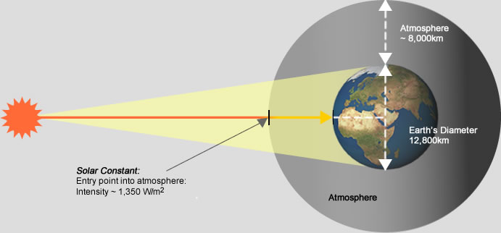
Solar energy
19% of the radiation received is absorbed by the clouds and other gases.
“Solar constant” = the rate at which solar energy reaches top of Earth’s atmosphere.
1354W/m² perpendicular to the rays.
Image: http://www.greenrhinoenergy.com/solar/radiation/images/solar-constant.jpg

Slide 34
SEGS (Solar Energy Generating Stations)
Facilities : in California
SEGS I–II (44 MW) were located at Daggett (34°51′45″N 116°49′45″W); they have been replaced with a solar photovoltaic farm.
SEGS III–VII (150 MW) were installed at Kramer Junction (35°00′43″N 117°33′32″W); all five SEGS have undergone demolition.
SEGS VIII–IX (160 MW) are located at Harper Lake (35°01′55″N 117°20′50″W).[NextEra Energy Resources operates and partially owns the plants located at Kramer Junction. On January 26, 2018, the SEGS VIII and IX at Harper Lake were sold to renewable energy company Terra-Gen, LLC.
A tenth plant (SEGS X, 80 MW) had been in construction and SEGS XI and SEGS XII had been planned by Luz Industries, but the developer filed for bankruptcy in 1992, because it was unable to secure construction financing. The site of SEGS X was later licensed for a solar photovoltaic farm, Lockhart Solar PV II.
Most of the thermal facilities were retired by 2021, and photovoltaics were built on the same sites.
Parabolic mirrors heat synth oil (in a pipeline at the focus) to 400°C (750°F), boiling water to run heat engine to generate electricity.
http://en.wikipedia.org/wiki/Solar_Energy_Generating_Systems

Slide 35
Principle of Operation of SEG
The installation uses parabolic trough, solar thermal technology along with natural gas to generate electricity.
About 90% of the electricity is produced by the sunlight
Natural gas is only used when the solar power is insufficient to meet the demand from Southern California Edison, the distributor of power in southern California.

Slide 36
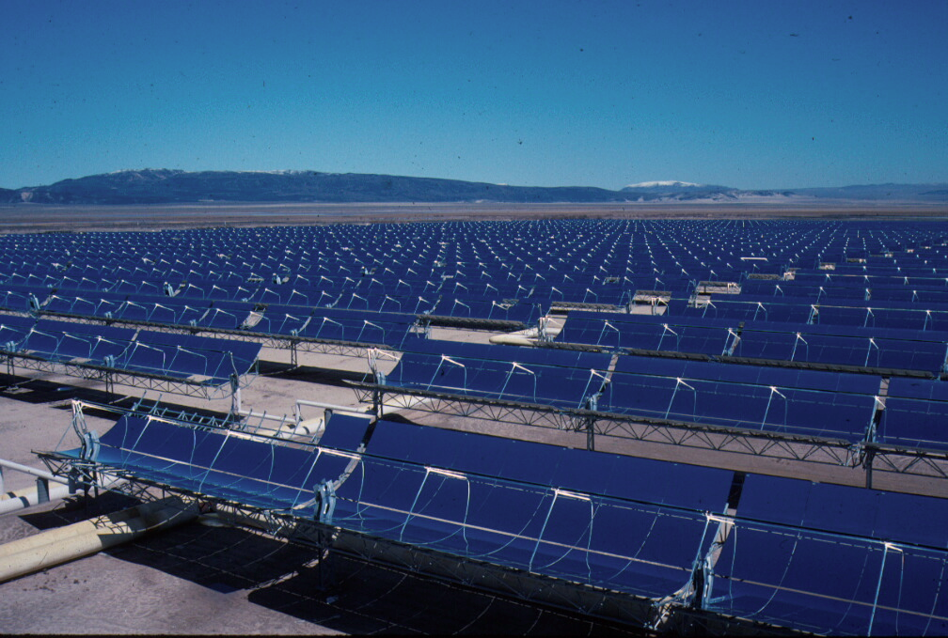
SEG III
The combined capacity from three separate locations at 354 megawatts and is the largest solar thermal energy generating facility in the world.
(Northern San Bernardino County, California)
http://en.wikipedia.org/wiki/Solar_Energy_Generating_Systems

Slide 37
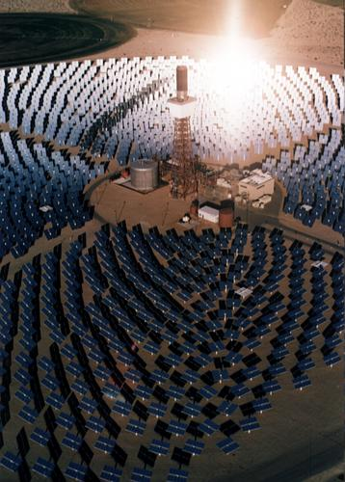
SEGS II
Flat panels form a “virtual parabola” shining on the heat collector tower, heating a fluid that stores the heat, produces electricity on demand (even at night).
Image: http://energy.saving.nu/solarenergy/images/tower.jpg

Slide 38
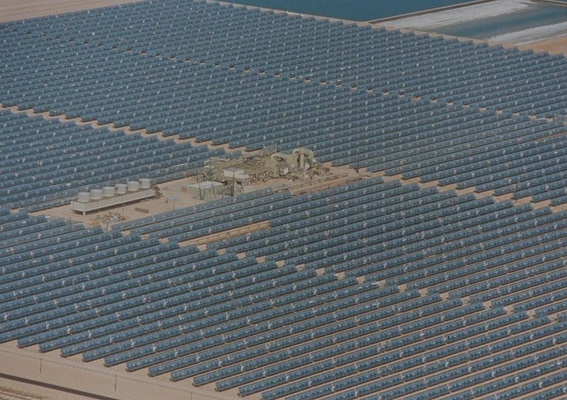
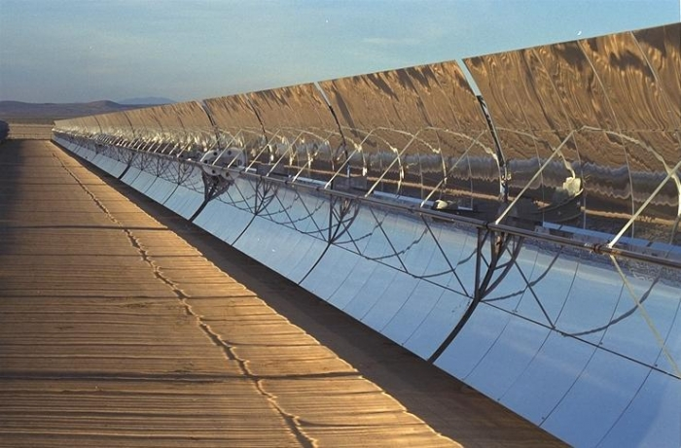
SEGS VIII: 80MW
Images: http://en.wikipedia.org/wiki/File:Aerial_View_of_SEGS_VIII_showing_most_of_80_MW_field.jpg. http://www.solaripedia.com/images/large/362.jpg

Slide 39
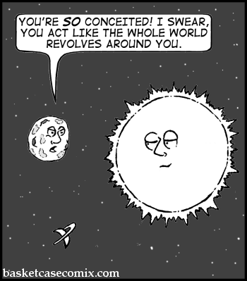
Insolation
“Insolation” = that part of the solar constant that reaches Earth
http://www.basketcasecomix.com/comics/2006-05-24-CXsun.gif

Slide 40
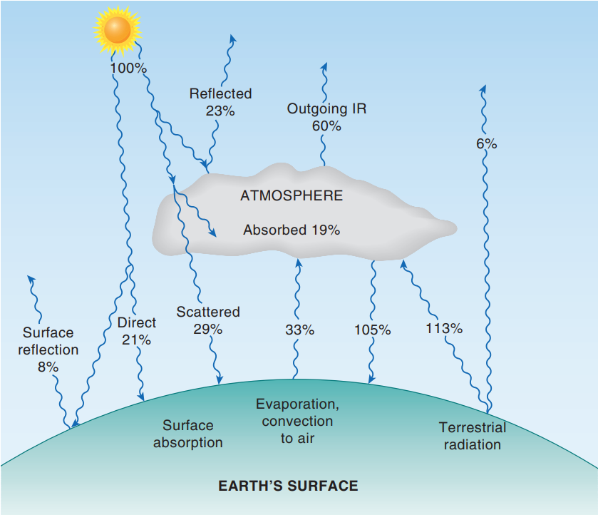
Characteristics of Incident Solar Radiation
The earth absorbs about 50% of the incident solar radiation: 21% is from direct radiation and 29% is scattered through the clouds.
The energy leaving the earth’s surface comes from evaporation and convection to the atmosphere (33%) and infrared radiation (noted here as terrestrial radiation).
Most of this infrared radiation (113%) is absorbed by the atmosphere and reradiated back to the surface (105%)—the greenhouse effect.
To have temperature equilibrium at the earth’s surface, the energy input must equal the energy output.
For the earth in this figure, 50% (incident radiation) = 3% (reflected) + 33% (evaporation) + 14% (net terrestrial radiation: 113% + 6% - 105%). For the atmosphere, the energy balance is 33% (evaporation) + (113%-105%) + 19% = 60% (outgoing infrared).
Energy balance for the earth-atmosphere system

Slide 41
Characteristics of Incident Solar Radiation
The measure of the position of the sun from the horizontal is called the altitude
Useful facts about insolation & inclination
Earth’s axis tilted at 23.5° (Let’s call it 23°)
The solar azimuth is the angle of the sun from the true south.
The insolation reaching a surface is composed of a direct beam from the sun, a diffuse component, and a reflected component.
The sun is lower in the sky (at a smaller altitude) during the winter, so the insolation on a vertical surface in the winter will be greater than on a horizontal surface. The opposite is true in the summer. This situation can be used for heating a house.

Slide 42
Re-radiation
How does re-radiation to the earth cause the greenhouse effect?
Answer: Most of the infrared radiation emitted from the earth (called terrestrial radiation) is absorbed by CO₂ and H₂O (and other gases) in the atmosphere. This radiation is then reradiated either back to earth or into outer space. This re-radiation back to the earth causes what is known as the greenhouse effect, and it maintains the surface temperature of the earth about 40°C higher than it would be without absorption and re-radiation.

Slide 43
History of Solar Heating
In the seventeenth and eighteenth centuries, scientists concentrated the sun’s rays with mirrors or lenses to melt metals.
The use of solar energy for cooking goes back at least to the latter half of the eighteenth century.
In contrast to the United States, where only about 1% of the total energy consumption is used for cooking, as much as 75% of the total household energy consumption in communities without reliable electrical power is used for cooking.

Slide 44
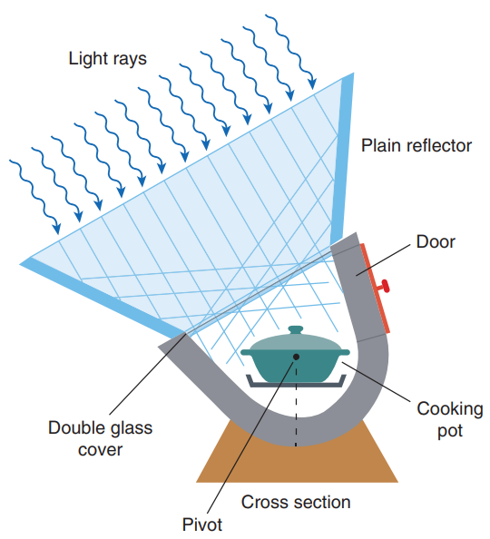
TeLkes’s Oven
working principle of Telkes’s oven as shown in the diagram.
In the United States, much of the work on the development and testing of solar cookers or “hot boxes” was done by Maria Telkes in the 1950s. One of these models is shown in Figure here, auxiliary reflectors were used to reach higher temperatures. Heating of the pot inside the hot box is done by direct absorption and convection.
Telkes’s oven. The design features a fixed cooking pot and a moveable reflector.
Notes:
Figure 7.15 Telkes’s oven. The design features a fixed cooking pot and a moveable reflector.

Slide 45
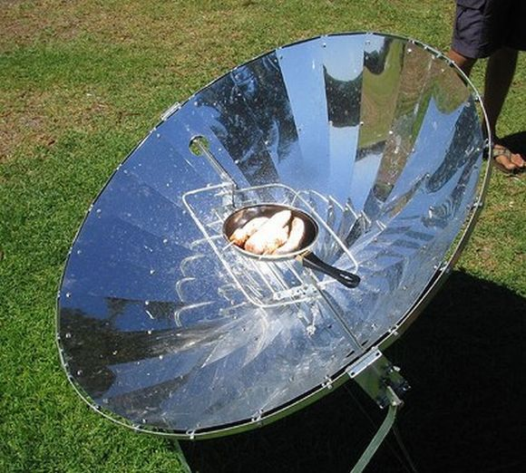
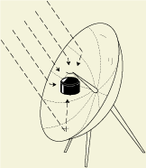
More solar cookers
Image: http://trendsupdates.com/ram%E2%80%99s-project-surya-replaces-biomass-fuels-with-solar-cookers/
http://www.solarcookers.org/basics/images/Parabolic_pot_rays.gif
Prof. Veerabhadran (Ram) Ramanathan Of University of California San Diego
solar cooker

Slide 46
Overview of Solar Heating Today
Today in the residential and commercial sectors, radiant solar heating is used primarily for swimming pools and domestic hot water (DHW).
Solar heating saw a large growth in the late 1970s and early 1980s due, in part, to rising oil and electricity prices.
An active solar-heating system uses a pump or fan to circulate the fluid that the sun has heated.
A passive solar-heating system uses no external power but allows the fluid (usually air) heated by the sun to circulate by natural means. Passive solar has strong economic advantages.

Slide 47
Solar Domestic Hot Water (DHW)
DHW systems can be divided into two types:
Active systems using flat-plate collectors (FPCs)
Passive (or thermosiphoning) systems
Passive solar water heaters use the thermosiphon approach in which water flows from the collector to the tank under natural circulation.
Energy costs for DHW can be reduced by both minimizing the amount of hot water used and shifting to a renewable energy source, such as solar energy.

Slide 48
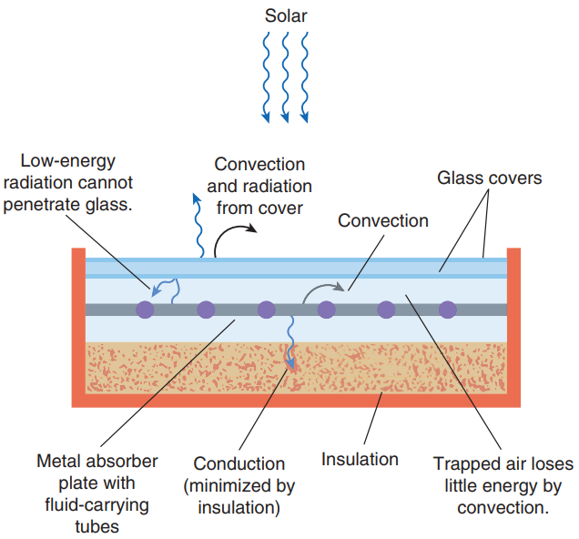
Solar Domestic Hot Water
Cross section of a flat-plate collector (FPC) showing heat losses and gains.
Water temperature of 160 ºF to 180 ºF can be achieved, although collector are more efficient when operated at lower temperature.
Notes:
Figure 7.18 Cross section of a flat-plate collector (FPC) showing heat losses and gains.

Slide 49
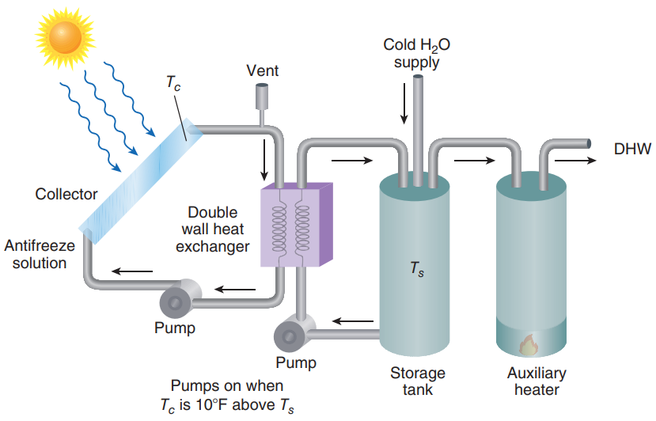
Solar domestic hot water system with heat exchanger as shown in the figure.
The flat-plate collector FPC is mounted on the roof, with the other components within the house. The use of antifreeze and a heat exchanger provides freeze protection. The system uses a backup tank to heat the water to desired temperatures if the solar system does not supply hot enough water. The area of the FPC depends on the insolation and the hot water requirements.
Solar domestic hot water system with heat exchanger.
Notes:
Figure 7.21 Solar domestic hot water system with heat exchanger.

Slide 50
Passive Solar Space-Heating Systems (1 of 3)
For passive solar space heating, the house itself acts as the solar collector and storage facility.
In direct gain systems, large south-facing windows are used to admit the sunlight.
An indirect gain system collects and stores the solar energy in one part of the house and uses natural heat transfer (convection and conduction) to distribute this heat to the rest of the house.

Slide 51
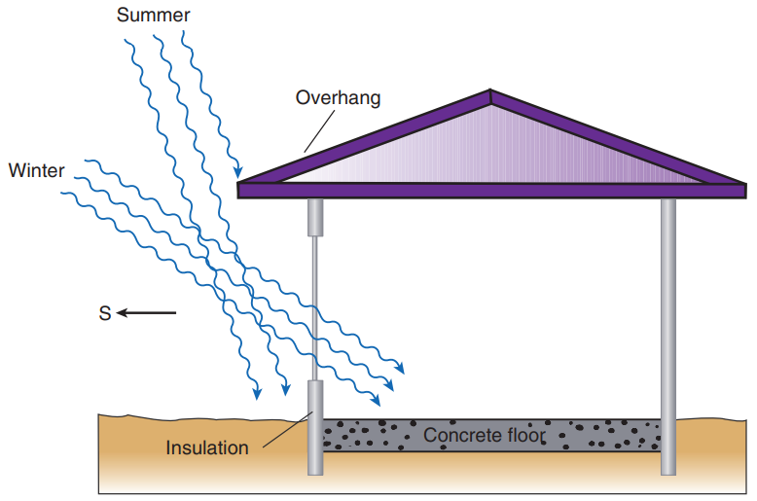
Passive Solar Space-Heating Systems (2 of 3)
Passive solar system—direct gain. South-facing windows act as solar collectors. Moveable insulation is used to cover the windows at night to reduce heat loss. A massive concrete floor acts as a storage device and prevents overheating. The overhang blocks the summer sun.
Passive solar system—direct gain

Slide 52
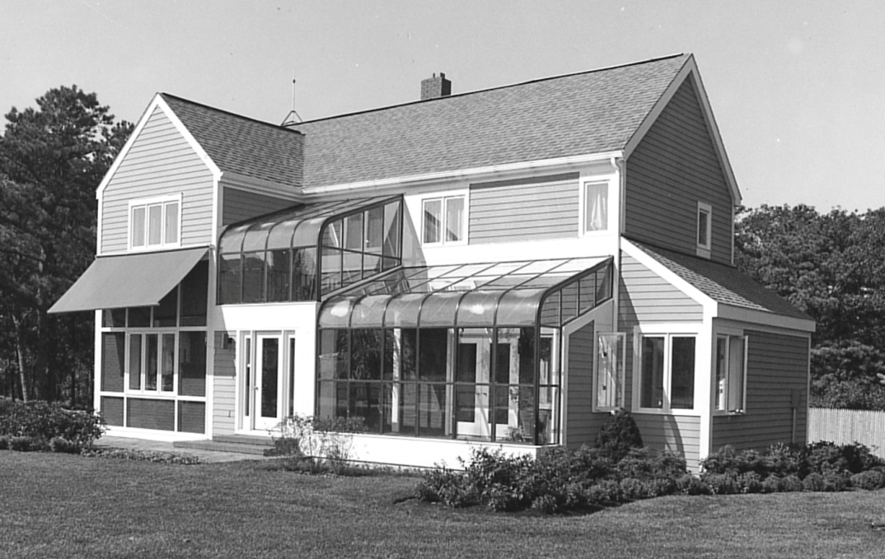
Passive Solar heating
For passive solar space heating, the house acts as a collector and the storage facility.
No pumps or fans are needed
The object is to let sunlight in through south-facing windows and store energy.
In Passive systems: The amount of solar energy transmitted through south-facing glass during a clear day is greater than heat lost .
BNL greenhouse

Slide 53
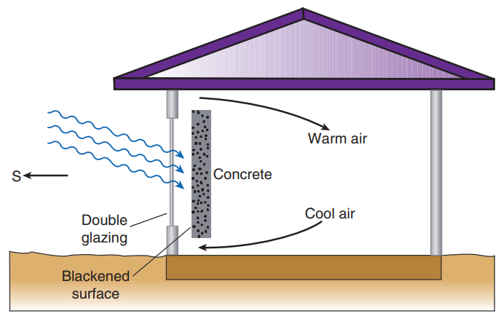
Passive Solar Space-Heating Systems (3 of 3)
This is an indirect gain house : it collects and stores solar energy in one part of the house, and uses natural heat transfer ( convection and conduction to distribute heat.
Indirect gain using a Trombe wall. The concrete wall acts as a solar collector and a heat-storage medium.
Notes:
Figure 7.27 Indirect gain using a Trombe wall. The concrete wall acts as a solar collector and a heat-storage medium.

Slide 54
Solar Collectors
Active solar space-heating systems usually use flat-plate or evacuated-tube collectors.
The fluid used to transfer heat from the FPC into storage and into the house is usually water or air.
Solar collectors are usually roof mounted, and a well-insulated thermal storage tank is typically located in the basement.
The pump in the solar collector loop of this system is controlled by a differential thermostat.

Slide 55
Thermal Energy Storage
One important requirement of a solar energy heating system is that it can store energy for night-time use and cloudy days. One of the general inherent difficulties with renewable energy is that of energy storage.
An important criterion in selecting a storage medium is the specific heat of the substance.
The relationship between a temperature change and the amount of heat Q added is given by
Other media for thermal storage are phase-change materials.
The amount of energy absorbed per unit mass without a temperature change is called the “heat of fusion.”

Slide 56
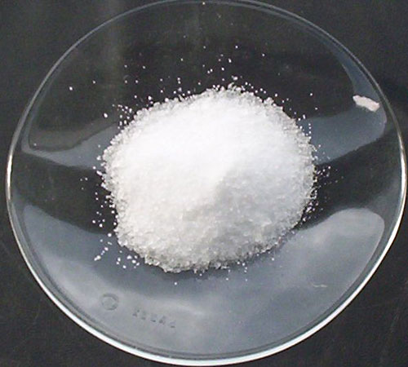
Phase-change materials [PCMs]
A phase-change material (PCM) is a substance with a high latent
heat of fusion which, melting and solidifying at a certain temperature,
is capable of storing and releasing large amounts of energy.
Heat is absorbed or released when the material changes from solid to liquid and vice versa; thus, PCMs are classified as latent heat storage (LHS) units.
Glauber’s salt
Na₂SO₄·10H₂O
Sodium sulfate (+water)
Melts: 33°C=91°F
L_{f}=251kJ/kg=108Btu/lb
Image: http://media-2.web.britannica.com/eb-media/47/123747-004-E4046C99.jpg

Slide 57
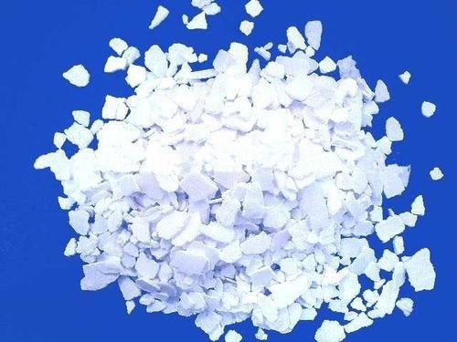
Phase-change materials [PCMs]
Calcium chloride hexahydrate
CaCl₂·6H₂O
Melts: 30°C=86°F
L_{f}=171kJ/kg=74Btu/lb
Image: http://www.supplierlist.com/photo_images/239498/Calcium_chloride_hexahydrate_2.jpg

Slide 58

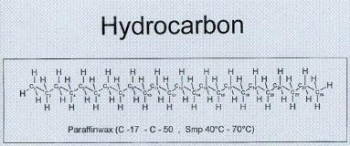
PCMs: paraffin (wax)
C_{n}H_{2n+2}, 20 ≤n ≤40
M.P. 20-60°C
(70-140°F)
≈200kJ/kg (90Btu/lb)
http://en.wikipedia.org/wiki/Paraffin;
Images: http://crunchydomesticgoddess.com/wp-content/uploads/2009/03/candlesburning.jpg
http://www.tokous.com/images/Pre%20Fall%202010/Chemie4

Slide 59
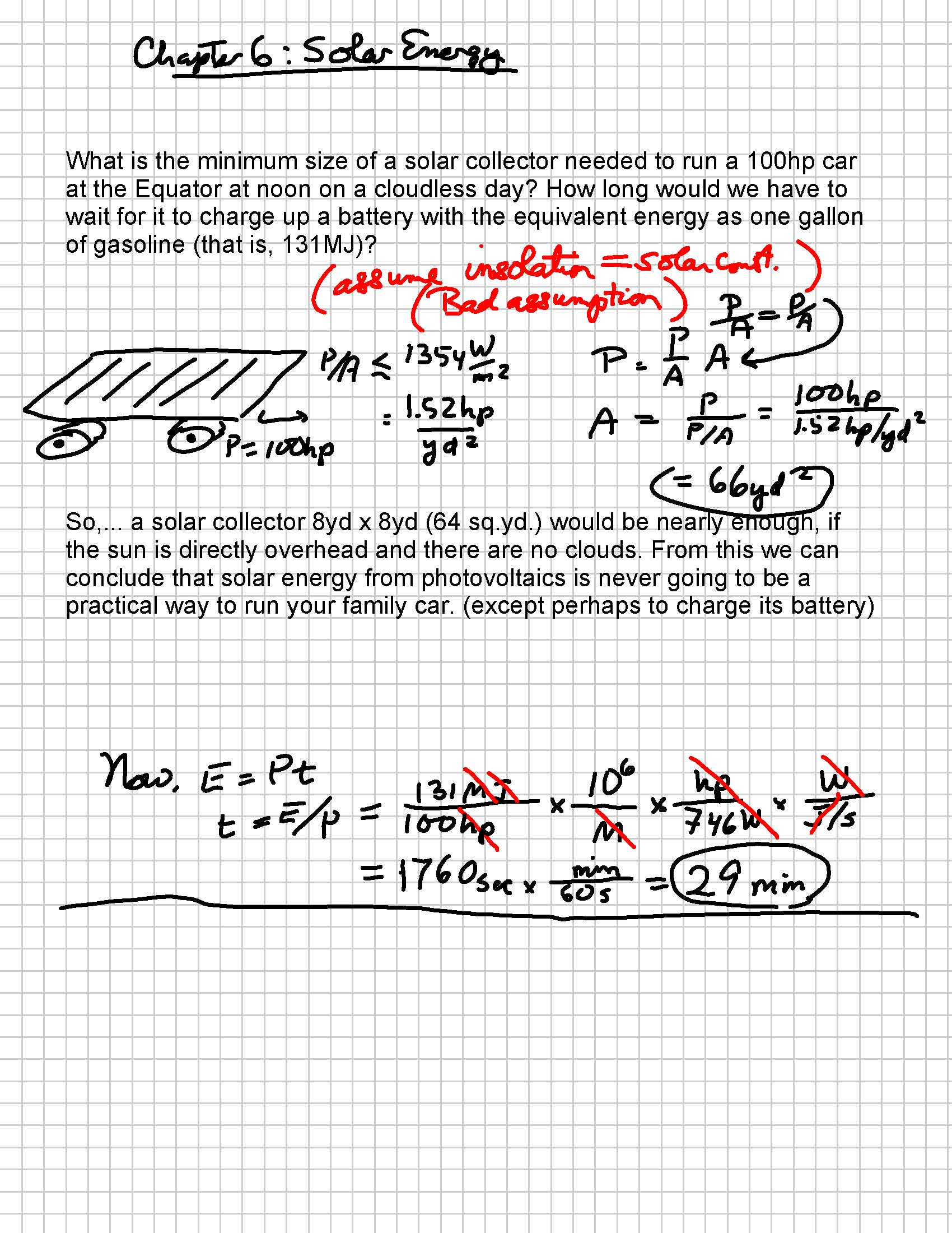
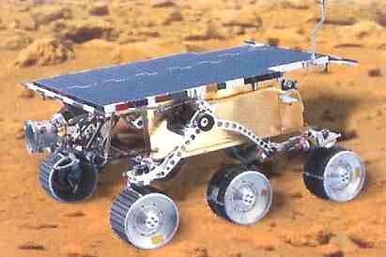
Worked Problem 1

Slide 60
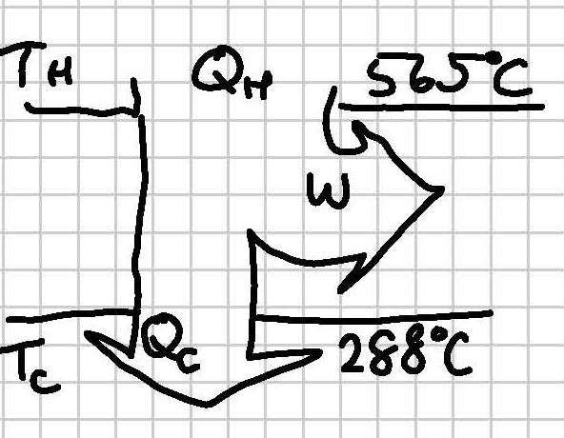
Worked Problem 2
The Solar Electric Generating station I stores solar energy as heat energy by melting salt at about 565°C. This heat is used in a heat engine to create electricity and is dumped at 288°C. What is the maximum efficiency we can hope for from this setup?
Convert all the Ts to Kelvin first
No better (or worse) than a coal-fired electric plant, but at least no non-renewable fossil fuels were consumed.

Slide 61
Study questions
The solar energy reaching the Earth’s surface in one day
is larger than the energy of all known deposits of fossil fuels.
is smaller than that, but much larger than the total energy consumed by mankind in one day.
is about comparable to a day’s worth of human energy consumption.
is almost completely absorbed by the Earth’s surface.

