Slide 1
Chapter 5: Heat and Work Chapter 6: Home Energy Conservation and Heat-Transfer Control
Homework 2 posted due Sept.30

Slide 2
Introduction
Approximately one-quarter of the energy used in the United States goes into the heating and cooling of buildings.
In the residential sector, more than 50% of this energy is used for space heating and cooling.
Commercial and Residential buildings account for 76% of the electricity used in the United States and 40% of all U.S. energy use.
In 2020, electricity use in buildings resulted in more than 1600 Million Metric Tons (MmT) of CO₂ emissions.

Slide 3
Thermodynamics: motivation
Heat plays major role in the three major consumption sectors:
Industrial
Transportation
Internal combustion engines ≈ 100%
Residential /Commercial
Space heating 51%
Hot water heating 18%
Cooling: 5%
(51%+18%+5%=74% of Res/Comm.)

Slide 4

Thermodynamics
Definition: the study of heat (“thermal energy”)
Heat, Q, is just another form of energy.
Therefore it has the same units as energy.

Slide 5
Zero^{th} Law of Thermodynamics
Two objects in thermal equilibrium with a third object are in thermal equilibrium with each other.
(It is possible to define temperature, such that two objects having the same temperature do not transfer heat energy with each other.)
Why is it the “Zeroth” Law?!
Because it’s more fundamental than the First Law, but was stated after it.

Slide 6
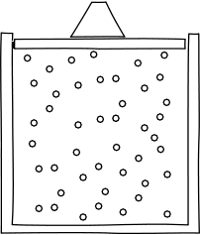
Heat vs temperature
Heat = “thermal energy” = a form of energy, a sort of microscopic kinetic energy
(molecules jiggling)
Temperature = a measure of the microscopic kinetic energy (heat) per molecule.
Heat ≠ temperature!!!

Slide 7
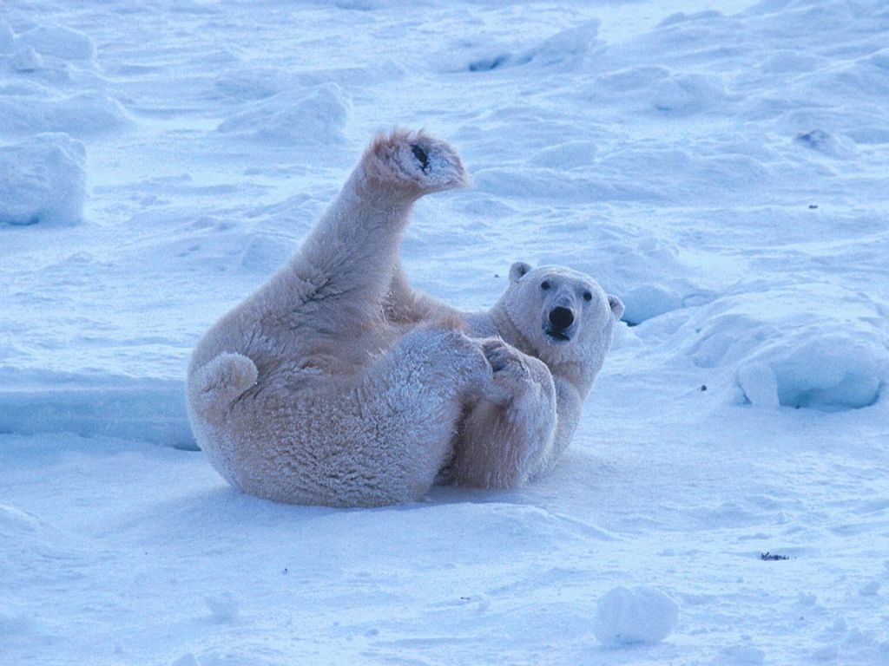
Heat vs temperature
Heat ≠ temperature.
A bear on an ice floe is “hotter” (has a higher temperature) than the ice.
But the ice floe has more heat because it contains more molecules, even if the average molecule is colder (has less heat energy)
toasty 98.6°F inside
http://www.firstpeople.us/pictures/polar-bears/polar-bear-lounging.html.
chilly, sub-32°F outside

Slide 8
Temperature and Heat
Temperature is a property of an object, much like color or shape.
When you measure the temperature of a substance, the temperature is the same whether you measure the temperature of a small piece or the entire substance.
Temperature cannot tell us the amount of energy contained in the substance because it is independent of the mass.
The higher the temperature, the more energetic are the atoms or molecules.

Slide 9
Measuring temperature
Fahrenheit scale:
Human body = 98.6°F
Coldest salt-water ≈ 0°F
Celsius scale:
Water boiling (standard pressure): 100°C
Water freezes: 0°C
Kelvin scale:
Same as Celsius, except start with T_{K}=0K for the lowest temperature possible (-273°C, or “absolute zero”).

Slide 10
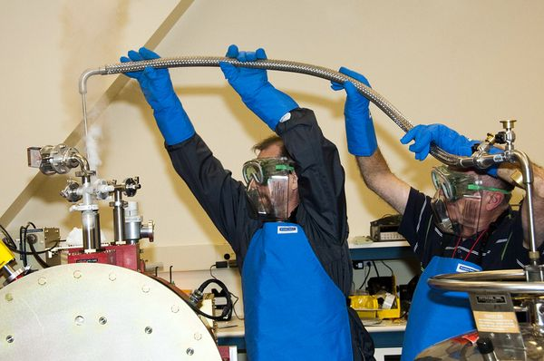
Converting temperatures
Celsius→Kelvin: T_{K}=T_{C}+273
Celsius→Fahrenheit: T_{C}=(5/9)(T_{F}-32)
Fahrenheit→Celsius: T_{F}=(9/5) T_{C}+32
Image: transferring liquid helium: http://images.nationalgeographic.com/wpf/media-live/photos/000/211/cache/sofia-flying-telescope-liquid-helium_21178_600x450.jpg.

Slide 11
Review: 0th Law
The Zero^{th} Law of Thermodynamics
Objects at same temperature do not exchange heat.
We can define temperature as a way of predicting which way heat flows.

Slide 12
Heat and Work and the First Law of Thermodynamics
The total energy is the sum of the object’s kinetic energy (KE), potential energy (PE), thermal energy (TE), chemical energy (CE), and electrical energy (EE).
Heat is the transfer of energy between two bodies as a result of a temperature difference.
Heat is not contained in a body but is manifest only as the interaction of that body with its surroundings.

Slide 13
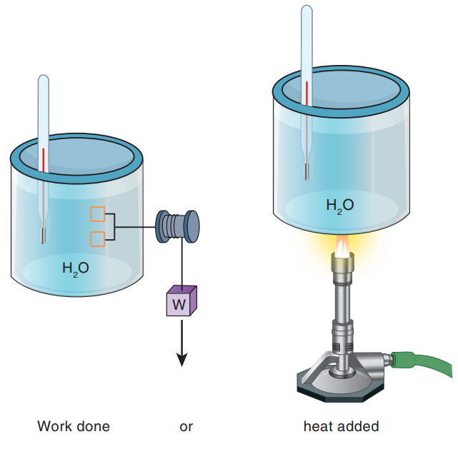
Heat and Work and the First Law of Thermodynamics (2 of 4)
Relationship between work and heat. A temperature change in the water can be caused either by letting the weight drop (causing the blades to rotate) or by adding heat from the gas burner.
Notes:
Figure 5.2 Relationship between work and heat. A temperature change in the water can be caused either by letting the weight drop (causing the blades to rotate) or by adding heat from the gas burner.

Slide 14
Heat and Work and the First Law of Thermodynamics (3 of 4)
The interchange among work, heat, and total energy E can be summarized in the first law of thermodynamics.
The work done on a system plus the net heat added to it is equal to the change in total energy of that system.
The energy put into a system is equal to the energy output plus the energy stored.
Another expression for the first law is;

Slide 15
The First Law of Thermodynamics
Heat can do two things
It can increase the internal thermal energy of a system.
It can do work.
...or it can do both (http://www.youtube.com/watch?v=JtDwV51Wh78)
The total heat entering a system equals the sum of the internal energy increase and the work done: Q = ΔU + W

Slide 16
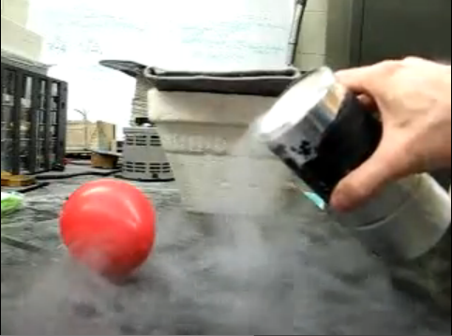
1st Law of Thermodynamics
Heat can change the internal [thermal] energy, or do work, or both.
Demo: liquid nitrogen + balloons.
http://www.youtube.com/watch?v=JtDwV51Wh78

Slide 17
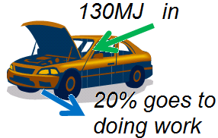
Worked problems
One gallon of gas is equivalent to about 130MJ. A car engine burns a gallon of gas with 20% efficiency. What are the values of Q, ΔE, and W? (Heat, change in thermal energy, work done by the engine)

Slide 18
1st Law of Thermodynamics
Balloon at liquid nitrogen T expands. The gas is warmer (ΔE) and it pushes against its surroundings (W=Fd)
But what is a change in internal energy?
(a) you can raise the temperature
(b) but you can also change the phase of the material

Slide 19
Internal Energy
Calorimetry – the study of changes in internal energy due to movement of heat.
or....
just how much does the temperature rise (or how much of the ice melts) when I add heat?

Slide 20
question
Heat is
energy that can be transferred by virtue of a temperature difference.
measured with thermometers.
completely absent from the environment on a very cold winter day.
another word for temperature.
a conceptual idea that is quantified by Kelvins.

Slide 21
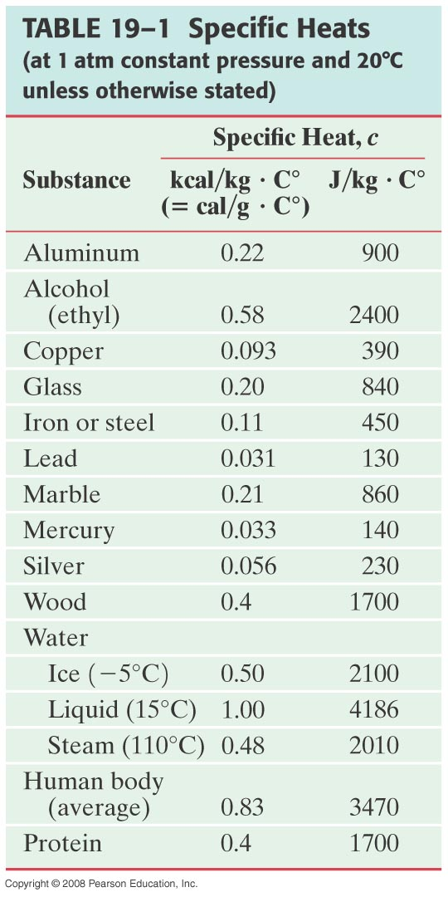
Internal energy: raising temperature
Heat added to an object
can raise T.
Q = heat (energy)
m = mass of object
c = specific heat of object
ΔT = change in object’s temperature

Slide 22
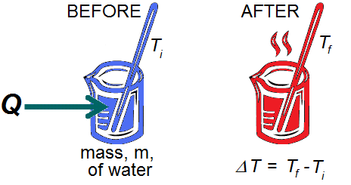
The specific heat,c, is characteristic of the material.
(liquid) water: c = 1 calorie / g / °C
= 4186J / kg/°C
= 1 Btu / lb* / °F
*Pounds are not units of mass.

Slide 23
Specific Heat
Problem: How heat transferred depends on specific heat.
How much heat input is needed to raise the temperature of an empty 20-kg vat made of iron from 10°C to 90°C?
(b) What if the vat is filled with 20 kg of water?
Notes:
Solution: a. Q = 720 kJ.
b. For the water alone, Q = 6700 kJ, so the total is 7400 kJ.

Slide 24
Calorimetry—Solving Problems
Closed system: no mass enters or leaves, but energy may be exchanged
Open system: mass may transfer as well
Isolated system: closed system in which no energy in any form is transferred
For an isolated system,
energy out of one part = energy into another part,
or: heat lost = heat gained.

Slide 25

question
Water has a higher specific heat than soil. If you add equal amounts of thermal energy to equal masses of water and soil, then
the soil will undergo the greater temperature change.
the water will undergo the greater temperature change.
the temperature change for water and soil will be the same. Specific heat has nothing to do with temperature changes.
it is impossible to tell which undergoes the greater temperature change. Specific heat has nothing to do with temperature changes.

Slide 26
Problem
When a 290-g piece of iron at 180°C is placed in a 95-g aluminum calorimeter cup containing 250 g of glycerin at 10°C, the final temperature is observed to be 38°C. ­Estimate the specific heat of glycerin.

Slide 27
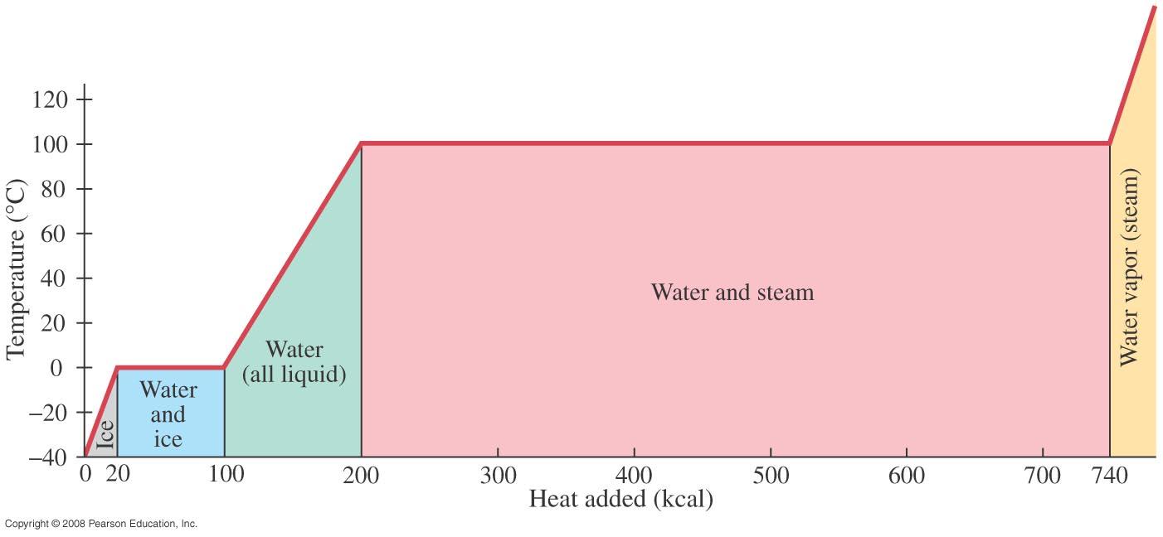
Latent Heat
Energy is required for a material to change phase, even though its temperature is not changing.
Latent heat is the heat (energy) required to change 1kg of substance from solid to liquid
Notes:
Figure 19-5. Temperature as a function of the heat added to bring 1.0 kg of ice at –40°C to steam above 100°C.

Slide 28

Latent Heat
The total heat required for a phase change depends on the total mass and the latent heat:
Notes:
Solution: First, figure out whether the final mixture will be ice or water (or a mix). The heat released when 3.0 kg of water is cooled from 20°C to 0°C is 250 kJ; the heat needed to raise 0.50 kg of ice to 0°C and then melt it is 177 kJ. Therefore, the final mixture will be liquid, at some temperature above zero. Now you can do conservation of energy; the heat required to heat the ice, melt it, and then raise its temperature to the final one is equal to the heat lost by the tea cooling from the original temperature to the final one. Solving for the temperature gives 5.0°C.

Slide 29
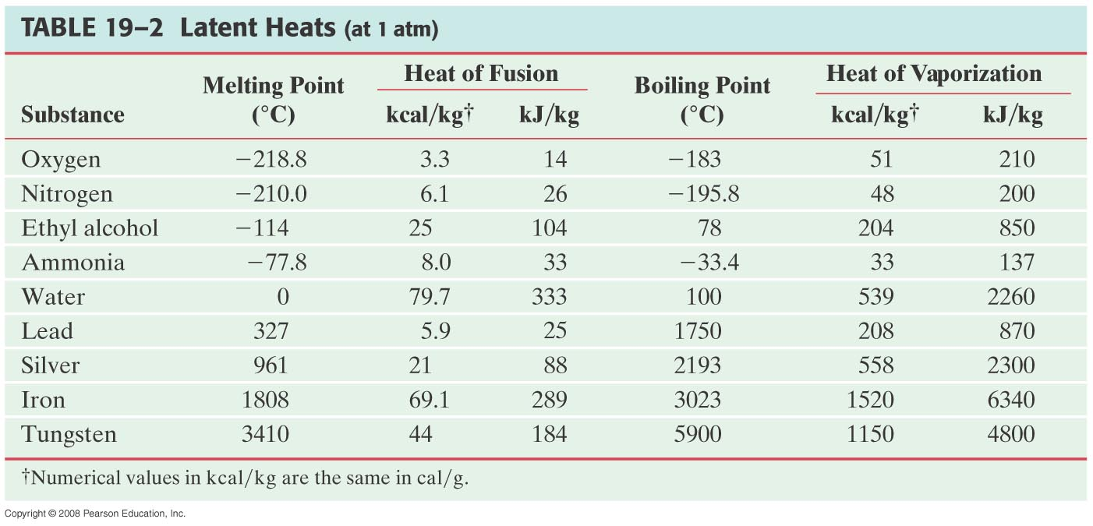
Latent Heat
Heat of fusion, L_{F}: heat required to change 1.0 kg of material from solid to liquid
Heat of vaporization, L_{V}: heat required to change 1.0 kg of material from liquid to vapor

Slide 30
Latent Heat
The latent heat of vaporization is relevant for evaporation as well as boiling. The heat of vaporization of water rises slightly as the temperature decreases.
On a molecular level, the heat added during a change of state does not increase the kinetic energy of individual molecules, but rather break the close bonds between them so the next phase can occur.

Slide 31
Problem :Latent Heat
Determining a latent heat.
The specific heat of liquid mercury is 140 J/kg·°C. When 1.0 kg of solid mercury at its melting point of -39°C is placed in a 0.50-kg aluminum calorimeter filled with 1.2 kg of water at 20.0°C, the mercury melts and the final temperature of the combination is found to be 16.5°C. What is the heat of fusion of mercury in J/kg?
Notes:
Solution: Again, use conservation of energy; we know the final system is liquid, so the heat required to melt the mercury and then raise its temperature to 16.5 degrees equals the heat lost by the water. Solving gives L_{Hg} = 11 kJ/kg.

Slide 32
The Second Law
“The entropy (disorder) in a closed system never decreases.”
Entropy change = heat / temperature = Q/T*
*T must be in absolute (Kelvin) temperature scale.
“It is impossible for heat to flow from cold object to hot object without the application of an outside agent.” (An unplugged AC never cools).
The entropy will always increase or stay the same never decreases.

Slide 33
Heat Engines
The heat engine is a central part of many of our energy-conversion devices.
An automobile engine converts the chemical energy of gasoline (through combustion) into the mechanical energy of a piston and crankshaft; the turbine in an electrical generating plant converts heat into shaft work to run a generator.
After doing work, the working fluid can either be exhausted into the environment or sent back to the heat source to start the cycle over.
The first case is called an open cycle; the second case is a closed cycle.

Slide 34
Heat Engines
Examples of heat engines in the Rankine cycle and a gas cycle.
Vapor or Rankine Cycle
Steam engine (electrical power plant, old train locomotive)
Refrigerator, heat pump (using Freon)
Gas Cycle
Internal combustion: Otto, diesel cycles (automobiles, trucks)
External combustion: Gas turbine (airplanes, electrical power plant), Stirling cycle
Notes:
Table 5.3 Examples of Heat Engines

Slide 35
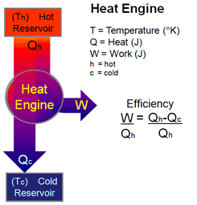
The heat engine
Heat , Q_{h}, from a “hot reservoir” -- a region of high temperature -- is partly converted to usable work, W, with the unused thermal energy, Q_{c}, dumped into a “cold reservoir” at a lower temperature. An efficient heat engine produces a lot of work from the heat it extracts.
Image adapted from: http://hendrix2.uoregon.edu/~dlivelyb/phys161/images/heat_engine_schem.gif

Slide 36
Efficiency
Useful work out/Energy input
Don’t confuse
with
For example the maximum possible efficiency for a heat engine, with a boiler temperature T_{H}, and the condenser temperature T_{c}
$T$ is in kelvin, we can never have an efficiency=100%

Slide 37
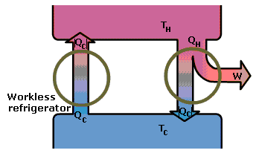
Heat engines & the 2nd Law
You cannot extract heat from a cold reservoir and dump it in a warmer one without using external energy.
If you could, you could combine this “workless refrigerator” with a
normal heat engine and produce nothing but work from your heat source.
But it’s even worse than that. The fraction of heat you can convert into work is a function of your two reservoirs.....
http://image.tutorvista.com/content/heat-and-thermodynamics/workless-refrigerator.gif

Slide 38
The Second Law and efficiency
This last equation is a limit set by the Second Law of Thermo.
It is a fundamental limit on the efficiency of gasoline-powered transportation run by heat engines.
If you wish to make a heat engine as efficient as possible, try raising the temperature of the hot reservoir (T_{h}), or dumping the waste heat to a lower T_{c}.

Slide 39
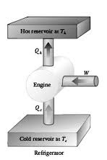
Refrigerator as a heat engine running backwards
Heat , Q_{c}, is pulled from a “cold reservoir” and dumped into a hot reservoir, but this requires the input of work, W. (An unplugged AC never cools).
Coefficient of Performance: C.O.P. = Q_{c}/W
Typical values ≈ 10. What does that mean physically?
Image: http://t3.gstatic.com/images?q=tbn:ANd9GcQzEsz13OtBSe1dEFeHLufQ9FSxmjU9VpnPohNJP4TdPW5jNa54b8L2KpeA3w

Slide 40
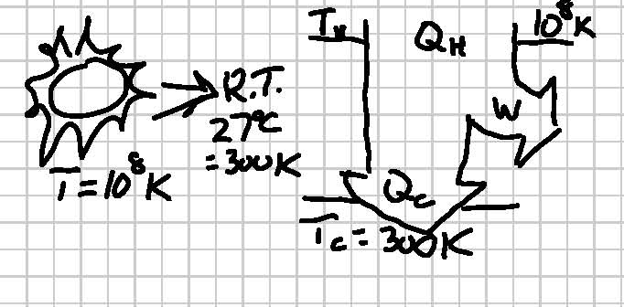
Worked problems: heat engines
Thermonuclear fusion takes place inside the Sun at a temperature of about 100million Kelvin. If we could run a heat engine that extracts that energy at 100MK and dump it at Earth’s “room temperature”, (say 27°C) what is the maximum theoretical efficiency we could expect?

Slide 41
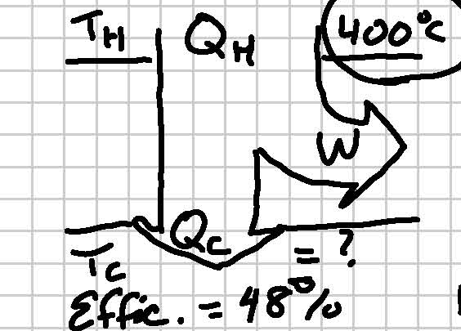
Worked problems: heat engines
A typical car engine has a maximum efficiency of about 48%. The temperature of the combusting gasoline in the piston is about 750°F, or about 400°C. What is the warmest possible value you would expect for the temperature of the exhaust coming out of the engine?
Remember first to convert the heat reservoir temperature into an absolute [Kelvin] scale!!

Slide 42
question
A heat engine operating between 1000K and 450K could not have an efficiency greater than
55%
50%
45%
30%
10%

Slide 43
question
Geothermal steam at 150ºC or higher is sometimes used to generate electricity. If the cold reservoir is 25ºC, then the maximum efficiency is about
10%
20%
30%
83%
Why would you use such an inefficient heat source?
(http://en.wikipedia.org/wiki/Geothermal_electricity)

Slide 44
Air Conditioners and Heat Pumps (1 of 4)
Devices which work on the second law of thermodynamics.
An air conditioner is similar to a refrigerator in that thermal energy from inside a cooled space is transferred to the warmer outdoor space.
This flow of heat from cold to hot is not a violation of the second law of thermodynamics because it does not occur spontaneously.
Energy is added to the system via electricity, natural gas combustion, or solar energy to accomplish this task.

Slide 45
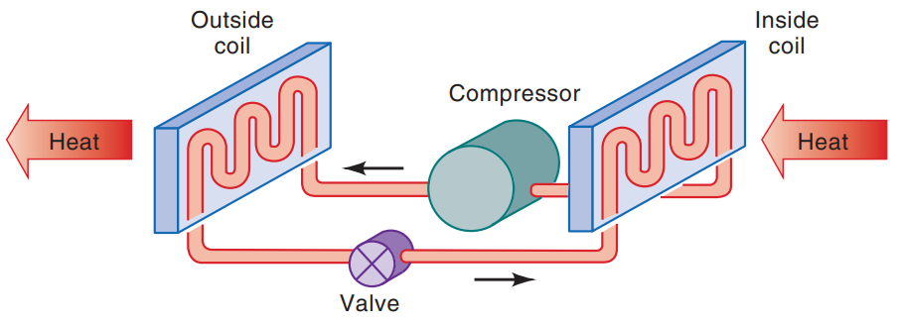
Air Conditioners and Heat Pumps (2 of 4)
Air conditioner operation.
Notes:
Figure 6.17 Air conditioner operation.

Slide 46
Air Conditioners and Heat Pumps (3 of 4)
A heat pump is a heat engine operating in reverse. This device can be used to heat or cool a space.
As the name implies, a heat pump can be used to extract or pump heat either into or out of space.
The performance of a heat pump is expressed not in terms of the ratio of energy output to energy input but instead in terms of the ratio of energy output to work input.
Heat-pump manufacturers suggest that the heat pump is most economical in locations in which both heating and air conditioning are needed.

Slide 47
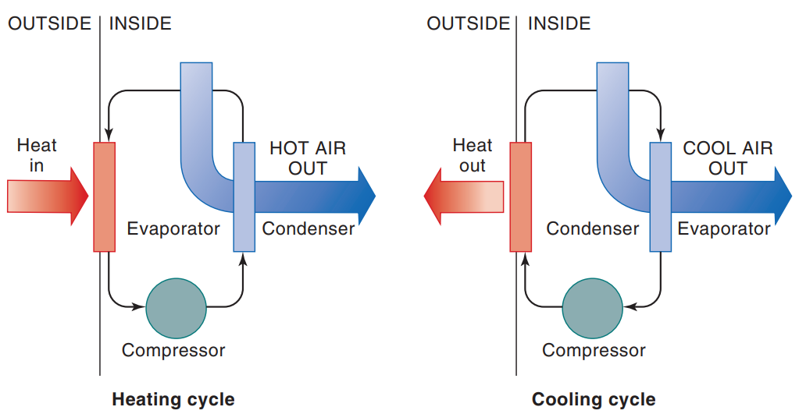
Air Conditioners and Heat Pumps (4 of 4)
Basic components of a heat-pump system.
Notes:
Figure 6.18 Basic components of a heat-pump system.

Slide 48
Heat Control In everyday life
Retrofitting a structure, that is, making modifications in an existing house without major construction or design changes, can also bring about significant reductions in heating and cooling costs.
The zero-energy house (ZEH) uses large amounts of insulation, tight sealing, and renewable technologies.
Energy consumption can be lowered by the use of energy-efficient appliances and the addition of solar-energy features to a house.

Slide 49
Building Materials
Material that is a good conductor of electricity, such as metal, is usually a good conductor of heat.
An insulator, such as fiberglass or neoprene, will retard the flow of heat from one object to another.
The color of a material also influences heat transfer when radiation is concerned.
A black object is both a better emitter and a better absorber of radiant energy than a white or shiny object.

Slide 50
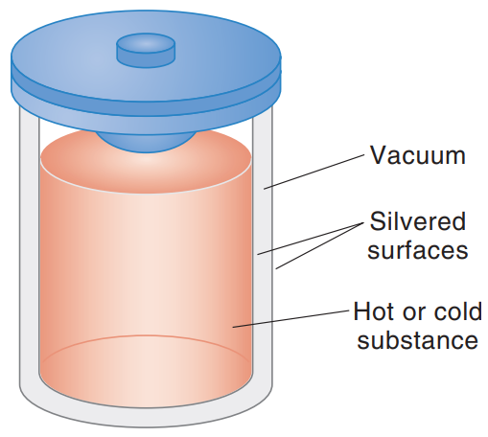
One device for reducing heat transfer is the thermos. A thermos is a bottle inside a bottle, with the inner vessel separated from the outer one by a vacuum. The evacuated region prevents the transfer of heat from or to the inner vessel by convection or conduction. The inner walls of both vessels are silvered, which cuts down on losses (or gains) from radiation. Glass and cork are poor conductors, so heat transfer by conduction through these materials is negligible.
Thermos bottle (cutaway view).
Notes:
Figure 6.4 Thermos bottle (cutaway view).

Slide 51
House Insulation and Heating Calculations (1 of 5)
Increased insulation of houses is one of the easiest and most cost-effective means of reducing energy consumption.
The addition of insulation to a house can save as much as 50% on heating and cooling bills.
A measure of the resistance of the material to heat flow is the thermal resistance R, often called its R-value.
The convective resistance depends strongly on the velocity of the air moving along the surface.

Slide 52
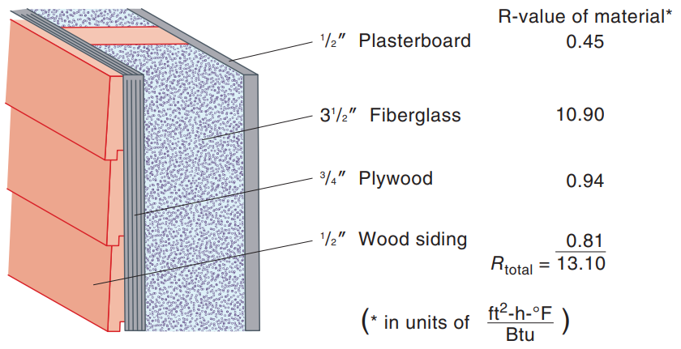
House Insulation and Heating Calculations
Example of the calculation of thermal resistance value for a composite wall.
Notes:
Figure 6.6 Example of the calculation of thermal resistance value for a composite wall.

Slide 53
House Insulation and Heating Calculations
Heat loss by natural convection on the inside of a window is also increased significantly if air is allowed to move freely past the window.
Windows are important for providing daylight and interaction with the outside world, but they can also be the source of large heat losses and gains.
A feature added to many higher-quality windows in recent years to improve their energy performance is low-e coatings.
Other heating losses come from air infiltration.
Infiltration can be responsible for almost 50% of home-heating requirements!

Slide 54
House Insulation and Heating Calculations
For any one day, the heating degree-day (DD) is found by averaging the high and low temperatures for that day and subtracting from 65°F.
Using this concept of degree-days, the annual total heating needs for conductive losses can be written as
In the above equation, A represents the surface area and the sum Σ includes all the exterior surfaces.

Slide 55
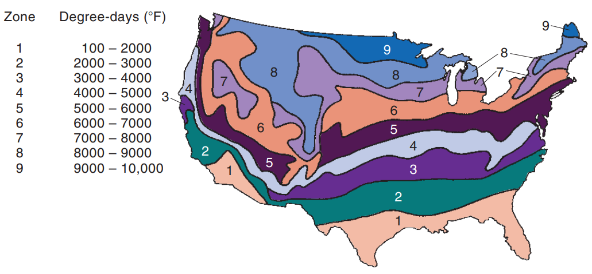
House Insulation and Heating Calculations
Annual heating degree-days (DD).
Notes:
Figure 6.12 Annual heating degree-days (DD).

Slide 56
Site Selection
When we examine the energy-efficient building design factor, which is site selection, we look at:
Heat losses through walls and roofs, as well as through window, door, and foundation cracks, directly depend on the wind velocity.
Winds should be blocked during cold periods and used for cooling during warm periods.
A garage situated on the northwest side of a house can be effective in blocking the prevailing winter winds.
Site selection should also consider the path of the sun.

Slide 57
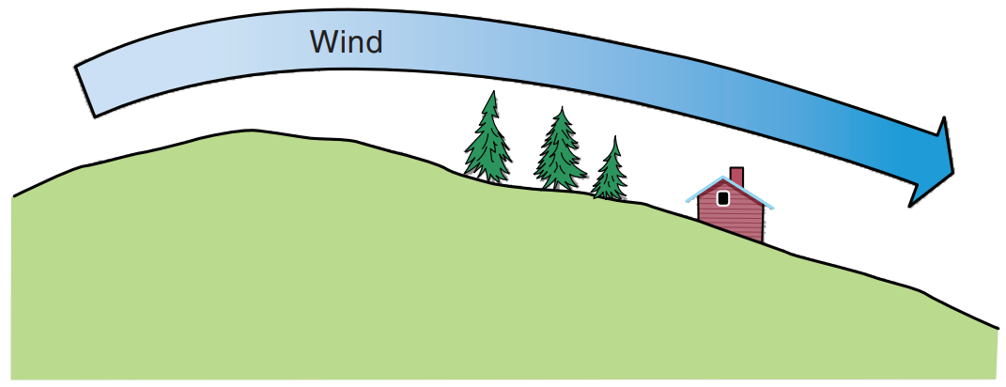
Site Selection (2 of 2)
Planting trees on the leeward side of a hill can substantially reduce the wind velocity over the site. Vegetation or walls can block or deflect natural air flow patterns to reduce convective heat loss.
Notes:
Figure 6.13 Planting trees on the leeward side of a hill can substantially reduce the wind velocity over the site. Vegetation or walls can block or deflect natural air flow patterns to reduce convective heat loss.

Slide 58
Impact of Energy Conservation Measures
Measures that can significantly reduce the operating costs of home-energy equipment while providing operational benefits.
With increased insulation, infiltration control, and night-time thermostat setback, the annual heating bill can be reduced by almost 50% in each area.
Home-energy audits are a great place to start in evaluating a building’s heat load.
Many utilities are required to make low-interest loans available for energy-conservation projects.

