Slide 1
Energy and Work
Chapter 3

Slide 2
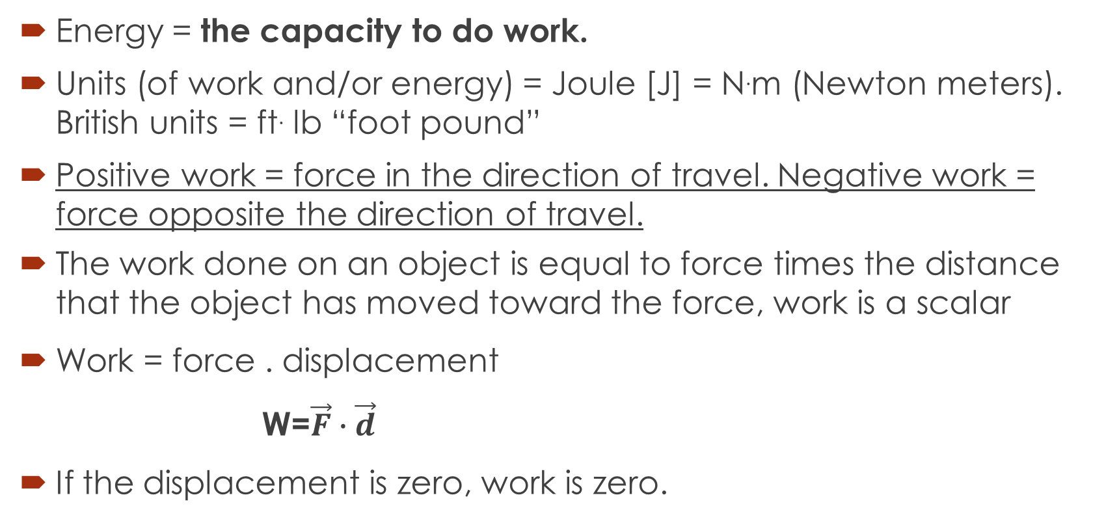
Energy
Energy = the capacity to do work.
Units (of work and/or energy) = Joule [J] = N.m (Newton meters). British units = ft. lb “foot pound”
Positive work = force in the direction of travel. Negative work = force opposite the direction of travel.
The work done on an object is equal to force times the distance that the object has moved toward the force, work is a scalar
Work = force . displacement
W=$\vec{F}∙\vec{d}$
If the displacement is zero, work is zero.

Slide 3
Energy: flavors
Forms of energy:
Kinetic (moving) energy. (translational)
Potential energy (stored).

Slide 4
Energy and Work
Quantity | SI | English | Conversions
Velocity | m/s | ft/s | 1 ft/s = 0.305 m/s 1 mph = 0.447 m/s 1 km/h = 0.28 m/s
Acceleration | m/s² | ft/s² | 1 ft/s² = 0.305 m/s²
Force | Newton (N) | lb | 1 lb = 4.45 N
Energy | joule (J) | ft-lb | 1 ft-lb = 1.356 J
Power | watt (W) | ft-lb/s, hp | 550 ft-lb/s = 1 hp = 746 W
Units In Mechanics
Notes:
Table 3.1 Units In Mechanics

Slide 5
Problem
Calculate the KE of the following at the board:
a 55mph car of 1000kg mass.
a 12 ton elephant running at 12m/s
a 100mph fastball with a 0.145kg mass.

Slide 6
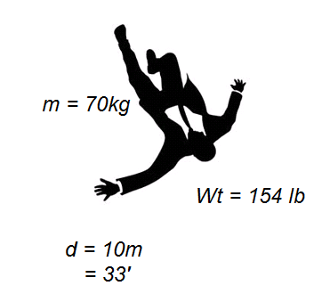
More worked examples...
A 70kg (154 pound) person jumps off a 10m (33′) building.
(a) What work is done by gravity?
(b) What work is done by the ground as this person comes to rest?

Slide 7
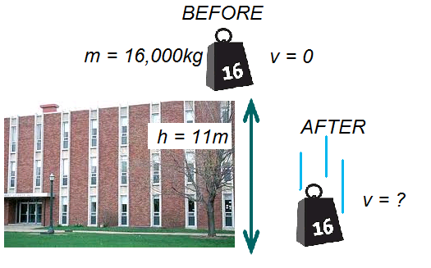
More worked examples...
A 16 ton weight (m = 16000kg) is dropped from the top of a building(h = 11m ). What is its kinetic energy the instant before it hits the ground? Its speed?

Slide 8
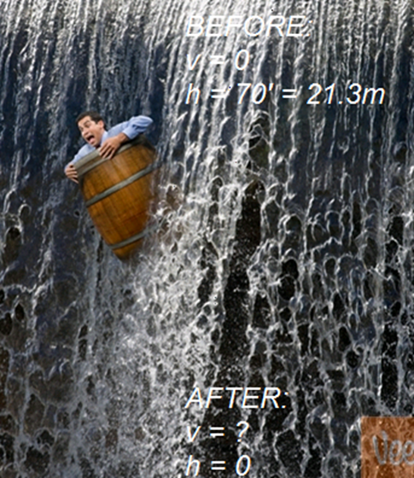
More worked examples...
People have been known to launch themselves over Niagara Falls inside a barrel. Sometimes they survive. The Falls are 176′, but the distance to the pile of rocks at the bottom is only 70 ′ (21.3m). What is the maximum speed you could expect to achieve before smashing into the rocks?
Image adapted from:
http://creatingacomic.com/images/waterfall-barrel.jpg,

Slide 9
Energy and Work
If an object is moving, the energy it will gain will be kinetic energy (KE).
When an object is raised to a certain height, the gravitational potential energy of the object increases due to work done on the object.
The units of both energy and work are those of force times distance.
The total work of the system can be expressed as an equation

Slide 10
Questions: work
If the net work on a car is positive, we know that
its kinetic energy decreases.
there is no net force on the car.
its kinetic energy increases.
there is no change in kinetic energy.
Newton’s second law of motion has been violated.

Slide 11
questions: work
If the brakes are applied in a moving automobile, the work down by the brakes is
negative, because the braking force applied and the motion are oppositely directed.
positive, because the braking force and motion are in the same direction.
converted to potential energy.
positive, because it is converted to positive energy in the form of heat.
none of the previous selections is correct.

Slide 12
Energy and Work
The thermal energy (TE) of an object is the function of its temperature.
Thermal energy is the internal energy of an object and is equal to the sum of all the microscopic energies of the molecules that makes up that object.
Heat (Q) is defined as the energy that is transferred due to a temperature difference between two objects.

Slide 13
Energy and Work
The relationship between work, heat, and energies is known as the first law of thermodynamics.
The first law of thermodynamics is often called the law of conservation of energy.
The law of conservation of energy is defined as that energy can be neither created nor destroyed; it is converted from one form to the other form.

Slide 14
Applying the Law of Energy Conservation
When we examine a system capable of interacting with the outside world and consider the transfer of energy into and out of the entire system, we see that
This system is no longer isolated, but energy is still a conserved quantity.
The net energy added (the energy in minus the energy out) is equal to the change in the system’s energy.
The principle of the conservation of energy can now be stated as: “The energy into a system equals the energy out plus the increase of energy stored in the system”.

Slide 15
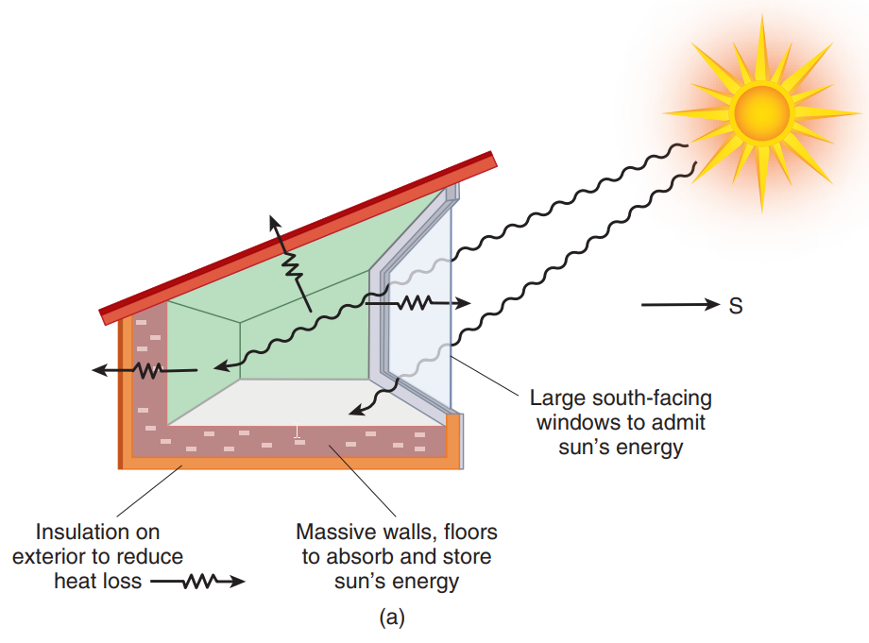
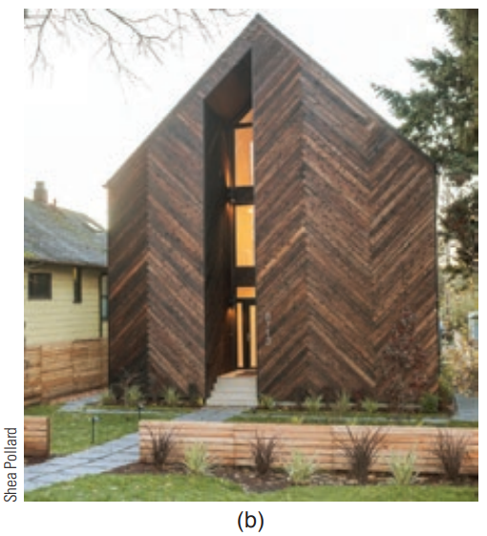
Applying the Law of Energy Conservation
(b) A passive house, like the one shown here, can reduce energy use to as little as 90% of Shea Pollard that used by a conventional home.
(a) A passive solar energy house. Energy in 5 energy out 1 energy stored.
The law of the conservation of energy can be illustrated with this passive solar house.
Such a house acts as a collector of solar energy.
Notes:
Figure 4.2 (a) A passive solar energy house. Energy in 5 energy out 1 energy stored. (b) A passive house, like the one shown here, can reduce energy use to as little as 90% of Shea Pollard that used by a conventional home.

Slide 16
Units
unit conversion factors between the English system and SI.
The units of energy are kg-m²/s², which is defined as a joule (J).
The unit of work is Newtons times meters or joules (J).
One of the most common units of energy you may see is the kilowatt hour (kWh).
Other commonly used units for energy include BTU and calories.

Slide 17
Energy Use in Developing Countries
Three-quarters of developing countries are oil importers, and of the poorest countries, three-quarters import more than 70% of their commercial energy.
The United Nations estimates that 1.4 billion people—more than 20% of the world’s population—lack access to electricity.
Oil and coal already provide more than 50% of the energy used in developing countries.
Biomass can make up to 90% of the energy used in some countries.
In the next 20 years, the developing countries' share of world CO₂ emissions will increase.

Slide 18
Energy Use in Developing Countries
Electricity demand is projected to continue to rise by 7% per year—a doubling time of 10 years.
Since 2000, electricity demand in developing countries has nearly tripled because of industrialization, growth, and expanded access to electricity.
To grow, developing countries will need to invest in more energy-efficient technologies, as well as develop alternatives to oil and coal.
By 2050, the global population is projected to grow 24%, from 7.8 billion to 9.7 billion.

Slide 19
Energy Use in Developing Countries
Source | Percent
Biomass | <1
Oil | 31
Coal | 27
Natural gas | 28
Other renewables | 10
Nuclear | 4
Global Electricity Production by Source
Notes:
Table 4.3 Global Electricity Production by Source
Source: Hannah Ritchie and Max Roser (2020) - “Energy”. Published online at OurWorldInData.org.

Slide 20
Energy-Conversion Efficiencies (1 of 3)
the key characteristics of the energy system is energy-conversion efficiencies.
In a conversion process
The efficiency of an energy-conversion process is defined as
The energy input that does not go into useful work goes into unusable energy forms.

Slide 21
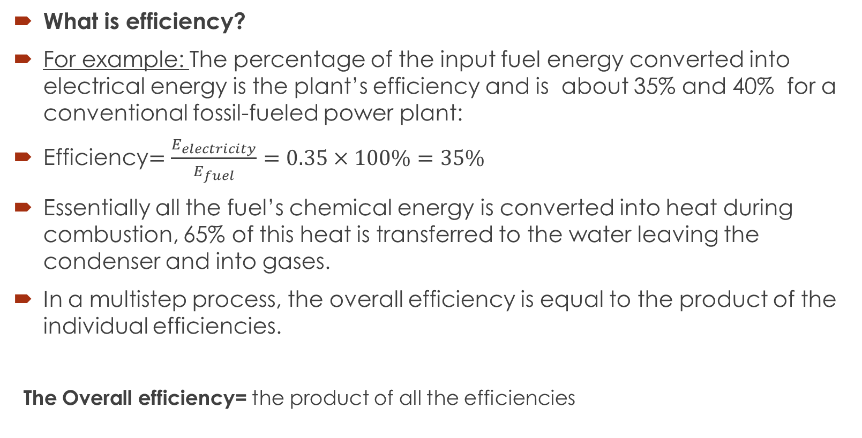
Energy Conversion Efficiencies
What is efficiency?
For example: The percentage of the input fuel energy converted into electrical energy is the plant’s efficiency and is about 35% and 40% for a conventional fossil-fueled power plant:
Efficiency$=\frac{E_{electricity}}{E_{fuel}}=0.35×100\%=35\%$
Essentially all the fuel’s chemical energy is converted into heat during combustion, 65% of this heat is transferred to the water leaving the condenser and into gases.
In a multistep process, the overall efficiency is equal to the product of the individual efficiencies.
The Overall efficiency= the product of all the efficiencies
Notes:
The overall efficiency is never greater than that of the step with the lowest efficiency in the process

Slide 22
Some important efficiencies
Coal-fired electric power plant (fuel chemical energy to electricity): 35%
Lighting (electricity to visible light)
  Incandescent: 5%
  Fluorescents: 20%
  [W]LEDs: up to about 80% and more (white light-emitting diodes)
ICE [Internal Combustion Engine]: 20-25% at converting gasoline chemical energy into mechanical motion (which then is converted nearly 100% into heat).

Slide 23
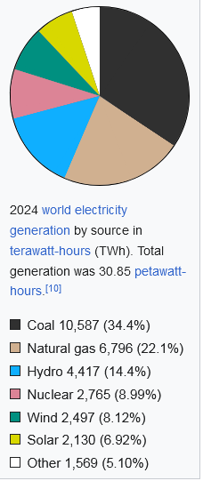
Conversion efficiencies: why care?
About 70% of US electricity comes from fossil fuels. China 80% and France 10%
Electric cars: How green are they?
That depends on where the electricity comes from.
http://en.wikipedia.org/wiki/Electricity_generation

Slide 24
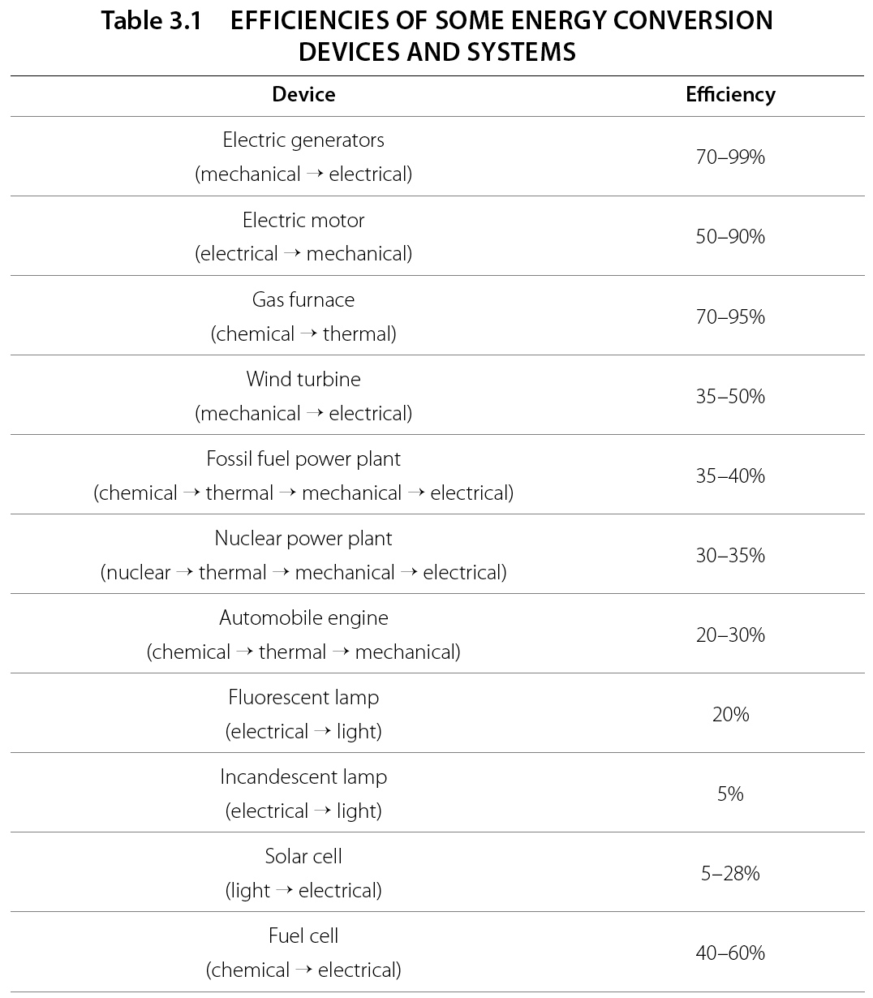

Slide 25
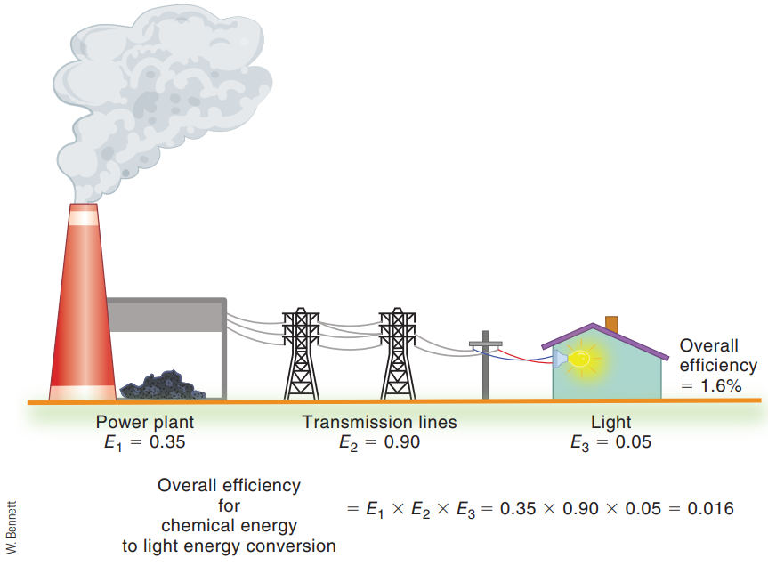
Energy-Conversion Efficiencies
Calculation of the overall efficiency for a multistep process involves multiplying the efficiencies of the individual steps.
Notes:
Figure 4.4 Calculation of the overall efficiency for a multistep process involves multiplying the efficiencies of the individual steps.

Slide 26
Energy-Conversion Efficiencies
One simple and well-known method uses electricity to split molecules of water into hydrogen and oxygen gases—electrolysis.
Electrolysis using electricity from solar cells or biological processes is a growing option.
Recent research has found metal catalysts that can produce oxygen and hydrogen without a large amount of input electricity.

Slide 27
Power and Force

Slide 28
Power
Power is the rate of doing work or the rate at which energy is used, produced, or transferred.
The short time interval job requires more power.

Slide 29
Power: definition & units
Units= Watts =Joule/sec [W=J/s=N.m/s]
Power is rate at which work is done. In common usage, “power” means the capacity to .....do work.

Slide 30
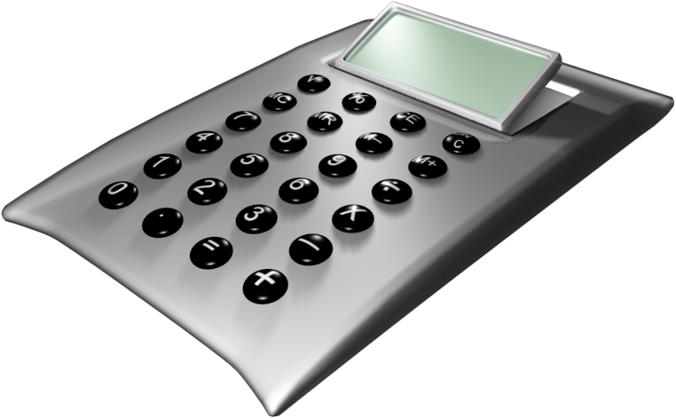
More on units
Since , W.s [=J], kW.hr are units of Energy.
How many Joule in a kW.hr?
Kilowatt hour is a unit of energy. 1kW h of electricity costs about 14.26¢ (2025)

Slide 31
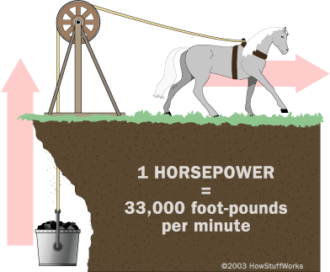
British units
British units of
would be ft.lb /s
Define horsepower
  hp = 550 ft.lb/s
  =746 W
Image: http://static.howstuffworks.com/gif/horsepower1.gif.

Slide 32
Power and force
P=W/t = Force × distance / time = force × speed=F v
force = can (1) the overcome friction (2) is mass x acceleration

Slide 33
questions: power
You walk up one flight of stairs, then run up the next flight. Which of the following is true?
The work and the power are the same in both cases.
The work is the same, but the power is higher when you run.
The power is the same, but the work is more when you run.
Not enough information is given to say anything.
None of the above.

Slide 34
Worked Problem
Consider climbing one flight of stairs that is about 11.98ft, or 365cm.
How much work does a 60kg (132lb) person do against gravity to climb it?
What power does this person exert against gravity walking (t=10s) or running (5s) up those stairs?
Repeat (a) for climbing two flights of stairs at the same speeds.

Slide 35
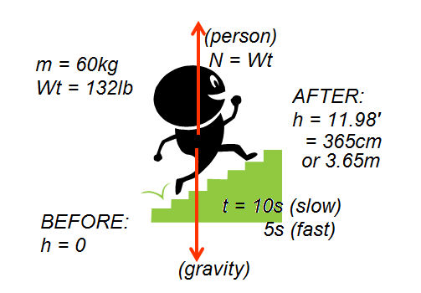
Worked problem
Consider climbing one flight of stairs that is about 11.98ft, or 365cm.
How much work does a 60kg (132lb) person do against gravity to climb it?
What power does this person exert against gravity walking (t=10s) or running (5s) up those stairs?
Repeat (a) for climbing two flights of stairs at the same speeds.

Slide 36
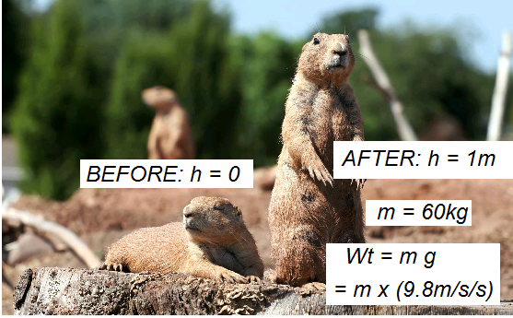
Example
Let’s assume you’re about 60kg (132lb) and 1m tall, with your body weight evenly distributed. That means that a physicist would see you as a 60kg point-mass 1m above the ground when you’re standing up. ;)
How quickly must you do “stand ups” (standing up from a full prone position) to recreate a 100W power bulb?
http://www.natures-desktop-hd.com/images/wallpapers/1680x1050/
animals/pair-prairie-dogs.jpg

Slide 37
Example
Let’s assume you’re about 60kg (132lb) and 1m tall, with your body weight evenly distributed. That means that a physicist would see you as a 60kg point-mass 1m above the ground when you’re standing up. ;)
How quickly must you do “stand ups” (standing up from a full prone position) to recreate a 100W power bulb?
http://www.natures-desktop-hd.com/images/wallpapers/1680x1050/
animals/pair-prairie-dogs.jpg

Slide 38
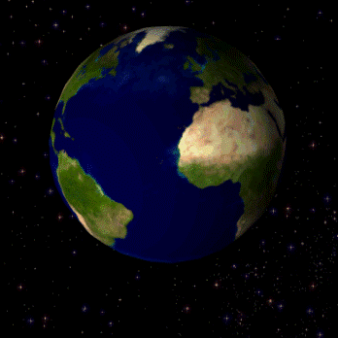
Worked example
World energy use is about 500Quad/yr. Translate that into Watts.
Energy used = 500Q
time = 1 yr
Coincidentally, the work “terra” means the Earth, while “tera” means a trillion. Handy way to remember the rough size of world power consumption.
Image: http://en.wikipedia.org/wiki/File:Rotating_earth_(large).gif

Slide 39
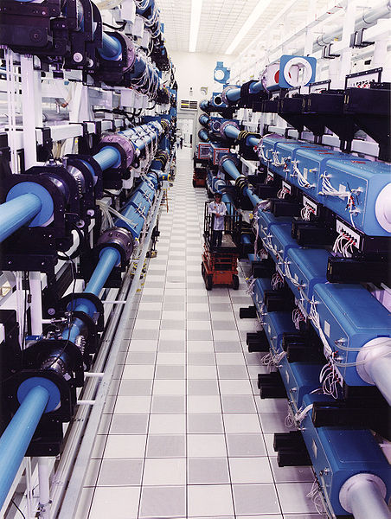
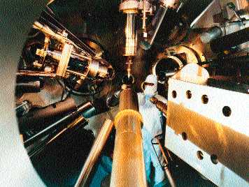
Example
The NOVA laser at Lawrence Livermore National Lab is capable of producing 100TW laser pulses.
How is that even possible?
These are 600J laser pulses. What is the duration of each?

Slide 40
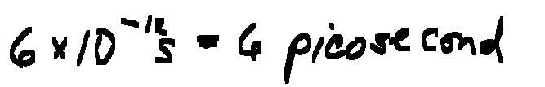
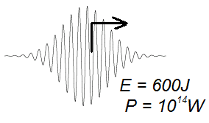
Worked exercise
The NOVA laser at Lawrence Livermore National Lab is capable of producing 100TW laser pulses.
How is that even possible?
These are extremely short pulses, punctuated by a lot of P=0W in between, so the average power usage is a LOT less than the Earth’s total power consumption.
These are 600J laser pulses. What is the duration of each?
Image: http://www.fusion-eur.org/fusion_cd/
pictures/page33_2.jpg. Accessed 9/1/11, http://upload.
wikimedia.org/wikipedia/commons/thumb/
8/81/Nova_laser_repairs.jpg/452px-Nova_laser_repairs.jpg.
http://skullsinthestars.files.wordpress.com/2007/12/disturbance2.gif?w=640.

Slide 41
Example
A 345hp Corvette delivers how many Watts of power?
A 110hp Ford Escort?

Slide 42
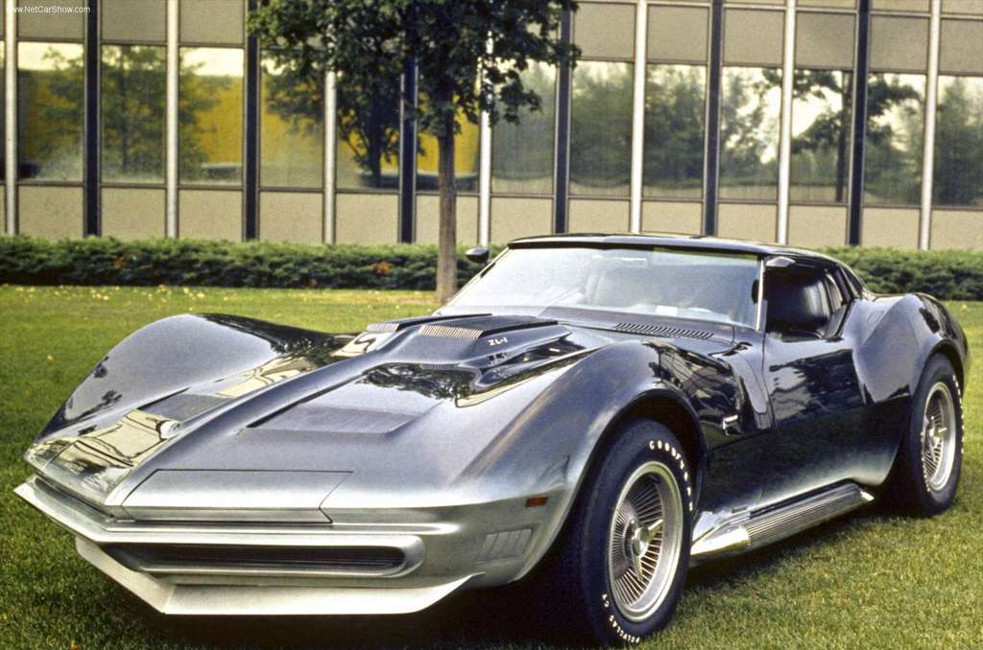
Worked examples
A 345hp Corvette delivers how many Watts of power?
A 110hp Ford Escort?
(These are just unit conversion exercises. Since 1hp = 746W, the answers are
Corvette: 345hp = 260kW
Escort: 110hp = 82kW.)
How long would a 100W light bulb need to burn to equal the amount of energy spent in your daily half-hour commute to work in your Escort?
The car burns E=Pt = 82kW(0.5hr) = 41kW.hr of energy, so a 100W = 0.1kW bulb needs to burn for 410 hours (16 days)!
Image: http://www.cardbs.com/images/chevrolet-corvette-17.jpg

Slide 43
Per Capita Energy and Power Use
The average power expended per person in the United States is about 10 kW.
The annual energy consumption in the United States is about 98×10¹⁵ Btu/year = 103×10¹⁸ joules/year.
The United States has one of the world’s highest energy consumption per capita and one of the highest standards of living.
In most countries, higher living standards, as measured by GDP per capita, are matched by higher energy consumption per capita.

Slide 44
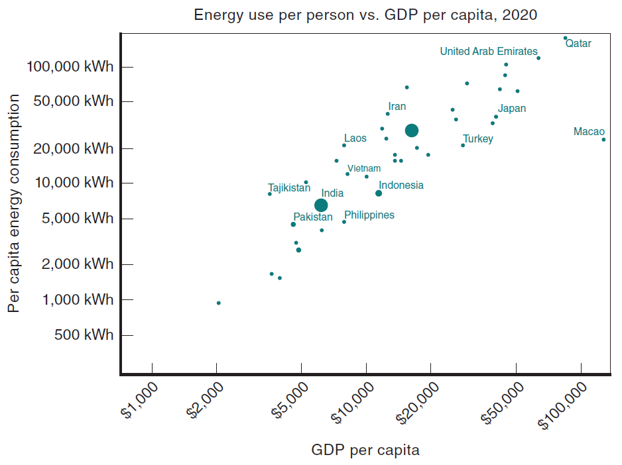
Per Capita Energy and Power Use
Comparison of 2021 energy use per capita versus GDP per capita for various countries.
Notes:
Figure 3.3 Comparison of 2021 energy use per capita versus GDP per capita for various countries.

Slide 45
Per Capita Energy and Power Use
The average power consumption per person is about 4 kW for Switzerland and Japan, countries with approximately the same standard of living as the United States.
The power consumption per capita in India is about 0.84 kW.
A modern-size power plant produces electrical energy at a rate of about 1 billion watts, or 1000 megawatts.
Hydropower is an example of electrical power obtained from a renewable source, which provides about 6% of the total U.S. electrical energy needs.

Slide 46
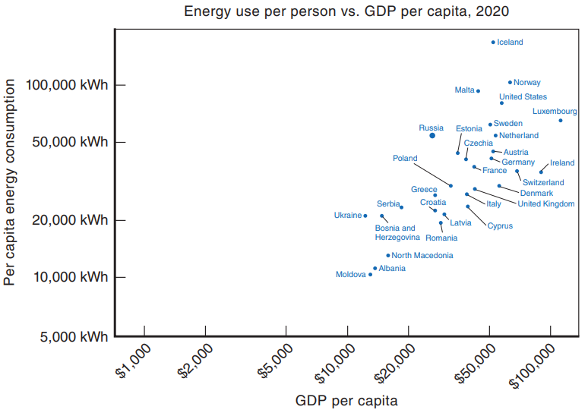
Per Capita Energy and Power Use
Comparison of 2021 energy use per capita versus GDP per capita for various developing countries.
Notes:
Figure 3.4 Comparison of 2021 energy use per capita versus GDP per capita for various developing countries.

Slide 47
Special Topic: Simple Machines (1 of 4)
The purpose of this section is to illustrate different devices that multiply a force at the expense of a distance.
The word for “machine” comes from the Greek meaning “to help make things easier.”
One of the simplest machines is the lever, which is a rigid bar pivoted at a point called the fulcrum.
Levers have been used since prehistoric times to move heavy stones, lift water, and help in building construction.
Other examples of a lever are a crowbar and a claw hammer.

Slide 48
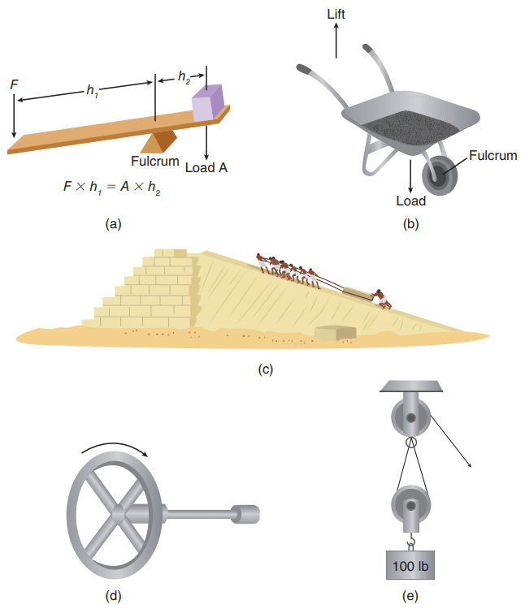
Simple Machines (2 of 4)
Several types of simple machines: (a) lever; (b) wheelbarrow; (c) inclined plane (pyramid construction); (d) wheel and axle; (e) pulley system.
Notes:
Figure 3.5 Several types of simple machines: (a) lever; (b) wheelbarrow; (c) inclined plane (pyramid construction); (d) wheel and axle; (e) pulley system.

Slide 49
Simple Machines (3 of 4)
Another very simple machine is the inclined plane.
Inclined planes or ramps were probably used during the construction of the Egyptian pyramids to move the large blocks of stone to the top.
Two other types of machines are the wheel and axle and the pulley. A wheel is like a circular lever.
The wheel is much bigger than the axle, so it can increase the force as it moves to a much larger distance.

Slide 50
Simple Machines (4 of 4)
A gear is a wheel with teeth and it is used to transfer a force to different parts of a machine; it also enables different parts to work at different speeds.
Pulleys can change the size and direction of a force.
A system of pulleys, called a block and tackle, can easily lift an engine out of a car.

Slide 51
Simple machines at Home
Different types of simple machines used at home.
Pulley: Blinds, garage doors, and flag poles.
Lever: See saw, pry bar, and lever action door latches.
Wedge: Scissors, a screw, and a knife.

Slide 52
Problem on Work
A 380-kg piano slides 3.9 m down a 27° incline and is kept from accelerating by a man who is pushing back on it parallel to the incline Determine: (a) the force exerted by the man, (b) the work done by the man on the piano, (c) the work done by the force of gravity, and (d) the net work done on the piano. Ignore friction.

Slide 53
Problem on Work
A 2800-kg space vehicle, initially at rest, falls vertically from a height of 3300 km above the Earth’s surface. Determine how much work is done by the force of gravity in bringing the vehicle to the Earth’s surface.

Slide 54
Problem on conservation of Energy
A 0.40-kg ball is thrown with a speed of 8.5 m/s.at an upward angle of 36°. (a) What is its speed at its highest point, and (b) how high does it go? (Use conservation of energy.)

Slide 55
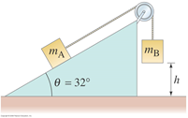
Problem on conservation of Energy
Two masses are connected by a string as shown in Fig. below. Mass m_{A}=4.0kg rests on a frictionless inclined plane, while m_{B}=5.0kg is initially held at a height of h=0.75m above the floor. (a) If m_{B} is allowed to fall, what will be the resulting acceleration of the masses? (b) If the masses were initially at rest, use the kinematic equations to find their velocity just before m_{B} hits the floor. (c) Use conservation of energy to find the velocity of the masses just before m_{B} hits the floor. You should get the same answer as in part (b).

