Slide 1
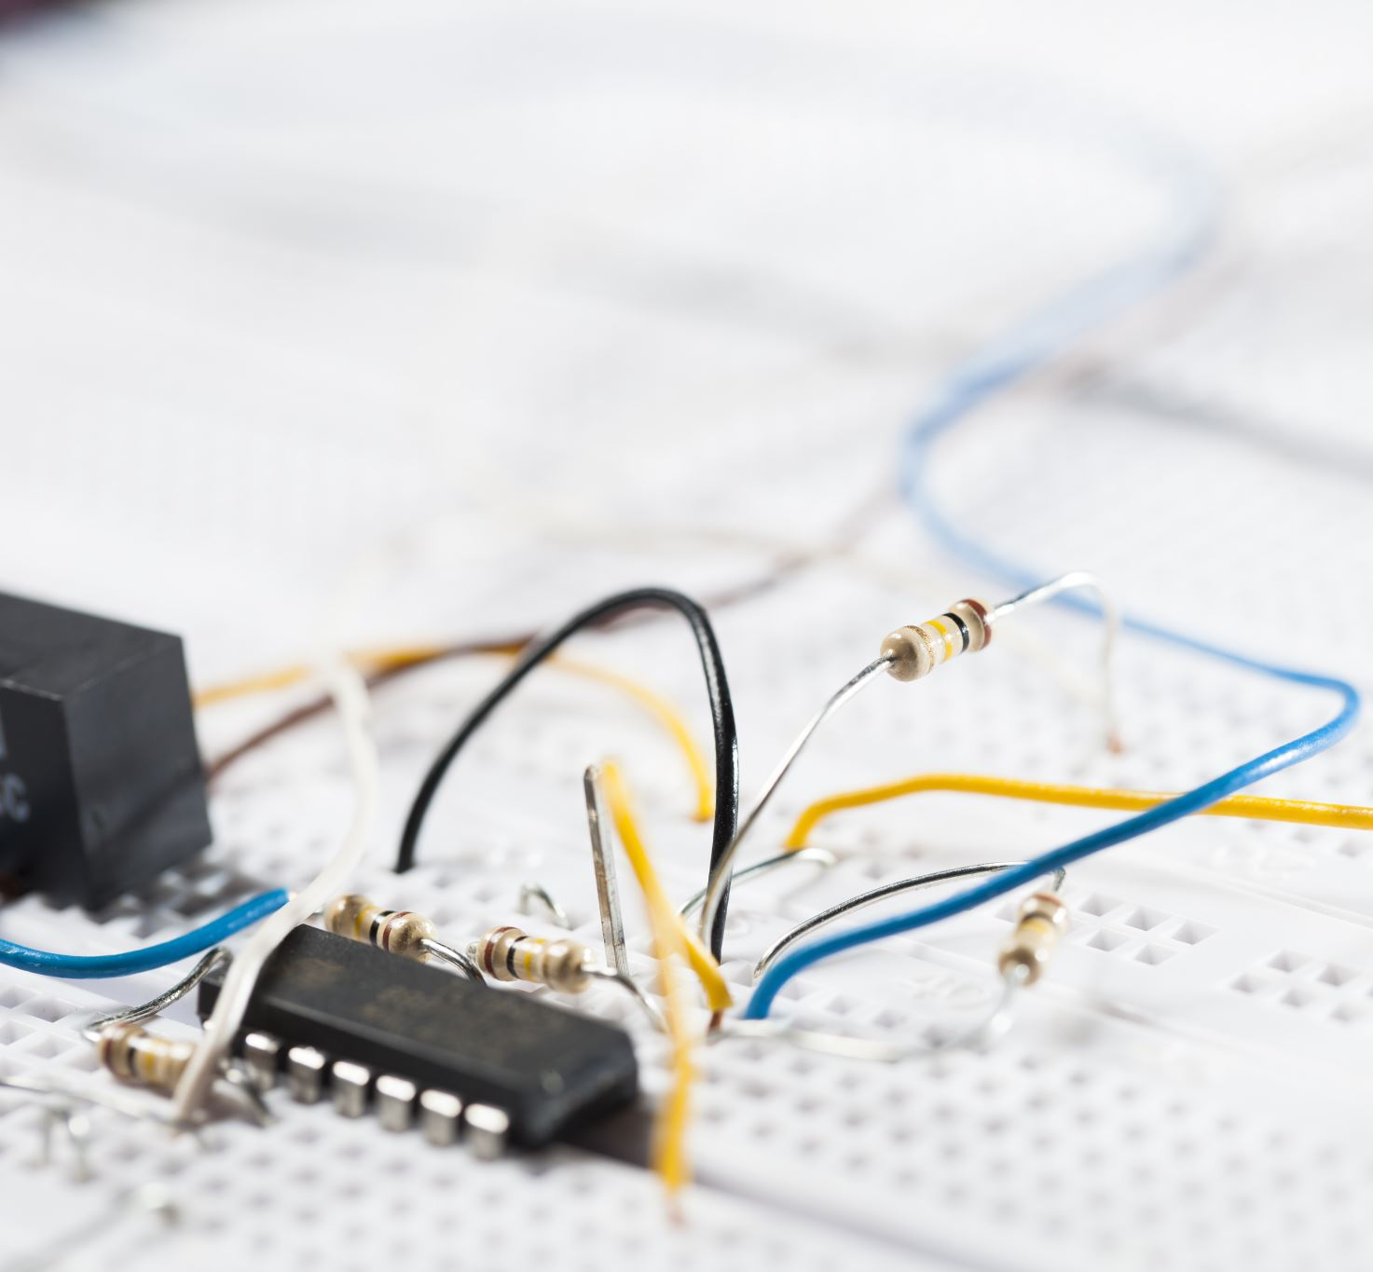
Chapter 11: Electricity: Circuits
HW 3 posted due on Nov. 11

Slide 2
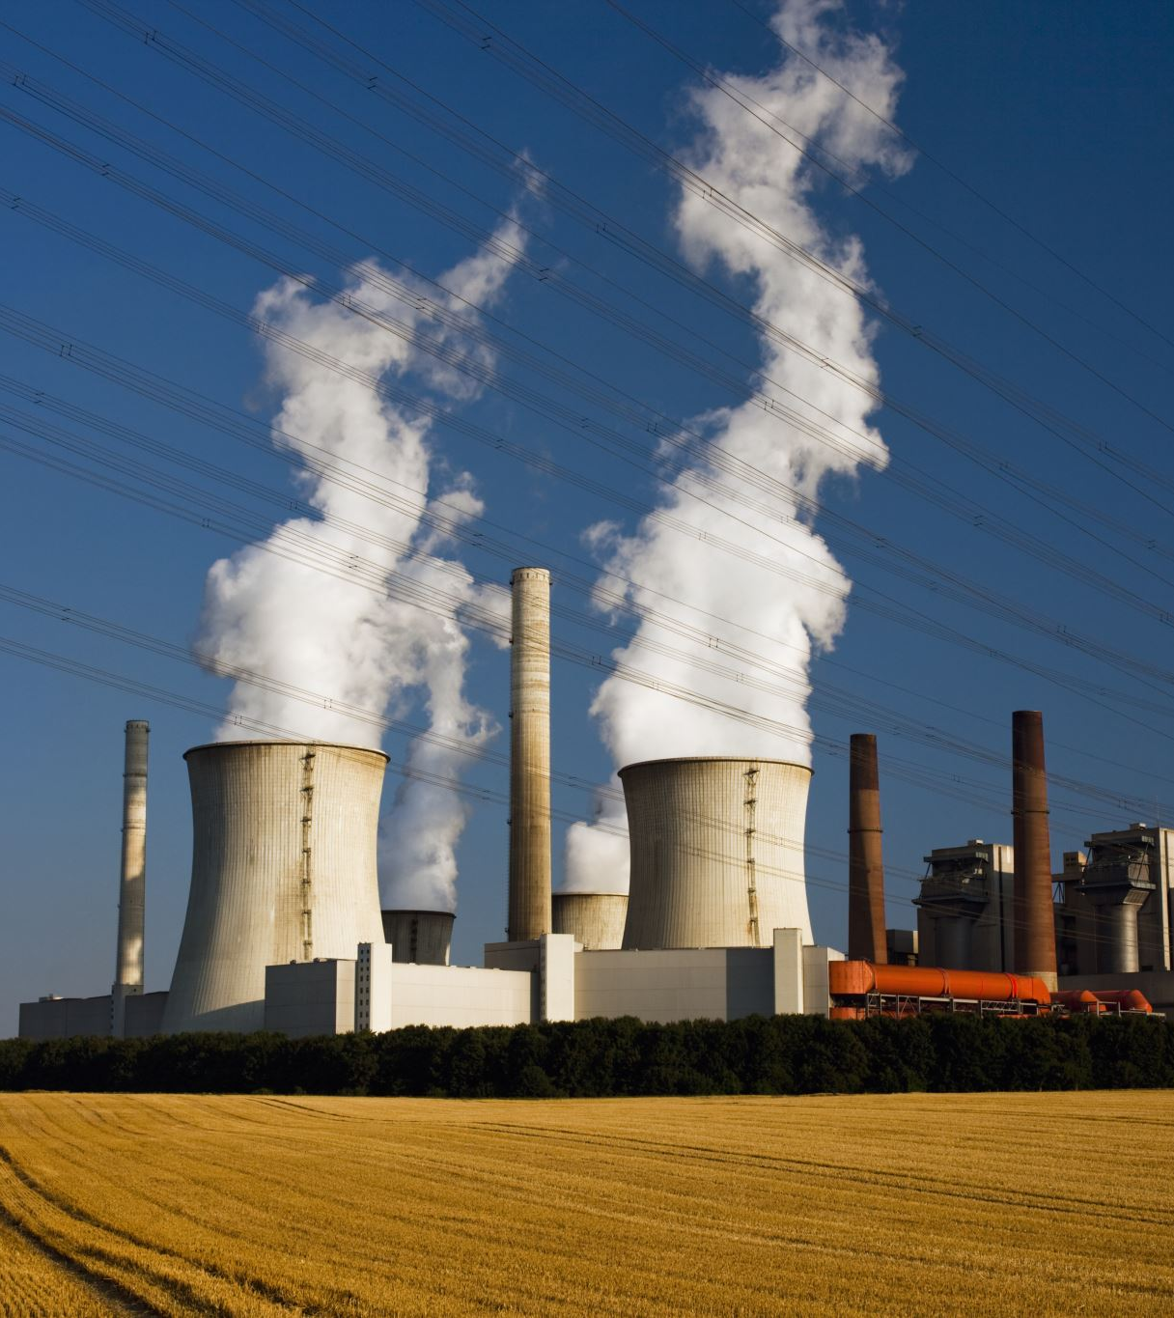
Introduction to “Electrification” (1 of 3)
Electricity consumption has the largest growth rate of any major energy use sector.
The growth rate slowed due to rising electricity costs due to increasing fuel prices and higher costs of new power plants.
The Clean Air Act also forced utilities to invest in expensive air pollution-control devices.
In the 1990s, U.S. electricity consumption grew by about 1.7% per year, not much more than the GDP growth rate.
dagostinom3@mailbox.winthrop.edu

Slide 3
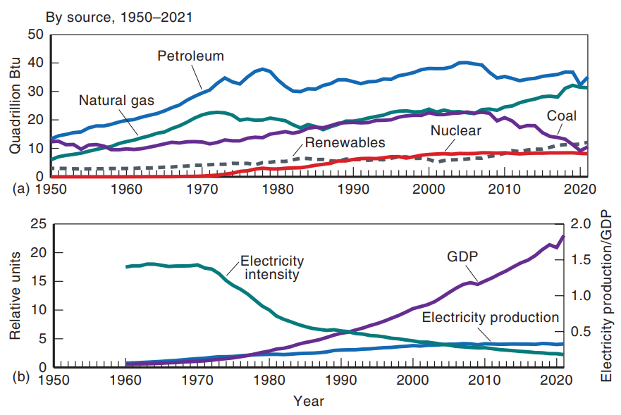
Introduction to “Electrification” (2 of 3)
(a) U.S. production of electricity by type of generation, 1950–2021.
(b) U.S. electricity production versus GDP, 1950–2021. Electricity intensity equals ratio of these two.
Notes:
Figure 11.1 (a) U.S. production of electricity by type of generation, 1950–2021. (b) U.S. electricity production versus GDP, 1950–2021. Electricity intensity equals ratio of these two. (Source: USEIA)

Slide 4
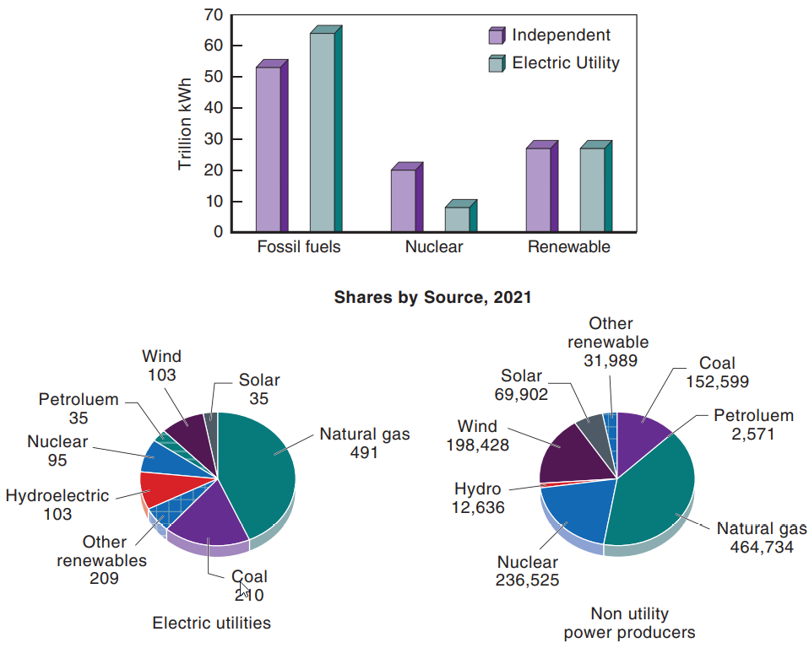
Introduction to “Electrification” (3 of 3)
U.S. electric power industry generation, 2020, for utilities and independent power producers.
Notes:
Figure 11.2 U.S. electric power industry generation, 2020, for utilities and independent power producers. (Source: USEIA)

Slide 5
Restructuring of the Electric Utility Industry (1 of 2)
Ground rules for how electricity will be generated, bought, and sold for the next few years.
Electricity has been generated primarily in central-station power plants.
The highly regulated structure of the twentieth century changed to a market that relies on competition and little regulation to set the price of electricity generation.
In 1978, the U.S. Congress passed the Public Utility Regulatory Policies Act (PURPA).

Slide 6
Restructuring of the Electric Utility Industry (2 of 2)
Feed-in tariff—a law that obliges energy suppliers to buy electricity produced from renewable resources at a fixed price.
Competition is expected to lower the price per kWh of electricity.
Many states require that your electric bill disclose what sources were used.
During a winter storm in 2021, most of Texas was without power.
California has regular rolling blackouts as disasters such as heat waves and wildfires strain the electrical grid.
Utilities are reluctant to build more power plants due to the uncertainty of the market and environmental legislation.

Slide 7
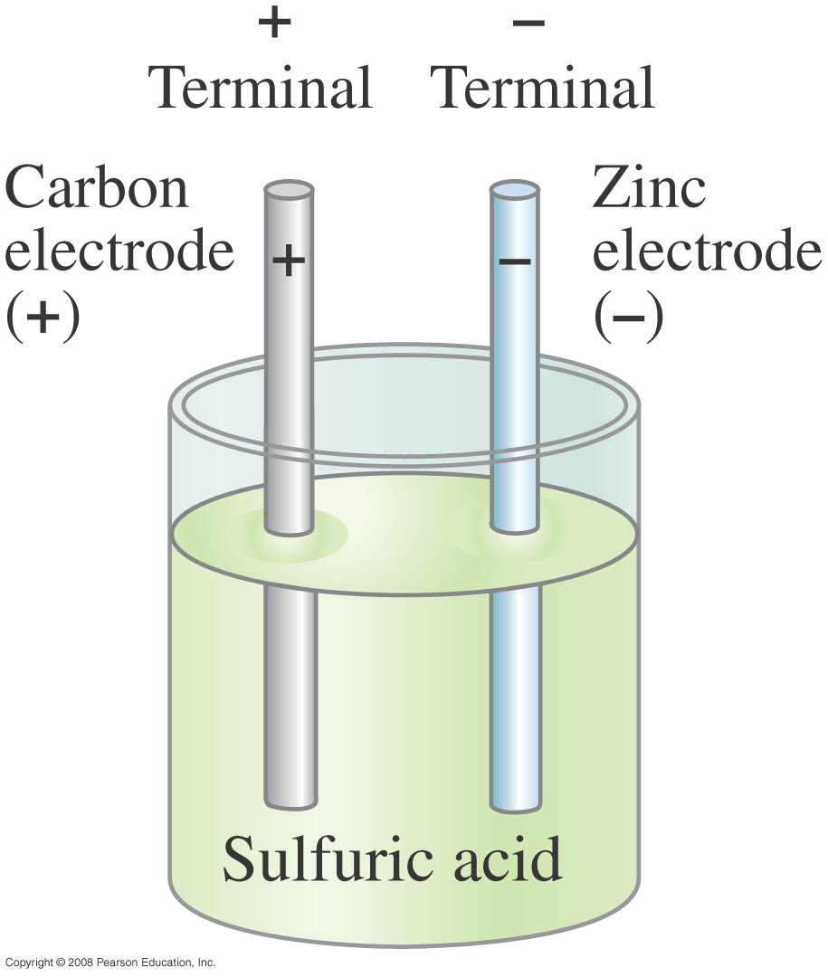
The Electric current
Volta discovered that electricity could be created if dissimilar metals were connected by a conductive solution called an electrolyte (1799).
He created the electric battery, and proved that electricity could be generated chemically debunking the theory that it was generated solely by living beings.
Notes:
Figure 25-3. Simple electric cell.

Slide 8
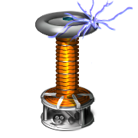
US Electric usage: history
1706-1790: Benjamin Franklin
Lightning as electricity (1750)
Positive/negative convention
1879: Edison invents incandescent bulb, first major public “app” for electricity. Replaces….
Gas lamps (using “city gas” = carbon monoxide) outdoors
Candles, [oil] lanterns indoors
“Lime light” in the theatre
1880s – ca. 1891 “The War of Currents”: Edison vs. Westinghouse, Siemens, etc. fight over whether electric grid should be AC or DC.
Westinghouse & AC win

Slide 9
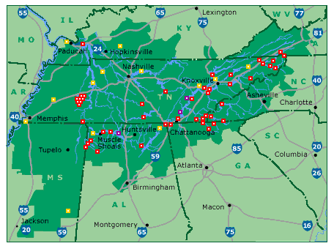
US Electric usage: history
Urban, then rural electrification throughout first half of 20th Century.
Tennessee Valley Authority (TVA), huge hydroelectric project, one of the lynchpins of FDR’s economic recovery plan from Great Depression.
1950s and 1960s: 7% average annual increase in usage (rise of refrigerators, TV)
By 1990s, annual increase slows to 1.7%
Image: TVA map: http://upload.wikimedia.org/wikipedia/commons/e/eb/TVA-sites-map.png

Slide 10
US Electric usage: history
Nuclear electric power production (post-WWII)
In 2011 nuclear power provided 10% of the world's electricity.
In 2007, the International Atomic Energy Agency reported that there were 439 nuclear power reactors in operation in the world, operating in 31 countries.
Many have now ceased operation in the wake of the Fukushima nuclear disaster while they are assessed for safety.
In 2011 worldwide nuclear output fell by 4.3%, the largest decline on record, on the back of sharp declines in Japan (-44.3%) and Germany
(-23.2%).
It is:
“Clean” alternative to fossil fuel burning plants that would be “too cheap to meter”.
Currently supplies are 80% of French electric power.
Political hot potato, especially after TMI (1979) & Chernobyl (1986), Japan (2011).
More about nuclear power in a later chapter.

Slide 11
Electric quantities: Static electricity & electric charge
Static [stationary] electricity.
as opposed to current electricity which has a normal state of motion.
e.g. sparks, lightning, “static cling”, “bad hair days”,
Electric charge, Q.
Units: Coulomb [C]. One electron has a charge of
e = 1.6×10⁻¹⁹C

Slide 12

Electric Charge, q or Q
+e
-e
Charge comes in two types
1e = 1.6x10⁻¹⁹ Coulombs (unit of charge) fundamental unit of charge
Law of Conservation of Charge: The net charge on a closed system never changes.
Charge can be transferred
Charges are added algebraically
Electricity comes from the Greek , and the word “elektron” (amber), the Greeks noticed that when rubbing a piece of amber with a cloth they a had static effect or “amber effect.”

Slide 13
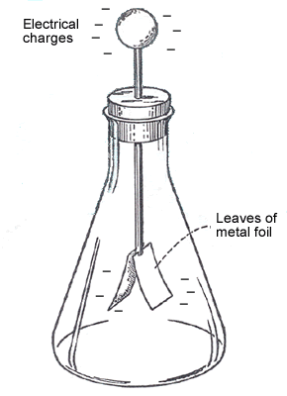
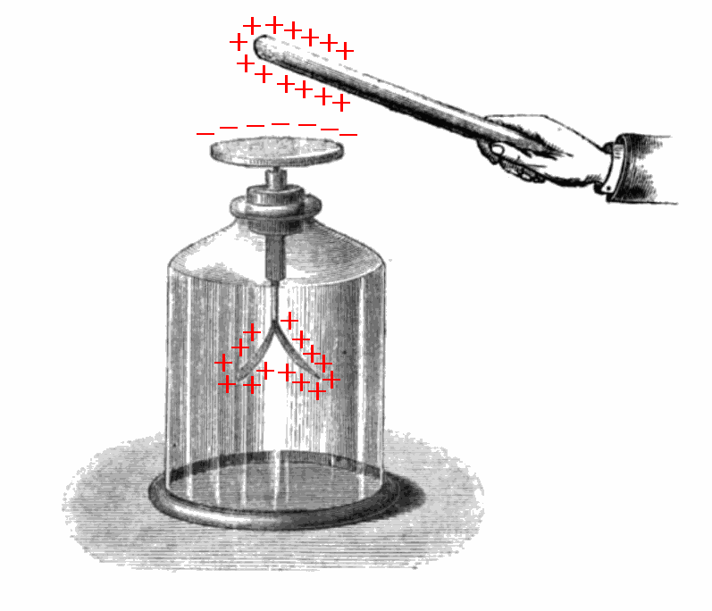
Electric charge
Two flavors: positive and negative
Like charges repel.
Opposite charges attract.
An electroscope is an early scientific instrument that is used to detect the presence and magnitude of electric charge on a body.
Images: http://www.teclas.org/chispas/images/electroscope1.gif
http://upload.wikimedia.org/wikipedia/commons/e/ec/Electroscope_showing_induction.png

Slide 14



Electric hazards
Current < 5 mA – No harm
10 – 20 mA – Involuntary muscle contraction or paralysis, burns
100 – 300 mA – Ventricular fibrillation
66A –Defibrillation. Temporary Respiratory paralysis. Burns.
A
Defibrillation.. Burns.
Shock disturbs heart rhythm
Shock restores heart rhythm

Slide 15
Electric quantities: Current electricity & electric current
Current electricity: Electric charge flows in a normally steady state fashion.
Current, I, is rate at which charge flows:
Units: Amperes (Amps) [A] = Coulomb/sec
Water flow analogy: Current in a wire is like the rate at which water flows through a river that has no streams flowing in or out of it. It’s constant along the length of the river.

Slide 16
Electric quantities: potential difference
Potential difference, ΔV, is potential energy difference per charge:
ΔV=ΔU/Q
Units: (Volts) [V] = Joules/Coulomb
Water flow analogy: Potential difference is like the difference in altitude between the top and bottom of a waterfall. This difference is what persuades the water to flow in that direction, rather than the other way around.

Slide 17
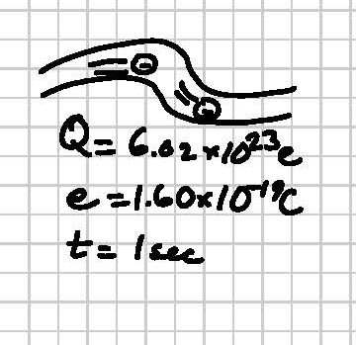
Worked problems
A “mole” is Avogadro’s number (6.02×10²³) of anything.
How much current would 1 mole of electrons per second be?
An amp is how many moles of electrons per second?

Slide 18
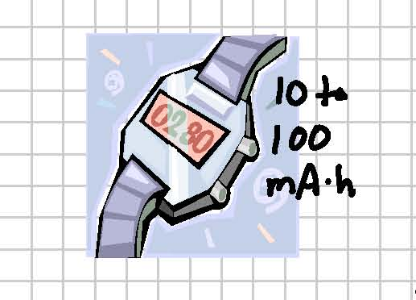
Worked problems
A typical watch battery is rated at between 10 and 100 “mAh”, or milliamp-hour. What electrical quantity would have units of mAh? Convert it into more familiar metric units.

Slide 19
Electric Current
Example : Current is flow of charge.
A steady current of 2.5 A exists in a wire for 4.0 min. (a) How much total charge passed by a given point in the circuit during those 4.0 min? (b) How many electrons would this be?
Notes:
Solution: a. Charge = current x time; convert minutes to seconds. Q = 600 C.
b. Divide by electron charge: n = 3.8 x 10²¹ electrons.

Slide 20

Electric quantities: resistance
A measure of the difficulty of sending current through some part of a circuit
Resistance = Voltage / current.
Units: Ohm [Ω] = Volt / Amp
V=RI is Ohm’s law
Image: http://www.circuitstoday.com/wp-content/uploads/2010/02/Symbol-of-resistor.JPG

Slide 21
Problem
5. An electric clothes dryer has a heating element with a resistance of 8.6Ω (a) What is the current in the element when it is connected to 240 V? (b) How much charge passes through the element in 50 min? (Assume direct current.)

Slide 22
Electrical Power
The electrical energy in a circuit, supplied by a generator or battery, is either converted into work (as in a motor) or dissipated as heat energy.
The following equation gives the rate at which electrical energy is delivered to a device
The rate at which electrical energy is converted into heat is related to the device’s resistance.
To prevent the overheating of wires, household circuits use heavy copper wires.

Slide 23
Electric quantities: power
As before, the rate at which energy is provided [or spent]
Units: Watt [W] = Joule / sec = Volt × Amp
We can apply Ohm’s Law (V=IR) to obtain

Slide 24
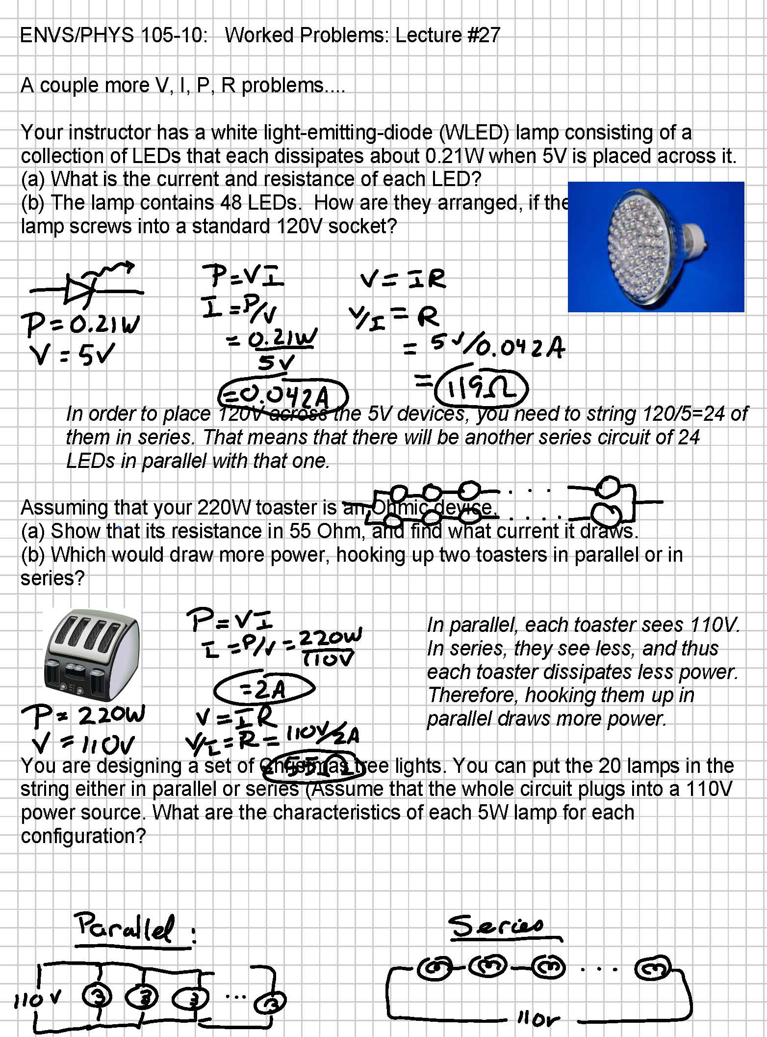
Worked problems
Assuming that your 220W toaster is an Ohmic device,
a) Show that its resistance is 55 Ohm, and find what current it draws.
b) Which would draw more power, hooking up two toasters in parallel or in series?

Slide 25
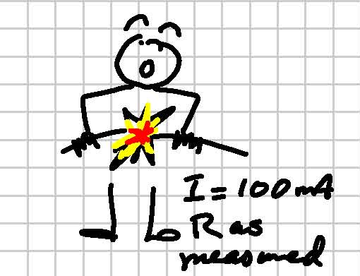
Worked problems
100 milliamps can kill. What resistance would you need to insert into a 110V socket to produce such a current? If your skin resistance is 2MΩ. How much voltage would be needed to off you if it required 100mA? What if his skin were wet (R=0.5MΩ)?

Slide 26
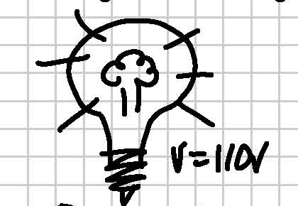
Worked problems
Given any of the following two quantities -- voltage, current, resistance, power -- you can calculate the other two. Verify that for the following problem: What is the resistance and current of a 100W lightbulb (Note that the wattage assumes a particular voltage source, in this case, 110V.)?
P=100W

Slide 27
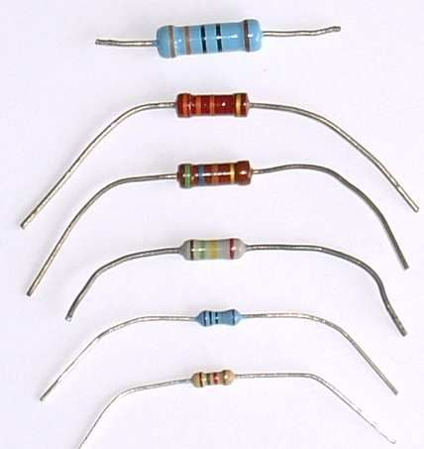
Worked problems
Which is more dangerous, sticking a 100kilohm resistor into a wall socket or a 10 ohm resistor (of the same physical size) across a 9V battery?
(The important quantity here is power dissipated. This will determine whether the resistor catches fire.)
Image: http://simonpstevens.com/Content/Projects/Microcontrollers/Posts/MicrocontrollerIntroEquipment_Files/Resistor.jpg

Slide 28
Study questions
For water to flow through a pipe, there must be a water pressure difference between the ends of the pipe. For electric charge to flow through a wire there must be a (an) ____ difference between the ends of the wire.
electrical
current
potential
power
charge

Slide 29
Study questions
When the switch in an electric circuit is in the off position, the current in the circuit is zero. Therefore, we would say the electric resistance of the switch is
zero.
very large, essentially infinite.
115 ohms.
impossible to determine without knowing the voltage.
irrelevant. Only wires have electrical resistance.

Slide 30
Circuits
Circuit = a loop (or series of loops) in which current flows.
A circuit can only function if it has…
motive (a power supply = potential difference)
opportunity (a complete path for the charge to return to the other terminal of the power supply). This is why a circuit needs two wires.

Slide 31
Elementary Circuits
Series Connections:
The devices can be put one after the other in series; for this situation, the same current flows through each one.
As more devices are added to this circuit, the total resistance of the circuit increases.
The total resistance is the sum of the resistances of the individual devices.
As the resistance in the circuit increases, a decrease in the amount of current will occur.
Parallel Connections:
In this arrangement, the incoming current divides between the devices.
The potential difference across each resistor is the same; each device in a parallel circuit receives the same voltage supplied by the source and is independent of the others.
The total resistance of the parallel circuit decreases as more devices are added.
As a parallel circuit’s total or equivalent resistance decreases, the total current increases.

Slide 32
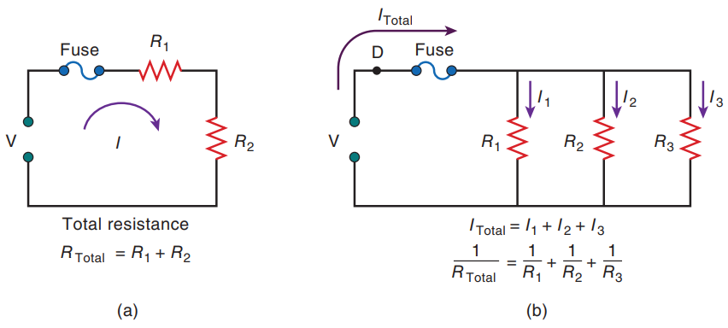
Series and Parallel circuits
(a) A circuit containing resistors in series. As more devices are added, the total resistance increases, and the current decreases. (b) A circuit containing resistors in parallel. As more devices are added, the total resistance decreases. However, the current through each device (I₁,I₂, etc.) remains the same.
Notes:
Figure 11.9 (a) A circuit containing resistors in series. As more devices are added, the total resistance increases, and the current decreases. (b) A circuit containing resistors in parallel. As more devices are added, the total resistance decreases. However, the current through each device (I₁,I₂, etc.) remains the same.

Slide 33
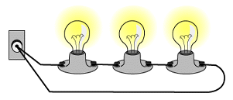
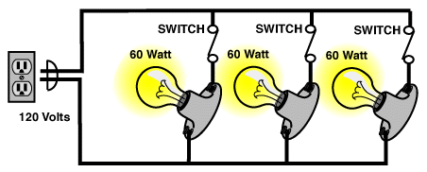
Series and Parallel circuits
Series: Parallel:
Currents same. Currents add.
Voltages add. Voltages same.
Series circuit: http://epb.apogee.net/foe/graphics/cspsc1.gif
Parallel circuit: http://c03.apogee.net/contentplayer/templates/foe/cspp3.gif. Accessed 10/24/11.

Slide 34
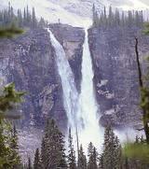

Parallel & Series circuits
Which quantity is the same for each of the twin falls? Which adds?
Rate of water flow (volume/time)
Height of the fall
Twin Falls, Idaho (left) Twin Falls of Devils Fork, Arkansas (right)
http://trialx.com/curetalk/wp-content/blogs.dir/7/files/2011/05/cities/Twin_Falls-3-small.jpg
http://coreofharrison.org/wp-content/uploads/2010/03/Twin-Falls-of-Devils-Fork-300x150.jpg

Slide 35

Series and parallel circuits
Which quantity is the same for each cascade in the falls? Which adds?
Rate of water flow (volume/time)
Height of the fall
Cascade Waterfall, near Mt. Rainier
http://farm3.static.flickr.com/2428/3613496401_a93f8073c4.jpg

Slide 36
Worked problems
You are designing a set of Christmas tree lights. You can put the 20 lamps in the string either in parallel or series (Assume that the whole circuit plugs into a 110V power source. What are the characteristics of each 5W lamp for each configuration?

Slide 37
Superconductivity (1 of 3)
Certain materials conduct direct current electricity without energy loss when they are cooled below a critical temperature.
One of the most exciting developments in recent times has been the discovery of “high-temperature” superconductors.
Physics research continues trying to understand the basic mechanism responsible for various unconventional classes of high-temperature superconductors.
The loss of resistance at temperatures below the critical temperature leads to numerous applications.

Slide 38
Superconductivity (2 of 3)
The conductor coils are envisioned as large circles 1/2 mile in diameter and buried underground.
Superconducting material also excludes magnetic fields from its interior, leading to levitation.
When a magnet is placed near a superconductor, the magnet hovers in the air.
Superconductivity is a fragile process that depends on more than just the temperature of the material.
High currents and strong magnetic fields in transmission lines can cause the material to return to its non-superconducting state.

Slide 39
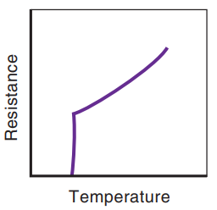
Superconductivity (3 of 3)
The applications of superconductors include computers used at higher speeds and denser arrays of electronic components. Superconductors also are used in medical imaging devices, such as magnetic resonance imaging (MRI) units, which use large currents to image the body’s soft tissue.
Resistance versus temperature for a superconductor. The resistance is like that of a normal metal for higher temperatures but drops to zero at the critical temperature.

Slide 40
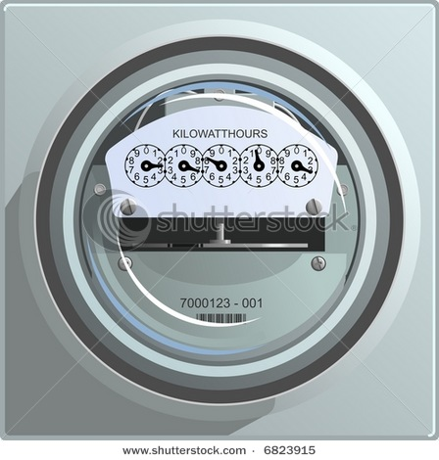
Study questions
Homeowners pay their electric utilities bills in units of cents per.....
watt.
kilowatt.
joule.
Btu.
kilowatt-hour.
Image: http://image.shutterstock.com/display_pic_with_logo/101406/101406,1194643101,1/stock-photo-electric-power-meter-6823915.jpg

Slide 41

Feed-in Tariff policy
What is the feed-in tariff policy? In what ways does it resemble with a net metering policy?
Answer: A feed-in tariff is a law that obliges energy suppliers to buy electricity produced from renewable resources at a fixed price. These legal guarantees ensure investment security and the support of viable renewable-energy technologies. This law is similar to a net metering policy, in which the customer gets credit for electricity generated (usually from wind or solar cells—PV) over demand.

Slide 42
Pricing Electrical Energy Use
The energy used is the power (in watts) expended × the period of use (in hours), expressed in units of kilowatt-hours (kWh).
Unfortunately, this small energy cost is one reason people have largely ignored electrical energy conservation and have continued to increase our per capita electricity consumption.
The average U.S. home uses about 900 kWh of electricity per month (excluding space heating).

Slide 43
Pricing Electrical Energy Use
A new system of setting electricity rates and increasing system efficiency is called time-of-use pricing.
This method charges customers according to what time of day they use electricity;
The cheapest rates are for using electricity during off-peak hours, usually from 9 pm to 7 am.
Computers and electronic controls can turn on appliances when the demand is low and electricity is less expensive, such as electric vehicle charging.
Heating and cooling can total 50% of the cost.

Slide 44
Battery types and energy density
Type | Energy density (W·hr/kg)
Lead-acid (car battery) | 30-50
Ni-Cd (Nickel-cadmium, “Ni-cad”) | 55
NiMH (Nickel-metal-hydride) | 60
Lithium ion | 150
Gasoline (okay, okay, not a battery) | 13,000
What does this table tell you about the feasibility of an electric car vs an internal combustion engine?
What technological breakthroughs will make (are making) the electric car a practical alternative?

Slide 45
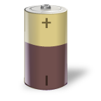
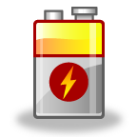
Battery energy capacity
Type | Q (A·hr) | E= Q·V (W·hr)
AAA | 1.2 | 2
AA | 2.9 | 4.4
C cell | 8 | 12
D cell | 15 | 23
Typical laptop | 50 | 950
A typical laptop battery can store about 1kW·hr of electricity when fully charged. How much would the electric company charge you for that?
Which costs more the electric charge in a battery you buy from the store or the “packaging” it comes in?

