Slide 1
Nuclear Physics

Slide 2

Alpha Decay
In general, alpha decay can be written:
Alpha decay occurs when the strong nuclear force cannot hold a large nucleus together. The mass of the parent nucleus is greater than the sum of the masses of the daughter nucleus and the alpha particle; this difference is called the disintegration energy.

Slide 3
Alpha Decay
Example 41-5: Uranium decay energy release.
Calculate the disintegration energy when (mass = 232.037156 u) decays to (228.028741 u) with the emission of an α particle. (As always, masses given are for neutral atoms.)
Example 41-6: Kinetic energy of the α in decay.
For the above decay, how much of the 5.4-MeV disintegration energy will be carried off by the α particle?
Notes:
Solution: Using conservation of energy gives E = 0.005812 u = 5.4 eV. Conservation of energy and momentum show that the α particle carries off 5.3 eV, or 98% of the disintegration energy.

Slide 4
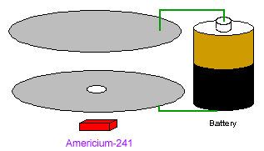
A use for alpha-decay
Smoke detectors contain radioactive americium-241 (half-life 432 yrs)
²⁴¹Am decays by alpha emission.
Alpha particles from the americium collide with oxygen and nitrogen particles in the air creating charged ions.
An electrical current is applied across the chamber in order to collect these ions (just like geiger counter!)
When smoke is in chamber,
smoke absorbs alpha particles.
Current decreases,
detected by electronics

Slide 5
Beta decay
Beta radiation…
  Now known to be an electron.
  Radioactive nucleus emits an electron
How can this be?
  There are no electrons in the nucleus!
  Has only neutrons and protons.
Particles are not forever!
  Charge is forever, energy + mass is forever
  But particles can appear and disappear or be changed

Slide 6
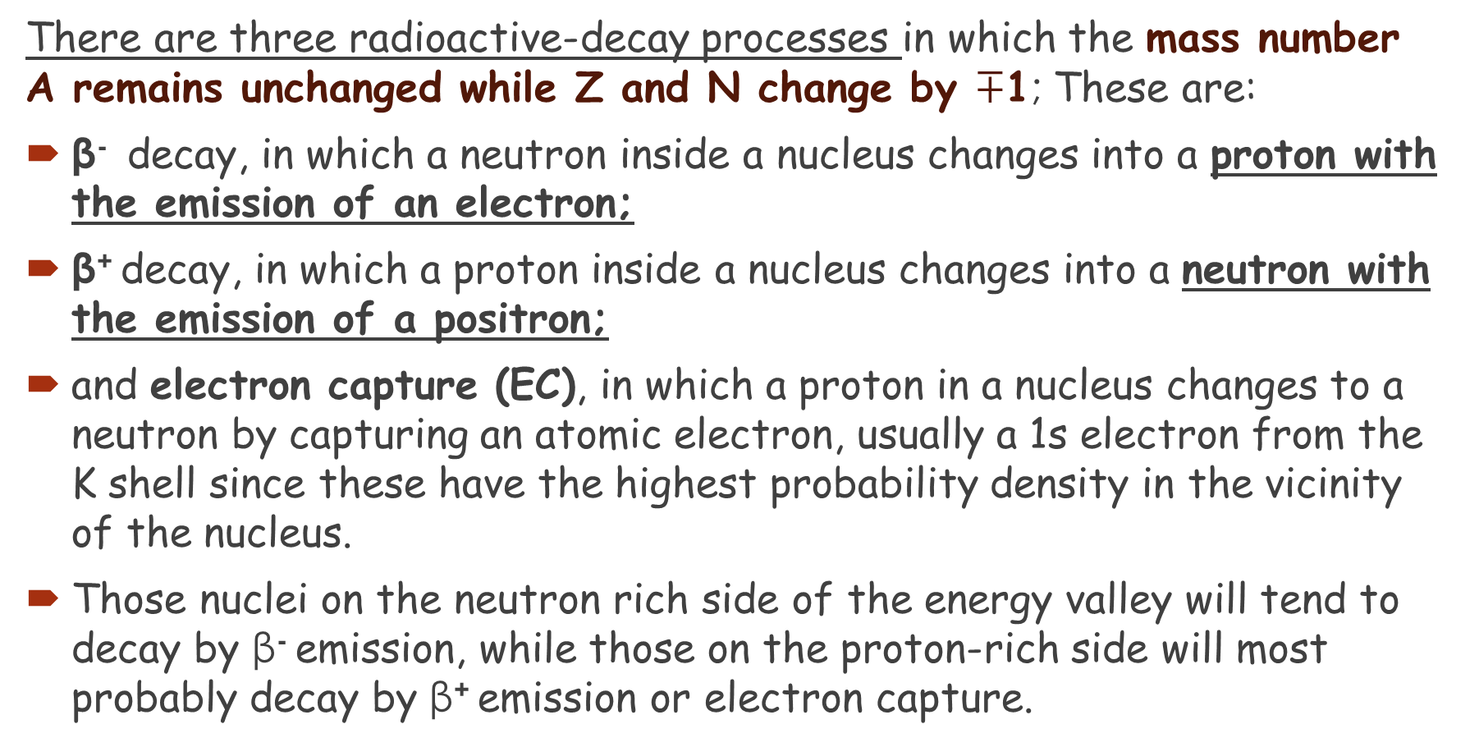
βeta decay
There are three radioactive-decay processes in which the mass number A remains unchanged while Z and N change by $∓$1; These are:
β⁻ decay, in which a neutron inside a nucleus changes into a proton with the emission of an electron;
β⁺ decay, in which a proton inside a nucleus changes into a neutron with the emission of a positron;
and electron capture (EC), in which a proton in a nucleus changes to a neutron by capturing an atomic electron, usually a 1s electron from the K shell since these have the highest probability density in the vicinity of the nucleus.
Those nuclei on the neutron rich side of the energy valley will tend to decay by β⁻ emission, while those on the proton-rich side will most probably decay by β⁺ emission or electron capture.

Slide 7
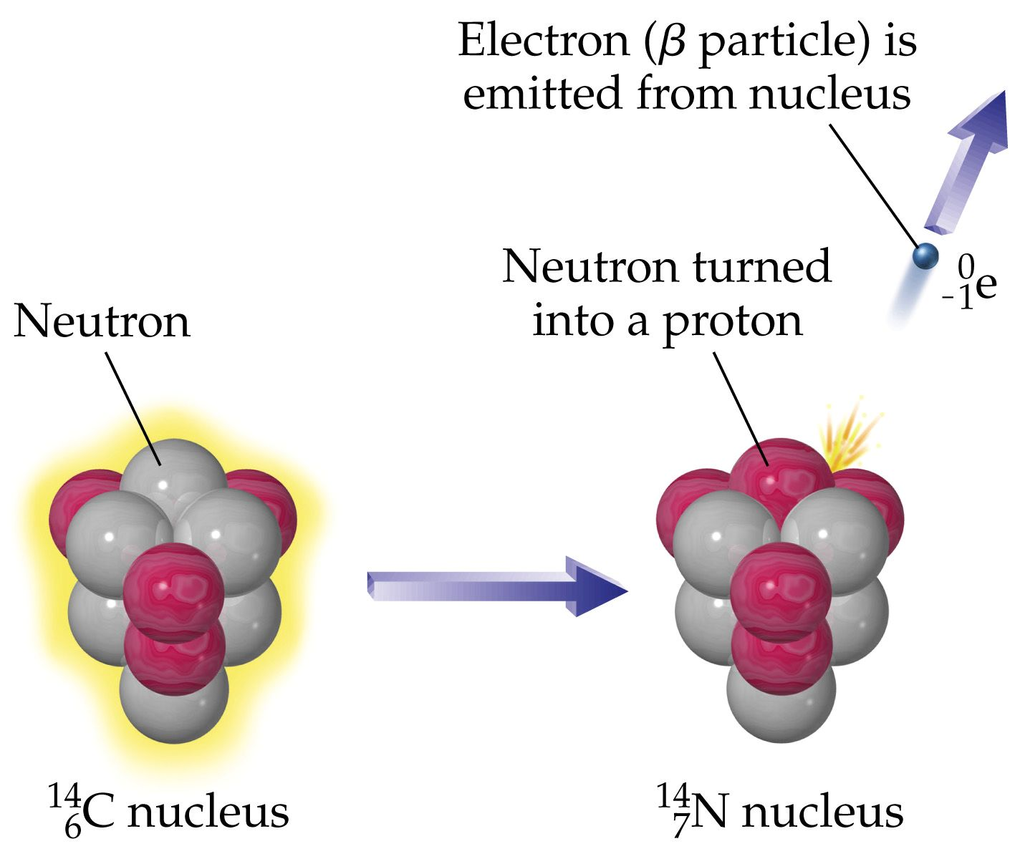
Beta decay
Nucleus emits an electron (negative charge)
Must be balanced
by a positive charge appearing in the nucleus.
This occurs as a neutron changing into a proton

Slide 8
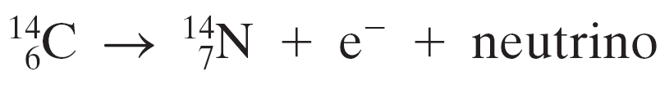
Beta Decay -Example
Beta (β⁻ )decay occurs when a nucleus emits an electron. An example is the decay of carbon-14:
The nucleus still has 14 nucleons, but it has one more proton and one fewer neutron.
This decay is an example of an interaction that proceeds via the weak nuclear force.

Slide 9
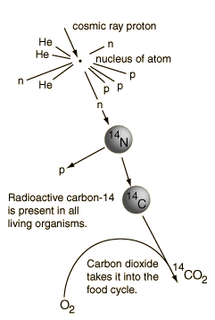
Example: Radioactive carbon
¹⁴C naturally present in the atmosphere
as a result of transmutation of ¹⁴N.
Cosmic ray proton shatters nucleus of atmospheric gas atom.
This produces neutrons.
Neutron knocks proton
out of ¹⁴N nucleus.
¹⁴N becomes ¹⁴C after losing neutron

Slide 10

Beta Decay
The electron in beta decay is not an orbital electron; it is created in the decay within the nucleus itself.
The fundamental process is a neutron decaying to a proton, electron, and neutrino ( q=0 and m=0):
One neutron changes to a proton in the process and in the process (to conserve charge) emits an electron.
The need for a particle such as the neutrino was discovered through analysis of energy and momentum conservation in beta decay – it could not be a two-particle decay.

Slide 11

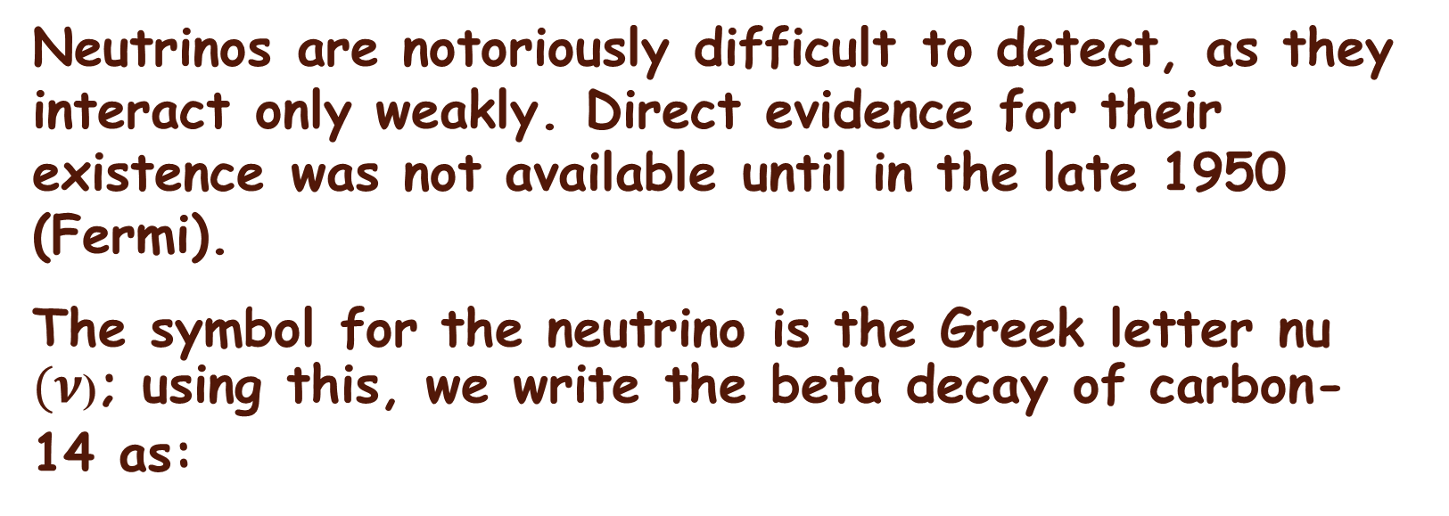
Beta Decay
Neutrinos are notoriously difficult to detect, as they interact only weakly. Direct evidence for their existence was not available until in the late 1950 (Fermi).
The symbol for the neutrino is the Greek letter nu $(ν$); using this, we write the beta decay of carbon-14 as:
The bar sign indicate that it is an antineutrino (through β⁻ )

Slide 12


Beta Decay- Example
Beta decay (β+)can also occur where the nucleus emits a positron rather than an electron:
And a nucleus can capture one of its inner electrons (EC):

Slide 13
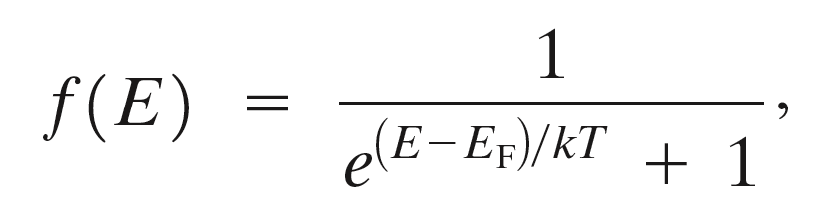

Beta Decay
In general, we can write beta decay in the following form:
And similarly for electron capture (EC):

Slide 14
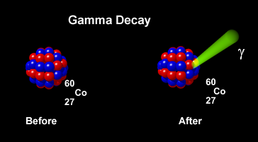
Gamma decay
So far
  Alpha decay: alpha particle emitted from nucleus
  Beta decay: electron or positron emitted
Both can leave the nucleus in excited state
  Just like a hydrogen atom can be in an excited state
  Hydrogen emits photon as it drops to lower state.
Nucleus also emits photon as it drops to ground state
This is gamma radiation
But energies much larger,
so extremely high energy photons.

Slide 15
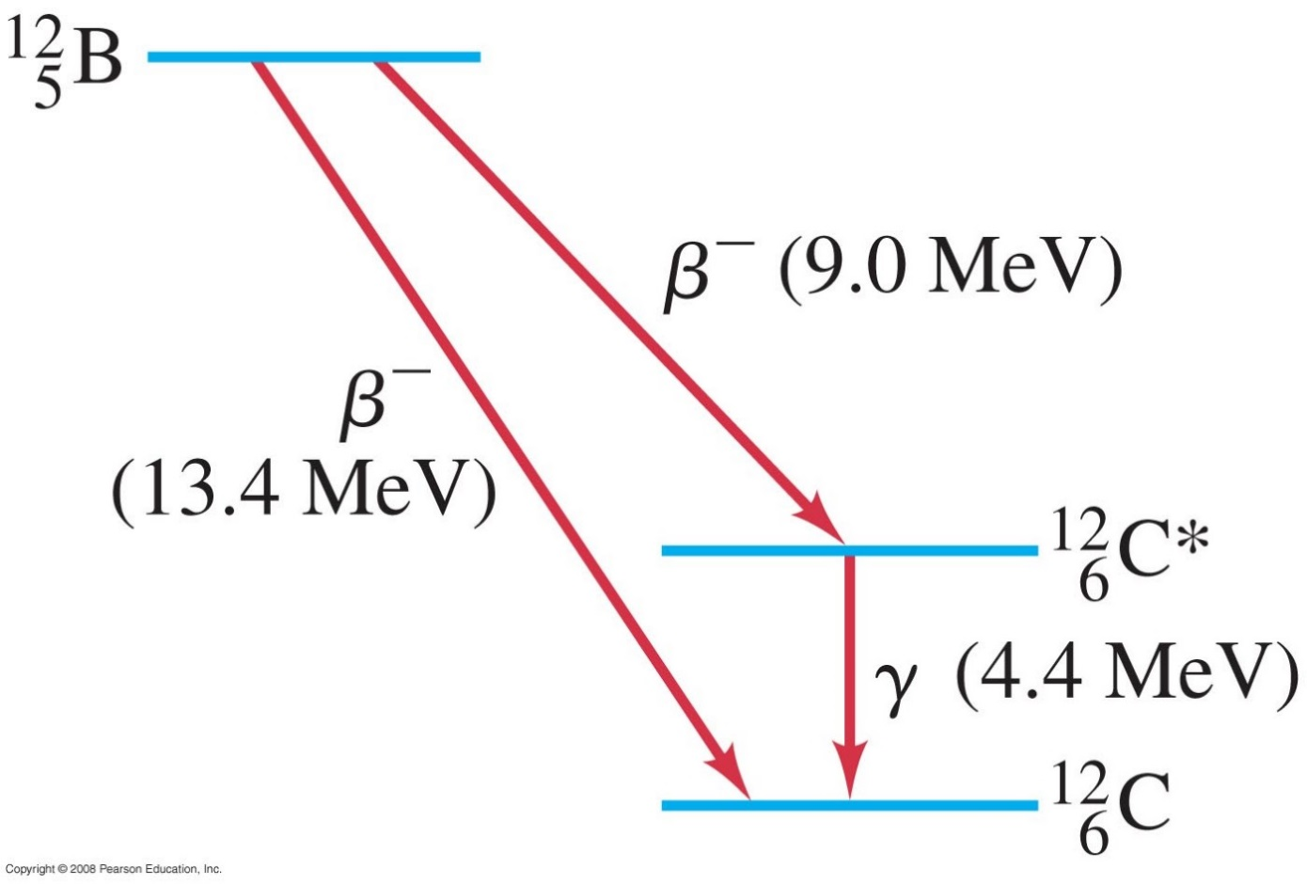
Gamma Decay
Gamma rays are very high-energy photons. They are emitted when a nucleus decays from an excited state to a lower state, just as photons are emitted by electrons returning to a lower state.
Notes:
Figure 41-9. Energy-level diagram showing how ¹²₅B can decay to the ground state of ¹²₆C by β decay (total energy released = 13.4 MeV), or can instead decay to an excited state of ¹²₆C (indicated by *), which subsequently decays to its ground state by emitting a 4.4-MeV γ ray.

Slide 16
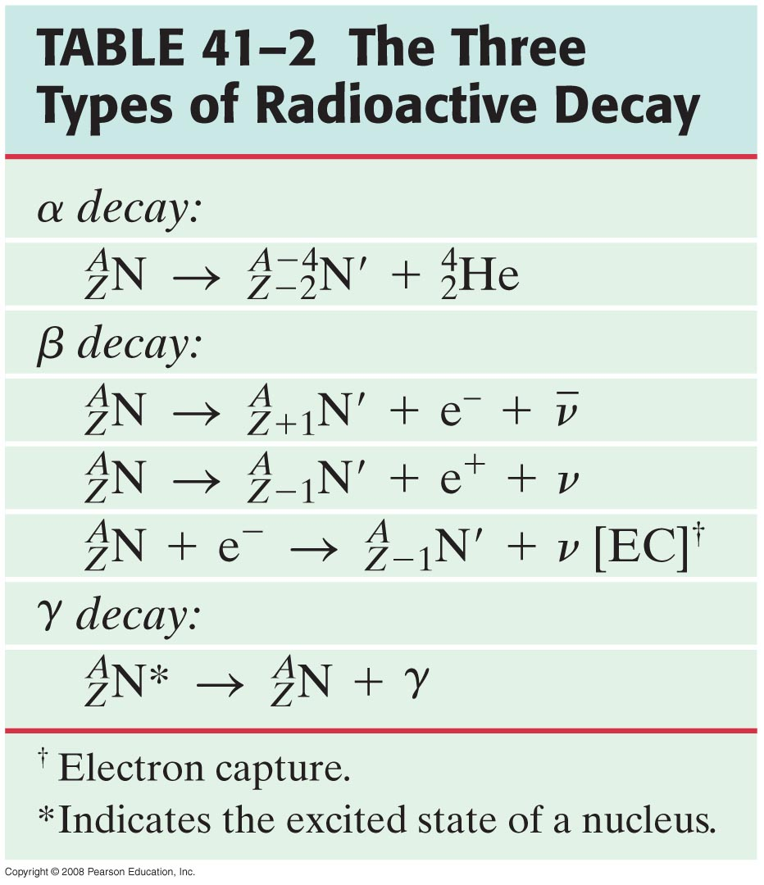
Conservation of Nucleon Number and Other Conservation Laws
A new law is evident by studying radioactive decay: the total number of nucleons cannot change.

Slide 17
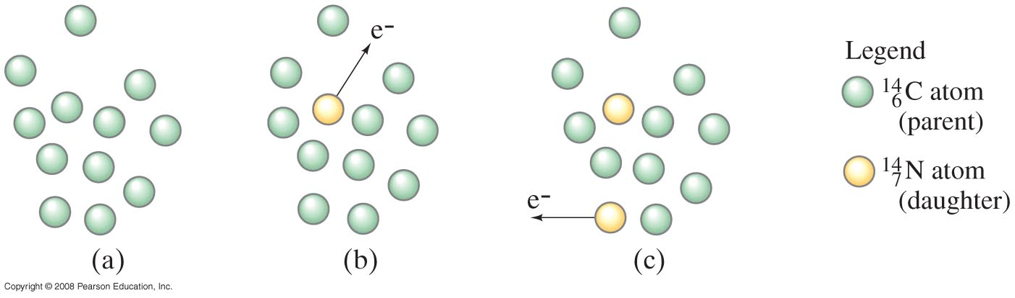
Half-Life and Rate of Decay
Nuclear decay is a random process; the decay of any nucleus is not influenced by the decay of any other.
Radioactive nuclei decay one by one. Hence, the number of parent nuclei in a
sample is continually decreasing. When a nucleus emits
the electron, the nucleus becomes a nucleus.
Notes:
Figure 41-10. Radioactive nuclei decay one by one. Hence, the number of parent nuclei in a sample is continually decreasing. When a ¹⁴₆C nucleus emits the electron, the nucleus becomes a ¹⁴₇N nucleus.

Slide 18

Half-Life and Rate of Decay
We can determine, on a probabilistic basis, approximately how many nuclei in a sample will decay over a given time period, by assuming that each nucleus has the same probability of decaying in each second that it exits.
Therefore, the number of decays ΔN in a very short time interval Δt is proportional to the number of nuclei present and to the time:
$$∆N=−λN Δt$$
Here, λ is a constant characteristic of that particular nuclide, and is called the decay constant.

Slide 19

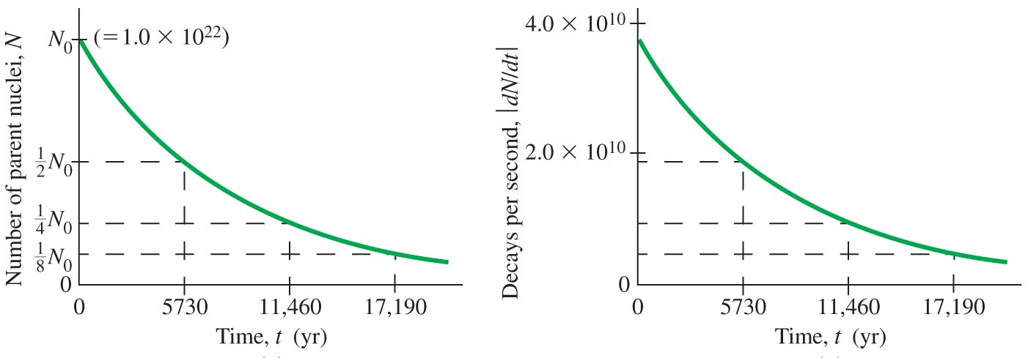
Half-Life and Rate of Decay
This equation can be solved for N as a function of time: This is the radioactive decay law
The number N of parent nuclei in a given sample of decreases exponentially.
The number of decays per second also decreases exponentially.
The half-life of is about 5730 year, which means that the number of parent nuclei, N,
and the rate of decay, |dN/dt|, decrease by half every 5730 yr.
Notes:
Figure 41-11. (a) The number N of parent nuclei in a given sample of ¹⁴₆C decreases exponentially. (b) The number of decays per second also decreases exponentially. The half-life of ¹⁴₆C is about 5730 yr, which means that the number of parent nuclei, N, and the rate of decay, |dNdt|, decrease by half every 5730 yr.

Slide 20
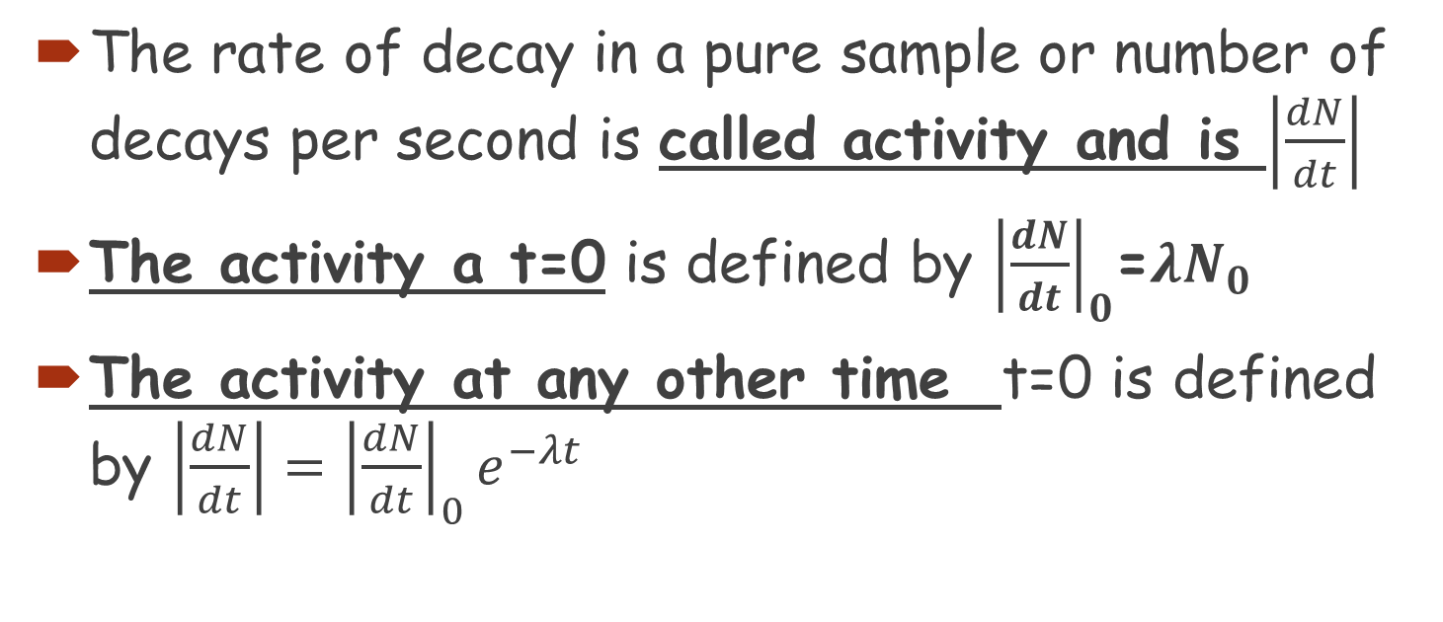
Activity of a sample
The rate of decay in a pure sample or number of decays per second is called activity and is $\left|\frac{dN}{dt}\right|$
The activity a t=0 is defined by ${\left|\frac{dN}{dt}\right|}_{0}$=$λN_{0}$
The activity at any other time t=0 is defined by $\left|\frac{dN}{dt}\right|={\left|\frac{dN}{dt}\right|}_{0}e^{−λt}$

Slide 21
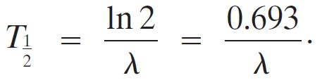
Half-Life and Rate of Decay
The half-life is the time it takes for half the nuclei in a given sample to decay. It is related to the decay constant:

Slide 22
Half-Life and Rate of Decay
Example 41-8: Sample activity.
The isotope has a half-life of 5730 yr. If a sample contains 1.00 x 10²² carbon-14 nuclei, what is the activity of the sample?
Notes:
Solution: Find the decay constant from the half life: λ = 3.83 x 10⁻¹² s⁻¹. Multiplying by the number of atoms in the sample gives the activity, 3.83 x 10¹⁰ decays/sec.

Slide 23
Half-Life and Rate of Decay
Conceptual Example 41-9: Safety: activity versus half-life.
One might think that a short half-life material is safer than a long half-life material because it will not last as long. Is this an accurate representation of the situation?
No, a Shorter half time means the activity is higher and thus more “radioactive” and can cause more biological damage. On the other hand, a longer half-life for the same sample size N means a lower activity but we have to worry about it for longer and find safe storage until it reaches a safe (low) level of activity.
Notes:
Solution: No. A shorter half-life means the activity is higher and thus more “radioactive” and can cause more biological damage. On the other hand, a shorter half-life means the material will all decay to a low level sooner. For the same sample size N, a short half-life material is more radioactive but for a shorter time. Longer half-life materials pose the problem that they have to be safely stored for longer until they reach a safe (low) level of activity.

Slide 24
Half-Life and Rate of Decay
Example 41-10: A sample of radioactive .
A laboratory has 1.49 μg of pure , which has a half-life of 10.0 min (600 s).
(a) How many nuclei are present initially?
(b) What is the activity initially?
(c) What is the activity after 1.00 h?
(d) After approximately how long will the activity drop to less than one per second (1 s⁻¹)?
Notes:
Solution: a. Use Avogadro’s number (or equivalently, the atomic mass); there are 6.90 x 10¹⁶ nuclei.
b. The decay constant is λ = 1.55 x 10⁻³ s⁻¹; therefore the activity at t = 0 is 7.97 x 10¹³ decays/sec.
c. Use equation 41-7c; the activity will be 1.25 x 10¹² s⁻¹.
d. Solving Equation 41-7c for t gives t = 7.70 h.

Slide 25
Radioactive Dating
Radioactive dating can be done by analyzing the fraction of carbon in organic material that is carbon-14.
The ratio of carbon-14 to carbon-12 in the atmosphere has been roughly constant over thousands of years. A living plant or tree will be constantly exchanging carbon with the atmosphere, and will have the same carbon ratio in its tissues.

Slide 26
Radioactive Dating
When the plant dies, this exchange stops. Carbon-14 has a half-life of about 5730 years; it gradually decays away and becomes a smaller and smaller fraction of the total carbon in the plant tissue.
This fraction can be measured, and the age of the tissue deduced.
Objects older than about 60,000 years cannot be dated this way – there is too little carbon-14 left.

Slide 27
Radioactive Dating
Other isotopes are useful for geologic time scale dating.
Uranium-238 has a half-life of 4.5 x 10⁹ years, and has been used to date the oldest rocks on Earth as about 4 billion years old.

Slide 28
Detection of Radiation
Individual particles such as electrons, neutrons, and protons cannot be seen directly, so their existence must be inferred through measurements. Many different devices, of varying levels of sophistication, have been developed to do this.

Slide 29
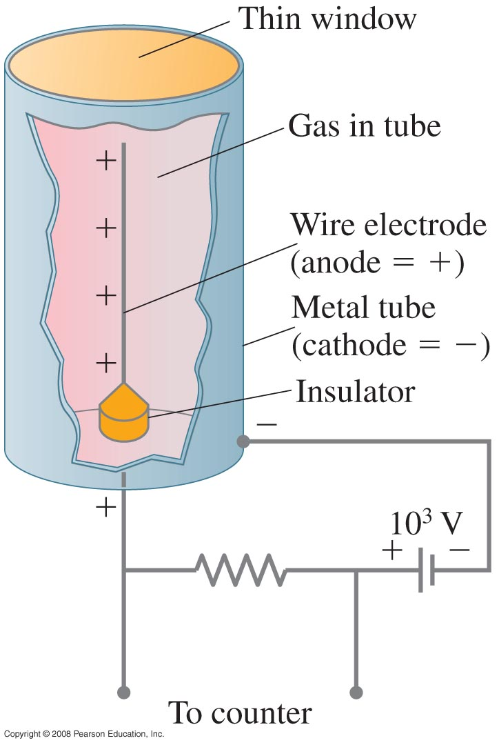
Detection of Radiation
The Geiger counter is a gas-filled tube with a wire in the center. The wire is at high voltage; the case is grounded. When a charged particle passes through, it ionizes the gas. The ions cascade onto the wire, producing a pulse.
Notes:
Figure 41-13. Diagram of a Geiger counter.

Slide 30
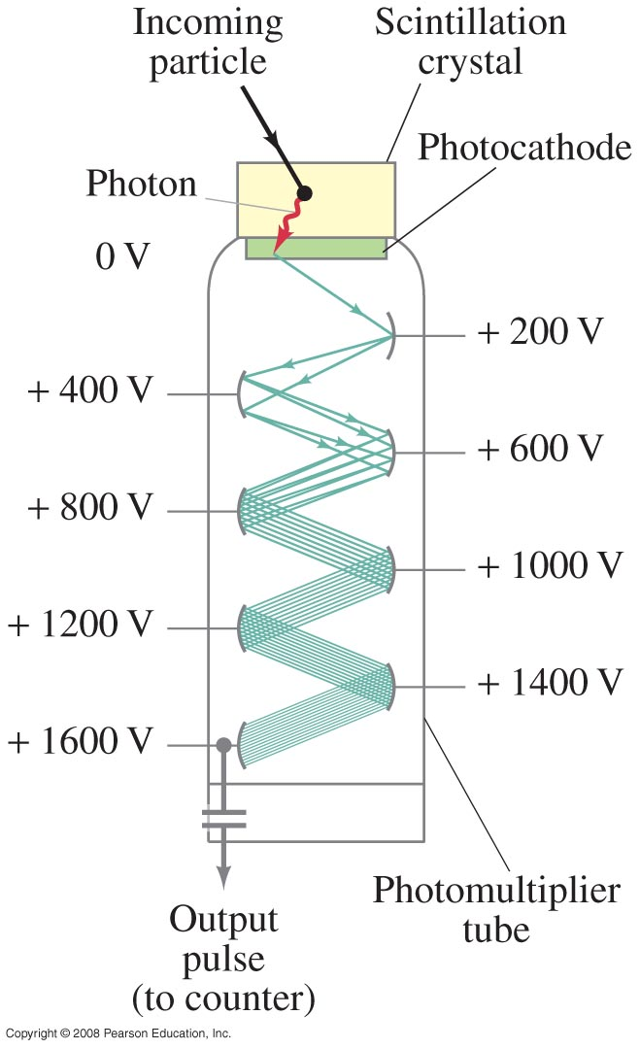
Detection of Radiation
A scintillation counter uses a scintillator – a material that emits light when a charged particle goes through it. The scintillator is made light-tight, and the light flashes are viewed with a photomultiplier tube, which has a photocathode that emits an electron when struck by a photon and then a series of amplifiers.
Notes:
Figure 41-14. Scintillation counter with a photomultiplier tube.

Slide 31
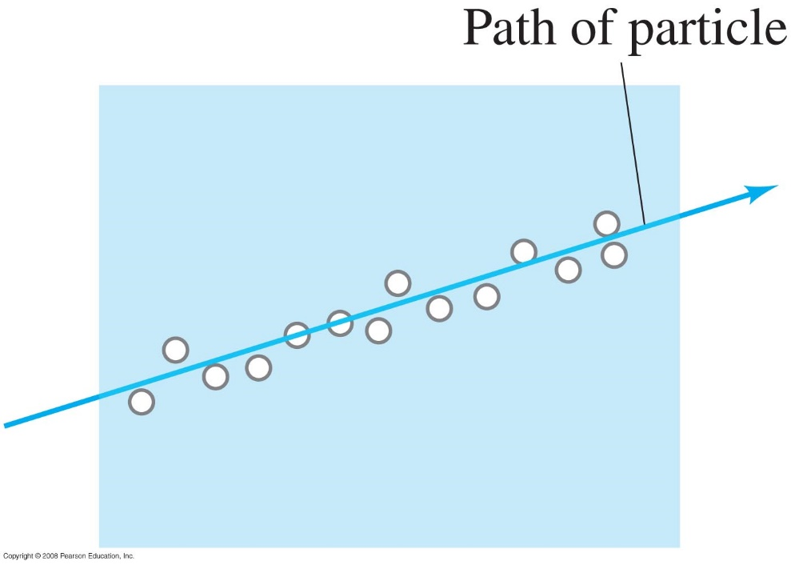
Detection of Radiation
A cloud chamber contains a supercooled gas; when a charged particle goes through, droplets form along its track. Similarly, a bubble chamber contains a superheated liquid, and it is bubbles that form. In either case, the tracks can be photographed and measured.
Notes:
Figure 41-15. In a cloud chamber or bubble chamber, droplets or bubbles are formed around ions produced by the passage of a charged particle.

Slide 32
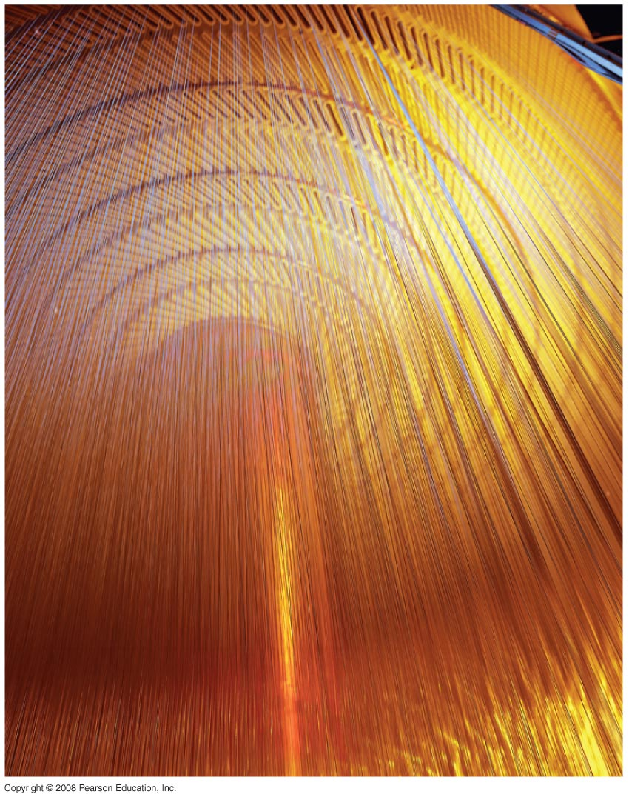
Detection of Radiation
A wire drift chamber is somewhat similar to, but vastly more sophisticated than, a Geiger counter. Many wires are present, some at high voltage and some grounded; in addition to the presence of a signal, the time it takes the pulse to arrive at the wire is measured, allowing very precise measurement of position.
Wire-drift chamber inside the Collider Detector at Fermilab (CDF)
Notes:
Figure 41-16. Wire-drift chamber inside the Collider Detector at Fermilab (CDF)

