Slide 1
Nuclear Physics

Slide 2
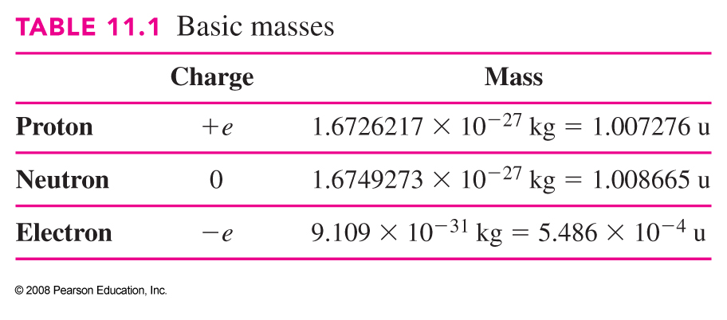
Structure and Properties of the Nucleus
Nucleus is made of protons and neutrons.
Proton has positive charge;
m_{p} = 1.6726217 x 10⁻²⁷ kg
Neutron is electrically neutral;
m_{n} = 1.674973 x 10⁻²⁷ kg

Slide 3
Neutrons and Protons
Neutron: zero charge (neutral)
Proton: positive charge
(equal and opposite to electron)
The number of protons in a nucleus is the same as the number of electrons since the atom has a net zero charge.
The number of electrons determines which element it is.
  1 electron → Hydrogen
  2 electrons → Helium
  6 electrons → Carbon
How many neutrons?

Slide 4
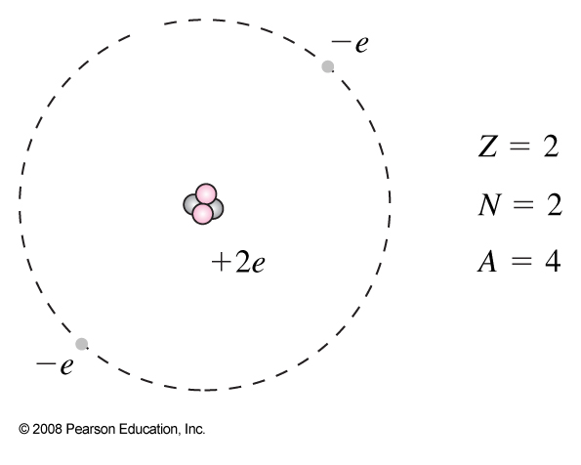
Structure and Properties of the Nucleus
Neutrons and protons are collectively called nucleons.
The different nuclei are referred to as nuclides.
Number of protons: atomic number, Z
Number of nucleons: atomic mass number, A
Neutrons number: N = A - Z
Crude picture of helium

Slide 5

Structure and Properties of the Nucleus
A and Z are sufficient to specify a nuclide. Nuclides are symbolized as follows:
X is the chemical symbol for the element; it contains the same information as Z but in a more easily recognizable form.

Slide 6
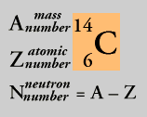
Carbon
Example: carbon
Carbon has 6 electrons (Z=6),
this is what makes it carbon.
Zero net charge so there are
6 protons in the nucleus.
Most common form of carbon has 6 neutrons in the nucleus. Called ¹²C
12
C
6
Another form of Carbon has
6 protons, 8 neutrons in the nucleus. This is ¹⁴C.

Slide 7
Structure and Properties of the Nucleus
Nuclei with the same Z – so they are the same element – but different N are called isotopes.
For many elements, several different isotopes exist in nature.
Natural abundance is the percentage of a particular element that consists of a particular isotope in nature.

Slide 8
Isotopes
Both ¹²C and ¹⁴C have same chemical properties.
This is why they are both called carbon. Same
number of electrons and same number of protons in nucleus.
But the nuclei are different. They have different number of neutrons. These are called isotopes.
Difference is most easily seen in the binding energy.
Nuclei that are bound more tightly are less likely to ‘fall apart’.
In fact ¹⁴C is radioactive or unstable.

Slide 9

Structure and Properties of the Nucleus-Size
Because of wave–particle duality, the size of the nucleus is somewhat fuzzy. Nuclei have a roughly spherical shape.
Measurements of high-energy electron scattering yield (r: radius)
A : atomic mass

Slide 10
Structure and Properties of the Nucleus
Masses of atoms are measured with reference to the carbon-12 atom, which is assigned a mass of exactly 12 u. A u is a unified atomic mass unit.

Slide 11
Structure and Properties of the Nucleus
Example 41-1: Nuclear and atomic densities.
Compare the density of nuclear matter to the density of normal solids.
Notes:
Solution: Essentially all the mass of the atom is in the nucleus; the radius of the nucleus is 10⁻⁵ times smaller than the radius of the atom, so the density will be (10⁵)³ = 10¹⁵ times higher.

Slide 12
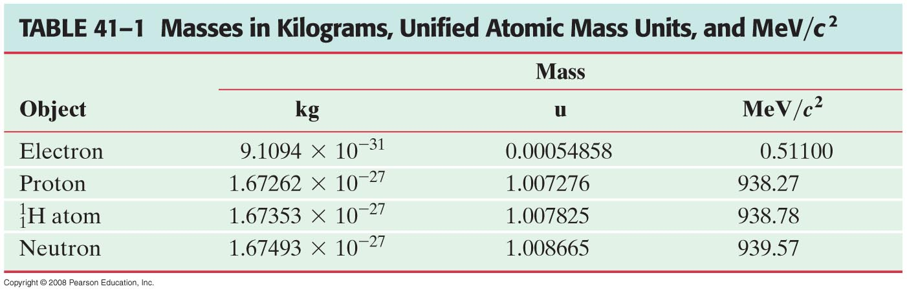
Structure and Properties of the Nucleus
From the following table, you can see that the electron is considerably less massive than a nucleon (neutrons and protons).
E=m_{p}c²= 931.5 MeV
1 u = 931.5 MeV/C²

Slide 13
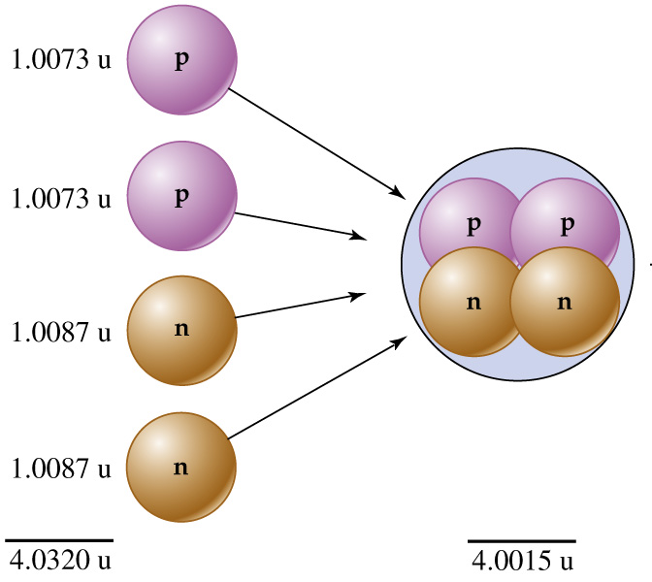
Nuclear Binding Energy
Mass of nucleus is less than mass of its isolated constituents.
The difference is the binding energy.
Helium nucleus
2 protons & 2 neutrons
Arises from E=mc²
Equivalence of mass and energy.

Slide 14
Binding Energy and Nuclear Forces
The total mass of a stable nucleus is always less than the sum of the masses of its separate protons and neutrons.
Where has the mass gone?
It has become energy, such as radiation or kinetic energy, released during the formation of the nucleus.
This difference between the total mass of the constituents and the mass of the nucleus is called the total binding energy of the nucleus.
The binding energy represents the amount that must be put into a nucleus in order to break it apart into its constituents.

Slide 15
Binding Energy and Nuclear Forces
Example 41-2: mass compared to its constituents.
Compare the mass of a atom to the total mass of its constituent particles.
Notes:
Solution: The mass of two protons plus the mass of two neutrons adds up to 4.032980 u. The mass of the helium atom is 4.002603 u. The difference is the binding energy.

Slide 16
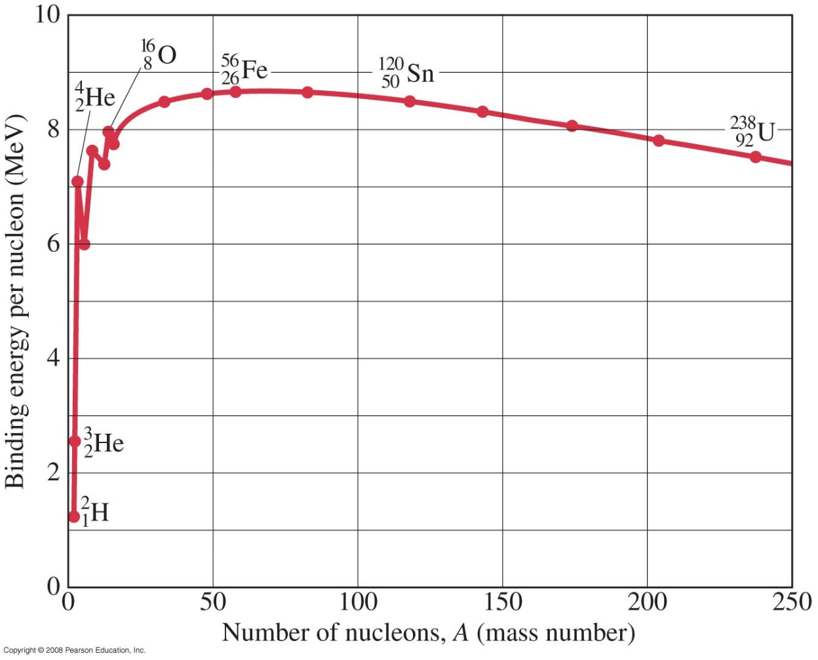
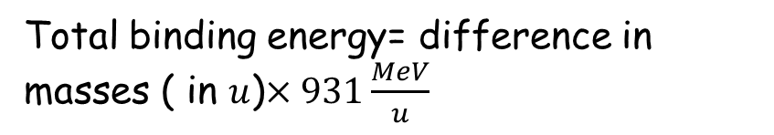
Binding Energy and Nuclear Forces
To compare how tightly bound different nuclei are, we divide the binding energy by A to get the binding energy per nucleon.
Total binding energy= difference in masses ( in $u$)$×931\frac{MeV}{u}$
Binding energy per nucleon for the more stable nuclides
as a function of mass number A.
Above 80 u, the curve decreases indicating that
much larger nuclei are held together less tightly than the ones in the middle of the atomic table.
Notes:
Figure 41-1. Binding energy per nucleon for the more stable nuclides as a function of mass number A.

Slide 17
Binding Energy and Nuclear Forces
Example 41-3: Binding energy for iron.
Calculate the total binding energy and the binding energy per nucleon for , the most common stable isotope of iron.
Notes:
Solution: Calculate the mass of the iron nucleus, the mass of 26 protons, and the mass of 30 neutrons. The total binding energy is the difference, 492 MeV, and the binding energy per nucleon is 8.79 MeV.

Slide 18
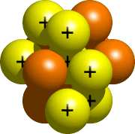
Binding: Nuclear Force
So what holds the nucleus together?
Coulomb force? Gravity?
Coulomb force only acts on
charged particles
  Repulsive between protons,
  and doesn’t affect neutrons at all.
Gravitational force is much too weak. It was showed that the gravitational force is much weaker than Coulomb force.

Slide 19
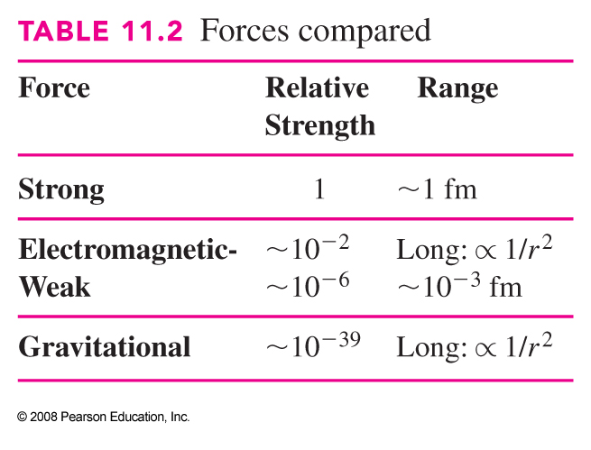
The Strong Nuclear Force
    New force.
Dramatically stronger than Coulomb force.
But not noticeable at large distances.
  I.e. Atoms do not attract each other.
Must be qualitatively different than Coulomb force.
How can we characterize this force?
  Range is on the order of the size of nucleus.
  Stronger than Coulomb force at short distances.

Slide 20
A strong nuclear force
Electron is bound in atom by Coulomb attraction. Strength ~10 eV.
Protons in nucleus are 50,000 times closer together.
Coulomb repulsion ~500,000 eV = 0.5 MeV
Nuclear force must be much stronger than this.
Experimentally, the strong nuclear force is ~ 100 times stronger than Coulomb force
Nucleons are bound in nucleus by ~ 8 MeV / nucleon
(8,000,000 eV / nucleon)

Slide 21
Binding Energy and Nuclear Forces
The force that binds the nucleons together is called the strong nuclear force. It is a very strong, but short-range, force. It is essentially zero if the nucleons are more than about 10⁻¹⁵ m apart. The Coulomb force is long-range; this is why extra neutrons are needed for stability in high-Z nuclei.
Nuclei that are unstable, decay; many such decays are governed by another force called the weak nuclear force.

Slide 22
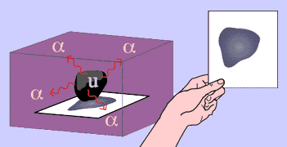
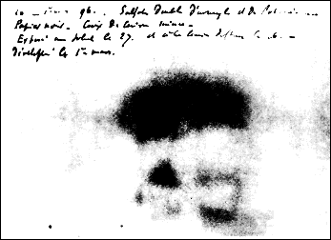
Discovery of radioactivity
Accidental discovery in 1896
Henri Becquerel was trying to investigate x-rays (discovered in 1895 by Roentgen).
Exposed uranium compound to sunlight, then placed it on photographic plates
Believed uranium absorbed sun’s energy and then emitted it as x-rays.
On the 26th-27th February, experiment "failed" because it was overcast in Paris.
Becquerel developed plates anyway,
finding strong images,
Proved uranium emitted radiation without an external source of energy.

Slide 23
Radioactivity
Toward the end of the 19th century, Becquerel found minerals (containing uranium) would darken a photographic plate even in the absence of light.
This phenomenon is now called radioactivity.
Marie and Pierre Curie isolated two new elements that were highly radioactive; they are now called polonium and radium.
It became obvious that the radioactivity is the result of the disintegration or decay of an unstable nucleus.

Slide 24
Radioactivity
A nucleus may bound yet still in relatively high energy state, and if it can attain a lower energy, it will eventually do so.
Nuclei fitting the above description are termed unstable, or radioactive, and the process is known as radioactive decay.
Kinetic energy increases as mass internal energy decreases. The energy released is Q
ΔKE=- Δmc²=-(m_{f}-m_{i}) c²
Q=(m_{f}-m_{i}) c²

Slide 25
Different types of radioactivity
Unstable nuclei decay by emitting some form of energy,
Three different types of decay observed:
  Alpha decay
  Beta decay
  Gamma decay
(First three letters of Greek alphabet).
Ernest Rutherford (1899): "These experiments show that the uranium radiation is complex and that there are present at least two distinct types of radiation - one that is very readily absorbed, which will be termed for convenience the alpha-radiation, and the other of more penetrative character which will be termed the beta-radiation."

Slide 26
Radioactivity
Radioactive rays were observed to be of three types:
Alpha rays, which could barely penetrate a piece of paper
Beta rays, which could penetrate 3 mm of Aluminum
Gamma rays, which could penetrate several centimeters of lead
We now know that alpha rays are helium nuclei, beta rays are electrons, and gamma rays are electromagnetic radiation.

Slide 27
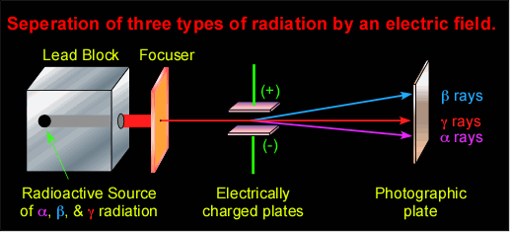
Is the radiation charged?
Alpha radiation positively charged
Beta radiation negatively charged
Gamma radiation uncharged

Slide 28
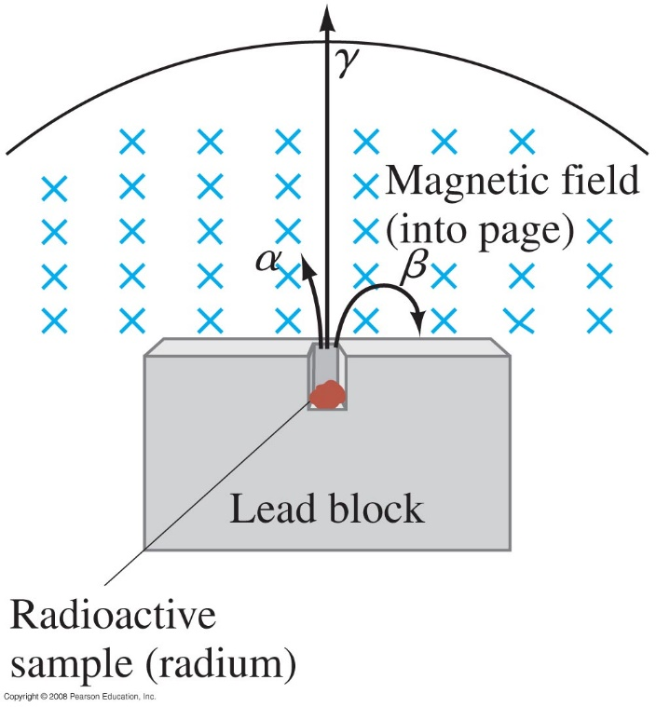
Radioactivity
Alpha and beta rays are bent in opposite directions in a magnetic field, while gamma rays are not bent at all. Rutherford and others studied the rays experimentally in 1898, it was found that alpha rays ( nuclei of Helium atom) are charged positively, beta rays are charged negatively (electrons) and gamma rays are neutral ( high energy photons).
Notes:
Figure 41-4. Alpha and beta rays are bent in opposite directions by a magnetic field, whereas gamma rays are not bent at all.

Slide 29
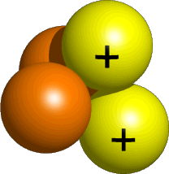
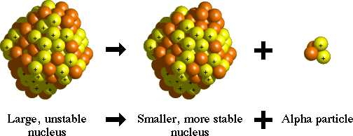
Alpha radiation
Alpha radiation now known to be a helium nucleus
(2 protons, 2 neutrons)
Piece of atom (alpha particle) is broken from heavy nucleus and ejected

Slide 30

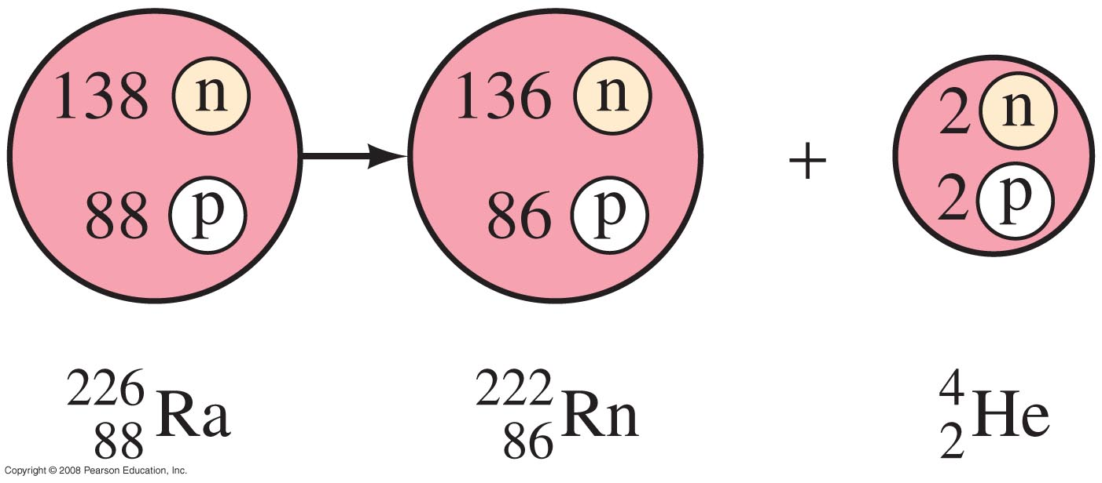
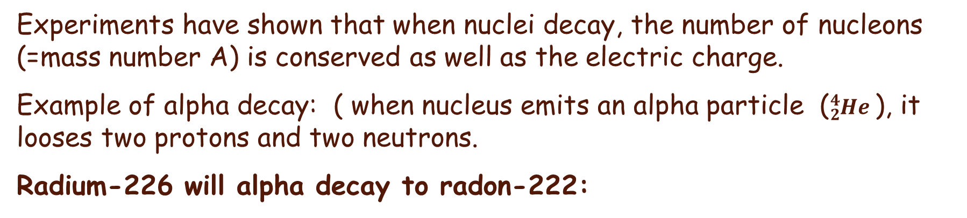
Alpha Decay
Experiments have shown that when nuclei decay, the number of nucleons (=mass number A) is conserved as well as the electric charge.
Example of alpha decay: ( when nucleus emits an alpha particle (${}_{2}^{4}{He }$), it looses two protons and two neutrons.
Radium-226 will alpha decay to radon-222:
Radioactive decay of radium to radon with emission of an alpha particle.
Parent nucleus
Daughter nucleus
This is called Transmutation
Notes:
Figure 41-5. Radioactive decay of radium to radon with emission of an alpha particle.

Slide 31
A new element-example
When a nucleus emits an alpha-particle, it loses two neutrons and two protons.
It becomes a different element (the number of protons in the nucleus has changed).
Example:
Alpha particle
92 protons
146 neutrons
2 protons
2 neutrons
90 protons
144 neutrons
Thorium is the element with 90 electrons
(and hence 90 protons in the nucleus)

Slide 32
Why?
Why does a piece come out of the atom?
  All nucleons (neutrons & protons)
  attracted by short-range strong force
  Protons forced apart by long-range Coulomb force.
  Smaller nuclei will be more stable
Why is the ejected piece an alpha-particle,
and not something else?
  Helium nucleus is much more stable than other light nuclei
  Smaller Thorium nucleus more stable as well
  Overall energy state is less

Slide 33
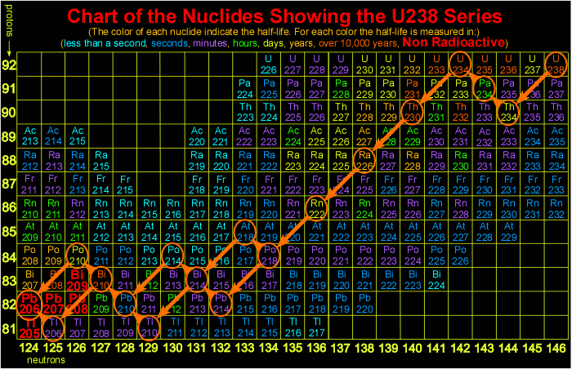
Decay chain originates at ²³⁸U
Number of protons
α decay
Number of neutrons

Slide 34

Alpha Decay
In general, alpha decay can be written:
Alpha decay occurs when the strong nuclear force cannot hold a large nucleus together. The mass of the parent nucleus is greater than the sum of the masses of the daughter nucleus and the alpha particle; this difference is called the disintegration energy.

