Slide 1
Chapter 6:Conductors, Insulators and Semiconductors

Slide 2
• How do atoms assemble into solid structures?
• This takes us to solid-state physics or Condensed matter physics
• Condensed Matter include studies of Solids,
liquids and other systems in which the behavior
of atoms must be understood.

Slide 3
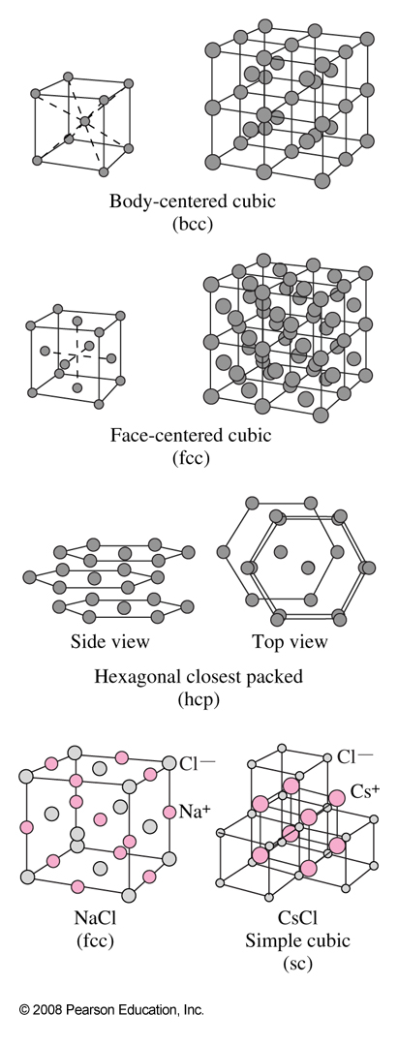
Crystalline Solids
Some solids are amorphous (no long-range order), but many are crystalline, having their atoms, ions or molecules arranged in an orderly array called lattice.
Most solids are at low temperature and /or high pressure have a crystal lattice where atoms are found at specific locations in a microscopic unit and have their molecules arranged in a regular lattice.
Here are 14 possible crystal lattices types

Slide 4
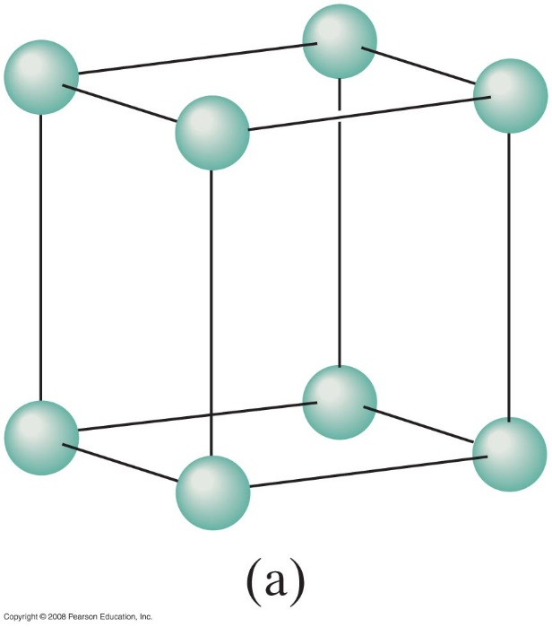
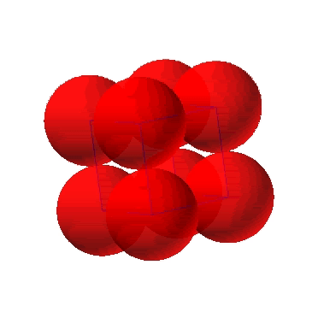
Simple Cubic Structure (SC)
• Rare due to low packing density
• Close-packed directions are cube edges.
The molecules of the solid are held by covalent bonding or ionic bonding.
(Courtesy P.M. Anderson)

Slide 5
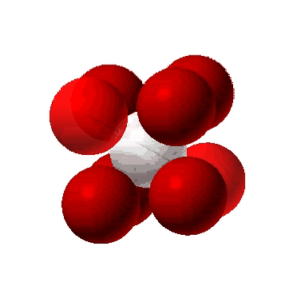
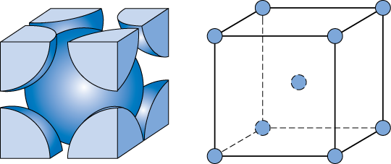
Body Centered Cubic Structure (BCC)
• Atoms touch each other along cube diagonals.
Note: All atoms are identical; the center atom is shaded
differently only for ease of viewing.
ex: Cr, Fe (α), Tantalum, Molybdenum
2 atoms/unit cell: 1 center + 8 corners x 1/8
(Courtesy P.M. Anderson)

Slide 6
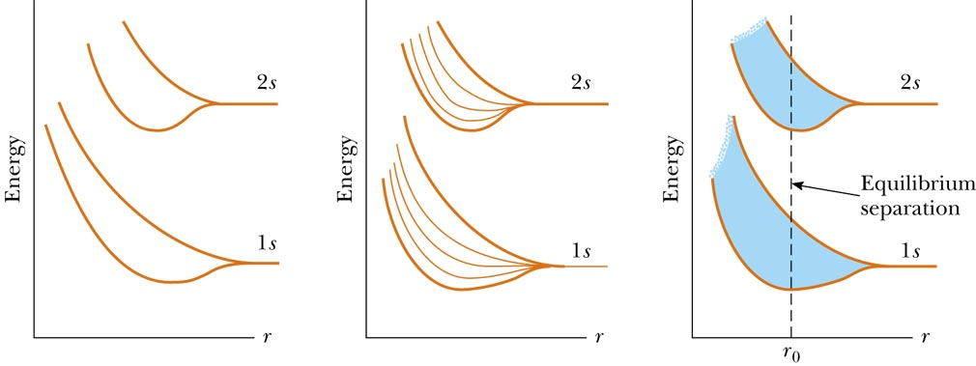
ENERGY Bands
Atomic orbitals interact to form new energy levels, and the wave functions overlap (example in H₂, the two 1s states of each divide into two states of different energy)
The more atoms are bound together with overlapping wave functions, the more continuous the energy bands will become.
Atomic separation
Atomic separation
Atomic separation
Two atom molecule or 2 state band
Five atom ‘molecule’
Many atom solid

Slide 7
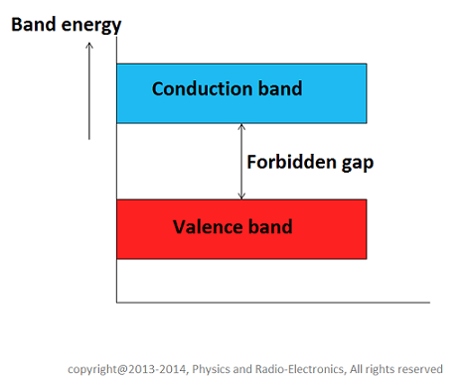
Energy Bands and Electrical conduction
Many atoms in a solid give many different quantum states. Spaced so closely together they are considered a ‘band’ of available energies. The energy region of densely packed quantum states in called an energy band.
Different bands correspond to different atomic orbitals on the atom (E.g. a 1s band, a 2s band, etc).
Energies depend on details (e.g. separation): These energy bands are
  Valence band
  Conduction band
  Forbidden energy band or band gap
The detailed arrangement of these energy bands is called the band structure.

Slide 8
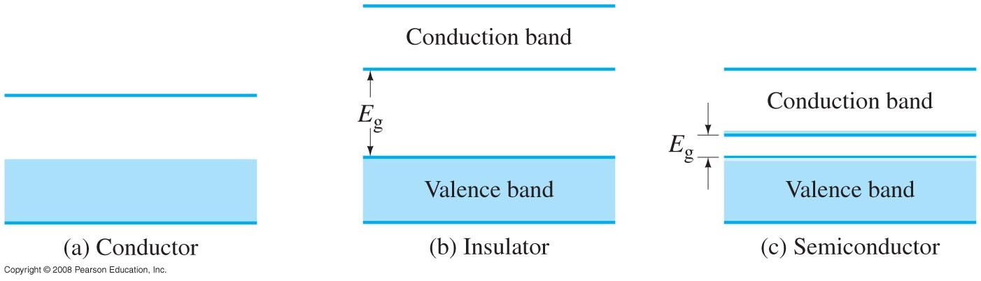
Band in Solids
A good conductor has its highest energy band only partially filled.
An insulator has its highest energy band (valence band) completely filled, with a substantial gap separating it from the next level.
A semiconductor also has its highest band filled, but the gap to the next level is small.
Energy bands for (a) a conductor, (b) an insulator, which has a large energy gap Eg,
and (c) a semiconductor, which has a small energy gap Eg. Shading represents occupied states.
Pale shading in (c) represents electrons that can pass from the top of the valence band to the
bottom of the conduction band due to thermal agitation at room temperature (exaggerated).
Notes:
Figure 40-32. Energy bands for (a) a conductor, (b) an insulator, which has a large energy gap E_{g}, and (c) a semiconductor, which has a small energy gap E_{g}. Shading represents occupied states. Pale shading in (c) represents electrons that can pass from the top of the valence band to the bottom of the conduction band due to thermal agitation at room temperature (exaggerated).

Slide 9
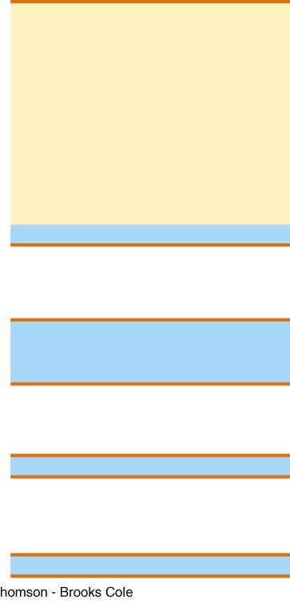
Solid sodium (metal)
This band not completely occupied
Na = [Ne]3s¹
3p
3p
empty
Partially Full
3s
3s
1 electron
2p
Full
2p
6 electrons
2s
Full
2s
2 electrons
1s
Full
1s
2 electrons
Sodium atom
Sodium metal

Slide 10
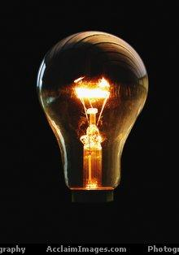
Electrical conduction
This little detail turns out to dramatically effect the electrical properties of materials.
In particular whether they will carry an electrical current
Only a partially full band
will carry electrical current!

Slide 11
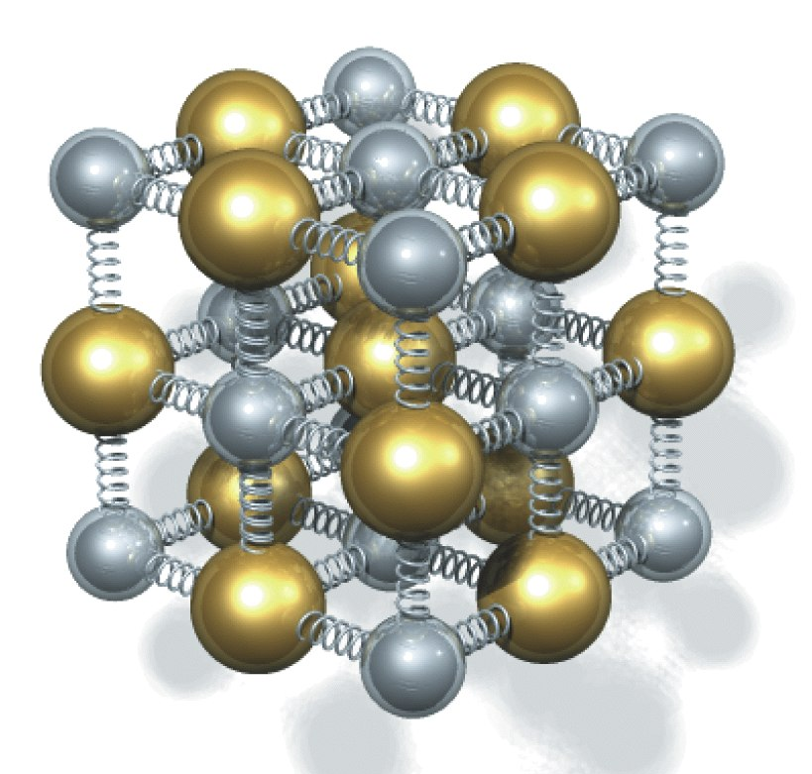
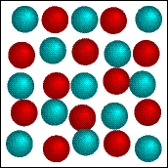
Life is tough
In the real world, electrons don’t have it so easy
Some missing atoms (defects)
Vibrating atoms!
Electron scatters from these irregularities, -> resistance

Slide 12
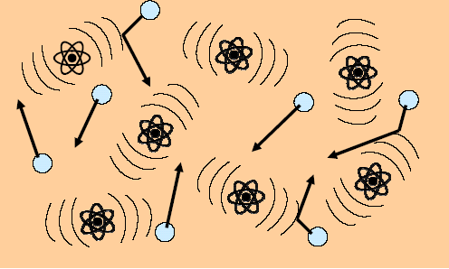
Resistance
As electron wave propagates through lattice, it faces resistance
Resistance:
  Bumps from vibrating atoms
  Collisions with impurities
  Repulsion from other electrons
Electrons ‘scatter’ from these atomic vibrations and defects.
Vibrations are less at low temperature, so resistance decreases.
Life is tough for electrons,
especially on hot days

Slide 13
Why does temperature matter?
Temperature is related to the kinetic energy of a macroscopic object.
The energy usually shows up as energy of random motion.
There really is a coldest temperature, corresponding to zero motional energy!
The Kelvin scale has the same size degree as the Celsius (˚C) scale. But 0 K means no internal kinetic energy.
0 degrees Kelvin (Absolute Zero) is the coldest temperature possible
  This is -459.67 ˚F

Slide 14
Conductors, Insulators and Semiconductors
Metals, insulators and semiconductors are usually differentiated by their ability to carry electrical current
Copper is an example of a good metal.
Diamond is an example of a good insulator
Silicon is an example of a semiconductor.

Slide 15
Properties of some elements
Metals
Copper
Zinc
Aluminum
Gold
Platinum
Sodium
Calcium
Insulators
Diamond (Carbon)
Sulfur
Semiconductors
Silicon
Germanium
Wider variety of insulators, semiconductors can be listed if compounds are included

Slide 16
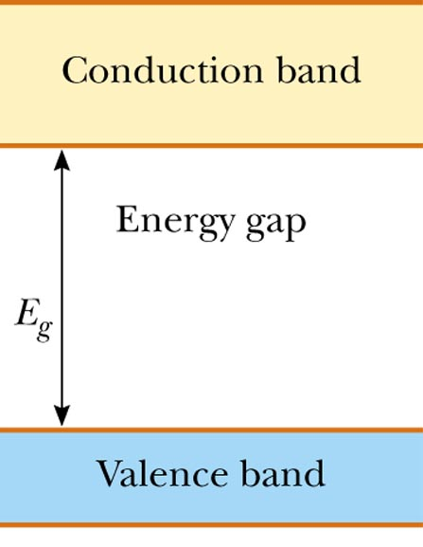
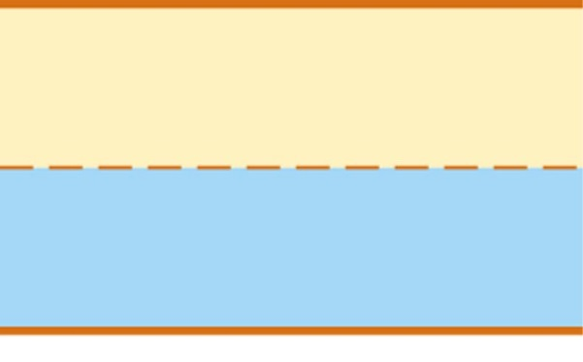
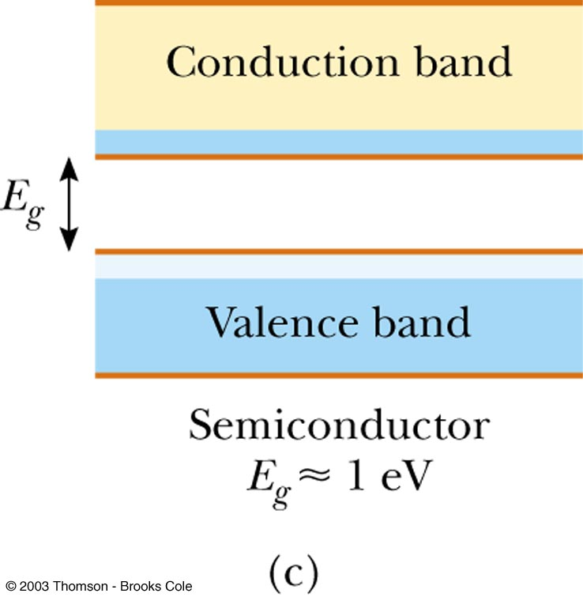
Band Occupation and conductivity
(empty)
(empty)
(full)
(full)
Metal
(at least one partially full band)
Insulator
(all bands completely full or empty)
Semiconductor (insulator with small energy gap)
Only partially full bands carry current
Completely full, or completely empty bands, carry no current

Slide 17
Band occupation and Conductivity
The enormous variation in electrical conductivity of metals, insulators, and semiconductors may be explained qualitatively in terms of energy bands.
METALS: If an electric field is applied to the metal, electrons can gain a small amount of additional energy from the field and reach nearby empty energy states. Thus electrons are free to move with only a small applied field in a metal because there are many unoccupied energy states very close to occupied energy states.

Slide 18
Insulators: It is common to refer to the separation between the outermost filled and empty bands as the energy gap, E_{g}, of the material. The lower band filled with electrons is called the valence band, and the upper, empty band is the conduction band.
Although an insulator has many vacant states in the conduction band that can accept electrons, there are so few electrons actually occupying conduction-band states at room temperature that the overall contribution to electrical conductivity is very small, resulting in a high resistivity for insulators.

Slide 19
Semiconductor:
a material that has a much smaller energy gap, on the order of 1 eV. Such materials are called semiconductors.
Since there are many empty nearby states in the conduction band, a small applied potential can easily raise the energy of the electrons in the conduction band, resulting in a moderate current.
Because thermal excitation across the narrow gap is more probable at higher temperatures, the conductivity of semiconductors depends strongly on temperature and increases rapidly with temperature. This contrasts sharply with the conductivity of a metal, which decreases slowly with temperature.

Slide 20
Semiconductor Theory and devices
https://www.youtube.com/watch?v=IcrBqCFLHIY

Slide 21
6.7 Semiconductors Theory
The most common semiconductors in use are silicon and germanium.
A tiny amount of impurity gives the semiconductor useful properties – this is called doping.
The doped semiconductor becomes slightly conducting; the conductivity can be controlled with great precision.

Slide 22
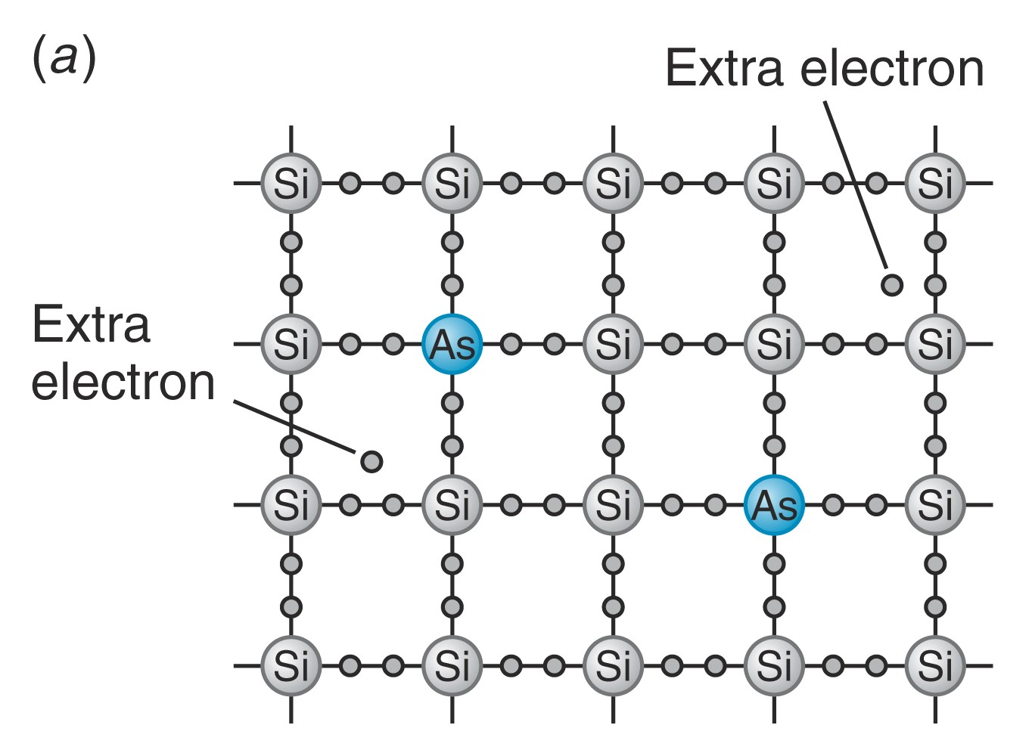
Doped semiconductors
If semiconductors are insulators, why is my computer made out of them?
An impurity atom (such as Arsenic) and be substituted for one of the Si atoms
Ge and Si have extra outer e-.This dramatically changes the electrical properties

Slide 23
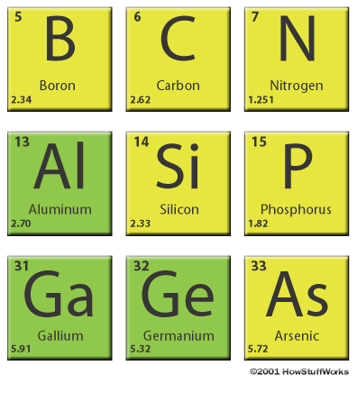
Doping a semiconductor
Elements in same column have same number of ‘outer’ electrons.
Substitution of element from another column changes band filling
In Si there is 4 outer e-
One fewer electron (acceptors)
One extra electron (donors)

Slide 24
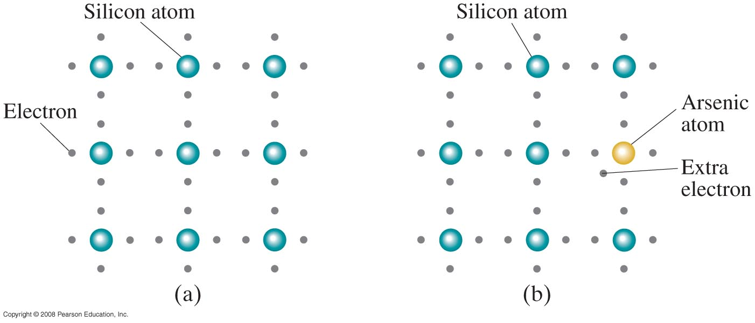
6.7 Semiconductors Theory
Arsenic-doped silicon is an n-type semiconductor, as the current is carried by negative charges.
This a n-type semiconductor
Arsenic has 5 outer e-, only 4 will bond. The extra e- can move freely somewhat like the e- in a conductor
There are a lot of free e- in the unit cell moving freely in a doped semiconductor, making it slightly conducting.
Notes:
Figure 40-34. Two-dimensional representation of a silicon crystal. (a) Four (outer) electrons surround each silicon atom. (b) Silicon crystal doped with a small percentage of arsenic atoms: the extra electron doesn’t fit into the crystal lattice and so is free to move about. This is an n-type semiconductor.

Slide 25
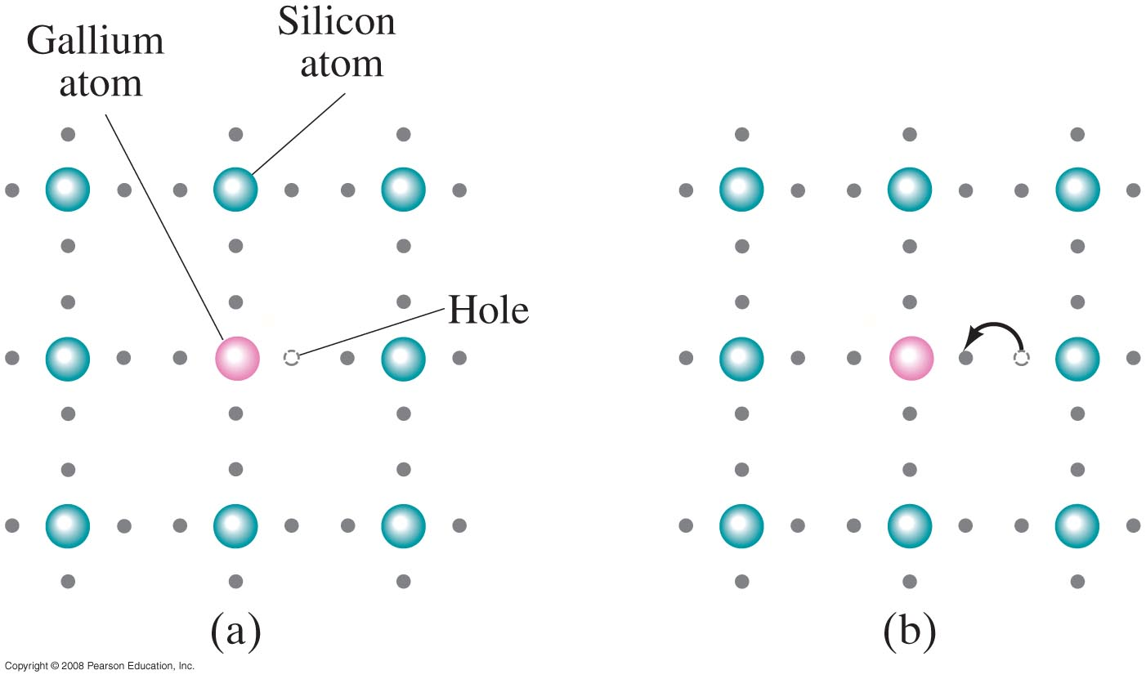
6.7 Semiconductors Theory
Gallium-doped silicon is a p-type semiconductor – the current is carried by “holes,” or spots that are missing electrons.
This a p-type semiconductor
In a p-type: Gallium has 3 outer e-, when you put an atom Si nearby, e- can jump from Si to fill the hole in Ga, leaving a hole in Si.
The created hole are near Si. Since Si need 4 outer e- to be neutral, the hole will have a positive charge (p-type).
Holes also carry charges, n-type and p-type have no net charge
Notes:
Figure 40-35. A p-type semiconductor, gallium-doped silicon. (a) Gallium has only three outer electrons, so there is an empty spot, or hole in the structure. (b) Electrons from silicon atoms can jump into the hole and fill it. As a result, the hole moves to a new location (to the right in this Figure), to where the electron used to be.

Slide 26
Example: Phosphorus-doped silicon
Si = [Ne]3p²
P = [Ne]3p³
P has one extra electron.
That electron goes into the conduction band
  Conduction band partially full
  Valence band full
  Called an n-type semiconductor
Electrons from dopants
According to the band theory, impurities in a doped semiconductor provide extra energy states

Slide 27
n- and p-type semiconductors
Electrons from donors
‘Holes’ from acceptors
n-type semiconductor
Donors have one extra electron
p-type semiconductor
Acceptors have one fewer electron

Slide 28
So what?
Real usefulness comes from combining n and p-type semiconductors
n-type
p-type
Junction develops a ‘built-in’ electric field at the interface due to charge rearrangement.

Slide 29
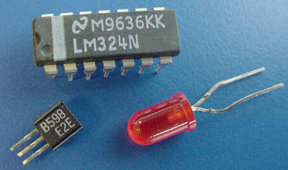
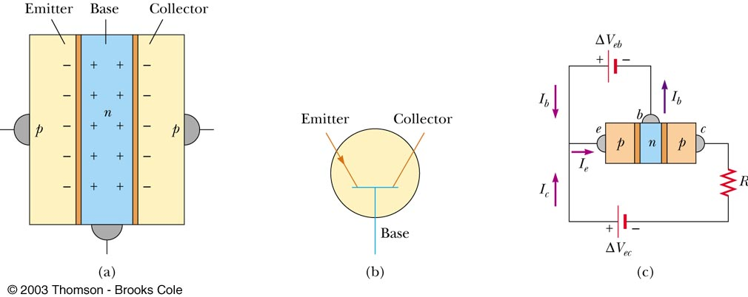
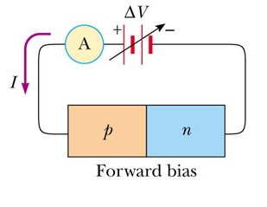
6.8 Semiconductor devices
This built-in electric field has a direction, so the diode behaves differently in different directions.
Many devices made from a junction between
n- and p-type materials.
  Diodes, transistors, LEDs (light-emitting diodes), diode lasers, solar cells etc.
Junction Diode
Bipolar Junction Transistor

Slide 30
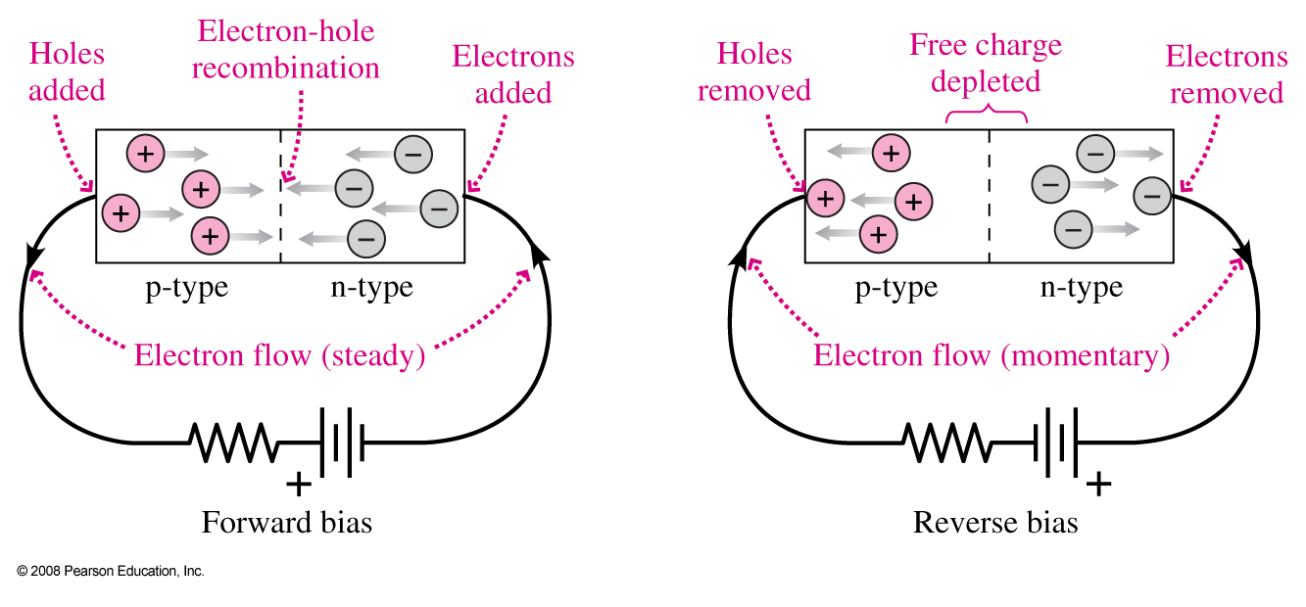
6.9 Semiconductor Diodes
When an n-type and a p-type semiconductor are joined, the result is a pn junction diode. This diode will conduct electricity in one direction but not the other.
Notes:
Figure 40-37. Schematic diagram showing how a semiconductor diode operates. Current flows when the voltage is connected in forward bias, as in (a), but not when connected in reverse bias, as in (b).

Slide 31
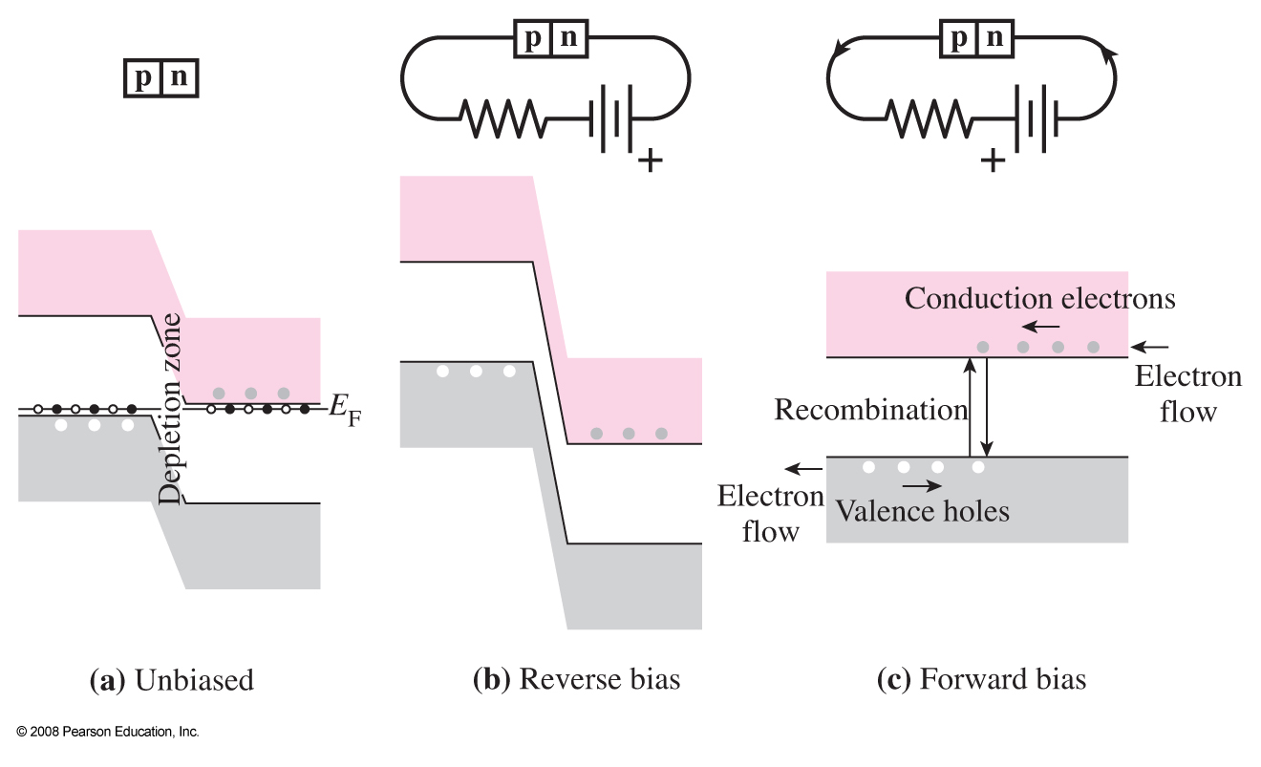
6.9 Semiconductor Diodes
Bands in Diodes: (a) With no external bias , the highest-energy electrons are in the same level in both p-type(left) and n-type (right).
(b) An externally applied reverse bias exacerbates the dogleg in the bands. (c) A forward bias evens it out and current flows.

Slide 32
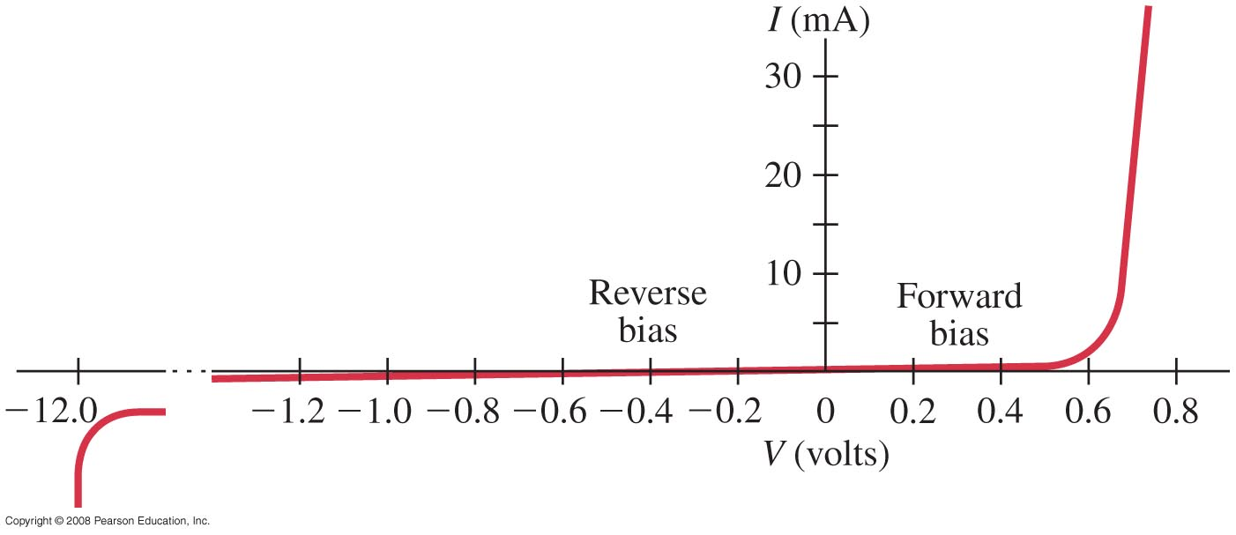
6.9 Semiconductor Diodes
A graph of current vs. voltage shows this effect clearly. If the potential difference is large enough, current will flow in the reverse direction as well.
Figure 40-38 goes here.
Notes:
Figure 40-38. Current through a diode as a function of applied voltage.

Slide 33
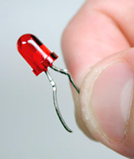
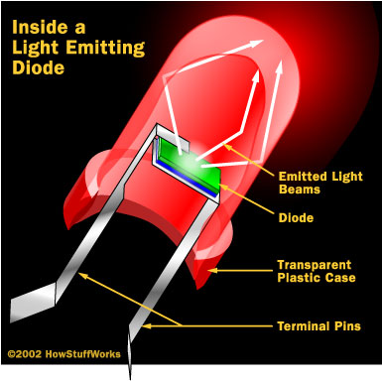
Light emitting diode
Battery causes electrons and holes to flow toward pn interface
Electrons and holes recombine
at interface (electron
drops down to lower level)
Photon carries
away released energy.
Low energy use - one color!

Slide 34
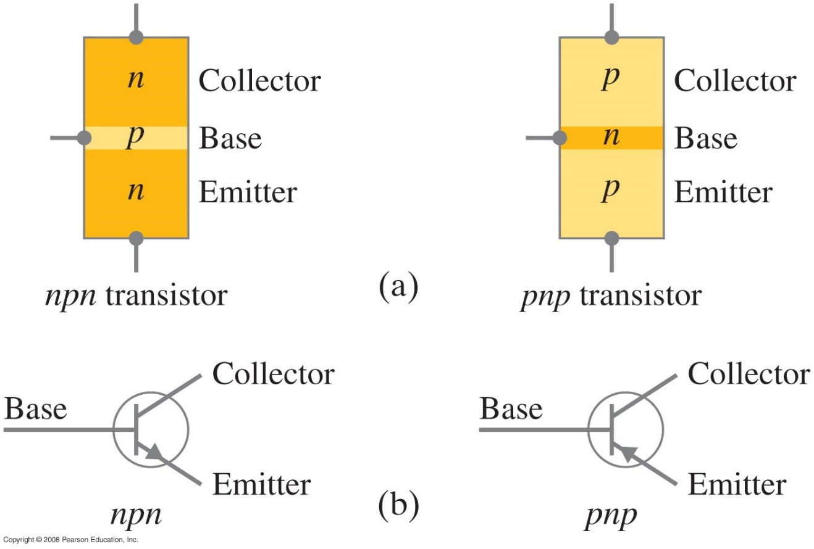
Transistors
A junction transistor is one type of semiconductor sandwiched between layers of another – npn or pnp. These layers are called the collector, base, and emitter.
Notes:
Figure 40-42. (a) Schematic diagram of npn and pnp transistors. (b) Symbols for npn and pnp transistors.

Slide 35
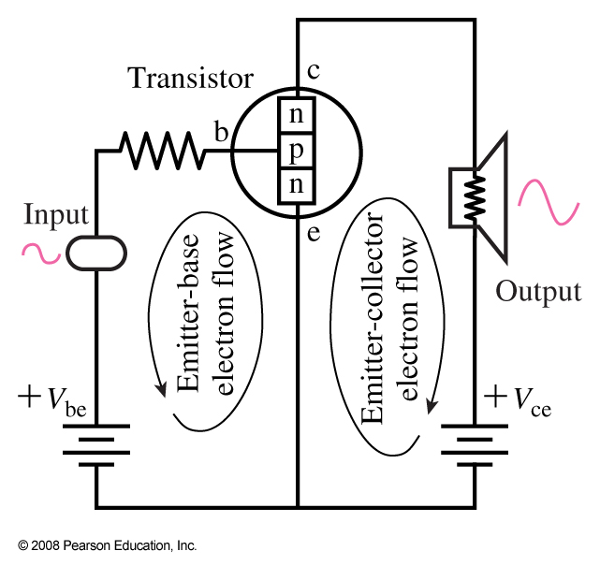
Transistors
Transistors can amplify a small current into a larger one, as the collector-emitter current is much larger than the base current. They are also used in digital circuits, and they can either let current pass or block it.
Notes:
Figure 40-43. An npn transistor used as an amplifier.

Slide 36
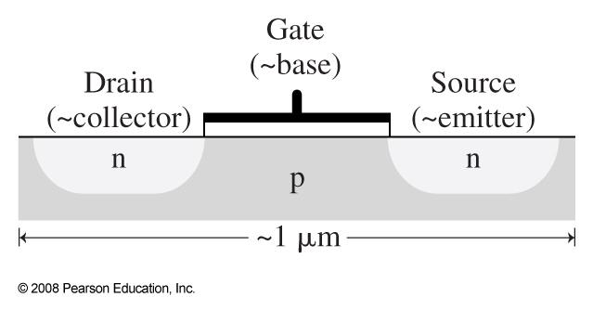
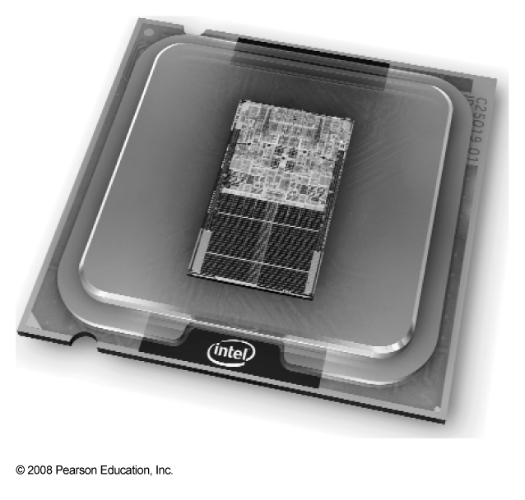
Bipolar Transistor and integrated Circuits
A modern computer processor. The small chip in the center only 143mm² in area, contains about 300 million transistors
MOSFET is well suited for integrated circuits. The gate is separated from the semiconductor by an insulating layer, controls electron flow the source to the drain.

