Slide 1
Chapter5:Bonding: Molecules and Solids-Class1
\

Slide 2
Chemical Bonds
A molecule is a group of atoms that held together and function as a single unit.
When atoms make such attachment , we say that Chemical bonds between them have formed.
Simplest case is the Hydrogen that forms the H₂ Molecule.
When the two H atoms approach each other, their electron cloud start to overlap, each electron can orbit both nuclei ( this is called sharing)

Slide 3
Spin
In quantum mechanics and particle physics, spin is an intrinsic form of angular momentum carried by elementary particles.
Spin is one of two types of angular momentum in quantum mechanics, the other being orbital angular momentum. The orbital angular momentum operator is the quantum-mechanical counterpart to the classical angular momentum of orbital revolution ( or the magnitude of the angular momentum of the electron or other particle).
The existence of spin angular momentum is inferred from experiments, such as the Stern–Gerlach experiment, in which silver atoms were observed to possess two possible discrete angular momenta despite having no orbital angular momentum.
In some ways, spin is like a vector quantity; it has a definite magnitude, and it has a "direction" (but quantization makes this "direction" different from the direction of an ordinary vector). All elementary particles of a given kind have the same magnitude of spin angular momentum, which is indicated by assigning the particle a spin quantum number.
The SI unit of spin is the (N·m·s) or (kg·m²·s⁻¹), just as with classical angular momentum.

Slide 4
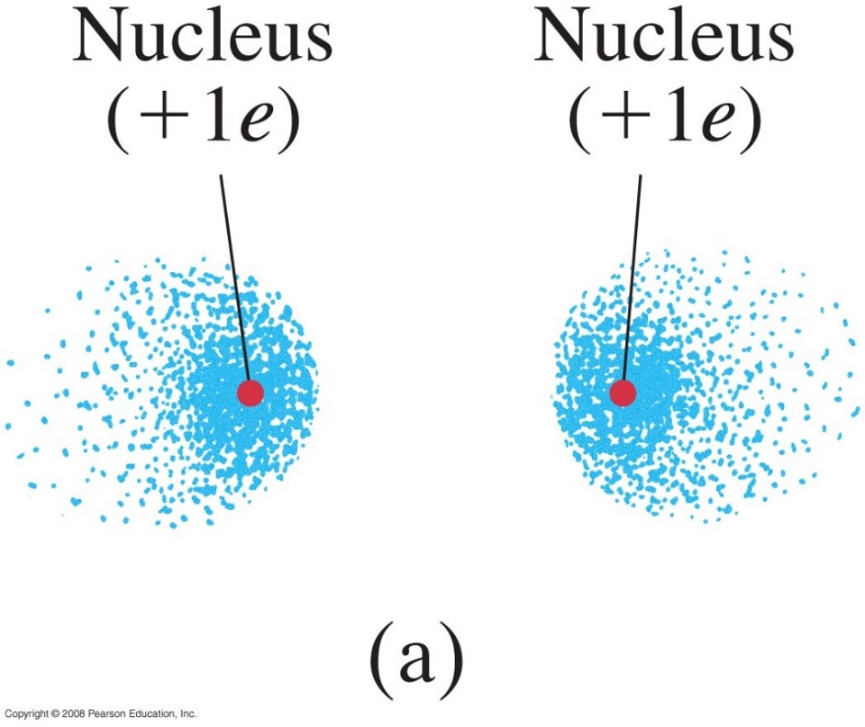
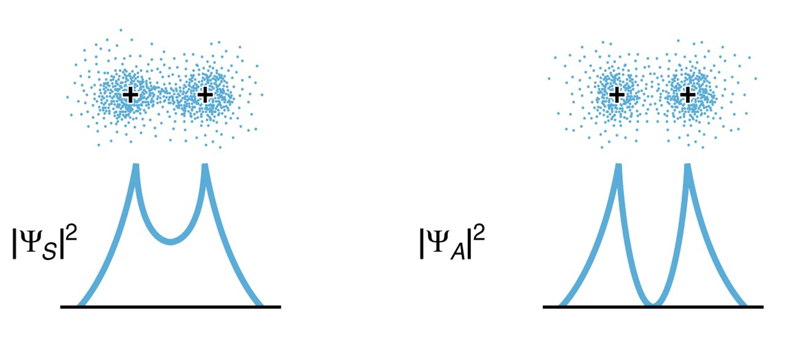

Covalent Bonds
Hydrogen molecule, H₂, is bound covalently.
If the atoms have their spins are parallel and in the same direction: S = 1 ( S=1/2 +1/2) for the molecule, the atoms will not bond due to the exclusion principle (the 2 electrons cannot be in the lowest energy state and attached to the same atom since they will have the same quantum number in violation with the exclusion principle .
Electron probability distribution (electron cloud) for 2 H atoms when S=1: (a) electron cloud,
(b) Projection of ${\left|ψ\right|}^{2}$ along the line through the centers of the two atoms
Notes:
Figure : Electron probability distribution (electron cloud) for two H atoms when the spins are the same (S = 1): (a) electron cloud.

Slide 5
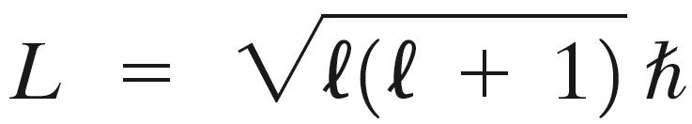
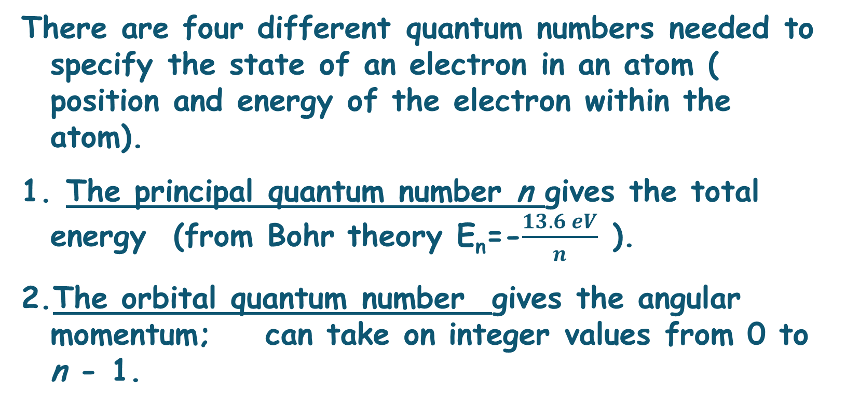
Quantum Mechanics of atoms:Quantum Numbers
There are four different quantum numbers needed to specify the state of an electron in an atom ( position and energy of the electron within the atom).
The principal quantum number n gives the total energy (from Bohr theory E_{n}=-$\frac{13.6 eV}{n}$ ).
The orbital quantum number gives the angular momentum; can take on integer values from 0 to n - 1.
Equation 39-3 goes here.

Slide 6
Quantum Mechanics of atoms
3. The magnetic quantum number,m , gives the direction of the electron’s angular momentum, and can take on integer values from – to + . ( L is derived from experiment)
L= m ћ

Slide 7
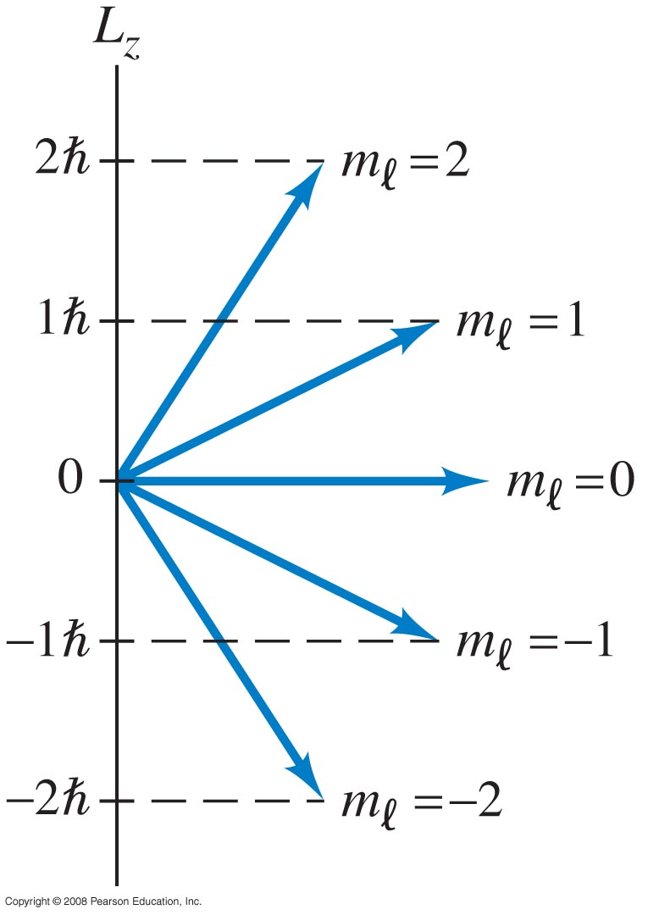
Quantum Mechanics of atoms: Quantum Numbers
Figure 39-3 goes here.
This plot indicates the quantization of angular momentum direction for = 2. The other two components (L_{x}, and L_{y}) of the angular momentum are undefined.
Notes:
Figure 39-3. Quantization of angular momentum direction for l = 2.

Slide 8
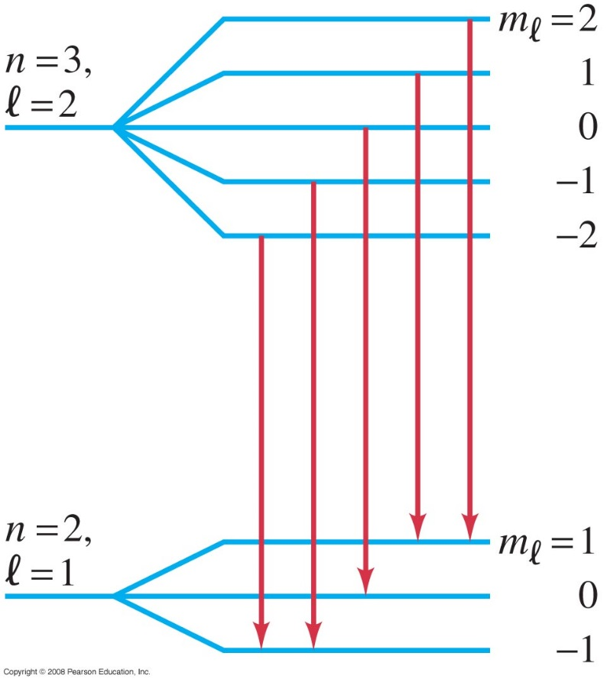
Quantum Mechanics of atoms: Quantum Numbers
In a magnetic field, the energy levels split depending on m . The splitting is know as the Zeeman effect.
When a magnetic field is applied, an n = 3, l = 2 energy level is split into five separate levels, corresponding to the five values of m_{l} (2, 1, 0, -1, -2).
An n = 2, l = 1 level is split into three levels (m_{l} = 1, 0 , -1). Transitions can occur between levels (not all transitions are shown), with photons of several slightly different frequencies being given off (the Zeeman effect).
Notes:
Figure 39-4. When a magnetic field is applied, an n = 3, l = 2 energy level is split into five separate levels, corresponding to the five values of m_{l} (2, 1, 0, -1, -2). An n = 2, l = 1 level is split into three levels (m_{l} = 1, 0 , -1). Transitions can occur between levels (not all transitions are shown), with photons of several slightly different frequencies being given off (the Zeeman effect).

Slide 9
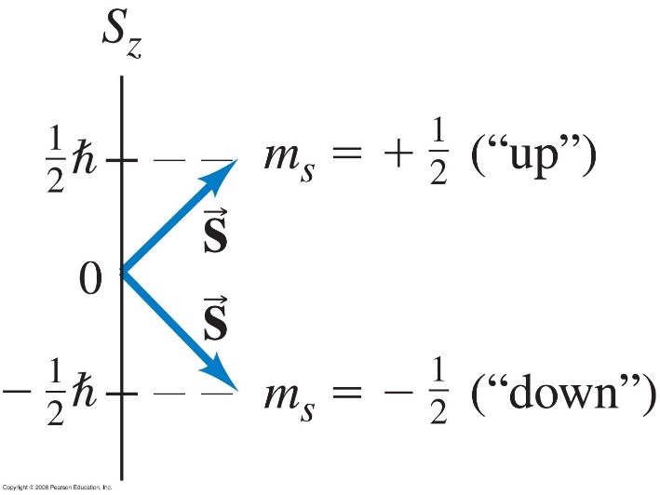
Quantum Numbers
4. The spin quantum number, m_{s}, for an electron can take on the values +½ and -½. The need for this quantum number was found by experiment;
Spin is one of two types of angular momentum in quantum mechanics, the other being orbital angular momentum. The orbital angular momentum operator is the quantum-mechanical counterpart to the classical angular momentum of orbital revolution ( or the magnitude of the angular momentum of the electron or other particle).
The spin angular momentum S can take on only two directions, m_{s} = +1/2 or -1/2, called “spin up” and “spin down.”
Notes:
Figure 39-5. The spin angular momentum S can take on only two directions, m_{s} = +1/2 or -1/2, called “spin up” and “spin down.”

Slide 10
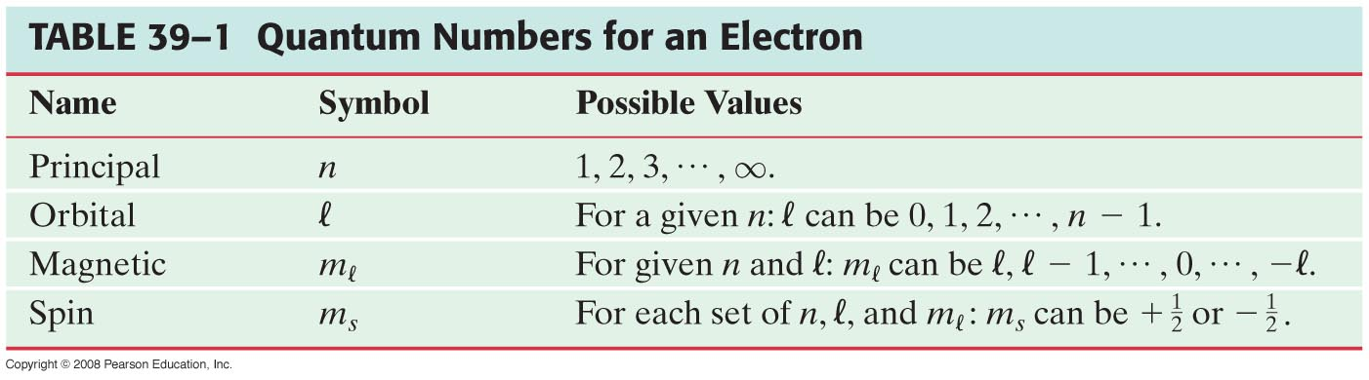
Quantum Numbers
This table summarizes the four quantum numbers.

Slide 11

Quantum Numbers :Allowed transitions
“Allowed” transitions between energy levels occur between states whose value of differ by one:
Other, “forbidden,” transitions also occur but with much lower probability.
An electron in =2 state can jump only to a state with =1 or =3. It cannot jump to a state with =2 or =0 ( forbidden transition)

Slide 12
Complex Atoms; the Exclusion Principle
Complex atoms contain more than one electron, so the interaction between electrons must be accounted for in the energy levels. This means that the energy depends on both n and .
A neutral atom has Z electrons, as well as Z protons in its nucleus. Z is the atomic number.

Slide 13
Complex Atoms; the Exclusion Principle
In order to understand the electron distributions in atoms, another principle is needed. This is the Pauli exclusion principle:
No two electrons in an atom can occupy the same quantum state.
The quantum state is specified by the four quantum numbers; no two electrons can have the same set.

Slide 14
Exclusion principle
The exclusion principle tells us that because , no two electrons can occupy the same quantum state, if the two electrons have the same quantum numbers, they must be different in some other way-namely by being at different places in space (attached to different atoms).

Slide 15
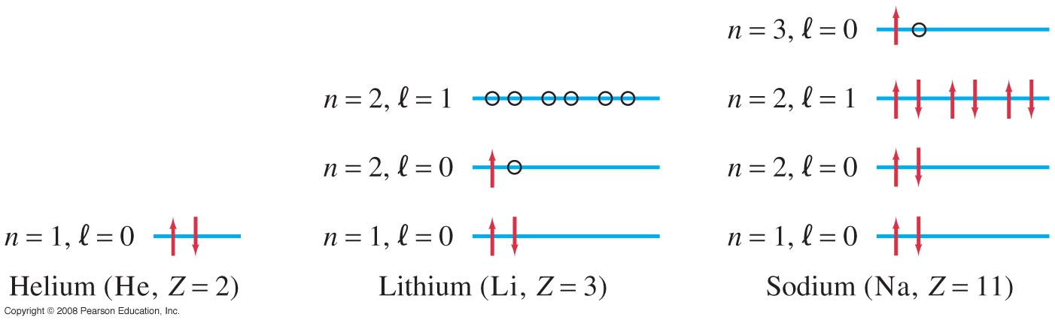
Complex Atoms; the Exclusion Principle
This chart shows the occupied – and some unoccupied – states in He, Li, and Na.
Energy level diagram (not to scale) showing occupied states (m_{s}=1/2 or -1/2 :arrows) and possible empty states (o) for He, Li, and Na. Note that we have shown the n = 2, l = 1 level of Li even though it is empty.
Notes:
Figure 39-10. Energy level diagram (not to scale) showing occupied states (arrows) and unoccupied states (o) for He, Li, and Na. Note that we have shown the n = 2, l = 1 level of Li even though it is empty.

Slide 16
Covalent Bonds
Hydrogen molecule, H₂, is bound covalently.
If the atoms have their spins are parallel and in the same direction: S = 1 ( S=1/2 +1/2) for the molecule, the atoms will not bond due to the exclusion principle (the 2 electrons cannot be in the lowest energy state and attached to the same atom since they will have the same quantum number in violation with the exclusion principle . So for s=1 when two atoms approach each other , the electrons will stay away from each other as shown by the probability distribution.
Electron probability distribution (electron cloud) for 2 H atoms when S=1: (a) electron cloud,
(b) Projection of ${\left|ψ\right|}^{2}$ along the line through the centers of the two atoms
Notes:
Figure : Electron probability distribution (electron cloud) for two H atoms when the spins are the same (S = 1): (a) electron cloud.

Slide 17
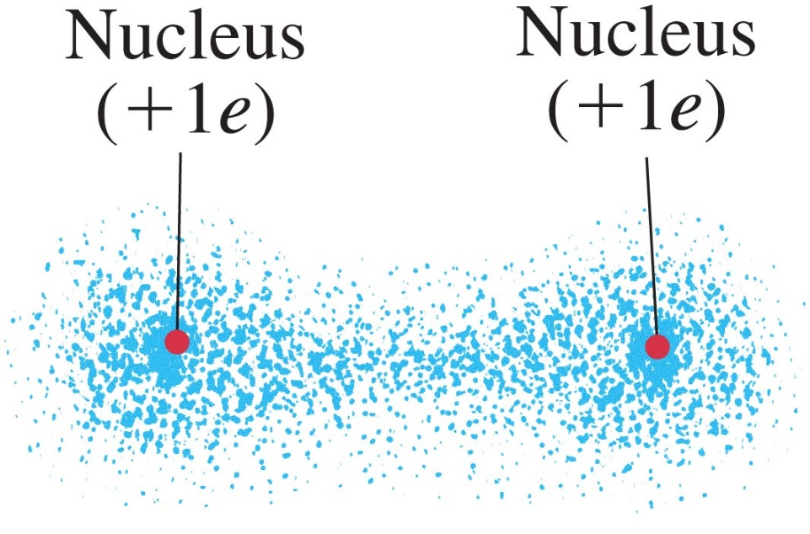
Covalent Bond
The molecule will form only if the spin S = 0 (spins in the opposite direction). The electrons are in different quantum states. The electrons can come close together and the probability looks like fig. (b). The positive nuclei are attracted to the concentration of the negative charge electron cloud between the them fig. (a). This is a covalent bond
The two electrons are shared by both atoms: sharing
When the electron cloud in the H atom start to overlap each electron orbit about both nuclei; this is called electron
(b)
(a)
The energy needed to bond the atoms is called the binding energy. Energy that we look at in x-ray spectroscopy to determine the elements in a material
Notes:
Figure 40-2a. Electron probability distribution for two H atoms when the spins are opposite (S = 0): In this case a bond is formed because the positive nuclei are attracted to the concentration of negative charge between them. This is a hydrogen molecule, H₂.

Slide 18
Covalent Bond-Wave interference
What the exclusion principle requires is that when the spins are the same , there is a destructive interference of the electron wave, and when the spins are opposite , there is a constructive electron wave interference ( electron acting as a wave).
This happens between the two atoms , there is a large amount of negative charge , and the bond is the result of constructive interference between the two atoms.

Slide 19
Covalent Bond-Energy
We can also explain the bond using the point of view of energy.
If the spin are opposite , the electron can occupy the same space, which means that the electron can move about the space of the two atoms instead of the volume of one atom only.
And because of the uncertainty principle: If ∆x is large ∆p should be low ( energy should be low), which means less energy when they combine then when they separate

Slide 20
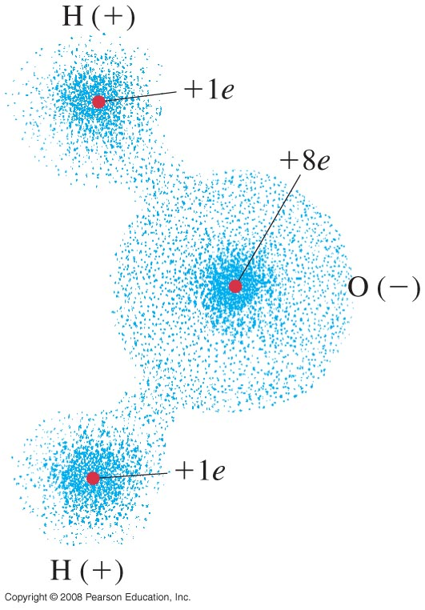
Covalent Bond
Pure covalent bonds are found in molecules consisting of only one type of atom.
Otherwise, electrons are likely to spend more time around one type of atom than another, giving a partial ionic character. Water (H₂O) is one such molecule.
Notes:
Figure 40-6. The water molecule H₂O is polar.

Slide 21
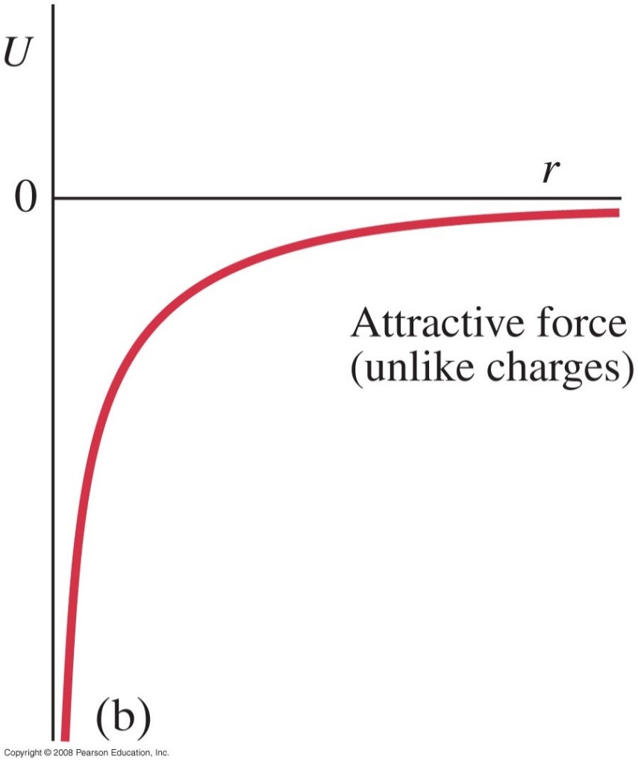
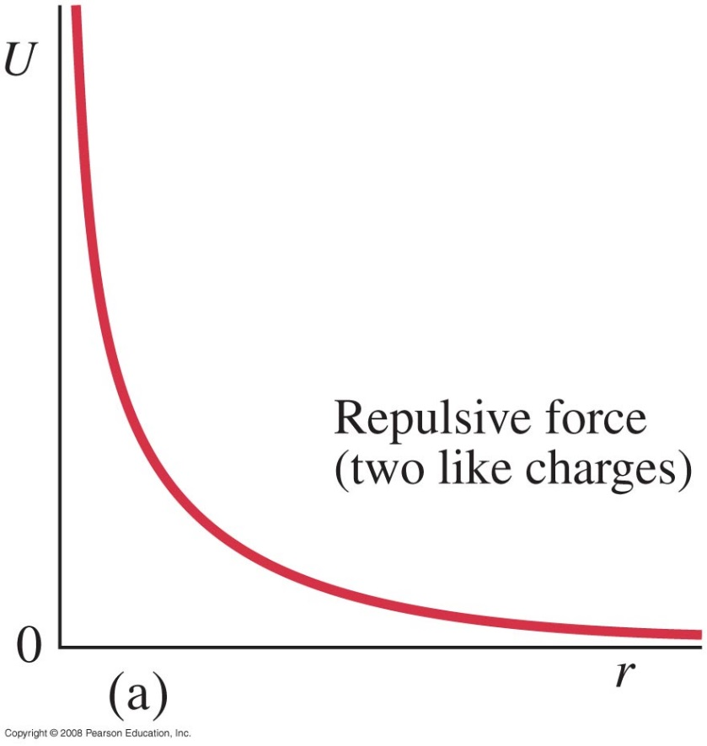

Potential-Energy Diagrams for Molecules
Potential energy of two point charges: r is the separation between the 2 point charges.
$$U=\frac{kq_{1}q_{2}}{r}$$
Notes:
Figure 40-7. Potential energy as a function of separation for two point charges of (a) like sign and (b) opposite sign.

Slide 22
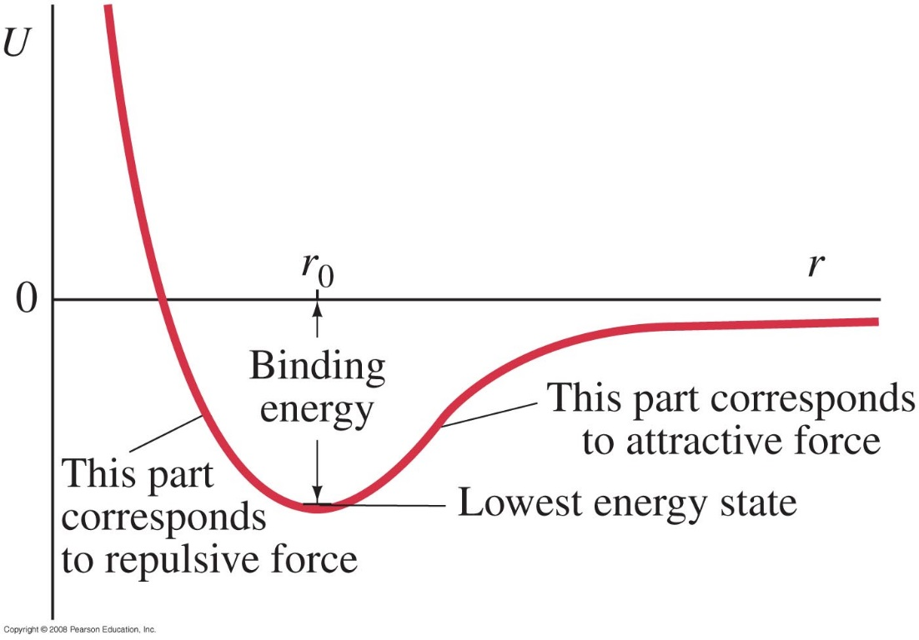
Potential-Energy Diagrams for Molecules
For the hydrogen molecule, the force between the atoms is attractive at large distances. If the atoms are too close, the electrons are too squeezed; therefore, there is a minimum in the potential.
The binding energy is the bond energy. When r increases , U decreases as atoms approach one another and the attraction happens.
r is the separation of the two H atoms
The binding energy (the energy difference between U = 0
and the lowest energy state near the bottom of the well)
is 4.5 eV, and r₀ = 0.074 nm.
The energy is the lowest for r₀,
r₀ is the average separation between atoms.
Notes:
Figure 40-8. Potential-energy diagram for H₂ molecule; r is the separation of the two H atoms. The binding energy (the energy difference between U = 0 and the lowest energy state near the bottom of the well) is 4.5 eV, and r₀ = 0.074 nm.

Slide 23
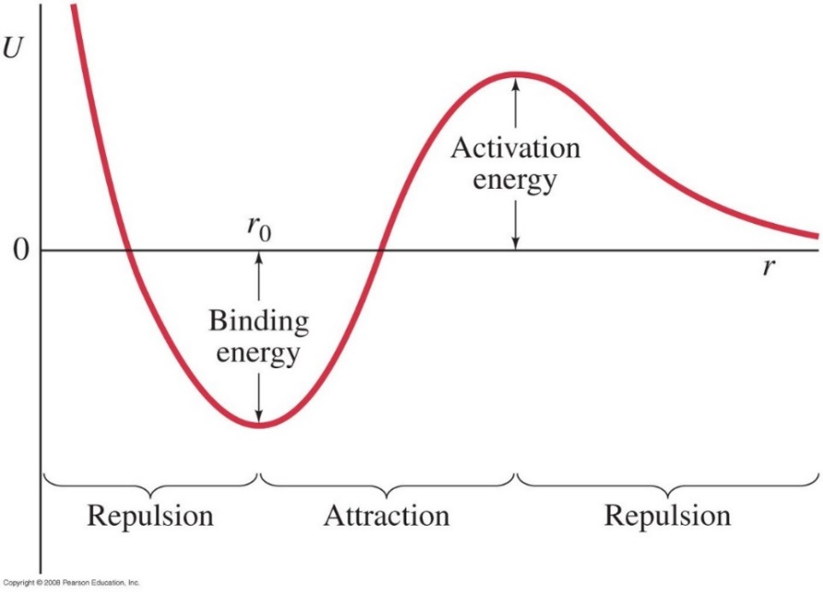
Potential-Energy Diagrams for Molecules
For many bonds, this is the real potential energy diagram. For example in H₂O, when the atoms approach, the force is rather repulsive than attractive, and some extra energy is needed into the system. H₂, and O₂ must be broken before H and O combine.
r₀ optimum distance at which the molecule is stable.
Often, there is an activation energy required – atoms must be separated from existing molecules before they can be combined to make new ones.
Potential-energy diagram for a bond requiring an activation energy.
Notes:
Figure 40-9. Potential-energy diagram for a bond requiring an activation energy.

Slide 24
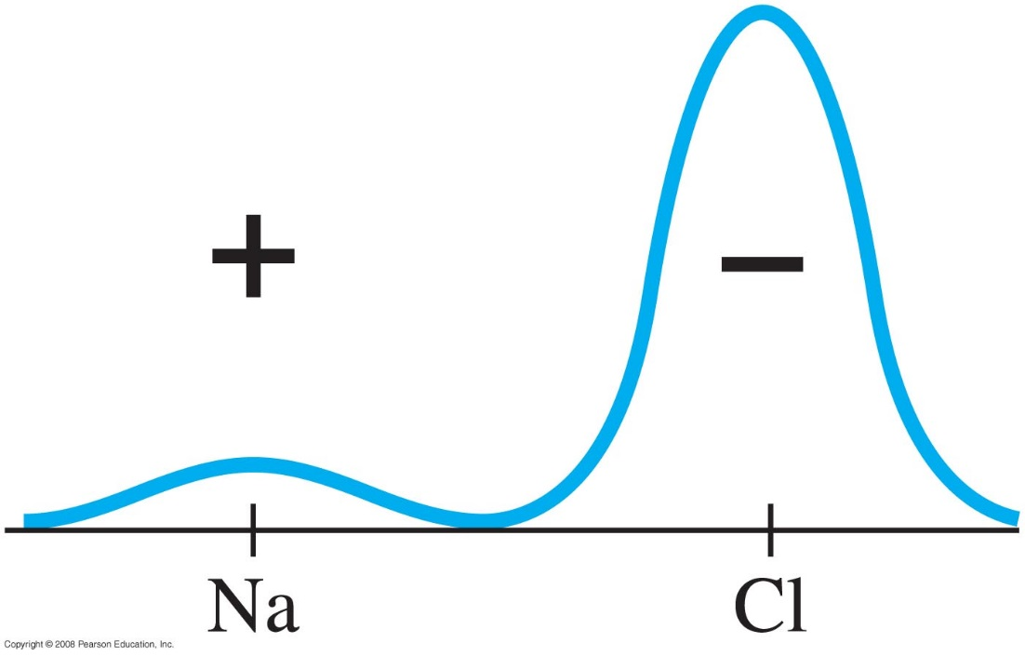
Ionic Bond
An ionic bond is created by the attraction of ions. It is a special case of covalent bond, but electron are shared unequally.
The electrostatic attraction between the two charged atoms hold them together, we have ionic bonds ( attraction between two ions).
For example, the outermost electron in the sodium atom spends most of its time around the chlorine atom in NaCl.
Na⁺ has 11 electrons , 10 in a closed shell and one electron outside the closed shell
Probability distribution |ψ|² for the outermost electron of Na in NaCl.

Slide 25
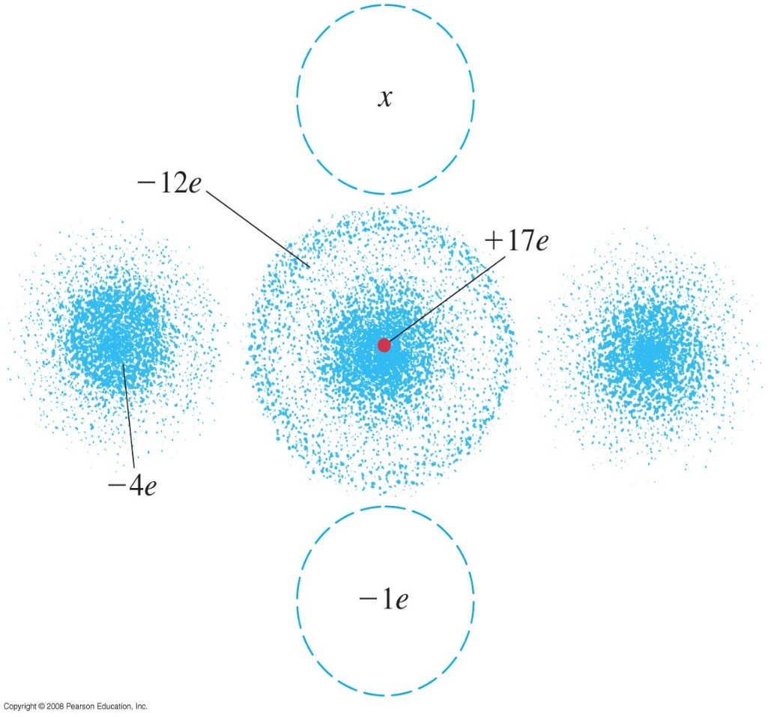
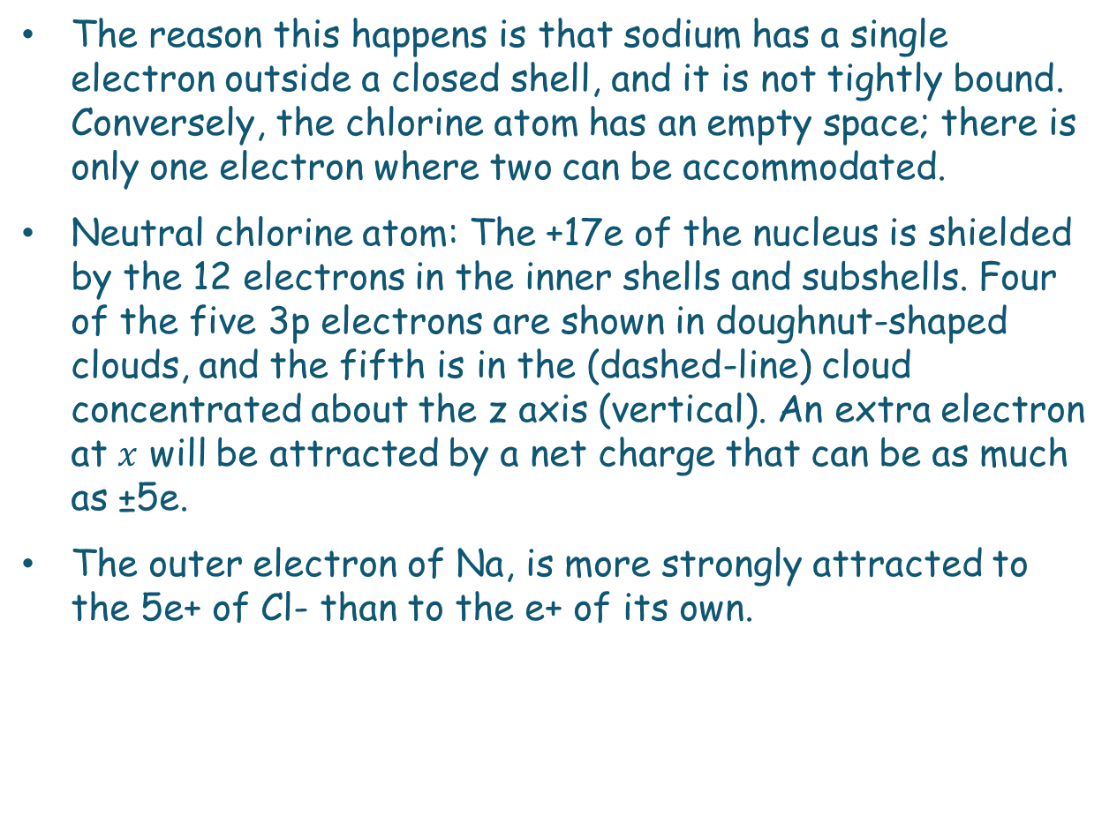
Ionic Bonding
The reason this happens is that sodium has a single electron outside a closed shell, and it is not tightly bound. Conversely, the chlorine atom has an empty space; there is only one electron where two can be accommodated.
Neutral chlorine atom: The +17e of the nucleus is shielded by the 12 electrons in the inner shells and subshells. Four of the five 3p electrons are shown in doughnut-shaped clouds, and the fifth is in the (dashed-line) cloud concentrated about the z axis (vertical). An extra electron at $x$ will be attracted by a net charge that can be as much as ±5e.
The outer electron of Na, is more strongly attracted to the 5e+ of Cl- than to the e+ of its own.
Notes:
Figure 40-5. Neutral chlorine atom. The +17e of the nucleus is shielded by the 12 electrons in the inner shells and subshells. Four of the five 3p electrons are shown in doughnut-shaped clouds, and the fifth is in the (dashed-line) cloud concentrated about the z axis (vertical). An extra electron at x will be attracted by a net charge that can be as much as ±5e.

Slide 26
Ionic Bond (NaCl)
Na (outer shell 3s¹)
Cl (outer shell 3s²3p⁵)
Has one weakly bound electron
Low ionization energy
Needs one electron to fill shell
Strong electron affinity
Na
e
+
-
Cl
U(r)
Repulsion when
atoms overlap
Separation
of ions
Na⁺
Cl⁻
Cl⁻
Na⁺
Energy
Attracted by coulomb attraction
Coulomb attraction

Slide 27
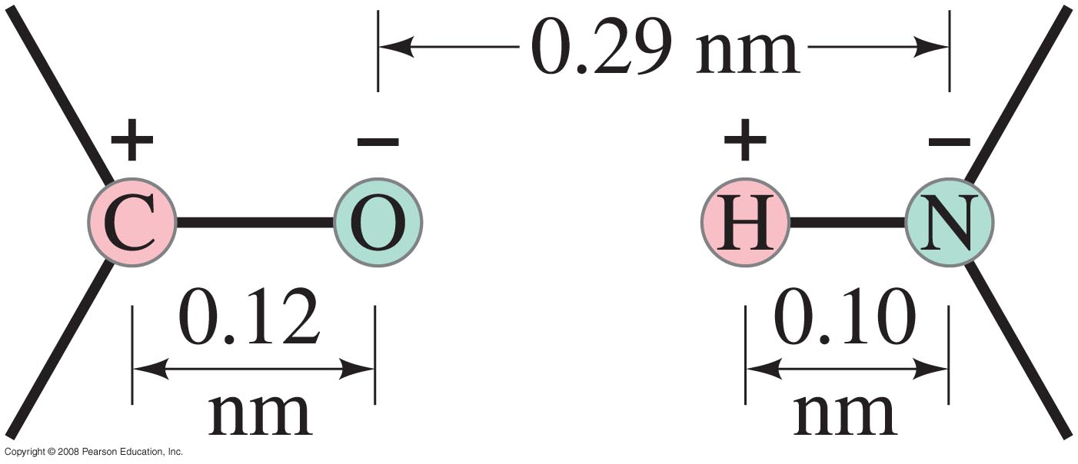
Weak (van der Waals) Bonds
Bond energy or binding energy between atoms are typically about 2 to 5 eV for strong bonds
Weak bonds are electrostatic bonds between molecules (and not between atoms within a molecule). The binding energy is much less than that of strong bonds, about 0.04 to 0.3 eV.
Weak bonds are usually the result of attraction between dipoles. The C+-O- and H+-N- dipoles attract each other.
The + and - charges typically have magnitudes of a fraction of e.
Notes:
Figure 40-12. The C⁺-O⁻ and H⁺-N⁻ dipoles attract each other. (These dipoles may be part of, for example, cytosine and guanine molecules. The + and - charges typically have magnitudes of a fraction of e.

Slide 28
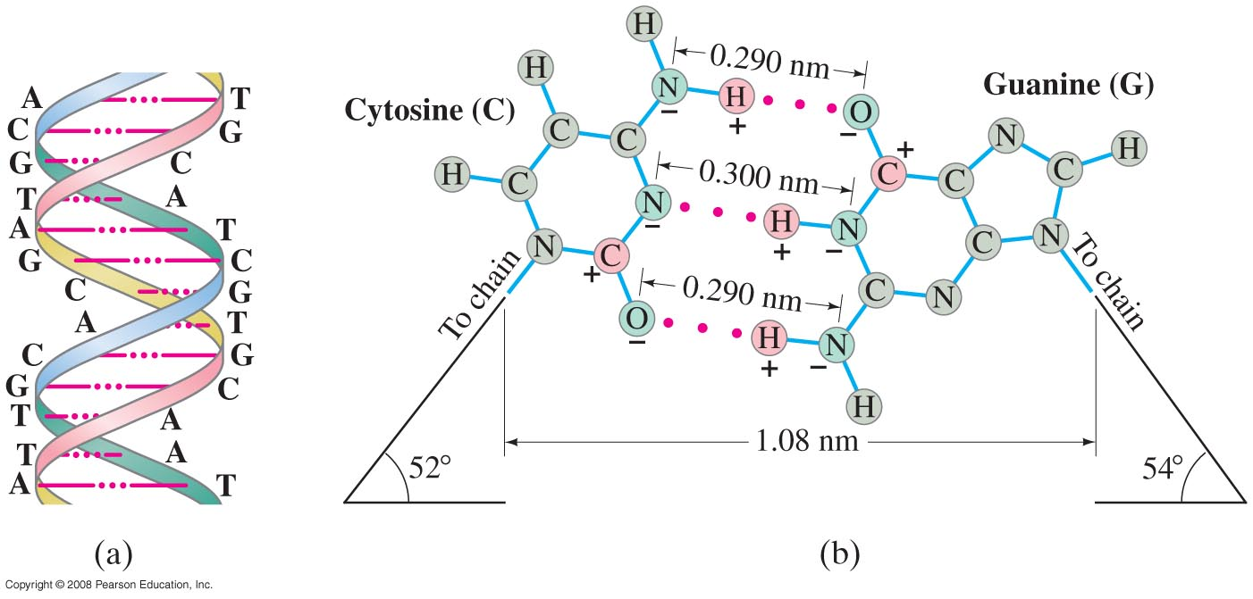
Weak (van der Waals) Bonds
Weak bonds become important in liquids and solids where strong bonds are absent.
They are also important in living cells, especially in DNA replication.
The red dots represent hydrogen
bonds between the two strands.
(a) Section of a DNA double helix
(b) “Close-up” view: cytosine (C) and guanine (G) molecules on
separate strands of a DNA double helix are held together
by the hydrogen bonds (red dots) involving an
H+ on one molecule attracted to an N- or C+-O- of
a molecule on the adjacent chain.

Slide 29
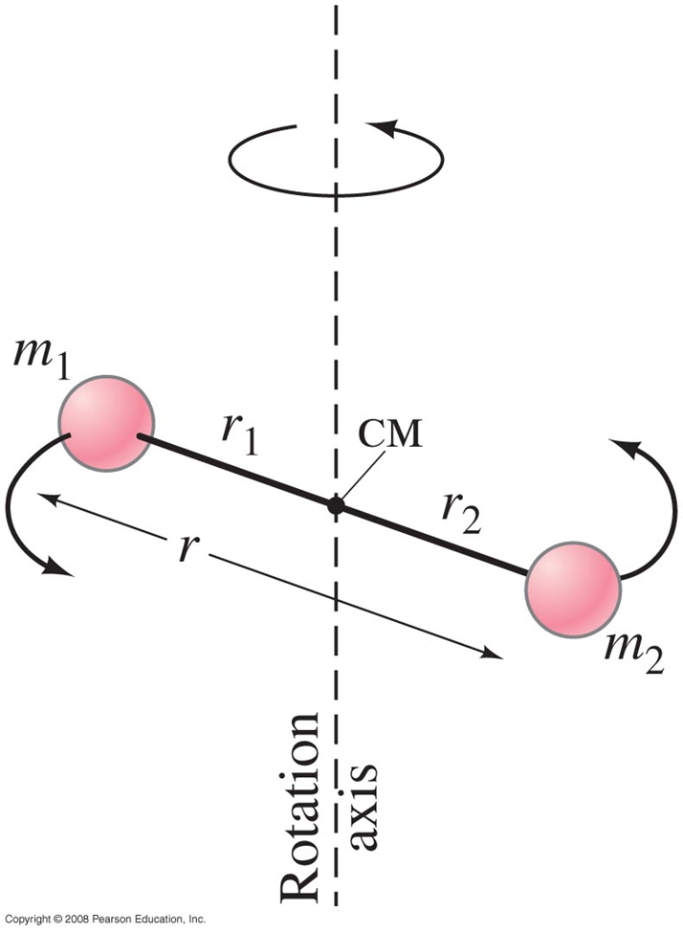
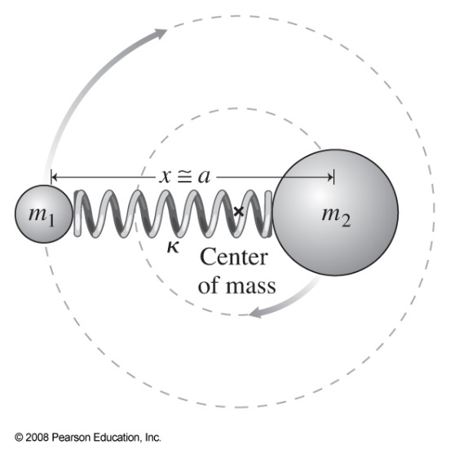
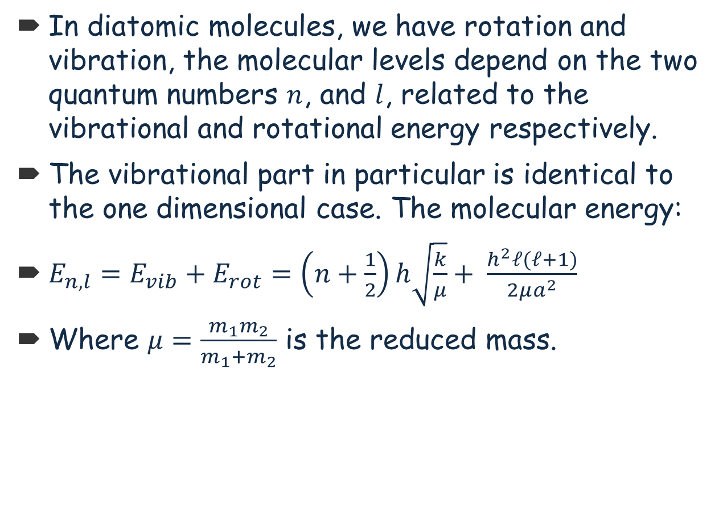
Rotation and Vibration
In diatomic molecules, we have rotation and vibration, the molecular levels depend on the two quantum numbers $n$, and $l$, related to the vibrational and rotational energy respectively.
The vibrational part in particular is identical to the one dimensional case. The molecular energy:
$E_{n,l}=E_{vib}+E_{rot}=\left(n+\frac{1}{2}\right)h\sqrt{\frac{k}{μ}}+ \frac{h^{2}ℓ(ℓ+1)}{2μa^{2}}$
Where $μ=\frac{m_{1}m_{2}}{m_{1}+m_{2}}$ is the reduced mass.

Slide 30
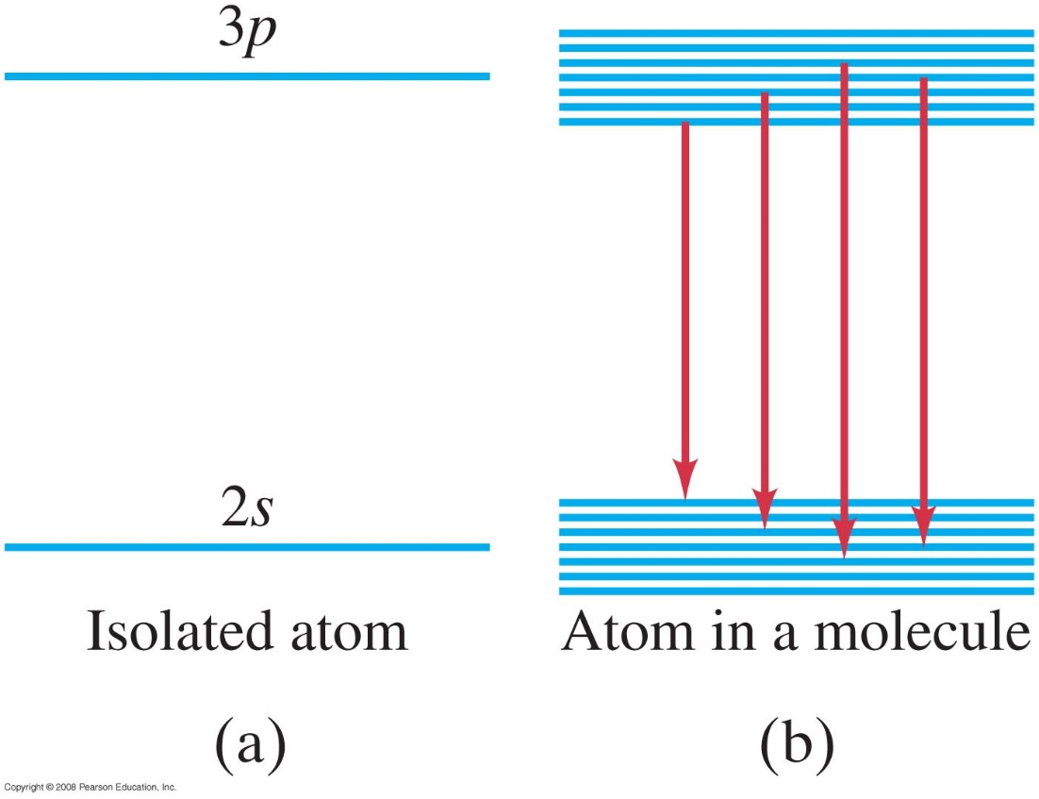
Rotation and Vibration
When there are vibrations or rotations, atoms combine to form molecules. The wave functions overlap, and the probability distributions of the outer electrons orbits overlap.
The overlap of orbits alters energy levels in molecules, but molecules can undergo transitions between electron energy levels just as atoms do
Also, more types of energy levels are possible, due to rotations and vibrations. The result is a band of closely spaced energy levels.
Each atomic level becomes a set of closely
spaced levels due to vibrations and rotations
Notes:
Figure 40-15. (a) The individual energy levels of an isolated atom become (b) bands of closely spaced levels in molecules, as well as in solids and liquids.

Slide 31
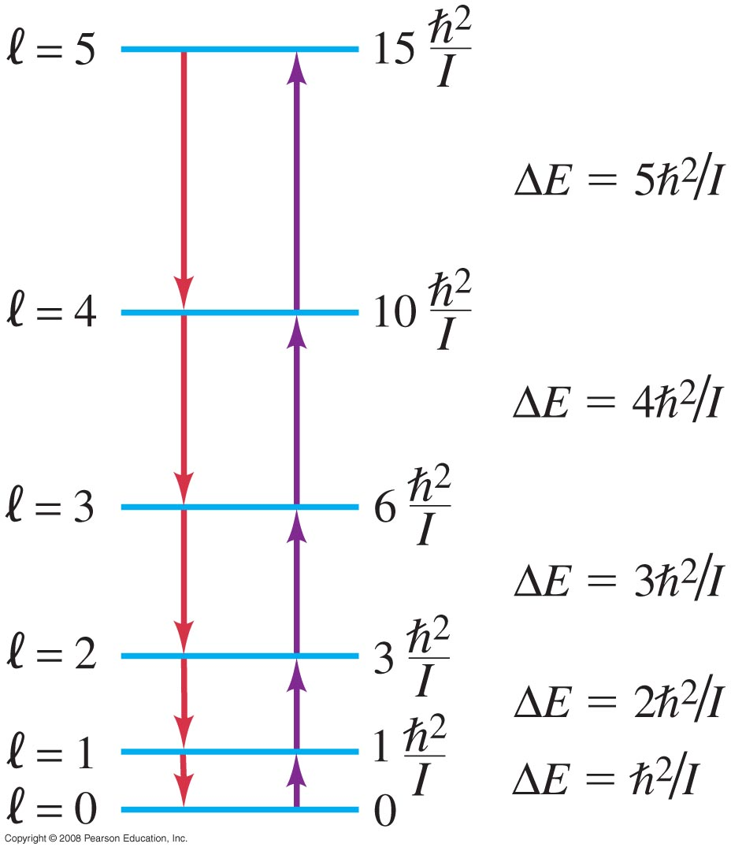
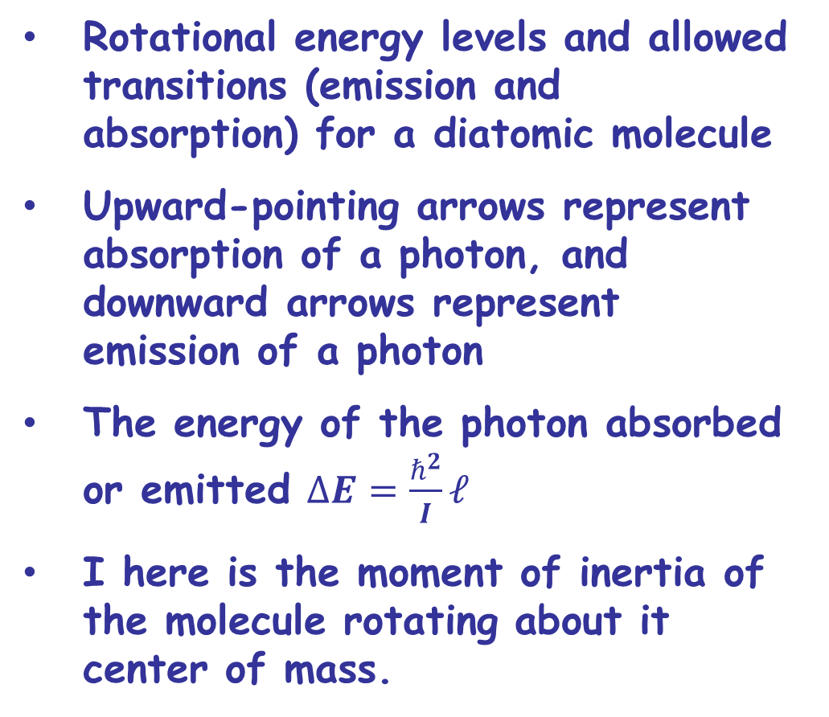
Molecular Spectra
Rotational energy levels and allowed transitions (emission and absorption) for a diatomic molecule
Upward-pointing arrows represent absorption of a photon, and downward arrows represent emission of a photon
The energy of the photon absorbed or emitted $∆E=\frac{ℏ^{2}}{I}ℓ$
I here is the moment of inertia of the molecule rotating about it center of mass.
Notes:
Figure 40-17. Rotational energy levels and allowed transitions (emission and absorption) for a diatomic molecule. Upward-pointing arrows represent absorption of a photon, and downward arrows represent emission of a photon.

Slide 32
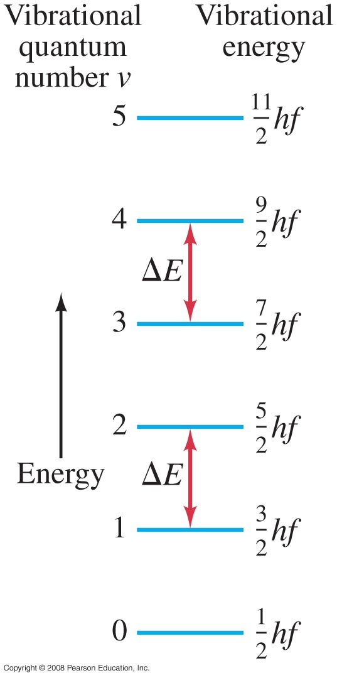
Molecular Spectra
Here are some vibrational energy levels in a diatomic molecule, and the allowed transitions, where f is the fundamental frequency of vibration
E_{vib}=(v+1/2) hf , v is the vibrational quantum number
Transitions give off photons with energy ΔE_{vib}=hf
The energy levels are equally spaced, and transitions are allowed only between adjacent levels (Δν = ±1).

Slide 33
Covalent Solid
In a covalent solid, each atom shares covalent bonds with those surrounding it, resulting in an unbroken network of strong Bonds.
They are poor electrical conductors because all valence electrons are locked into bonds between adjacent atoms.

Slide 34
Ionic Solids
When atoms with nearly filled shells meet atoms with weakly bond valence electrons, they seize electrons from the atoms with weakly bond electrons and produce ionic solids.
The solid is held together by the strong electrostatic attraction between ions.
Ionic solids are relatively hard with high melting points.
Elements do not form ionic solids.
Electrons are not free to respond to electric fields (voltages), so ionic solids are poor electrical conductors.

Slide 35
Metallic Solids
Metallic bonds, where electrons are shared by all atoms in the metal, are neither ionic nor covalent. The binding energy of metallic bonds is slightly weaker than that of ionic or covalent bonds – about 1 to 3 eV – but they are still strong bonds.
Because the cohesive forces are not in the form of covalent bonds between ions forming the lattice, metals are sometimes malleable and possess lower melting points than covalent solids.
The conduction electrons respond to an external field. Metallic solids are excellent conductors of electricity

Slide 36
• How do atoms assemble into solid structures?
• This takes us to solid-state physics or Condensed matter physics
• Condensed Matter include studies of Solids,
liquids and other systems in which the behavior
of atoms must be understood.

Slide 37
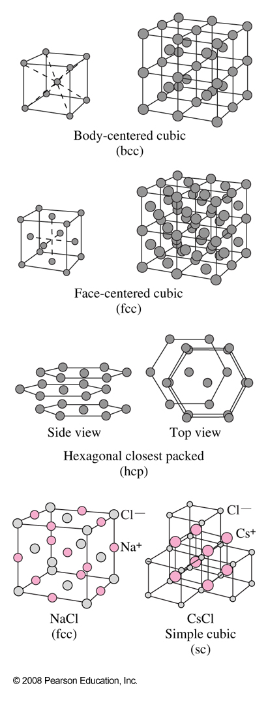
Crystalline Solids
Some solids are amorphous (no long-range order), but many are crystalline, having their atoms, ions or molecules arranged in an orderly array called lattice.
Most solids are at low temperature and /or high pressure have a crystal lattice where atoms are found at specific locations in a microscopic unit and have their molecules arranged in a regular lattice.
Here are 14 possible crystal lattices types

Slide 38
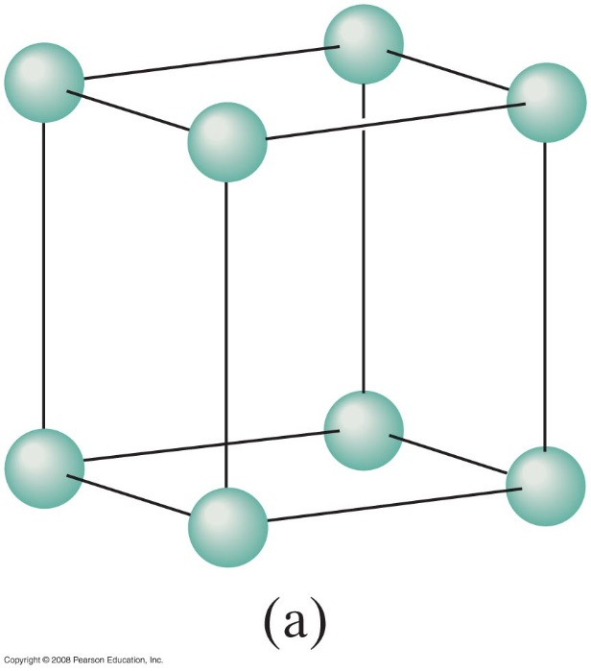
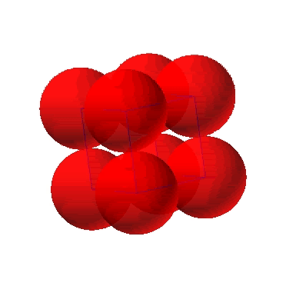
Simple Cubic Structure (SC)
• Rare due to low packing density
• Close-packed directions are cube edges.
The molecules of the solid are held by covalent bonding or ionic bonding.
(Courtesy P.M. Anderson)

Slide 39
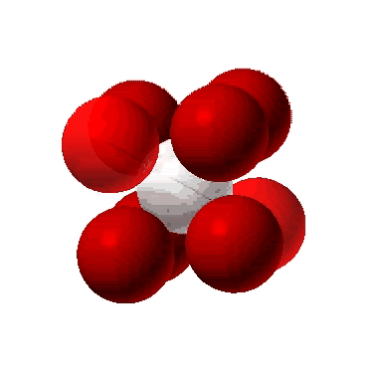
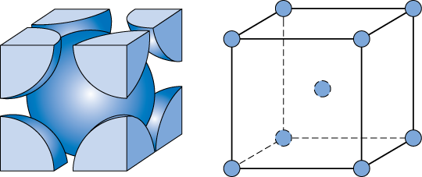
Body Centered Cubic Structure (BCC)
• Atoms touch each other along cube diagonals.
Note: All atoms are identical; the center atom is shaded
differently only for ease of viewing.
ex: Cr, Fe (α), Tantalum, Molybdenum
2 atoms/unit cell: 1 center + 8 corners x 1/8
(Courtesy P.M. Anderson)

