Slide 1
Quantization of light, charge and energy Chapter 2-Class3
Light carries energy :sun
How does light travel and in what form this energy is carried?
Energy can be carried by particles and waves: So does light travel as a stream of particles or as waves?

Slide 2
Applications of photoelectric effect
https://www.youtube.com/watch?v=nrCEVbS2oeo

Slide 3
Photoelectric effect
https://www.youtube.com/watch?v=wFY9ZvUmM5o

Slide 4
A note about units of energy
Joules are good for macroscopic energy conversions.
But when talking about energy of single electrons, Joules are inconvenient…
Define new energy unit: The electron-volt (eV)
1eV = kinetic energy gained by an electron when
accelerated through 1 volt of potential difference
1eV ≈ 1.6·10⁻¹⁹ J
+
+
+
+
0V
1V
F
E
path
+
1V
Notes:
For ref. not to be covered in class.

Slide 5
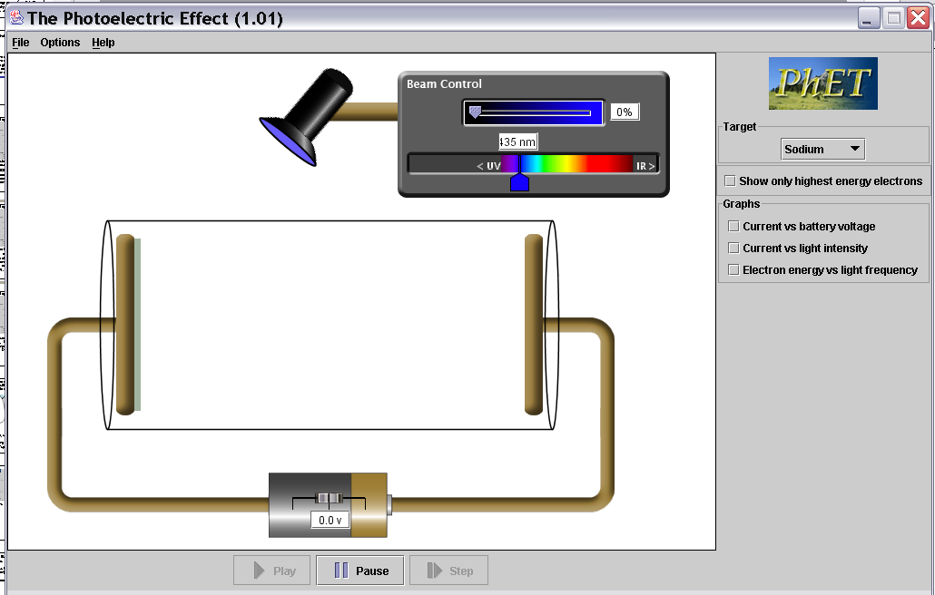
Photoelectric effect experiment apparatus.
Two metal plates in vacuum, adjustable voltage between
them, shine light on one plate. Measure current between plates.
When you hit a metal with a light of a certain wavelength ( blue light- higher energy and lower wavelength) you may have more electrons released.
When using the simulation, do not use the java option. Increase the voltage to 10, and increase the intensity, you will see electrons knocked off the plate.
A
B
https://phet.colorado.edu/en/simulation/legacy/photoelectric
-
+
Potential difference between A and B = 10 V
10 V
Notes:
What happens at 5V
186 responses, no breakdown

Slide 6
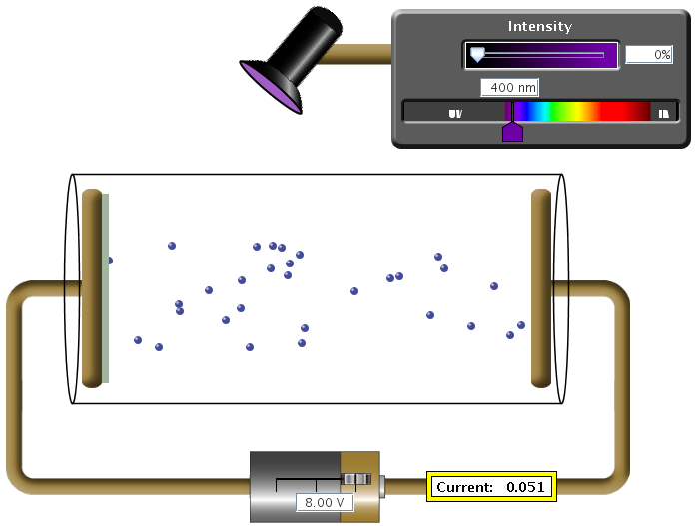
How to get the e⁻ out of plate A?
Shine light on the plate!!
Metal surface
Glass cylinder
+++++
A
Electrons get pulled towards plate B by the electric field
B
Vacuum
F = E·q_{e-}
Adjustable voltage
Current meter

Slide 7
Experimental apparatus: PE effect
Play with color and intensity. Measure current I. (I ~ ^{#e-}/_{s})
Measure the current!

Slide 8
Potential difference between A and B is 10 V
Without light, no electrons can get across gap.
But if we put an electron near the surface of plate A it 'feels' the electric field between the two plates.
The electron accelerates towards the positive plate (B) and picks up the energy (and electric field ) ΔE=qΔV= q(10V) = 1 electron charge x 10 V = 10 eV
E
Uniform E-field between plates
F=qE
+
+
+
+
+
10V
0V
A
B
Constant force on electron →constant acceleration
- 10V +
Current = 0 A
Current = 0.1 A
0V
10Volts

Slide 9
Kicker analogy: a ball in a pit
Light like a Kicker…
Puts in energy. All concentrated
on one ball/electron.
Blue kicker always kicks the same
Ball emerges with:
KE = kick energy - mgh
mgh = energy needed to
make it up hill and out.
mgh for highest electron
analogous to work function.
Kick energy. Top ones
get out, bottom don’t.
Harder kick (shorter
wavelength light),
more get out.
electrons
metal
Notes:
show photon view
On sim…

Slide 10
Kicker analogy: a ball in a pit
Light like a Kicker…
Puts in energy. All concentrated
on one ball/electron.
Ball emerges with:
It all depends on the metal
KE = kick energy - mgh
energy needed to get most
energetic electron out of pit
(“work function”)
h
h
sodium- easy to kick out
small work function Φ = shallow pit
platinum, hard to kick out
large work function Φ = deep pit

Slide 11
If photon has enough energy, electron emerges with:
KE = photon energy – work function
Photon…
Puts in kick of energy
energy needed to kick
highest electron out of metal.
“WORK FUNCTION” (Φ)
Each photon has: Energy =h f = Planks constant * Frequency
(Energy in Joules) (Energy in eV)
E=hf=(6.626*10⁻³⁴ J-s)*(f s⁻¹) E=hf= (4.14*10⁻¹⁵ eV-s)*(f s⁻¹)
E=hc/λ = (1.99*10⁻²⁵ J-m)/(λ m) E= hc/λ = (1240 eV-nm)/(λ nm)
Initial KE of electron = E_{photon} - energy needed to kick
as it comes out of metal electron out of metal
Depends on type of metal.

Slide 12
Typical energies
Photon Energies:
Each photon has: Energy =h f = Planks constant * Frequency
(Energy in Joules) (Energy in eV)
E=hf=(6.626*10⁻³⁴ J-s)*(f s⁻¹) E=hf= (4.14*10⁻¹⁵ eV-s)*(f s⁻¹)
E=hc/λ = (1.99*10⁻²⁵ J-m)/(λ m) E= hc/λ = (1240 eV-nm)/(λ nm)
Red Photon wavelength: 650 nm
E_{photon} = 1240 eV-nm = 1.91 eV
650 nm
Work functions of metals (in eV):
Aluminum | 4.08 eV | Cesium | 2.1 | Lead | 4.14 | Potassium | 2.3
Beryllium | 5.0 eV | Cobalt | 5.0 | Magnesium | 3.68 | Platinum | 6.35
Cadmium | 4.07 eV | Copper | 4.7 | Mercury | 4.5 | Selenium | 5.11
Calcium | 2.9 | Gold | 5.1 | Nickel | 5.01 | Silver | 4.73
Carbon | 4.81 | Iron | 4.5 | Niobium | 4.3 | Sodium | 2.28
Uranium | 3.6
Zinc | 4.3

Slide 13
Energy, Mass, and Momentum of a Photon
Clearly, a photon must travel at the speed of light. We already know that the energy is hf; we can put this in the relativistic energy-momentum relation and find the momentum:

Slide 14
Energy, Mass, and Momentum of a Photon
Example 10: Photon momentum and force.
Suppose the 10¹⁹ photons emitted per second from the 100-W lightbulb, were all focused onto a piece of black paper and absorbed. (a) Calculate the momentum of one photon and (b) estimate the force all these photons could exert on the paper.
Notes:
Solution: a. The momentum of one photon is h/λ = 1.3 x 10⁻²⁷ kg-m/s.
b. The force is the total momentum per second, which is about 10⁻⁸ N.

