Slide 1
Quantization of light, charge and energy Chapter 2-class 2
HW2 posted due- Tuesday Oct. 3
Light carries energy :sun
How does light travel and in what form this energy is carried?
Energy can be carried by particles and waves: So does light travel as a stream of particles or as waves?

Slide 2
Interference – Young’s Double-Slit Experiment
If light is a wave, interference effects will be seen, where one part of a wave front can interact with another part.
One way to study this is to do a double-slit experiment:
Notes:
Figure 34-5. (a) Young’s double-slit experiment. (b) If light consists of particles, we would expect to see two bright lines on the screen behind the slits. (c) In fact, many lines are observed. The slits and their separation need to be very thin.

Slide 3
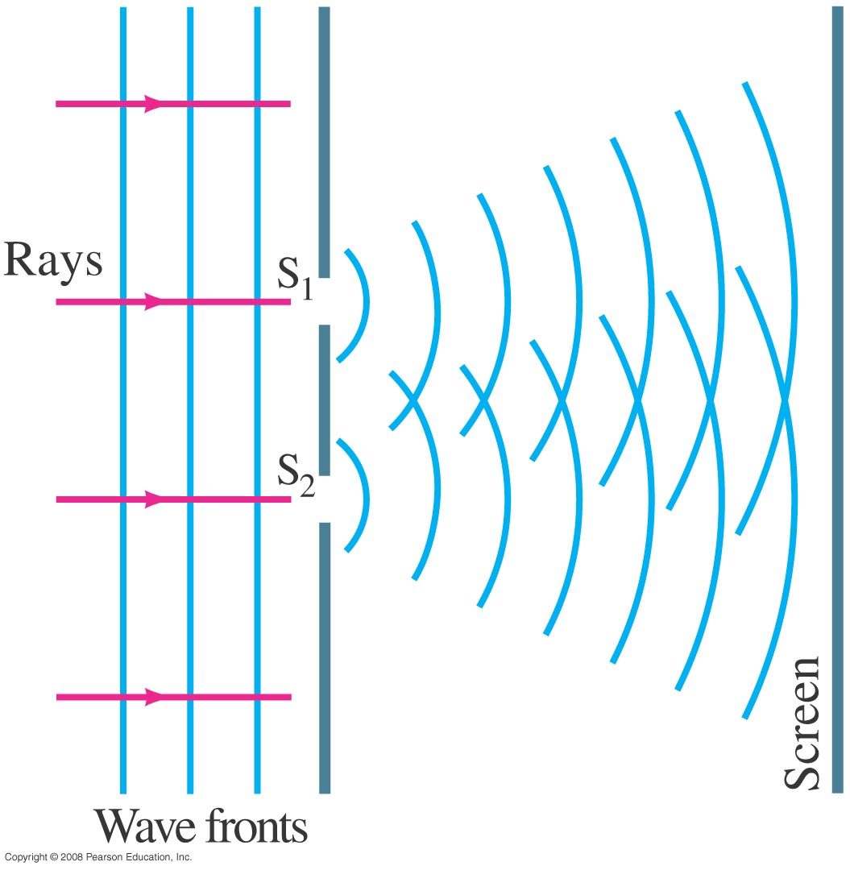
Interference – Young’s Double-Slit Experiment
Monochromatic wavelength (single wavelength) through two slits.
If light is a wave, there should be an interference pattern.
Notes:
Figure 34-6. If light is a wave, light passing through one of two slits should interfere with light passing through the other slit.

Slide 4
Interference – Young’s Double-Slit Experiment
The interference occurs because each point on the screen is not the same distance from both slits. Depending on the path length difference, the wave can interfere constructively (bright spot) or destructively (dark spot).
Notes:
Figure 34-7. How the wave theory explains the pattern of lines seen in the double-slit experiment. (a) At the center of the screen the waves from each slit travel the same distance and are in phase. (b) At this angle θ, the lower wave travels an extra distance of one whole wavelength, and the waves are in phase; note from the shaded triangle that the path difference equals d sin θ. (c) For this angle θ, the lower wave travels an extra distance equal to one-half wavelength, so the two waves arrive at the screen fully out of phase. (d) A more detailed diagram showing the geometry for parts (b) and (c).

Slide 5
Interference – Young’s Double-Slit Experiment
We can use geometry to find the conditions for constructive and destructive interference:
and

Slide 6
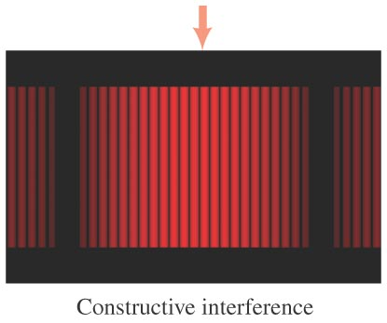
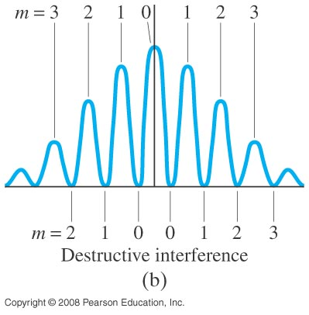
Interference – Young’s Double-Slit Experiment
Between the maxima and the minima, the interference varies smoothly.
Notes:
Figure 34-9. (a) Interference fringes produced by a double-slit experiment and detected by photographic film placed on the viewing screen. The arrow marks the central fringe. (b) Graph of the intensity of light in the interference pattern. Also shown are values of m for Eq. 34–2a (constructive interference) and Eq. 34–2b (destructive interference).

Slide 7
Interference – Young’s Double-Slit Experiment
Conceptual Example 1: Interference pattern lines.
(a) Will there be an infinite number of points on the viewing screen where constructive and destructive interference occur, or only a finite number of points? (b) Are neighboring points of constructive interference uniformly spaced, or is the spacing between neighboring points of constructive interference not uniform?
Notes:
Solution. a. Due to the fact that sin θ cannot be greater than 1, the maximum value of m is equal to the (truncated) value of d/λ.
b. The spacing increases with θ, although for small θ it is close to being uniform.

Slide 8
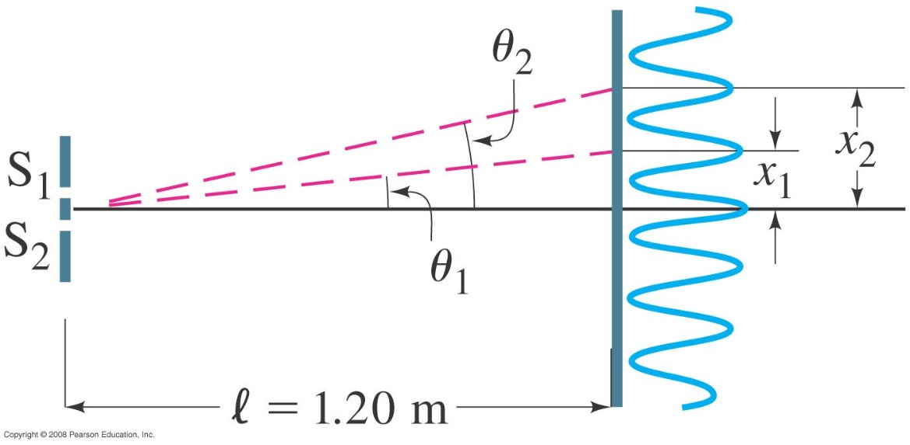
Interference – Young’s Double-Slit Experiment
Example 2: Line spacing for double-slit interference.
A screen containing two slits 0.100 mm apart is 1.20 m from the viewing screen. Light of wavelength λ = 500 nm falls on the slits from a distant source. Approximately how far apart will adjacent bright interference fringes be on the screen?
Notes:
Figure 34-10. Examples 34–2 and 34–3. For small angles θ (give θ in radians), the interference fringes occur at distance x = θl above the center fringe (m = 0); θ₁ and x₁ are for the first-order fringe (m = 1), θ₂ and x₂ are for m = 2.
Solution: Using the geometry in the figure, x ≈ lθ for small θ, so the spacing is 6.0 mm.

Slide 9
Interference – Young’s Double-Slit Experiment
Conceptual Example 3: Changing the wavelength.
(a) What happens to the interference pattern in the previous example if the incident light (500 nm) is replaced by light of wavelength 700 nm? (b) What happens instead if the wavelength stays at 500 nm but the slits are moved farther apart?
Notes:
Solution: a. As the wavelength increases, the fringes move farther apart.
b. Increasing the slit spacing causes the fringes to move closer together.

Slide 10
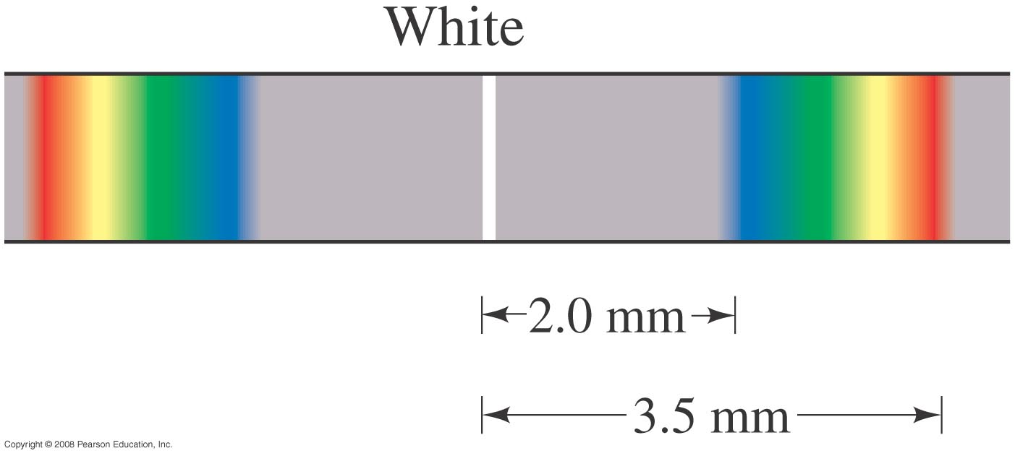
Interference – Young’s Double-Slit Experiment
For white light going through slits:
Since the position of the maxima (except the central one) depends on wavelength, the first- and higher-order fringes contain a spectrum of colors.
Notes:
Figure 34-11. First-order fringes are a full spectrum, like a rainbow.

Slide 11
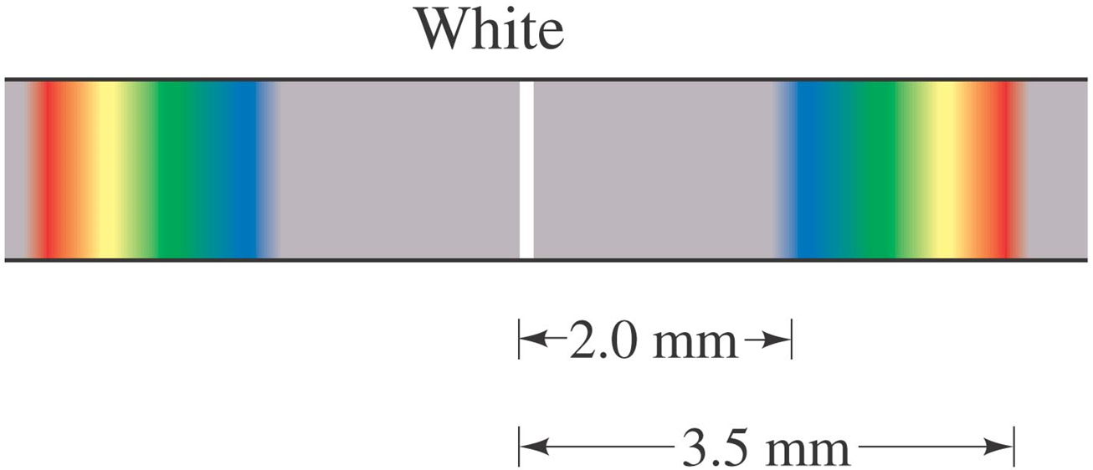
Interference – Young’s Double-Slit Experiment
Example 4: Wavelengths from double-slit interference.
White light passes through two slits 0.50 mm apart, and an interference pattern is observed on a screen 2.5 m away. The first-order fringe resembles a rainbow with violet and red light at opposite ends. The violet light is about 2.0 mm and the red 3.5 mm from the center of the central white fringe. Estimate the wavelengths for the violet and red light.
Notes:
Solution: Using the geometry of the previous examples and the small-angle approximation, the wavelength for the first-order fringe is given by dx/l = 400 nm for the violet light and 700 nm for the red light.

Slide 12
Black Body Radiation
All objects emit energy in the form of electromagnetic radiation.
We define a blackbody as an object that would absorb all the radiation that falls on it.
The blackbody radiation is an electromagnetic radiation emanating solely due to thermal motion of charges.
Any radiation striking the blackbody object must be absorbed rather than reflected
The Sun’s surface, from which reflection is insignificant is a blackbody.
A blackbody at room temperature appears black, as most of the energy it radiates is infra-red, and cannot be perceived by the human eye.
At high temperatures, there is enough infrared radiation and we can feel the heat if we are close to the object.

Slide 13
Black Body Radiation
Light colored bodies reflect most of the visible spectrum, and black bodies absorb most of it
The radiation absorbed by the black body object increases the kinetic energy of the constituent atoms, which oscillates about the equilibrium positions.
The kinetic energy of the atoms determines the temperature, the absorption causes the temperature to rise, and because the atoms have charges (e-), they are accelerated by the oscillations and emit electromagnetic radiation.

Slide 14
Blackbody Radiation
All objects emit radiation whose total intensity is proportional to the fourth power of their temperature.
This is called thermal radiation; a blackbody is one that emits thermal radiation only.
The spectrum of blackbody radiation has been measured; it is found that the frequency of peak intensity increases linearly with temperature.

Slide 15
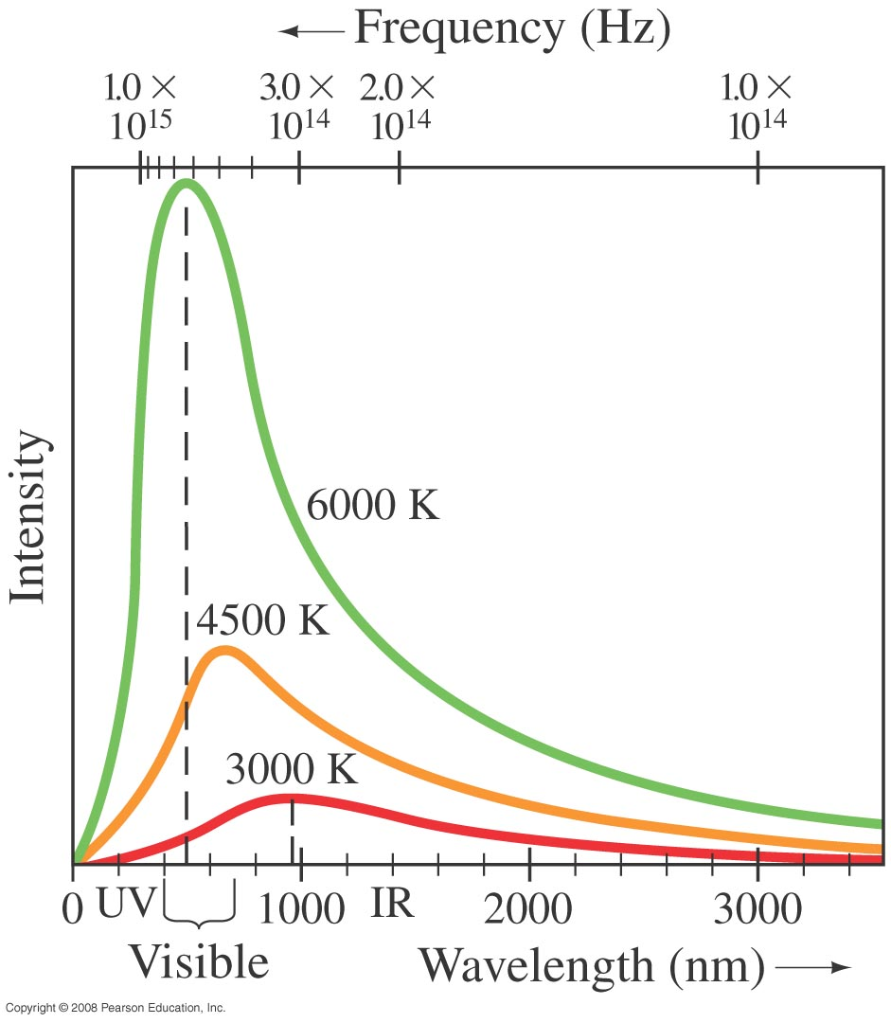
Planck’s Quantum Hypothesis; Blackbody Radiation
This figure shows blackbody radiation curves for three different temperatures for an idealized blackbody. Note that frequency increases to the left. The relationship between the temperature and peak wavelength is given by Wien’s law ( found experimentally):
Temperature of the surface of the sun
Red glow of a stove burner.
When T increases, body emits visible light, and the intensity of light increases. The object glows just as a stove burner.
Over 2000 K, objects glow with yellow or white (light bulbs filaments)
Notes:
Figure 37-1. Measured spectra of wavelengths and frequencies emitted by a blackbody at three different temperatures.

Slide 16
Planck’s Quantum Hypothesis; Blackbody Radiation
Example 5: The Sun’s surface temperature.
Estimate the temperature of the surface of our Sun, given that the Sun emits light whose peak intensity occurs in the visible spectrum at around 500 nm.
Notes:
Solution: Using Wien’s law we find T = 6000K.

Slide 17
Planck’s Quantum Hypothesis; Blackbody Radiation
Example 6: Star color.
Suppose a star has a surface temperature of 32,500 K. What color would this star appear?
Notes:
Solution: From Wien’s law, the peak wavelength would be 89.2 nm, well into the ultraviolet. The visible part of the spectrum will be increasing from longer to shorter wavelengths, and the star will look white or blue-white.

Slide 18
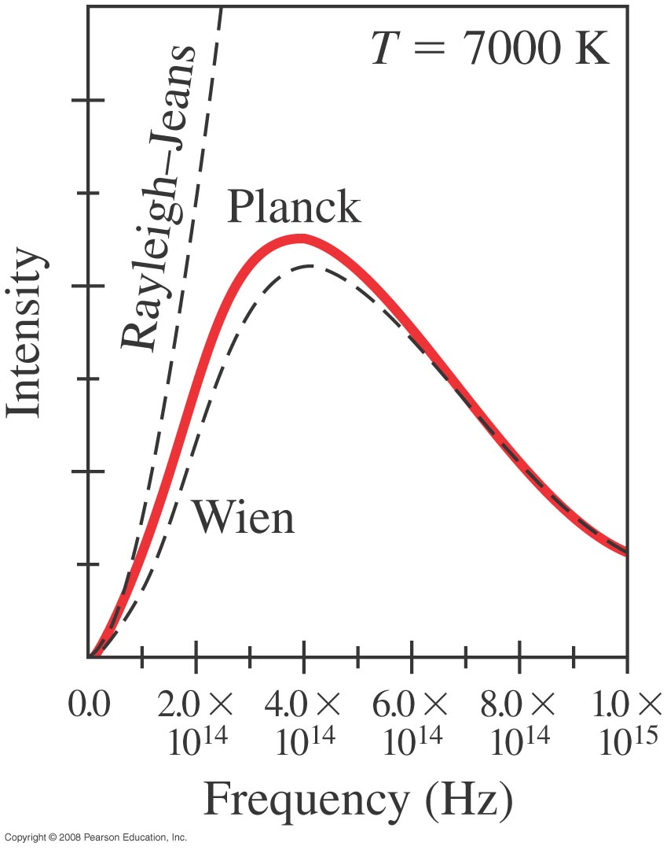
Planck’s Quantum Hypothesis; Blackbody Radiation
The observed blackbody spectrum could not be reproduced using 19th-century physics. This plot shows the disagreement.
This part of the story of radiation was first explained by Maxwell via wave theory but the predicted and actual intensity vs. frequency curves did not go together right. At higher frequencies classical physics predicted that more and more energy would be radiated from the body until the energy became infinite. This broke the first law of thermodynamics which is a fundamental part of all physics. This was called the ultraviolet catastrophe.
Works well
Here at low wavelengths
Notes:
Figure 37-2. Comparison of the Wien and the Rayleigh–Jeans theories to that of Planck, which closely follows experiment. The dashed lines show lack of agreement of older theories.

Slide 19
Planck’s Quantum Hypothesis; Blackbody Radiation
The solution proposed by Max Planck in 1900, suggested that the energy of atomic oscillations within atoms cannot have an arbitrary value; it is related to the frequency:
The constant h is called Planck’s constant.
n is a quantum number ( discrete number as opposed to continuous)

Slide 20
Planck’s Quantum Hypothesis; Blackbody Radiation
Planck found the value of his constant by fitting blackbody curves to the formula
giving
Planck’s proposal was that the energy of an oscillation had to be an integral multiple of hf. This is called the quantization of energy.

Slide 21
Planck’s Quantum Hypothesis
E= nhf is called Plank’s quantum hypothesis.
The quantum hypothesis states that the energy of an oscillator can be hf, 2hf, 3hf, and so on, and no values between.
Energy would not be a continuous, rather quantized, it exists only discrete amounts of it, not just any amount of amplitude of vibration is possible but the amplitude of vibration is related to frequency.
( Simple analogy of quantized or discrete: is stairs, when continuous energy is similar to a ramp)

Slide 22
Albert Einstein and The Photoelectric Effect
https://www.youtube.com/watch?v=0b0axfyJ4oo

Slide 23
Photon Theory of Light and the Photoelectric Effect
It took 100 years…And Einstein used Planck theory
Einstein suggested that, given the success of Planck’s theory, light must be emitted in small energy packets:
.
These tiny packets, or particles, are called photons (called first quantas).
"…the energy in a beam of light is not distributed continuously through space, but consists of a finite number of energy quanta, which are localized at points, which cannot be subdivided, and which are absorbed and emitted only as whole units.”

Slide 24
Photon Theory of Light and the Photoelectric Effect
Example 7: Photon energy.
Calculate the energy of a photon of blue light, λ = 450 nm in air (or vacuum).
Notes:
Solution: E = hf = hc/λ = 4.4 x 10⁻¹⁹ J = 2.8 eV.

Slide 25
Photon Theory of Light and the Photoelectric Effect
Example 8: Photons from a lightbulb.
Estimate how many visible light photons a 100-W lightbulb emits per second. Assume the bulb has a typical efficiency of about 3% (that is, 97% of the energy goes to heat).
Notes:
Solution: Assume an average wavelength of 500 nm. Only 3 W is emitted as light from the bulb, which is 3 J in one second. So the number of photons is the total energy divided by the energy per photon: N = E/hf = Eλ/hc = 8 x 10¹⁸ photons.

Slide 26
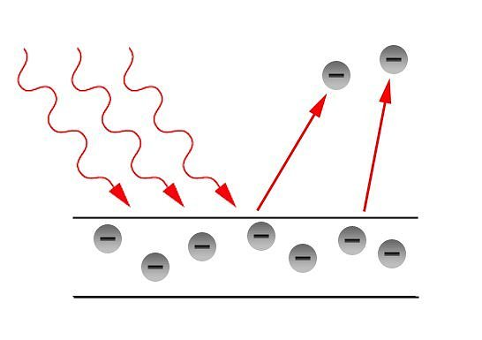
The Photoelectric Effect
The photoelectric effect is a phenomenon in which electrons are emitted from a metal as a consequence of the electrons absorbing energy from light.
The effect was only observed with UV light, but not so with red or IR light. → Effect is frequency dependent!?
But Maxwell told us that the light intensity doesn’t depend on frequency! (Intensity only depends on |E|²)

Slide 27
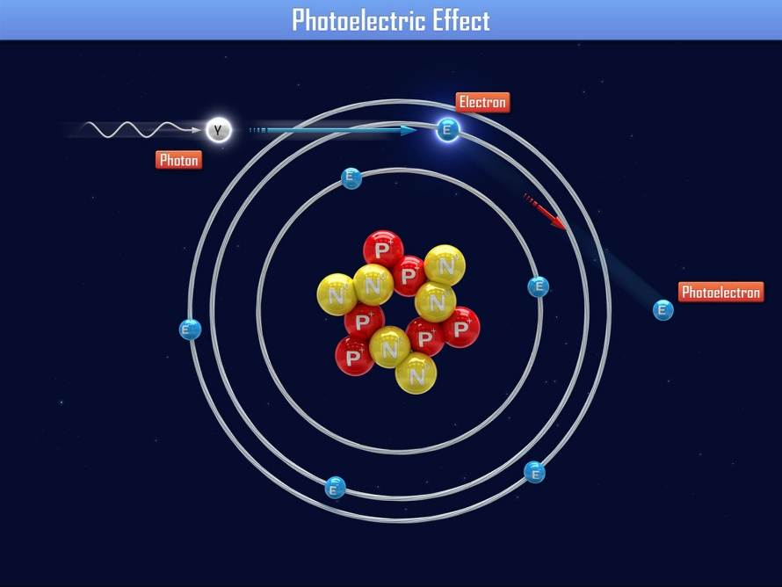
The Photoelectric Effect
Light with energy above a certain point can be used to knock electrons loose, freeing them from a solid metal surface. Each particle of light, called a photon, collides with an electron and uses some of its energy to dislodge the electron. The rest of the photon's energy transfers to the free negative charge, called a photoelectron.
The effect was only observed with UV light, but not so with red or IR light.

Slide 28
Photoelectric effect applications
Automatic Doors:
Many elevators and garage-door systems use a beam of light and a photoelectric device known as a photocell as a safety feature.
Solar Energy Panels:
Photocells are also the basic unit in the solar energy panels that convert some of the energy in sunlight into electrical energy. These panels are able to operate billboards and safety lights in remote areas far from power lines.
Other applications:
Old Television Camera Tubes
Light-Activated Counters
Intrusion Alarms

Slide 29
The photoelectric effect
The results from the photoelectric effect where inconsistent with the classical view of EM theory.
(Discovered 1887 by Hertz, Explained by Einstein (using some of Plank's ideas) 1905. Nobel prize: 1921)
Einstein proposed:
"…the energy in a beam of light is not distributed continuously through space, but consists of a finite number of energy quanta, which are localized at points, which cannot be subdivided, and which are absorbed and emitted only as whole units.”
He took the energy of these single units to be hf, as proposed earlier by Planck.

Slide 30
The photoelectric effect
In the photoelectric effect again, light is behaving as a collection of particles called photons, each with energy
E=hf
When the frequency is high enough, the electron ejected from a plate has a maximum kinetic energy
K_{max}= hf-Ф
It is the maximum energy because Ф (work function) is the energy needed to free the least strongly bound electrons.

Slide 31
Photon Theory of Light and the Photoelectric Effect
Example 9: Photoelectron speed and energy.
What are the kinetic energy and the speed of an electron ejected from a sodium surface whose work function is W₀ = 2.28 eV when illuminated by light of wavelength (a) 410 nm and (b) 550 nm?
Notes:
Solution: a. For 410 nm, hf = 3.03 eV. The ejected electrons will have a maximum energy of 0.75 eV; that energy corresponds to a speed of 5.1 x 10⁵ m/s.
b. For 550 nm, hf = 2.26 eV; no electrons will be ejected.

