Slide 1
Quiz 4
02/23/2024

Slide 2
Chapter 25-Problem 31
31. (I) What is the maximum power consumption of a 3.0-V portable CD player that draws a maximum of 270 mA of current?

Slide 3
Chapter 25-Problem 25
25. (II) A length of wire is cut in half and the two lengths are wrapped together side by side to make a thicker wire. How does the resistance of this new combination compare to the resistance of the original wire?

Slide 4
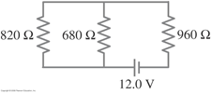
Chapter 26 Problem 16
16. (II) Determine (a) the equivalent resistance of the circuit shown in Fig. 26–39, and (b) the voltage across each resistor.

