Slide 1
Quiz 3

Slide 2
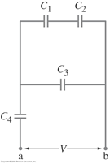
Problem 29-Chapter 24
29. (II) In Fig. 24–23, suppose (a) Determine the equivalent capacitance between points a and b. C₁=C₂=C₃=C₄=C. (b) Determine the charge on the capacitor C₄.

Slide 3
Problem 27 Chapter 24
27. (II) Consider three capacitors, of capacitance 3600 pF, 5800 pF, and 0.0100μF What maximum and minimum capacitance can you form from these? How do you make the connection in each case?

Slide 4
Problem 4-Chapter 25
4. (I) What is the resistance of a toaster if 120 V produces a current of 4.2 A?

Slide 5
Problem 6-Chapter 25
6. (II) A hair dryer draws 9.5 A when plugged into a 120-V line. (a) What is its resistance? (b) How much charge passes through it in 15 min? (Assume direct current.)

