Slide 1
Quiz 2
PHYS212

Slide 2
Chapter 21 Problem 28
28. (II) Determine the magnitude and direction of the electric field at a point midway between a $−8.0μC$ and a $+5.8μC$ charge 8.0 cm apart. Assume no other charges are nearby.

Slide 3
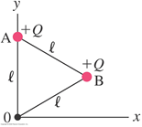
Chapter 21 Problem 38
38. (II) (a) Determine the electric field $\vec{E}$ at the origin 0 in Fig. 21–59 due to the two charges at A and B.

