Slide 1
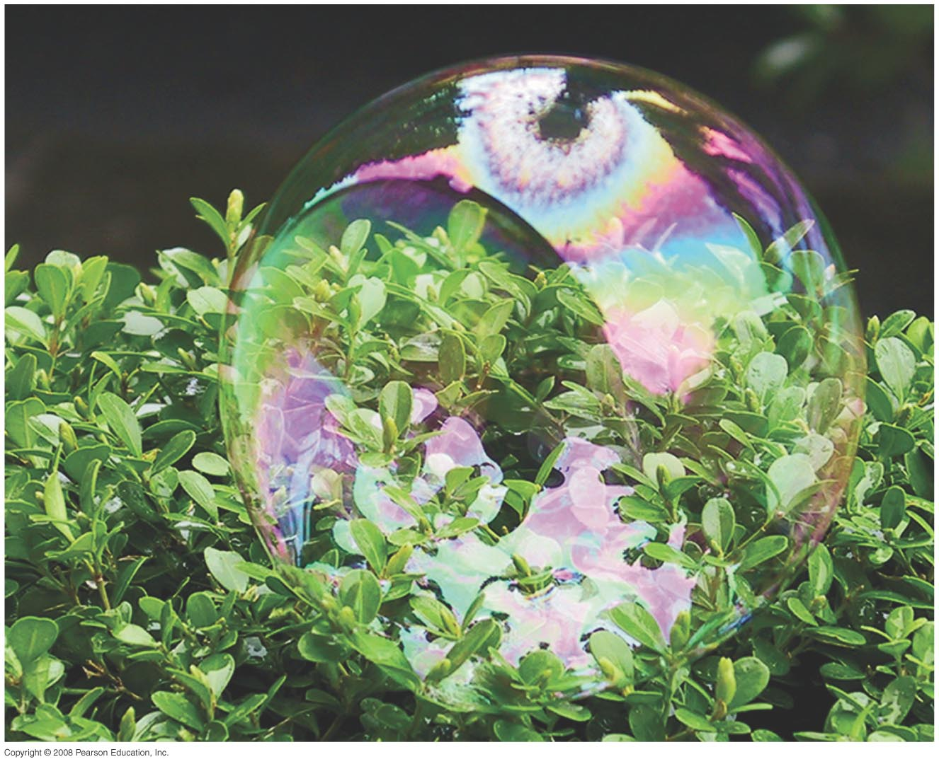
34 Waves versus Particles; Huygens’ Principle and Diffraction
Evaluations in Lecture and Lab.
Quiz on Friday-Problems on earlier chapters.
Notes:
Chapter 34 Opener. The beautiful colors from the surface of this soap bubble can be nicely explained by the wave theory of light. A soap bubble is a very thin spherical film filled with air. Light reflected from the outer and inner surfaces of this thin film of soapy water interferes constructively to produce the bright colors. Which colors we see at any point depends on the thickness of the soapy water film at that point and also on the viewing angle. Near the top of the bubble, we see a small black area surrounded by a silver or white area. The bubble’s thickness is smallest at that black spot, perhaps only about 30 nm thick, and is fully transparent (we see the black background). We cover fundamental aspects of the wave nature of light, including two-slit interference and interference in thin films.

Slide 2
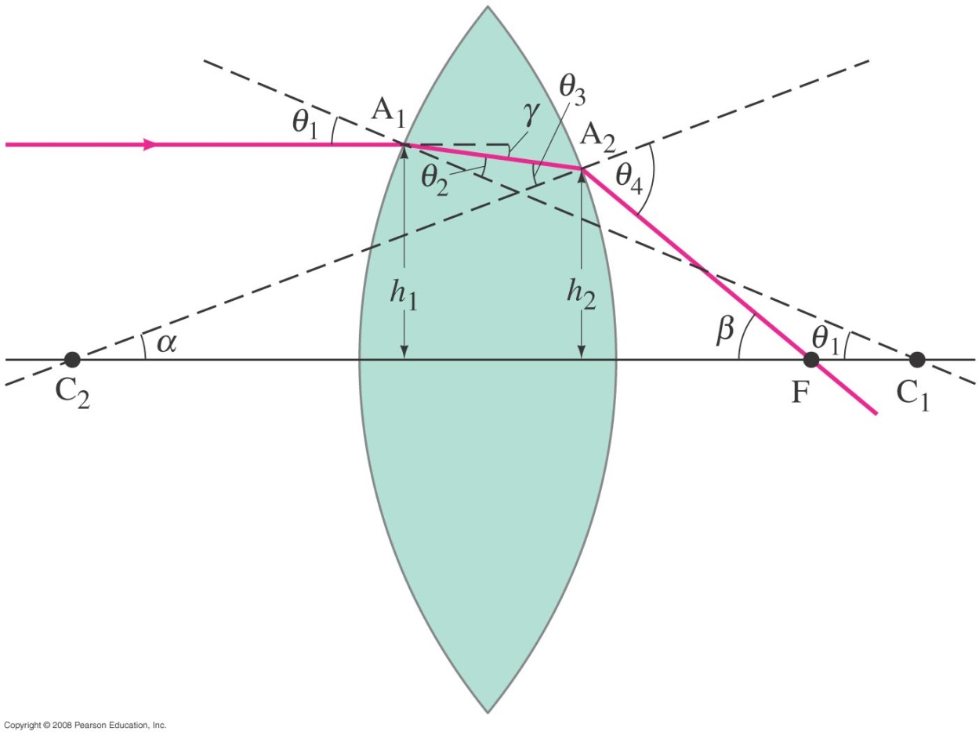
33-4 Lensmaker’s Equation
This useful equation relates the radii of curvature of the two lens surfaces, and the index of refraction, to the focal length:
Notes:
Figure 33-16. Diagram of a ray passing through a lens for derivation of the lensmaker’s equation.

Slide 3
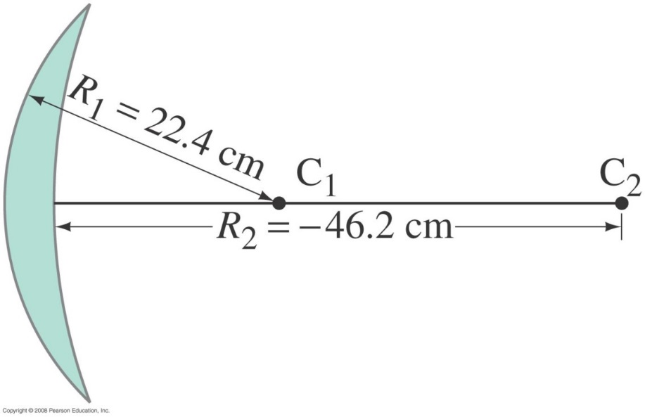
33-4 Lensmaker’s Equation
Example 33-7: Calculating f for a converging lens.
A convex meniscus lens is made from glass with n = 1.50. The radius of curvature of the convex surface is 22.4 cm and that of the concave surface is 46.2 cm. (a) What is the focal length? (b) Where will the image be for an object 2.00 m away?
Notes:
Solution: Using the lensmaker’s equation gives f = 87 cm. Then the image distance can be found: d_{i} = 1.54 m.

Slide 4
Problem 29
*29. (I) Both surfaces of a double convex lens have radii of 31.4 cm. If the focal length is 28.9 cm, what is the index of refraction of the lens material?

Slide 5
34 Waves versus Particles; Huygens’ Principle and Diffraction
Notes:
Chapter 34 Opener. The beautiful colors from the surface of this soap bubble can be nicely explained by the wave theory of light. A soap bubble is a very thin spherical film filled with air. Light reflected from the outer and inner surfaces of this thin film of soapy water interferes constructively to produce the bright colors. Which colors we see at any point depends on the thickness of the soapy water film at that point and also on the viewing angle. Near the top of the bubble, we see a small black area surrounded by a silver or white area. The bubble’s thickness is smallest at that black spot, perhaps only about 30 nm thick, and is fully transparent (we see the black background). We cover fundamental aspects of the wave nature of light, including two-slit interference and interference in thin films.

Slide 6
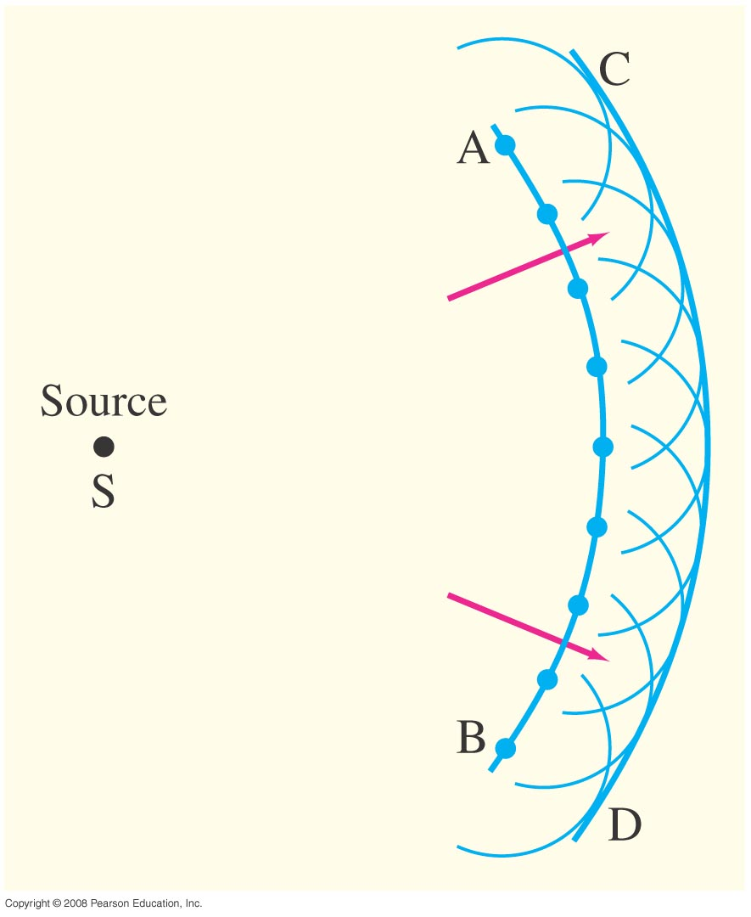
34-1 Waves versus Particles; Huygens’ Principle and Diffraction
Huygens’ principle: every point on a wave front acts as a point source; the wave front as it develops is tangent to all the wavelets.
Notes:
Figure 34-1. Huygens’ principle, used to determine wave front CD when wave front AB is given.

Slide 7
34-1 Waves versus Particles; Huygens’ Principle and Diffraction
Huygens’ principle is consistent with diffraction: The wave bend in behind an obstacle, this is called diffraction
Notes:
Figure 34-2. Huygens’ principle is consistent with diffraction (a) around the edge of an obstacle, (b) through a large hole, (c) through a small hole whose size is on the order of the wavelength of the wave.

Slide 8
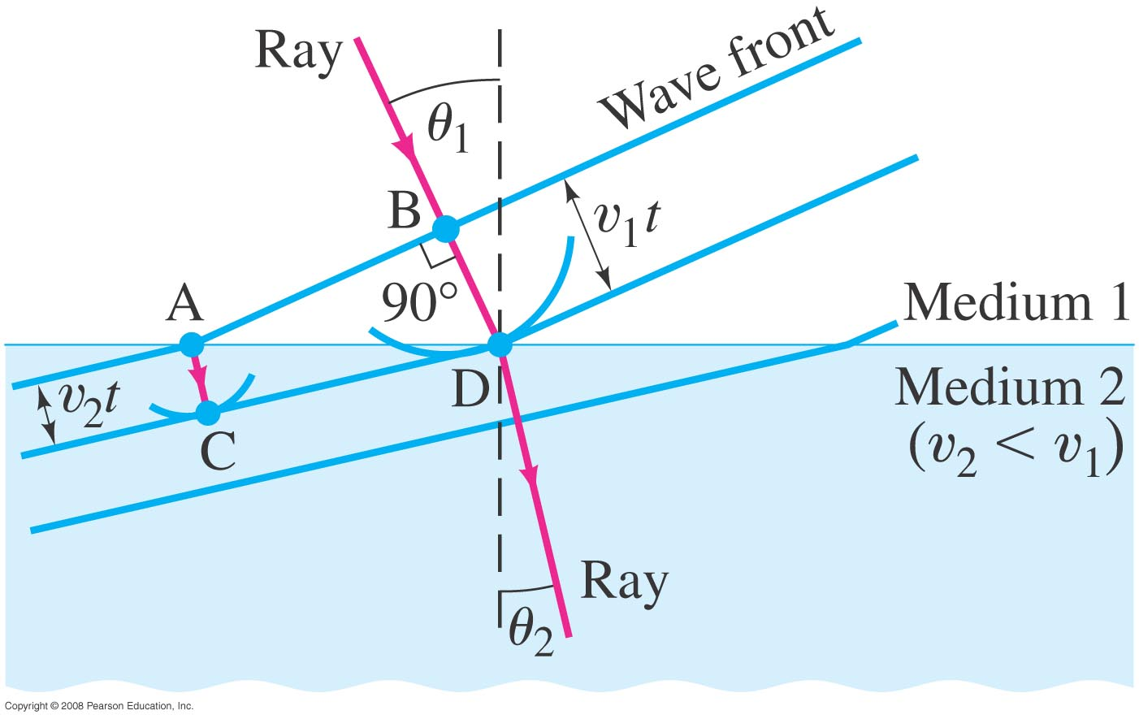
34-2 Huygens’ Principle and the Law of Refraction
Newton believed that light was a particle only. Newton’s calculations of reflection and refraction did not distinguish between a wave and a particle, he also did not count for diffraction. He predicted in his theory that v₂>v_{1.}
θ₁
θ₂
We know that because of refraction v₂<v₁ light will bend.
And in 1850 Foucault measured v of light in water.
Notes:
Figure 34-3. Refraction explained, using Huygens’ principle. Wave fronts are perpendicular to the rays.

Slide 9
34-2 Huygens’ Principle and the Law of Refraction
Newton’s particle theory predicted that v₂>v₁ which is wrong when using geometry and speed of light changing in a medium.
Huygens’ principle can also explain the law of refraction (Snell’s Law).
As the wavelets propagate from each point, they propagate more slowly in the medium of higher index of refraction.
This leads to a bend in the wave front and therefore in the ray.

Slide 10
34-2 Huygens’ Principle and the Law of Refraction
The frequency of the light does not change, but the wavelength does as it travels into a new medium:

Slide 11
34-3 Interference – Young’s Double-Slit Experiment
If light is a wave, interference effects will be seen, where one part of a wave front can interact with another part.
One way to study this is to do a double-slit experiment:
Notes:
Figure 34-5. (a) Young’s double-slit experiment. (b) If light consists of particles, we would expect to see two bright lines on the screen behind the slits. (c) In fact, many lines are observed. The slits and their separation need to be very thin.

Slide 12
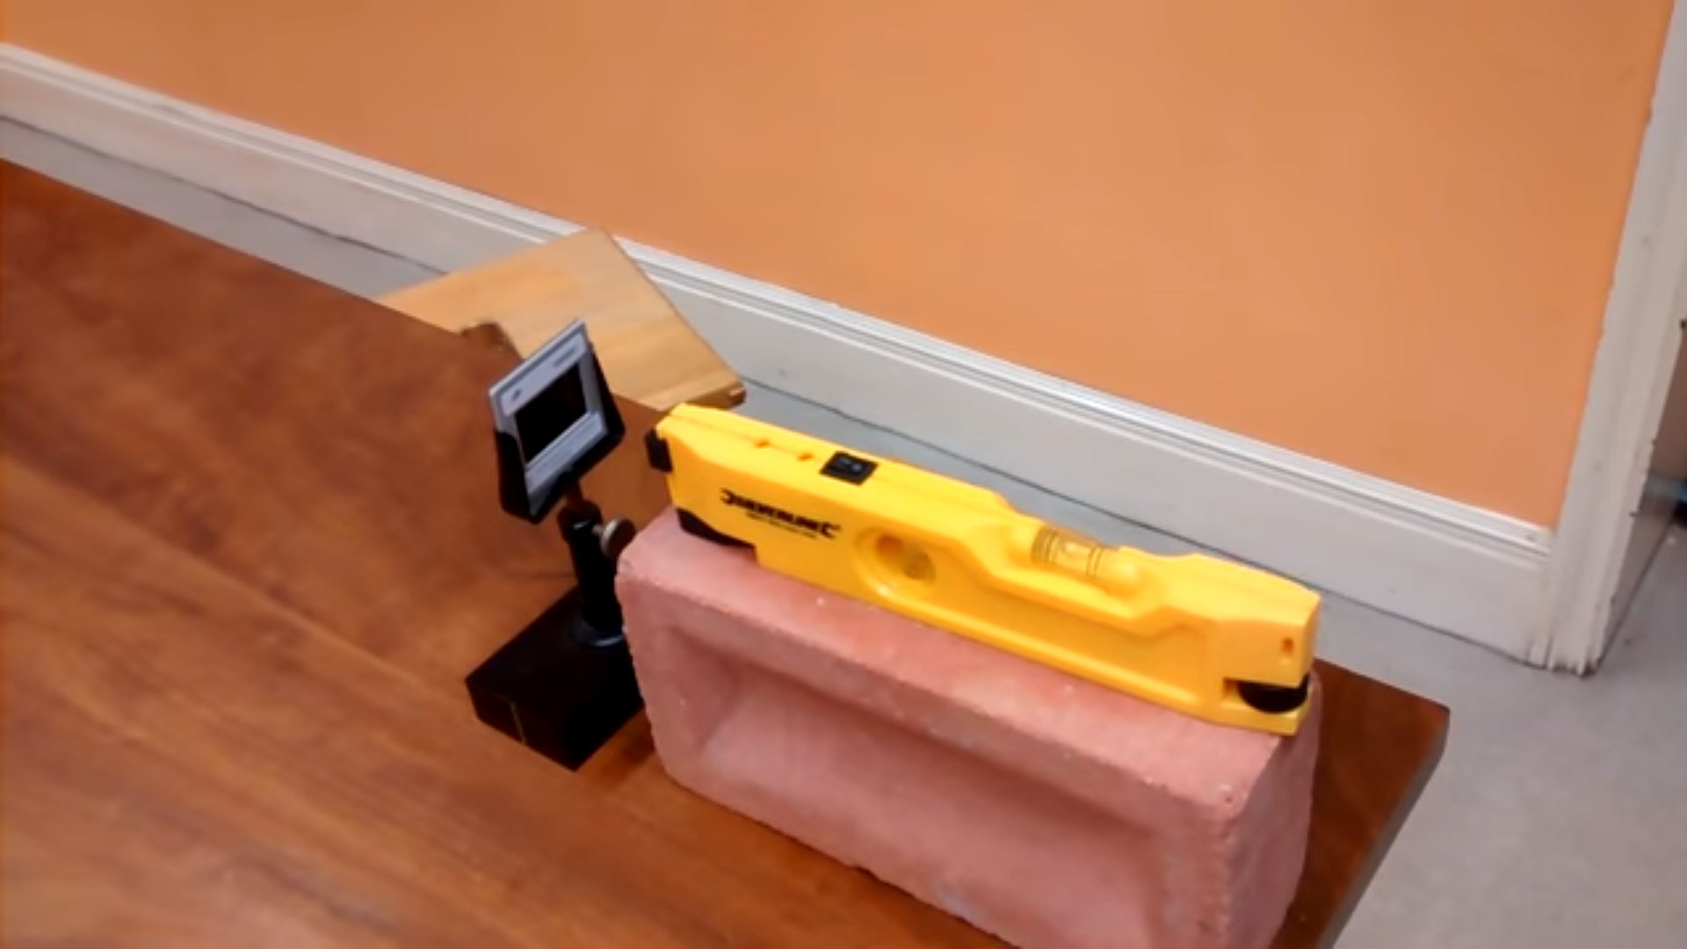
34-3 Interference – Young’s Double-Slit Experiment
https://www.youtube.com/watch?v=nuaHY5lj2AA

Slide 13
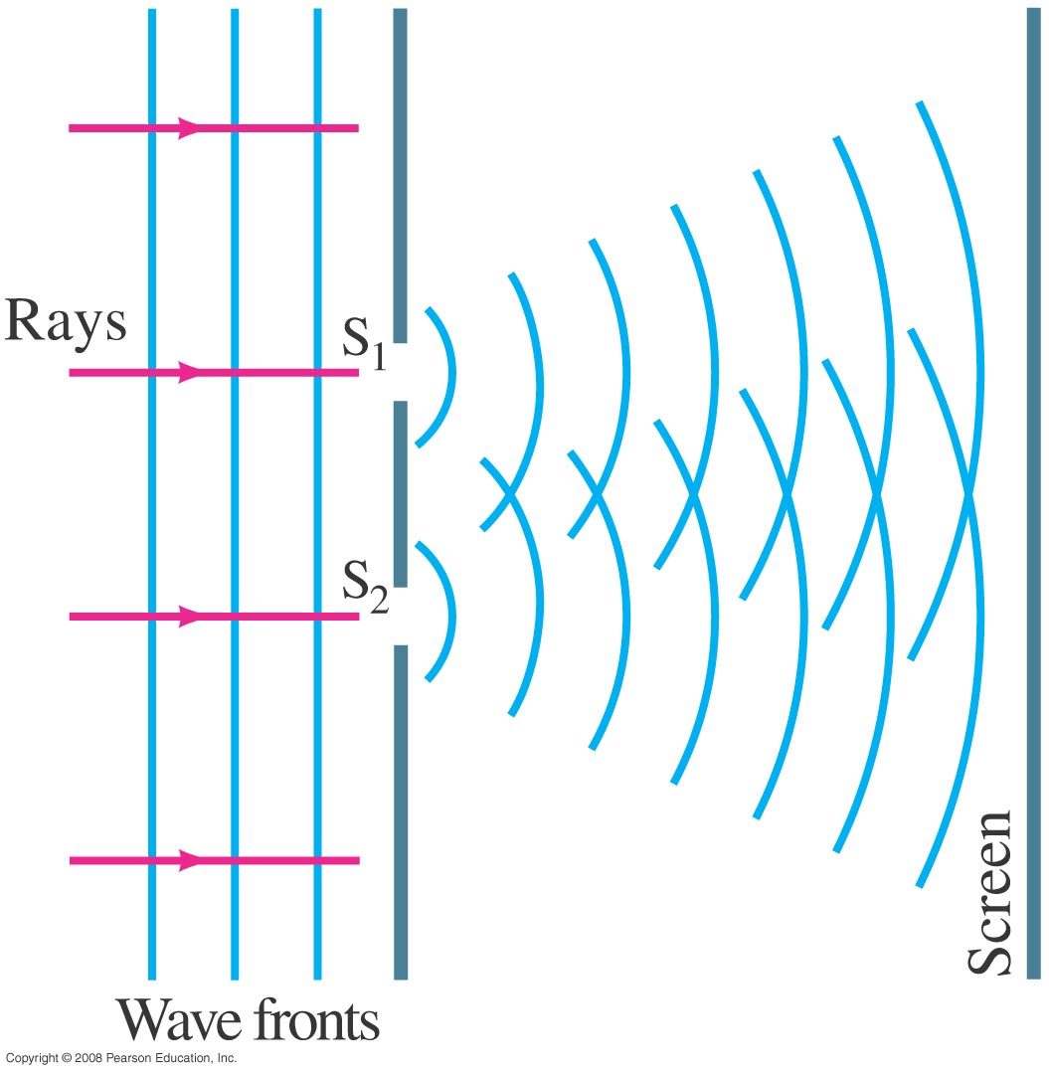
34-3 Interference – Young’s Double-Slit Experiment
Monochromatic wavelength (single wavelength) through two slits.
If light is a wave, there should be an interference pattern.
Notes:
Figure 34-6. If light is a wave, light passing through one of two slits should interfere with light passing through the other slit.

Slide 14
Principle of Superposition
When waves overlap, their amplitudes add
Constructive
Destructive
λ
+
+
Phase
Shifted
180°,
π,
or λ/2
λ
=
=
Peaks line up with peaks
Peaks line up with troughs

Slide 15
What are PHASE differences?
Phase difference is a term used to describe the relative alignment of the peaks
IN PHASE= two waves are lined up—constructive interference
OUT of PHASE= one wave is upside down relative to the other—destructive interference

Slide 16
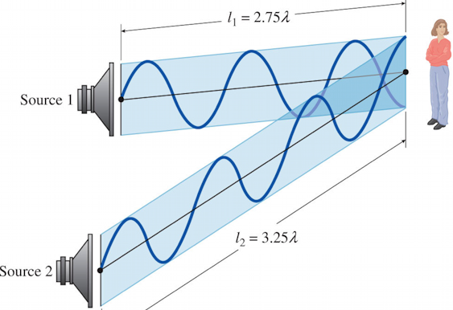
What causes Phase differences?
Light travels different distances just like any other wave
d₁
Source 1
d₂
Source 2
Constructive Interference when in phase
If Path difference is an integral number of wavelengths
∆d = d₁-d₂ = mλ
Where m is an integer
Destructive Interference when out of phase
If Path difference is a half integral number of wavelengths
∆d = d₁-d₂ = (m+$\frac{1}{2}$) λ
Where m is an integer

Slide 17
34-3 Interference – Young’s Double-Slit Experiment
The interference occurs because each point on the screen is not the same distance from both slits. Depending on the path length difference, the wave can interfere constructively (bright spot) or destructively (dark spot).
Notes:
Figure 34-7. How the wave theory explains the pattern of lines seen in the double-slit experiment. (a) At the center of the screen the waves from each slit travel the same distance and are in phase. (b) At this angle θ, the lower wave travels an extra distance of one whole wavelength, and the waves are in phase; note from the shaded triangle that the path difference equals d sin θ. (c) For this angle θ, the lower wave travels an extra distance equal to one-half wavelength, so the two waves arrive at the screen fully out of phase. (d) A more detailed diagram showing the geometry for parts (b) and (c).

Slide 18
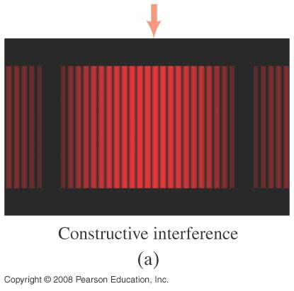
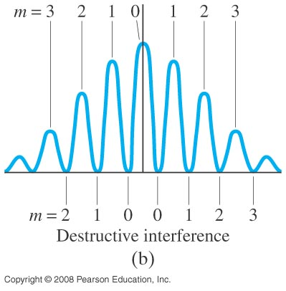
34-3 Interference – Young’s Double-Slit Experiment
Between the maxima and the minima, the interference varies smoothly.
Constructive interference
Notes:
Figure 34-9. (a) Interference fringes produced by a double-slit experiment and detected by photographic film placed on the viewing screen. The arrow marks the central fringe. (b) Graph of the intensity of light in the interference pattern. Also shown are values of m for Eq. 34–2a (constructive interference) and Eq. 34–2b (destructive interference).

Slide 19
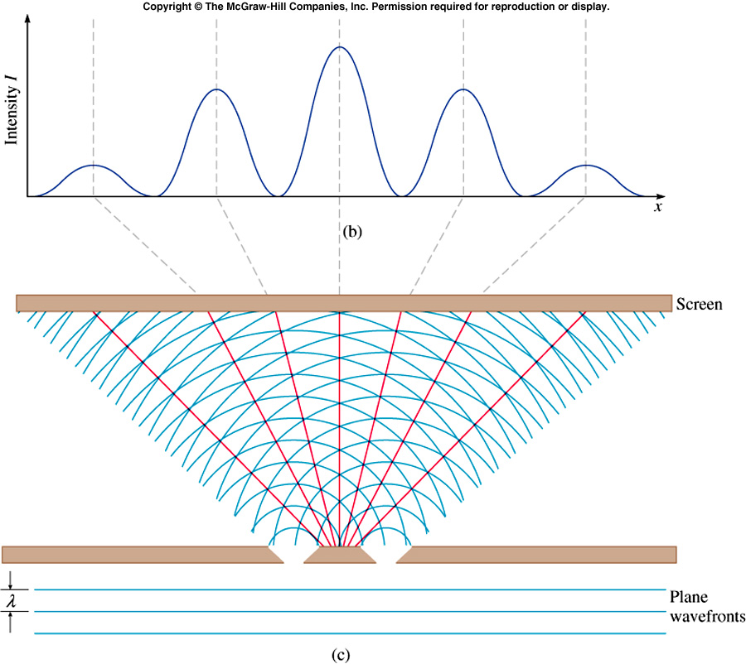
Young’s Double Slit
Light from each slit travels to a screen where the waves interfere
m = 0
m = -1
m = +1
m = -2
m = +2
m = fringe order
l = distance to screen
l
d = slit separation
Phase differences due entirely to path differences
d

Slide 20
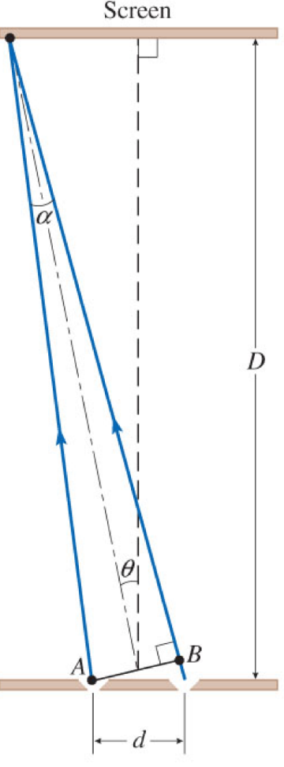
Young’s Double Slit
Maxima : Constructive Interference
- occur where s₁-s₂=dsinθ= mλ
Y
m = order = 0, ±1, ±2, …
Minima: destructive Interference
- occur where Δd = (m + ½)λ
l
Path difference
d: distance between slits
sinθ≈tanθ ≈ θ for small angles
d

Slide 21
Problem 3
3. (I) The third-order bright fringe of 610 nm light is observed at an angle of 28° when the light falls on two narrow slits. How far apart are the slits?

Slide 22
Problem 8
8. (II) Light of wavelength 680 nm falls on two slits and produces an interference pattern in which the third-order bright fringe is 38 mm from the central fringe on a screen 2.6 m away. What is the separation of the two slits?

Slide 23
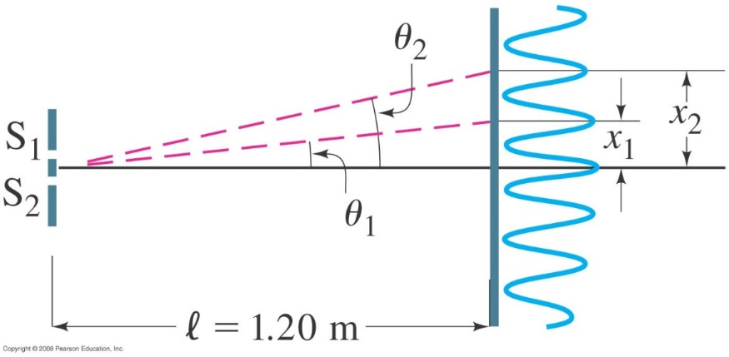
34-3 Interference – Young’s Double-Slit Experiment
Example 34-2: Line spacing for double-slit interference.
A screen containing two slits 0.100 mm apart is 1.20 m from the viewing screen. Light of wavelength λ = 500 nm falls on the slits from a distant source. Approximately how far apart will adjacent bright interference fringes be on the screen?
Notes:
Figure 34-10. Examples 34–2 and 34–3. For small angles θ (give θ in radians), the interference fringes occur at distance x = θl above the center fringe (m = 0); θ₁ and x₁ are for the first-order fringe (m = 1), θ₂ and x₂ are for m = 2.
Solution: Using the geometry in the figure, x ≈ lθ for small θ, so the spacing is 6.0 mm.

Slide 24
Problem 12
12. (II) In a double-slit experiment it is found that blue light of wavelength 480 nm gives a second-order maximum at a certain location on the screen. What wavelength of visible light would have a minimum at the same location?

