Slide 1
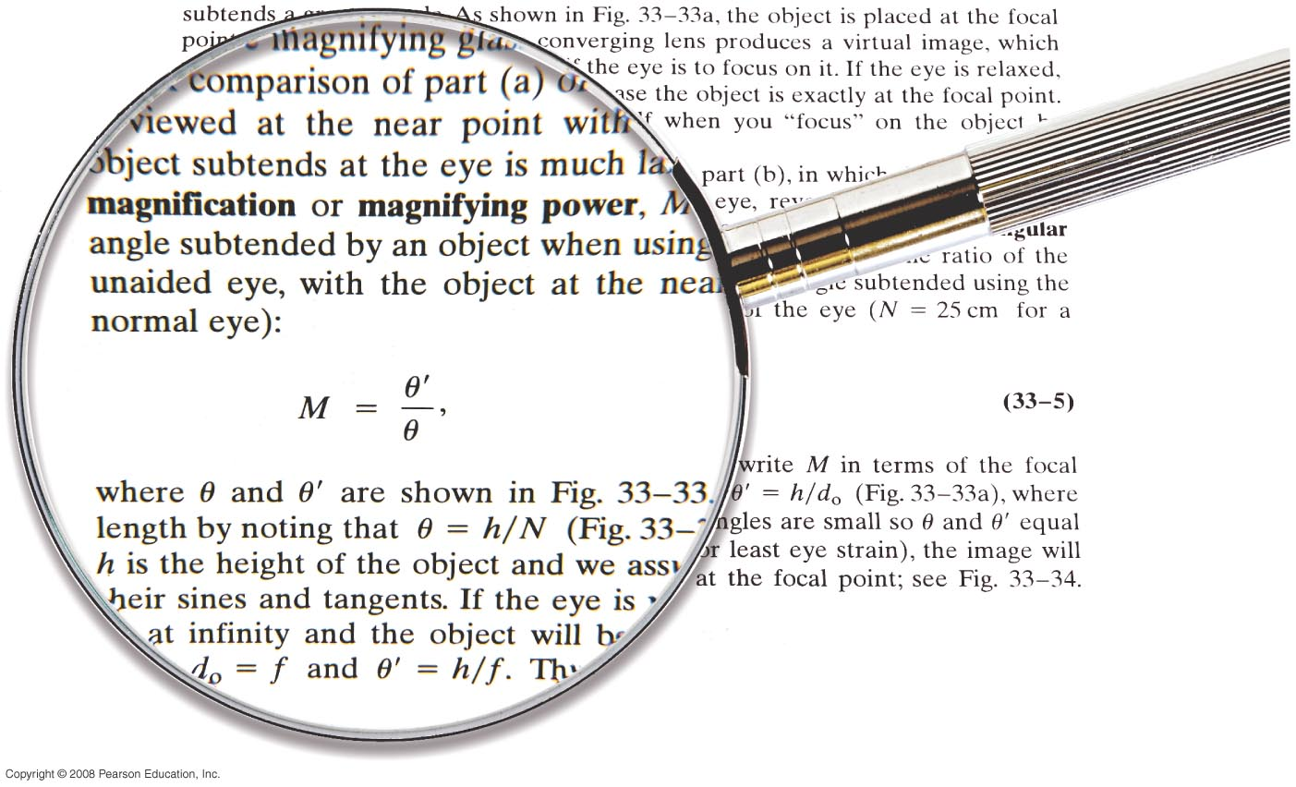

Chapter 33
Lenses and Optical Instruments
Quiz on Friday on Chapters 32, and 33
Notes:
Chapter 33 opener. Of the many optical devices we discuss in this Chapter, the magnifying glass is the simplest. Here it is magnifying part of page 886 of this Chapter, which describes how the magnifying glass works according to the ray model. In this Chapter we examine thin lenses in detail, seeing how to determine image position as a function of object position and the focal length of the lens, based on the ray model of light. We then examine optical devices including film and digital cameras, the human eye, eyeglasses, telescopes, and microscopes.

Slide 2
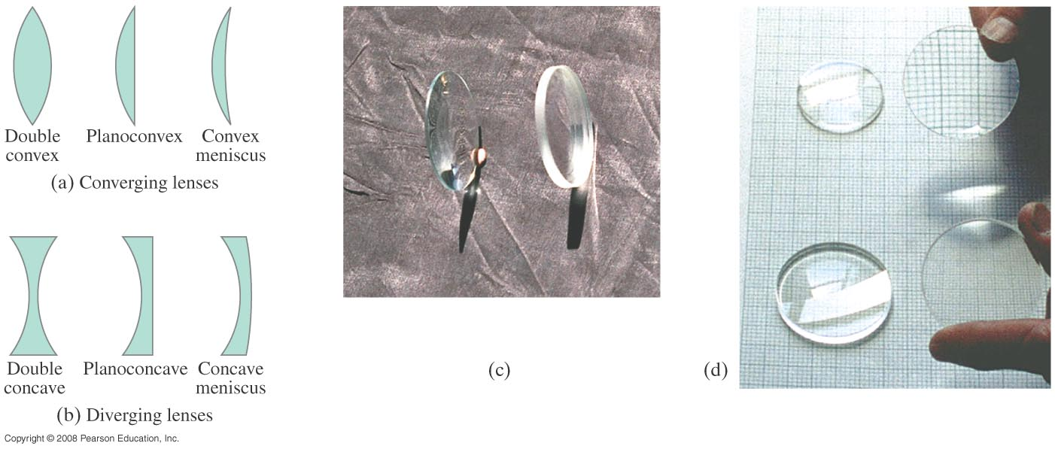
33-1 Thin Lenses; Ray Tracing
Thin lenses are those whose thickness is small compared to their radius of curvature. They may be either converging (a) or diverging (b).
Notes:
Figure 33-2. (a) Converging lenses and (b) diverging lenses, shown in cross section. Converging lenses are thicker in the center whereas diverging lenses are thinner in the center. (c) Photo of a converging lens (on the left) and a diverging lens (right). (d) Converging lenses (above), and diverging lenses (below), lying flat, and raised off the paper to form images.

Slide 3
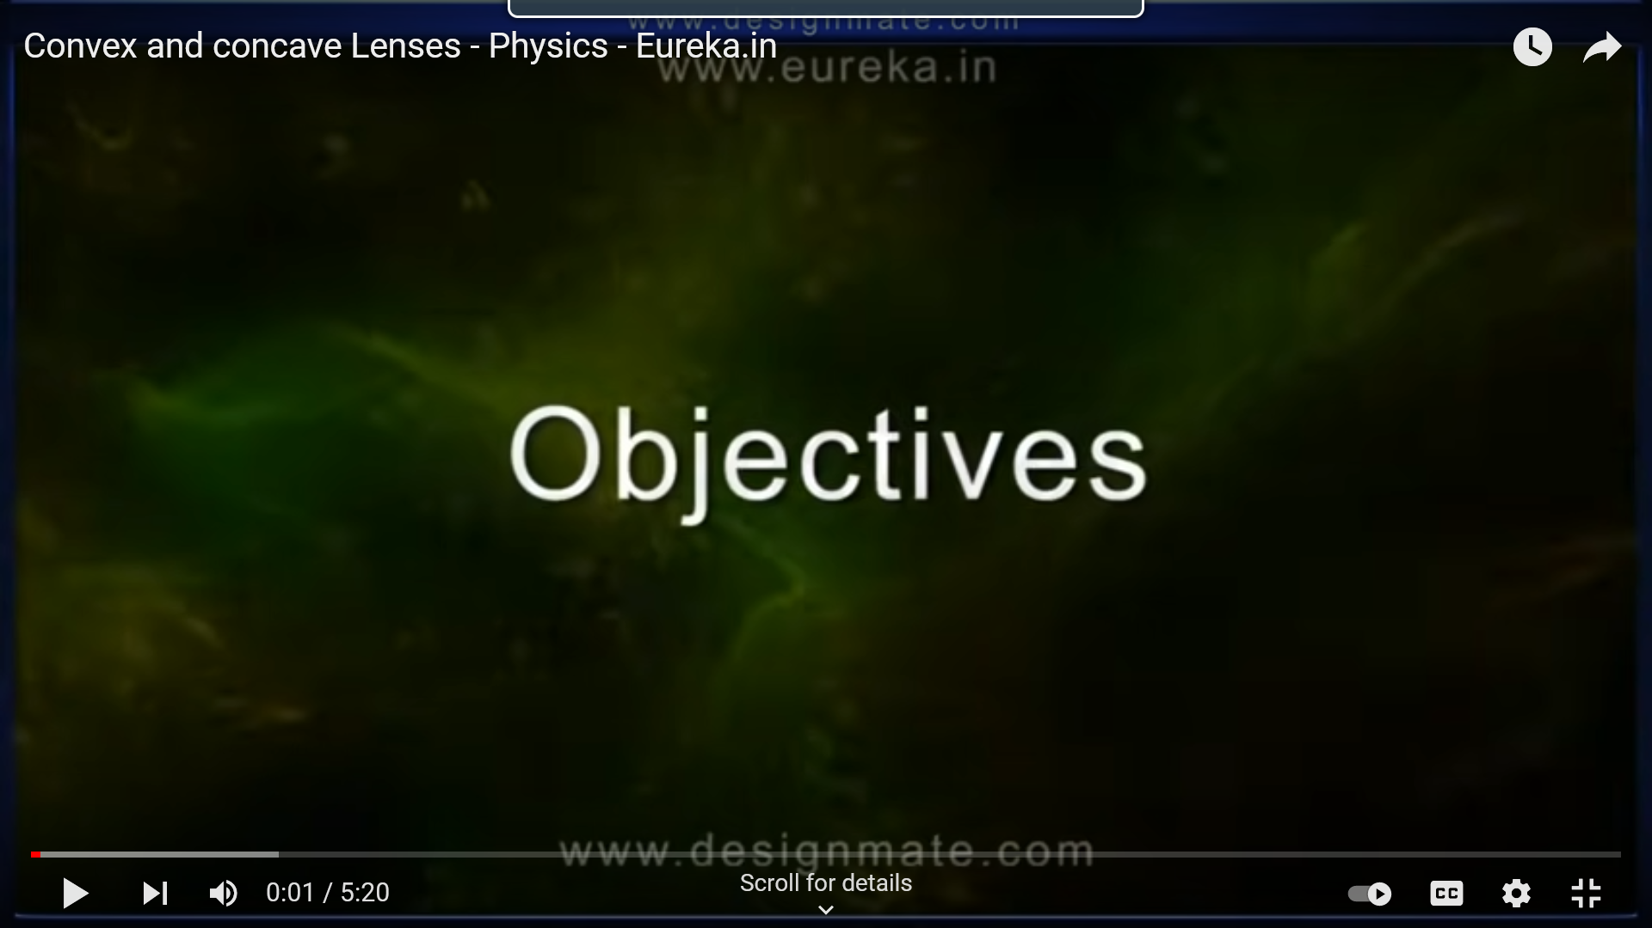
Converging lenses
https://www.youtube.com/watch?v=4zuB_dSJn1Y

Slide 4
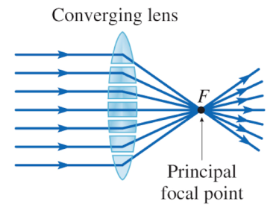
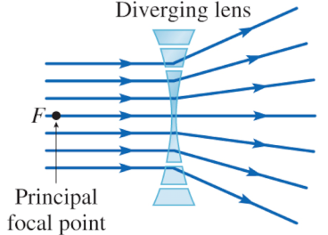
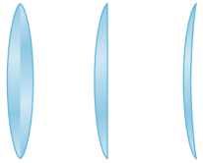

Thin Lenses
Thickest in the center
Thickest on the edges

Slide 5
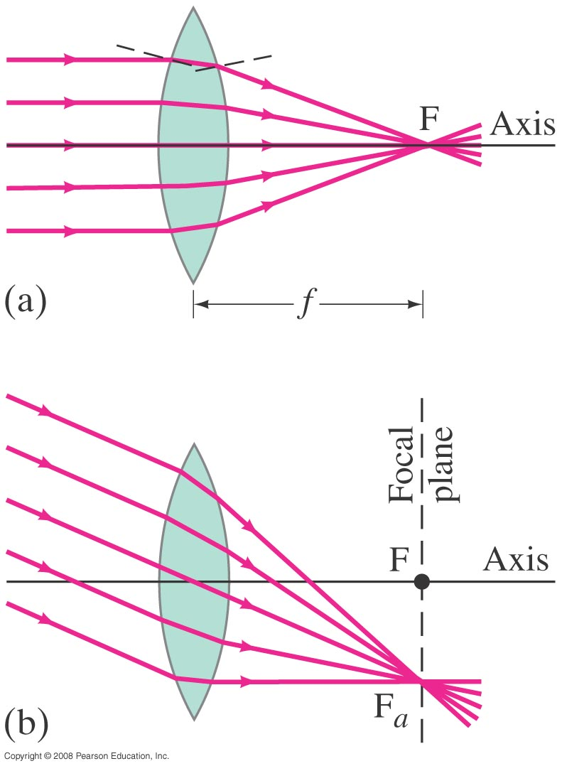
33-1 Thin Lenses; Ray Tracing
Parallel rays are brought to a focus by a converging lens (one that is thicker in the center than it is at the edge).
Notes:
Figure 33-3. Parallel rays are brought to a focus by a converging thin lens.

Slide 6
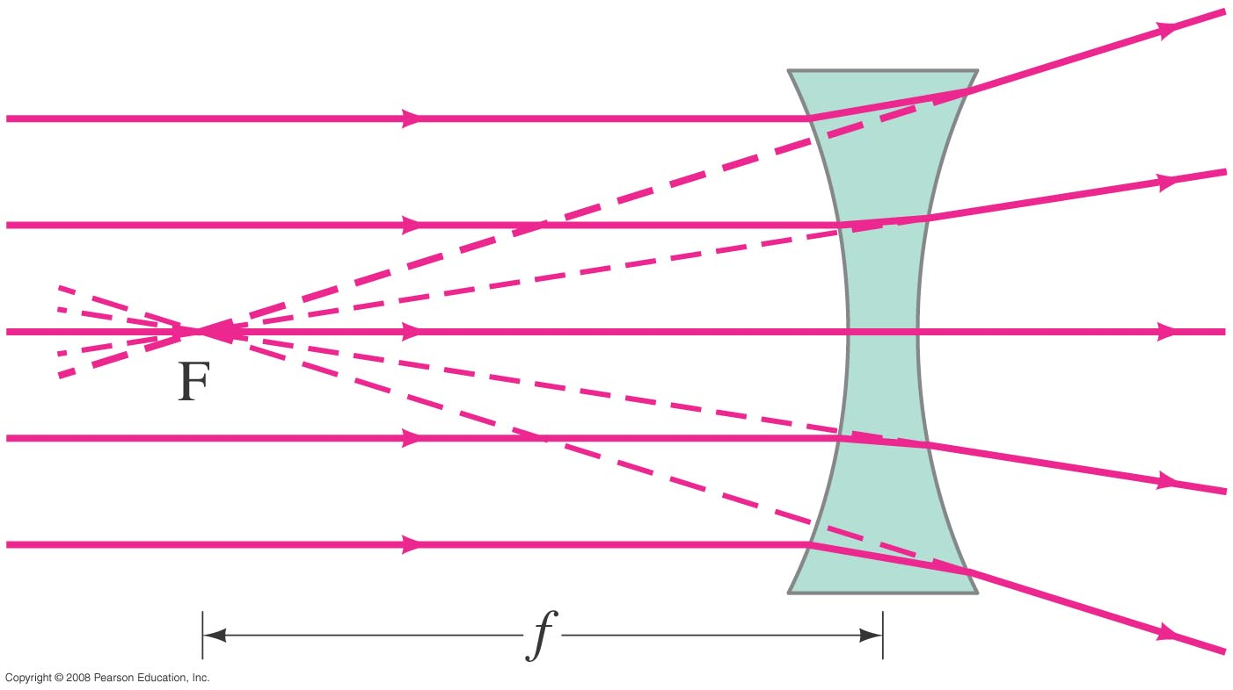
33-1 Thin Lenses; Ray Tracing
A diverging lens (thicker at the edge than in the center) makes parallel light diverge; the focal point is that point where the diverging rays would converge if projected back.
Notes:
Figure 33-5. Diverging lens.

Slide 7
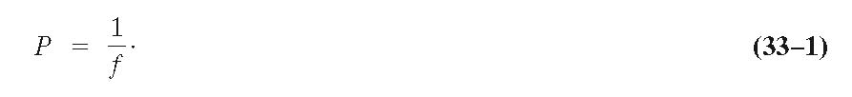
33-1 Thin Lenses; Ray Tracing
The power of a lens is the inverse of its focal length:
Lens power is measured in diopters, D:
1 D = 1 m⁻¹.

Slide 8
33-1 Thin Lenses; Ray Tracing
Ray tracing for thin lenses is similar to that for mirrors. We have three key rays:
The ray that comes in parallel to the axis and exits through the focal point.
The ray that comes in through the focal point and exits parallel to the axis.
The ray that goes through the center of the lens and is undeflected.

Slide 9
Thin Lenses: Converging
Focal point is on both sides of the lens equidistant from the lens
f
image
object
f
Principle axis
Image:
Upright or upside down
Real or virtual
Bigger or smaller
Parallel ray goes through f
Ray through center
Ray through f comes out parallel

Slide 10
Thin Lenses: Converging
This video shows how to draw the rays for converging lenses for different cases,
please watch it carefully
https://www.youtube.com/watch?v=c6mLLaqLdvg&t=57s

Slide 11
Thin Lenses: Diverging
Virtual images are formed in front of the lens
object
image
f
f
f
Image:
Parallel ray goes through f
Ray through center is straight
Ray through f comes out parallel
Upright or upside down
Real or virtual
Bigger or smaller

Slide 12
Thin Lenses: Diverging (concave lenses)
This video shows how to draw the rays for diverging lenses for different cases, please watch it carefully
https://www.youtube.com/watch?v=c2GFG6cvPew

Slide 13
33-2 The Thin Lens Equation; Magnification
The sign conventions are slightly different than the mirrors:
The focal length is positive for converging lenses and negative for diverging.
The object distance is positive when the object is on the same side as the light entering the lens (not an issue except in compound systems); otherwise it is negative.
The image distance is positive if the image is on the opposite side from the light entering the lens; otherwise it is negative.
The height of the image is positive if the image is upright and negative otherwise.

Slide 14
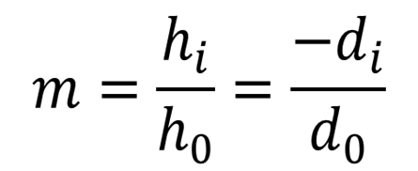
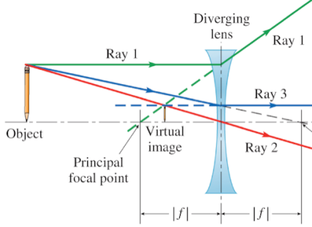
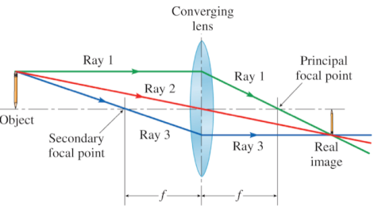
33-2 Magnification:
Magnification = image height / object height
= - image distance (d_{i}) / object distance (d₀)
Negative m = upside down
Negative d_{i} =virtual
d_{i}
d₀
d₀
-d_{i}

Slide 15
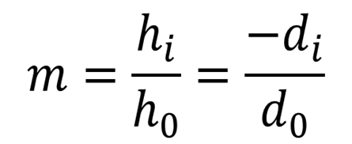
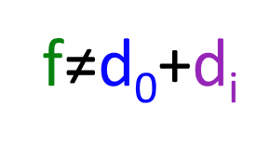
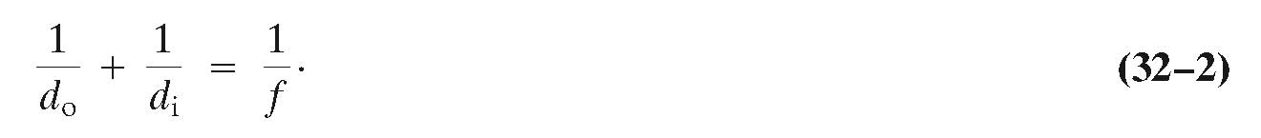
Lens Equation
Sign Conventions for lenses
Quantity | Positive “+” | Negative “-”
Object distance d₀ | Real | Virtual
Image distance, d_{i} | Real and behind the lens | Virtual and same side as object
Focal length, f | Converging | Diverging
Magnification, m | Upright | Upside down

Slide 16
33-2 The Thin Lens Equation; Magnification
Example 33-3: Object close to converging lens.
An object is placed 10 cm from a 15-cm-focal-length converging lens. Determine the image position and size (a) analytically, and (b) using a ray diagram.
Notes:
Figure 33-12. An object placed within the focal point of a converging lens produces a virtual image. Example 33–3.
Solution: a. The thin lens equation gives d_{i} = -30 cm and m = 3.0. The image is virtual, enlarged, and upright.
b. See the figure.

Slide 17
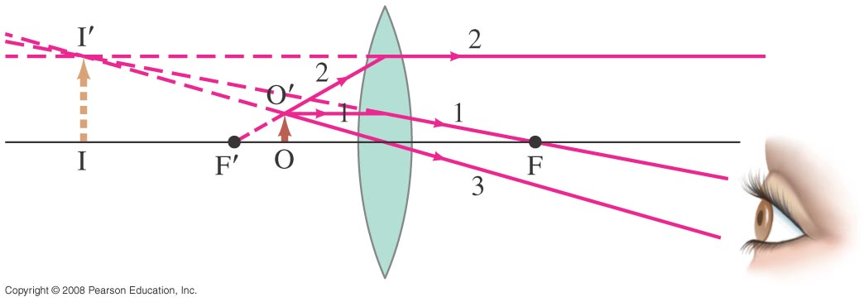
Example 33-3 Diagram

Slide 18
Problem 3
3. (I) (a) What is the power of a 23.5-cm-focal-length lens? (b) What is the focal length of a -6.75 D lens? Are these lenses converging or diverging?

Slide 19
Problem 6
6. (II) A stamp collector uses a converging lens with focal length 28 cm to view a stamp 18 cm in front of the lens. (a) Where is the image located? (b) What is the magnification?

Slide 20
Problem 11
11. (II) How far from a converging lens with a focal length of 25 cm should an object be placed to produce a real image which is the same size as the object?

Slide 21
33-3 Combinations of Lenses
In lens combinations, the image formed by the first lens becomes the object for the second lens (this is where object distances may be negative). The total magnification is the product of the magnification of each lens.
m=m₁m₂

Slide 22
Problem 21
21. (II) Two 25.0-cm-focal-length converging lenses are placed 16.5 cm apart. An object is placed 35.0 cm in front of one lens. Where will the final image formed by the second lens be located? What is the total magnification?

Slide 23
Problem 25
25. (II) Two lenses, one converging with focal length 20.0 cm and one diverging with focal length of 10cm are placed 25.0 cm apart. An object is placed 60.0 cm in front of the converging lens. Determine (a) the position and (b) the magnification of the final image formed. (c) Sketch a ray diagram for this system.

Slide 24
Problem 25

