Slide 1
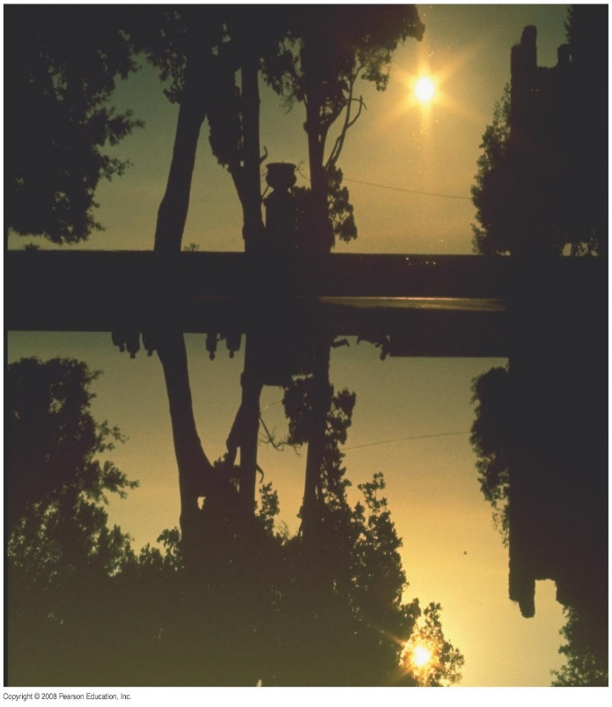
Chapter 32 Light: Reflection and Refraction
Final Exam study guide posted.
Final Exam on Thursday, April 25 at 8:00 am
Notes:
Chapter 32 opener. Reflection from still water, as from a glass mirror, can be analyzed using the ray model of light. Is this picture right side up? How can you tell? What are the clues? Notice the people and position of the Sun. Ray diagrams, which we will learn to draw in this Chapter, can provide the answer. See Example 32–3. In this first Chapter on light and optics, we use the ray model of light to understand the formation of images by mirrors, both plane and curved (spherical). We also begin our study of refraction—how light rays bend when they go from one medium to another—which prepares us for our study in the next Chapter of lenses, which are the crucial part of so many optical instruments.

Slide 2
32-3 Formation of Images by Spherical Mirrors
We use ray diagrams to determine where an image will be. For mirrors, we use three key rays, all of which begin on the object:
A ray parallel to the axis; after reflection it passes through the focal point.
A ray through the focal point; after reflection it is parallel to the axis.
A ray perpendicular to the mirror; it reflects back on itself.

Slide 3
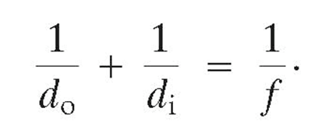
Mirror Equation
Sign Conventions for Mirrors
Quantity | Positive “+” | Negative “-”
Object distance d₀ | Real | Virtual
Image distance, d_{i} | Real | Virtual
Focal length, f | Concave: f=r/2 | Convex: f=-r/2
Magnification, m | Upright | Upside down
f≠d₀+d_{i}

Slide 4
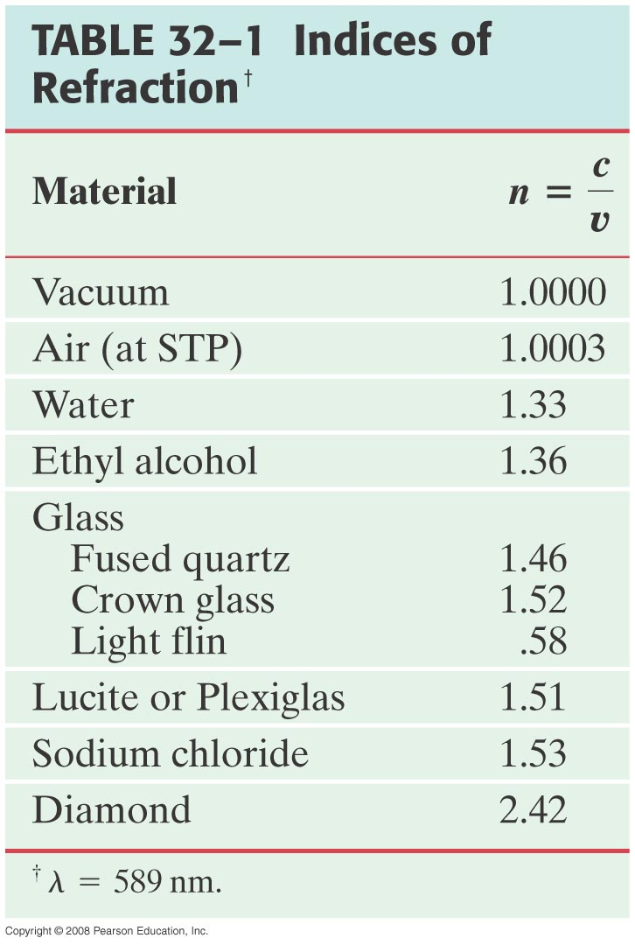
32-4 Index of Refraction
In general, light slows somewhat when traveling through a medium. The index of refraction of the medium is the ratio of the speed of light in vacuum to the speed of light in the medium:

Slide 5
Problem 36
36. (II) The speed of light in a certain substance is 88% of its value in water. What is the index of refraction of that substance?

Slide 6
Problem 33
33. (I) What is the speed of light in (a) ethyl alcohol, (b) lucite, (c) crown glass?

Slide 7
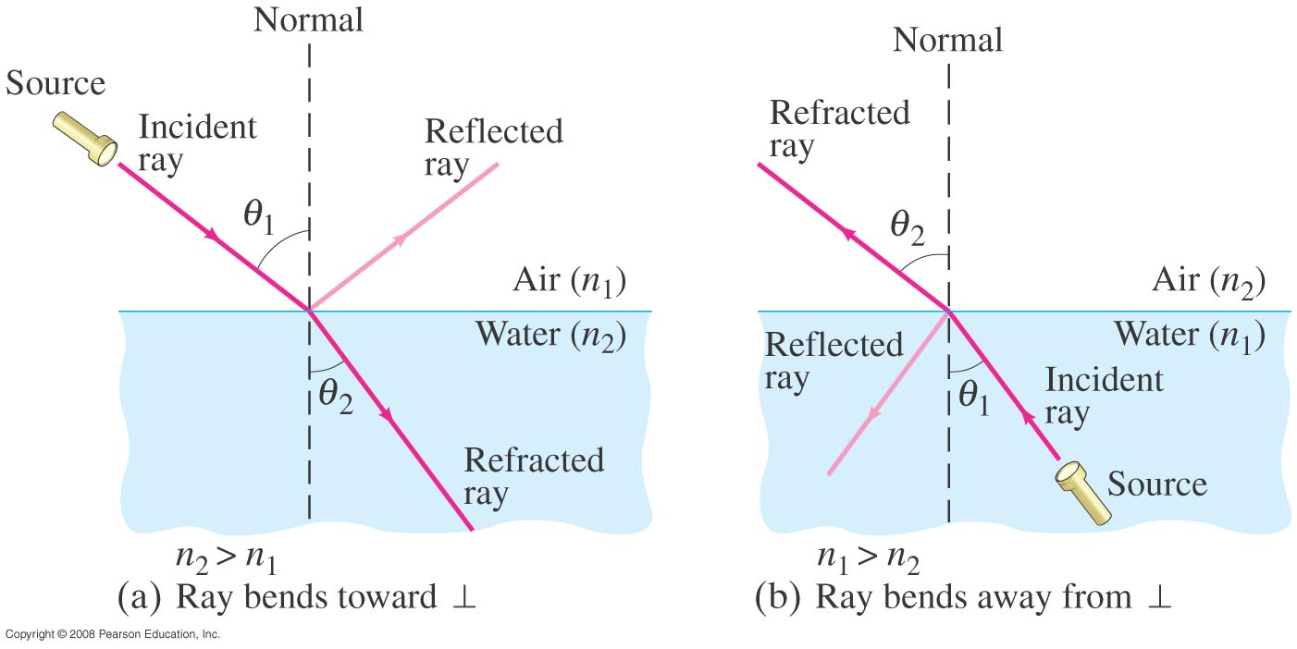
32-5 Refraction: Snell’s Law
Light changes direction when crossing a boundary from one medium to another. This is called refraction, and the angle the outgoing ray makes with the normal is called the angle of refraction.
Notes:
Figure 32-21. Refraction. (a) Light refracted when passing from air (n₁) into water (n₂): n₂ > n₁. (b) Light refracted when passing from water (n₁) into air (n₂): n₂ < n₁.

Slide 8
32-5 Refraction: Snell’s Law
The angle of refraction depends on the indices of refraction, and is given by Snell’s law:

Slide 9
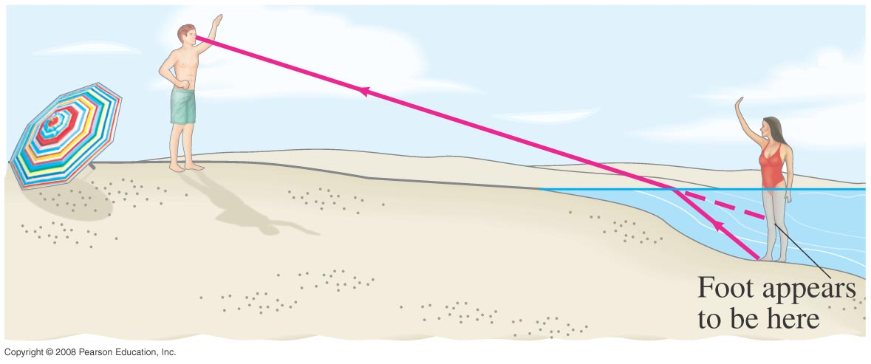
32-5 Refraction: Snell’s Law
Refraction is what makes objects half-submerged in water look odd.
Notes:
Figure 32-22. Ray diagram showing why a person’s legs look shorter when standing in waist-deep water: the path of light traveling from the bather’s foot to the observer’s eye bends at the water’s surface, and our brain interprets the light as having traveled in a straight line, from higher up (dashed line).

Slide 10
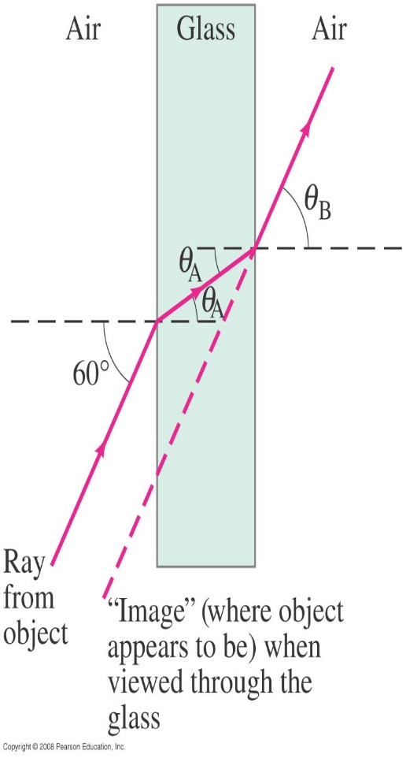
32-5 Refraction: Snell’s Law
Example 32-8: Refraction through flat glass.
Light traveling in air strikes a flat piece of uniformly thick glass at an incident angle of 60, as shown. If the index of refraction of the glass is 1.50, (a) what is the angle of refraction θ_{A} in the glass; (b) what is the angle θ_{B} at which the ray emerges from the glass?
Notes:
Solution: a. Applying Snell’s law gives sin θ_{A} = 0.577, or θ_{A} = 35.3°.
b. Snell’s law gives sin θ_{B} = 0.866, or θ_{B} = 60°. The outgoing ray is parallel to the incoming ray.

Slide 11
Problem 41
41. (I) A light beam coming from an underwater spotlight exits the water at an angle of 56.0°. At what angle of incidence did it hit the air–water interface from below the surface?

Slide 12
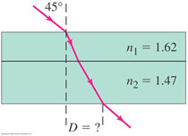
Problem 43
43. (II) A light beam strikes a 2.0-cm-thick piece of plastic with a refractive index of 1.62 at a 45° angle. The plastic is on top of a 3.0-cm-thick piece of glass for which n₂=1.47.What is the distance D in Fig. 32–48?

Slide 13
32-6 Visible Spectrum and Dispersion
The visible spectrum contains the full range of wavelengths of light that are visible to the human eye.
Notes:
Figure 32-26. The spectrum of visible light, showing the range of wavelengths for the various colors as seen in air. Many colors, such as brown, do not appear in the spectrum; they are made from a mixture of wavelengths.

Slide 14
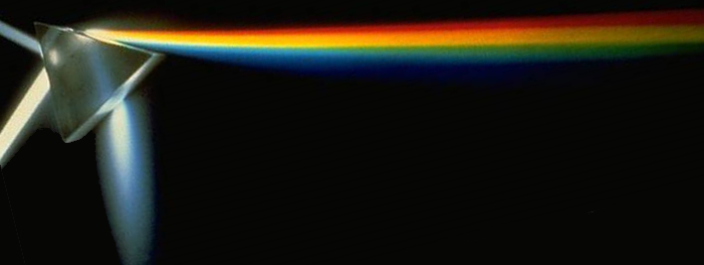
32-6 Visible Spectrum and Dispersion
This spreading of light into the full spectrum is called dispersion.
If Light goes from air to a certain medium:
Notes:
Figure 32-20. (a) Ray diagram explaining how a rainbow (b) is formed.

Slide 15
32-7 Total Internal Reflection
If light passes into a medium with a smaller index of refraction, the angle of refraction is larger. There is an angle of incidence for which the angle of refraction will be 90°; this is called the critical angle:

Slide 16
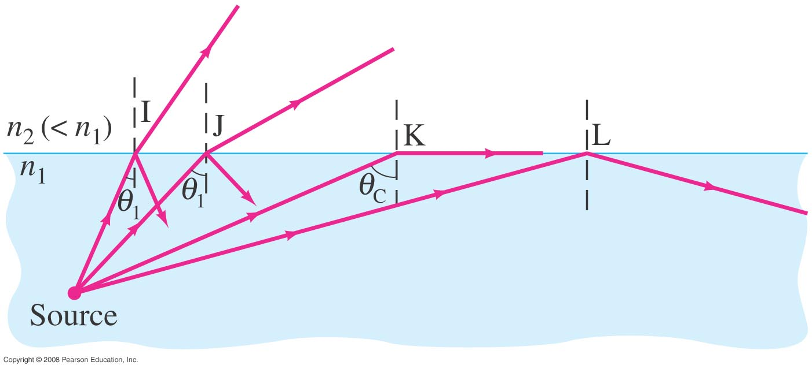
32-7 Total Internal Reflection; Fiber Optics
If the angle of incidence is larger than the critical angle, no refraction occurs. This is called total internal reflection.
Notes:
Figure 32-31. Since n₂ < n₁, light rays are totally internally reflected if the incident angle θ₁ > θ_{c}, as for ray L. If θ₁ < θ_{c}, as for rays I and J, only a part of the light is reflected, and the rest is refracted.

Slide 17
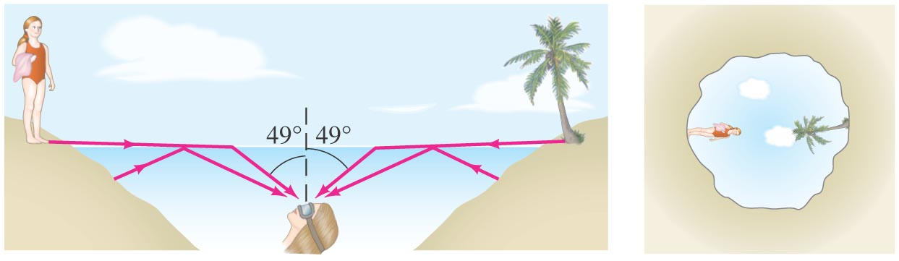
32-7 Total Internal Reflection; Fiber Optics
Conceptual Example 32-11: View up from under water.
Describe what a person would see who looked up at the world from beneath the perfectly smooth surface of a lake or swimming pool.
Notes:
Figure 32-32. (a) Light rays, and (b) view looking upward from beneath the water (the surface of the water must be very smooth). Example 32–11.
Solution: The critical angle for an air-water interface is 49°, so the person will see the upwards view compressed into a 49° circle.

Slide 18
Problem 59
59. (II) A beam of light is emitted in a pool of water from a depth of 72.0 cm. Where must it strike the air–water interface, relative to the spot directly above it, in order that the light does not exit the water?

Slide 19
Problem 60
60. (II) A ray of light, after entering a light fiber, reflects at an angle of 14.5° with the long axis of the fiber, as in Fig. 32–56. Calculate the distance along the axis of the fiber that the light ray travels between successive reflections off the sides of the fiber. Assume that the fiber has an index of refraction of 1.55 and is 1.40$×{10}^{−4}$m in diameter.

Slide 20
Problem 60 Solution

