Slide 1
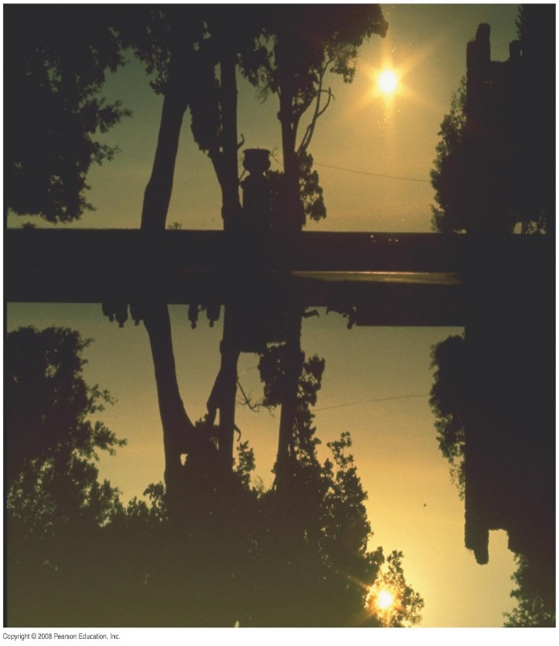
Chapter 32 Light: Reflection and Refraction
Notes:
Chapter 32 opener. Reflection from still water, as from a glass mirror, can be analyzed using the ray model of light. Is this picture right side up? How can you tell? What are the clues? Notice the people and position of the Sun. Ray diagrams, which we will learn to draw in this Chapter, can provide the answer. See Example 32–3. In this first Chapter on light and optics, we use the ray model of light to understand the formation of images by mirrors, both plane and curved (spherical). We also begin our study of refraction—how light rays bend when they go from one medium to another—which prepares us for our study in the next Chapter of lenses, which are the crucial part of so many optical instruments.

Slide 2
Speed of Light in matter
Generally light slows down when it encounters a medium other than vacuum.
n is the index of refraction of the medium n≥1
λ_{ο}
λ
λ_{ο}
c
v
n
Frequency is unchanged

Slide 3
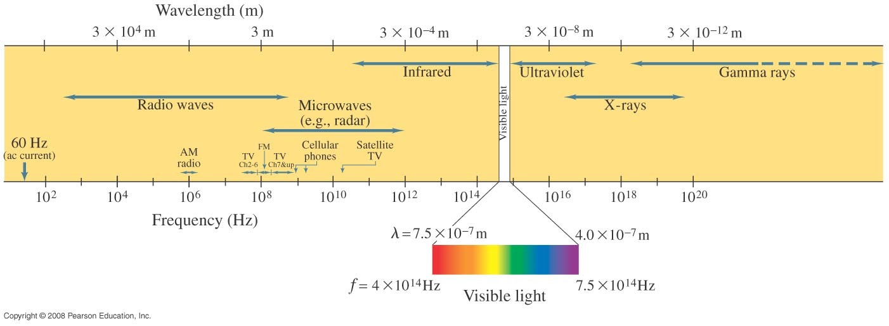
31-6 Light as an Electromagnetic Wave and the Electromagnetic Spectrum
Electromagnetic waves can have any wavelength; we have given different names to different parts of the wavelength spectrum.
Notes:
Figure 31-12. Electromagnetic spectrum.

Slide 4
Problem 14
14. (I) (a) What is the wavelength of a $25.75×{10}^{9}$ Hz radar signal? (b) What is the frequency of an X-ray with wave-length 0.12 nm?

Slide 5
Problem 16
16. (I) An EM wave has frequency $8.56×{10}^{14}$Hz What is its wavelength, and how would we classify it?

Slide 6
Problem 20
20. (II) An electromagnetic wave has an electric field given by
$\vec{E}$=$\hat{i}$ (225V/m)sin[0.077m⁻¹)z-(2.3$×$10⁷ rad/s)t]
(a) What are the wavelength and frequency of the wave? (b) Write down an expression for the magnetic field.

Slide 7
Chapter 32 Light: Reflection and Refraction
Notes:
Chapter 32 opener. Reflection from still water, as from a glass mirror, can be analyzed using the ray model of light. Is this picture right side up? How can you tell? What are the clues? Notice the people and position of the Sun. Ray diagrams, which we will learn to draw in this Chapter, can provide the answer. See Example 32–3. In this first Chapter on light and optics, we use the ray model of light to understand the formation of images by mirrors, both plane and curved (spherical). We also begin our study of refraction—how light rays bend when they go from one medium to another—which prepares us for our study in the next Chapter of lenses, which are the crucial part of so many optical instruments.

Slide 8
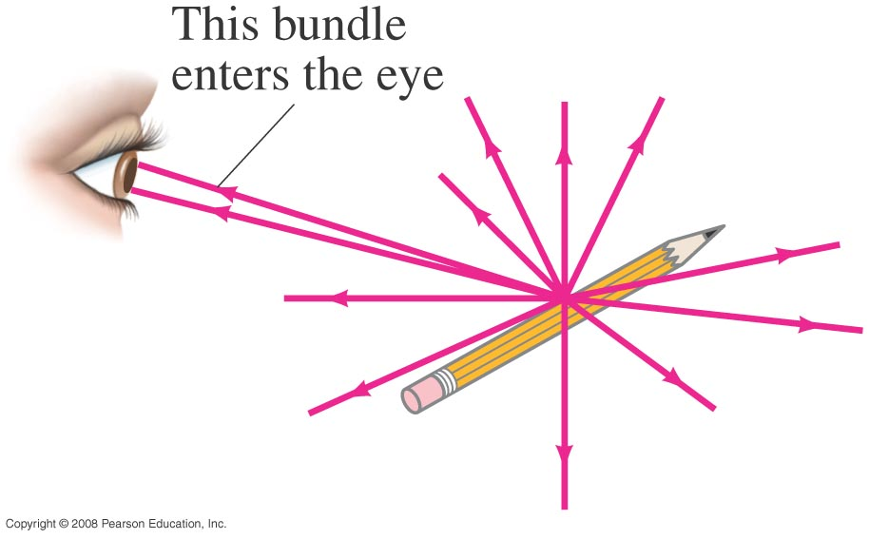
32-1 The Ray Model of Light
Light very often travels in straight lines. We represent light using rays, which are straight lines emanating from an object. This is an idealization, but is very useful for geometric optics.
So how do we see objects?
Light enters the eyes and causes sight.
The object can be seen in 2 ways:
It can be a source of light such as a lamp, or
A reflection of light by an object such as a pencil: light is reflected from each point of the object and is usually a bundle of rays that leave one point of the object.
Notes:
Figure 32-1. Light rays come from each single point on an object. A small bundle of rays leaving one point is shown entering a person’s eye.

Slide 9
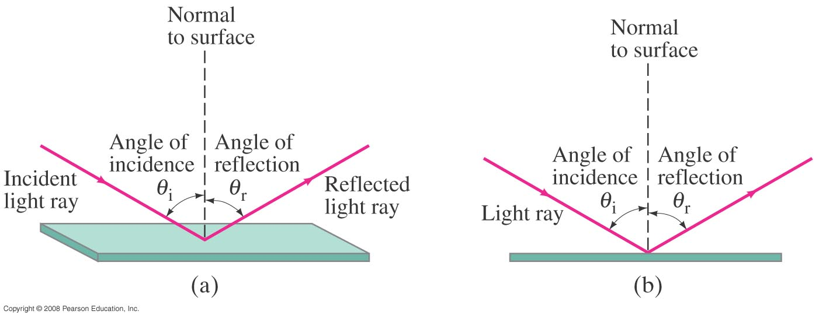
32-2 Reflection; Image Formation by a Plane Mirror
Since light is a wave, we will apply the ray model of waves.
Law of reflection: the angle of reflection (that the ray makes with the normal to a surface) equals the angle of incidence.
θ_{i}=θ_{r}
Notes:
Figure 32-2. Law of reflection: (a) Shows a 3-D view of an incident ray being reflected at the top of a flat surface; (b) shows a side or “end-on” view, which we will usually use because of its clarity.

Slide 10
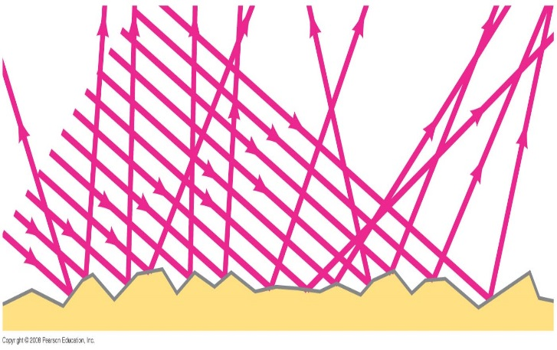
32-2 Reflection; Image Formation by a Plane Mirror
When light reflects from a rough surface, the law of reflection still holds, but the angle of incidence varies. This is called diffuse reflection.
With diffuse reflection, your eye sees reflected light at all angles.
Notes:
Figure 32-4. A narrow beam of light shines on (a) white paper, and (b) a mirror. In part (a), you can see with your eye the white light reflected at various positions because of diffuse reflection. But in part (b), you see the reflected light only when your eye is placed correctly mirror reflection is also known as specular reflection. (Galileo, using similar arguments, showed that the Moon must have a rough surface rather than a highly polished surface like a mirror, as some people thought.)

Slide 11
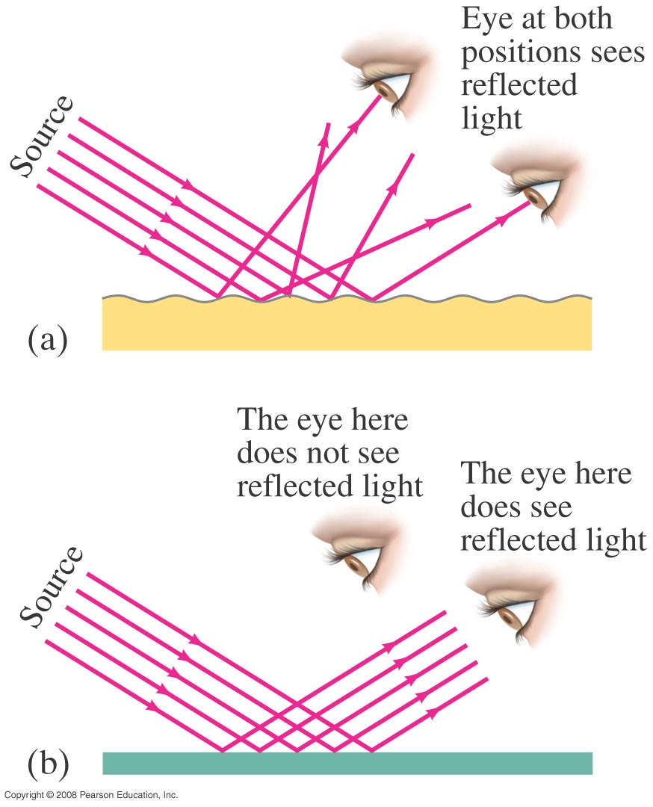
32-2 Reflection; Image Formation by a Plane Mirror
With specular reflection (from a mirror), your eye must be in the correct position to see the reflected rays.

Slide 12
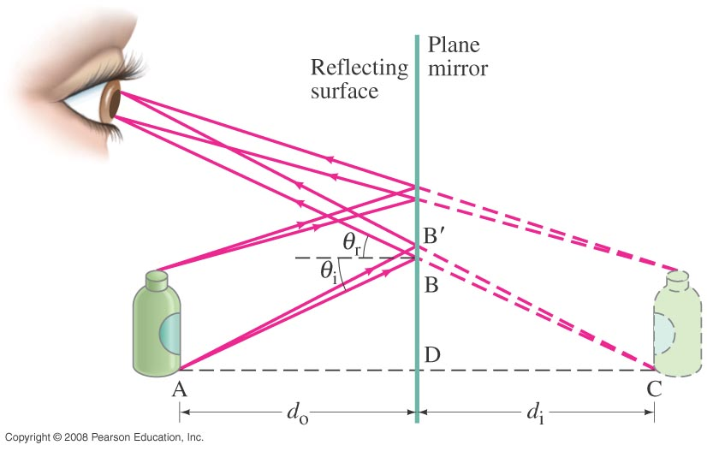
32-2 Reflection; Image Formation by a Plane Mirror
What you see when you look into a plane (flat) mirror is an image, which appears to be behind the mirror.
Notes:
Figure 32-7. Formation of a virtual image by a plane mirror.

Slide 13
32-2 Reflection; Image Formation by a Plane Mirror
This is called a virtual image, as the light does not go through it (the mirror). The distance of the image from the mirror d_{i} is equal to the distance of the object from the mirror d₀

Slide 14
32-2 Reflection; Image Formation by a Plane Mirror
Example 32-1: Reflection from flat mirrors.
Two flat mirrors are perpendicular to each other. An incoming beam of light makes an angle of 15° with the first mirror as shown. What angle will the outgoing beam make with the second mirror?
Notes:
Solution. The rays are drawn in figure 32-5b. The outgoing ray from the first mirror makes an angle of 15° with it, and an angle of 75° with the second mirror. The outgoing beam then makes an angle of 75° with the second mirror (and is parallel to the incoming beam).

Slide 15
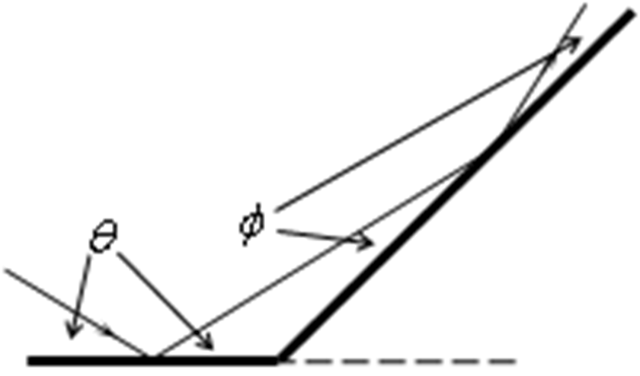
Problem 3
3. (II) Two plane mirrors meet at a 135° angle, Fig. 32–45. If light rays strike one mirror at 38° as shown, at what angle Ф do they leave the second mirror?

Slide 16
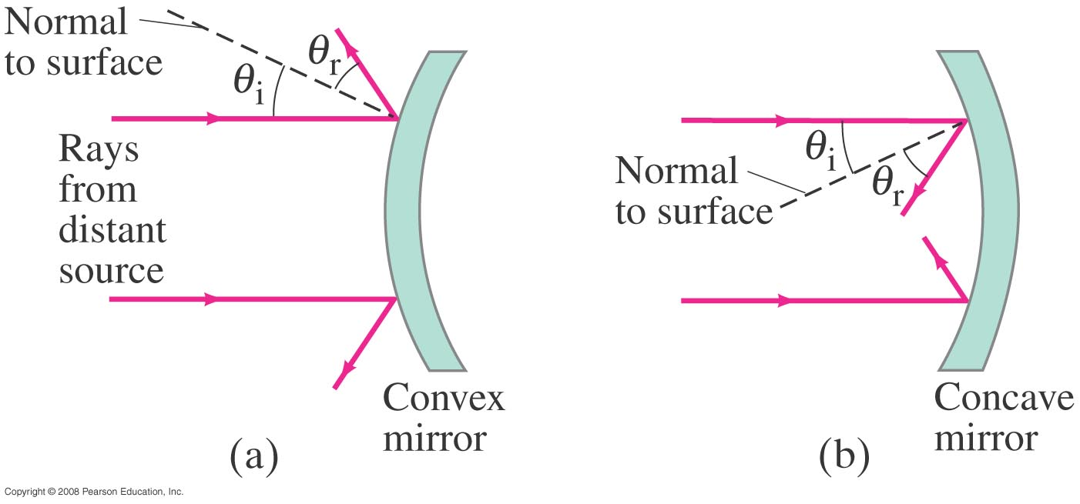
32-3 Formation of Images by Spherical Mirrors
Spherical mirrors are shaped like sections of a sphere, and may be reflective on either the inside (concave) or outside (convex).
Notes:
Figure 32-10. Mirrors with convex and concave spherical surfaces. Note that θ_{r} = θ_{i} for each ray.

Slide 17
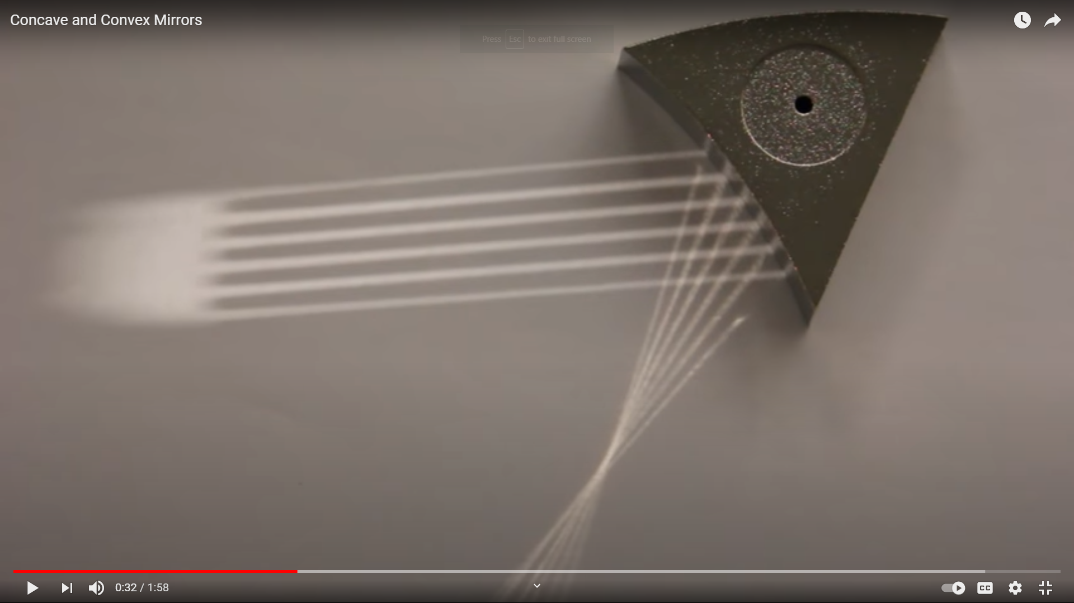
Spherical Mirrors
https://www.youtube.com/watch?v=jtTBOMVMSYM

Slide 18
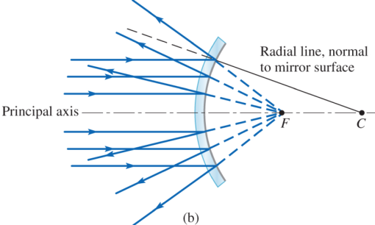
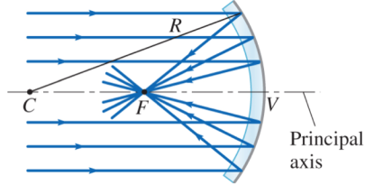
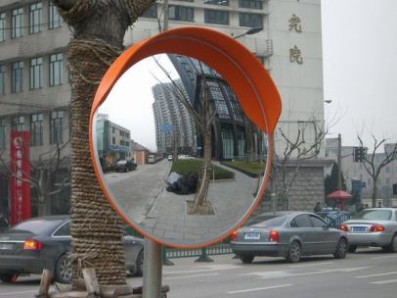
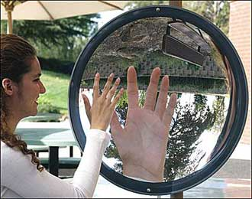
Spherical Mirrors
Convex
Concave
Like you are
in a cave
Used in cars, streets, and have a wide field of view
Used in cosmetics (make up mirrors)

Slide 19
32-3 Formation of Images by Spherical Mirrors
Rays coming from a faraway object are effectively parallel.
If the object’s distance is large compared to the size of the mirror (or lens), the rays are nearly parallel. They are parallel for an object at infinity (∞).
Notes:
Figure 32-12. If the object’s distance is large compared to the size of the mirror (or lens), the rays are nearly parallel. They are parallel for an object at infinity (∞).

Slide 20
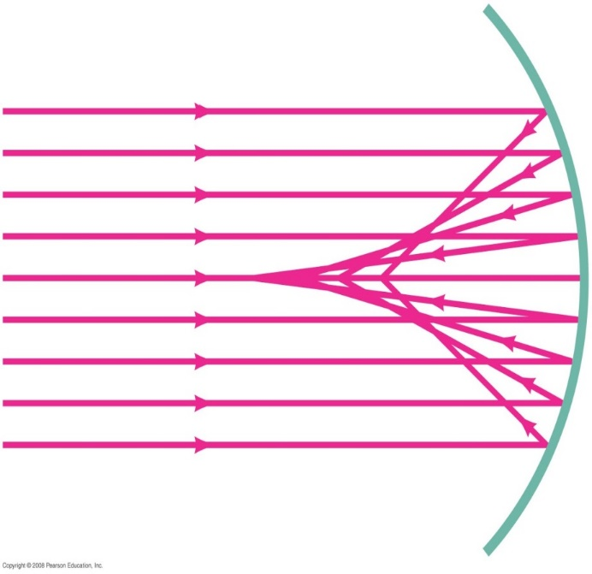
32-3 Formation of Images by Spherical Mirrors
Parallel rays striking a spherical mirror do not all converge at exactly the same place if the curvature of the mirror is large; this is called spherical aberration.
Parallel rays striking a concave spherical mirror do not intersect (or focus) at precisely a single point.
Notes:
Figure 32-13. Parallel rays striking a concave spherical mirror do not intersect (or focus) at precisely a single point. (This “defect” is referred to as “spherical aberration.”)

Slide 21
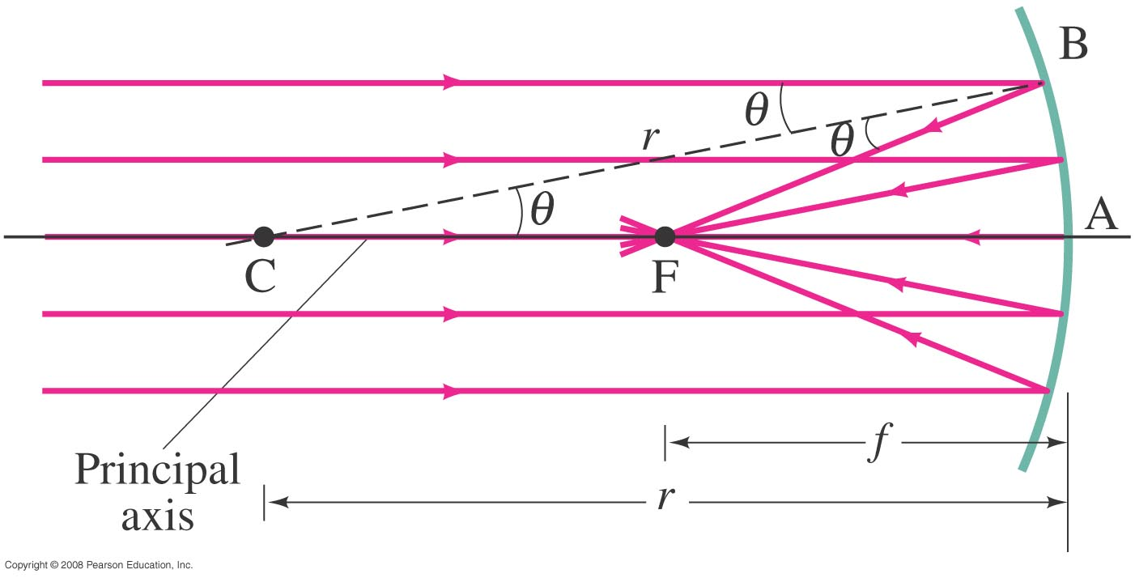
32-3 Formation of Images by Spherical Mirrors
If the curvature is small, the focus is much more precise; the focal point is where the rays converge.
Center of curvature:
f=r/2
:Focal point
:Focal length
Radius of curvature
The radius of curvature needs to be small for a sharp and focused image at one point
Notes:
Figure 32-14. Rays parallel to the principal axis of a concave spherical mirror come to a focus at F, the focal point, as long as the mirror is small in width as compared to its radius of curvature, r, so that the rays are “paraxial”—that is, make only small angles with the horizontal axis.

Slide 22
Spherical Mirrors: Concave
Parallel ray goes through f
Ray through center reflects back
Ray through f comes out parallel
object
image
C
f
Image:
Upright or upside down
Real or virtual
Bigger or smaller

Slide 23
Spherical Mirrors: Concave
This video teaches you how to draw the rays diagram for the concave mirrors , and how to get the image for few positions for the object.
https://www.youtube.com/watch?v=7iK1nIJs49Y

Slide 24
Spherical Mirrors: Convex
R
Radius of
Curvature
Center of
Curvature
object
image
C
f
Principle axis
Focal point
f=R/2
Image:
Upright or upside down
Real or virtual
Bigger or smaller
Parallel ray goes through f
Ray through center reflects back
Ray through f comes out parallel

Slide 25
Spherical Mirrors: Convex
This video include the diverging lens, that you need for next chapter, but the middle of the video shows the convex mirror
https://www.youtube.com/watch?v=c2GFG6cvPew

Slide 26
32-3 Formation of Images by Spherical Mirrors
The intersection of the three rays gives the position of the image of a point on the object. To get a full image, we can do the same with other points (two points suffice for many purposes).
Because the light passes through the image itself, this is called “Real image”.

Slide 27
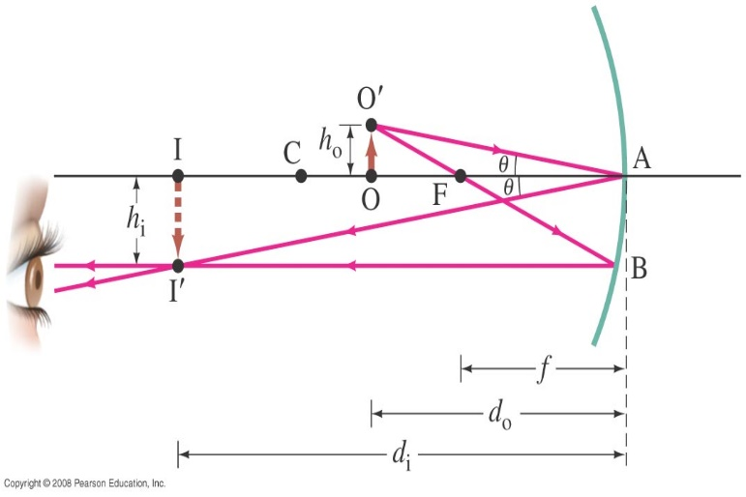
32-3 Formation of Images by Spherical Mirrors
Geometrically, we can derive an equation that relates the object distance, image distance, and focal length of the mirror:
d₀ distance between the object and the lens
d_{i} distance between the image and the lens
f is the focal distance
Notes:
Figure 32-16. Diagram for deriving the mirror equation. For the derivation, we assume the mirror size is small compared to its radius of curvature.

Slide 28
32-3 Formation of Images by Spherical Mirrors
Using geometry, we find that the focal length is half the radius of curvature:
The More curved is the mirror, the worse is the approximation and the more blurred is the image. Spherical aberration can be avoided by using a parabolic reflector; these are more difficult and expensive to make, and so they are used only when necessary, such as in research telescopes.

Slide 29
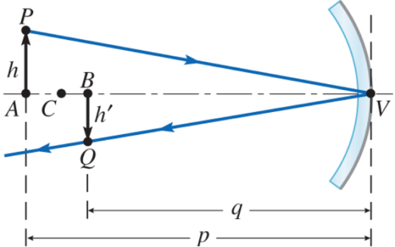
Magnification:
Magnification = image height / object height
= - image distance (d_{i}) / object distance (d₀)
m and h_{i} are negative if the image is upside down.
d_{i}
d₀
d_{i} is negative if the image is virtual

Slide 30
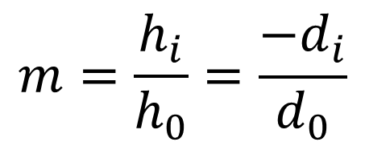
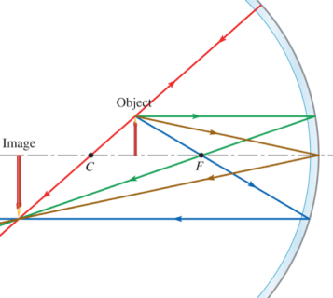
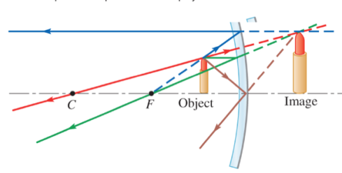
Magnification:
Magnification = image height / object height
= - image distance (d_{i}) / object distance (d₀)
d_{o}
-di
d₀
d_{i}
Negative m = upside down
Negative d_{i} = virtual (behind mirror)

Slide 31
Problem 12
12. (II) A small candle is 35 cm from a concave mirror having a radius of curvature of 24 cm. (a) What is the focal length of the mirror? (b) Where will the image of the candle be located? (c) Will the image be upright or inverted?

Slide 32
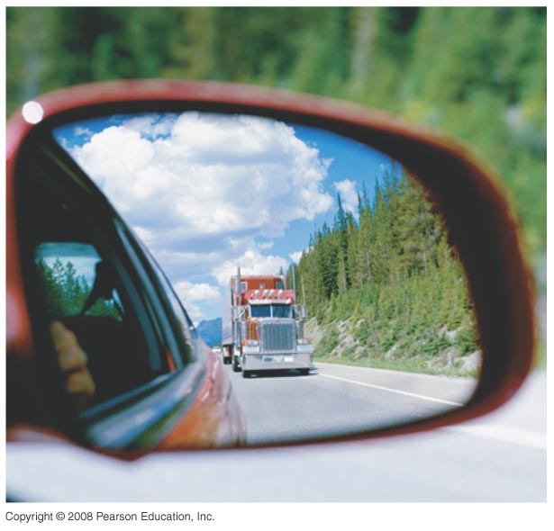
32-3 Formation of Images by Spherical Mirrors
Example 32-7: Convex rearview mirror.
An external rearview car mirror is convex with a radius of curvature of 16.0 m. Determine the location of the image and its magnification for an object 10.0 m from the mirror.
Notes:
Solution: The ray diagram for a convex lens appears in Figure 32-19b. A convex mirror has a negative focal length, giving d_{i} = -4.4 m and M = +0.44. The image is virtual, upright, and smaller than the object.

Slide 33
Problem 18
18. (II) An object 3.0 mm high is placed 18 cm from a convex mirror of radius of curvature 18 cm. (a) Show by ray tracing that the image is virtual, and estimate the image distance. (b) Show that the (negative) image distance can be computed from Eq. 32–2 using a focal length of -9.0 cm (c) Compute the image size, using Eq. 32–3.

